Slide 1

Statistics of Axion Wind Detection with Superfluid Helium-3
J. Foster, C. Gao, Y. Kahn, A. Mande
PIKIMO, University of Illinois
4th May, 2024
aamande2@illinois.edu

Slide 2


Slide 3
Introduction
Axions and axion-like particles are well-motivated candidates for dark matter that may couple to nuclear spins like a weak oscillating effective magnetic field, the “axion wind.”
In attempts to search for the elusive particle, the Homogeneous Precession Domain of Superfluid He-3 has been identified as a detection medium for these couplings.
The effect of axions would be a small shift in the precession frequency of a large-amplitude NMR signal.
In this work, we make a detailed study of the statistical and dynamical properties of the axion field and the HPD system in order to make realistic projections for a full-fledged experimental program.....

Slide 4
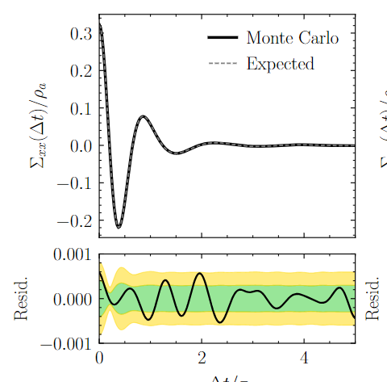
Axion Field Statistics
Gradient of the axion field is simply a plane wave
Φ ~ Uniform [0, 2π)
α ~ Rayleigh-distributed [0, ∞)
Hence, it is a gaussian process
characterized by two-point
correlator:

Slide 5
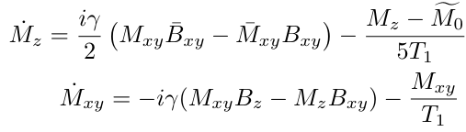
HPD of Superfluid He-3
HPD phase of He-3 can be thought of as a BEC of spin-1 magnons
Stochastic and quantum mechanical internal dynamics
Largely characterized by an effective description using Bloch equations
Transverse and longitudinal magnetizations are locked together at the Leggett angle β0 = arccos (−1/4) ≈ 104◦

Slide 6
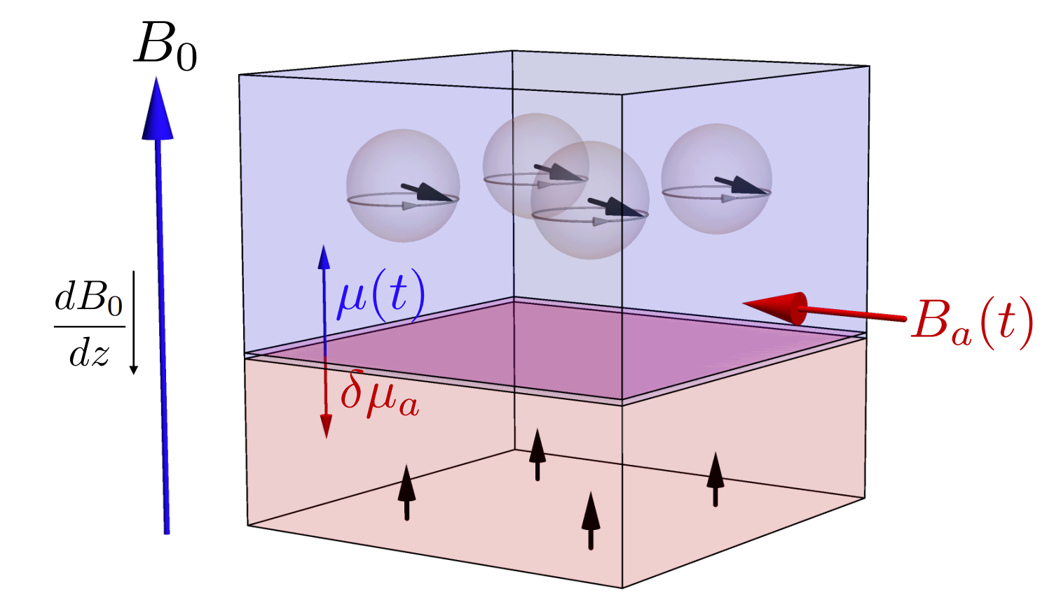
HPD of Superfluid He-3
An applied B-field with gradient creates a domain wall separating precessing and stationary spins at position z
Due to stochastic magnon loss, domain wall moves up
Frequency of precession ω(t) = γ . B(z(t))

Slide 7
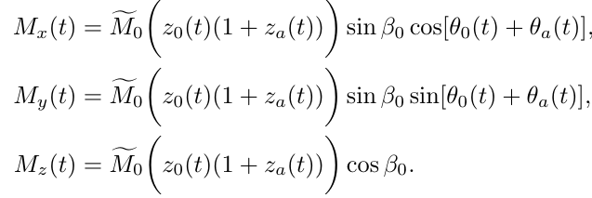
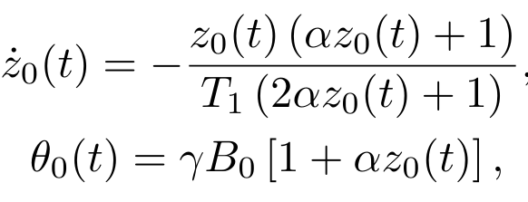

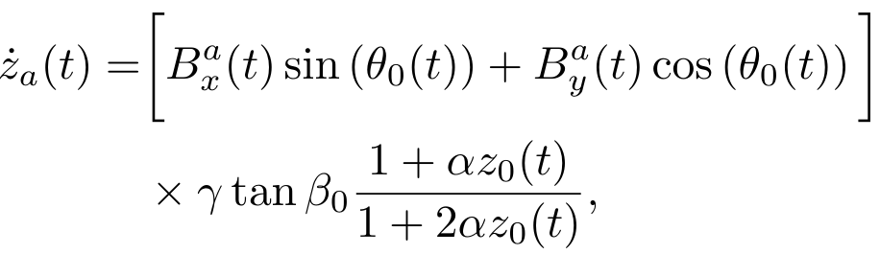
How does presence of axions affect the system?
Expand the position and precession angle perturbatively around equilibrium values: z(t) = z₀(t) (1 + z_{a}(t)) and θ(t) = θ₀(t) + θ_{a}(t)

Slide 8
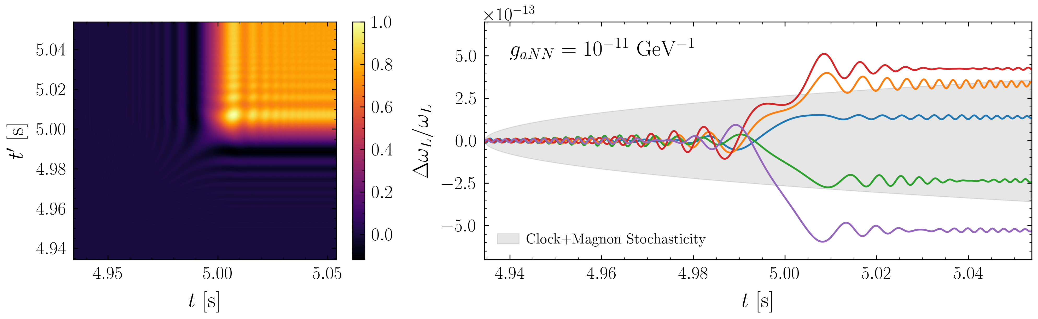
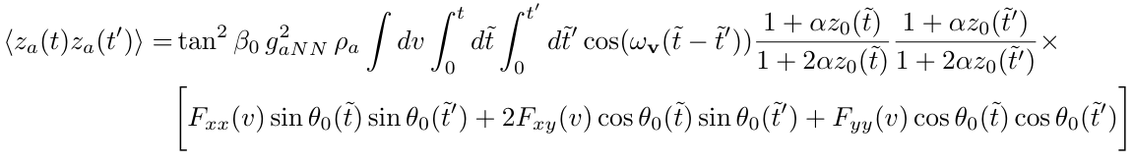
Dynamics near resonance
z_{a}(t) is a mean zero Gaussian – How do we detect it?
It has a non-zero covariance!
(Left) The time-dependent covariance of the axion-induced domain wall shift. The behavior is approximately that of a step function modulated by beat frequency oscillations. (Right) Five realizations of the axion-induced domain wall shift drawn from the multivariate Gaussian distribution

Slide 9
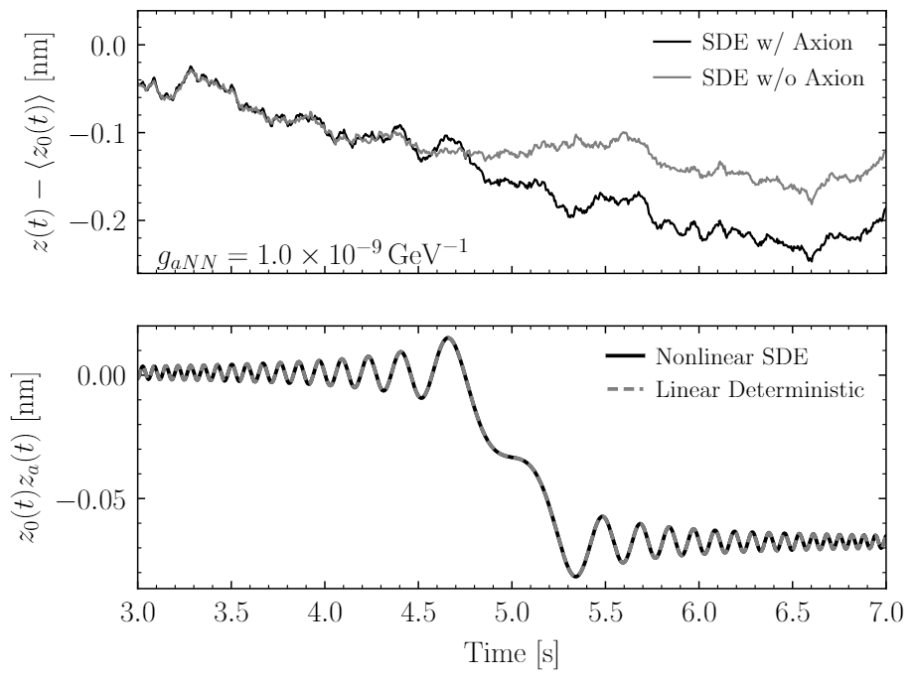
Stochastic domain wall motion
Domain wall loss is governed by a stochastic differential equation
We must validate that stochasticity of magnon loss has no significant effect on HPD dynamics
(Left) Domain wall position relative to the expected equilibrium DW position plotted for a single realization of SDE evolution with and without the axion. (Right) Comparison of axion-induced shift computed with SDE evolution and linear deterministic equations, demonstrating striking resemblance

Slide 10
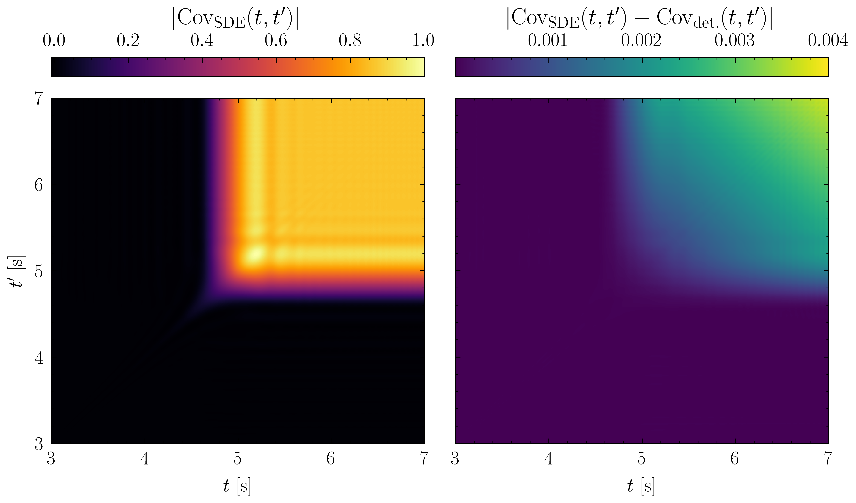
Stochastic domain wall motion
(Left) Covariance matrix of axion-induced domain wall shift averaged from 512 realizations of the SDE. (Right) Difference between covariance calculated using SDE vs linear ODE. Good agreement is demonstrated

Slide 11
Measurement
Since the signal we seek lies only in the domain wall and hence in frequency measurements, we aim for a measurement scheme that is as insensitive as possible to amplitude noise but maximally sensitive to frequency shift
Quantum metrology achieves this using adaptive optimal control, with single qubit errors scaling as 1/T² upto qubit coherence T_{q}
A frequency error scaling of ~ (T_{q} T³)^{-1/2} has been demonstrated experimentally T²
Instead of using SQUIDs as magnetometers, we imagine coupling the SQUID to N transmon qubits and instead readout qubit states at intervals T_{q}

Slide 12
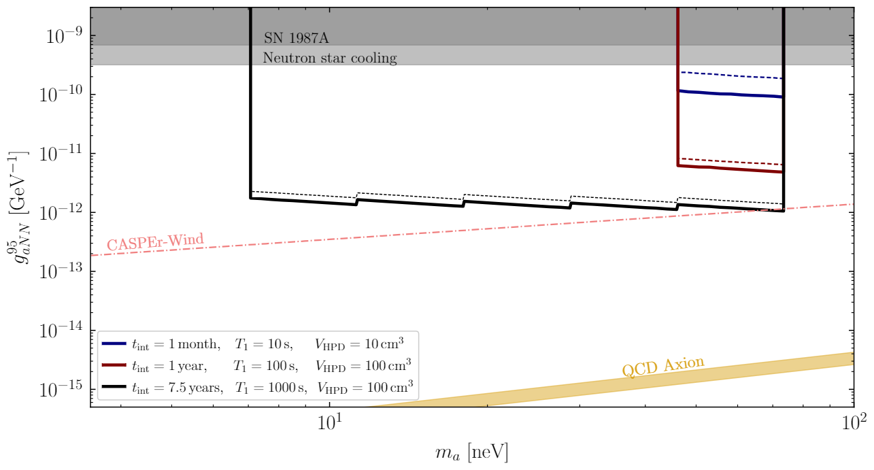
Projected Sensitivities!
Projected 95th percentile upper limits on gaN N for three benchmark scenarios which vary the total collection time, relaxation time, and system volume. In all scenarios, we fix z0(t0) = h = 10 cm and α = 1 cm⁻¹. In solid lines, we assume a measurement precision provided by N = 100 qubits, each with a coherence time of 1 ms, while in dashed lines, we assume only T_{q} = 0.1 ms.

Slide 13
Summary Conclusion
We conduct a full statistical treatment of the HPD in presence of an axion
Results are validated through simulations of the stochastic background of the HPD system
We also optimize sensitivity with respect to B-field gradient and Earth’s velocity
An HPD setup possibly has sensitivities competitive with CASPEr-Wind for the same data taking time

