Slide 1

Large Blue isocurvature from a classical conformal limit
Tadepalli Sai Chaitanya
with Prof. Daniel Chung
May 04, 2024

Slide 2

Isocurvature Perturbations [2110.02272, 2309.17010]

Slide 3
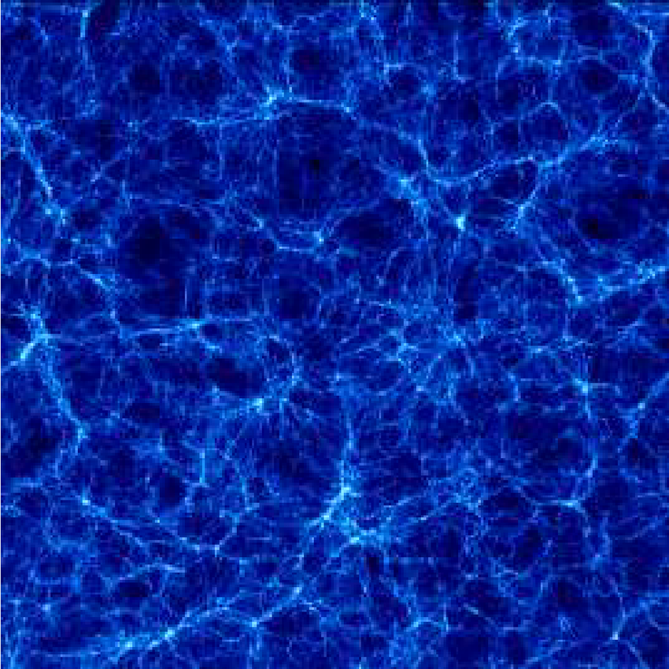
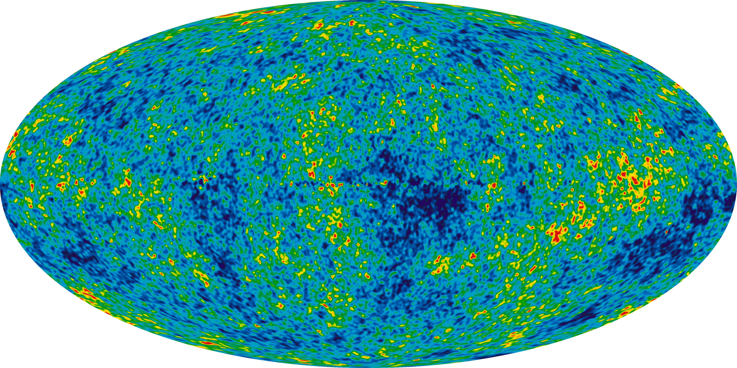

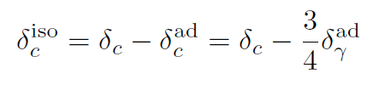
Adiabatic
single dynamical mode
Isocurvature
Multiple independent dynamical modes

Slide 4


Currently, scale invariant isocurvature perturbations are observationally constrained to be less than 2% on large (CMB) scales at k=0.05/Mpc. [1807.06211]
Blue isocurvature
n>1
Blue n > 1
Red n < 1
Adiabatic n ~ 1
2-sigma hint found in 1711.06736, 1707.09354 from combined Planck+BOSS-DR12 data analysis.
Flat isocurvature n=1
Future ?
(not statistically significant yet)
Well constrained

Slide 5
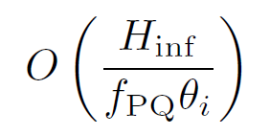
Why study blue isocurvature
Isocurvature can offer valuable insights into inflation and the presence of spectator DM fields and their mass scales.
Blue isocurvatures with nI > 2.4, uniquely hint towards spectator fields with time-dependent mass during inflation. [1509.0585]
Blue isocurvature can relax the constraint on H-f parametric region

Slide 6

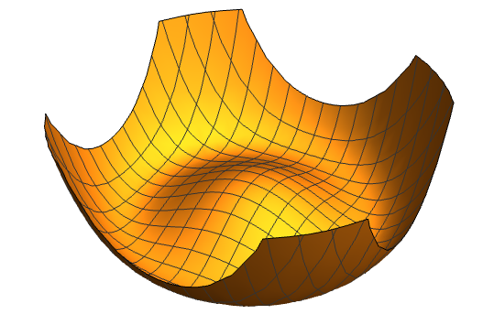
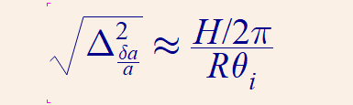

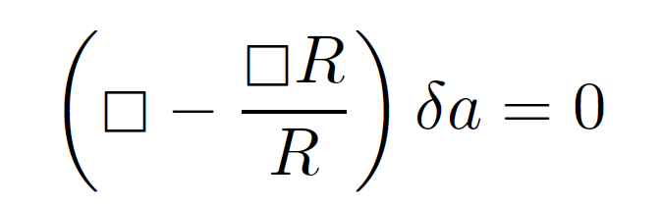

Generate blue-tilted spectra via non-equilibrium radial field
S. Kasuya, M. Kawasaki [0904.3800]
Dynamical non-equilb mass
Massless axion
1501.05618

Slide 7
Questions:
Mass of spectator field to obtain large blue-tilt (niso > 2)?
  > H
How do you switch off the mass at the end of the rolling to ensure that the axion density isn’t diluted away by inflation?
How do we get a large initial displacement and not worry about quartic interaction term?
All conditions satisfied by Kasuya-Kwasaki’s SUSY axion model.
Q1 via SUGRA and Q2&3 via “SUSY flat-directions”.

Slide 8
Kasuya-Kawasaki model relies on having a SUSY flat-direction (and two dynamical chiral PQ fields) and no quartic self interaction.
Is there a generic way to generate large blue isocurvature without flat-direction, for single PQ field and with quartic interaction term?

Slide 9
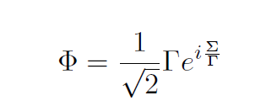
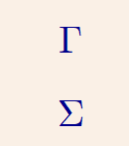
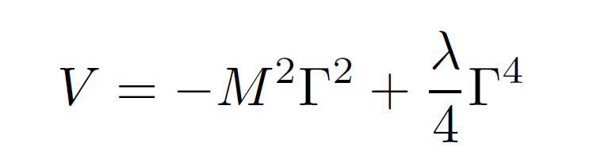
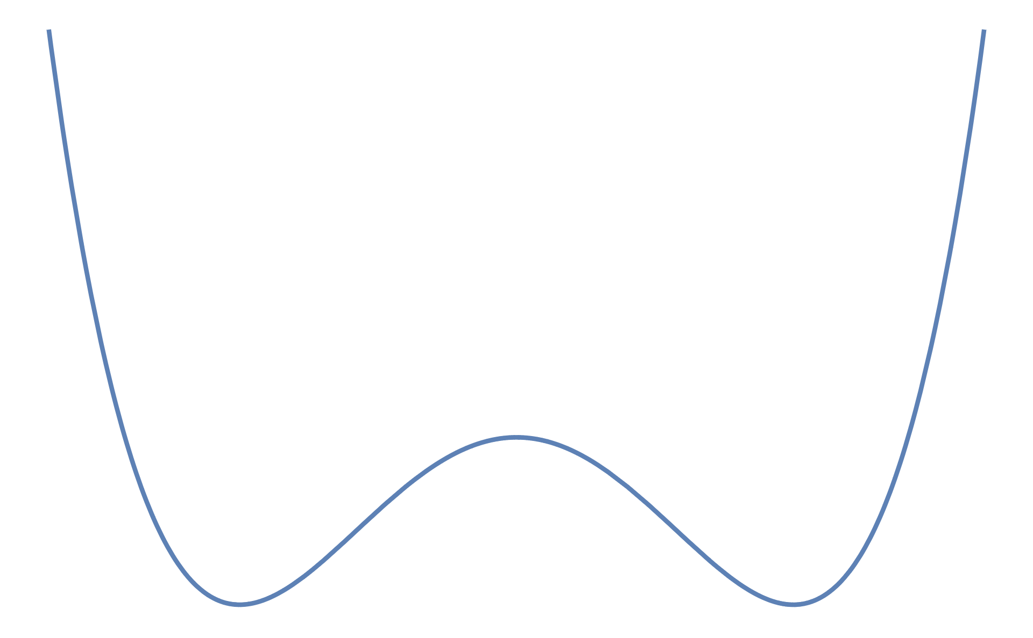
Radial field
U(1) PQ field
Axial field
PQ symmetry breaking potential
Has the usual quartic self-interaction term
Displaced away from minimum vev

Slide 10
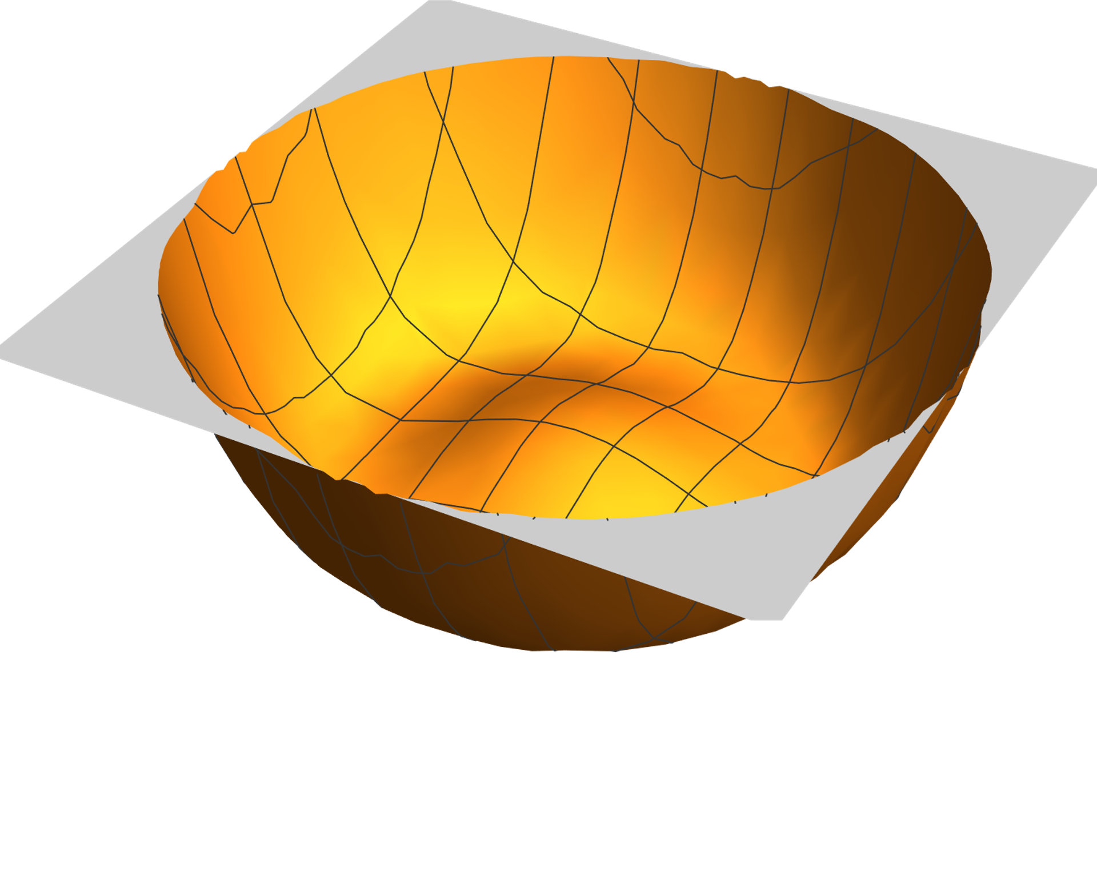

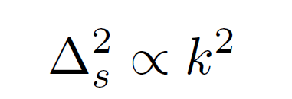
Impart initial angular momentum, or, equivalently have a non-zero U(1)PQ charge
a.k.a rotating axion
Generates blue isocurvature spectrum

Slide 11

Classical background conformal solution

Slide 12
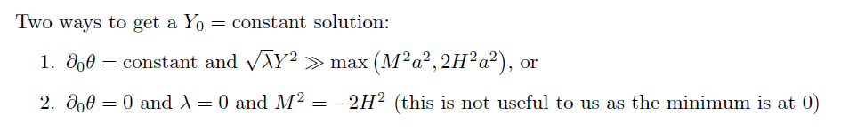

Classical background conformal solution
Y field is conformal and doesn’t see the curved spacetime until the end of ‘spiral’ rolling
Conserved U(1)PQ charge

Slide 13

The axial rotations cause a strong mixing between the radial and axial fluctuations.
In such a scenario, it is not obvious how to consistently quantize the two strongly coupled fields, define proper vacuum, identify the Goldstone mode and get correct correlation functions.

Slide 14

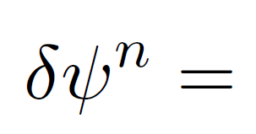
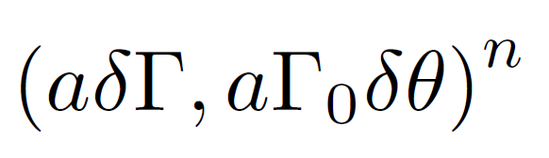
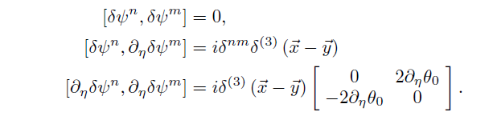
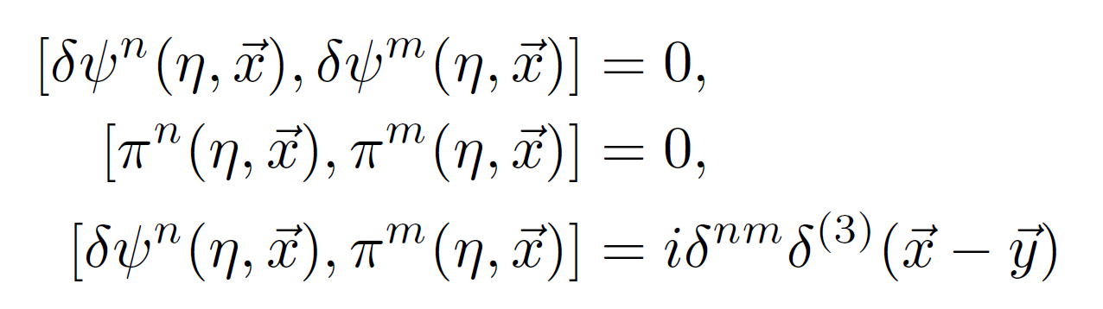
2 annihilating ladder operators with ++ and +- belonging to different eigen-solutions

Slide 15
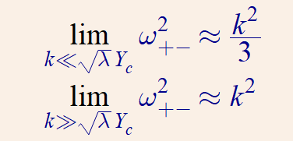
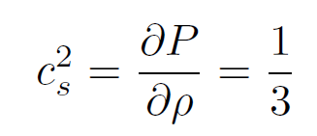

Post quantization and identifying proper vacuum
Goldston mode
Behaves like a radiation-matter fluid
The theory behaves like a CFT that flows from k²/3 → k²
-induced mixing is generating an axion pressure-supported acoustic wave in the mixture of axions and radial fields.

Slide 16
“Correlation remains Minkowskian even after modes have k < aH” until rotations seize

Slide 17
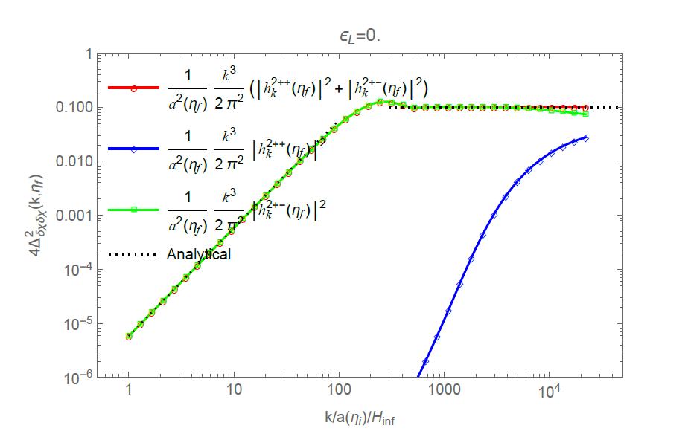
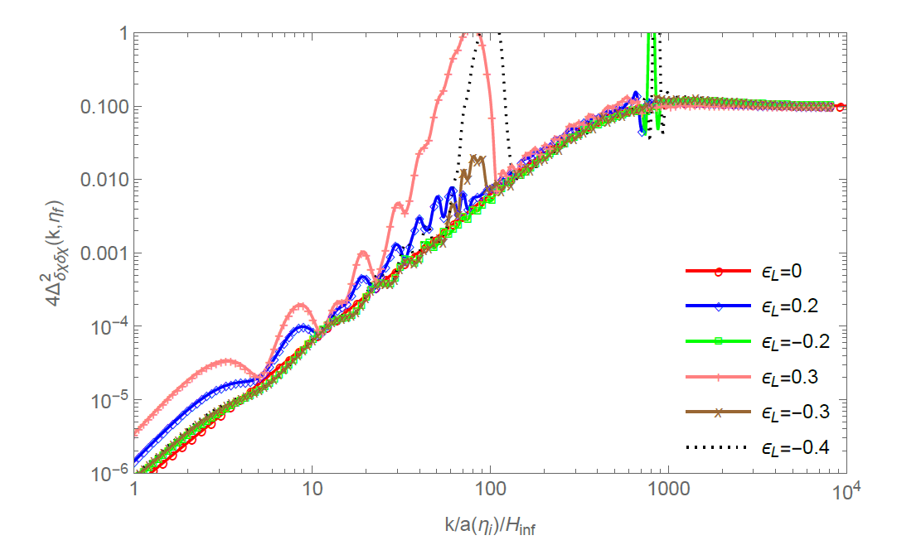
Plots of axion blue-tilted isocurvature

Slide 18
Rotating axion during inflation has cool properties
resembles a CFT that flows from k²/3 → k²
Isocurvature quantity frozen even during subhorizon evolution
Goldston mode behaving like a radiation-matter fluid during rotation
Kinetic correlation even though no field correlation.
Mimics a flat direction without having flat direction. (Y=constant)

Slide 19
Thanks…

Slide 20
Talking points
Initiate discussion into how blue-tilted isocurve can evade constraints.
  State current and previous analysis in support of this hypothesis.
Sketch caricature argument to generate blue spectrum and how the duration of rolling is controlled.
Discuss KK model and how flat-direction helps stabilize the system to ensure larger rolling period through a Hubble-induced mass term.
Discuss new axion model with quartic potential
Classical conformal limit to avoid radial field going to zero.
Non-zero U(1)PQ charge
Quantization of the strongly coupled fields.
  Goldston mode behaving like a radiation fluid (what is the intuitive reason?)
How the correlation remains Minkowskian even when k/aH<1.
Show some plots and present some results for deviation from conformal limit.

Slide 21

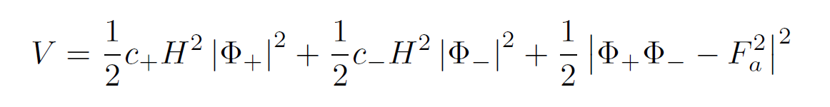
SUSY axion model
S. Kasuya, M. Kawasaki [0904.3800]
Renormalizable superpotential:
subscripts on Φ indicate U(1) PQ charges.
Kaehler induced mass terms
F-term
Notes:
R-symm generates flat-direction

