Slide 1
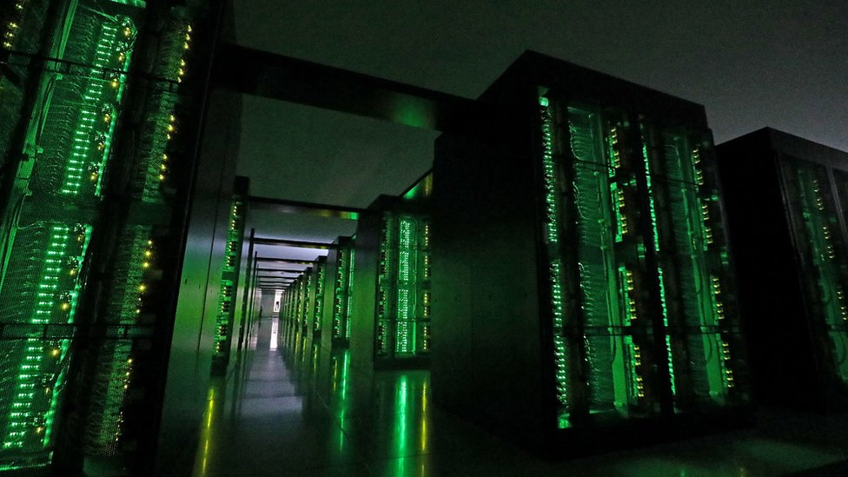
The
Ultimate SuperComputer-on-a-Chip for
Massive Big Data and Highly Iterative Algorithms
Veljko Milutinović

Slide 2
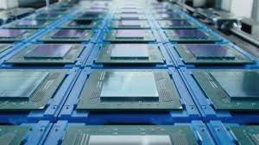
The Flynn's Classification of Computer Systems:
SISD
SIMD
MISD
MIMD

Slide 3
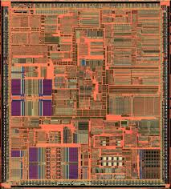
Early 80s: DARPA's First GaAs Microprocessor (SISD)
Lesson Learned:
Mere technological change is NOT a solution,
due to large OFF-CHIP/ON-CHIP delays,
leading fast to asymptotic saturations
of the achievable speedup!

Slide 4
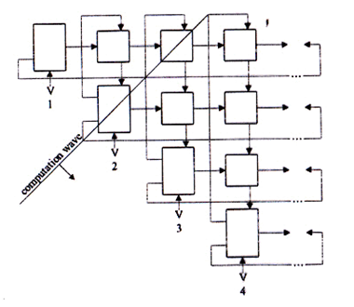
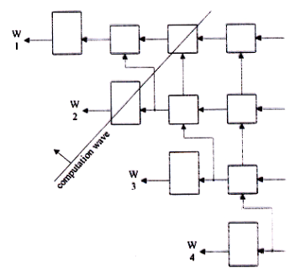
Mid 80s: DARPA's First GaAs Systolic Array 4096 (SIMD)
Lesson Learned: Good Mostly for TENSOR CALCULUS!
(now optimal: Google TPU)

Slide 5
Late 80s: The AeroSpace Fourier Transform Engine (MISD)
Lesson Learned: Good Mostly for TRANSFORMATIONAL ALGORITHMS
(now optimal: Intel MultiCore)

Slide 6
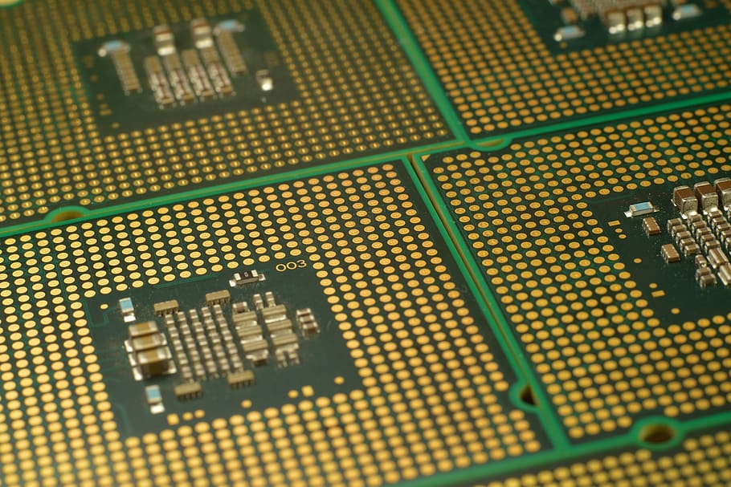
End 80s: The NCR Vertical Migration Engine (MIMD)
Lesson Learned: Good Mostly for IMAGE UNDERSTANDING
(now optimal: nVidia ManyCore)

Slide 7
ControlFlow: Inherent Characteristics Represent Limitations
SISD: IEEE T/Computers
SIMD: IEEE T/Communications
MISD: IEEE T/ASSP
MIMD: IEEE T/Software
Helbig, W., & Milutinovic, V. (1989). A dcfl e/d-mesfet gaas experimental risc machine.
IEEE transactions on computers,
38(2), 263-274.
Milutinovic, V. (1988). A comparison of suboptimal detection algorithms
applied to the additive mix of orthogonal sinusoidal signals.
IEEE transactions on communications, 36(5), 538-543.
Milutinovic, V., Fortes, J., & Jamieson, L. (1986). A multimicroprocessor architecture
for real-time computation of a class of DFT algorithms. IEEE transactions on acoustics,
speech, and signal processing, 34(5), 1301-1309.
Milutinovic, V. (1987). A simulation study of the Vertical-Migration microprocessor architecture.
IEEE transactions on software engineering, (12), 1265-1277.

Slide 8
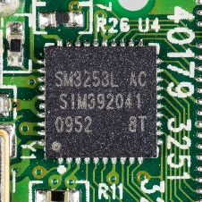
DataFlow: New Paradigms Badly Needed,
NOT to Substitute,
BUT to Supplement!
The First FineGrain DataFlow Idea: Proceedings of the IEEE
The First FineGrain DataFlow Implementation: Communications of the ACM
Milutinovic, V. (1989).
Mapping of neural networks on the honeycomb architecture.
Proceedings of the IEEE, 77(12), 1875-1878.
Flynn, M. J., Mencer, O., Milutinovic, V., Rakocevic, G., Stenstrom, P., Trobec, R., & Valero, M. (2013).
Moving from petaflops to petadata.
Communications of the ACM, 56(5), 39-42.

Slide 9
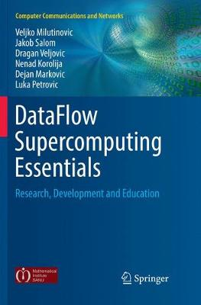
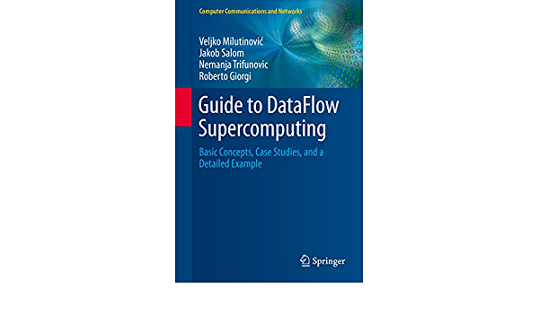
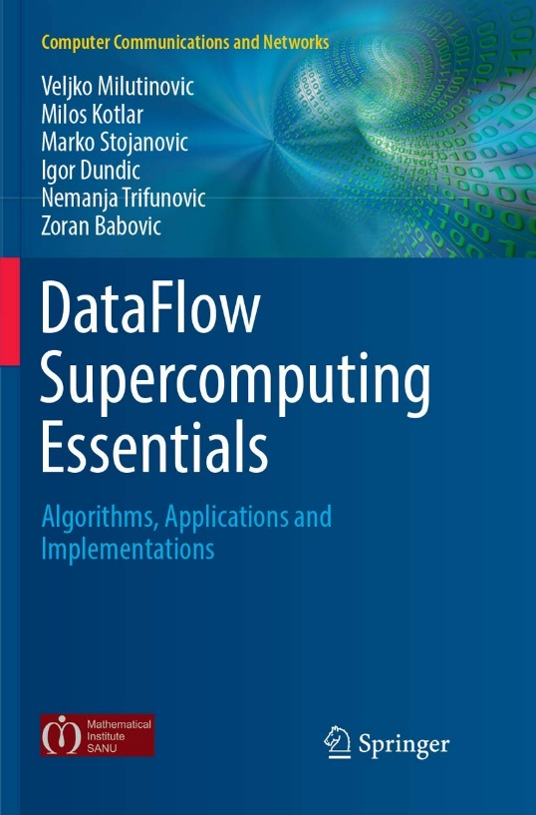
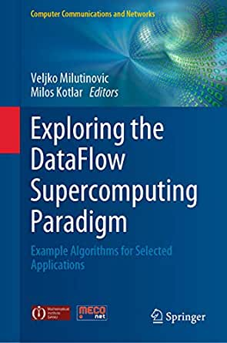

Conclusion: Synergy of ControlFlow and DataFlow
N.B. Successful marriage is THE solution!

Slide 10

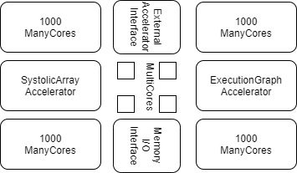
The Optimal Architecture
CF (ControlFlow):
N MultiCore CPUs
1000N ManyCore GPUs (10000N, etc…)
DF (DataFlow):
An ASIC SystolicArray (Fixed)
An FPGA ExecutionGraph (Reconfigurable)
Peripherals to External Accelerators (EnergyFlow):
Chemical
Molecular
Opto
Quantum
+ Memory and I/O + Peripherals to WSN and IoT (DiffusionFlow)

Slide 11
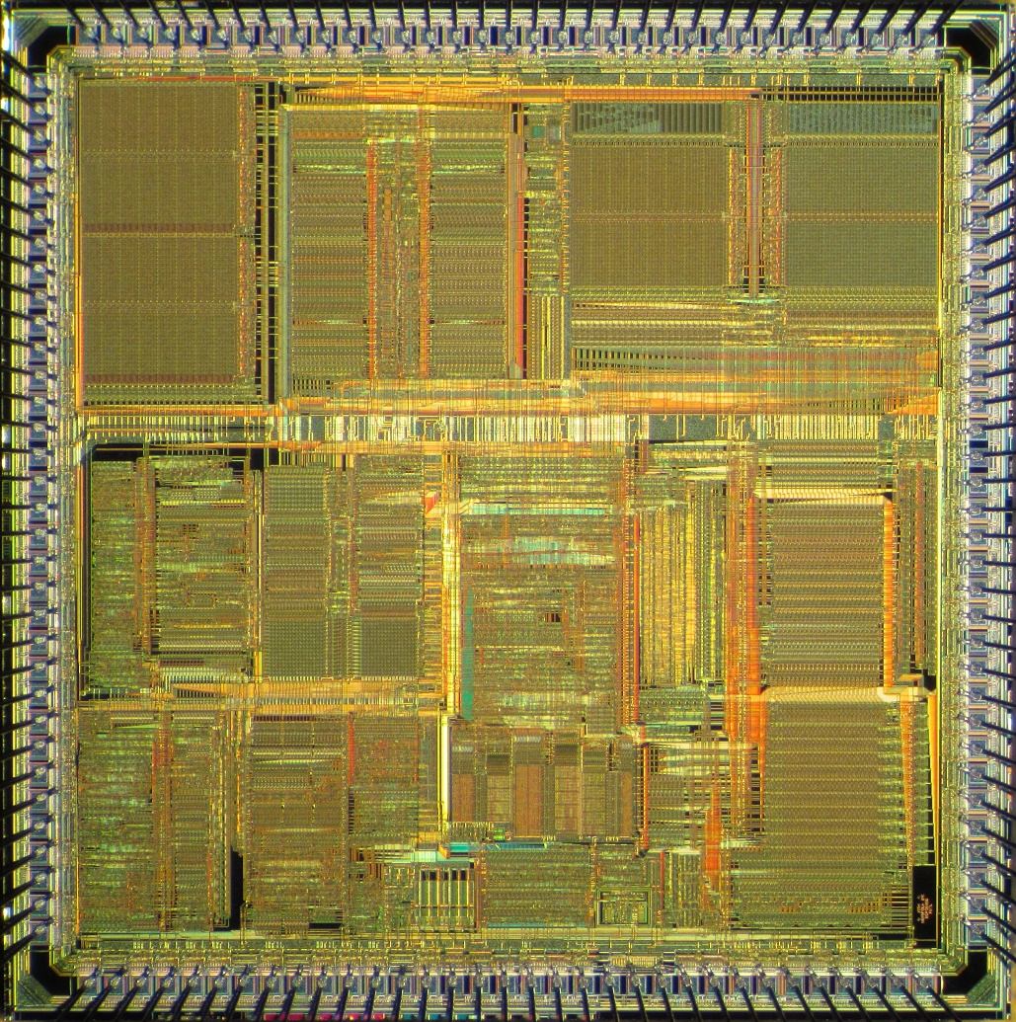
Optimal Distribution of Transistor Budget
Ceiling-Dependent:
  VLSI: 100BTr
  WSI: 1TTr
Application-Dependent:
  SW DataFlow
  ML ControlFlow
Strategy-Dependent:
  CF-Oriented
  DF-Oriented
Memory-Dependent!

Slide 12

Pioneering Efforts:
Company | Product name | Country | City | Number of CPU cores | Number of GPU cores | CPU clock rate | Launched
Alibaba | XT910 | China | Hangzhou | 1/2/4 per cluster | N/A | 2.0 – 2.5 GHz | 2020
RISC-V | Micro Magic RISC-V Core [39] | US | San Francisco | 1 | N/A | 4.25 – 5.19 GHz | 2020
SiFive | FU740 RISC-V SoC [25] | US | San Francisco | 4 | 1 | 1.4 – 1.5 GHz | 2020
AMD | AMD Ryzen™ 5 3400G with Radeon™ RX Vega 11 Graphics [24] | US | Santa Clara | 4 | 11 | 3.7 – 4.2 GHz | 2019
Nvidia | Tegra Xavier [28] | US | Santa Clara | 8 | 512 CUDA | N/A | 2019
Esperanto Technologies | N/A | US | Mountain View | 16 ET-Maxion cores | 4096 ET-Minion cores + ET-Graphics [26,27] | 2+GHz | 2018
Intel | Intel Sandy Bridge [23] | US | Santa Clara | 1-4 (4-6 Extreme, 2-8 Xeon) | 6 | 1.60 – 3.60 GHz | 2011
Moscow Center of SPARC Technologies (MCST) | Elbrus-2S+ (1891ВМ7Я) [29] | Russia | Moscow | 2 Elbrus 2000 cores | 4 DSP Elcore-09 cores | 300 – 800 MHz | 2011
State of the Art:
Biren (77BTr@2023) = Chip Integration (China)
Cerebras (1.4TTr@2023) = Wafer Integration (California)

Slide 13
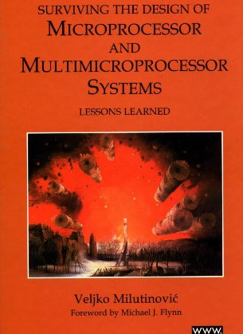
Past Experiences:
MultiCore
Split Cache
  Milutinovic, V. (1996).
  The Split Temporal/Spatial Cache:
  Initial Performance Analysis.
  SCIzzL-5, March 1996, 63-69.

Slide 14
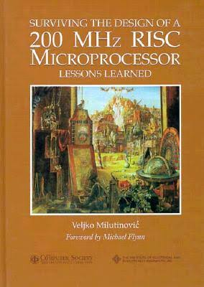
Past Experiences:
ManyCore
GaAs Microprocessor
  Milutinovic, V., Fura, D., & Helbig, W. (1986).
  An Introduction To GaAs
  Microprocessor Architecture for VLSI.
  Computer, (3), 30-42.

Slide 15
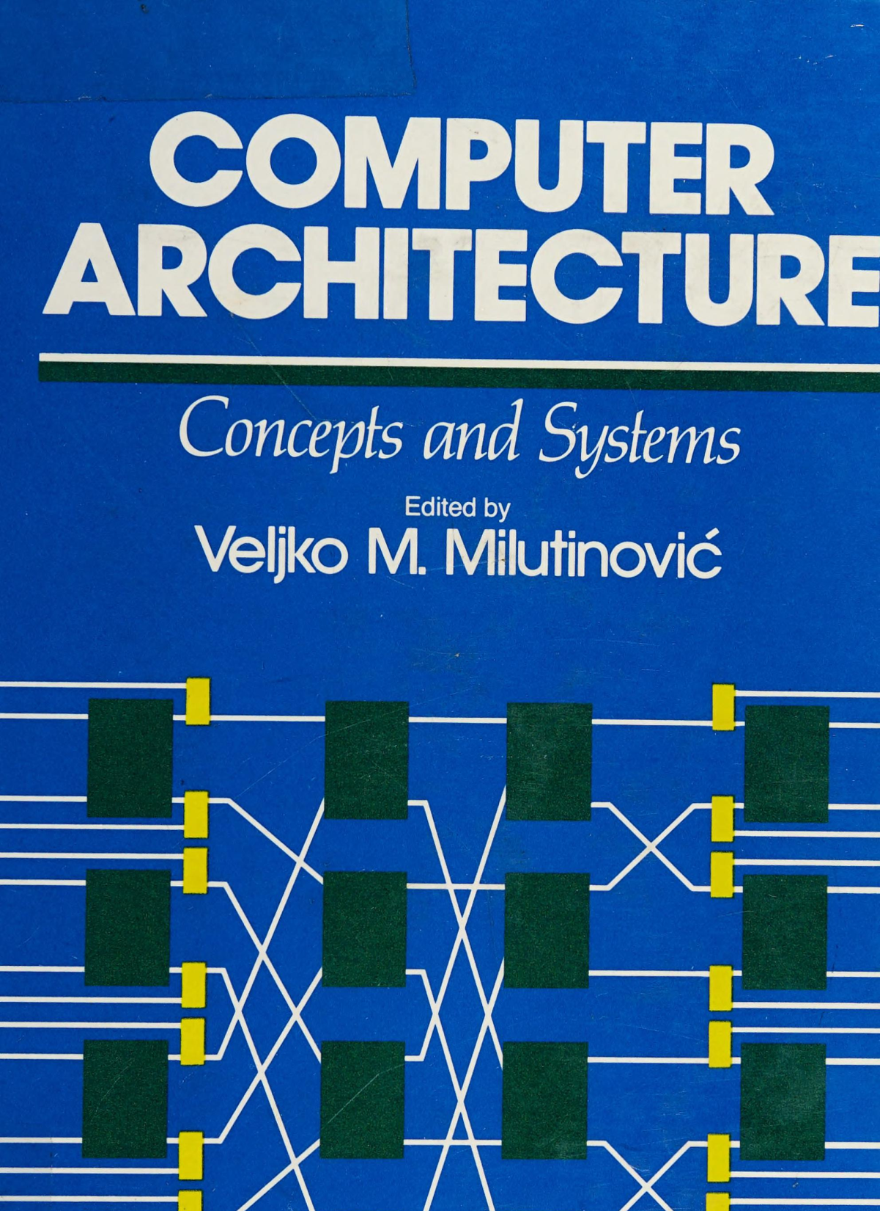
Past Experiences:
SystolicArrays
GaAs Systolics
  Fortes, J. A., Milutinovic, V.,
  (1986, January).
  A High-Level Systolic Architecture
  for GaAs.
  In Proc. 19th Ann. Hawaii Int'l Conf. System Sciences (pp. 253-258).

Slide 16
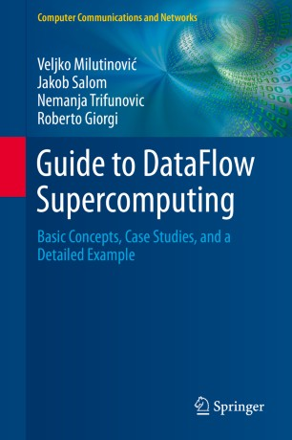
Past Experiences:
ExecutionFlow
DataFlow
  Milutinović, V., Salom, J., Trifunović, N.,
  & Giorgi, R. (2015).
  Guide to DataFlow Supercomputing.
  Cham: Springer Nature.

Slide 18
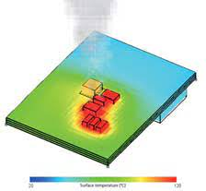
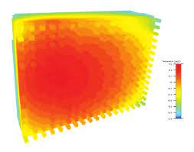
3D Implementations Offer Effective Cooling
In a hybrid processor,
multi-layer semiconductor structure fabrication can spread:
  MultiCore on the entire chip surface,
  ManyCore on the entire chip surface, and
  DataFlow on the entire chip surface.
Thus, for jobs that use predominantly one paradigm,
the frequencies of other chiplets could be lowered by:
  Hardware (automatically) [1], or
  Software (scheduled) [2].
[1] Lakhani, S., Wang, Y., Milenković, A., & Milutinović, V. (1996). 2D matrix multiplication on a 3D systolic array. Microelectronics journal, 27(1), 11-22.
[2] Milenkovic, A., & Milutinovic, V. (1998). A quantitative analysis of wiring lengths in 2D and 3D VLSI. Microelectronics journal, 29(6), 313-321.

Slide 19
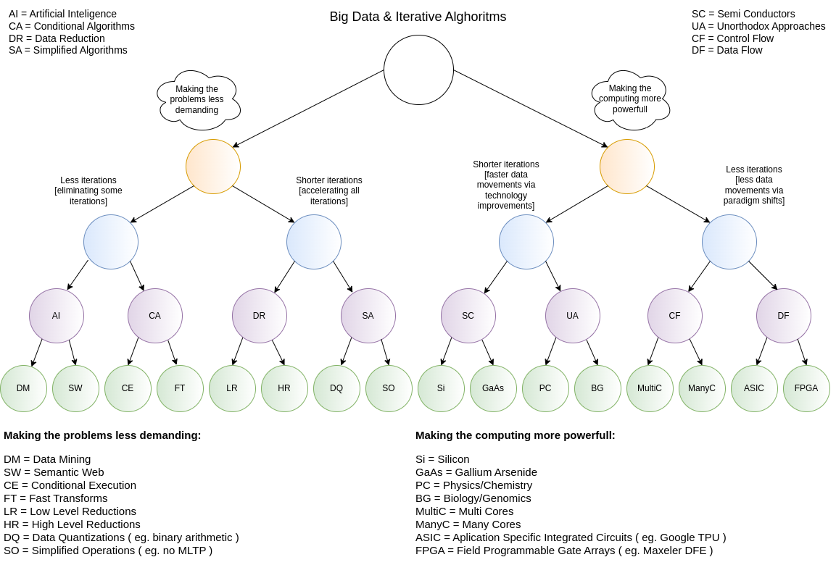
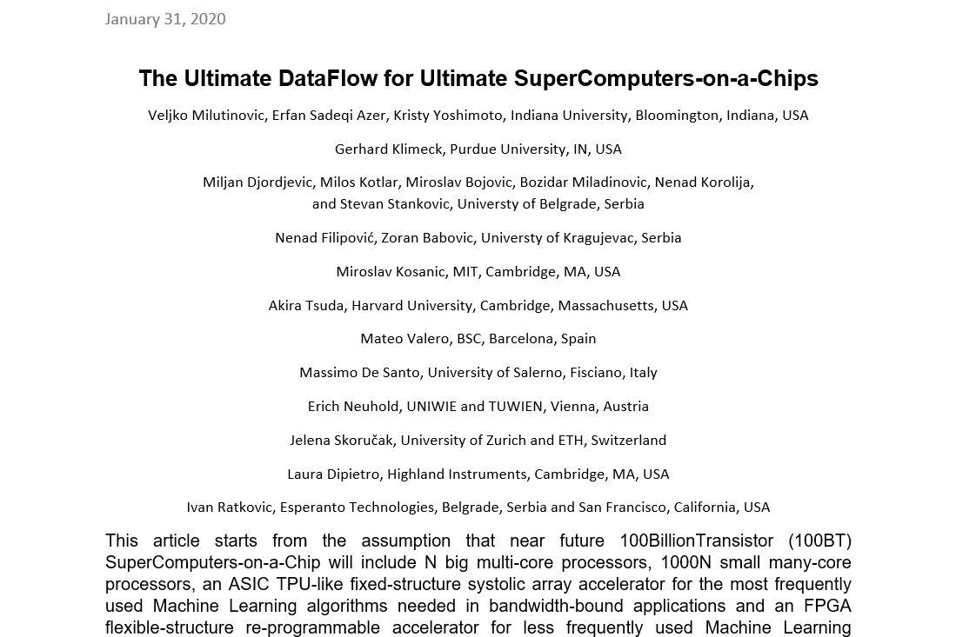
Current Research:
Research in computing-intensive simulations for nature-oriented civil-engineering and related scientific fields, using machine learning and big data: an overview of open problems
Zoran Babović, Branislav Bajat, Vladan Đokić, Filip Đorđević, Dražen Drašković, Nenad Filipović, Borko Furht, Nikola Gačić, Igor Ikodinović, Marija Ilić, Ayhan Irfanoglu, Branislav Jelenković, Aleksandar Kartelj, Gerhard Klimeck, Nenad Korolija, Miloš Kotlar, Miloš Kovačević, Vladan Kuzmanović, Marko Marinković, Slobodan Marković, Avi Mendelson, Veljko Milutinović, Aleksandar Nešković, Nataša Nešković, Nenad Mitić, Boško Nikolić, Konstantin Novoselov, Arun Prakash, Ivan Ratković, Zoran Stojadinović, Andrey Ustyuzhanin, Stan Zak
Journal of Big Data volume 10, Article number: 73 (2023)

Slide 20
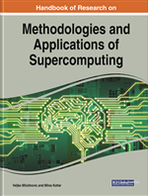
Handbook of Research on Methodologies and Applications of Supercomputing

Slide 21
Table of Contents #1
An introduction to Controlflow and Dataflow Supercomputing
Introduction to Control Flow
Optimal Scheduling of Parallel Jobs With Unknown Service Requirements
Intelligent Management of Mobile Systems Through Computational Self-Awareness
Paradigms for Effective Parallelization of Inherently Sequential Graph Algorithms
Data Flow Implementation of Erosion and Dilation
Transforming the Method of Least Squares to the Dataflow Paradigm
Forest Fire Simulation: Efficient Realization Based on Cellular Automata
High Performance Computing for Understanding Natural Language
Deposition of Submicron Particles by Chaotic Mixing in the Pulmonary Acinus

Slide 22
Table of Contents #2
Recommender Systems in Digital Libraries Using Artificial Intelligence and Machine Learning
Unified Modeling for Emulating Electric Energy Systems: Toward Digital Twin That Might Work
A Backtracking Algorithmic Toolbox for Solving the Subgraph Isomorphism Problem
AI Storm ... From Logical Inference and Chatbots to Signal Weighting, Entropy Pooling...
Efficient End-to-End Asynchronous Time-Series Modeling
Mind Genomics With Big Data for Digital Marketing on the Internet
Supercomputing in the Study and Stimulation of the Brain
An Experimental Healthcare System: Essence and Challenges
What Supercomputing Will Be Like in the Coming Years
The Ultimate Data Flow for Ultimate Super Computers-on-a-Chip

Slide 23
Reviews and Testimonials of 8 Nobel Laureates

Slide 24
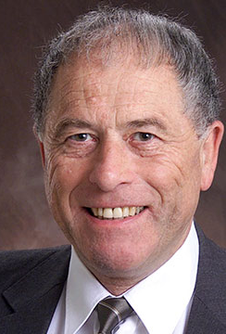
"I want to commend Dr. Veljko Milutinovic and Dr. Milos Kotlar for having completed this volume in the timely field of supercomputing in these difficult times, and I want to share their optimism regarding its use as a textbook around the world."
– Prof. Kurt Wüthrich, Nobel Laureate, Switzerland

Slide 25
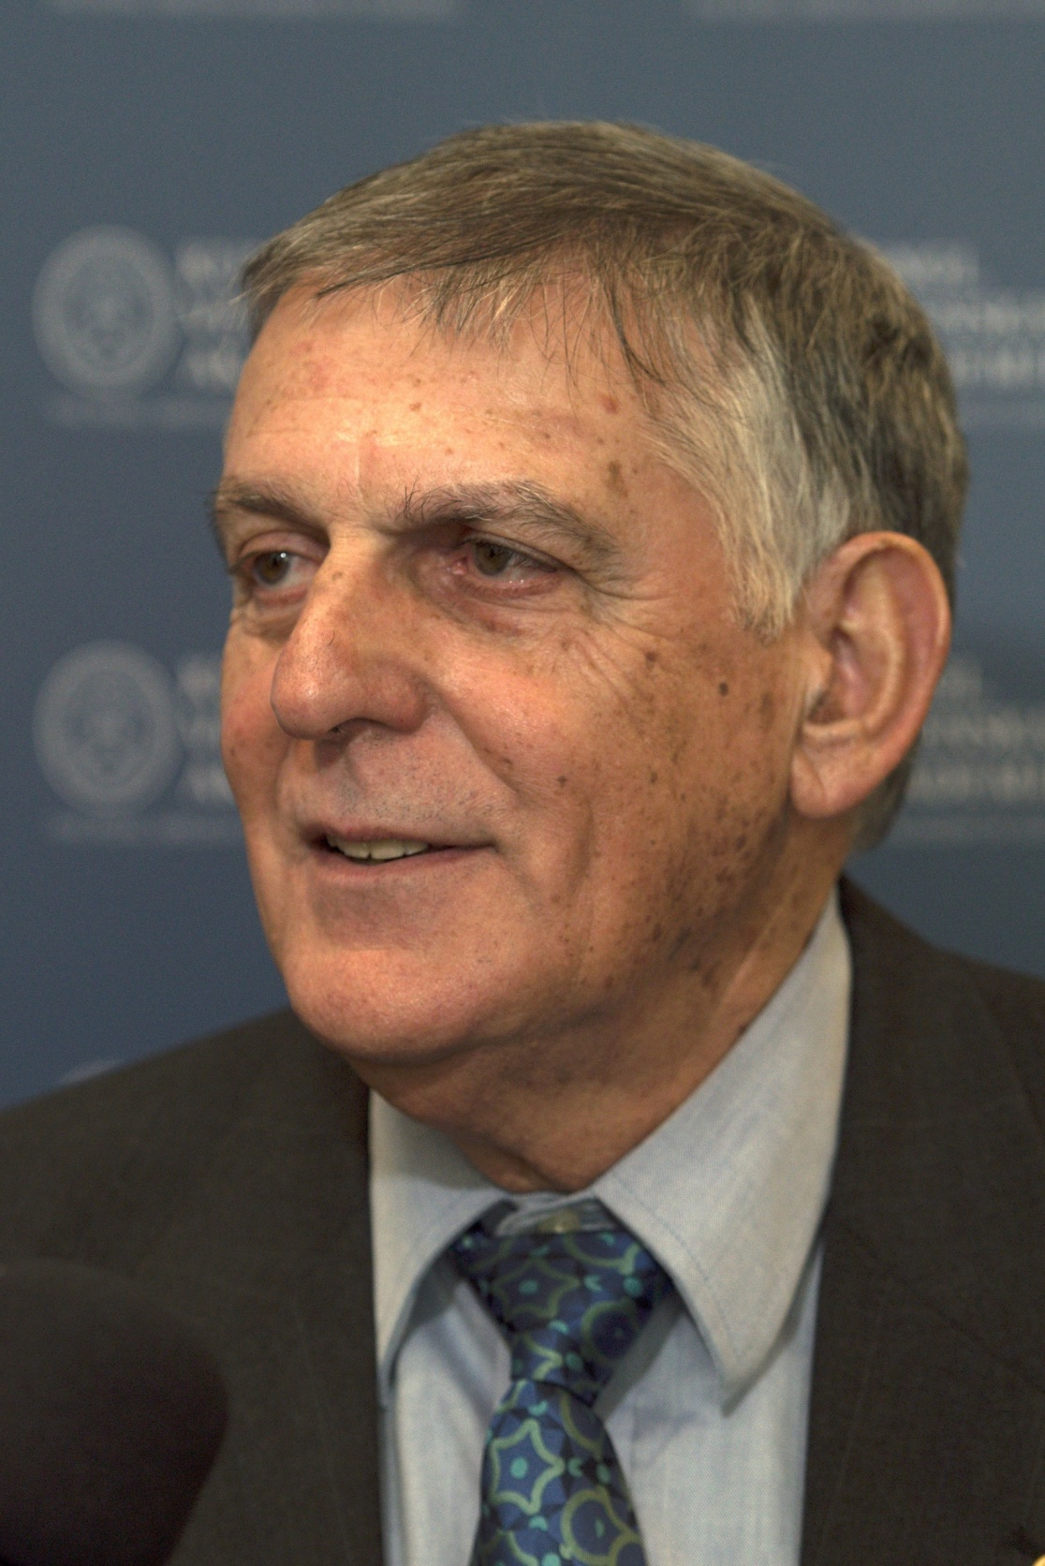
"Our complex and fast-moving world meets big data issues that call for reliable, efficient analysis and prompt response. A most advanced approach to dealing with these issues is presented in this book where algorithms of Control Flow represent the host architecture of supercomputers and Data Flow represents the acceleration architecture. A comprehensive list of applications is illustrated in the book including natural language processing, medical research, customer-oriented studies, and many more.“
– Prof. Dan Shechtman, Nobel Laureate, Israel

Slide 26
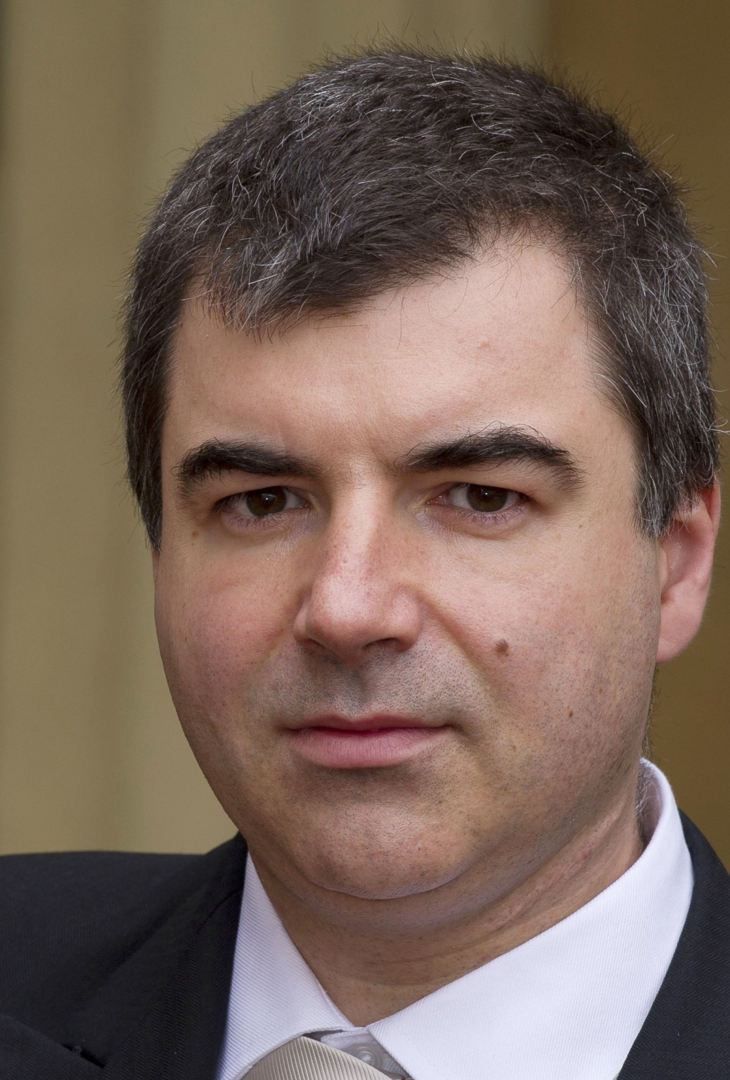
"Supercomputers have become a ubiquitous instrument in many areas of science and technology. Very hard to imagine modern physics, biology or chemistry without the use of this versatile tool. The breakthroughs in the development of supercomputers expand the range of problems we can tackle. Supercomputers, as well as specialised computers will undoubtedly contribute significantly to the overall landscape of discoveries in many different disciplines in the future."
– Prof. Konstantin Novoselov, Nobel Laureate, National University of Singapore, Singapore– Prof. Kurt Wüthrich, Nobel Laureate, Switzerland

Slide 27
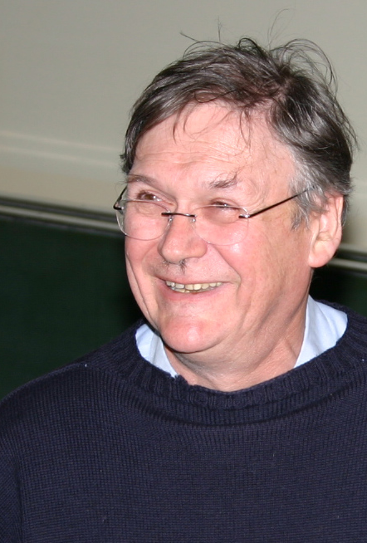
"It’s clear that computers can do anything, as the pioneers already recognised, and it’s probably only a matter of time before they can perform any of the kinds of tasks we humans take for granted quicker than blinking. I guess this book represents a stage on this exciting and very important journey."
– Prof. Tim Hunt, Nobel Laureate, UK

Slide 28
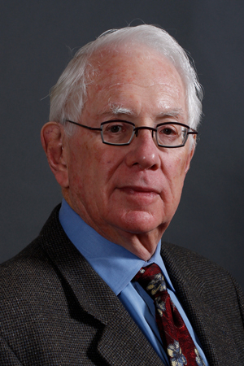
"Computers have become essential tools for the pursuit of both experimental and theoretical physics, as well as synthetic chemistry, paleontology, the medical sciences, economics the social sciences and so much more. Science, being the most international of all endeavors, will be well served by this important book, which honors the golden anniversary of the creation of Montinegro’s Academy of Science."
– Prof. Sheldon Glashow, Nobel Laureate, Boston University and Harvard University, USA

Slide 29
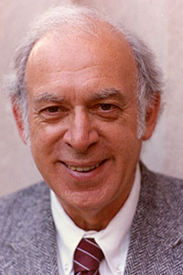
"Humankind’s continuing quests to uncover, understand, and utilize the secrets of nature have been greatly enhanced and will be further extended by the power of supercomputers."
– Prof. Jerome I Friedman, Nobel Laureate, USA

Slide 30
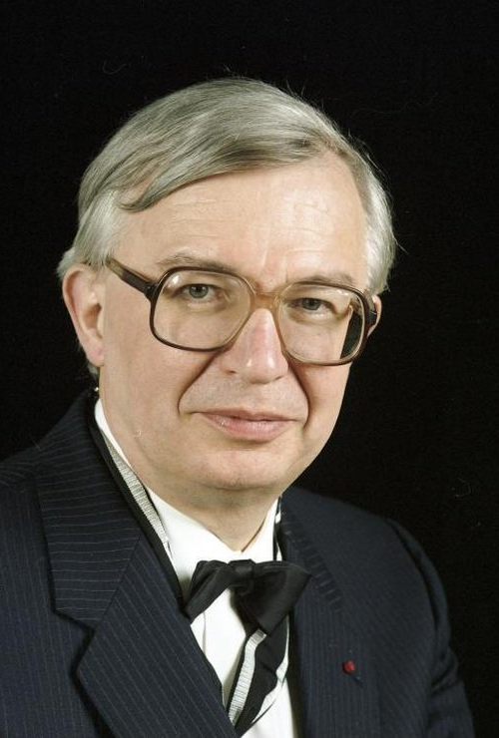
"I wish to congratulate very warmly the Montenegrin Academy of Arts and Sciences on the occasion of its 50th Anniversary and wish the CANU a highly successful future. Science shapes the Future of Mankind."
– Prof. Jean-Marie Lehn, Nobel Laureate, France

Slide 31
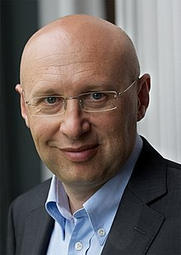
"Aim high, stay grounded! These four crisp words of wisdom accompany the best wishes for the 50th anniversary of the Montenegrin Academy of Sciences and Arts."
– Prof. Stefan Hell, Nobel Laureate, Germany

Slide 32
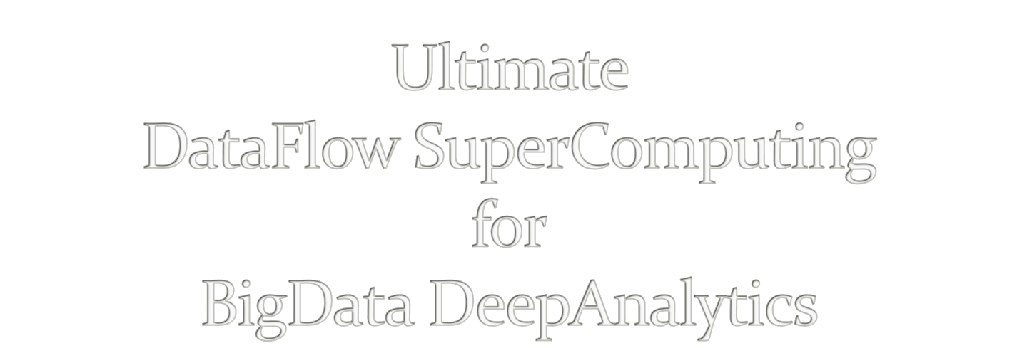
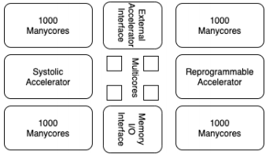
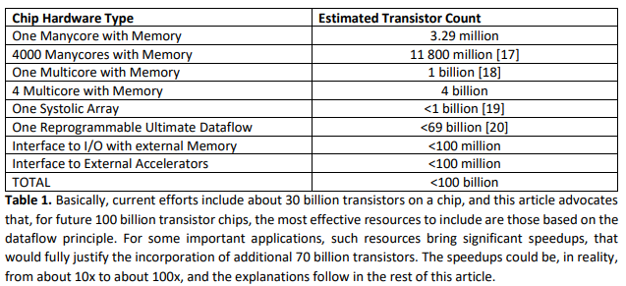
V. Milutinovic, University of Indiana, Bloomington, USA
Acknowledgements: O. Mencer, Imperial College, London, GBR, M.J. Flynn, Stanford University, Palo Alto, USA,
M. Kotlar, School of Electrical Engineering, University of Belgrade, SRB

Slide 33

A. Richard Feynman:
Impact of logic/arithmetic and memory/IO
Compiler-generated execution graph
Ilya Prigogine:
Impact of energy, entropy, order, and optimization
Compiler-generated data separation
Daniel Kahneman:
Impact of approximate computing on precision
Compiler-controlled approx computing
Tim Hunt:
Impact of system latency on precision
Compiler-controlled system latency

Slide 34

A. Whenever the Technology changes,
the Fundamental Paradigm of Computer Architecture
has to change, too.
aSoG (not: FPGA)
B. If several paradigms are available,
the most suitable paradigm for adoption
is the one most effective for modern Applications.
BrontoData (not: ExaBigData)
Is the von Neumann Paradigm still the most effective one?
A. MultiCores?
B. ManyCores?

Slide 35


Applications
Architecture
Size
Power
Speedup
Precision
Technology

Slide 36
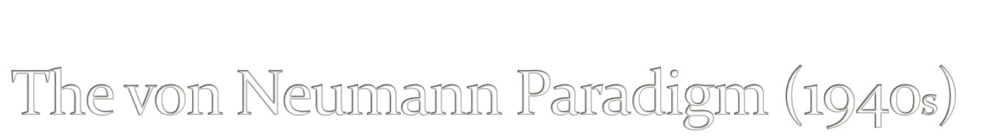
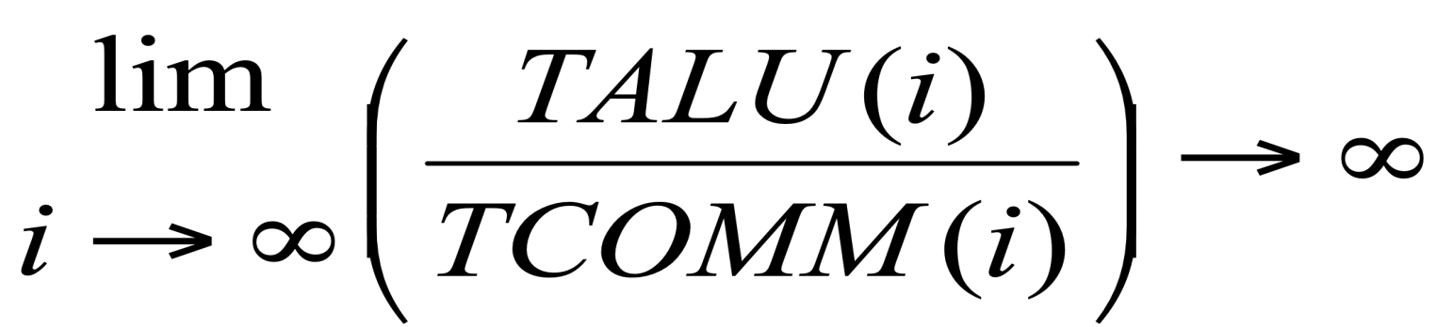

Slide 37

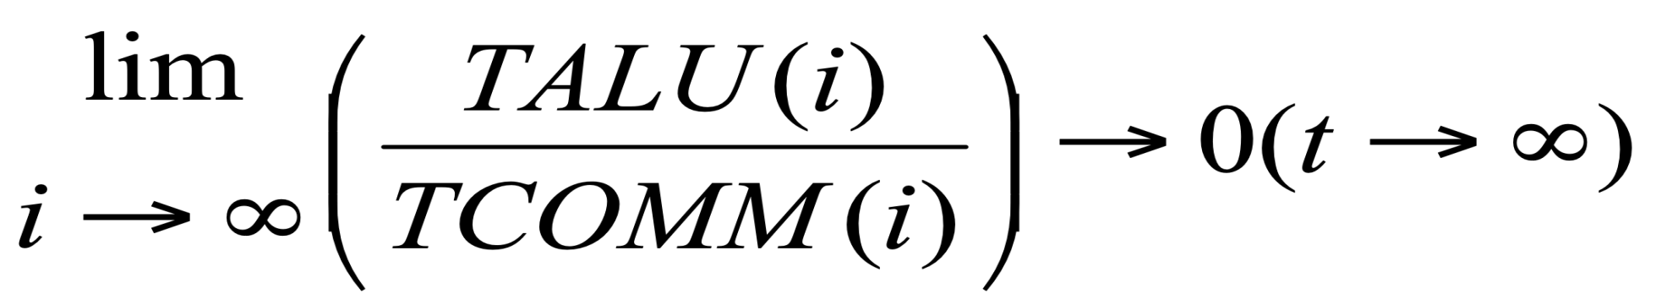
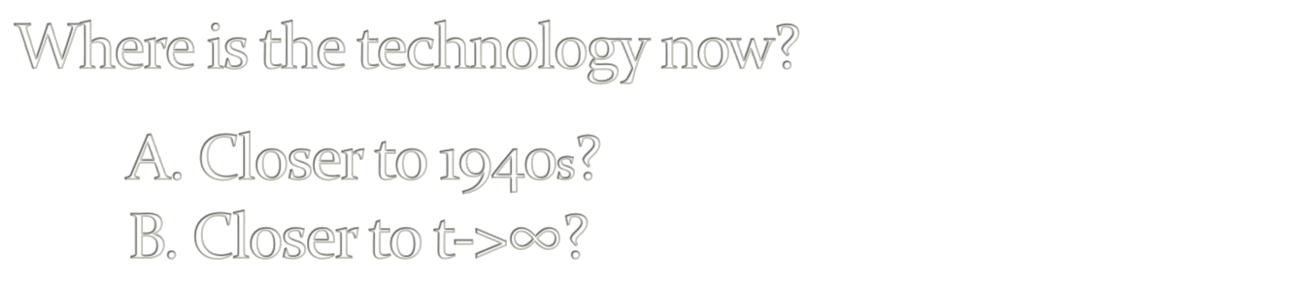

Slide 38
The Power Challenge
State of the Art in Technology Today
The Data Movement Challenge
 | 2015 | 2020
Double precision FLOP | 100pj | 10pj
Moving data to off-chip memory | 5000pj | 2000pj
Moving data off-chip will use 200x more energy than computing!
Moving data in 1940s was using 1/60x ...
Conclusion: We are getting close to the Feynman Asymptote!
Important: Power and speed could be traded!
7/60
Notes:
So what is dataflow buying us? Predictable performance, simpler architecture (no OOO – with its power & area overhead), and less data movement

Slide 39


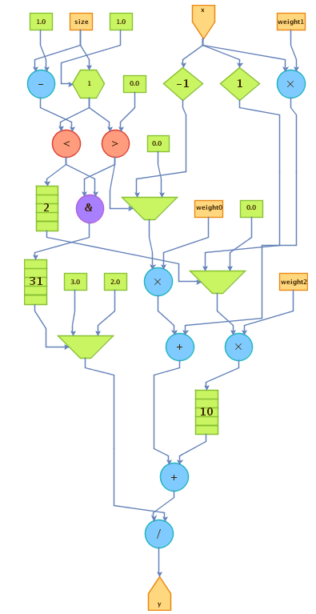
The Maxeler Technology Vision: MultiScale DataFlow
Space
Thinking in space
rather than in time
Difficult change in mindset
to overcome
Transformation of data
through flow over time
Instructions are parallelized
across the available space
Flow / Time
Optimal Solution: Execution Graph

Slide 40
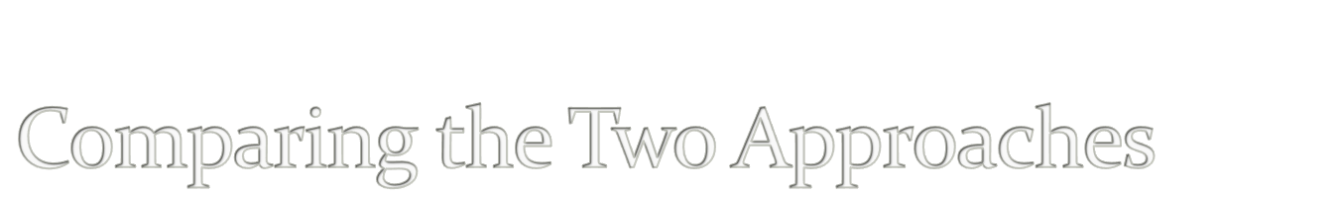
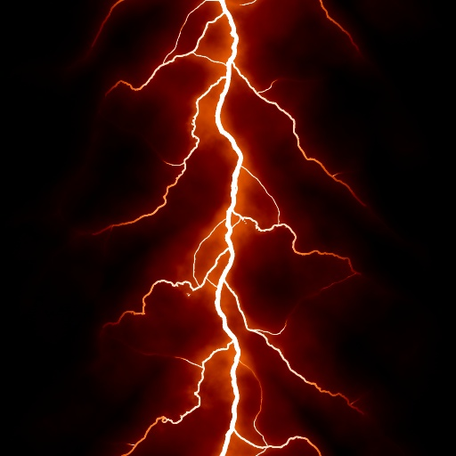
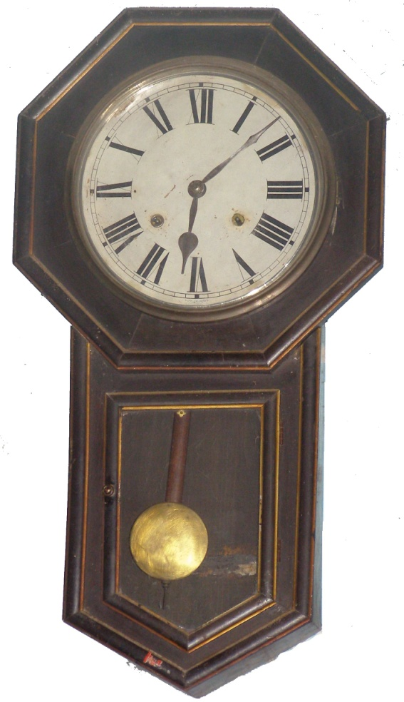
The Von-Neumann paradigm resembles an old wall clock
The Feynman paradigm resembles lightning!
Why?

Slide 41

von Neumann:
The Program Moves Data
Feynman:
The Program Configures Hardware
What moves data?
External sources till input.
Voltage difference through aSoG!
Voltage difference moves the important stuff!

Slide 42
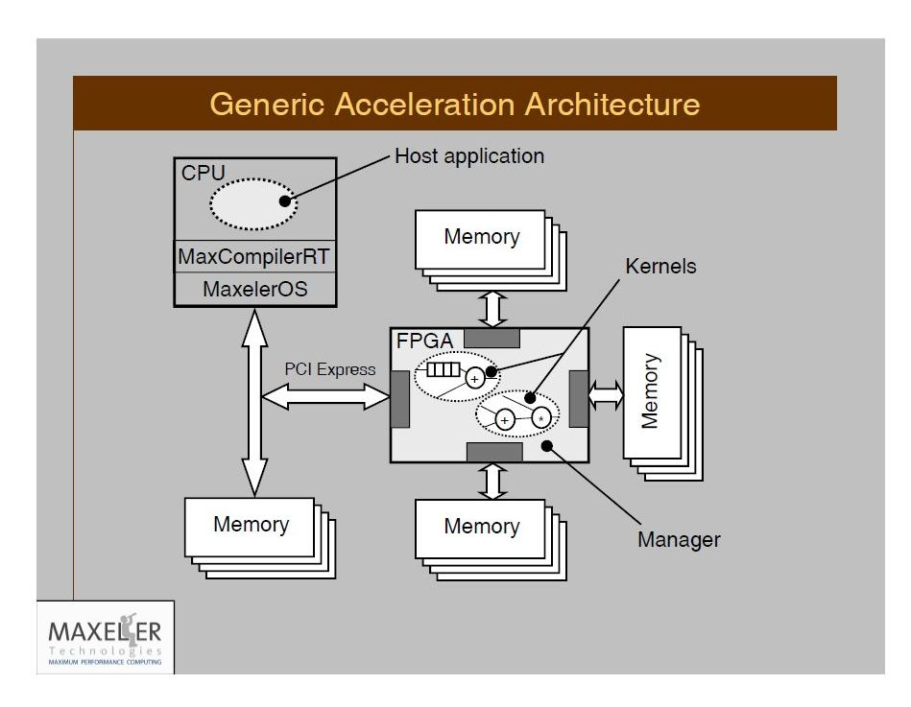
The Maxeler Generic Architecture Application
+ Tests
aSoG
Simulator builder
Hardware builder
2n+3
Important: Supporting any CL and any OS!
11/60

Slide 43

Nobel Laureate Ilya Prigogine:
Injecting Energy to Decrease Entropy!
Corollary:
Burning energy to split spatial and temporal
decreases the entropy of computing
and enables the DataFlow compiler
to create a maximally effective execution graph.
Final goal:
The execution graph with the minimal length of edges.

Slide 44
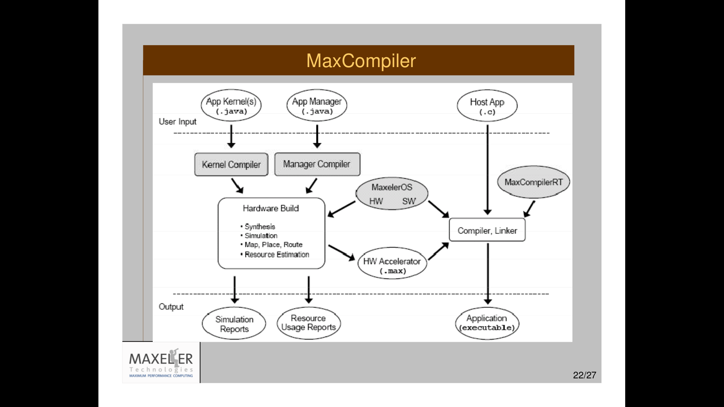

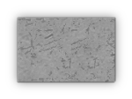
13/60

Slide 45

Intel acquired Altera
Qualcomm and IBM teaming up with Xilinx
However:
C C C
OpenCL(I) OpenCL(A) MaxCompiler
Intel Altera Altera@MaxZ
1 X>>1 Y>>X

Slide 46

Invisible on the DataFlow Concept Level
Invisible to DataFlow Programmers
Visible to the MaxCompiler
The MaxCompiler knows how to utilize them
Best protected by two aSoG (now FPGA) protection levels
and two Vendor (e.g., Maxeler) protection levels!

Slide 47
Publications of Interest for NanoAcceleration
========================================================================================================
Flynn, M., Mencer, O., Milutinovic, V., Rakocevic, G., Stenstrom, P., Trobec, R., Valero, M.,
Moving from Petaflops (on Simple Benchmarks) to Petadata per Unit of Time and Power (On Sophisticated Benchmarks),
Communications of the ACM (nano-acceleration), May 2013.
2. Trobec, R., Vasiljevic, R., Tomasevic, M., Milutinovic, V., Beiveide, M., Valero, M.,
Interconnection Networks for SuperComputing,
ACM Computing Surveys (nano-acceleration) , 2017.
------------------------------------------------------------------------------------------------------------------------------------------------------------------------------
3. Milutinovic, V., Tomasevic, M., Markovic, B., Tremblay, M.,
The Split Temporal/Spatial Cache: Initial Performance Analysis,
Proceedings of the SCIzzL-5, Santa Clara, California, USA, March 26, 1996, pp 72-78.
4. Milutinovic, V., Tomasevic, M., Markovic, B., Tremblay, M.,
The Split Temporal/Spatial Cache: Initial Complexity Analysis,
Proceedings of the SCIzzL-5, Santa Clara, California, USA, September, 1996.
------------------------------------------------------------------------------------------------------------------------------------------------------------------------------
5. Milutinovic, V.,
A Comparison of Suboptimal Detection Algorithms Applied to the Additive Mix of Orthogonal Sinusoidal Signals,
IEEE Transactions on Communications, Vol. COM-36, No. 5, May 1988, pp. 538-543.
6. Milutinovic, V.,
Mapping of Neural Networks on the Honeycomb Architectures,
Proceedings of the IEEE, Vol. 77, No 12, December 1989, pp. 1875-1878.
------------------------------------------------------------------------------------------------------------------------------------------------------------------------------
7. Helbig, W., Milutinovic, V.,
The RCA's DCFL E/D MESFET GaAs 32-bit Experimental RISC Machine,
IEEE Transactions on Computers, Vol. 36, No. 2, February 1989, pp. 263-274.
8. Jovanovic, Z., Milutinovic, V.,
FPGA Accelerator for Floating-Point Matrix Multiplication,
IEE Computers & Digital Techniques (nano-acceleration), 2012, 6, (4), pp. 249-256.
The IET 2014 Premium Award for Computing & Digital Techniques.
========================================================================================================
Inspired by:
Feynman
Inspired by:
Prigogine
Inspired by:
Kahneman
Inspired by:
Hunt

Slide 48
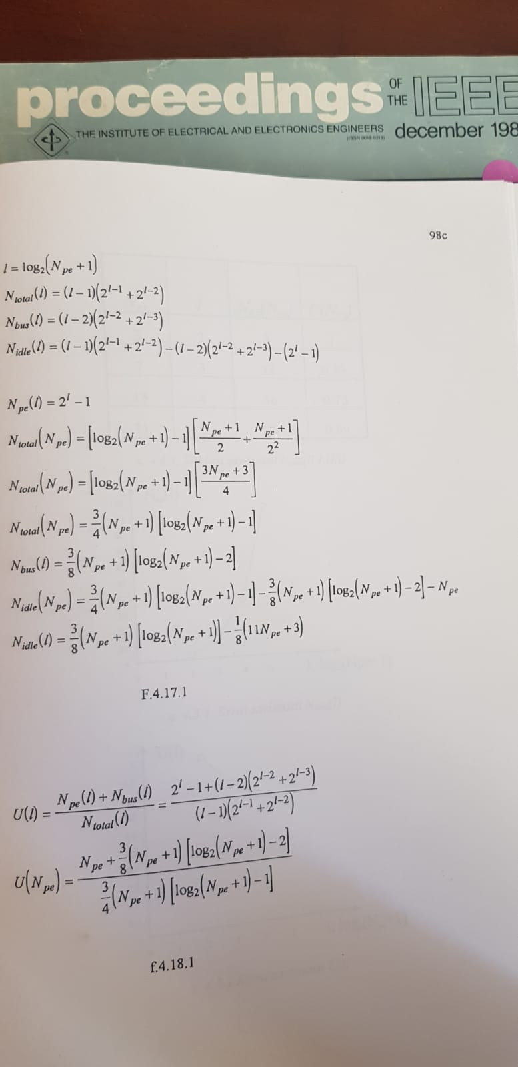
Feynman
48

Slide 49
Prigogine
49

Slide 50
Kahneman
50

Slide 51
Hunt
51

Slide 52
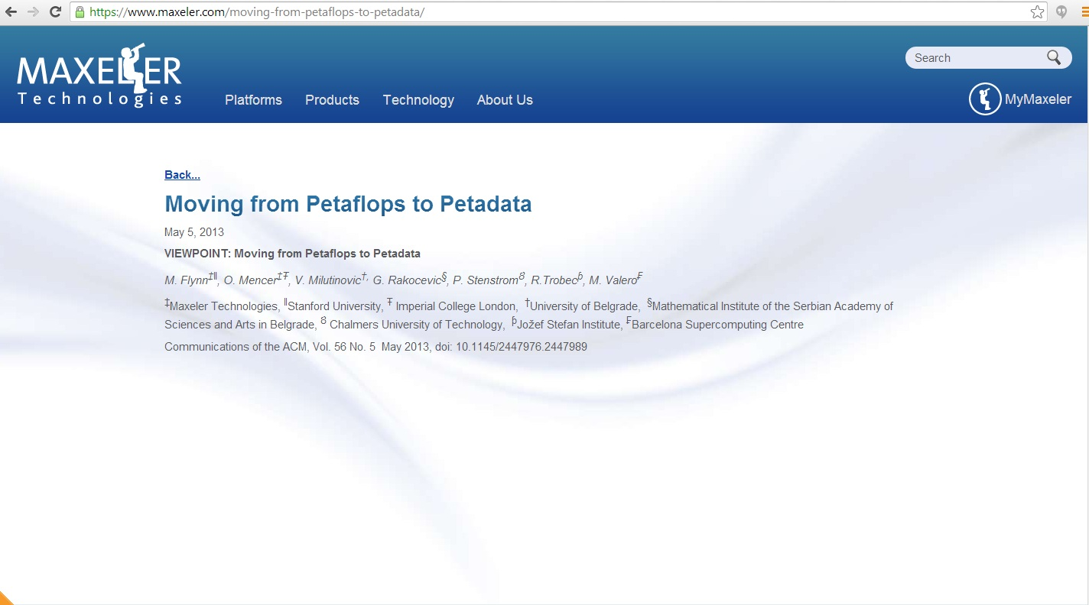
Special Acknowledgements to:
Simon Aglionby, Georgi Gaydadjiev, Itay Greenspon, and Nemanja Trifunovic
IF(2012)=3.80

Slide 53
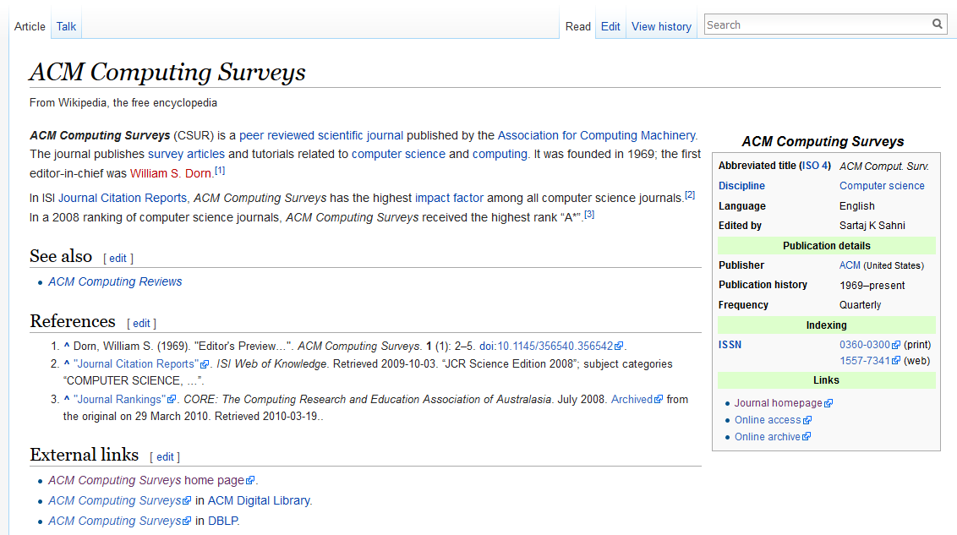
IF (2007) = 15

Slide 54
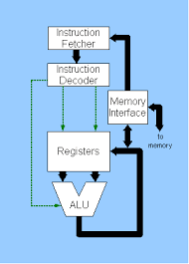
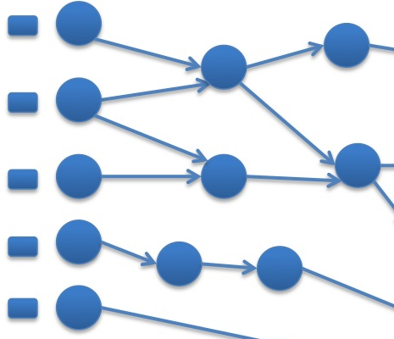
Essence: Feynman Enabled by Prigogine
TALU possible at zero power (Arithmetic+Logic)
TCOMM not possible at zero power (MEM+MPS)

Slide 55
Essence: Feynman
TALU possible at zero power (Arithmetic+Logic)
TCOMM not possible at zero power (MEM+MPS)

Slide 56
Essence: Feynman
TALU possible at zero power (Arithmetic+Logic)
TCOMM not possible at zero power (MEM+MPS)

Slide 57

a DSL acting as a SuperSet of classical Java:
A. A vector of built-in domain-specific classes
B. Two sets of variables: SW + HW
MaxJ is a SubSet of OpenSPL,
created by the Imperial-Stanford-Tokyo-Tsinghua consortium.
Possible Future Mutations of OpenSPL:
MaxPython and/or MaxR
(lower Kolmogorov complexity)
MaxHaskel and/or MaxScala
(easier extension to approximate computing).
MaxJ, the Maxeler Java,

Slide 58

Note: Small approximations in one domain
may bring large benefits in another domain
Example: Weather forecast
A 15-bit computational precision (rather than the 64-bit precision)
may decrease the forecast precision for only 2%,
and at the same time,
may increase the grid precision 25 times,
and the forecast precision at grid intersections up to 10⁴.
Easily doable in DataFlow, difficult to do in ControlFlow.

Slide 59
Delayed Decision for Better Precision: Hunt
Note: Small latencies in time domain
may bring large benefits in precision domains
Example: Optimal utilization of internal DataFlow pipelines
Compiler optimizations create internal pipelines
that experienced DataFlow programmers know how to utilize

Slide 60


Existing Maxeler-based publications:
Ultimate aSoG-based future:
20 [Size]
20 [Power]
20, 200 [Speedup]
20 [Precision]
20-200 [Size]
20-200 [Power]
20, 200, 2000, 20000 [Speedup]
20+ [Precision]
Applications
Architecture
Technology

Slide 61
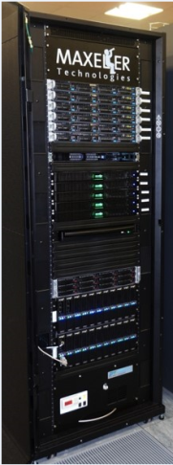







Maxeler Dataflow Appliance
40U: Good for Cloud
Software Based Solution
Dataflow Computing in the Datacentre
The CPU
Conventional CPU cores and
up to 6 DFEs with 288GB of RAM
The Dataflow Appliance
Dense compute with 8 DFEs, 768GB of RAM and dynamic allocation of DFEs to CPU servers with zero-copy RDMA access
The Networking Appliance
Intel Xeon CPUs and 4 DFEs with direct links to up to twelve 40Gbit Ethernet connections
1U: Good for Fog
MicroMAX.5: Good for Dew (Edge Processing of IoT Data)

Slide 62
The Major Application Successes
Finances:
  Credit derivatives
  Risk assessment
  Stability of economical systems
  Evaluation of econo-political mechanisms
GeoPhysics:
  Oil&Gas
  Weather forecast
  Astronomy
  Climate changes
Science:
  Physics
  Chemistry
  Biology
  Genomics
Engineering: Synergy of all the Above (ML, etc...)

Slide 63

28/60

Slide 64

The know-how needed for deep security!
29/60

Slide 65


30/60

Slide 66





Juniper for Online Trading
NASDAQ
31/60

Slide 67

32/60

Slide 68

Seismic Imaging
Running on MaxNode servers
- 8 parallel compute pipelines per chip
- 10x less power: 150MHz vs 1.5GHz
- 30x faster than microprocessors
An Implementation of the Acoustic Wave Equation on FPGAs
T. Nemeth†, J. Stefani†, W. Liu†, R. Dimond‡, O. Pell‡, R.Ergas§
†Chevron, ‡Maxeler, §Formerly Chevron, SEG 2008

Slide 69







Global Weather Simulation: Size is Relevant
Atmospheric equations
Equations: Shallow Water Equations (SWEs)
[L. Gan, H. Fu, W. Luk, C. Yang, W. Xue, X. Huang, Y. Zhang, and G. Yang, Accelerating solvers for global atmospheric equations through mixed-precision data flow engine, FPL2013]
Tsinghua

Slide 70


Weather Model – Performance Gain
Platform | Performance () | Speedup
6-core CPU | 4.66K | 1
Tianhe-1A node | 110.38K | 23x
MaxWorkstation | 468.1K | 100x
MaxNode | 1.54M | 330x
14x

Slide 71


Weather Model -- Power Efficiency
Platform | Power Efficiency ( ) | Speedup
6-core CPU | 20.71 | 1
Tianhe-1A node | 306.6 | 14.8x
MaxWorkstation | 2.52K | 121.6x
MaxNode | 3K | 144.9x
9 x

Slide 72




Weather and Climate Models: Precision
Which one is better?
Finer grid and higher precision are obviously preferred
but the computational requirements will increase ➔ Power usage → $$
What about using reduced precision? (15 bits instead of 64 double precision FP)

Slide 73



Maxeler Running Smith Waterman

Slide 74





Niederman-Wuensch

Slide 75


Analysis of the Tensor Calculus Operations on DataFlow
(PhD Thesis by Miloš Kotlar, on DataFlow-based Machine Learning)
  The speedup of 6.75x achieved as early as for KiloData (Perceptron),
  with 10x less on-chip transistors and the power savings of 4.6x
8/11

Slide 76


Conditions for the Y-Chart-Based “Kernelization” of Loops @ML
(PhD Thesis by Nenad Korolija, on the Mapping of Algorithms onto DataFlow)
1. | BigData (RAM vs. STREAM) | O(n²)
2. | Code reusability (WORO vs. WORM) | +
3. | Overall application tolerance to latency | +
4. | Over 95% of run time in loops | ++
5. | Reusability of the data in loops | ++
6. | Potential for utilization of pipes | O(n)
Essentials for speedup:
algorithmic modifications,
pipeline utilization,
data choreography,
decision making on precision

Slide 77

Value profiling
PDE(FE) for risk assessment
PDE(FD) for emergency warnings
BOTH for complex simulations
ML for intelligence upgrade (TENSOR CALCULUS)
Input: Output:
vectors to analyse min-max values

Slide 78

Reducing precision
+, -, *, / operators overloading with custom (reduced precision).

Slide 79

appgallery.maxeler.com
http://www.mi.sanu.ac.rs/~appgallery.maxeler/

Slide 80


Slide 81


Slide 82

appgallery.maxeler.com
http://www.mi.sanu.ac.rs/~appgallery.maxeler/

Slide 83

webide.maxeler.com
https://maxeler.mi.sanu.ac.rs

Slide 84

webide.maxeler.com
https://maxeler.mi.sanu.ac.rs

Slide 85

48/60

Slide 86



49/60

Slide 87


MultiCore
Which way are the horses going?
DualCore?

Slide 88


ManyCore
Is it possible
to use 2000 chicken instead of two horses?
?
==
What is better, real and anecdotic?

Slide 89



DataFlow
Data
How about 2 000 000 ants?

Slide 90
DataFlow
Big Data Input

Slide 91
DataFlow
FPGA
Big Data Input

Slide 92

DataFlow
FPGA
Big Data Input
Results
Marmelade

Slide 93

An Edited Book Covering the Applications
http://www.amazon.com/Dataflow-Processing-Volume-Advances-Computers/dp/0128021349
http://www.elsevier.com/books/dataflow-processing/milutinovic/978-0-12-802134-7
Indexed by: WoS (SCI)
Contributions welcome for the follow-ups: Vol. 102 + Vol. 104 + Vol.126 + etc…

Slide 94

An Original Book Covering the Essence
http://www.amazon.com/Guide-DataFlow-Supercomputing-Concepts-Communications/dp/3319162284
http://www.springer.com/gp/book/9783319162287
The first source to use the term the Feynman Paradigm in contrast with the Von Neumann Paradigm

Slide 95

Alibaba recently did the same!

Slide 96


Intel says logic is faster than GPUs
Alibaba recently claimed the same!

Slide 97
QoL
Maxeler is one of the Top 10 HPC projects
to impact QoL in the World :)
Scientific Computing
[www.scientificcomputing.com/articles/2014/11]
by
Don Johnson
of
Lawrence Livermore National Labs
[editor@ScientificComputing.com]

Slide 98


How About QoL?

Slide 99
DataFlow
SW
HW
AW

Slide 100
Essence of the Paradigm:
For Big Data algorithms
and for the same hardware price as before,
achieving:
a) speed-up, 20-200
b) monthly electricity bills, reduced 20 times
c) size, 20 times smaller
d) precision, X times better
The major issues of engineering are: design cost and design complexity.
Remember, economy has its own rules: production count and market demand!

Slide 101
Why is DataFlow so Much Faster?
Factor: 20 to 200
MultiCore/ManyCore
DataFlow
Machine Level Code
Gate Transfer Level

Slide 102

Why are Electricity Bills so Small?
Factor: 20
MultiCore/ManyCore
DataFlow

Slide 103
Why is the Cubic Foot so Small?
Factor: 20
MultiCore/ManyCore
DataFlow
Data Processing
Process Control
Process Control
Data Processing

Slide 104

Why is the Precision Better?
Factor: X

Slide 105


Q&A
vm@etf.rs
© H. Maurer

Slide 106


Slide 107


Slide 108

BQCD on a Maxeler Dataflow Computer

Slide 109

BQCD on a Dataflow Computer
Porting BQCD from BlueGene to a Maxeler Dataflow Computer
Quantum Chromodynamics (QCD): models interactions of subatomic particles
Lattice QCD (LQCD): its discretisation, suitable for numerical computation
Berlin QCD (BQCD): most popular implementation of the LQCD algorithm
Conjugate Gradient (CG): Majority of the compute time (benchmark: 68%)
  CG iteratively solves linear algebra problem of form Mx = b
  Operator M contains Wilson-dslash and Clover operators
PROJECT TARGET 40x speedup of CG part of BQCD,
followed by speedup of the entire application by 20x
comparing same size boxes Dataflow vs BlueGene/Q

Slide 110


Maxeler QCD - Deployment
Maxeler QCD solution is deployed at Jülich Supercomputing Center,
running on a Maxeler Dataflow system (TEV = 682.38).
 | 2 racks of Jülich BlueGene/Q machine | On-premise Maxeler Dataflow system: scale to 1PF equivalent | Factor
Volume | 6.75 m³ | 0.87 m³ | 7.76
Overall Time to Solution | 1576.60 s | 689 s | 2.29
Overall Energy to Solution | 169.6 kWh | 4.42 kWh | 38.4
Volume x TTS | 10,642.05 m³s | 599.43 m³s | 17.8

Slide 111

Maxeler QCD on Amazon EC2 F1
74

Slide 112


QCD Demo
75

Slide 113


QCD Demo
76

Slide 114

subEdge: microMAX₅

Slide 115
Purdue, IU, MIT, Harvard, Boston, NEU, Dartmouth, U of Massachusetts at Amherst, USC, UCLA, Columbia, NYU, Princeton, NJIT, CMU, Temple U,
UIUC, Michigan, Wisconsin, Minnesota, FAU, FIU, Miami, Central Florida,
U of Alabama, U of Kentucky, GeorgiaTech, Ohio State, Imperial, King's,
Manchester, Huddersfield, Cambridge, Oxford, Dublin, Cork, Cardiff,
Edinburgh, EPFL, ETH, TUWIEN, UNIWIE, Graz, Linz, Karlsruhe, Stuttgart, Bonn, Frankfurt, Heidelberg, Aachen, Darmstadt, Dortmund, KTH, Uppsala,
Karlskrona, Karlstad, Napoli, Salerno, Siena, Pisa, Barcelona, Madrid,
Valencia, Oviedo, Ankara, Bogazici, Koc, Istanbul, Technion, Haifa,
BerSheba, Eilat, Belgrade, Podgorica, Koper, Ljubljana, Maribor, Nova Gorica, etc, etc. Also at the World Bank in Washington DC, IMF,
the Telenor Bank of Norway, the Raiffeisen Bank of Austria, Brookhaven
National Laboratory, Lawrence Livermore National Laboratory, IBM TJ
Watson, HP Encore Labs, Intel, Qualcomm VP, NCR, RCA, Fairchild,
Honeywell, Yahoo NY, Google CA, Microsoft, Finsoft, ABB Zurich, Oracle
Zurich, and many other industrial labs, as well as at Tsinghua University,
Shandong, NIS of Singapore, NTU of Singapore, Tokyo, Sendai, Seoul,
Pusan, Sydney University of Technology, University of Sydney, Hobart, Auckland, Toronto, Montreal, Durango, MontereyTech, Cuernavaca, UNAM, Kragujevac, Novi Sad...

Slide 116


Slide 117
Design of an SIMD Multimicroprocessor for RCA
GaAs Systolic Array Based on 4096 Node Processor Elements
Adaptive signal processing is of crucial importance for advanced radar and communications systems. In order to achieve real-time throughput and latencies, one is forced to use advanced semiconductor technologies (e.g., gallium arsenide, or similar) and advanced parallel architectures (e.g., systolic arrays, or similar).
The systolic array described here was designed to support two important applications: (a) adaptive antenna array beam forming, and (b) adaptive Doppler spectral filtering. In both cases,
in theory, the system output is calculated as the product of the signal vector x (complex
N-dimensional vector) and the weight vector w (optimal N-dimensional vector).
Complex vector x is obtained by multiplying N input samples with the corresponding window weighting function consisting of N discrete values. Optimal vector w is obtained as:

Slide 118
Symbol R refers to the N-by-N inverse covariance matrix of the signal with the (i,j)-th component defined as:
and symbol refers to N-dimensional vector which defines the antenna direction
(in the case of adaptive antenna beamforming)
or Doppler peak (in the case of adaptive Doppler spectral filtering).
Symbols M and v represent scaled values of R and s, respectively.
In practice, the scaled values M and v may be easier to obtain,
and consequently the remaining explanation is adjusted.
The core of the processing algorithm is the inversion of a N-by-N matrix in real time.
This problem can be solved in a number of alternative ways which are computationally less complex.
The one chosen here includes the operations explained in Figure abcd.

Slide 119

Positive semi definite matrix M can be defined as:
M = U D U^{T}
Matrices U and D are defined using the formula:
which is recursively updated using the formula:
a.
Legend:
SAA1 – Cells involved in root covariance update, and the first step of back substitution;
SAA2 - Cells involved in root covariance update, and in both steps of back substitution;
U – Lower triangular matrix with unit diagonal elements
D – Diagonal matrix with positive or zero diagonal elements
b – A scalar initially set to 1
K – Iteration count.

Slide 120



Slide 121



Slide 122



Slide 123
Veljko Milutinović
VLSI for SuperComputing:
From Applications and Algorithms to Masks and Chips

Slide 124
World Top Foundries in VLSI for SuperComputing
#1?

Slide 125
World Top Foundries in VLSI for SuperComputing
#1? Qualcomm

Slide 126
World Top Foundries in VLSI for SuperComputing
#1? Qualcomm
#2?

Slide 127
World Top Foundries in VLSI for SuperComputing
#1? Qualcomm
#2? Intel

Slide 128
World Top Foundries in VLSI for SuperComputing
#1? Qualcomm
#2? Intel
#3?

Slide 129
World Top Foundries in VLSI for SuperComputing
#1? Qualcomm
#2? Intel
#3? TSM (Taiwan Semiconductor Manufacturing)

Slide 130
World Top Foundries in VLSI for SuperComputing
#1? Qualcomm
#2? Intel
#3? TSM
The Qualcomm VP/TD started from this course
(first as my PhD student and later as the course TA)

Slide 131
World Top Foundries in VLSI for SuperComputing
#1? Qualcomm
#2? Intel
#3? TSM
The Qualcomm VP/TD started from this course
(first as my PhD student and later as the course TA)
An Intel VP/TD took the IR4RVL in-a-nut-shell
(at my past IEEE/ACM tutorial)

Slide 132
World Top Foundries in VLSI for SuperComputing
#1? Qualcomm
#2? Intel
#3? TSM
The Qualcomm VP/TD started from this course
(first as my PhD student and later as the course TA)
An Intel VP/TD took the IR4RVL in-a-nut-shell
(at my past IEEE/ACM-HICSS conference tutorial)
Maybe,
a Next Gen VP/TD comes from ETF

Slide 133
World Top Foundries in VLSI for SuperComputing
#1? Qualcomm
#2? Intel
#3? TSM
The Qualcomm VP/TD started from this course
(first as my PhD student and later as the course TA)
An Intel VP/TD took the IR4RVL in-a-nut-shell
(at my past IEEE/ACM-HICSS conference tutorial)
Maybe,
a next TSM VP/TD comes from ETF
or MAT

Slide 134
World Top Foundries in VLSI for SuperComputing
#1? Qualcomm
#2? Intel
#3? TSM
The Qualcomm VP/TD started from this course
(first as my PhD student and later as the course TA)
An Intel VP/TD took the IR4RVL in-a-nut-shell
(at my past IEEE/ACM-HICSS conference tutorial)
Maybe,
a next TSM VP/TD comes from ETF
or MAT or FFH

Slide 135
World Top Foundries in VLSI for SuperComputing
#1? Qualcomm
#2? Intel
#3? TSM
The Qualcomm VP/TD started from this course
(first as my PhD student and later as the course TA)
An Intel VP/TD took the IR4RVL in-a-nut-shell
(at my past IEEE/ACM-HICSS conference tutorial)
Maybe,
a next TSM VP/TD comes from ETF
or MAT or FFH or FON

Slide 136

Who works here?

Slide 137
The Holistic Foundry (R&DFab) in VLSI for SuperComputing
Phase#1: From Applications to Algorithms
Phase#2: From Algorithms to Masks
Phase#3: From Masks to Chips
Phase#4: From Chips to Applications

Slide 138
The Holistic Foundry (R&DFab) in VLSI for SuperComputing
Phase#1: From Applications to Algorithms
Phase#2: From Algorithms to Masks
Phase#3: From Masks to Chips
Verification is crucial
in each one of these phases,
and related teaching is done in coop
with ELSYS or HDLDH!

Slide 139
The Holistic Foundry (R&DFab) in VLSI for SuperComputing
Phase#1: From Applications to Algorithms
Phase#2: From Algorithms to Masks
Phase#3: From Masks to Chips
Phase#4: From Chips to Applications
Verification is crucial
in each one of these phases,
and related teaching is done in coop with ELSYS or HDLDH!
Management issues of importance for an R&D Fab
are covered in the accompanying course: IR4USP
(including 12 related homework assignments)!

Slide 140

Contents:
From Algorithms to Masks
Part#1: VLSI for ControlFlow SuperComputing
Part#2: VLSI for DataFlow SuperComputing
Part#3: VLSI for WirelessFlow SuperComputing
Part#4: VLSI for EnergyFlow SuperComputing (QMOC)

Slide 141
VLSI for ControlFlow SuperComputing
ManyCore Systems:
Enabler Technology: VHDL vs Verilog (0.5 weeks)
Design and Programming of a 200MHz RISC Microprocessor (2.5 weeks) + HW#1
MultiCore Systems:
Enabler Technology: Verification by Elsys (2 weeks) + Lab#1
Design of MicroProcessor and MultiMicroProcessor Systems by Wiley (1 week)

Slide 142


Slide 143


Slide 144
VLSI for DataFlow SuperComputing
FineGrain DataFlow:
Enabler Technology: Altera vs Xilinx (0.5 weeks)
Design and Programming of the 200MHz Maxeler Machine (3.5 weeks) + HW#2
SystolicArray DataFlow:
Enabler Technology: Systolic Array Architectures (0.5 weeks)
Design of DARPA Systolic Architectures (0.5 weeks) + Lab#2

Slide 145

On Flexible DataFlow:
Advances in Computer Architecture (North Holland)
by Veljko M. Milutinovic
with a contribution from John Hennessy

Slide 146

On Fixed DataFlow:
High-Level Language Computer Architecture
(Elsevier Computer Science Press)
by Veljko M. Milutinovic
with a contribution from Michael Flynn

Slide 147
VLSI for WirelessFlow SuperComputing
WSNs: Part#1
Hardware (0.25 weeks)
Software (0.25 weeks)
WSNs: Part#2
Systems (SUN+Slimmer) (0.25 weeks)
Applications (UbiComputing@WSN+DataMining@WSN) (0.25 weeks)
The stress is on integration of WSNs, IoT, Ethernet, and Internet:
Z. Babovic et al., “Web Performance Evaluation of Internet of Things Applications,” IEEE Access 2016.

Slide 148


Slide 149

opt.html

Slide 150
VLSI for Quantum, Molecular, Optical, and Chemical SuperComputing
Basics:
Hardware (N weeks)
Software (N weeks)
Advances:
Systems (N weeks)
Applications (N weeks)
Optional class projects for extra points!

Slide 151
Quantum Computing
A quantum computer uses qubits
to run multidimensional quantum algorithms.
Their processing power increases exponentially
as qubits are added.
A classical processor uses bits
to operate various programs.
Their power increases linearly as more bits are added.

Slide 152
Potentials:
Quantum computing is 158 million times faster
than the most sophisticated supercomputer
we have in the world today.
It is a device that could do in four minutes
what it would take a traditional supercomputer
10,000 years to accomplish.

Slide 153

Reality:

Slide 154
The First Eight Companies in Quantum Computing:
Atom Computing
Xanadu
IBM
ColdQuanta
Zapata Computing
Azure Quantum
D-Wave
Strangeworks

Slide 155

Beginnings:

Slide 156
The Best Quantum Computing Stocks:
IBM (NYSE: IBM)
Alphabet (Nasdaq: GOOG, Nasdaq: GOOGL)
Intel (Nasdaq: INTC)
Microsoft (Nasdaq: MSFT)
Amazon (Nasdaq: AMZN)
Quantum Computing (OTC: QUBT)

Slide 157
Libraries:
TensorFlow Quantum (TFQ)
is a quantum machine learning library
for rapid prototyping
of hybrid quantum-classical ML models.
Interfacing for control-flow.

Slide 158
Tensor Flow Quantum:
TensorFlow Quantum focuses on quantum data
and building hybrid quantum-classical models.
It integrates quantum computing algorithms
and logic designed in Cirq,
and provides quantum computing primitives compatible with existing TensorFlow APIs,
along with high-performance
quantum circuit simulators.

Slide 159
A Programming Example:
# A hybrid quantum-classical model.
model = tf.keras.Sequential
([
# Quantum circuit data comes in inside of tensors.
tf.keras.Input(shape=(), dtype=tf.dtypes.string),
# Parametrized Quantum Circuit (PQC) provides output
# data from the input circuits run on a quantum computer.
tfq.layers.PQC(my_circuit, [cirq.Z(q1), cirq.X(q0)]),
# Output data from quantum computer passed through model.
tf.keras.layers.Dense(50)
])

Slide 160

Molecular Computing
Molecular computing is a branch of computing
that uses DNA, biochemistry,
and molecular biology hardware,
instead of traditional
silicon-based computer technologies,
to achieve dense computing!
Applications for dense computing are many!

Slide 161
Who invented DNA computing?
Leonard Adleman,
professor of computer science and molecular biology
at the University of Southern California, USA,
who pioneered the field
when he built the first DNA based computer.
L. M. Adleman, Science 266, 1021–102; 1994.

Slide 162
Essence:
With DNA,
the way the molecules can be triggered
to bind with each other
can be used to create a circuit
of logic gates in test tubes.
Compatible with nature based computing!

Slide 163
Techniques:
Many gates can be combined in a circuit:
Each output DNA will bind to the next logic gate
until some predictable terminal output strand
is liberated,
to produce an intermediate or final result.

Slide 164
N.B.:
In DNA computing, information is represented
using the four-character genetic alphabet:
A [adenine], G [guanine], C [cytosine], and T [thymine].
The core advantage of molecular computing is its potential
to pack vastly more circuitry onto a microchip
than silicon will ever be capable of—and to do it cheaply.

Slide 165
Miniaturization:
Molecules are only a few nanometers in size.
Making it possible to manufacture chips
that contain billions, even trillions,
of switches and components.

Slide 166
Can DNA be programmed?
Researchers at The University of Texas at Austin have programmed DNA molecules
to follow specific instructions
to create sophisticated molecular machines
that could be capable of communication,
signal processing, problem-solving, decision-making,
and control of motion in living cells.
Libraries under construction at MIT.

Slide 167
How does DNA computing work?
In one method, called DNA strand displacement,
the input of DNA that binds to a DNA logic gate
displaces a strand of DNA that serves as the output.
Many gates can be combined in a circuit:
Each output DNA will bind to the next logic gate
until some predictable terminal output strand
is liberated.

Slide 168

An Experiment:

Slide 169
Flexibility:
With the flexible molecular algorithms on the rise,
one might be able to assemble a complex entity
on the nanoscale
with the reprogrammable tile set.
Flexibility is the issue
for a great number of applications!
Amato and Rauchwerger, UIUC, USA

Slide 170

Do DNA computers exist?
The DNA Computing Technology is in the research phase.
DNA computers can't be found
at your local electronics store yet.
The technology is still in development;
it didn't even exist as a concept a decade ago.

Slide 171



Connecting Living Neurons Through Synapses
Systolic array connected through resistors
(varied electrical conductivity represents the strength of the connection
between the neurons/resistors - adaptable based learning)
To match the world of computing to the needs of AI, we must build computers with a structure inspired by the brain. These computers should have no separation between storage and computation, but instead use units capable of calculating and saving the values simultaneously. Electrical circuits inspired by the brain are called neuromorphic circuits
Electronic circuits that mimic the behavior of neurons in the human body.
Neuromorphic circuits can be combined to create neuromorphic computers.
In neuromorphic circuits, the same electronic components are used to both perform a calculation and to store the result locally. The structure of such a computer is completely different from a von Neumann machine, and it looks like a neural network in the brain.
Researchers from John Hopkins University and Cortical Labs suggest that it’s time to create a new type of computer that uses biological components. They believe that biological computers could outperform electronic computers in certain applications and use significantly less electricity.
Courtesy of Prof. Josep Torrellas, Prof. Shahar Kvatinsky, and
Researchers from John Hopkins University and Cortical Labs

Slide 172
Optical Computing
Optical computing or photonic computing
uses light waves produced by lasers
or incoherent sources for data processing,
data storage or data communication for computing.
For decades, photons have shown promise
to enable a higher bandwidth
than the electrons used in conventional computers.

Slide 173
Essence:
“Computation-by-propagation,
where the computation takes place
as the wave propagates through a medium,
can perform computation at the speed of light!”
Speed of light = 300.000km/sec

Slide 174
Applications:
Application-specific devices,
such as synthetic-aperture radar (SAR)
and optical correlators,
have been designed
to use the principles of optical computing.
Correlators can be used, for example,
to detect and track objects,
and to classify serial time-domain optical data.

Slide 175
Techniques:
Techniques have been developed
that can perform continuous Fourier Transform optically, by utilizing the natural
Fourier transforming property of lenses.
The input is encoded using
a liquid crystal spatial light modulator.

Slide 176
Artificial Neural Network with Optical Components:
Early optical neural networks
used a photorefractive Volume Hologram
to interconnect arrays of input neurons
to arrays of output.
With synaptic weights in proportion
to the multiplexed hologram's strength.

Slide 177
Optical Neural Networks:
Some artificial neural networks
that have been implemented
as optical neural networks
include the Hopfield neural network.
Also the Kohonen map
with liquid crystal spatial light modulators.

Slide 178
Do Photonic Chips Exist?
Now scientists have developed
a deep neural network on a photonic microchip
that can classify images in less than a nanosecond,
roughly the same amount of time
as a single tick of the kind of clocks
found in state-of-the-art electronics.
A lot more effective
compared to microprocessor based design!

Slide 179

An Application:

Slide 180
Chemical Computing
Computing with real molecules
like programming electronic devices,
but using principles taken from chemistry
and appropriate chemical processes.
Effective for simulations in chemistry
and physical chemistry!

Slide 181

An Example:

Slide 182
A chemical computer, also called a reaction-diffusion computer:
Belousov–Zhabotinsky (BZ) computer, or gooware computer,
is an unconventional computer
based on a semi-solid chemical "soup"
where data are represented
by varying concentrations of chemicals.
The computations are performed
by naturally occurring chemical reactions.

Slide 183
Origins:
Originally chemical reactions were seen
as a simple move towards a stable equilibrium
which was not very promising for computation.
This was changed by a discovery made
by Boris Belousov, a Soviet scientist, in the 1950s.

Slide 184
Belousov:
Belousov created a chemical reaction
between different salts and acids
that swing back and forth
between being yellow and clear.
This is because the concentration
of the different components
changes up and down in a cyclic way.

Slide 185
Adamatzky:
Andrew Adamatzky
at the University of the West of England
has demonstrated simple logic gates
using reaction–diffusion processes.
An important step towards programmability.

Slide 186

An Implementation:

Slide 187
European Projects
ESF:
RoMoL: Riding on Moore's Law (0 weeks)
HiPeac: Parallel Programming Models (0 weeks)
FP7/H20:
FP7: ProSense (0 weeks)
FP7: BalCon (0 weeks)

Slide 188
USA Projects
Nature Based Construction and Computing:
  Purdue (X weeks)
  Indiana University (X weeks)
Nature Based Media and Computing:
  MIT (X weeks)
  Harvard (X weeks)

Slide 189
Example Algorithms for Practical Implementations
Engineering:
Computer Engineering (M weeks)
Financial Engineering (M weeks)
Science:
Physical Chemistry (M weeks)
Computer Science (M weeks)

Slide 190
SOME PREVIOUS OFFERINGS OF THIS TECH COURSE
Purdue, Indiana;
MIT, Harvard;
Imperial, Kings;
ETH, EPFL;
UNIWIE, TUWIEN;
Siena, Salerno, Barcelona, Madrid;
Ljubljana, Koper, Zagreb, Rijeka, Podgorica, Sarajevo;
Technion, Jerusalem;
Bogazici, Koc;
Tsinghua, Shandong.
Previous offerings of the related MGMT course: Amherst, Dartmouth, Harvard, MIT Media, Pisa, Genova.

Slide 191

BOTTOM LINE:
BRINGING ADVANCED INDUSTRIAL EXPERIENCE INTO THE CLASSROOM

Slide 192

BOTTOM LINE:
BRINGING ADVANCED INDUSTRIAL EXPERIENCE INTO THE CLASSROOM

Slide 193
BOTTOM LINE:
BRINGING ADVANCED INDUSTRIAL EXPERIENCE INTO THE CLASSROOM

Slide 194

BOTTOM LINE:
BRINGING ADVANCED INDUSTRIAL EXPERIENCE INTO THE CLASSROOM (2)

Slide 195

BOTTOM LINE:
BRINGING ADVANCED INDUSTRIAL EXPERIENCE INTO THE CLASSROOM (2)

Slide 196

BOTTOM LINE:
BRINGING ADVANCED INDUSTRIAL EXPERIENCE INTO THE CLASSROOM (2)

Slide 197

BOTTOM LINE:
BRINGING ADVANCED INDUSTRIAL EXPERIENCE INTO THE CLASSROOM (3)

Slide 198

BOTTOM LINE:
BRINGING ADVANCED INDUSTRIAL EXPERIENCE INTO THE CLASSROOM (3)

Slide 199
BOTTOM LINE:
BRINGING ADVANCED INDUSTRIAL EXPERIENCE INTO THE CLASSROOM (3)
Wireless Sensor Networks: ApplicationDesign and DataMining

Slide 200
SUGGESTED READINGS:
Z. Babovic, V. Milutinovic, “Novel System Architectures for Semantic-Based Integration
of Sensor Networks,” Elsevier, Advances in Computers, 2013.
Z. Babovic, “DataFlow systems: From their origins to future applications in data analytics,
deep learning, and the Internet of Things,”
In V. Milutinovic et al. “DataFlow Supercomputing Essentials,” Springer, 2017.
IPSI TIR (Transactions on Internet Research), 2024.
IPSI TAR (Transactions on Advanced Research), 2024.
Special Issues of Elsevier – Advances in Computers 2024.
Special Issues of Springer – Journal of Big Data, 2024, 2025.

Slide 201

Google: prof vm
Powered by: Amazon AWS and Microsoft AZURE

Slide 202


