Slide 1
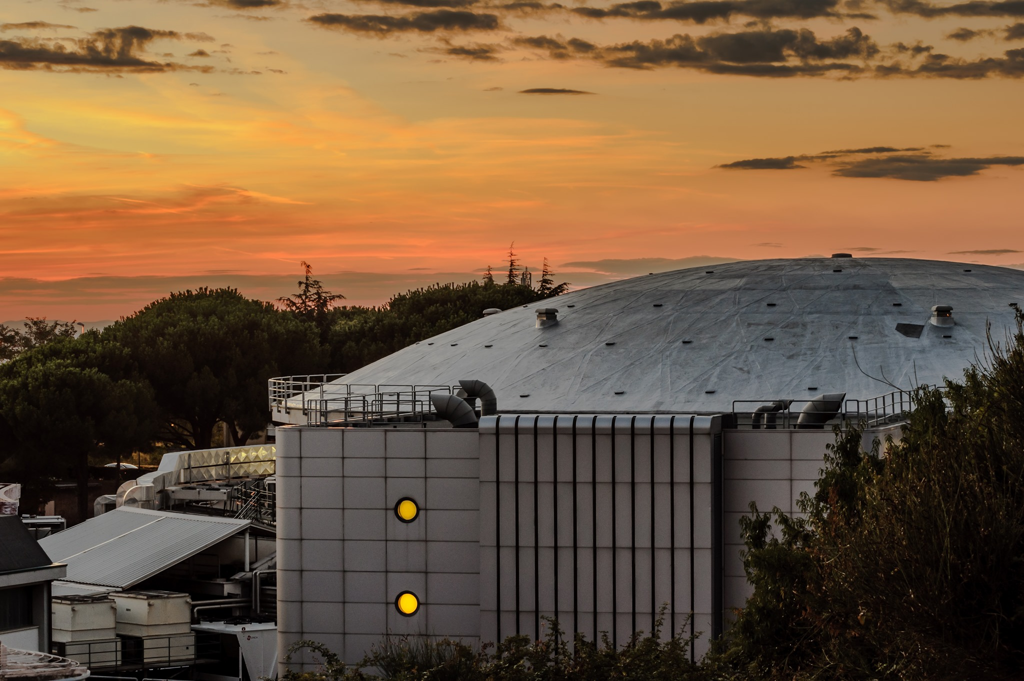

Advances in the investigation of weak and strong interactions
1-4 July 2024,
Crowne Plaza, Bucharest, Romania
Low-energy kaon-nuclei interaction studies at the DAFNE collider:
a strangeness Odyssey
Catalina Curceanu on behalf of the SIDDHARTA-2 Collaboration

Slide 2
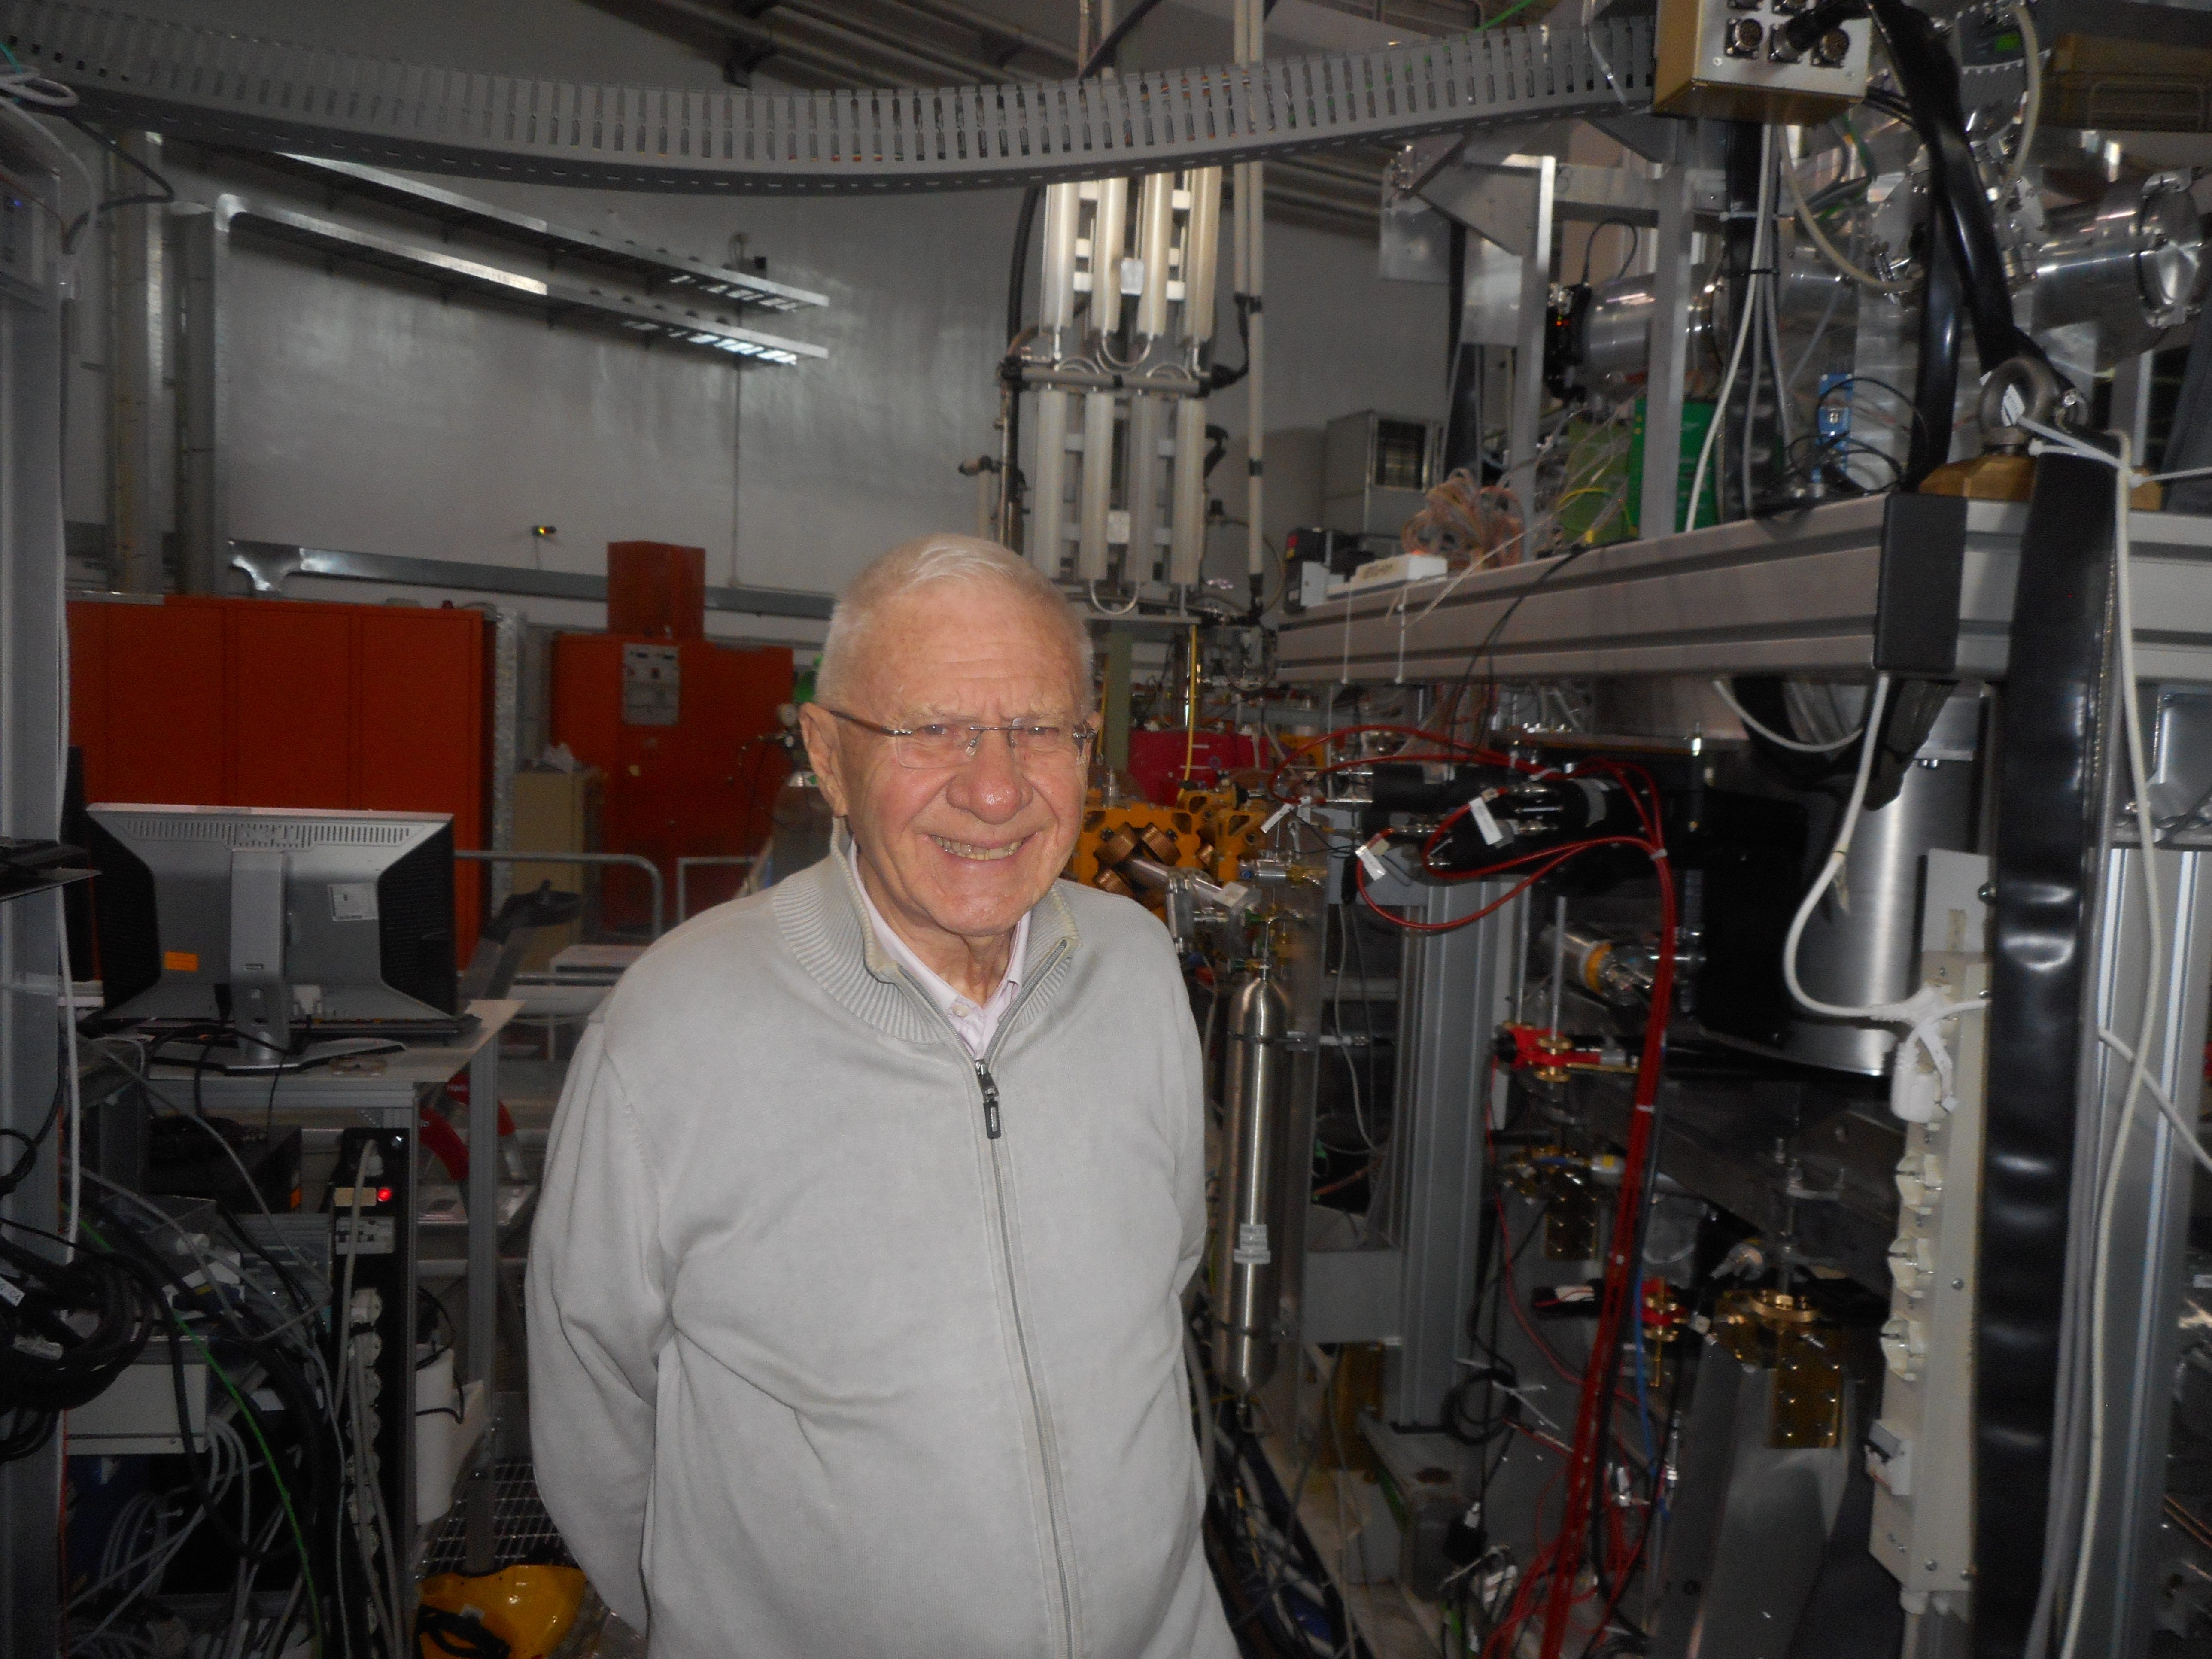
We dedicated our results to our dear colleague and friend Prof Carlo Guaraldo you’ll be very much missed!

Slide 3


Slide 4
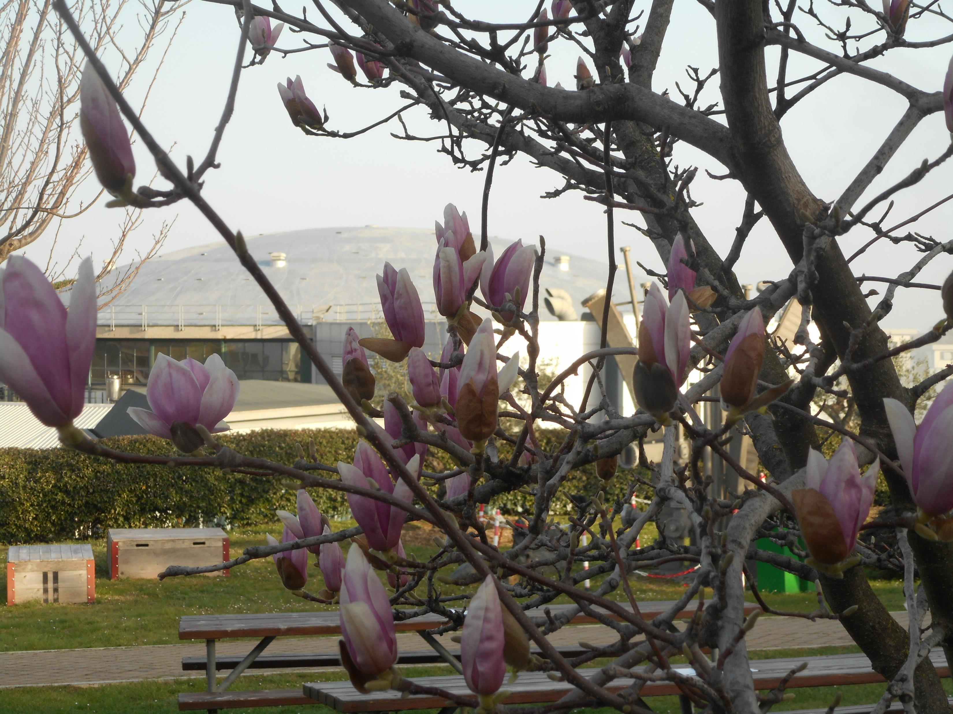

Slide 5






SIDDHARTA-2
SIlicon Drift Detector for Hadronic Atom Research by Timing Applications
LNF-INFN, Frascati, Italy
SMI-ÖAW, Vienna, Austria
Politecnico di Milano, Italy
IFIN –HH, Bucharest, Romania
TUM, Munich, Germany
RIKEN, Japan
Univ. Tokyo, Japan
Victoria Univ., Canada
Univ. Zagreb, Croatia
Univ. Jagiellonian Krakow, Poland
ELPH, Tohoku University
CERN, Switzerland
Helmholtz Inst. Mainz, Germany
Francesco Sgaramella
A new renaissance for kaonic atoms at DAΦNE: future measurements and perspectives

Slide 6
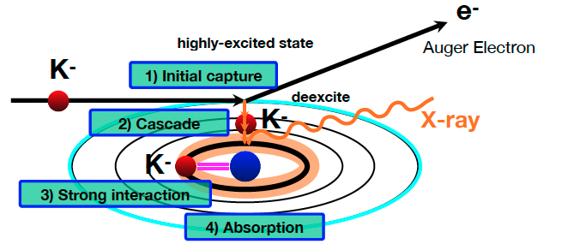
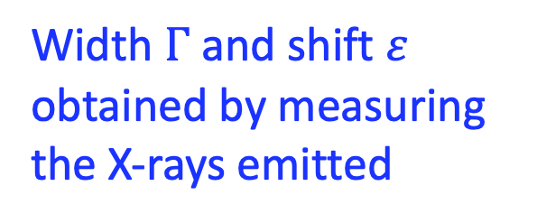
Kaonic atom Formation
Width $Γ$ and shift $ε$ obtained by measuring the X-rays emitted
Catalina Curceanu (A. Scordo)
A new renaissance for kaonic atoms at DAΦNE: future measurements and perspectives

Slide 7
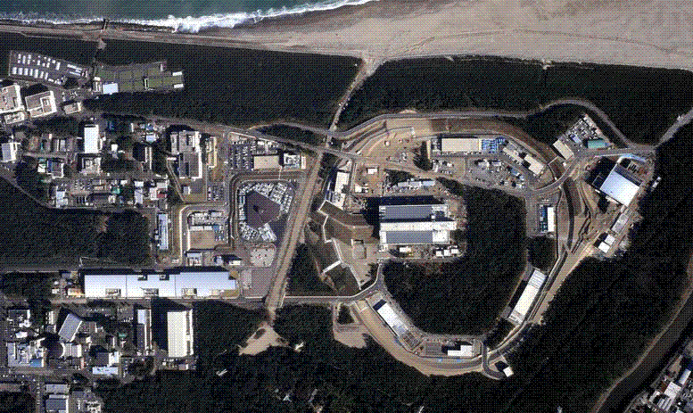
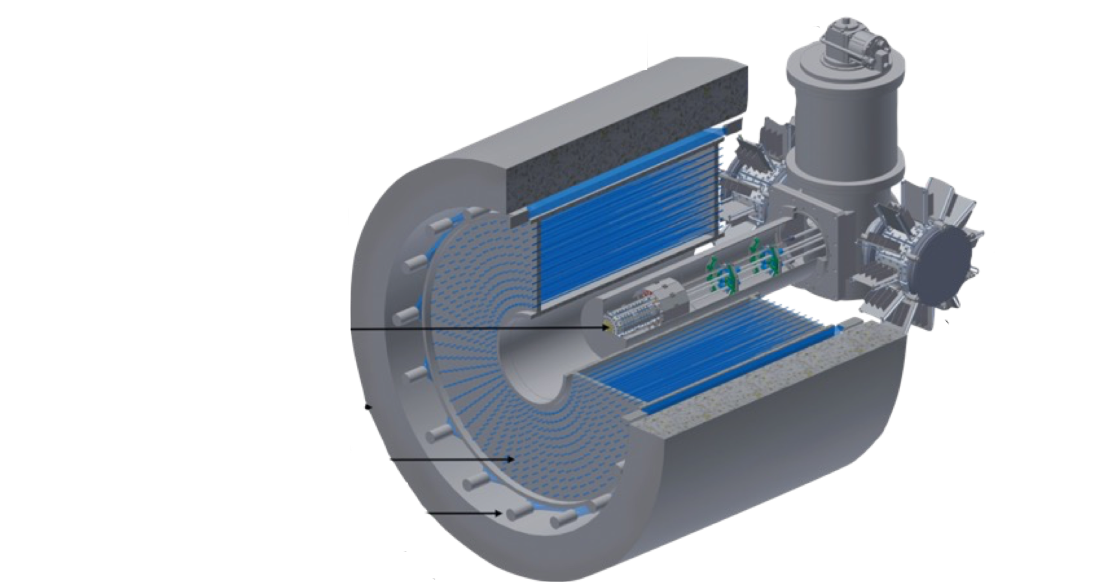
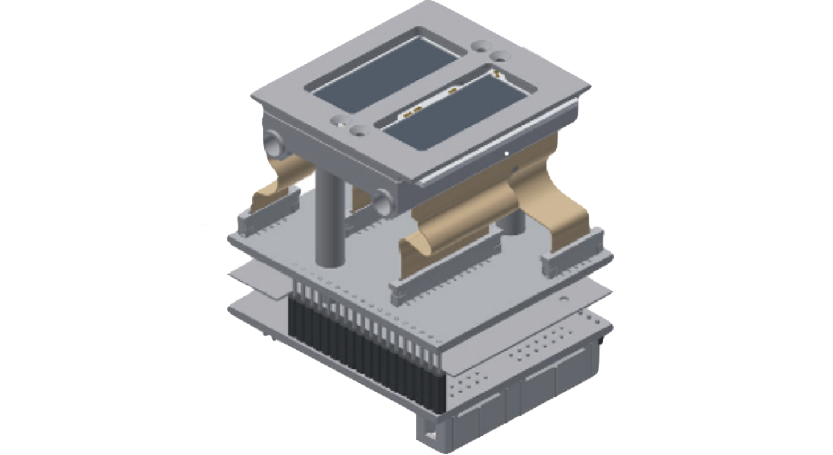
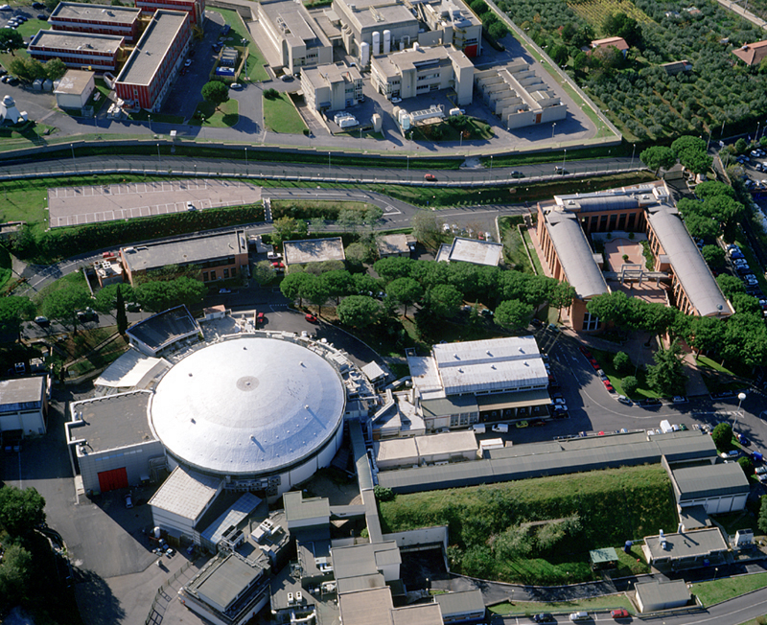
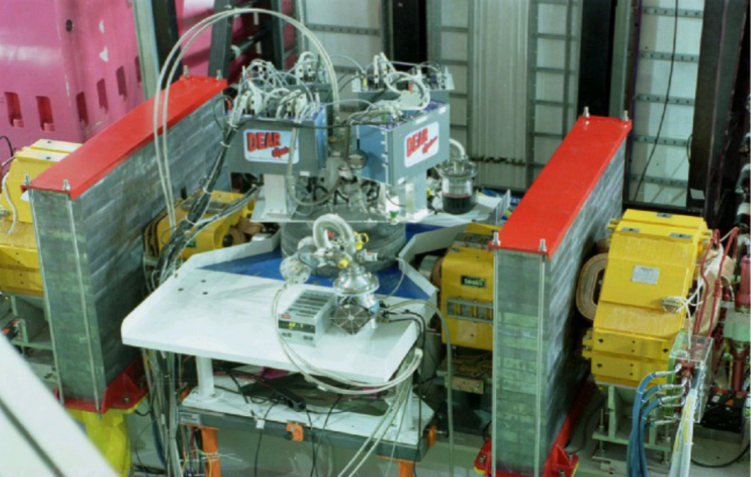
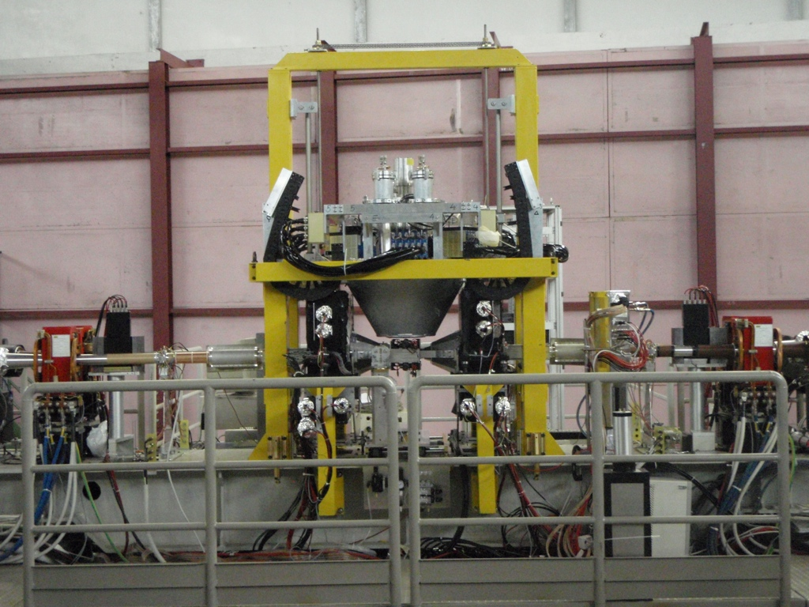
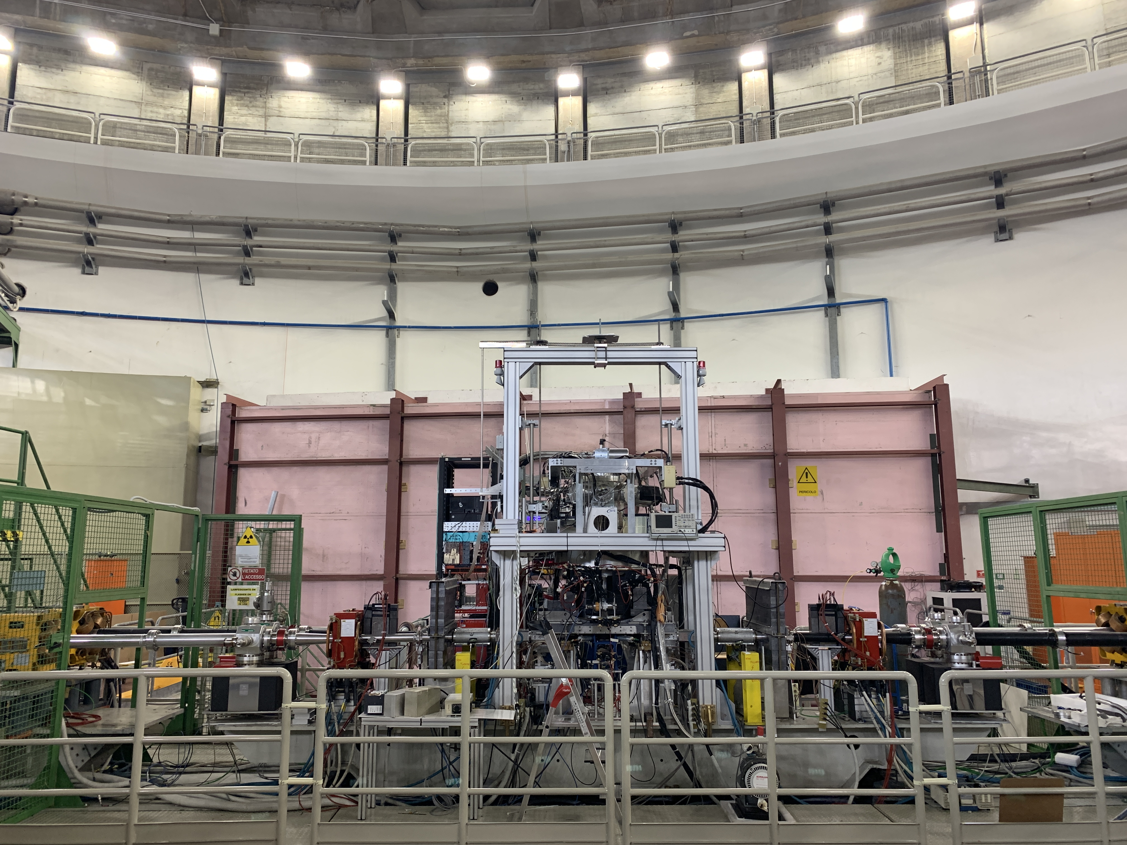
A long journey
J-PARC
The modern era of light kaonic atom experiments
Catalina Curceanu, Carlo Guaraldo, Mihail Iliescu, Michael Cargnelli, Ryugo Hayano, Johann Marton, Johann Zmeskal, Tomoichi Ishiwatari, Masa Iwasaki, Shinji Okada, Diana Laura Sirghi, and Hideyuki Tatsuno
Rev. Mod. Phys. 91, 025006 – Published 20 June 2019
DAFNE
DEAR
2002
SIDDHARTA
2009
SIDDHARTA-2 2022

Slide 8


Slide 9
On self-gravitating strange dark matter halos around galaxies
Phys.Rev.D 102 (2020) 8, 083015
Fundamental physics
New Physics
Dark Matter studies
The modern era of light kaonic atom experiments
Rev.Mod.Phys. 91 (2019) 2, 025006
Kaonic atoms
Kaon-nuclei interactions (scattering and nuclear interactions)
Kaonic Atoms to Investigate
Global Symmetry Breaking
Astrophys.J. 881 (2019) 2, 122
Merger of compact stars in
the two-families scenario
Symmetry 12 (2020) 4, 547
Part. and Nuclear physics
QCD @ low-energy limit
Chiral symmetry, Lattice
Astrophysics
EOS Neutron Stars
The equation of state of dense matter:
Stiff, soft, or both?
Astron.Nachr. 340 (2019) 1-3, 189

Slide 10
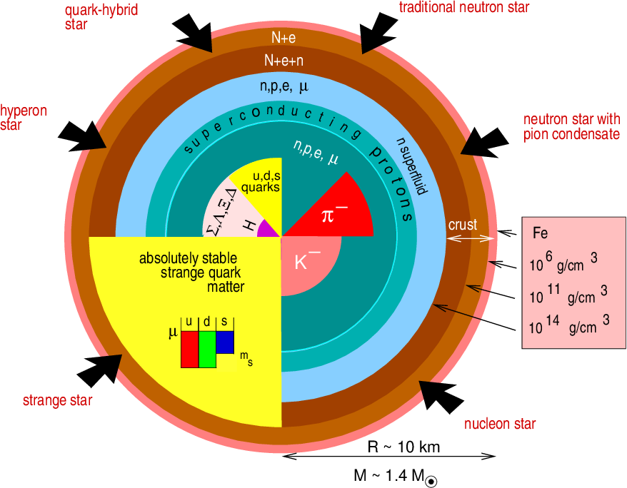
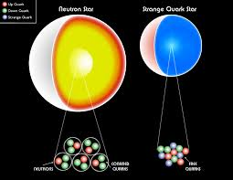

Slide 11



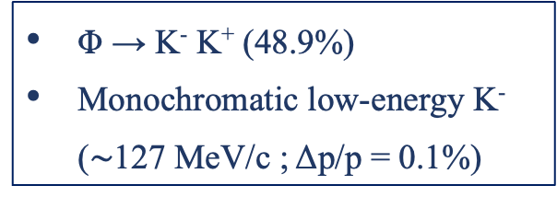


LNF - ${ e}^{+}e^{−}$ Accelerator Complex
Φ → K⁻ K⁺ (48.9%)
Monochromatic low-energy K⁻ ($\sim$127 MeV/c ; Δp/p = 0.1%)
DA$Φ$NE
LINAC
$$e^{+}$$
$$Φ$$
$$e^{−}$$
DAMPING RING
Catalina Curceanu (A. Scordo)
A new renaissance for kaonic atoms at DAΦNE: future measurements and perspectives

Slide 12
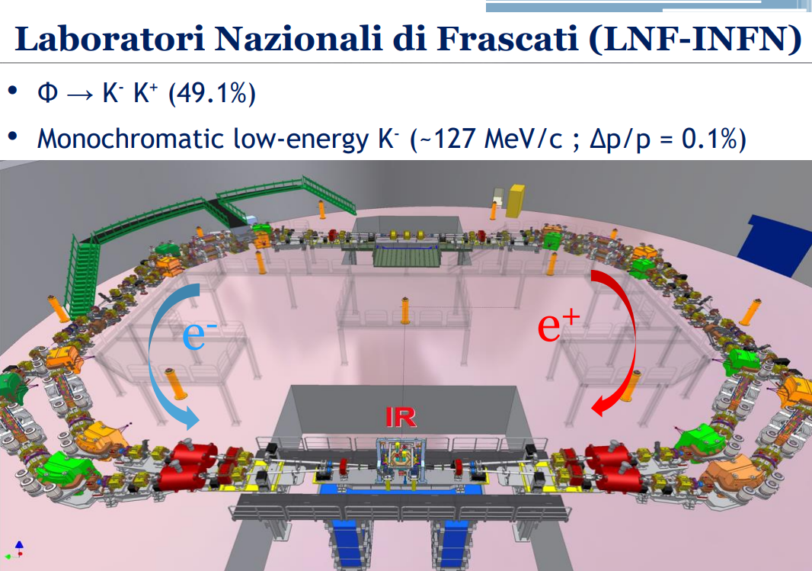

Slide 13
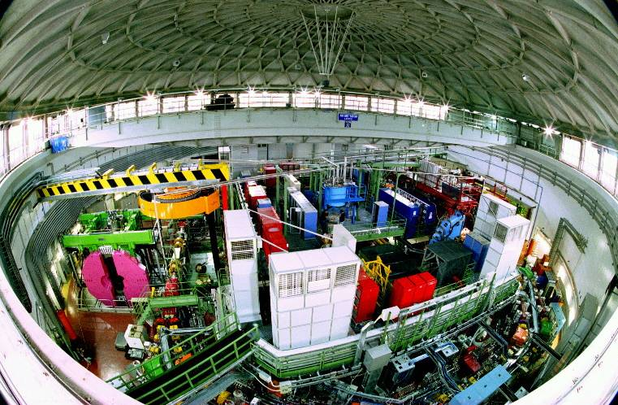
DAΦNE

Slide 14
The DAFNE principle
K+
e⁺
e⁻
e⁺
e⁻
e⁺
Φ
e⁻
e⁻
e⁻
e⁺
e⁺
e⁺
e⁻
e⁺
e⁻
e⁻
e⁺
e⁻
e⁻
K-
Flux of produced kaons: about 1000/second

Slide 15
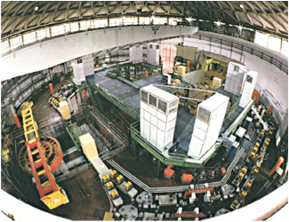

Φ → K⁻ K⁺ (49.1%)
Monochromatic low-energy K⁻ (~127MeV/c)
Less hadronic background due to the beam
( compare to hadron beam line : e.g. KEK /JPARC)
Suitable for low-energy kaon physics:
kaonic atoms
Kaon-nucleons/nuclei interaction studies

Slide 16
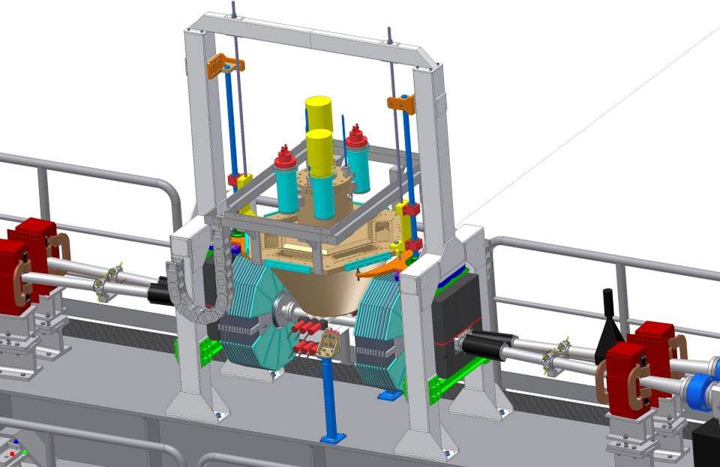

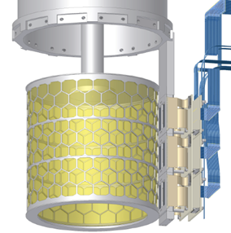

SIDDHARTA overview
Target
Detect
by SDDs
K⁻
e⁻
Detect by two scintillators
Φ
510 MeV/c
e⁺
127 MeV/c
Δp/p=0.1%
K⁺
510 MeV/c
y
x
z
16

Slide 17










SIDDHARTA - 2009
SIlicon Drift Detector for Hadronic Atom Research by Timing Applications
LNF- INFN, Frascati, Italy
SMI- ÖAW, Vienna, Austria
IFIN – HH, Bucharest, Romania
Politecnico, Milano, Italy
MPE, Garching, Germany
PNSensors, Munich, Germany
RIKEN, Japan
Univ. Tokyo, Japan
Victoria Univ., Canada
EU Fundings: JRA10 – FP6 - I3H
FP7- I3HP2
Rev.Mod.Phys. 91 (2019) 2, 025006

Slide 18
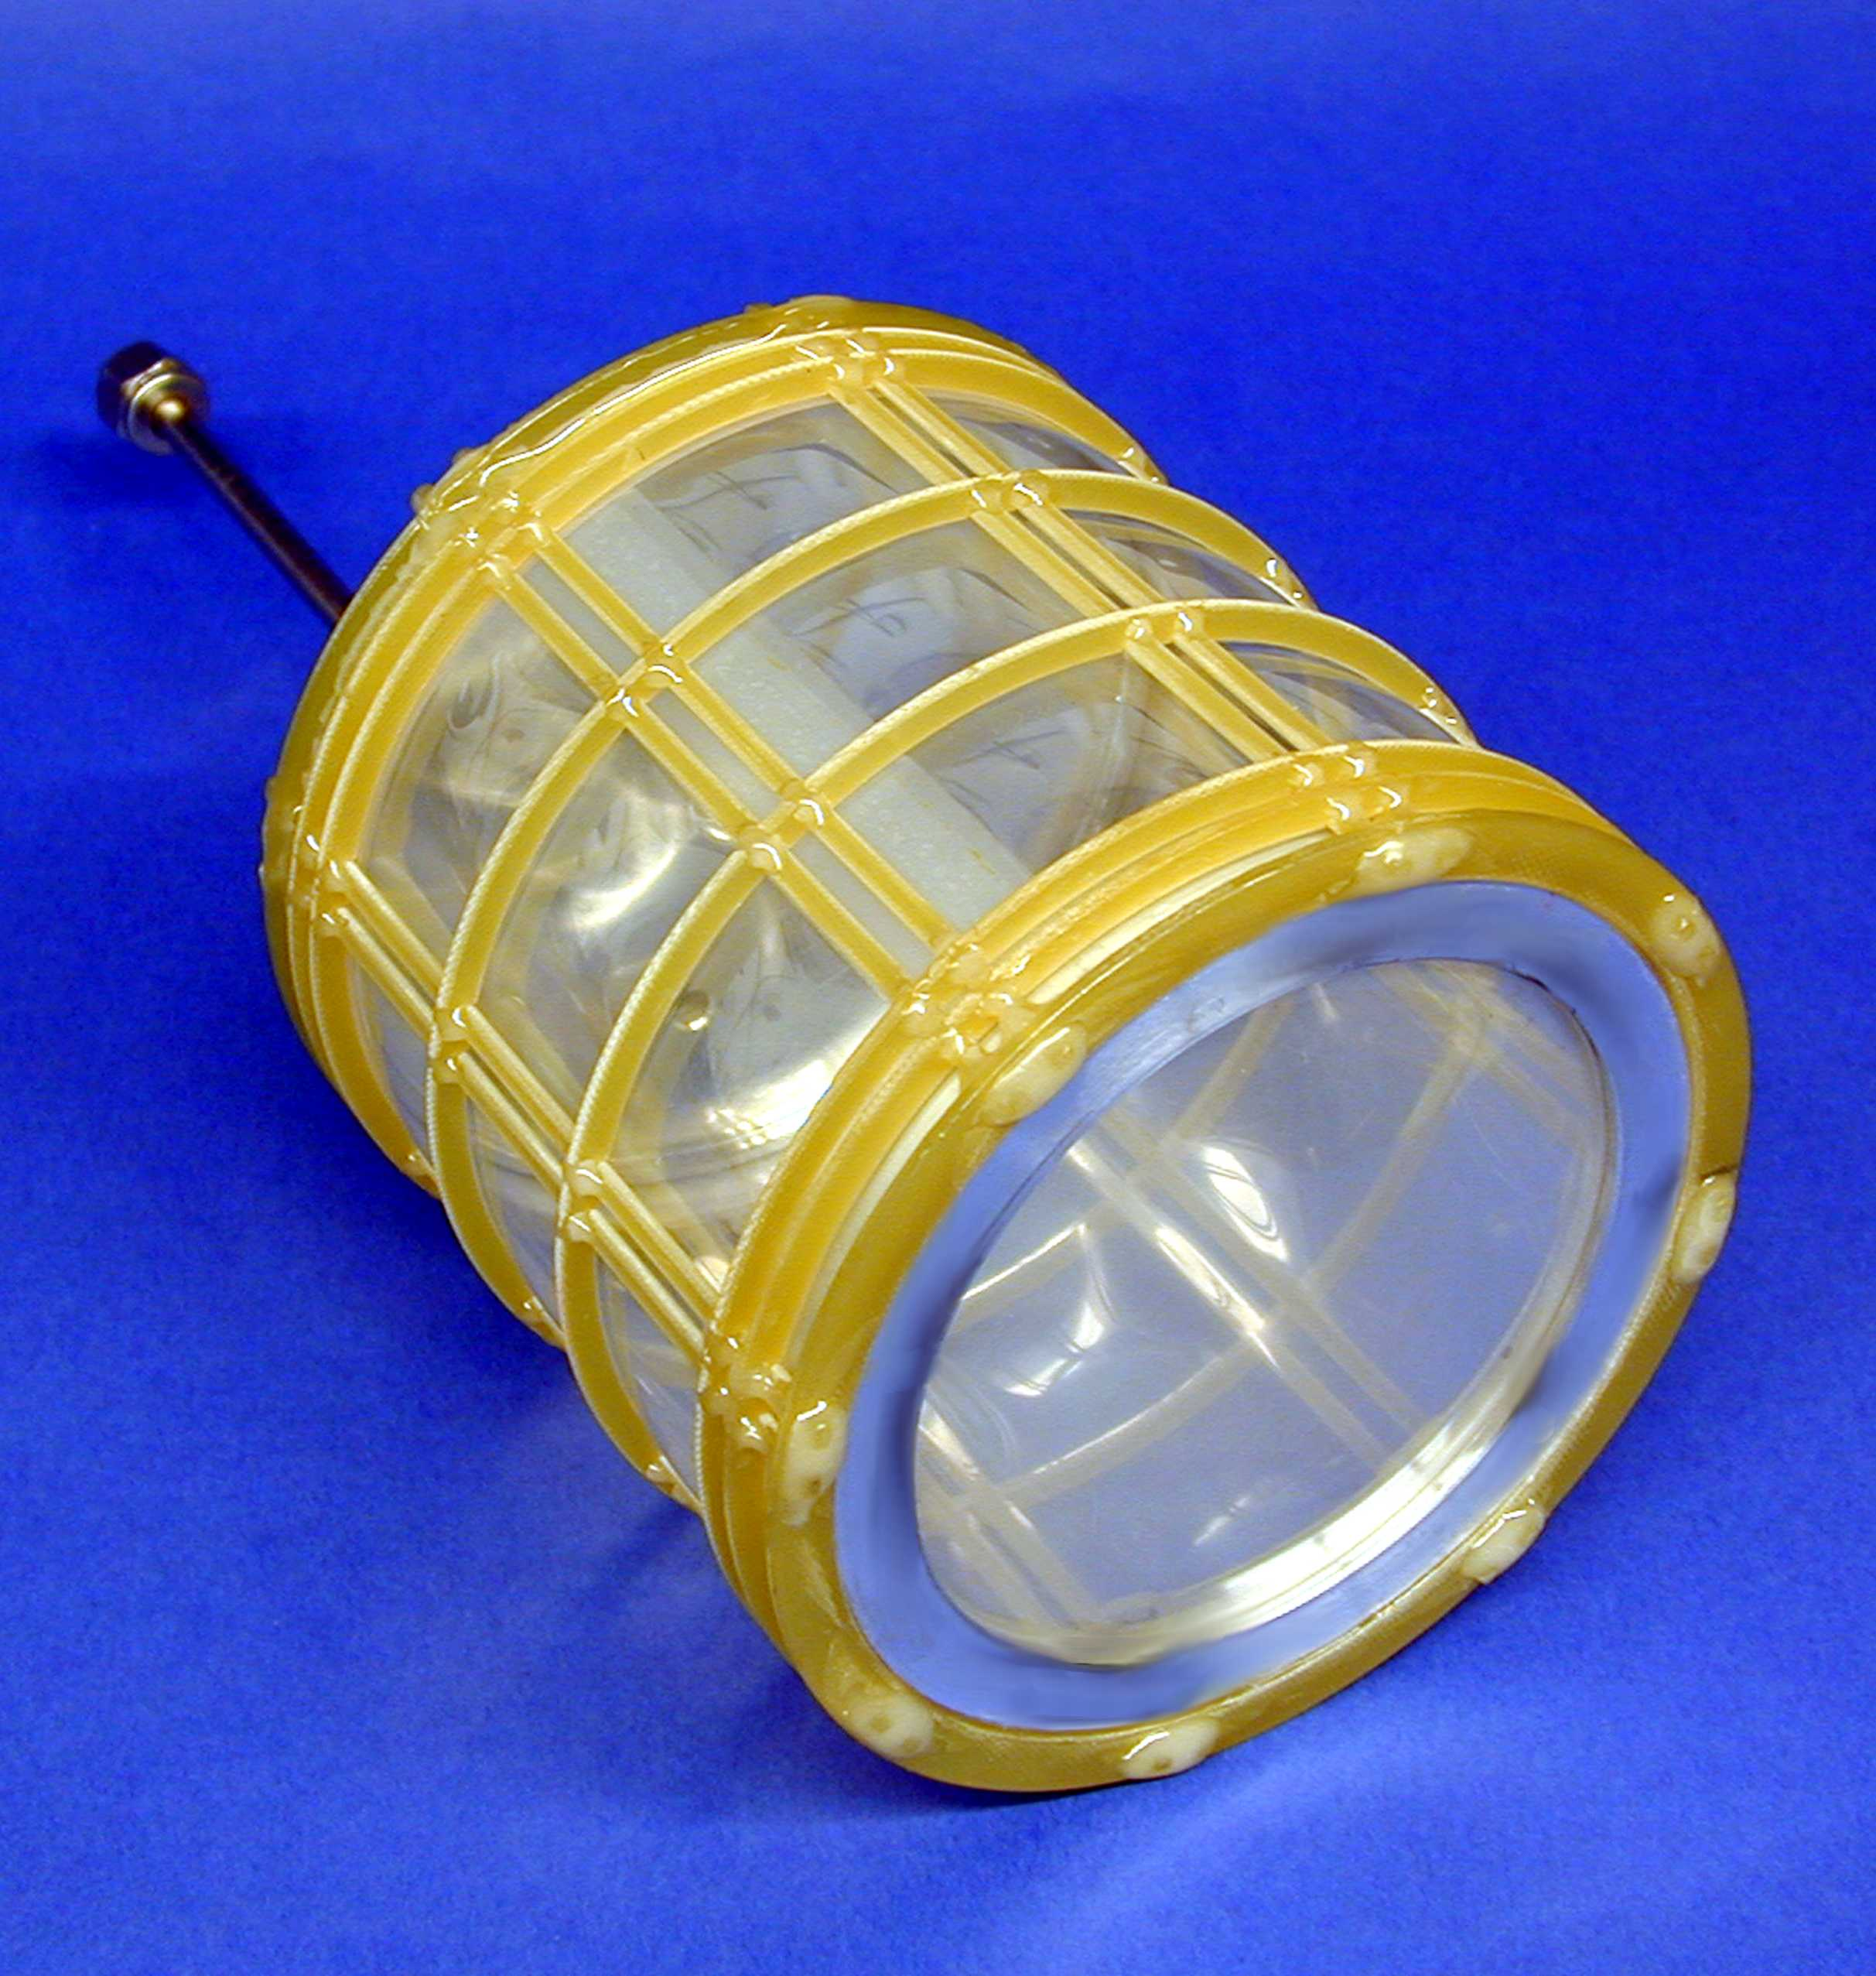
The Cryogenic Target Cell
Notes:
Gewicht = 410 g

Slide 19
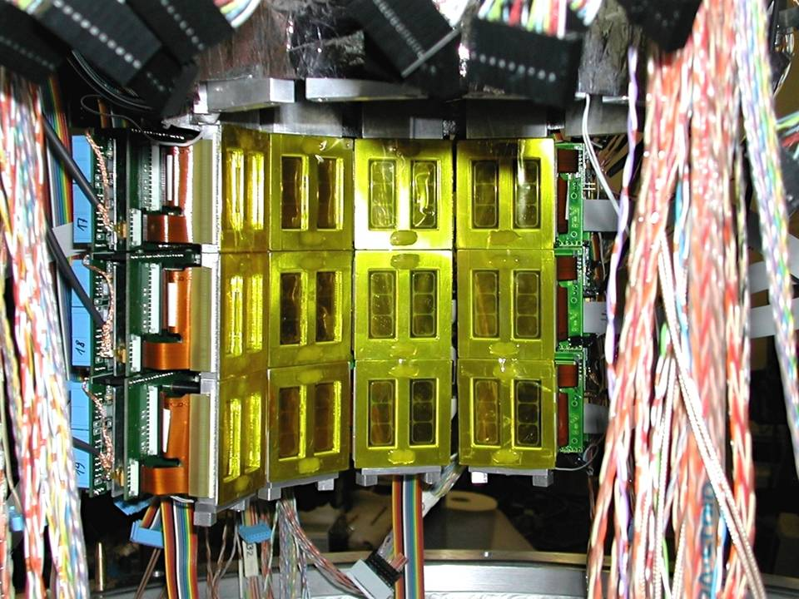

1 cm² x 144 SDDs

Slide 20
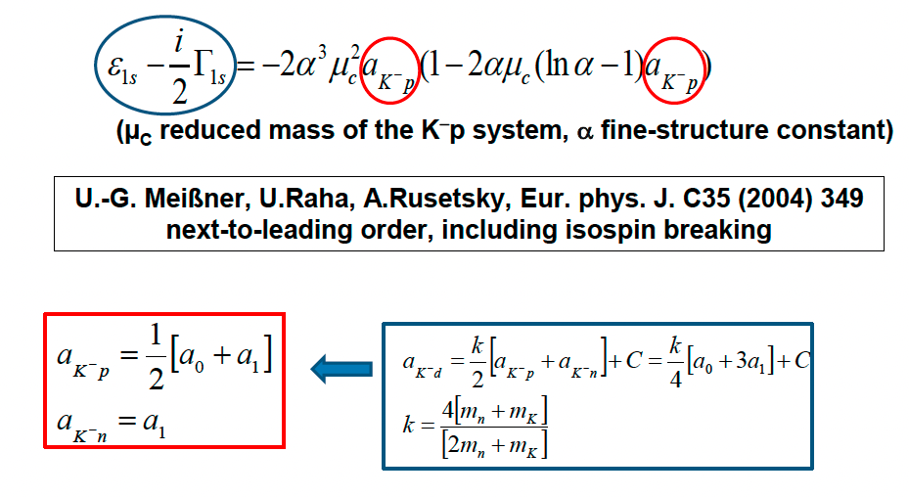
SIDDHARTA Scientific Goal
To perform the first measurement ever of kaonic deuterium X-ray transition to the ground state (1s-level) such as to determine its shift and width induced by the presence of the strong interaction (but also other kaonic atoms).
Analysis of the combined measurements of kaonic deuterium and kaonic hydrogen
Experimental determination of the isospin-dependent
K-N scattering length
Catalina Curceanu (A. Scordo)
A new renaissance for kaonic atoms at DAΦNE: future measurements and perspectives

Slide 21
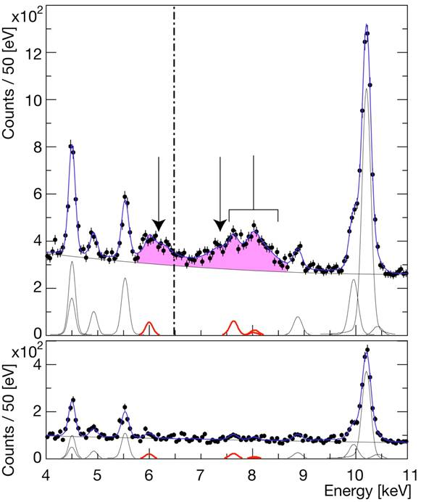
Hydrogen
spectrum
EM value
K-p Kα
Kaonic hydrogen
Kα
Kβ
higher
KC54
Ti Kα
KC65
simultaneous
fit
Ti Kβ
KC75
KO65
KO76
KN65
Cu
KAl87
Deuterium
spectrum
Background estimation

Slide 22
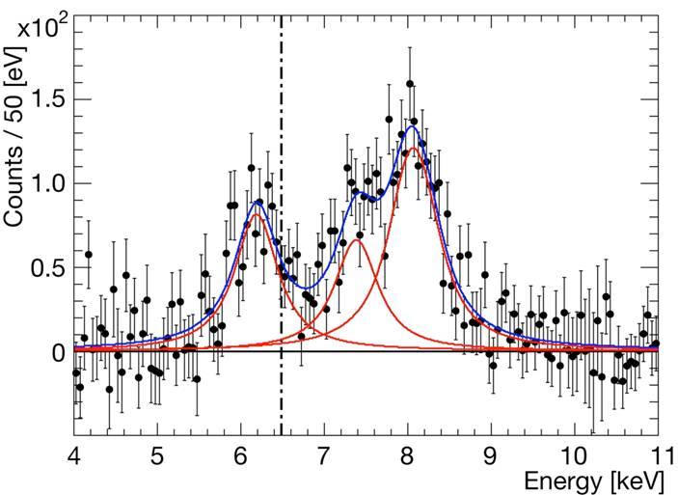
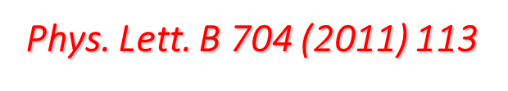
Residuals of K-p x-ray spectrum
after subtraction of fitted background
ε_{1S}= −283 ± 36(stat) ± 6(syst) eV
Γ_{1S}= 541 ± 89(stat) ± 22(syst) eV
Kaonic hydrogen
higher
Kα
Kβ
EM value
K-p Kα

Slide 23
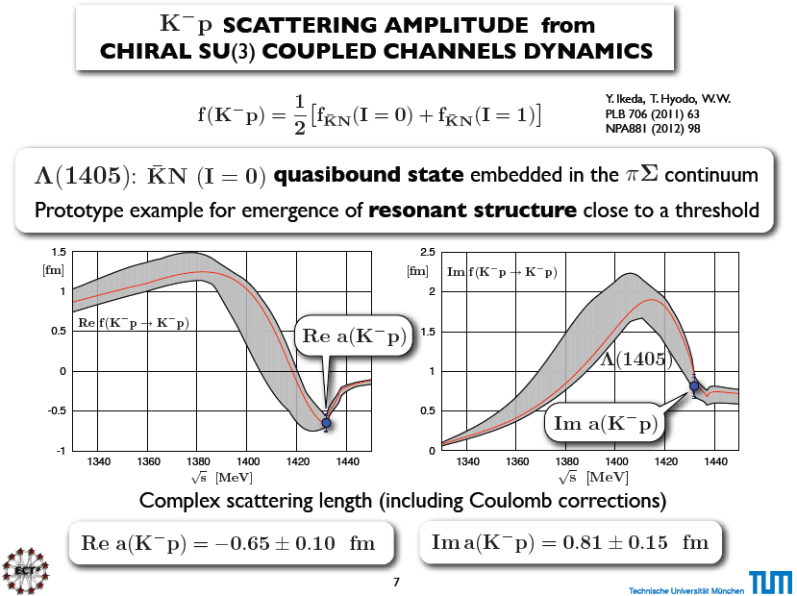

Slide 24
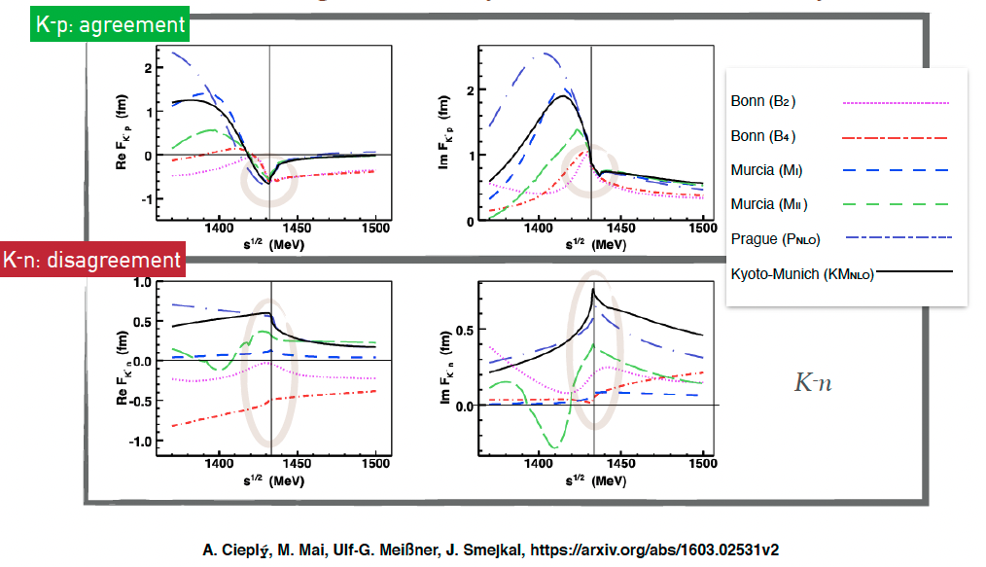
Kaonic atoms – scattering amplitudes
A new renaissance for kaonic atoms at DAΦNE: future measurements and perspectives

Slide 25
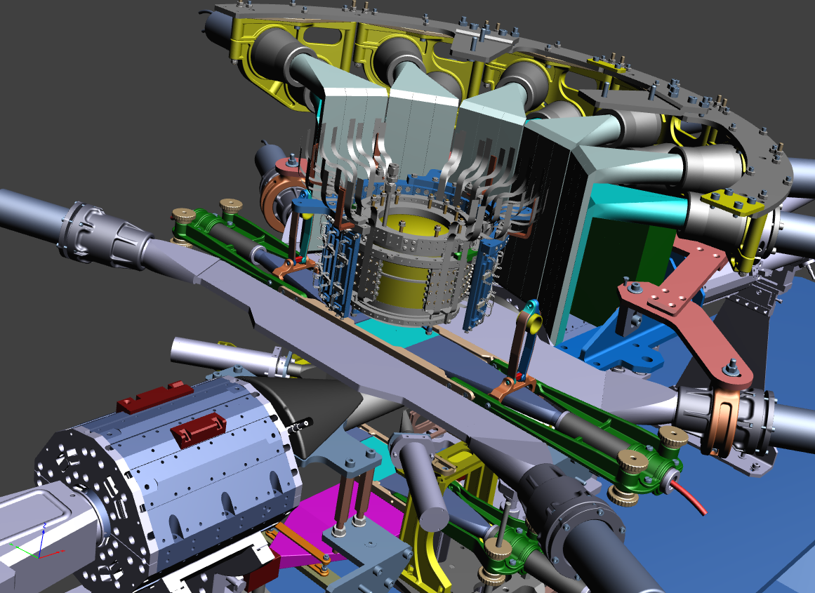

The SIDDHARTA-2 apparatus
Experimental Measurement
Veto-1
Target
Veto-2
384 SDDs
Kaon Trigger
Veto-3

Slide 26
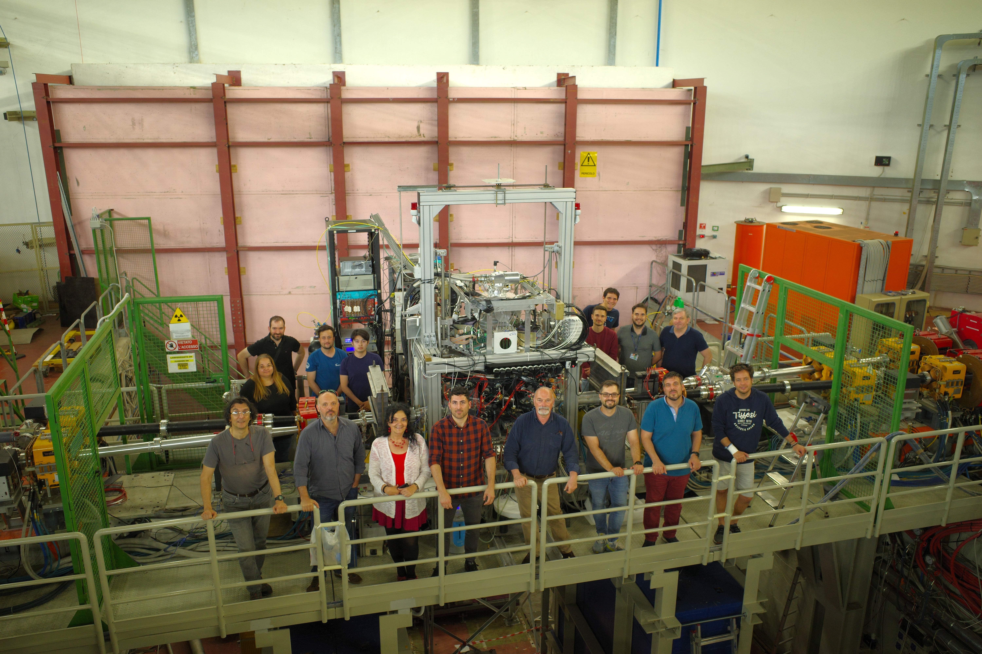
SIDDHARTA-2 installed on DAFNE

Slide 27



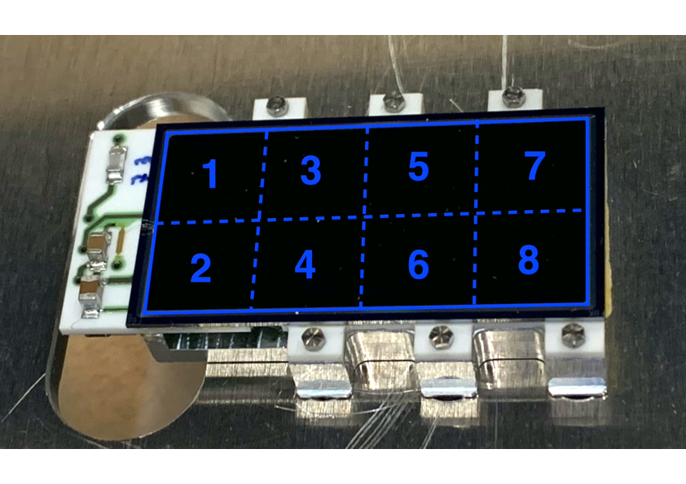
Silicon Drift Detectors
SDD cross section
8 SDD units (0.64 cm²)
for a total active area of 5.12 cm²
Thickness of 450 μm which ensures a high collection efficiency for X-rays of energy between 5 keV and 12 keV
Catalina Curceanu (A. Scordo)
A new renaissance for kaonic atoms at DAΦNE: future measurements and perspectives

Slide 28
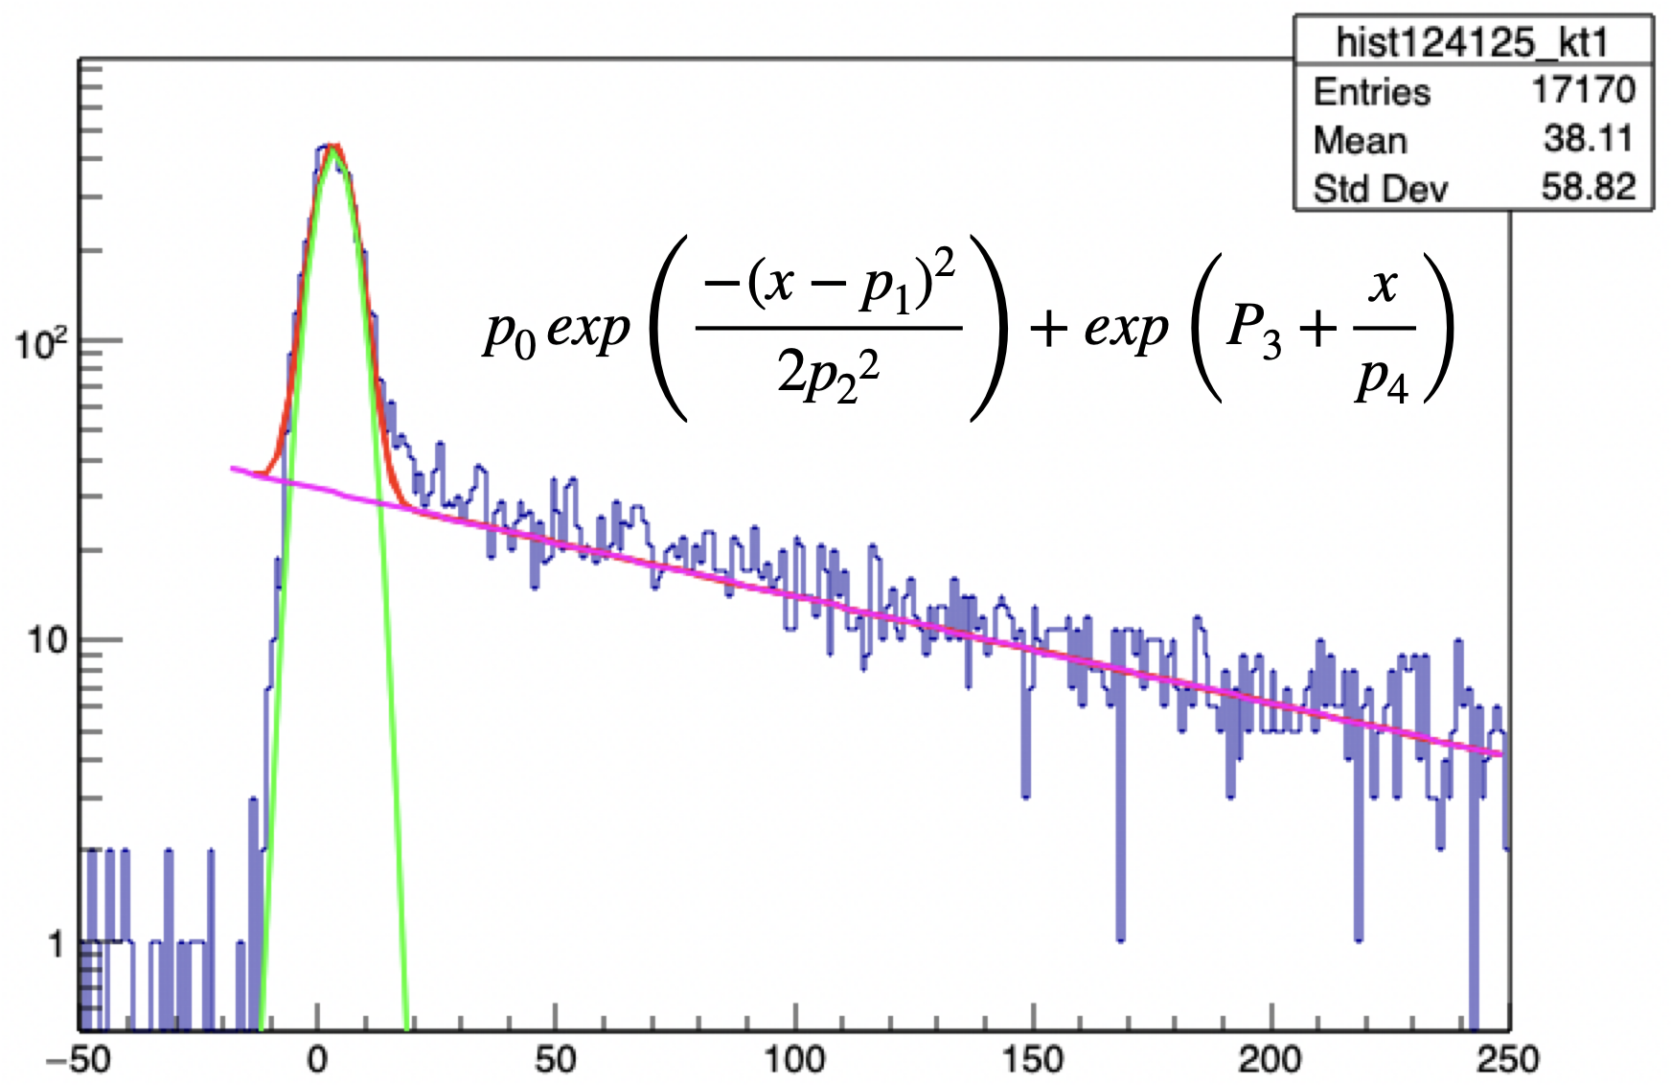
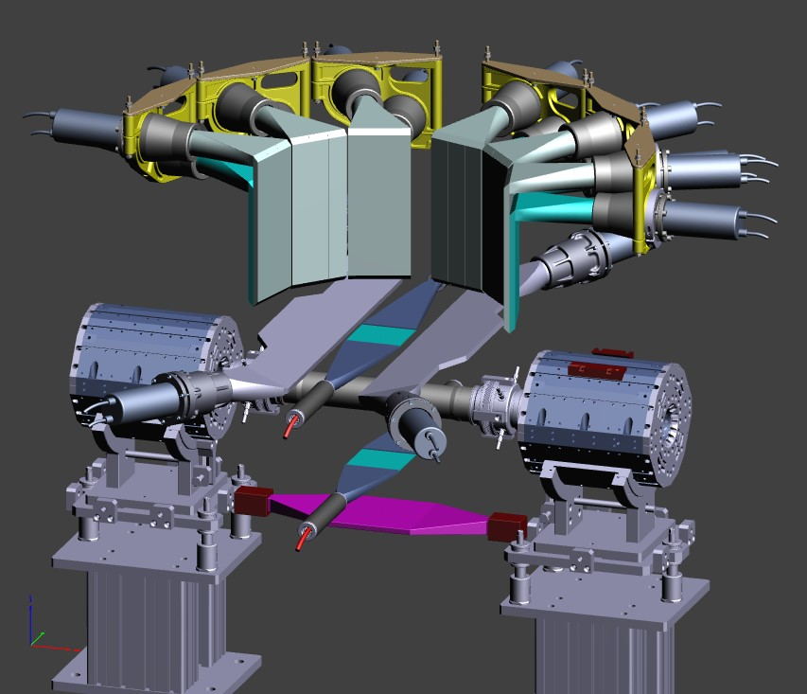

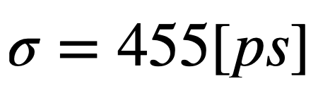



The Kaon charge detector
Done in Sendai!
Stop both $K^{+}$ and $K^{−}$ in a passive layer (Teflon) and detect secondaries in a scintillator
$$K^{−}$$
Count
$$K^{+} decay$$
Bottom Kaon detector
28
tdc (1 ch=100 ps)

Slide 29
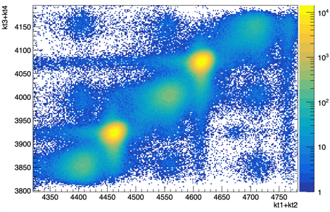
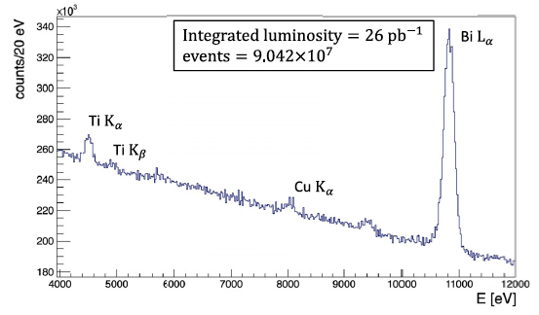
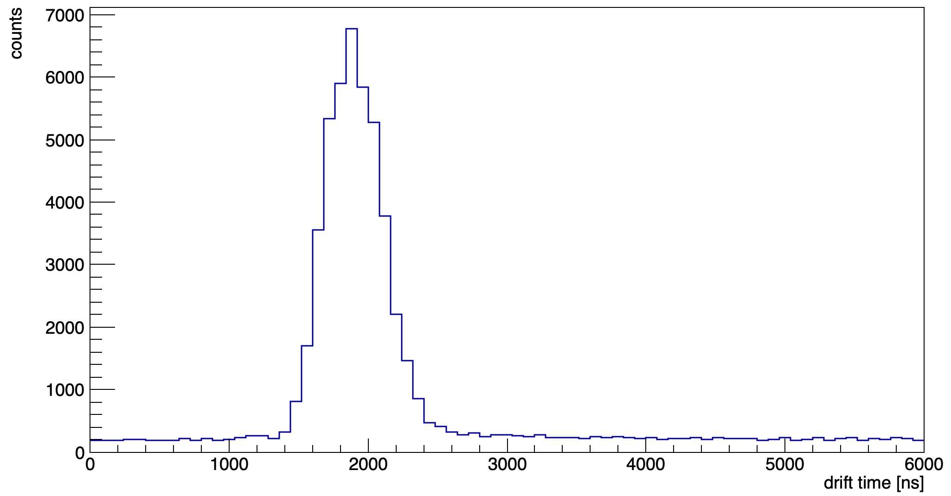

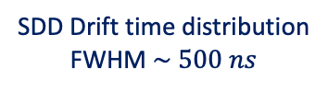
Kaonic ⁴He $3d→2p$ measurement
Kaon Trigger
SIDDHARTINO spectrum before applying the kaon trigger and the drift time rejection
Kaons
MIPS
SDD Drift time distribution
FWHM $\sim 500 ns$
Catalina Curceanu (A. Scordo)
A new renaissance for kaonic atoms at DAΦNE: future measurements and perspectives

Slide 30
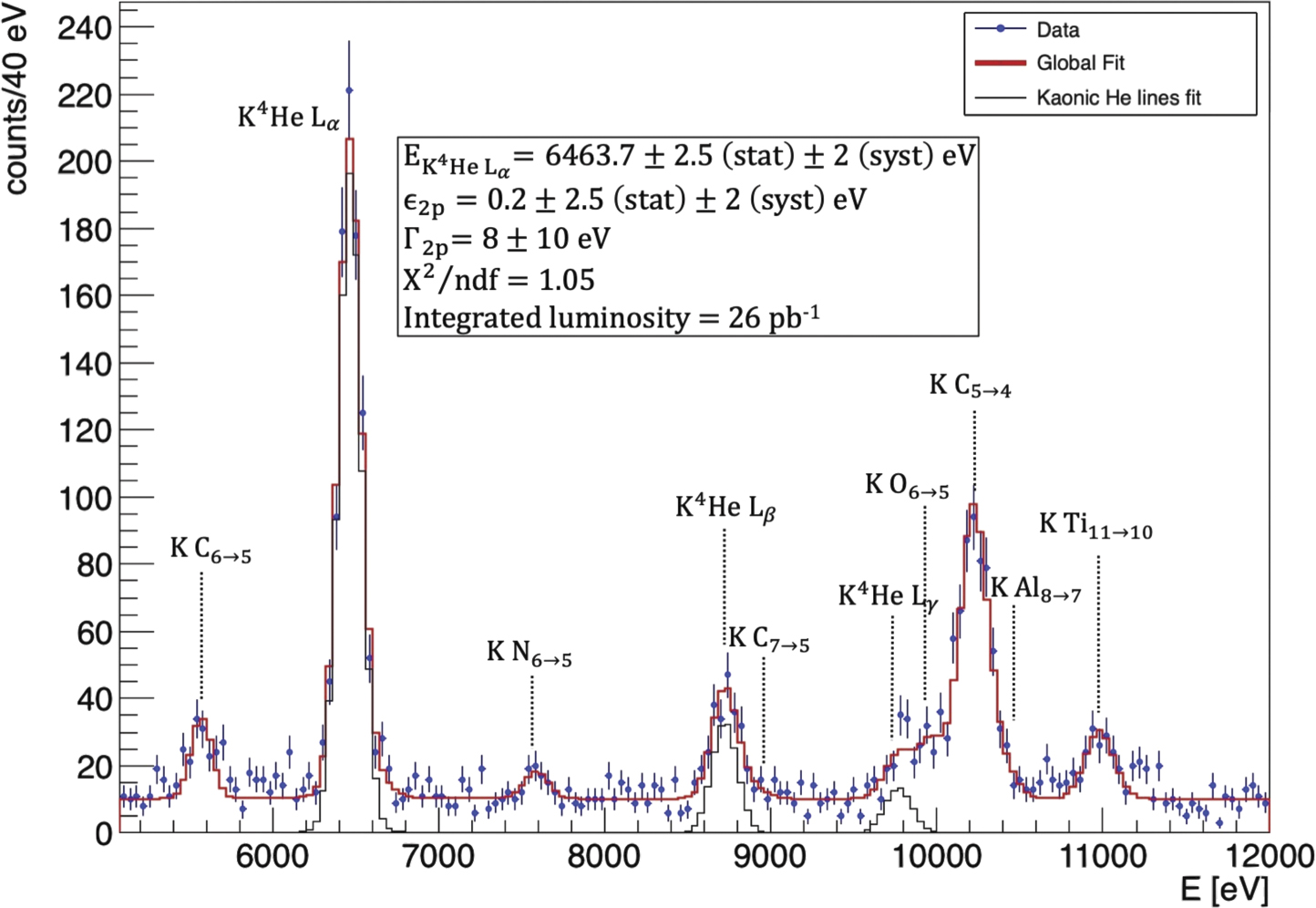
SIDDHARTINO (2021)
D Sirghi et al 2022 J. Phys. G: Nucl. Part. Phys. 49 055106

Slide 31
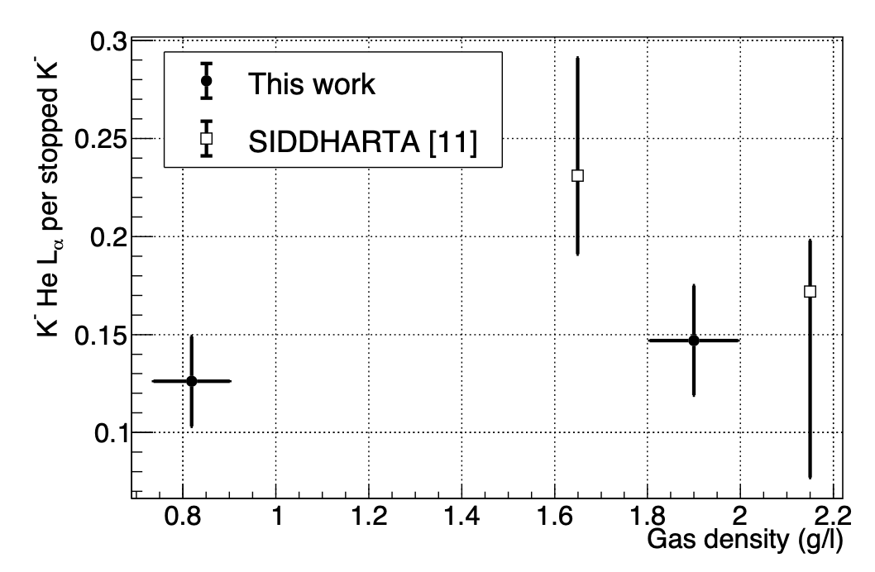
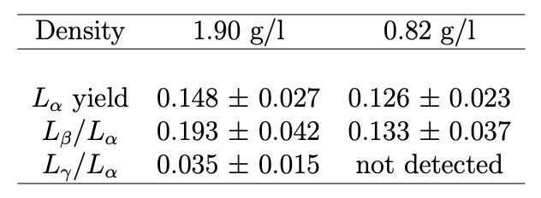
K-⁴He low density run: 0.75% liquid helium density -> yields at lowest measured density
SIDDHARTINO (2021)
D.L. Sirghi, et al. Nuclear Physics A 1029 (2023) 122567

Slide 32
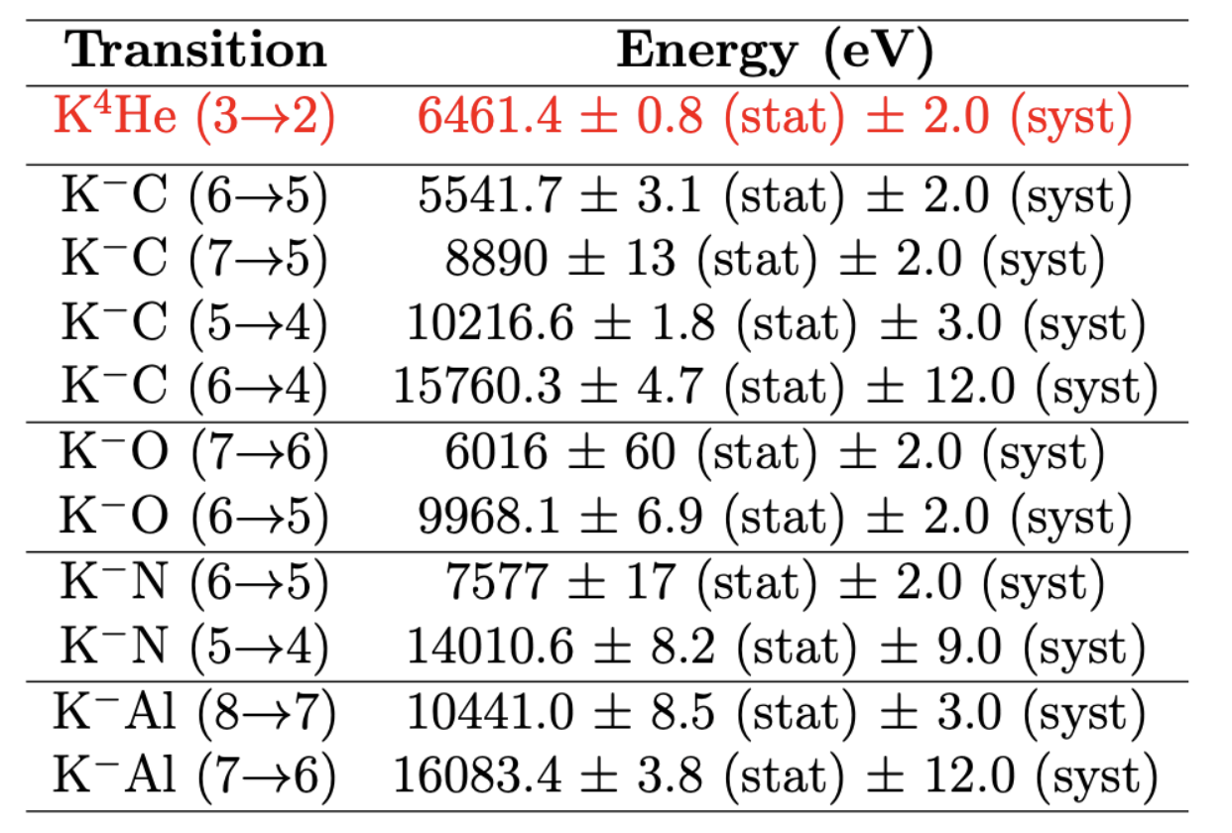
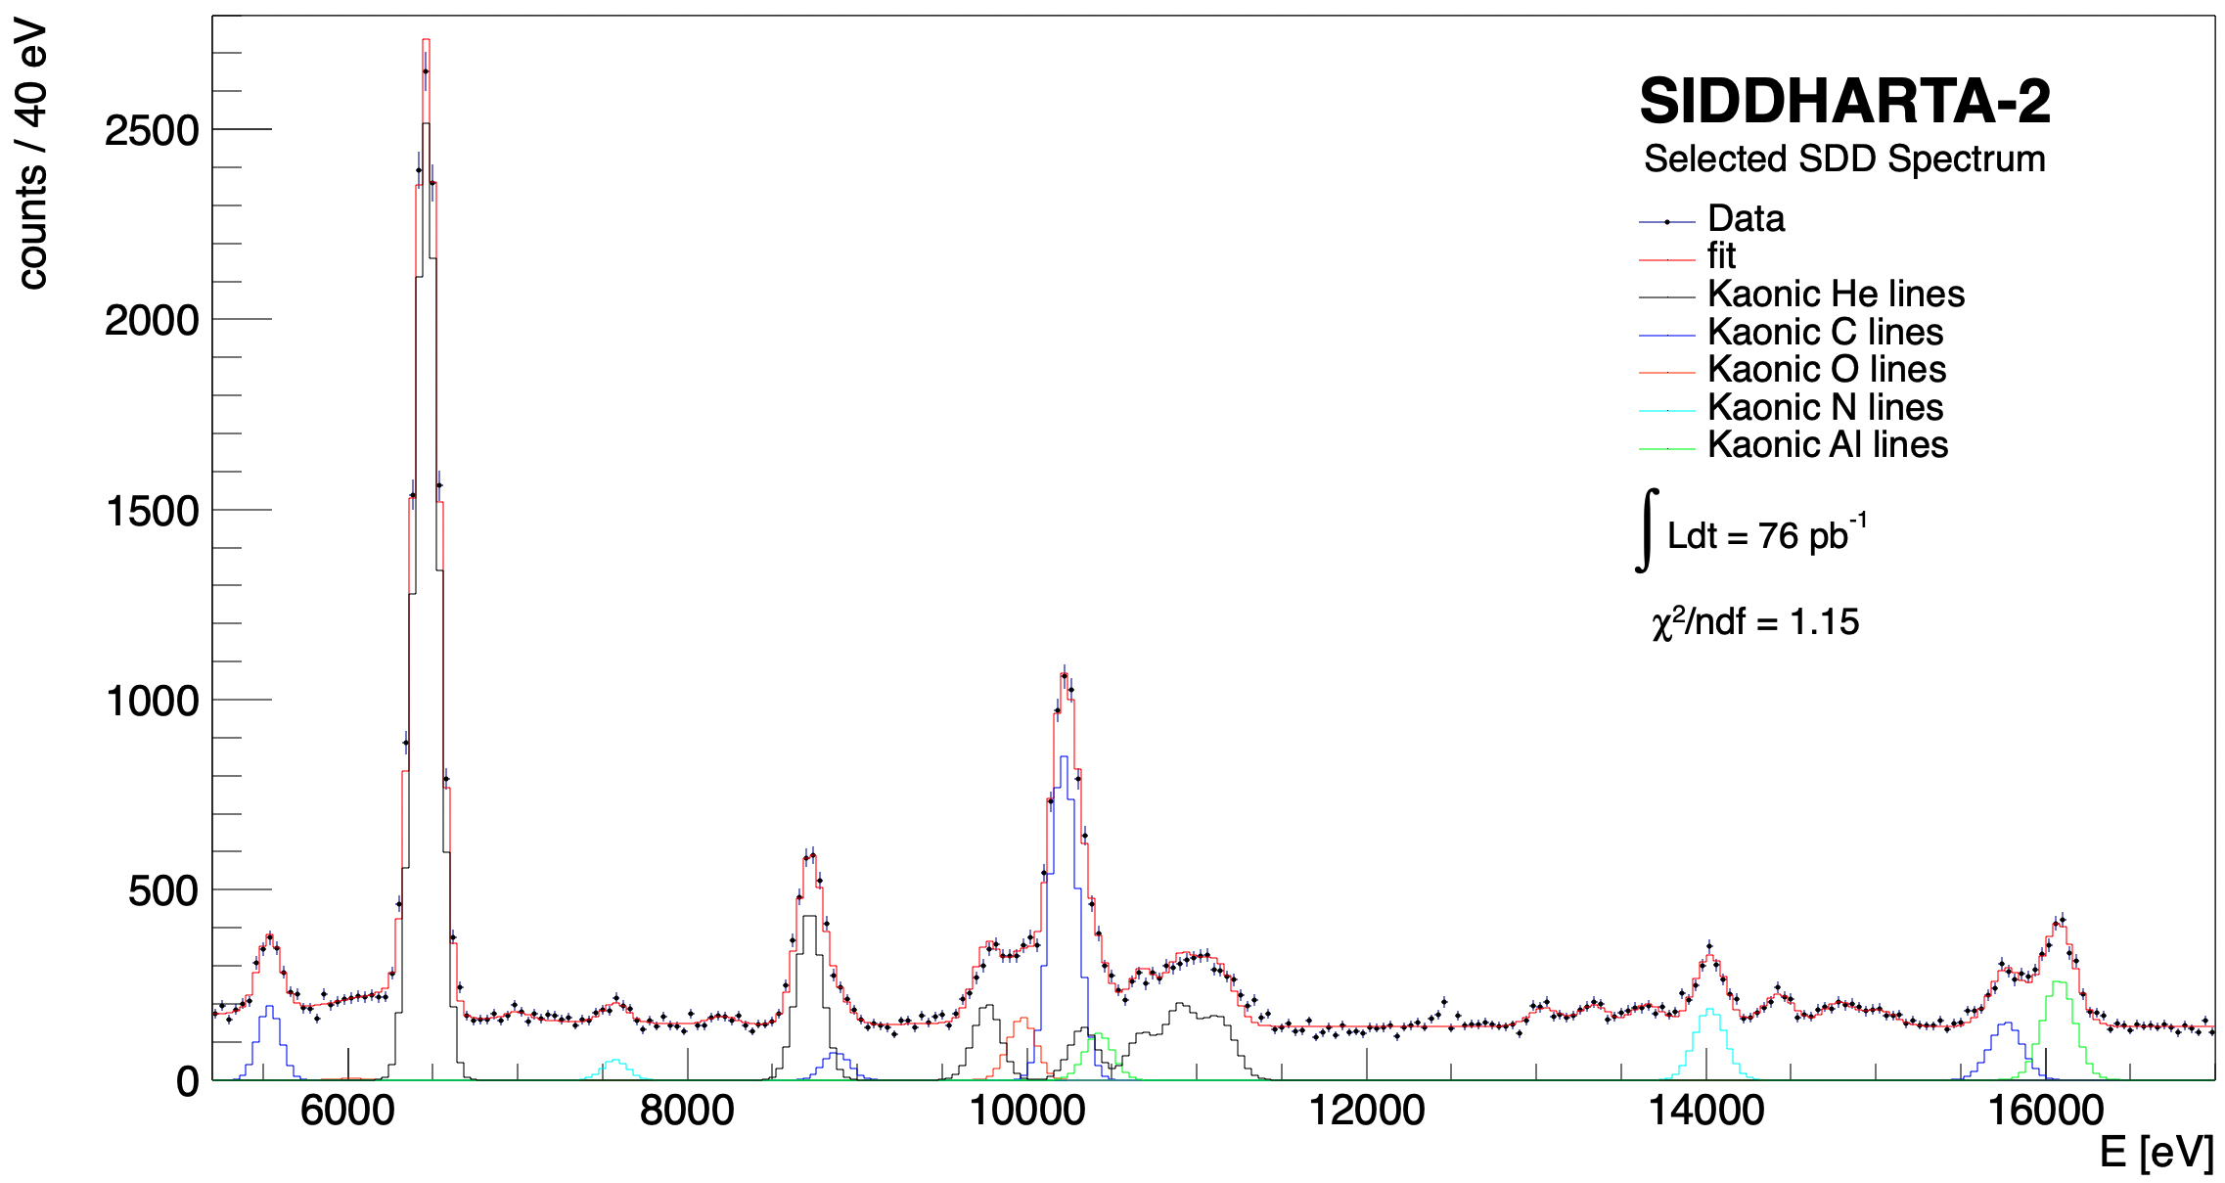
SIDDHARTA-2 (2022)
Measurements of high-n transitions in intermediate mass kaonic atoms
K⁴He 3->2
KAl 8->7
KO 6->5
K⁴He 5->2
KC 5->4
KC 7->5
KO 7->6
K⁴He 4->2
KAl 7->6
KC 6->5
K⁴He L-high
KN 5->4
KC 6->4
KN 6->5
Sgaramella, F., al. Eur. Phys. J. A 59, 56 (2023)

Slide 33
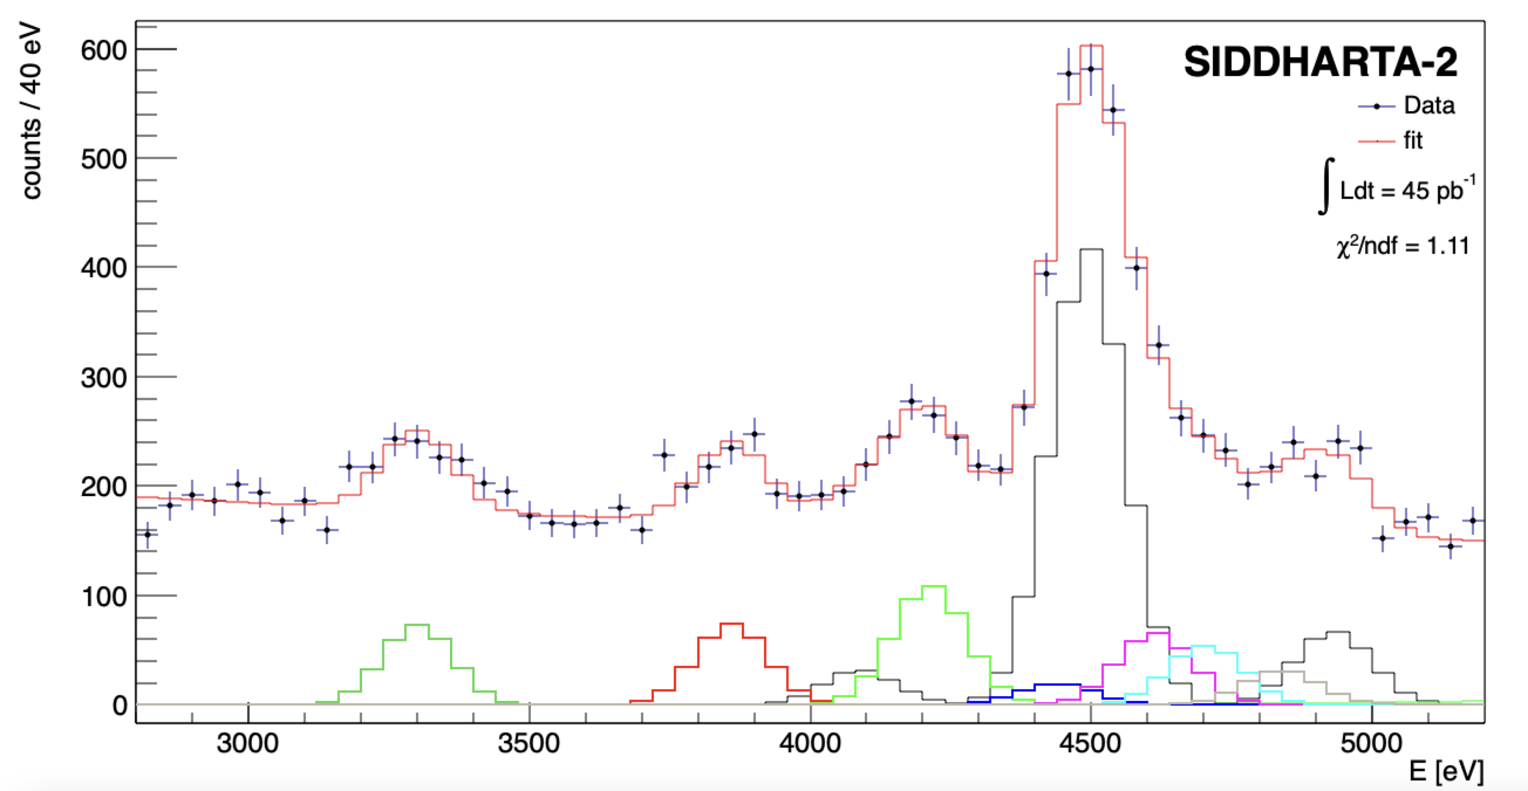





SIDDHARTA-2 Kaonic ⁴He – M-type transitions
KHe 6->3
(M$γ$)
KHe 7->3
(M$η$)
KHe 8->3
4435.4 eV
KHe 9->3
4587.3 eV
KHe 11->3
4696.6 eV
Line | Energy [eV]
K-⁴He M | 3300.8 13.2 (stat) 2.0 (sys)
K-⁴He M | 3860.4 13.6 (stat) 2.2 (sys)
K-⁴He M | 4214.1 19.6 (stat) 2.2 (sys)
 | X-ray relative yield
M/ M | 0.48 0.11
M/ M | 0.43 0.12
L/ M | 0.91 0.14
L/ L | 0.172 0.008
L/ L | 0.012 0.001
KHe 10->3
4696.6 eV
Ti K$α$
KHe 5->3
(M$β$)
Ti K$β$

Slide 34
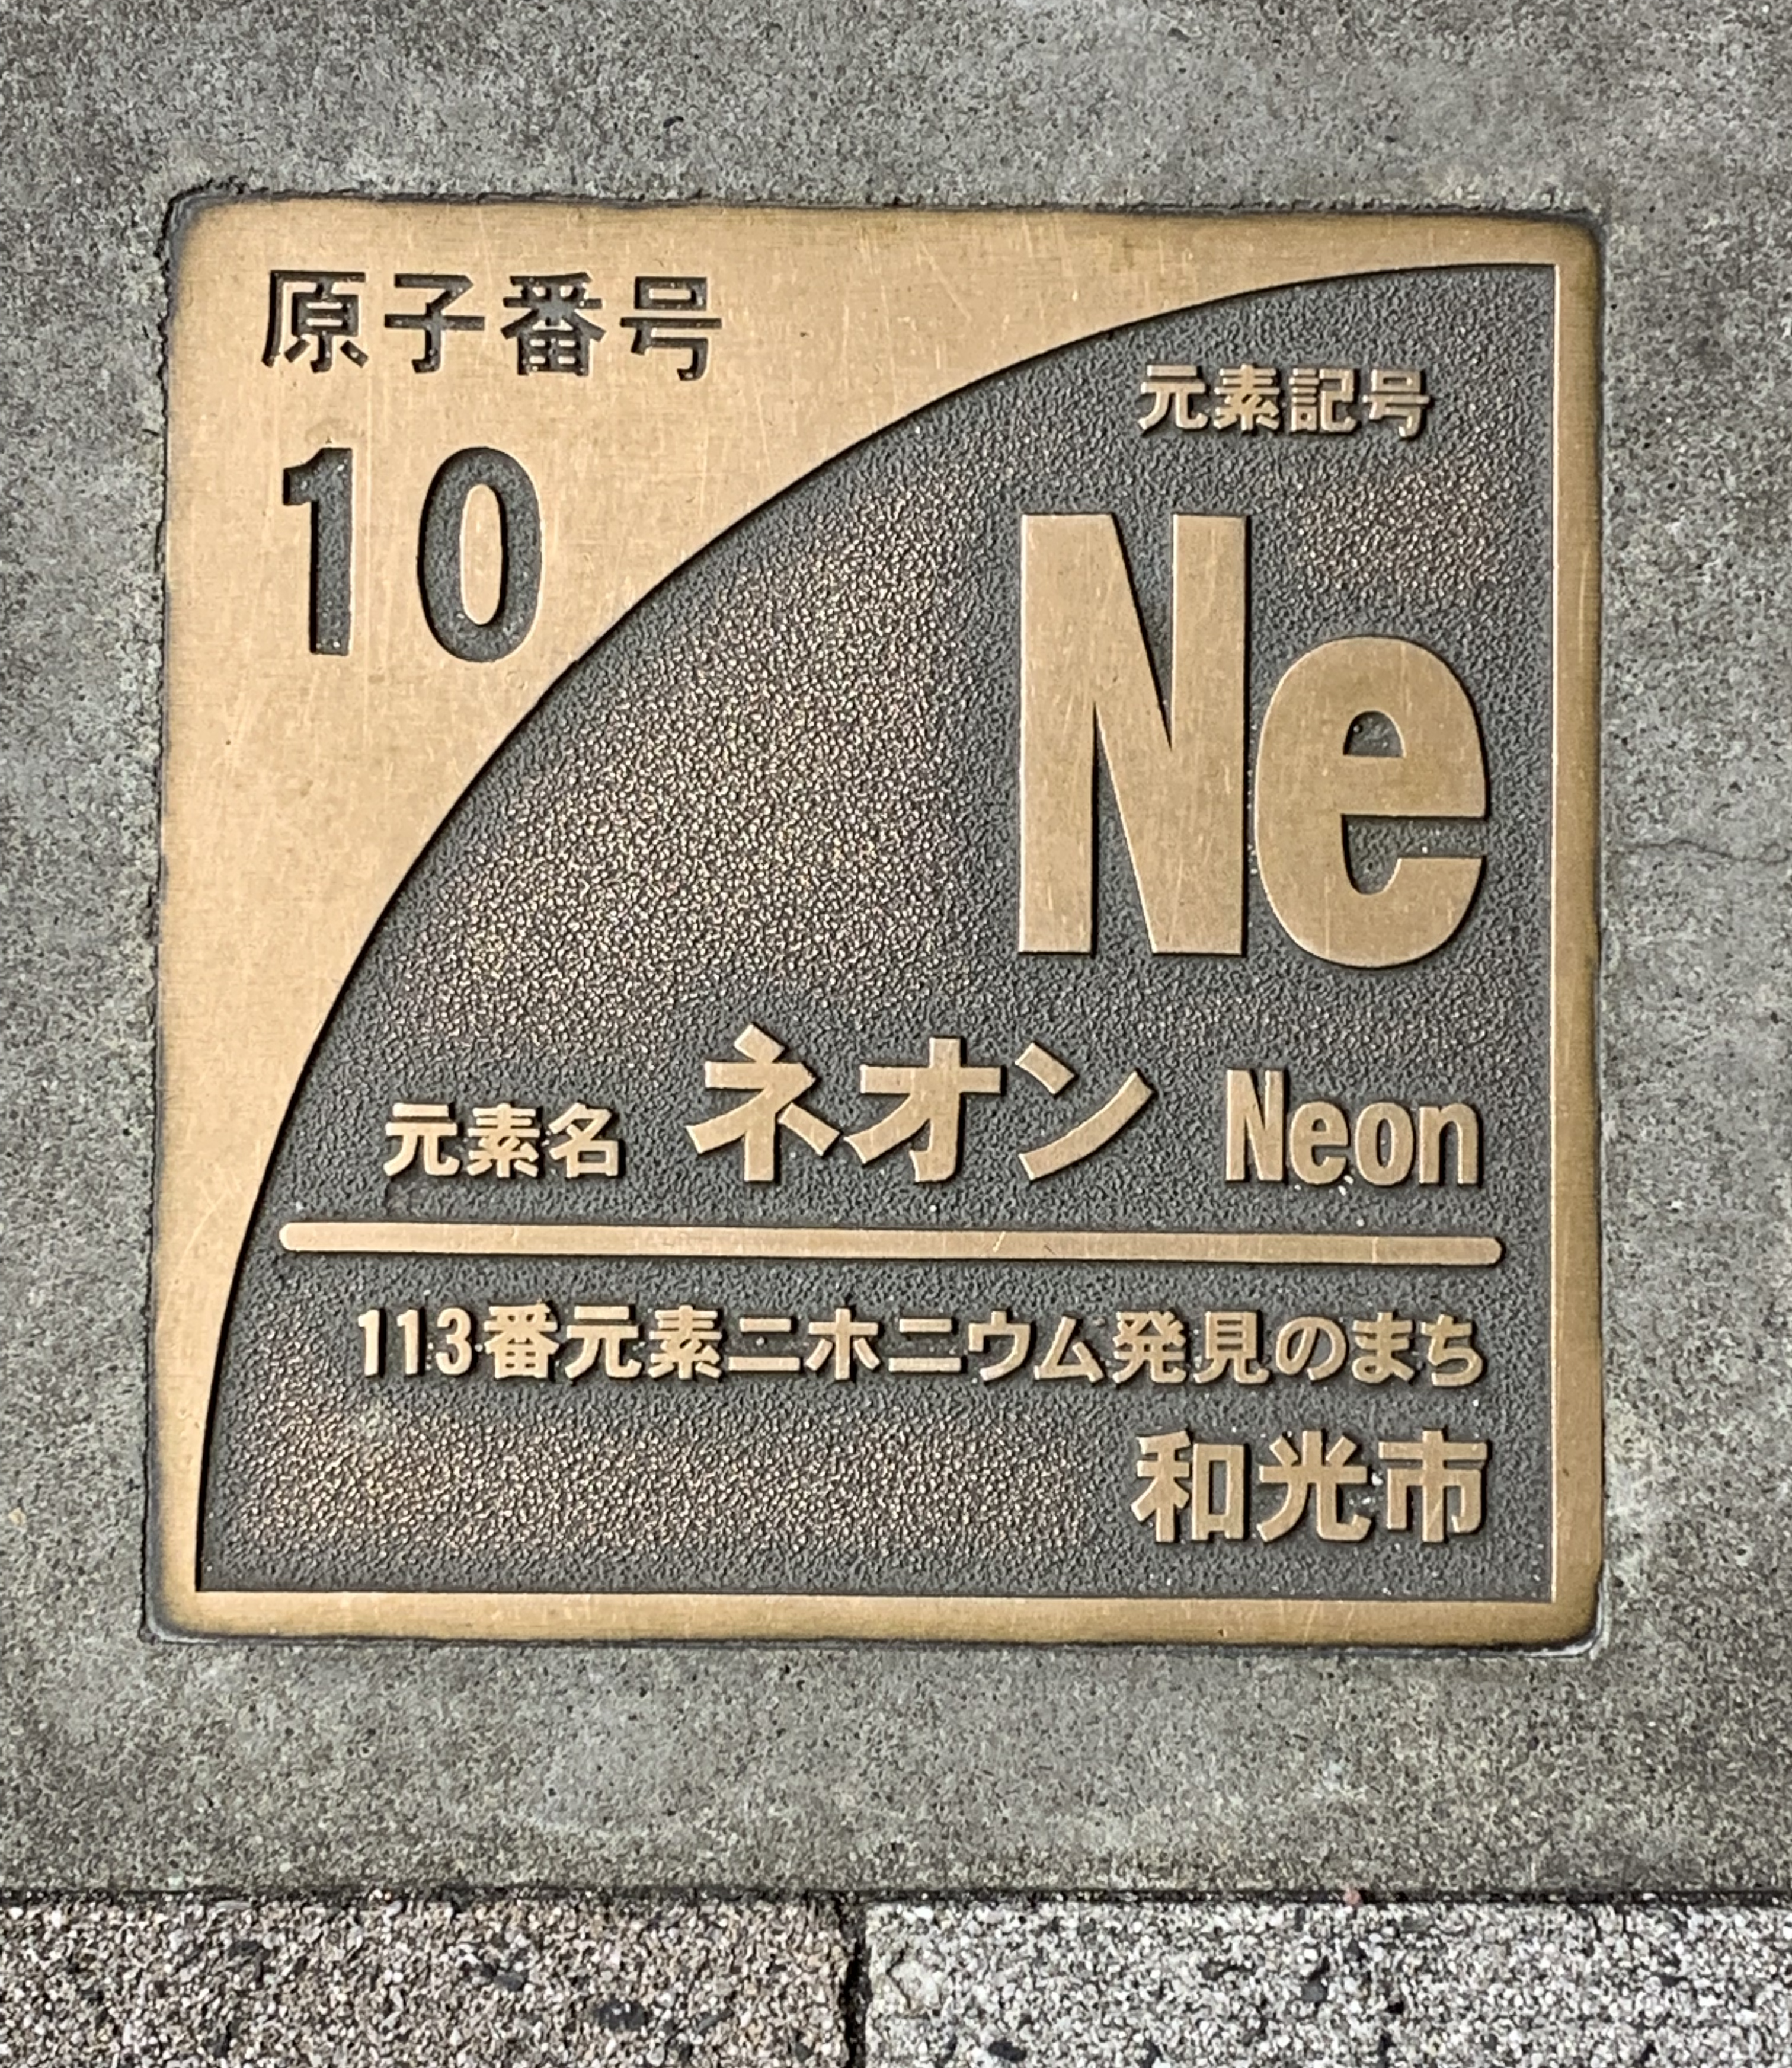
kaonic Neon

Slide 35
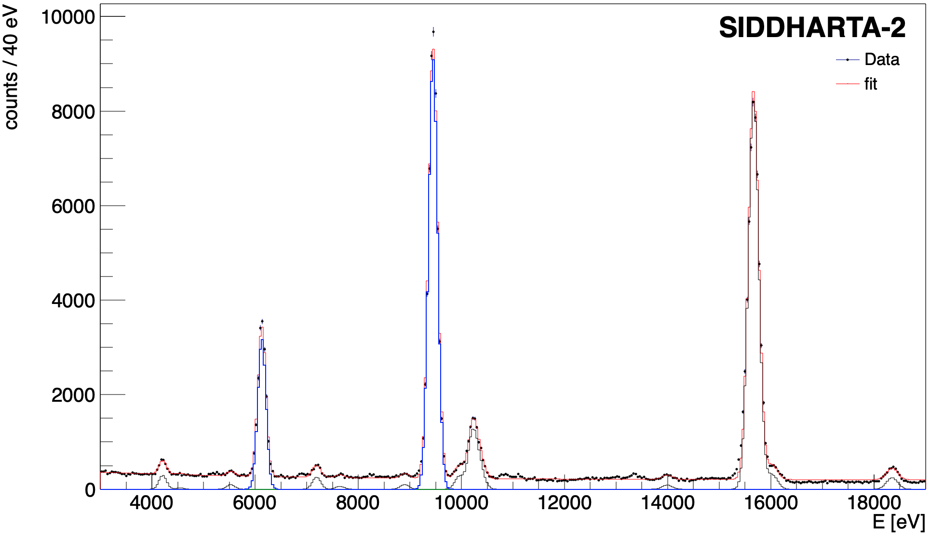
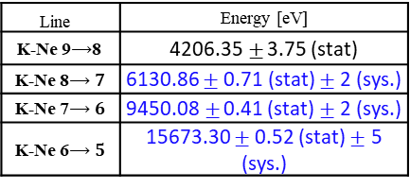




First measurement of kaonic neon X-ray transitions
The Kaonic Neon measurement (2023)
First measurement of kaonic neon X-ray transitions ( record of precision $<1$ eV )
Line | Energy [eV]
K-Ne 9$⟶$8 | 4206.35$±$ 3.75 (stat)
K-Ne 8$⟶7$ | 6130.86 $±$ 0.71 (stat) $±$ 2 (sys.)
K-Ne 7$⟶6$ | 9450.08$±$ 0.41 (stat) $±$ 2 (sys.)
K-Ne 6$⟶5$ | 15673.30 $±$ 0.52 (stat) $±$ 5 (sys.)
K-Ne 7->6
K-Ne 6->5
Implications on
kaon - multinucleon interaction
and kaon mass
K-Ne 8->7
KO 6->5
KC 5->4
K-Ne 9->8
KAl 7->6
KC 6->4
KC 7->5
KAl 8->7
KO 5->4
Kaonic Neon Yield analysis on going $⟶$ paper in preparation
35

Slide 36
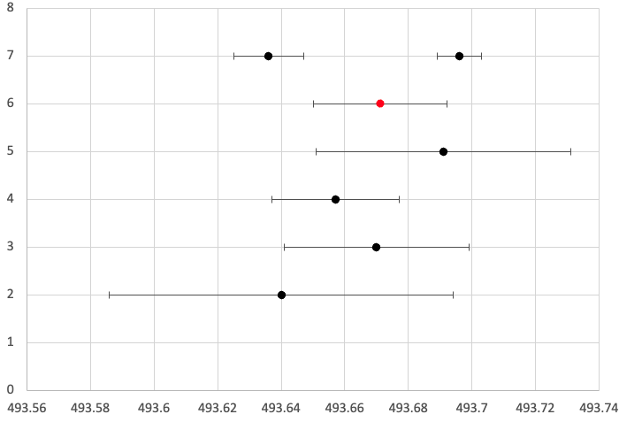
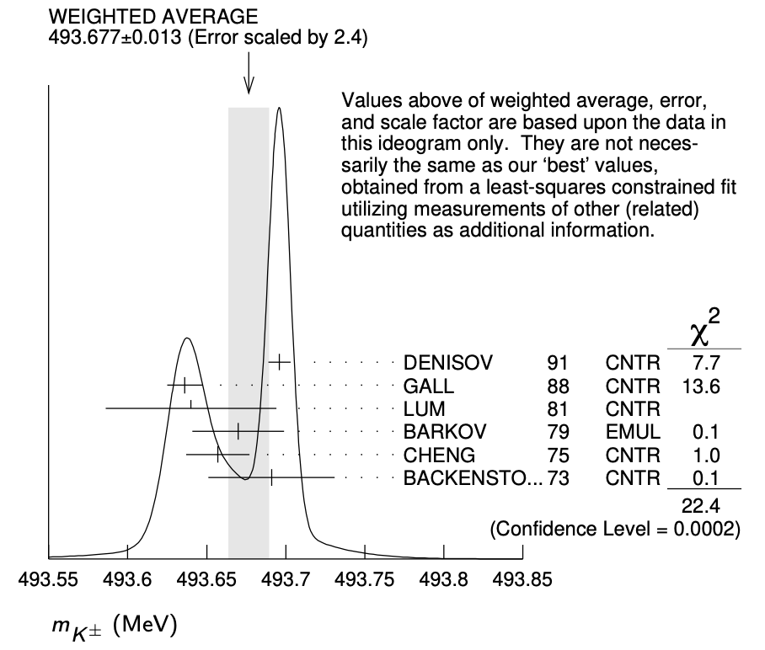
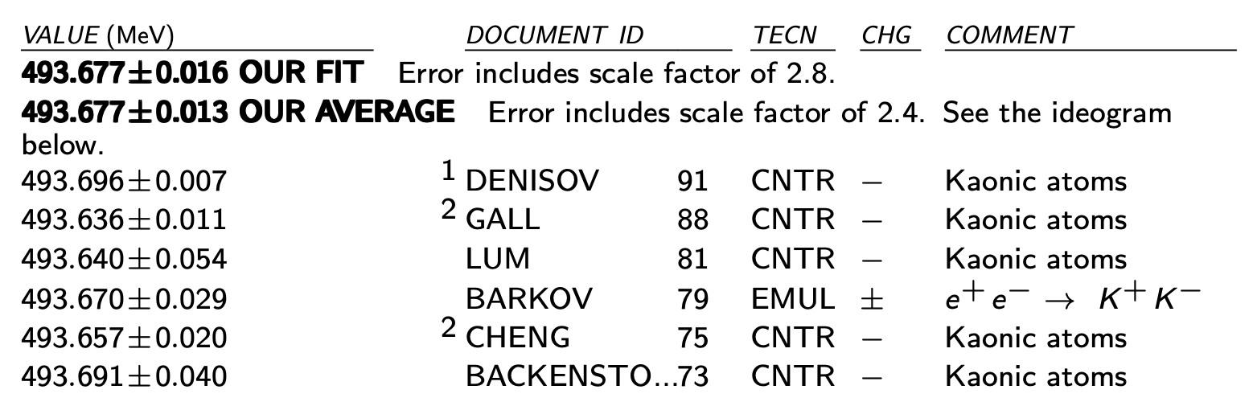

The (charged) Kaon mass puzzle and kaonic Neon
Kaon mass (K-Ne $8⟶7$and K-Ne $7⟶6$) = $493.671 ±0.021 \left(stat\right) MeV$
Feasibility test in view of a dedicated measure
Preliminary
GALL 88
DENISOV 91
Kaon mass discrepancy
SIDDHARTA-2
The kaonic Neon measurement to determine the K⁻ (K⁺) mass
Particle Data Group, 2020, 083C01 (2020)
BACKENSTO 73
CHENG 75
BARKOV 79
LUM 81
Less systematic uncertainty with respect to DENISOV 91 and GALL 88 measurements, thanks to the use of a low Z gas (Ne) target
Kaon mass [MeV]
Impact on the charmonium spectrum and on all processes in which charged kaons are involved
A dedicated kaonic Ne run
could solve the kaon mass discrepancy issue

Slide 37

SIDDHARTA-2
preliminary: kaonic deuterium measurement

Slide 38
The Kaonic Deuterium Measurement - Timeline
First Kd run May - July 2023: 164 pb⁻¹ integrated luminosity;
Second Kd run October - December 2023: 276 pb⁻¹ integrated luminosity;
Third Kd run February - April 2024: 375 pb⁻¹ integrated luminosity;
2024, May - ongoing
2024, Feb - April
2023, Dec
Kaonic deuterium Run4 – lower density
HPGe and CdZnTe data taking
Kaonic deuterium Run3
HPGe and CdZnTe data taking
2023, Oct - Dec
Winter stop
Ordinary maintenance of the setup
2023, Nov
Kaonic deuterium Run2
HPGe and CdZnTe data taking
Annual meeting
 | Luminosity delivered [pb⁻¹]
Run1 | 196
Run2 | 344
Run3 | 435
Total | 975
…with the aim of collecting 800-900 pb-1 in total – goal achieved!
Thanks to excellent DAΦNE working conditions.

Slide 39

Kaonic Deuterium Run1: data analysis
Preliminary energy spectrum after asynchronous (electromagnetic) background rejection
Refined calibration
Analysis of all veto systems data
  Veto-1 system
  Veto-2 system
  Charged kaon system
Hadronic background rejection
Preliminary fit of the energy spectrum

Slide 40





Kaonic Deuterium Run1: veto-1 system analysis
Veto-1 for synchronous background reduction:
measure the arrival time of the charged particles emitted by
the kaon-nucleus absorption
Veto-1
$$π$$
$$π$$
K-
Signal from gas target
Veto-1
K+
Veto-1: 14 plastic scintillators placed around and below the vacuum chamber

Slide 41



Kaonic Deuterium Run1: preliminary result (F. Sgaramella Ph.D. thesis)
Preliminary fit of the kaonic deuterium energy spectrum
$$ε_{1s}=−816±53 \left(stat\right)±2 \left(syst\right) eV$$
$$Γ_{1s}=756±271 \left(stat\right) eV$$

Slide 42

Kaonic Deuterium Run1: preliminary result
Preliminary comparison between SIDDHARTA-2 Run1 result and the theoretical model
Liu 2020
VERY PRELIMINARY
Oset 2001
Shevchenko 2012
SIDDHARTA-2
Revai2016
Weise 2017
Mizutani 2013
Gal 2007
Meißner 2011

Slide 43



Kaonic Deuterium Run2 and Run3: analysis ongoing
Preliminary energy spectrum from run2 + run3 (partial statistics $∼$300 pb⁻¹)
Ti K$α$
ROI
KC _{5->4}
Next Step of the analysis:
Refined calibration of Run3 data
(ongoing)
Veto-1 analysis (similar to run1 data)
Define a proper fit function
Fit of the energy spectrum
(full dataset)
KC _{6->5}
Ti K$β$
KC _{7->5}
KO _{7->6}
KTi _{11->10}
KN _{6->5}
The analysis of the full dataset can potentially improve the statistical accuracy by a factor 2
(precision similar to kaonic hydrogen measurement)

Slide 44



Kaonic Deuterium yield puzzle– low density run
T. Koike, T. Harada, Y. Akaishi, Phys.Rev.C 53 (1996), 79-87
M Raeisi, S. Z. Kalantari, Phys.Rev.A 79, 012510 (2009)
Several cascade model predict completely different kaonic deuterium X-ray yields (absolute and relative) and
different trends as function of the density
T.S. Jensen, Frascati Phys.Ser. 36 (2004), 349-354
Low density kaonic deuterium measurement
(60% lower compared to the previous run )
Providing unique data to investigate the de-excitation mechanism in kaonic atoms (cascade model)
The combined analysis of the kaonic deuterium measurement performed at 1.4% LDD and the ongoing measurement at 0.8% LDD can help to disentangle between the various theoretical cascade models

Slide 45


SIDDHARTA-2 Kd run – Future plan
First Kd run May - July 2023: 164 pb⁻¹ integrated luminosity;
Second Kd run October - December 2023: 276 pb⁻¹ integrated luminosity;
Third Kd run February - April 2024: 375 pb⁻¹ integrated luminosity;
Calibration run with hydrogen 150 pb⁻¹;
Kd low density run – goal 200 pb⁻¹
We aim to collect 200 pb⁻¹
(similar statistics to Kd run1)
24th May – End of June - first week of July
6th -12th May
Kaonic deuterium “low density” run
15th Apr – 6th May
(3 weeks)
DA$Φ$NE maintenance:
refill of the target cell with deuterium
(low density)
12th April 2024
Calibration run with
kaonic hydrogen
End of Kaonic deuterium Run3
First measurement
ever of Kd
DEAR
SIDDHARTA
SIDDHARTA-2

Slide 46

Kaonic Lead Measurement at DA$Φ$NE with HPGe
HPGe provided by Zagreb University (Croatian Science Foundation project 8570)
to perform the kaonic lead measurement
in parallel with the SIDDHARTA-2 kaonic deuterium measurement
BSI HPGe detector with transistor reset preamplifier (TRP).
DAQ based on CAEN DT5781 digitizer
Coincidence between:
-> ch0 Luminometer
-> ch1 HPGe signal
-> ch2 TAC signal
Data acquired:
-> June-July 2023: 109.38 pb⁻¹
-> September-now 2023: 117.67 pb⁻¹
HPGe active detector
diameter ~60 mm,
height ~60 mm.
46

Slide 47

The Kaonic Lead Measurement
(Zagreb Uni; Krakow, Jagiellonian Uni – Lumi)
Integrated luminosity: 109.38 pb⁻¹ ( June – July 2023)
Preliminary analysis of June-July 2023 data (D.. Bosnar and I. Friščić) :
Gaus+linear function was fitted for each peak:
(10 -> 9) : 906 events in peak,
position 209.191 ± 0.171 keV
(9 -> 8) : 947 events in peak,
position 292.939 ± 0.134 keV
(8 -> 7) : 943 events in peak,
position 427.200 ± 0.152 keV
Optimization and detailed analysis is in progress-> towards a publication
Preliminary

Slide 48



Kaonic Lead Measurement at DA$Φ$NE with HPGe
(Zagreb Uni; Krakow, Jagiellonian Uni – Lumi)
Installed in the antiboost side of the IP to perform the kaonic lead measurement in parallel with the SIDDHARTA-2 kaonic deuterium measurement
Integrated luminosity: 109.38 pb⁻¹: subset of 40 pb⁻¹ already analysed
HPGe active detector
diameter ~60 mm,
height ~60 mm.
Article submitted to Nuclear Instruments and Methods A preprint: arXiv:2405.12942

Slide 49







CdZnTe detectors: test run with 8 detectors
8 cm² CdZnTe detectors to perform X-ray spectroscopy of kaonic aluminium in parallel with SIDDHARTA-2 kaonic deuterium run
(L. Abbene, A. Buttacavoli, F. Principato, A. Scordo)
Two modules (8 CdZnTe) installed
Advanced ultra-fast solid STate detectors for high precision RAdiation spectroscopy : ASTRA
~ 60 pb⁻¹ of data with a 2,2 mm Al target
Pb K$α$
Raw spectrum
Pb K$β$
K+
Luminometer
K-
CdZnTe
Al target

Slide 50









CdZnTe detectors: test run with 8 detectors
Preliminary result from the kaonic aluminium analysis ($∼$60 pb⁻¹)
K-Al$4→3$ : $107.8±0.6$ keV
K-Al$5→4$ : $51.4±0.4$ keV
First kaonic atoms’ spectrum measured with CZT detectors
CZT proved to be the perfect technology for intermediate mass kaonic atoms, with very good “in-beam” performances during preliminary tests
CdZnTe detectors can be easily used in parallel with already existing experiments, requiring very small space and not invasive electronics.
Pb K$α$
K-Al$5→4$
K-Al$4→3$
Au K$α$
Pb K$β$
K-Pb$13→12$
K-Pb$17→16$
K-Pb$12→11$
An article is in preparation

Slide 51

Strangeness precision frontier at DAΦNE: a unique opportunity for measurements of kaonic atoms along the periodic table: will represent a reference in physics with strangeness
Present status: old and very old measurements with low precisison (some even wrong: kaonic helium puzzle)
We propose to do precision measurements along the periodic table at DAΦNE for:
Selected light kaonic atoms
Selected intermediate mass kaonic atoms
Selected heavy kaonic atoms
charting the periodic table

Slide 52

EXtensive Kaonic Atoms research:
from LIthium and Beryllium to Uranium
EXKALIBUR

Slide 53



The measurement for the first EXKALIBUR module were selected based on two criteria:
Feasibility with minimal modifications/addings of the already existent SIDDHARTA-2 setup and within a reduced timescale
Impact: i.e. the maximal scientific outcome:
Kaonic Neon -> kaon mass
Light kaonic atoms (KLi; Be; B)
In parallel intermediate mass kaonic atoms
Built up on our world-recognized expertise:
Kaonic Hydrogen
Kaonic Nitrogen
Kaonic Helium
Kaonic Neon
Kaonic deuterium
+ more

Slide 54

Kaonic neon for the charged kaon mass
The first measurement we plan doing is the kaon neon high-n levels transition with precisions below 1 eV, to extract the charged kaon mass.
By using a gaseous target, we can resolve the ambiguity in the charged kaon mass de-termination, providing a new precise value through the measurement of kaonic neon high-n transitions. Moreover, the measurement also provides a precision test of QED in atomic systems with strangeness (Rydberg constant, as example).

Slide 55


Our own Kaonic Neon measurement (2023)

Slide 56


Our own Kaonic Neon measurement (2023)
$$∼15 keV$$

Slide 57


Our own Kaonic Neon measurement (2023)
$$∼60 keV$$

Slide 58





Refined calibration system : 7 (8) movable fluorescent foils
X-ray tubes
Current calibration system
Wide
aperture
holding
3 targets,
all exposed
Fixed Teflon@ slits
Ti, Cu, Zr calibration foils holder
Upgraded calibration system
Holding structure
Actuator motor and gear box
Conical collimated
aperture
exposing
a single
target at a
time
Movable targets arm inserted behind the collimator.
Selected materials:
GaAs, Pt, Au, Ge, Fe, Mn, Zr
Adjustable slits

Slide 59
New calibration system for a systematic error of 0.2 eV or better
X-ray tubes
Teflon collimators/shutters

Slide 60

Light Mass (low-Z) Kaonic Atoms
The second module of measurement are light mass (Li, Be, B) kaonic atoms, to study in detail the strong interaction between kaon and few nucleons (many body).
Now precise measurements for these kaonic atoms of the shifts, widths and yields will result in a significative improvement on the knowledge of the interactions of kaons in matter, with a great impact on the low energy QCD and astrophysics (equation of state for neutron stars) .

Slide 61



Solid targets replacing the gaseous one and possible use of 1/2 buses of 1 mm SDDs (>20 keV)
Precision measurements:
Precision below (around) eV

Slide 62

As a bonus: intermediate-mass kaonic atoms measurements with CdZnTe setups (same beam)
Kaonic Oxygen: key role in the description of the nuclear-matter density distribution which enters in the formula for the density-dependent optical potentials
Kaonic Aluminium; 3->2 QCD – never measured; 4->3 the inconsistent measurements Kaonic Sulphur:

Slide 63
AMADEUS scientific case (with KLOE data)
AMADEUS (Antikaonic Matter At DAΦNE: an Experiment with Unravelling Spectroscopy )
investigates low-energy K⁻ absorption in nuclei with the aim to extract information on
K⁻N interaction above and below threshold
  Λ(1405) nature
  K⁻N scattering amplitudes and cross sections
K⁻NN, K⁻NNN, K⁻NNNN (multi-nucleon) interactions
  K⁻-multi nucleon cross sections
  essential for the determination of K⁻-nuclei optical potential
  kaonic bound states
Hyperon-nucleon/(multi-nucleons) interaction cross sections

Slide 64


Slide 65


AMADEUS
The KLOE detector
Cylindrical drift chamber with a 4π geometry and electromagnetic calorimeter, 96% acceptance
optimized in the energy range of all charged particles involved
good performance in detecting photons and neutrons checked by kloNe group
[M. Anelli et al., Nucl Inst. Meth. A 581, 368 (2007)]
K⁻
e⁺
e⁻
K⁺
KLOE used as an active target
DC wall (750 μm C foil , 150 μm Al foil);
DC gas (90% He, 10% C₄H₁₀).
+
pure sample of K⁻ ¹²C absorptions at-rest

Slide 66

K⁻ absorptions at-rest and in-flight
AT-REST
K⁻ absorbed from atomic orbitals
(p_{K} ~ 0 MeV/c)
IN-FLIGHT
(p_{Κ}~ 100 MeV/c)
p_{Κ}~ 100 MeV/c
e⁻

Slide 67






Highlights of AMADEUS results
K- p -> (Σ⁰/Λ) π⁰
cross section at p_{K-} = 98 ± 10 MeV/c :
Phys.Lett. B782 (2018) 339-345
Nucl. Phys. A 954 (2016) 75-93
Phys.Rev.C 108 (2023) 5, 055201
Eur.Phys.J. C79 (2019) no.3, 190
Acta Phys. Pol. B 48 (2017) 1881
Phys.Lett. B 758, 134-139 (2016)

Slide 68

Future perspectives
The present knowledge of total and differential cross sections of low energy kaon-nucleon reactions is very limited: below 150 MeV/c there is a “desert” - the experimental data are very scarce and with large errors and practically no data exist below 100 MeV/c.
Kaon-nucleon scattering/interaction data are fundamental to validate theories: chiral symmetries; lattice calculations; potential models etc.

Slide 69







Neutron star EOS
Particles structure
Cold Dense matter
Strangeness Fundamental Physics
Mass generation, visible Universe
QCD
Chiral symm.
Strangelets & Dark Matter

Slide 70

ThanK You
Immortals are never alien to one another.
― Homer, The Odyssey
Grazie Carlo!

Slide 72



Kaonic deuterium data analysis – Run1
First run, May – July 2023, integrated luminosity 200 pb⁻¹ (with injections)
Refined data calibration completed
KC6->5
5545 eV
ROI
KC5->4
10216 eV
VERY PRELIMINARY
KO6->5
9968 eV
KO7->6
6007 eV
KC7->5
8886 eV
KN6->5
7595 eV
Fe $K_{α}$
6400 eV
Cu K$α$
8041 eV

