Slide 1

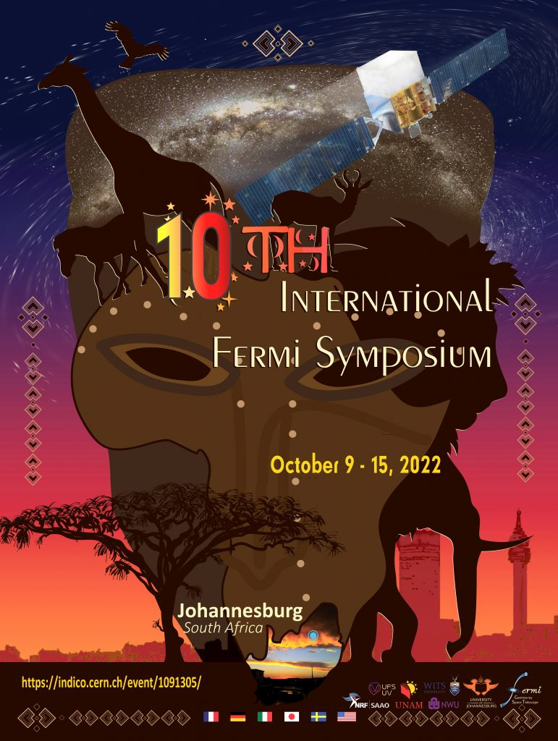


Welcome from The South African Gamma-Ray Astronomy Programme (SA-GAMMA)
0
Markus Böttcher
North-West University
Potchefstroom, South Africa
Chair of SA-GAMMA

Slide 2

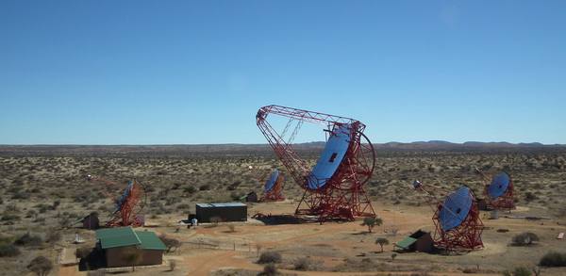
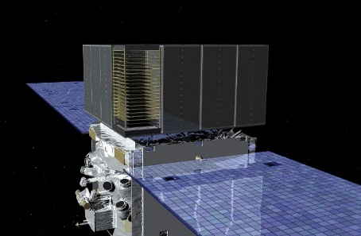
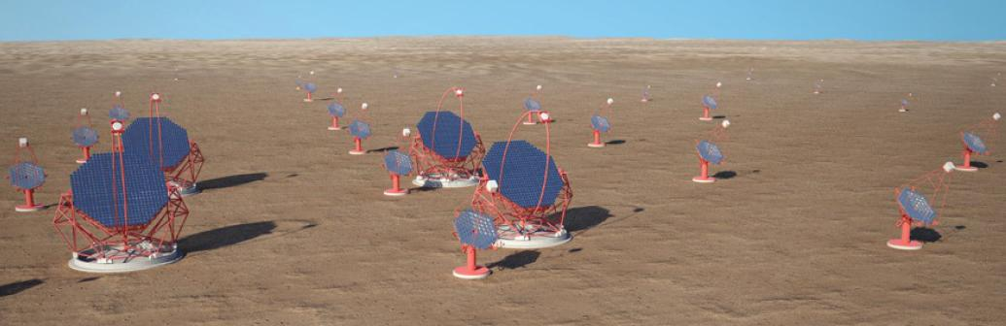
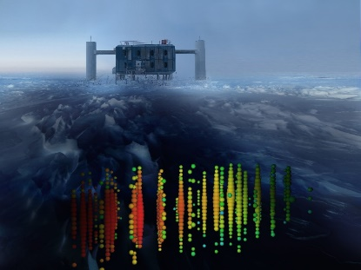
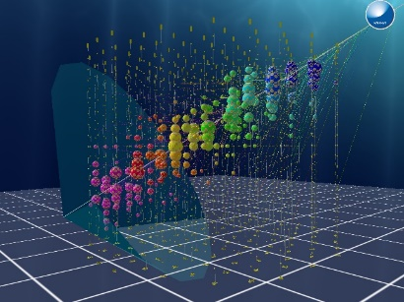

SA-GAMMA Consortium
Coordinating research activities and funding
needs for gamma-ray astronomy in South Africa
and Namibia
H.E.S.S.
CTA
Fermi
IceCube, KM3NeT
24 permanent staff scientists,
10 postdocs, 30 Ph.D. students, 28 M.Sc. Students
at 6 institutions:
H.E.S.S.
Fermi
CTA
IceCube
Km3NeT

Slide 3

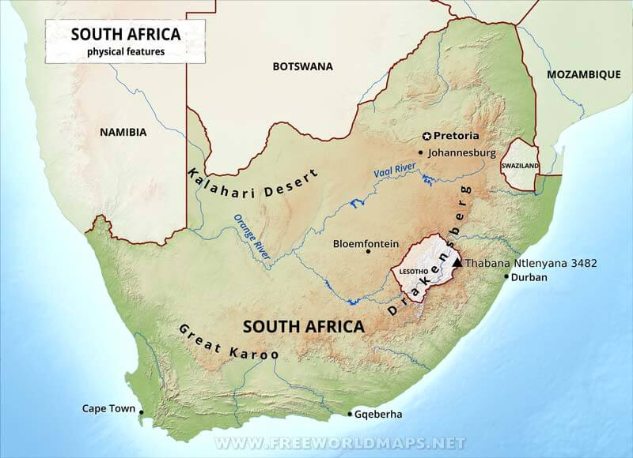





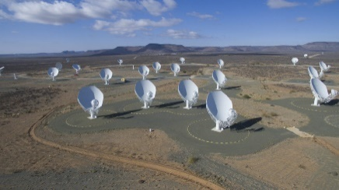

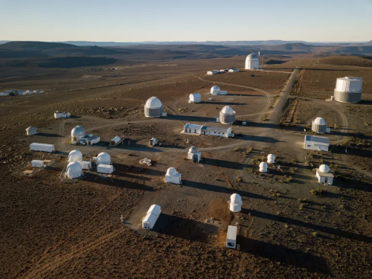
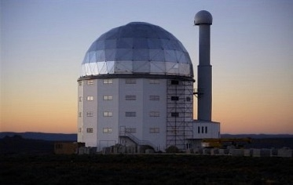

SA-GAMMA Consortium
Windhoek
1 invited +
17 contributed
talks by
SA-GAMMA
members
H.E.S.S.
Potchefstroom
MeerKAT
SALT

Slide 4
SA-GAMMA
Funded by DSI at over
ZAR 4M per year
(ZAR 4.2M for 2022 – 2023)
Thank you!

