Slide 1
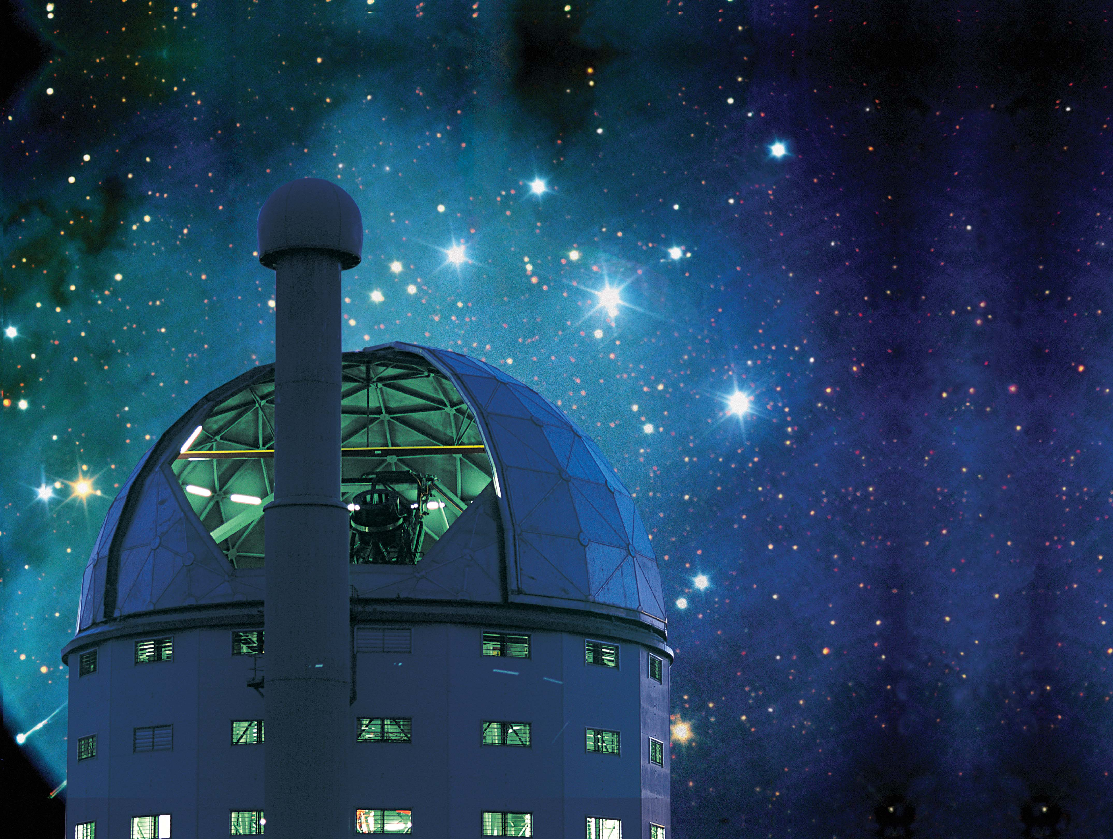
Optical Follow-up of X-ray and Gamma-ray Transients
David Buckley
South African Astronomical Observatory
University of the Free State
University of Cape Town
SALT Transient Programme PI

Slide 2
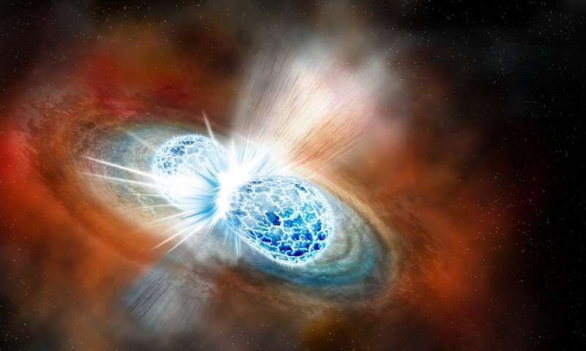
The Transient Universe
Time domain and transient astronomy is a growing frontier of discovery space
  “things that go bump in the night”
Allows studies of phenomena over timescales of milliseconds to decades
Observations of transient behaviour for a wide range of objects and timescales, including high energy events (X-rays/γ-rays)
From Galactic to extragalactic objects
Most HE transients associated with accretion and resulting outflows
Merging neutron star binary
(e.g. kilonova GW170817)
Nova eruption

Slide 3
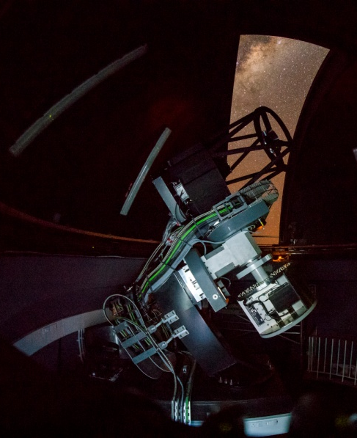
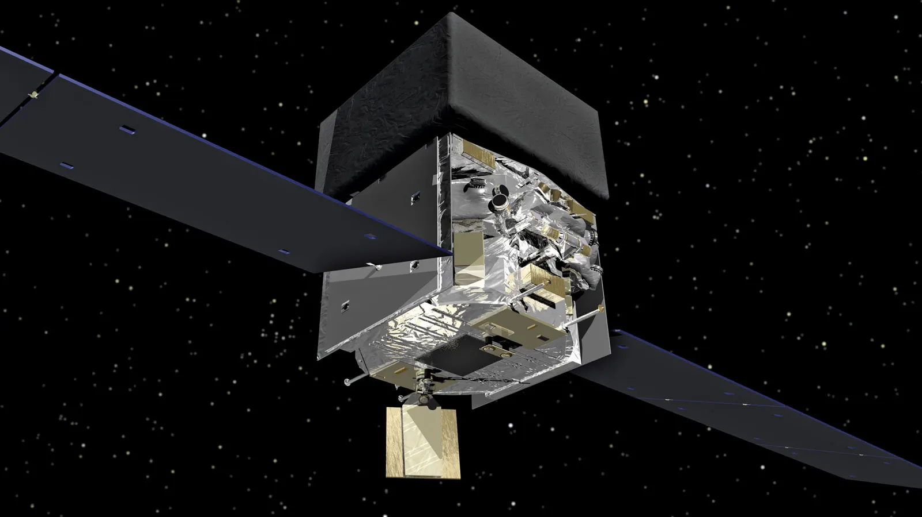
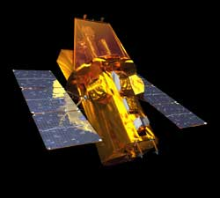
The Transient Universe across the E-M spectrum
Increasing number of facilities and surveys leading to discoveries of transients of all classes (including new optical facilities at SAAO)
Some dedicated to specific classes of objects (e.g. supernovae, GRBs)
Others finding many different classes of transients as a by-product of wide-field surveys (e.g. Gaia, OGLE, PanSTARRS, ZTF, TESS)
Both ground-based and space-based facilities are sources of alerts
X-ray/γ-ray satellite for the latter (e.g. Swift, Fermi, MAXI)
A SALT large science programme on transients began in 2016
Experience gained helping to pave the way for the next big transient discovery machine: the Rubin Observatory Legacy Survey of Space and Time(LSST)
Need for machine learning tools based on current experiences
MeerLICHT (optical followup
of radio transients)
Fermi (γ-ray)
Swift (UV/X-ray/γ-ray)

Slide 4
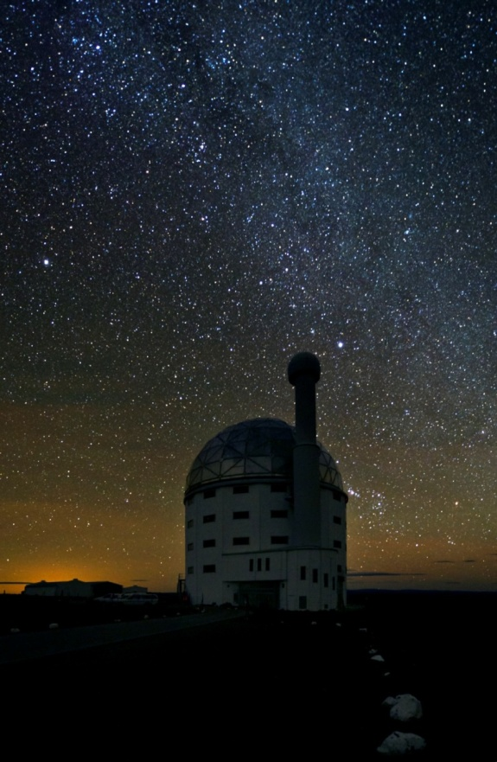
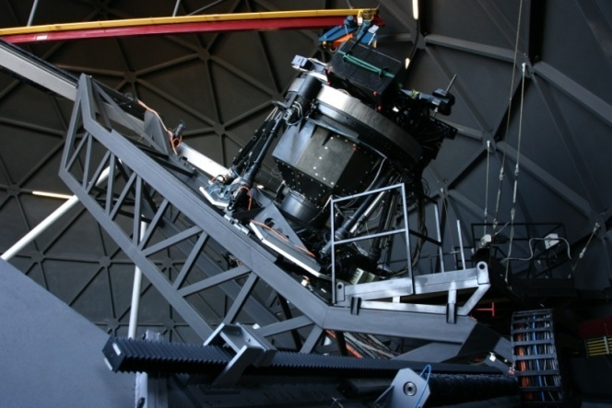
The SALT Transient Programme
SALT Large Science Program on transients
  Ramping up since 2016
  Grown to a large allocation ~400 ksec (111 h) / semester (~15% of time) in 2022
  High fraction in highest priority class (for ToO)
  allows for rapid response to alerts
  monitor objects on different cadences
  Continuous time resolved observations (0.1 s – few hours)
  Basic pipeline reduced data available in < 12 h (raw data immediately)
  Over 60 refereed papers to date, many involving multi-γ facilities
Multi-institutional/multi-partner program
  5 South African institutions (SAAO, UCT, UFS, NWU,
  UJ)
  4 other SALT partners (Poland, India (IUCAA), UK, U. Wisconsin) plus other international collaborations
  36 co-investigators (incl. 12 graduate students)

Slide 5
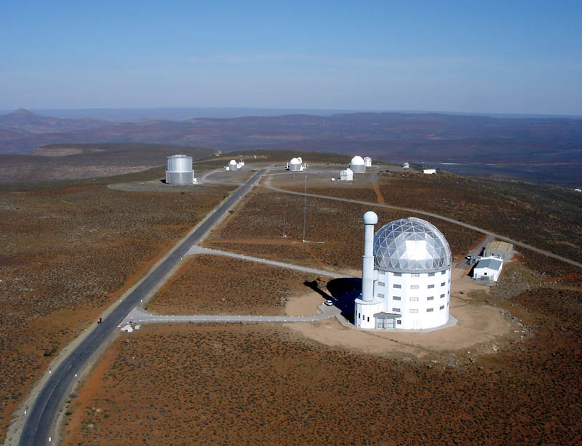

Slide 6
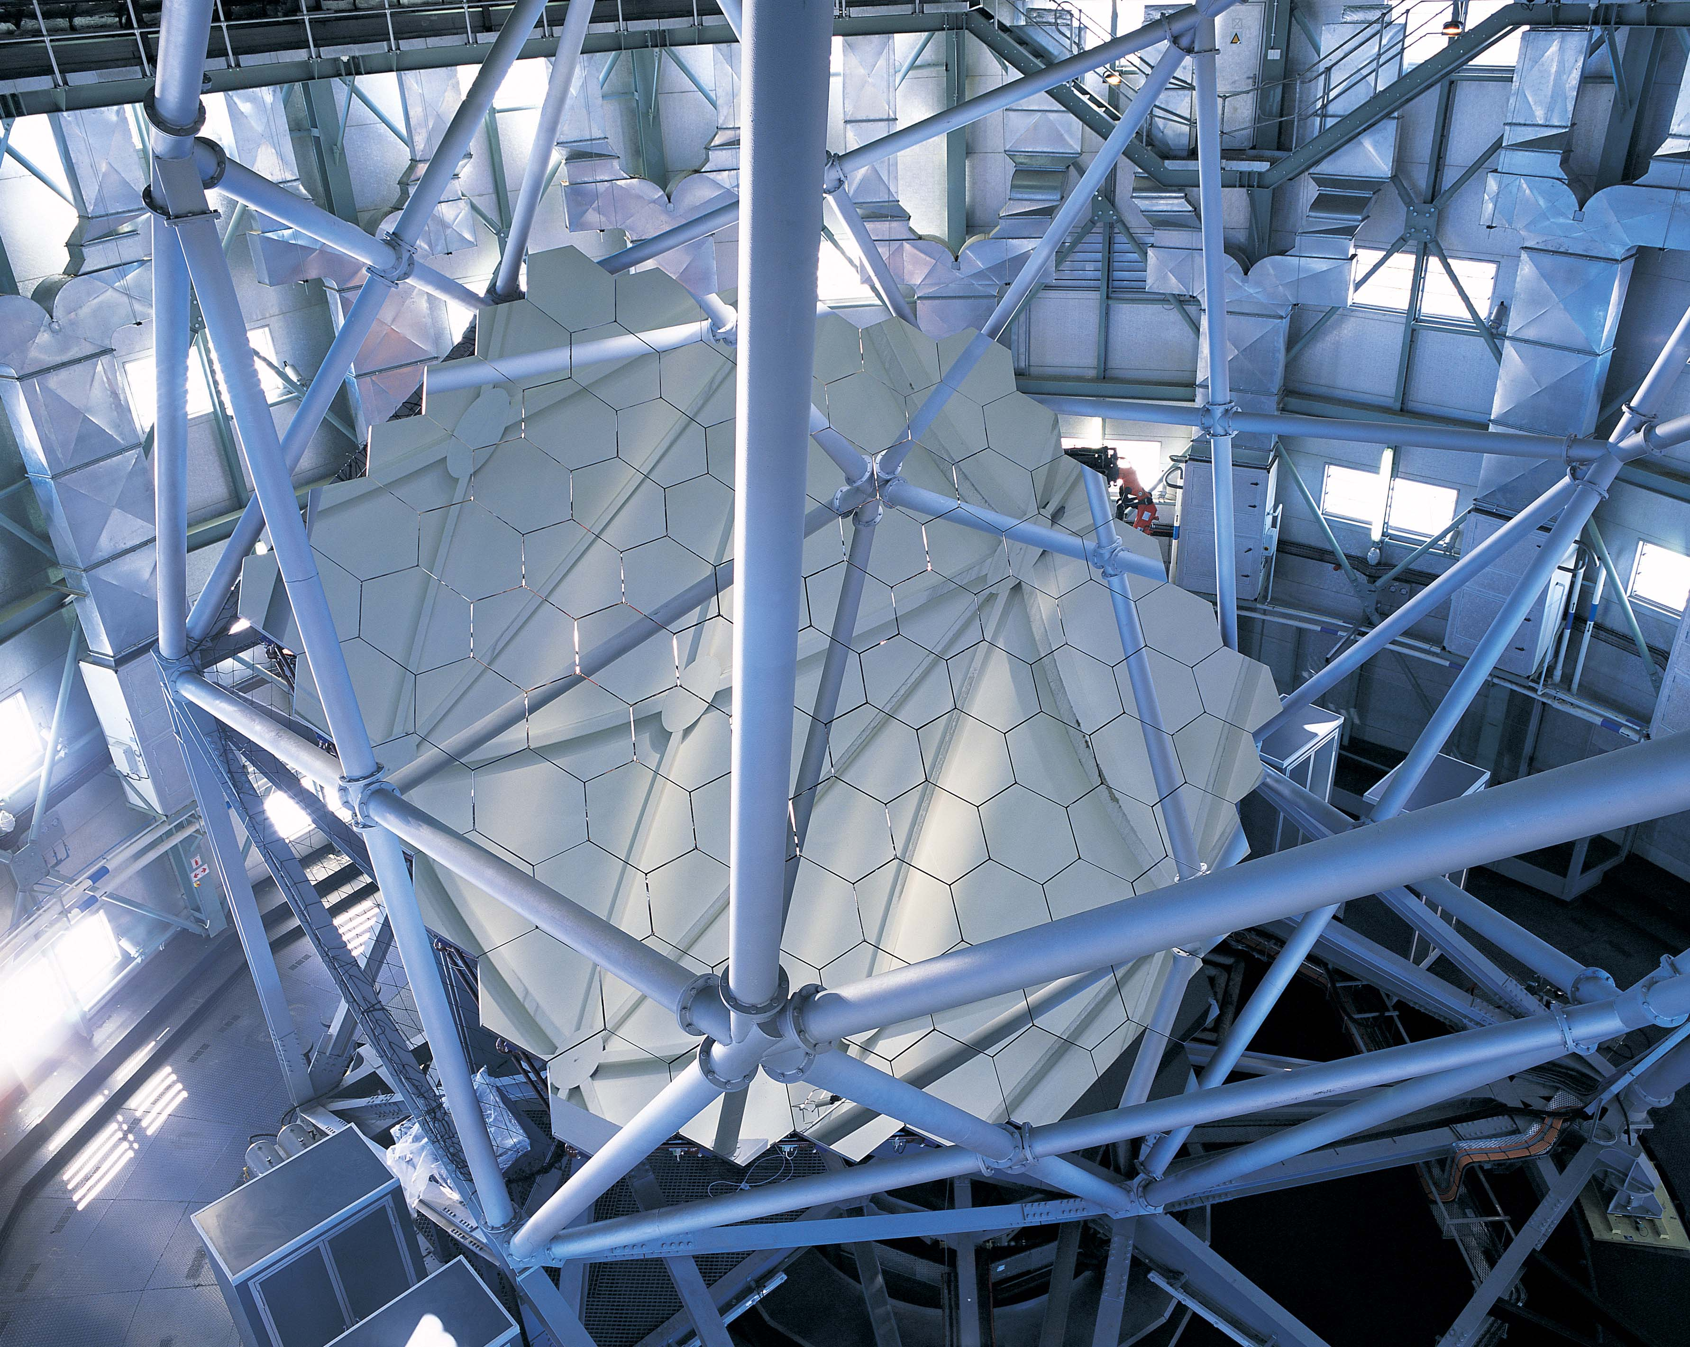

Slide 7
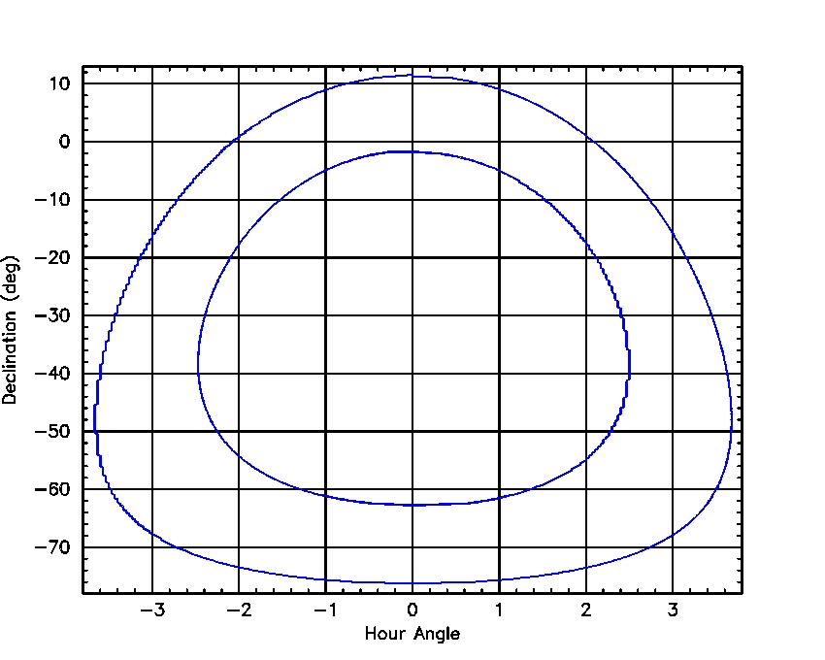
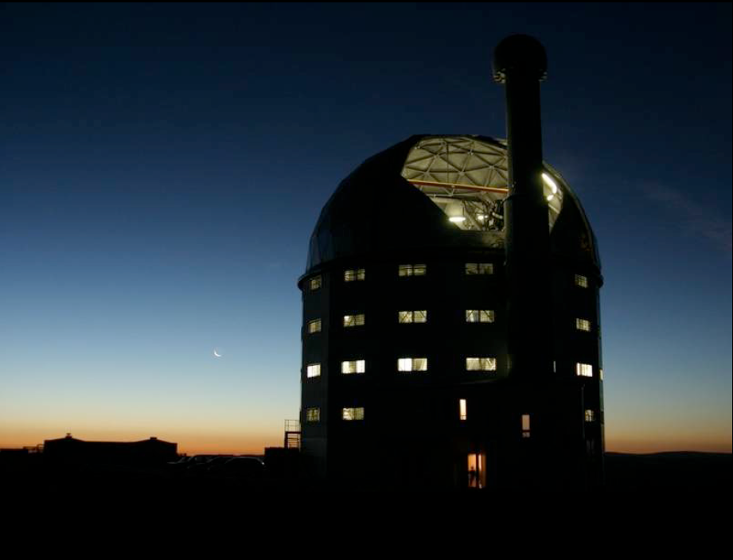
Observing Transients With SALT
SALT Viewing Annulus
100% queue scheduled service observing
Variety of instruments/modes
Rapid instrument changes and mode configurations
Scheduling allows for synoptic monitoring at difference cadences
Targets of Opportunity can be done at short notice
Ideal for followup of transients
Notes:
SALT Partners = SA, USA, UK, Poland, Germany, India, New Zealand – SA owns ~1/3 share
7

Slide 8
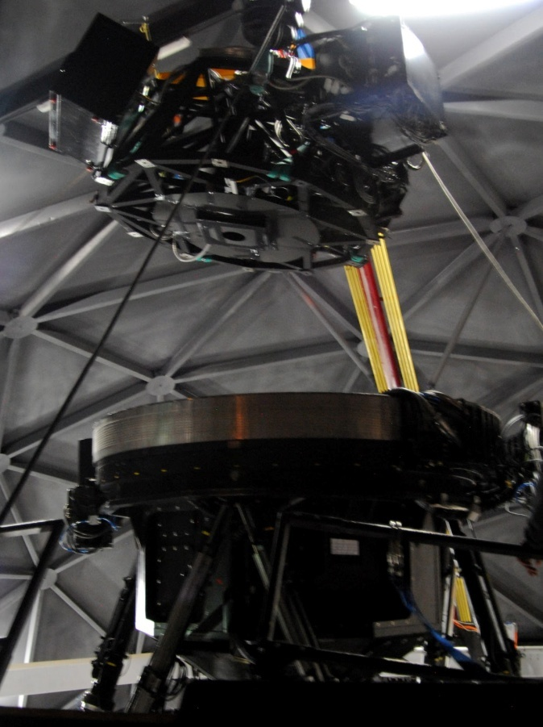
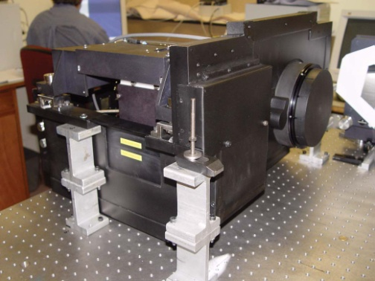
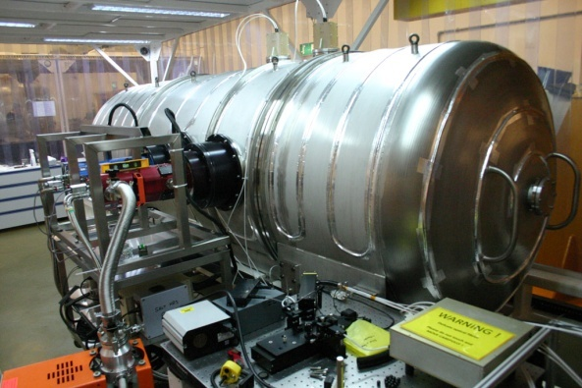
Observing Transients With SALT
Currently available instruments:
Robert Stobie Spectrograph (RSS)
  Low-medium resolution (300 – 6000)
  3200 – 9000Å
  Fast spectroscopy (10 Hz)
  Fast imaging (10 Hz)
  Spectropolarimetry
  Imaging polarimetry
  Fabry-Perot imaging
SALTICAM
  Fast imaging (15 Hz)
  Deep multi-filter imaging (griz, UBVRI, Hα)
High Resolution Spectrograph (HRS)
  High resolution (16,000, 34,000, 60,000) 3800 – 8900Å
  Fibre-fed
  Precision radial velocity capability (vacuum, laser freq comb soon)
Notes:
SALT Partners = SA, USA, UK, Poland, Germany, India, New Zealand – SA owns ~1/3 share
8

Slide 9
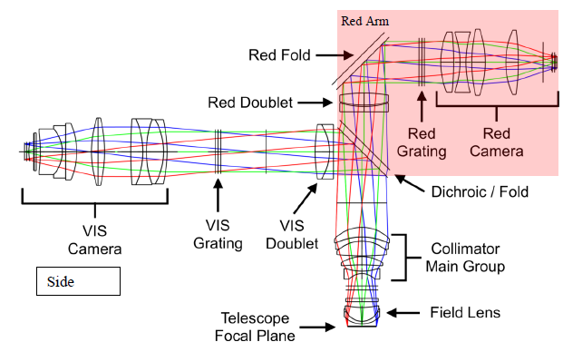
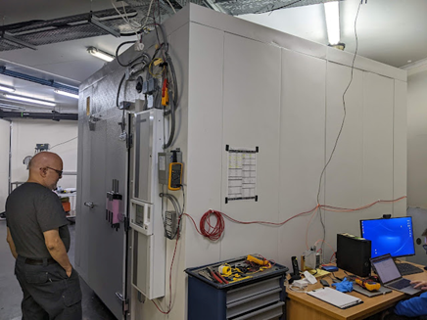
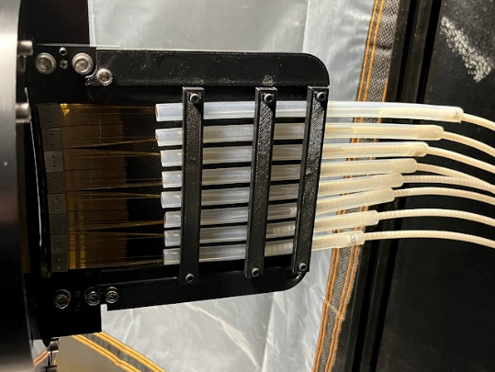
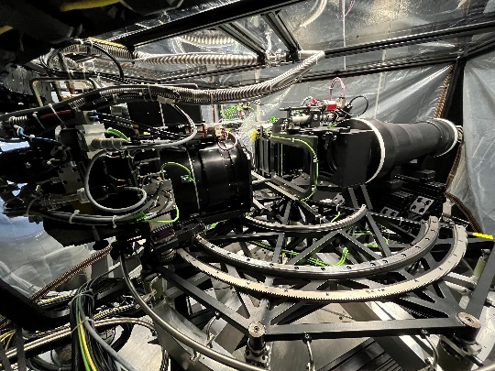
Observing Transients With SALT
Future instruments:
RSS Red Arm (2024)
  medium resolution (~2000 seeing limited)
  6300 – 10000Å at high efficiency (56%)
  turns RSS into dual-beam instrument
  optimized for blue and red
  versatile (different gratings/resolutions)
  fast modes (~10 Hz)
Near-Infrared Integral Field Unit (IFU) Spectrograph (2023)
  covering 8000-17,000Å (z,Y,J,H)
  medium resolution (~2000-5200)
  Fed by 25 arcsec IFUs (212 fibres)
  Inside cold room (-40°C)
Notes:
SALT Partners = SA, USA, UK, Poland, Germany, India, New Zealand – SA owns ~1/3 share
9

Slide 10
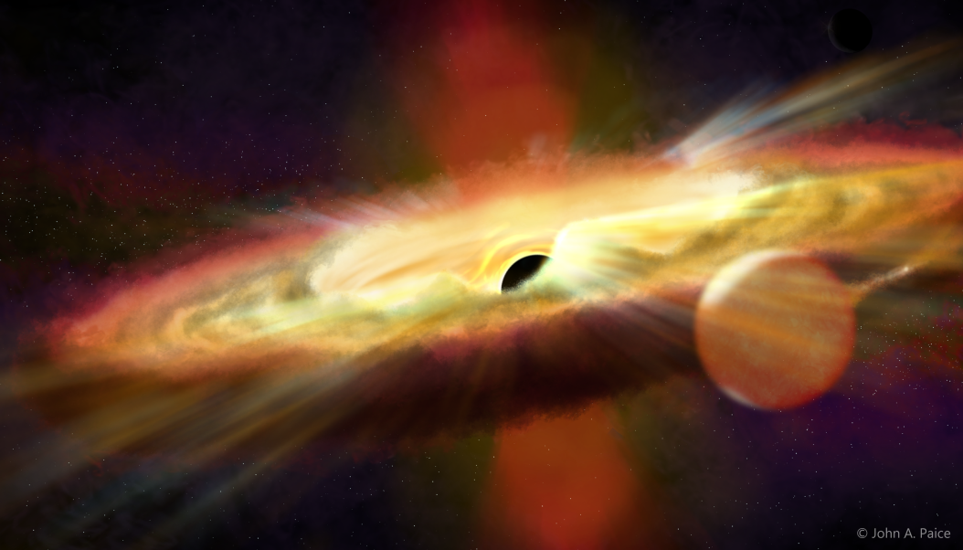
SALT Transient Program
Covering wide range in luminosity (& therefore distance)
Variability on a wide range of timescales
  Sub-sec domain is relatively unexplored
Covering many object classes
  X-ray transients (LMXs; HMXBs)
  Cataclysmic Variables
  Novae
  Intermediate luminosity transients
  Tidal Disruption Events (TDEs)
    From Gaia, OGLE, eROSITA
  Black Hole microlensing events
  Flaring Blazars
  Unusual supernovae (e.g. Super Luminous Supernovae)
  Gamma-Ray Bursts (GRBs)
  Multi-messenger (Gravitational Wave &
  Neutrino) events
  Radio transients with MeerKAT (ThunderKAT programme)
(red font: relevant to X-ray & /γ-ray sources)

Slide 11
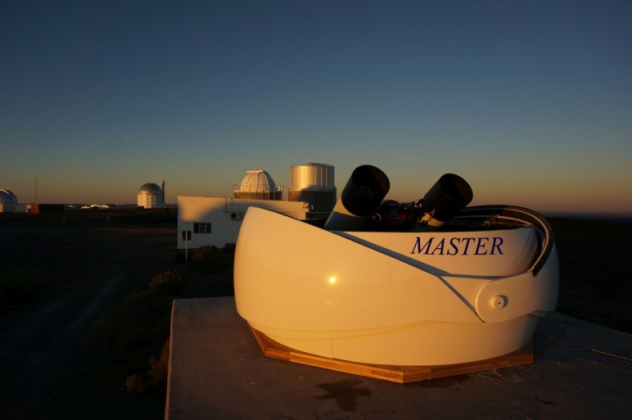
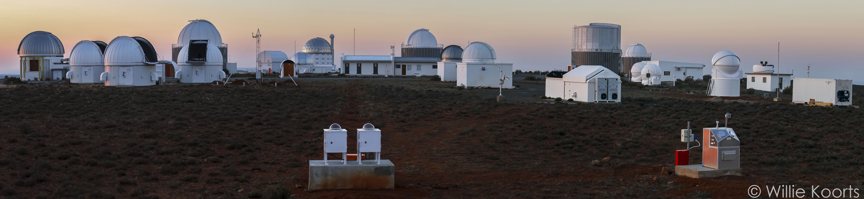
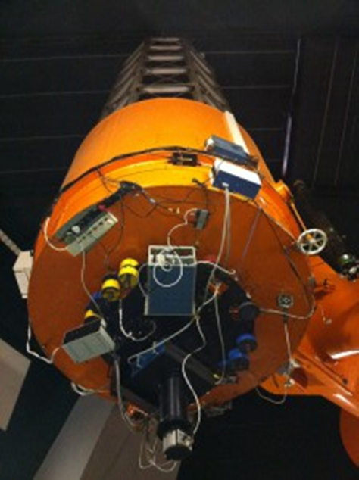
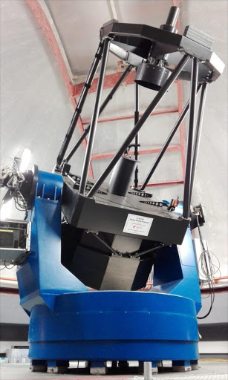
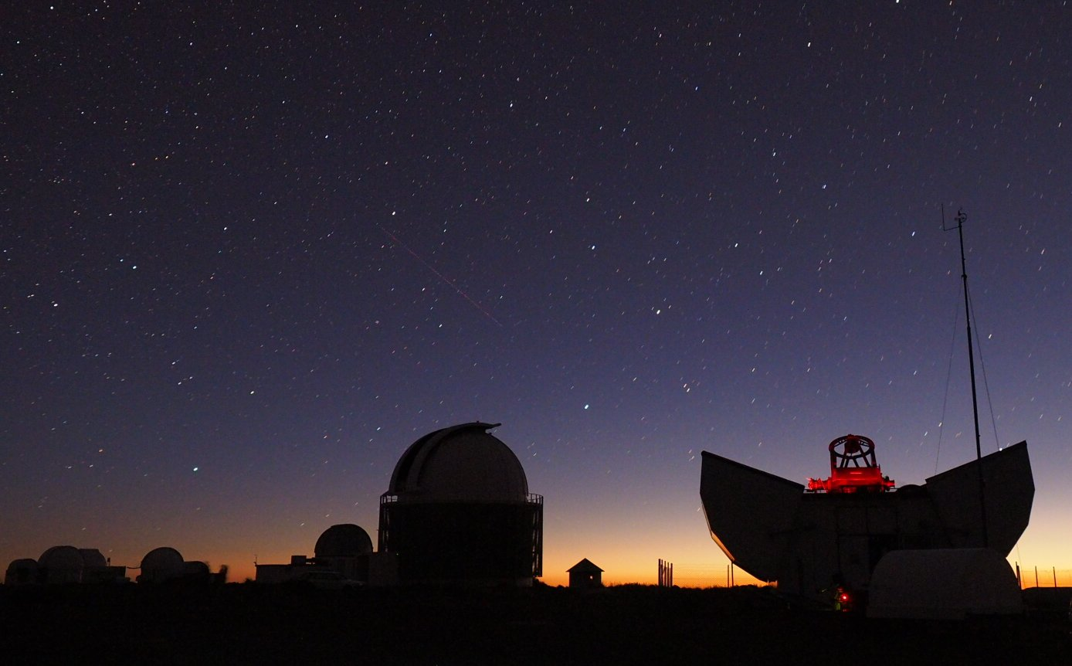
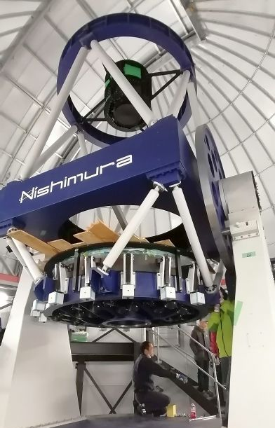
Supporting Optical Observations in South Arica: current & future
Majority of facilities at the SAAO site in Sutherland
~20 telescopes with 0.40 – 1.9-m apertures, in optical and NIR
Some dedicated to transients (ATLAS, MASTER, MeerLICHT)
Mostly supporting time series optical photometry, spectroscopy and photo-polarimetry
1.0-m
(Lesedi)
1.-8-m NIR (PRIME)
1.9-m
Monet 1.2-m

Slide 12
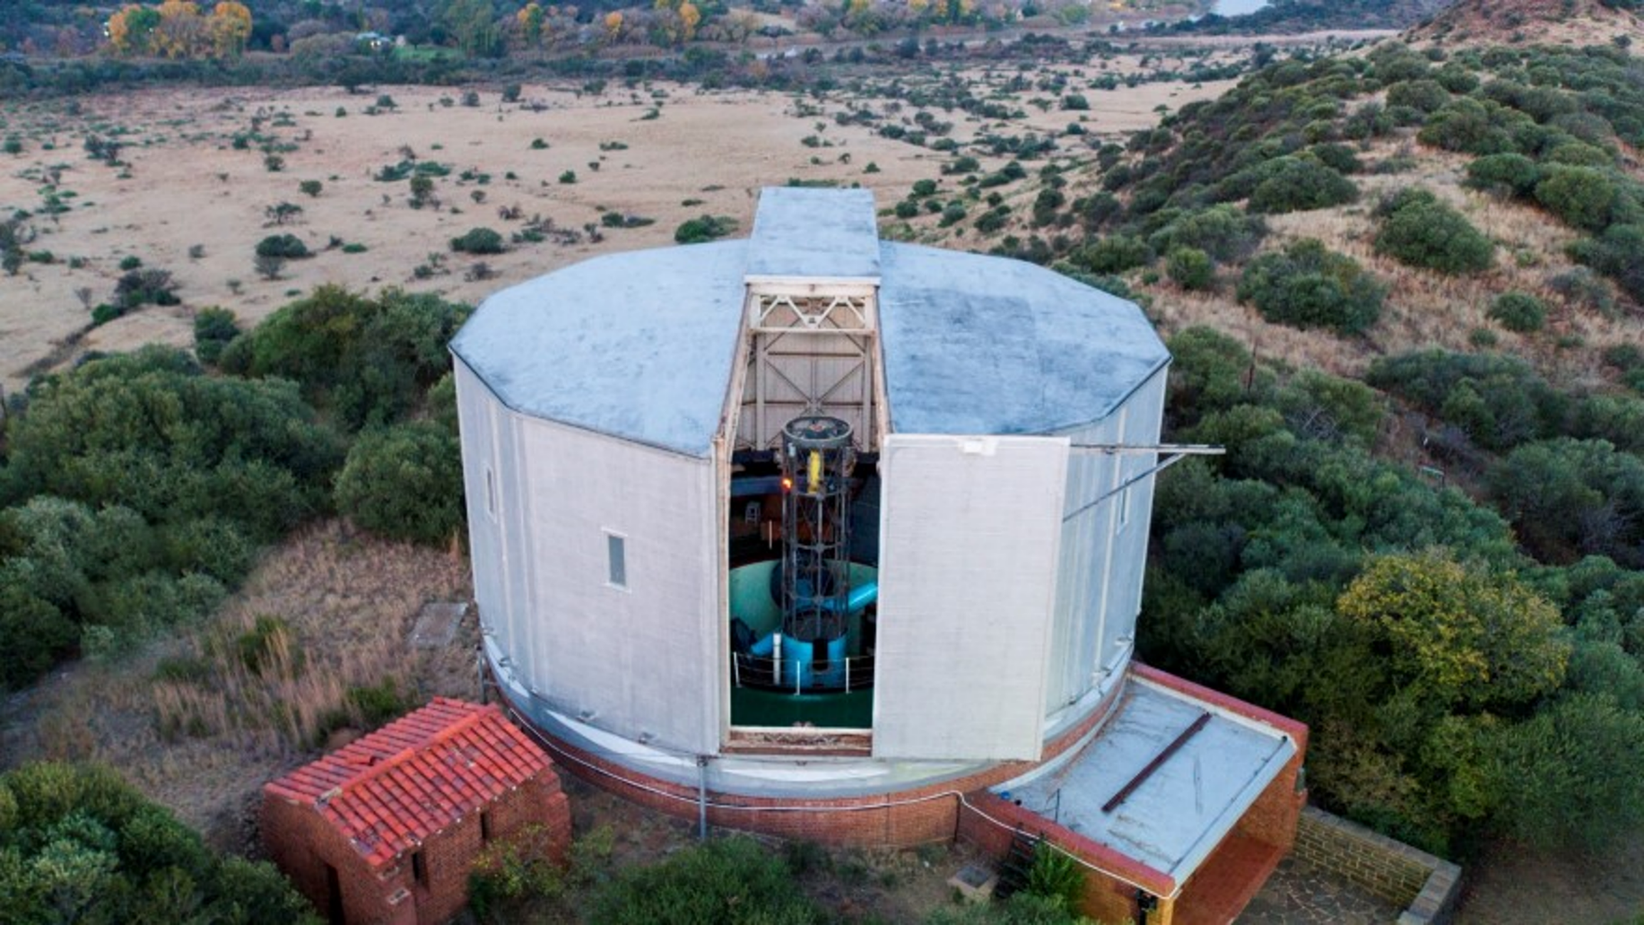
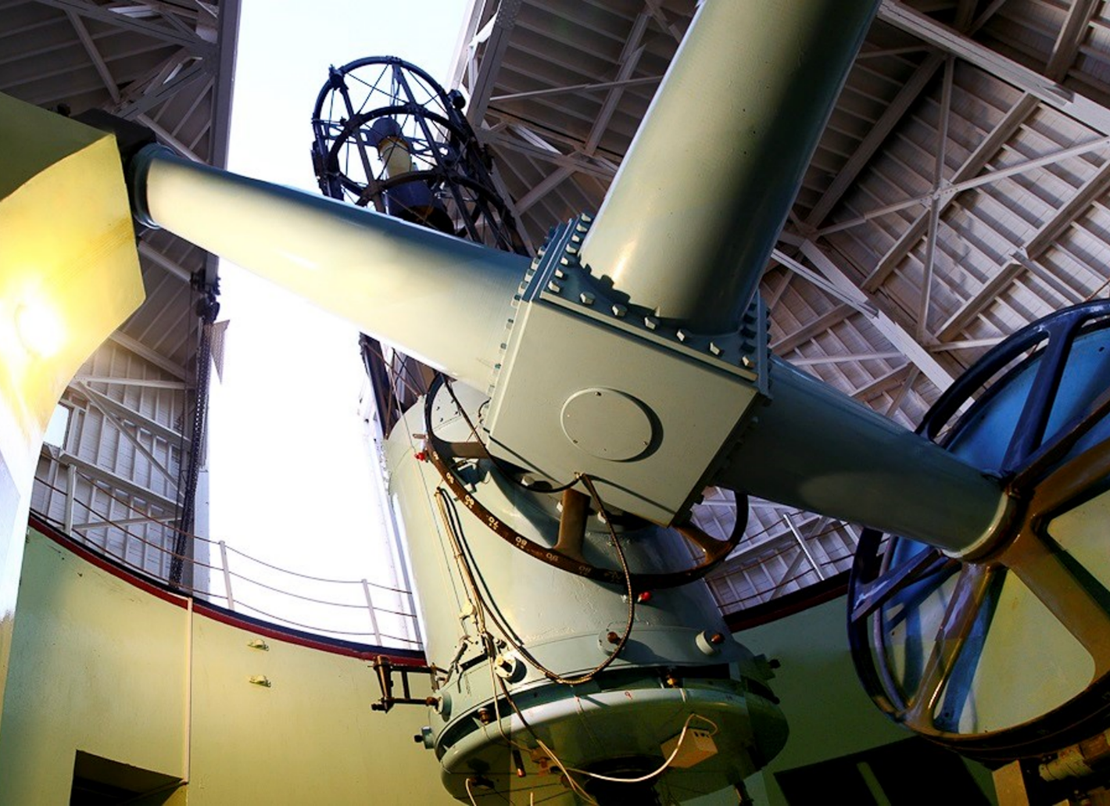
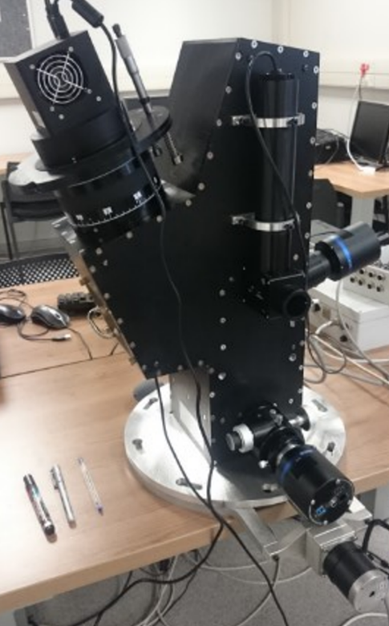
Supporting Optical Observations in South Arica: current & future
Boyden Observatory (University of the Free State)
Rapid followup telescopes (Watcher, Boötes)
Refurbishment of Boyden 1.25-m telescope and new spectrograph (~2023)
Potential for new robotic facilities in future at various South African
universities
New spectrograph & spectropolarimeter

Slide 13
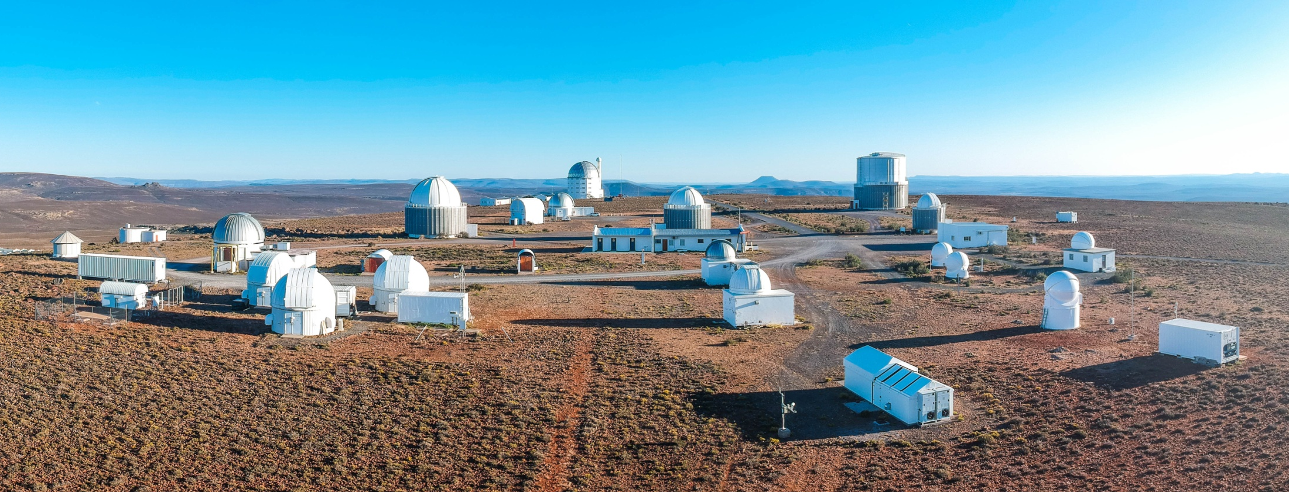
The Future: SAAO Intelligent Observatory
Network telescopes on the Sutherland site to allow automated follow-up from multi-wavelength alert brokers
Science driver: follow-up on Rubin LSST transient & variable sources and transient alerts from other facilities (including space-based)
Project started in 2020 with 3 telescopes and utilizing SW system developed at LCO
Eventually extend to some of the other hosted facilities
Telescopes now routinely remotely operated and one in autonomous mode
Eventually part of global networks using AEON protocols

Slide 14
Examples of Science Results from SALT X-ray/γ-ray transient programme
Novae
Cataclysmic Variables (& related objects)
  super-soft sources
  magnetic systems
  white dwarf “pulsars”
Low Mass X-ray Binaries (LMXBs)
  Neutron star & black holes systems
  Transitional millisec pulsars
High Mass X-ray Binaries (HMXBs)
  Be X-ray Binaries
Blazars
  Followup of gamma-ray flaring blazars
GRBs
  Bright or long
Results of followup on eROSITA X-ray survey
  Compact binary White Dwarfs
  Quasi-Periodic Eruptions in non-active galaxes

Slide 15
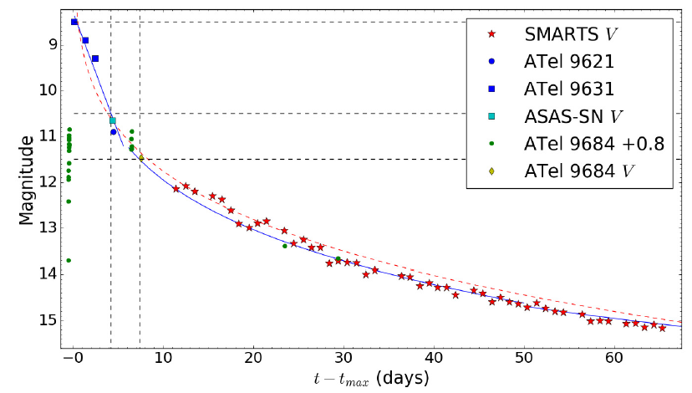
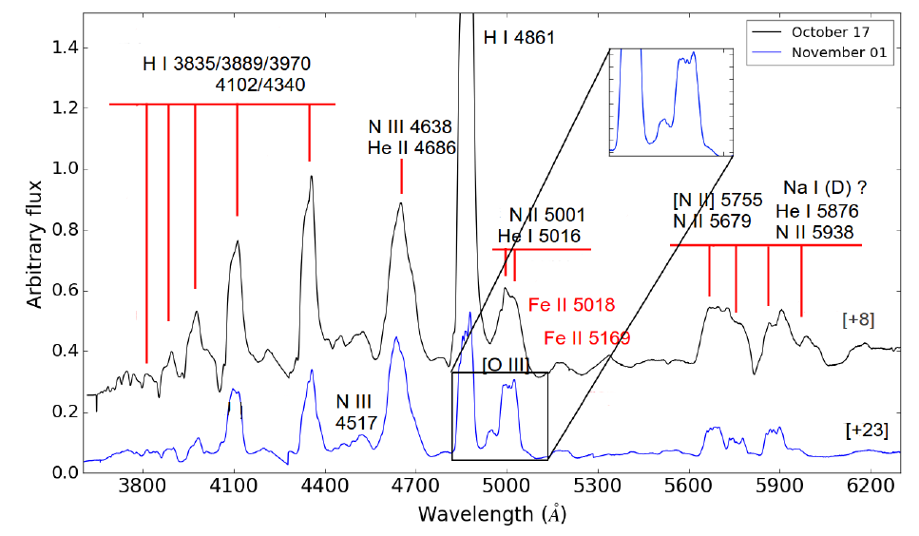
Novae
Program instigated by Elias Aydi (PhD student at the time, now Hubble Fellow at MSU)
Discovery of nova SMCN 2016-10a (in SMC) by MASTER (V = 9)
Follow-up by SALT (opt) Swift (UV/X-ray), SMARTS (opt/NIR), Chandra (X-ray)
M_{V} (max) = -10.5 (most luminous)
Fast He/N nova; WD mass > 1.2M_{ʘ}
(Aydi, Page, Kuin et al., 2018,
MNRAS, 474, 2679)

Slide 16
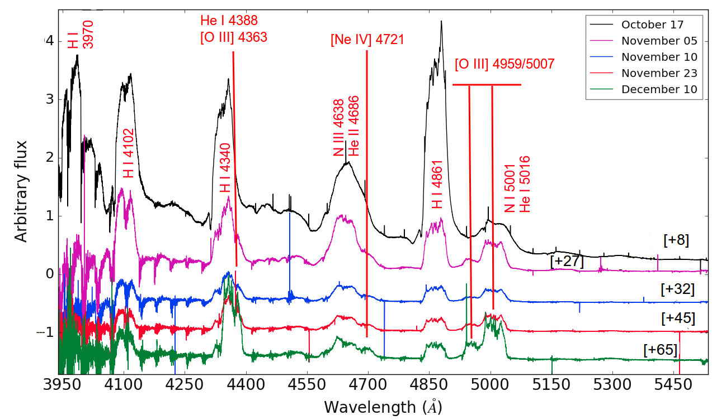
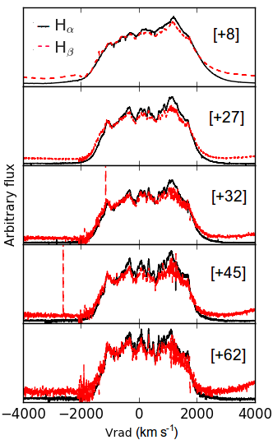
Nova SMC N 2016-10a
Observed evolution from initial outburst through nebular phase to supersoft phase
SALT HRS spectra
20
28
(Aydi, Page, Kuin et al., 2018, MNRAS, 474, 2679)

Slide 17
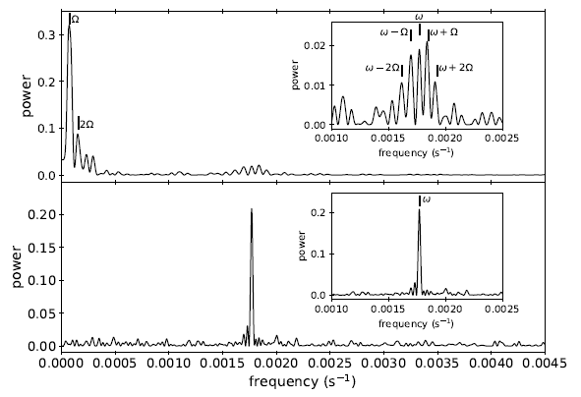
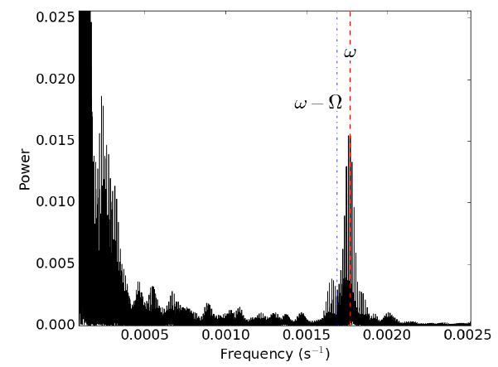
Nova V407 Lup (ASASSN-16kt)
Another fast nova Evidence that the remnant is an intermediate polar (asynchronously rotating magnetic WD)
  3.57 h orbital period and 565 s spin period
  Spin modulation of hot-spot?
(Aydi, Orio, Beardmore et al. 2018, MNRAS, 480, 572)
XMM
Optical

Slide 18
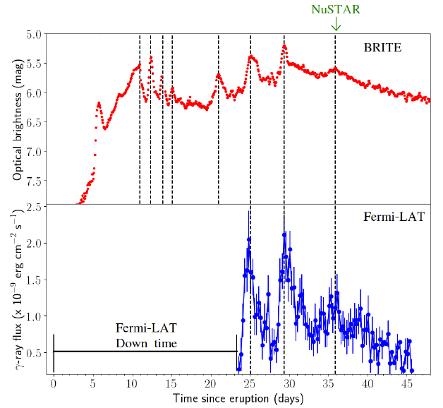
Gamma ray emission from Novae
V906 Car (ASASSN-18fv):
Unprecedented continuous optical monitoring with BRITE satellites (6 nanosats)
Complex outbursts different from the normal nova paradigm
Repeated γ-ray flares from shocks in ejecta
(Aydi, Sokolovsky, Chomiuck et al., 2020, Nat Ast, 4, 766)

Slide 19
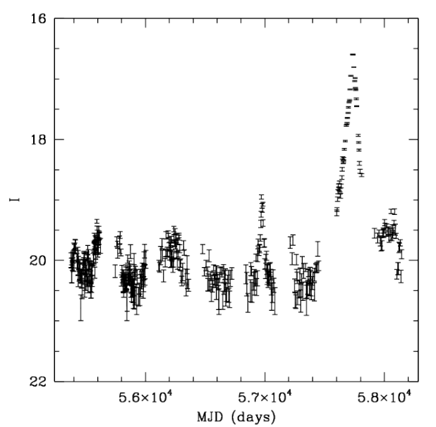
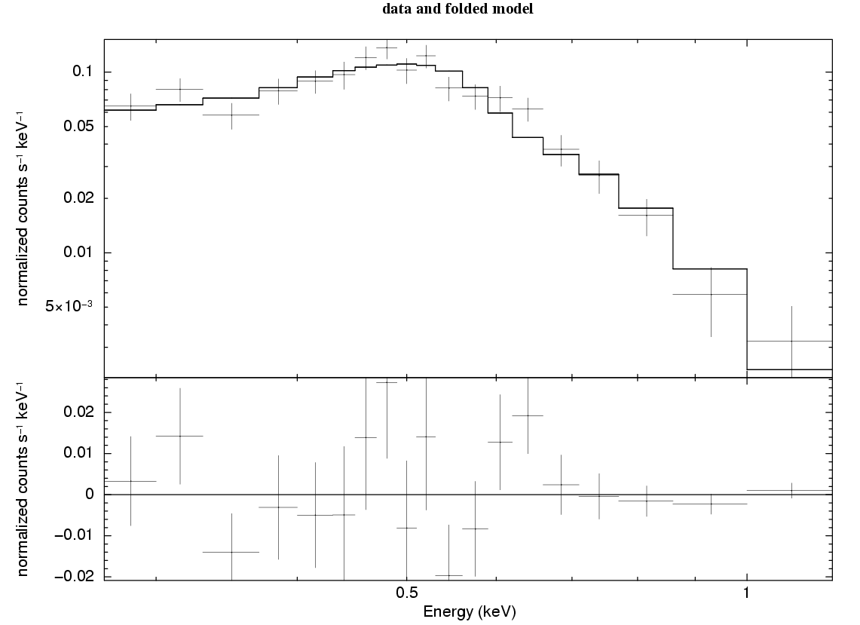
Super Soft Source discovered in the SMC: ASASSN-16oh
Discovery of a new Super Soft Source in the SMC in Dec 2016
Followup SALT RSS spectroscopy
  Strong HeII 4686
  Small R.V. variations
  Consistent with 5.6 d period
Followup LCO photometry (DDT)
  ~34 hours over X-mas period 2016
OGLE photometry
  Symmetrical and long-lived (~200 d) outburst
  Evidence of previous lower amplitude ones
Swift/ASTROSAT observations
  Very soft X-ray spectrum
  Outburst from hot (~900,000 K) spreading layer on a on white dwarf
  Not a thermonuclear powered event, as in most SSSs
(Maccarone, Nelson, Brown et al., 2019,
Nat Ast, 3, 173)

Slide 20
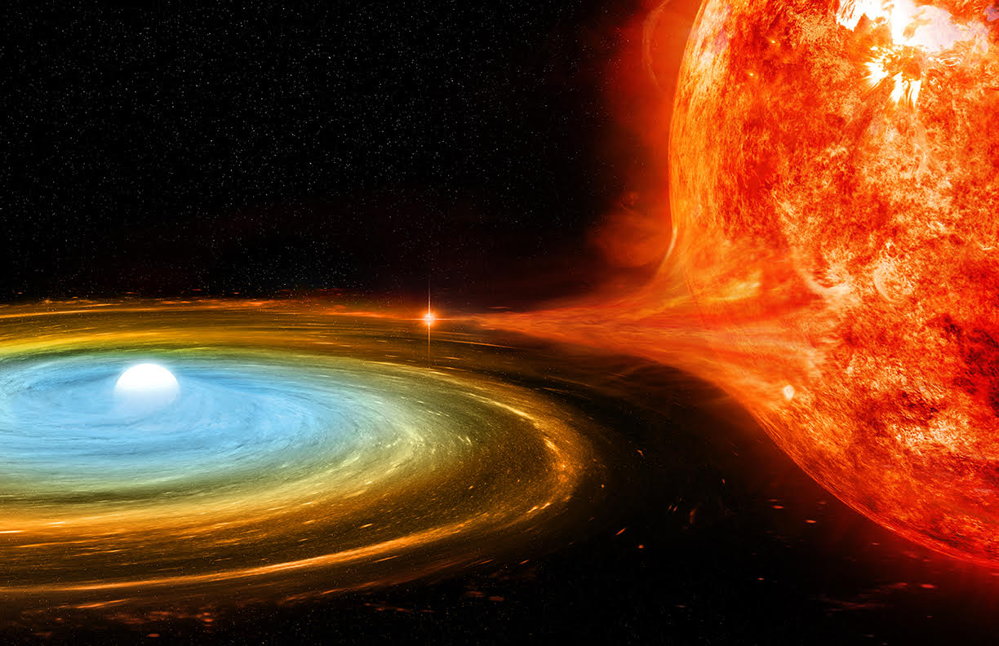
ASASSN-16oh
Credit: NASA/CXC/M.Weiss

Slide 21
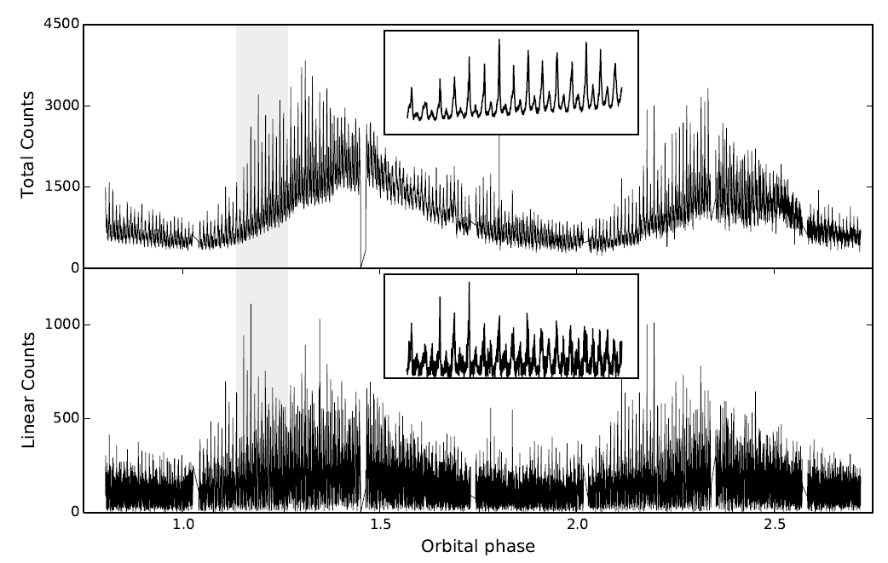
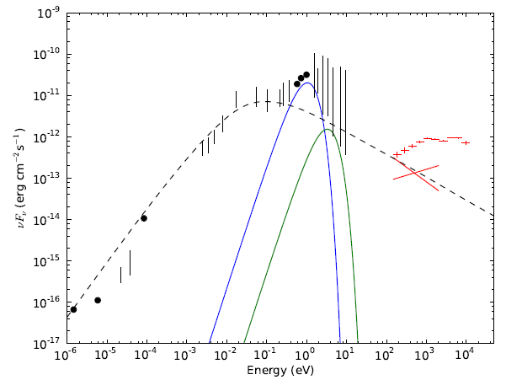
White Dwarf Pulsars
AR Sco first example (Marsh et al. 2016; Buckley et al. 2017)
Coherent pulsations across the E-M spectrum at 117.12 s spin and 118.2 s beat period with a 3.6 h orbital period
Strongly polarized (40%) and pulsed: magnetic WD dipole
System is a detached binary consisting of a rapidly spinning-down highly magnetic (>200 MG) White Dwarf + M5 companion
SED is non-thermal and powered by spin-down of WD
New example recently discovered with similar behavior (525 s spin; 4 h orbit)

Slide 22
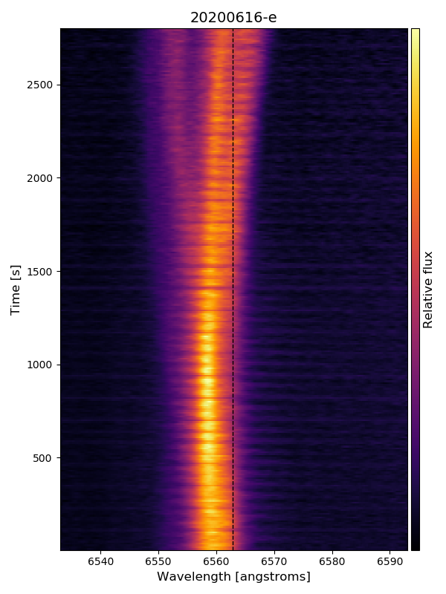
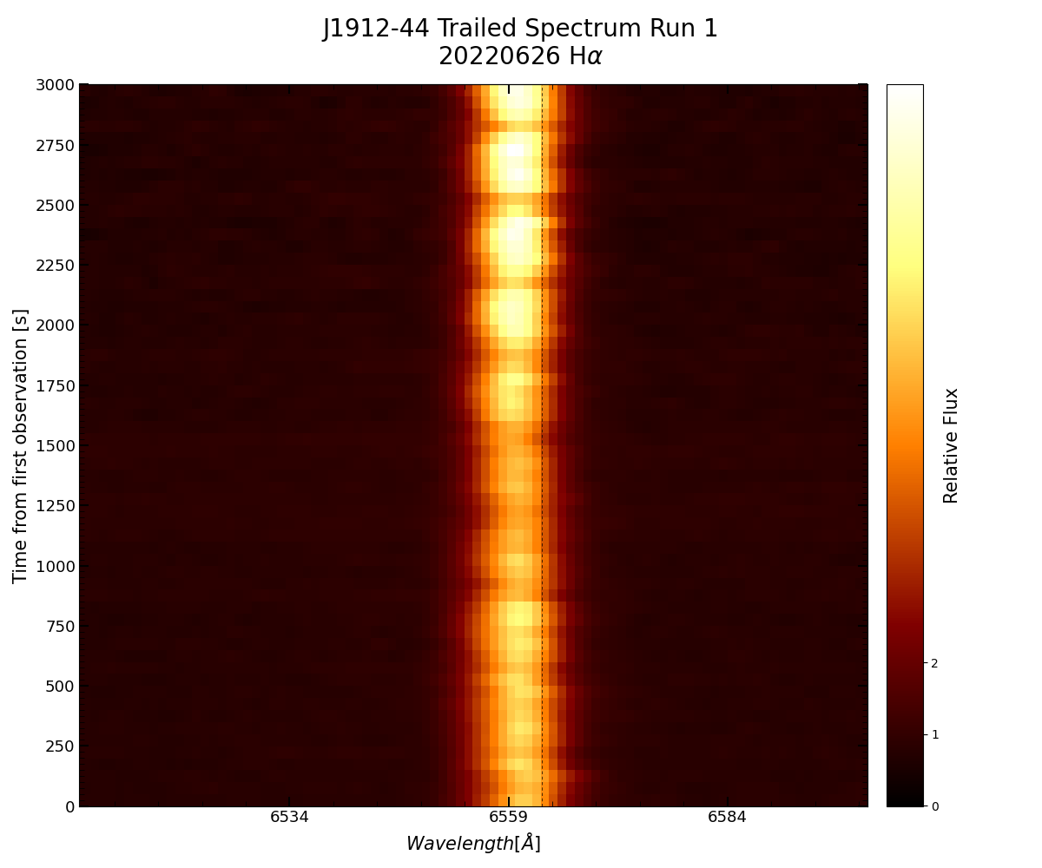
Emission Line Pulsations
SALT high speed spectroscopy (10 s and 30 s time res. respectively)
Both systems show spin pulsations in narrow emission lines from companion
New “AR Sco”
system
AR Sco

Slide 23
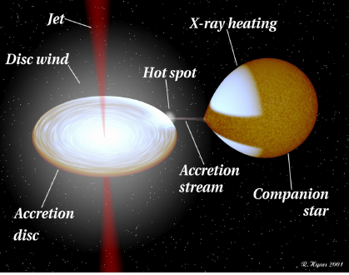
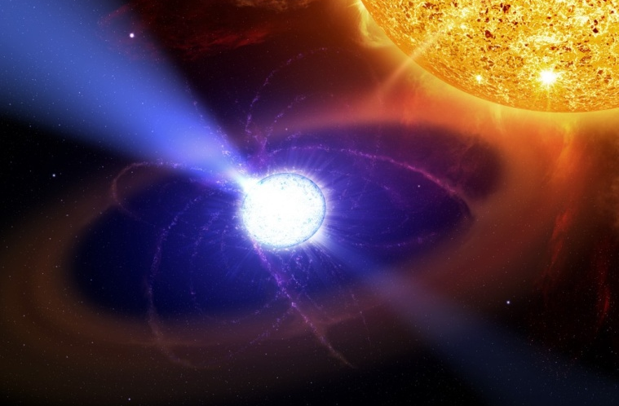
X-ray Binary Transients
High Mass X-ray Binaries
Low Mass X-ray Binaries
Transitional millisec pulsars
(also first observations with
MeerKAT)
Involves accretion onto either a neutron star or a black hole.
Mass donor is usually “normal” M-S star (rare ones a sub-solar)
Orbital periods of hours – days (LMXBs) or weeks – years (HMXBs)
Most go through outburst states
Jets seen in some systems at certain transition times (Hard -> Soft)

Slide 24
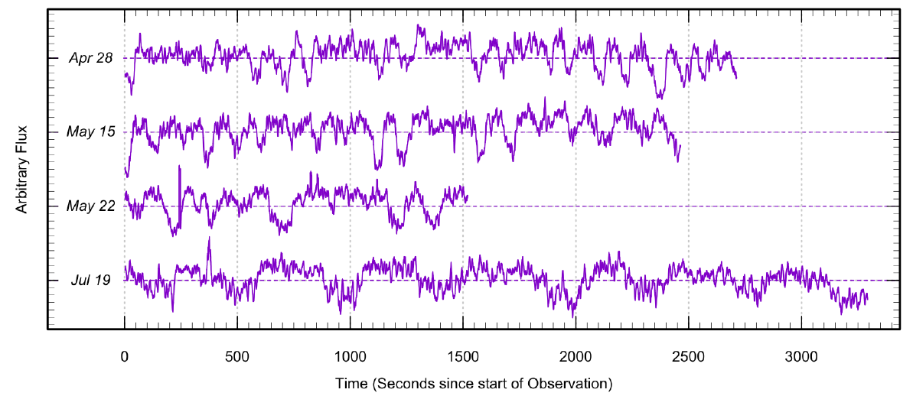
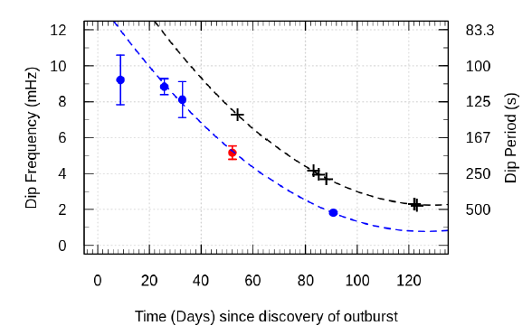
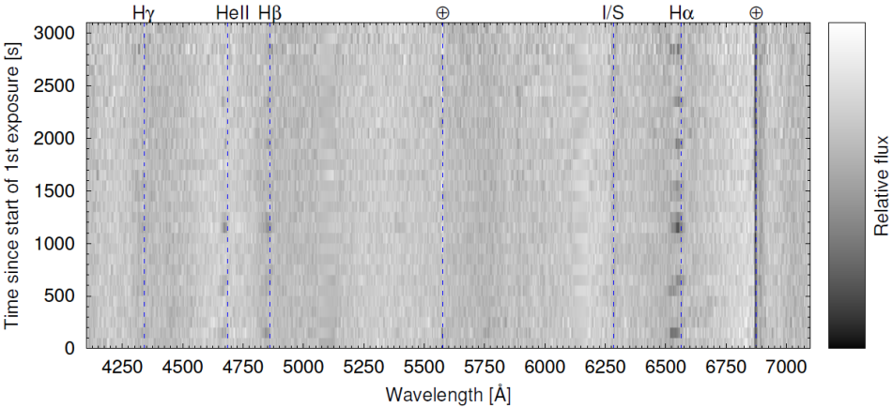
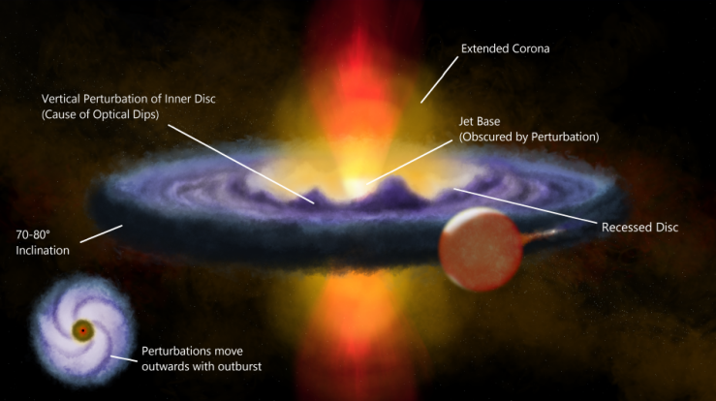
Example of an LMXB: Swift J1357-0933
A black hole X-ray transient (discovered in 2011; M > 9.3 M_{ʘ})
SALT observations during recent o/b in 2017 & 2019 (0.15 s sampling)
Time resolved (30 s) spectroscopy during 2017 & 20 revealed transient absorption lines (Balmer & HeII) on same timescale as photometric dips, attributed to clumps in disk/torus
Evidence of hot dense accretion disk wind (Charles, Matthews, Buckley et al., 2019, MNRAS 489, L47)
SALT high-speed (0.15 s) photometry
(Paice, Gandhi, Charles et al., 2019, MNRAS, 488, 512)

Slide 25
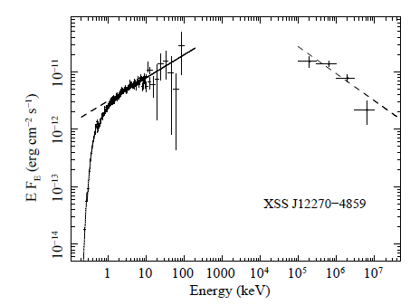


The transitional millisec pulsar XSS J12270-4859
Detected by RXTE & INTEGRAL and coincident with unusual FERMI VHE (0.1-300 GeV) source 2FGL J1227.7-4853
first seen by RXTE and suggested to an IP, but not confirmed from Suzaku or XMM and no Fe line (as in accreting WDs)
seen in 1FGL & 2FGL catalogues (24 σ)
X-ray flares & dips (e.g. EXO0748-676), but not phase dependent and no spectral changes
weakly abs power law with no cut-off up to 100 keV. Power law slope 1.7 (X-rays) to 2.3 (VHE)
first considered as microquasar, but these are more X-ray variable and don’t exhibit VHE
detection of 1.69 ms radio pulsations in quiescence (2012) confirms it is an accreting millisec pulsar and a redback LMXB
U-band: SAAO 1.9-m EMCCD

Slide 26



XSS J12270-4859
2012 observing campaign (SAAO/SALT, ESO)
  Spectroscopy & photometry
Radial velocity curve => 5.9 h orbital period
Doppler tomography revealed accretion disc
Spectral type changers from G - > F due to irradiation
Companion is under massive for its size (0.06 – 0.12 M _{ʘ})
(de Martino, Casares, Mason et a., 2014, MNRAS 444, 3004)

Slide 27

Observations of a new tMSP candidate
CXOU J1109-6502
XMM-Newton (X-rays)
MeerKAT (radio)
XMM-Newton (UV)
(Coti Zelati, Hugo, Torres et al., 2021, A&A, 655, A71)
Supporting time resolved spectroscopy undertaken with SALT

Slide 28



High Mass X-ray Binaries: Be XRBs
Be/Neutron star binaries with elliptical orbits
Outburst due to periastron passage through Be’s disk or changes in Be disk
Be/X-ray binary outburst (e.g. 2016 super-Eddington outburst of SMC-X3)
Discoveries of new systems in Magellanic Clouds from X-rays (Swift, eROSITA)
One new Be-WD SSS
SALT spectroscopy for monitoring disk emission lines
SMC X-3
Townsend, Kennea, Coe et al. 2017, MNRAS, 471, 3878)

Slide 29

SALT Spectropolarimetry of Flaring Blazars
Program led by UFS, UJ and NWU (van Soelen, Britto, Razzaque & Boettcher) + students (Joleen Barnard, Justin Cooper, Hester Schutte)
Alerts from X-ray satellites (e.g. Fermi LAT, Swift BAT)
Utilizing SALT spectropolarimetric modes
Observations taken at different epochs and covering flares and quiescent phases
Investigate the jet geometries through position angle variations during flares
(Example: PKS 0035-252)

Slide 30


SALT Observations of the FSRQ NVSS J141922-083830
Optical transient discovered in 2015 from MASTER network (3 mag optical flares)
Polarization detected at ~14% level
SALT spectra determined z = 0.903
Fermi data shows 4 flaring episodes over ~5 y
SED supports FSRQ classification and one-zone leptonic model
(Buckley, Britto, Chandra et al., 2022, MNRAS in press)

Slide 31


GRBs: Long GRB191221B
A long, bright GRB which reached V = 10
MASTER coverage from ~80 s
SALT & VLT spectropolarimetry
1 – 1.5% polarized
Consistent with forward shock
Refreshed shock explains plateau
(Buckley, Bagnulo, Britto et al., 2021, MNRAS 506, 4621)

Slide 32



GW170817: South African follow-up
SALT observation on 18 & 19 Aug (1.2 & 2.2 d after GW event
observations done with 3 other telescopes at SAAO:
  Optical photometry (MASTER-SAAO and SAAO 1-m & KMTNet)
  Infrared photometry (Japanese IRSF telescope, followed decline over ~2 weeks)
  SALT & SAAO results have appeared in 9 refereed papers (including Nature and Science)
Abbott et al. 2017

Slide 33


Spectrum Röntgen Gamma satellite

Slide 34


Followup of eROSITA-DE X-ray transients

Slide 35



eROSITA accreting Compact White Dwarf Binaries
First example studied:
SRGt J062339.9-265751: factor 50 variability between eRASS:1 and :2 Factor 10 variability in eRASS:2
Detected with both instruments on SRG (eROSITA & PARTC-XC)
Bright, thermal X-ray spectrum
Among the brightest objects of its kind (g ~12.5)
3.9 h period seen in TESS
Looks like a mCV from SALT spectrum and SAAO high speed photometry
SALT/HRS 1 Nov 2020
HeII & CIII/NIII → soft X-ray ionizing source → a Compact WD Binary
(Schwope, Buckley, Kawka et al. 2022, A&A 661, 43S)

Slide 36



eROSITA accreting Compact White Dwarf Binaries
Second example studied:
eRASSt J192932.9-560346 is a new polar (magnetic CV).
Eclipsing system with 1.54 h period
Two-pole system
SALT spectrum
(Schwope, Buckley, Malyali et al. 2022, A&A, 661, 42S)

Slide 37


eROSITA HMXB discoveries in the Magellanic Clouds
SALT observations of transient HMXBs in the MCs, mostly Be X-ray binaries, many harbouring new X-ray pulsars.
A number of new discoveries have been made in the LMC, which has a relatively low population compared to the SMC
Optical characterization and Be disk changes from SALT observations
One new SSS with He spectrum (He donor with H stripped envelope
(Greiner et al., submitted)

Slide 38


Major eROSITA Discovery:
Quasi-Periodic Eruptions In “”Normal” Galaxies
QPEs are dramatic quasi-periodic soft X-ray bursts, first seen in AGN (e.g. Miniutti+2019), that occur on few hour timescale
2 previously known showed AGN-like lines indicative of supermassive black hole
2 new eROSITA QPEs seen in non-active galaxies from SALT spectra(Accordia+2021; Nature)
Followup shows regular X-ray eruptions (every ~18.5 & 2.4 h)
Periods, amplitudes and profiles inconsistent with current models that invoke radiation-pressure driven accretion disk instabilities
Proposed explanation involves orbiting compact objects
Maybe viable candidates for the EM counterparts of extreme mass ratio inspirals
QPE2 – XMM light curve (6 Aug 2020)
QPE2 SALT spectrum
(Arcodia, Merloni, Nandra et al., 2021, Nature 592, 704)

Slide 39
fol
The End

