Slide 1

The GBM Accreting Pulsar Program (GAPP) – 20 Years
Peter Jenke*
*jenkep@uah.edu

Slide 2

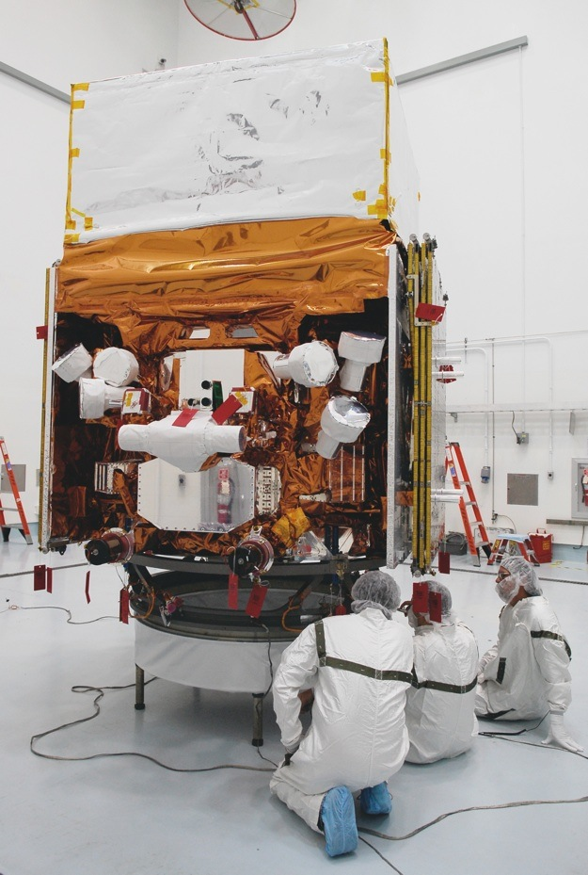
Obligatory Slide of the Spacecraft
Large Area Telescope
20 MeV - 300 GeV
Triggering, localization and spectroscopy
Gamma Ray Burst Monitor
12 Sodium Iodide detectors
8.0 - 1000 keV
Triggering, localization and spectroscopy
2 Bismuth Germanate detectors
200 keV - 40 MeV
spectroscopy
Bridges gap between NaI and LAT
Small size vs. long observations

Slide 3
Why GBM excels at observing accreting pulsars
GBM is not an imagining instrument but has the advantage that it observes the entire unocculted sky all the time.
Large Instantaneous Field of View
>40,000 s/day for a typical source
Fourier Modeling to extract the pulsed portion of the signal from the data.
So… What can we see?

Slide 4
GAPP Strengths and Weaknesses
GBM Pulsed Frequency
GBM Pulsed Flux
BATSE Pulsed Flux and Frequencies where available
Pulse Profiles
Orbit phase* and pulse phase*
Observe pulsed sources with pulse periods between 0.01 – 1000s.
  0.01 – 0.5s uses CTTE data but..
  0.5 – 1000s uses CTIME data. With the low end is bound at the Nyquist frequency and the upper end is a loose bound on data segment length and background subtraction.
  Pulsed sensitivity is around 20 mCrab (100% pulse fraction) between 8 and 50 keV. We can do better for some sources and worse for others. Depends on background, if the orbit is known, and accuracy of the phase model.
In principle we can perform pulse searches throughout the NaI’s energy range (8-1000 keV). In practice we limit our searches between 8-50 keV and for some sources 25-50 keV.
Public GAPP pulse frequencies, pulse flux and pulse profiles are provided in 8-12, 12-25, and 25-50 keV bands. Upon request, we can provide them in any band available with CTTE data.

Slide 5
Exceptions
NaI 12 – 25 keV
BGO 130 - 1020 keV
Normalized Flux
Normalized Flux
0.0 0.5 1.0 1.5 2.0
0.0 0.5 1.0 1.5 2.0
Pulse Phase (Cycles)
Pulse Phase (Cycles)
In principle we can time fast pulsars but GBM is sensitive to only a few, most notably the Crab.

Slide 6
Persistent Sources Detected By GBM
Source Frequency Classification Orbital period
GX 1+4 4.65 mHz LMXB No orbit used > 304 days
Her X-1 807.9 mHz LMXB Orbit 1.7 days
Vela X-1 3.53 mHz Wind-Fed HMXB Orbit 8.9 days
Cen X-3 208.5 mHz Disk-Fed HMXB Orbit 2.08 days
GX 301-2 1.49 mHz Wind-Fed HMXB Orbit 41.47 days
4U 1626-67 130.4 mHz LMXB No orbit used << 1 day
4U 1538-52 1.90 mHz Wind-Fed HMXB Orbit 3.73 days
OAO 1657-415 26.0 mHz Wind-Fed HMXB Orbit 10.447 days

Slide 7
Examples - Persistent
Roche-Lobe Overflow
Wind Fed
4U 1626-67 Long Term

Slide 8
Transients Detected By GBM – Most are Be XRBs

Slide 9
Transients Detected By GBM – Most are Be XRBs

Slide 10
Examples - Transients

Slide 11
Source we hope to detect (monitored but not detected)
We are encouraged by sources that were detected in BATSE and sources with high pulse flux and periods between 0.5 and 1000 seconds. GBM tends to be more sensitive to sources with periods between 2 and 800 seconds. We search multiple harmonics.
GS 1843+00 29.5s Detected with BATSE
4U 1145-619 292.4s Detected with BATSE
XTE J0111.2-7317 30.72s Detected with BATSE
XTE J1543-568 27.07 Detected with BATSE
Swift J1626.6-5156 15.4s ????

Slide 12
The Nitty Gritty
Estimate the frequency and phase model
Fit pulse profiles using a harmonic expansion in pulse phase
Harmonic coefficients
Harmonic number
time
Model photon rate
By minimizing:
Background
Photon rates
Errors

Slide 13

Find the phase model that gives the most significant average pulse profile over the search interval.
Grid of phase Offsets
For each offset in pulse phase, we shift the individual pulse profiles:

Slide 14
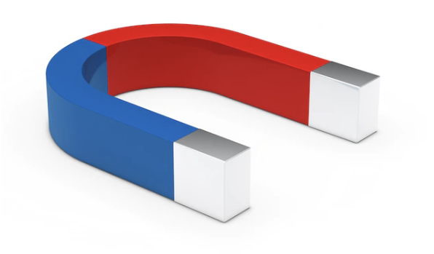
What are we doing with the data?
Wile E. Coyote
Fundamental Parameters
Magnetic field
Distance
Mass fraction
Orbital elements
Orbital Decay
Ghosh and Lamb
I. Caballero, J. Wilms
Accretion Column Geometry
Disk Magnetosphere interactions
What will you do with or data?

Slide 15
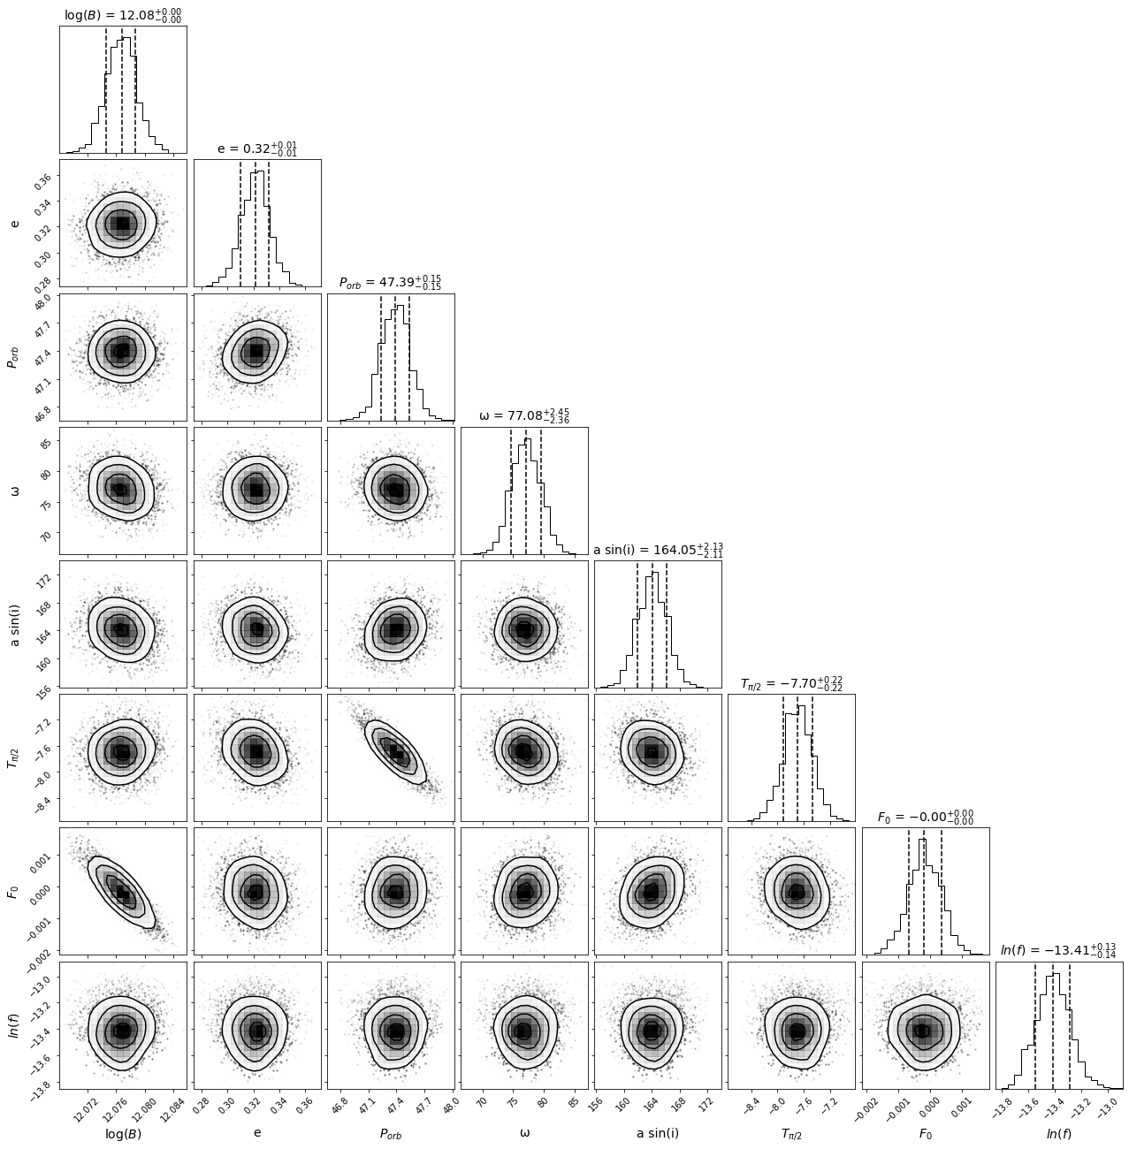
Coming Soon – Orbital modeling simplified
Use GAPP products and a proxy for luminosity (Swift/BAT data perhaps)
Choose your Torque Model
Ghosh and Lamb 1979
Wang 1995
Estimate posterior distributions for standard accretion torque model parameters and binary orbital parameters for X-ray binaries using a nested sampling algorithm for Bayesian Parameter Estimation.
A Bayesian approach for torque modelling of BeXRB pulsars with application to super-Eddington accretors (Submitted for Publication in MNRAS).
A. S. Karaferias, G. Vasilopoulos, M. Petropoulou, P. A. Jenke, C. A. Wilson-Hodge, C. Malacaria

Slide 16
How we can help further
Custom requests
  New source search
  Different integration period
  different energy range
  More harmonic content for more detailed pulse profiles
We have python scripts to create pulse frequency, flux and profiles
We can provide orbital and pulse phases for many of our detected sources
Jenkep@uah.edu
https://gammaray.nsstc.nasa.gov/gbm/science/pulsars.html

Slide 17
Thank you for your attention!
Peter Jenke*
* jenkep@uah.edu

