Slide 1





Anomaly Detection in Astronomy
Michelle Lochner
Senior Lecturer
University of the Western Cape/
South African Radio Astronomy Observatory

Slide 2
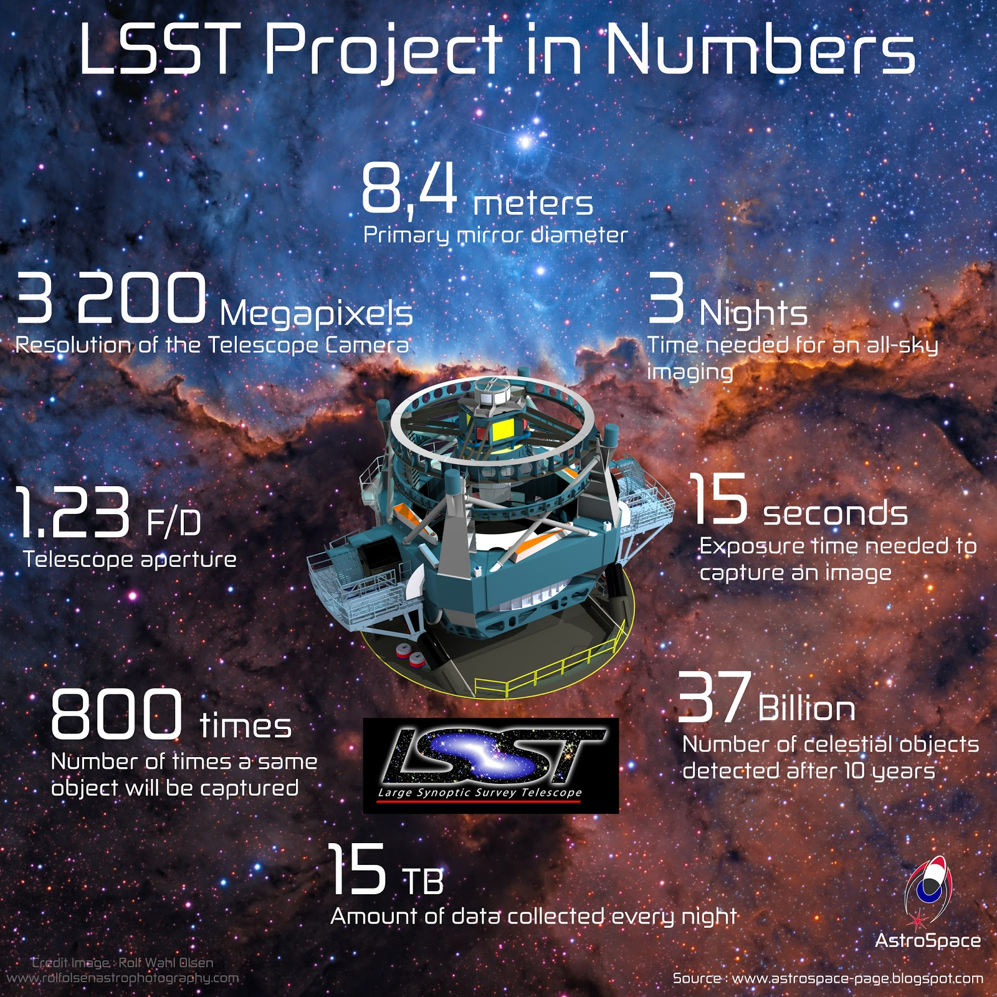
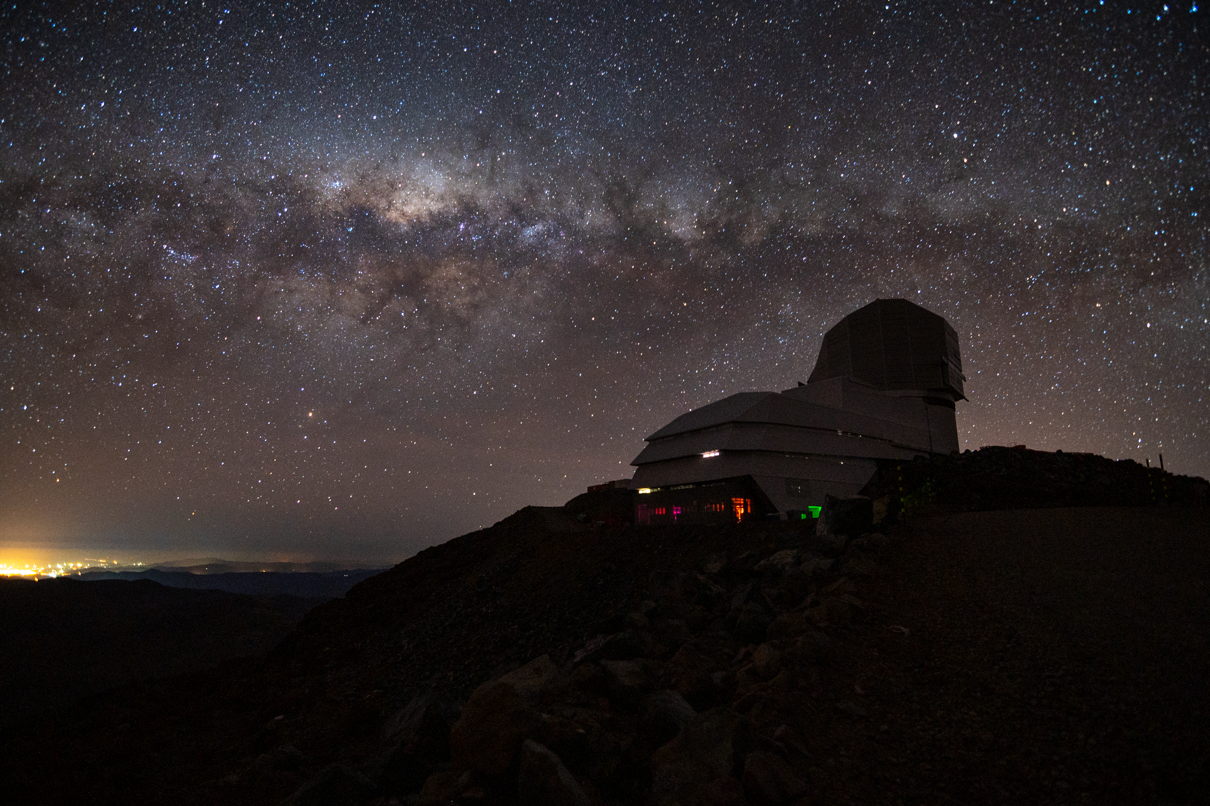
The Vera C. Rubin Observatory
Legacy Survey of Space and Time (LSST)
Rubin Obs/NSF/AURA & Bruno C. Quint

Slide 3
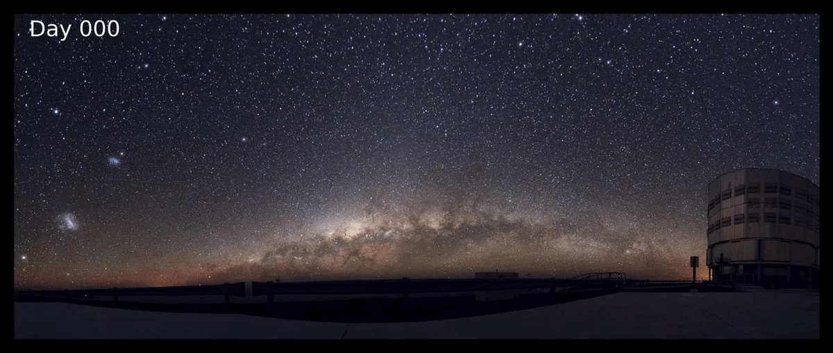
Vera C. Rubin Observatory

Slide 4

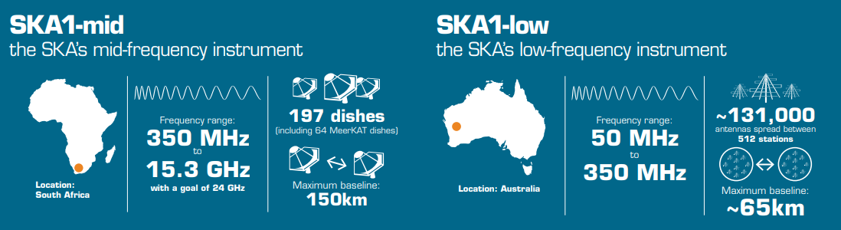
The Square Kilometre Array
Square Kilometre Array Observatory

Slide 5
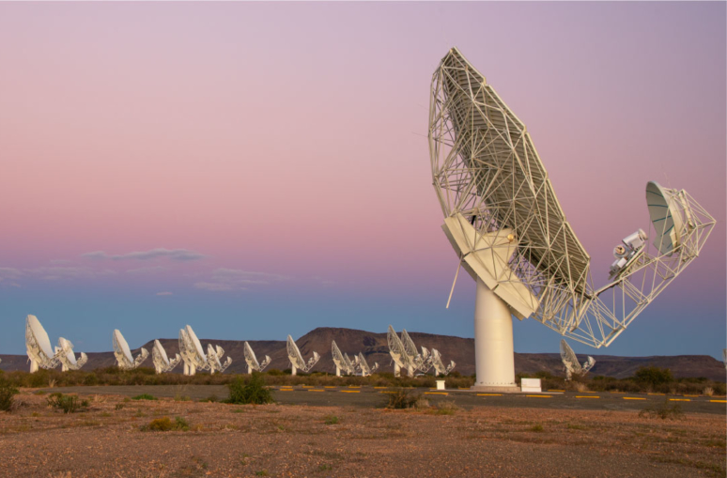
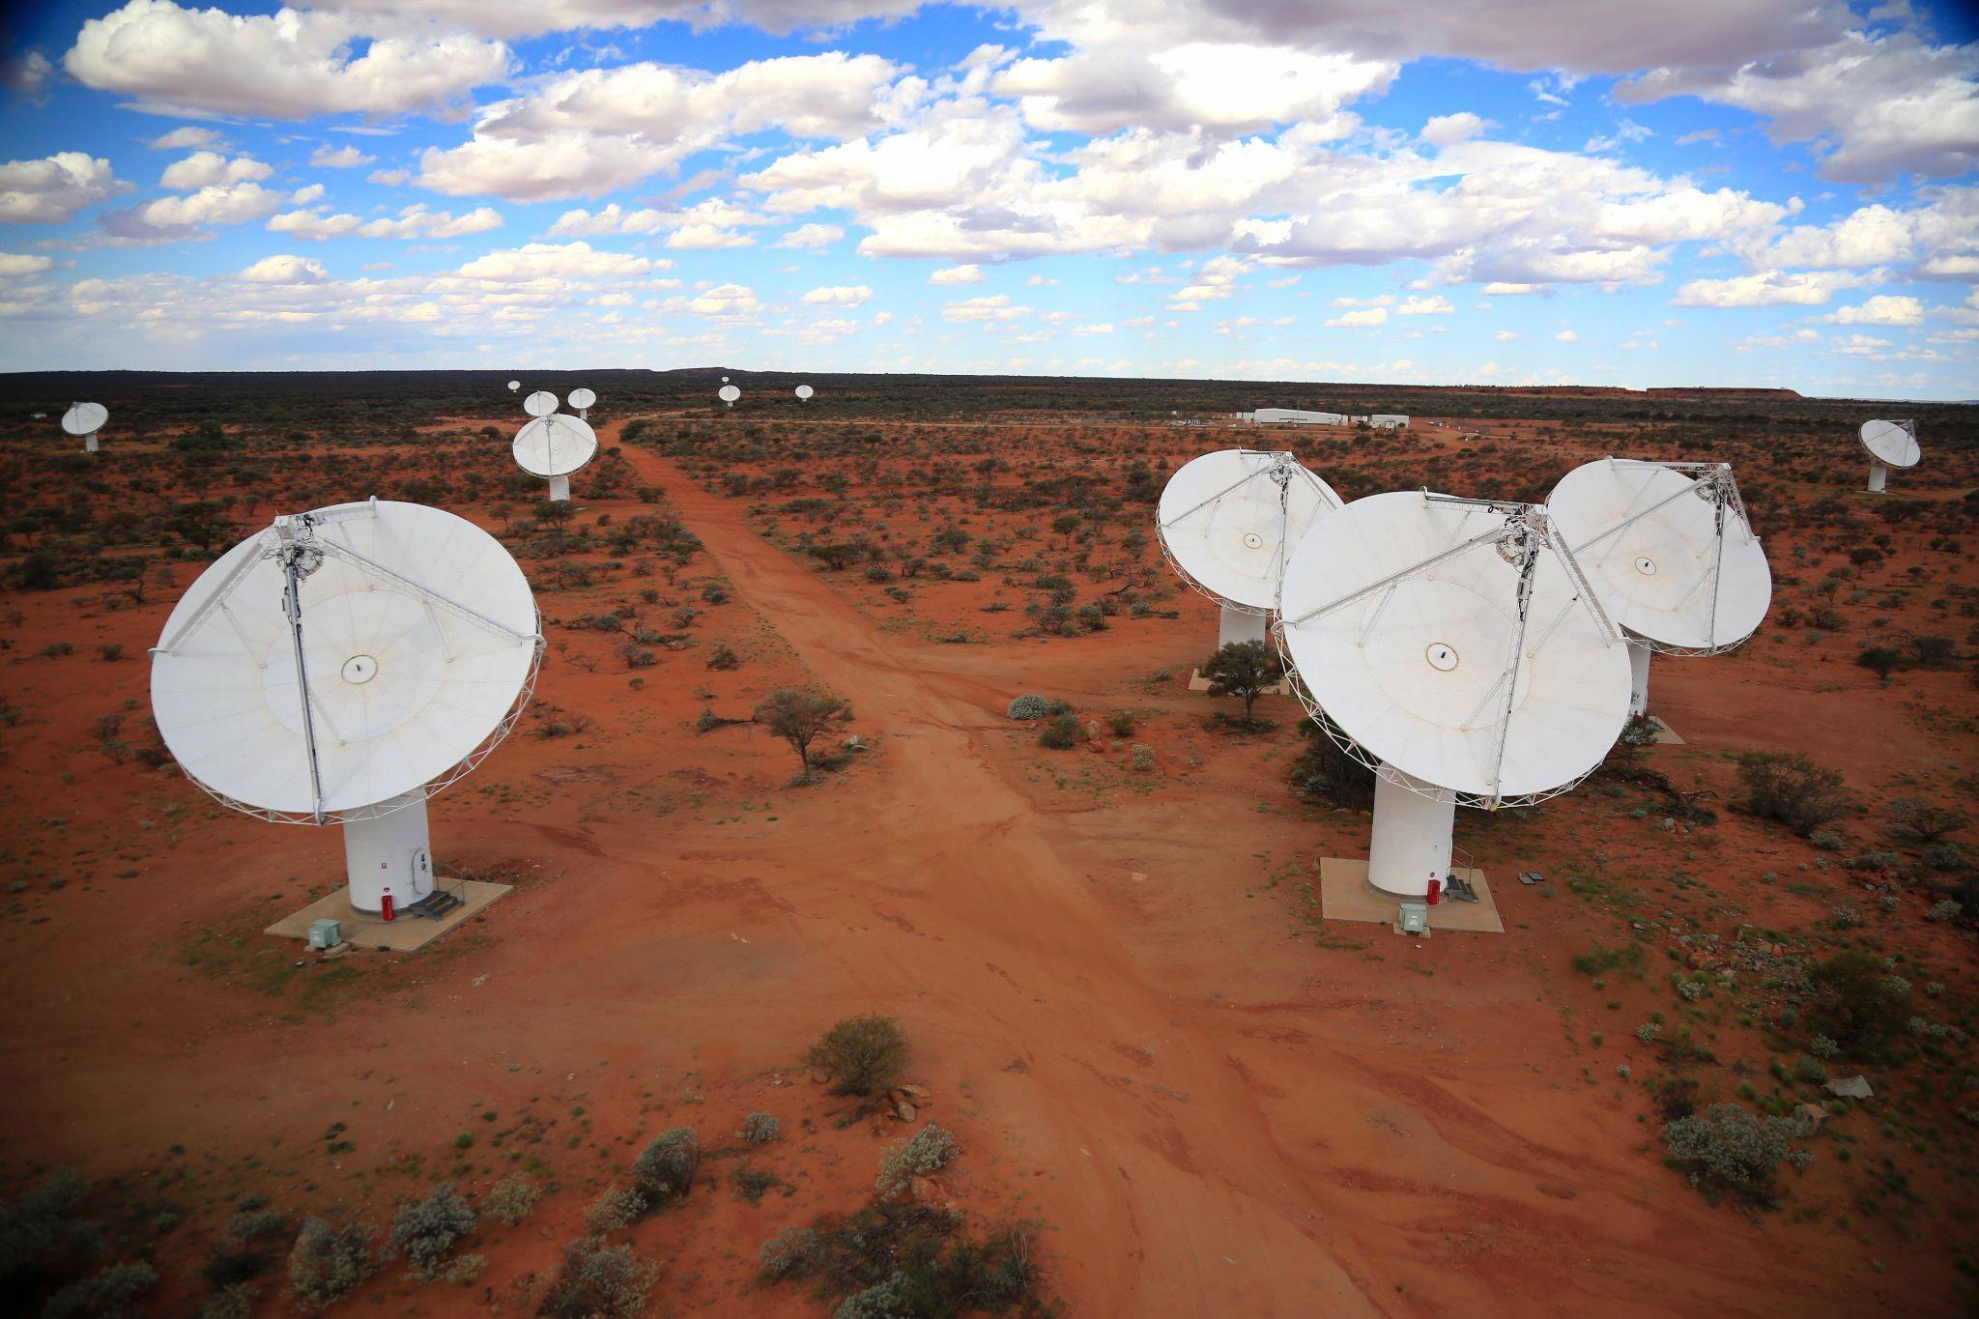
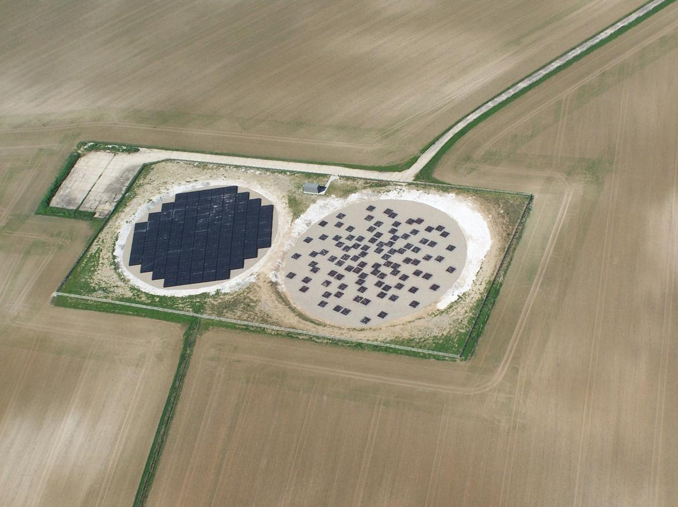
MeerKAT
ASKAP
LOFAR
SARAO
CSIRO
LOFAR

Slide 6

We’re facing a data explosion
Harvard Business Review

Slide 7
Machine Learning

Slide 8
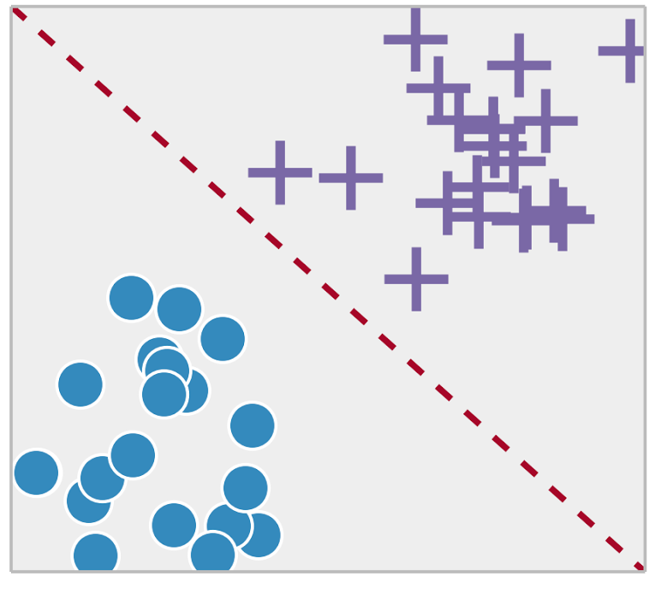
Supervised Machine Learning
Automatically learns a model to map inputs to outputs, using a training set.
https://towardsdatascience.com

Slide 9
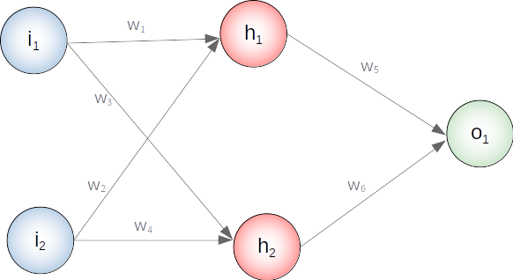
Machine Learning

Slide 10
Anomaly Detection

Slide 11

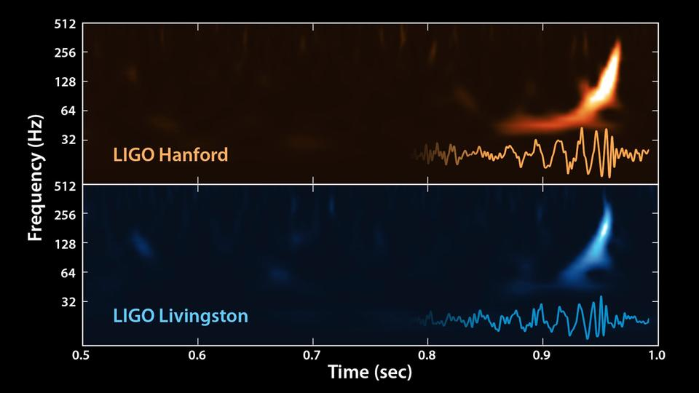
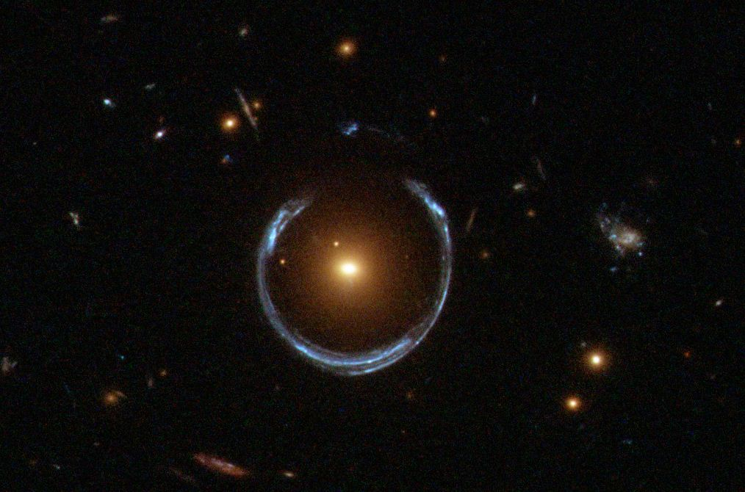
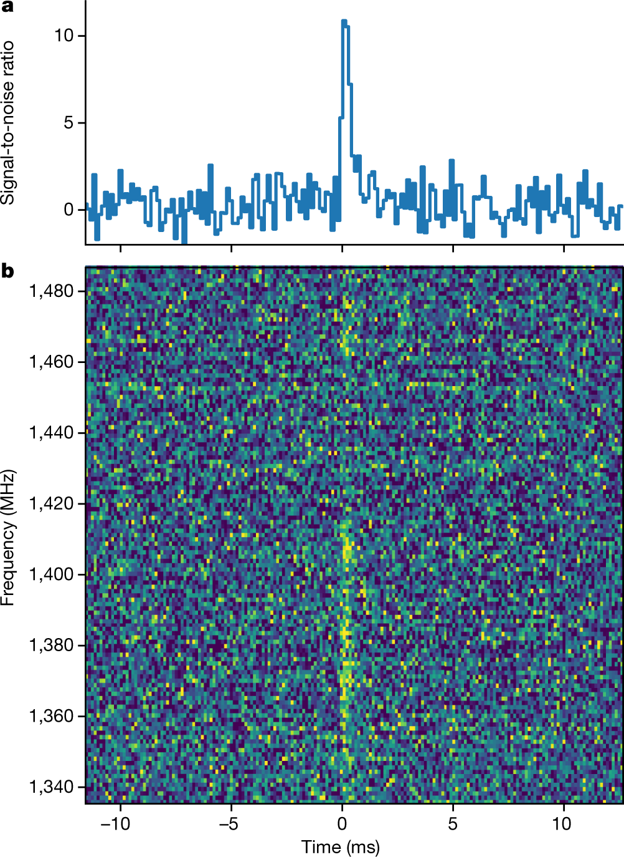
Known Unknowns - rare events
Ravi et al. (2019)
Hubble/ NASA/ ESA

Slide 12
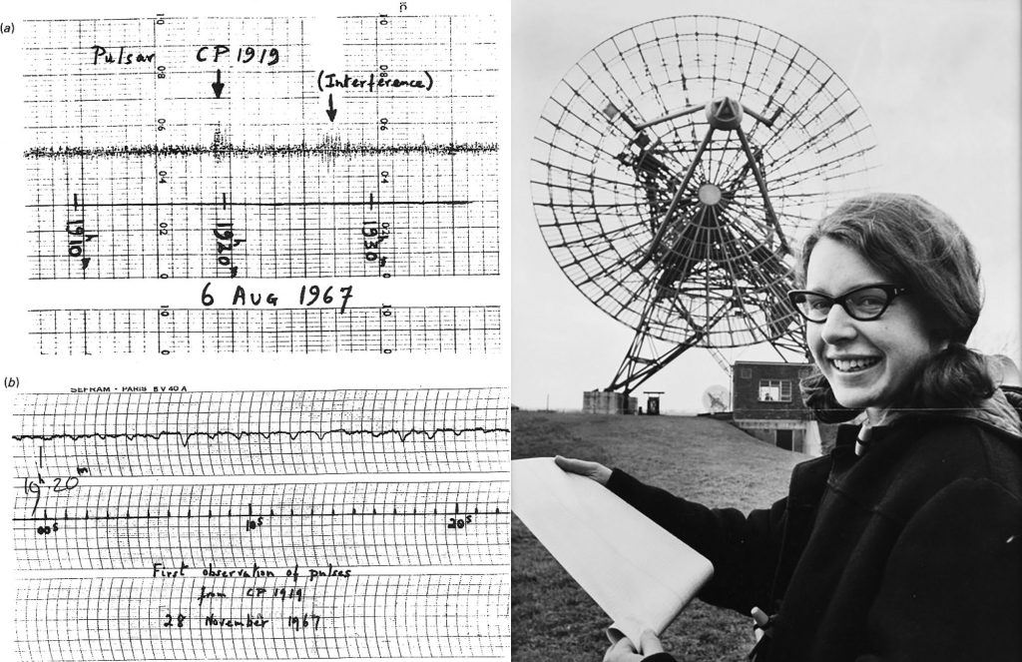
Unknown Unknowns - new anomalies
Daily Herald Archive / SSPL / Getty Images

Slide 13
How do we discover new phenomena...
...among 10 million possibilities?

Slide 14
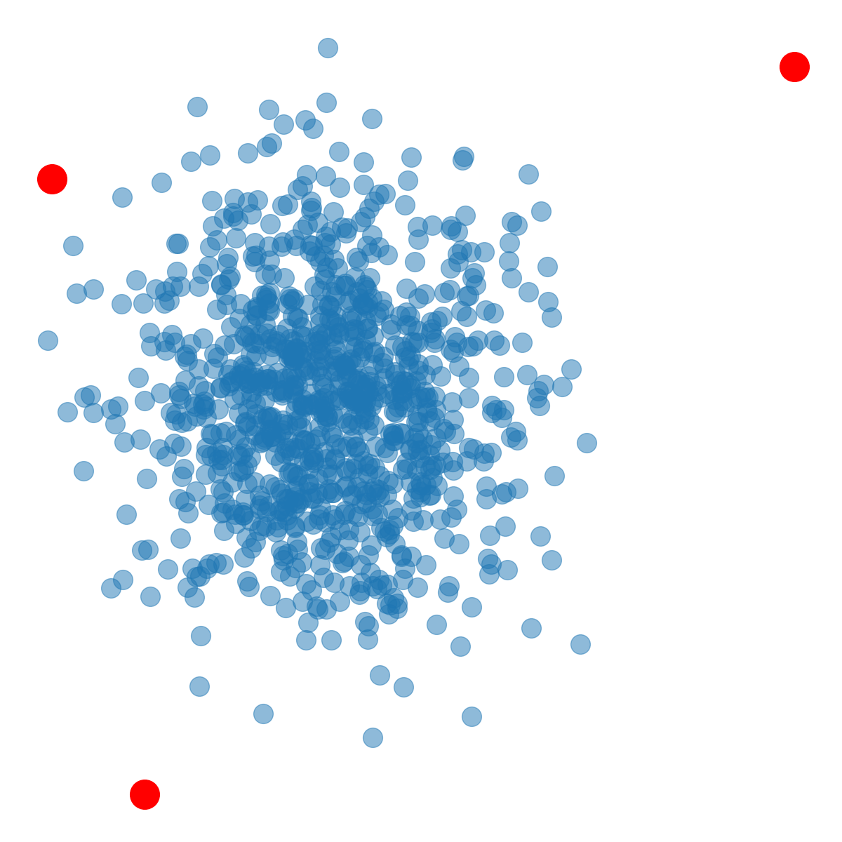
Anomaly Detection
The farther away from normal the higher the anomaly score
Try to learn what “normal” is

Slide 15
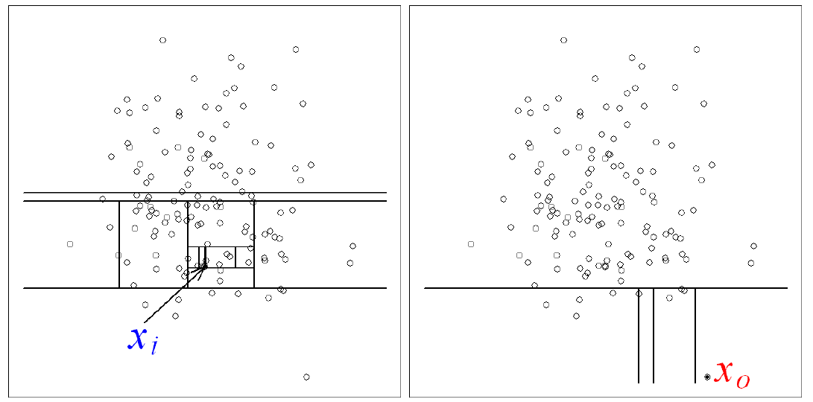
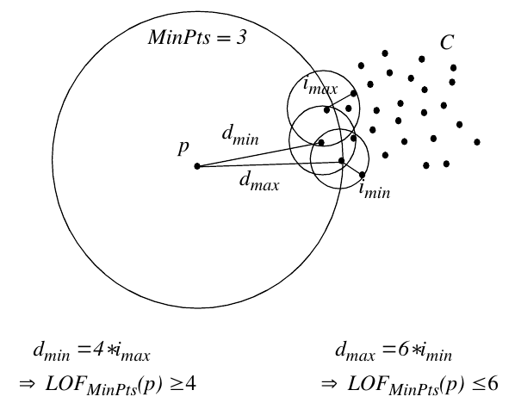
Anomaly Detection Algorithms
Local Outlier Factor (Breunig et al; 2008)
Isolation Forest (Liu, Ting & Zhou; 2008)

Slide 16
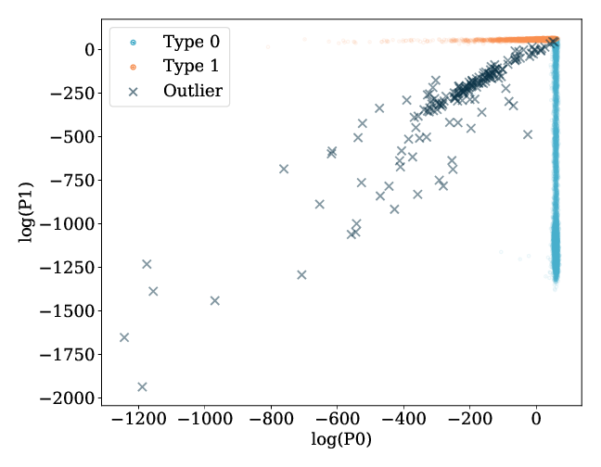
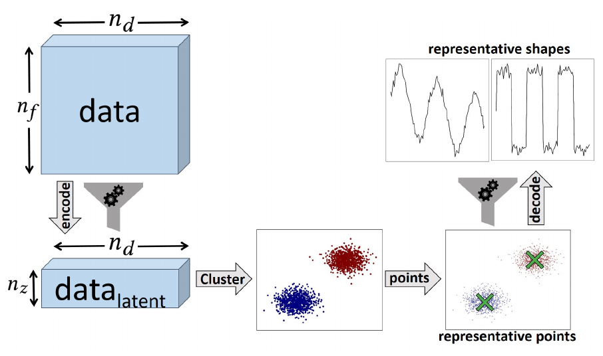
Anomaly Detection Algorithms
DRAMA (Vafaei Sadr, Bassett & Kunz - 1909.04060)
BADAC (Roberts, Bassett & Lochner - 1902.08627)

Slide 17
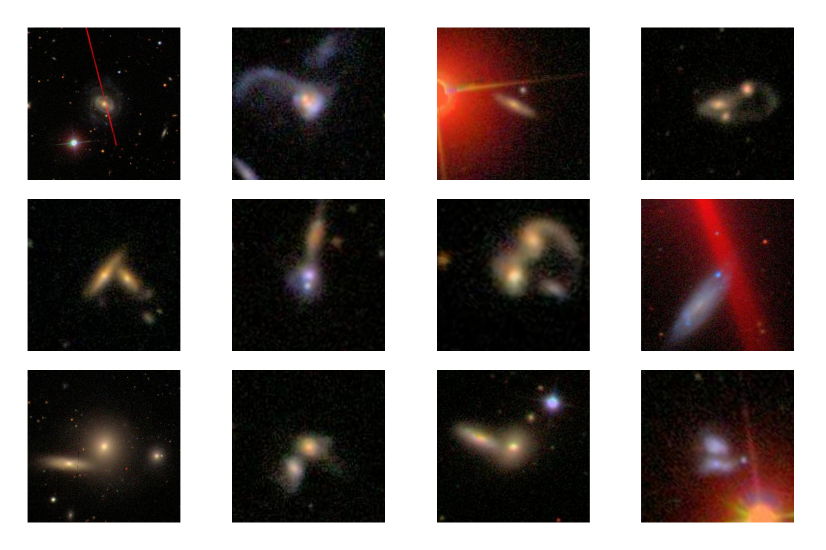
Anomaly Detection Isn’t Enough
Artefacts
Real sources

Slide 18

Active Learning
www.clickworker.com

Slide 19
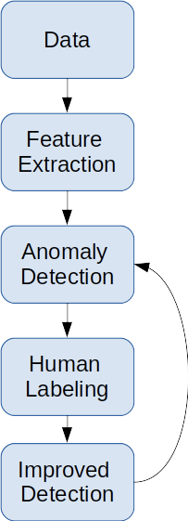
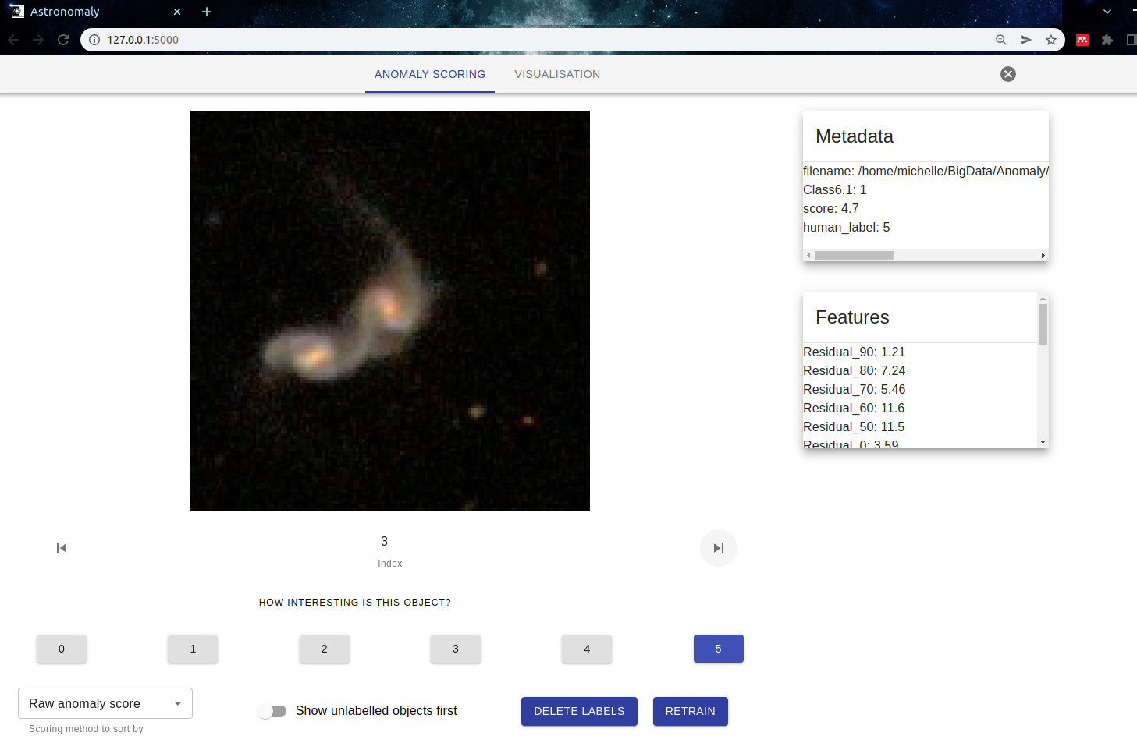
Astronomaly
Lochner and Bassett (2020) - 2010.11202
https://github.com/MichelleLochner/astronomaly

Slide 20
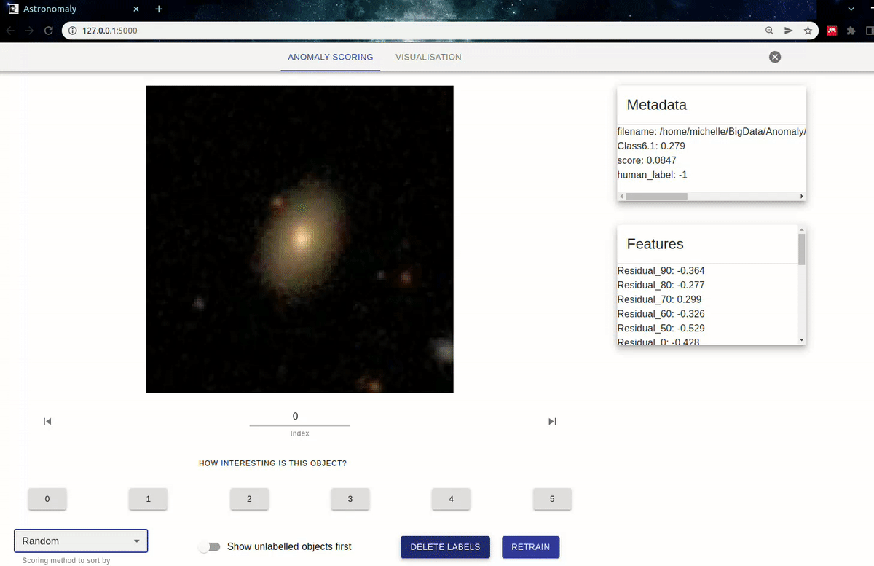
Galaxy Zoo - Random Examples

Slide 21
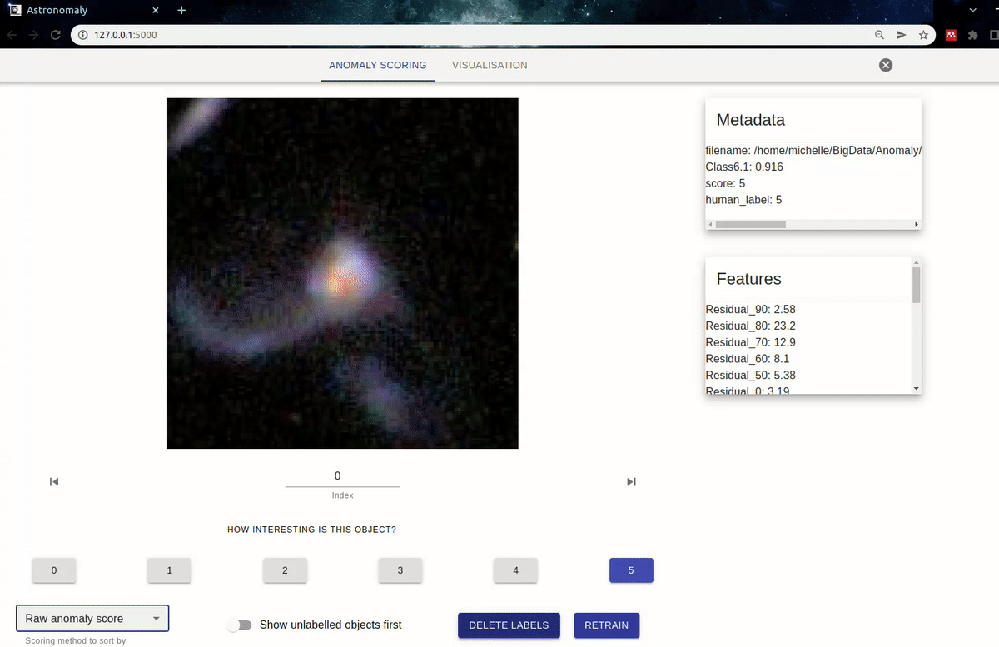
Galaxy Zoo - No Active Learning

Slide 22
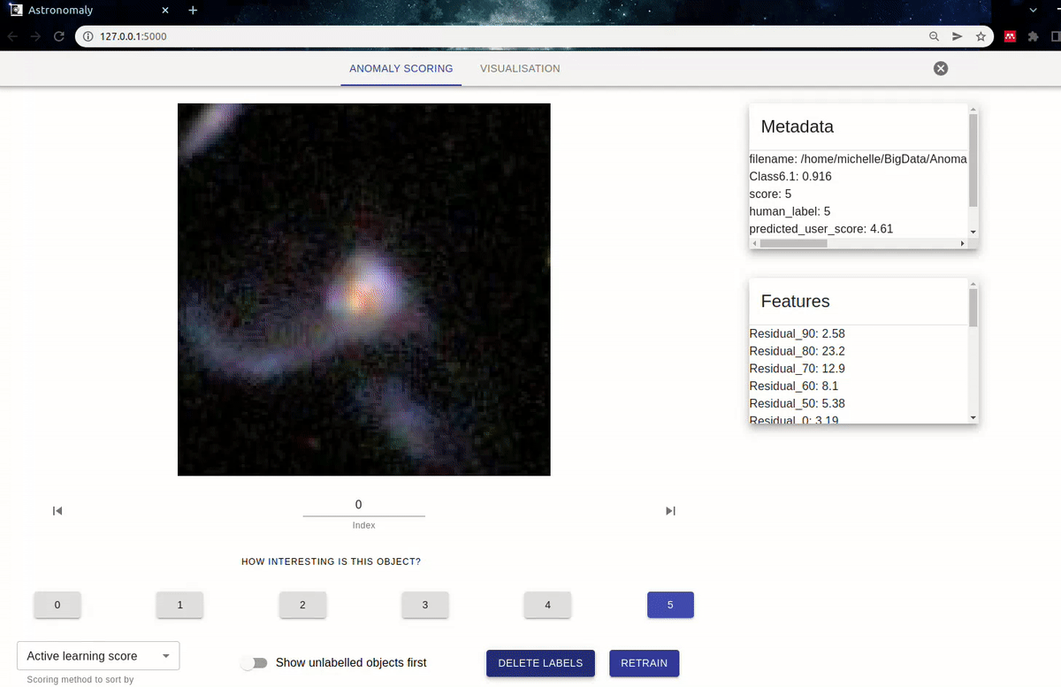
Galaxy Zoo - Active Learning

Slide 23
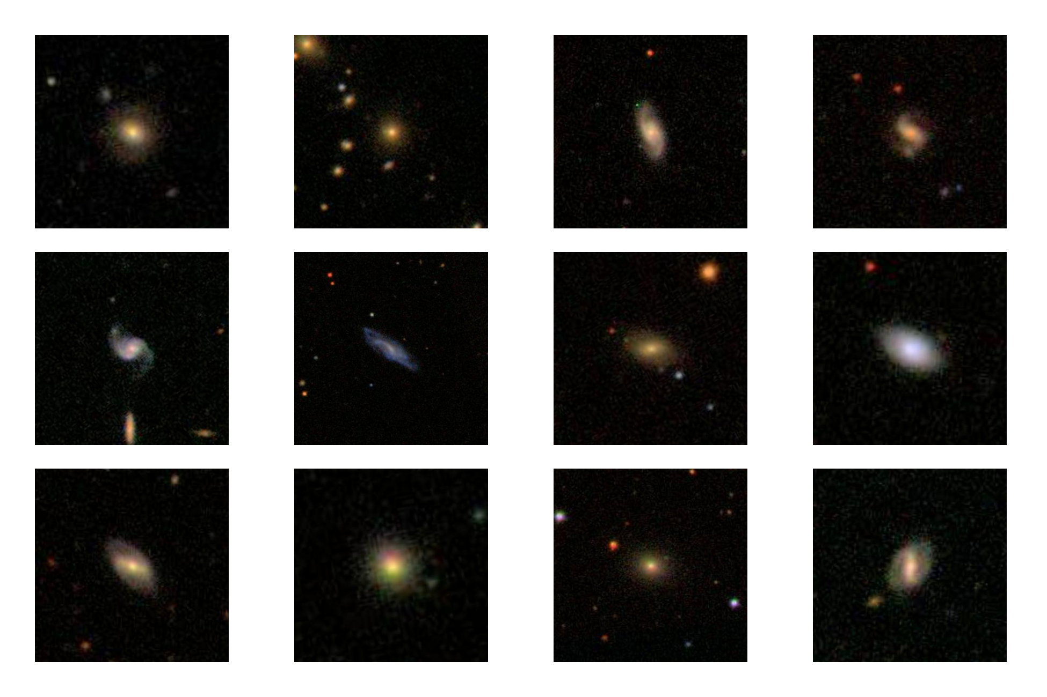
Galaxy Zoo - Random Examples

Slide 24
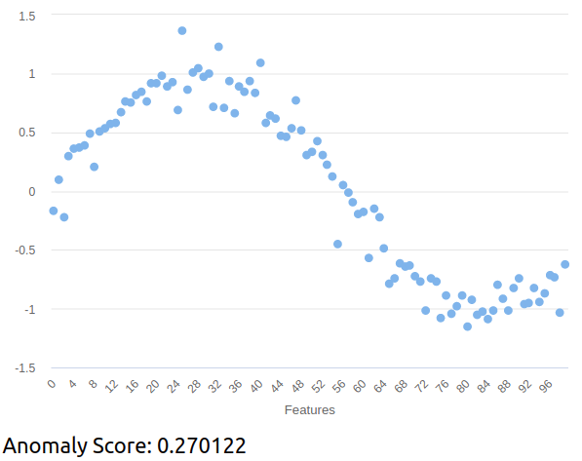
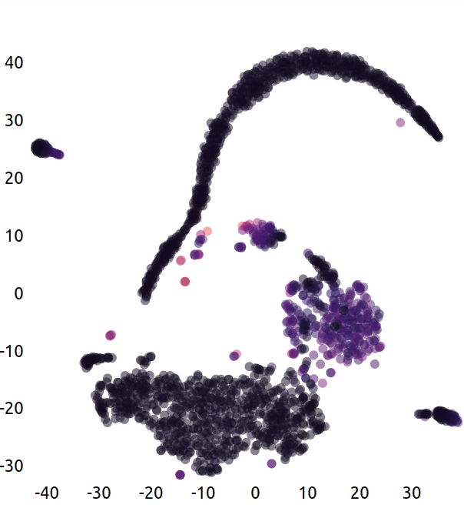
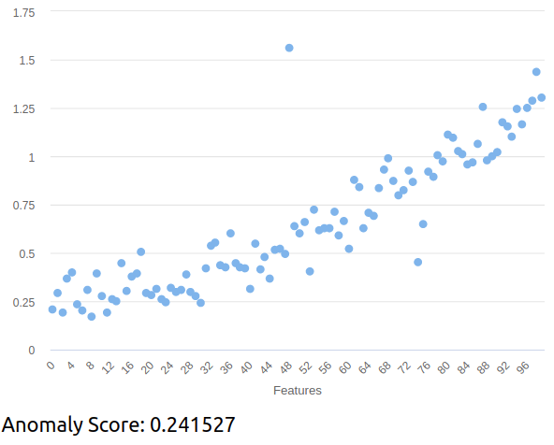
Synthetic data
Normal
Lochner and Bassett (2020)

Slide 25
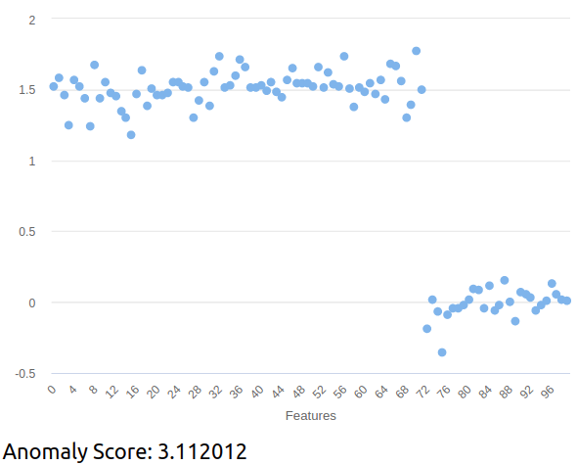
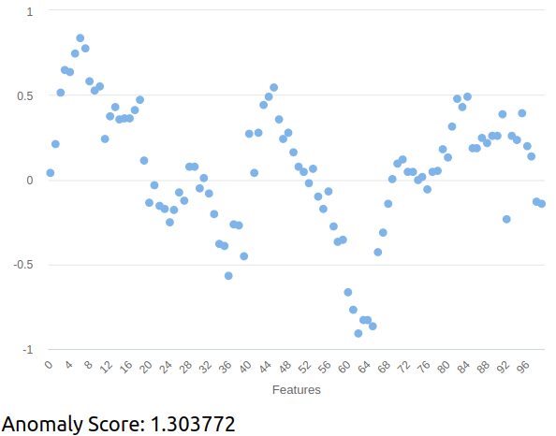
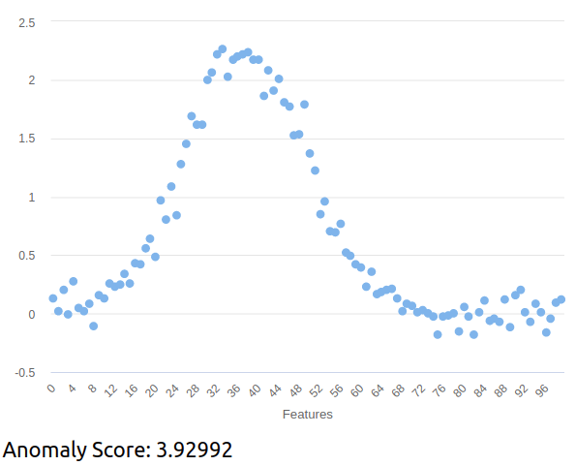
Synthetic data
Anomalous
Lochner and Bassett (2020)

Slide 26
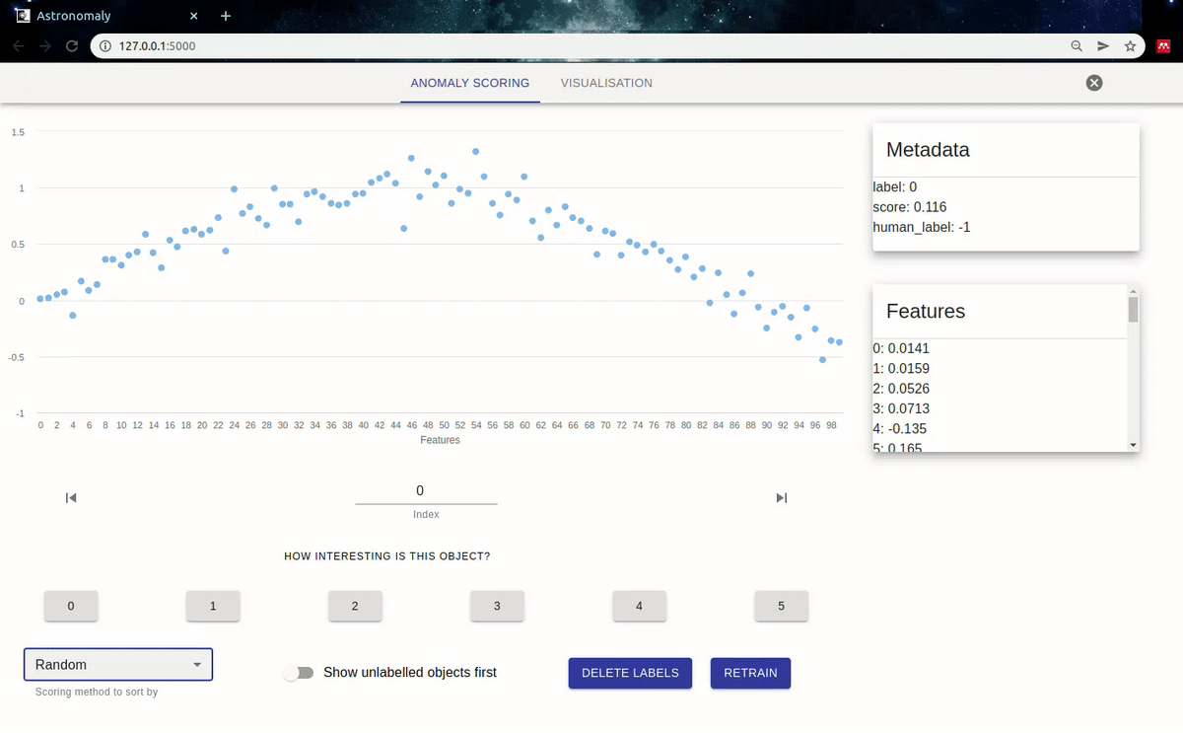
Synthetic data - Random

Slide 27
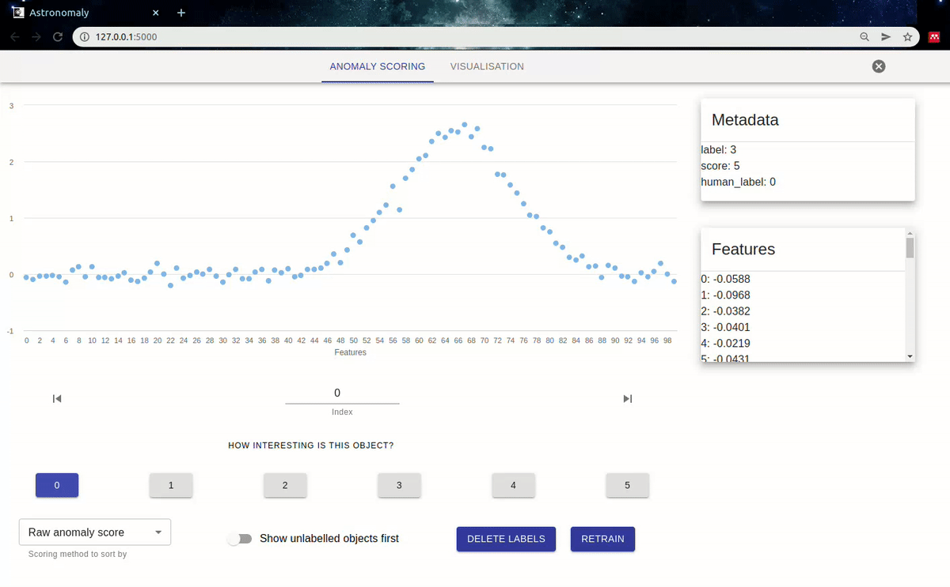
Synthetic data - No active Learning

Slide 28
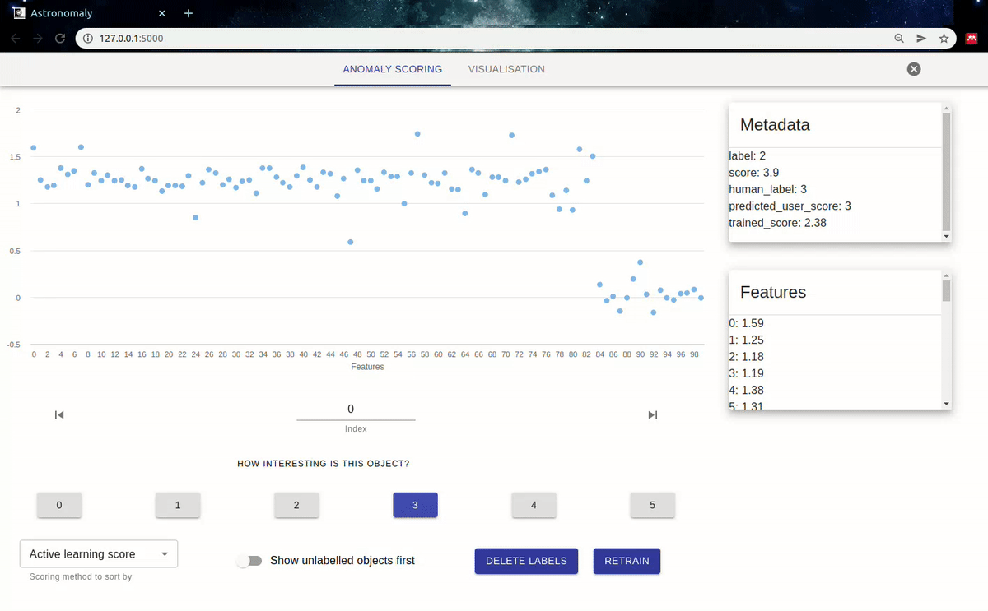
Synthetic data - Active Learning

Slide 29
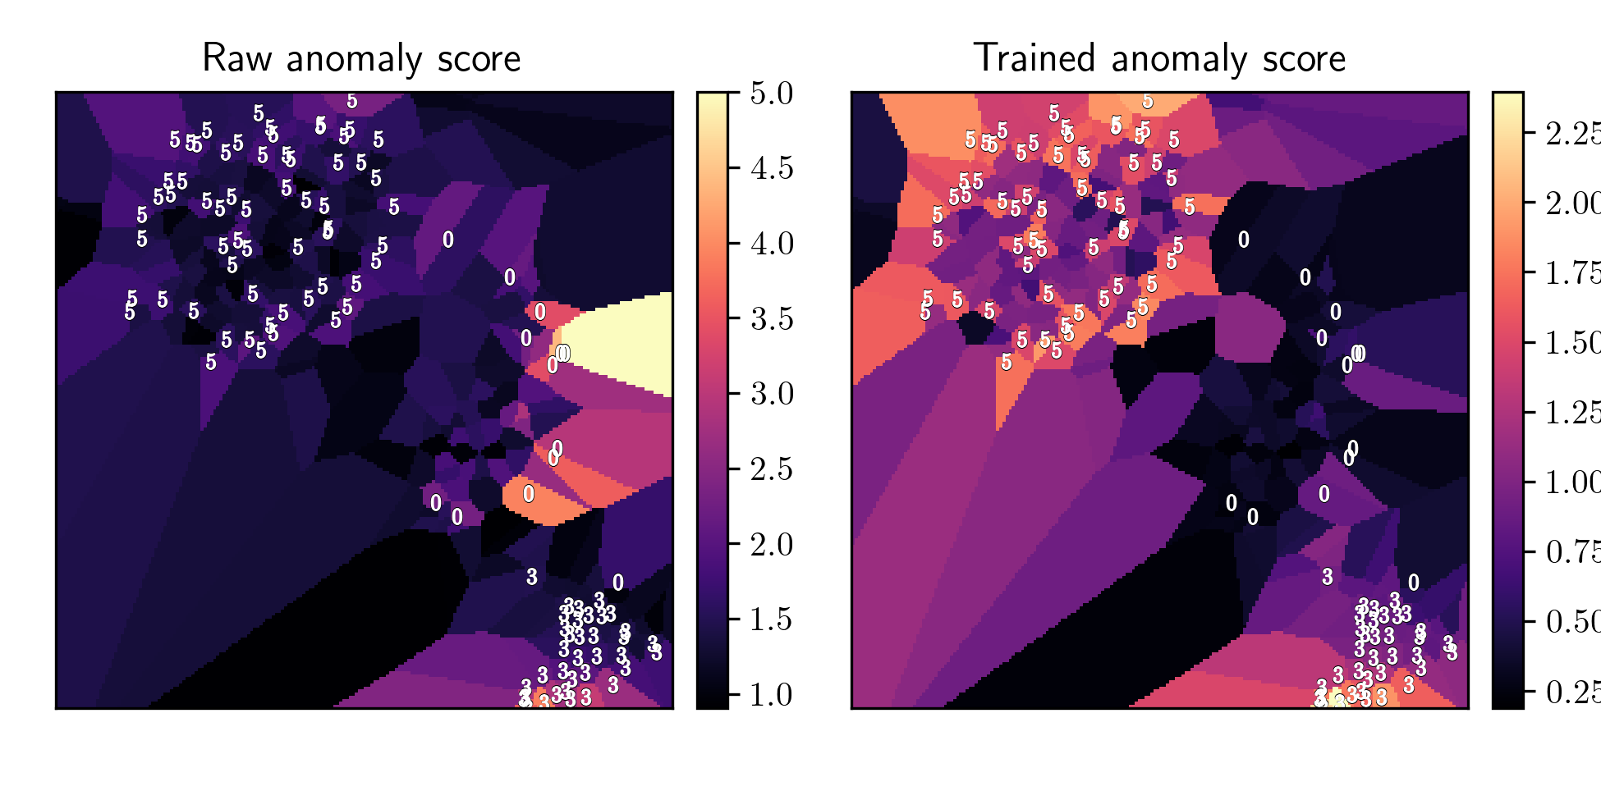
Visualisation with Synthetic Data

Slide 30

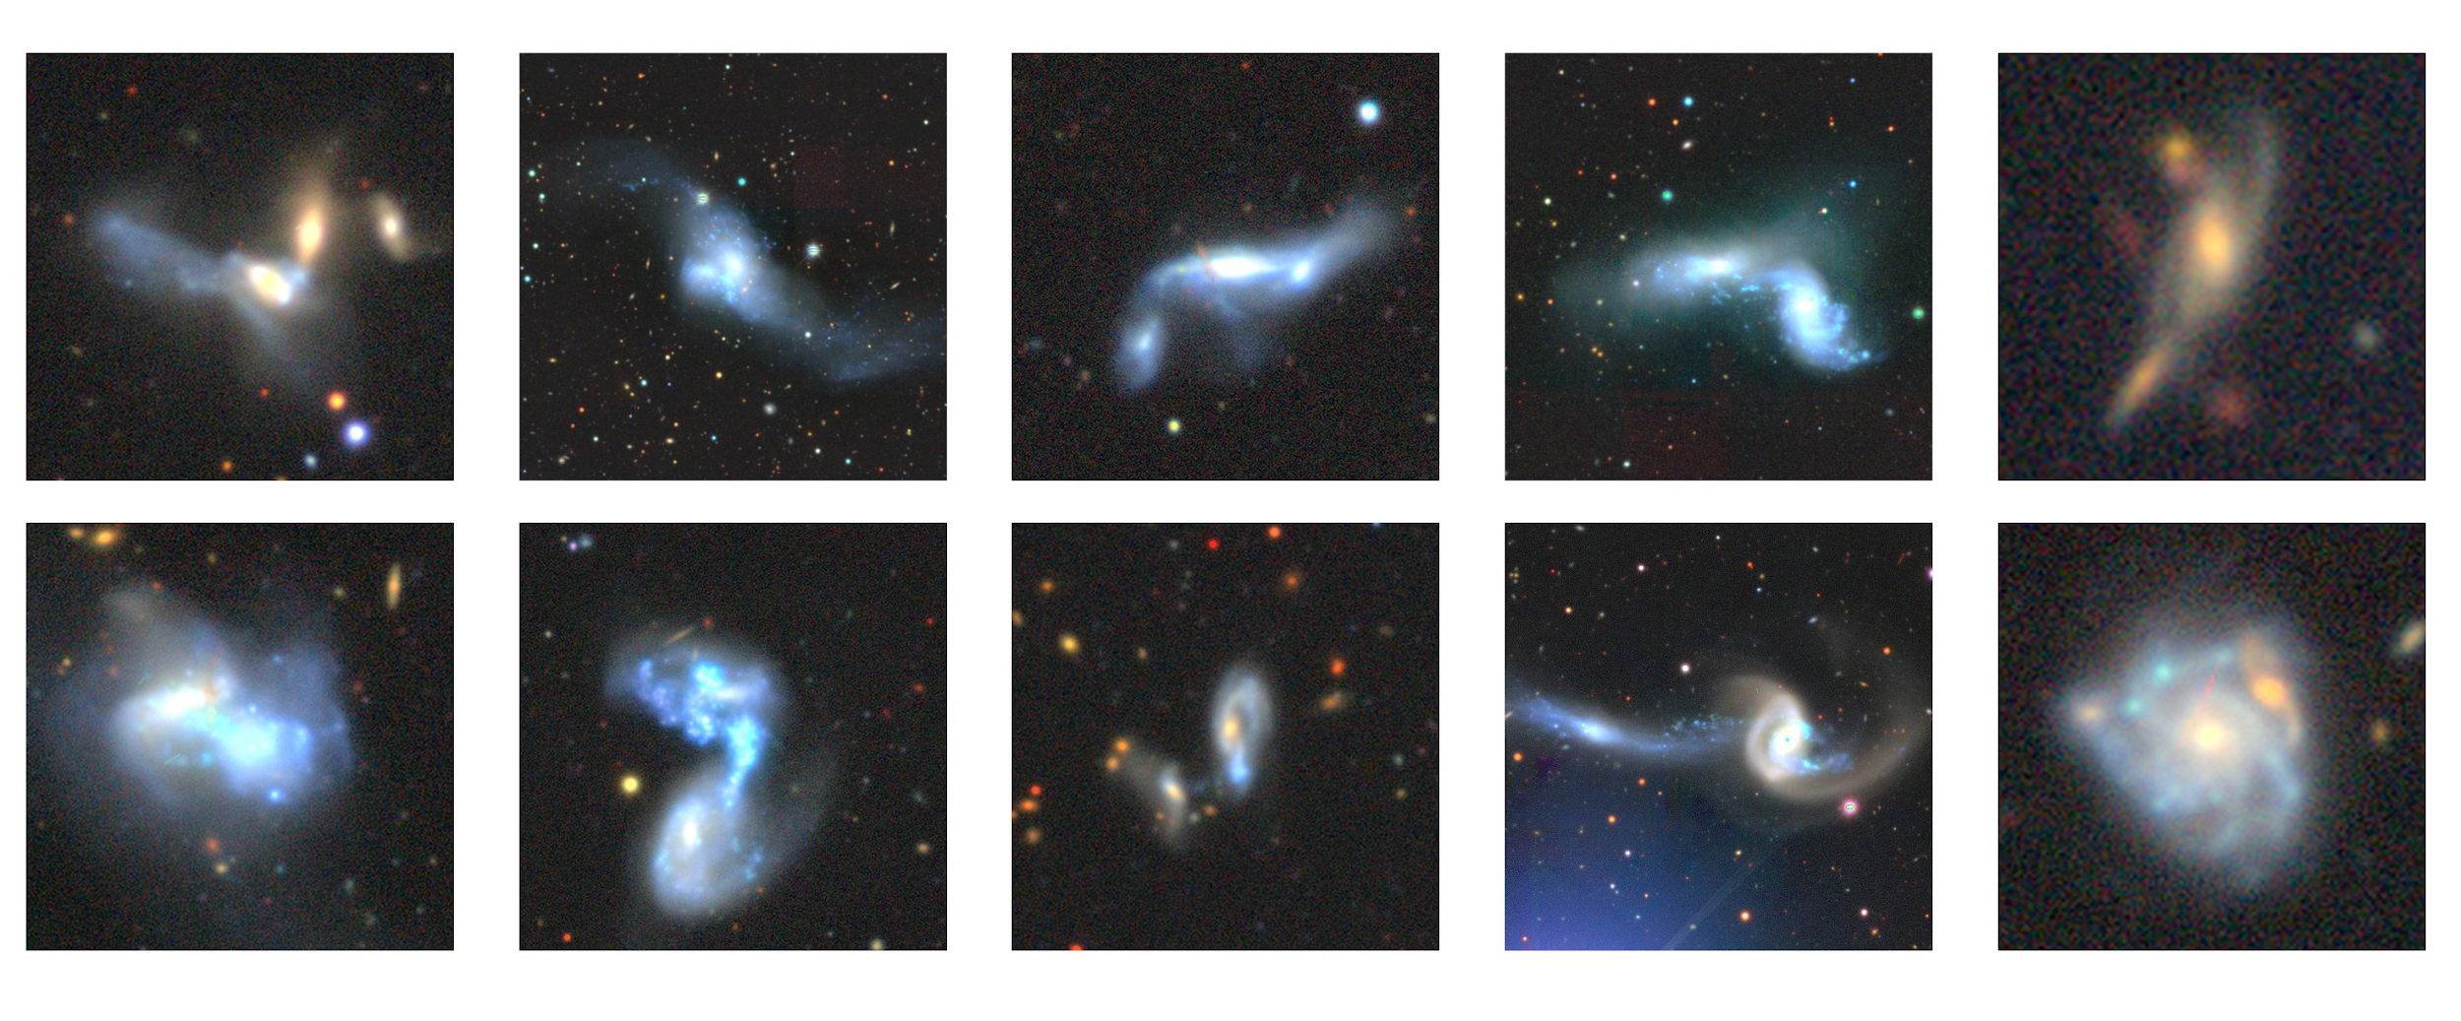
Anomalies in DECALS
Verlon Etsebeth (MSc student)

Slide 31
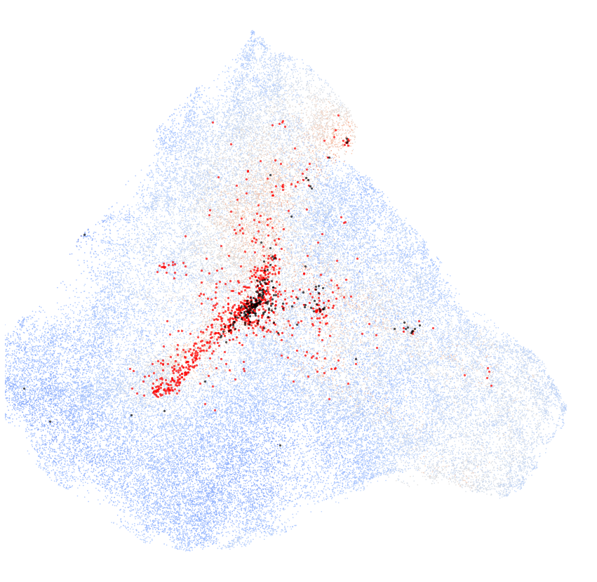
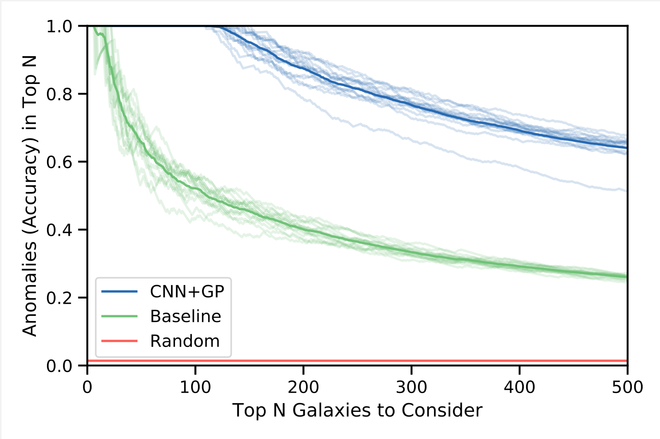
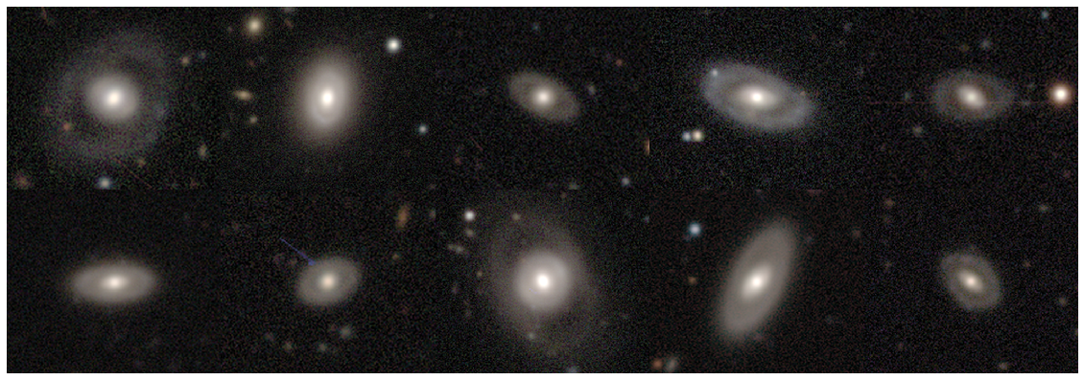

Deep Representation Learning
Walmsley et al. (2021) 2110.12735

Slide 32
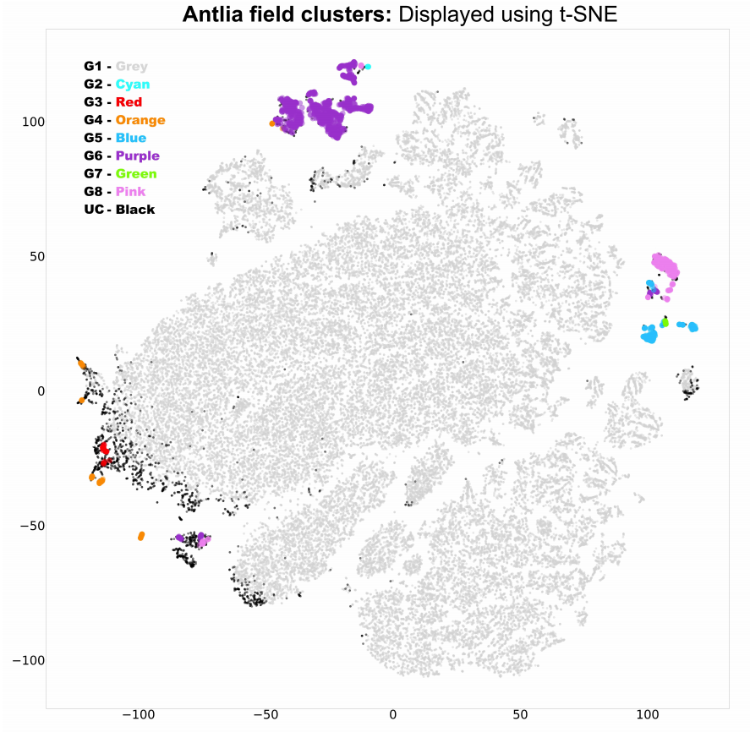

Astronomaly Applied to DWF
Webb et al. (2020) - 2008.04666

Slide 33
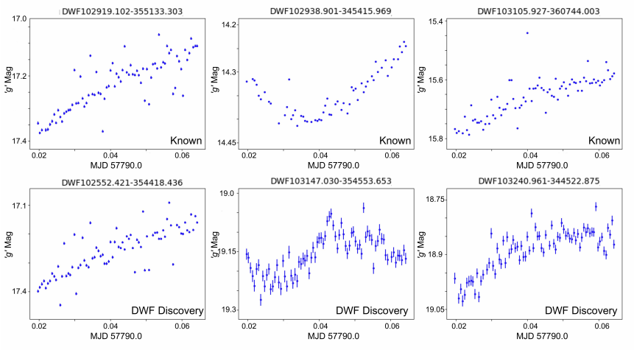
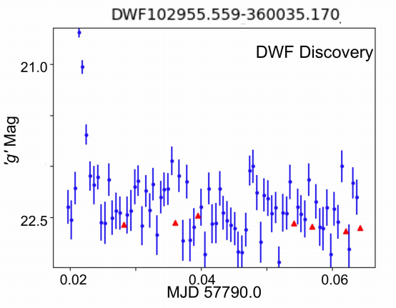
Astronomaly Applied to DWF
Webb et al. (2020) - 2008.04666

Slide 34

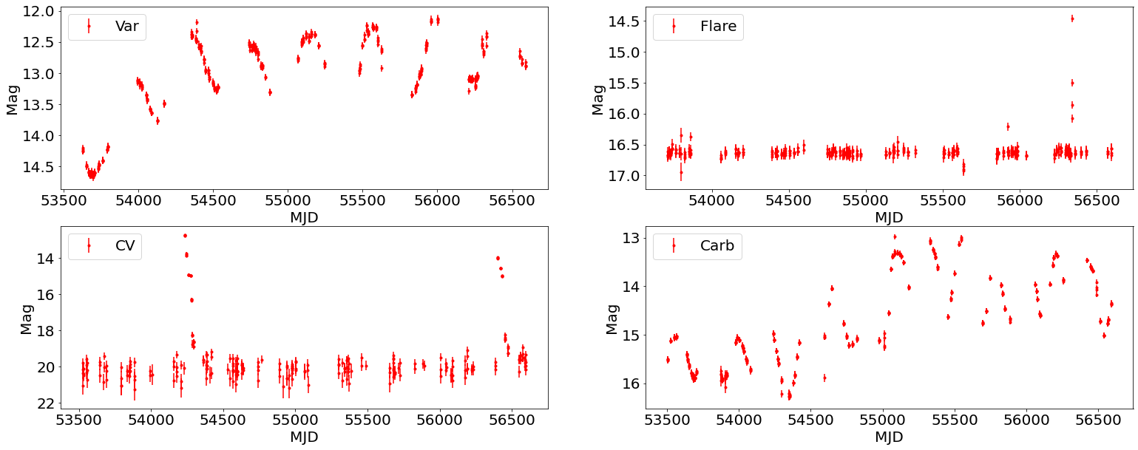
Anomalous Transients
Malema Ramonyai (MSc student)

Slide 35
Real-time anomaly detection

Slide 36
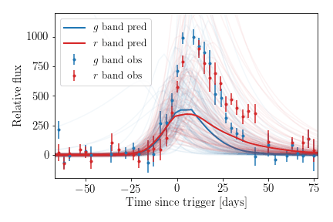

Real-time anomaly detection
Muthukrishna et al. (2021) 2111.00036

Slide 37
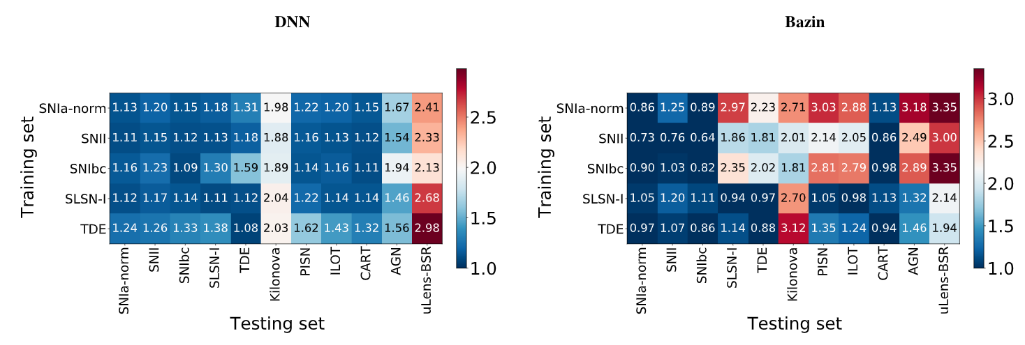
Real-time anomaly detection
Muthukrishna et al. (2021) 2111.00036

Slide 38
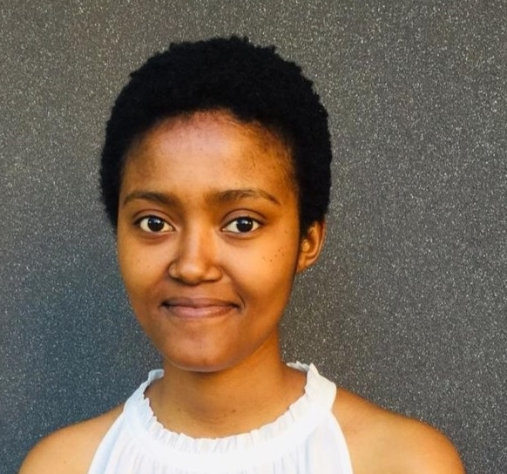
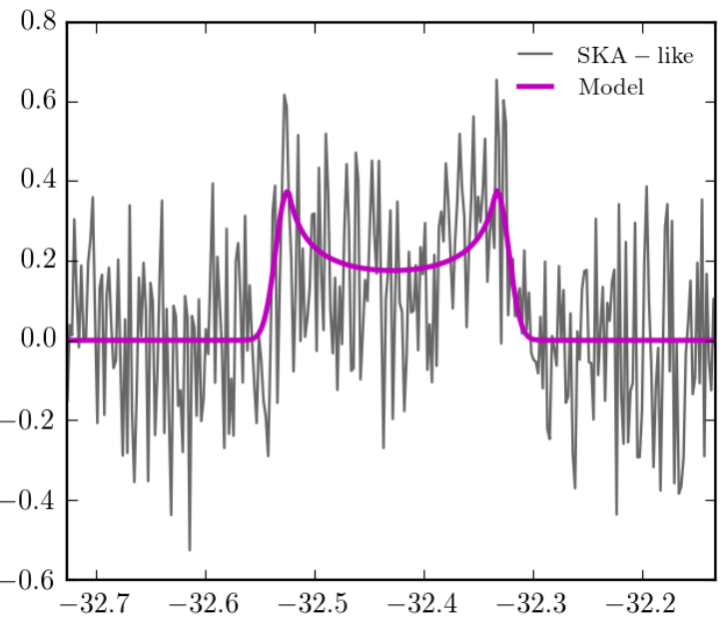

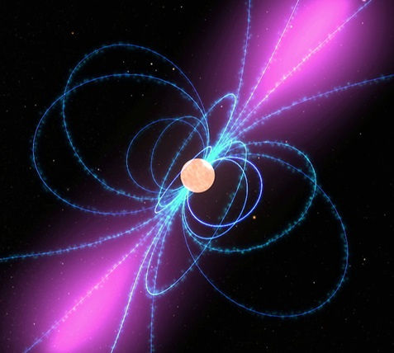


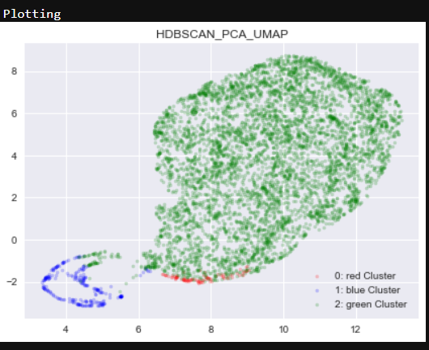
Ongoing student projects
PhD Students
MSc Students
Thendie Motha Synergies between LSST & MeerKAT/SKA | Jade Petersen-Charles Detecting anomalous transients in MeerTRAP data
Verlon Etsebeth Anomaly detection in optical and radio images | Koketso Mohale Novel unsupervised learning approaches

Slide 39
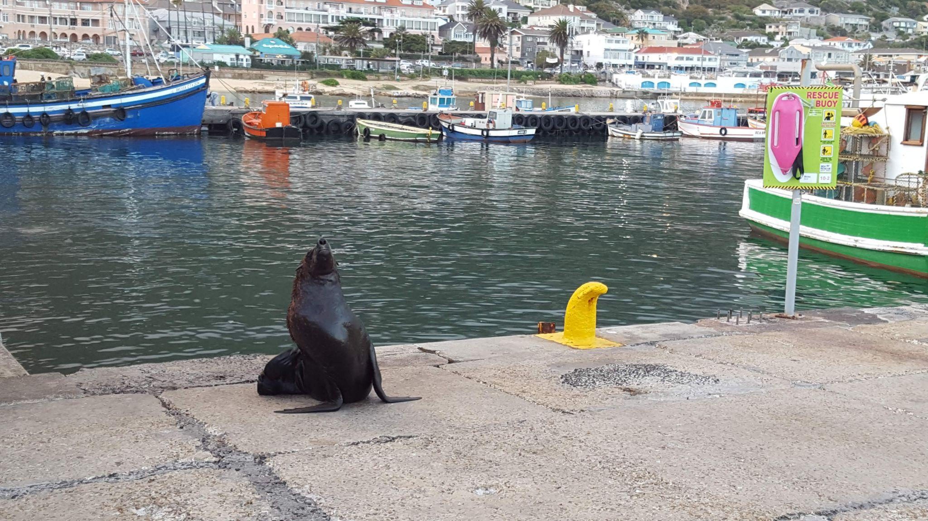



Interested in a Postdoc (starting 2022)?
dr.michelle.lochner@gmail.com
https://jobregister.aas.org/ad/98c33541

Slide 40

MeerKAT Data - Random Examples
MGCLS data from Knowles, K et al. (2021) 2111.05673

Slide 41

MeerKAT Data - Anomalies
MGCLS data from Knowles, K et al. (2021) 2111.05673

Slide 42

MeerKAT Galaxy Cluster Legacy Survey
MGCLS data from Knowles, K et al. (2021) 2111.05673

Slide 43


A genuine machine learning discovery
Lochner et al. (in prep)

Slide 44

www.supernovafoundation.org

Slide 45
Conclusions
Machine learning is critical in facing the data deluge
We need automated anomaly detection to ensure scientific discoveries in datasets aren’t missed
Check out Astronomaly:
  https://arxiv.org/abs/2010.11202
  https://github.com/MichelleLochner/astronomaly
And the Supernova Foundation:
  https://www.supernovafoundation.org/
And postdoc positions available
  https://jobregister.aas.org/ad/98c33541
dr.michelle.lochner@gmail.com

Slide 46

A Novel Active Learning Approach

Slide 47
A Novel Active Learning Approach
Predicted User Anomaly Score
ML Anomaly Score
Distance penalty term

Slide 48

A Novel Active Learning Approach
Predicted User Anomaly Score
ML Anomaly Score
Distance to nearest label
Distance penalty term

