Slide 1






North-West University
South Africa
Astronomical Observatory
Ivan Franko University of Lviv
Ukraine
DESY Zeuthen
Germany
Leptonic Nonthermal Emission from Supernova Remnants Evolving in the Circumstellar Magnetic Field
Iurii Sushch
Robert Brose, Martin Pohl, Samata Das, Pavlo Plotko
Powered by
iurii.sushch@gmail.com

Slide 2
Let’s look at core-collapse SNRs for a bit longer than 20 years…

Slide 3

Let’s look at core-collapse SNRs for a bit longer than 20 years…
A long time ago in a galaxy far, far away…

Slide 4
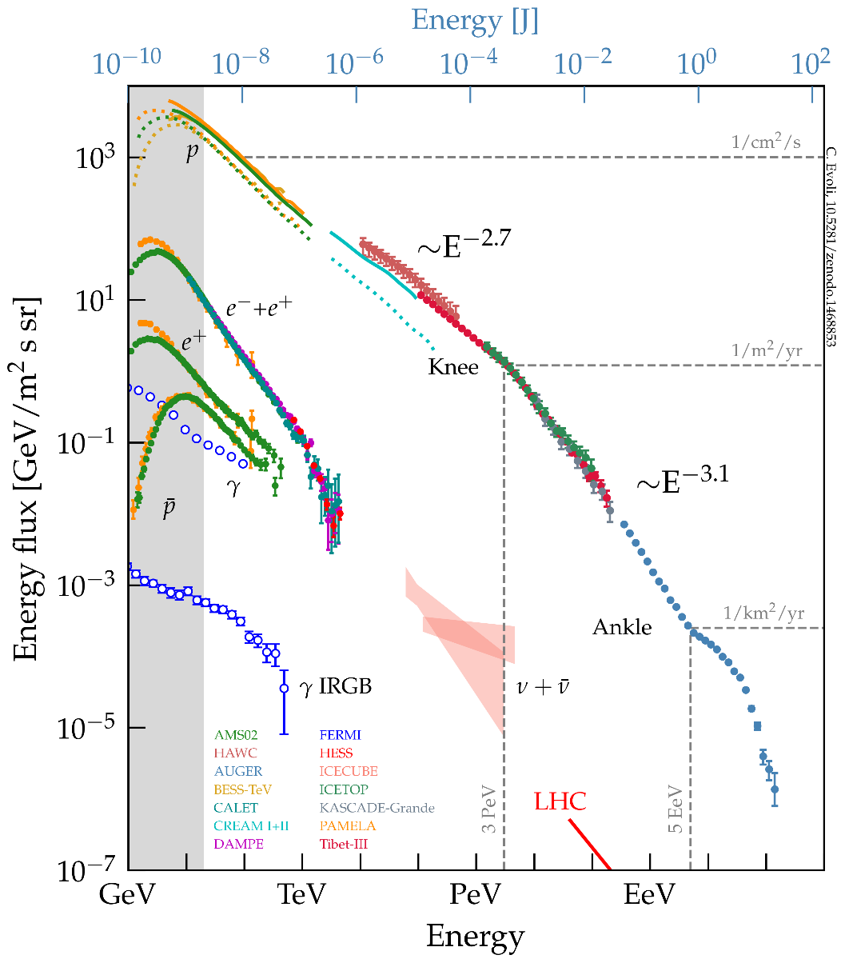
SNRs are sources of Galactic CRs - or are they?
Evoli, 2018

Slide 5
SNRs are sources of Galactic CRs - or are they?
How do we accelerate protons to PeV energies?
Evoli, 2018

Slide 6
SNRs are sources of Galactic CRs - or are they?
How do we accelerate protons to PeV energies?
  Hard to explain theoretically
Evoli, 2018

Slide 7
SNRs are sources of Galactic CRs - or are they?
How do we accelerate protons to PeV energies?
  Hard to explain theoretically
As you already know from Robert’s talks
Evoli, 2018

Slide 8
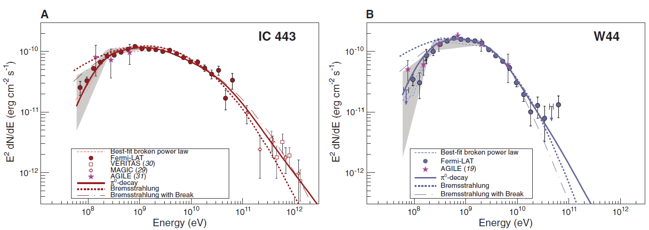
SNRs are sources of Galactic CRs - or are they?
How do we accelerate protons to PeV energies?
  Hard to explain theoretically
  No observational evidence
“Hadronic” SNRs – usually old and not able to accelerate particle to high enough energies anymore
Evoli, 2018

Slide 9

SNRs are sources of Galactic CRs - or are they?
How do we accelerate protons to PeV energies?
  Hard to explain theoretically
  No observational evidence
The CR spectral index
  Propagation models require the injection particle spectrum with the spectral index of $∼2.4$
  Diffusive shock acceleration at strong shocks provides the spectral index of $2$
Evoli, 2018

Slide 10
SNRs are sources of Galactic CRs - or are they?
How do we accelerate protons to PeV energies?
  Hard to explain theoretically
  No observational evidence
The CR spectral index
  Propagation models require the injection particle spectrum with the spectral index of $∼2.4$
  Diffusive shock acceleration at strong shocks provides the spectral index of $2$
Could be due to the particle escape?
See
Brose, R., Pohl, M., Sushch, I., et al. (2020) A&A, Volume 634, A59
Evoli, 2018

Slide 11
SNRs are sources of Galactic CRs - or are they?
How do we accelerate protons to PeV energies?
  Hard to explain theoretically
  No observational evidence
The CR spectral index
  Propagation models require the injection particle spectrum with the spectral index of $∼2.4$
  Diffusive shock acceleration at strong shocks provides the spectral index of $2$
Wait until the end of this talk
Evoli, 2018

Slide 12
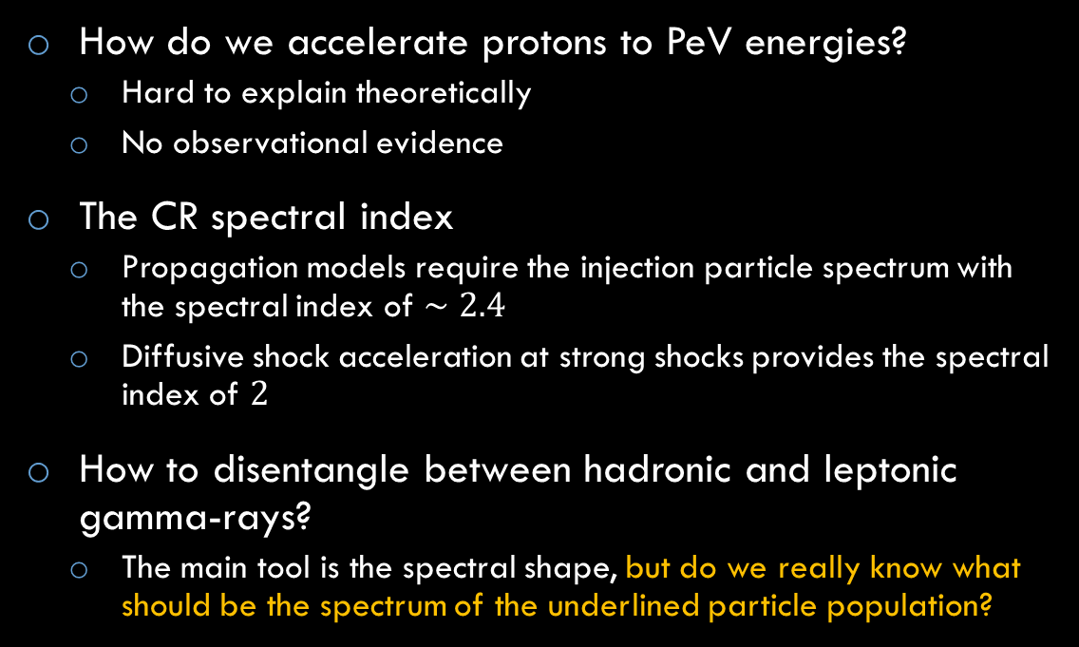
SNRs are sources of Galactic CRs - or are they?
How do we accelerate protons to PeV energies?
  Hard to explain theoretically
  No observational evidence
The CR spectral index
  Propagation models require the injection particle spectrum with the spectral index of $∼2.4$
  Diffusive shock acceleration at strong shocks provides the spectral index of $2$
How to disentangle between hadronic and leptonic gamma-rays?
  The main tool is the spectral shape, but do we really know what should be the spectrum of the underlined particle population?
Evoli, 2018

Slide 13
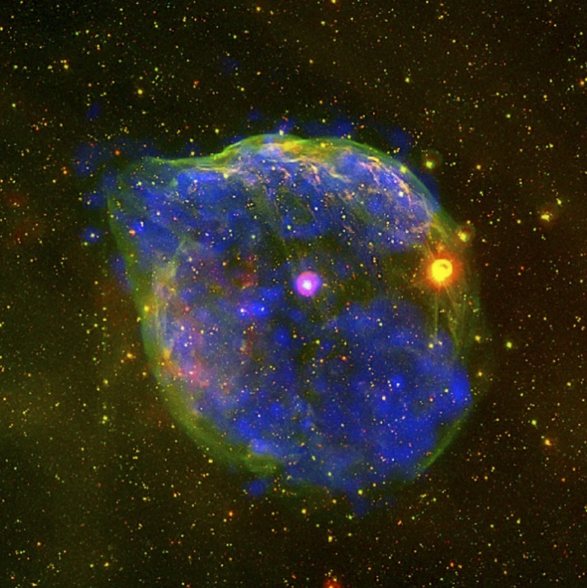
Circumstellar medium
About 80% of all SNRs are core-collapse evolving in stellar wind bubbles of progenitor stars
A bubble blown by the massive Wolf-Rayet star HD 50896, the pink star in the centre. Credit: ESA
Does it change anything?

Slide 14
Circumstellar medium
About 80% of all SNRs are core-collapse evolving in stellar wind bubbles of progenitor stars
Mostly based on the paper:
“Leptonic Nonthermal Emission from Supernova Remnants Evolving in the Circumstellar Magnetic Field”
Sushch, I., Brose, R., Pohl, M., Plotko, P., and Das S. (2022)
The Astrophysical Journal, Volume 926, id. 140, 14 pp.
A bubble blown by the massive Wolf-Rayet star HD 50896, the pink star in the centre. Credit: ESA
Does it change anything?

Slide 15
RATPaC
Radiation Acceleration Transport Parallel Code
Powered by
Cosmic-ray transport equation
Hydro equations
(solved with PLUTO)
Transport equation for magnetic turbulence

Slide 16
RATPaC
Radiation Acceleration Transport Parallel Code
Powered by
Cosmic-ray transport equation
Hydro equations
(solved with PLUTO)
Transport equation for magnetic turbulence
(not used in this study)

Slide 17
RATPaC
Radiation Acceleration Transport Parallel Code
Powered by
Cosmic-ray transport equation
Output:
Spectrum of CRs as a function of location and time
Hydro equations
(solved with PLUTO)
Prescription for the upstream magnetic field amplification and diffusion.
Induction equation for downstream

Slide 18
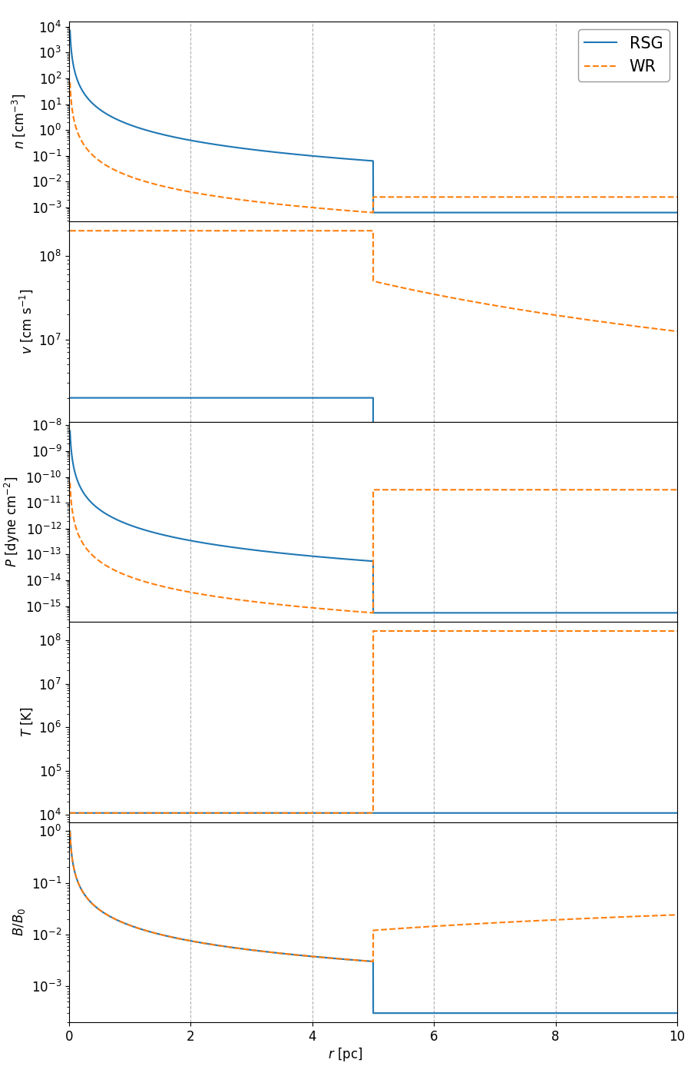
Initial MHD Setup
Red Supergiant:
describing the inner part of the stellar wind bubble for RSG and WR cases
transition from the free wind to the shocked wind is assumed to be at 5 pc
corresponds to the early stages of the SNR evolution
Wolf-Rayet:

Slide 19
Initial MHD Setup
Red Supergiant:
describing the inner part of the stellar wind bubble for RSG and WR cases
transition from the free wind to the shocked wind is assumed to be at 5 pc
corresponds to the early stages of the SNR evolution
Wolf-Rayet:

Slide 20
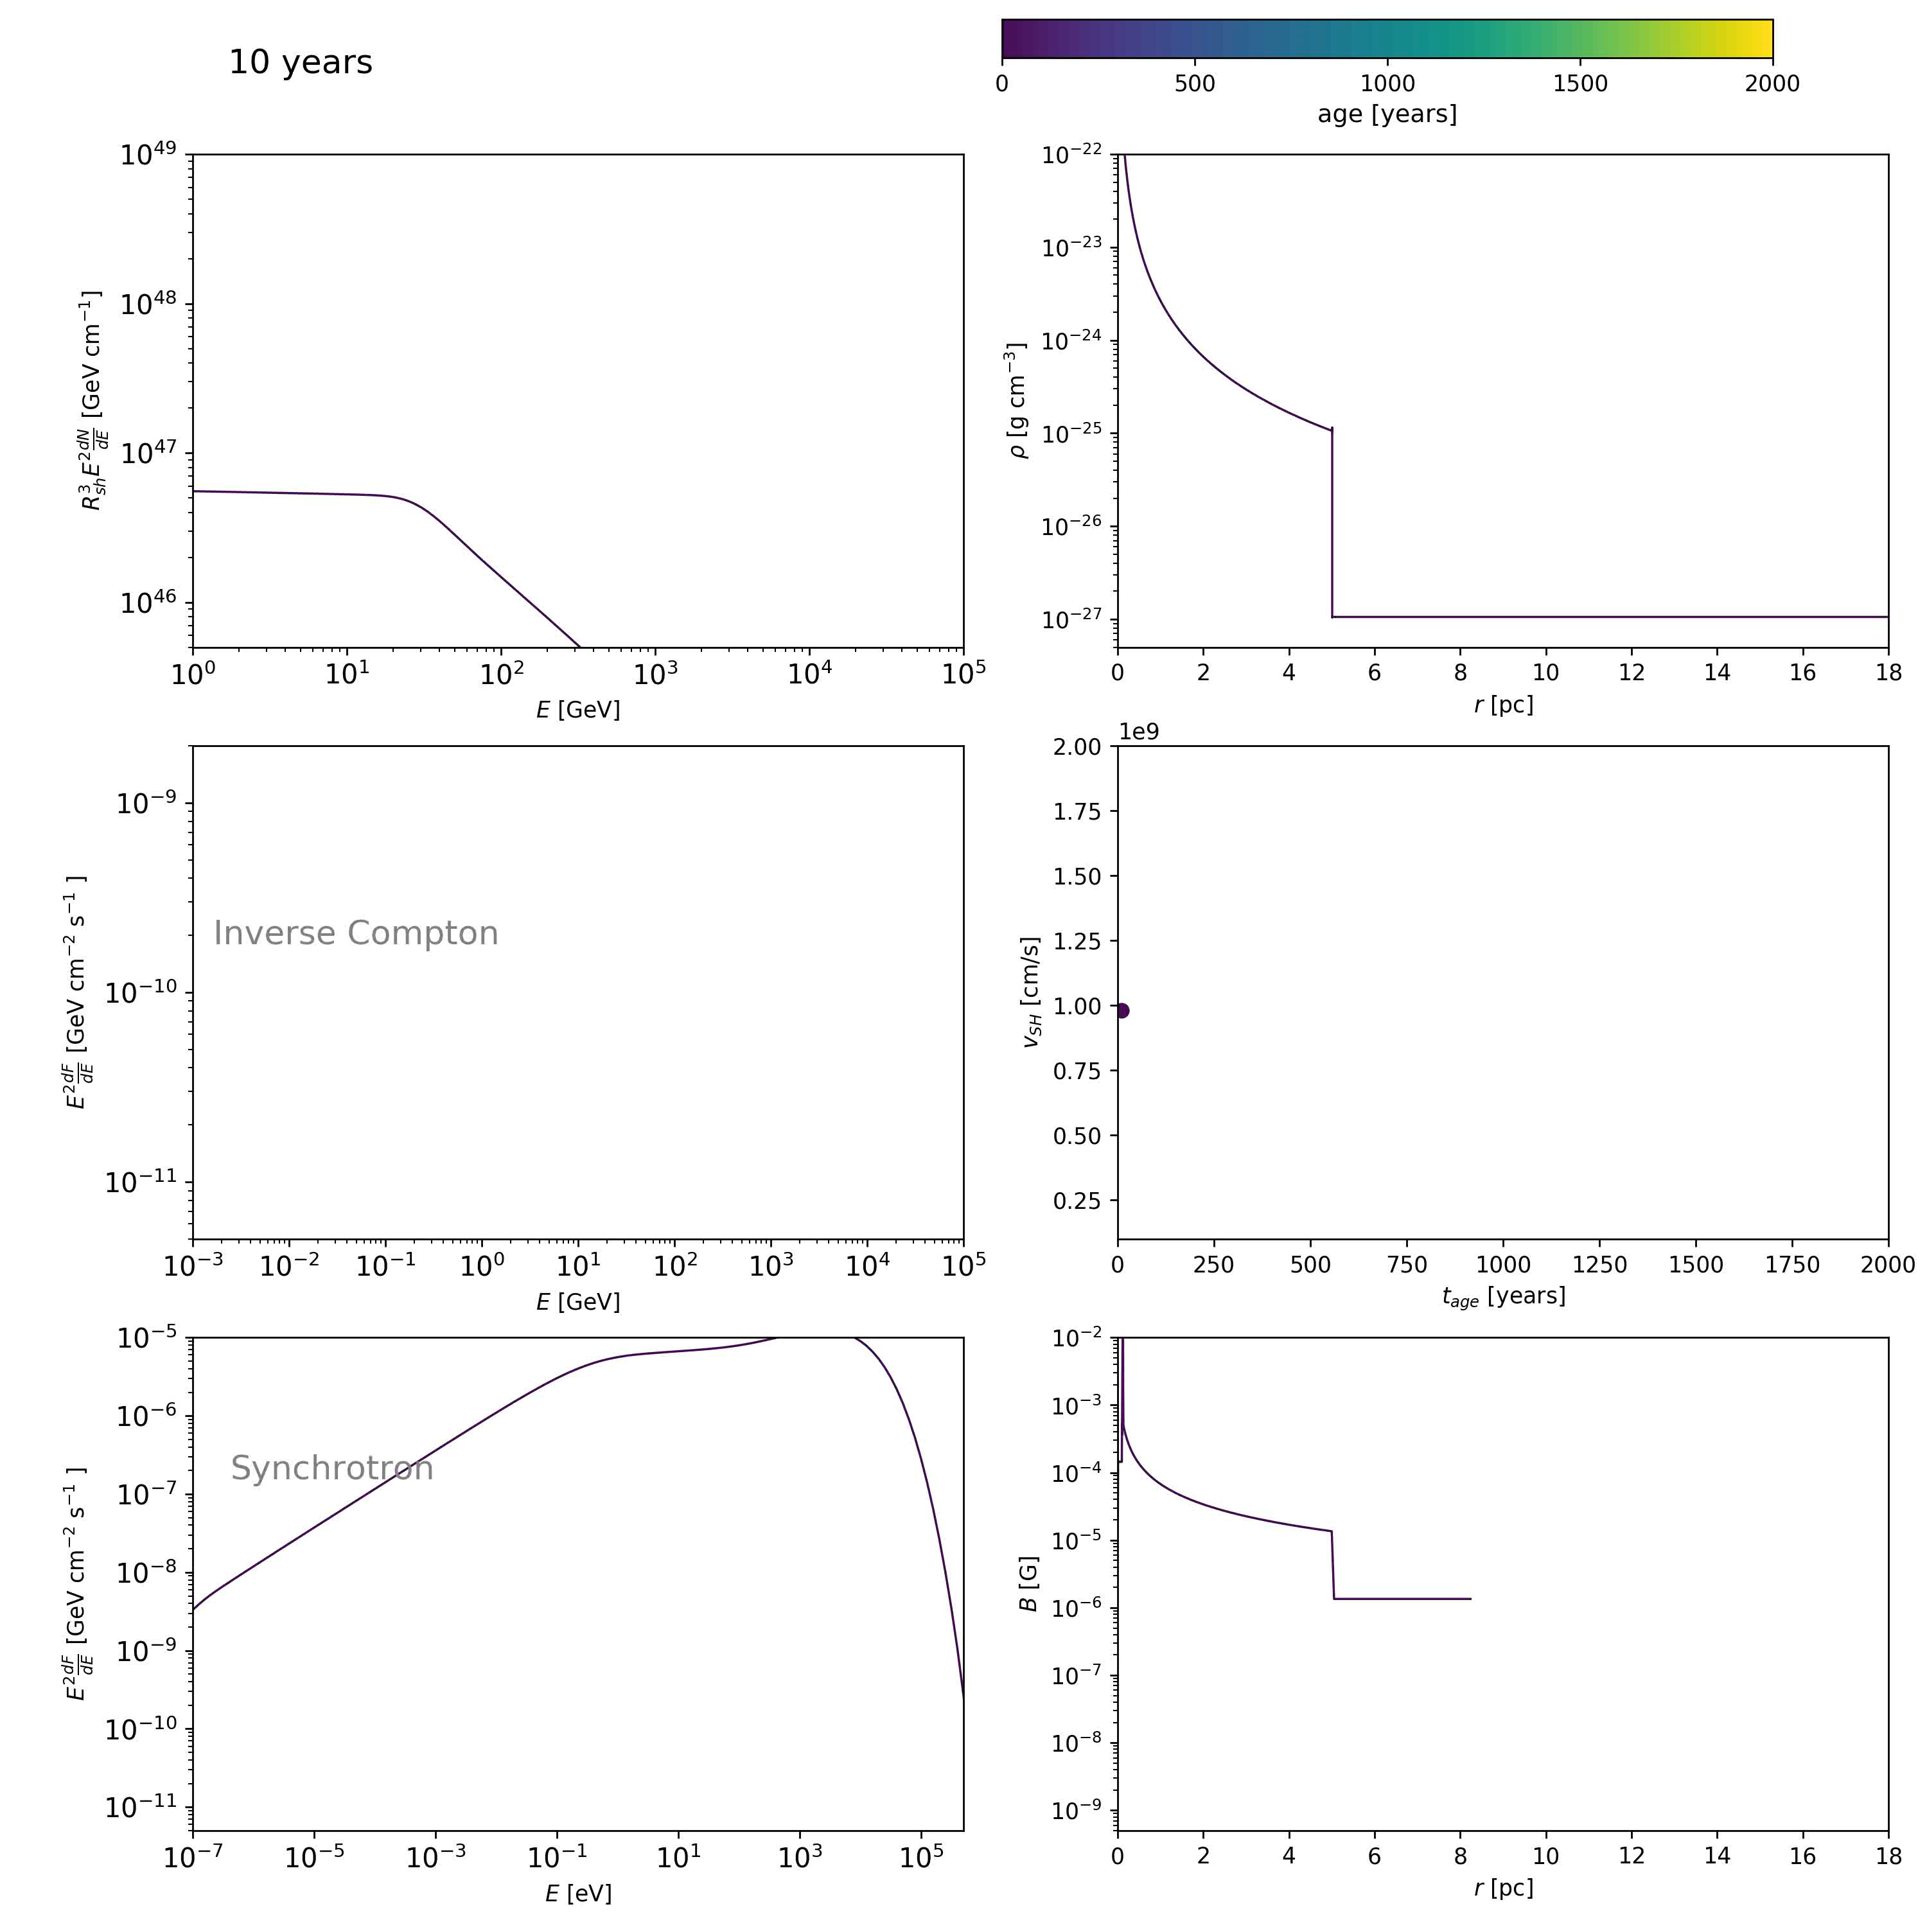
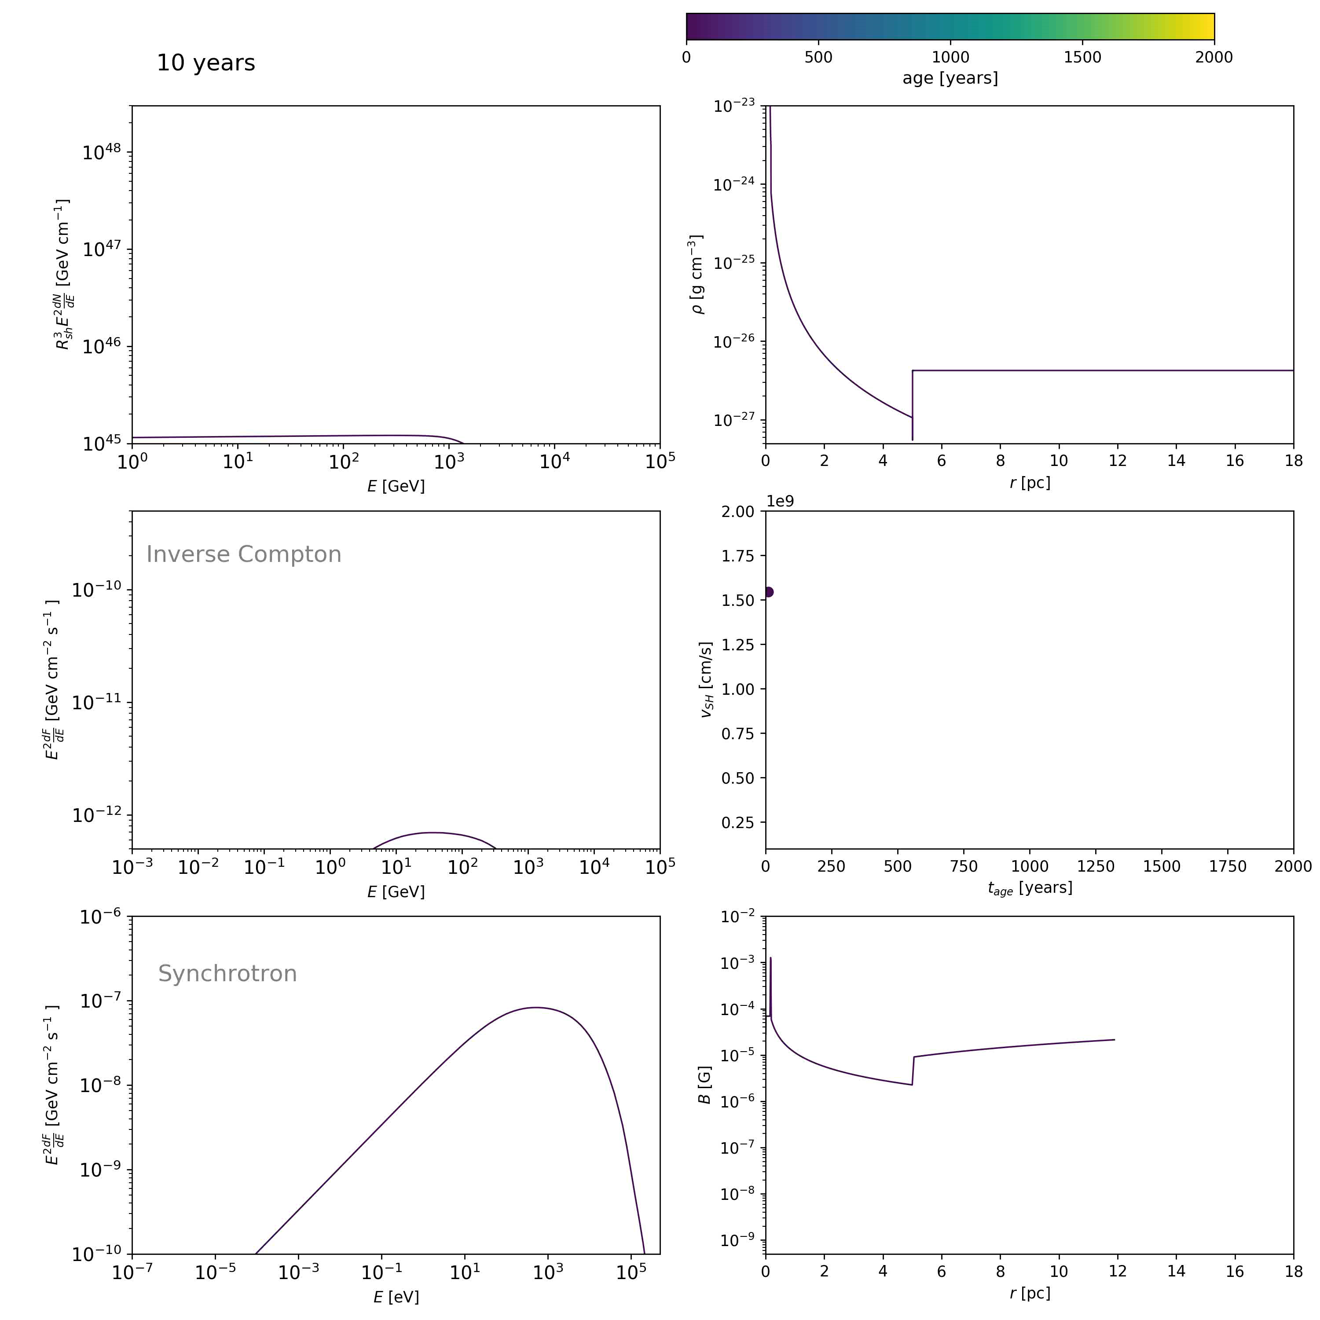
Simulations for electrons
RSG
WR

Slide 21
Main features
Strongly cooled spectrum at the early stages due to the high magnetic field

Slide 22
Main features
Strongly cooled spectrum at the early stages due to the high magnetic field
Formation of two energetically distinct and spatially separated components of particles as the shock passes the transition point
  Caused by a combination of cooling and confinement effects and the change of the shock velocity
  Results in concave particle and emission spectra and complex morphologies

Slide 23
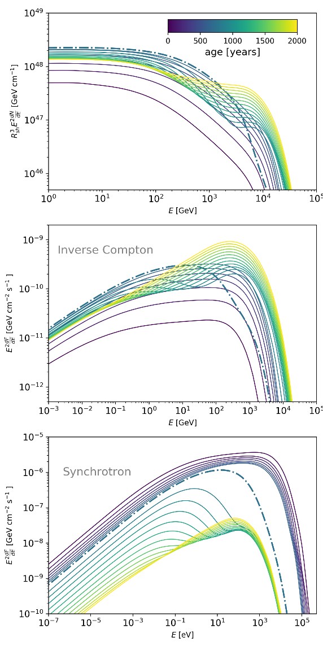
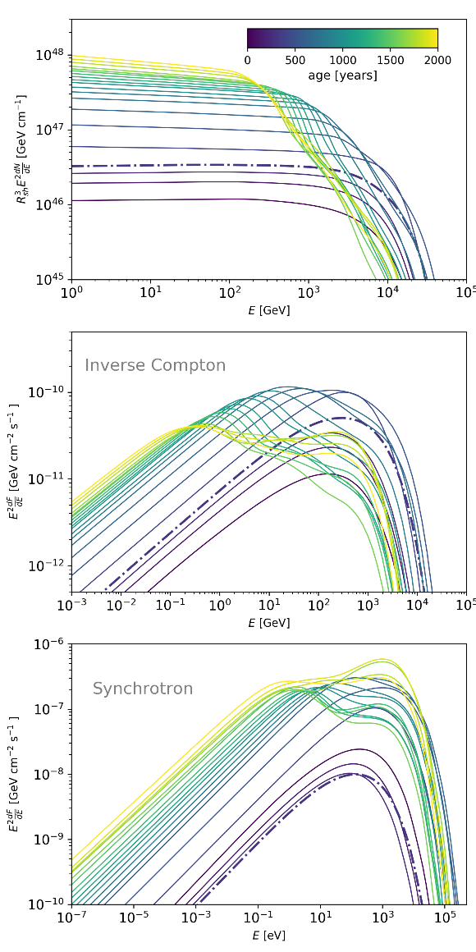




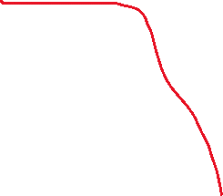
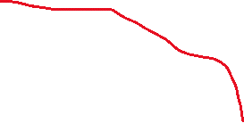
Spectra
RSG
WR
“new” effectively cooled particles close to the shock
SUM
“old” cooled particles farther downstream
“old” particles farther downstream with lower
maximum energy
SUM
“new” particles close to the shock accelerated to higher energies

Slide 24
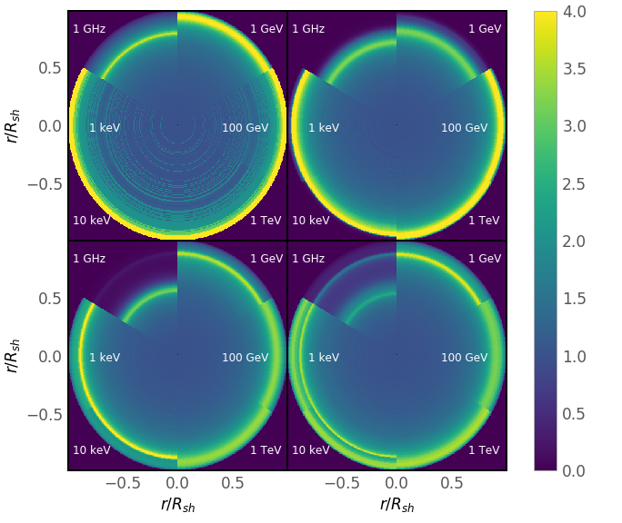
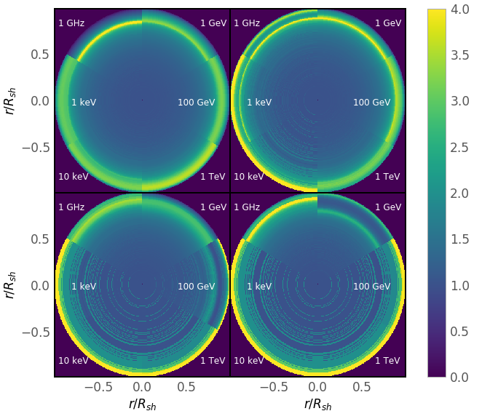
Morphology
Formation of two spatially separated components of electrons is reflected in formation “double-ring” morphologies at different enegies
RSG
WR
* emission is normalized to the projected emission from the centre

Slide 25
Main features
Strongly cooled spectrum at the early stages due to the high magnetic field
Formation of two energetically distinct and spatially separated components of particles as the shock passes the transition point
  Caused by a combination of cooling and confinement effects and the change of the shock velocity
  Results in concave particle and emission spectra and complex morphologies
Strong and fast change of luminosity at the transition point, especially in X-rays

Slide 26
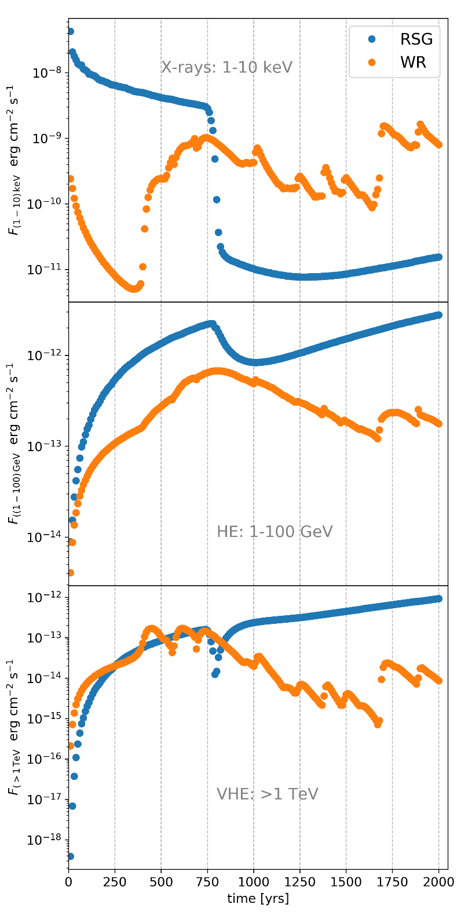
Light curves
Rapid decrease/increase of the X-ray and gamma-ray emission during the transition stage that can be well detectable on a 10-years time scale
The average rate of dimming in the RSG case is about 1.5 % per year

Slide 27
Cas A: observed decrease of X-ray flux
Patnaude, et al. 2011
Believed to be a result of the explosion of the RSG
Decline of the X-ray emission at the level of 1.5% per year

Slide 28
Main features
Strongly cooled spectrum at the early stages due to the high magnetic field
Formation of two energetically distinct and spatially separated components of particles as the shock passes the transition point
  Caused by a combination of cooling and confinement effects and the change of the shock velocity
  Results in concave particle and emission spectra and complex morphologies
Strong and fast change of luminosity at the transition point, especially in X-rays
Formation of a reflected shock that propagates and get deflected back and forth in the downstream
  Results in sporadic boosts of the forward shock velocity that increases the maximum energy and hence also X-ray and very high energy gamma-ray emission

Slide 29
Spectra
WR
Interaction of the reflected shock with the forward shock speeds the latter one up which results in an instantaneous increase of the maximum energy
“Heart-beat” behavior of the spectrum

Slide 30
Light curves
Sporadic spikes in WR light curves connected to the interaction of the reflected shock with the forward shock. Should be detectable in both X-rays and gamma-rays

Slide 31
Time variability of X-ray stripes in Tycho
Observed brightening of the knot is accompanied by hardening of the spectrum
Okuno et al., 2020
This is exactly what you expect in the event of the forward shock boosting by the reflected shock

Slide 32
Main features
Strongly cooled spectrum at the early stages due to the high magnetic field
Formation of two energetically distinct and spatially separated components of particles as the shock passes the transition point
  Caused by a combination of cooling and confinement effects and the change of the shock velocity
  Results in concave particle and emission spectra and complex morphologies
Strong and fast change of luminosity at the transition point, especially in X-rays
Formation of a reflected shock that propagates and get deflected back and forth in the downstream
  Results in sporadic boosts of the forward shock velocity that increases the maximum energy and hence also X-ray and very high energy gamma-ray emission
  Additional compression of particles at the reflected shock

Slide 33
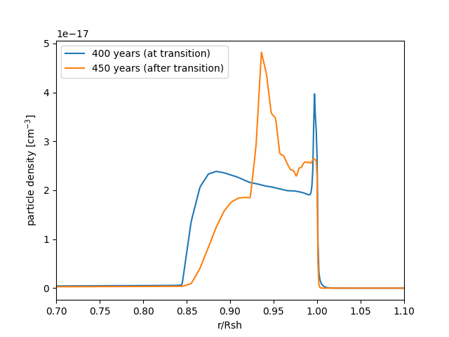
Reflected shock
Radial profile for 1 TeV electrons
The pile up of particles corresponds to the location of the reflected shock
See the poster by Kobus Le Roux

Slide 34
Main features
Strongly cooled spectrum at the early stages due to the high magnetic field
Formation of two energetically distinct and spatially separated components of particles as the shock passes the transition point
  Caused by a combination of cooling and confinement effects and the change of the shock velocity
  Results in concave particle and emission spectra and complex morphologies
Strong and fast change of luminosity at the transition point, especially in X-rays
Formation of a reflected shock that propagates and get deflected back and forth in the downstream
  Results in sporadic boosts of the forward shock velocity that increases the maximum energy and hence also X-ray and very high energy gamma-ray emission
  Additional compression of particles at the reflected shock?
Softening of the spectrum as the forward shock propagates into the hot medium

Slide 35
Softening of the spectrum
Shock propagates in the hot shocked wind → Mach number decreases → compression ratio decreases → the particle spectrum becomes softer

Slide 36
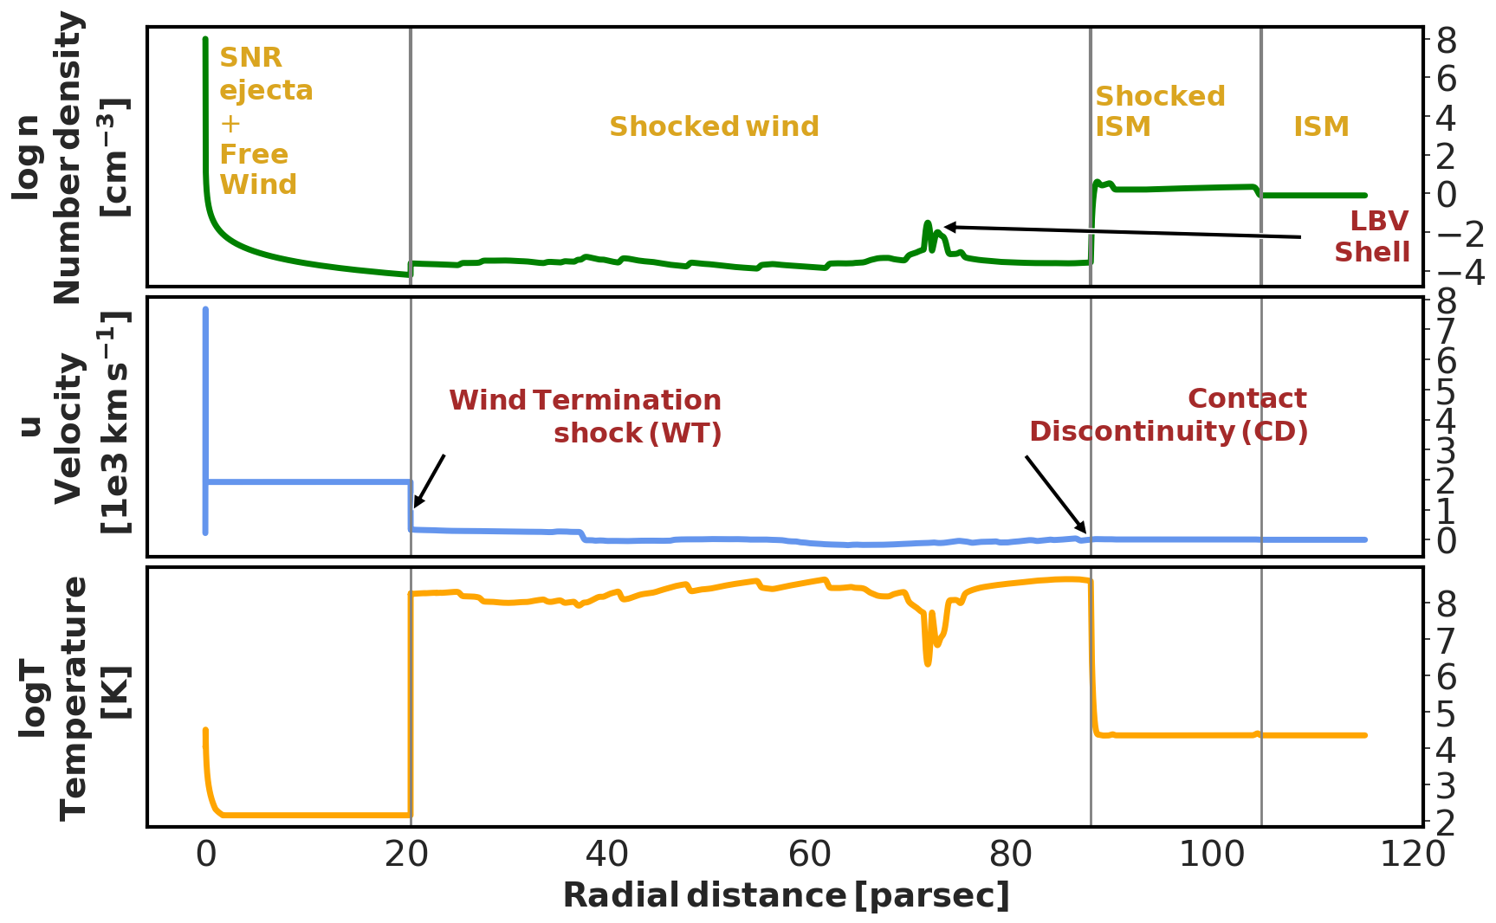
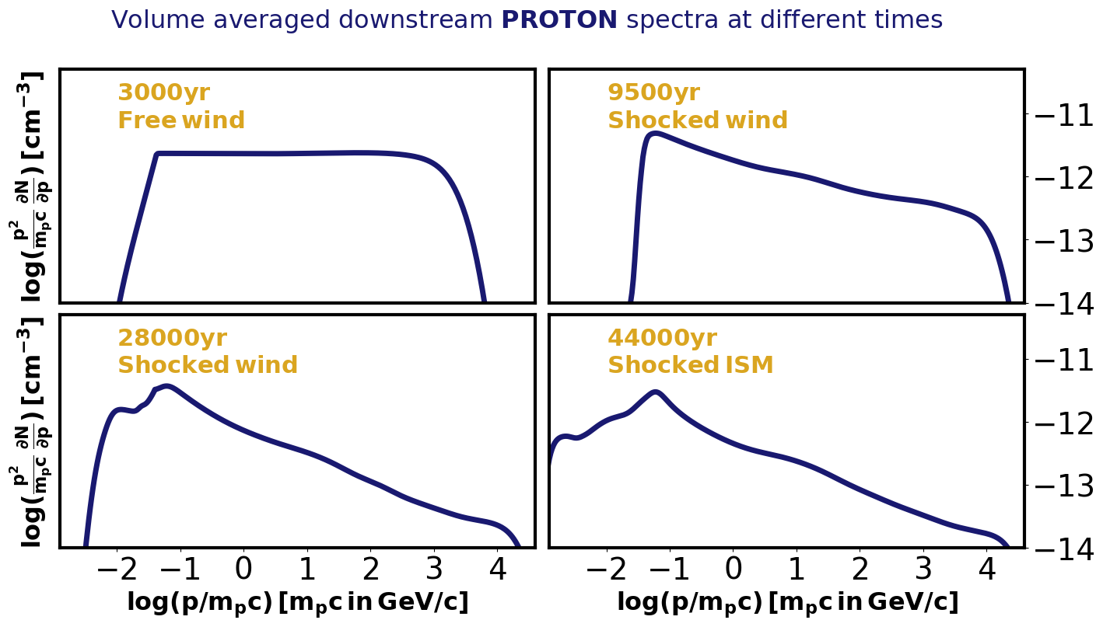

Softening of the spectrum
“Spectral softening in core-collapse supernova remnant expanding inside wind-blown bubble”
Das S., Brose, R., Meyer, D., Pohl, M., Sushch, I., and Plotko, P.
Astronomy & Astrophysics, Volume 661, id.A128, 13 pp.
Even more prominent at later stages!
Up to the spectral index of 2.5
Evolution of the SNR inside the stellar wind bubble of the 60 $M_{⊙}$ star
Check the poster by Samata Das

Slide 37
Summary
Formation of energetically distinct and spatially separated components of particles that results in a concave emission spectrum and complex morphology
Potential strong brightening/dimming of the X-ray/gamma-ray emission. Possibly what we see in Cas A.
Sporadic spikes in X-ray/gamma-ray light curves connected to reflected-forward shocks interaction
Propagation of the forward shock in the hot shocked wind medium results in a softer particle spectrum

Slide 38
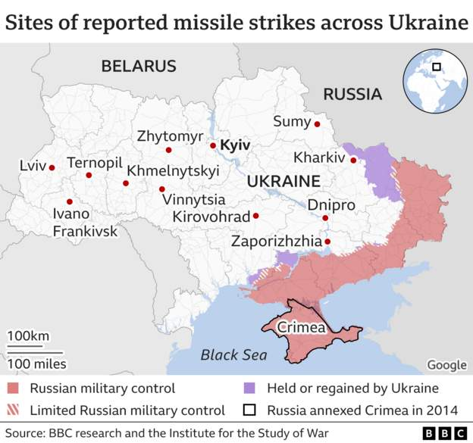


#StandWithUkraine !
Today:
83 missiles (43 shot down by air defence)
Strikes on civilian infrastructure in big cities in 14 regions of Ukraine
10 killed, more than 60 injured
Wide-spread power outages across the country
Lukashenko orders to deploy Belarussian forces together with Russian
Donate to:
Charity foundation “Come back alive”
www.comebackalive.in.ua
Charity foundation of Serhiy Prytula https://prytulafoundation.org/en

Slide 39
BACKUP slides

Slide 40
Very brief description
Powered by
We solve all equations numerically
  Time-dependently
  In 1D with spherical symmetry
Thermal particles are injected at the same injection momentum (multiple of thermal momentum) at every time step at the shock
Then we evolve those particles in space and time
Magnetic field:
  Amplification – either by hand or self-consistently from turbulence transport
  Diffusion – either Bohm-like or self-consistently from turbulence transport
  Passively transported downstream solving induction equation

Slide 41

Hydrodynamics
Numerically solve standard gas-dynamical equations (Pluto) for the SNR propagating in the pre-defined medium
1D and spherically symmetric
The choice of ejecta/medium profiles is based on the type of he SN
$$\frac{∂}{∂t}\left(\begin{matrix}ρ \\ m \\ E\end{matrix}\right)+∇{\left(\begin{matrix}ρv \\ mv+PI \\ \left(E+P\right)v\end{matrix}\right)}^{T}=\left(\begin{matrix}0 \\ 0 \\ 0\end{matrix}\right)$$
$\frac{ρv^{2}}{2}+\frac{P}{γ−1}=E$

Slide 42


Transport equation for particles
$$\frac{∂N}{∂t} = ∇\left({ D}_{r}∇N − vN\right) − \frac{∂}{∂p}\left(N\dot{p} − \frac{∇v}{3}Np\right) + Q$$
Diffusion Advection Cooling Acceleration Injection
1D in spherical symmetry
Test-particle
Synchrotron cooling for electrons
On a co-moving, expanding grid → no free escape boundary, all particles are kept in simulations
Change of variables: ${x−1=\frac{r}{R_{sh}}−1= (x_{∗}−1)}^{3}$ → fine resolution at the shock

Slide 43
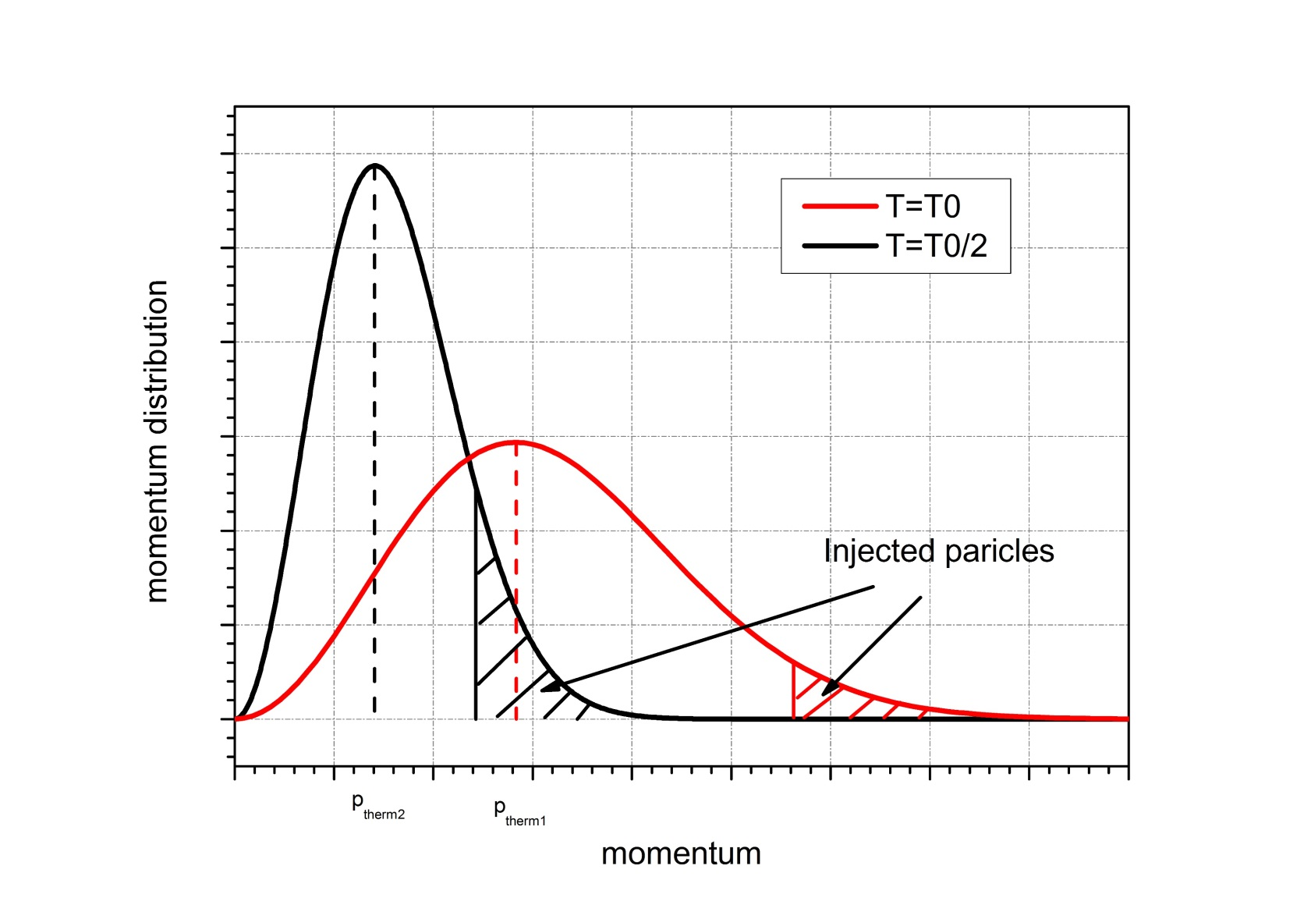

Injection
Inject particles with the injection momentum $p_{inj}$ at the shock at every time step
$p_{inj}=ξp_{thermal}$; the tail of the Maxwellian distribution
$Q∝n_{up}v_{inj}δ\left(R−R_{sh}\right)δ(p−p_{inj})$

Slide 44
Magnetic field/Amplification/Diffusion coefficient
Two ways
Prescribed large-scale magnetic field Amplification of the magnetic field upstream by a linear scaling factor Compression at the shock Passively transported downstream; induction equation solved Bohm-like diffusion | Prescribed large-scale magnetic field Turbulent magnetic field due to resonant streaming instability The transport equation for the magnetic turbulence assuming Alfven waves is solved in parallel to the transport equation of particles Amplification and diffusion coefficient are calculated self-consistently

Slide 45
Magnetic field/Amplification/Diffusion coefficient
Two ways
Prescribed large-scale magnetic field Amplification of the magnetic field upstream by a linear scaling factor Compression at the shock Passively transported downstream; induction equation solved Bohm-like diffusion | Prescribed large-scale magnetic field Turbulent magnetic field due to resonant streaming instability The transport equation for the magnetic turbulence assuming Alfven waves is solved in parallel to the transport equation of particles Amplification and diffusion coefficient are calculated self-consistently
This is what we used for this study

Slide 46
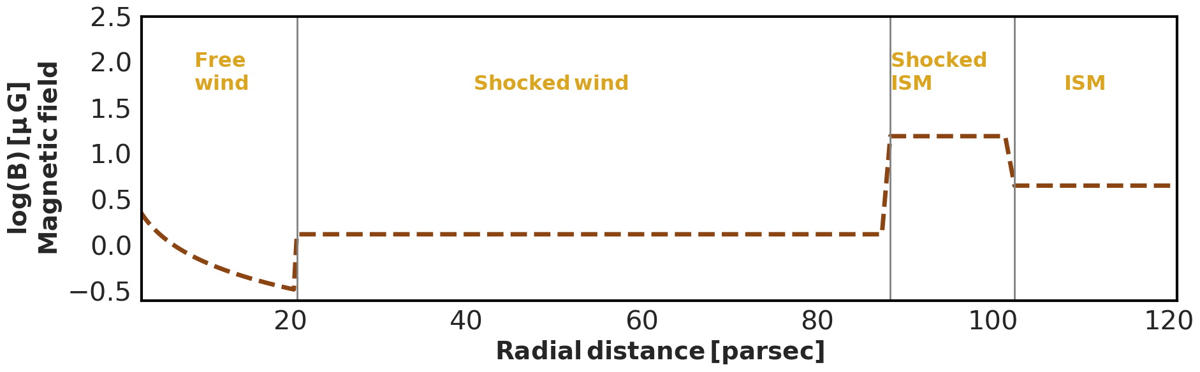

Complex MHD profiles of the medium
MHD profiles right after the explosion of the 60 $M_{⊙}$ star with WR as a final stage (Das et al., 2022):
Hydro profiles are obtained from 1D numeric simulations following the stellar evolution track
Magnetic field – prescribed approximation following the idea of frozen field
Stellar winds throughout the stellar evolution shape strongly inhomogeneous environments in which later evolve SNRs
This should have a strong impact on the spectrum of accelerated particles and on emission spectrum

Slide 47
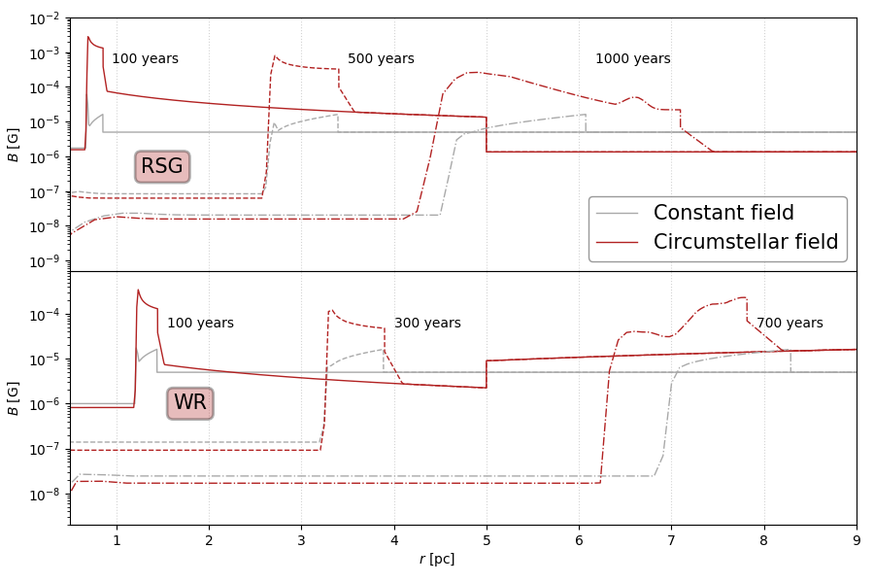

Circumstellar magnetic field
Amplified upstream of the shock
Compressed at the shock and transported downstream following the induction equation
Constant ambient magnetic field of 5 $μG$which is not amplified upstream is shown for reference
Sushch+, 2022
Notes:
Illustration of magnetic field profiles

Slide 48
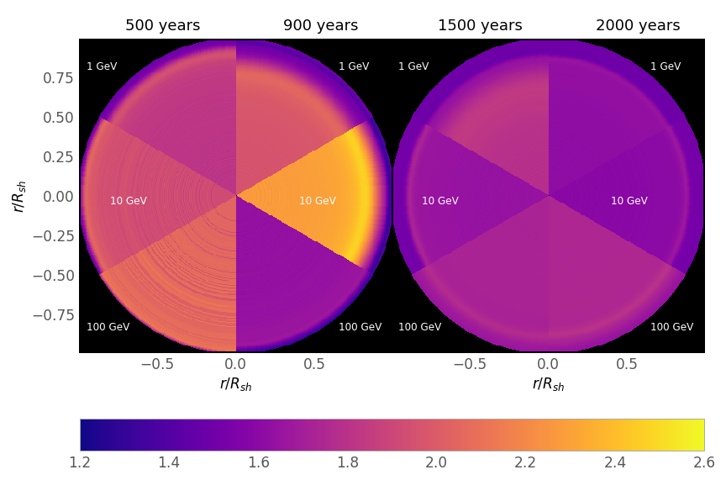
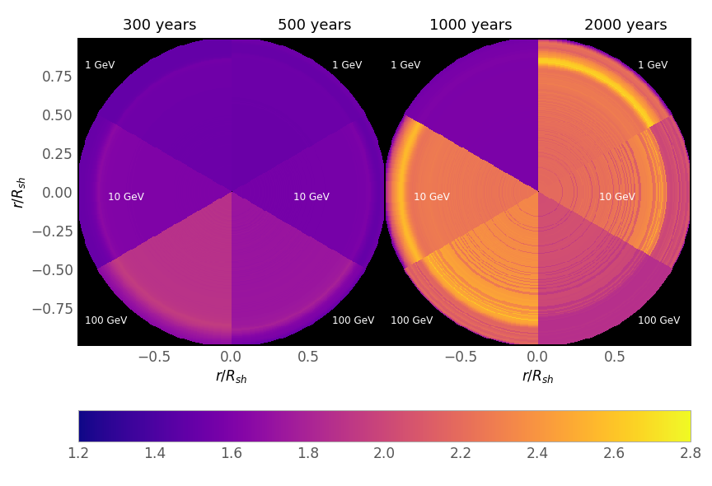


Spectral morphology
RSG
WR
Formation of two components
$$Δα∼1$$
well detectable!
Formation of two components
$$Δα∼0.3$$
$∼$detectable…

Slide 49
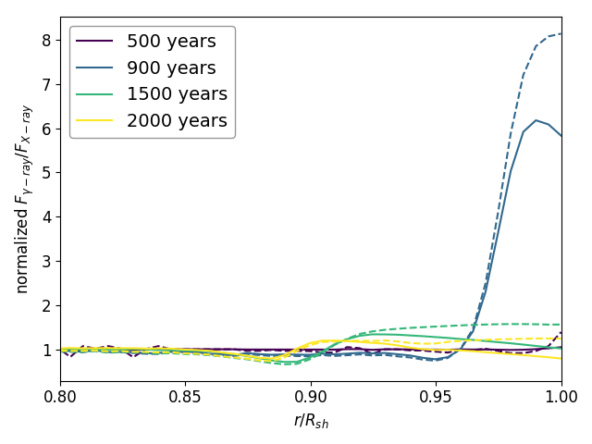
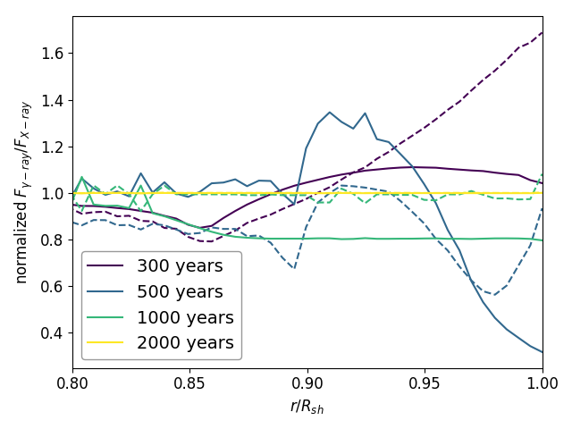
X-ray/gamma-ray correlation?
RSG
Conventionally:
We expect X-rays and gamma-ray to come from the same regions in the leptonic scenario as the emission is created by the same electrons
Lack of correlation suggests hadronic scenario
In reality:
X-ray and gamma-ray morphologies do not necessarily have to correlate as the former one strongly depends on the distribution of the magnetic field
WR
Sushch+, 2022

