Slide 1



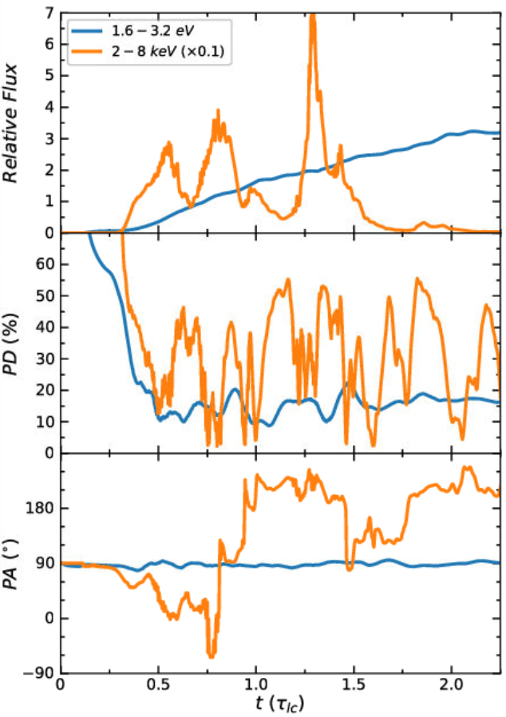
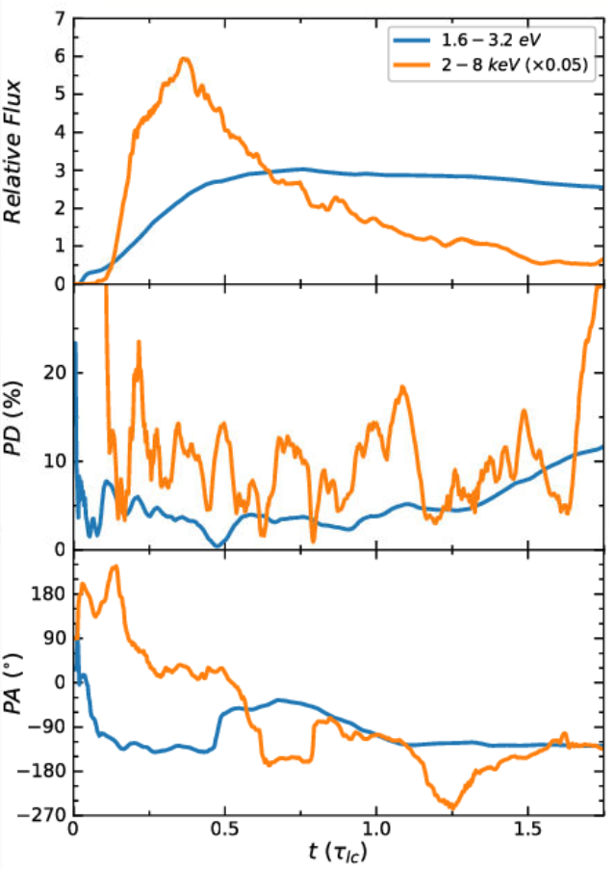
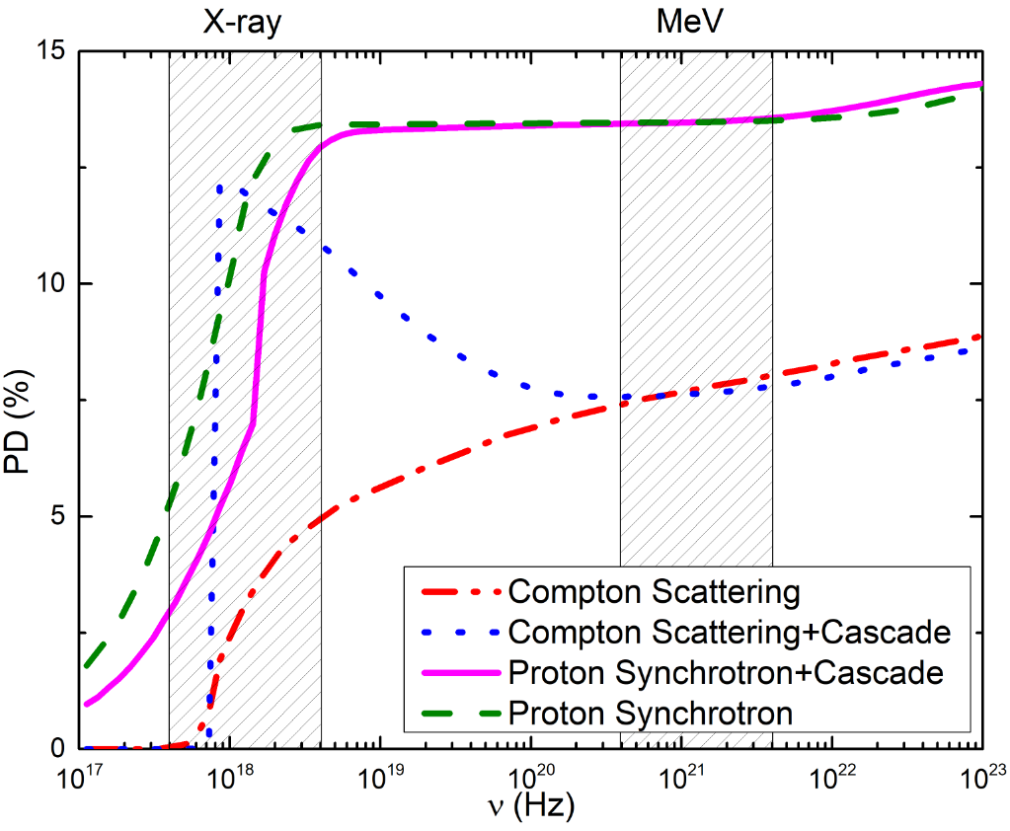
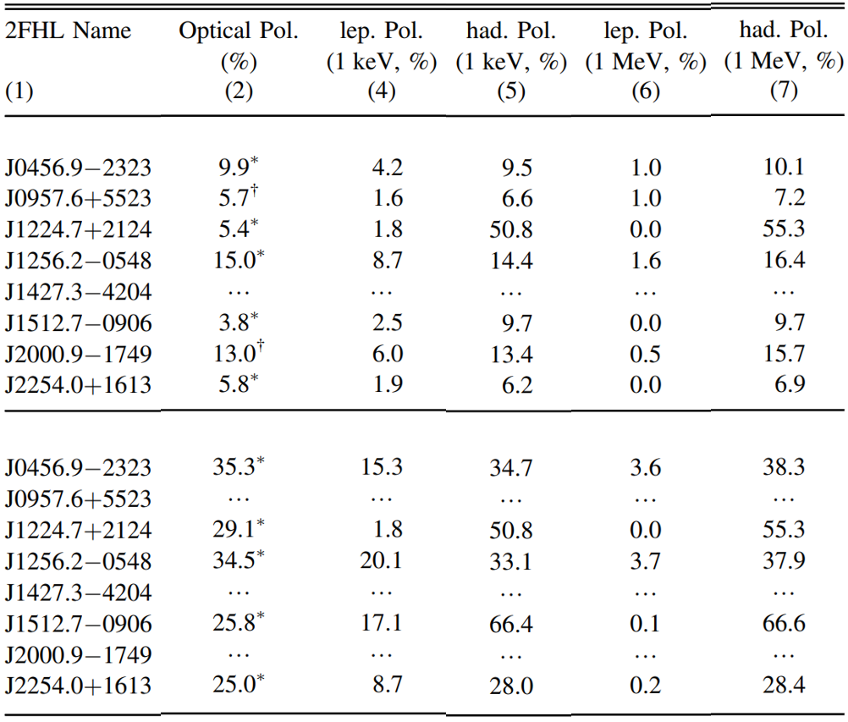
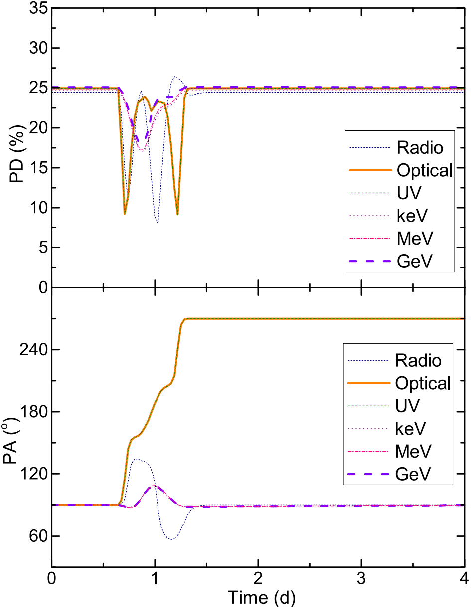
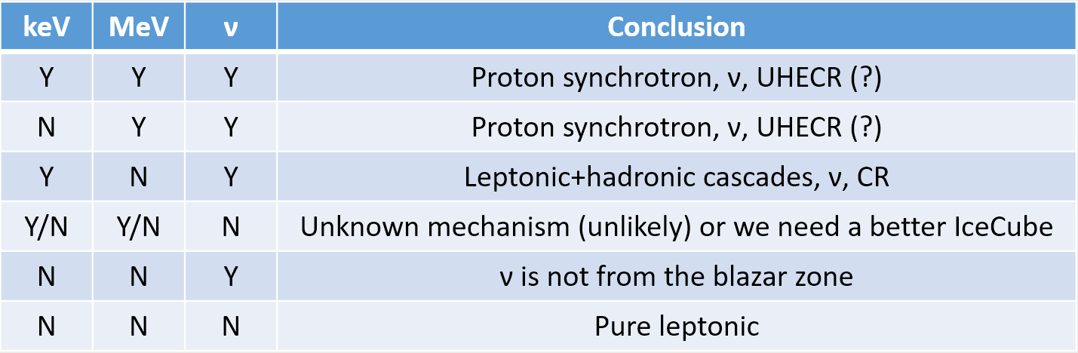
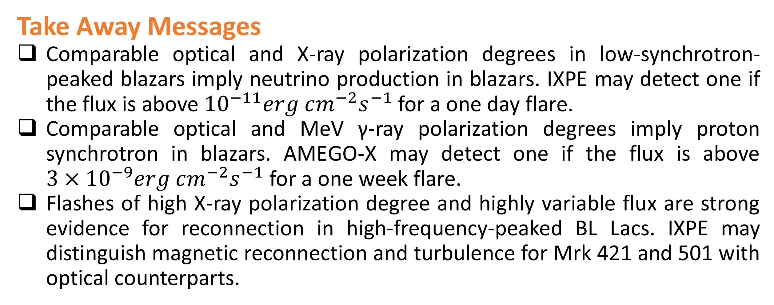
X-ray and MeV Polarization as Powerful Diagnostics for Blazars
Markus Böttcher (North-West University)
Haocheng Zhang (NPP Fellow/NASA GSFC)
haocheng.zhang@nasa.gov
Scientific Goals and Methods
Blazars are among the most powerful cosmic particle accelerators, which can be origins of extragalactic cosmic rays and neutrinos.
Leptonic and hadronic radiation mechanisms give rise to distinct X-ray and MeV γ-ray polarization in blazars.
Time-dependent X-ray polarization can probe the most energetic particle acceleration in high-frequency-peaked BL Lacs.
We use semi-analytical approach to study blazar spectra and predict high-energy polarization and neutrino flux.
We use particle-in-cell and polarized radiation transfer to compare time-dependent X-ray polarization from magnetic reconnection and turbulence.
Take Away Messages
Comparable optical and X-ray polarization degrees in low-synchrotron-peaked blazars imply neutrino production in blazars. IXPE may detect one if the flux is above ${10}^{−11}erg cm^{−2}s^{−1}$ for a one day flare.
Comparable optical and MeV γ-ray polarization degrees imply proton synchrotron in blazars. AMEGO-X may detect one if the flux is above ${3×10}^{−9}erg cm^{−2}s^{−1}$ for a one week flare.
Flashes of high X-ray polarization degree and highly variable flux are strong evidence for reconnection in high-frequency-peaked BL Lacs. IXPE may distinguish magnetic reconnection and turbulence for Mrk 421 and 501 with optical counterparts.
Leptonic and Hadronic Models
Compton scattering by electrons predicts consistently lower polarization degree than synchrotron by protons or hadronic cascading pairs.
Non-detection or up to half of the synchrotron polarization degree implies that the high-energy emission is purely leptonic.
Similar optical and X-ray polarization degrees suggest pair synchrotron from hadronic cascades. IXPE may detect it during bright X-ray flares in low-synchrotron-peaked blazars.
Similar optical and MeV γ-ray polarization degrees are a unique signature for proton synchrotron, implying that the entire high-energy spectral component is dominated by proton synchrotron. AMEGO-X can detect it during bright MeV γ-ray flares in all types of blazars.
Reconnection and Turbulence Predict Distinct X-ray Polarization
Reconnection features highly variable X-ray light curve with multiple peaks, while turbulence has overall smooth X-ray light curve with a clear cooling tail.
Reconnection predicts flashes of high X-ray polarization degree and highly variable polarization angle. While turbulence also predicts highly variable X-ray polarization degree and angle, the polarization degree is much lower.
Reconnection
Turbulence
Fast X-ray flares
Long cooling tail
Flashes of high polarization degree
X-ray and MeV γ-ray Polarization from Hadronic Models are Steady
Protons cool slower than electrons in the hadronic model, their cooling time scale is usually comparable to the light crossing time of the emission region.
While electron synchrotron can trace the local magnetic field evolution, synchrotron by protons and hadronic cascading pairs only react to global magnetic field evolution in the emission region, which happens on much longer time scales.
Whether it is shock, reconnection, or turbulence, hadronic X-ray and MeV γ-ray polarization do not vary significantly in time, even if the electron synchrotron counterparts exhibit strong polarization variability.
Steady X-ray and MeV γ-ray polarization are ideal for current and future high-energy polarimeters.
References
Zhang et al. 2016, ApJ 829, 69
Paliya et al., 2018, ApJ 863, 98
Zhang et al., 2019, ApJ 876, 109
Zhang et al., 2021, ApJ 912, 129
Tenth International Fermi Symposium, Johannesburg 9th–15th October 2022

