Slide 1



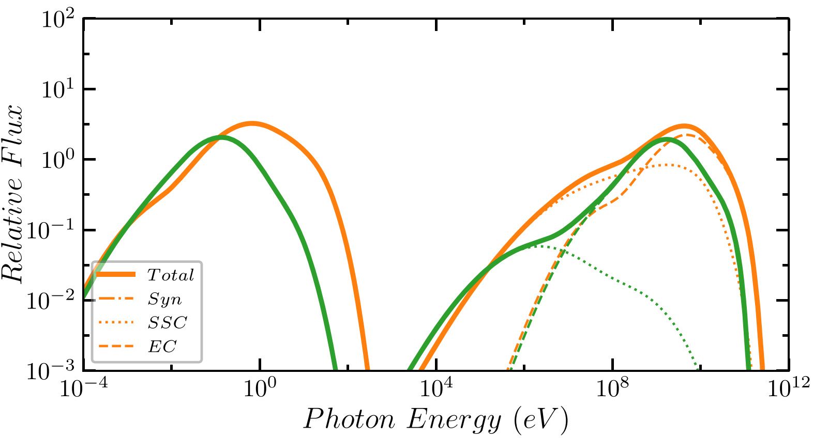
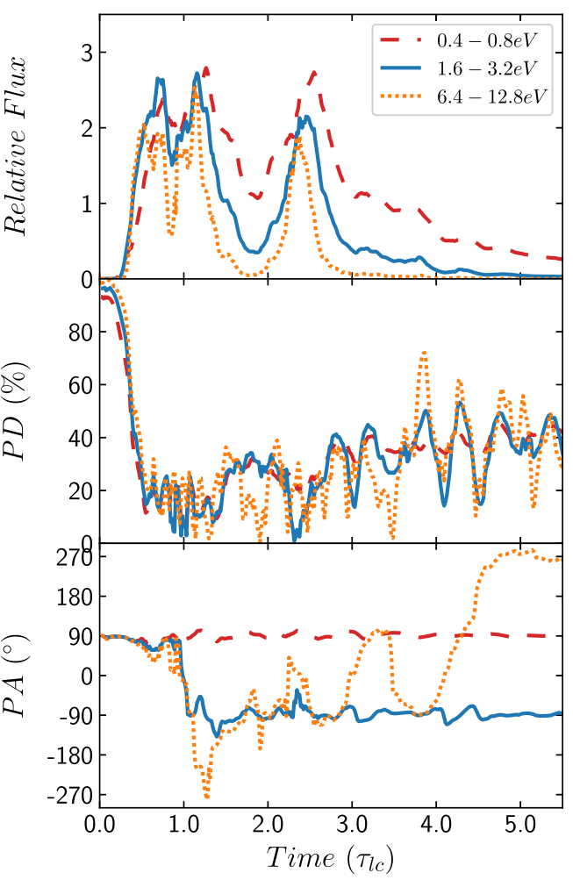
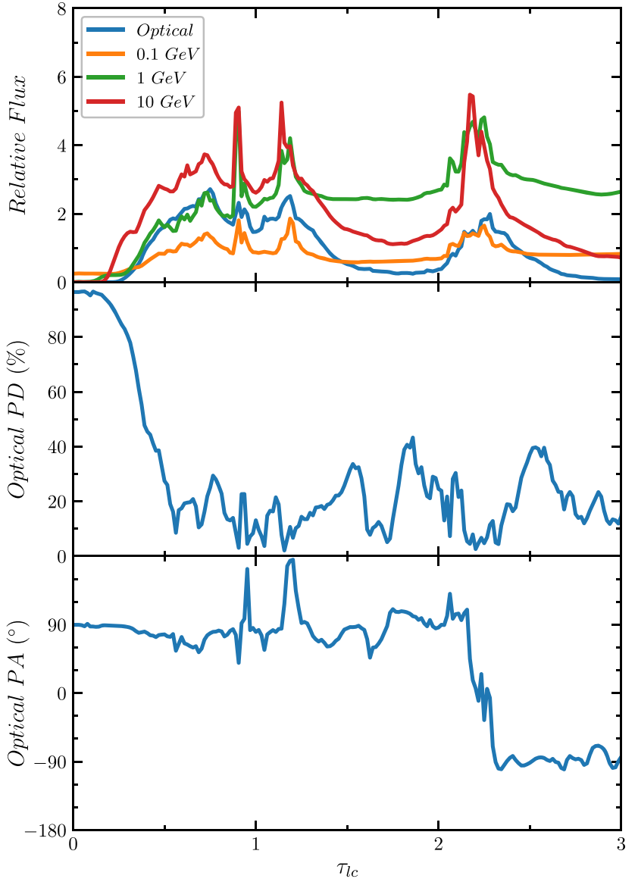
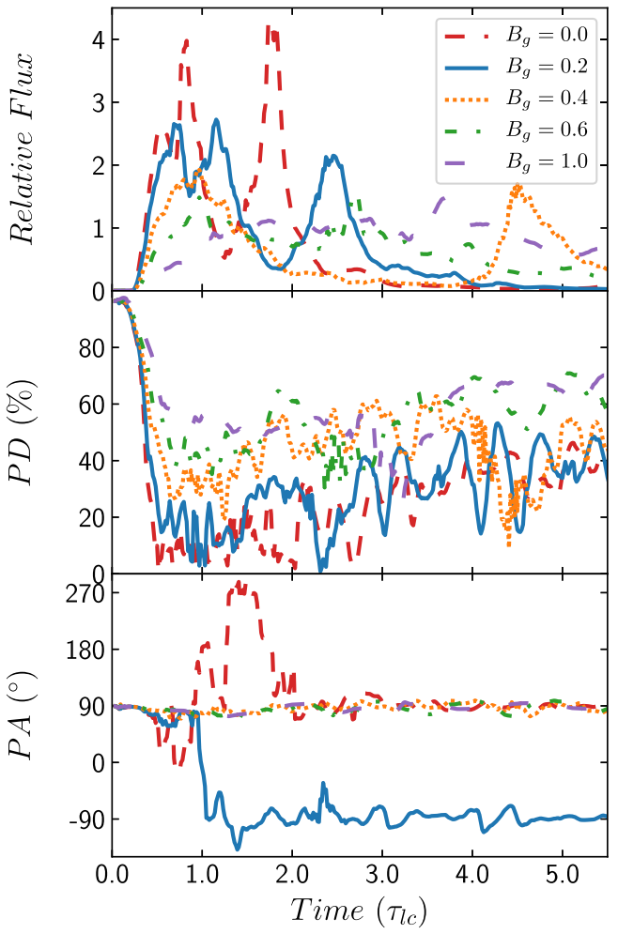
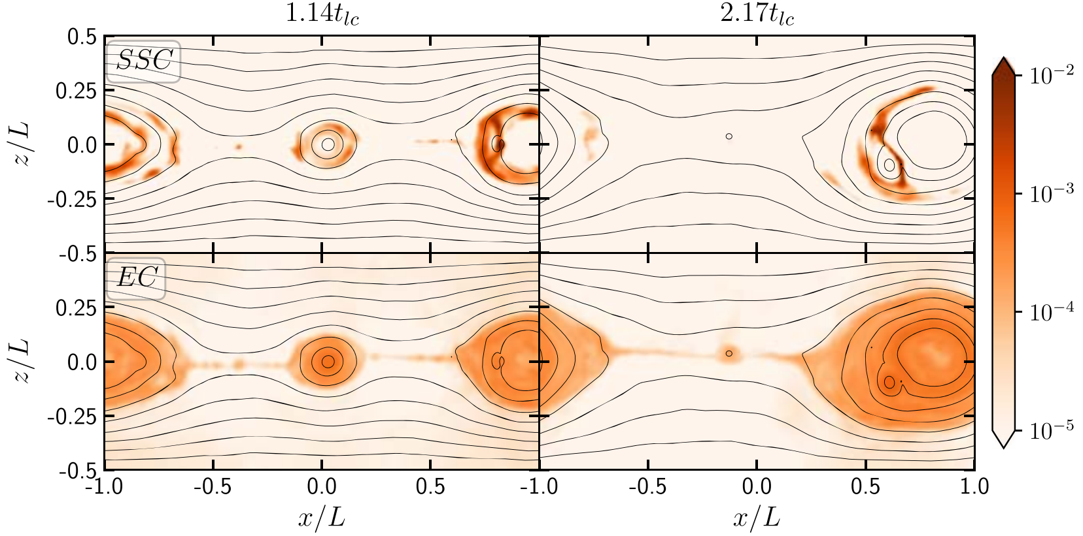
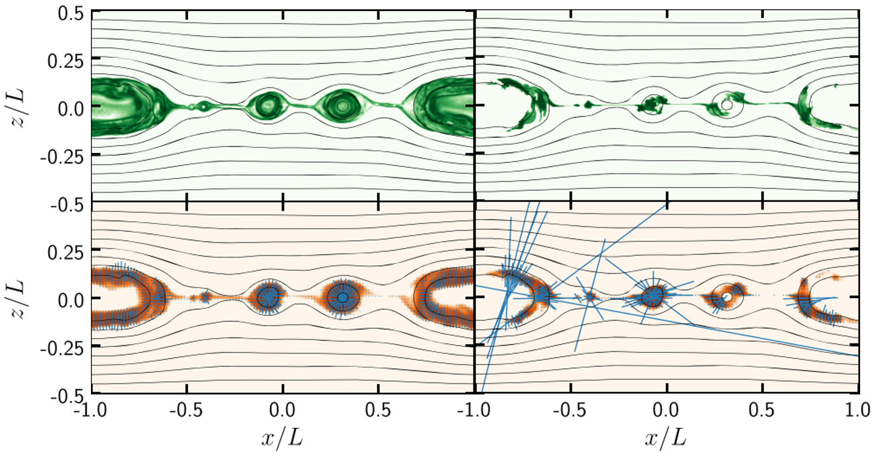
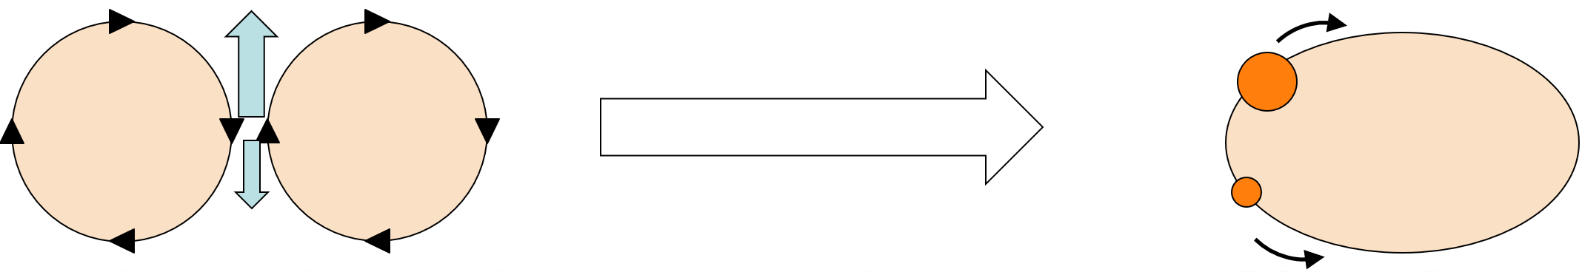
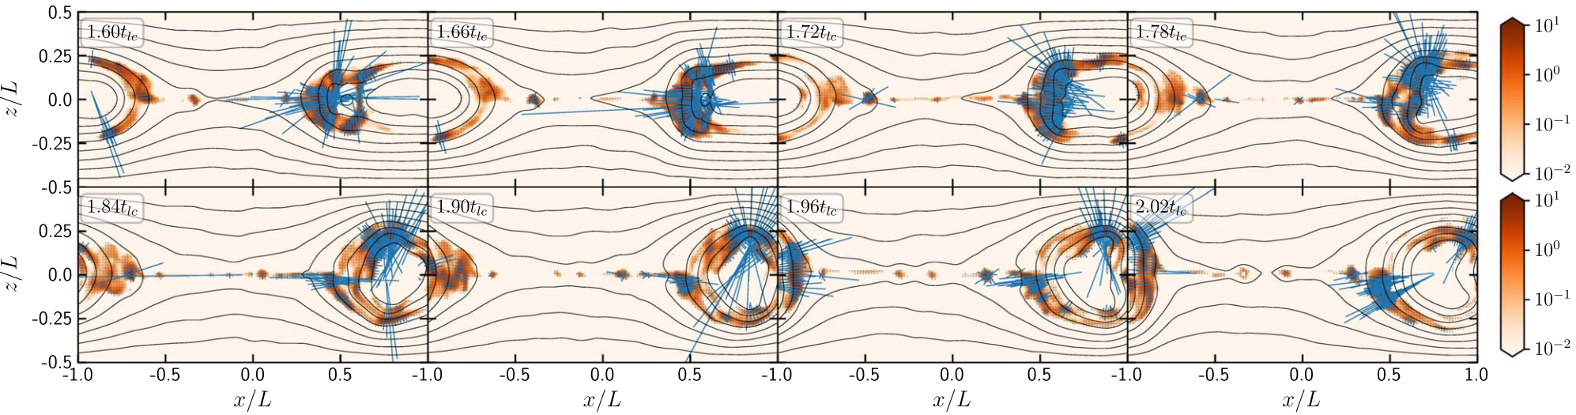
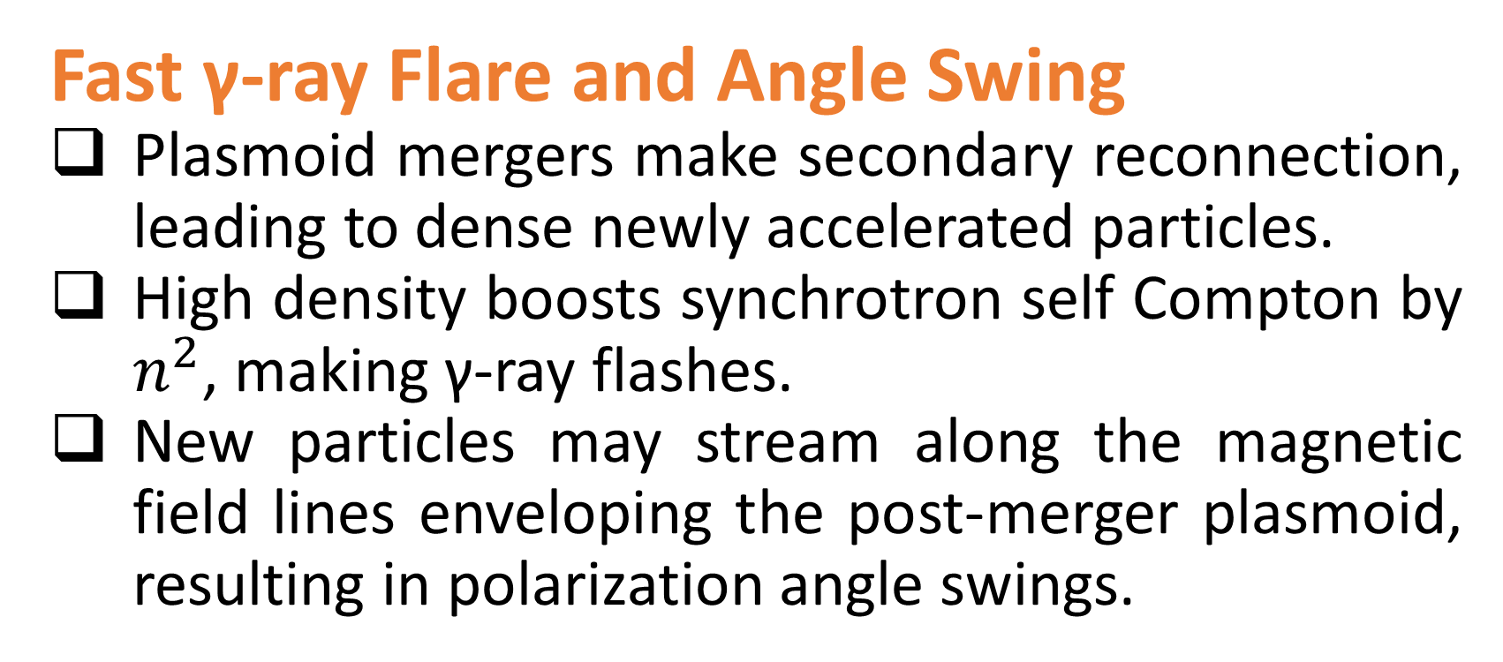
Radiation and Polarization from Magnetic Reconnection in Blazars
Haocheng Zhang (NPP Fellow/NASA GSFC)
haocheng.zhang@nasa.gov
Scientific Goals and Methods
Blazars exhibit highly variable multi-wavelength emission, implying strong particle acceleration in very localized regions.
Magnetic reconnection is an efficient particle acceleration mechanism in a magnetized blazar emission region.
Previous works have not thoroughly explored the multi-wavelength radiation and polarization signatures from reconnection.
We use coupled particle-in-cell and polarized radiation transfer simulations to study observable patterns under first principles.
We focus on the dependence of variability on the physical conditions in the blazar emission region.
Take Away Messages
Reconnection exhibits a harder-when-brighter trend in spectrum.
Higher-energy bands are more variable in flux and polarization.
Fast gamma-ray flares result from synchrotron self Compton by dense nonthermal particles at plasmoid merger sites.
Optical polarization angle swings are correlated to multi-wavelength flares, due to stream of nonthermal particles around the post-merger plasmoid.
Polarization degree drops during angle swings.
Flux and polarization are more variable with lower guide field in the reconnection region. Angle swings are only possible with very low guide field strengths.
Harder-When-Brighter Trend
Particles are accelerated to maximal energy very efficiently, then gradually cool down by radiation. Thus the spectrum is hard at high states.
More Variable at Higher Energies
Higher-energy particles cool faster.
Particles beyond the cooling break occupy less regions, resulting in higher polarization degree.
Those regions are mostly plasmoid mergers, where the acceleration and magnetic evolution are the strongest, leading to stronger variability.
Fast γ-ray Flare and Angle Swing
Plasmoid mergers make secondary reconnection, leading to dense newly accelerated particles.
High density boosts synchrotron self Compton by $n^{2}$, making γ-ray flashes.
New particles may stream along the magnetic field lines enveloping the post-merger plasmoid, resulting in polarization angle swings.
High State
Low State
Spectrum is harder at high state
Fast γ-ray flares
Variability and Guide Field
Lower guide field leads to stronger reconnection and more plasmoids.
More plasmoids imply more disordered magnetic field and more plasmoid mergers.
Strong plasmoid mergers lead to flares and polarization angle swings.
More variable flux and polarization in UV than IR
More variable with lower guide field
Polarization angle swing
Lower polarization degree with lower guide field
Low-energy
High-energy
Dense new particles boost SSC.
Angle swings can happen with very low guide field
References
Zhang et al., 2018, ApJL 862, L25
Zhang et al., 2020, ApJ 901, 149
Zhang et al., 2021, ApJ 912, 129
Zhang et al., 2022, ApJ 924, 90
New particles stream in both directions, if asymmetric, there is a PA swing.
Tenth International Fermi Symposium, Johannesburg 9th–15th October 2022

