Slide 1
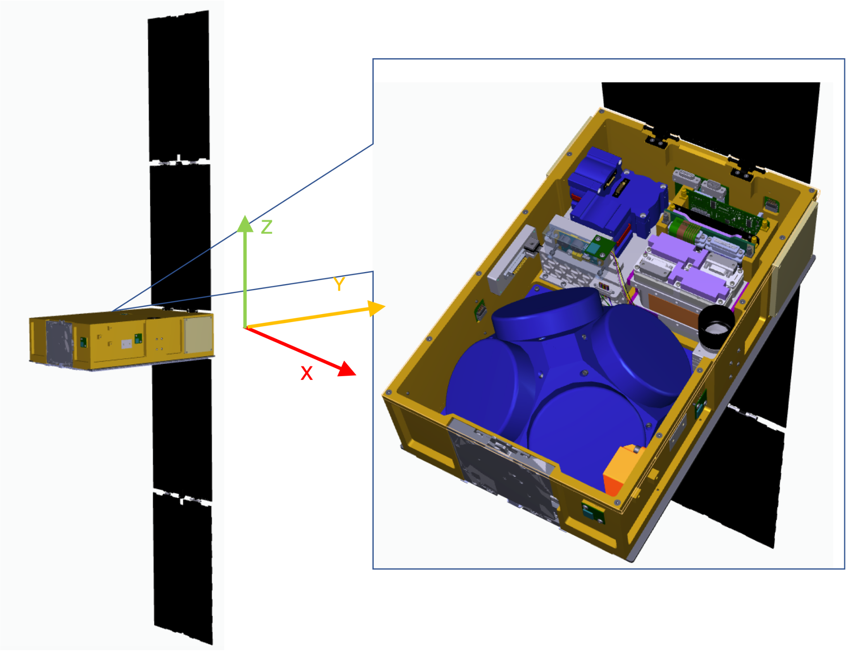
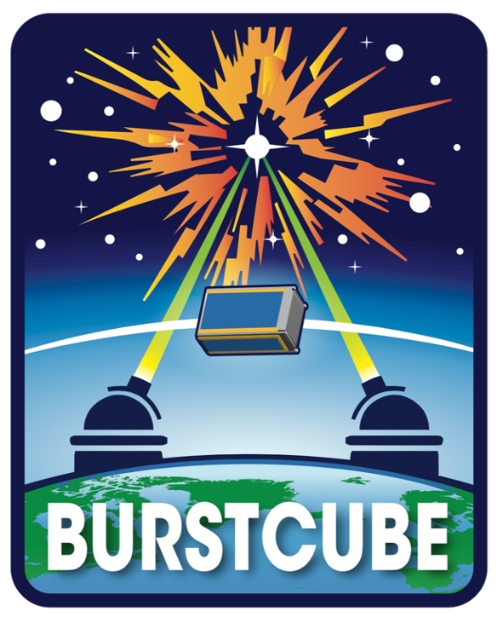
BurstCube: A CubeSat for Gamma-Ray Burst Counterparts to Gravitational Wave Events
Pi Nuessle (Ph.D. student, George Washington University) on behalf of the BurstCube team

Slide 2
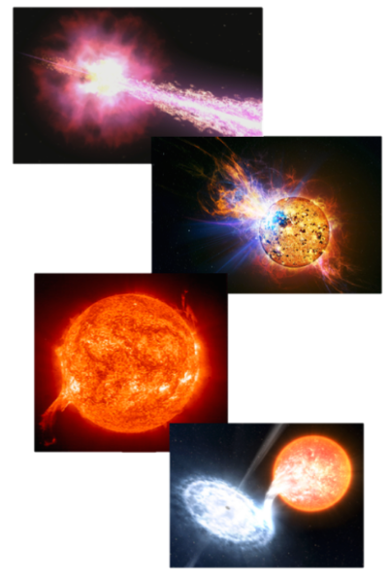
BurstCube’s Science Mission
Primary Goals
Follow-up/coincident GW-GRB triggers with LIGO-Virgo-KAGRA
Provide more coverage of gamma-ray prompt emission complimentary to Swift-BAT and Fermi-GBM
Secondary Goals
Subthreshold searches for other instrument’s GRB triggers initiated by GCN notices
Improving sky coverage for rare and unusual transients
Long and short GRB prompt emission with enough localization to allow other instruments to do rapid afterglow follow-up
Notes:
BurstCube’s purpose is to observe gamma-ray bursts in the entire unocculted gamma-ray sky for a small fraction of the cost of an explorer mission. It will be able to provide rough localization and broadband spectra in addition to accurate light curves. It is most sensitive to 50 kev to 1 MeV, so it makes sense to only have it follow up other instruments’ gamma-ray burst detections. However, it can store and relay some detailed past data on other types of events, including magnetars, solar flares, and terrestrial gamma-ray flashes through the down-to-earth network. It can also accept a limited number of manual requests from the community, as will be discussed later.

Slide 3
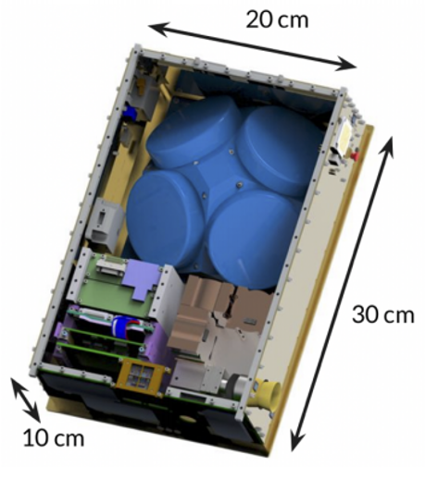
Mission Overview
4U instrument
2U spacecraft components
Capabilities
  FOV: full unocculted sky
  Effective area: 60% 1 BC CsI to 1 GBM NaI
  Energy range: 50 keV to 1 MeV
  Energy resolution: 10% at 662 keV
  Localization: <30 deg. (radius, 90% containment) for 90% of bursts
Current launch date: Early 2023
Notes:
2U instrument–in-house design by Goddard using mostly commercially available, off-the-shelf parts. BurstCube uses both the tracking and data relay satellite system and the direct to earth network.
It will launch in February of 2023 for a one or two-year mission, limited by solar activity and orbital lifetime.

Slide 4
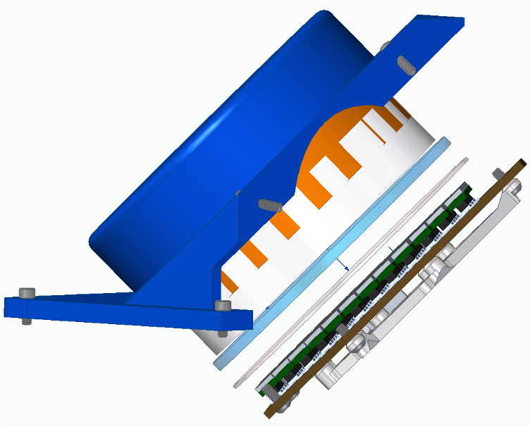
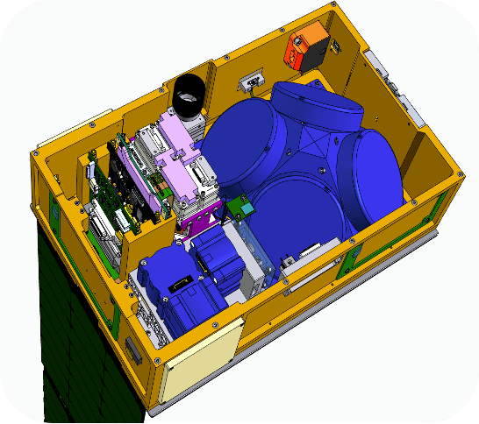
Instrument and Spacecraft detail
Aluminum housing
MEMS Inertial measurement unit
CsI (Tl) scintillator crystal
Star tracker
Solar panel release mechanism
γ
Batteries
Electrical power system
On-board computer
Special services card with GPS
Quartz window to allow light to escape rather than being diffusely reflected
Instrument assembly
Instrument Detector Analog Board (IDAB) which sums the signals. The signal amplitude should be proportional to the true photon energy
3 Magnetic torquers
Radio
3 Reaction wheels
116 Hamamatsu SiPMs
Fine sun sensor
2 S-band antennae
Notes:
Scintillates at 550 nm

Slide 5
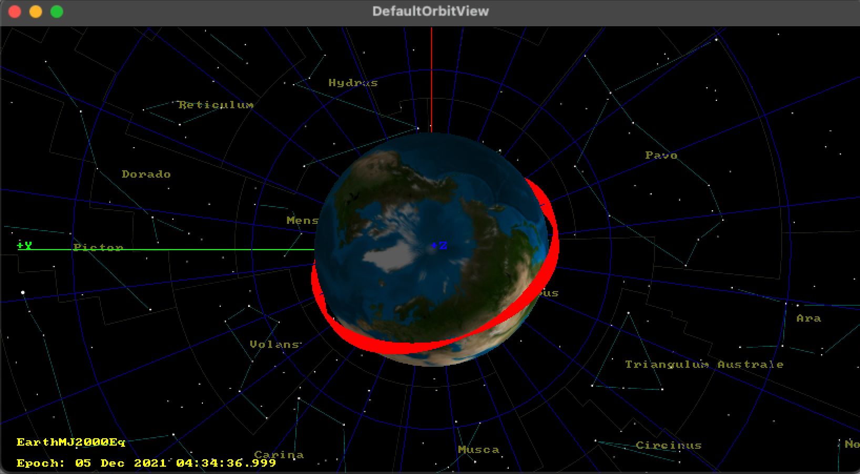
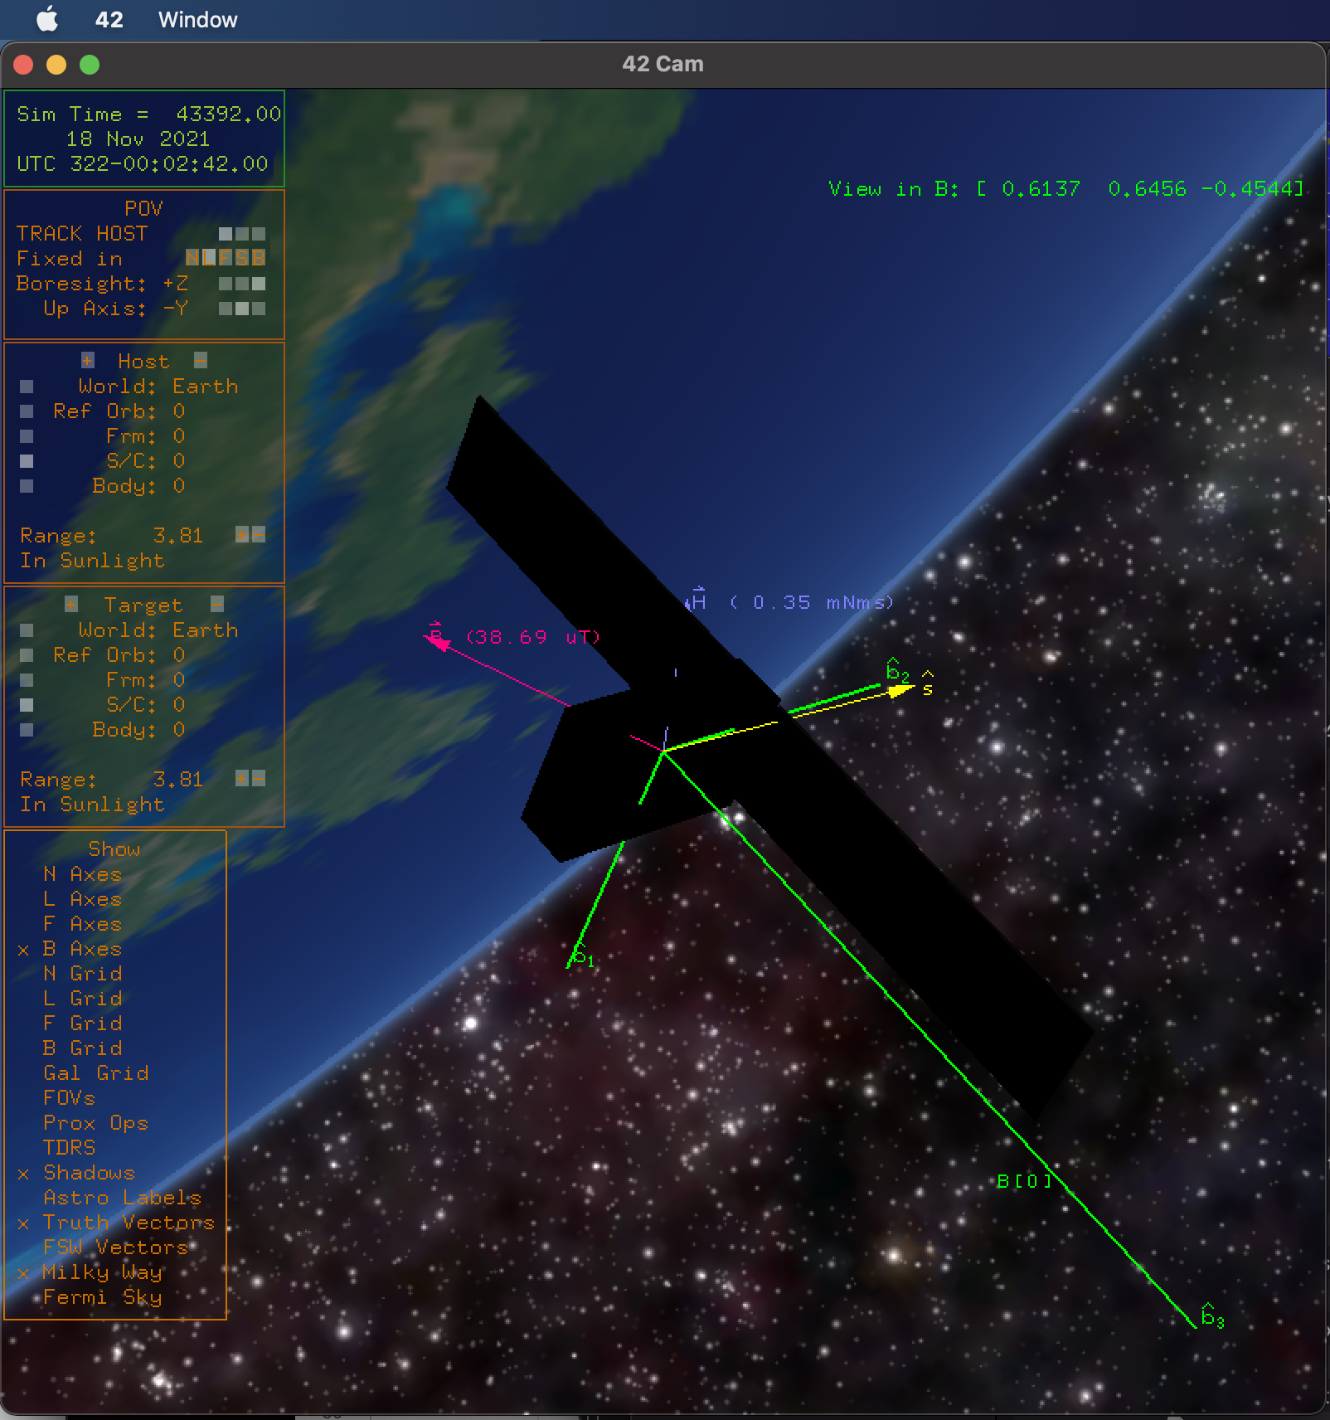
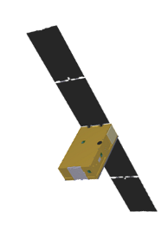

Orbit and Pointing Strategy
ISS-like orbit
  Deployed from ISS
  Low earth orbit (altitude=450 km, i=51.8°)
  Orbit modeled with GMAT (source)
Sky monitoring with repoints for power and drag
  Most of the time, the z-axis of the instrument points away the earth (zenith pointing)
  Beta low (>27 deg), in the daytime the satellite turns towards the sun to maximize power to the solar panels
  Modeled with 42 (source)
Done to develop the science operations
and simulations for the
instrument
z
z
Notes:
BurstCube’s orbit will look similar to NICER but have an energy closer to Fermi-GBM’s. As we will see, this presents some interesting implications to what the instrument sees and its SAA boundaries. There are no boosters on-board.
However, the reaction wheels will turn the instrument away from zenith at low beta on the day side of the earth to maximize power to the solar panels while also minimizing drag on the instrument. This is accounted for in the ACS and time-tagged event software.
BC’s pointing depends on the angle between the orbital plane and the sun (the beta angle)

Slide 6
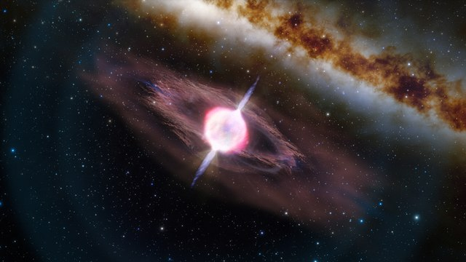
Concept of Operations
First CubeSat!
TDRSS
Mission Operations
Trigger Logic
Within 15 min
Data Buffer
DTE
Once per day
Science Operations
GRB signal
Instrument
Commands for triggers, requests, and binned data; saa; timeline
Noise from Sun, SAA, cosmic rays, etc.
Science
Pipeline
HEASARC
SAA is a convolution of Fermi-GBM and NICER
  Lower altitude than Fermi, but similar energy
  Higher energy than NICER, but similar orbit
  Will be refined on-orbit using spurious triggers
Science Team
Public GCN notice
Buffer Data Requests
Public GCN circular
Notes:
We are the first CubeSat to connect to TDRSS, and it helps our mission to localize and allow follow-up/correlation of GRBs, especially those seen by LVK. It only tells us where and when a burst was, while the detailed data needs to be downloaded from the direct to earth network up to 24 hours later.
Meanwhile, most of the detailed data–the triggered time-tagged event data, the requests, and the daily instrument housekeeping–as well as the continuous binned data are all downloaded once per data from the DTE. We will always download all of the day’s binned data and all of its triggers, but that may only leave limited space for any instrument and community requests. The availability is also limited because solar activity slowly fills the data buffer with noise, overwriting the oldest data.

Slide 7
Data Types–Prompt Data (TDRSS)
Data type |  | Resolution | Network | Latency
Alert Trigger data | ATD | 50 or 2000 ms/16 chan. | TDRSS | <15 min
Trigger housekeeping | Trigger HK | 1024 ms/- | TDRSS | <15 min
Notes:
Finally, we reach the types of data we can expect from BurstCube. There is the continuous binned data, which will be downloaded once per day through the Direct to Earth network. It encompasses all the data from the past 24 hours that did not occur during an SAA pass, coarsely binned in energy and time. It has its own housekeeping data which monitors the health of the instrument.
There is also the Alert Trigger Data, which comes down through TDRSS as soon as possible after the instrument triggers. It relays what the burst looked like, where it was, and when, so that it can be added to the triggered time-tagged event download timeline. Again, it has its own form of housekeeping that also comes down through TDRSS.
Finally, the triggered time-tagged events and requested time-tagged events are data downloaded from the instrument once per day through the Direct to Earth Network that are finely-binned in energy and time. While triggered events are likely to come from the past 24 hours, requests may sometimes be pulled from 48 to 72 hours before the download time depending on solar activity filling up the data buffer.

Slide 8
Data Types–Full Data (DTE)
Data type |  | Resolution | Network | Latency
Continuous binned data | CBD | 256 ms/16 chan. | DTE | <24 hr.
Triggered time-tagged event data | T³E | 1 ms/1024 chan. | DTE | <24 hr.
Requested time-tagged events | RTTE | 1 ms/1024 chan. | DTE | Possibly 24-48 hr
Daily housekeeping | Daily HK | 1024 or 60 s/- | DTE | <24 hr.
Notes:
Finally, we reach the types of data we can expect from BurstCube. There is the continuous binned data, which will be downloaded once per day through the Direct to Earth network. It encompasses all the data from the past 24 hours that did not occur during an SAA pass, coarsely binned in energy and time. It has its own housekeeping data which monitors the health of the instrument.
There is also the Alert Trigger Data, which comes down through TDRSS as soon as possible after the instrument triggers. It relays what the burst looked like, where it was, and when, so that it can be added to the triggered time-tagged event download timeline. Again, it has its own form of housekeeping that also comes down through TDRSS.
Finally, the triggered time-tagged events and requested time-tagged events are data downloaded from the instrument once per day through the Direct to Earth Network that are finely-binned in energy and time. While triggered events are likely to come from the past 24 hours, requests may sometimes be pulled from 48 to 72 hours before the download time depending on solar activity filling up the data buffer.

Slide 9
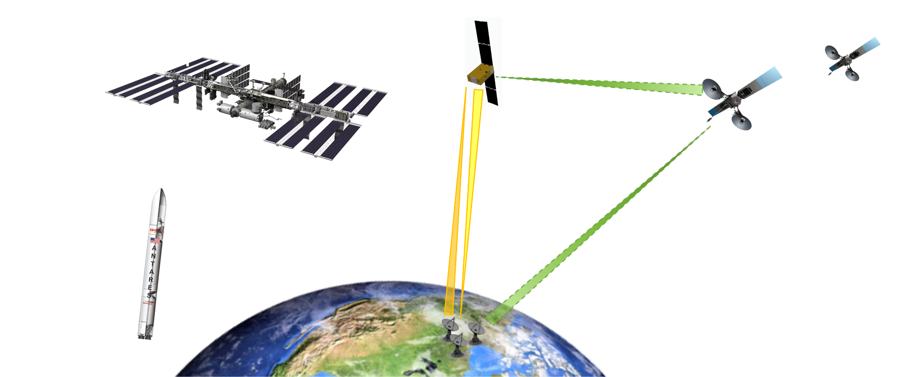
Why we take unbinned data requests
BurstCube cannot download all the unbinned data in the buffer
  We do not have Fermi’s bandwidth
We can sometimes analyze binned data for untriggered events, then request unbinned data
  ~48 hours of allowable data, depending on the sun, the SAA, and other sources of noise
We can take requests from multiple sources
  Automatically from GCN notices, especially from LVK
  Manually through a website for observers for any observation type that includes a position and does not occur in the SAA
More detail on my poster

Slide 10
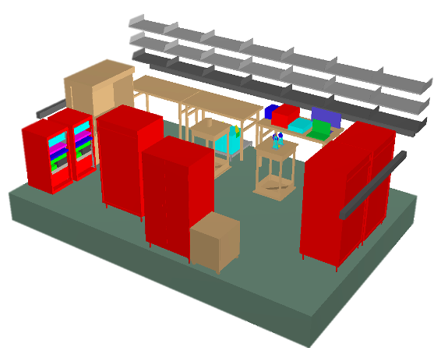
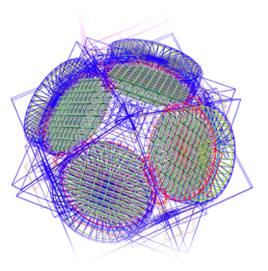
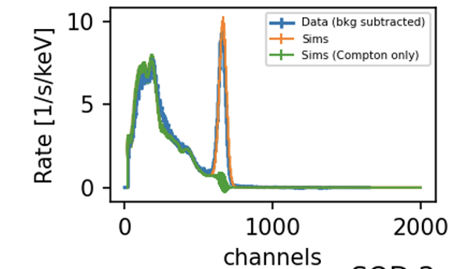
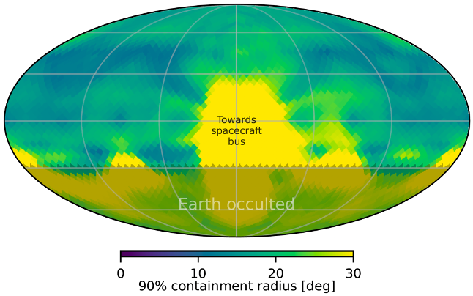
Calibrations and Simulations
Two calibration campaigns (single detector, and flight instrument) completed
Next campaign (full observatory) coming up
To the left are mass models of instrument and lab
used in MegaLib sims
Below are images showing how well the data compares to simulation
Alyson Joens
Notes:
As one can see in these figures created by our former Ph.D. student Alyson Joens, the effective area of BurstCube meets the requirement to be 70% of Fermi-GBM’s at 100 keV and 15 degrees. It actually exceeds its energy sensitivity requirements, with preliminary results suggesting it may give accurate results all the way out from 30 keV to 1.3 MeV instead of 50 keV to 1 MeV. It easily meets its spectral resolution goal. It also satisfied the requirements by being able to localize 90% of bursts better than 30 degrees. These loose localizations are the main advantage of Fermi and Swift, and they are limited due to the uneven distribution of detectors in the BurstCube instrument. The only complication is that these calibrations were done before the full instrument was integrated, and they will need to be done a third time on the full observatory.

Slide 11
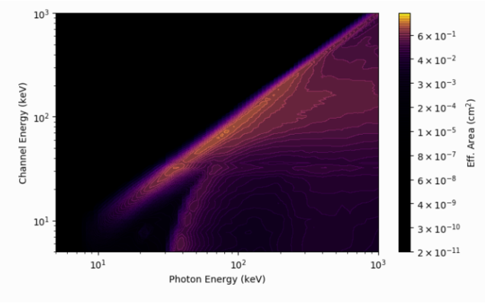
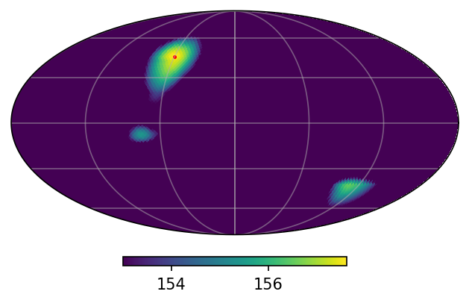
bc-tools
Open source python package for analyzing BurstCube data
Built on the gbm-data-tools
Towards an effort to make detector-agnostic programming interface for count-based gamma-ray instruments
Open source: https://gitlab.com/burstcube/bc-tools
Israel Martinez
Joe Asercion
Channel energy (keV)
Image showing how well BC is simulated to localize a point source
Photon energy (keV)
Notes:
Bc-tools is a python package that acts as an expansion of the gbm-data-tools to all gamma-ray count-based instruments. When given an instrument’s Detector Response Matrix from another program like MegaLib, bc-tools can extract the appropriate response function for a given detector and direction. It can also calculate event localizations using healpix, which allows a probability confidence region to immediately be released. It will also encapsulate data processing, detector response generation, data binning and light curve generation, and spectral fitting.

Slide 12
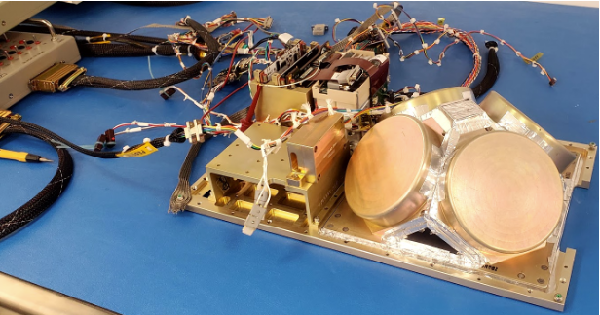
Current Status
Integration with spacecraft ongoing
  Upcoming environmental testing
  Upcoming calibrations
Flight and ground software
Developing procedures
Communications testing
Delivery in December
Launch early next year
  Rideshare to ISS
  Deployment: 1 week – few months
  Commissioning: 1 month
  Duration: 1-2 years
Notes:
Currently, the engineering team is integrating BurstCube into its housing and doing final testing before it is sent to for observatory calibrations. Once that is completed, the instrument should only need a few weeks of calibrations and some response function modeling before it will physically be ready.
On the software side, the prompt detections and localizations are still being modeled. They need to be done before launch. The instrument flight software is also being developed and tested.
Finally, the bc-tools should be fully documented online very soon.

Slide 13
Summary
Large FOV and good spectral resolution allow it to capture GRBS that could be coincident with BNS mergers
  Subthreshold events could be downloaded at a later time at high resolution thanks to the DTE network
Localizations allow for rapid afterglow follow-up by other instruments
Improving sky coverage for rare and unusual transients
  They will be prioritized and may be downloaded in high-resolution if solar activity and trigger events allow

Slide 14













The full BurstCube team
PI: Jeremy Perkins (NASA/GSFC) Website: https://asd.gsfc.nasa.gov/burstcube/
Clemson
Dieter Hartmann
CRESST/GSFC
John Krizmanic
Israel Martinez
CUA/GSFC
Alessandro Bruno
Teresa Tatoli
Delaware
Isabella Brewer
GWU
Sylvain Guiriec
Alyson Joens
Grant Mitchell
Pi Nuessle
NASA/MSFC
Michelle Hui
Daniel Kocevski
Colleen Wilson-Hodge
LSU
Eric Burns
NASA/Glenn
Lucia Tian
NASA/GSFC
Regina Caputo
Brad Cenko
Georgia de Nolfo
Carolyn Kierans
Julie McEnery
Ava Myers
Judith Racusin
NRL
Lee Mitchell
Jacob R. Smith
UAH
Michael Briggs
Boyan Hristov
UCD
Lorraine Hanlon
Sheila McBreen
David Murphy
Alexey Uliyanov
Sarah Walsh
UMD
Peter Shawhan
USRA
Adam Goldstein
Oliver Roberts
UVI
Antonino Cucchiara
David Morris
Wisconsin
Sean Griffin

Slide 15
Notes
Likely to see 100 long and 20 short bursts per year based on current models
  Based on Fermi-GBM’s rate of roughly 200 bursts per year, the orbital mechanics of the two instruments, the relative sensitivities, and so on
Still modelling how many of those will probably be coincident with LVK
Raises the gamma-ray sky coverage from roughly 60% to 95% or above
  However, not as sensitive to low energies as GBM and only goes up to 1 MeV

Slide 16
Requesting Data
Prioritized:
Most detailed,
Most likely to have gamma-rays
Made by people
Passes out of buffer soon
GW-GRB joint events
Seen better
Priority | Criteria
10 | Automated triggers of simultaneous GW-GRB events
9 | Automated triggers from LVK that likely contain a neutron star
8 | Community-requested events that are well-localized
7 | Extended time on triggered time-tagged events
6 | Community requested triggers that are poorly localized
5 | Automated external triggers of GRBs
4 | Community requests that only included a time
3 | Automated requests of GRBs or NS GWs that were poorly localized
2.5 | Automated Requests of Terrestrial Gamma-ray Flashes
2 | Automated requests of solar events
1 | Automated requests of GW events that were likely to be binary black hole mergers
Notes:
Because there is such a wide range of times and ways that requests can come in, the code which accepts RTTE requests must prioritize them following this table. The main way that automated requests will be accepted is through GCN notices and alerts, which will be read, turned into a request, and added to the request timeline on the Missions Operation Computer to be uploaded to the instrument. The main way that community requests will be handled is via a webform that again, turns the request into a machine-readable request, accepts or rejects it with a prioritization (or error) code, and sends it to the MOC to be prioritized and added to the download timeline uploaded to the instrument. The only exception to these rules is the extended time of T3E, which is requested by the science operators to get more information on something BurstCube triggered on but is still added to the MOC download timeline.
These requests all fall below the triggered data downloads. They make it possible to download detailed data that was slightly off-axis for the instrument or for events that are not short GRBs (and therefore don’t meet the typical triggering algorithm). There is only about 2Gb of data download possible per day, meaning not all requests will be downloaded.

Slide 17
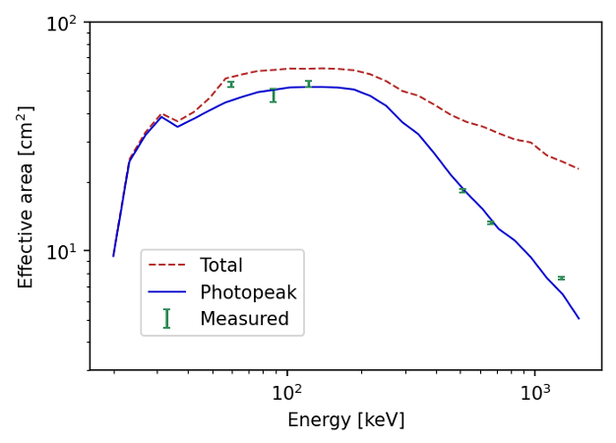
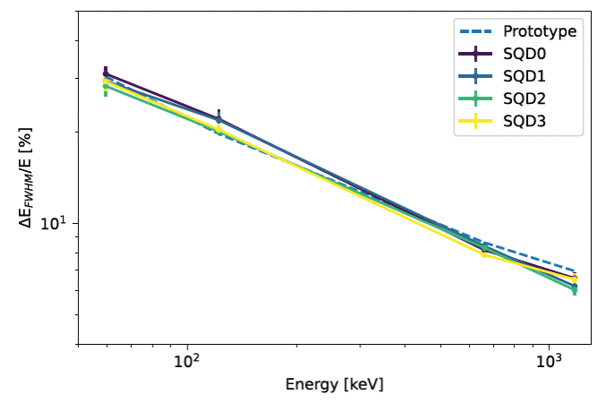
Raw data from our calibrations

Slide 18
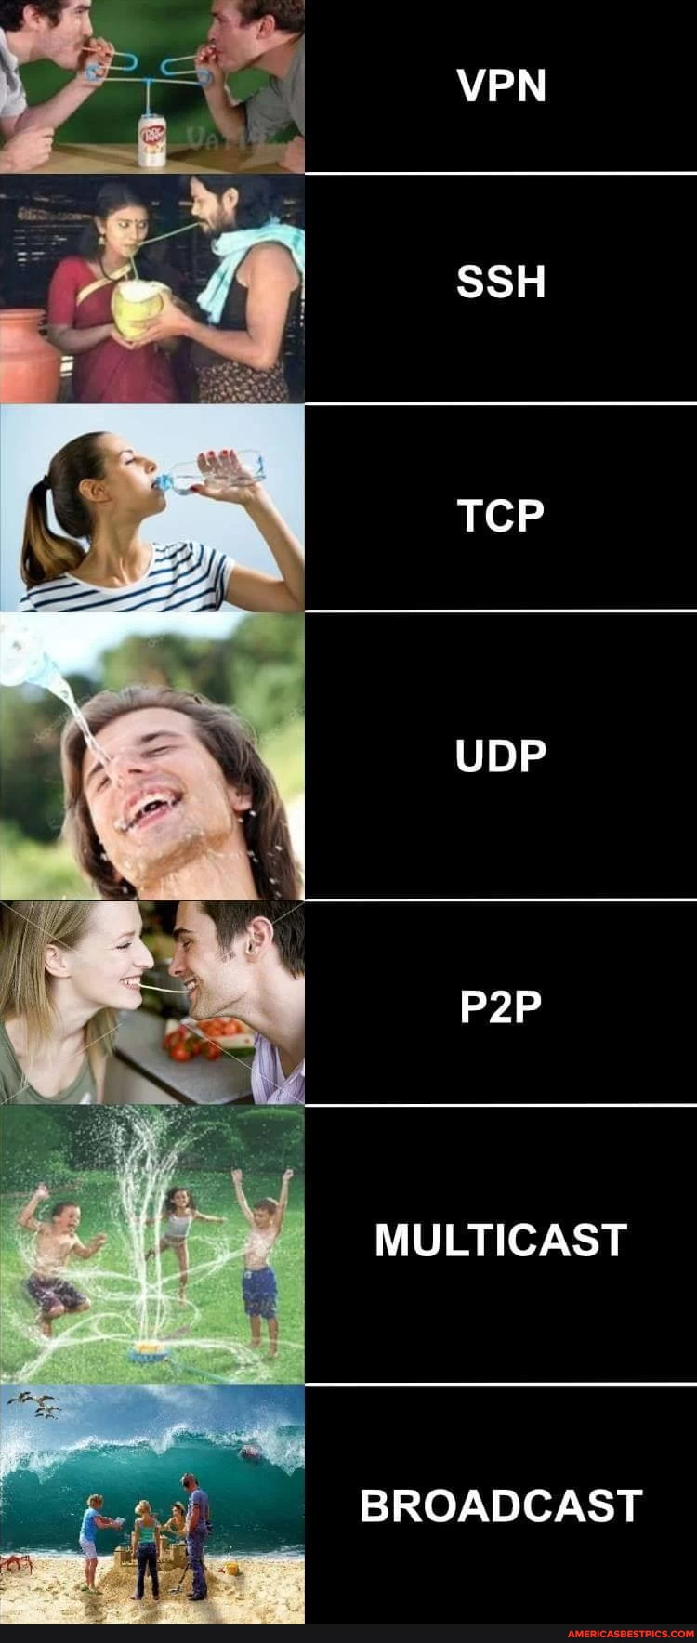
How data is downloaded
Most like this one
We do data initialization through File Transfer Protocol (FTP) handshaking
Makes sure that the file exists on the the buffer
Ensures the connection is secure
Does take up some space that could used for data

