Slide 1

The Moon Burst Energetics
All-sky Monitor (MoonBEAM)
Cori Fletcher (USRA)
The MoonBEAM Team
cfletcher@usra.edu
Notes:
12 min +3 min for questions

Slide 2

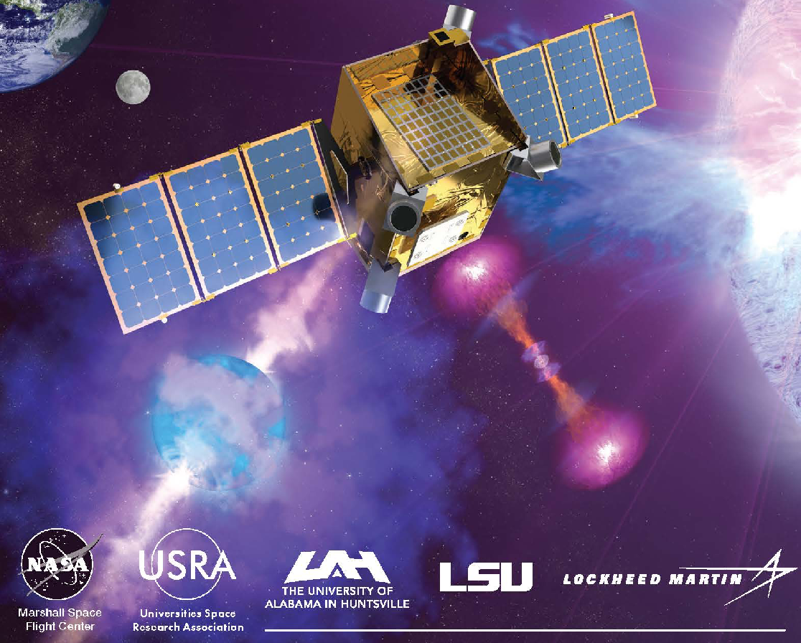
MoonBEAM Overview
Science Goals:
  explore the behavior of matter and energy under extreme conditions by observing relativistic astrophysical explosions.
3-year gamma-ray mission:
  Provides time for observations of :
    1600 binary compact mergers
    5900 optically discovered core collapse supernovae
    140 magnetar giant flares
    and enables 55 very high energy gamma-ray and 360 optical follow-up
Cislunar orbit:
  instantaneous all-sky gamma-ray field of view
  uninterrupted observations with >96% duty cycle
  background radiation stability
Astro2020 Decadal Survey:
Astronomical Transient Events
“Higher sensitivity all-sky monitoring of the high-energy sky, complemented by capabilities in the optical such as from Kepler and TESS, is a critical part of our vision for the next decade in transient and multi-messenger astronomy.”

Slide 3
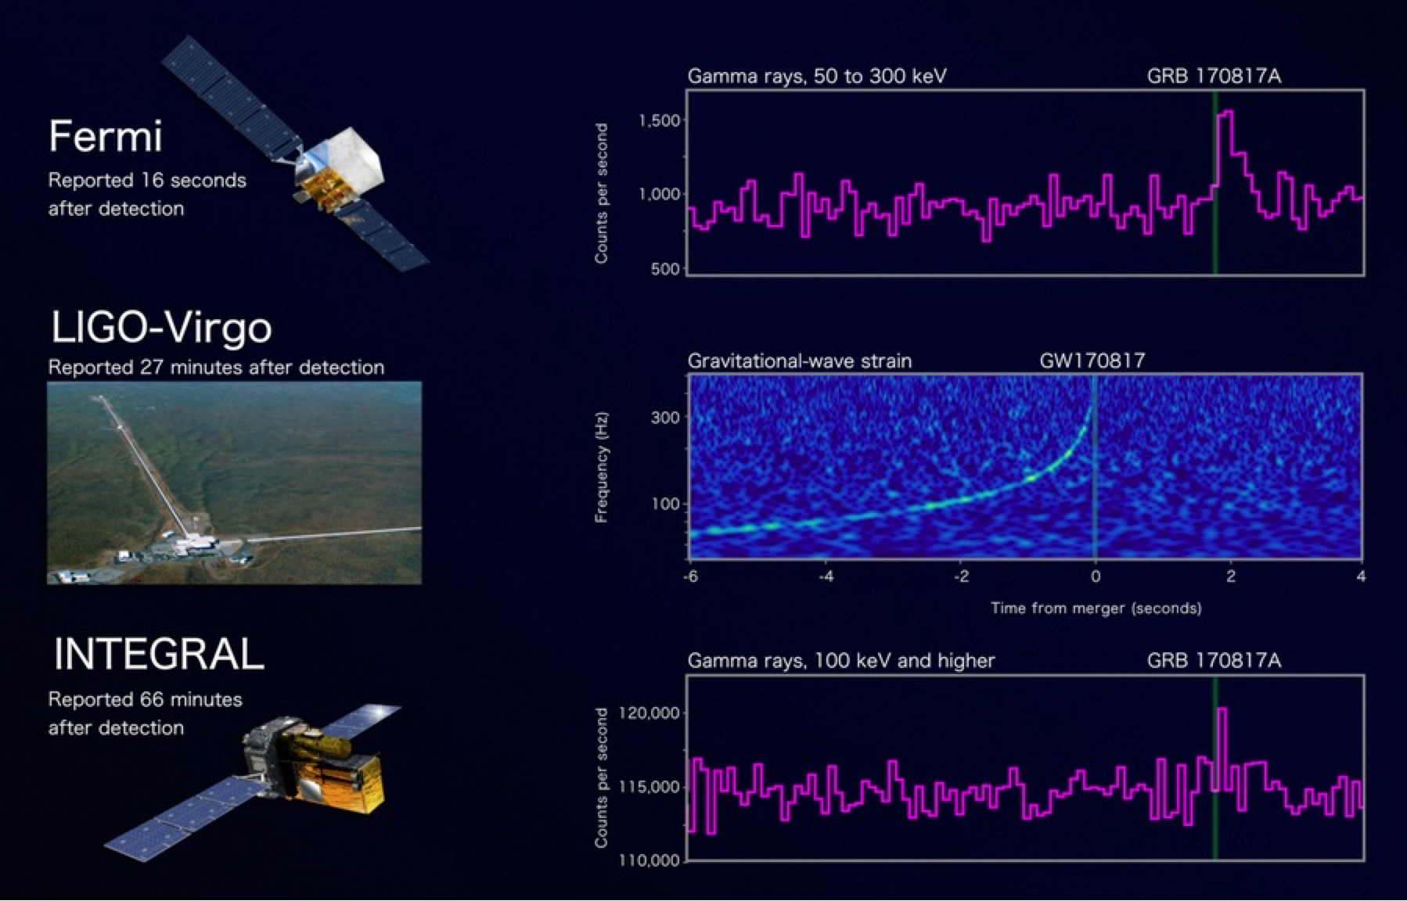
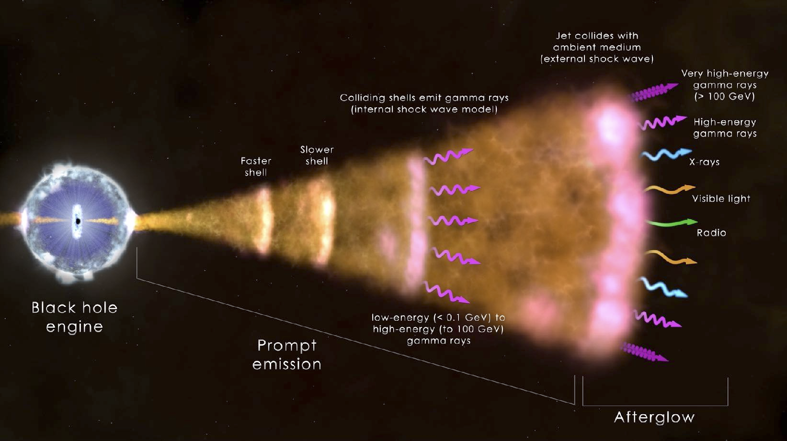
Science: GRBs
Gamma-ray Bursts (GRBs): most energetic explosions in the Universe.
  Multiwavelegnth: detected from radio to gamma rays.
  Multimessenger: can generate gravitational waves, neutrinos, and cosmic rays.
  Transient nature:
    prompt emission in gamma rays, lasting <1s to >100 s.
    afterglow starting within minutes and can last up to years.
    detectable ~once per day, distributed all over the sky.
Era of Multi-Messenger Astrophysics
  Open Questions: merger and jet geometry,intrinsic properties etc.
  Need a population of joint detections.
  LVK O4 coming up in March!

Slide 4
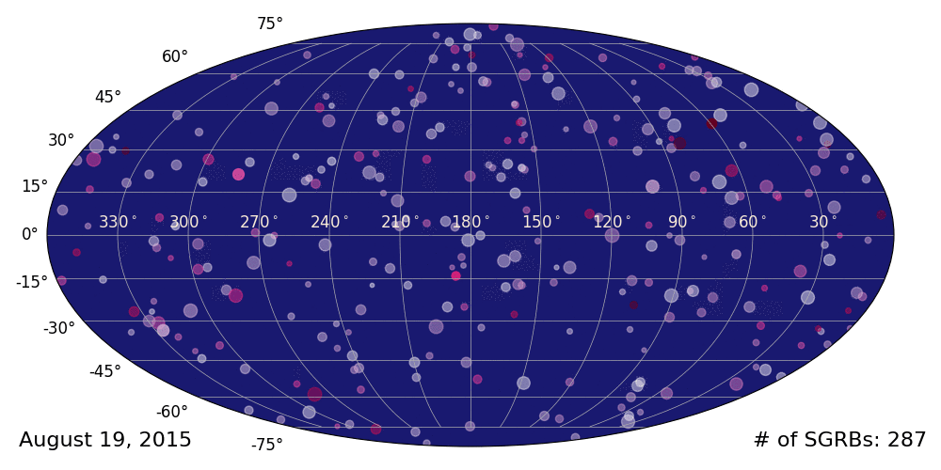
Science: GRBs
Gamma-ray Bursts (GRBs): most energetic explosions in the Universe.
  Multiwavelegnth: detected from radio to gamma rays.
  Multimessenger: can generate gravitational waves, neutrinos, and cosmic rays.
  Transient nature:
    prompt emission in gamma rays, lasting <1s to >100 s.
    afterglow starting within minutes and can last up to years.
    detectable ~once per day, distributed all over the sky.
Era of Multi-Messenger Astrophysics
  Open Questions: merger and jet geometry,intrinsic properties etc.
  Need a population of joint detections.
  LVK O4 coming up in March!

Slide 5
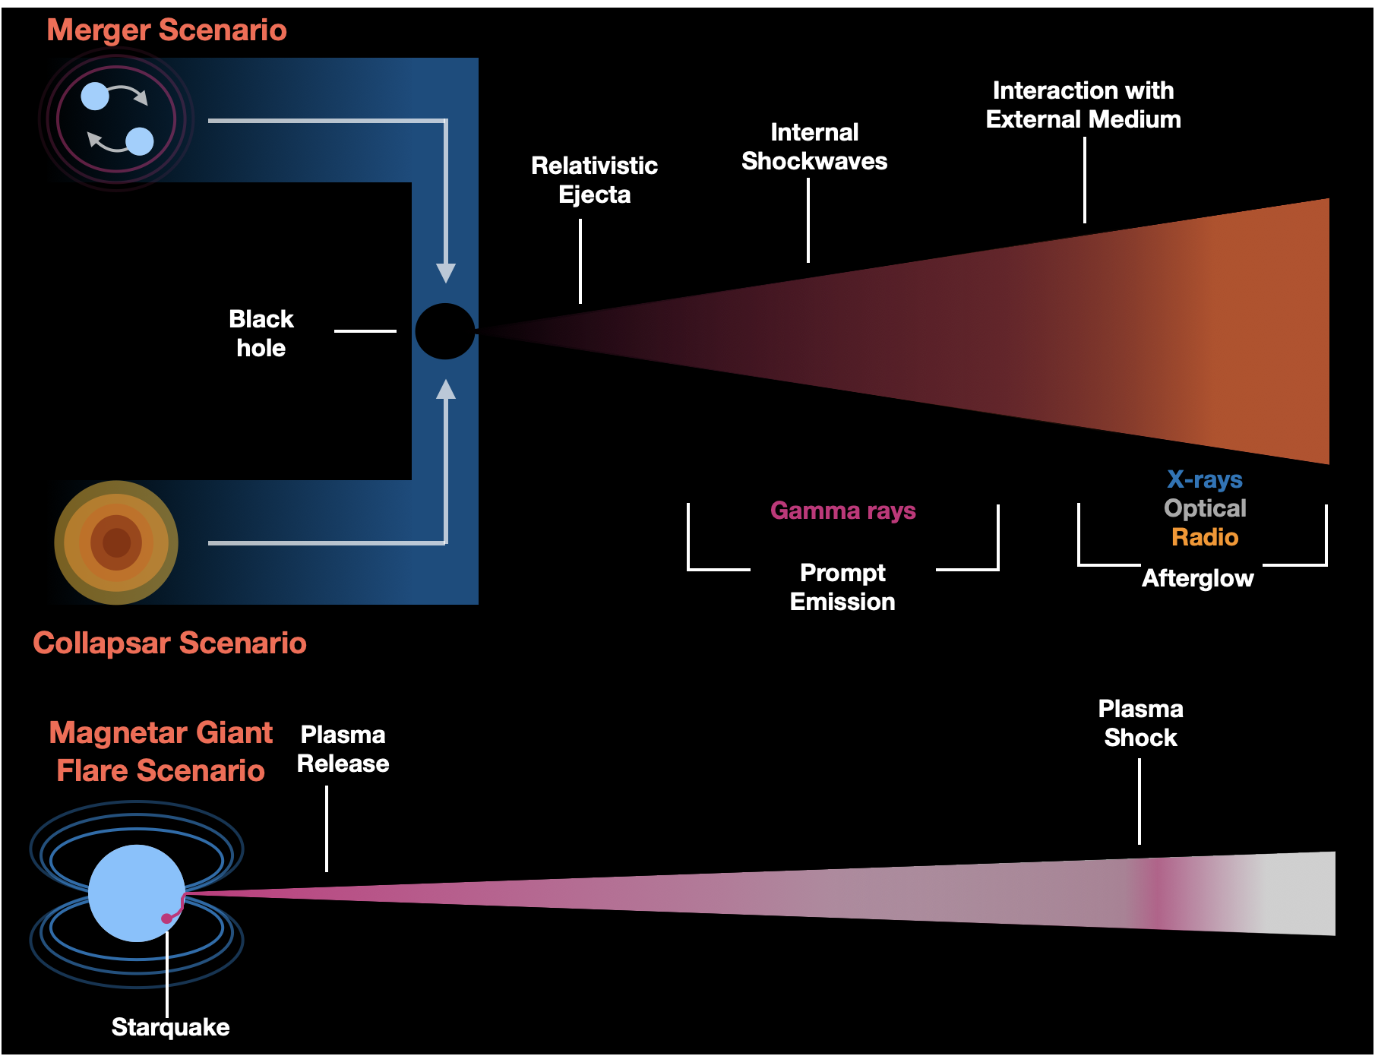
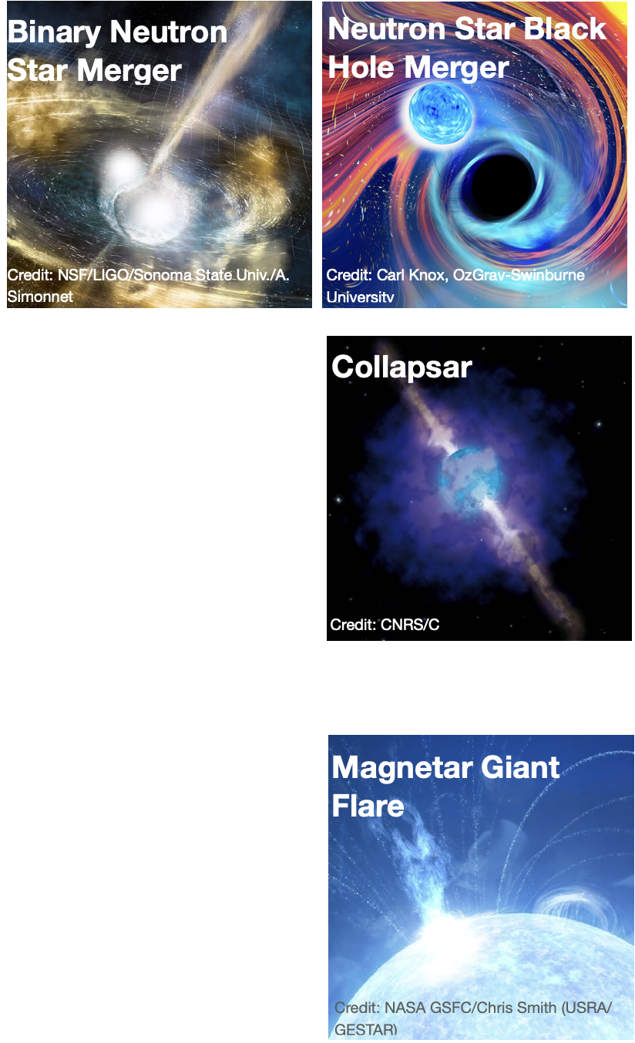
Mission Objectives
Mission Goal: Explore the behavior of matter and energy in its most extreme environments
  Objective 1: Characterize the progenitors of GRBs and their multi-messenger and multi-wavelength signals
  Objective 2: Identify conditions necessary to launch a transient astrophysical jet
  Objective 3: Determine the origins of the observed high-energy emission within the relativistic outflow

Slide 6
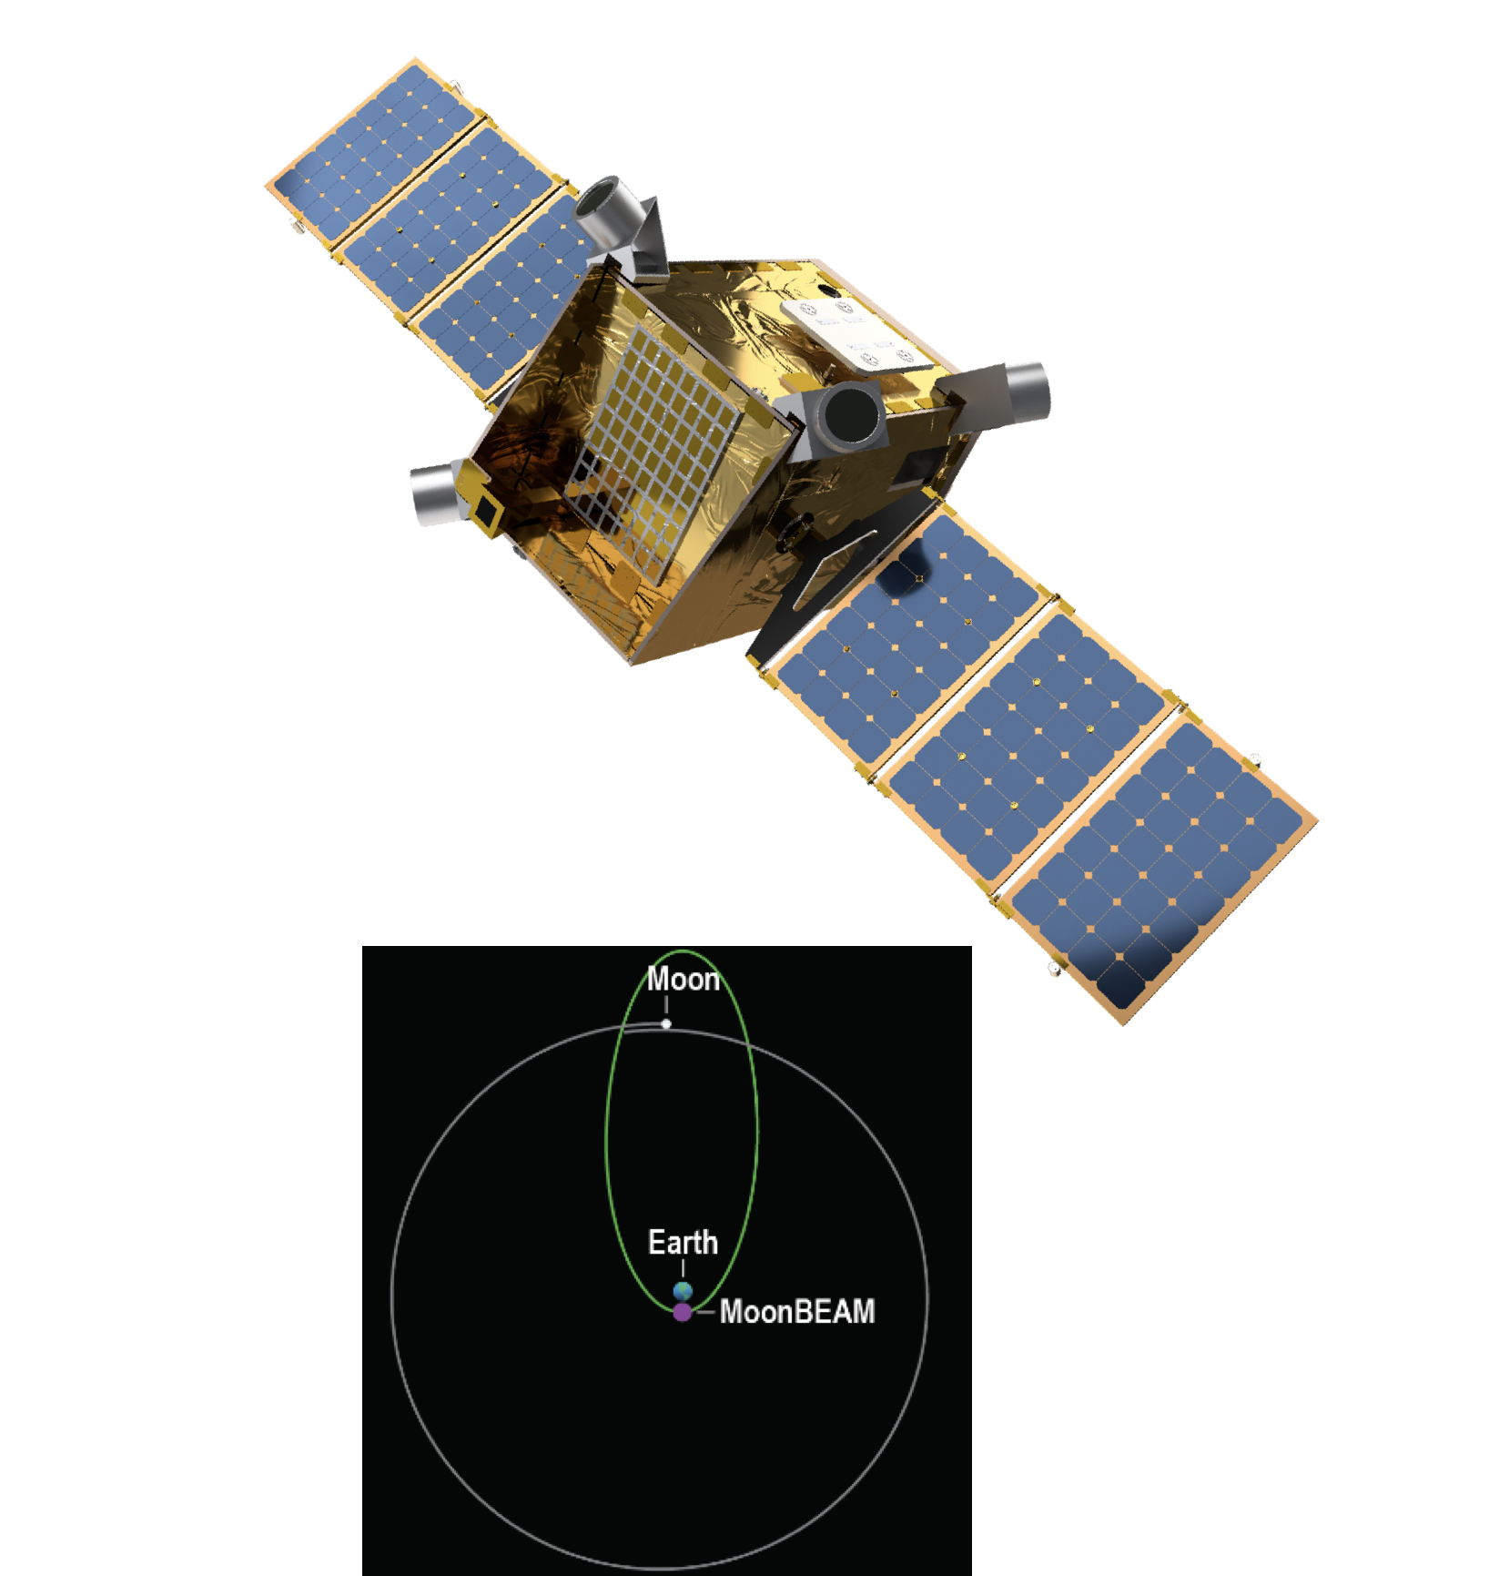
Spacecraft and Mission Design
Lockheed Martin SmallSat spacecraft bus:
  reusing >90% of high-maturity Lunar Trailblazer design.
  compatible with ESPA Grande mass and volume constraint.
  high-heritage deep space propulsion approach to lunar resonant orbit from any Geosynchronous Transfer Orbit (GTO) rideshare launch.
Orbital distance: up to 460,000 km from Earth (1.5 light-seconds).
Orbital period: 13.7 days.
Mission lifetime: 3 years.
Communication:
  continuous burst alert coverage with dedicated ground stations.
  daily data downlink with the Near Space Network.
Notes:
Lunar Trailblazer, studies water on the Moon, targeted launch 2023 (June).
components are spec-ed to a minimum operation of 3 years and will be launch ready in 2027.
orbit: 2/3 of the time MoonBEAM is ~1s from Earth.

Slide 7
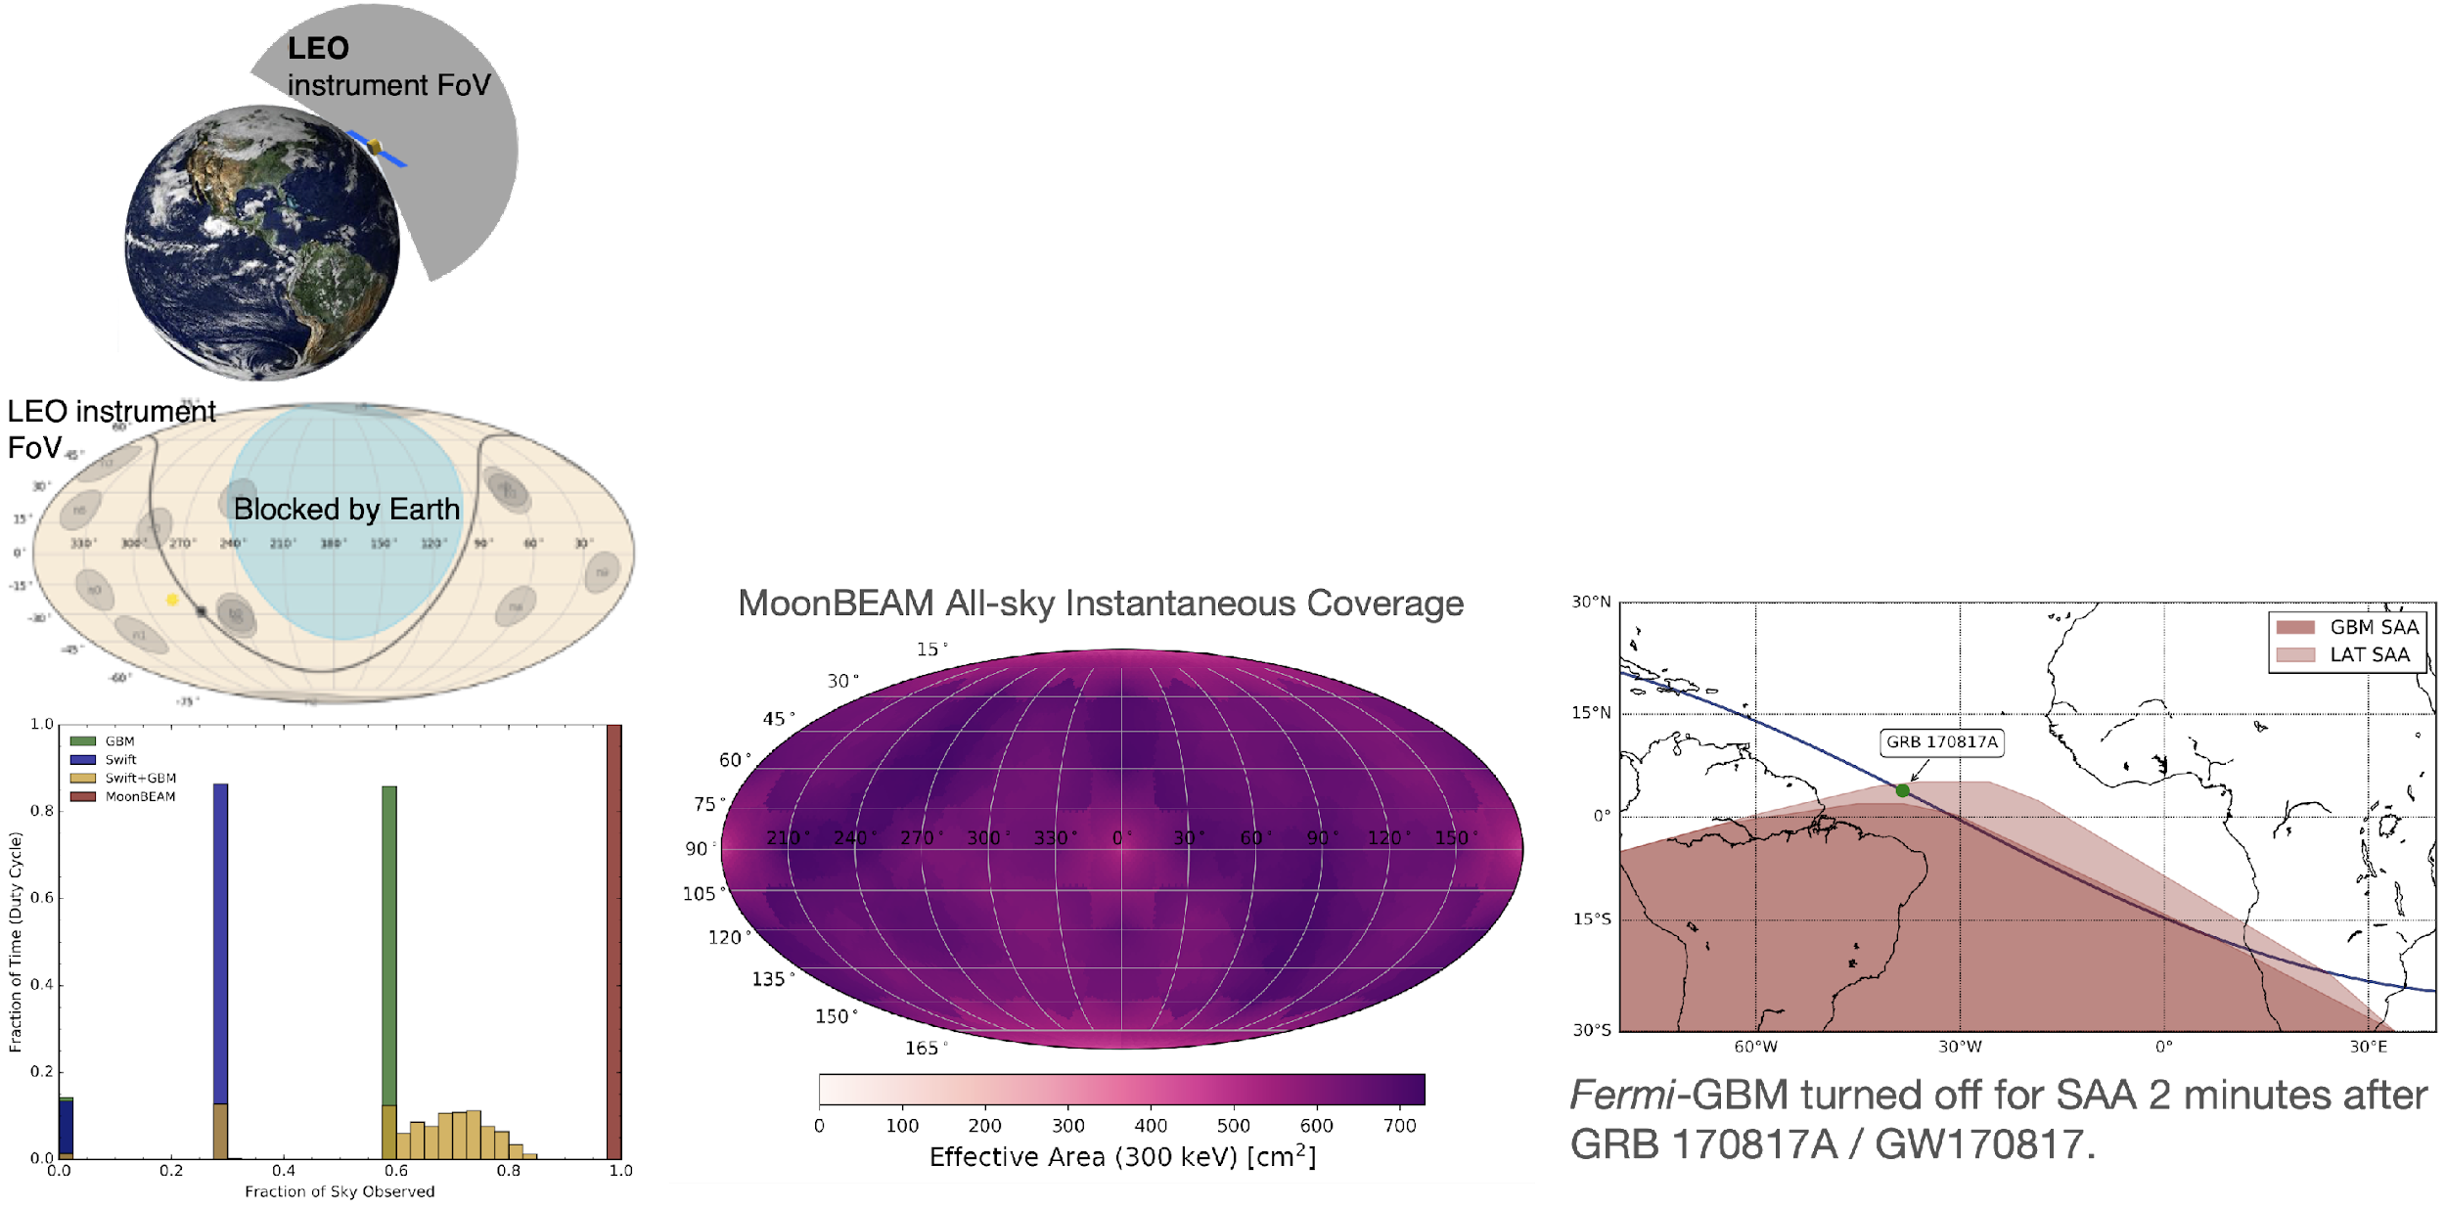
Mission Capability
Orbital distance: 22,000km to 460,000km from Earth (up to 1.5 light-seconds).
  instantaneous all-sky field of view: Earth only occults ~2% of the sky at closest approach, <<1% on average.=
  high duty cycle >96%, 13+ days uninterrupted livetime: no passage through the South Atlantic Anomaly (SAA)
  stable background compared to LEO: no atmospheric scattering and SAA-related radiation.
  add to localization improvement: timing triangulation technique with other gamma-ray missions.
Notes:
~10% energy resolution (8% for NaI, 11% for CsI) at 662keV
pulse discrimination identifies origin >96% for background rejection
avg eff. area at 300keV is 645cm^2
1000 short GRBs with spectra randomly sampled from GBM catalog, assumed 64ms GBM on-board trigger algorithm
left plot is sGRB sensitivity, our cislunar orbit reduces the background such that a 4-detector threshold design is still comparable to GBM’s 12 detectors, also increased detector size (~25% increase in detector area)
long GRB matches GBM performance at 4-s integration
localization (using CsI veto):
60k GRBs sampled from spectral catalog, assuming T90 duration for localization exposure. Poisson background from estimated avg background rate.
<15deg 1-sigma radius can improve joint NS merger detection localization, increasing chance of successful afterglow observation.
3deg systematics estimated from GBM, conservative because MoonBEAM will have less scattering from spacecraft and atmosphere.
median localization radius is 5.2deg. Median O4 GW localization is 15deg (has more fainter signal as they search further out)

Slide 8
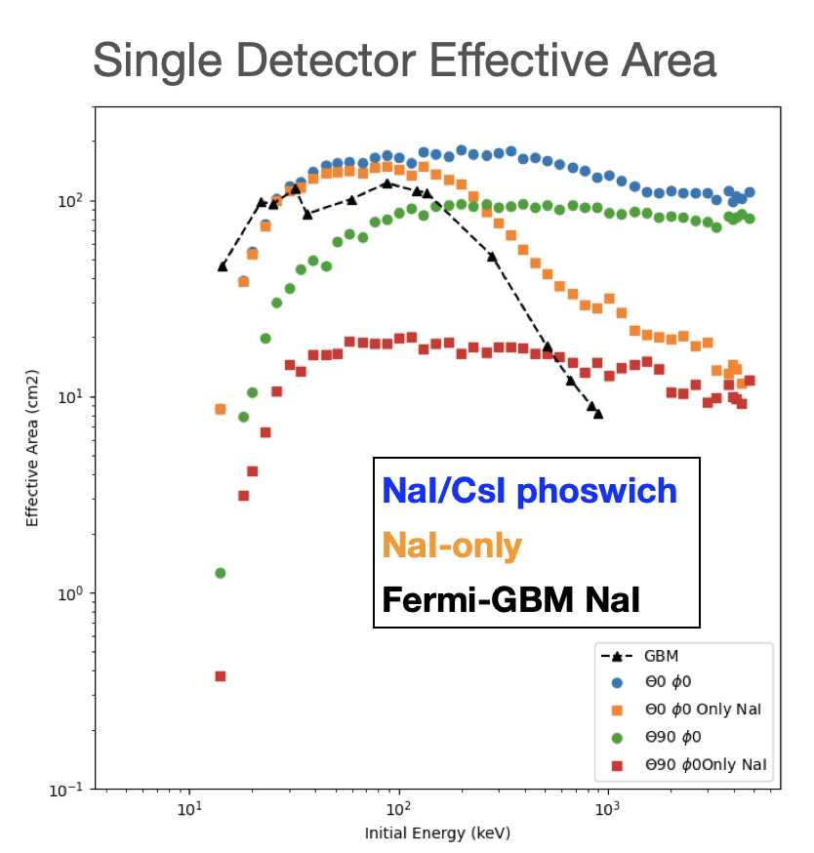
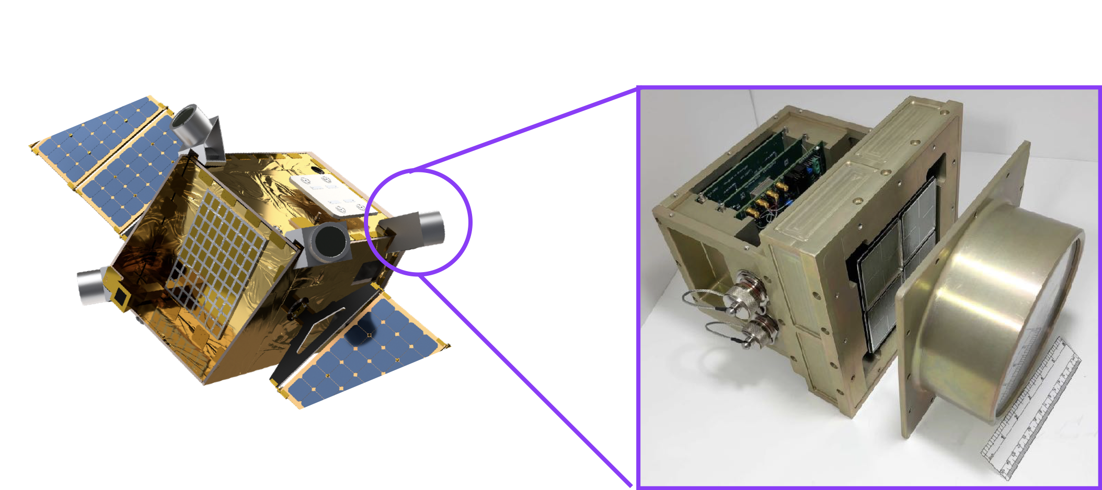
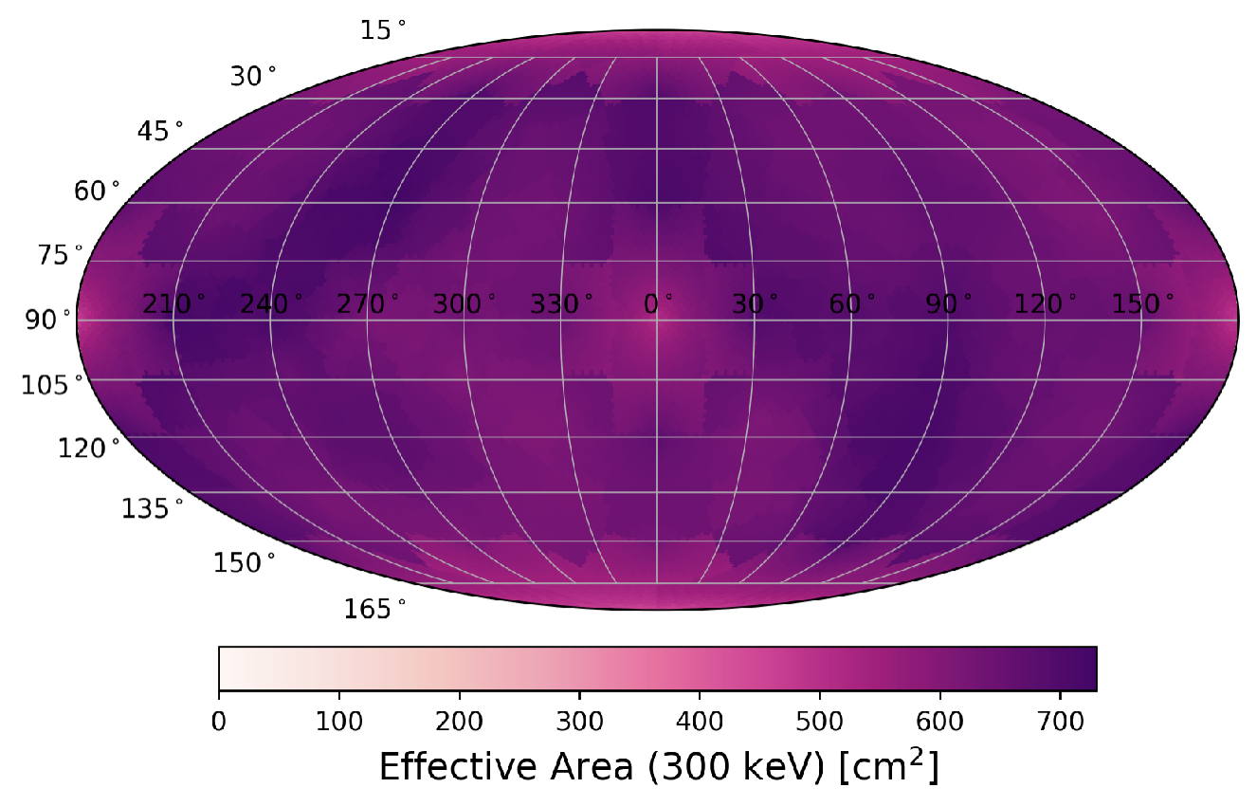
Instrument Design
6 scintillating detectors positioned for instantaneous all-sky coverage: no pointing needed.
each detector module consists of a NaI(Tl)/CsI(Na) phoswich and flat panel PMTs.
phoswich design: simultaneous dual-mode observations:
low background, direction dependency for localization
  pulse discrimination identifies origin >96% for background rejection
Spectroscopy: wide energy range and wide field-of-view
  10—5000 keV, prompt GRB peak energy range
  10% energy resolution at 662 keV

Slide 9
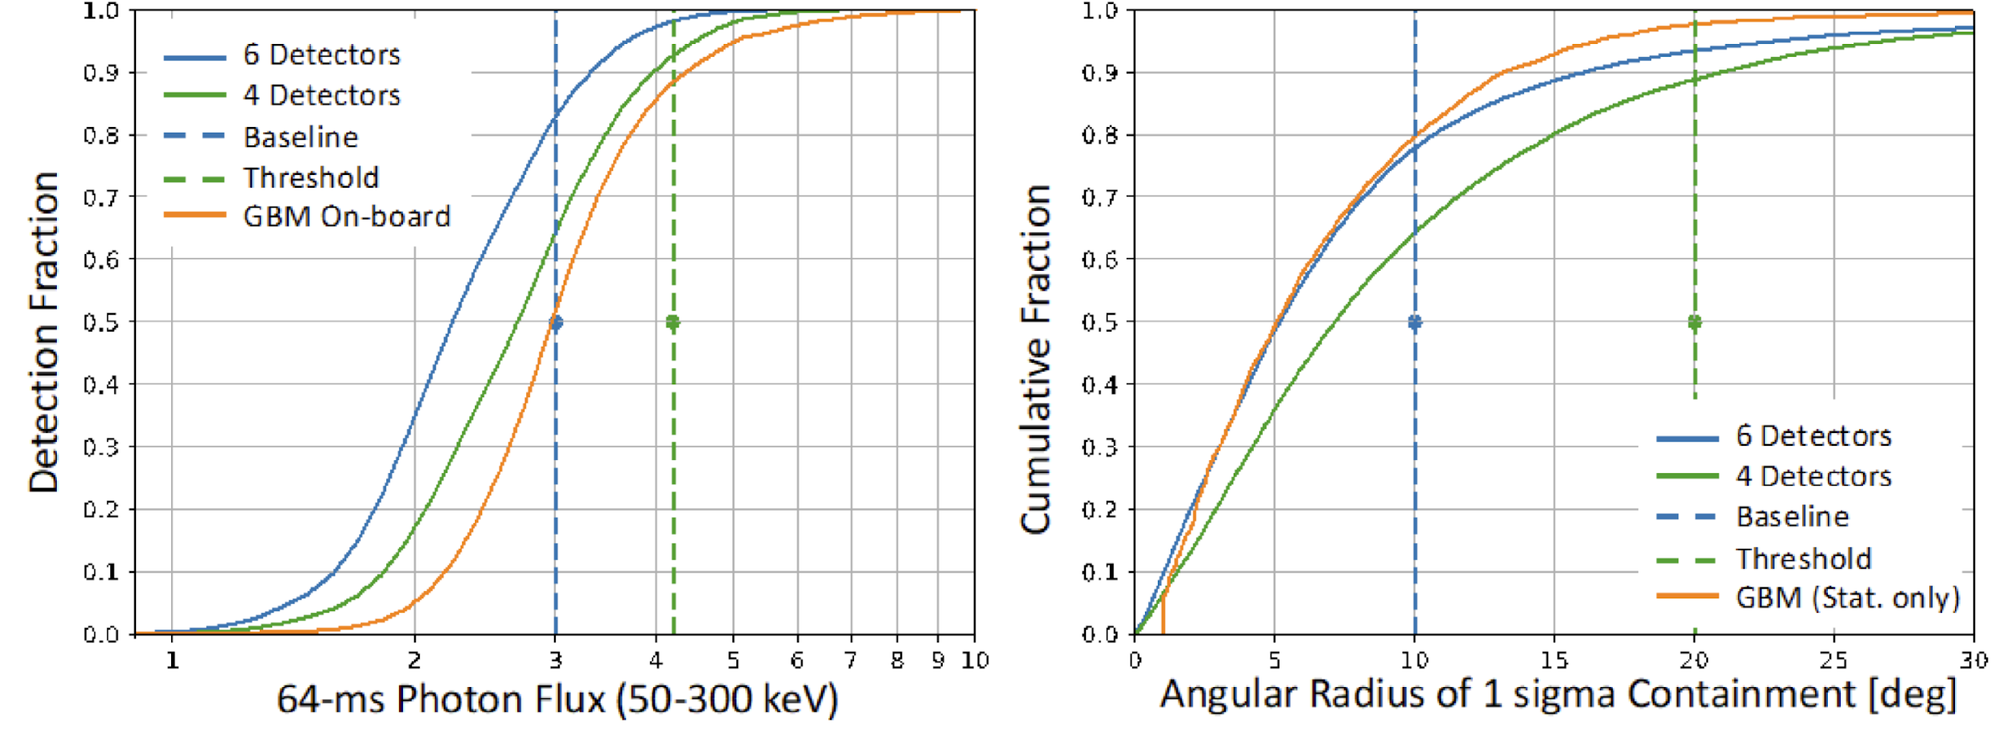
Instrument Capability
Short GRB sensitivity: MoonBEAM benefits from lower background and increased detector size compared to Fermi GBM.
Localization: Independent localization comparable to Fermi GBM. (Median IPN timing annulus width is 1.4 deg.)

Slide 10
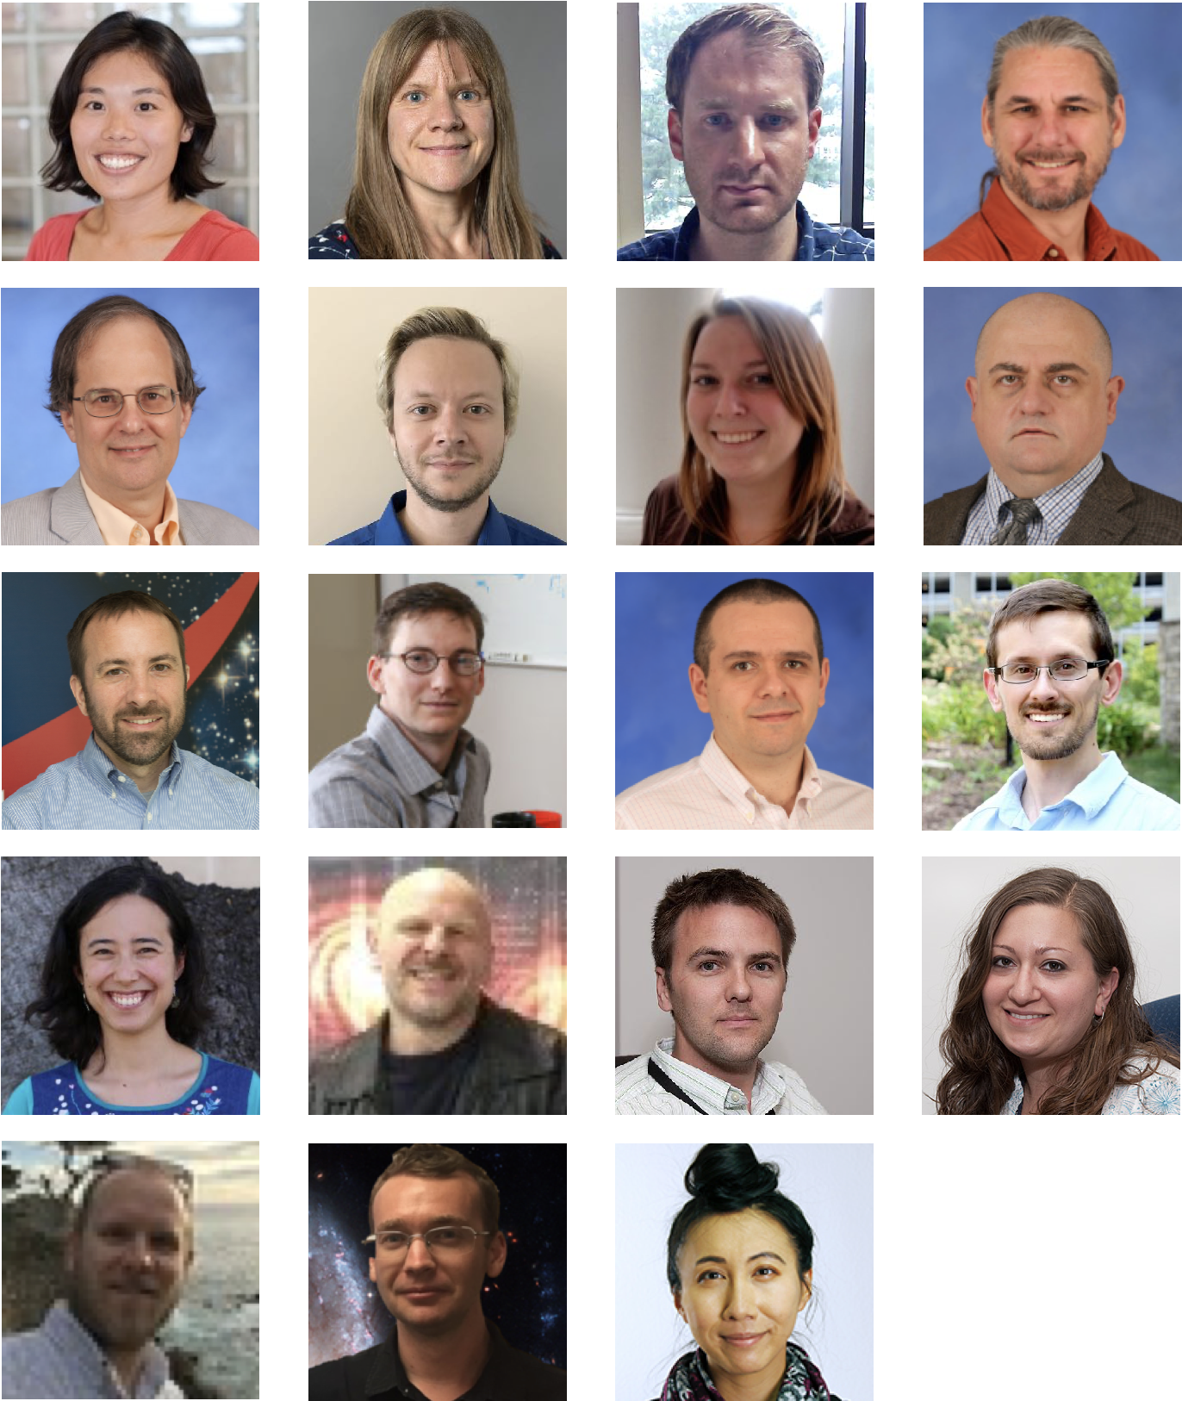
The MoonBEAM Team
PI: C. Michelle Hui (MSFC)
Deputy PI: Colleen Wilson-Hodge (MSFC)
Project Scientist: Adam Goldstein (USRA)
Instrument Scientist: Peter Jenke (UAH)
Co-Is: Collaborators:
Michael Briggs (UAH) Anna Ho (Cornell)
Eric Burns (LSU) Eric Howell (UWA)
Cori Fletcher (USRA) Jeremy Perkins (GSFC)
Boyan Hristov (UAH) Judith Racusin (GSFC)
Daniel Kocevski (MSFC) Oliver Roberts (USRA)
Tyson Littenberg (MSFC) Jacob Smith (NRL)
Peter Veres (UAH) Sylvia Zhu (DESY Zeuthen)
Joshua Wood (MSFC)
Notes:
MSFC is leading and building the project, LM is our spacecraft bus provider and key role in integration, along with UAH, USRA, and LSU who are major contributors to instrument, software, and operation.
over half of the team is on the Fermi-GBM team, we have Fermi GBM PI as the deputy, StarBurst PI and team, BurstCube PI and team, as well as scientists from GW, higher energy gamma-rays and optical community making up a diverse team

Slide 11
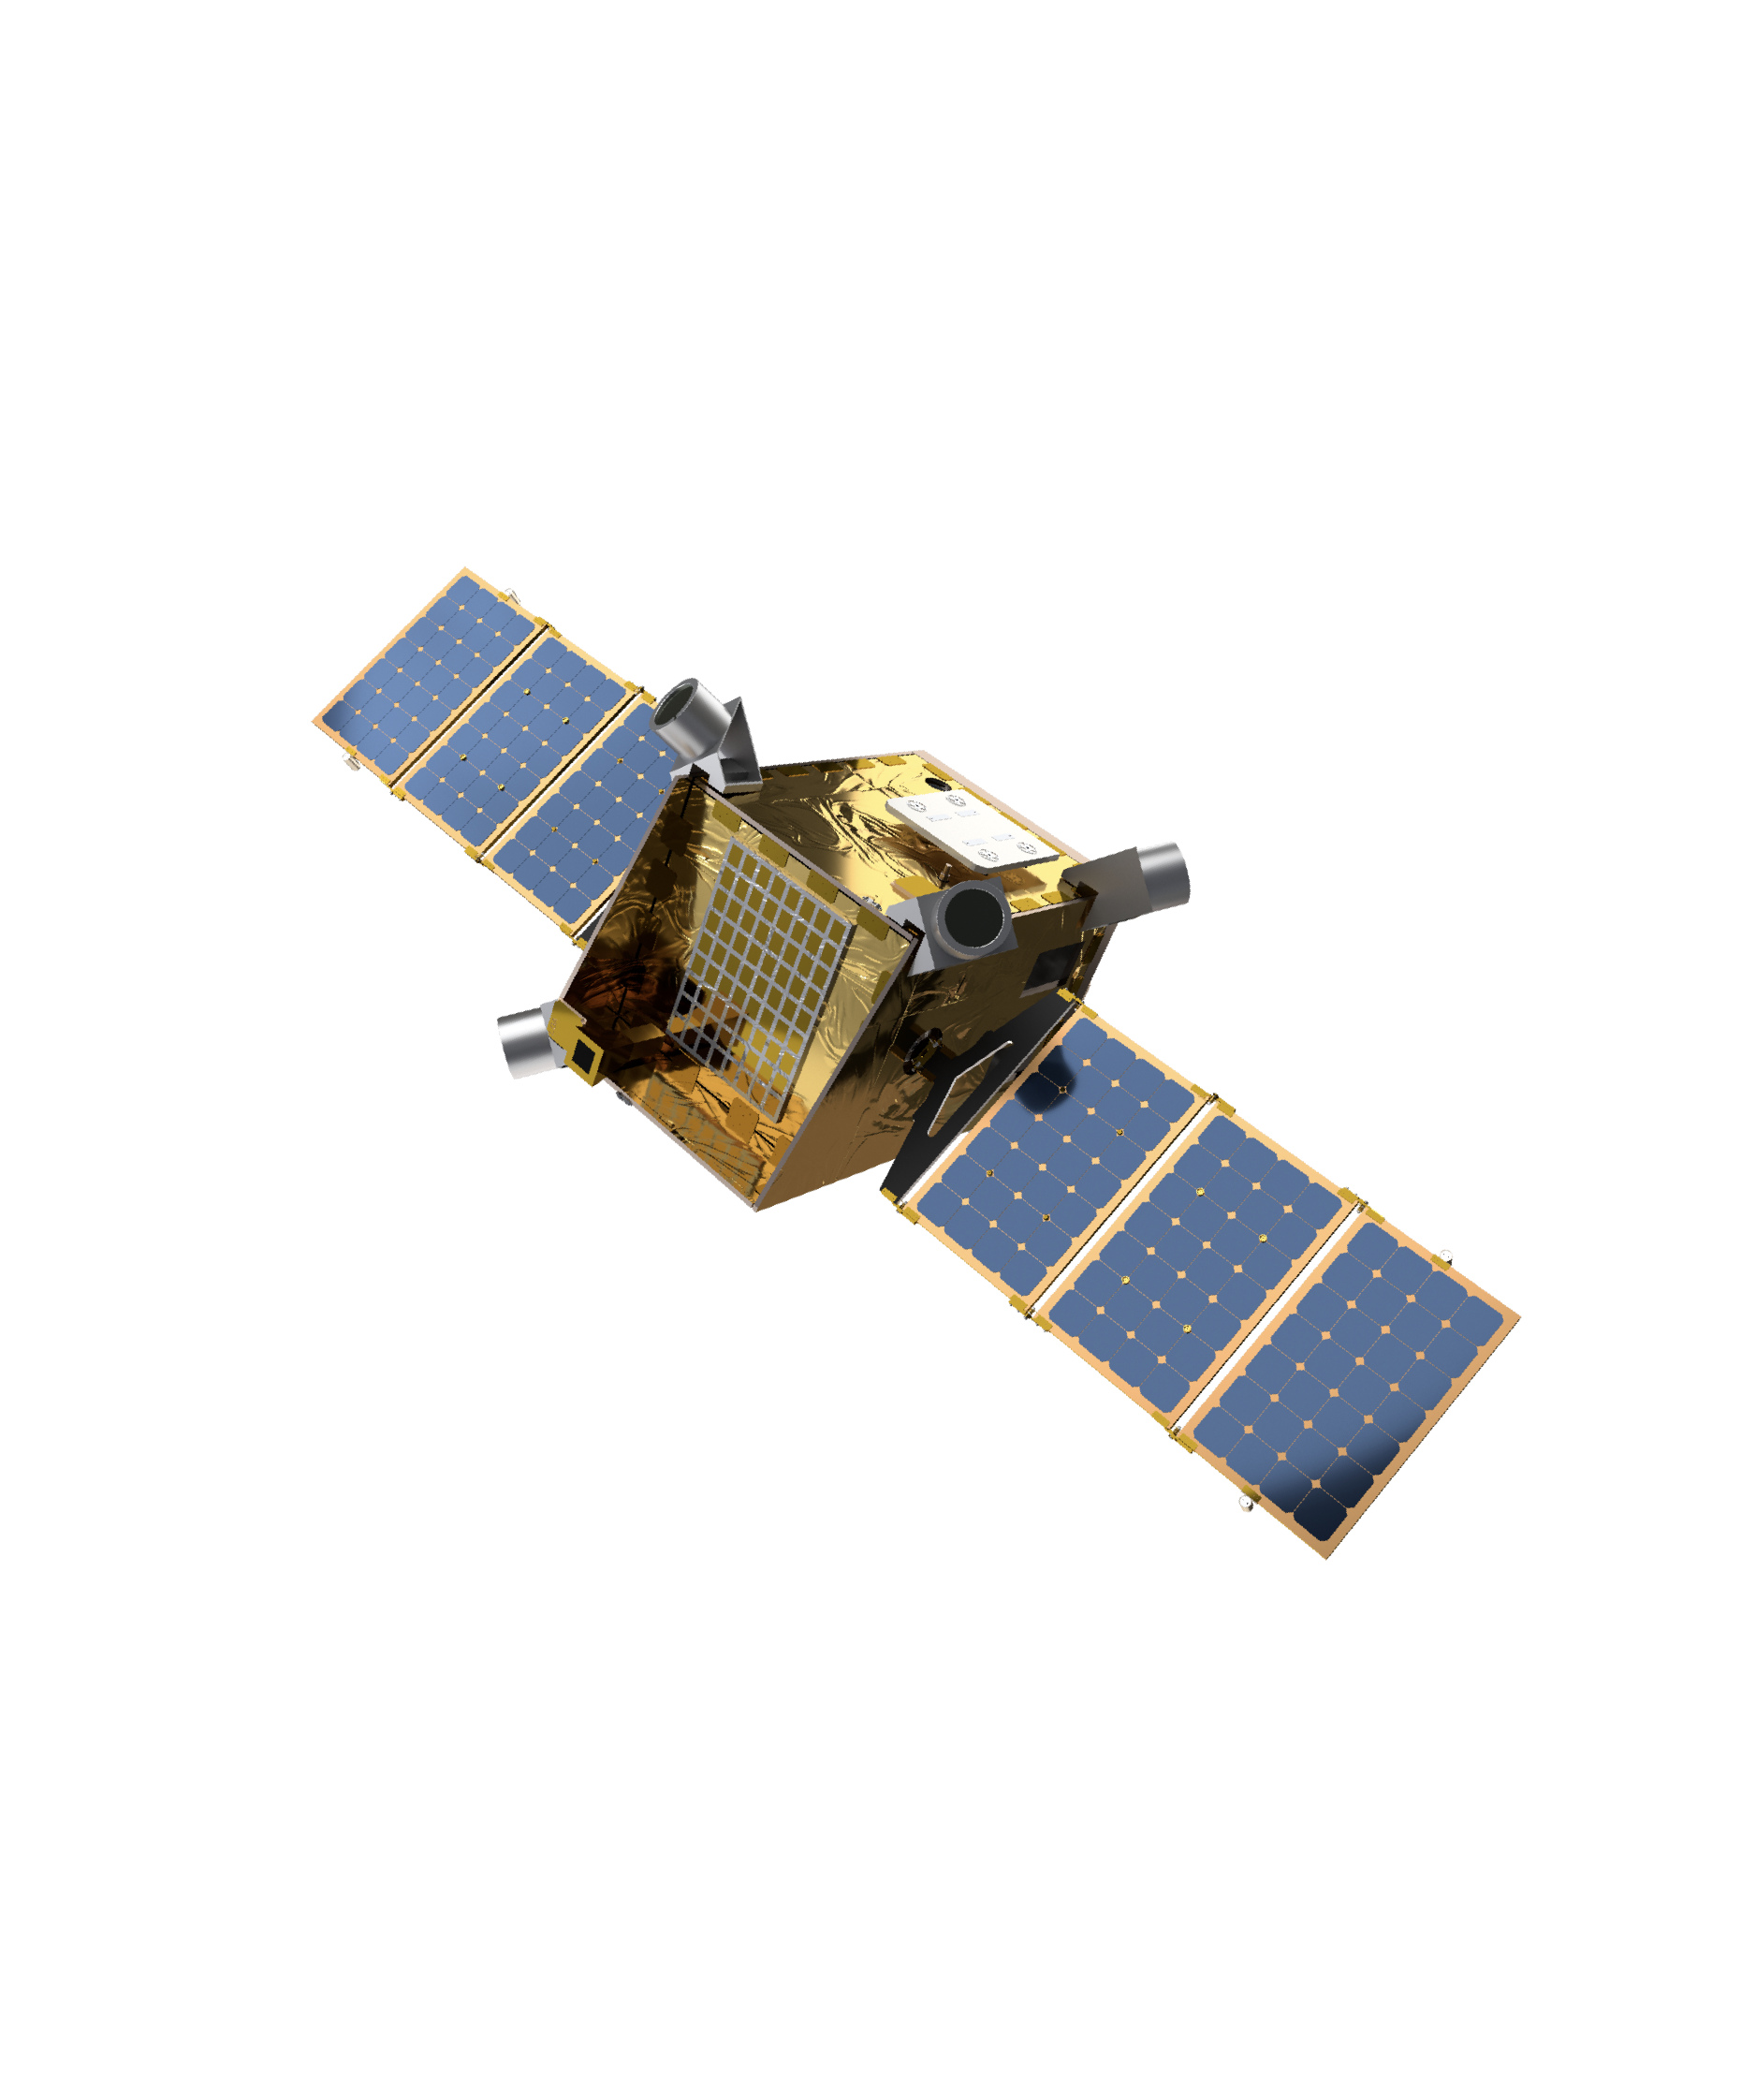
Summary
MoonBEAM provides essential gamma-ray observations of relativistic astrophysical transients with the following capabilities:
instantaneous all-sky field of view from lunar resonant orbit.
13+ days of uninterrupted livetime.
stable background for ultra long duration GRBs.
sensitive to prompt GRB emission energy range, with broad coverage for spectroscopy.
independent localization and longer baseline for additional localization improvement with other gamma-ray missions.
rapid alerts to the astronomical community for contemporaneous and follow-up observations.
Potential future collaborations with MoonBEAM:
LIGO Laboratory
IceCube Neutrino Observatory
InterPlanetary Network for Gamma-ray Bursts
Cherenkov Telescope Array Consortium
Southern Wide-field Gamma-ray Observatory
Received Funding through the NASA Mission of Opportunity for Phase A Study!!

Slide 12
Thank you for your attention!
Cori Fletcher*
*cfletcher@usra.edu

