Slide 1




Physics of Neutrino Emission from Blazars
Markus Böttcher*
Supported by the South African Research Chairs Initiative (SARChI) of the Department of Science and Innovation and the National Research Foundation of South Africa (grant no. 64789).
*Markus.Bottcher@nwu.ac.za

Slide 2
Origin of IceCube-Detected Neutrinos
(Buson et al. 2022)
Significant correlation of IceCube neutrinos with blazars (chance coincidence p = 6∙10⁻⁷) – but can not be responsible for all IceCube neutrinos (e.g., Murase et al. 2018)

Slide 3
Basics of Neutrino Production
p + p (N) → p + p/n + n₀π⁰ + n₊π⁺ + n₋π⁻
p + γ → p + π⁰
or n + π⁺
π⁰ → 2γ
π⁺ → μ⁺ + ν_{μ} τ = 2.55×10⁻⁸ s
π⁻ → μ⁻ + ν_{μ}
μ⁺ → e⁺ + ν_{μ} + ν_{e} τ = 2.2×10⁻⁶ s
μ⁻ → e⁻ + ν_{μ} + ν_{e}
(σ_{pp} ~ 0.1 mb)
(σ_{pγ} ~ 0.6 mb)

Slide 4
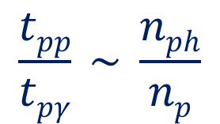
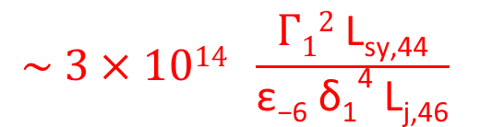
Neutrino Production in AGN Jets
$$\frac{tpp}{tpγ} \sim \frac{nph}{np}$$
$$\sim 3×1014 \frac{Γ12 \text{L}\text{sy}\text{,44}}{\text{ε}\text{−6} \text{δ}\text{1}\text{4} \text{Lj}\text{,46}}$$
In AGN jets, pγ dominant over pp or pN.

Slide 5
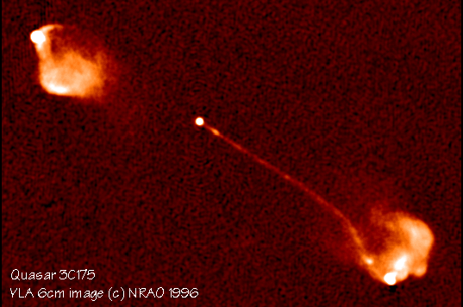

Photo-pion induced neutrino production in relativistic jets
pγ → p π⁰
n π⁺
θ
Earth
$$δ= \frac{1}{Γ (1 − β cosθ)}$$
Γ
E_{obs} = δ E’

Slide 6
Photo-Pion Production Cross Section
Δ⁺ resonance
σ(pγ→pπ⁰) : σ(pγ→nπ⁺) = 2:1
(Morejon et al. 2019)

Slide 7
Photo-Pion Production
Spectral index (n[ε] ~ ε^{−α}) of target photon field
Interaction Probability
(Mücke et al. 1999)
Center-of-Momentum energy
For realistic target photon fields, most interactions occur near threshold (at Δ⁺ resonance).

Slide 8
Photo-pion production - Energetics
At Δ⁺ resonance:
s = E’_{p} E’_{t} (1 – β_{p}’ μ) ~ E’_{p} E’_{t} ~ E_{Δ+}² = (1232 MeV)²
and E’_{ν} ~ 0.05 E’_{p}
To produce IceCube neutrinos (~ 100 TeV → E_{ν} = 10¹⁴ E₁₄ eV):
(i.e., E’_{ν} = 10 E₁₄ δ₁⁻¹ TeV)
Need protons with E’_{p} ~ 200 E₁₄ δ₁⁻¹ TeV
and target photons with E’_{t} ~ 1.6 E₁₄⁻¹ δ₁ keV
=> X-rays!

Slide 9
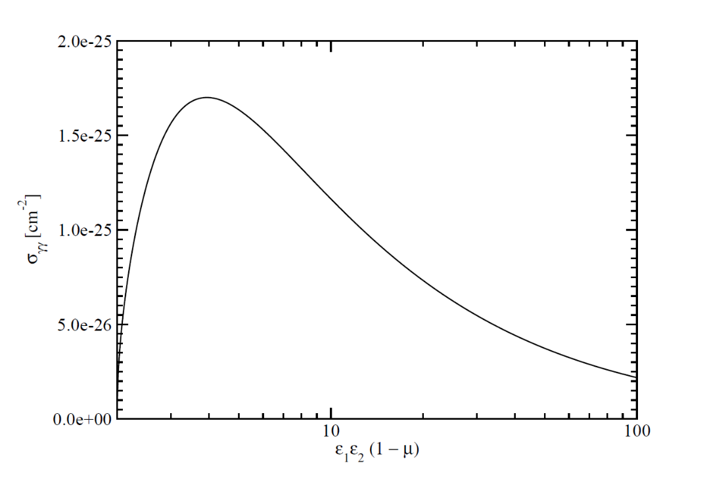
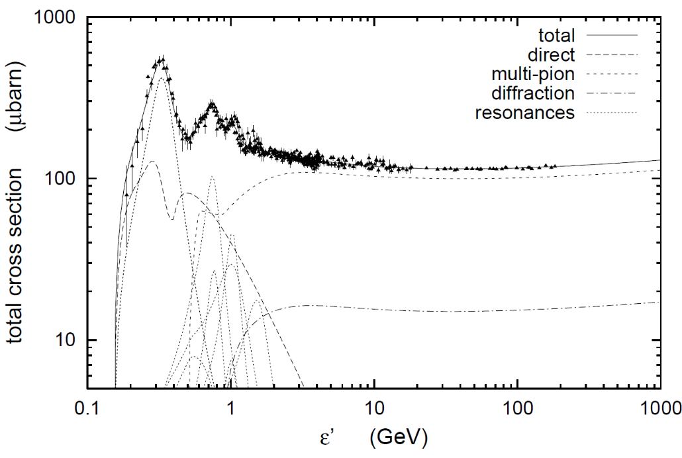
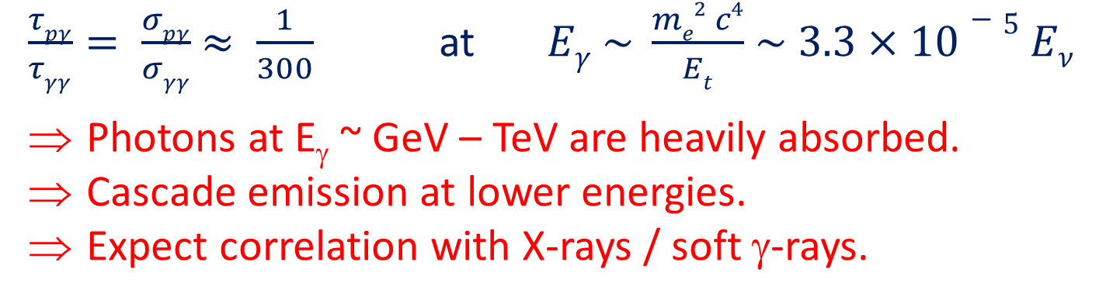
The pγ Efficiency Problem
Efficiency for protons to undergo pγ interaction ~ τ_{pγ} = R σ_{pγ} n_{ph}
Likelihood of γ-ray photons to be absorbed ~ τ_{γγ} = R σ_{γγ} n_{ph}
σ_{pγ}
σ_{γγ}
$\frac{τpγ}{τγγ}= \frac{σpγ}{σγγ}$ $≈ \frac{1}{300}$ at $Eγ \sim \frac{me2 c4}{Et}$ $\sim 3.3×10−5 Eν$
Photons at E_{γ} ~ GeV – TeV are heavily absorbed.
Cascade emission at lower energies.
Expect correlation with X-rays / soft γ-rays.

Slide 10
Examples of neutrino – X-ray correlation without γ-ray activity
IceCube-190730A – PKS 1502+106
(IceCube Collaboration et al. 2019; Franckowiak et al. 2020; Rodrigues et al. 2021)
IceCube-190730A
  Neutrino event during a long-term radio outburst (started 2014).
  Low γ-ray flux, but moderate X-ray activity.
(Franckowiak et al. 2020)

Slide 11
Examples of neutrino – X-ray correlation without γ-ray activity
IceCube-200107 – 3HSP J095507.9+35510
(Giommi et al. 2020; Paliya et al. 2020; Krauss et al. 2020; Petropoulou et al. 2020)
HBL at z = 0.5573 (Paiano et al. 2020; Paliya et al. 2020)
HESE with uncertain energy (E_{ν} ~ 330⁺²²³⁰ TeV)
Bright X-ray flare on the day after the neutrino
event (Swift ToO), but no γ-ray flare.
-270
(Paliya et al. 2020)

Slide 12
Photo-pion production –
Origin of Target Photons
To produce IceCube neutrinos (~ 100 TeV → E_{ν} = 10¹⁴ E₁₄ eV):
Need protons with E’_{p} ~ 200 E₁₄ δ₁⁻¹ TeV
and target photons with E’_{t} ~ 1.6 E₁₄⁻¹ δ₁ keV
(At least) two possible scenarios for target photons:
Co-moving with the emission region
E_{t}^{obs} ~ 16 E₁₄⁻¹ δ₁²/(1+z) keV
Observed as hard X-rays
Doppler boosted into observer’s frame
Stringent constraints on co-moving energy density
Typically large proton power requirements!
Stationary in the AGN frame
E_{t}^{obs} ~ 160 E₁₄⁻¹/(1+z) eV
Observed as UV / soft X-rays
Doppler boosted into co-moving frame
Strongly relaxed constraints on energy density
Much lower proton power requirements!

Slide 13
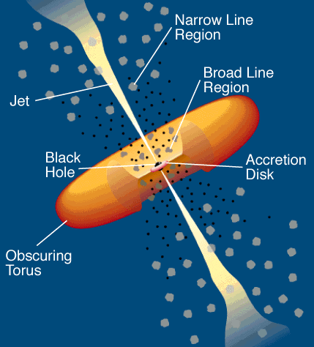
Photo-pion production –
Origin of Target Photons
Possible sources of external UV / soft X-ray target photons:
Broad Line Region?
(Padovani et al. 2019)
Slow-moving sheath
(Tavecchio & Ghisellini 2005)
Accretion flow (RIAF)
(Righi et al. 2019)

Slide 14
Summary
Production of IceCube neutrinos requires
  Protons of ~ PeV energies
  Target photons of co-moving UV / X-ray energies
For IceCube neutrino production in AGN jets, external target photon fields strongly preferred over co-moving (electron-synchrotron) photon field.
γγ opacity for co-spatially produced GeV – TeV γ-rays is ~ 300 times larger than pγ efficiency
=> Expect neutrino correlation with X-ray / soft γ-ray activity more naturally than with GeV – TeV γ-rays!
Supported by the South African Research Chairs Initiative (SARChI) of the Department of Science and Innovation and the National Research Foundation of South Africa (grant no. 64789).

Slide 15
Senior Postdoc Opening at NWU
Senior Postdoc in observational or theoretical extragalactic high-energy / multi-messenger astrophysics.
Initially for one year, renewable up to 5 years, depending on satisfactory performance.
The salary will be ZAR 438 000 per year (~ US $ 24 200 ~ € 24 900 – income-tax free and significantly higher than a usual postdoc salary in South Africa).
Prior postdoctoral experience highly desirable, but Ph.D. not more than 5 years ago.
Institutional expectations:
- publication of at least 4 refereed journal papers per year;
- co-supervision of at least 1 M.Sc. or Ph.D. student per year;
- participation in grant proposal writing - at least one submission per year;
- a moderate amount of participation in administration.
Send CV, publication list, statement of research experience and interests, contact information of 3 references
Application deadline: 20 October 2022
Contact: Markus.Bottcher@nwu.ac.za

Slide 16
Thank you for your attention!
Markus Böttcher*
Any opinion, finding and conclusion or recommendation expressed in this material is that of the authors and the NRF does not accept any liability in this regard.
*Markus.Bottcher@nwu.ac.za

Slide 17
Backup

Slide 18
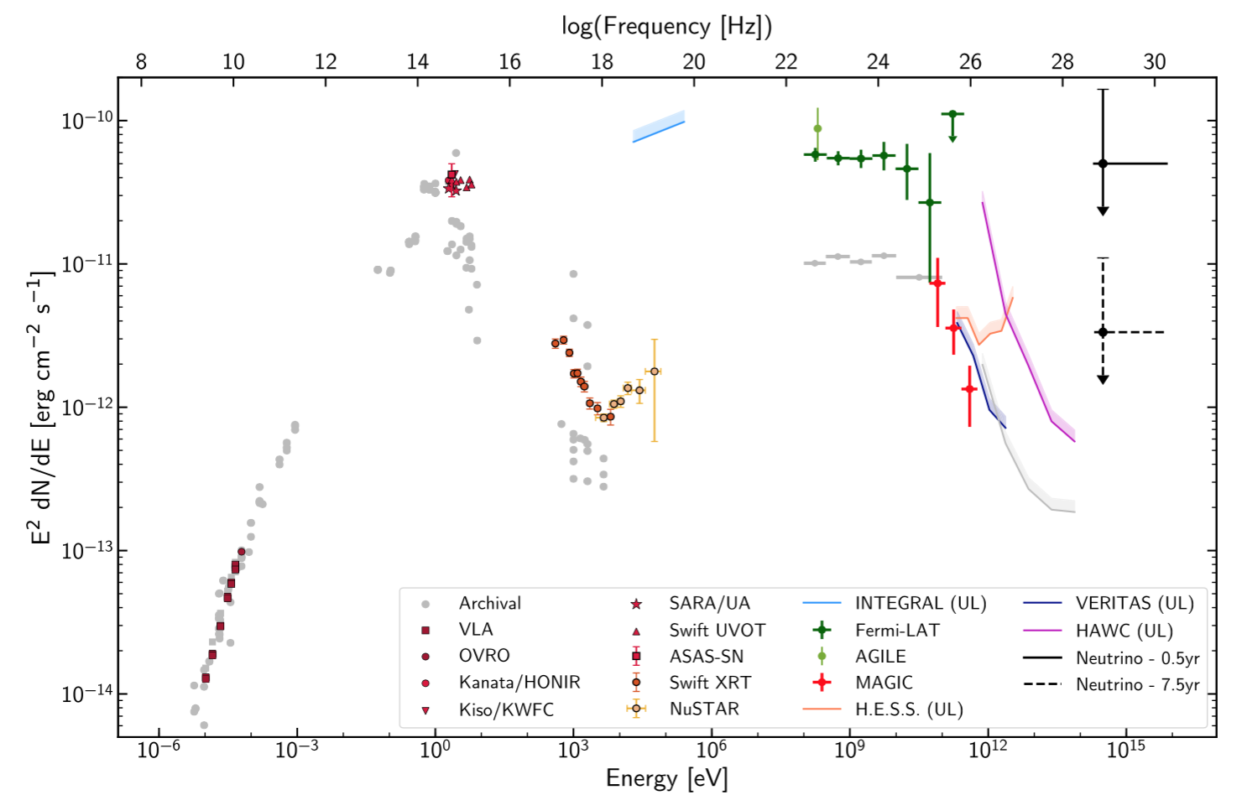
Spectral Energy Distribution of TXS 0506+056
2014-15 ν flare
IC 170922A
limits
F_{X} ~ 10⁻¹² erg/(cm² s)

Slide 19
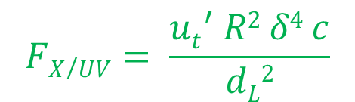
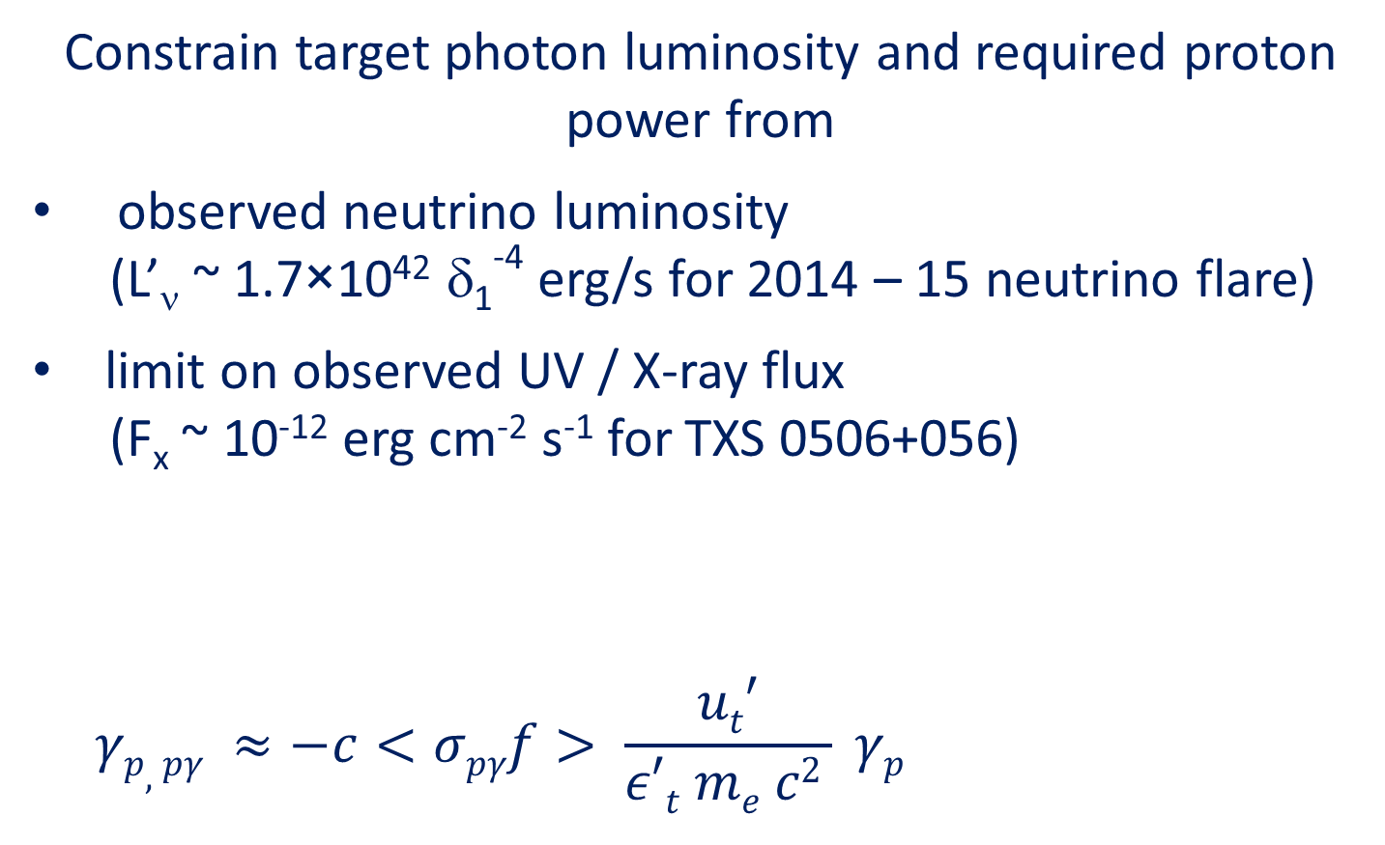
Photo-pion production –
Origin of Target Photons
Constrain target photon luminosity and required proton power from
observed neutrino luminosity
(L’_{ν} ~ 1.7×10⁴² δ₁⁻⁴ erg/s for 2014 – 15 neutrino flare)
limit on observed UV / X-ray flux
(F_{x} ~ 10⁻¹² erg cm⁻² s⁻¹ for TXS 0506+056)
$$γp,pγ ≈−c<σpγf> \frac{ut′}{ε′t me c2 } γp$$
L_{kin,p}
$$FX/UV= \frac{{ut}^{′} R2 δ4 c}{dL2}$$
.
≈ 10⁻²⁸ cm²

Slide 20
Photo-pion production –
Origin of Target Photons
Co-moving target photon field
X-ray flux limit => u’_{t} < 9×10⁻⁴ R₁₆⁻² δ₁⁻⁴ erg cm⁻³
=> L_{p,kin} > 4.9×10⁵² R₁₆ Γ₁² erg/s
Unrealistically large kinetic power;
requires very low B-field (B < 1 G) to suppress proton synchrotron below X-ray flux limit
=> Ruled out!
~

Slide 21
Photo-pion production –
Origin of Target Photons
Stationary target photon field
From UV / X-ray flux: u’_{t} < 100 Γ₁² R_{t,17}⁻² erg cm⁻³
L_{p,kin} > 4.7×10⁴⁷ δ₁⁻⁴ R_{t,17}² R₁₆⁻¹ erg/s
Below Eddington limit for M_{BH} > 10⁹ M₀ => plausible.
Can suppress p-sy below UV/X-ray limit for B ~ 10 G.
Plausible!
Stationary UV / soft X-ray target photon field external to the jet is plausible!
~
~

