Slide 1
Interpreting the High-energy
Sub-exponentially Cutoff
Spectral Shape of the Vela Pulsar
Christo Venter¹, Alice Harding², Anu Kundu¹, Hend Hamed¹, Constantinos Kalapotharakos^{3,4,5}
¹Centre for Space Research, North-West University, Potchefstroom, South Africa
²Los Alamos National Laboratory
³Department of Astronomy, University of Maryland, College Park, MD
⁴Gravitational Astrophysics Laboratory, NASA/Goddard Space Flight Center
⁵Center for Research and Exploration in Space Science and Technology, NASA/GSFC
10th International Fermi Symposium, 9 – 15 October 2022, Johannesburg

Slide 2
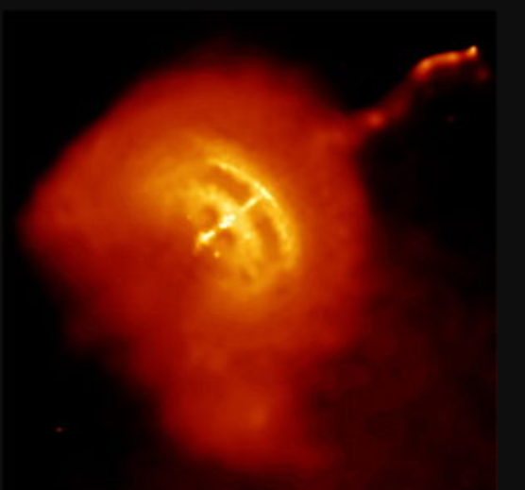
Outline
Vela Pulsar
Gamma-ray observations
Curvature Radiation (CR)
Synchro-curvature (SC) emission
Initial parameter study
Conclusion
https://upload.wikimedia.org/wikipedia/commons/thumb/1/1d/Vela_Pulsar_jet.jpg/300px-Vela_Pulsar_jet.jpg
chandra.harvard.edu/photo/2008/kes75/more.html

Slide 3
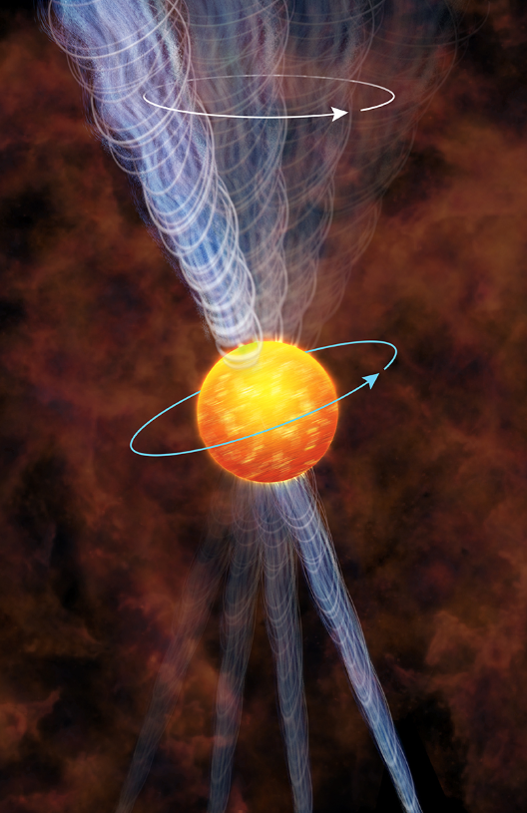
The Vela Pulsar
Brightest persistent (non-flaring) source in GeV gamma-ray sky
Detected in 1972 by SAS-2
(Thompson et al. 1975)
Phase-resolved results – COS-B (Grenier et al. 1988) and EGRET
(Kanbach et al. 1994; Fierro et al. 1998)
First source to be studied by AGILE (Pellizzoni et al. 2009)
Calibration source for Fermi LAT
Fermi LAT observations ruled out PC models; P3 vs. E_{γ}
chandra.harvard.edu/photo/2013/vela/vela_ill.jpg

Slide 4
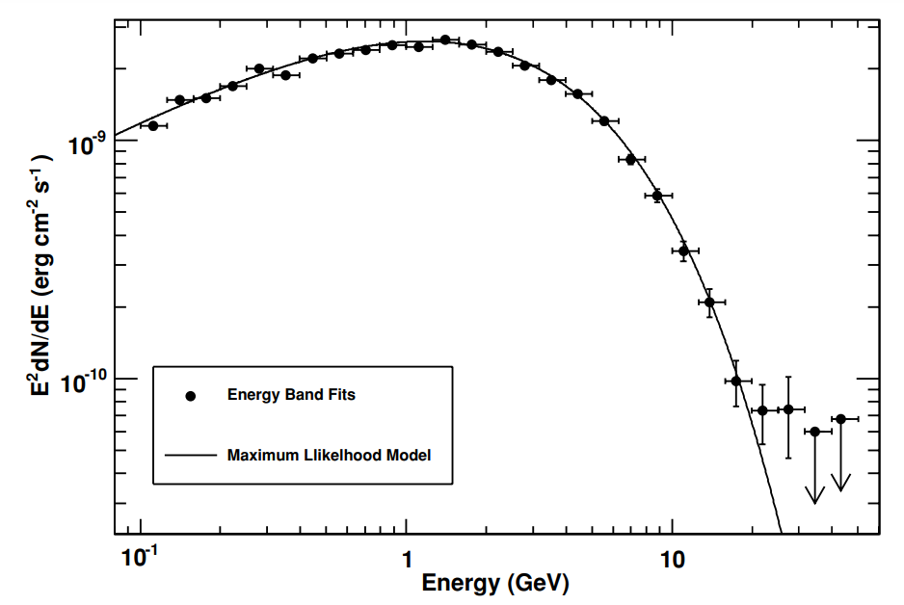
HE Observations of Vela
  Age ~ 11 kyr
  d ~ 0.3 kpc,
  E ~ 7e36 erg/s
  Glitching
  Γ ~ 1.4
  E_{cut} ~ 2 GeV,
  b ~ 0.7
  b < 1 inconsistent
  with magnetic
  pair attenuation
  thus favours
  outer-
  magnetosphere
  models
Abdo et al. (2010)
Γ
b
E_{cut}

Slide 5
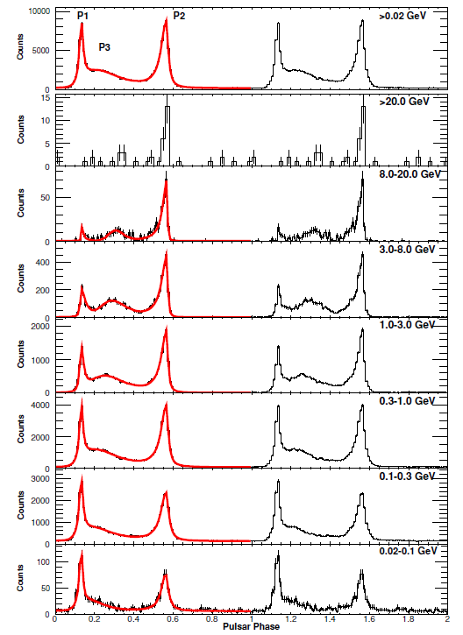
HE Light Curves
Abdo et al. (2010)
Vela light curves’
energy evolution:
  P1/P2
  Φ
  W
  Edges
  Bridge (P3)

Slide 6
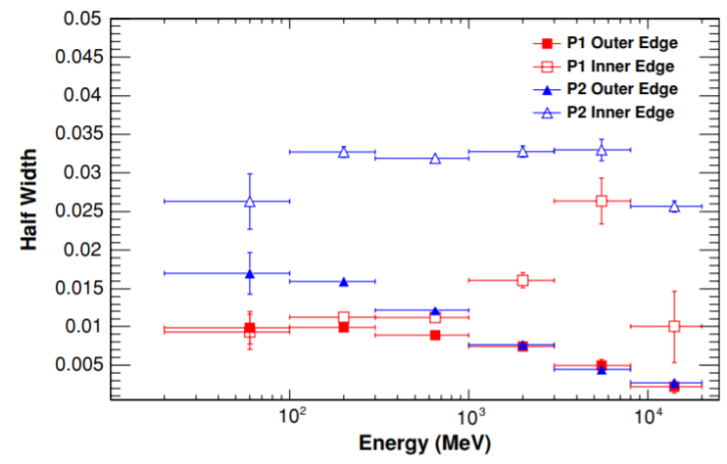
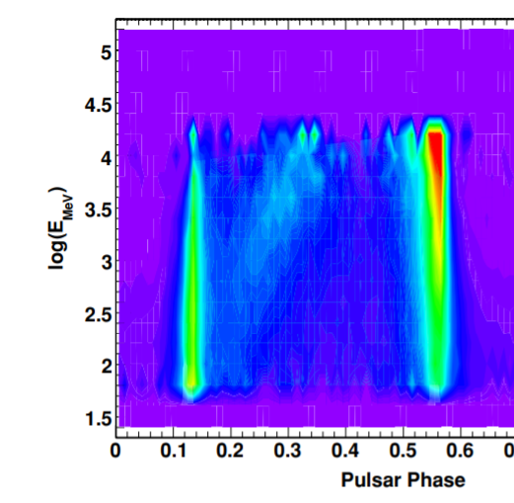
HE Light Curves
Abdo et al. (2010)
Vela LC energy evolution: P1/P2, φ, W, edges, bridge

Slide 7
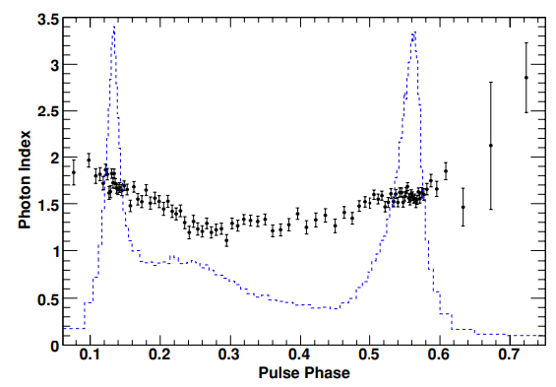
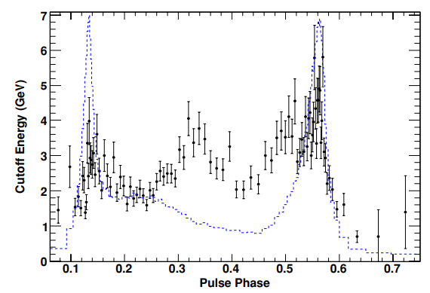
HE Phase-resolved HE Spectrum
Variation of Γ with φ
Variation of E_{cut} with φ
Abdo et al. (2010)

Slide 8
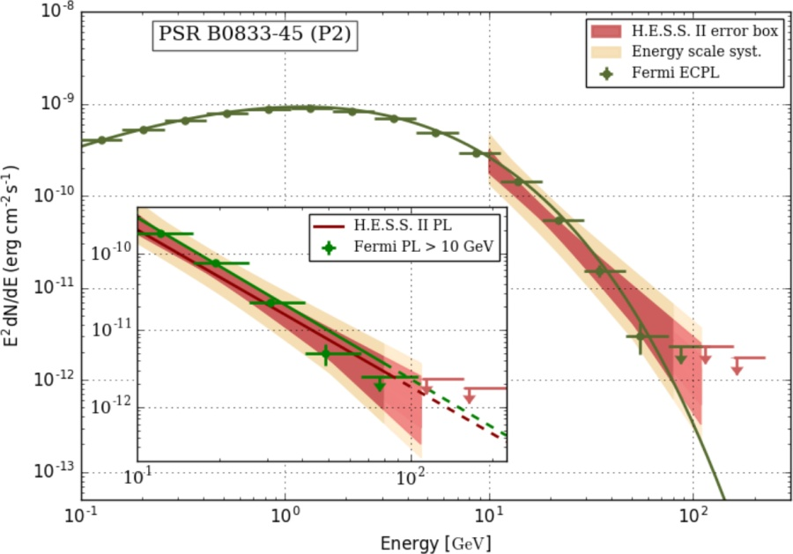
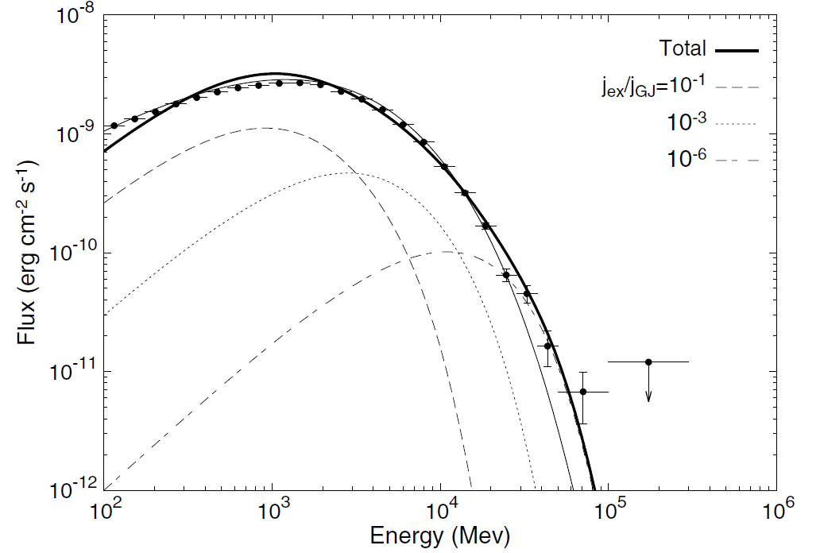
Pulsations up to ~100 GeV
62 months of Fermi LAT data
Photons > 50 GeV (4.2 σ)
Photons > 79 GeV (>4 σ)
Photons > 90 GeV (3 σ)
H.E.S.S. II
Leung et al. (2014)
Abdalla et al. (2018)

Slide 9
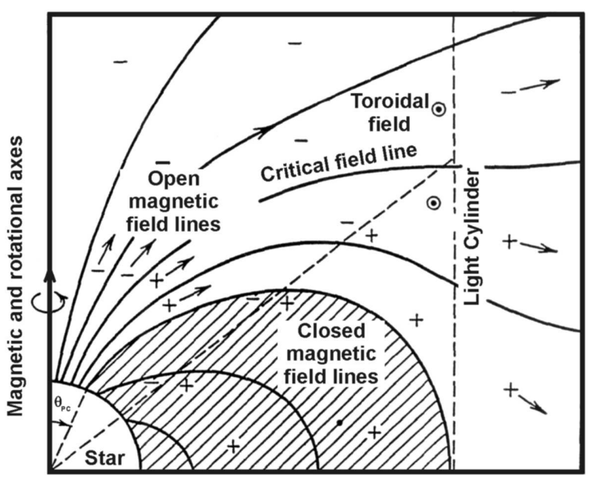
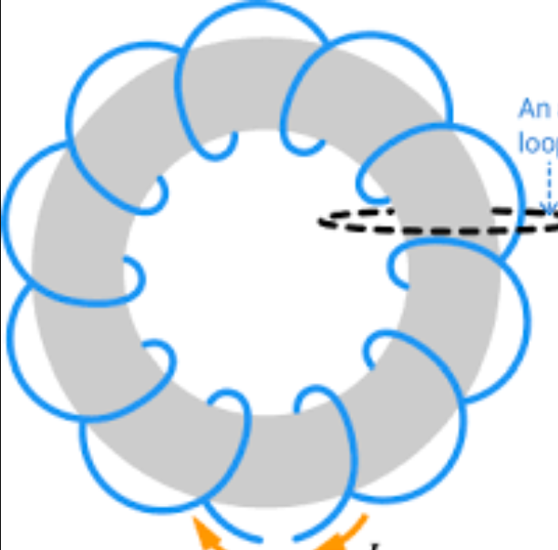
Two Components of Particle motion
Perpendicular: SR
Parallel: CR
Synchro-curvature (SC)
Goldreich & Julian (1969)
physicskey.com
Cheng & Zhang (1996)

Slide 10
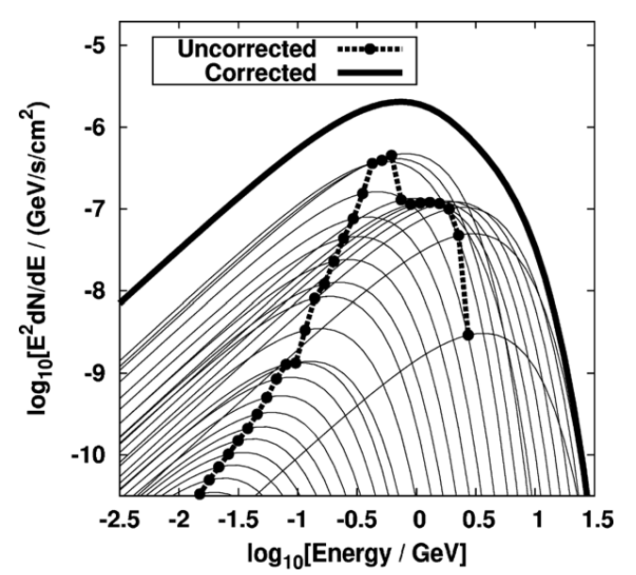
Cumulative Spectra –
Sub-exponential HE tail
Cf. Celik, Johnson (circa 2009)
Venter & de Jager (2010)

Slide 11


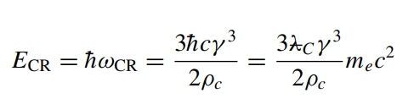

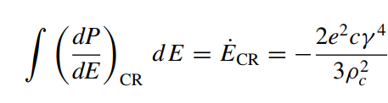
Curvature Radiation
Radiation Reaction
(CRR):
Spectral cutoff:
Total loss rate:
Venter & de Jager (2010)

Slide 12
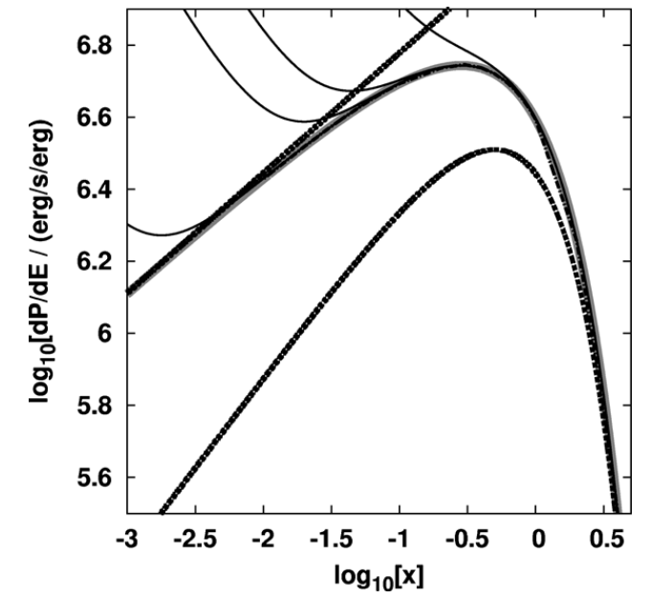

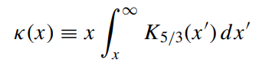
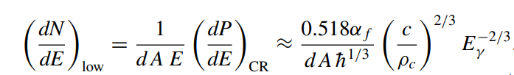
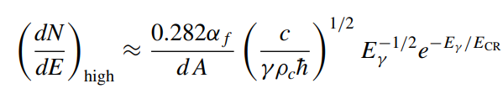
Curvature Radiation
Radiation Spectrum:
Limits:
Venter & de Jager (2010)

Slide 13






Synchro-curvature Radiation
Encapsulates 2 limits: CR, SR
“Magnetic brehmsstrahlung”
Vigano et al. (2015)
Cheng & Zhang (1996)
Zhang, Xia & Yang (2000)
Kelner & Aharonian (2012)
Prosekin, Kelner & Aharonian (2013)
Cutoff energy:
SR
CR
Total power:

Slide 14
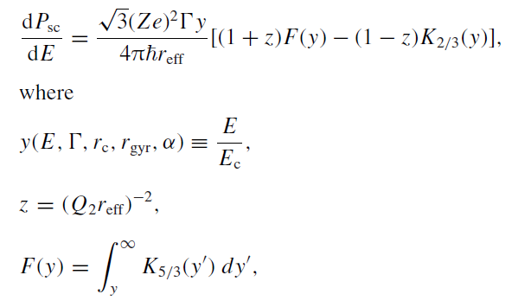

Synchro-curvature Radiation
Encapsulates 2 limits: CR, SR
“Magnetic brehmsstrahlung”
Vigano et al. (2015)
Cheng & Zhang (1996)
Zhang, Xia & Yang (2000)
Kelner & Aharonian (2012)
Prosekin, Kelner & Aharonian (2013)
Radiation Spectrum:

Slide 15
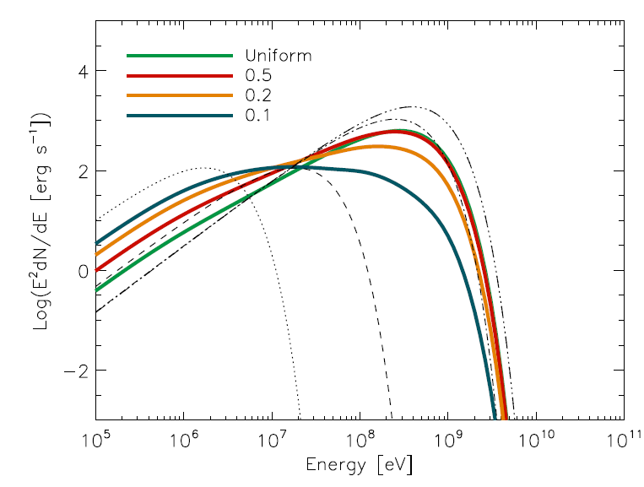
Synchro-curvature Radiation
Vigano et al. (2015)
Single-particle spectra are modulated by particle dynamics (dN_{e}/dE, γ) and local B-field structure (ρ_{c})

Slide 16
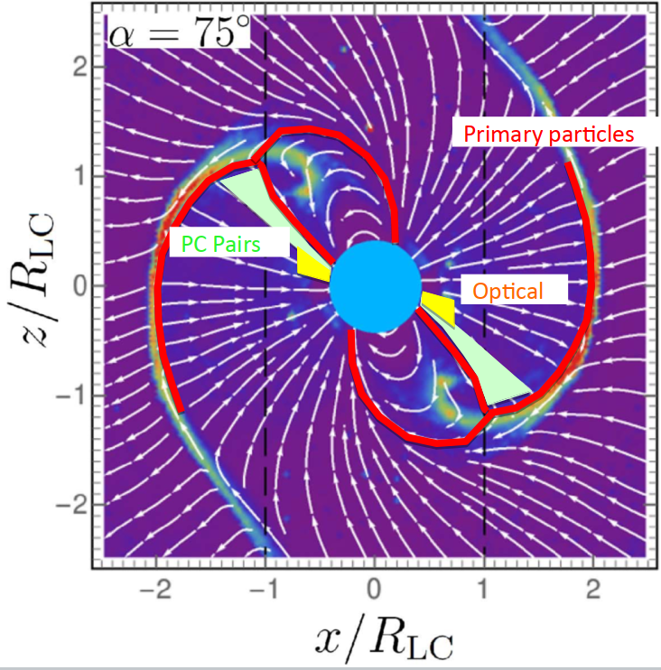
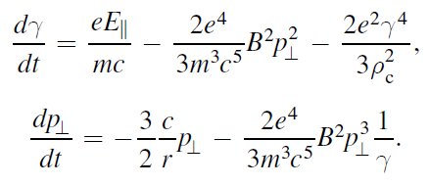
Separatrix / CS Model
Harding & Kalapotharakos (2015), Harding et al. (2018, 2021)
Force-free magnetosphere.
Primaries (γ_{inj}~ 10²) from PC; pairs (γ ~ 10⁵) from cascade in offset-PC B-field
(Harding & Muslimov 2011a,b).
Primaries accelerated only near separatrix and predominantly in CS (out to r = 2R_{LC}) assuming a constant or two-step E-field (reaching γ ~ 10⁷ – 10⁸).
No pair acceleration. Free primary / pair multiplicities. Injection at φ_{PC} where J/J_{GJ} < 0.
Empirical radio core / cone model. Resonant cyclotron absorption of radio photons by particles (cf. Lyubarski & Petrova 1998).
Solve particle dynamics in observer frame.
SC (CR+SR), ICS, SSC radiation mechanisms.

Slide 17
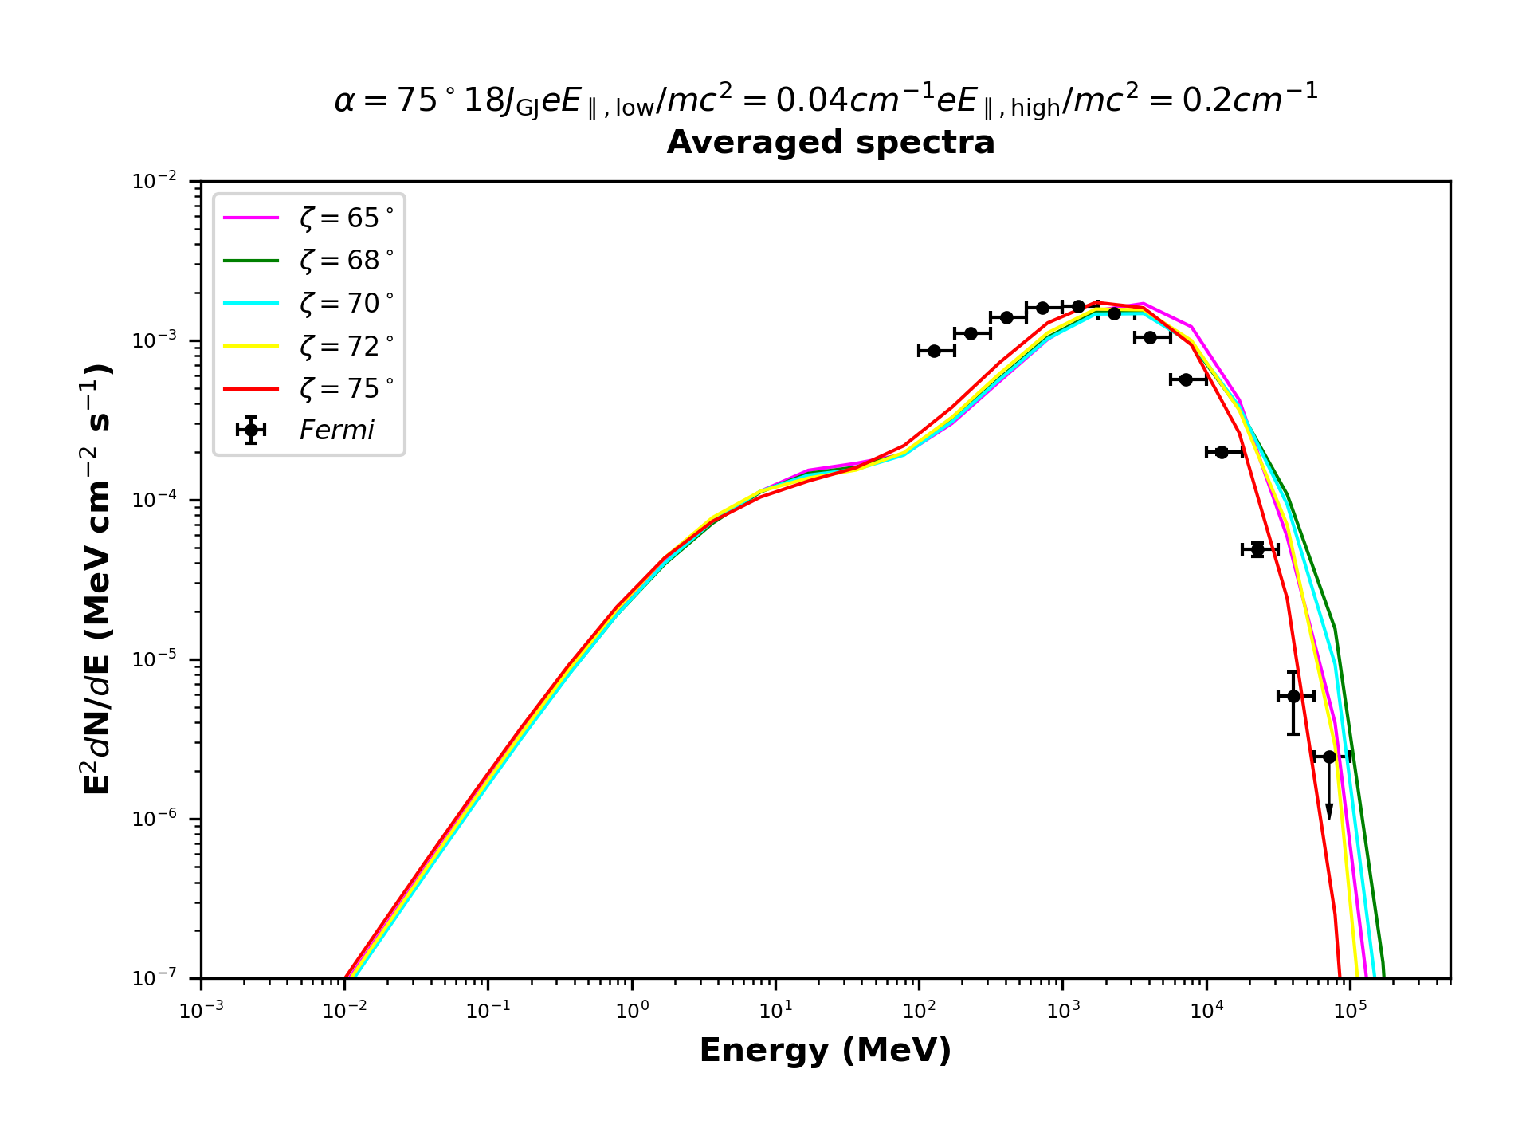
SC: change in ζ
PRELIMINARY!
Credit: A Kundu

Slide 18
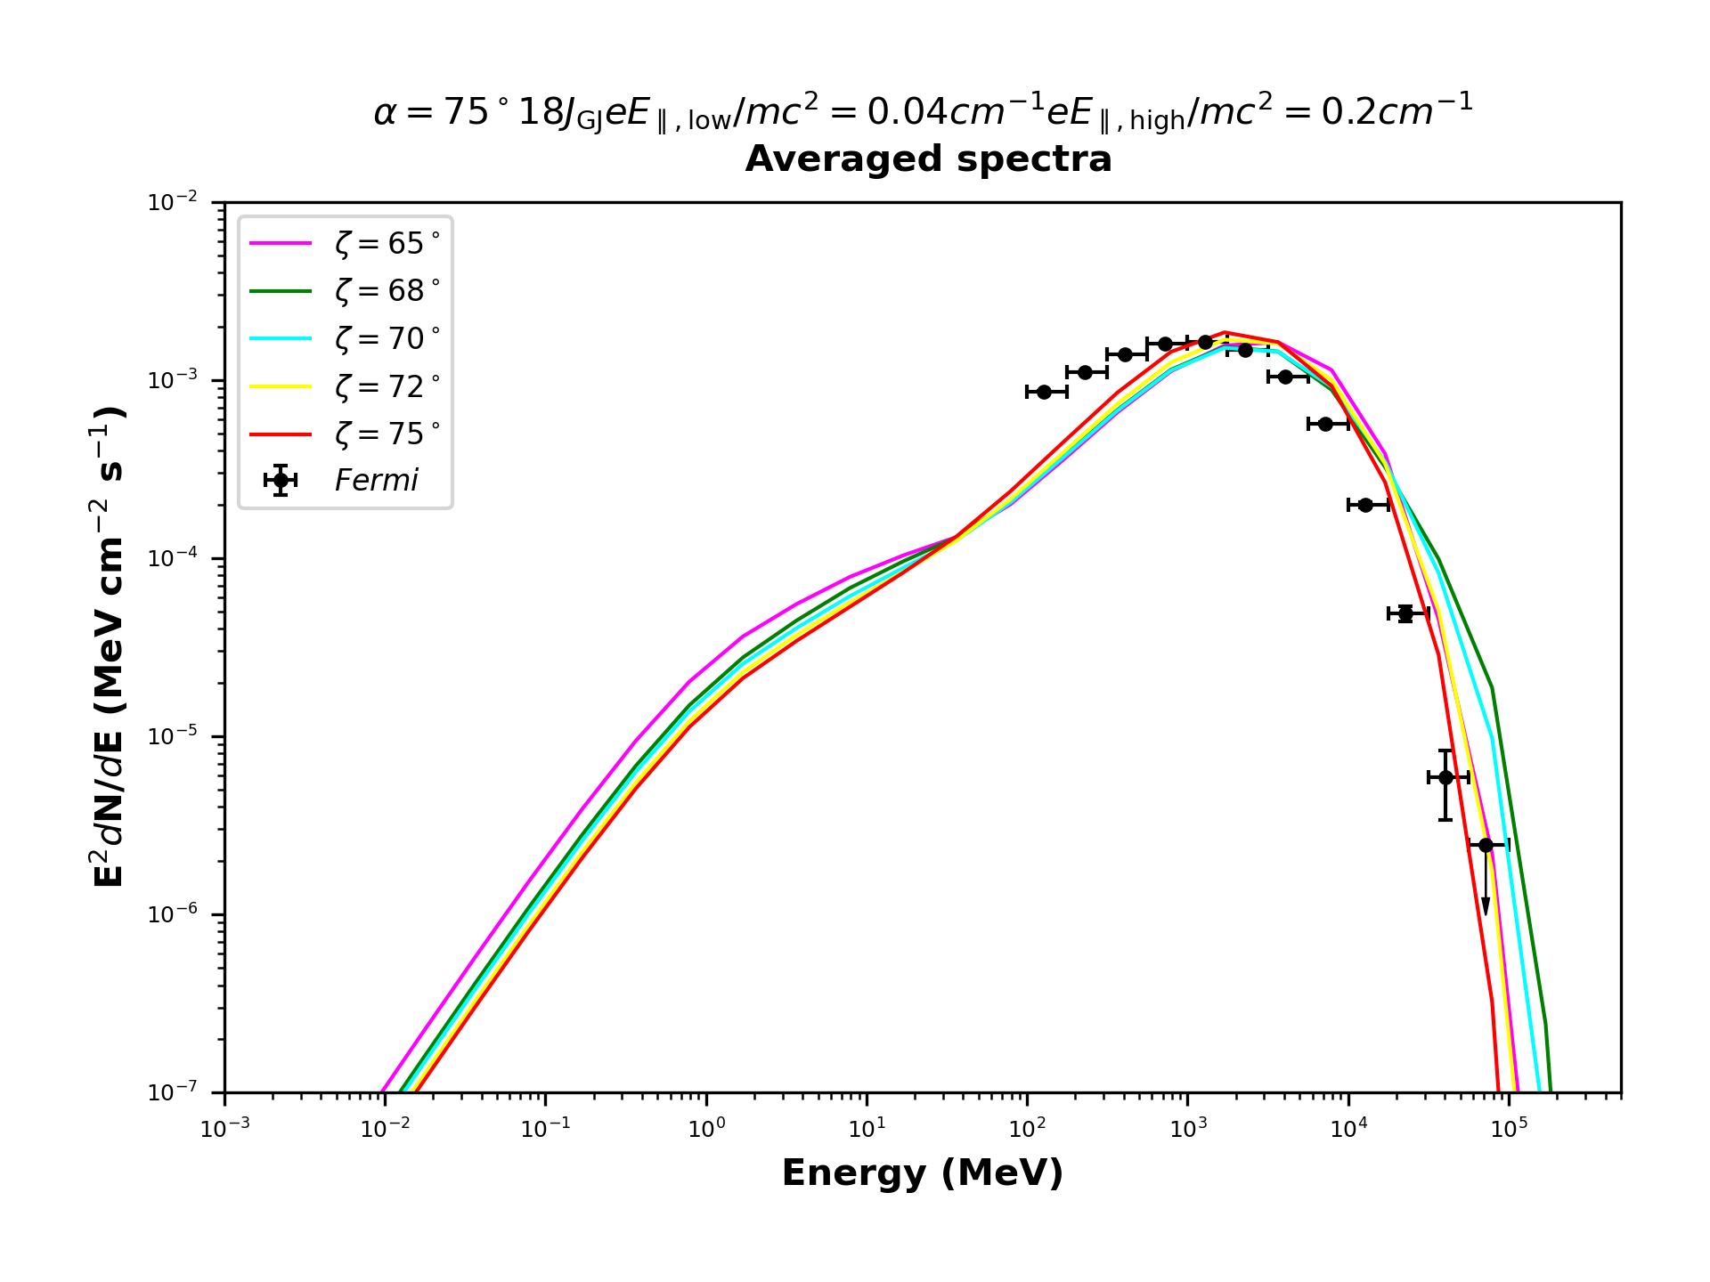
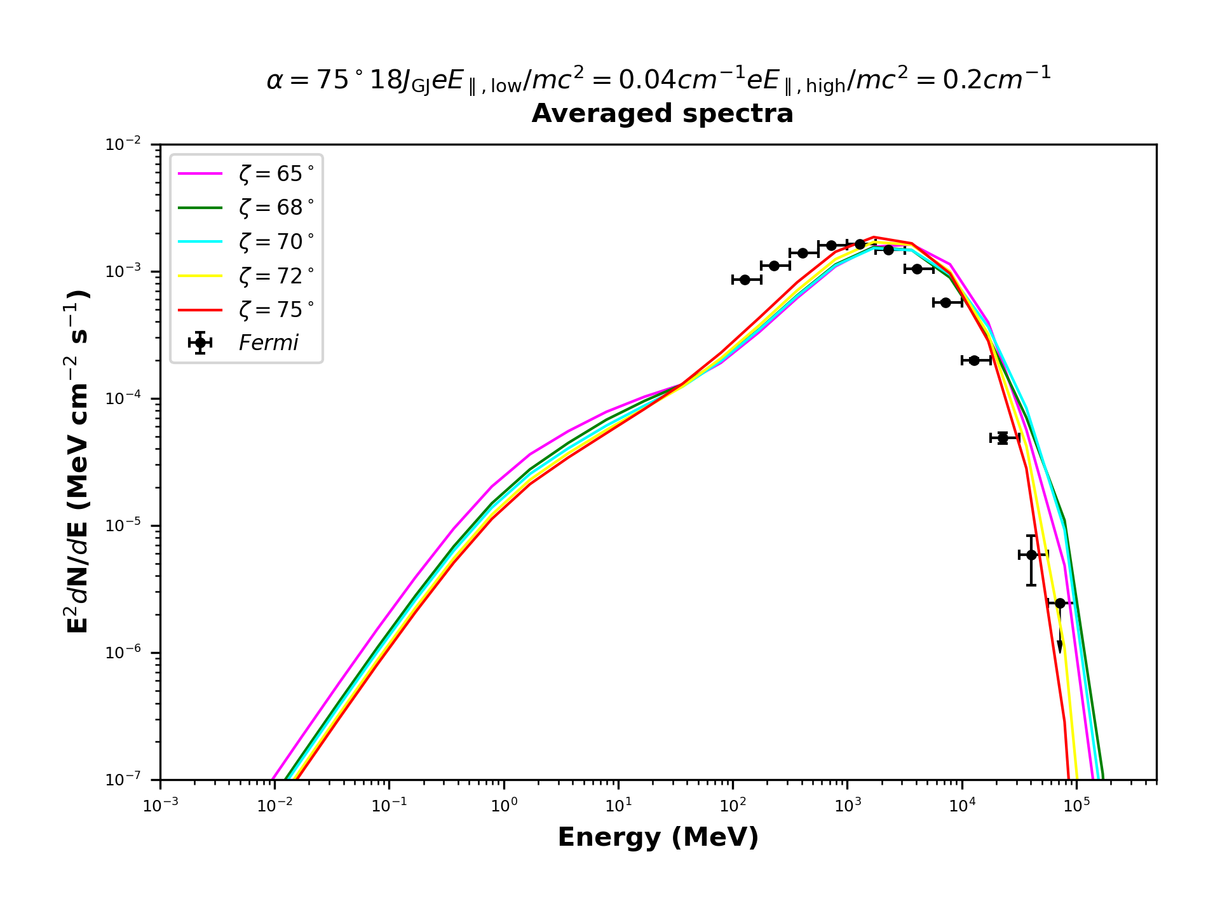
SC: change in E||(r)
PRELIMINARY!
Step in E|| at 1.0 R_{LC}
Ramp between 0.9 R_{LC} and 1.1 R_{LC}
Ramp between 0.8 R_{LC} and 1.2 R_{LC}
Credit: A Kundu

Slide 19
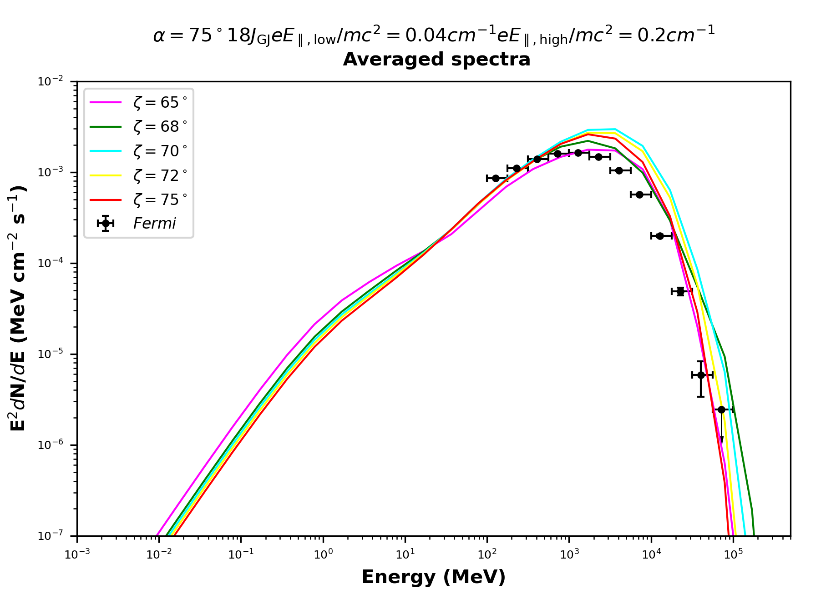
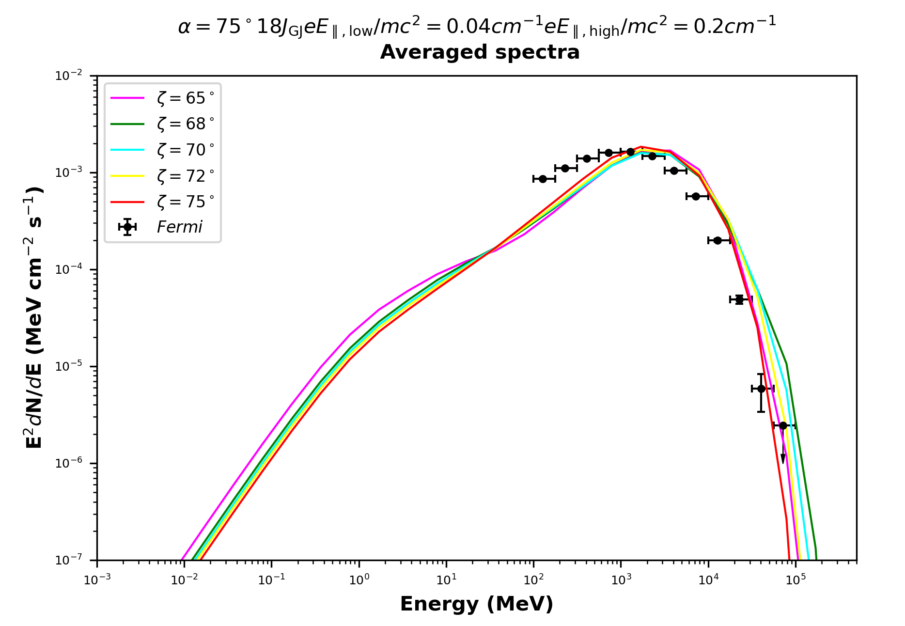
SC: change in N(φ)
PRELIMINARY!
γ₀ = 200
γ₀ = 200 – 2000
γ₀ = 200 – 4000
Credit: A Kundu

Slide 20
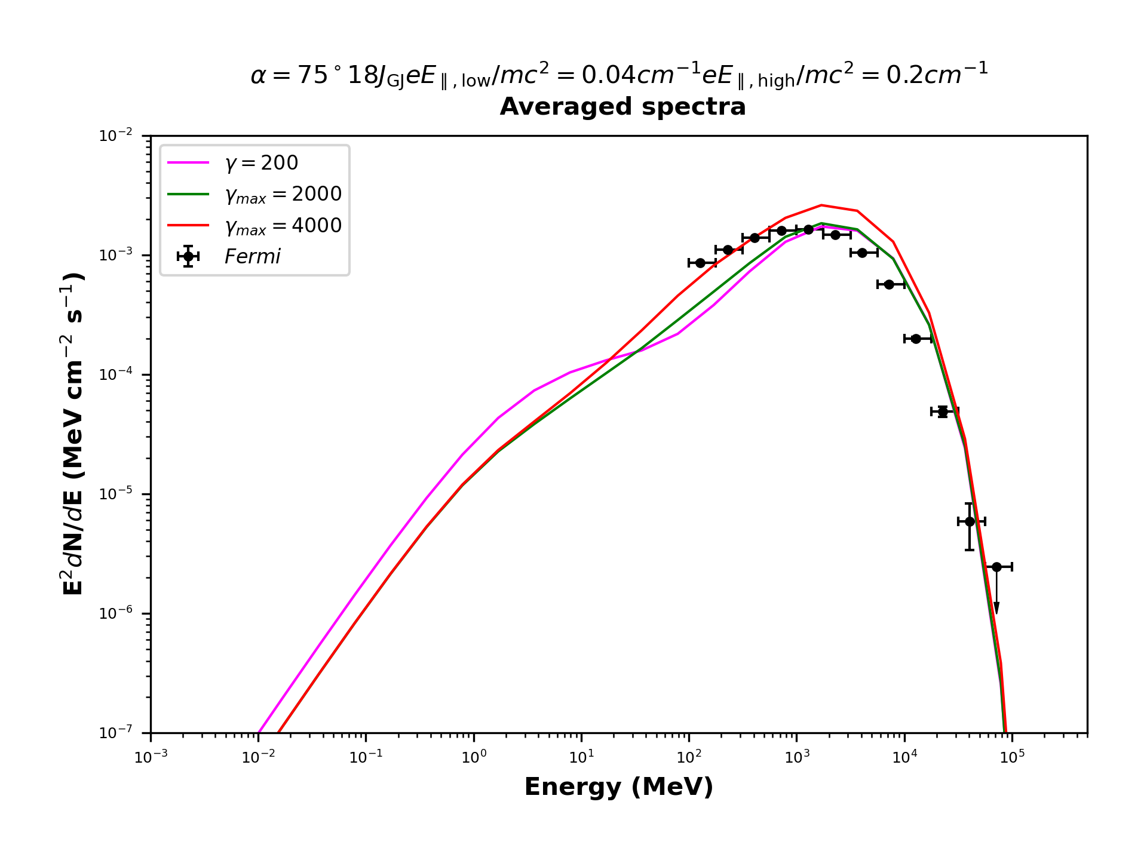
SC: change in N(φ)
PRELIMINARY!
ζ = 75º
Credit: A Kundu

Slide 21

SC: Mix
PRELIMINARY!
ζ
Ramp between 0.9 R_{LC} and 1.1 R_{LC}
γ₀ = 200 – 2000
Credit: A Kundu

Slide 22
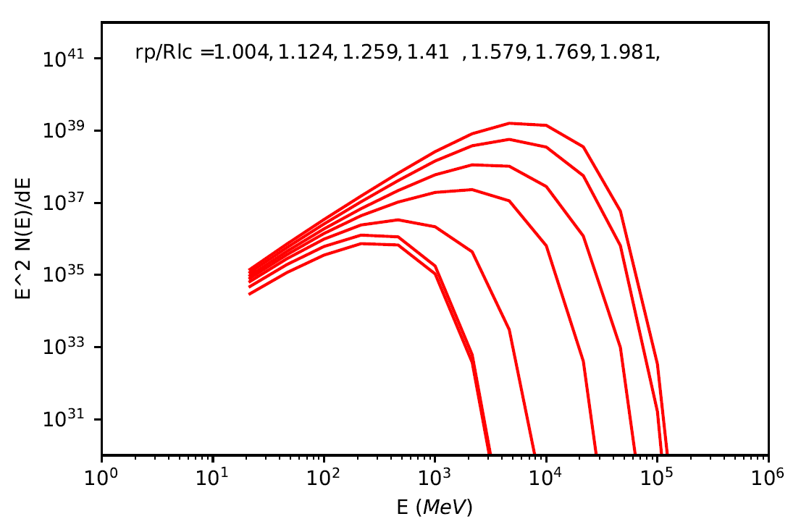
Cumulative SC vs. Altitude
Phase-averaged spectra
Cumulative up to r_{p}
ζ = 60º
PRELIMINARY!
UP TO r/R_{LC} = 1.004, 1.124, 1.259, 1.41 ,1.579,1.769,1.981
Credit: AK Harding

Slide 23
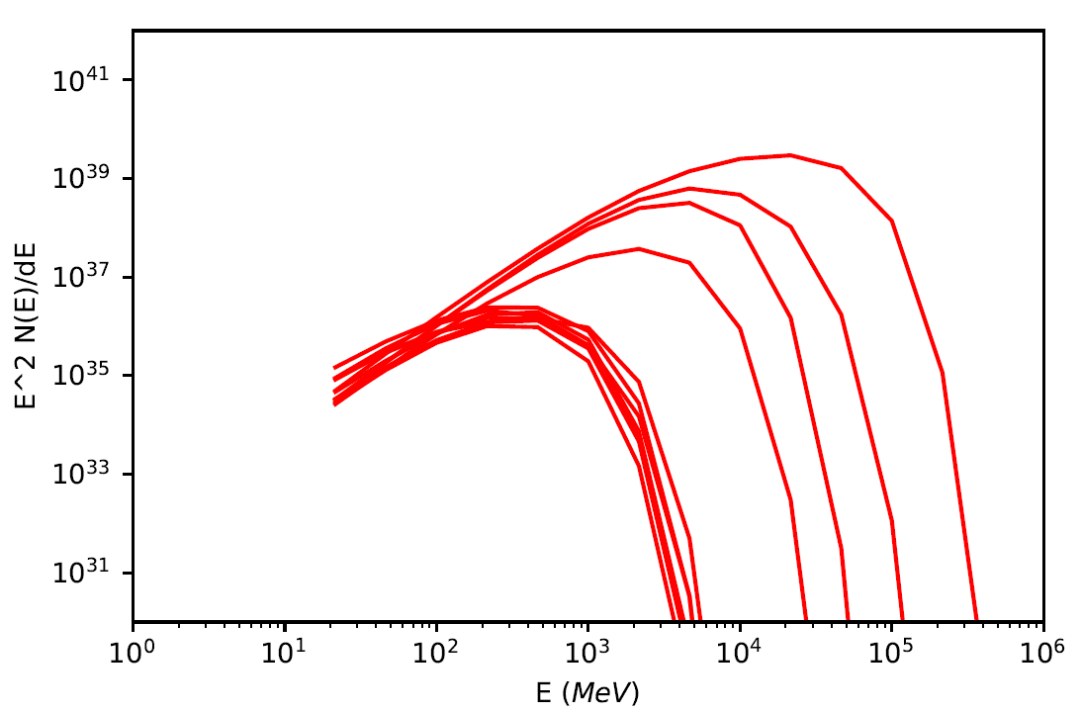
‘Differential’ SC vs. Altitude
Phase-averaged spectra
Fixed at r_{p}
ζ = 60º
PRELIMINARY!
r/R_{LC} = 0.46 , 0.529, 0.6083, 0.6996, 0.8045, 0.9252, 1.064, 1.224, 1.407, 1.618, 1.861
Credit: AK Harding

Slide 24
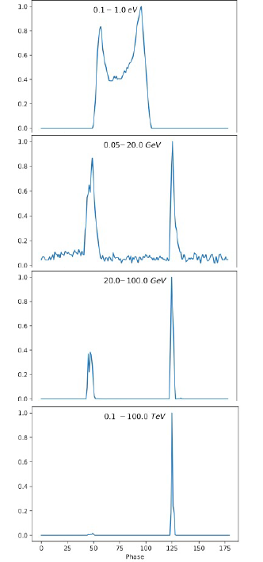
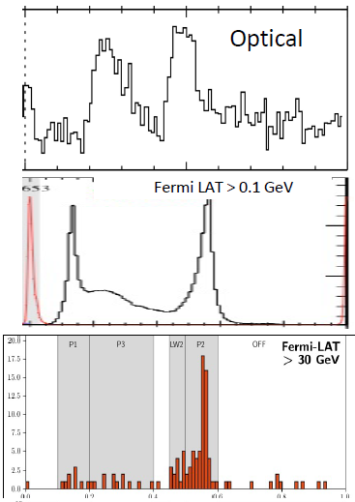
P1/P2 vs. E_{γ}
Reasonable multi-wavelength LC predictions
P1/P2 vs. E_{γ} effect: higher-energy photons in P2 – larger ρ_{c}
Only P2 in TeV: highest-energy particles responsible
Narrowing of peaks with energy
E||(φ) leading to azimuthally-dependent emissivity improves
radio-to-γ lags
Harding et al. (2021)

Slide 25
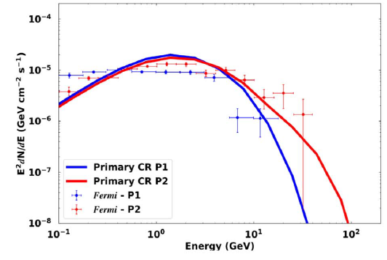
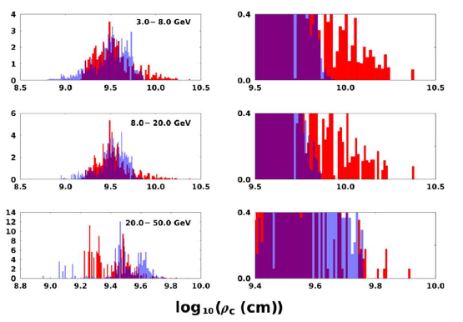
P1/P2 vs. E_{γ}
Barnard et al. (2022)

Slide 26
Conclusions
Vela is a unique source with high-quality, multi-band data
HE spectrum: sub-exponential tail
Traditionally: CR
SC may give a broader spectral (GeV) peak
SC vs. altitude:
  Differential and integral; parameter study
  Build-up of broad(er) spectrum – dominant in CS
  Compare spectra below / beyond R_{LC}
  Local γ ∼ 10⁸, ρ_{c} ~10 − 100 R_{LC} – are the ranges adequate?
Constraining model parameters via spectral shape?
Joint fitting of spectra and light curves more constraining

Slide 27

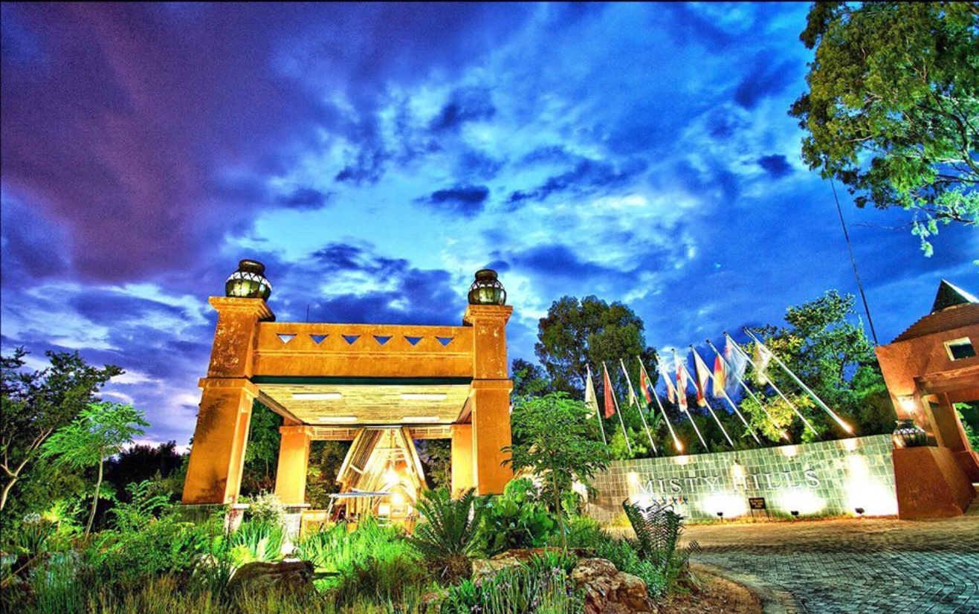
Thanks!
This work is based on the research supported wholly / in part by the National Research Foundation (NRF) of South Africa (Grant Numbers 92860, 93278, and 99072). The Grantholder acknowledges that opinions, findings and conclusions or recommendations expressed in any publication generated by the NRF supported research is that of the author(s), and that the NRF accepts no liability whatsoever in this regard. We also acknowledge support from the UKRI STFC Global Challenges Research Fund project ST/S002952/
https://twitter.com/mistyhillshotel
“For the Lord is the great God, the great King above all gods. In His hand are
the depths of the earth, and the mountain peaks belong to Him (Psalm 95:3-4).

