Slide 1



The Galactic diffuse gamma-ray emission meets the PeV frontier
Pedro de la Torre Luque*
Based on ArXiv: 2203.15759 and ArXiv: 2209.10011 in collaboration with D. Grasso, D. Gaggero, C. Evoli, O. Fornieri, K. Egberts, C. Steppa, A. Marinelli
* Pedro.delatorreluque@fysik.su.se

Slide 2
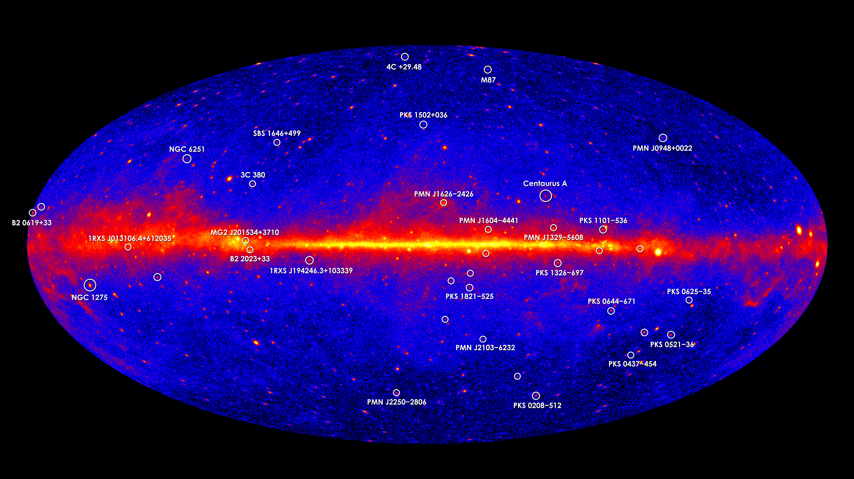
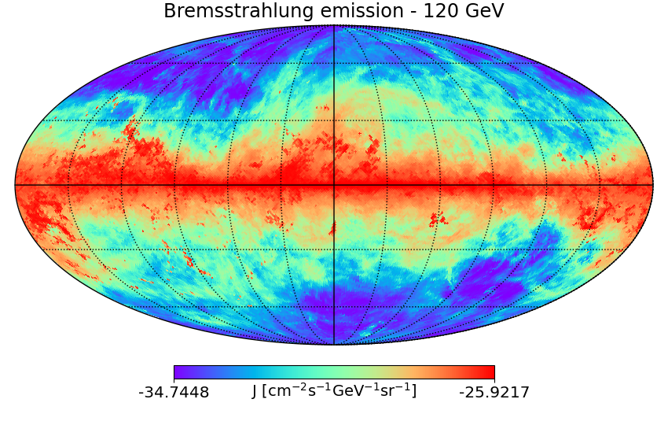
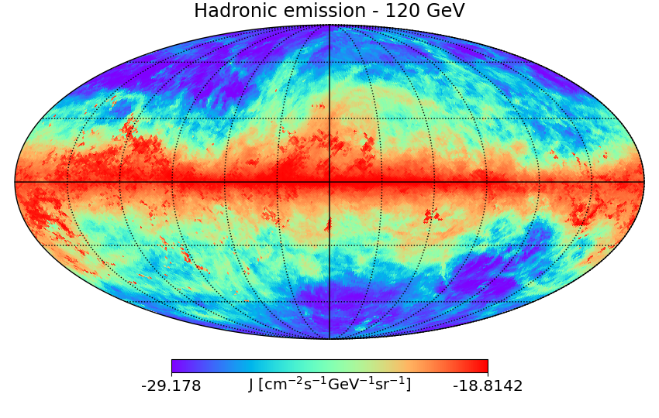
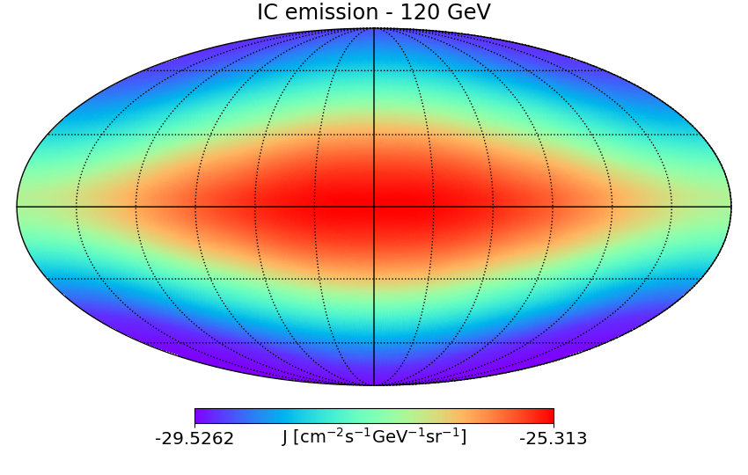
The Gamma-ray diffuse sky
Diffuse emission totally correlated with the propagation of cosmic rays
Dominated by protons, He (and e⁻)
$e +N →e^{′}+γ$’ + N
$$p+p → π0$$
$$π0→2 γ$$
$e +γ →e^{′}+γ$’
Hadronic (and Bremss.) emission follows the ISM gas distribution
IC emission depends on the energy density of the ISRFs

Slide 3
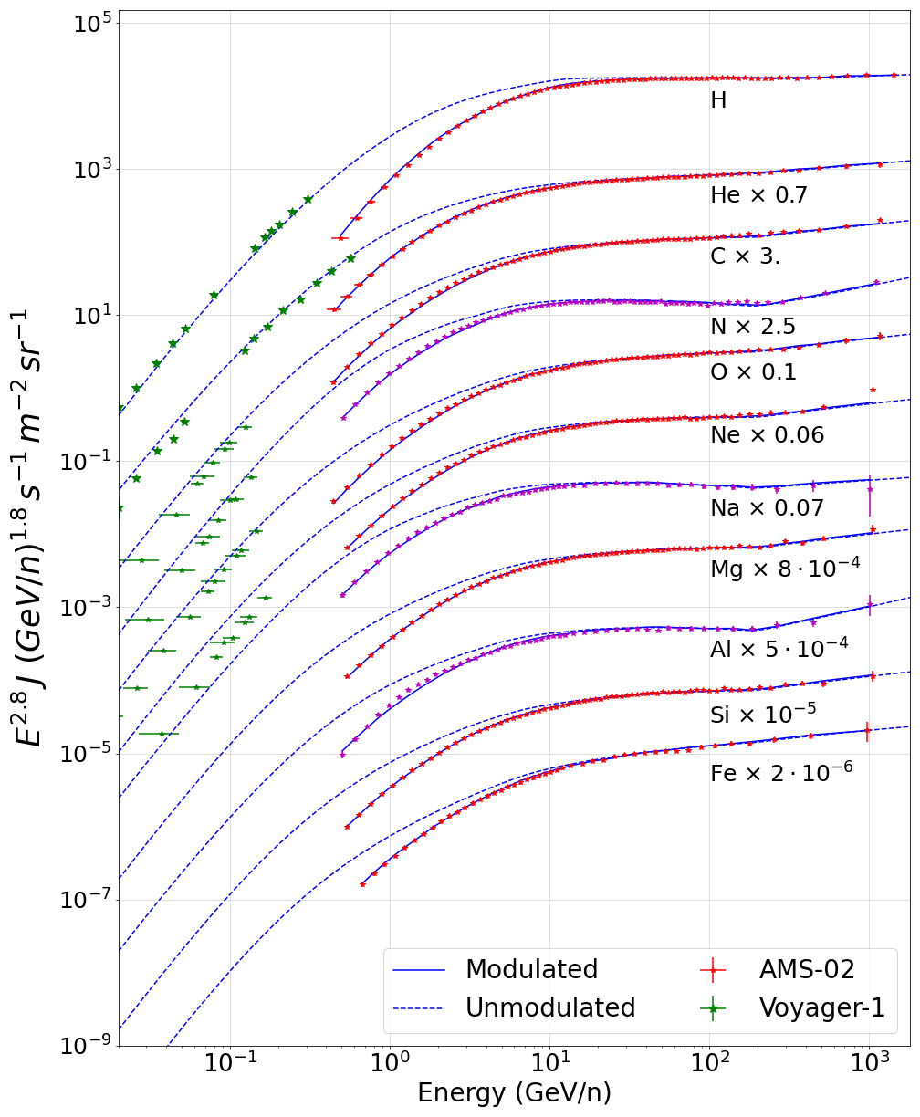
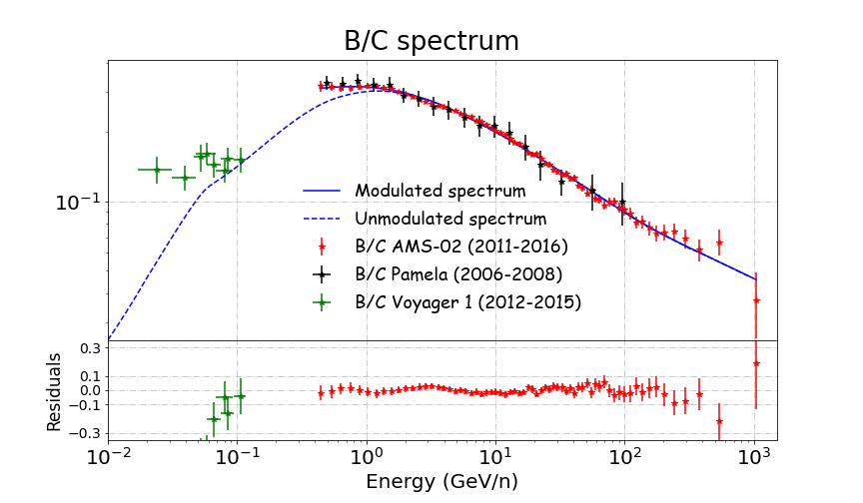
Galactic gamma-ray diffuse emission – Local cosmic rays
Too limited information on Galactic CR propagation to build theoretical models beyond the Solar System
P.D.L. et al JCAP 07 (2022) 07, 008
P.D.L. et al JCAP03 (2021) 099
$$δ\left(x=REarth\right) \sim 0.5$$
$$J∝E^{ (α+δ)}$$

Slide 4
Galactic gamma-ray diffuse emission – Local cosmic rays
$\frac{\text{J}\text{sec}}{\text{J}\text{pr}} \sim$σ(E)/ $D\left(E\right)$
$D\left(E, x\right)$ ~ D₀${\left(\frac{E}{E0}\right)}^{δ(x)}F(x)$
P.D.L. et al JCAP 07 (2022) 07, 008
P.D.L. et al JCAP03 (2021) 099
$$δ\left(x=REarth\right) \sim 0.5$$
$$J∝E^{ (α+δ)}$$

Slide 5
Galactic gamma-ray diffuse emission – Local cosmic rays
$\frac{\text{J}\text{sec}}{\text{J}\text{pr}} \sim$σ(E)/ $D\left(E\right)$
$D\left(E, x\right)$ ~ D₀${\left(\frac{E}{E0}\right)}^{δ(x)}F(x)$
P.D.L. et al JCAP 07 (2022) 07, 008
P.D.L. et al JCAP03 (2021) 099
$$δ\left(x=REarth\right) \sim 0.5$$
$$J∝E^{ (α+δ)}$$

Slide 6
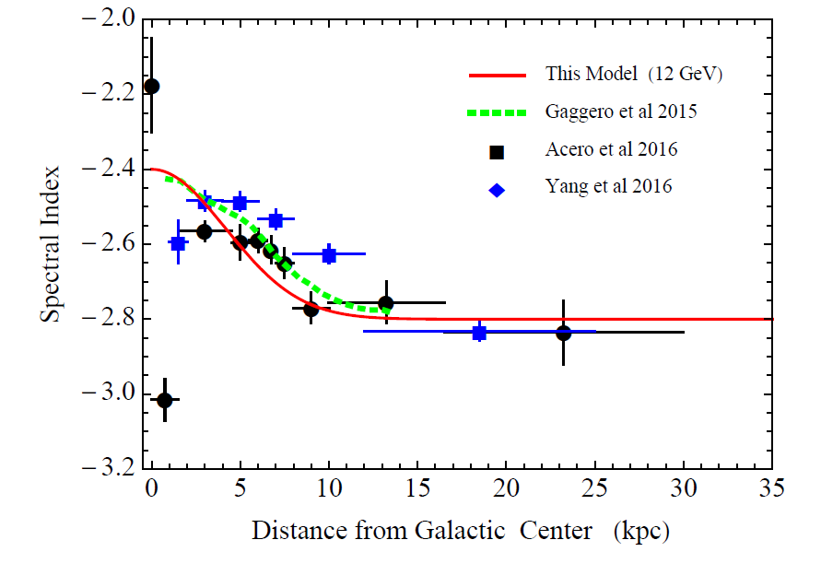
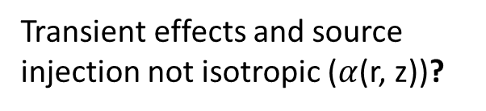
Galactic gamma-ray diffuse emission – Hardening towards the centre
The conventional picture of spatially-constant diffusion is not able to explain this consistently
Progressive hardening of the gamma-ray diffuse spectrum towards the centre
Diffuse gamma-ray spectrum essentially follows the spectrum of CR protons:
Purely diffusive – $\text{φ}∝E^{−\left(α+ δ\right)}$
Advection dominated – $\text{φ}∝E^{−α}$
Lipari et al 2020 (12 GeV)
Transient effects and source injection not isotropic ($α$(r, z))?
P. Lipari, S.Vernetto 2020

Slide 7
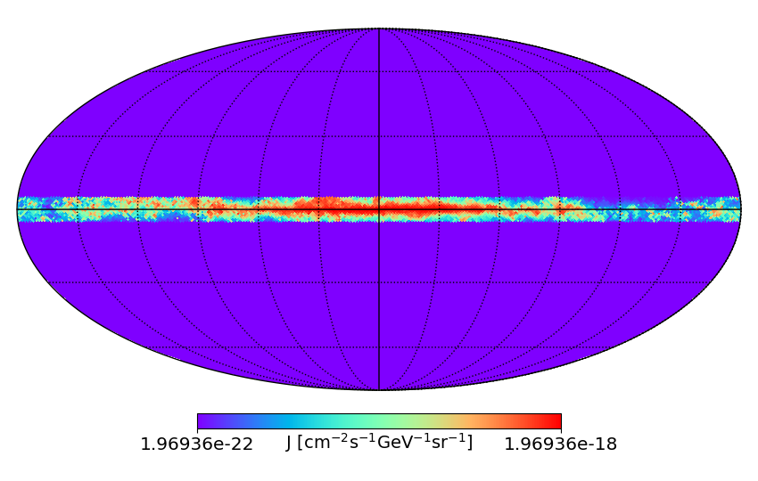
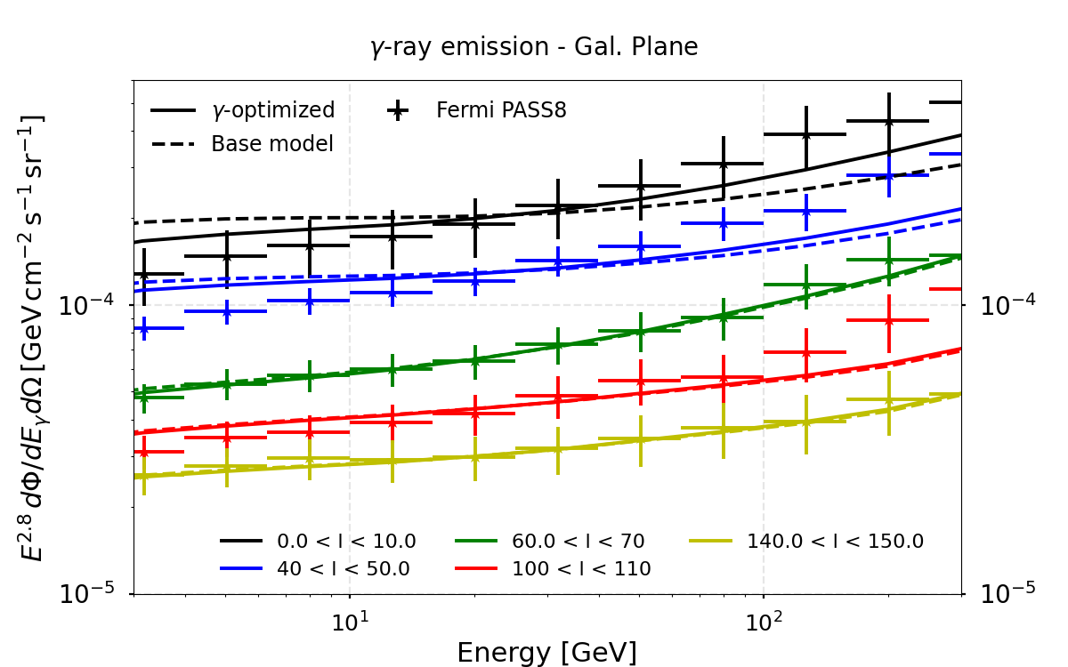
Inhomogeneous diffusion model
Diffusion coefficient changes towards the Galaxy centre $D∝E^{ δ(R)}$
$$δ\left(R\right)=δ0+δAR$$
P.D.L. et al arXiv: 2203.15759
|b| < 5
DRAGON2
$$D= {D_{0}β\left(\frac{E}{E_{0}}\right)}^{δ(R)}$$
  Base model: Constant ($δ_{A}$ = 0)
  γ-optimized model: $δ_{A}$ = 0.04
  $δ_{0}$ = 0.17
Notes:
The normalization of the spectra at different longitudes is tuned by changing the XCO value

Slide 8
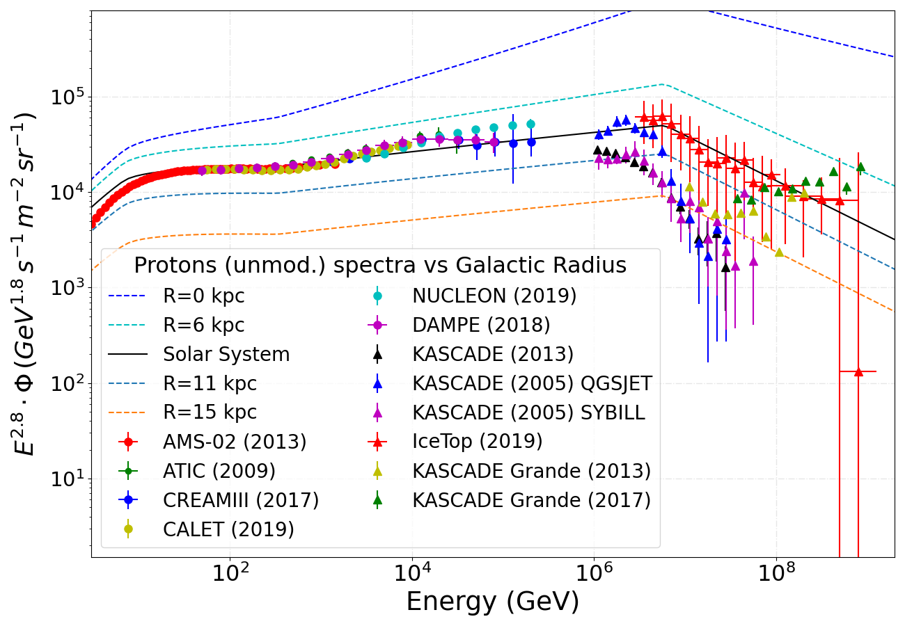
Inhomogeneous diffusion model (δ → δ(R))
Different interpretations of local data
Local sources vs global features
Two different interpretations (models) of the local proton and He data based on the “bump” at ~10 TeV found by DAMPE and the discrepancy from particle shower experiments.
MAX model adopted connects AMS-02 data with IceTop
MIN model adopted connects the DAMPE “bump” with KASCADE
Both models incorporate a break at ~ 300 GeV and a strong softening (cut-off) at a few PeV
P.D.L. et al arXiv: 2203.15759
MAX model

Slide 9
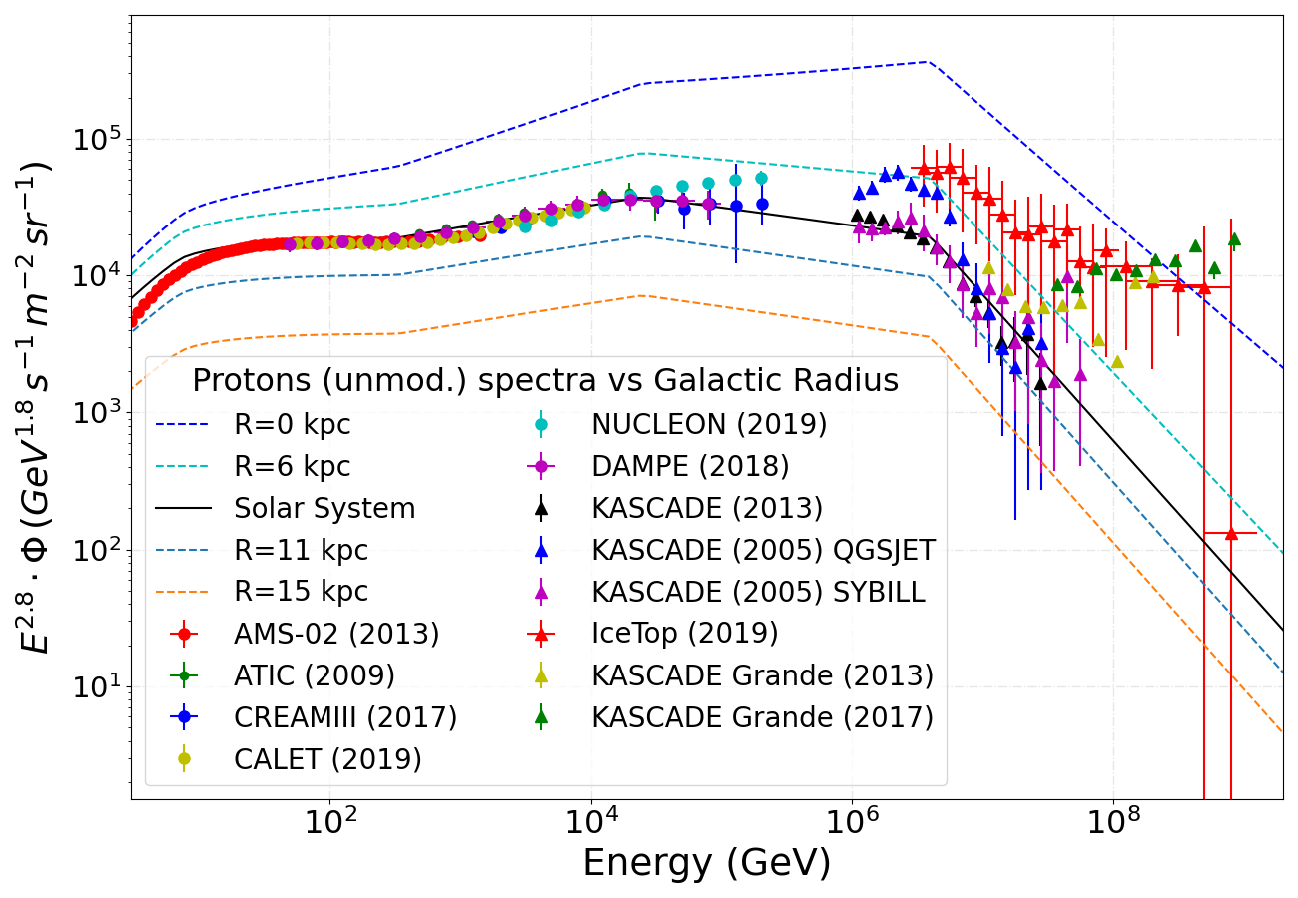
Inhomogeneous diffusion model (δ → δ(R))
Different interpretations of local data
Local sources vs global features
Two different interpretations (models) of the local proton and He data based on the “bump” at ~10 TeV found by DAMPE and the discrepancy from particle shower experiments.
MAX model adopted connects AMS-02 data with IceTop
MIN model adopted connects the DAMPE “bump” with KASCADE
Both models incorporate a break at ~ 300 GeV and a strong softening (cut-off) at a few PeV
P.D.L. et al arXiv: 2203.15759
MIN model

Slide 10
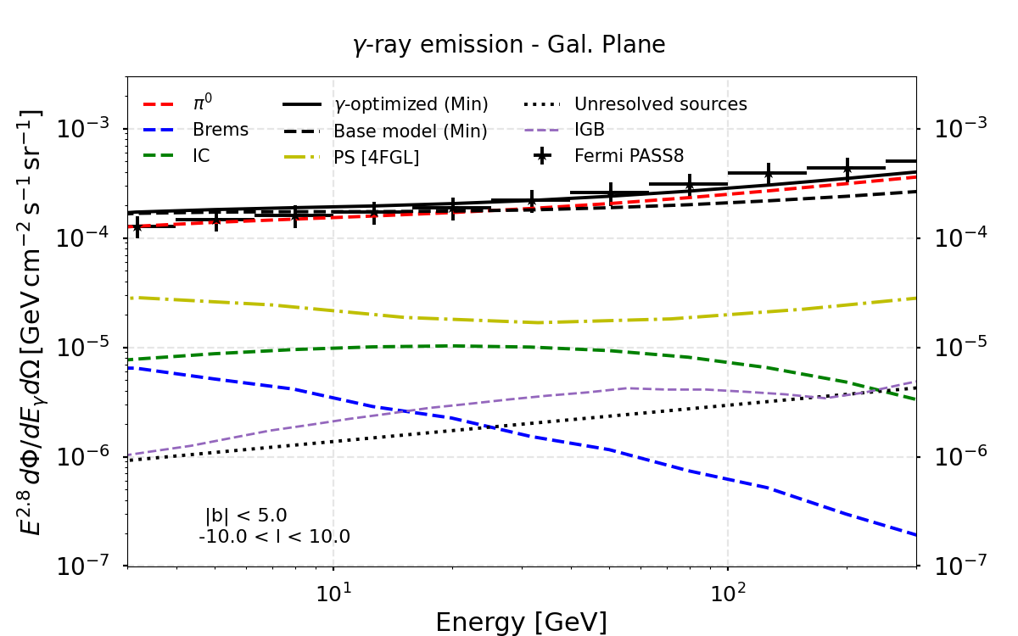
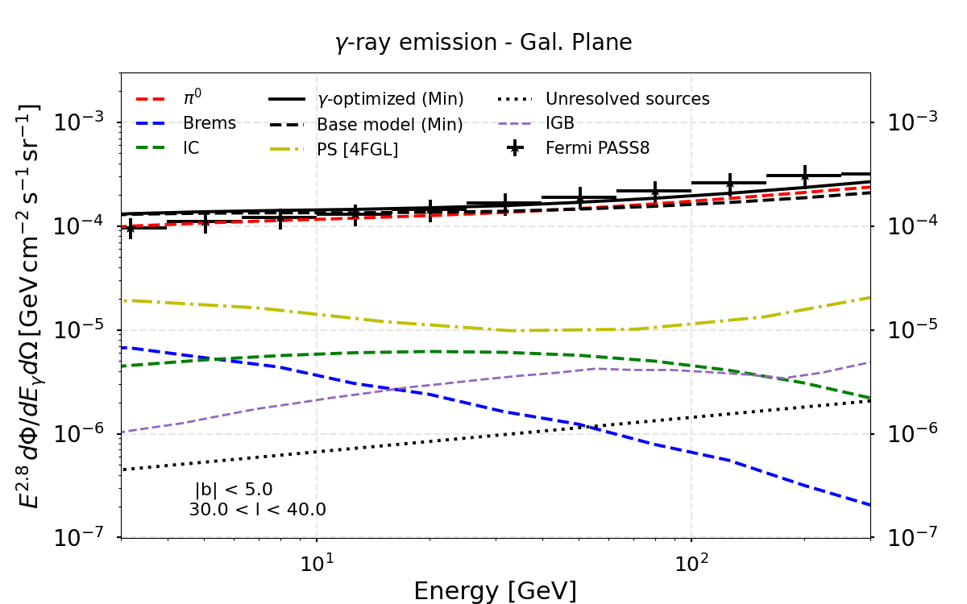
Inhomogeneous diffusion model – The different components
The diffuse emission at GeV energies dominate over the emission sources emission (4FGL catalogue)
Unresolved point sources (UPS) become more important at higher energies (Steppa+ A&A 643, A137 (2020))
Isotropic gamma-ray background (IGB) contains Extra-galactic plus Fermi’s instrumental background
P.D.L. et al arXiv: 2203.15759

Slide 11
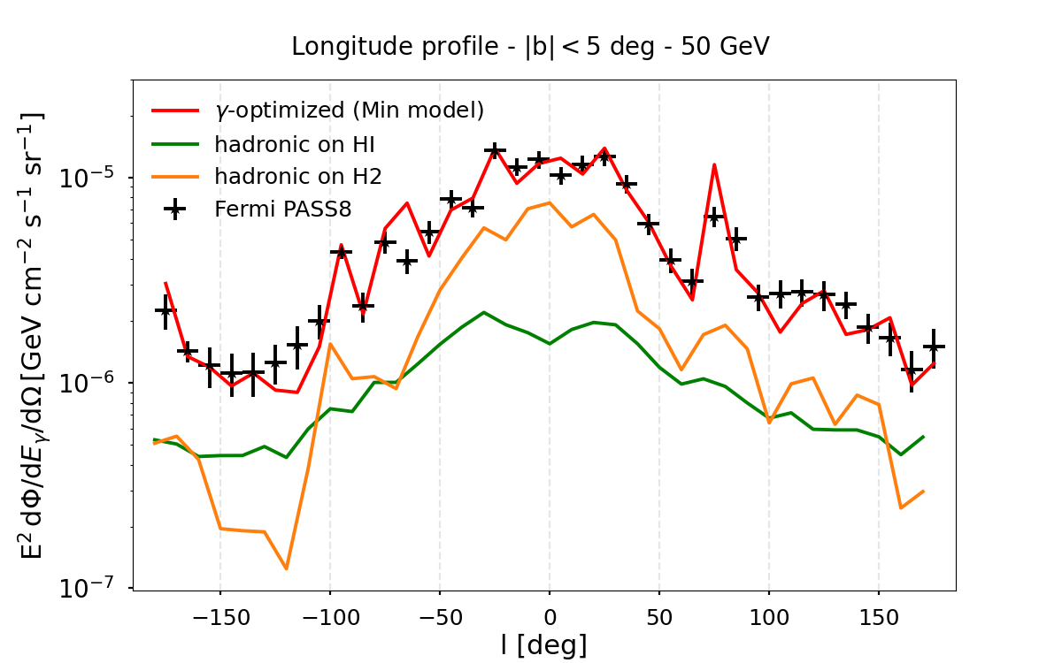
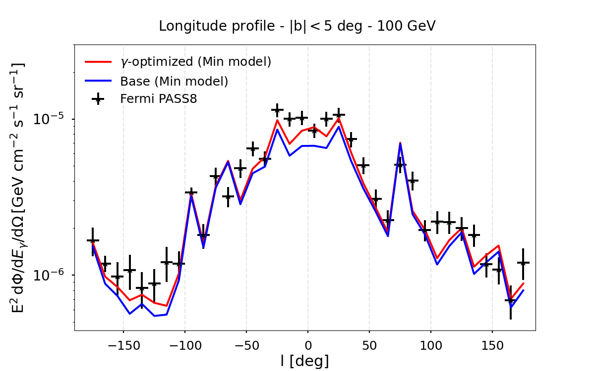
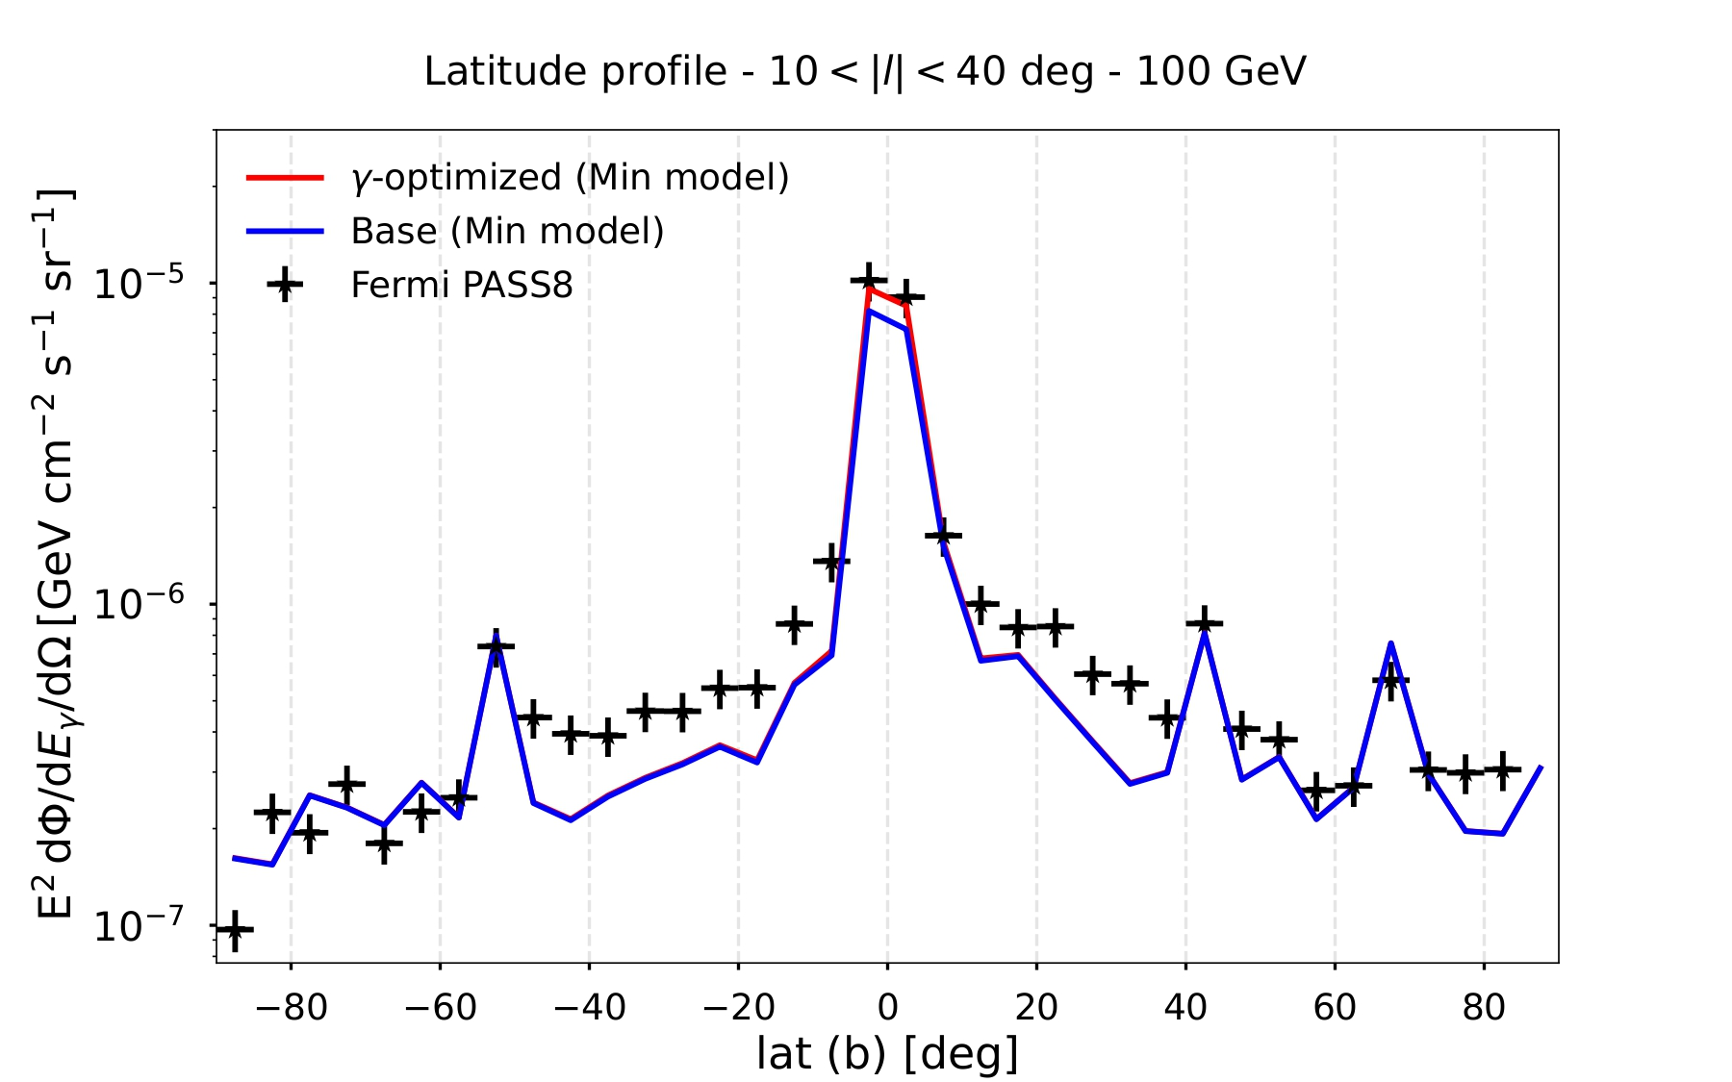
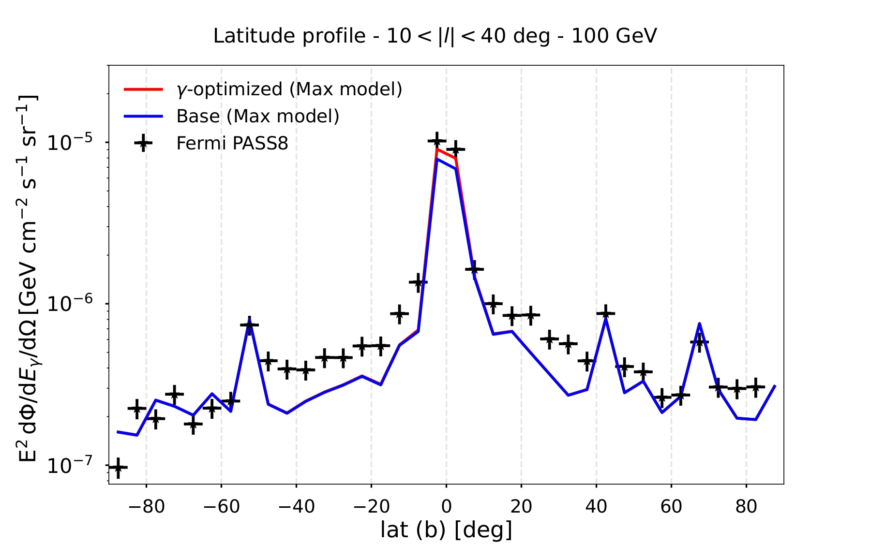
γ-optimized model vs Fermi
ISM gas distribution based on the ring gas model developed by Q. Remy
ISRF distribution (CMB + IR + Stellar) from Vernetto&Lipari Phys. Rev. D 94, 063009
XCO factor divided in rings to tune the normalization (main caveat!!)
P.D.L. et al arXiv: 2209.10011

Slide 12
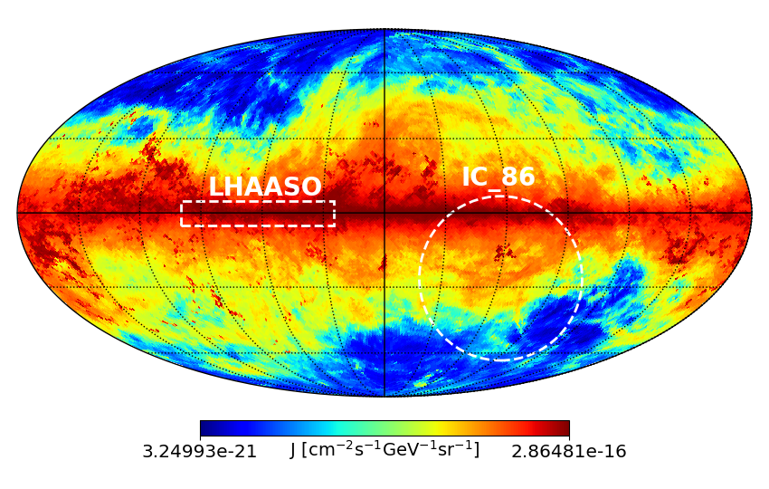
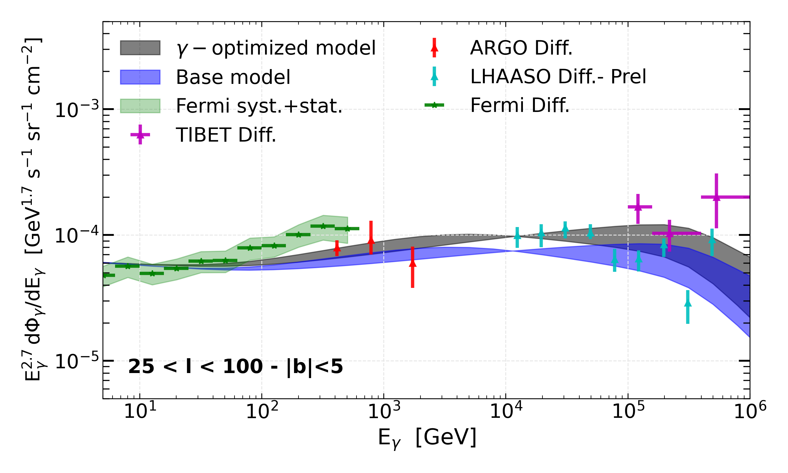
Inhomogeneous diffusion model
The diffuse emission meets TeV data
P.D.L. et al arXiv: 2203.15759
The spatially-dependent (γ-optimized) models, tuned on Fermi-LAT data are also favoured by very high energy detectors like LHAASO
Important implications for future experiments like CTA and for dedicated studies of the Galactic Centre (GeV excess)
$$D∝E^{ δ(R)}$$

Slide 13
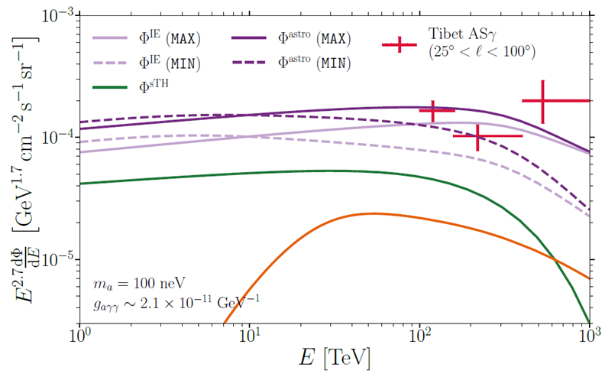
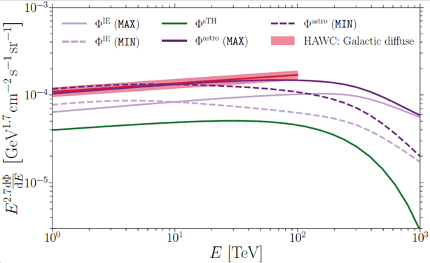
Total diffuse emission → MAX/MIN (truly diffuse) + Unresolved sources contribution
Compatibility with the total diffuse emission from the TeV (HAWC) to the PeV (TIBET)
(43◦ < l < 73◦, |b| < 4)
Eckner & Calore 2022 arXiv: 2204.12487
Eckner & Calore 2022 arXiv: 2204.12487

Slide 14
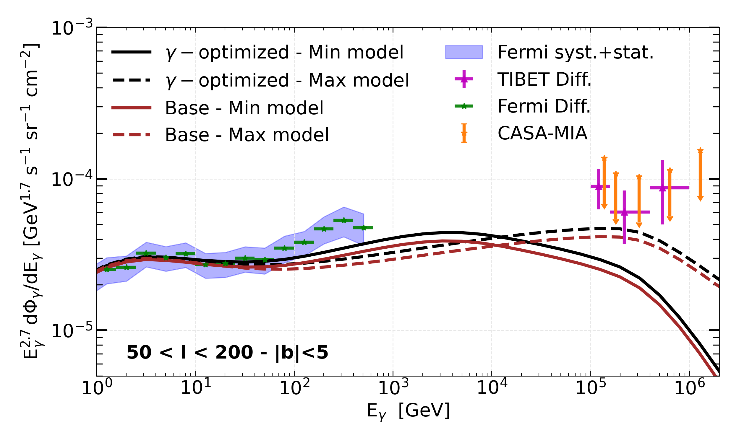
Inhomogeneous diffusion model
The diffuse emission meets TeV data
Both models under-produce TIBET data → Region very affected by the emission of unresolved sources! (dependent on the experiment)
The effect of the inhomogeneous transport in such externals regions is small, therefore, more data at these ROIs can help solving the degeneracy on the injection spectra (MAX/MIN)
See also:
Vecchiotti et al ArXiv:2107.14584
Linden and Buckman PRL 120, 121101 (2018)
P.D.L. et al arXiv: 2203.15759

Slide 15
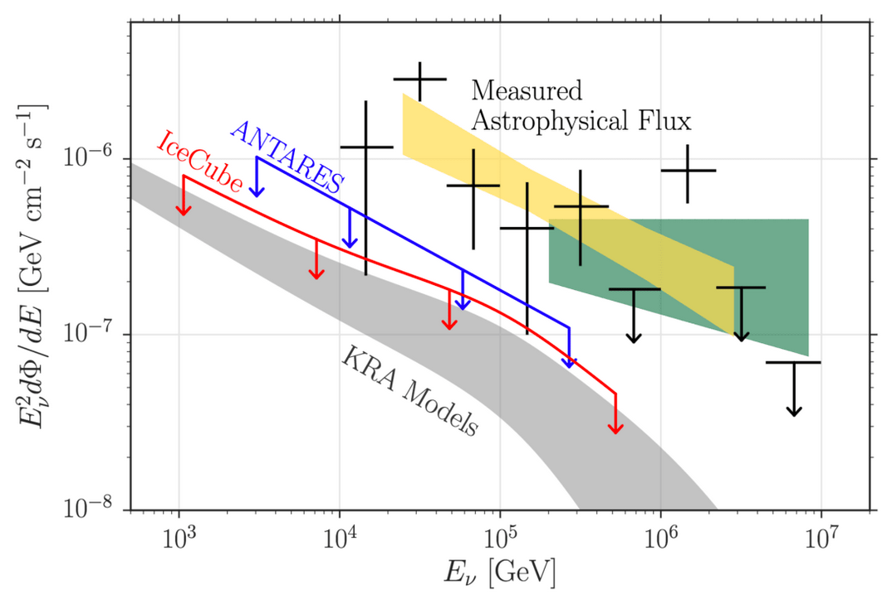
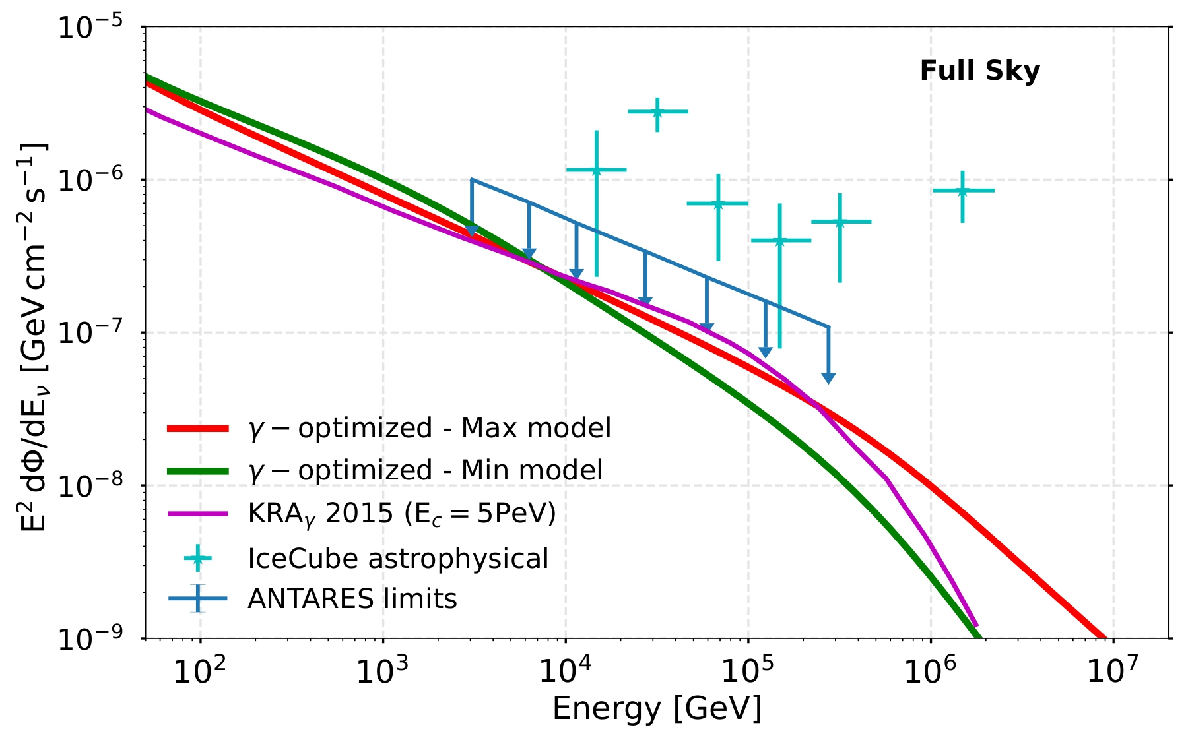

Diffuse gamma-ray production: detection of neutrinos as a smoking gun
IceCube, ApJ 849 (2017) 67
Neutrinos are also generated by CR collisions with ISM. This emission is similar in intensity and spectral shape to the gamma-ray emission
P.D.L. et al arXiv: 2209.10011
2$σ$ hint observed by IceCube (Aartsen, et al. 2019, Astrop. J., 886, 12).
4.1$σ$ observed in track-like IceCube events (arXiv: 2208.080423).
Indication that a Galactic diffuse component (10-20% of the total flux above 200 TeV) is already identified by IceCube.
Notes:
galactic flux less than 14% of the total flux. Galactic centre region

Slide 16
To conclude…
pedro.delatorreluque@fysik.su.se
Gamma rays offer crucial information about the propagation of cosmic rays in different zones of the Galaxy, although many ingredients are involved…
A formal study of the generation of turbulence (and its evolution) in different zones of the Galaxy is necessary
Precise predictions of unresolved sources and TeV halos would help us improve our models. The detection of Galactic neutrinos would support the scenario of inhomogeneous CR propagation

Slide 17
Thanks for your attention!
The Galactic diffuse gamma-ray emission meets the PeV frontier
Pedro de la Torre Luque*
Based on ArXiv: 2203.15759 and ArXiv: 2209.10011 in collaboration with D. Grasso, D. Gaggero, C. Evoli, O. Fornieri, K. Egberts, C. Steppa, A. Marinelli
*Pedro.delatorreluque@fysik.su.se

Slide 18
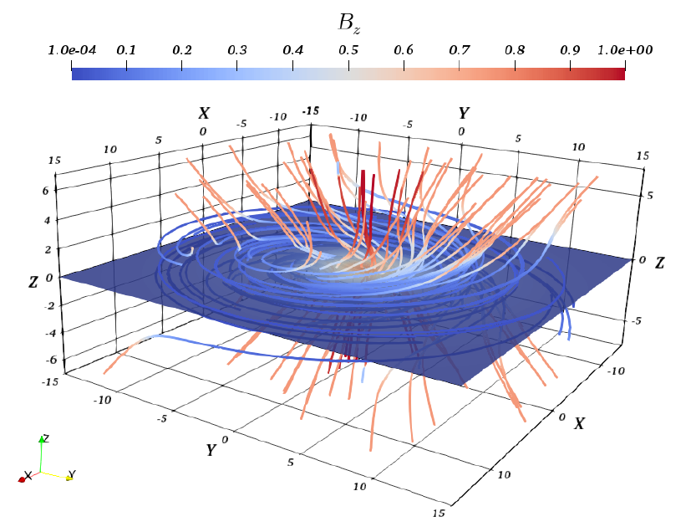
Inhomogeneous diffusion model (δ → δ(R))
Many reasons to believe that the turbulence is progressively different towards the Galactic centre:
- Magnetic field intensity (and direction)
- Gas distribution (contributing to damping of MHD waves)
- Distribution of sources
- Anisotropy of turbulence cascade
- Non-steady particle distribution?
Cerri et al., 2017

Slide 19
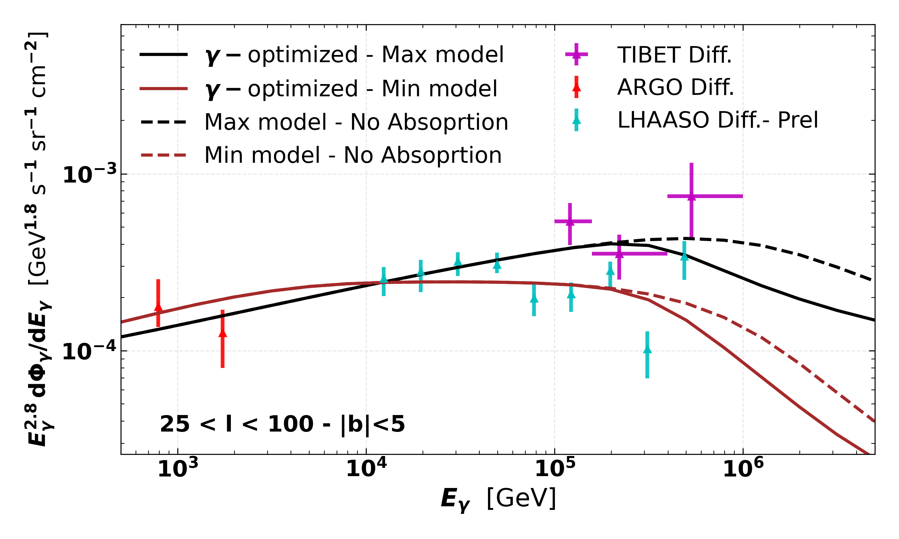
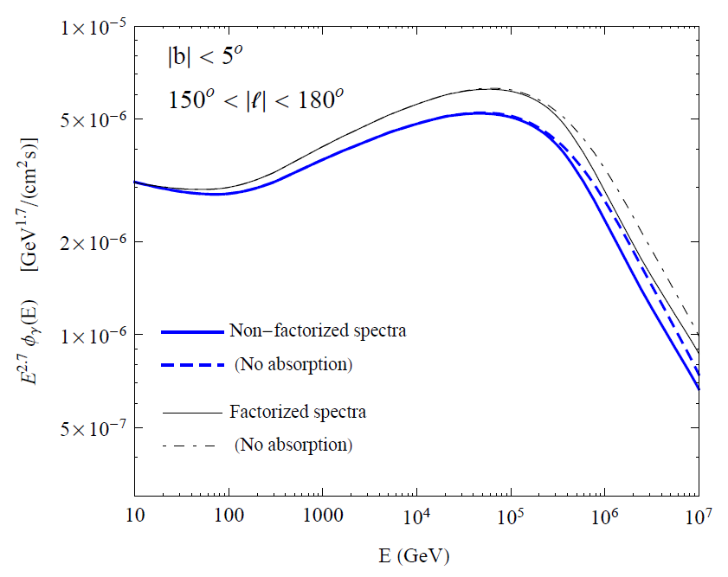
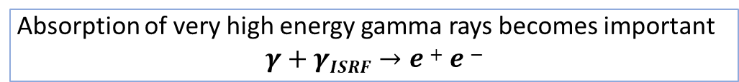
Inhomogeneous diffusion model
The diffuse emission meets TeV data
Absorption from the CMB dominates over the other ISRFs (IR from dust, Optic and UV from stars and extra-galactic background light)
P. Lipari, S.Vernetto 2020
Absorption of very high energy gamma rays becomes important
$$γ+γISRF→e+e−$$

Slide 20
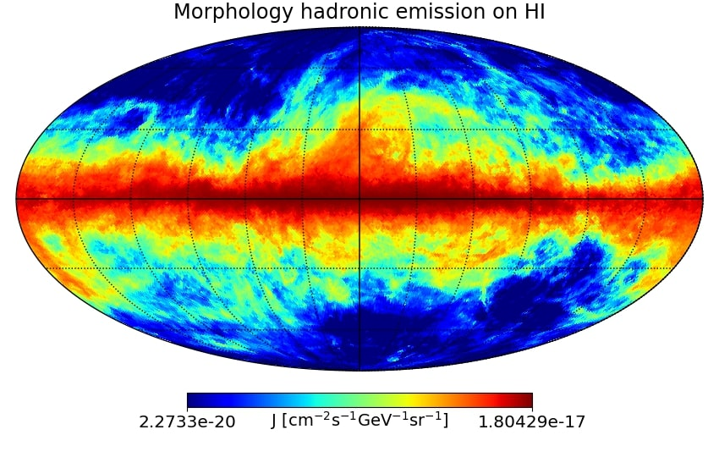
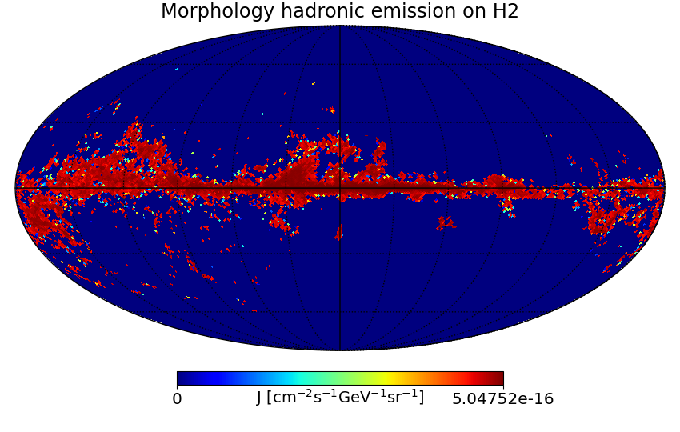

Slide 21
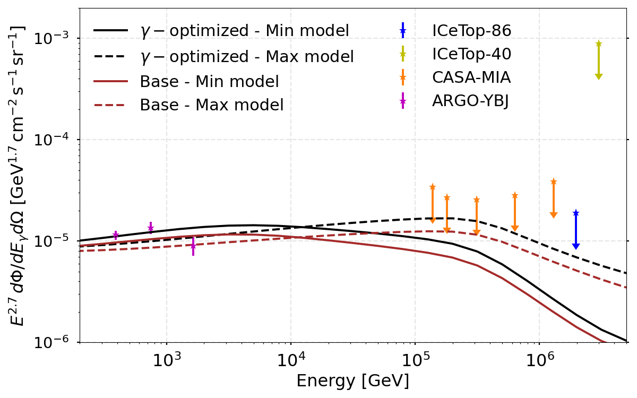
Inhomogeneous diffusion model
The diffuse emission meets TeV data
Within the region of sensitivity of IceTop there is little difference between models conventional diffusion and the gamma-optimized models
Observations in this region seem to be around the corner! In addition, unresolved sources may play a crucial role here
P.D.L. et al arXiv: 2203.15759

