Slide 1




Implications from 3-dimensional modeling of gamma-ray signatures in the Galactic Center
Julien Dörner *
J. Becker Tjus, P. S. Bloomenkamp, H. Fichtner,
A. Frankowiak, M. Hoerbe, E. M. Zaninger
arXiv:2207.08097
* julien.doerner@ruhr-uni-bochum.de

Slide 2
Galactic Center
the enviroment

Slide 3
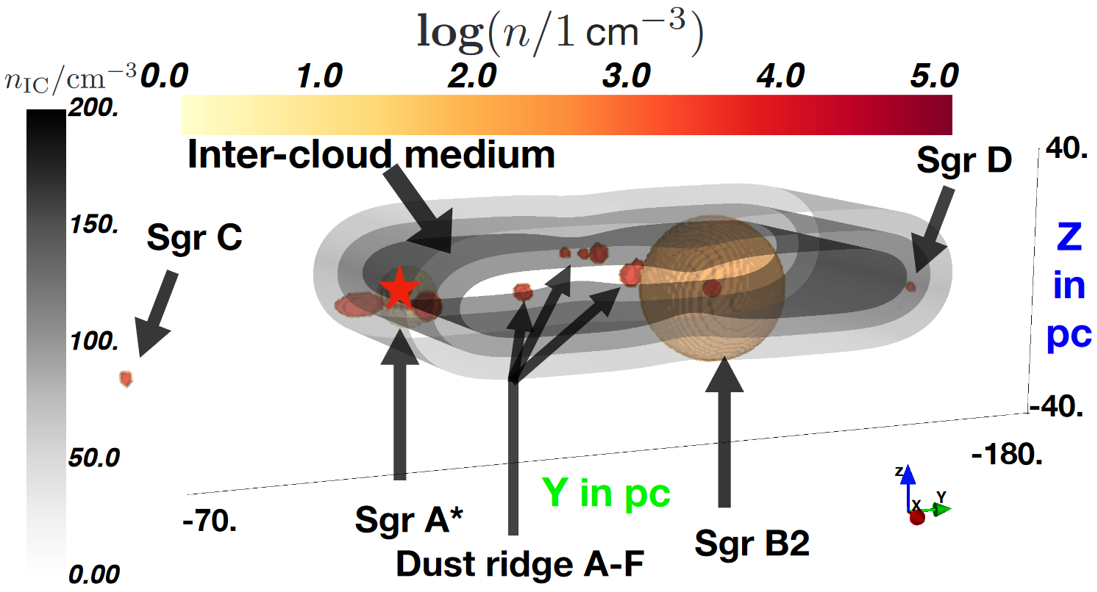
Galactic Center enviroment – gas distribution
13 molecular clouds
(Guenduez et al. (2020))
Central 10 pc structure
  (Ferriere et al. (2012))
diffuse intercloud component
(Ferriere et al. (2007))
Notes:
Difficulty:
Standard assumption circular motion around the GC. => velocity goes to 0 => no resolution with tracers
Inter cloud component reduced by MC and central structure

Slide 4
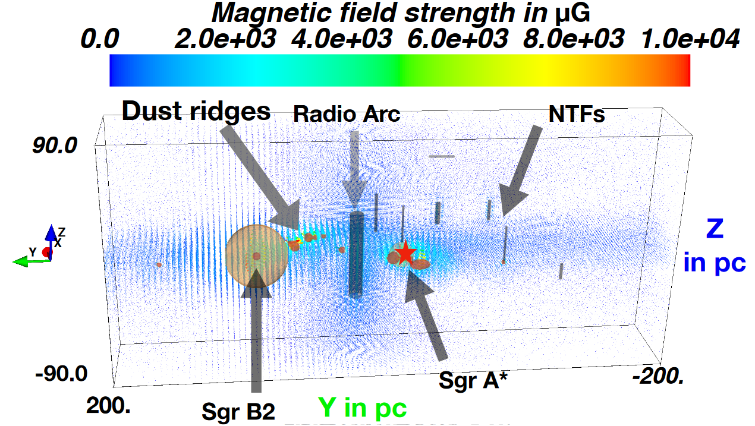
Galactic Center enviroment – magnetic field
13 molecular clouds
7 non-thermal filaments
Radio arc
Inter-cloud component
Guenduez+ A&A 644 (2020) A71
Notes:
Inter cloud component reduced by MC and central structure

Slide 5
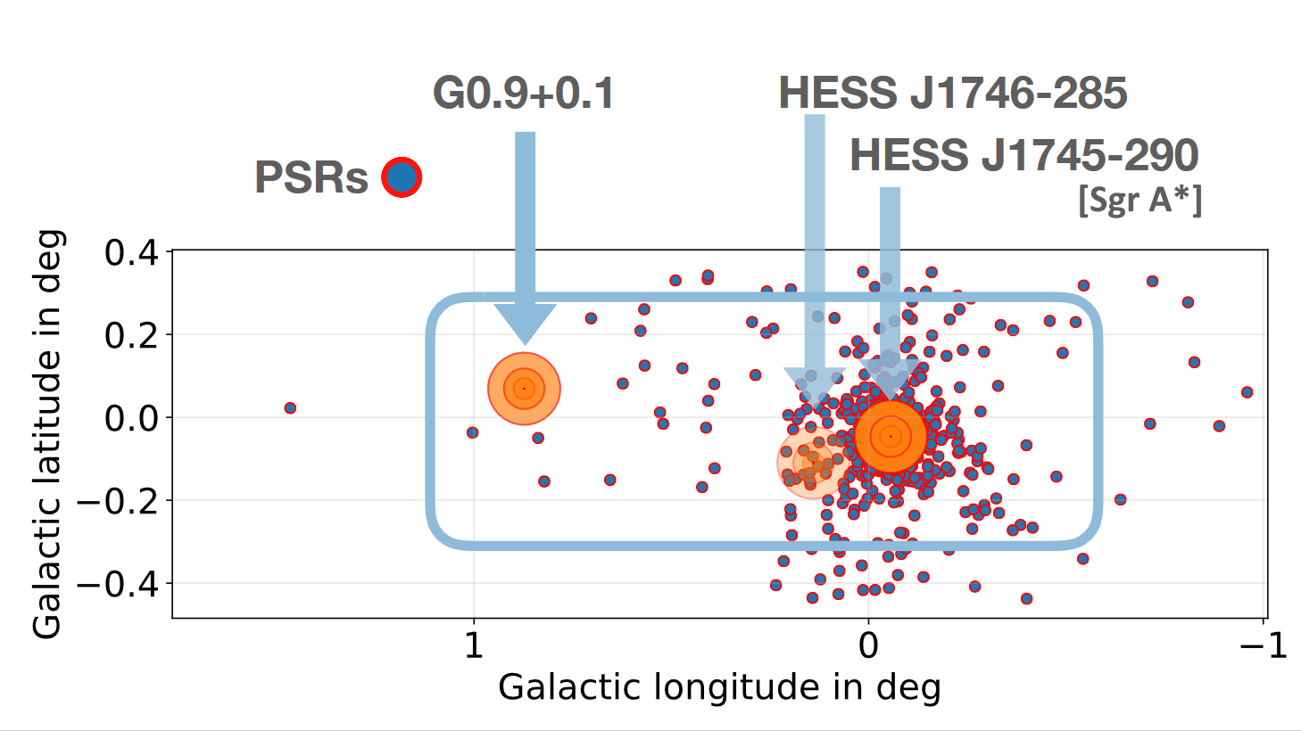
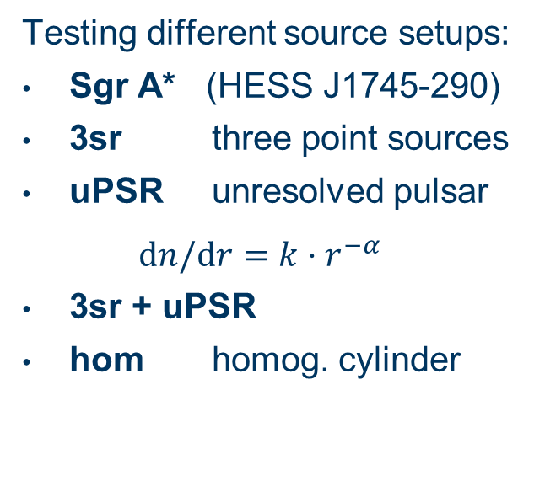
sources of cosmic rays
Testing different source setups:
Sgr A* (HESS J1745-290)
3sr three point sources
uPSR unresolved pulsar
$dn/dr=k⋅r^{−α}$
3sr + uPSR
hom homog. cylinder
Source | Contirbution [3sr] | Contribution [3sr + uPSR]
HESS J1745-290 | 72 % | 58 %
HESS J1746-285 | 6 % | 5 %
G0.9+0.1 | 22 % | 18 %
uPSR | - | 19 %
Notes:
Alpha ~ 2.6 (aus Fermi Daten)

Slide 6
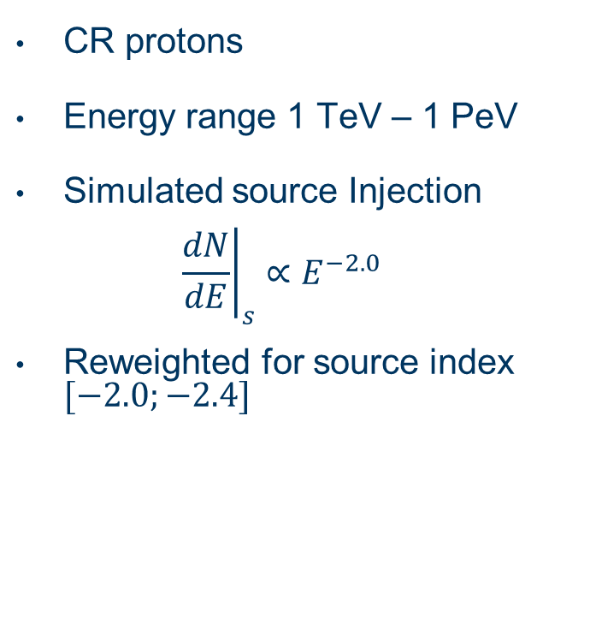
sources of cosmic rays – (2)
CR protons
Energy range 1 TeV – 1 PeV
Simulated source Injection
${\left.\frac{dN}{dE}\right|}_{s}∝E^{−2.0}$
Reweighted for source index $[−2.0;−2.4]$

Slide 7
Galactic Center
the transport model

Slide 8

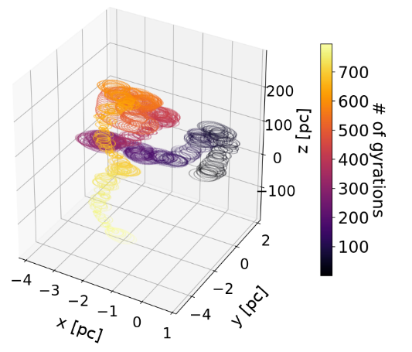
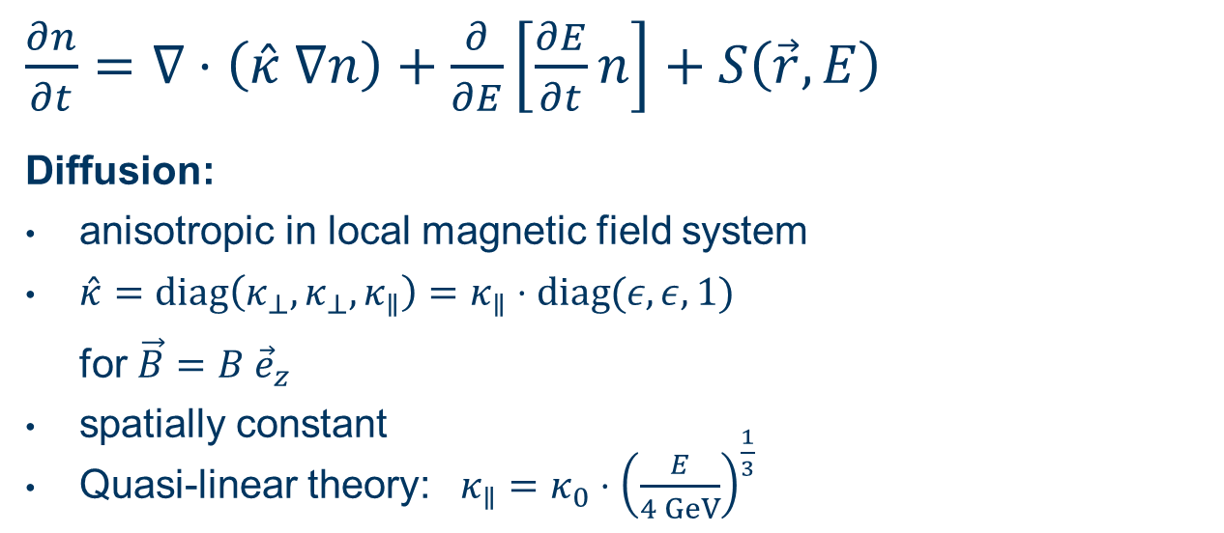
transport model
$\frac{∂n}{∂t}=∇⋅\left(\hat{κ} ∇n\right)+\frac{∂}{∂E}\left[\frac{∂E}{∂t}n\right]+S\left(\vec{r},E\right)$
Diffusion:
anisotropic in local magnetic field system
$\hat{κ}=diag\left(κ_{⊥}, κ_{⊥}, κ_{∥}\right)=κ_{∥}⋅diag(ε, ε, 1)$
for $\vec{B}=B {\vec{e}}_{z}$
spatially constant
Quasi-linear theory: $κ_{∥}=κ_{0}⋅{\left(\frac{E}{4 GeV}\right)}^{\frac{1}{3}}$
J. Becker Tjus, L. Merten, Physics Reports 872 (2020)

Slide 9
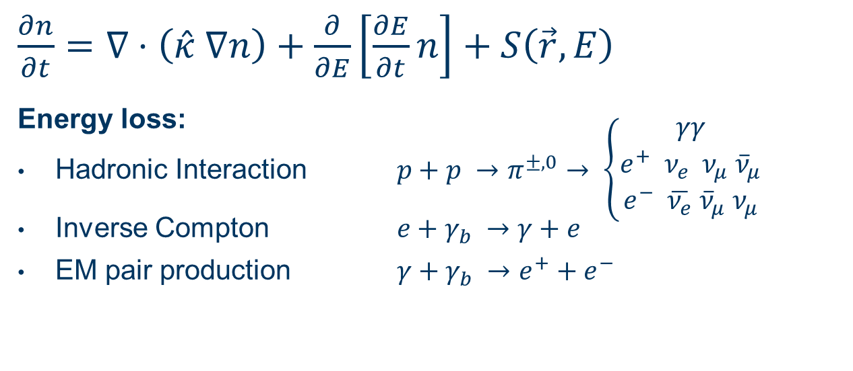
transport model – (2)
$\frac{∂n}{∂t}=∇⋅\left(\hat{κ} ∇n\right)+\frac{∂}{∂E}\left[\frac{∂E}{∂t}n\right]+S\left(\vec{r},E\right)$
Energy loss:
Hadronic Interaction $p+p →π^{±, 0}→ \left\{\begin{aligned}γγ \\ e^{+} ν_{e} ν_{μ} {\overline{ν}}_{μ} \\ e^{−} \overline{ν_{e}} {\overline{ν}}_{μ} ν_{μ}\end{aligned}\right.$
Inverse Compton $e+γ_{b} →γ+e$
EM pair production $γ+γ_{b} →e^{+}+e^{−}$

Slide 10
Galactic Center
determining the model parameter

Slide 11
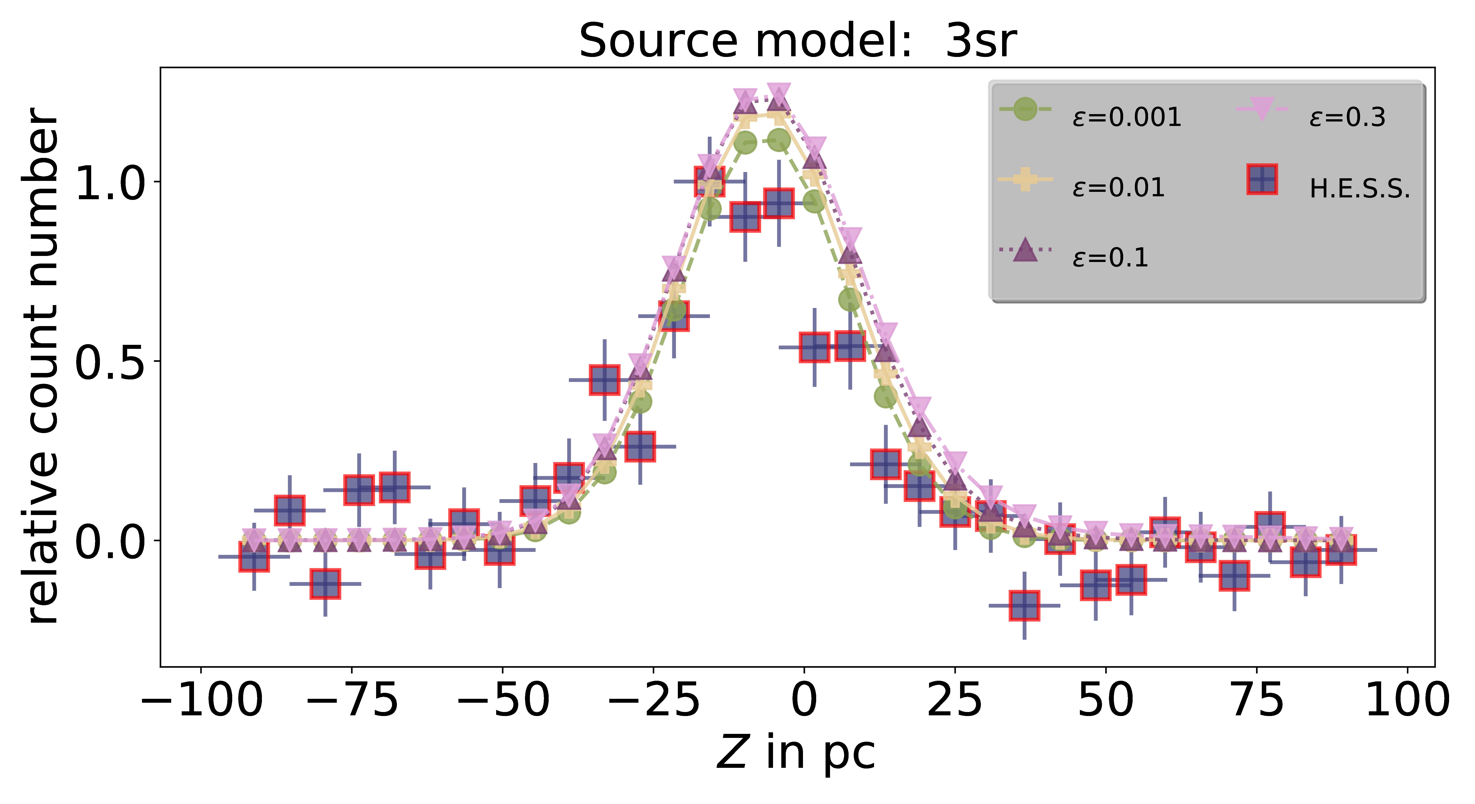
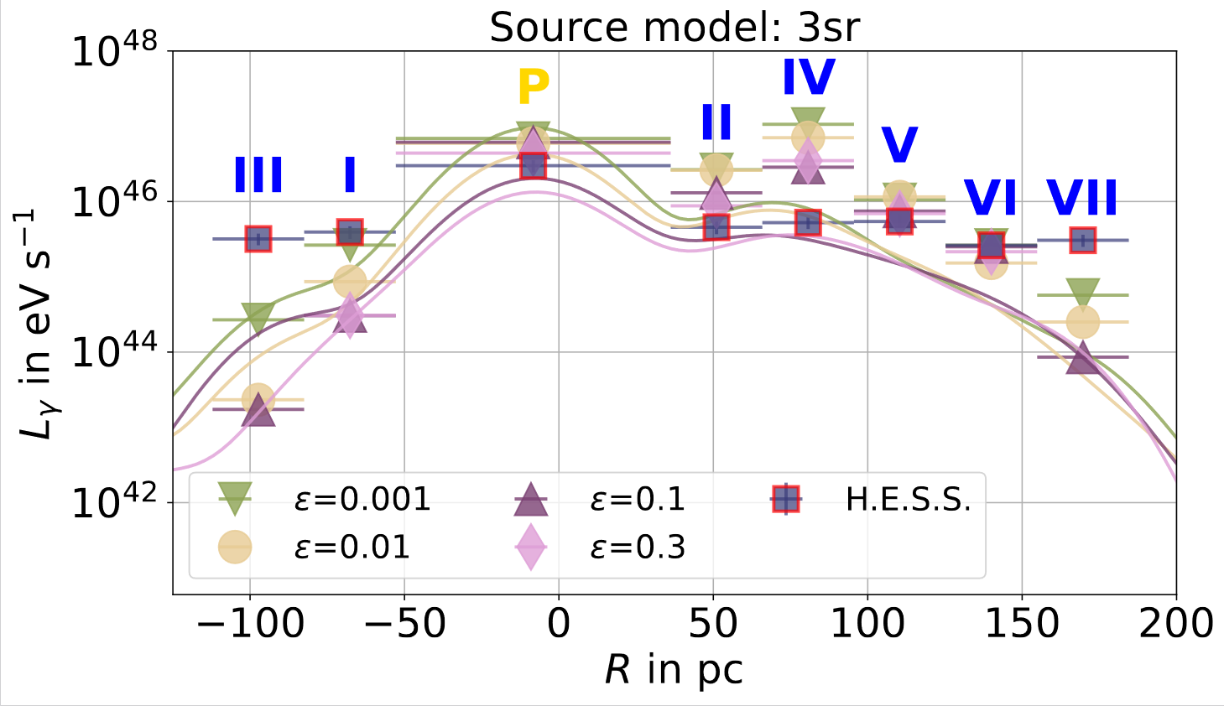
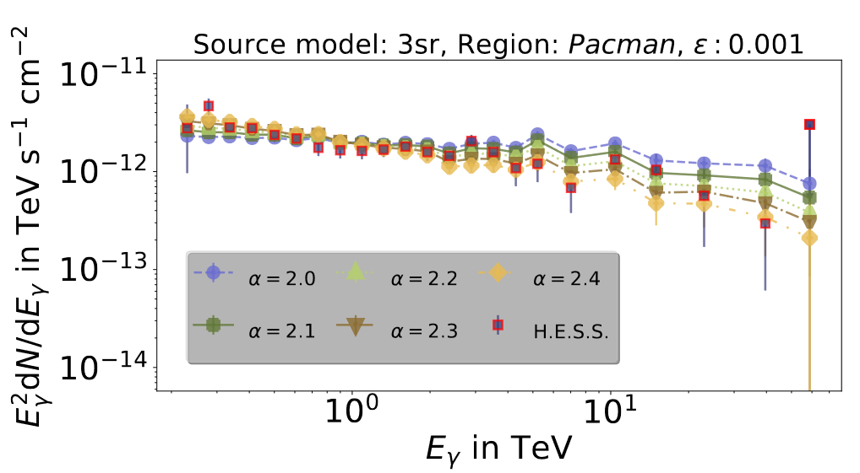
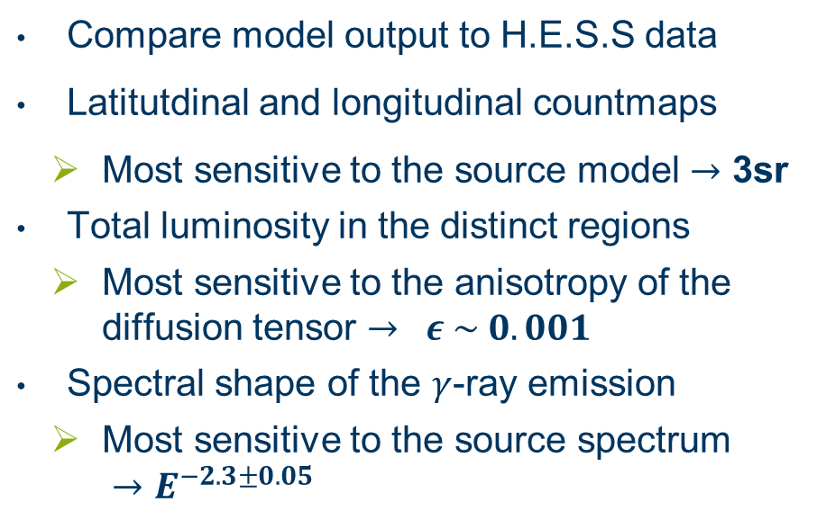
Find the best source model
Compare model output to H.E.S.S data
Latitutdinal and longitudinal countmaps
    Most sensitive to the source model $→$ 3sr
  Total luminosity in the distinct regions
    Most sensitive to the anisotropy of the diffusion tensor $→ ε \sim 0.001$
  Spectral shape of the $γ$-ray emission
    Most sensitive to the source spectrum
    $→E^{−2.3±0.05}$
11
Notes:
Latitude on the right site
Long below the text

Slide 12
Galactic Center
resulting messengers

Slide 13
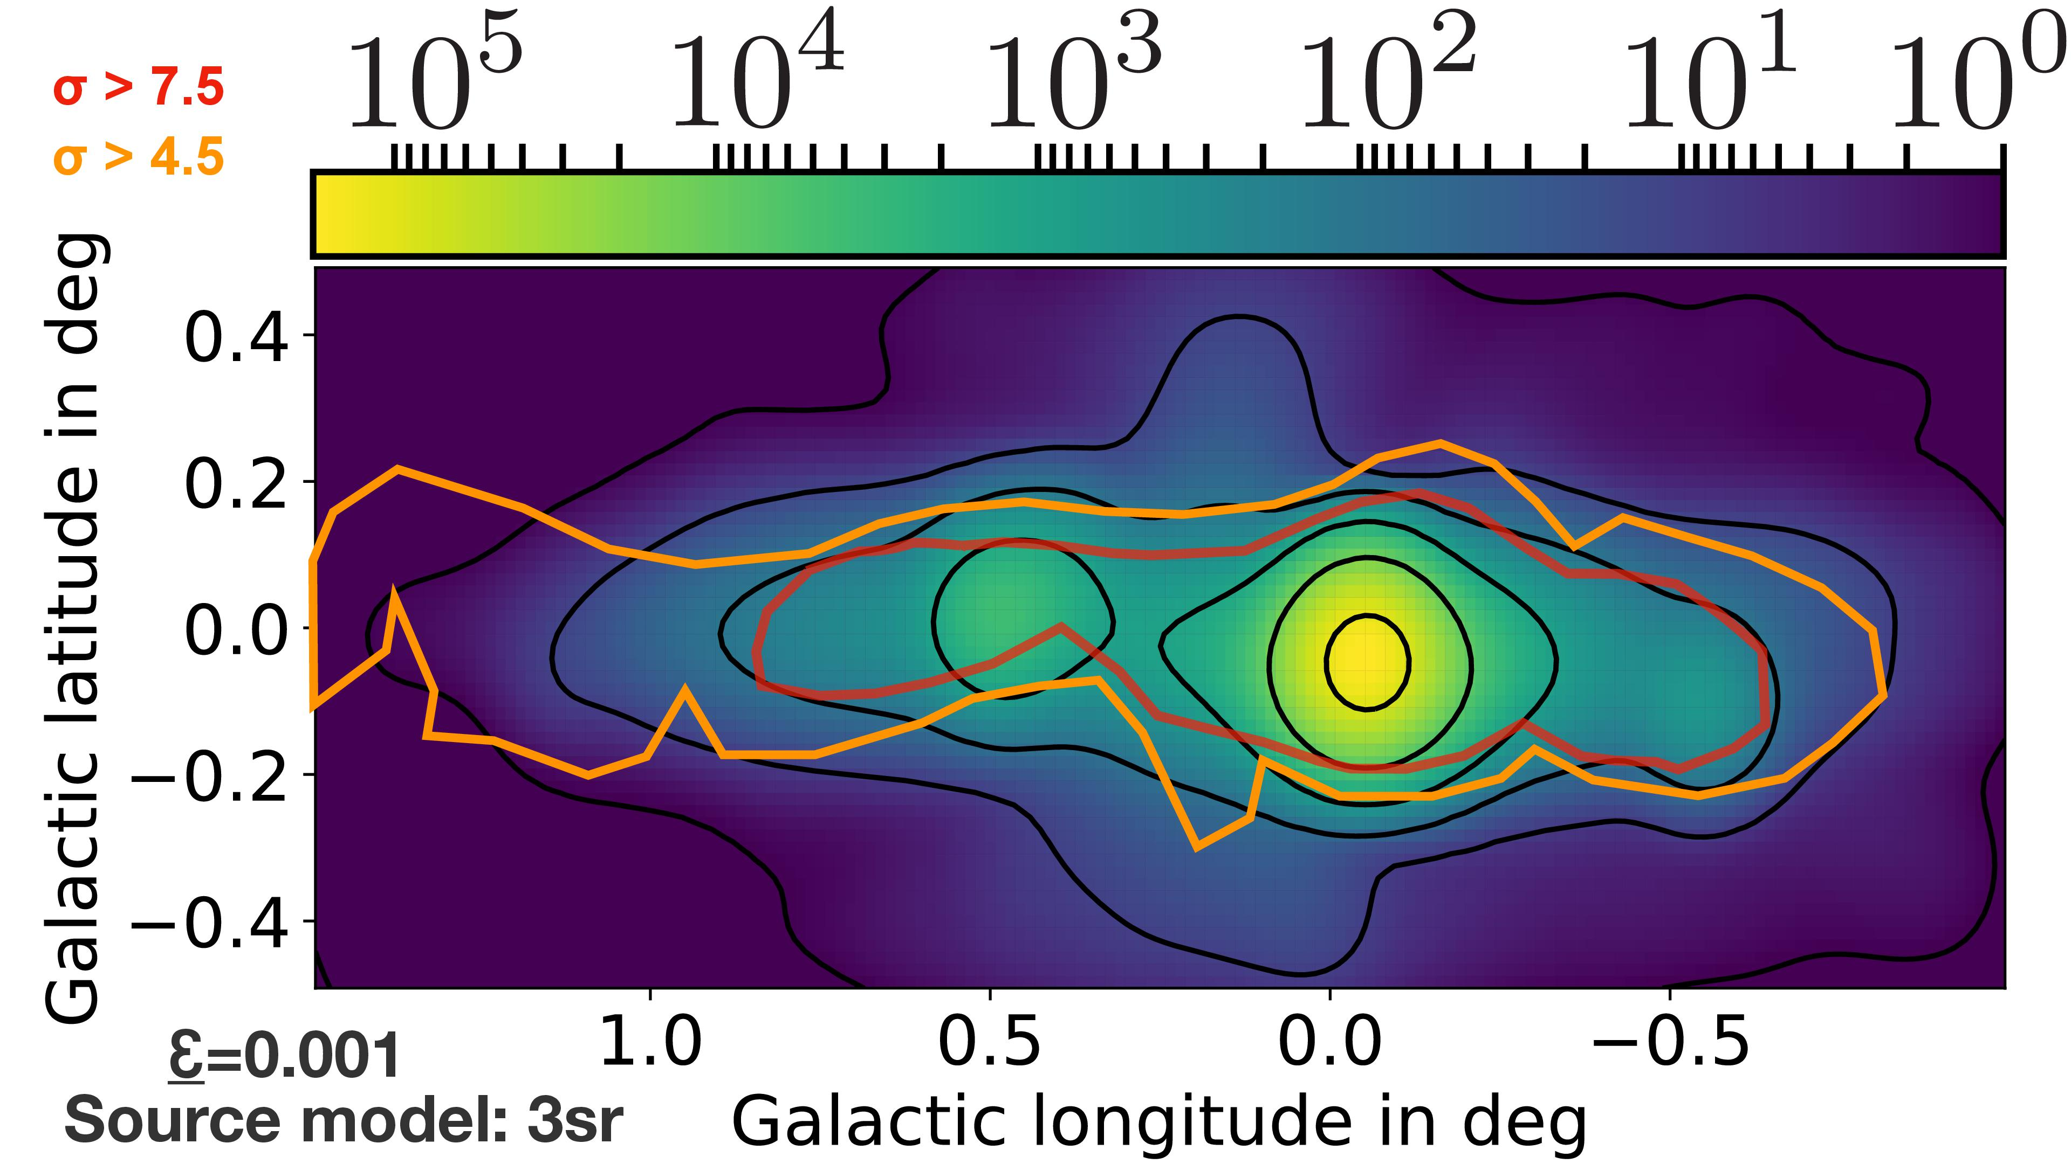

Countmap for H.E.S.S.
H.E.S.S. resolution
$$σ=0.077°$$

Slide 14
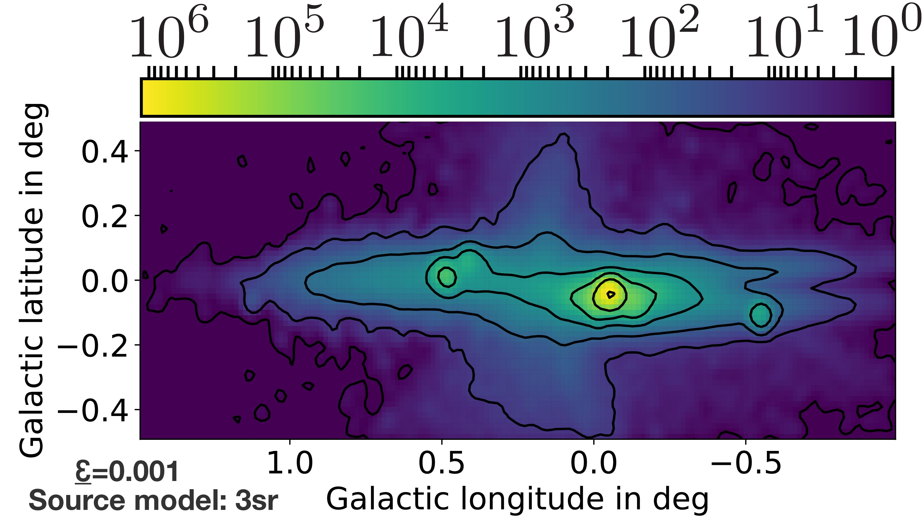

Countmap for CTA
CTA resolution
$$σ=0.03°$$

Slide 15
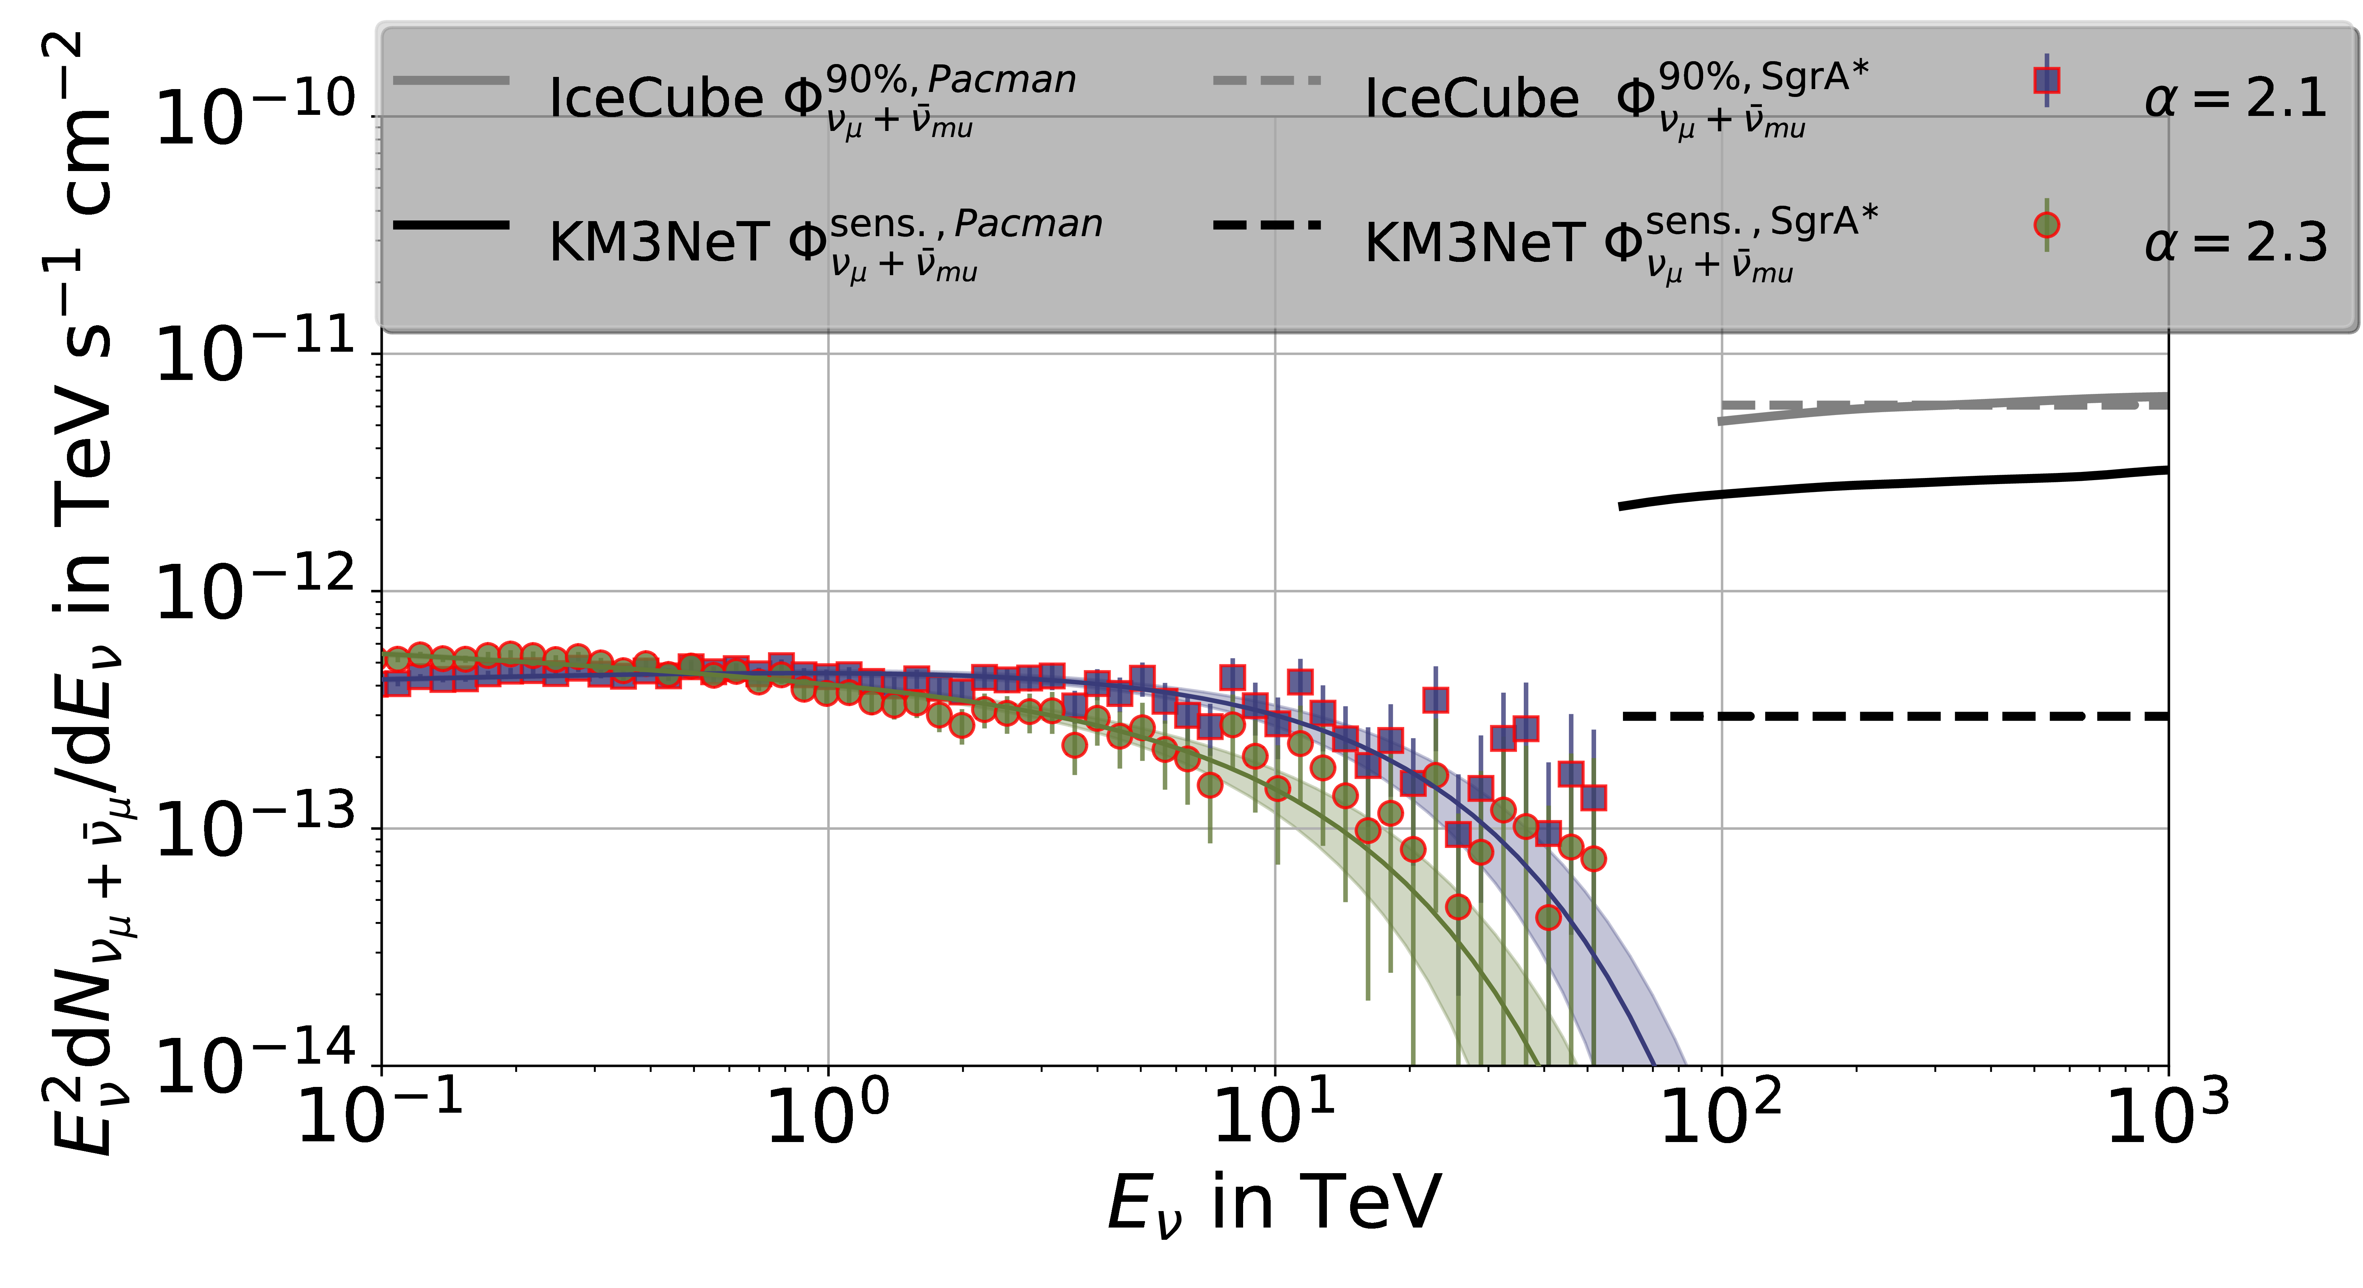
Neutrino flux
Notes:
Neutrino Numbers (10 years)
HESE: 2e-4 -- 0.08
MESE: 0.03

Slide 16
Galactic Center
summary

Slide 17
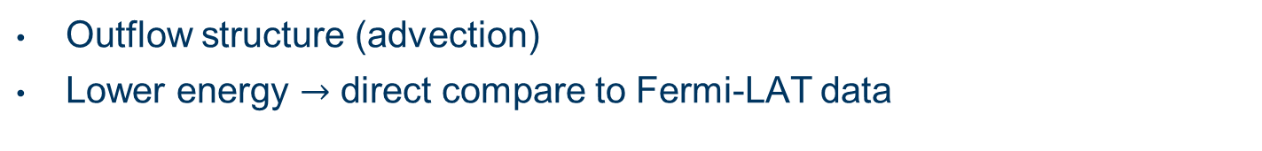
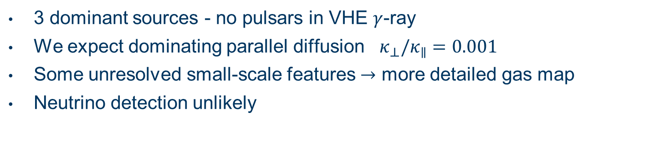
Conclusion
3 dominant sources - no pulsars in VHE $γ$-ray
We expect dominating parallel diffusion $κ_{⊥}/κ_{∥}=0.001$
Some unresolved small-scale features $→$ more detailed gas map
Neutrino detection unlikely
Outlook
Outflow structure (advection)
Lower energy $→$ direct compare to Fermi-LAT data

Slide 18
Back up

Slide 19
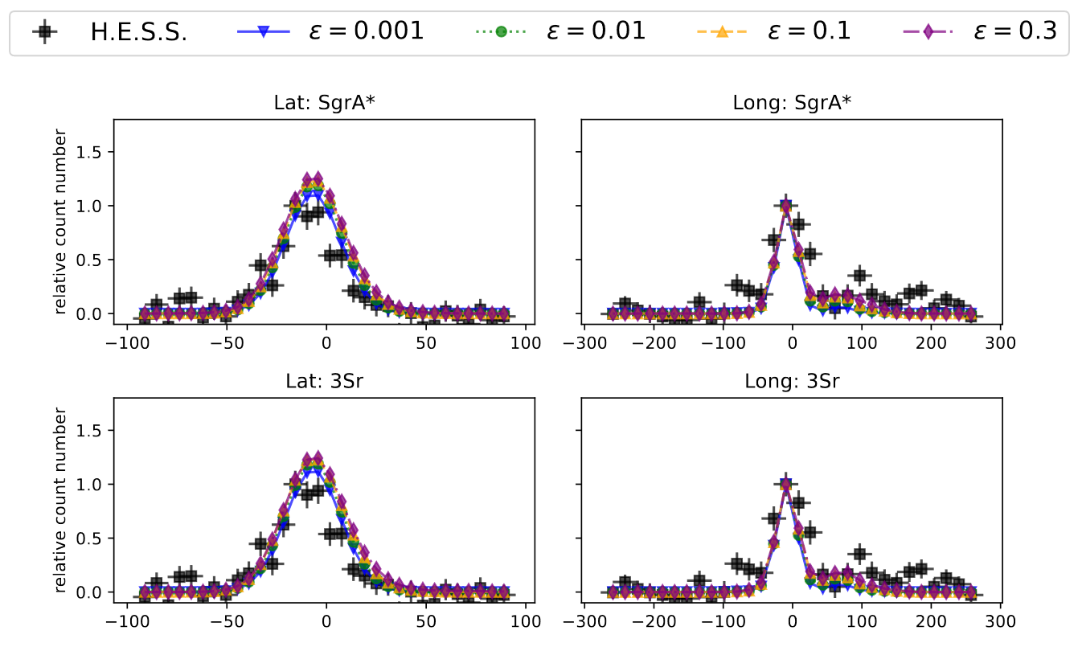

Slide 20
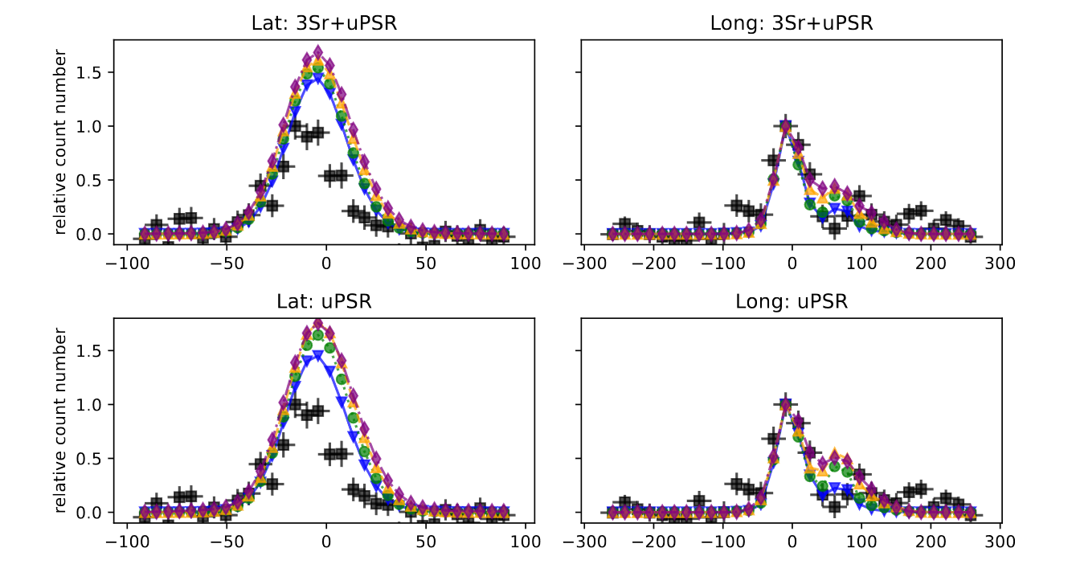

Slide 21
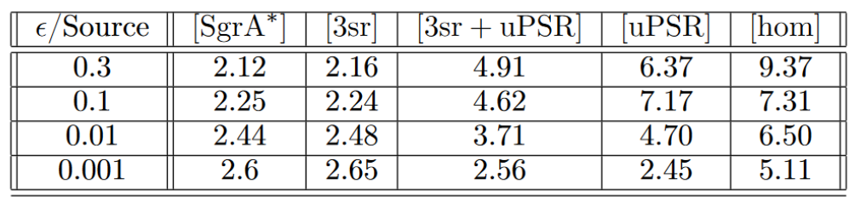
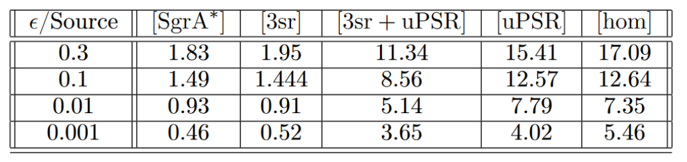
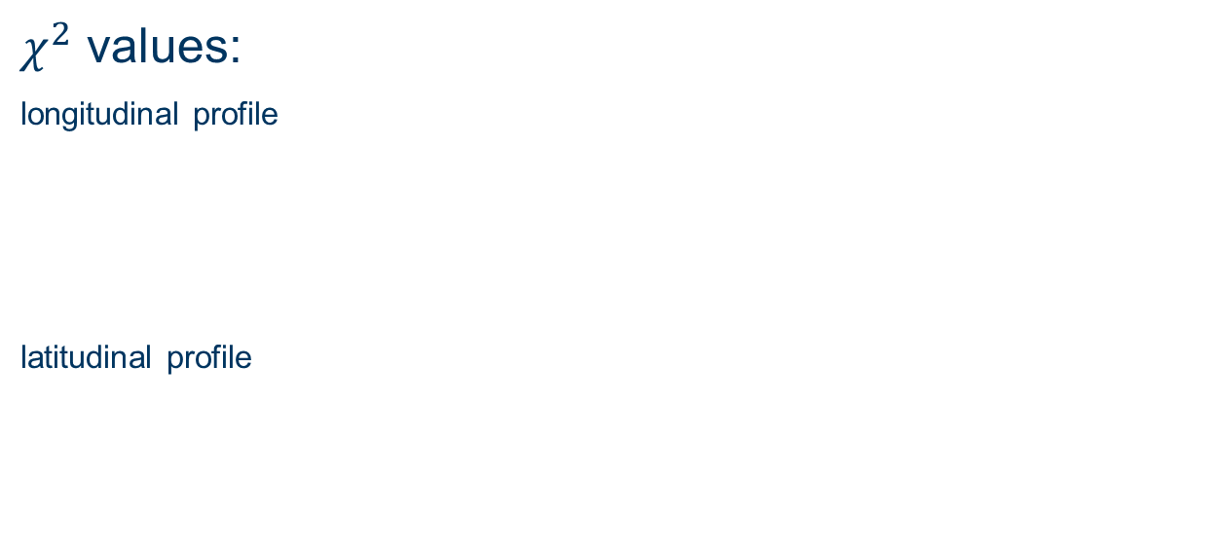
Optimal source distribution
$χ^{2}$ values:
longitudinal profile
latitudinal profile

Slide 22
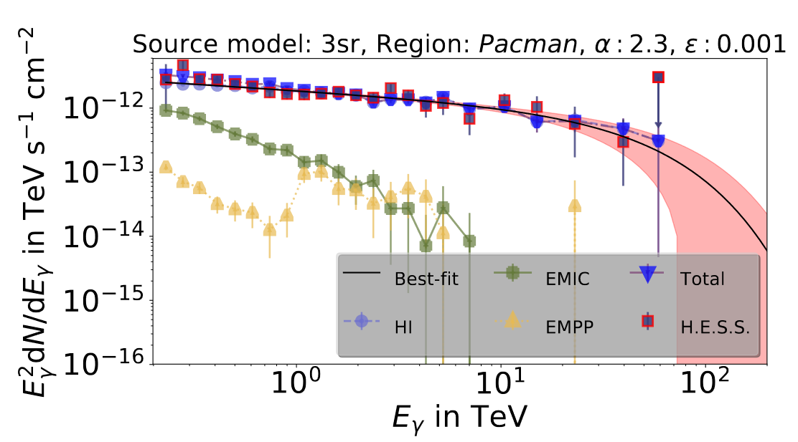
Gamma-ray by secondaries and absorption

Slide 23
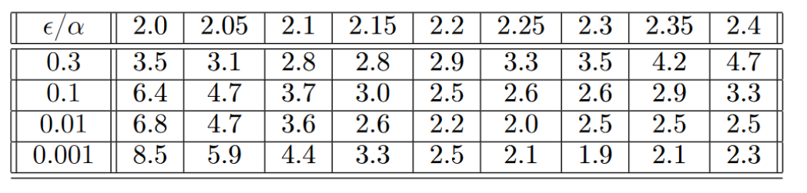
Optimal spactral index ($χ^{2}$results)

Slide 24
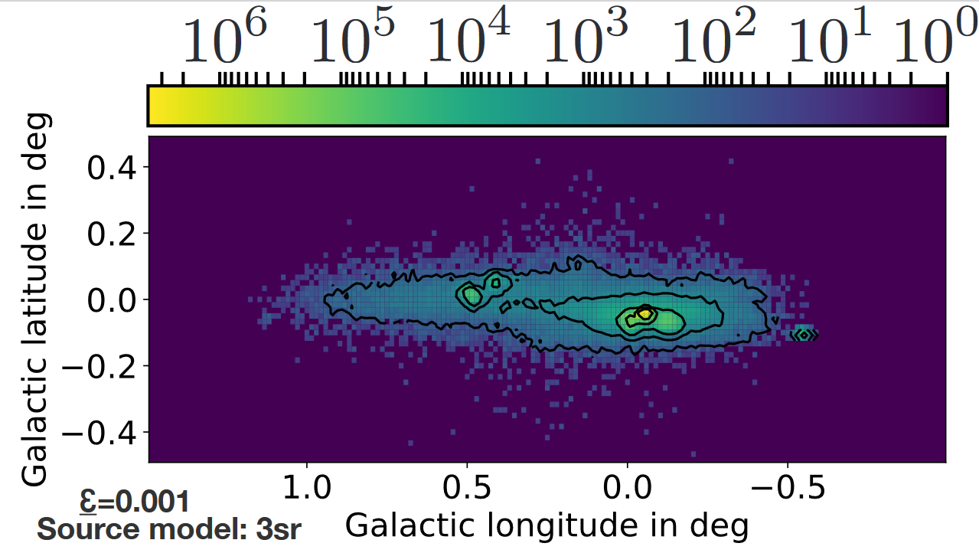
Neutrino emission – raw data

Slide 25
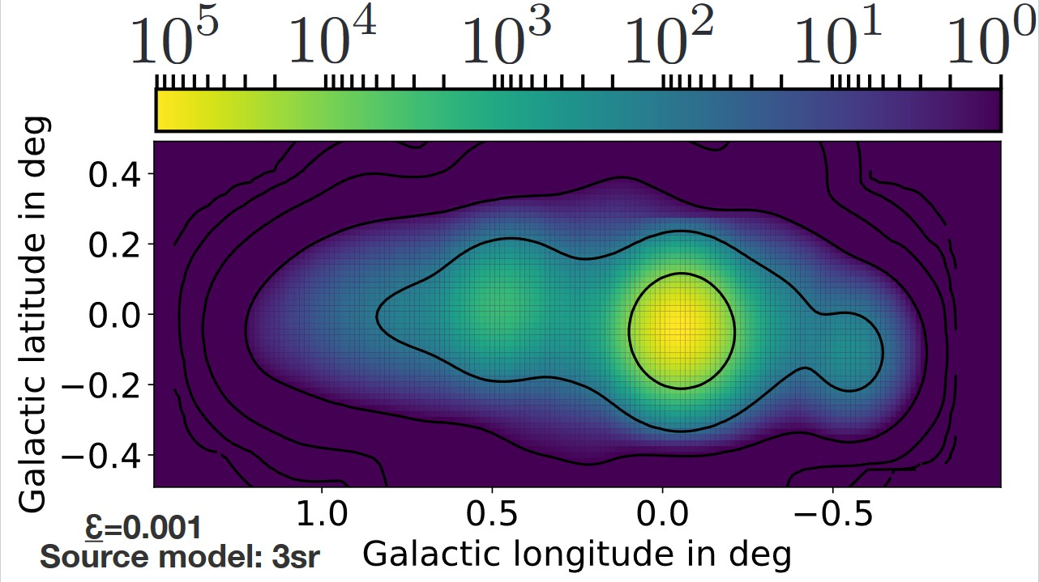
Neutrino emission – IceCube resolution

