Slide 1

Implications of Cutoff observed in Fermi-LAT GRBs spectrum
Vikas Chand*
Astrophysics Research Center of the Open University of Israel
*vikas.chand.physics@gmail.com

Slide 2

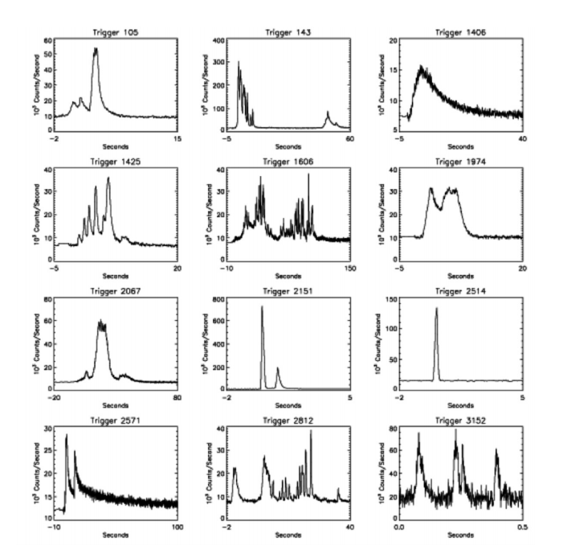
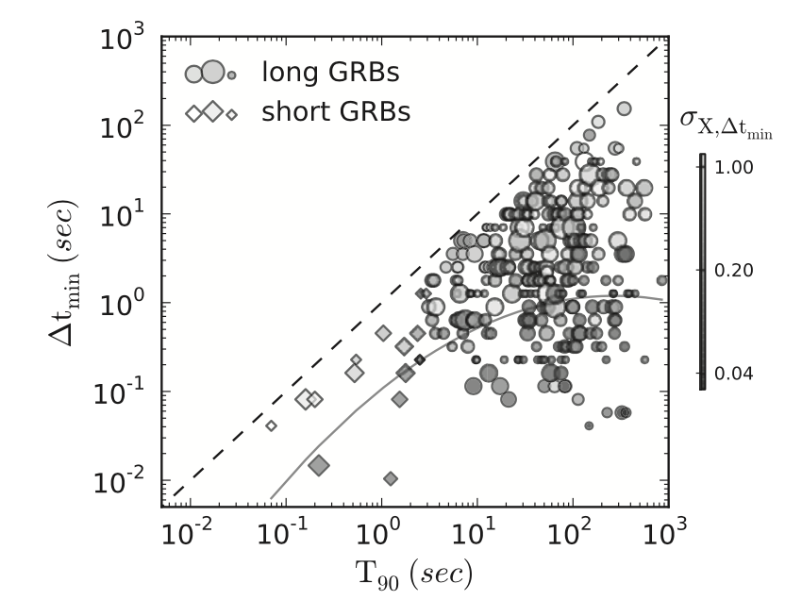
Lightcurves: Prompt emission
Golkhou et al. 2015
Fishman, et al. 1995

Slide 3
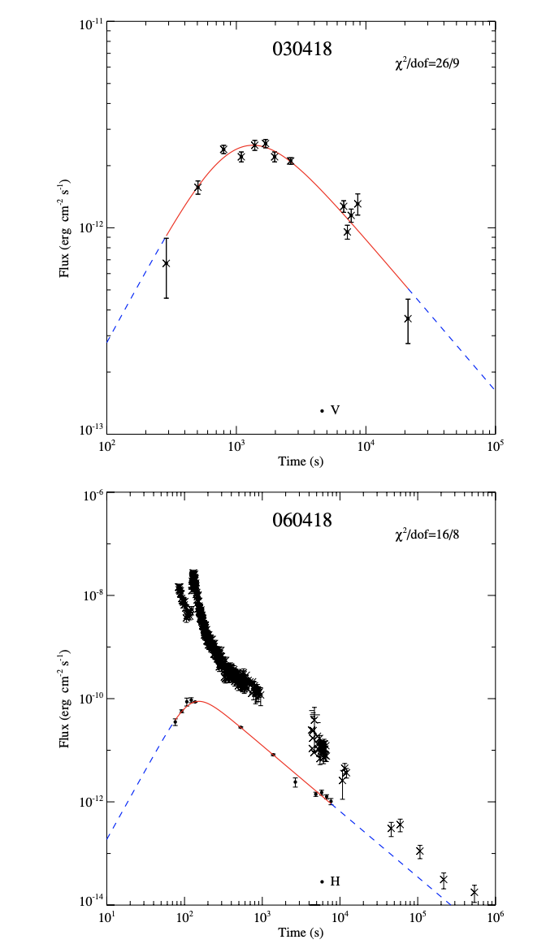
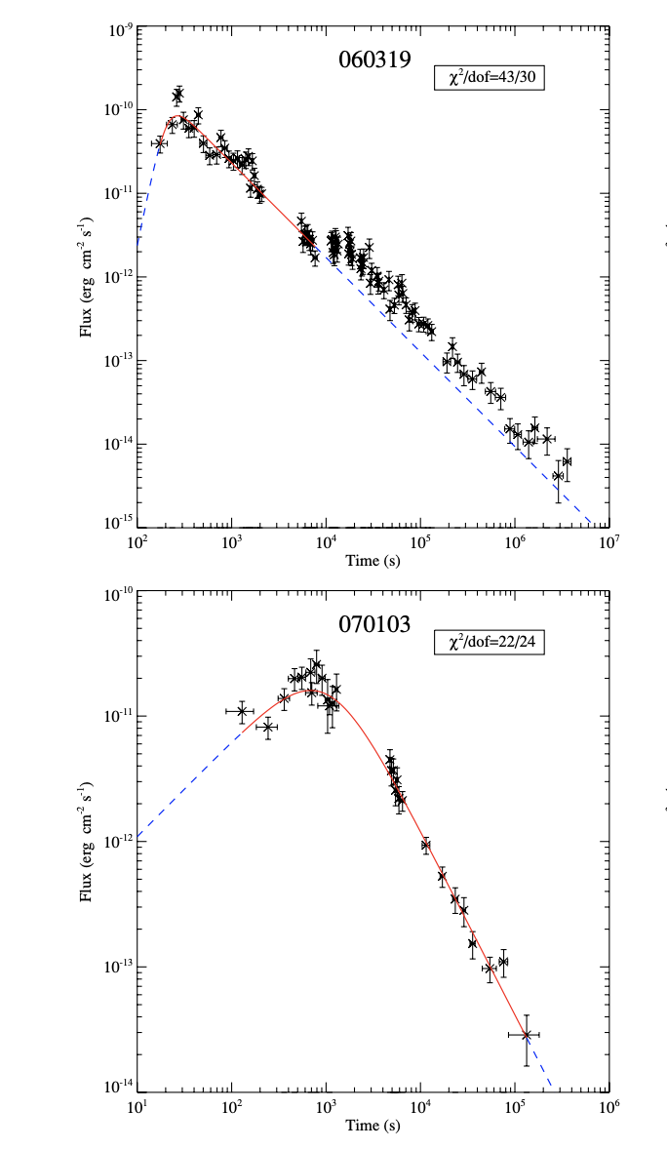
Blastwave deceleration

Slide 4
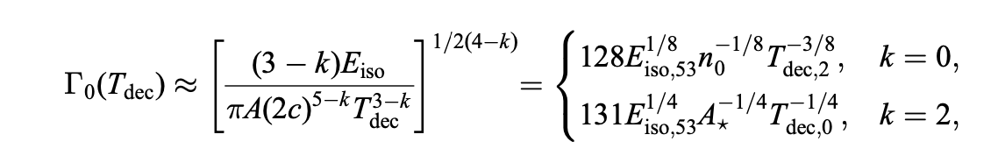
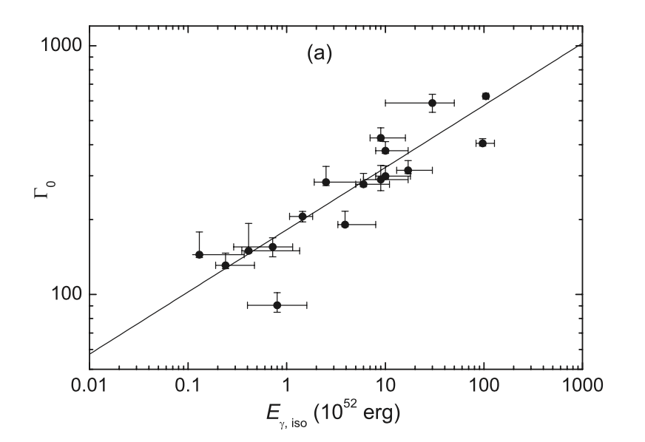
Lorentz factor from the early afterglow
More powerful jets move faster
Sari & Piran 1999
Liang & Zhang 2010

Slide 5
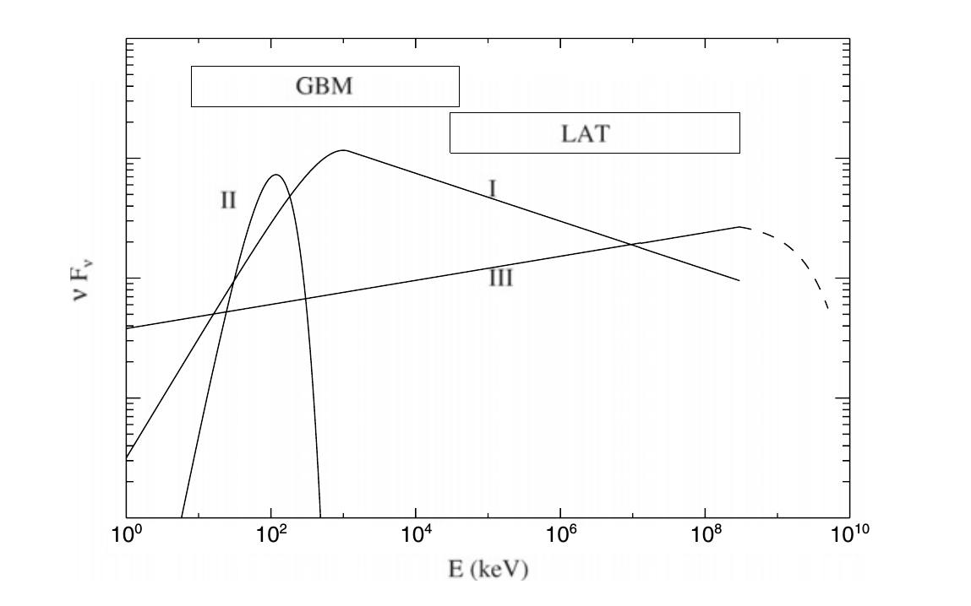
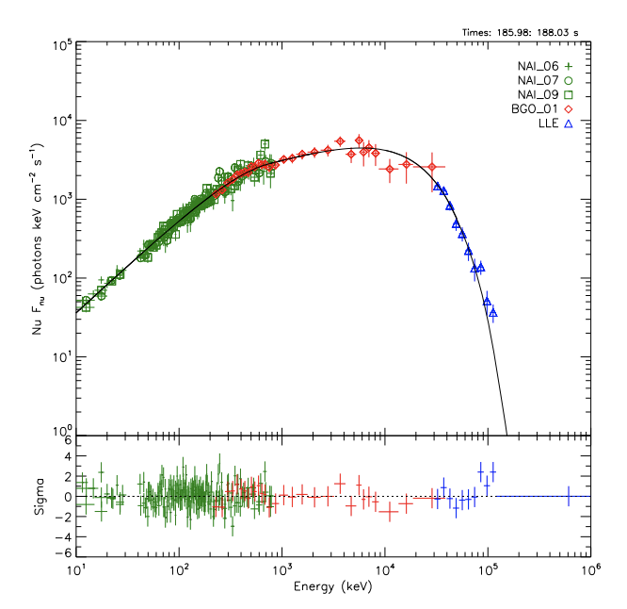
Prompt Emission Spectrum
Band + BB + High energy emission extending to GeVs
B.-B. Zhang, et al. 2011
Y.-Z. Wang et al. 2017

Slide 6
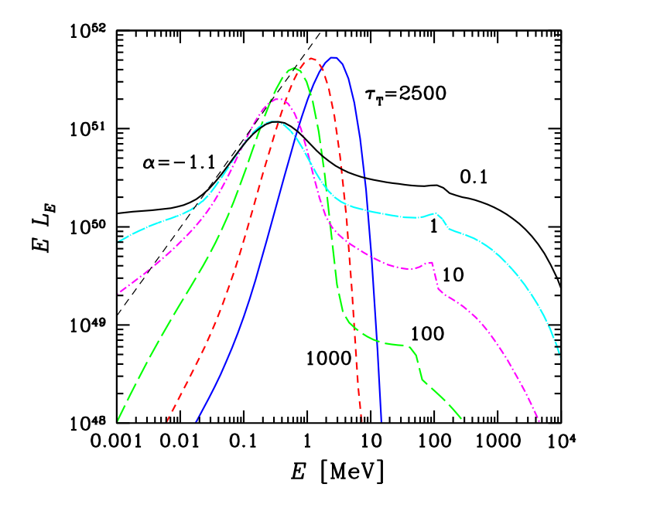
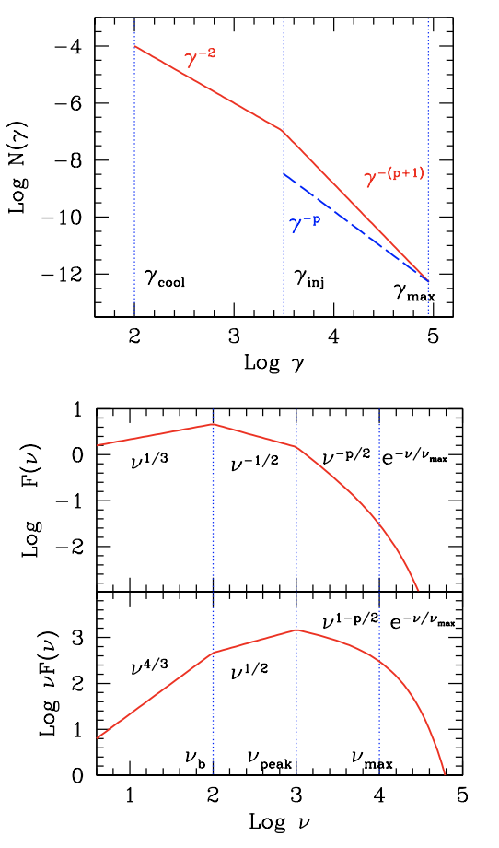
Prompt Emission Spectrum

Slide 7
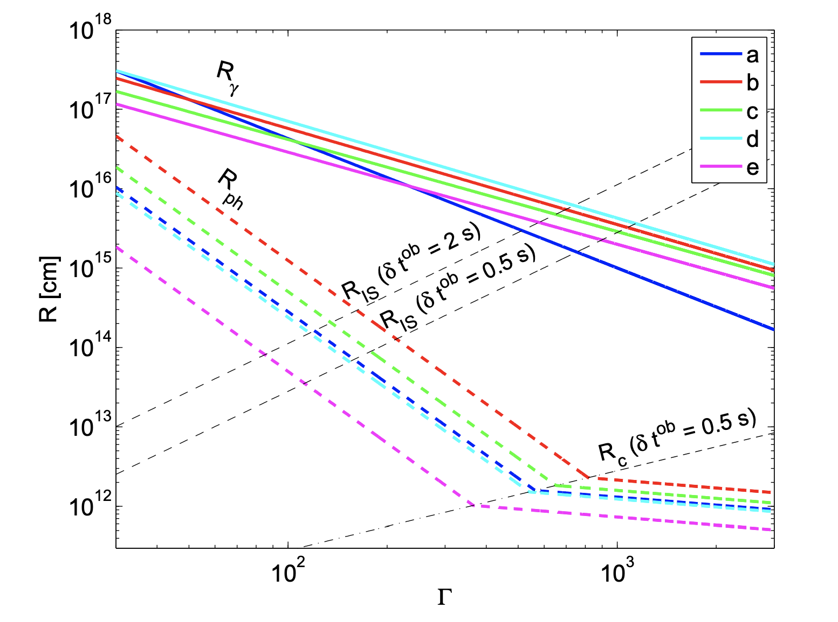




Diagnosing the Emission site
?

Slide 8
Diagnosing the Emission site

Slide 9
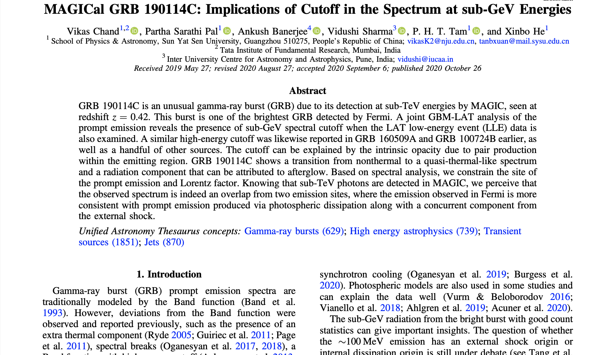
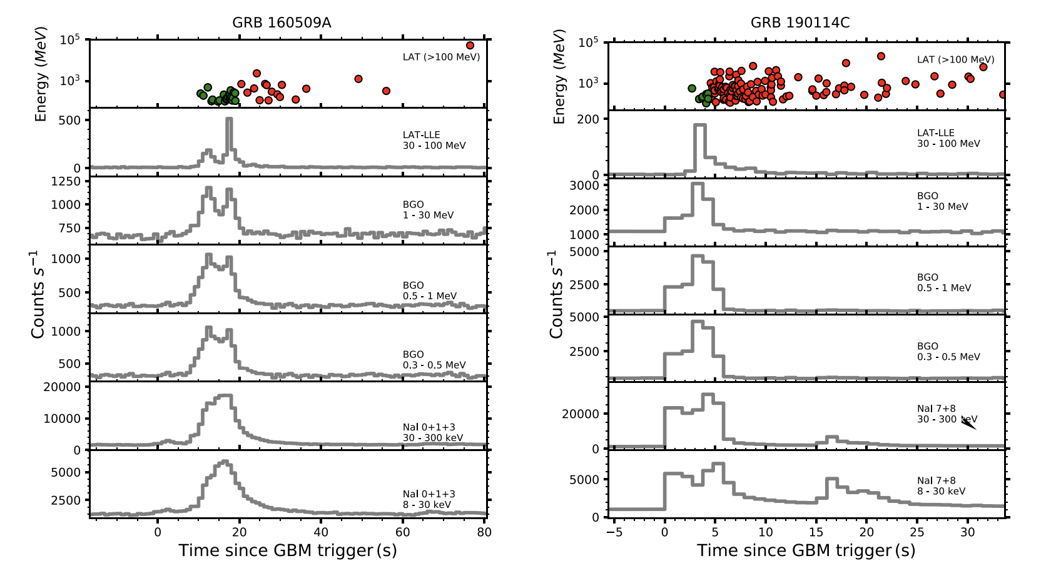
Sub-GeV cutoff in GRB 190114C

Slide 10


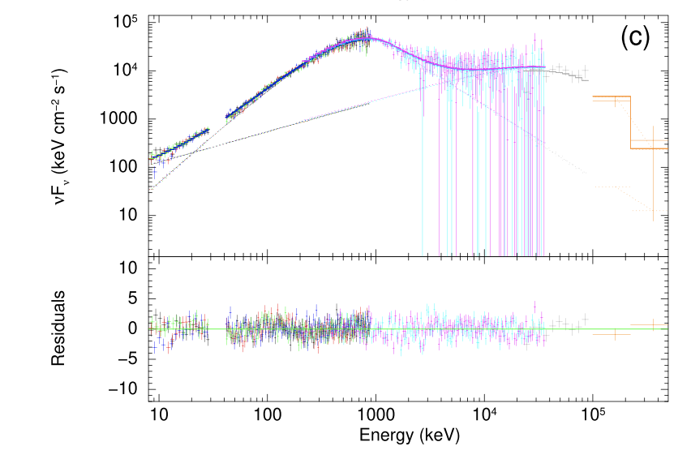
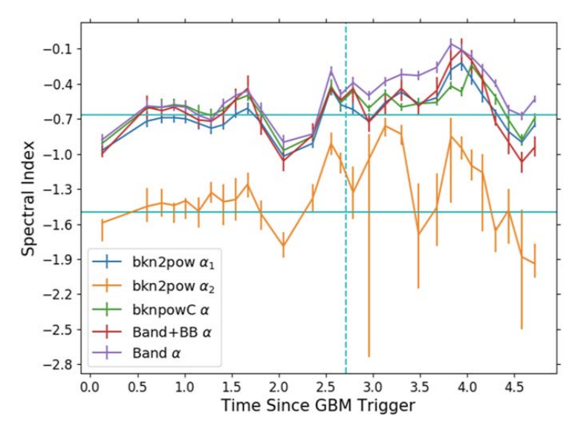
Sub-GeV cutoff in GRB 190114C

Slide 11

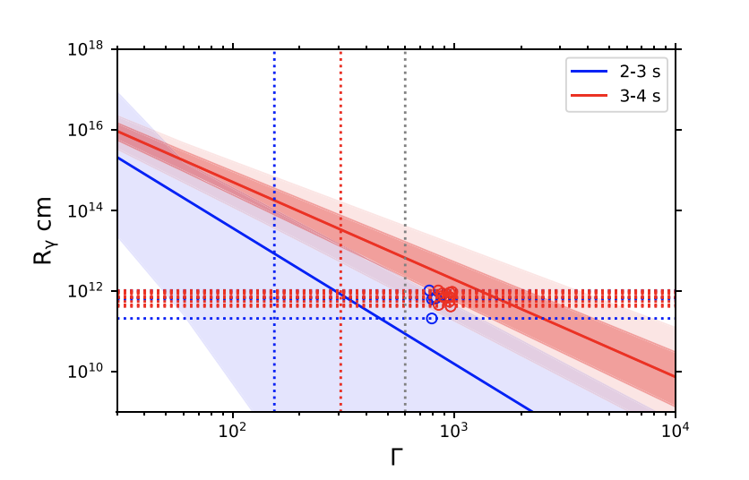
Sub-GeV cutoff in GRB 190114C

Slide 12
Thank you for your attention!
Vikas Chand*
*vikas.chand.physics@gmail.com

