Slide 1

The GW-GRB Working Group
and IPN in the O4 Observing Run
Eric Burns
On behalf of the GW-GRB Working Group and the third InterPlanetary Network
ericburns@lsu.edu

Slide 2
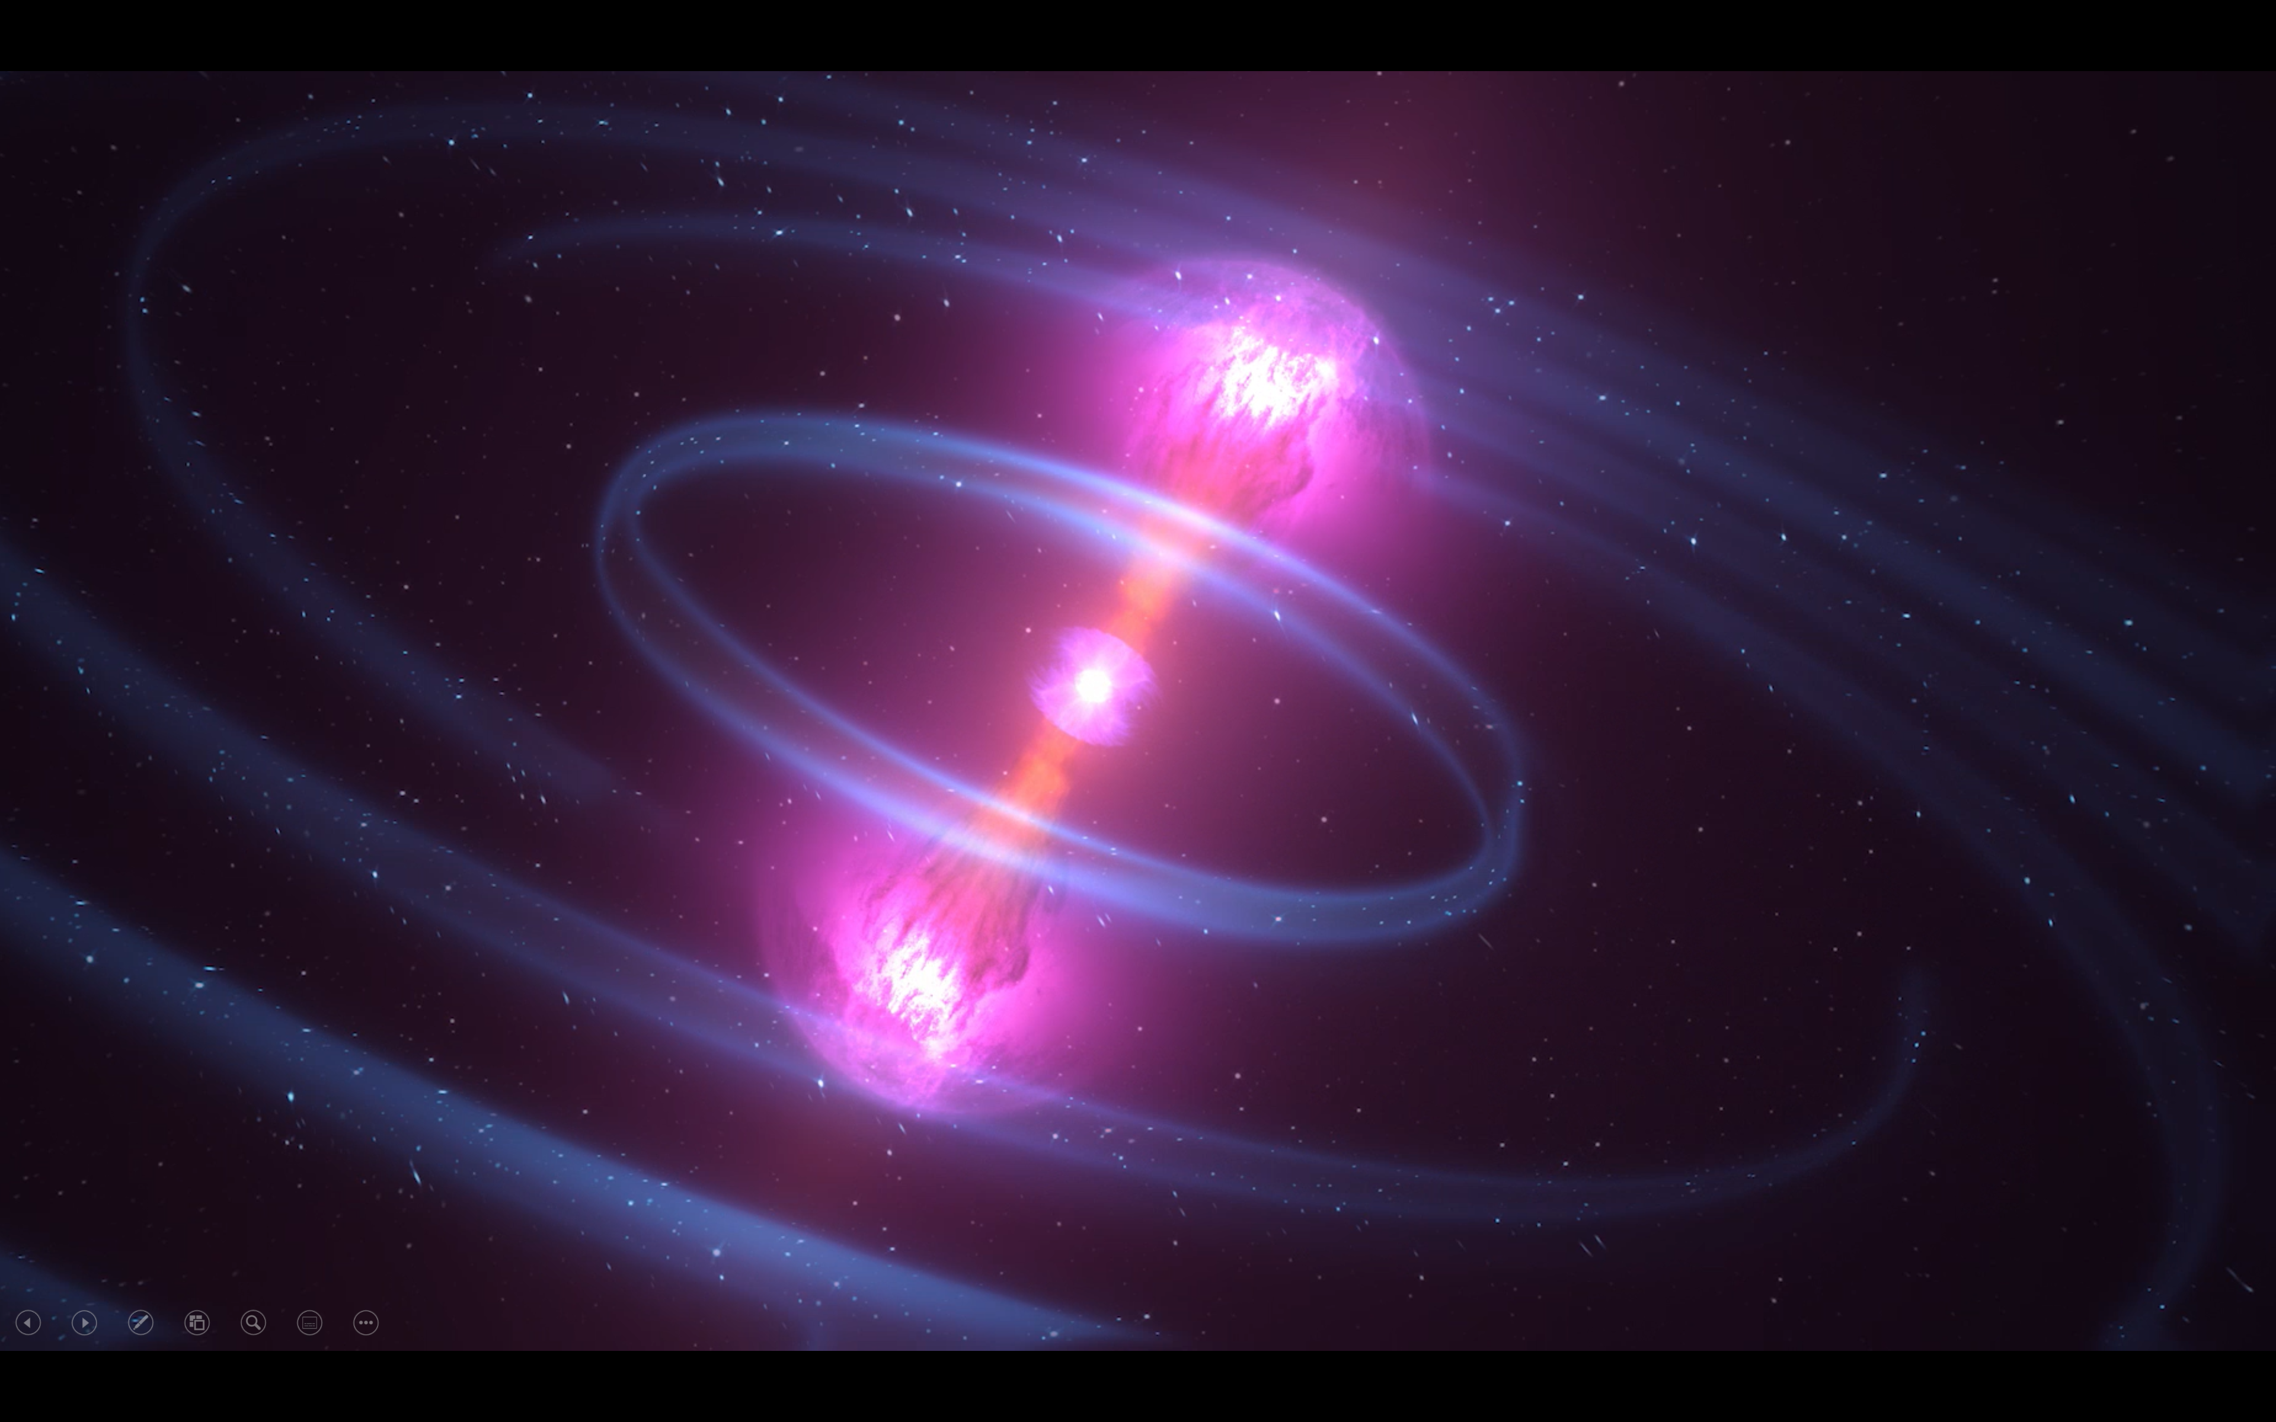

Slide 3

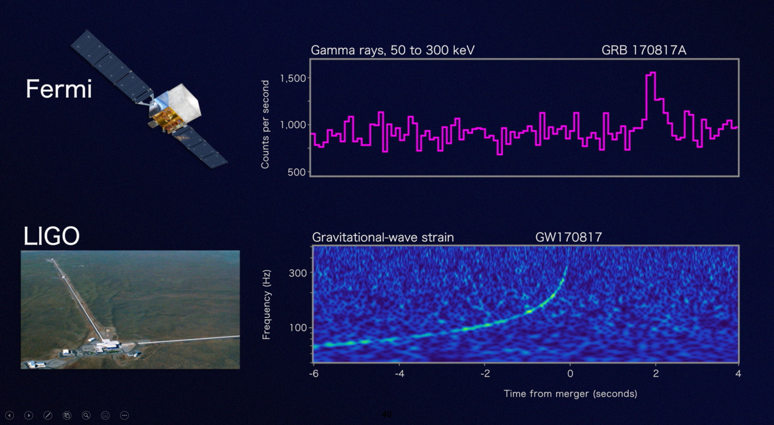
The GW-GRB Working Group: Overview
1 decade old; ~40 active members
  2012 – 2017; Organizers: Valerie Connaughton, Jordan Camp
    Members: LIGO, Fermi-GBM
  2017 – 2022; Organizers: Eric Burns, Nelson Christensen
    New Members: Virgo, Swift-BAT/GUANO
  2022 – ; Organizers: Rachel Hamburg, Tito dal Canton
    New Members: KAGRA, BurstCube
    Future members: GlowBug, StarBurst, COSI, MoonBEAM?
Outputs:
  >7000 citations
  10 lead papers, contributions to several more
  Multiple papers in development
  Combined prompt alert streams
  Multimessenger association formalisms
  Successful predictions proven with GRB 170817A

Slide 4
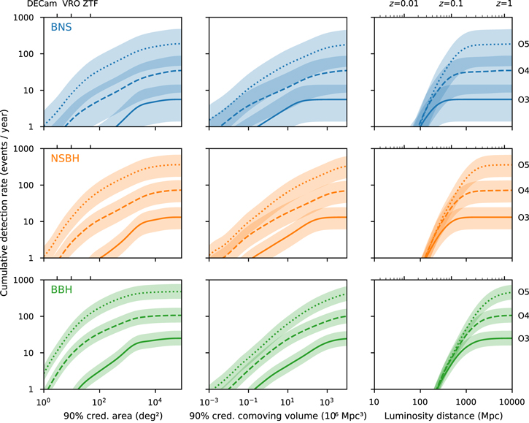
The GW-GRB Working Group: Joint Localizations
Petrov et al. ApJ 924 2 (2022)
GW localizations improve, but less than previously thought
This is due to adapting reporting criterion from the GW Network
GW-GRB Events will by systematically further away, and thus more poorly localized

Slide 5
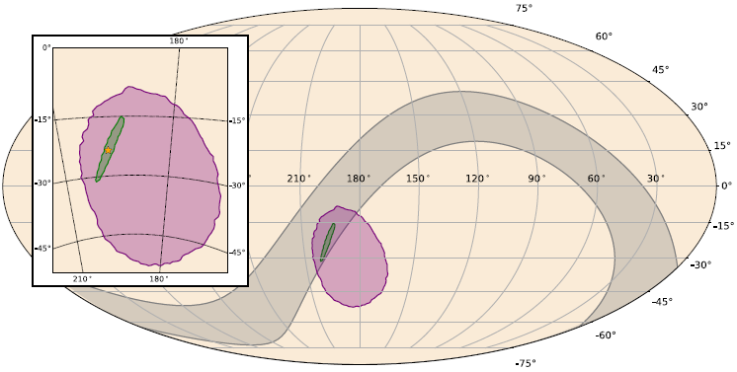
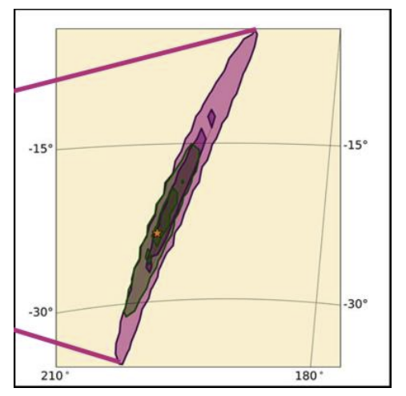
The GW-GRB Working Group: Joint Localizations
Fermi+INTEGRAL Annulus
Fermi-GBM
LIGO+Virgo
LVK alerts will be automatically associated to Fermi-GBM and Swift-BAT triggers in O4, the localizations combined, and distributed through the LVK alert stream
Swift-BAT localizations are ~3’
Fermi-GBM localizations vastly reduce ~half of LVK localizations in O4
Expect ~1 joint detection
LIGO + Fermi-GBM
LIGO+Virgo

Slide 6
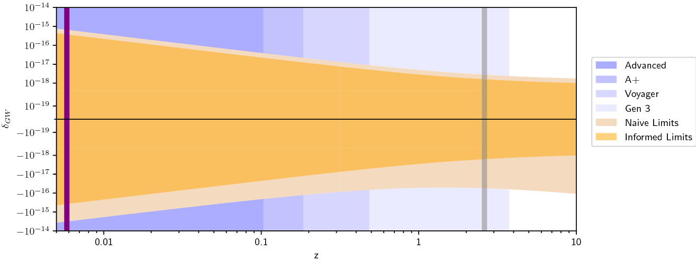
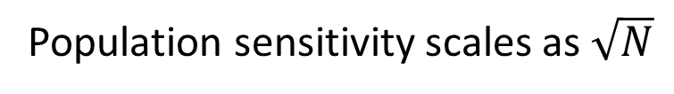
The GW-GRB Working Group: Speed of Gravity
Burns Living Reviews in Relativity 23 4 (2020)
Population sensitivity scales as $\sqrt{N}$

Slide 7
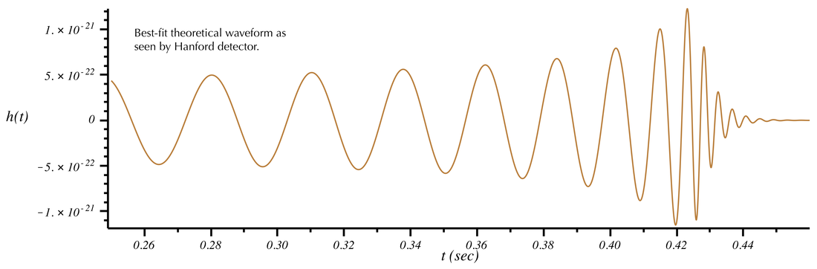
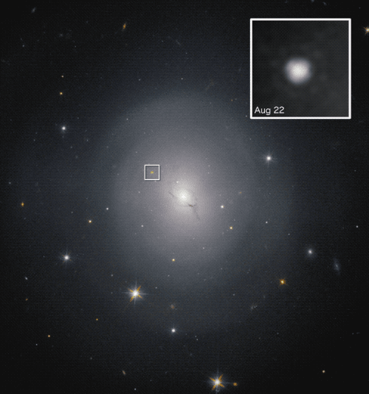
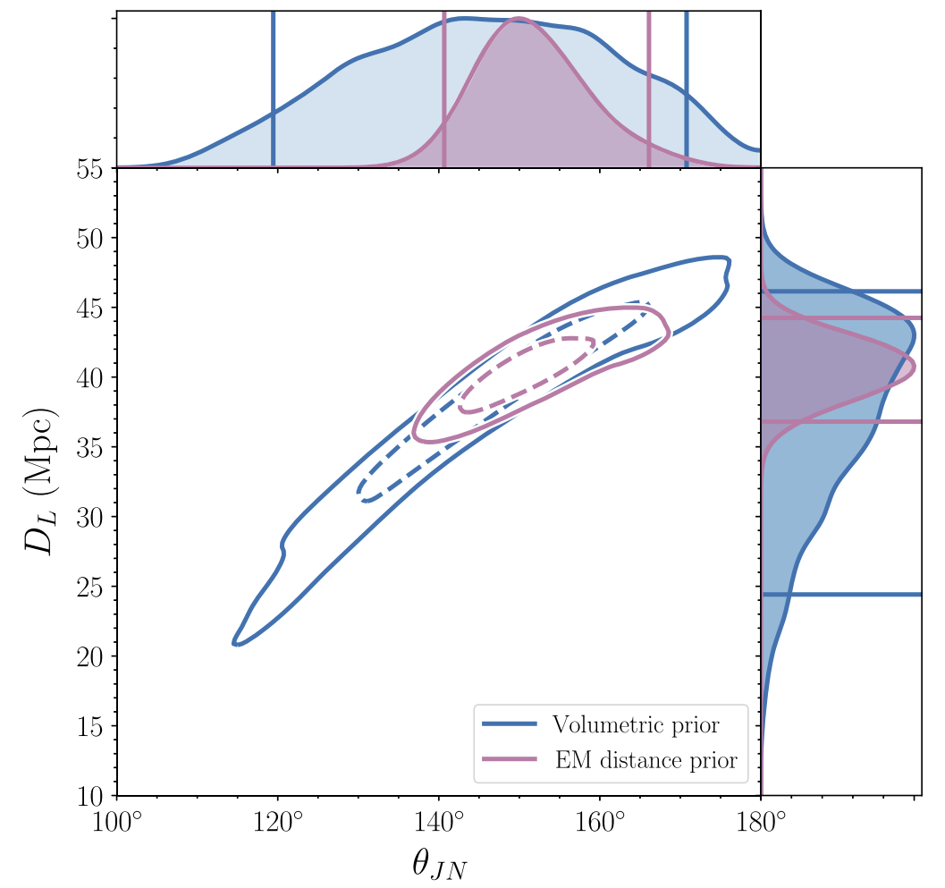
The GW-GRB Working Group: Science
Other future measurement areas
Behavior of speed-of-light jets
Origin of the elements
Neutron star equation of state
  Maximum NS mass
Standard Siren cosmology
  Hubble constant
  Nature of neutrinos
Fundamental physics
  Lorentz Invariance
  GW polarization
  Extra large dimensions
  Gravitational parity
N
1
d_{L}^{EM}/d_{L}^{GW}

Slide 8
The GW-GRB Working Group: Other Works
Fermi-GBM GRBs with characteristics similar to GRB 170817A
GRB 150101B as an analogue of GRB 170817A
Isolation of magnetar giant flares from the broader short GRB sample
Exploration of magnetar flares as sources of GWs and fast radio bursts
Providing tools and formalisms for IPN modernization
Forthcoming papers:
  GBM and BAT follow-up of GWTC-3 - Cori Fletcher (USRA), Josh Wood (NASA Marshall) for GBM; Milena Crnogorčević (UMD) for BAT; Tyson Littenberg (NASA Marshall)
  Joint sub-threshold GW-GRBs, GBM - Marion Pillas (Universite Paris-Saclay), Tito Dal Canton, Cosmin Stachie, Brandon Piotrzkowski (UW-Milwaukee), Fergus Hayes (University of Glasgow)
  Joint sub-threshold GW-GRBs, BAT – methods - Aaron Tohuvavohu (U Toronto), Rebecca Ewing (PSU), Brandon Piotrzkowski (UW-Milwaukee)
  Joint sub-threshold GW-GRBs, BAT – results - Gayathri Raman (PSU)
  Swift-BAT Biased Pointing; Swift-BAT Early Warning Response -Aaron Tohuvavohu (U Toronto)

Slide 9
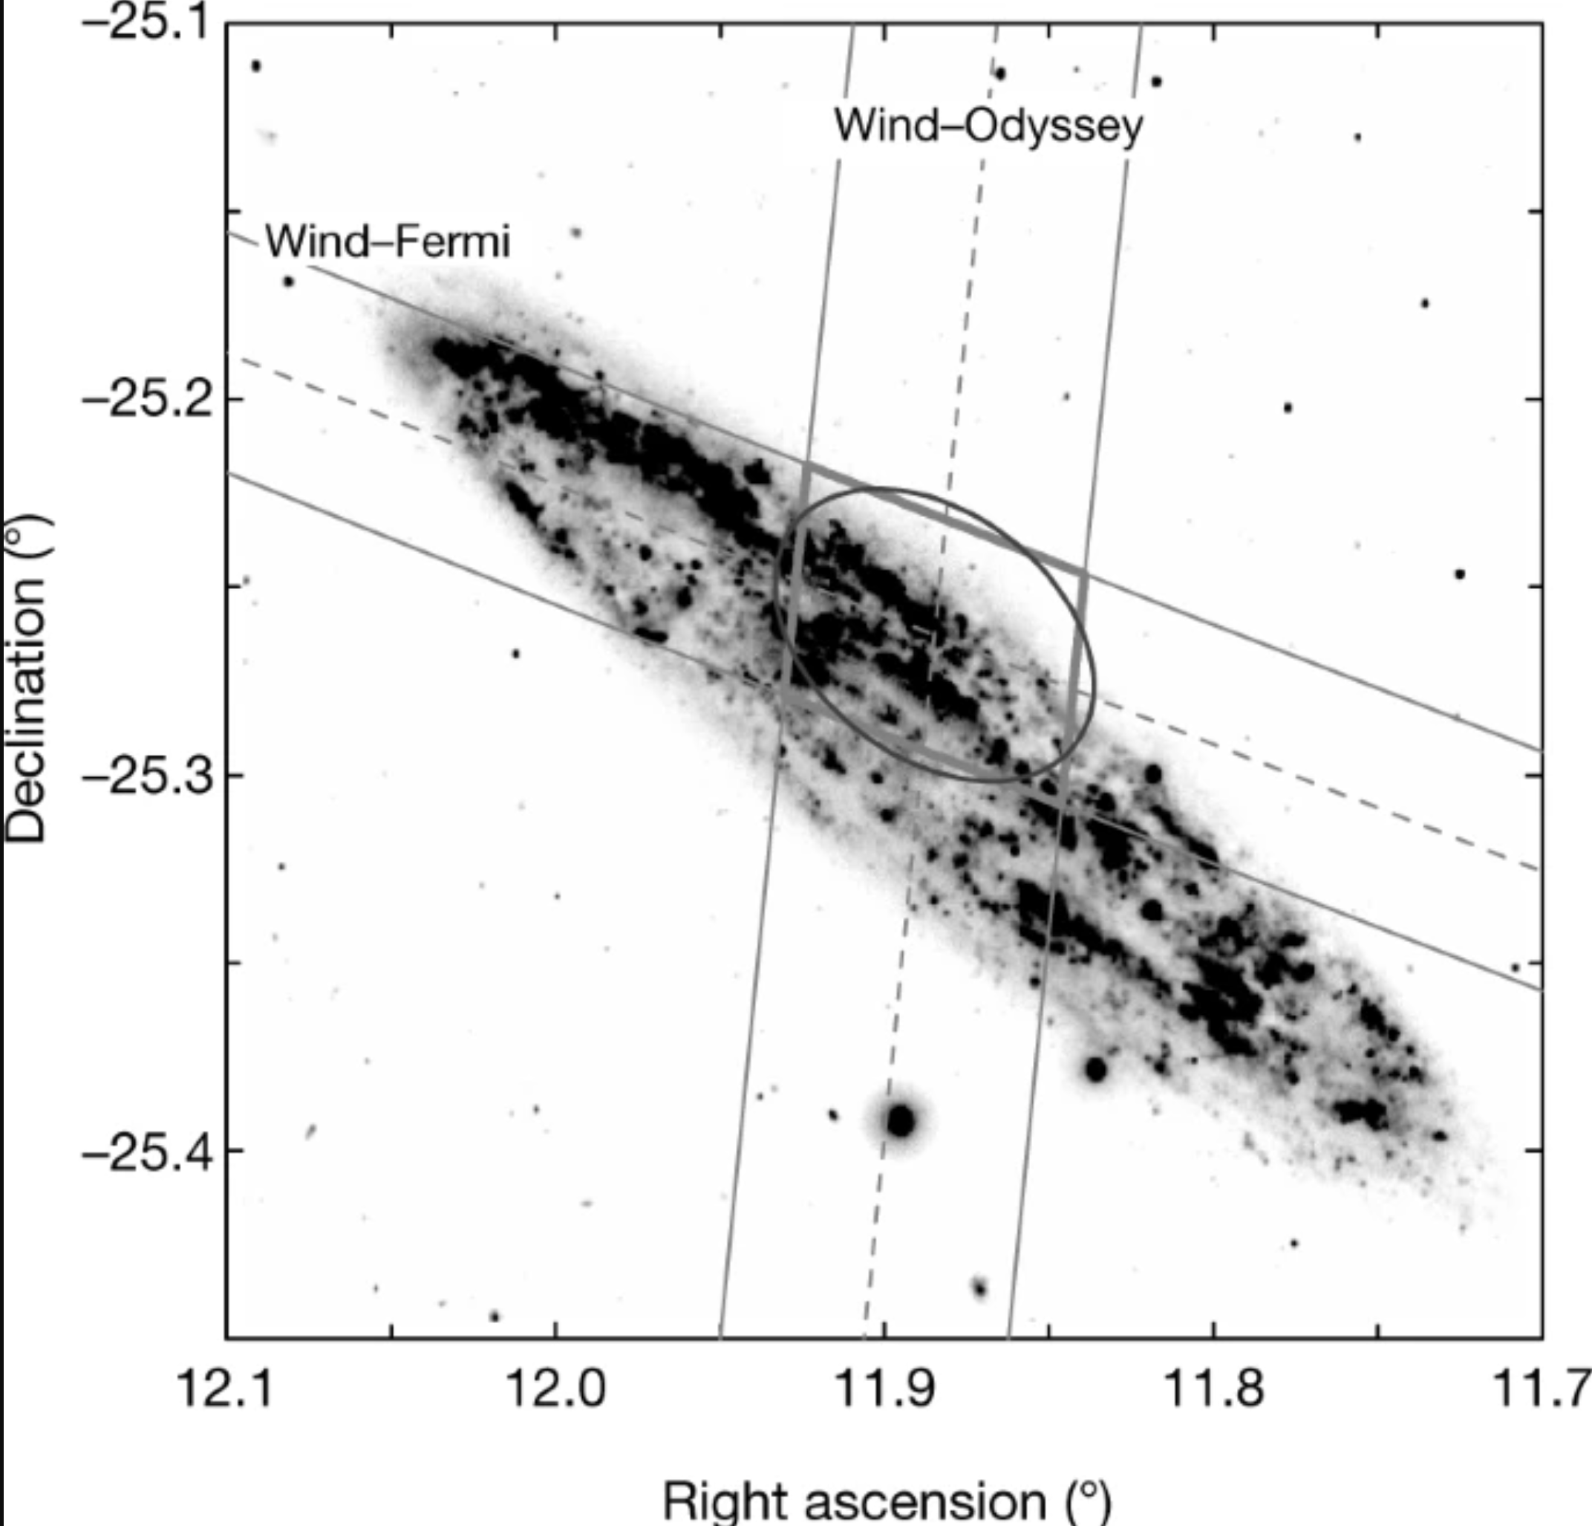
The InterPlanetary Network (IPN): Past and Present
5* decades old, ~70 members
  1967 – Vela triangulation
  ~1978 – 1992; Organizers: Kevin Hurley
  1992 – 2021; Organizers: Kevin Hurley, Russian Scientists
    Key Members: AGILE, Bepi-Colombo, CALET, CGRO, Fermi, GECAM, Insight, INTEGRAL, Konus, Mars Odyssey, MESSENGER, RHESSI, Swift, Suzaku
  2022 - ; Organizers: Eric Burns, Russian Scientists
    Future instruments: StarBurst, COSI, Psyche, MEGANE
Discoveries
  >3500 direct citations, thousands more enabled
  Separation of GRBs, soft gamma-ray repeaters (SGRs)
  Anisotropy of SGRs, association with supernova remnants
  Discovery of magnetars
  Separation of short GRBs from neutron star mergers from extragalactic magnetar giant flares
Svinkin et al. 2021 Nature 589 221

Slide 10
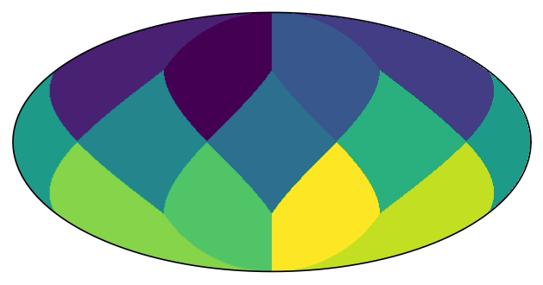
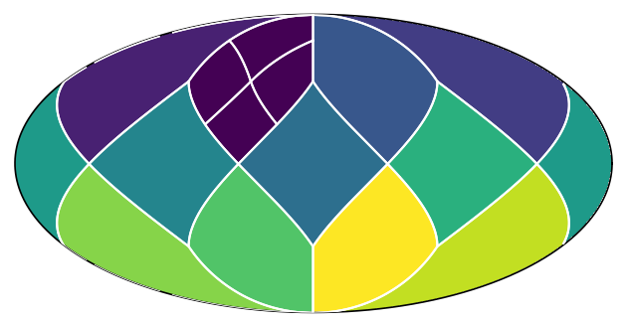
The IPN: Recent and Future Progress
Ease of access to localization information
Multi-resolution healpix maps
  mhealpy as a lightweight version; MartinezCastellanos et al. 2022 AJ 163 259
  New IPN localizations are being distributed with healpix maps
Prompt GRB Catalog
All prompt GRB detections back to 1967
Localization info combined into healpix format
Additional duration and spectral parameters
Designed for community contribution

Slide 11
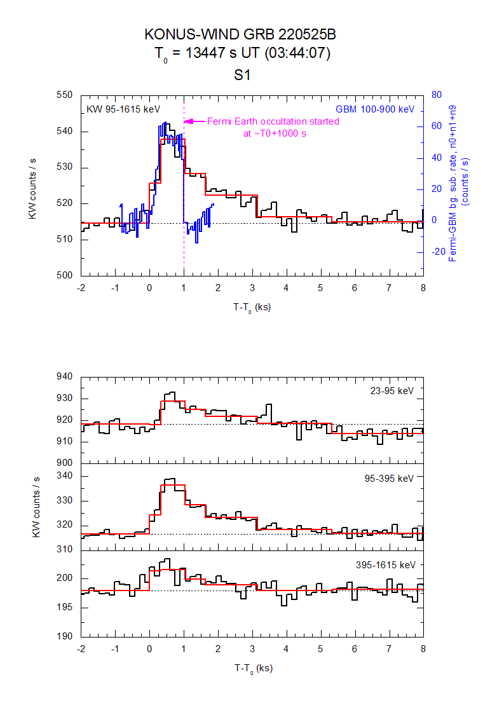
The IPN: Recent and Future Progress
Identification of ultra-long GRBs
Identification of a sub-class of ultra-long GRBs?
  GRB 220525B – GCN 32591 Svinkin et al.
  No LAT detection
  The third of its kind in ~30 years

Slide 12
Putting it together: a combined GRB alert stream
Automatic association of reported GRB triggers
Automatic combination of autonomous localizations
Automatic annuli calculation immediately after data is available
  Likely limited to manual at O4 start
Distribution to wider community with coherent information
Prioritization ranking
Fermi+INTEGRAL Annulus
Fermi-GBM
LIGO+Virgo

Slide 13
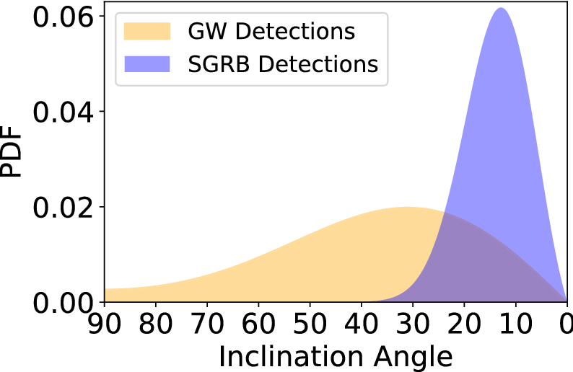

Predicted GW-GRB (Fermi-GBM) Rates for O4
Limitations:
  GW interferometer sensitivity
  GRB monitor sensitivity
Benefits:
  Face-on events are louder in GWs
  ~x2 gain in searchable volume using seeded (targeted) searches
One estimate for BNS GW-GRBs from LVK arXiv: 2111.03608:
Burns 2020 LRR 23 4
Pulling from:
Schutz 2011 CQG 28:125023
Fong et al. 2015 ApJ 815 102
0-2 w/ Poisson uncertainty, neglects sub-threshold detections

Slide 14
Thank you for your attention!
Eric Burns
ericburns@lsu.edu

