Slide 1

Investigating the nature of the 4FGL soft Galactic unassociated sources
Benoit Lott ^{1,}*
J. Ballet²
¹LP2IB
²AIM, CEA Saclay
*lott@cenbg.in2p3.fr

Slide 2
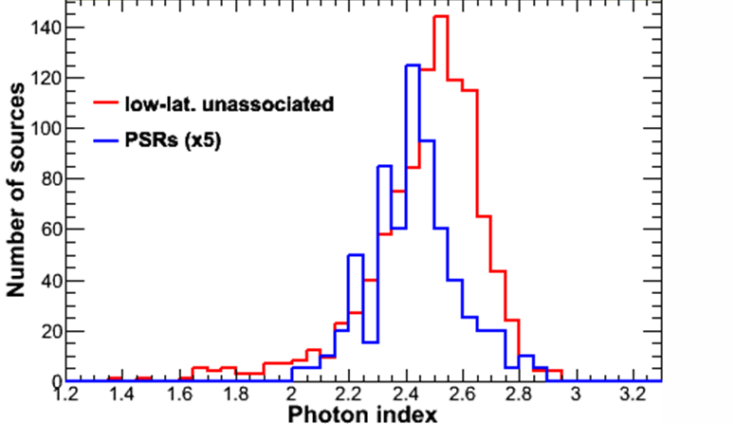
Low-b unassociated sources in 4FGL-DR3
4FGL-DR3
established with 12 years of data
uses iem_v07 diffuse emission model
6659 entries (6658 sources)
only point sources added relative to 4FGL
no systematic test for source extension
overall association fraction 68%
1018 |b|<10° unassociated sources
soft component unseen in any classes of
Galactic sources :
« SGUs »: Soft Galactic Unassociated sources
Unassociated && Photon index>2.4 && |b|<10°

Slide 3
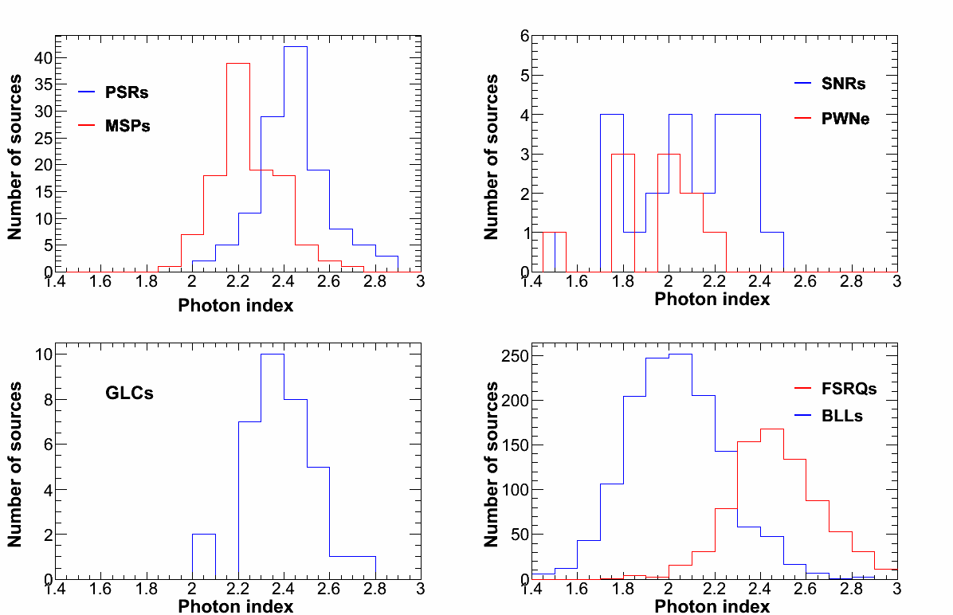
Photon-index distributions
globular
clusters
Fairly distinctive distributions

Slide 4
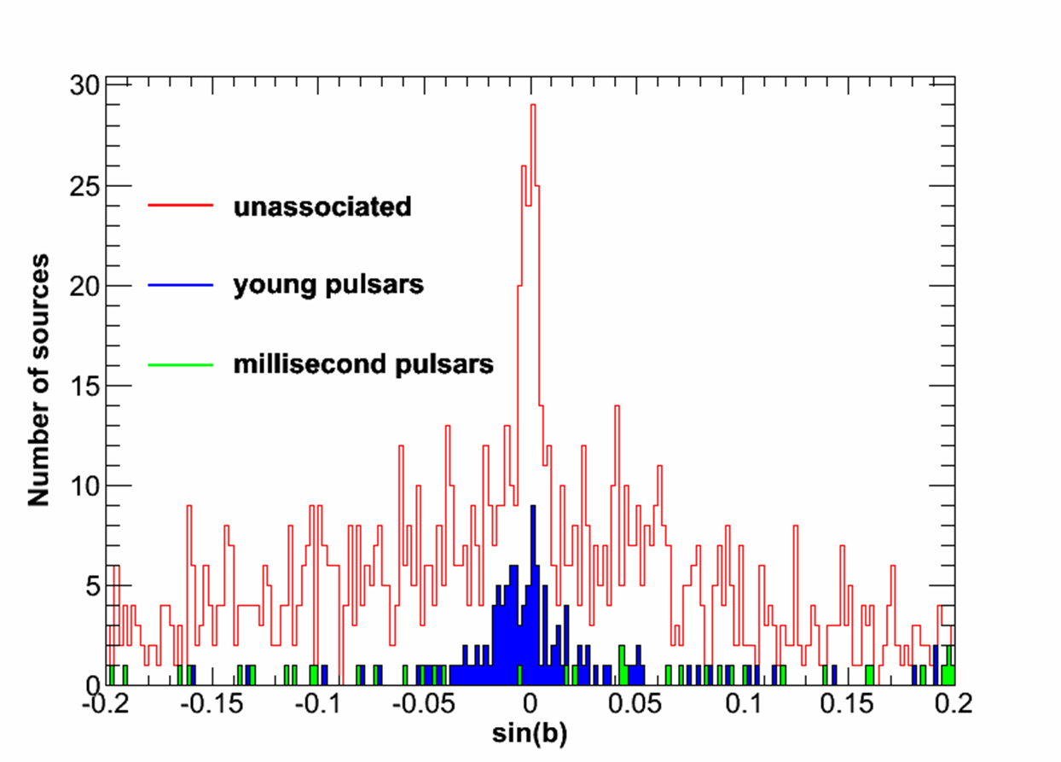
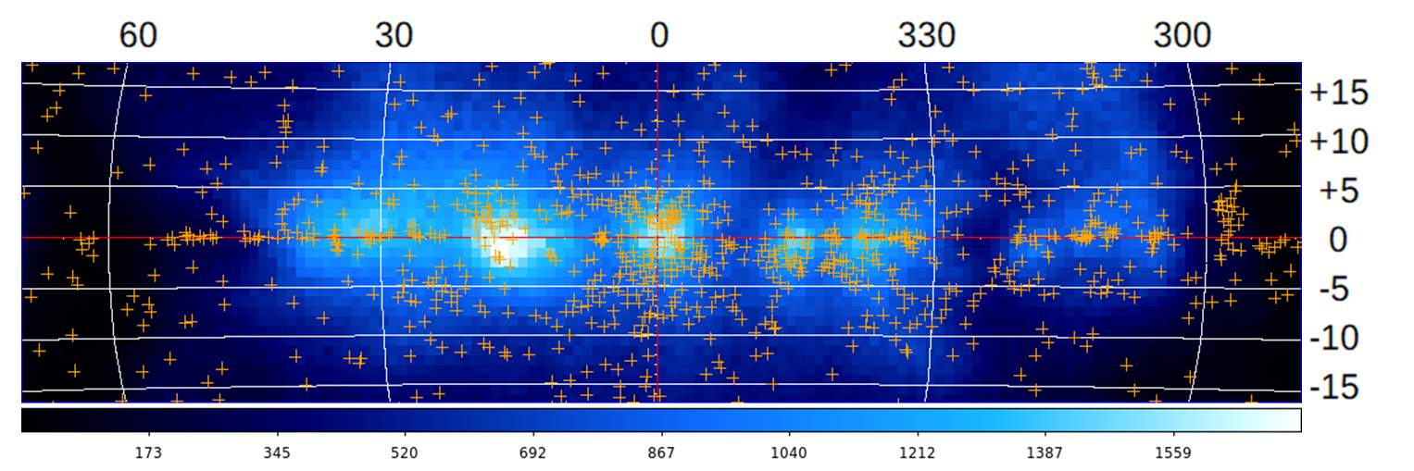
Low-b unassociated sources
Low contribution from background AGNs
Specific latitude distribution: « spike » and « shoulder »
Notable clustering
Indication for extension for some sources
Correlation with patch component of Galactic diffuse emission model

Slide 5
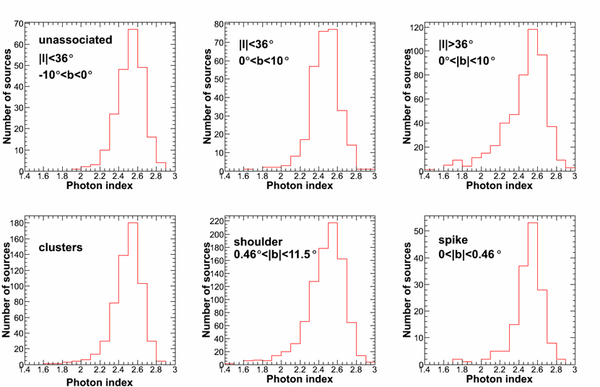
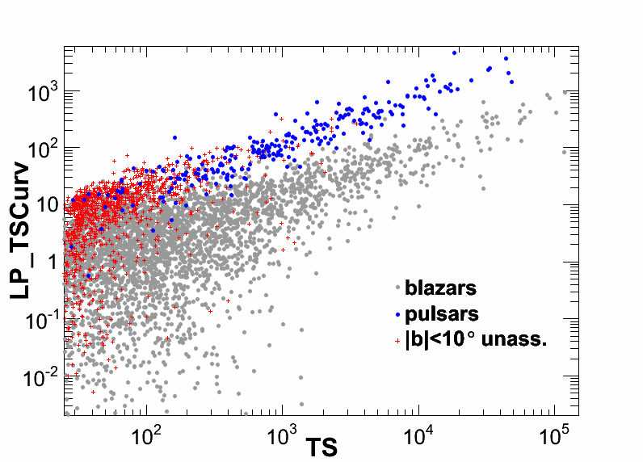
SGU spectral features
Similar SGU index distribution in different
sky regions
Spectral curvature similar to that
of pulsars
Flag 14 in DR3 devised to indicate SGUs (+SPPs+UNKs) in high-density regions
(HEALpix tesselation)
Condition: within high-density pixels && Γ>2.4 &&TS<500
446 SGUs, 45 SPPs and 49 UNKs

Slide 6
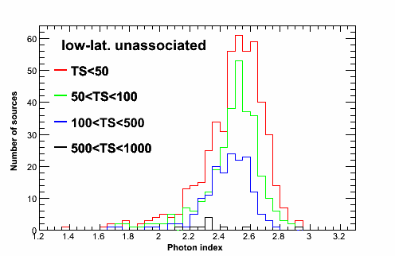
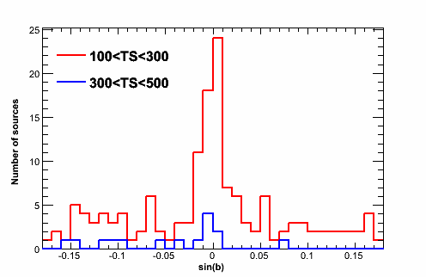
TS dependence
Relatively high TS (100<TS<500) sources retain similar properties as less
significant ones.
Worth investigating via dedicated MW studies

Slide 7
Nature of SGUs?
Not pulsars (b distributions, too many, photon index distributions…)
correlation with patch
Possibilities and avenues for exploring them
Mismodeled Galactic diffuse emission?
Try to reproduce spectral features via simulations
Improve model
Test other source-detection approaches
Existence of an abundant, entirely new class of sources?

Slide 8
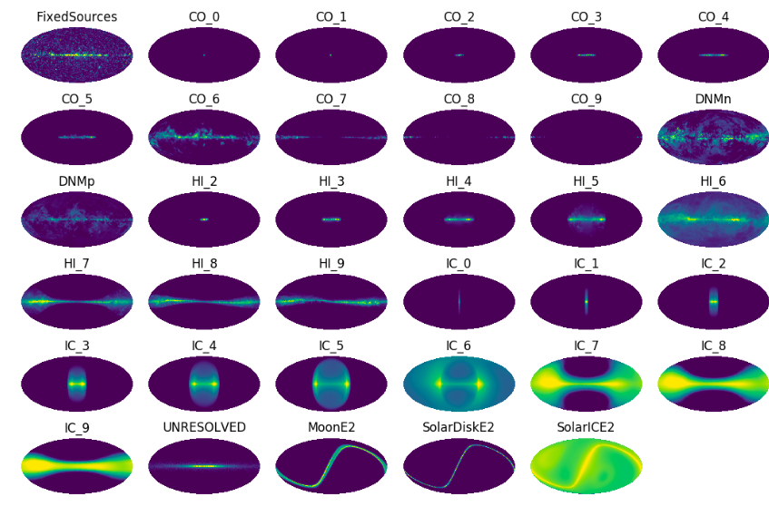
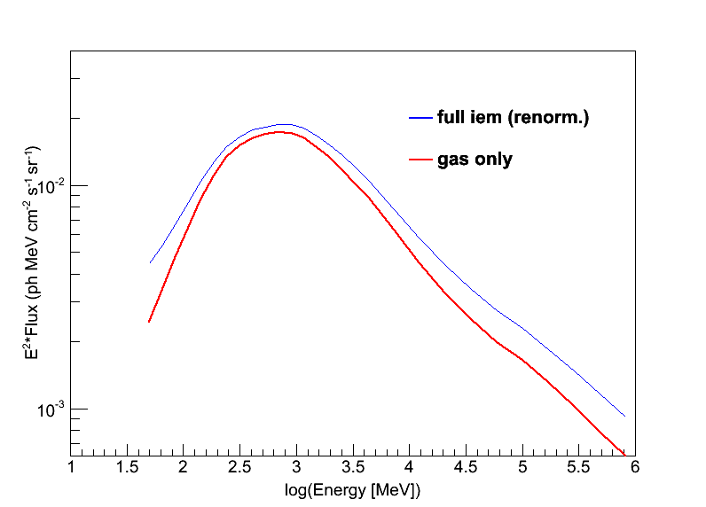
Refresher on diffuse emission model
Components
CO (10 rings)
HI (10 rings)
IC (10 rings)
Dark Neutral Medium
(DMNp+DMNn)
unresolved
Patch (residuals smoothed out
over a spatial scale of 4°)
isotropic
https://fermi.gsfc.nasa.gov/ssc/data/analysis/software/aux/4fgl/Galactic_Diffuse_Emission_Model_for_the_4FGL_Catalog_Analysis.pdf

Slide 9

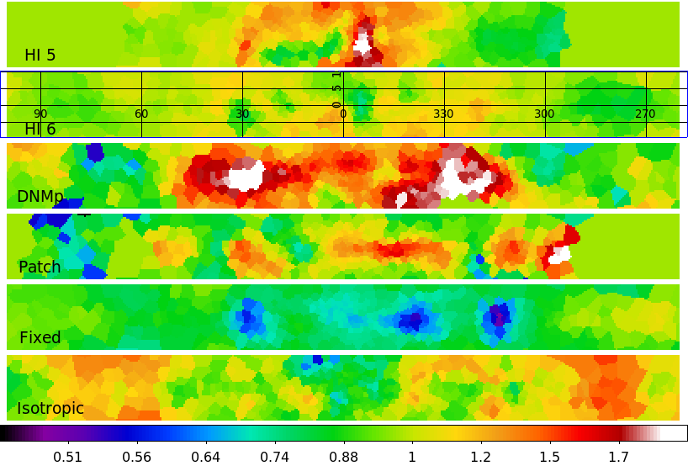
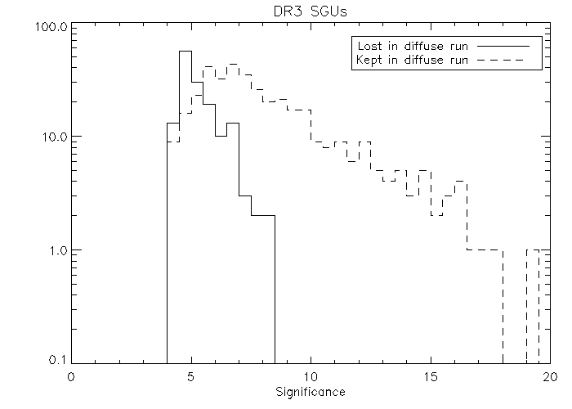
Freeing IEM components
A total of 14 IEM components (including isotropic) were left free for each RoI.
More than 70% of the SGUs remain.
A simple renormalization of the diffuse components at the RoI scale by itself does not allow suppressing the SGUs.
Interpretation of the observed spatial features still lacking

Slide 10
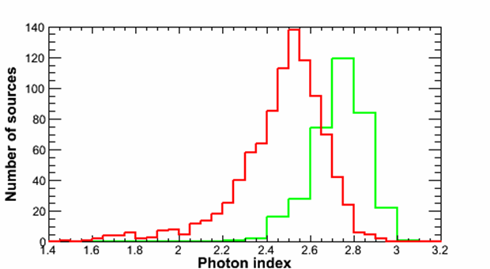
Spurious sources from IEM excess
Simulations with boosted (x2)
CO, DNMp or patch components
Detection of resulting sources
with fermipy’s find_src tool
Analysis with standard pipeline
Results
Spurious sources considerably
softer (mean photon index=2.71)
than the data.
Excess photons analyzed as point sources: measured spectra softer than real ones
because of the energy–dependent PSF (downplaying high-energy photons)
unass.
sim.

Slide 11

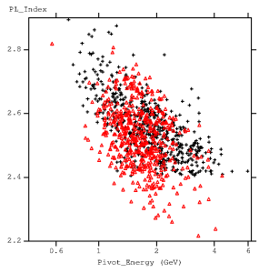
Effect of possible extension
Simulations of sources with:
spectra matching that of the Galactic diffuse emission
similar locations as SGUs
slight extension (σ=0.1°) , to mimic the spatial granularity of the diffuse emission.
Some of the SGU spectral features reproduced under these ad-hoc conditions.
The spectra are harder than those in simulations presented in the previous slide because the spatial scale (0.1°) is much less than that of features present in the IEM.
SGU positions, TS=55
+ SGUs
Δ sim.

Slide 12
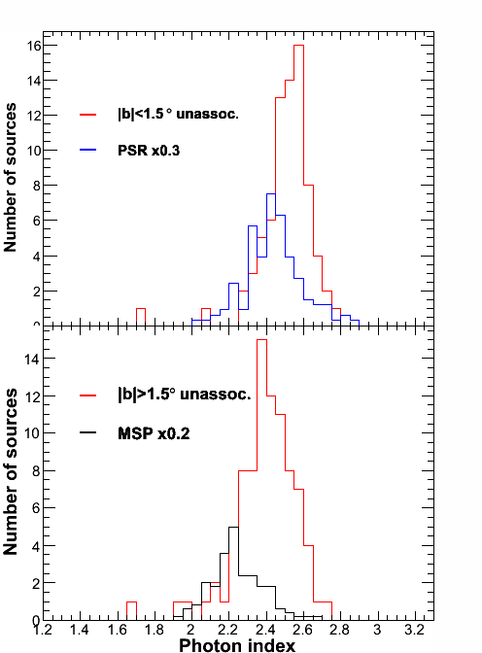
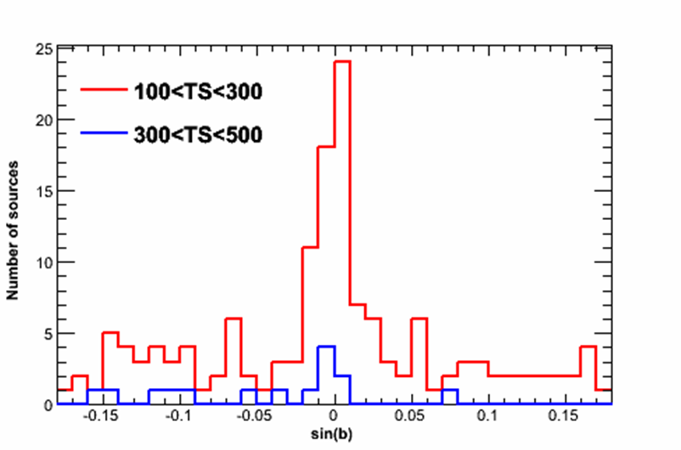
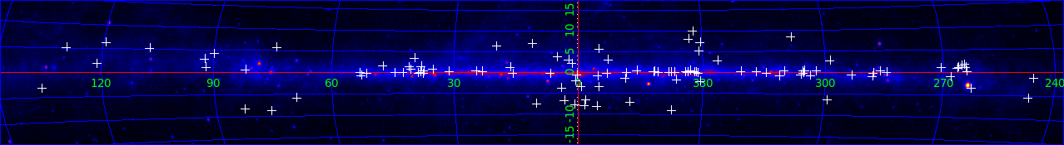
High-TS sample
100<TS<500 && |b|<10° && PL_Index>2.4
108 unassociated sources
Preliminary
MW investigation of regions surrounding these bright SGUs is in progress.

Slide 13
Conclusion
SGUs constitute an important population of the current catalogs, not fitting in any known classes;
Attempting to break down the unassociated sources solely into « AGN-like » and «pulsar-like » classes is not appropriate;
Some SGUs are possibly related to small-scale structures of
the diffuse emission.
The MW investigation of the brightest SGUs is underway.

