Slide 1

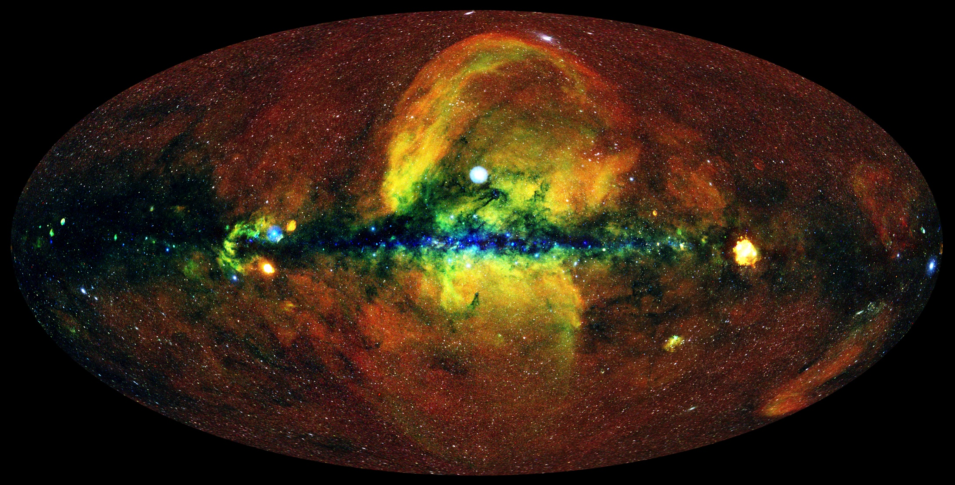
eROSITA on SRG
Mapping the Hot Universe
on behalf of the eROSITA_DE team
Andreas von Kienlin
Max-Planck-Institut für extraterrestrische Physik (MPE), Garching

Slide 2
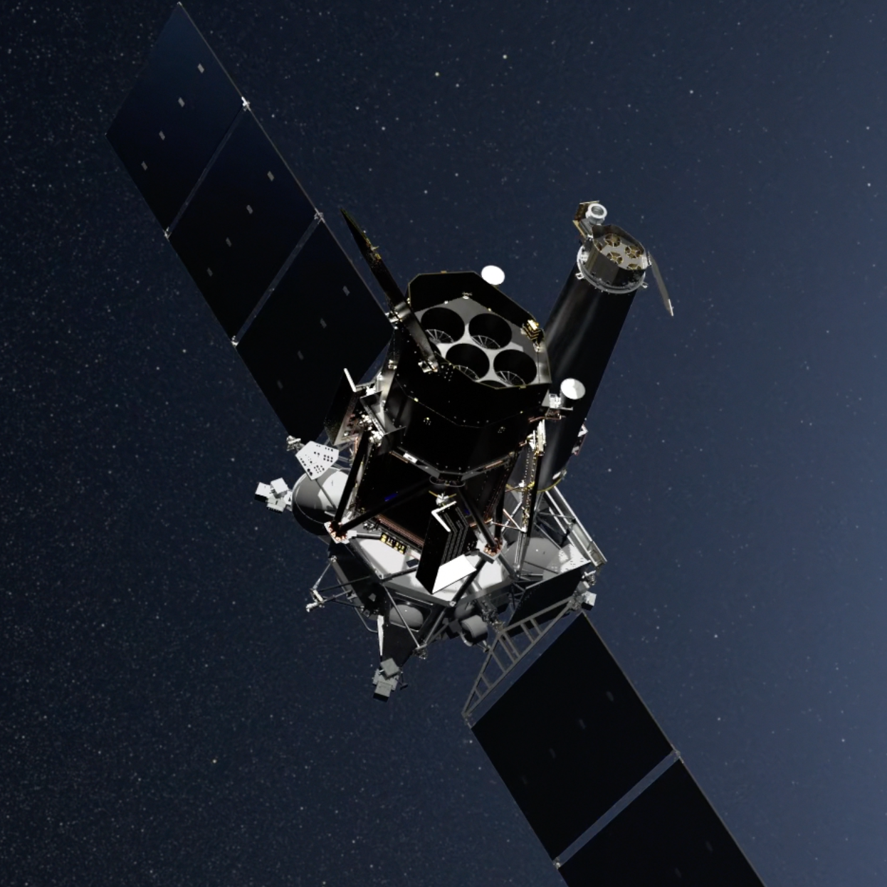


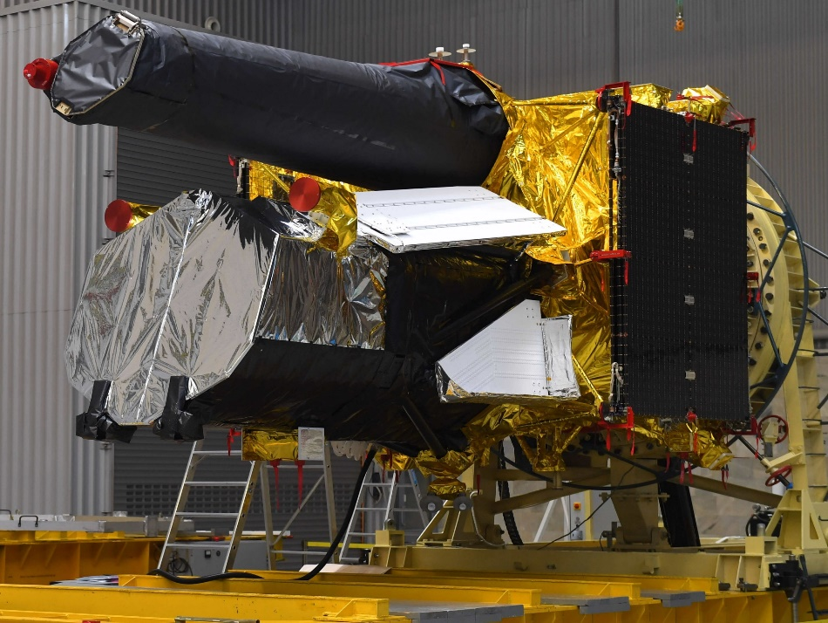

eROSITA on SRG
Mapping the Hot Universe
SRG
Spektrum-Roentgen-Gamma
Launch: 13. July 2019
ART-XC (IKI)
Secondary Instrument
350 kg
Navigator
Platform
eROSITA (MPE)
Primary Instrument
808 kg / 3.5 m x 1.9 m

Slide 3
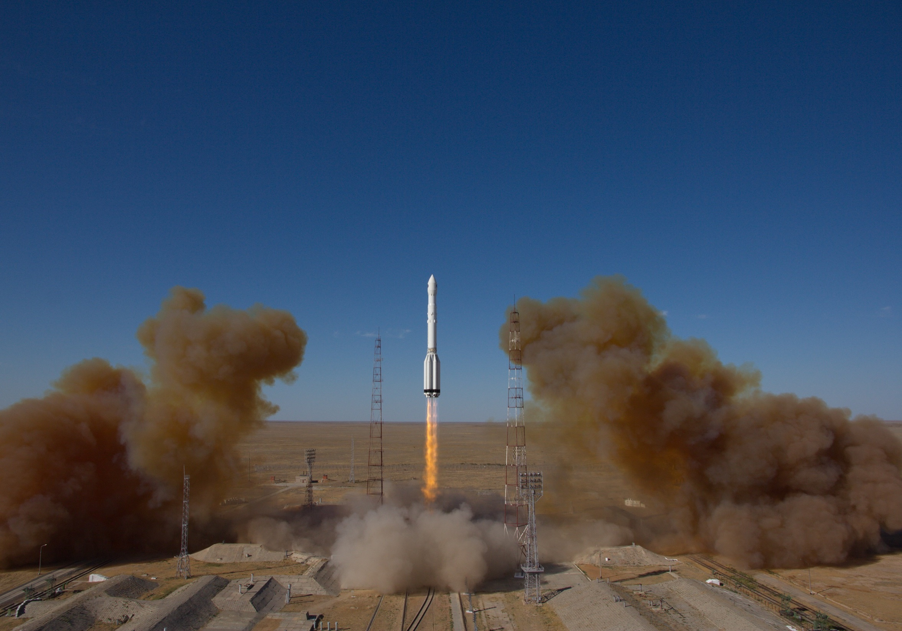
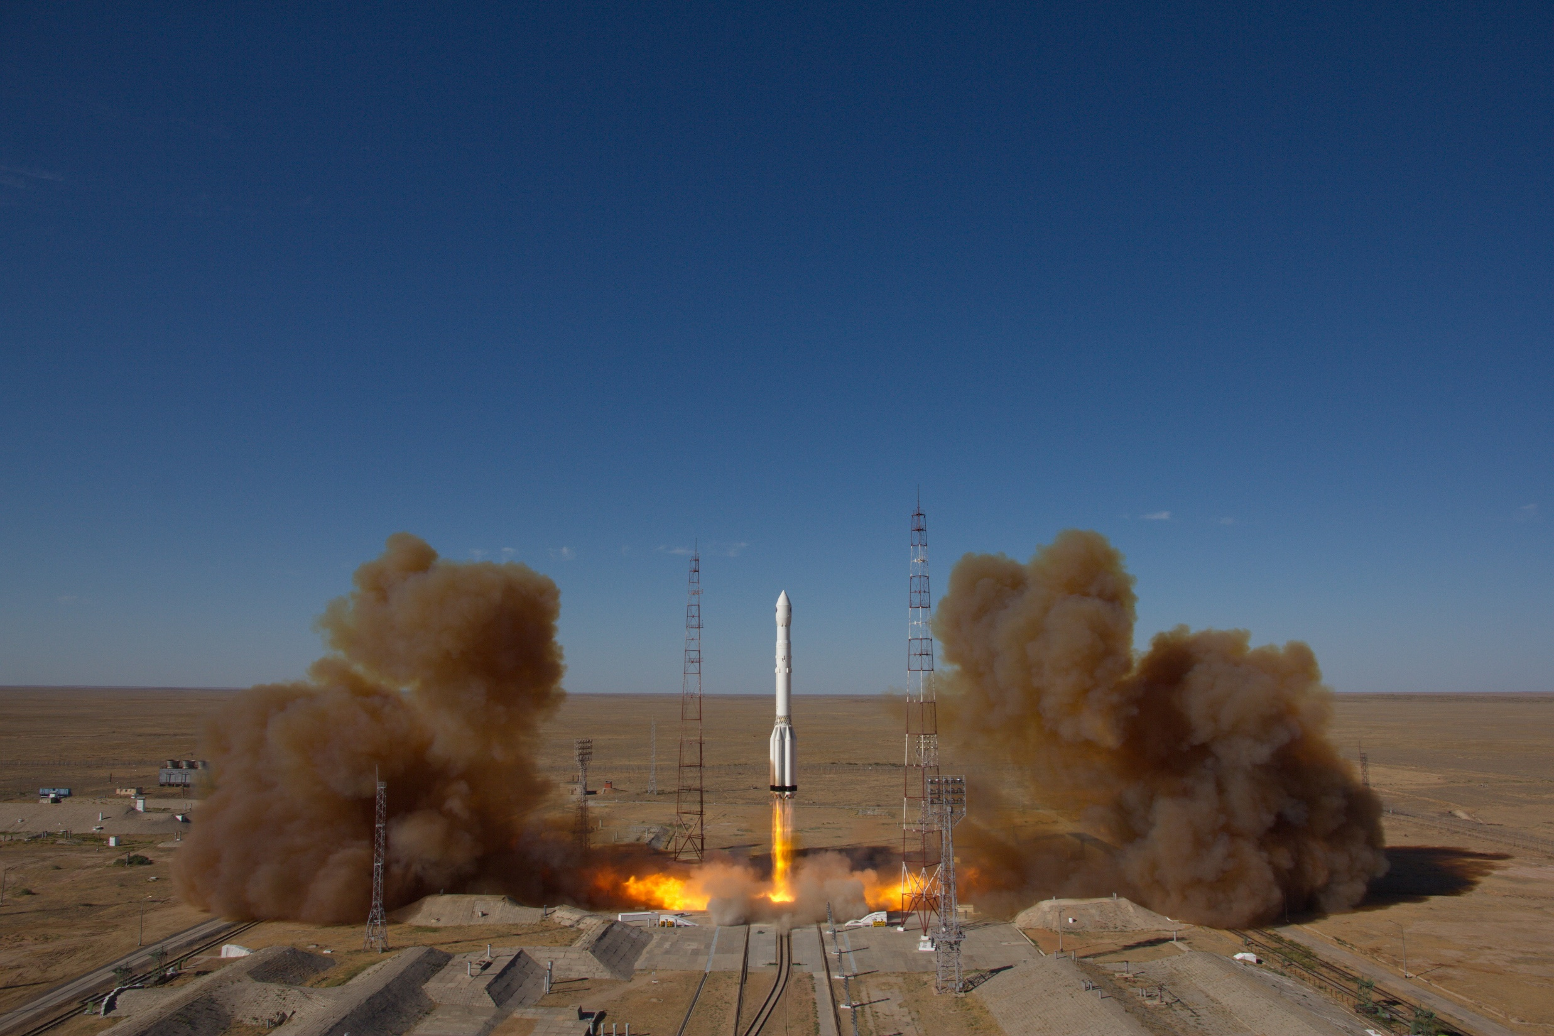
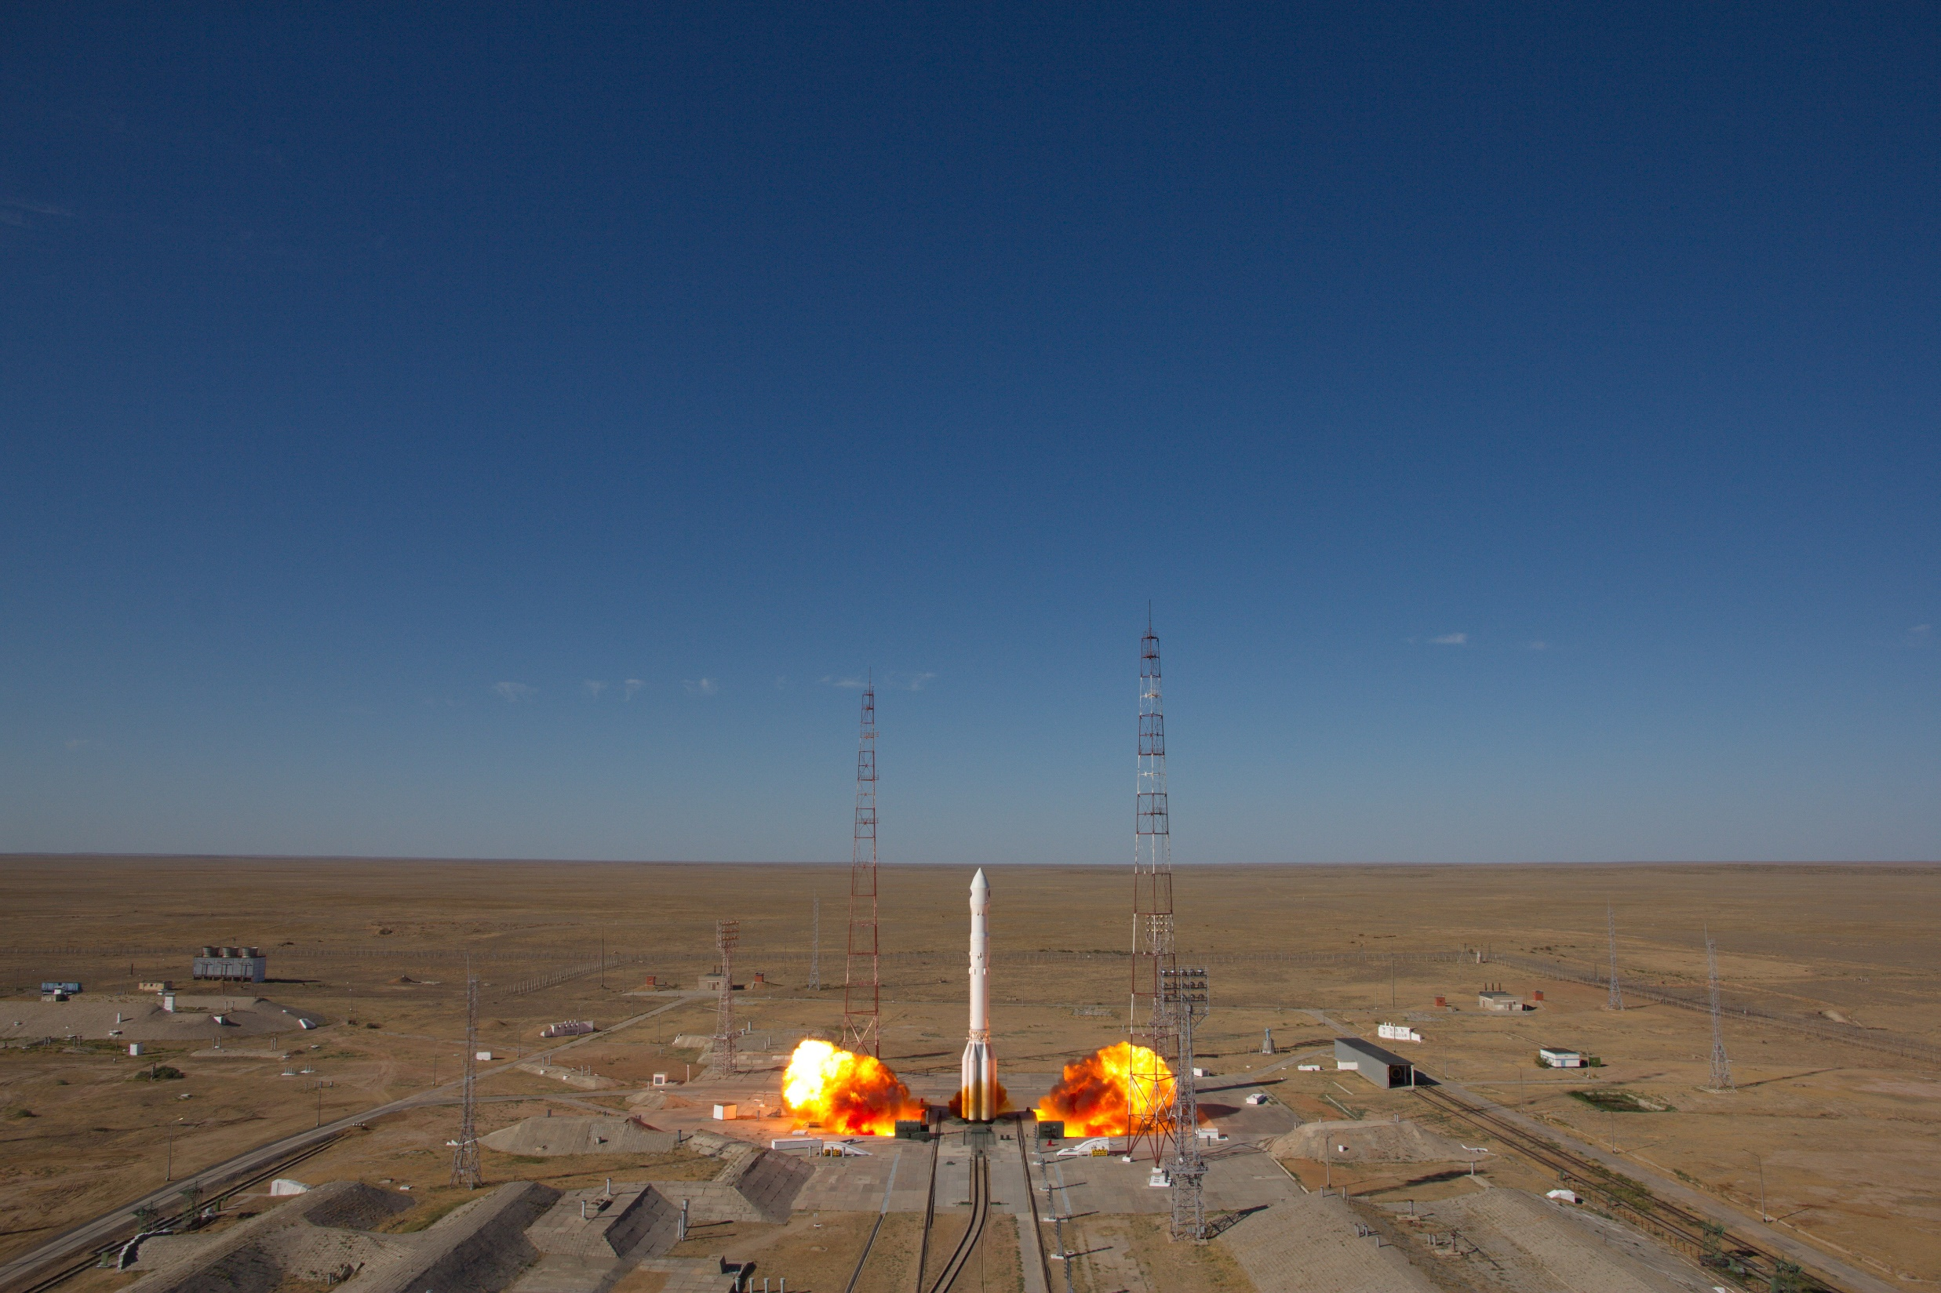
13.07.2019, 17:31
Cosmodrom Baikonur/Kazakhstan
Proton-M / BLOK-DM03

Slide 4
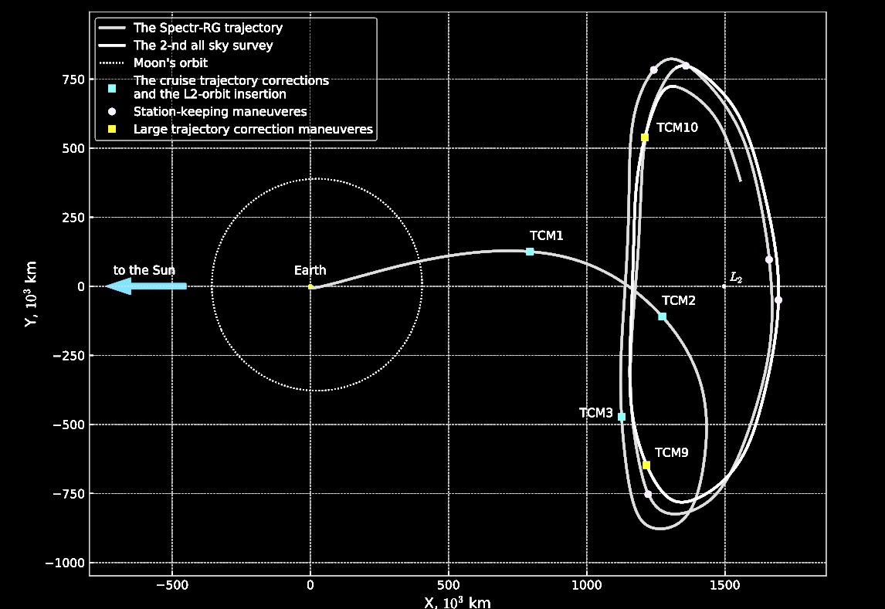
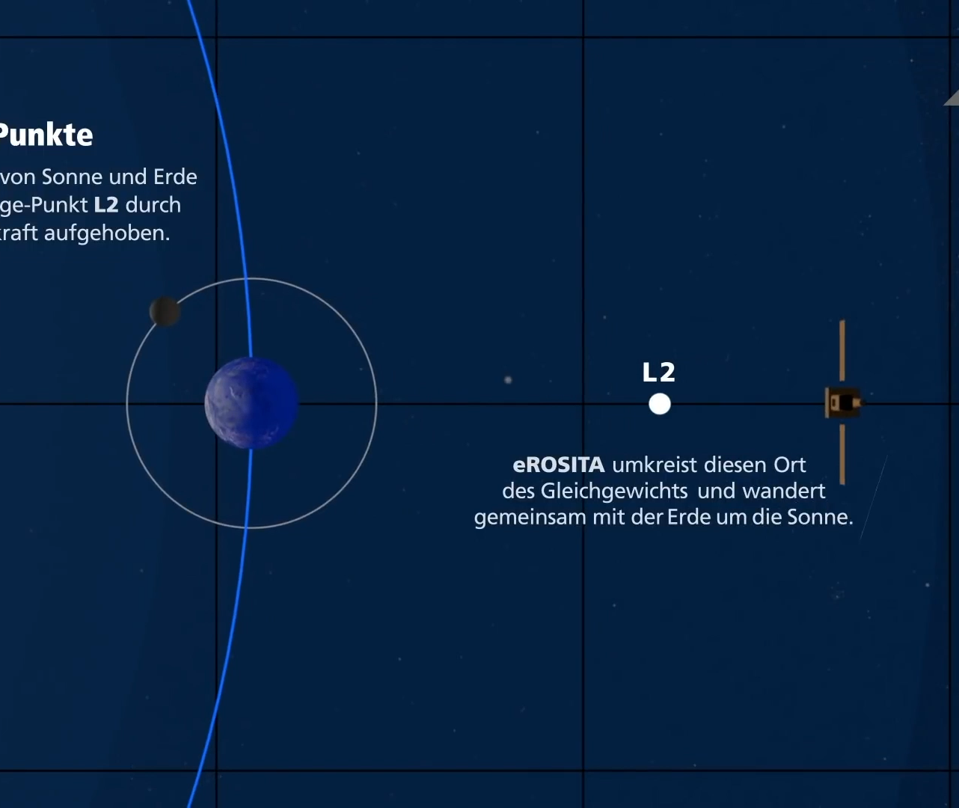
A large Halo L2 Orbit:
4 years: 8 all sky surveys (eRASS 1 - 8, 6 rotations/day)
2.5 years: pointed observations
Sunyaev et al. (2021)
25.01.21

Slide 5
Data sharing
Memorandum of 2007 between Roscosmos and DLR: SRG/eROSITA data belong in equal parts to the German and Russian scientists
  Constructing all-sky X-ray maps and creating X-ray source catalogs: German scientists are responsible for the processing and publication of data in one hemisphere of the sky, and the Russian scientists provide this in the other hemisphere
All data obtained by the ART-XC telescope belong to the scientists of IKI
  Area of 200 square degrees around the north ecliptic pole: IKI + MSFC

Slide 6
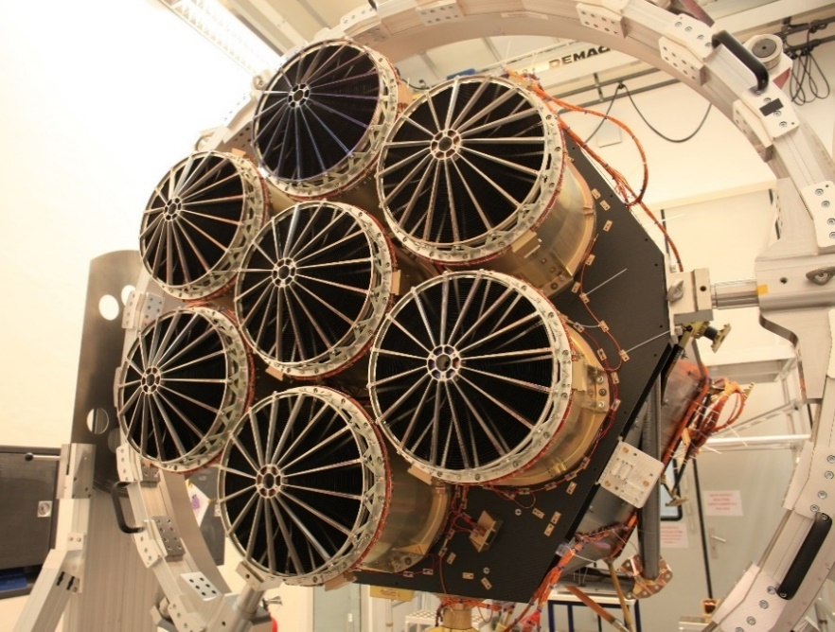
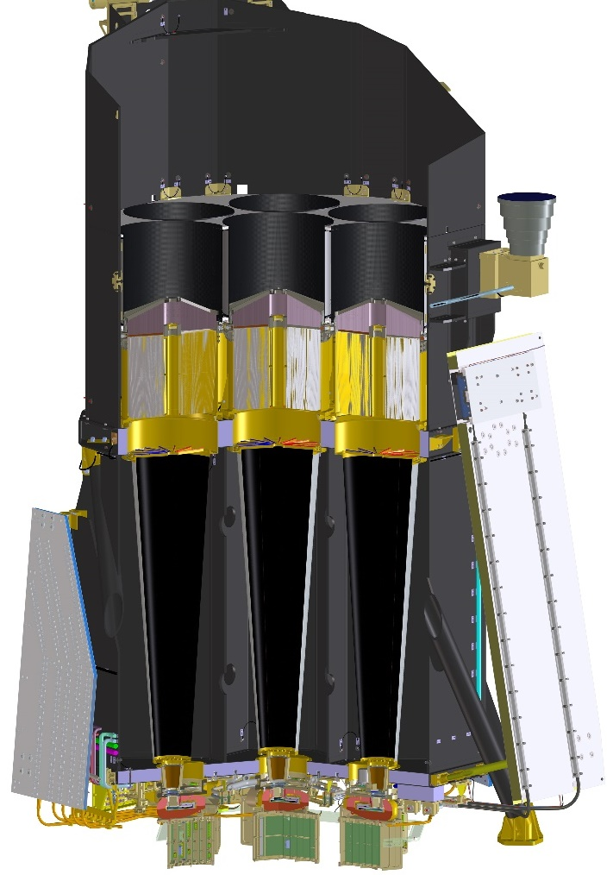
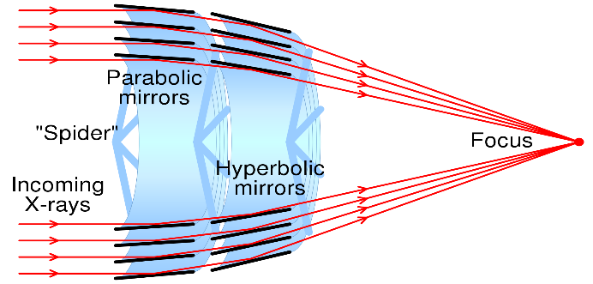
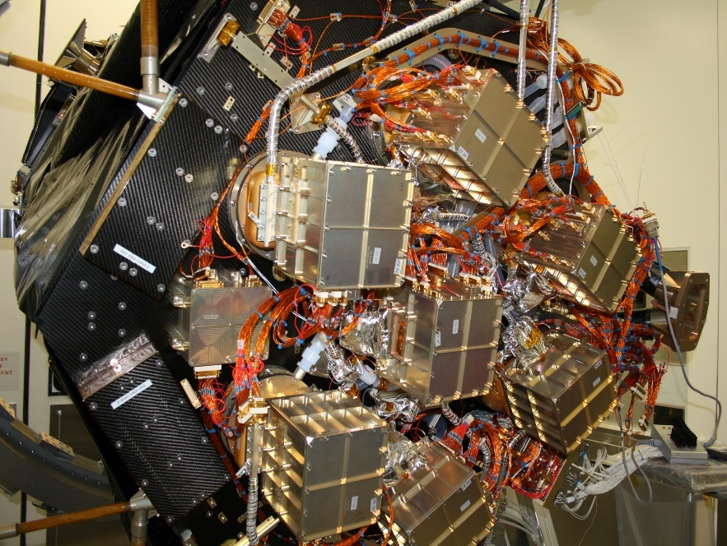
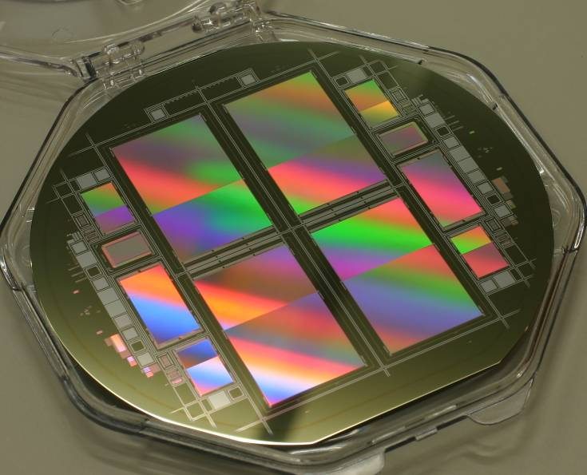
eROSITA X-ray Telescope
378 X-ray Mirrors
in 7 parallel Telescope Modules
X-ray CCD
7 X-ray CCD Cameras, 9 Elektronic-Boxes
Predehl et al., A&A 647, A1 (2021)

Slide 7
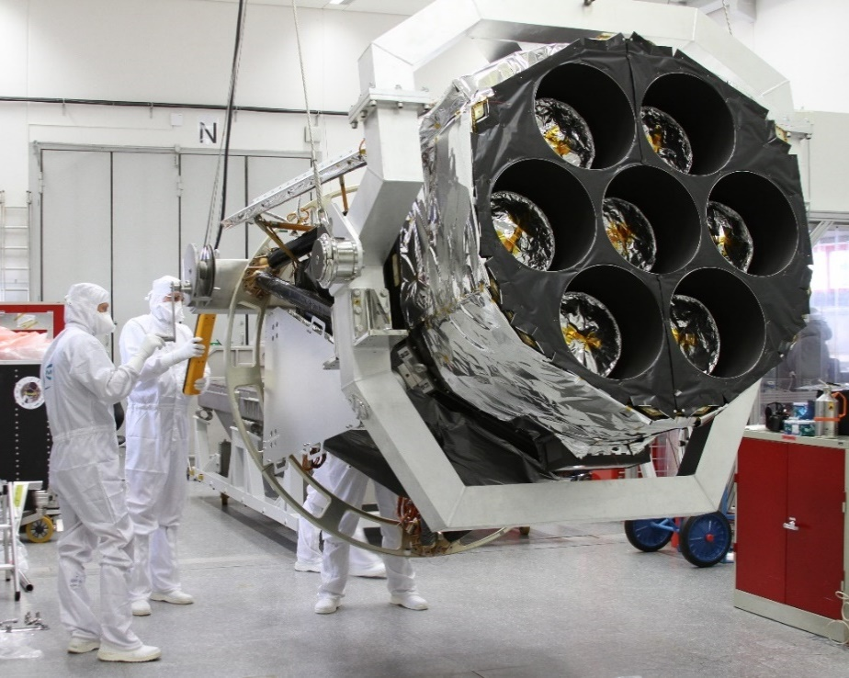
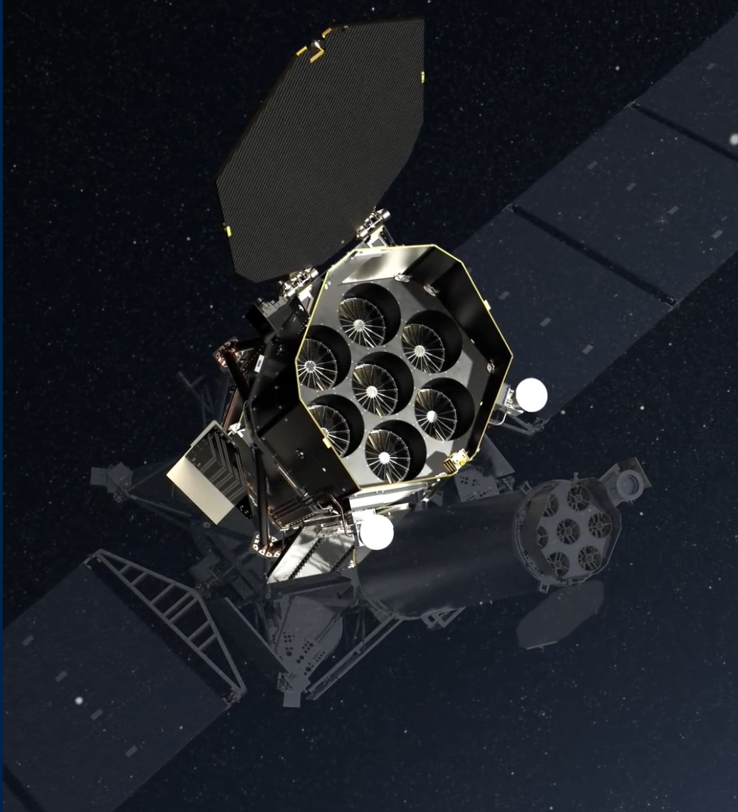
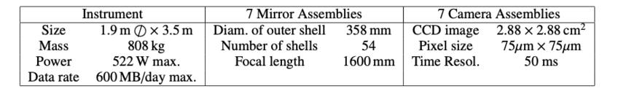
eROSITA Technical Parameters
X-ray focusing telescope optimized for surveys
  large field of view, high quality mirrors and sensitive CCD cameras.

Slide 8
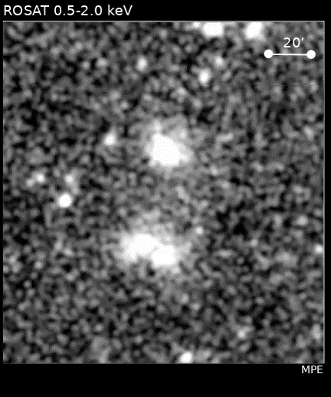
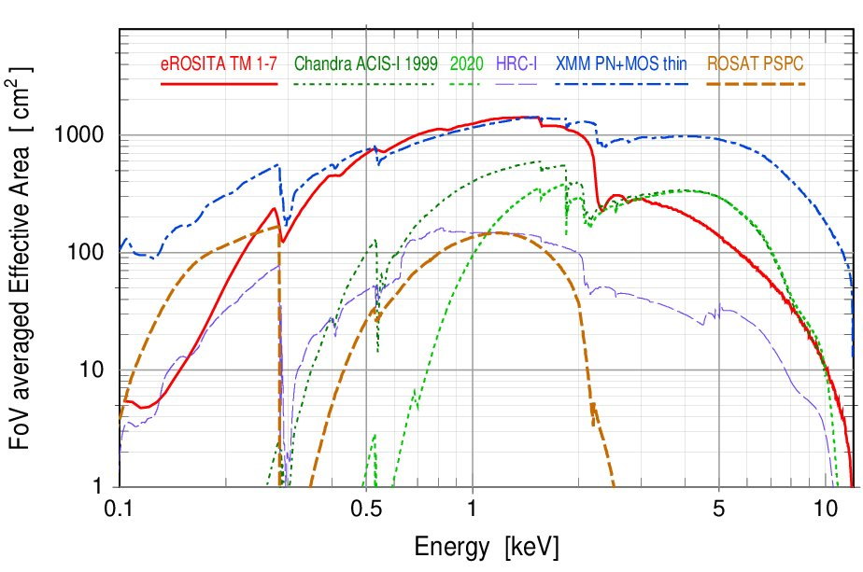
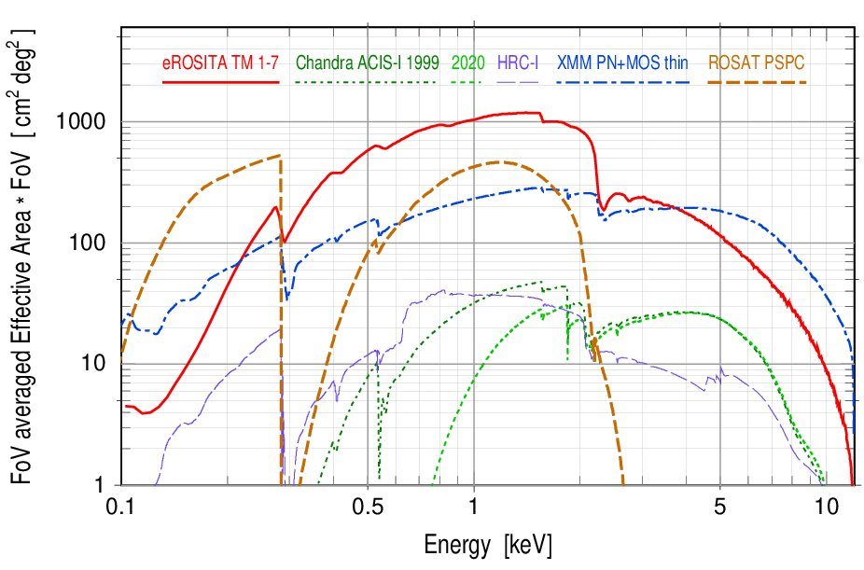
eROSITA Performance
Large Effective area | ~ 1300 cm² @1keV ⇨ ~XMM-Newton
Large Field of view | 1 degree (diameter) ⇨ Grasp ~5 x XMM
Half-Energy width (HEW) | ~ 18” (on-axis, point.) / ~30” (FoV avg., survey)
Positional accuracy | ~ 4.5” (1σ)
X-ray baffle | 92% stray light reduction
pnCCD with framestore | very good detector uniformity, little T dependence
384x384x7 pixels | ~10⁶ pixels (9.4”), no chip gaps, no ‘out of time’ events
Spectral resolution at all measured energies within specs (~80eV @1.5keV)

Slide 9
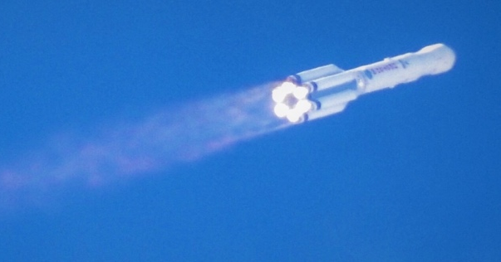
Programatics / Data Releases
eRASS = eROSITA All-Sky Survey
CalPV:
Calibration and
Performance Verification
26.2.2022
eROSITA in safe mode
eRASS8
All-Sky Survey
“Following the recommendation to freeze co-operation with Russia, eROSITA was placed into safe mode during the ground contact on Saturday 26th February. Science operations with the instrument are currently paused. […] We hope that circumstances will permit a return to normal operations as soon as possible. […]”
eRASS1
eRASS3
eRASS2
eRASS4
eRASS6
eRASS5
eRASS7
2.5-years pointed observations
GTO/GO phase
2019
2020
2021
2022
2023
2024
2025
2026
Launch
July 1st 2021: EDR
CalPV data and
~ 40 associated papers
⇨ A&A special issue
DR1
eRASS1
Q1 2023
DR2
eRASS:3
Q3 2024
TBC
DR3
All-sky survey
Q1 2026
TBC
Preparation ongoing for DR1: final re-processing of eRASS1 completed in January
Future DR plan will be revisited depending on the development of the collaboration with IKI

Slide 10
Cal-PV observations
Individual Pointings (> 100) + Field Scans, 4 Categories:
  Survey Fields:
  Magellanic Clouds,
  Galatic Fields,
  Extragalatic Fields
Early Data Release (EDR) site: https://erosita.mpe.mpg.de/edr/
  eROSITA Science Analysis Software System (eSASS)
A&A special issue 661 (2022): https://erosita.mpe.mpg.de/publications
eFEDS: Final Equatorial Depth Survey
140 deg²; ; 1/300th of the area of the entire sky
~2.5ks exposure (~4 days of observations)
Brunner et al. (2021)

Slide 11
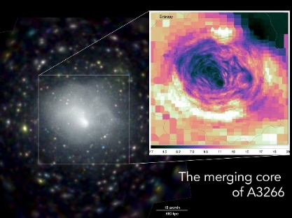
Cal-PV observations
Individual Pointings (> 100) + Field Scans, 4 Categories:
  Survey Fields: proof-of-concept survey
  Magellanic Clouds,
  Galatic Fields,
  Extragalatic Fields
Early Data Release (EDR) site: https://erosita.mpe.mpg.de/edr/
  eROSITA Science Analysis Software System (eSASS)
A&A special issue 661 (2022): https://erosita.mpe.mpg.de/publications
Sanders et al. (2021)

Slide 12
eFEDS: a preview survey
Exposure corrected image in the 0.5–2.0 keV band
Flux limit (0.2 – 2.3 keV) ~7×10⁻¹⁵ erg/s/cm²
                27910 X-ray sources
  27369 Point like sources
  542 Clusters of Galaxies (19 Superclusters)
  ~10k spectroscopic redshifts (SDSS-IV,V)

Slide 13
eFEDS: a preview survey
Exposure corrected image in the 0.5–2.0 keV band
Flux limit (0.2 – 2.3 keV) ~7×10⁻¹⁵ erg/s/cm²
542 cluster candidates

Slide 14
eFEDS: a preview survey
Exposure corrected image in the 0.5–2.0 keV band
Flux limit (0.2 – 2.3 keV) ~7×10⁻¹⁵ erg/s/cm²
HST
eROSITA

Slide 15
eROSITA’s First Supercluster
Exposure corrected image in the 0.5–2.0 keV band
Flux limit (0.2 – 2.3 keV) ~7×10⁻¹⁵ erg/s/cm²
Ghirardini et al. (2021)
Liu et al. (2021)
Biffi et al. (2021)
eROSITA
Magneticum Simulations

Slide 16
The first Sky-Survey: eRASS 1
eRASS-1: 13.12.19 – 11.06.20 (182 days)
IKI
MPE
SRG/eROSITA 0.3 – 2.3 keV RGB Map (red: 0.3-0.6 keV, green: 0.6-1.0 keV, blue: 1.0-2.3 keV)
∼1.000.000 X-ray sources
Diffuse Emission = hot gas

Slide 17
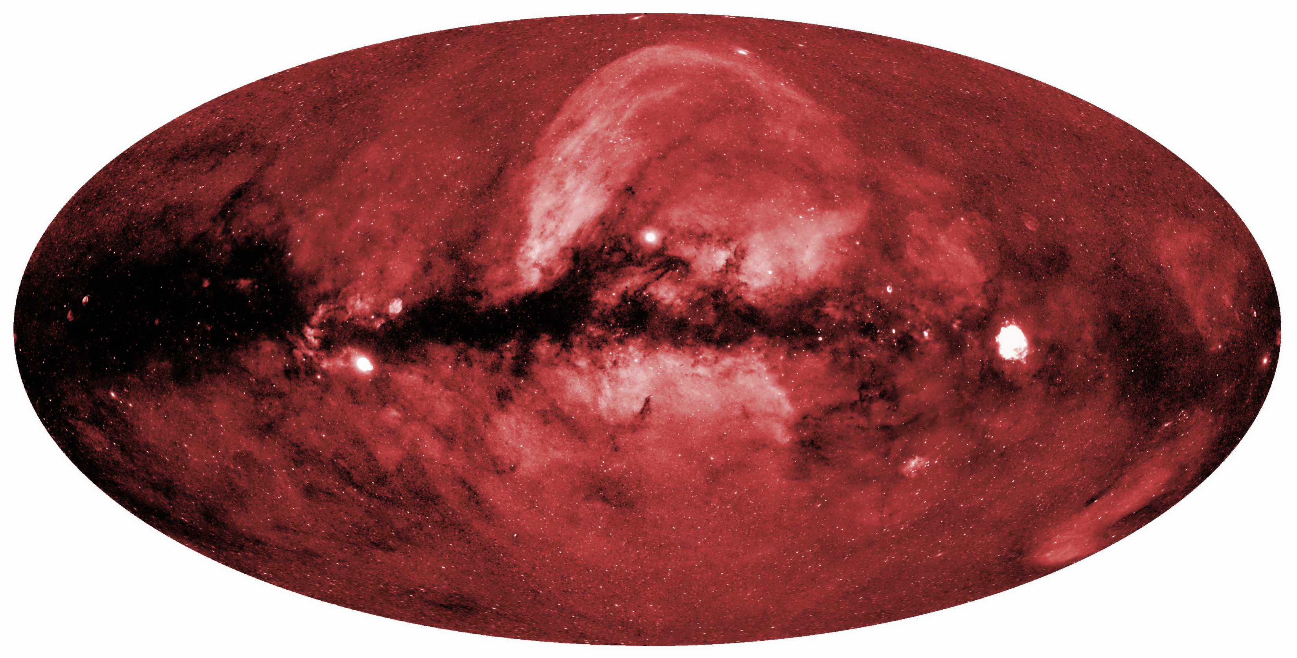
The first Sky-Survey: eRASS 1
SRG/eROSITA
0.3-0.6 keV
IKI
MPE

Slide 18
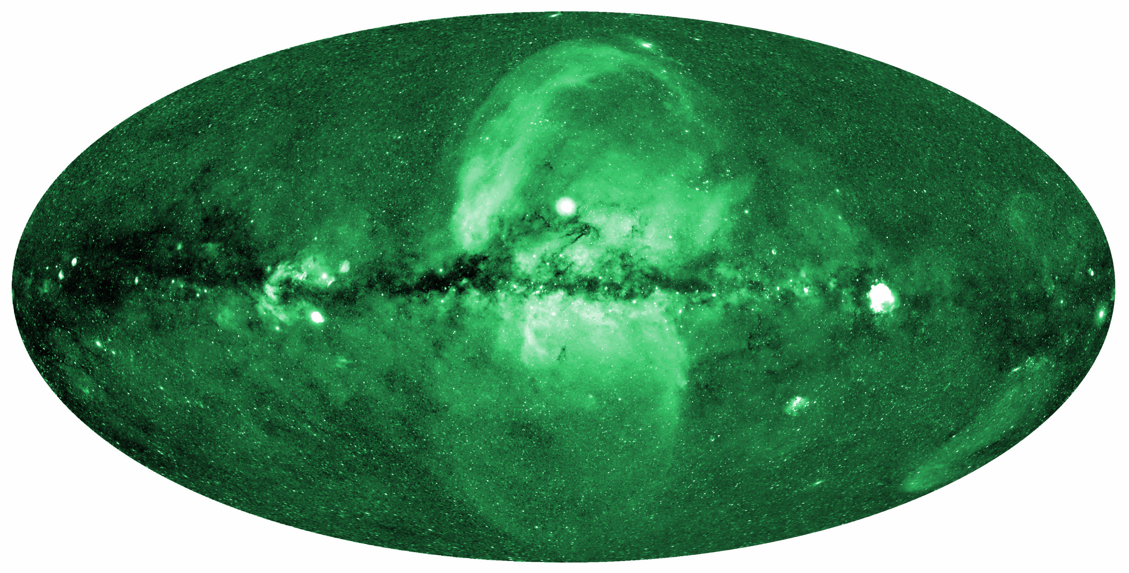
The first Sky-Survey: eRASS 1
SRG/eROSITA
0.6-1.0 keV
IKI
MPE

Slide 19
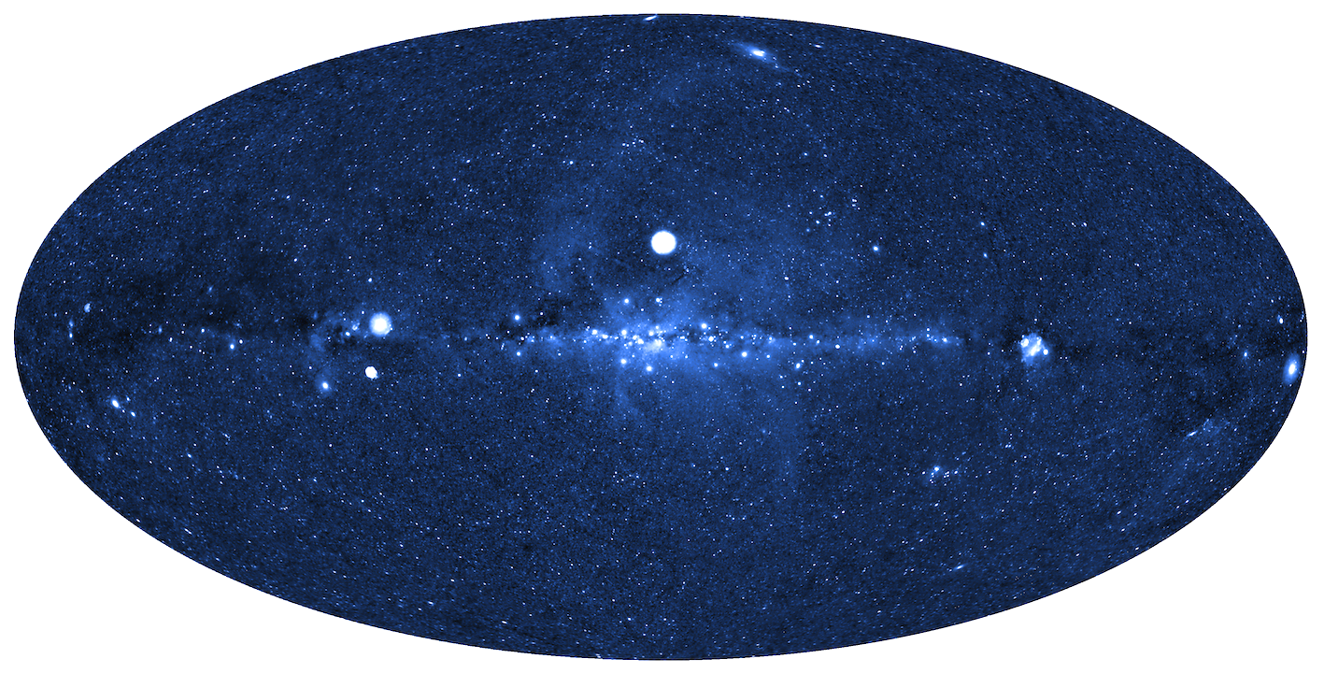
The first Sky-Survey: eRASS 1
SRG/eROSITA
1.0-2.3 keV
IKI
MPE

Slide 20
The first Sky-Survey: eRASS 1
Coma Cluster
[99 Mpc]
Sco X-1
[2.8 kpc]
z=3.1 QSO [26 Gpc]
Cygnus
Superbubble
[1-2 kpc]
Cyg X-1
[1.9 kpc]
Virgo Cluster
[17 Mpc]
Shapley Supercluster
[200 Mpc]
Cas A
[3.4 kpc]
Centaurus Cluster
[41 Mpc]
Crab Pulsar
[~2 kpc]
North Polar Spur
Orion Nebula
[412 pc]
G156.2+05.7
SNR
[1.7-3 kpc]
Vela SNR
[250 pc]
Perseus Cluster
[74 Mpc]
Fornax Cluster
[19 Mpc]
Cyg X-2
[600 pc?]
Cygnus Loop
[770 pc]
Large Magellanic Cloud
[50 kpc]

Slide 21
eROSITA Bubbles
IKI
MPE
Predehl, Sunyaev, et al., Nature, 2020

Slide 22
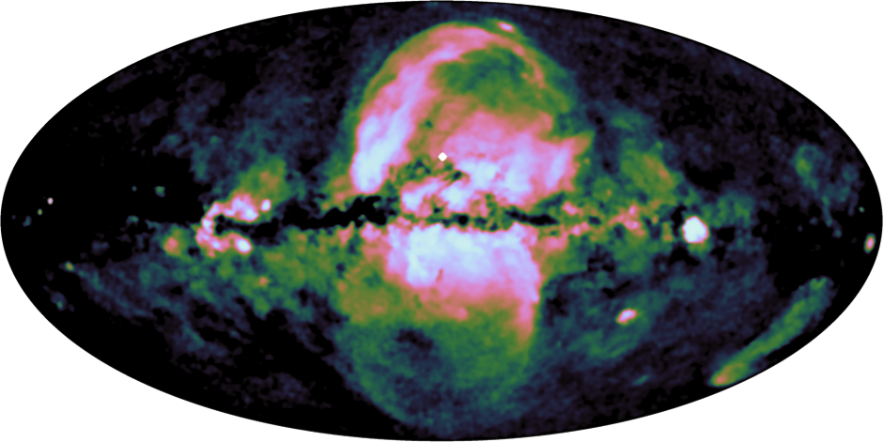
eROSITA Bubbles
0.6-1.0 keV, point source substracted
Predehl, Sunyaev, et al., Nature, 2020

Slide 23
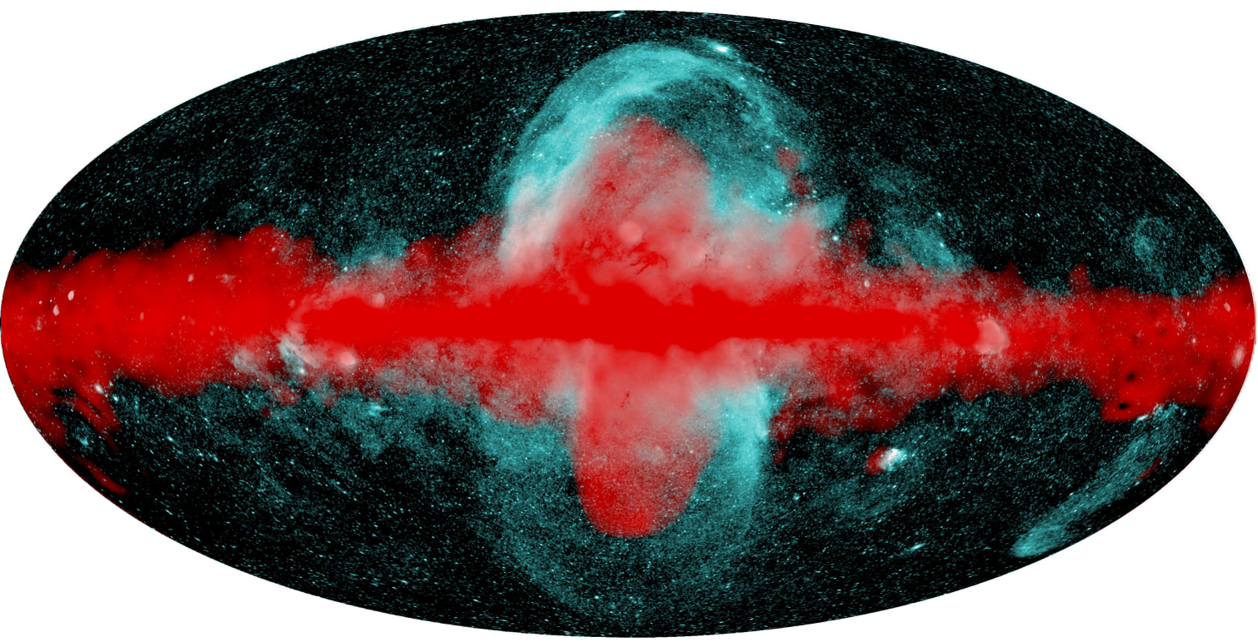
eROSITA & Fermi Bubbles
⇨ Talk by H.-Y. Karen Yang: Fermi/eRosita bubbles as relics of the past activity of Sgr A*
Predehl, Sunyaev, et al., Nature, 2020

Slide 24
eRASS1 ⇨ 17000 Cluster Candidates
Optical Follow-up
with Legacy DR9
Panstars DR2
DES Y1
NSC DR2

Slide 25
eRASS1 ⇨ 17000 Cluster Candidates
Scientific motivation for eROSITA: detect and spatially resolve a large number (about10⁵) of clusters over a wide redshift range (up to at least z∼1) in order to constrain cosmological parameters
Optical Follow-up
with Legacy DR9
Panstars DR2
DES Y1
NSC DR2
8157 clusters are confirmed in 15000 deg²
> 6500 new clusters
(Bulbul+, Ider Chitham+)

Slide 26
Summary
eROSITA on SRG is in operation since more than 2 years. All subsystem are working with minimal losses
We have completed ~4.3 all-sky surveys, 3.7 to go!?
Thanks to its large Grasp, stable background and observing cadence eROSITA opens up new parameter space for X-ray astronomy across different source classes
eFEDS demonstrates the all-sky survey design requirements can be met
The completed all-sky survey will represent a unique legacy dataset that will be unsurpassed for many years
The list of science highlights has become too long for a summary slide…

