Slide 1

The Search for Extragalactic Magnetar Giant Flares in Fermi-GBM Data
Aaron Trigg*
M. Baring, E. Burns, M. Briggs, N. Christiansen, N. Di Lalla,
D. Frederiks, M. Negro, N. Omodei, A. Ridnaia, O. Roberts, D. Svinkin, A. Tohuvavohu, P. Veres, Z. Wadiasingh,
G. Younes
*atrigg2@lsu.edu

Slide 2
What’s going on?
Magnetar giant flare (MGF) basics
Galactic vs. extraglactic MGF
Why do we care?
Search process
Results (preliminary)

Slide 3
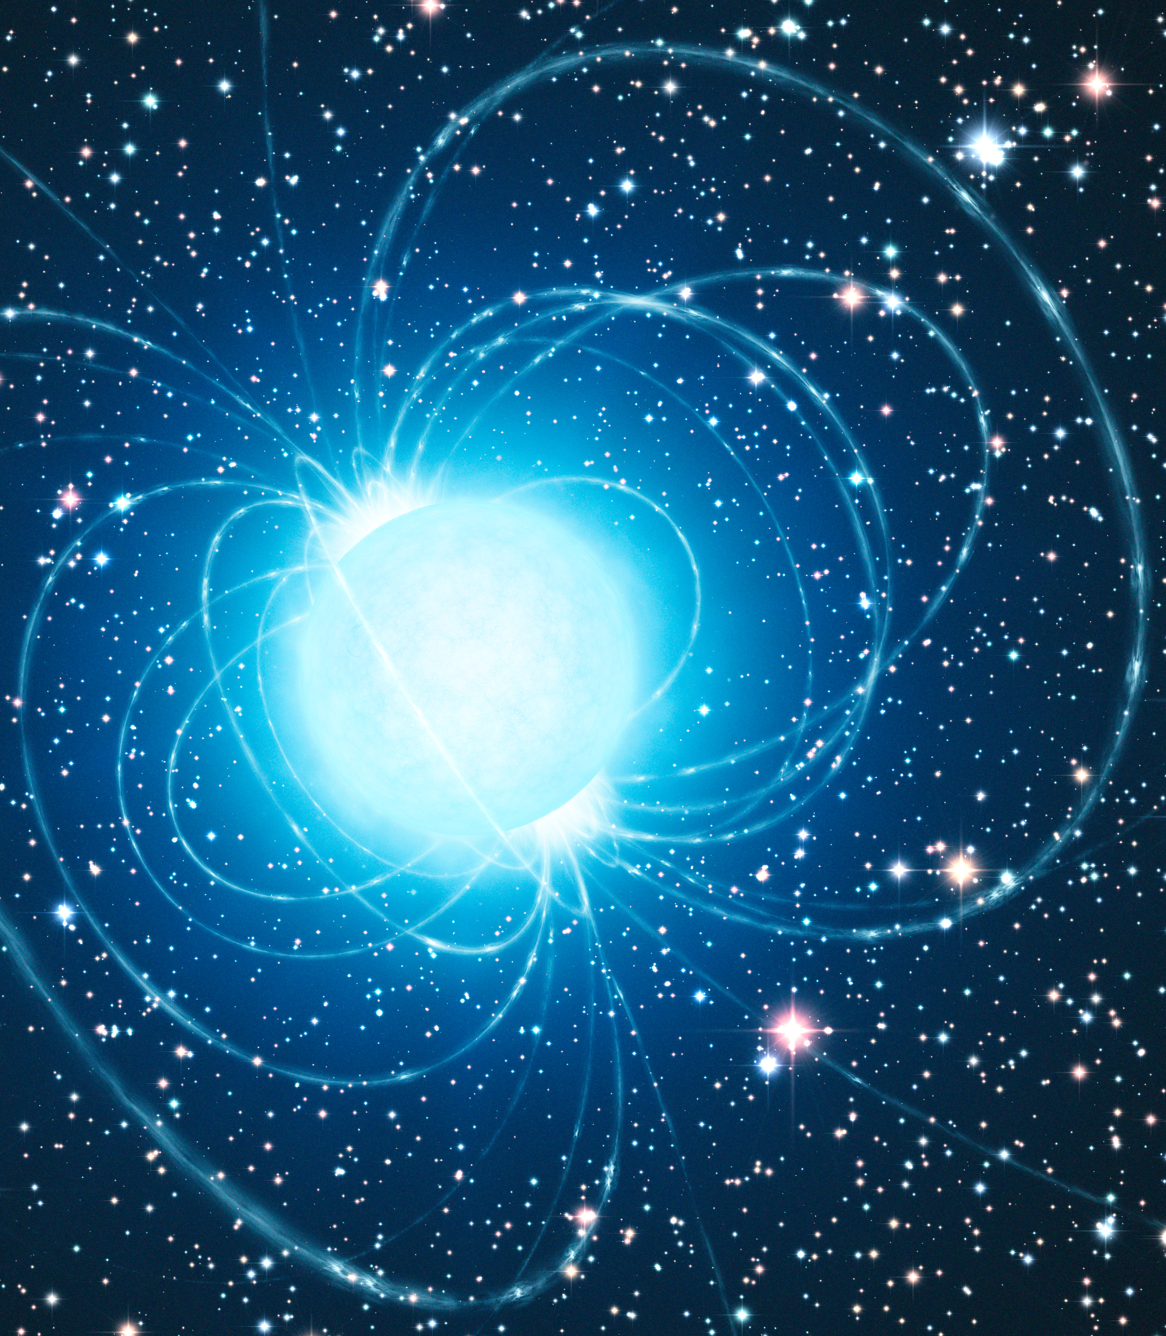
Magnetars
Neutron stars characterized by an extremely strong magnetic fields
They display a wide variety of unpredictable transient activity
The most energetic events are magnetar giant flares (MGF)
So far only 7 confirmed MGFs: 3 local, 4 extragalactic
Inferred volumetric rate: $R_{MGF}={3.8}_{−3.1}^{+4.0}×{10}^{5}\text{Gp}{\text{c}}^{\text{−3}} \text{y}{\text{r}}^{\text{−1}}$ Burns et al. 2021
Credit: ESO/L. Calçada
Notes:
Field strength > 10^14 Gauss
from short bursts, to burst forests, to outbursts (durations: ms to weeks, months, even years. Peak L 10^36-10^41 ergs/s)
The most energetic of these are magnetar giant flares (duration: ms. Peak L 10^41-10^47 ers/s)
3 in MW and LMC -> suffered from instrument saturation. 4 extragalactic localized to nearby star forming galaxies
The detection of three from the Milky Way and its satellite galaxies implies a high volumetric rate (READ).

Slide 4
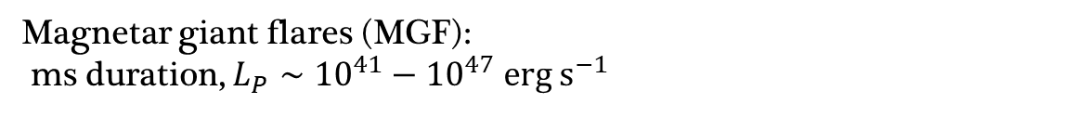
Magnetars
Extremely strong magnetic fields: $>{10}^{14}\text{G}$
Transient activity: ms→weeks/months/years, $L_{p}∼{10}^{36}−{10}^{41}\text{erg} {\text{s}}^{−1}$
Magnetar giant flares (MGF):
ms duration, $L_{P}∼{10}^{41}−{10}^{47} \text{erg} {\text{s}}^{−1}$
So far only 7 confirmed MGFs: 3 local, 4 extragalactic
Inferred volumetric rate: $R_{MGF}={3.8}_{−3.1}^{+4.0}×{10}^{5}\text{Gp}{\text{c}}^{\text{−3}} \text{y}{\text{r}}^{\text{−1}}$ Burns et al. 2021
Credit: ESO/L. Calçada
Notes:
Field strength > 10^14 Gauss
Display a wide variety of transient activity. from short bursts, to burst forests, to outbursts
The most energetic of these are magnetar giant flares (duration: ms. Peak L 10^41-10^47 ers/s)
3 in MW and LMC -> suffered from instrument saturation. 4 extragalactic localized to nearby star forming galaxies
The detection of three from the Milky Way and its satellite galaxies implies a high volumetric rate (READ).
.

Slide 5
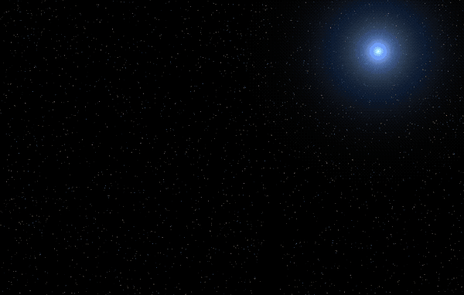

Galactic vs. Extraglactic MGFs
Galactic MGFs:
Prompt (ms) emission
Total${ E}_{iso}\sim {10}^{44}−{10}^{47}$erg
Transition to periodic tail
Extragalactic MGFs:
Current instrumentation cannot detect periodic tail emission
Requires spatial alignment with nearby star forming galaxies
Credit: NASA Goddard/S. Wiessinger
Notes:
Characterized by prompt ms emission
The initial hard gamma-ray pulses then transitions into a modulating tail due to the rotation of the NS. This is the “smoking gun” signature for these flares
However, at extragalactic distances, the rotationally modulated tail indicative of a MGF has not be observed with current instruments.
Thus, events displaying the distinct properties of the prompt gamma-ray emissions that can be spatially aligned with nearby galaxies is perhaps the best method to identify extragalactic MGF candidates

Slide 6
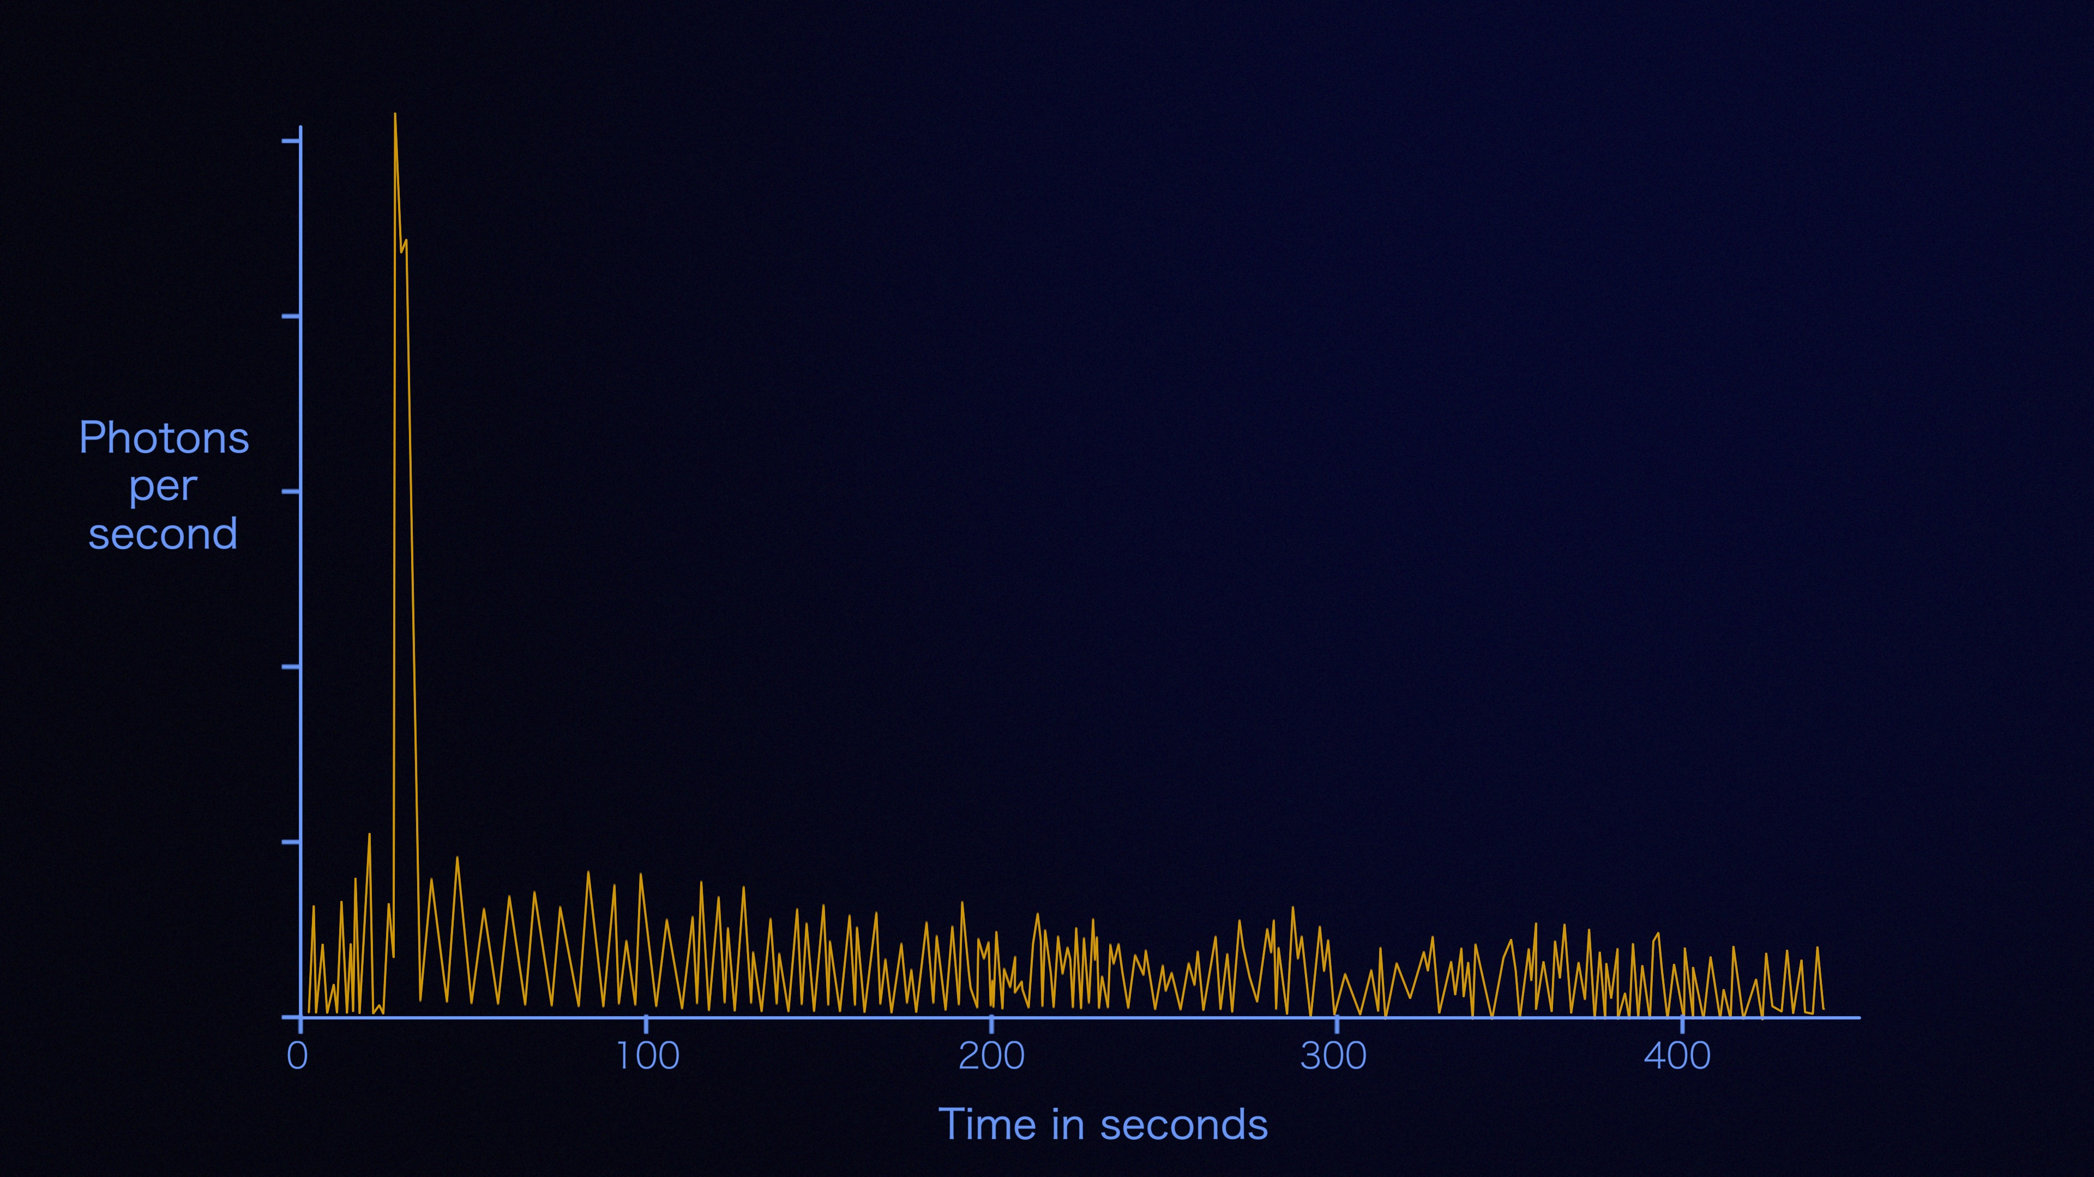
Extragalactic MGFs
Extragalactic MGFs:
Prompt (ms) emission
Highly energetic
Current instrumentation cannot detect periodic tail emission
Requires spatial alignment with nearby star forming galaxies
Extragalactic Source
Credit: NASA Goddard/S. Wiessinger

Slide 7
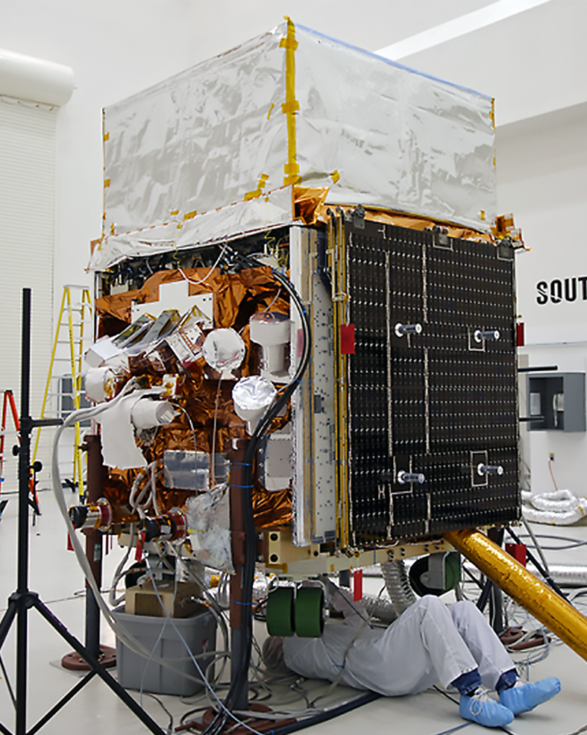
Fermi Gamma-ray Burst Monitor
Consists of 14 gamma-ray detectors
  12 NaI detectors
  2 BGO detectors
Time-tagged event data (TTE)
  Temporal resolution of 2 μs
  128 energy channels
GBM Data Tools API
NaI
BGO
Credits: NASA/General Dynamics Advanced Information Systems
Notes:
The Gamma-ray Burst Monitor, or GBM has a total of 14 detectors
There are 12 sodium iodide scintillators, sensitive to lower energy ranges from a few keV to around 1 MeV
Then there are also 2 bismuth germanate scintillators that cover the energy range from ~150 keV to ~30 MeV so there is good overlap with the NaI detectors
The time-tagged event data has 2μs resolution and recorded continuously to provide pre-trigger data for any GRB events stored in one of 128 energy channels
An Application Programming Interface called The Fermi GBM Data Tools is available to make analysis of GBM data a little simpler and is designed to be plugin-like for various aspect like binning methods

Slide 8
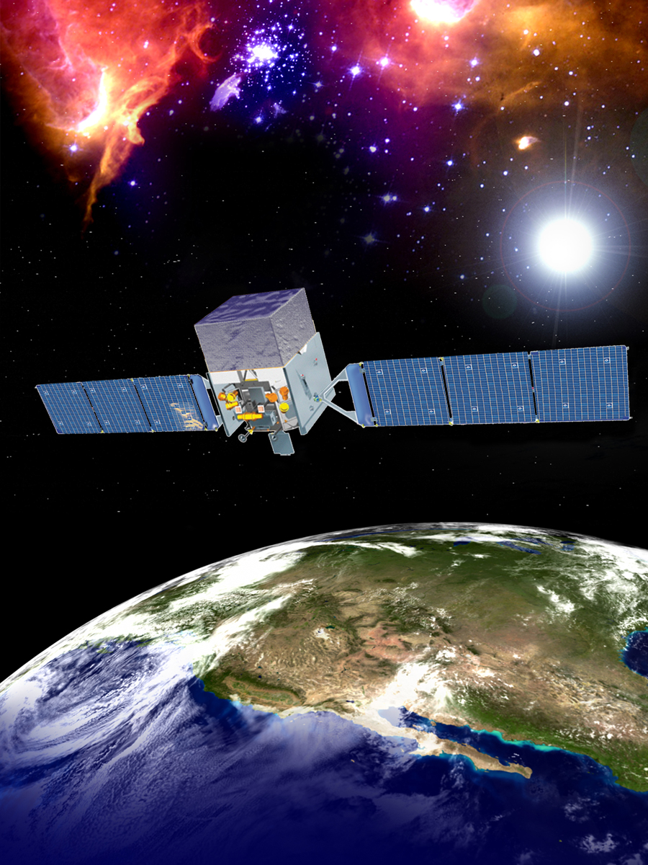
MGFs in Archival Data
Characterize population
Underlying physical mechanisms
MGF intrinsic rate
Formation sites and
channels
Which galaxies do/don’t
form magnetars
Maximal energy release
Fermi-GBM data best suited for search
Spectral/temporal relations
Notes:
Why identify additional MGFs?
The study of these events offers unique insights into energy, density, and magnetic field extremes that cannot be studied in terrestrial laboratories
Use results in population analyses to increase our understanding of these rare events,
their potential contribution as fast radio bursts progenitors
contribution to stochastic gravitational-wave backgrounds
Constrain MGF intrinsic rates
Maximal energy release
Investigating spectral and temporal relations
Probing their underlying mechanism
Study formation sits and channels
Determine which galaxies do or don’t form magnetars
Due to its spectral and temporal resolution, Fermi-GBM data is uniquely suited for such a search

Slide 9
MGFs in Archival Data
Underlying physical mechanisms
Characterize population
Formation sites and
channels
Fast radio bursts
Which galaxies do/don’t
form magnetars
Stochastic GW background
Fermi-GBM data best suited for search
MGF intrinsic rate
Credit: NASA
Notes:
Why identify additional MGFs?
The study of these events offers unique insights into energy, density, and magnetic field extremes that cannot be studied in terrestrial laboratories
Use results in population analyses to increase our understanding of these rare events,
Maximal energy release
Investigating spectral and temporal relations
their potential contribution as fast radio bursts progenitors
contribution to stochastic gravitational-wave backgrounds
Constrain MGF intrinsic rates
Probing their underlying mechanism
Study formation sits and channels
Determine which galaxies do or don’t form magnetars
Due to its spectral and temporal resolution, Fermi-GBM data is uniquely suited for such a search

Slide 10
Hunting MGFs in Fermi-GBM Data
39 candidates
Most significant bin <20 ms
Exclude known MGFs and GRBs with known redshift
$$T_{50}<100 ms$$
𝑇_50<100 ms
TTE Data
Determine first (temporally) significant bin: SNR>3.5
Run Bayesian Blocks Analysis
First significant bin within 10 ms of most significant bin
Compare with known events
137 candidates
20 candidates
Notes:
Searched time-tagged events for each detector
Triggered events tagged w/ arrival time and recorded continuously to provide pre-trigger data for any GRB
Most distinct parameters of MGF: rise time and pulse duration
T₅₀ < 100 ms: most extragalactic MGFs duration <100 ms
T₅₀ over T₉₀: ensure any real MGFs not excluded
137 Candidates
BB analysis applied
Discarded events where most sig bin > 20 ms
Short enough: omit longer GRBs
Still long enough: include entire initial pulse of known MGFs
39 Candidates
Determine first temporally significant bin (SNR>3.5)
Discard events where first bin > 10 ms from most sig bin
Ensure only events with very sharp rise-times considered
20 candidates
Finally compared 20 against known events
Removed previously considered/known redshift

Slide 11
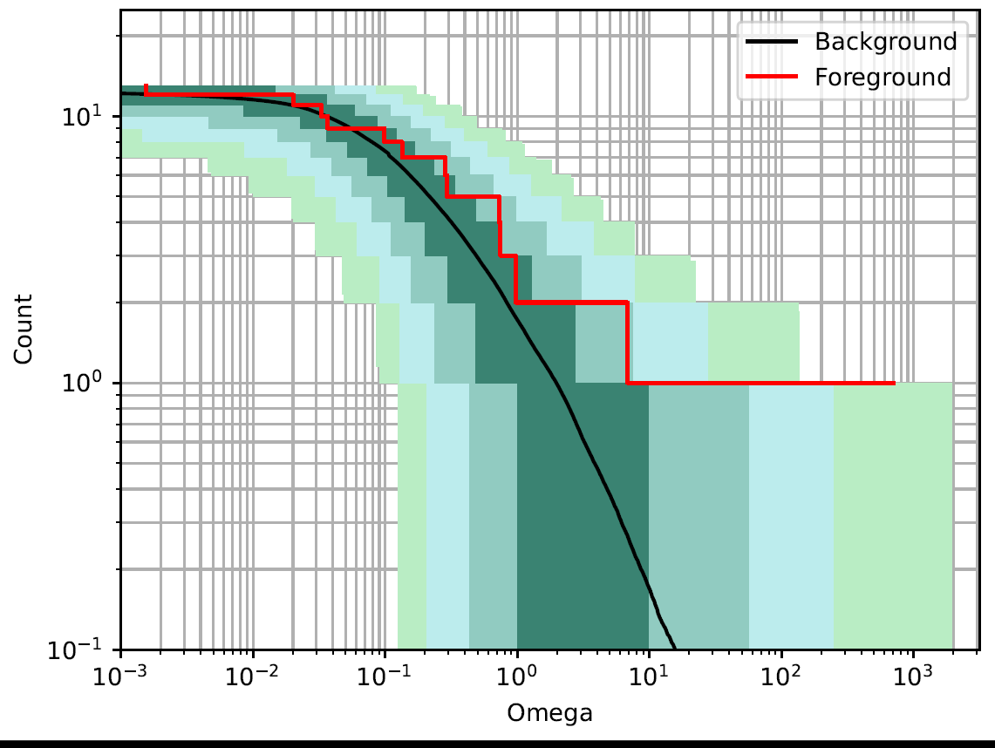

The Candidates
13 Extragalactic MGF candidates
How likely a GRB has MGF origin
$Ω=4π\sum_{i}{\frac{P_{i}^{GRB}P_{i}^{MGF}}{A_{i}}}$ (Burns et al. 2021)
Only one outlier…
Preliminary
Notes:
Final tally: 13 MGF candidates
How believable the event is to be an extragalactic MGF
We quantify likelihood a given GRB has a MGF origin using Omega
Green shaded areas: 1, 2, 3, 4 sigma confidence intervals (significance determined by false alarm method w/ omega as ranking statistic)
One outlier at 3.3 sigma significance

Slide 12
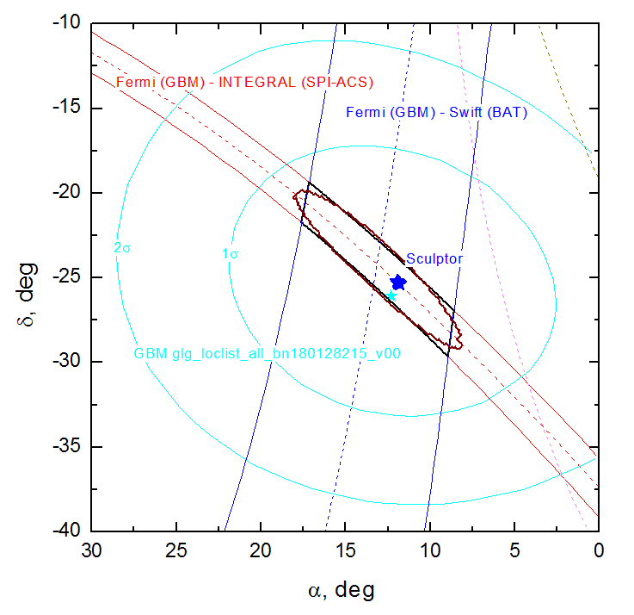
The Localization
IPN localization: Sculptor Galaxy (Second burst from Sculptor) 3.7 Mpc away
No associated supernovae, gravitational wave, or radio signals
Preliminary
Notes:
The localization is defined by Fermi-Integral and Fermi-Swift(BAT) annuli
The overlap of the annuli gives an ellipse with a 90% confidence area of 9.3 deg^2.
shown annuli widths are 3 sigma.
To rule out later supernova and typical afterglow :
Zwicky Transient Facility: no obvious candidates
MASTER net: no detections made in area covered
Gravitational waves signals:
LIGO and Virgo both offline
Given recent connection of FRB to magnetars and their possible MGF origins checks for radio signals
Checked CHIME and FRB catalogs as well as Very Large Array archieve: no detections that coincided temporally/spatially with this event

Slide 13
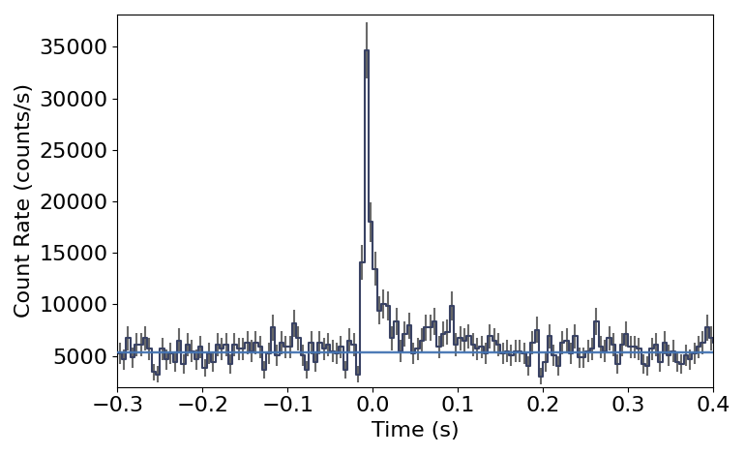
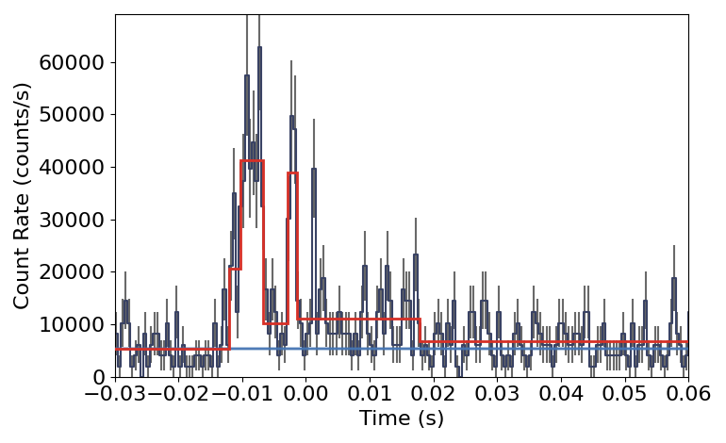

The new MGF Candidate
GRB 180128A
Time-integrated “Comptonized” fit (T_{BB} interval)
  $E_{p}=280 keV (1σ)$
  $E_{iso}=5×{10}^{44} erg$
2 pulses apparent at ~ms resolution
  GRB 070222 (Burns et al. 2021)
Preliminary
Notes:
Potentially the 8th MGF
Power-law w/ high –energy cutoff or “Comptonized” fit
(Quote Ep and Eiso)
Left side: lightcurve binned to temporal resolution of 50 ms
Right side: lightcurve binned to temporal resolution of ms
BB overlayed to highlight second peak
second event found with 2 peaks

Slide 14
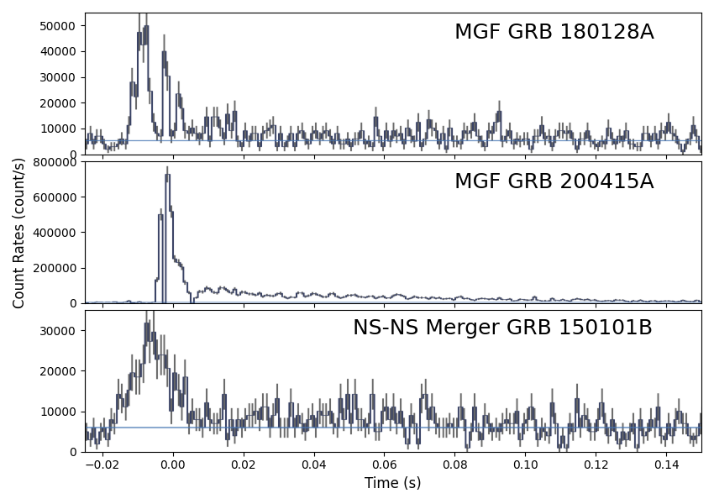

Burst Comparisons
Compared with other bursts
GRB 200415A (D. Svinkin et al 2021)
  Both localized to Sculptor Galaxy
  $E_{p}=1.2 \text{MeV}$
  $E_{iso}=1.3×{10}^{46} ergs$
GRB 150101B
  Host galaxy 2MASX J12320498-105601 (0.52 Gpc)
  $E_{p}=550 \text{MeV}$
  $E_{iso}=2.3×{10}^{49} ergs$
Preliminary
Notes:
Chose to compare with 2 other events:
GRB 200415A: MGF localized to same galaxies as GRB 180128A
E peak 4 times greater than GRB 180128A
Total isotropic energy 2 orders of magnitude greater
GRB 150101B: got through initial selection process but has a known redshift and believed to be NS merger
E peak 2 orders of mag greater
E iso 5 orders of mag greater

Slide 15
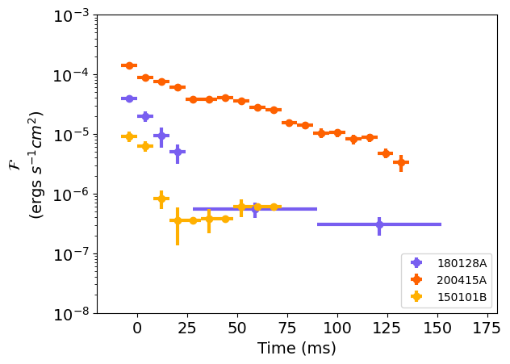
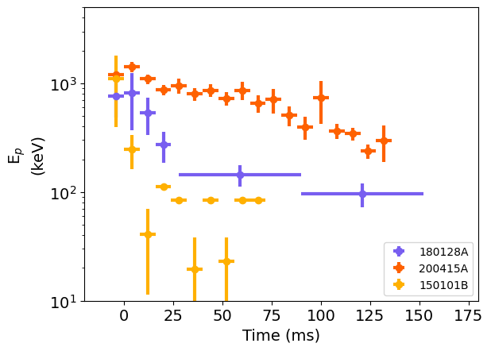
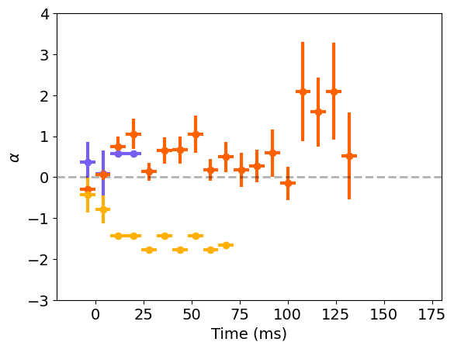
GBM Analysis
Energy Flux
Peak Energy
Power-law index
Preliminary
Notes:
Further comparing bursts : Spectral variability over time
Energy Flux, Peak energy:
Decay timescales
Power law index for Compt fit: 180128A and 200415A ~0.0 (what we expect for MGF)
For 150101B ~-1.5

Slide 16
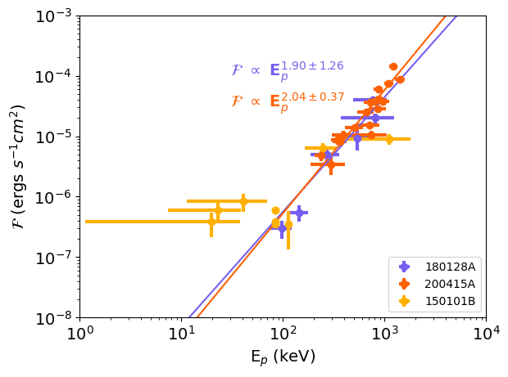

GBM Analysis
GRB 200415A & GRB 180128A:
strong $ℱ∝E_{p}^{2}$ relationship
Preliminary
Notes:
Energy Flux vs E peak
GRB 180128A and GRB 200415A show strong E^2 relationship (a signature of a relativistic wind.)
can be readily explained by relativistic Doppler boosting

Slide 17
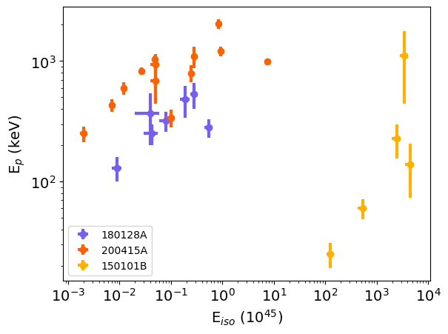

GBM Analysis
Clear trend in E_{p} vs. E_{iso}
$E_{p}+∝E_{iso}^{2}$ scaling relation?
Preliminary

Slide 18
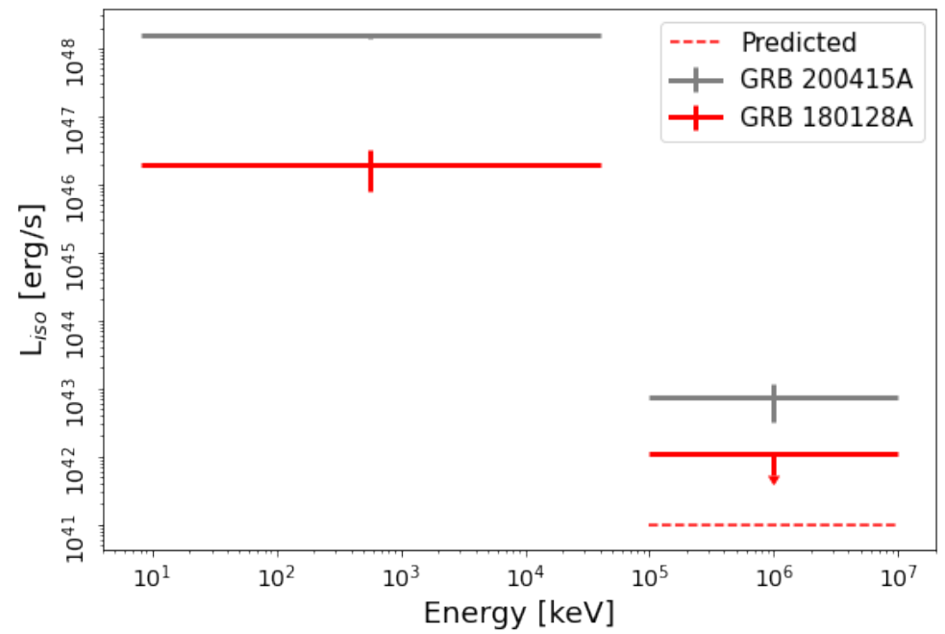
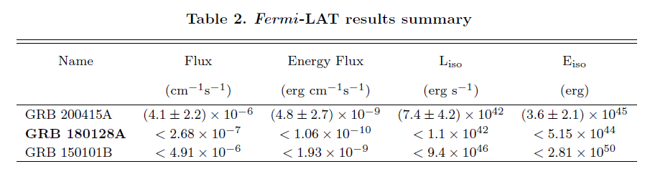

Fermi - LAT Analysis
Sculptor within LAT field of view ~3000 s
No significant detections at source location
Likelihood analysis Upper limit
  $E_{iso}<5.15×{10}^{44} \text{erg}$
Preliminary
Notes:
For GRB 200415A Lat detected 3 photons between 0.48 and 1.7 GeV
Given this, we checked for GRB 180128A
(READ)

Slide 19
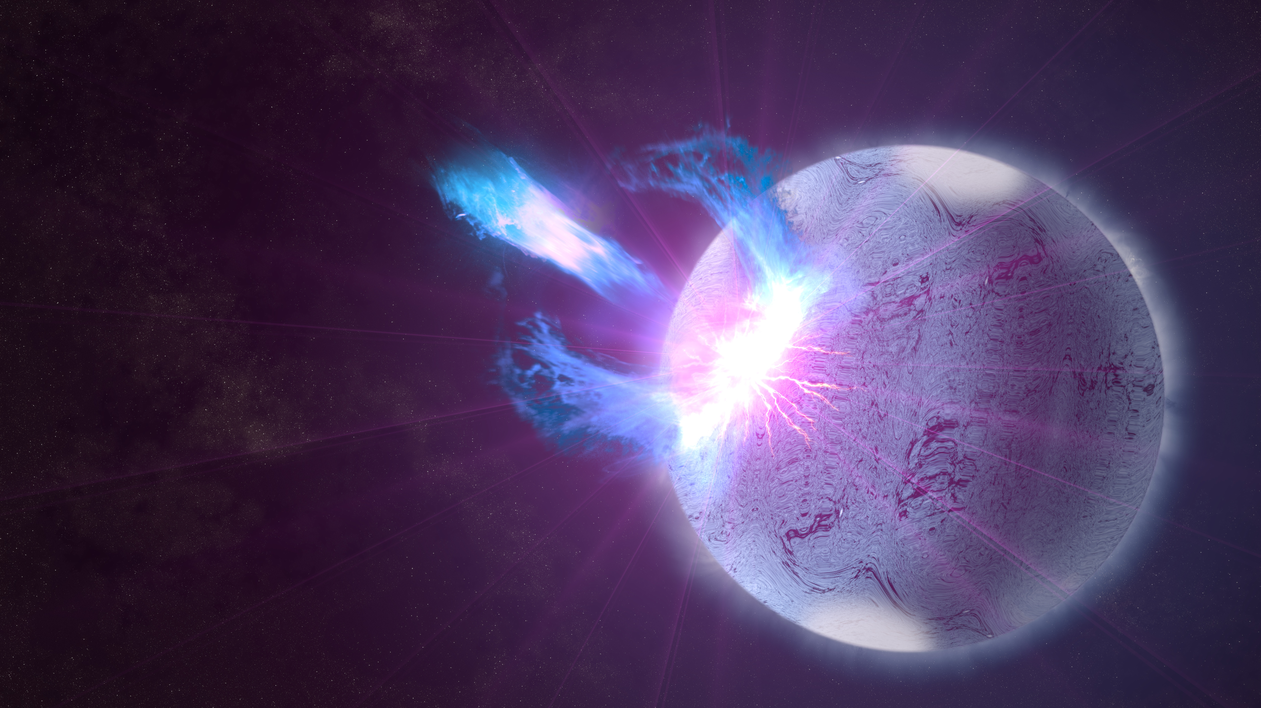
Conclusion
8th MGF
Second localized to Sculptor (same source?)
Second MGF with double peak
Not all MGFs produce observable GeV-photons
Credits: NASA's Goddard Space Flight Center/S. Wiessinger

Slide 20
Thank you for your attention!
Aaron Trigg*
*atrigg2@lsu.edu

