Slide 1


Search for periodicities in irregularly-sampled AGNs with a time-domain approach
Héctor Rueda*
François Brun, Jean-François Glicenstein
*hector.ruedaricarte@cea.fr

Slide 2

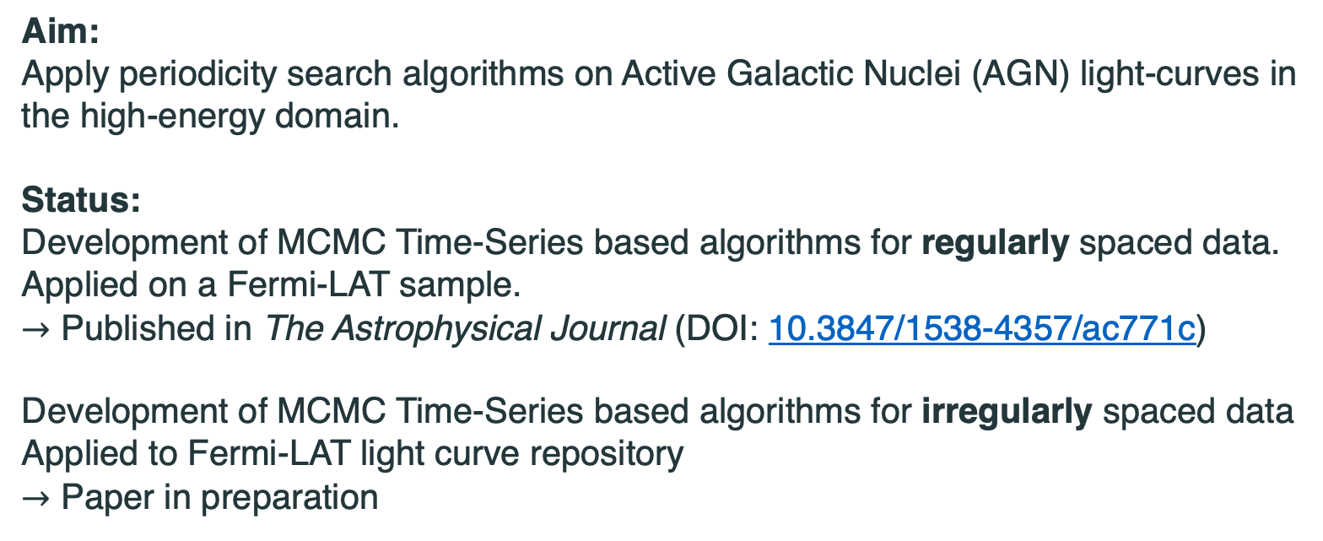
Overview
Aim:
Apply periodicity search algorithms on Active Galactic Nuclei (AGN) light-curves in
the high-energy domain.
Status:
Development of MCMC Time-Series based algorithms for regularly spaced data.
Applied on a Fermi-LAT sample.
$→$ Published in The Astrophysical Journal (DOI: 10.3847/1538-4357/ac771c)
Development of MCMC Time-Series based algorithms for irregularly spaced data
Applied to Fermi-LAT light curve repository
$→$ Paper in preparation

Slide 3
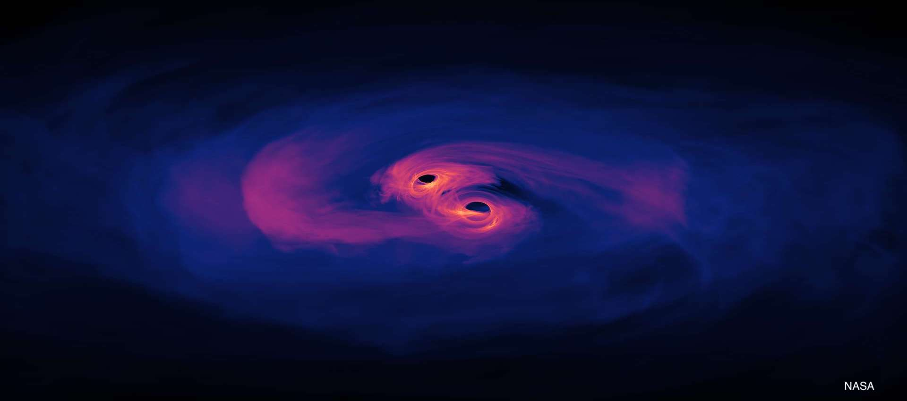
Introduction
Binary super-massive black holes (BSMBH) could be responsible for the apparent precession of radio jets and would have detectable periodic modulation of their fluxes.
Binary BH has become a hot topic due to the detection of gravitational waves from merger events by LIGO and VIRGO and expected future detection of BSMBH.
These sources are well identified through their High Energy (HE) emission by detecting periodicities on their light curves. Then, it is necessary to separate the true period from the stochastic noise.

Slide 4
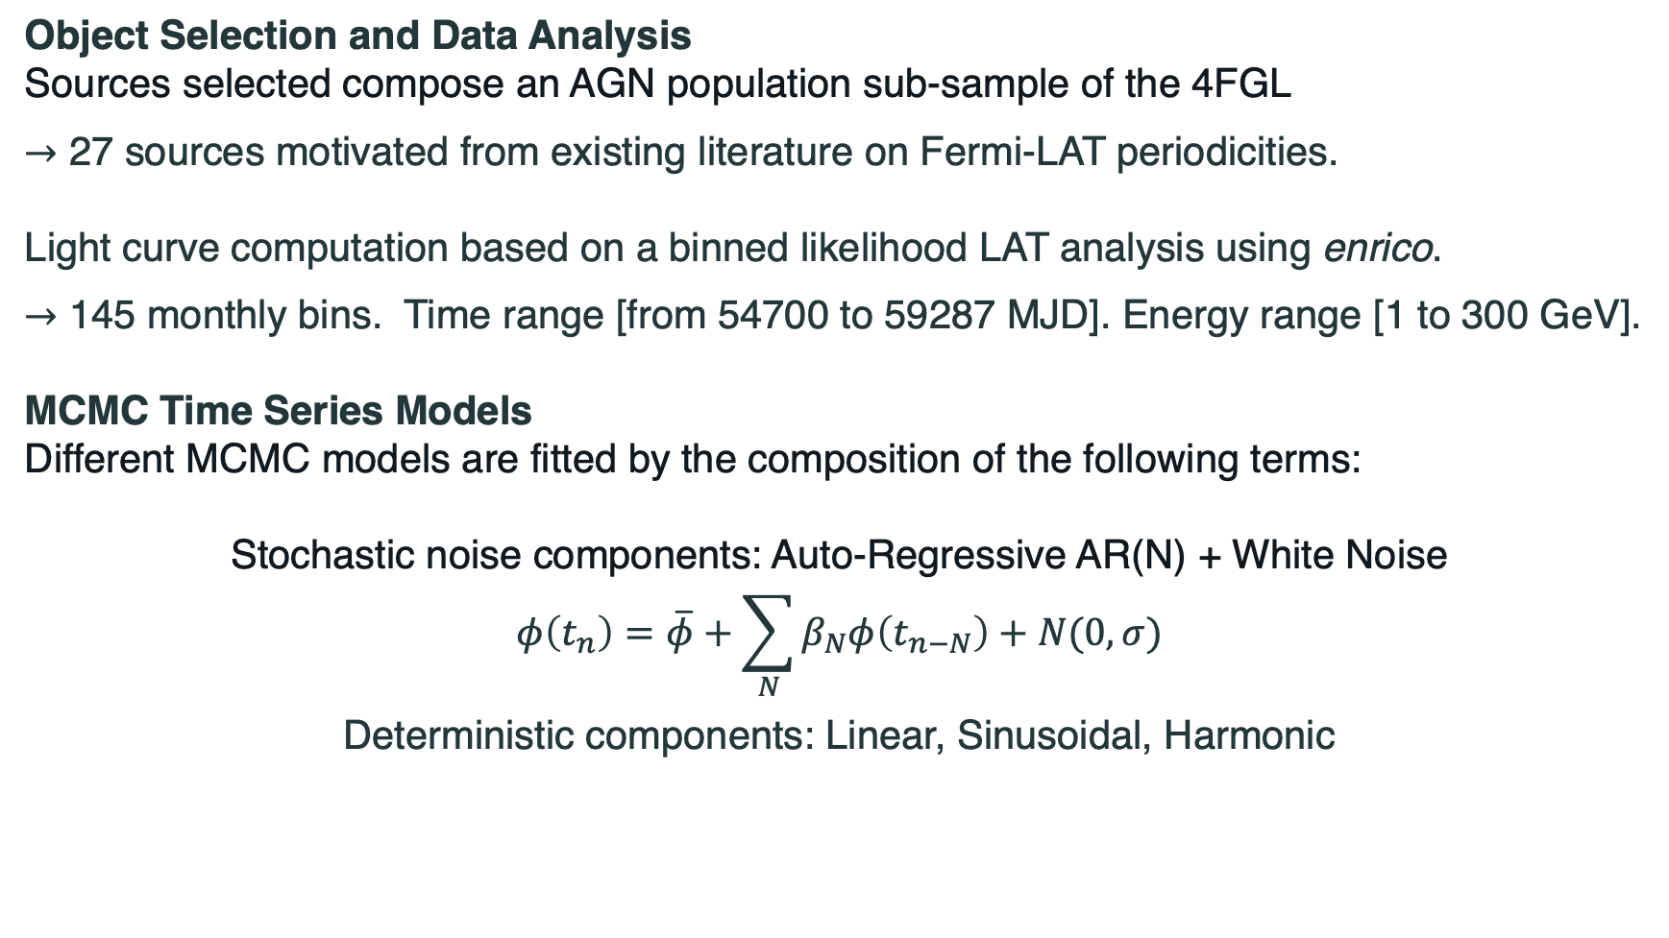
Regularly sampled data - Methodology
Object Selection and Data Analysis
Sources selected compose an AGN population sub-sample of the 4FGL
$→$ 27 sources motivated from existing literature on Fermi-LAT periodicities.
Light curve computation based on a binned likelihood LAT analysis using enrico.
$→$ 145 monthly bins. Time range [from 54700 to 59287 MJD]. Energy range [1 to 300 GeV].
MCMC Time Series Models
Different MCMC models are fitted by the composition of the following terms:
Stochastic noise components: Auto-Regressive AR(N) + White Noise
$$φ\left(t_{n}\right)=\overline{φ}+\sum_{N}{β_{N}φ\left(t_{n−N}\right)+N(0,σ)}$$
Deterministic components: Linear, Sinusoidal, Harmonic

Slide 5
Regularly sampled data - Results
Model Selection
For each light curve, within all the possible MCMC models, the one with the minimum AIC is selected.
Period significance is assessed by AIC comparison between the periodic and the only noise model.
Full Light-Curve example: PG 1553+113
14 periodic sources found by a novel method which separates the stochastic and the periodic component.
The fit shows a stochastic noise term, a linear term and a sinusoidal with a 774 days periodicity.
→ Spectral cross-check: Bayes Factor Periodogram (BFP) computed from Agatha software.
→ The result is compatible with the spectral analysis and with previous literature.

Slide 6
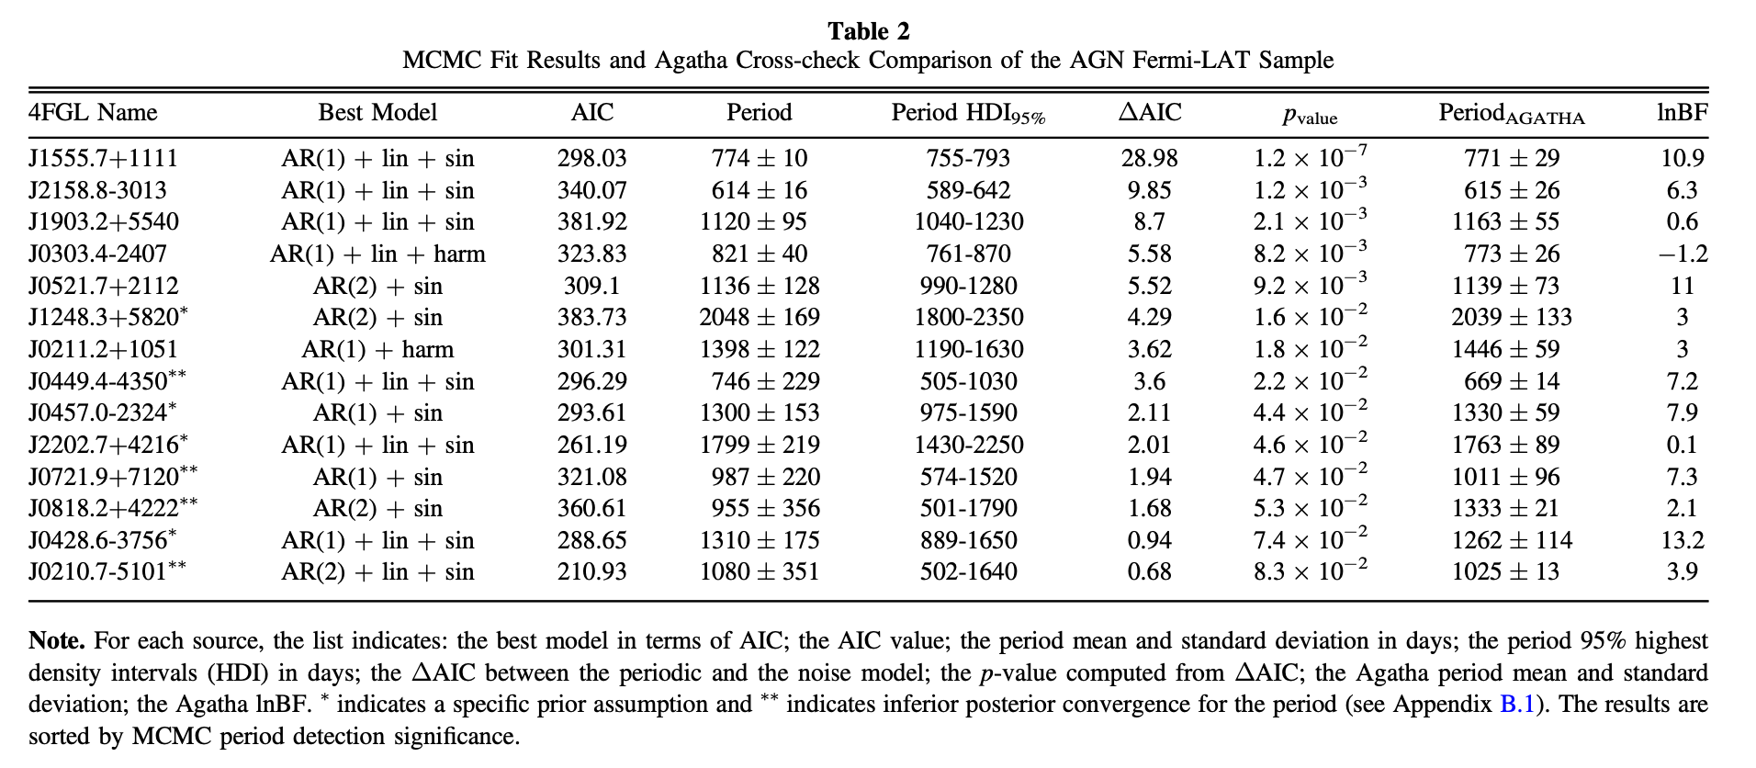
Regularly sampled data - Results

Slide 7
Regularly sampled data - Results
Harmonics example: PKS 0301-243
Source shows a periodic component of 821 days with a second harmonic.
Time-Windows example: PKS 2155-304
The observed data is divided into 5 equally spaced and overlapped time windows.
To analyse the period change with time and the variation of the sinusoidal amplitude with period.
→ Useful for understand and constrain the physical mechanisms of periodicity in HE emission.

Slide 8
Regularly sampled data - Discussion
Physical Models explaining periodic emission
Jet Precession originated in a BSMBH system. (Caproni et al. 2013, MNRAS, 428, 280) (Sobacchi et al. 2017, MNRAS, 465, 161)
Periodic changes in the disk accretion flow. (Gracia et al. 2003, MNRAS, 344, 468)
Geometric models where periodicities are related to helical trajectories. (Rieger 2004, ApJL, 615, L5)
Lighthouse model explains periods of a few hundred days by the rotation of plasma bubbles around the central axis of the jet. (Camenzind & Krockenberger 1992, A&A, 255, 59)
Results constraining different emission models
PG 1553+113 period and amplitude are constant in time.
  In agreement with a BSMBH model such as the 2-jet model. (Tavani et al. 2018, ApJ, 854, 11)
  Not in agreement with lighthouse effect where both are expected to change
PKS 2155-304 period slightly changes, and amplitude is constant in time.
  Disfavours again models based on the lighthouse effect.

Slide 9
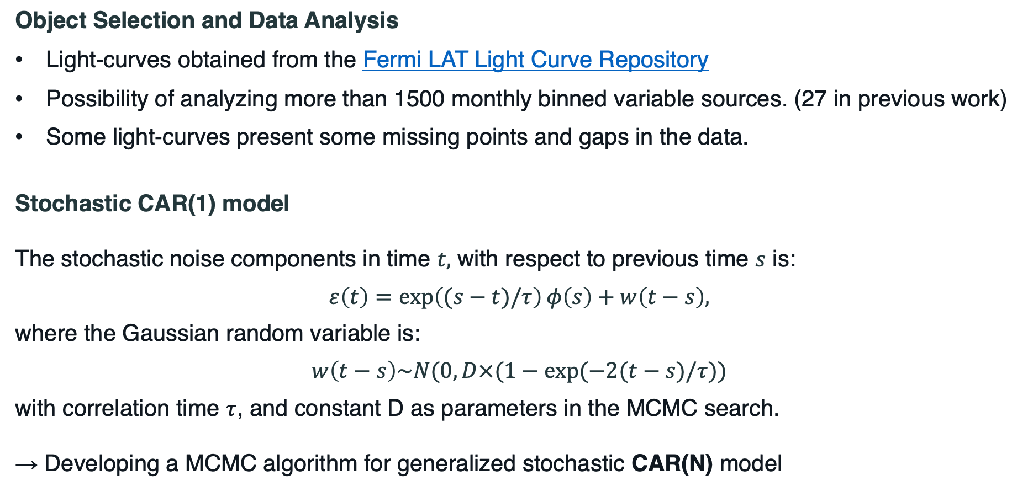
Irregular data - Methodology
Object Selection and Data Analysis
Light-curves obtained from the Fermi LAT Light Curve Repository
Possibility of analyzing more than 1500 monthly binned variable sources. (27 in previous work)
Some light-curves present some missing points and gaps in the data.
Stochastic CAR(1) model
The stochastic noise components in time $t,$ with respect to previous time $s$ is:
$$ε\left(t\right)=\exp\left((s−t)/τ\right)φ\left(s\right)+w\left(t−s\right),$$
where the Gaussian random variable is:
$$w\left(t−s\right)\sim N(0,D×(1−exp⁡(−2(t−s)/τ))$$
with correlation time $τ$, and constant D as parameters in the MCMC search.
→ Developing a MCMC algorithm for generalized stochastic CAR(N) model

Slide 10
Irregular data – Preliminary Results
~ 1 hundred periodic 4FGL sources found with different models and significance.

Slide 11
Conclusions
Adding a periodic component can significantly improve the fit to the data compared to AR noise-only models.
Adding an AR (CAR) component can significantly improve the fit to the data compared to white noise models.
This method is able to analyse harmonics and the evolution in time of periods and amplitudes.
Time-domain approach is able to parametrize a light-curve with data gaps and inhomogeneous sampling.
All this knowledge helps to understand better the physical mechanism models of the AGN HE emission.
→ This analysis can be applied not only to Fermi-LAT data but to any other instrument/wavelength data

Slide 12
Thank you for your attention!
Héctor Rueda*
François Brun, Jean-François Glicenstein
*hector.ruedaricarte@cea.fr

