Slide 1

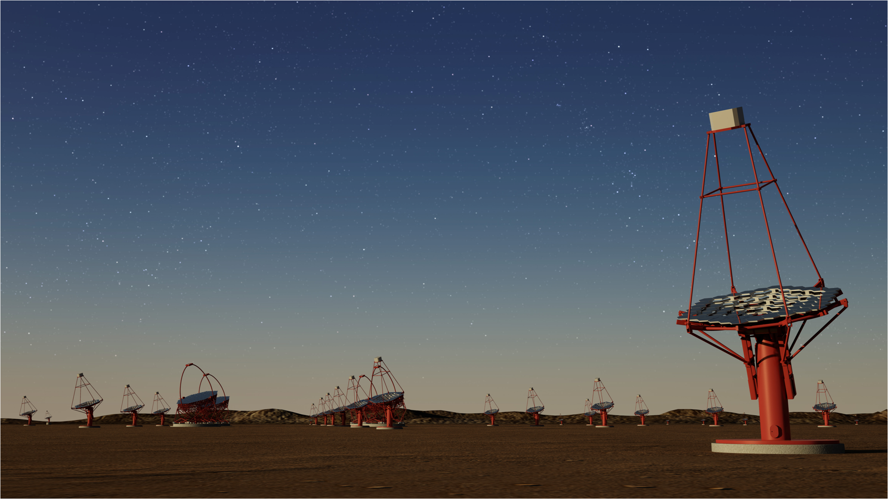
Redshift Determination of the Hard
Spectrum Fermi-LAT Gamma-Ray Blazars Detectable with CTA
P. Goldoni (APC/IRFU) for CTA Consortium
12/10/22
P. Goldoni

Slide 2
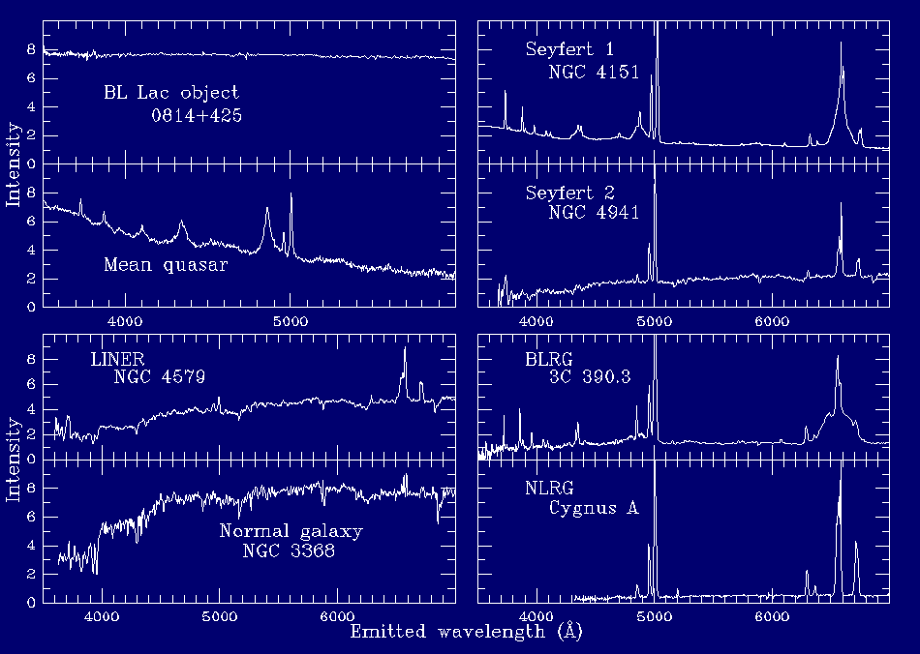
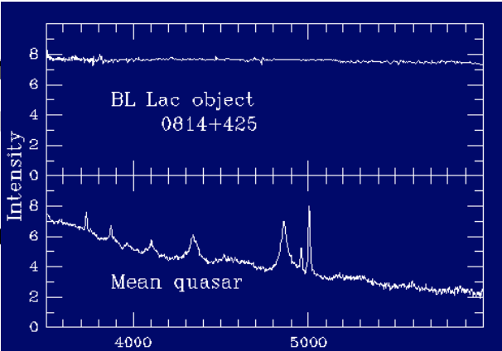
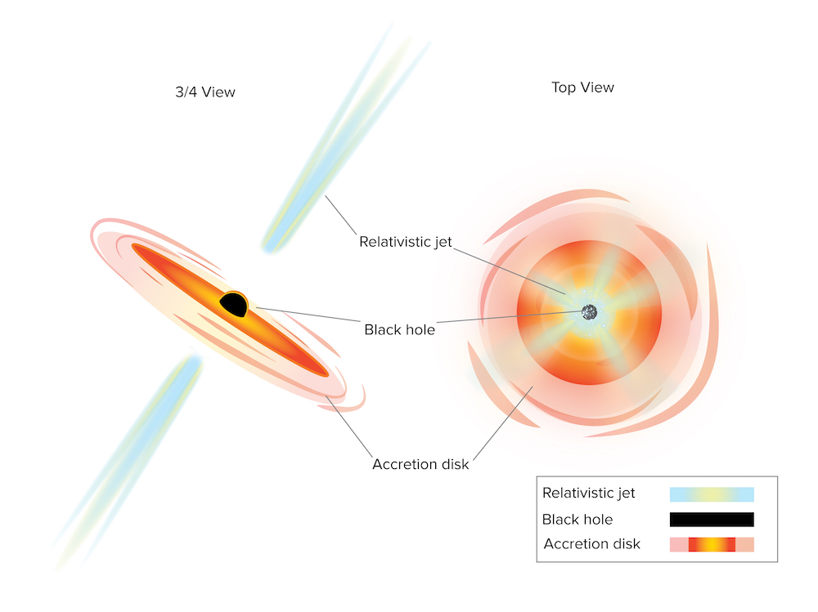
Blazars in Gamma-rays
Most numerous extragalactic
gamma-ray sources (4FGL-DR3: 56%
83 % of identified/associated)
AGNs with jets directed towards the
observer
Doppler boosting ==> jet outshines
the host galaxy
Redshift often unknown
S. D’Agnello NRAO
12/10/22
P. Goldoni

Slide 3
The challenge of BL Lac spectra
The thermal features are weak and often not measurable even with the best IR/optical telescopes and instruments. Several well known VHE BL Lacs have no measured spectroscopic redshift yet (PG 1553+113, 3C66A,…)
A spectroscopic observation of a BL Lac is often a “shot in the dark” as the probability of a successful measurement is difficult to guess. Some tricks:
    High S/N spectra
    Search for absorption systems
    Detection of the host galaxies in imaging
    Spectroscopy in low state
As the measurement is difficult, the results are also difficult to interpret, leading to conflicting statements. A detailed report on the results is very important.
12/10/22
P. Goldoni
Notes:
Weak features
Variability
High number of potential targets with little to distinguish them

Slide 4
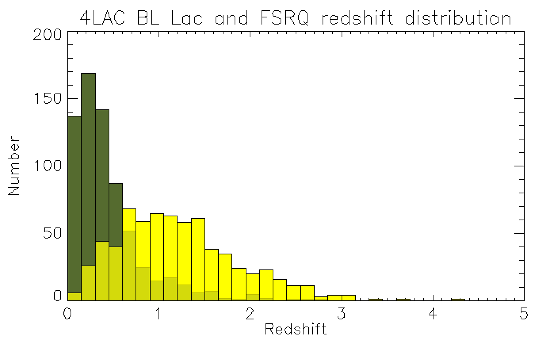
Fermi-LAT Blazar redshifts
Several hundred of the Fermi-LAT BL Lac optical spectra have been taken in the last 10 years (Shaw+ 2013, Massaro+ 2015, Paiano+ 2017,…)
For most objects short observations and low sensitivity (with exceptions).
Shaw+13: 372 objects, 44 % redshift z_med~0.33
Peña-Herazo+20: 416 objects, 30% redshift z_med~0.28
Moreover, due to the number of objects, often little information on the observations is available.
12/10/22
P. Goldoni
Notes:
What has been done up to now
Several hundred of targets
Survey with hundred of targets, low exposure times
Low S/N
Not popular with TAC

Slide 5
VHE (0.1-10 TeV) Astronomy
TeV astronomy relies on the detection of Cherenkov light from showers generated by gamma rays with the arrays of telescopes.
Blazars (again) are main Extragalactic sources
IACTs H.E.S.S., MAGIC and VERITAS (proprietary instruments) led to the detection of about 150 sources in the range 200 GeV – few TeV
  Sensitivities ~10 mCrab
  Field of View ~few degrees
  Angular Resolution ~5-6 arcminutes
81 Blazars, 69 BL Lacs detected at TeV energies with <z>= 0.12 ,
6 FSRQs, 1 BL Lac with z> 0.5 (tevcat.uchicago.edu)
Smaller sample, more detailed observations possible
Cherenkov Telescope Array under development, operating as an observatory
12/10/22
P. Goldoni

Slide 6
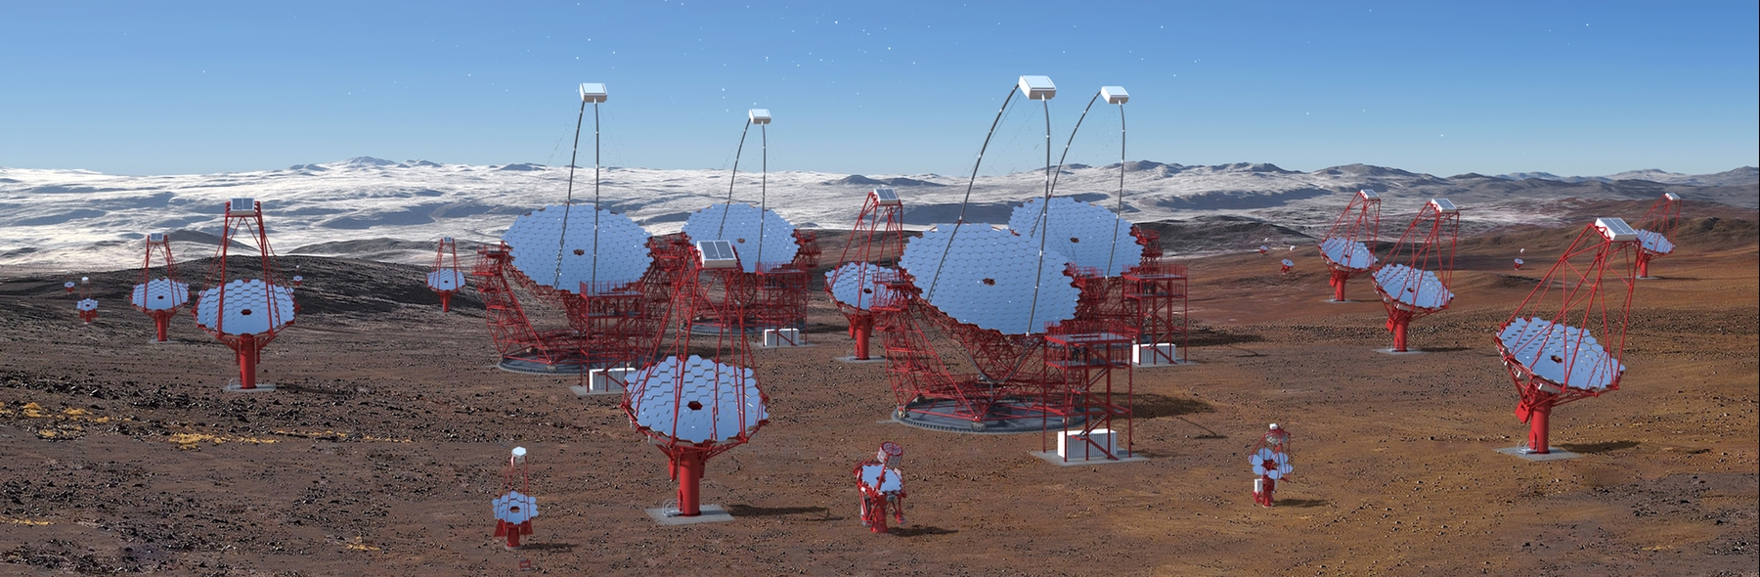
Cherenkov Telescope Array
CTA is the next generation IACT (www.cta-observatory.org)
Built by the CTA Consortium (1500 members, > 150 institutes, 25 countries),
operated by the CTA Observatory, open to proposals from member countries
Three Key Science Themes:
  Probing Extreme Environments
  Understanding the Origin and Role of Relativistic Particles
  Exploring Frontiers in Physics
Expected to detect several hundreds of Blazars !
12/10/22
P. Goldoni

Slide 7
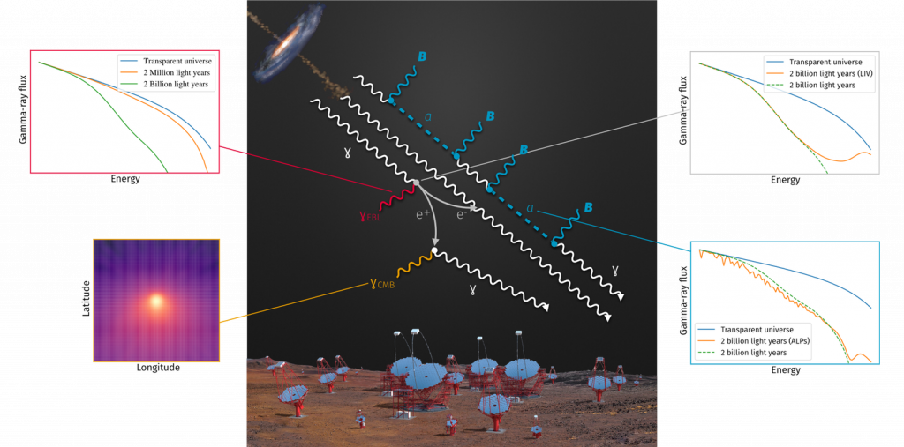
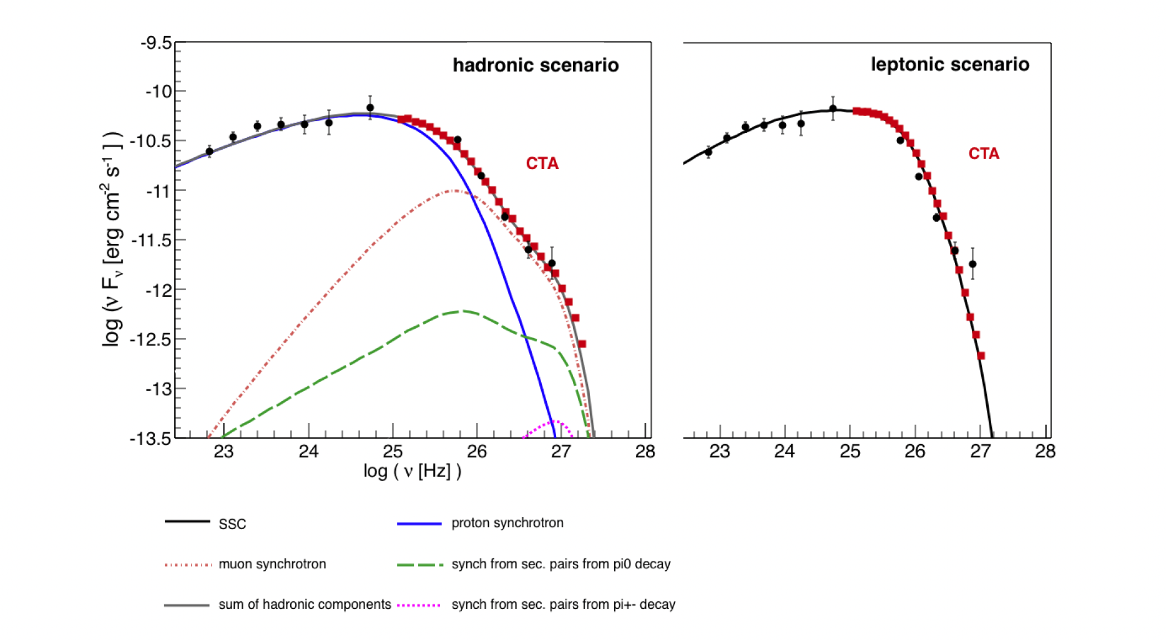
Gamma-Ray Blazars Science topics
Gamma-Ray Emission Modelling
Population Studies
Interaction with EBL, IGMF
LIV, ALP
Redshift is fundamental for each of these subjects !
E.G. Zech, Cerruti & Mazin 2017.
12/10/22
P. Goldoni

Slide 8
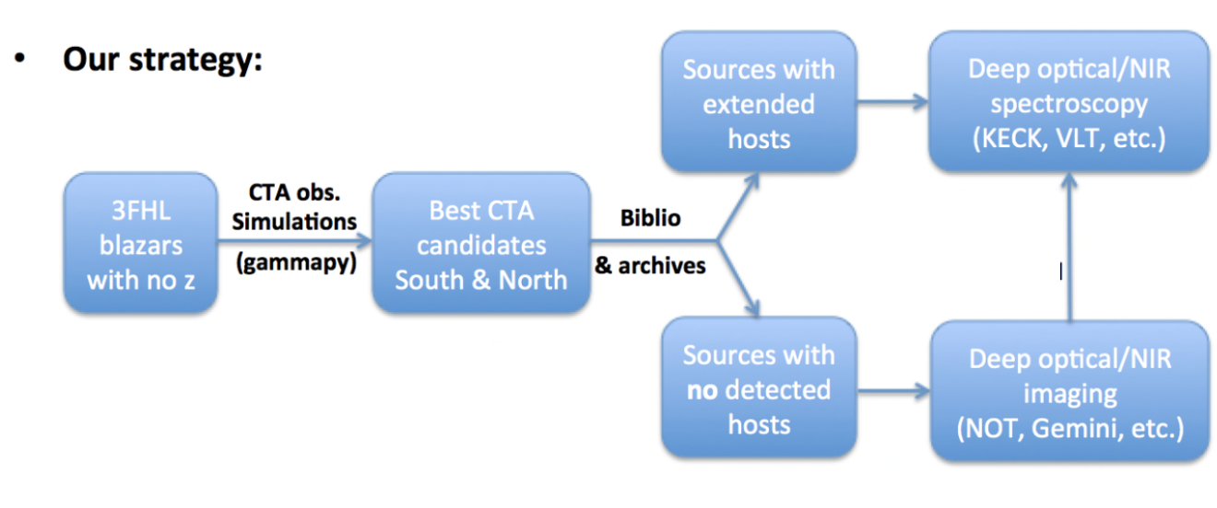
Redshift Determination Task force
Organize within the CTA Consortium the effort to determine redshifts of Blazars that are candidates for the detection with CTA.
Simulations using the latest (and hardest) Fermi catalog (3FHL) to pick the most promising candidates without redshift for the CTA observations.
Imaging and Spectroscopy Proposals to observatories in both hemispheres
Results published incrementally (about 1 spectroscopic paper/year)
12/10/22
P. Goldoni

Slide 9
Sample from simulations
We start from the results of Fermi-LAT observations as they represent state-of-the-art knowledge of the gamma-ray sky
1) 3FHL catalog (Ajello + 17) (0.1-10 GeV) (less extrapolation)
2) Simulate CTA observations of all BL Lacs and BCUs in the 3FHL catalog using the redshifts available in the catalog (GammaPy + CTA response matrices)
3) For sources detectable in 50 hours or less, double-check the redshifts and add spectroscopic lower limits when available
4) Redo Simulations
Final sample: Sources with no measured redshift from 3FHL that can be detected in less than 30 hours: 165
(New simulations ongoing !!)
12/10/22
P. Goldoni
Notes:
Starting point 165, then selection about 100

Slide 10
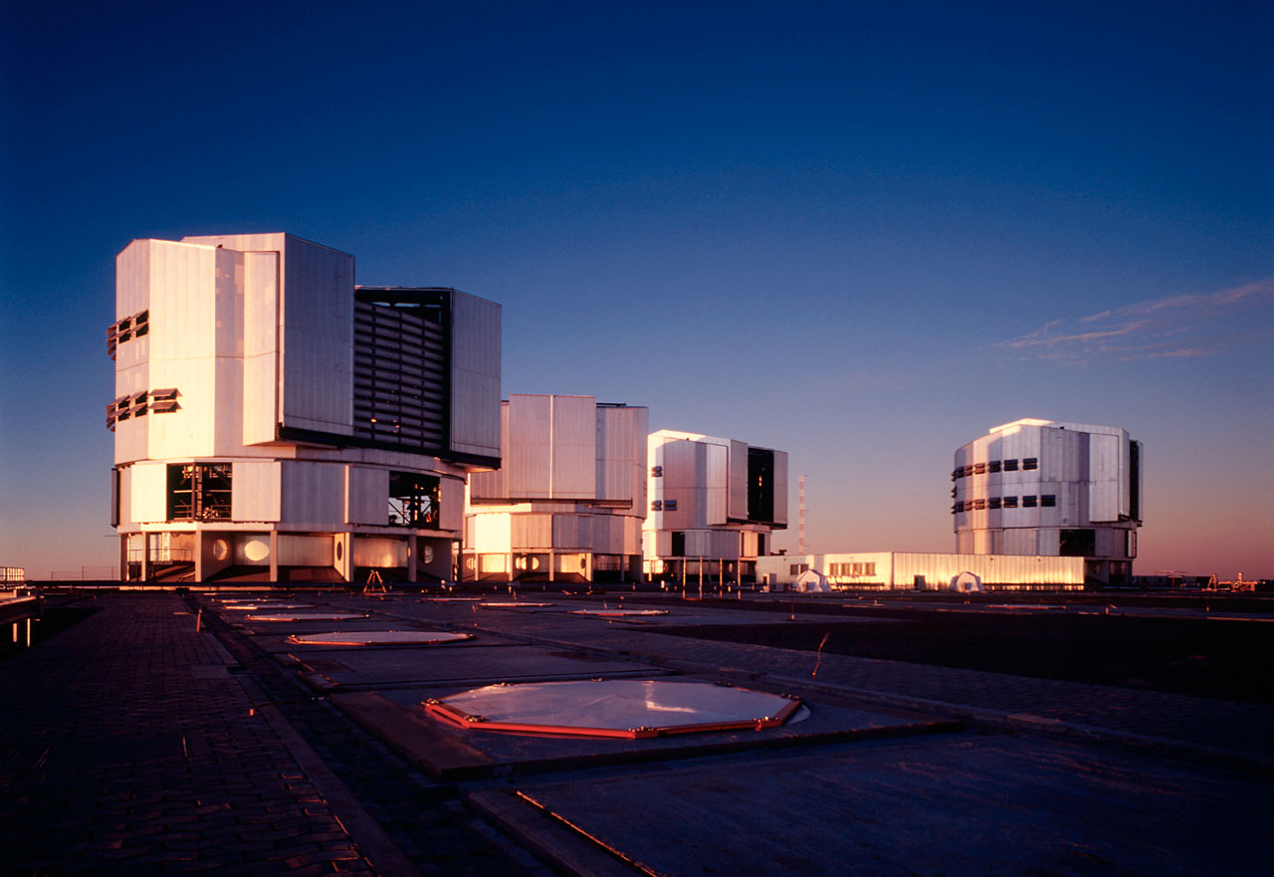

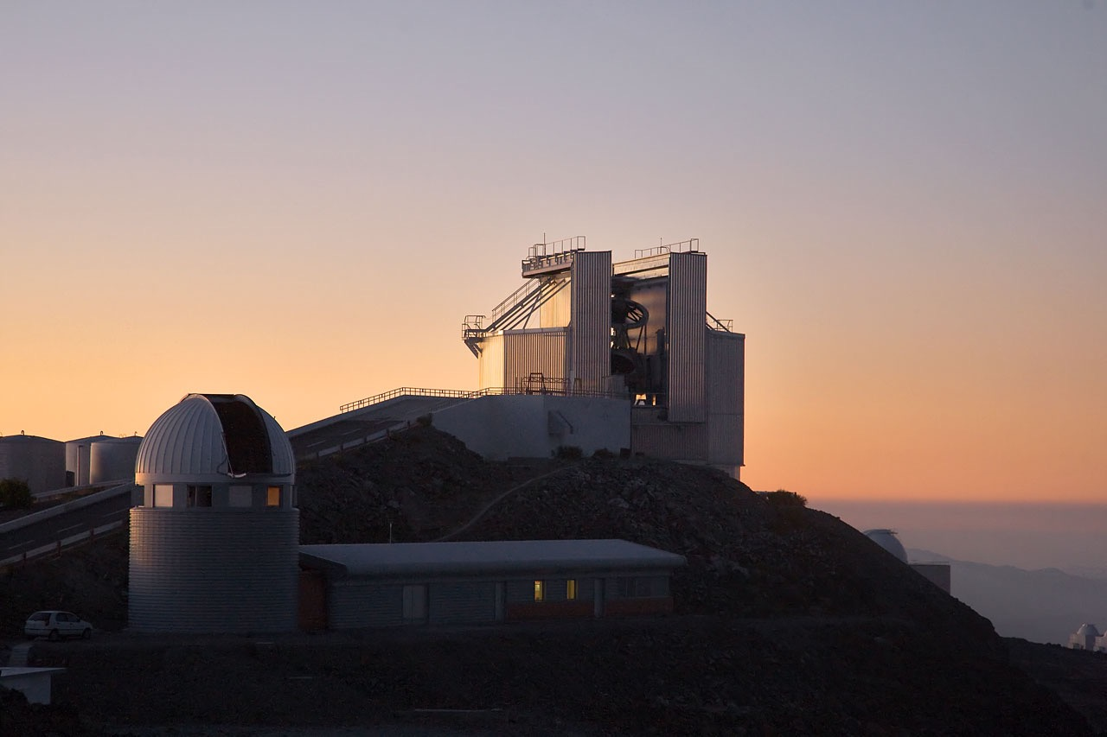

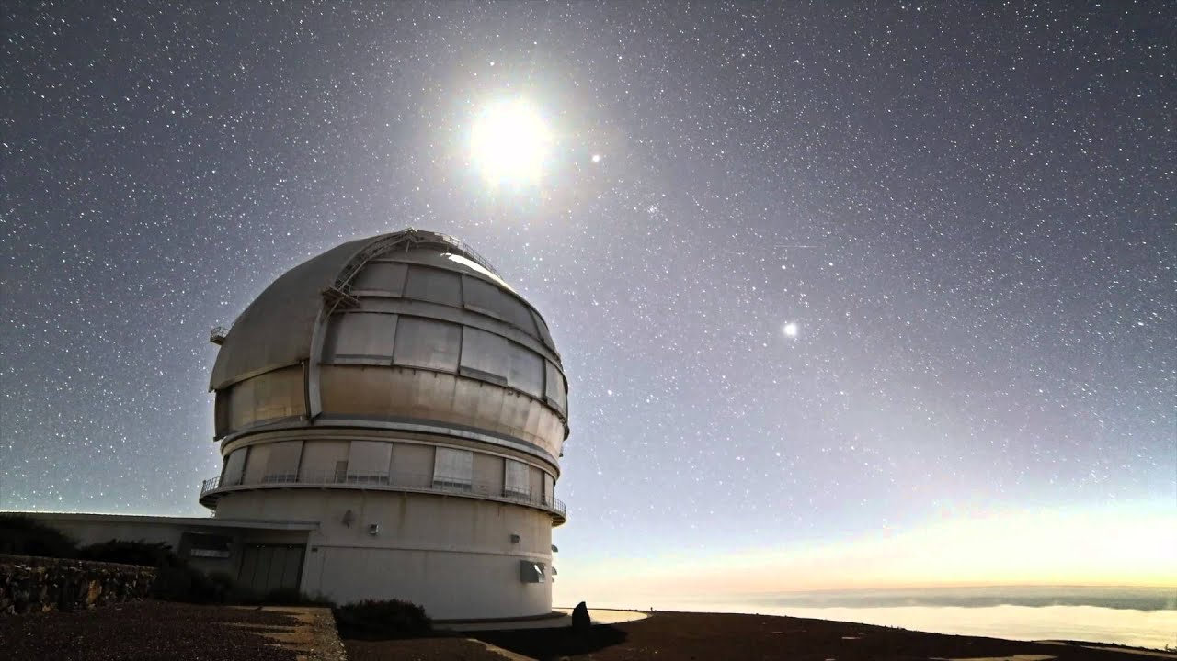
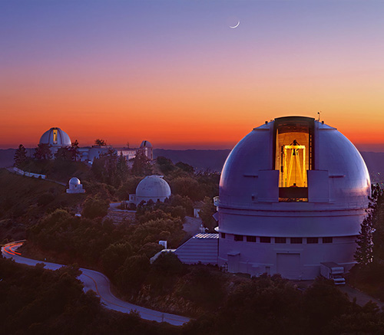


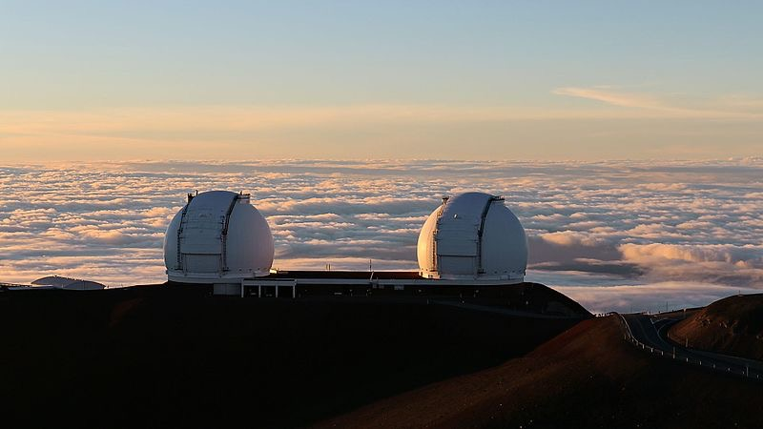
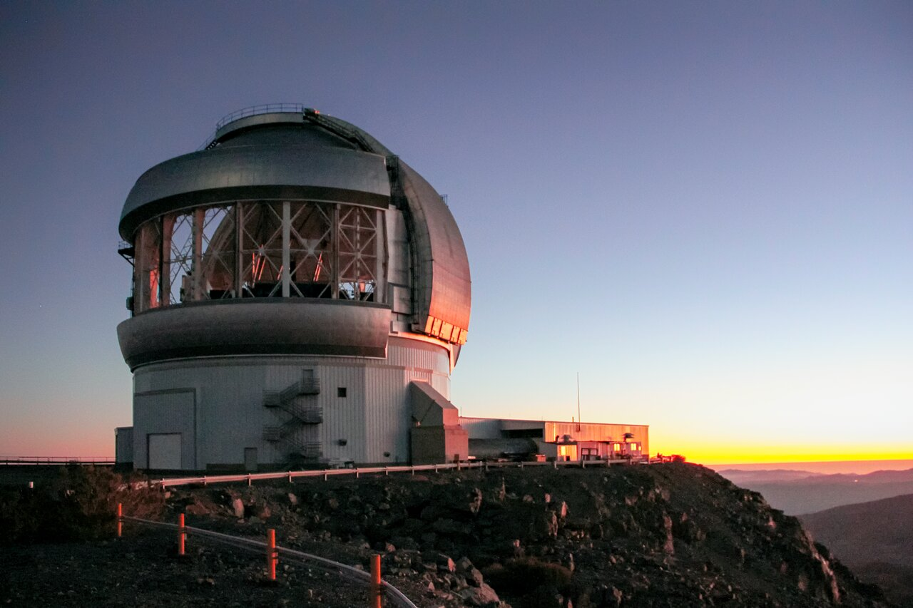


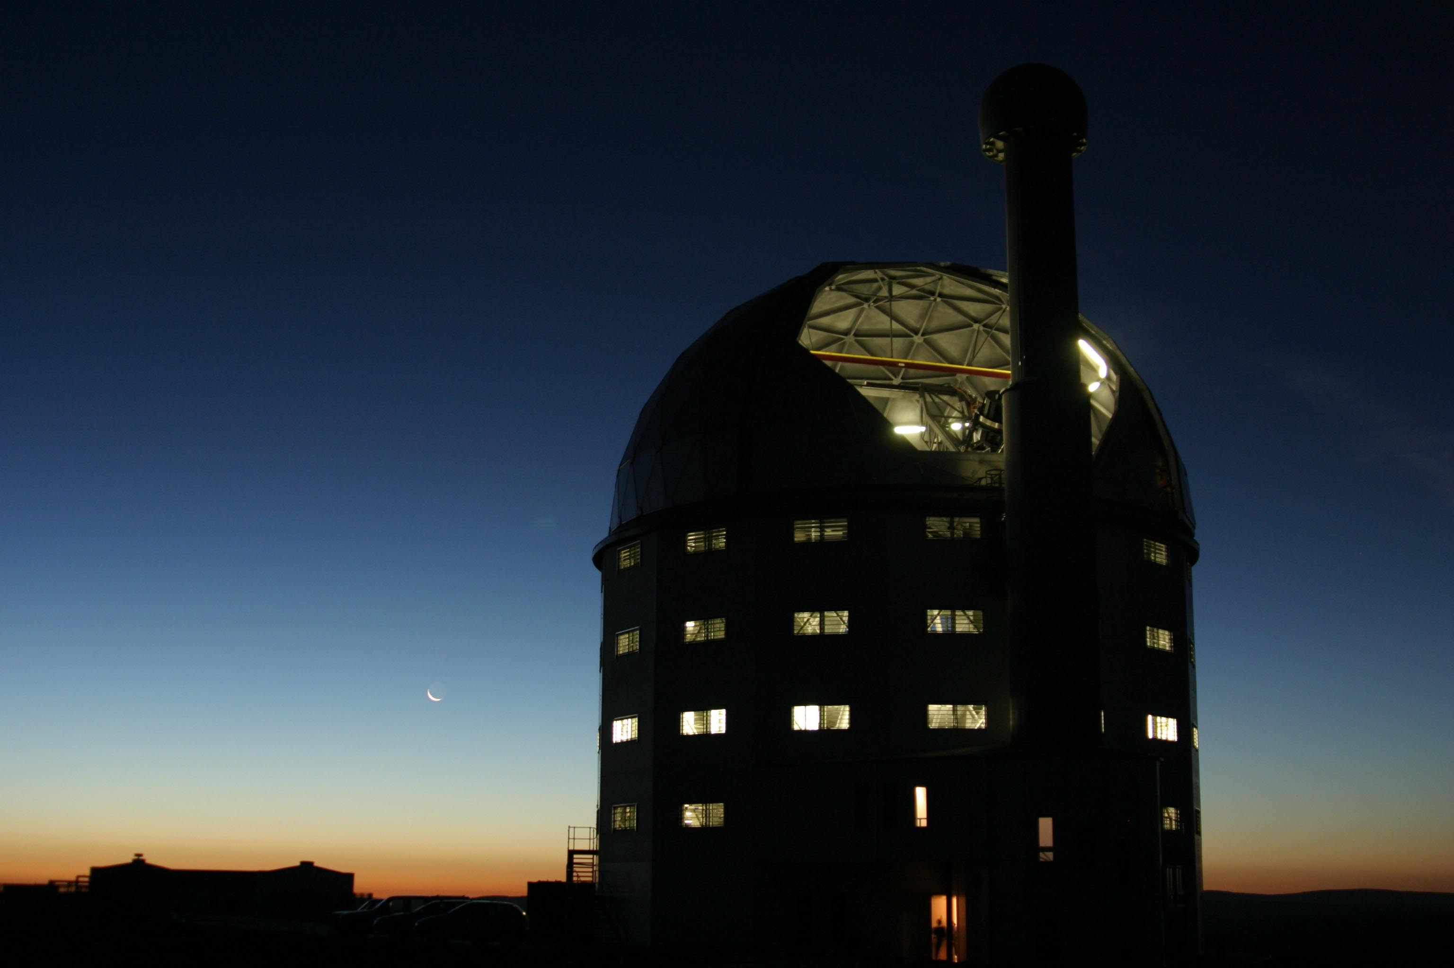
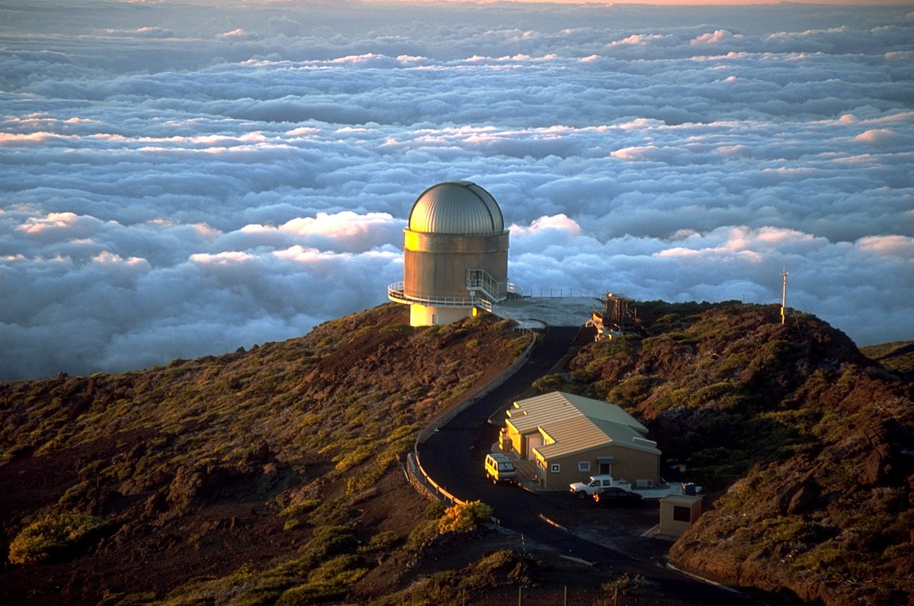


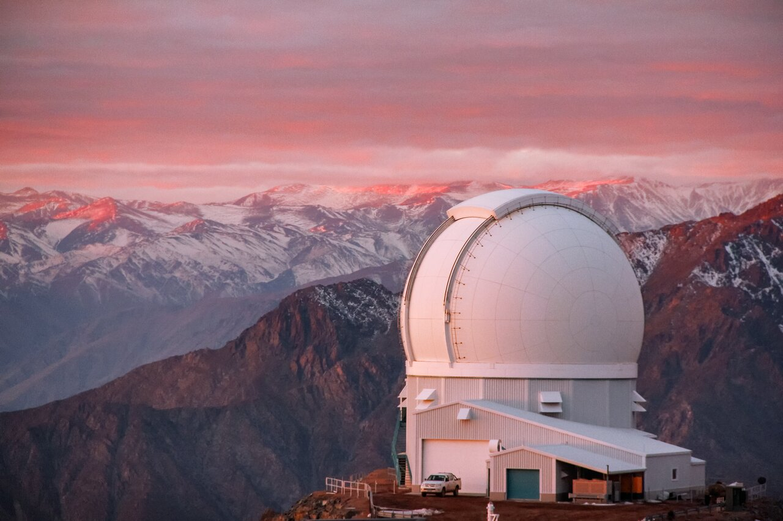
Telescopes and Instruments
Spectroscopy
VLT(ESO) (8.2 m mirror)
FORS 28 targets
Keck (10 m mirror)
ESI 15 targets
SALT (11.2 m mirror)
RSS 27 targets
NTT(ESO) (3.5 m mirror)
EFOSC2 18 targets
Shane (Lick) (3.5 m mirror)
KAST 31 targets
GTC 10m mirror
OSIRIS 1 target (DDT)
Imaging
NOT (2.5m mirror)
ALFOSC 17 targets
SOAR (4.1 m mirror)
SAM 6 targets
Gemini (8 m mirror)
2 targets
12/10/22
P. Goldoni

Slide 11
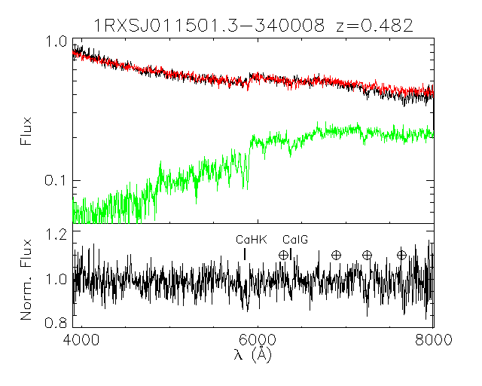
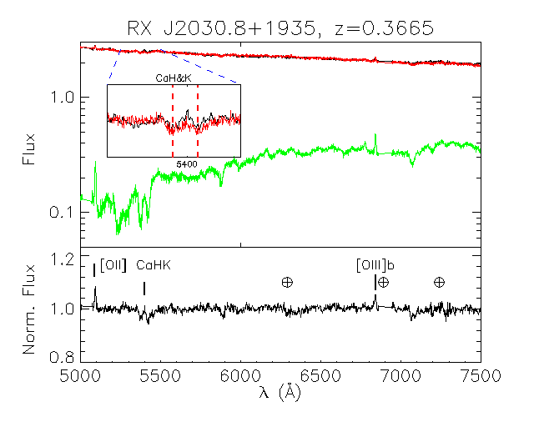
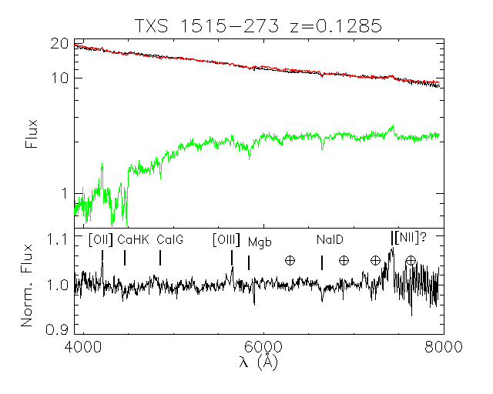
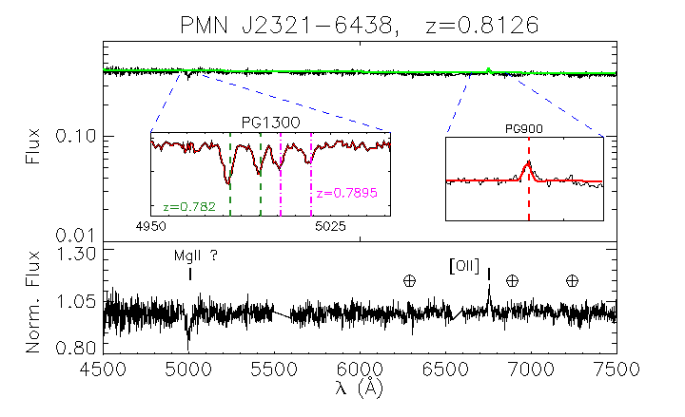
Spectroscopy Paper I+II
Goldoni et al. A&A,650, 106; Kasai et al. MNRAS,submitted
  11(12)/19 redshifts ; 14(15)/26 redshifts
  0.1116 <z<0.482 ; 0.0838<z<0.8125
  z>0.449 z>0.868; z>0.382; z>0.629
  z_med = 0.21(0.23 w.ll); z_med = 0.37(0.38 w.ll)
    z_med = 0.26(0.32 w.ll)
  M_R=-22.6 +/-0.4; M_R=-22.6 +/-1.0
Preliminary success of our strategy
More details in the presentation by Kasai
12/10/22
P. Goldoni

Slide 12
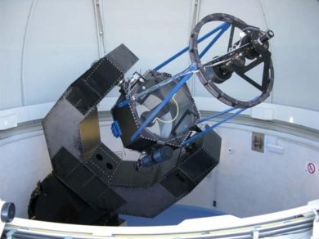
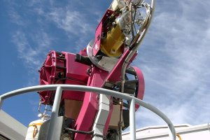
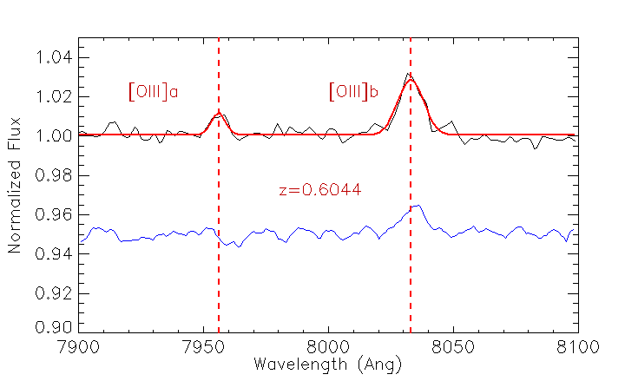
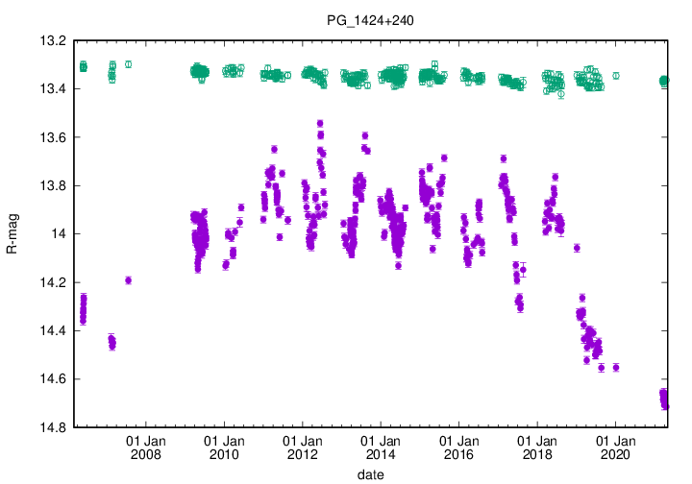
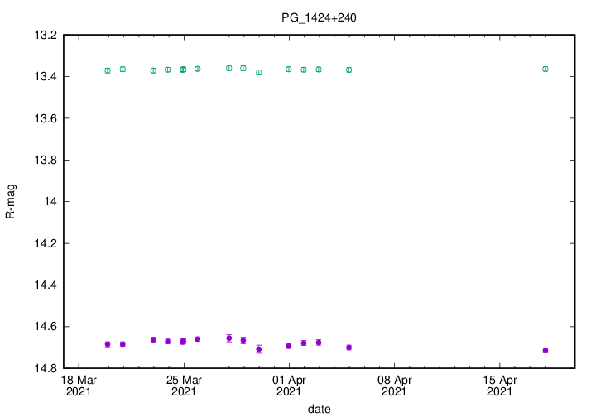
Monitoring and Low State
Spectroscopy
If high S/N spectroscopy unsuccessful
Optical follow-up of the sources (~50)
When in low state - trigger optical spectroscopy
N-TJO
S-REM
PKS 1424+240, z=0.6044 (low S/N) Paiano+ 17
GTC
https://users.utu.fi/kani/1m/PG_1424+240.html
12/10/22
P. Goldoni

Slide 13
Future plans
New simulations, larger sample
Continue observations and publications: third spectroscopy
paper in preparation
Imaging (paper in preparation)
Public web database (in preparation)
Feel free to contact us if interested to participate
in our program
12/10/22
P. Goldoni

Slide 14
Backup
12/10/22
P. Goldoni

Slide 15
AGN optical spectra
Example optical spectra of
different types of AGNs
Several different features
appear in the spectra
They can be originated in the Broad Line Region, Narrow Line Region or the host galaxy
A non-thermal continuum is almost always present and becomes dominant in quasars and BL Lacs
In particular BL Lacs and FSRQs have their jet directed towards the observer (or at a small angle < 15-20 deg)
12/10/22
P. Goldoni

Slide 16
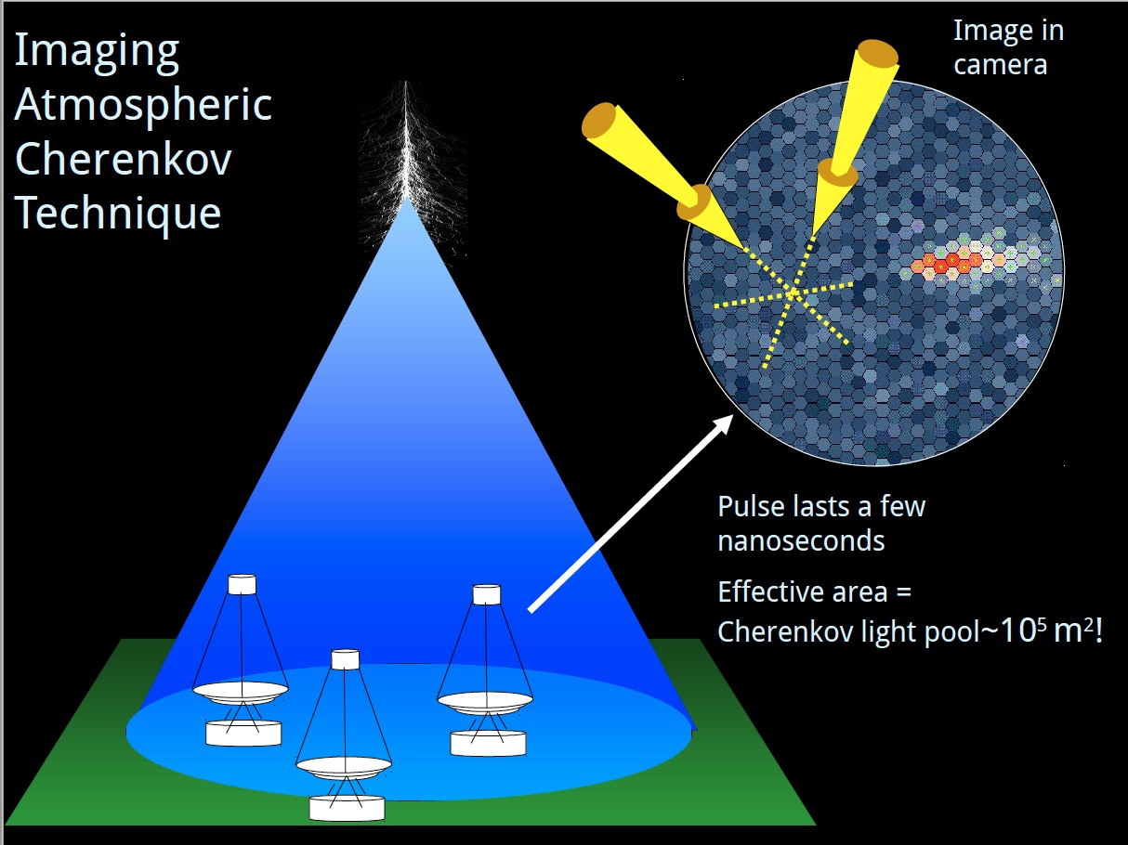
Ground Based TeV Astronomy
12/10/22
P. Goldoni

