Slide 1

Fermi LAT observation of the Moon
Francesco Loparco*
Salvatore De Gaetano, Mario Nicola Mazziotta
on behalf of the Fermi LAT Collaboration
*e-mail: francesco.loparco@ba.infn.it

Slide 2

The gamma-ray Moon
The Moon is among the brightest sources in the gamma-ray sky
Lunar gamma rays are produced in the hadronic interactions of cosmic rays with the regolith
The gamma-ray flux from the Moon is sensitive to:
  Cosmic-ray fluxes
  Composition of the lunar surface
  Mechanisms of the hadronic interactions
The Fermi LAT has already measured the gamma-ray flux from the Moon using the data collected in its first 7 years of operation
  For further details see PRD 93, 082001 (2016)
The previous results have been now updated using a 14-years dataset
  The observation period exceeds the duration of a solar cycle

Slide 3
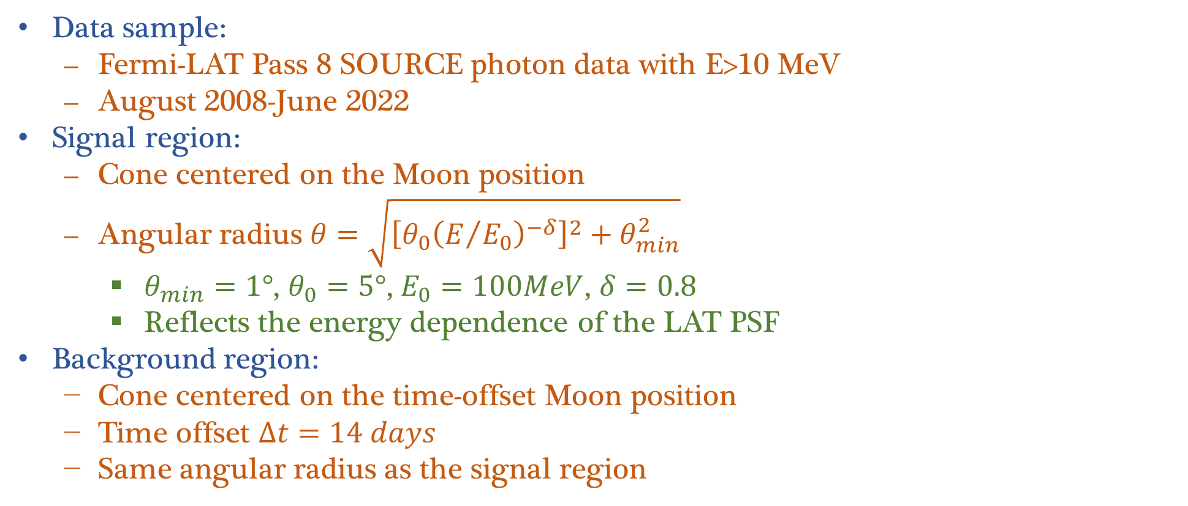
Data selection (1/2)
Data sample:
  Fermi-LAT Pass 8 SOURCE photon data with E>10 MeV
  August 2008-June 2022
Signal region:
  Cone centered on the Moon position
  Angular radius $θ=\sqrt{{\left[θ_{0}{\left(E/{E_{0}}\right)}^{−δ}\right]}^{2}+θ_{min}^{2}}$
    $θ_{min}=1°$, $θ_{0}=5°$, $E_{0}=100MeV$, $δ=0.8$
    Reflects the energy dependence of the LAT PSF
Background region:
  Cone centered on the time-offset Moon position
  Time offset $∆t=14 days$
  Same angular radius as the signal region

Slide 4
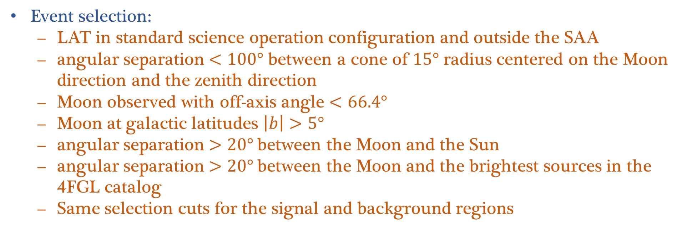
Data selection (2/2)
Event selection:
  LAT in standard science operation configuration and outside the SAA
  angular separation $<100°$ between a cone of $15°$ radius centered on the Moon direction and the zenith direction
  Moon observed with off-axis angle $<66.4°$
  Moon at galactic latitudes $\left|b\right|>5°$
  angular separation $>20°$between the Moon and the Sun
  angular separation $>20°$between the Moon and the brightest sources in the 4FGL catalog
  Same selection cuts for the signal and background regions

Slide 5
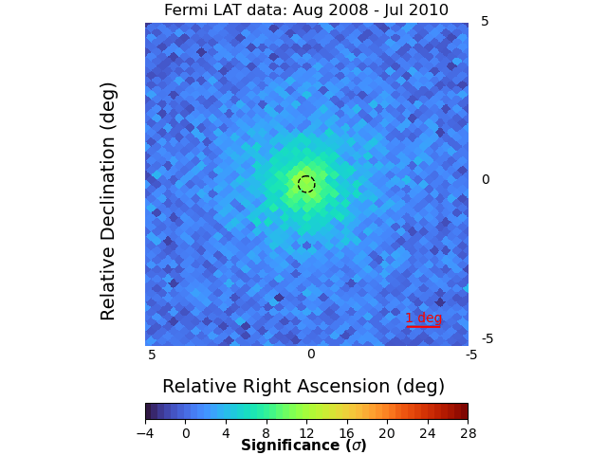
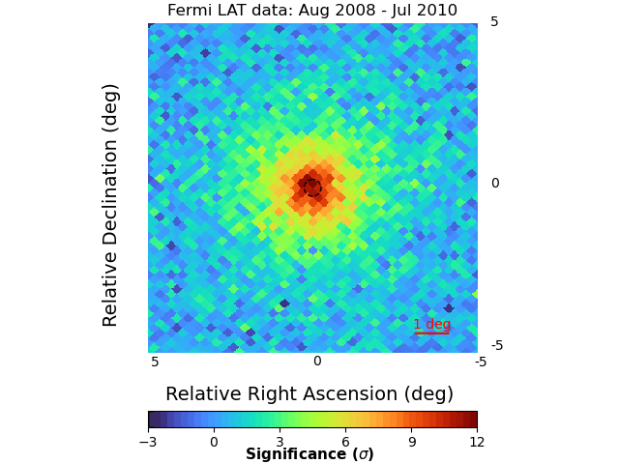
Significance maps of the Moon
The significance maps are built from the counts in the signal and background regions with the Li&Ma approach
  The significance increases as the time interval increases
  The significance evaluated over 2-years time intervals changes due to solar modulation

Slide 6
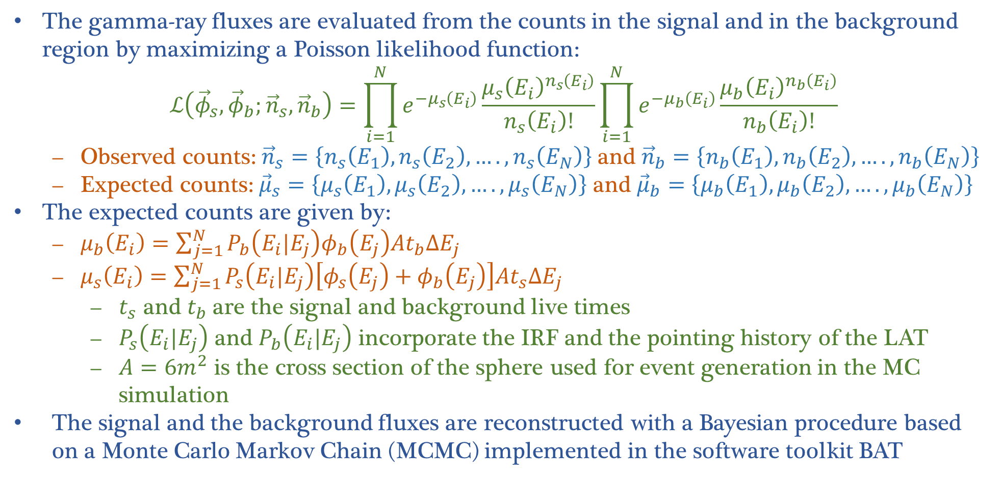
Reconstruction of the gamma-ray energy spectrum
The gamma-ray fluxes are evaluated from the counts in the signal and in the background region by maximizing a Poisson likelihood function:
$$ℒ\left({\vec{φ}}_{s},{\vec{φ}}_{b};{\vec{n}}_{s},{\vec{n}}_{b}\right)=\prod_{i=1}^{N}{e^{−μ_{s}\left(E_{i}\right)}\frac{{μ_{s}\left(E_{i}\right)}^{n_{s}\left(E_{i}\right)}}{n_{s}\left(E_{i}\right)!}}\prod_{i=1}^{N}{e^{−μ_{b}\left(E_{i}\right)}\frac{{μ_{b}\left(E_{i}\right)}^{n_{b}\left(E_{i}\right)}}{n_{b}\left(E_{i}\right)!}}$$
  Observed counts: ${\vec{n}}_{s}=\left\{n_{s}\left(E_{1}\right),n_{s}\left(E_{2}\right),….,n_{s}\left(E_{N}\right)\right\}$ and ${\vec{n}}_{b}=\left\{n_{b}\left(E_{1}\right),n_{b}\left(E_{2}\right),….,n_{b}\left(E_{N}\right)\right\}$
  Expected counts: ${\vec{μ}}_{s}=\left\{μ_{s}\left(E_{1}\right),μ_{s}\left(E_{2}\right),….,μ_{s}\left(E_{N}\right)\right\}$ and ${\vec{μ}}_{b}=\left\{μ_{b}\left(E_{1}\right),μ_{b}\left(E_{2}\right),….,μ_{b}\left(E_{N}\right)\right\}$
The expected counts are given by:
  $μ_{b}\left(E_{i}\right)=\sum_{j=1}^{N}{P_{b}\left(E_{i}|E_{j}\right)φ_{b}\left(E_{j}\right)At_{b}{ΔE}_{j}}$
  $μ_{s}\left(E_{i}\right)=\sum_{j=1}^{N}{P_{s}\left(E_{i}|E_{j}\right)\left[φ_{s}\left(E_{j}\right)+φ_{b}\left(E_{j}\right)\right]At_{s}{ΔE}_{j}}$
    $t_{s}$ and $t_{b}$are the signal and background live times
    $P_{s}\left(E_{i}|E_{j}\right)$ and $P_{b}\left(E_{i}|E_{j}\right)$ incorporate the IRF and the pointing history of the LAT
    $A=6m^{2}$ is the cross section of the sphere used for event generation in the MC simulation
The signal and the background fluxes are reconstructed with a Bayesian procedure based on a Monte Carlo Markov Chain (MCMC) implemented in the software toolkit BAT

Slide 7
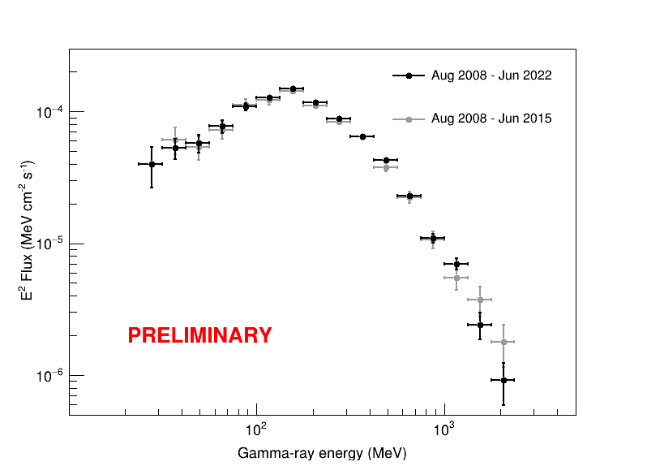
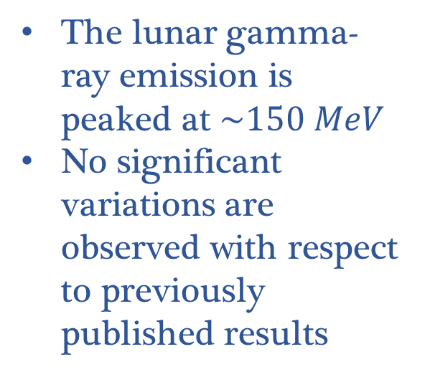
The Moon gamma-ray spectrum
The lunar gamma-ray emission is peaked at $\sim 150 MeV$
No significant variations are observed with respect to previously published results

Slide 8
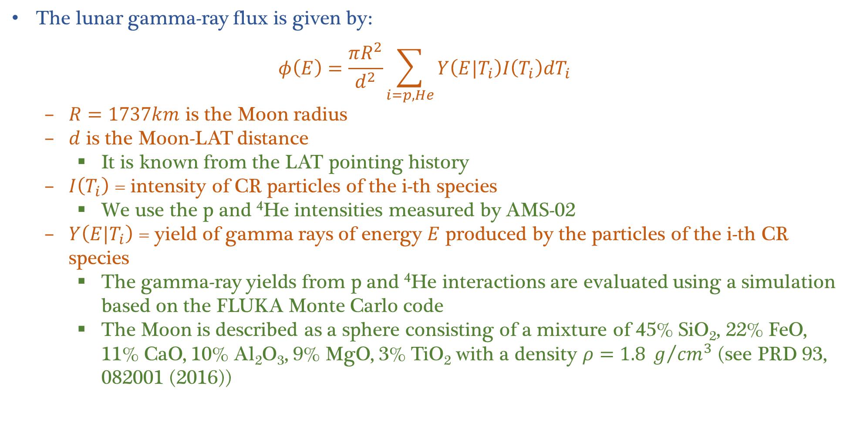
Evaluation of the expected gamma-ray fluxes
The lunar gamma-ray flux is given by:
$$φ\left(E\right)=\frac{πR^{2}}{d^{2}}\sum_{i=p,He}{Y\left(E|T_{i}\right)I\left(T_{i}\right){dT}_{i}}$$
  $R=1737km$ is the Moon radius
  $d$ is the Moon-LAT distance
    It is known from the LAT pointing history
  $I\left(T_{i}\right)$ = intensity of CR particles of the i-th species
    We use the p and ⁴He intensities measured by AMS-02
  $Y\left(E|T_{i}\right)$ = yield of gamma rays of energy $E$ produced by the particles of the i-th CR species
    The gamma-ray yields from p and ⁴He interactions are evaluated using a simulation based on the FLUKA Monte Carlo code
    The Moon is described as a sphere consisting of a mixture of 45% SiO₂, 22% FeO, 11% CaO, 10% Al₂O₃, 9% MgO, 3% TiO₂ with a density $ρ=1.8 g/{{cm}^{3}}$ (see PRD 93, 082001 (2016))

Slide 9
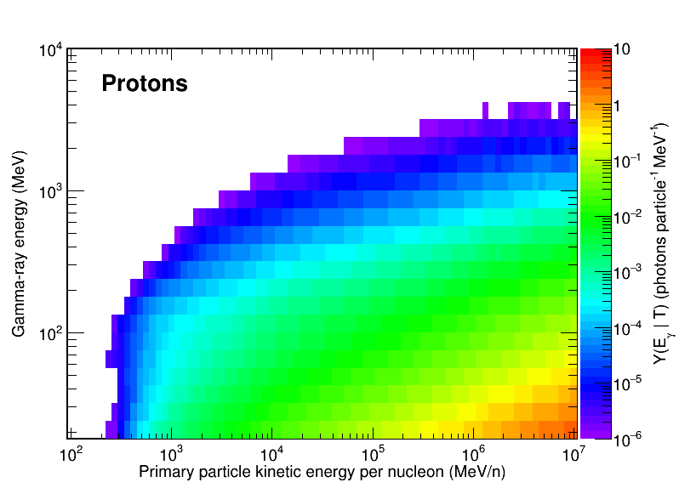
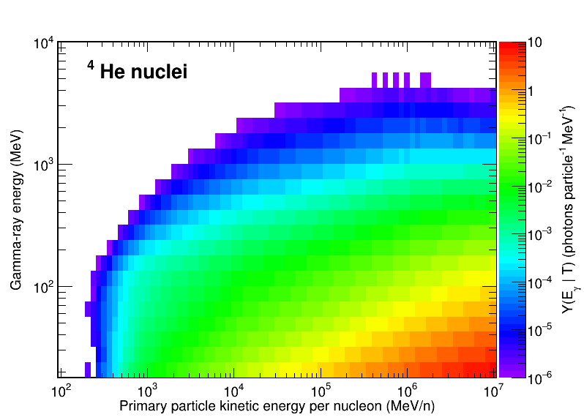
Gamma-ray yields from protons and ⁴He nuclei
Plots from PRD 93, 082001 (2016)

Slide 10
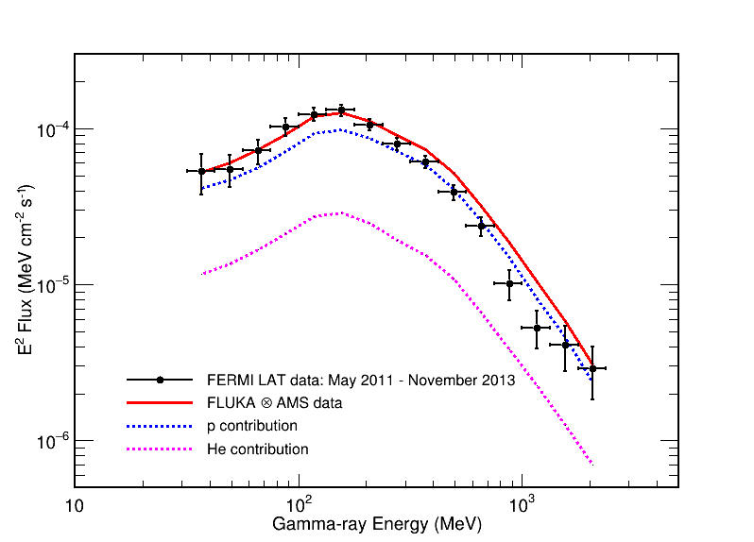
Data-model comparison
The data collected in the period May 2011-Nov 2013 are compared with MC predictions obtained by folding the p and ⁴He spectra measured by AMS-02 with the gamma-ray yield evaluated with FLUKA
Plot from PRD93, 082001 (2016)

Slide 11
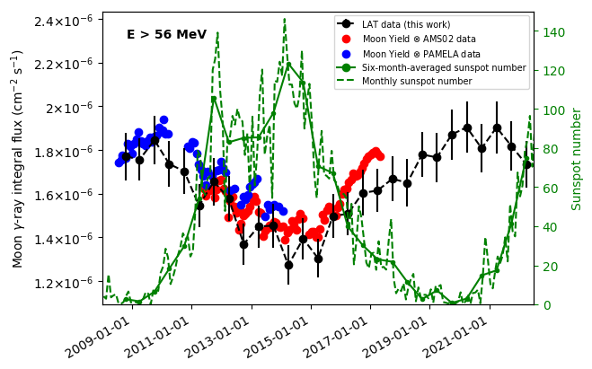
Time evolution of the lunar gamma-ray flux
The Moon gamma-ray flux is evaluated in 6-months time intervals and compared with the model predictions based on CR measurements
Predictions are obtained by folding the AMS-02 and PAMELA data with the gamma-ray yields evaluated with FLUKA
The Moon gamma-ray flux is anticorrelated with the solar activity

Slide 12
Conclusions
We have updated the measurement of the gamma-ray flux from the Moon using a 14-years dataset collected by the Fermi LAT
  The observation period exceeds the duration of a whole solar cycle
The average Moon gamma-ray fluxes are not significantly changed from the previously published LAT data analysis with a 7-years data sample
We have studied the time evolution of the lunar gamma-ray emission
  The lunar gamma-ray flux is anticorrelated with the solar activity
  The measurements are in agreement with the predictions obtained by folding the measured spectra of cosmic-ray protons and ⁴He nuclei with the gamma-ray yields evaluated with a MC simulation based on the FLUKA code

