Slide 1

Study of gamma rays from the Small Solar System Bodies with the Fermi-LAT data
Salvatore De Gaetano*
Leonardo Di Venere, Francesco Loparco, Nicola Mazziotta
*salvatore.degaetano@ba.infn.it

Slide 2
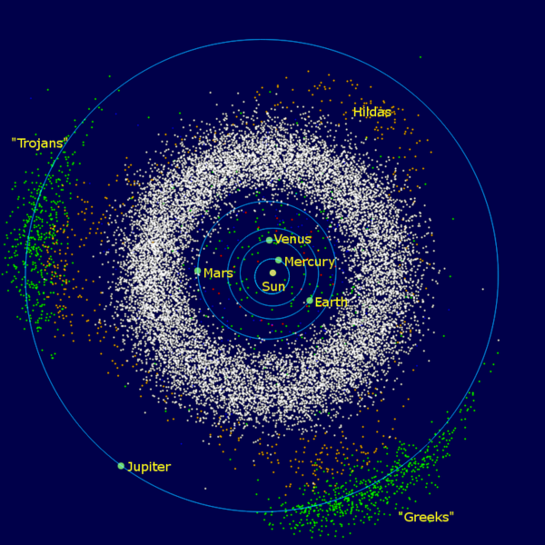
Small solar system bodies (SSSBs)
Three main families of asteroids:
  Main Belt asteroids (between Mars and Jupiter orbits)
  Trojans (share an orbit with a larger planet or moon)
  Kuiper Belt asteroids (Trans-Neptunian objects)
Mainly made of carbon, silicate (C- or S-type) and metal (M-type), but also ice
JPL Small-Body Database Browser provides data for all known asteroids (d > 2m)
Asteroids should produce a diffuse emission close to the ecliptic plane
  – we evaluate the flux from the ecliptic using LAT data from Aug 2008 to Dec 2020
  – we constrain gamma emission from SSSBs
  – we used FLUKA to predict the gamma emission from SSSBs
  – we put constraints on the total number of asteroids

Slide 3
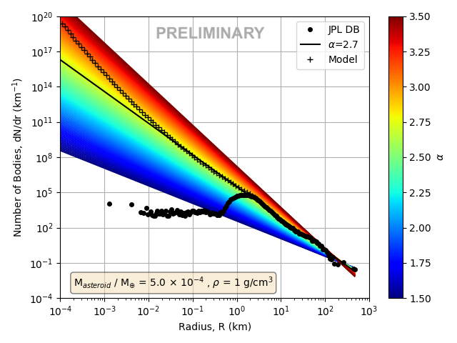
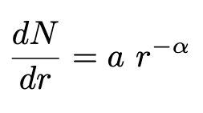
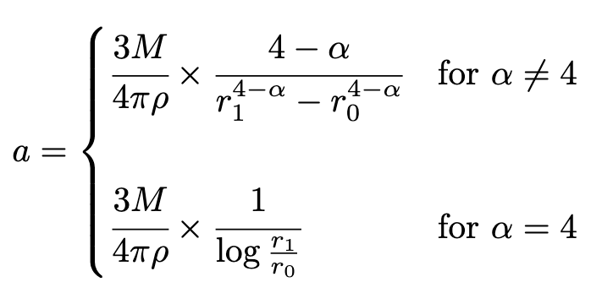
SSSB population
Based on the collisional story of asteroids, their population can be described by a PL
Assuming they are homogeneous spheres, we can write:

Slide 4
SSSB population
Based on the collisional story of asteroids, their population can be described by a PL
Assuming they are homogeneous spheres, we can write:
We propose a model given by the extrapolation of Durda et al. (1998) down to 20 cm
Ceres

Slide 5
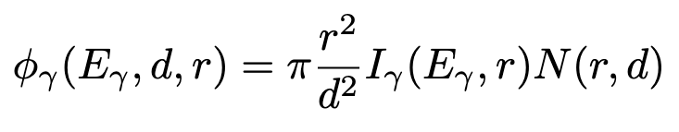
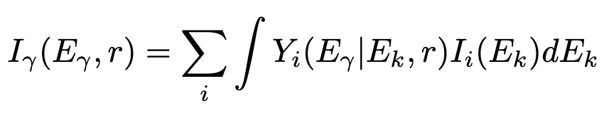
SSSB gamma-ray emission
Asteroids should produce a diffuse gamma emission due to CR interactions
We compute the yield using FLUKA
  each SSSB is defined as a spherical body with radius from 10 cm to 100 km of a given material;
  we simulated ice (0.93 g/cm³), silica (2 g/cm³) and carbon (2 g/cm³)
We assume two limiting CR spectra (mostly p, e– and ⁴He):
  LIS spectra
  spectra at Earth (mainly AMS02 data)
Flux at Earth (GeV^{–1} cm^{–2} s^{–1})
Intensity at production (GeV^{–1} cm^{–2} s^{–1} sr^{–1})
gamma yield
CR spectrum
we bracket the asteroid emission
between two limiting cases

Slide 6
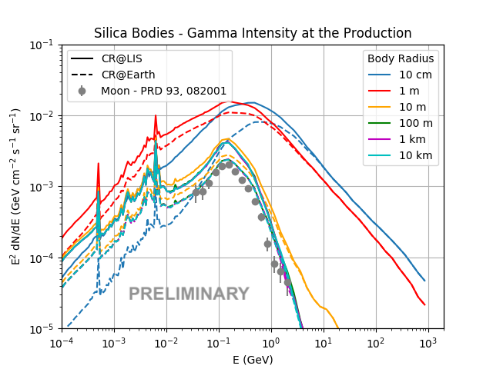
SSSB gamma-ray intensity
For r > 10 m, the shape does not change
Secondary gamma rays can only escape from external layers
  CRs can penetrate down to depths of a few tens of g/cm²
  Gamma-ray absorption length is shorter
When the asteroid size > both these lengths, the gamma production becomes independent on the size

Slide 7
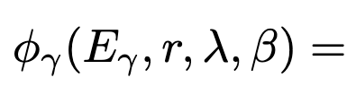
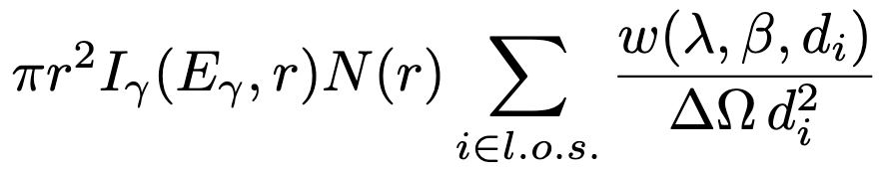
SSSB spatial map
We built a template describing SSSB gamma-ray emission
We divided the sky in equal solid-angle pixels and we added contribution from each pixel

Slide 8
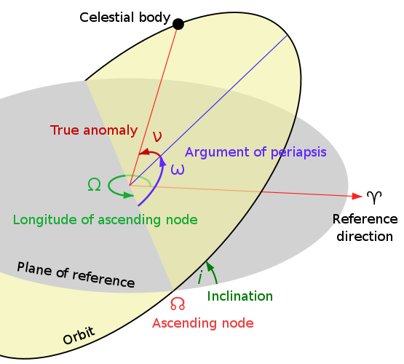
SSSB spatial map
We built a template describing SSSB gamma-ray emission
We divided the sky in equal solid-angle pixels and we added contribution from each pixel
Knowing the spectral factor and the spatial factor, we can put constraints on N(r)
The spatial map is built sampling 10⁷ times the asteroid orbital parameters from JPL catalog
Spatial factor
Spectral factor
the true anomaly is extracted with uniform distribution between 0 and 360°
the sky is divided into pixels each one corresponding to a solid angle of 1.02 x 10^{–3} sr

Slide 9
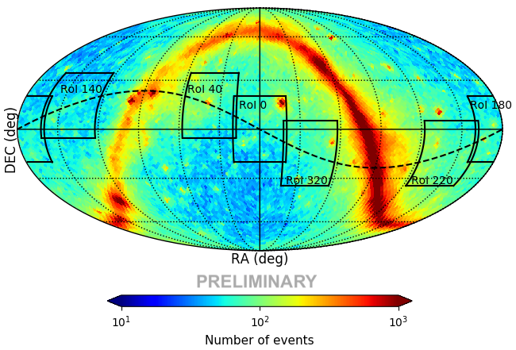
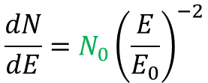

Data analysis with fermipy
Data sample:
  149 months data: Aug 2008 – Dec 2020
  PASS 8 P305 ULTRACLEANVETO (FRONT + BACK) events
    Energy: 56 MeV – 1.78 TeV, 8 bins/decade
  Six RoIs of ±20°
  For each RoI, the observation time is divided into 13 years of data and 12 months (5 months in 2008)
GTI filters:
  'DATA_QUAL>0 && LAT_CONFIG==1
  Maximum LAT off-axis angle = 70°
  Sun 45° away from the central position of the RoI
    not all RoIs will be visible, according to Sun position
  Moon 35° away from the central position of the RoI
  roicut = no
Catalog: 4FGL
  Only free normalization of sources within 25 deg w.r.t. the center of the RoI and TS>25
Asteroid diffuse model:
  Spectral model: power-law with index -2
  Spatial model: the spatial map defined in slide 4
  Free parameter: normalization
We retrieve the SED for each observation:
  this creates a likelihood scan in each energy bin
  more spectral models can be tested this way
  we set free_background = True
Spectral model
Spatial model
$$\frac{dN}{dE}=N_{0}{\left(\frac{E}{E_{0}}\right)}^{−2}$$
$$\frac{w\left(λ,β\right)}{ΔΩ \overline{d^{2}}}$$

Slide 10
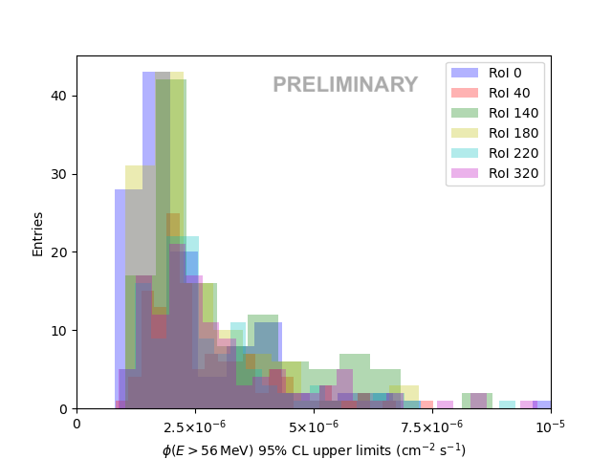
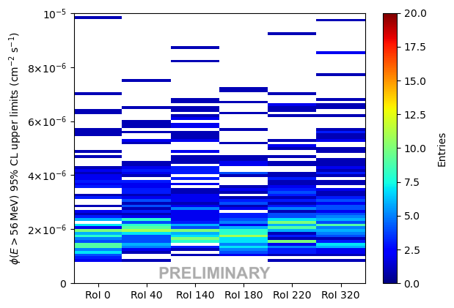
Results
The ULs lay in the range [10^{–6} – 10^{–5}] cm^{–2}s^{–1}
In each time window, we found no significance (TS ≃ 0)

Slide 11
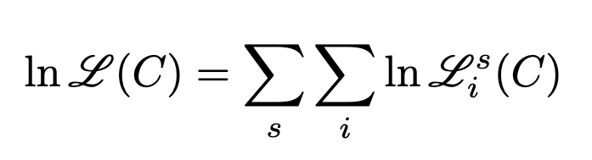
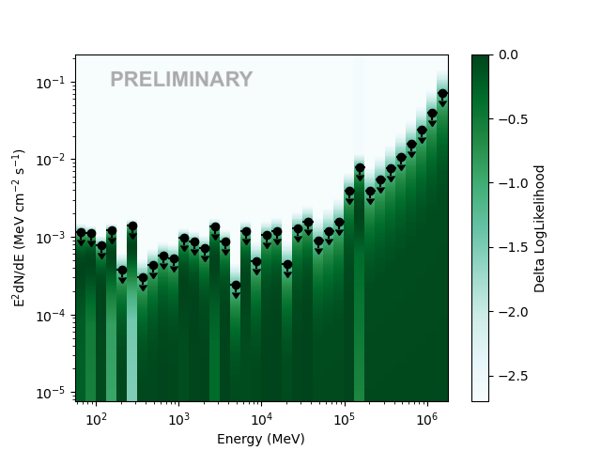


Combined analysis
In each energy bin, we evaluated the likelihood profile for the flux from asteroids
  the parameter N₀ (see slide 10) is varied, while the spectral index is kept to 2
  the likelihood values do not change when changing the spectral index between 2 and 3
We combined all profiles in each energy bin, RoI and time window
  to evaluate constraints on a possible source population with spectral shape f(E) and free norm. C
TS =
The 95% CL UL is the value of C for which

Slide 12
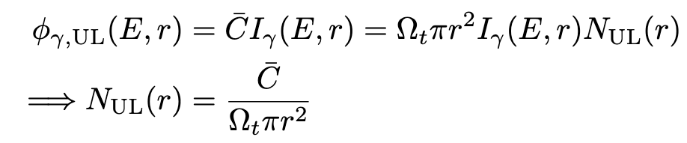
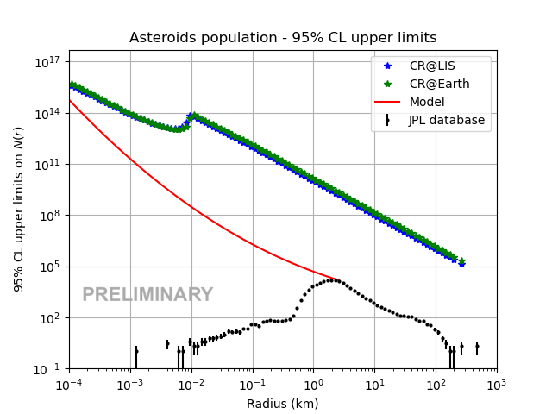
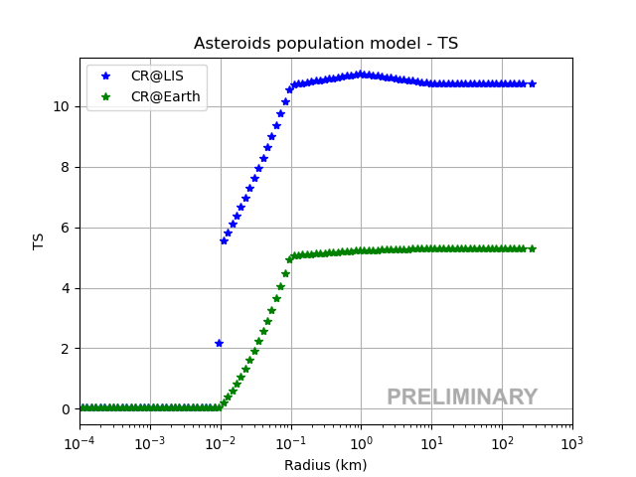
Combined analysis – studies on the asteroid population
The upper limit on the flux can be expressed as an upper limit on the asteroid population

Slide 13
Combined analysis – studies on the asteroid population
The upper limit on the flux can be expressed as an upper limit on the asteroid population
TS not significant
ULs/model go from 1 to 10⁶
constant slope: the intensity
at production does not depend on r
softer intensity spectra with higher likelihood values
hard components for intensity at production with low likelihood values

Slide 14
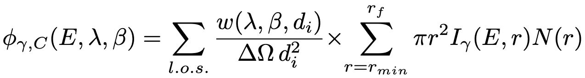
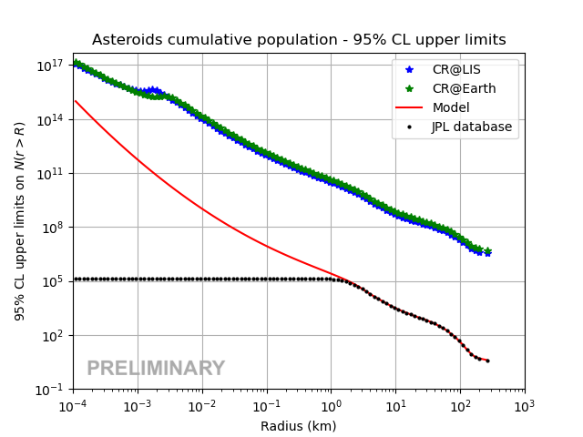
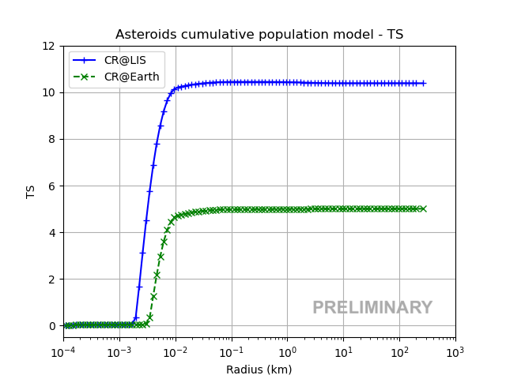
Combined analysis – population model dependent
We put an upper limit on the cumulative flux from r_{min} = 10 cm to r_{f} up to 300 km
This UL reflects into an UL on the cumulative population: we test it on our model (see slide 4)
the cumulative spectral shape does not change at high radii
ULs/model go from 10² to 10⁶
TS not significant

Slide 15
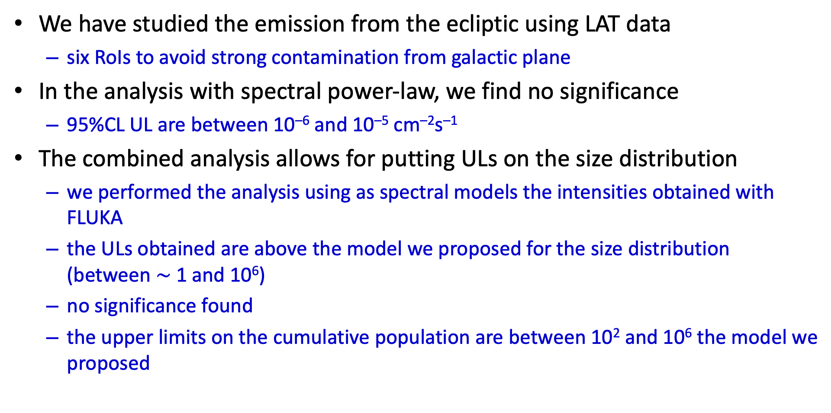
Conclusions
We have studied the emission from the ecliptic using LAT data
  six RoIs to avoid strong contamination from galactic plane
In the analysis with spectral power-law, we find no significance
  95%CL UL are between 10^{–6} and 10^{–5} cm^{–2}s^{–1}
The combined analysis allows for putting ULs on the size distribution
  we performed the analysis using as spectral models the intensities obtained with FLUKA
  the ULs obtained are above the model we proposed for the size distribution (between $\sim$ 1 and 10⁶)
  no significance found
  the upper limits on the cumulative population are between 10² and 10⁶ the model we proposed

Slide 16
Thank you for your attention!
Salvatore De Gaetano*
*salvatore.degaetano@ba.infn.it

Slide 17
References
https://ssd.jpl.nasa.gov/
Davis et al., Collisional Evolution of Small-Body Populations, 2002, Asteroids III
http://www.fluka.org/
https://fermi.gsfc.nasa.gov/
https://fermipy.readthedocs.io/en/latest/
https://healpix.sourceforge.io/
De La Torre Luque, P et al., 2021, JCAP, 03, 099
Aguilar, M., et al. 2014, Phys. Rev. Lett., 113, 221102
Aguilar, M., et al. 2015, Phys. Rev. Lett., 114, 171103
Aguilar, M., et al. 2015, Phys. Rev. Lett., 115, 211101
Aguilar, M., et al. 2017, Phys. Rev. Lett., 119, 251101
Ackermann, M., et al., 2016, Phys. Rev. D, 93, 082001
Abdollahi, S., et al. 2017, Phys. Rev. D, 95, 082007
Ambrosi, G., et al. 2017, Nature, 552, 63

Slide 18
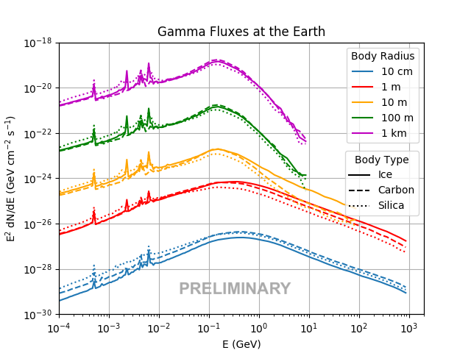
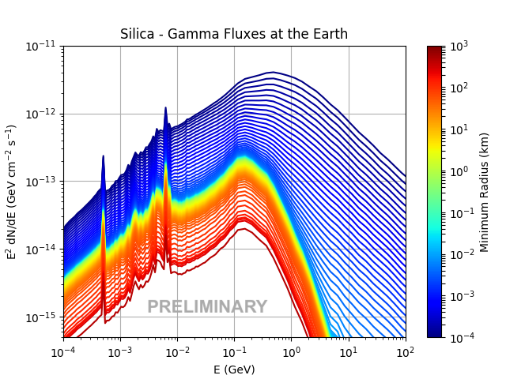
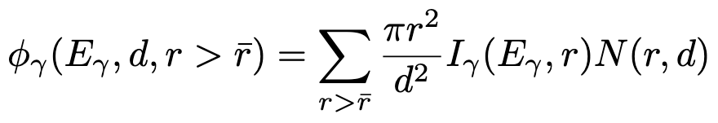
BACKUP - SSSB gamma-ray flux at Earth
Gamma-ray fluxes at the Earth from single spherical bodies of different radii and types at the distance of 2.7 AU from the Earth
d = 2.7 AU, N given by our model

Slide 19
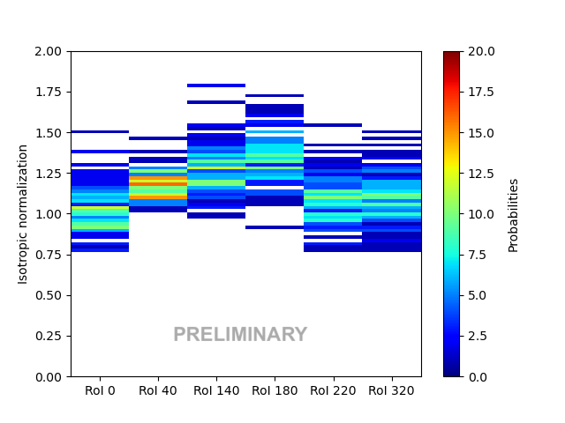
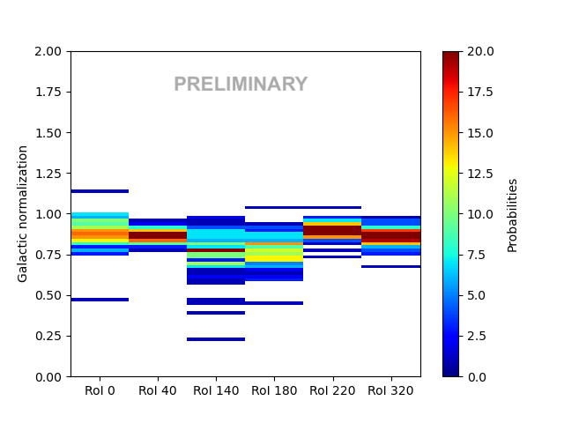
BACKUP
Anticorrelation between isotropic normalization and galactic normalization

Slide 20
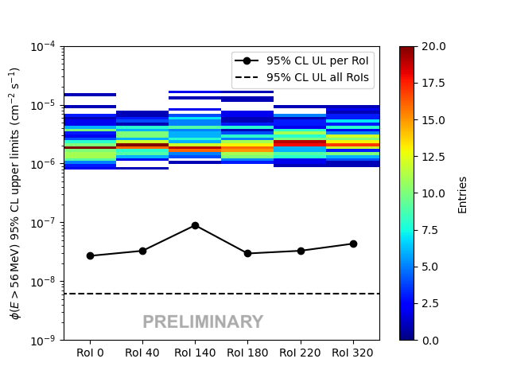
BACKUP - Combined analysis
Combining the likelihoods in each RoI provides an upper limit > 10 times lower
Combining all the likelihoods provides an upper limit ~ 10 times lower

Slide 21
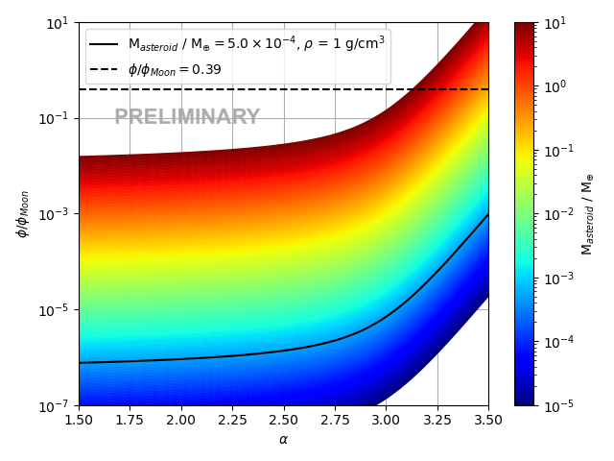
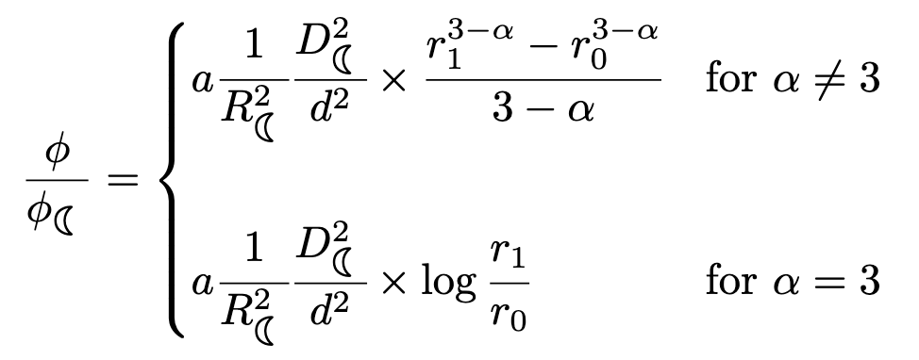
BACKUP – Combined analysis – Moon spectrum
As a spectral model, we use the Moon flux measured by the LAT in its first 7 years
The 95% CL UL is 0.39 the Moon flux
We evaluate the ratio between asteroids and Moon flux, assuming:
  a power-law of index α for the size distribution
  asteroid density 1 g/cm³ and d_{AT} = 2.7 AU
  asteroid intensity = Moon intensity (true for big radii)

