Slide 1


Linking the LHC and astrophysics with anomalies
Geoff Beck* (University of the Witwatersrand)
Ralekete Temo, Elias Malwa, Muskesh Kumar, and Bruce Mellado
*geoff.m.beck@gmail.com

Slide 2


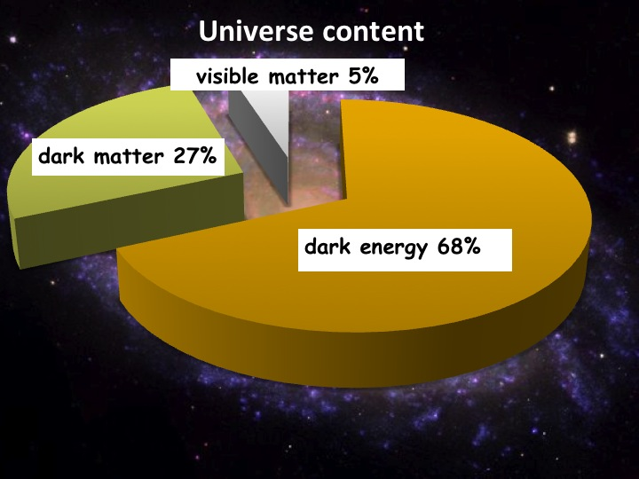
The matter with Dark Matter

Slide 3
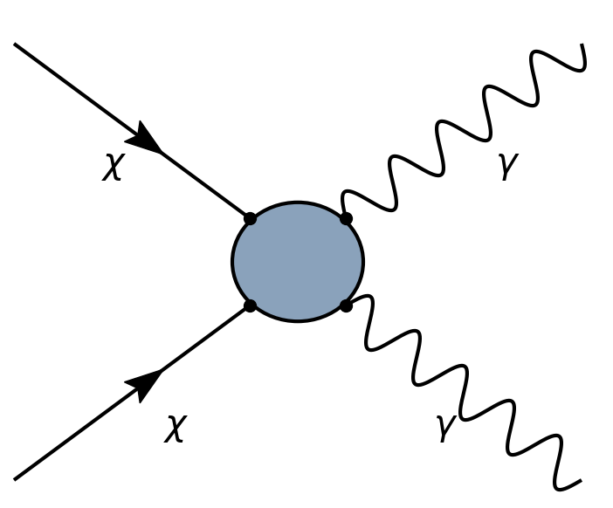
How to see in the dark?
DM particles annihilate
???
Gamma-rays are observed by us
???

Slide 4
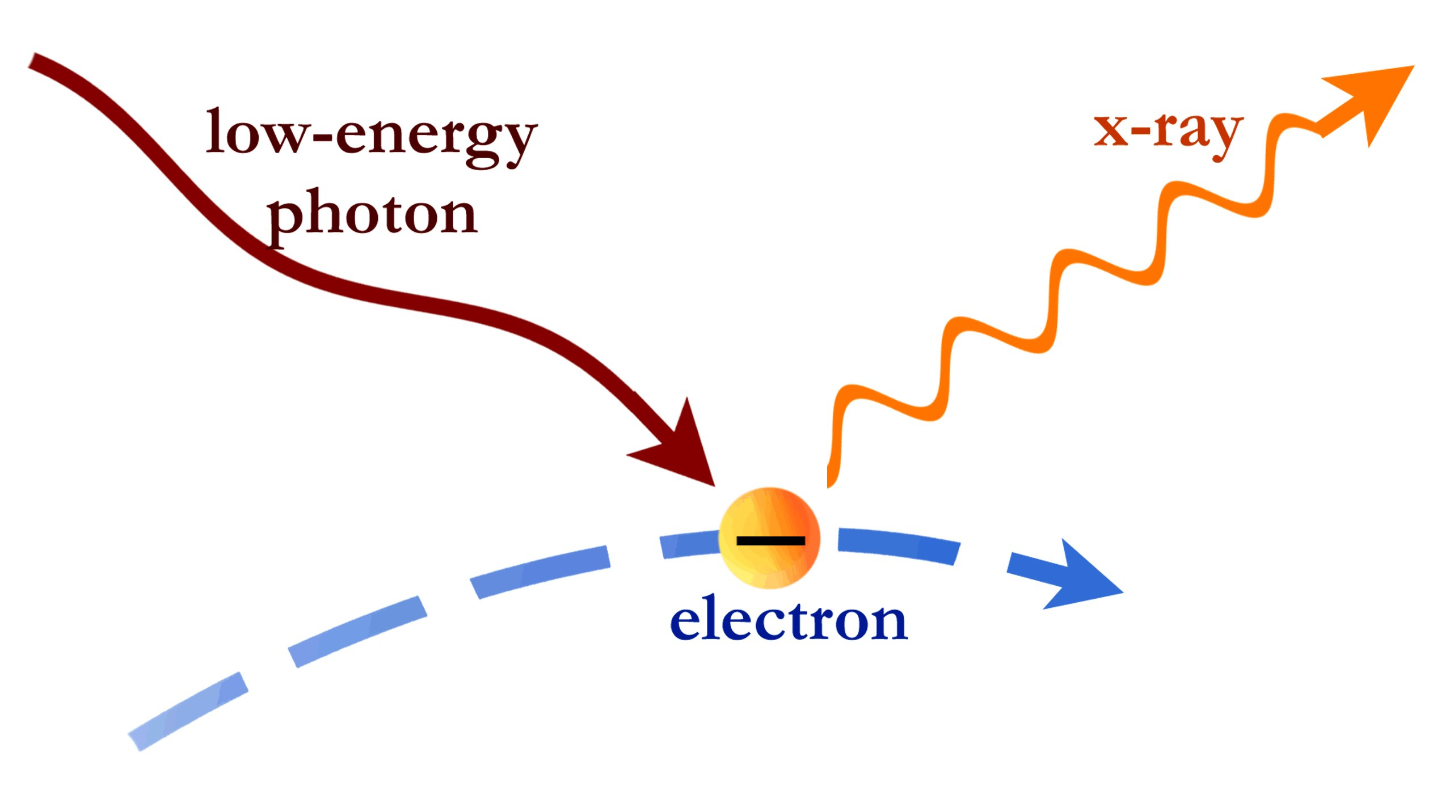
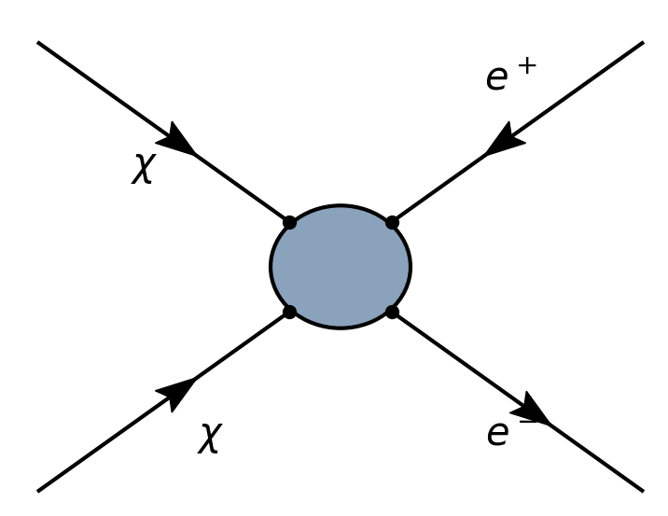
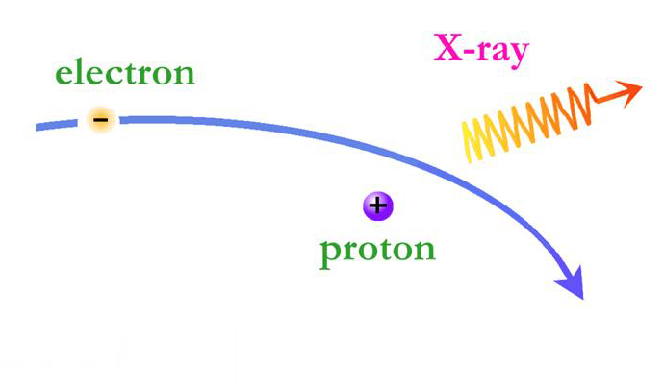
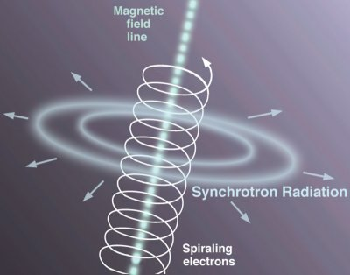
Or
How to see in the dark?
Inverse Compton
Bremmstrahlung
???
Synchrotron

Slide 5
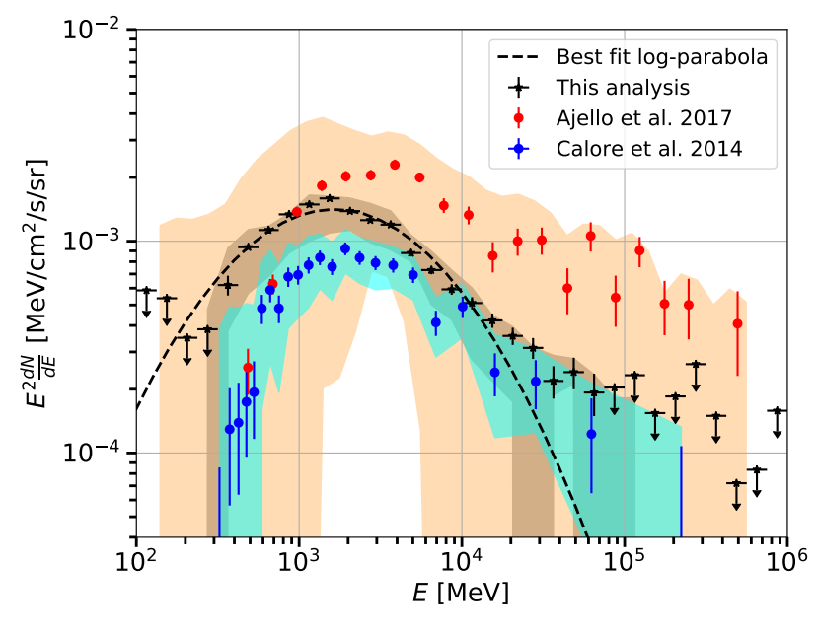
Anomaly hunting: astrophysics
Dark matter is an anomaly
Let’s look at other anomalies (and hope they are related)
Fermi Galactic centre
(2101.04694)
The saga continues!

Slide 6
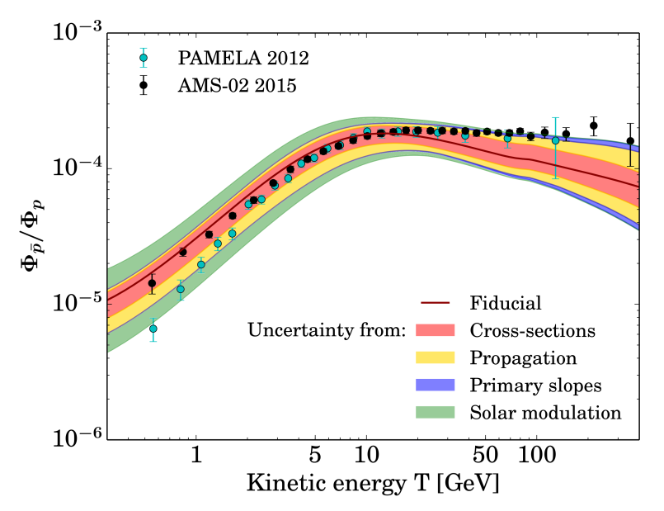
Anomaly hunting: astrophysics
Dark matter is an anomaly
Let’s look at other anomalies (and hope they are related)
AMS-02 anti-protons (1504.04276)
May just be correlated errors (2005.04237)

Slide 7
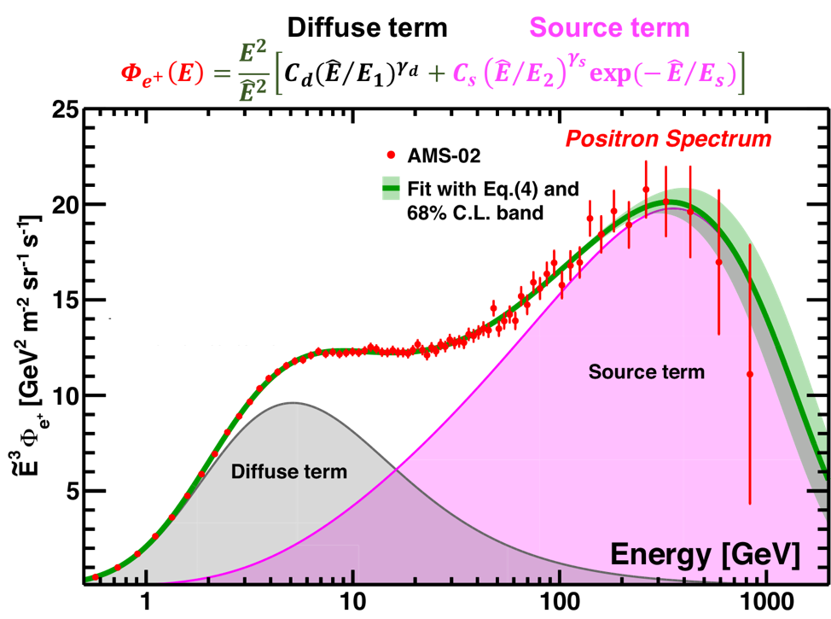
Anomaly hunting: astrophysics
Dark matter is an anomaly
Let’s look at other anomalies (and hope they are related)
AMS-02 positrons
(Phys. Rev. Lett. 122, 041102)
Unexplained source term

Slide 8
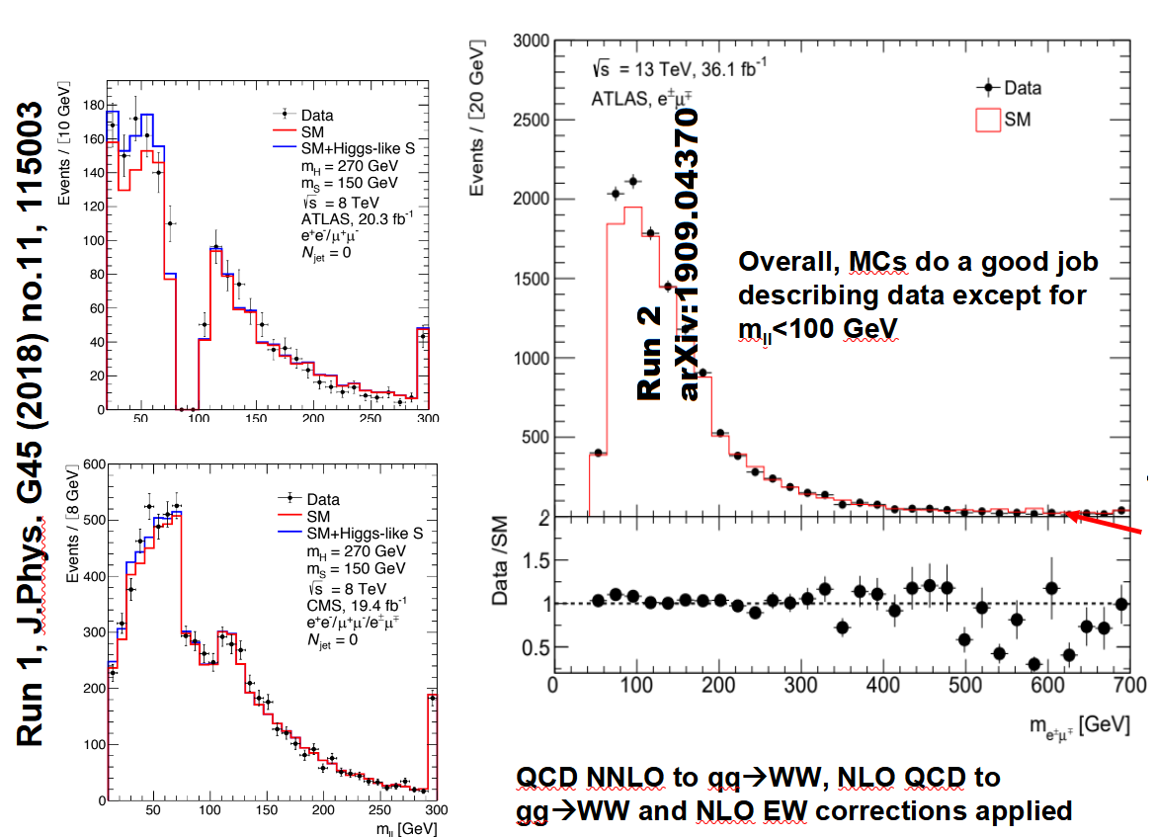
Anomaly hunting: the LHC
(Image: Bruce Mellado)

Slide 9
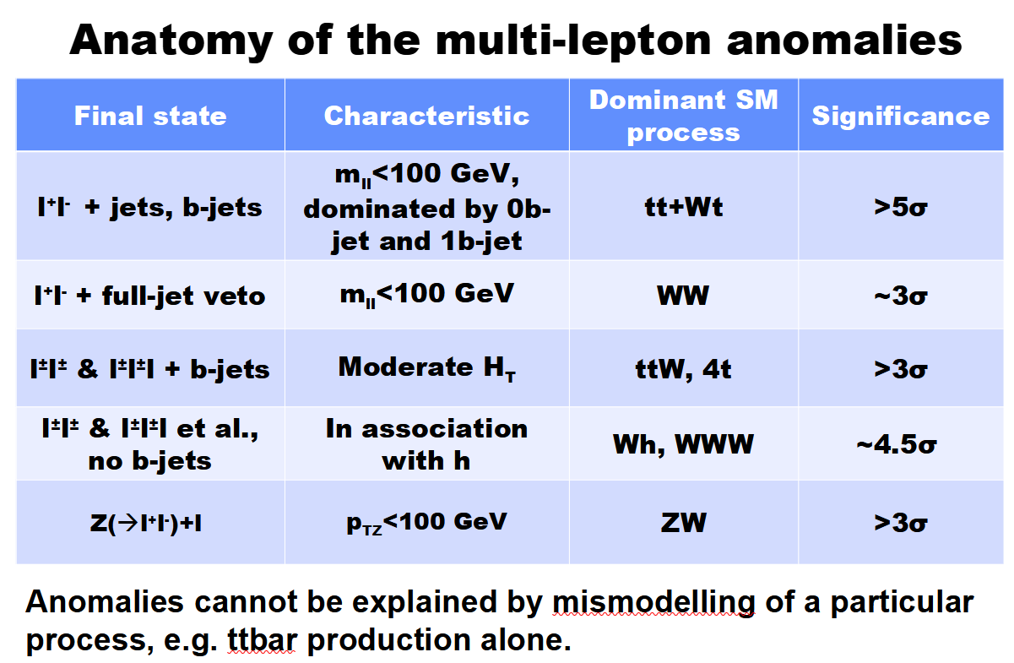
Anomaly hunting: the LHC
(Credit: Bruce Mellado)

Slide 10
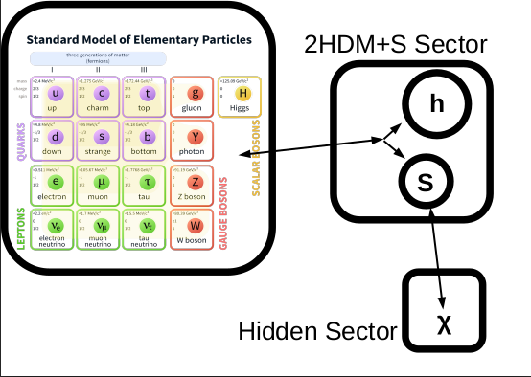
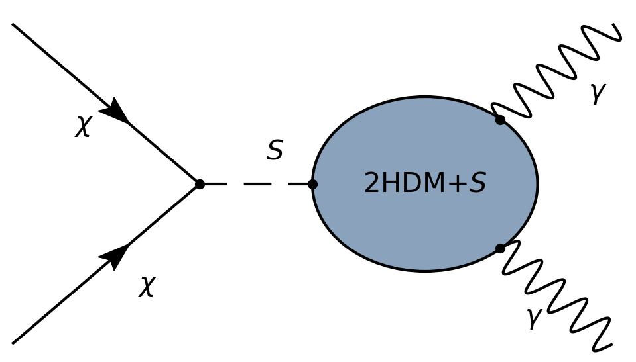
Introducing 2HDM+S

Slide 11
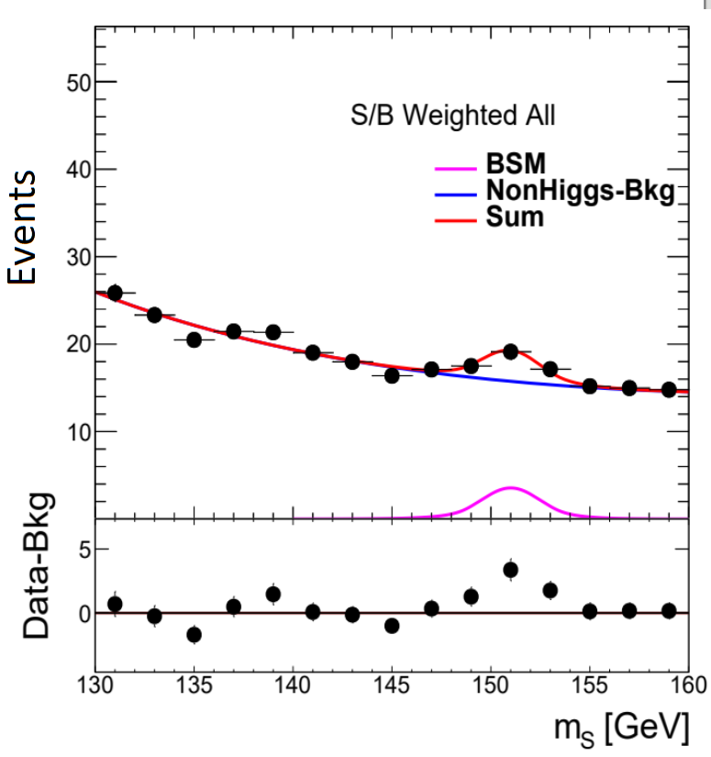
Evidence for 2HDM+S
Evidence above 4σ for S boson at mass need to explain other excesses!
m_{S} ~ 150 GeV
m_{H} ~ 270 GeV
Higgs-like couplings
See 2109.03800

Slide 12
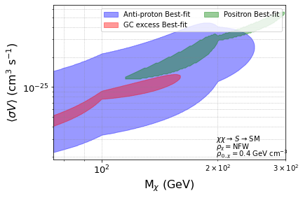
2HDM+S and astrophysics
Can fit our astrophysics anomalies
Surprising near overlap
Big cross sections!
Already ruled out?
Let’s see what Fermi-LAT can do
See: 2102.10596

Slide 13
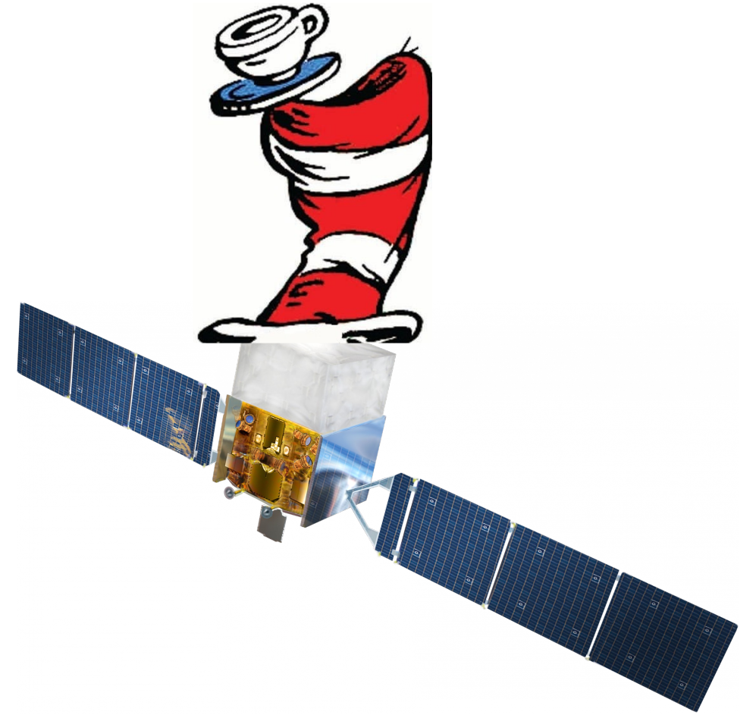
Fermi-LAT with a MADHAT
No, not the right hat

Slide 14
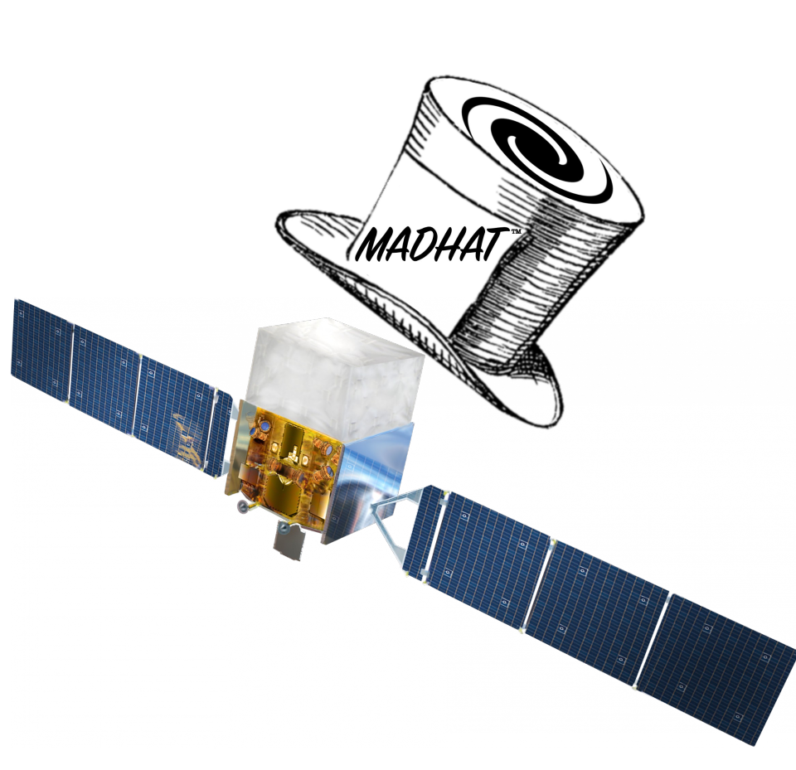
Fermi-LAT with a MADHAT
That’s better
MADHAT (1802.03826 and 1910.02890)
Dark matter limits from integrated fluxes
Stacked analysis with dwarf galaxies
Fermi Pass 8 data

Slide 15
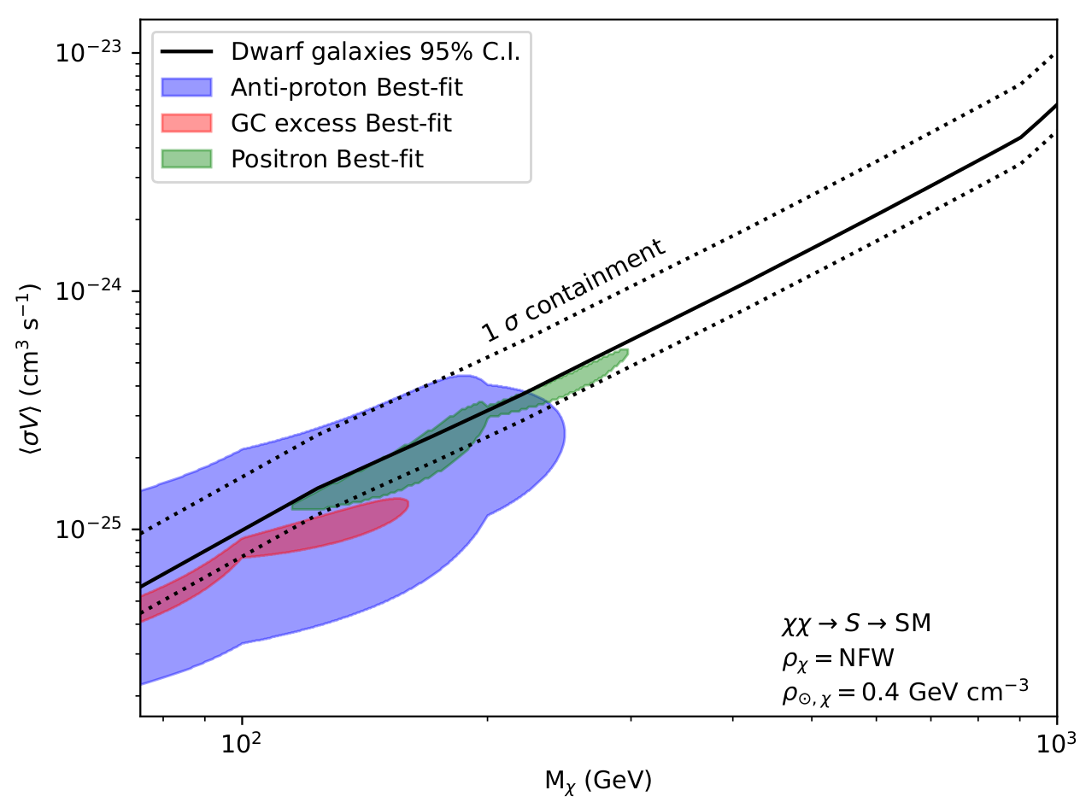
MADHAT results
Some impact
Surprisingly hard to rule out!
Can we do better?

Slide 16
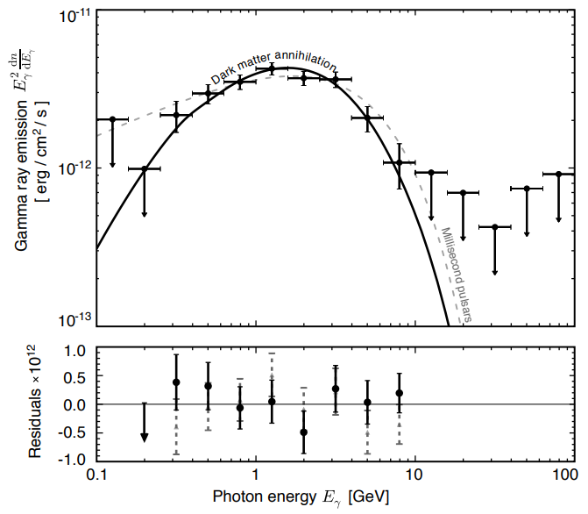
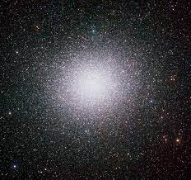
Omega-Centauri
Globular cluster at ~ 5 kpc
Observed by Fermi-LAT
Fit claimed by Brown 2019
Very small cross-section
(~ 10⁻²⁸ cm³ s⁻¹), mass ~ 30 GeV

Slide 17
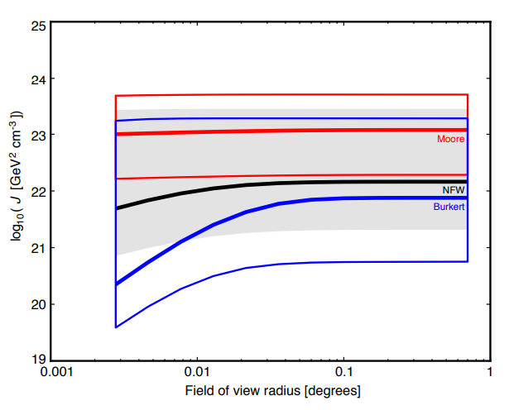
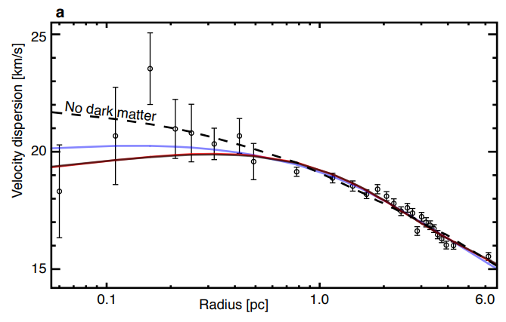
Omega-Centauri: full of dark matter?
1907.08564 suggests high DM density
No DM is too viable for comfort...
See also: 2109.10998

Slide 18
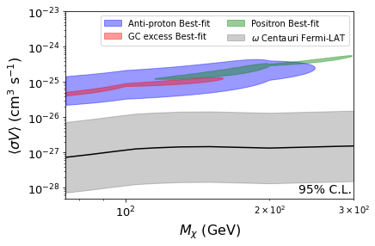
Omega-Centauri: Limits
Rules out the model!
Even with cored halo profile
Similar limits from radio!
Can do this for standard annihilation channels too

Slide 19
Summary
Omega centauri is an attractive target
  Even better than a dwarf?
  High DM density (probably)
  Lots of observations
Gamma-ray and radio limits can rule out 2HDM+s anomaly models
  Generic thermal WIMPs out to > 1 TeV
X-rays do surprisingly well
Caveat: Large uncertainties from dynamical data
Astrophysics constraining collider models!
Yes, I did just present a model and break it in the same talk

Slide 20
Thank you for your attention!
Geoff Beck* (University of the Witwatersrand)
*geoff.m.beck@gmail.com

Slide 21
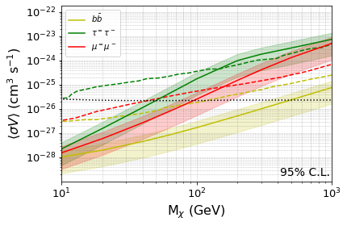
Backup Slide
X-ray data from 1803.04822

Slide 22
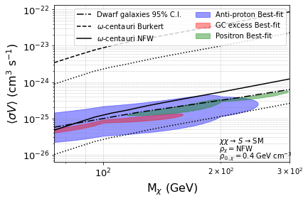
Backup Slide
X-ray data from 1803.04822

Slide 23
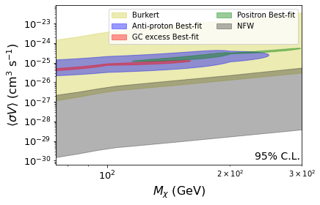
Backup Slide
Radio and B-field data from 2005.11962

