Slide 1

A search for Centaurus A-like features in the spectra of Fermi-LAT detected radio galaxies
Cameron Rulten*
Anthony M. Brown and Paula M. Chadwick.
University of Durham
*cameron.b.rulten@durham.ac.uk

Slide 2

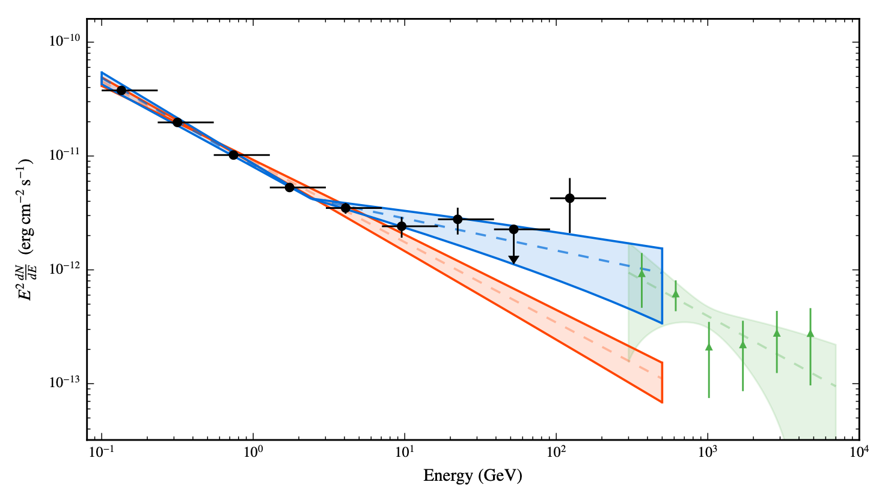
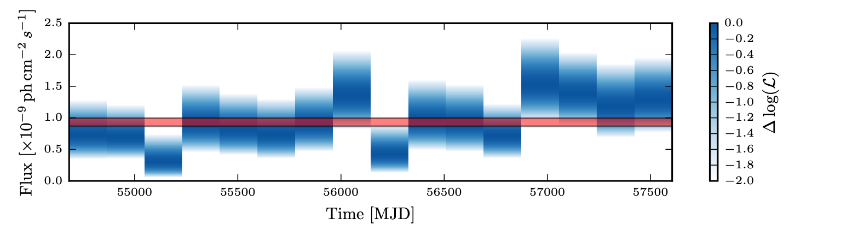

Motivation
Study by Brown et al. (2017) [see also Sahakyan et al. (2013)]
evidence for a new population of energetic particles near Centaurus A’s core
Hardening in the Fermi-LAT spectrum >5σ
Γ=2.73±0.02 → Γ=2.29±0.07 at Ebreak=2.6±0.3 GeV
Lack of variability → feature not due to jet-induced leptonic processes (4FGL-DR3 var. index= 33)
Combined GeV-TeV SED compatible with:
  A spike in the DM halo profile
  Population of unresolved millisecond pulsars
Look at other Fermi-LAT detected radio galaxies
Image credit: Brown, Anthony M., et al., Discovery of a new extragalactic population of energetic particles, Phys. Rev. D, 95, 063018 (2017)
Image credit: Brown, Anthony M., et al., Discovery of a new extragalactic population of energetic particles, Phys. Rev. D, 95, 063018 (2017)

Slide 3

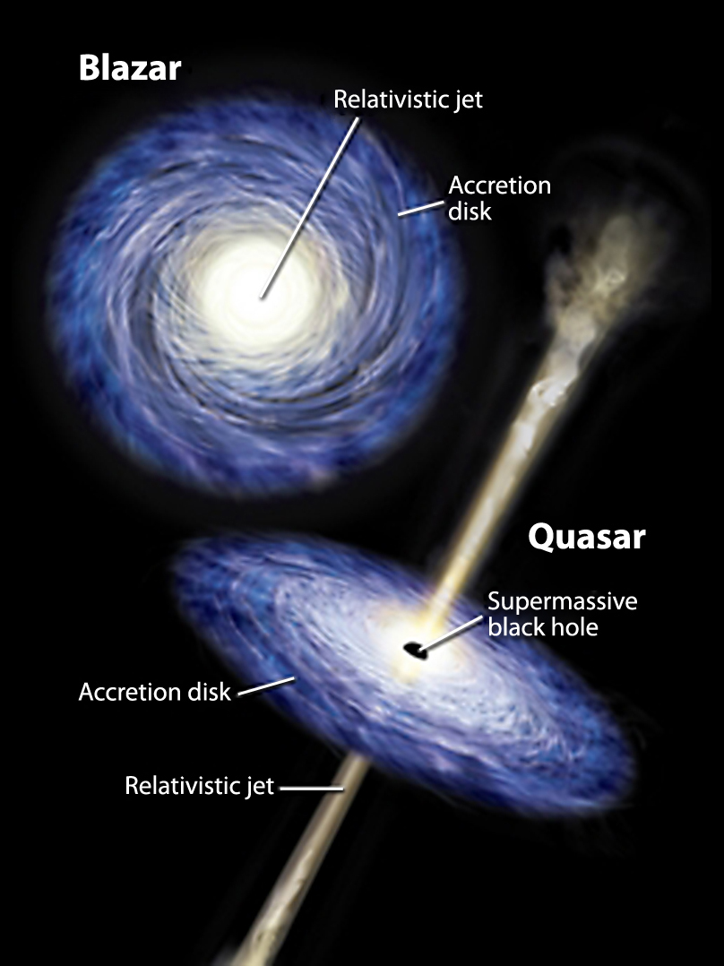
Radio galaxies in the 4FGL
Work done 2.5 years ago → 4FGL 8-year point source catalog
More than half associated with AGN (e.g. BL Lacs, FSRQs and unknown type blazars)
<1% associated with radio galaxies → 30
Orientation determines what we see
Face on → blazar
More edge on → radio galaxy
View of black hole and jet
Not dominated by highly beamed jet → weak gamma-ray sources
Image credit: Astronomy Magazine, NASA/Caltech

Slide 4
Analysis Details
Photons recorded by Fermi-LAT
Roughly 10 years of data for each target
100 MeV <= E <= 300 GeV
15 degree region of interest
Pass8 data analysis criteria
Quality cuts used:
  Zenith angle cut → 90 degrees
  (DATA_QUAL>0)&&(LAT_CONFIG==1)
Fermipy v0.18.0 with Fermitools v1.0.1
Binned maximum-likelihood method (Mattox et al. 1996)
IRFs → P8R3_SOURCE_V2
Background:
  4FGL sources within ROI
  Galactic (gll_iem_v07.fits)
  Isotropic (iso_P8R3_SOURCE_V2_v1.txt)
Searched for additional point sources → fermipy find_sources algorithm TS>=25
Modelled using a power law fixed at peak excess
Final likelihood → normalisation and index free to vary

Slide 5
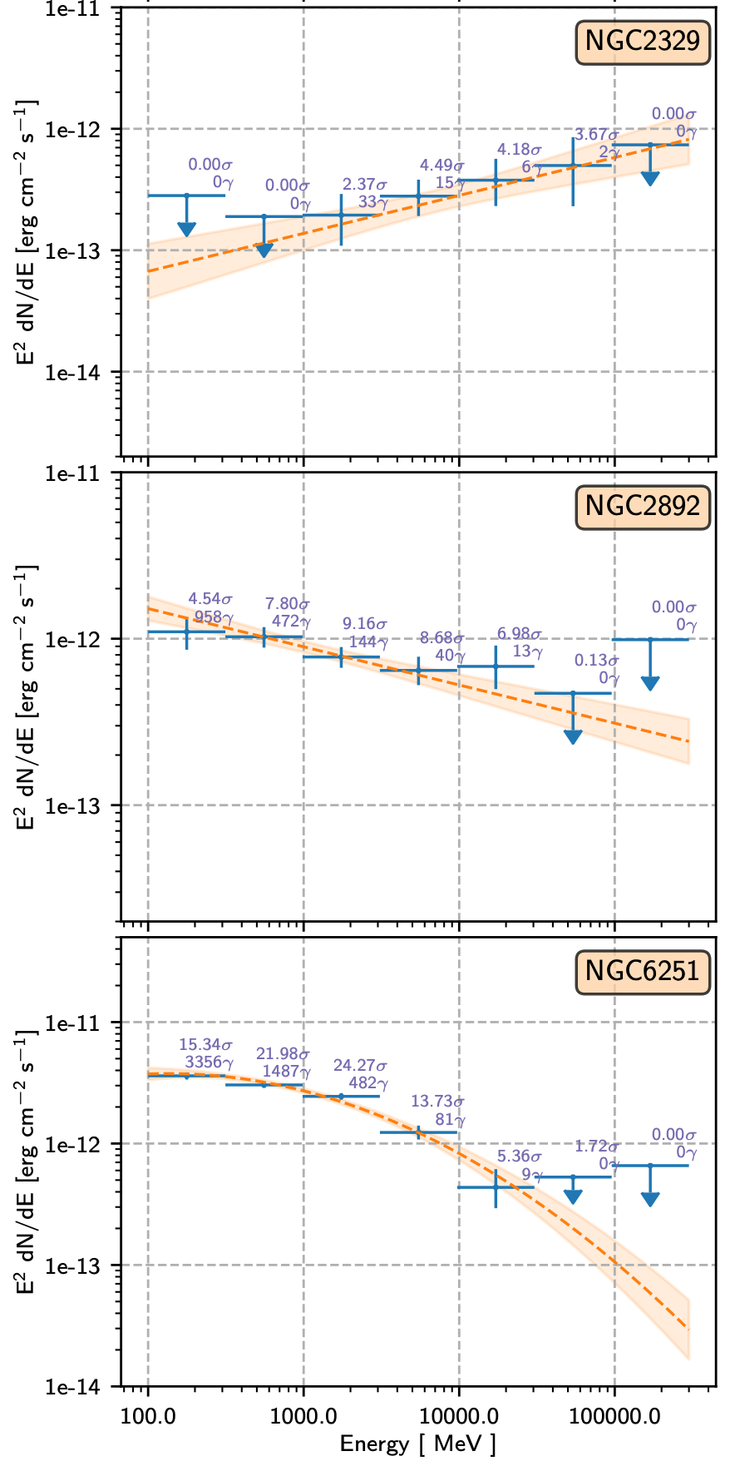
Spectral analysis results
Produced a spectral energy distribution for each radio galaxy
SED flux points → separate likelihood analysis for each bin
Initially 8 bins per decade → rebinned into 2 bins per decade
TS >=4 and photons >=2
Otherwise 95% confidence-level upper limit calculated
1σ uncertainty band shown for each
Initially only considered spectral models in 4FGL
Most are well-described by a simple power law model
Exceptions: 3C120, NGC1218, NGC6251, PKS2152-69 → Log Parabola

Slide 6
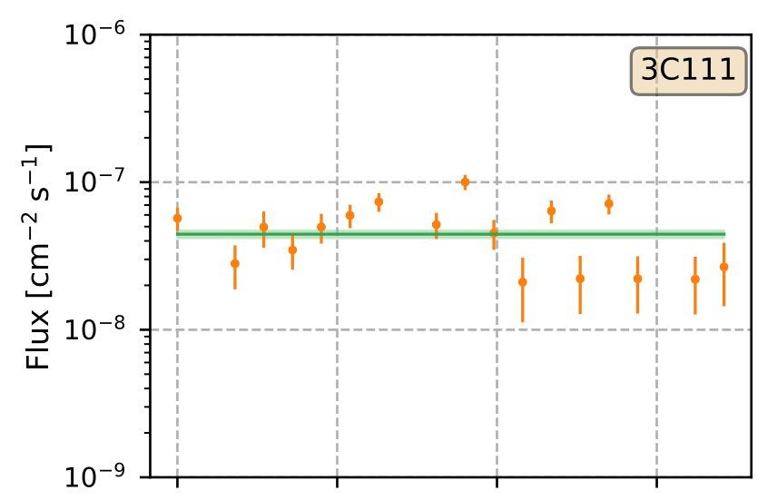
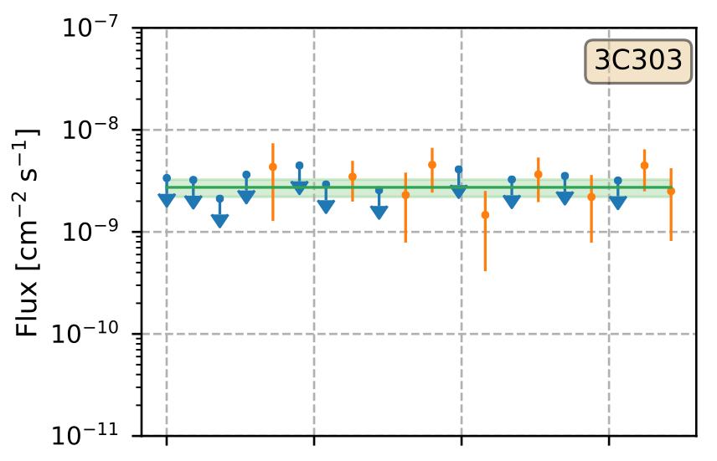
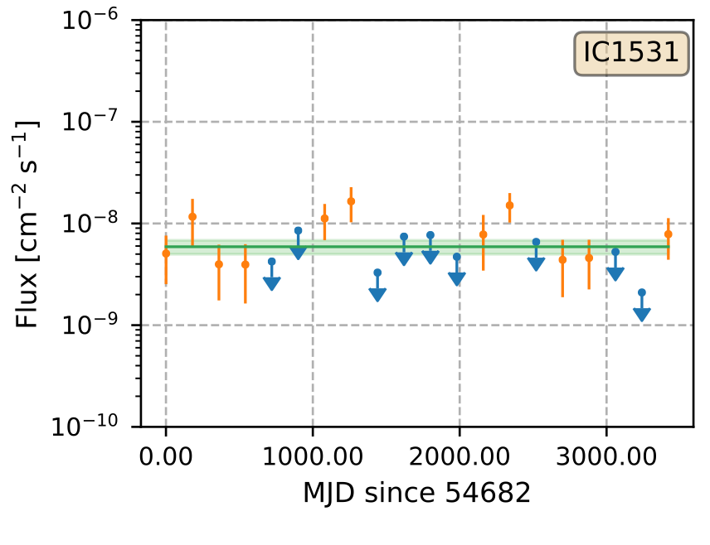
Temporal analysis results
Lightcurve produced for each target
Weak gamma-ray sources → Fermi-LAT not best
Timescales < 6 months → low statistics
20 bins of 180 days, covering 10 years
Binned likelihood approach, normalisation for all sources within 1 degree free to vary
Diffuse background free to vary
Variability index → Likelihood Ratio test
Most RGs not variable on 6 monthly timescale
Evidence for variability in 7 RGs: 3C111, 3C120, 3C264, IC4516, NGC1218, NGC2892 and PKS0625-35.

Slide 7

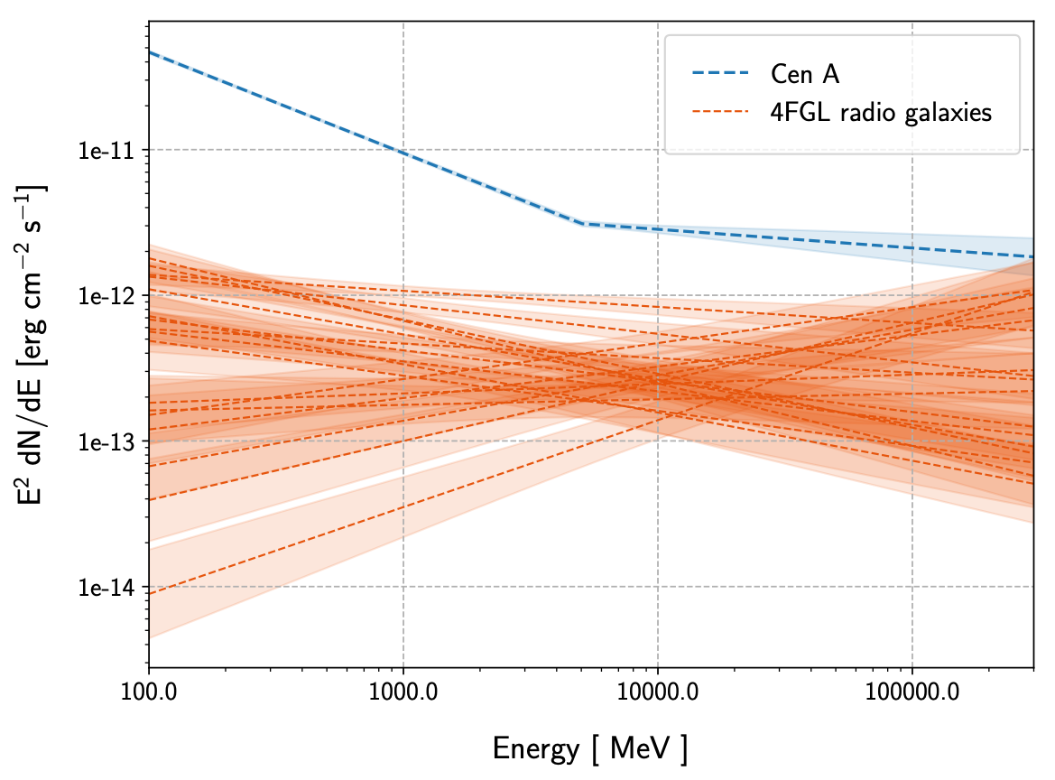
Comparing SEDs to Cen A
No evidence for hardening over the 10-year averaged Fermi-LAT SEDs calculated for each radio galaxy
Relative to other RGs → Cen A appears unique
Any hardening would’ve been seen → unless break occurs outside Fermi-LAT energy range
Single-zone SSC models not adequate
Current instruments cannot resolve jets → difficult to distinguish between emission scenarios
Cen A → associated with region close to core
Most recent H.E.S.S. observations → imply part of the VHE gamma-rays originate on large scales [see The H.E.S.S. Collaboration, Resolving acceleration to very high energies along the jet of Centaurus A, Nature, volume 582, pages 356–359 (2020)]
RG’s appear to have relatively hard SEDs

Slide 8
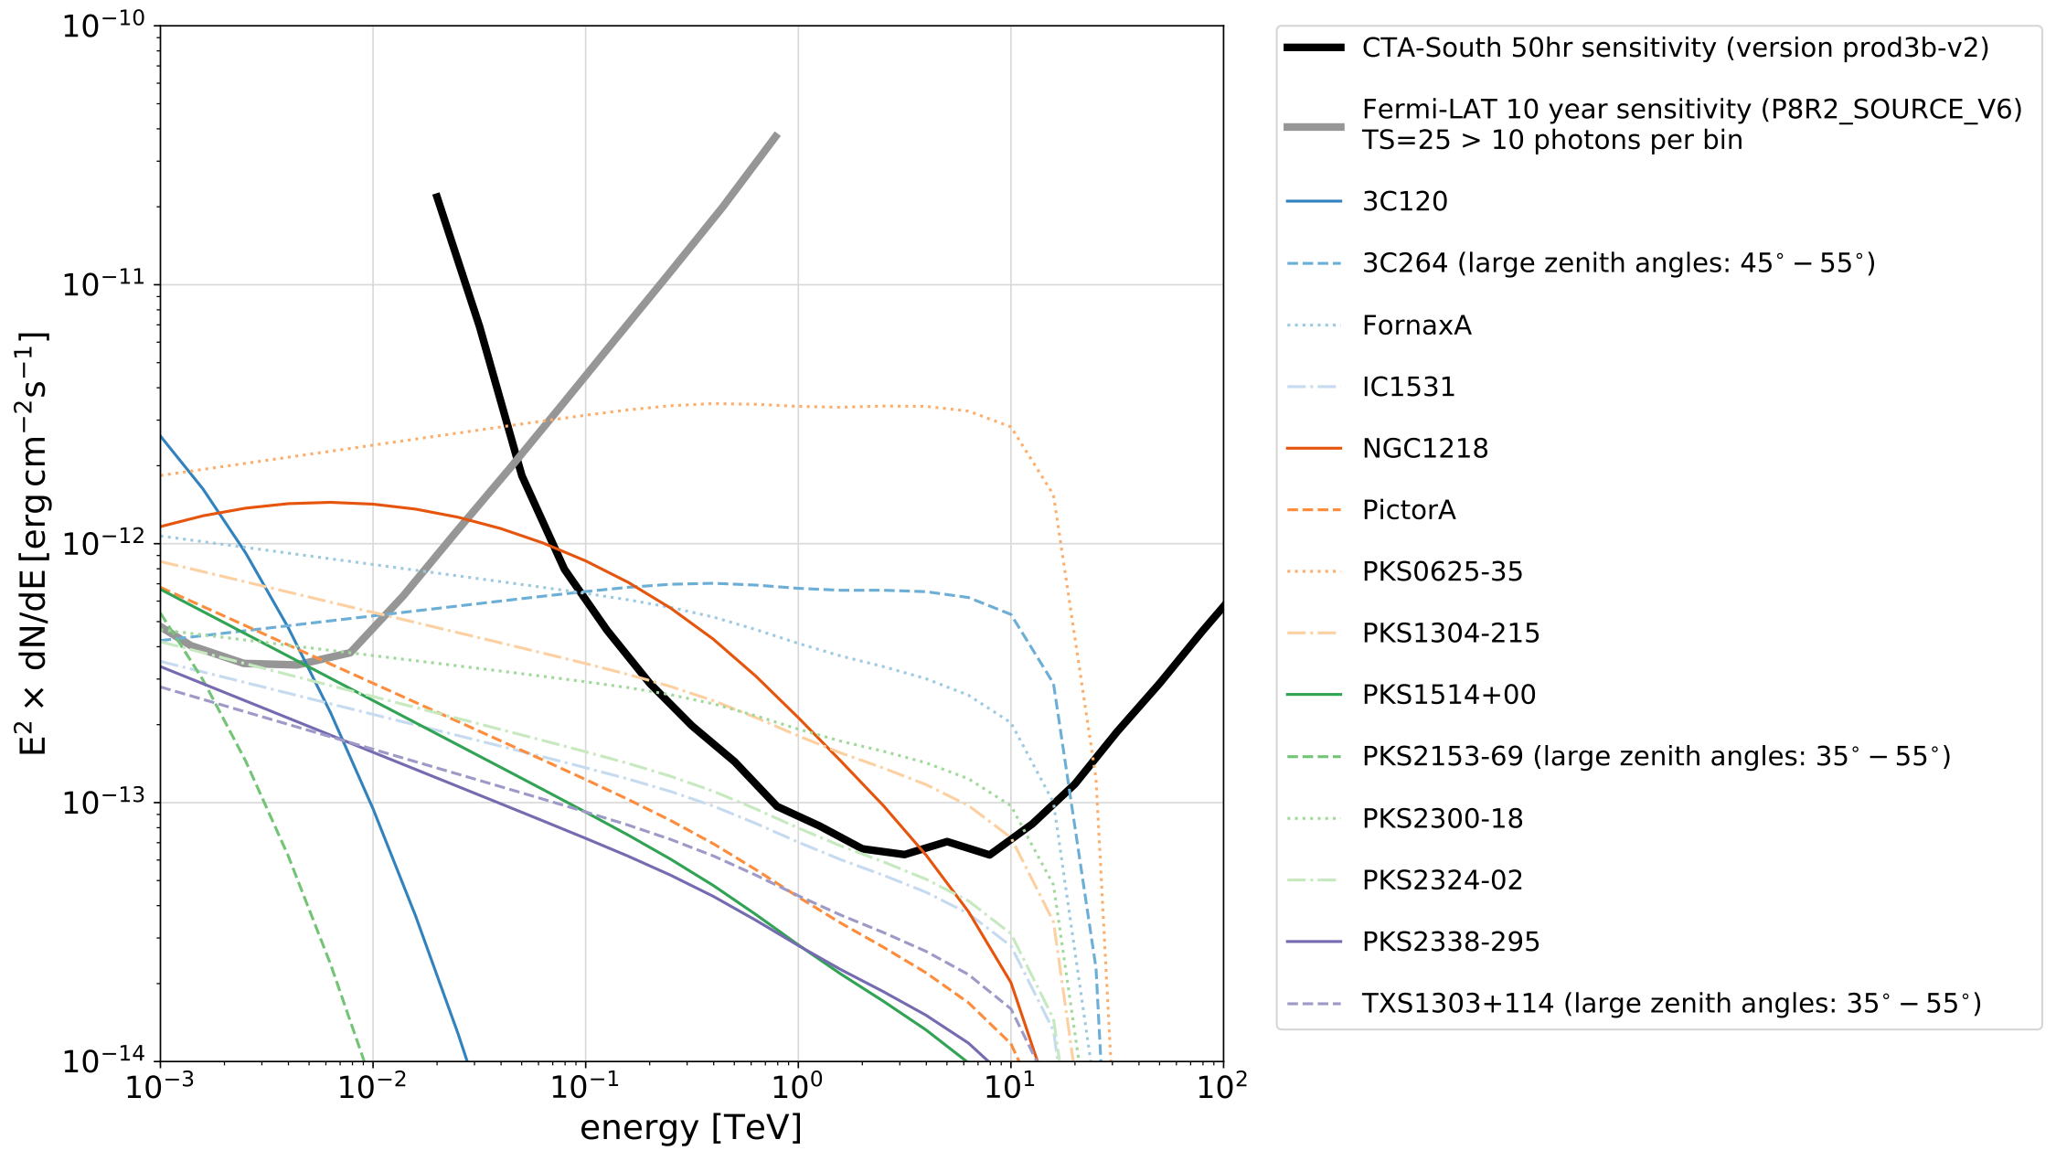
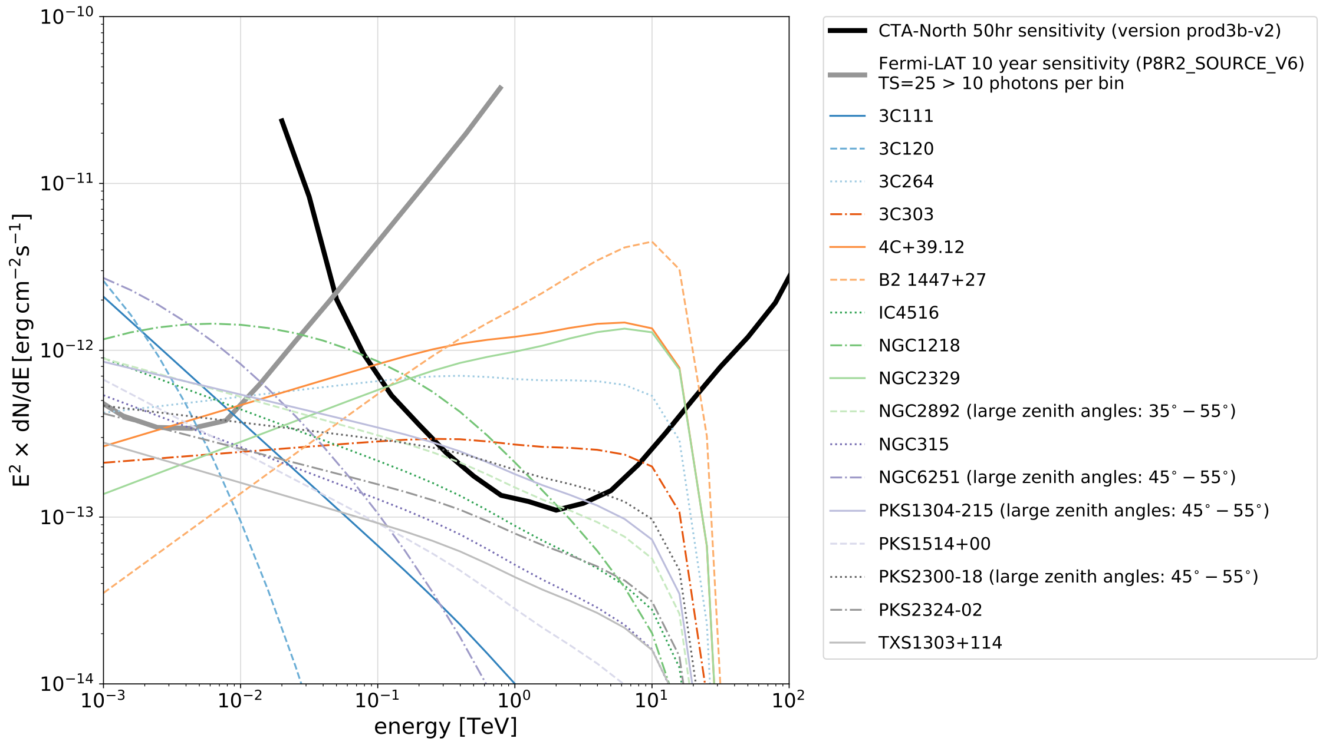
Future VHE detection prospects
Only 4 radio galaxies currently detected at VHE
Cen A, M87, NGC 1275 and 3C 264
The Cherenkov Telescope Array (CTA) → E.T.A.?
Expected to increase the sample of VHE-detected radio galaxies
Using Fermi-LAT as a pathfinder, we extrapolated the 4FGL fluxes into VHE
EBL absorption effects not in paper → given the relative closeness of RGs, assumed this would not majorly effect results
Updated extrapolations assume Dominguez EBL absorption model
Same result → 13 of 26 radio galaxies from 4FGL sample detectable
Also assume no other breaks, features or flaring events etc.

Slide 9
Conclusions & future work
Other “similar” objects do not appear to have Cen A-like features in their SEDs
Such a Cen A-like spectral feature would have been apparent from this analysis
Either Cen A is unique, or any break occurs outside Fermi-LAT energy range
Study limited to 4FGL 8-year point source catalog and 10-year data set
4FGL-DR3 12 year catalog includes 44 radio galaxies++
Preliminary analysis of 14 year data set with 4FGL-DR3
Results for updated work will be published
References:
Rulten, Cameron B., Brown, Anthony, M. and Chadwick, Paula, M., A search for Centaurus A-like features in the spectra of Fermi-LAT detected radio galaxies, Monthly Notices of the Royal Astronomical Society, Volume 492, Issue 4, p.4666-4679 (2020)
Rulten, Cameron, Radio Galaxies at TeV Energies, Galaxies, vol. 10, issue 3, p. 61 (2022)

Slide 10
Thank you for your attention!
Cameron Rulten*
*cameron.b.rulten@durham.ac.uk

