Slide 1


Modeling TXS 0506+056 for AMEGO-X
Tiffany R. Lewis
NPP Fellow at NASA Goddard’s Astroparticle Physics Lab
Collaborators: Christopher Karwin, Tonia Venters, Henrike Fleischhack, Yong Sheng, Carolyn Kierans, Regina Caputo, Julie McEnery
10th International Fermi Symposium
10 October 2022
tiffanylewisphd@gmail.com
Notes:
Good Afternoon, it’s wonderful to see you all. For those who don’t know me, my name is Tiffany Lewis and I’m a Postdoctoral Fellow in the at NASA Goddard Space Flight Center.
My research tends to focus on understanding the environment in blazar jets with a focus on tracking particle energetics through acceleration and emission processes.

Slide 2
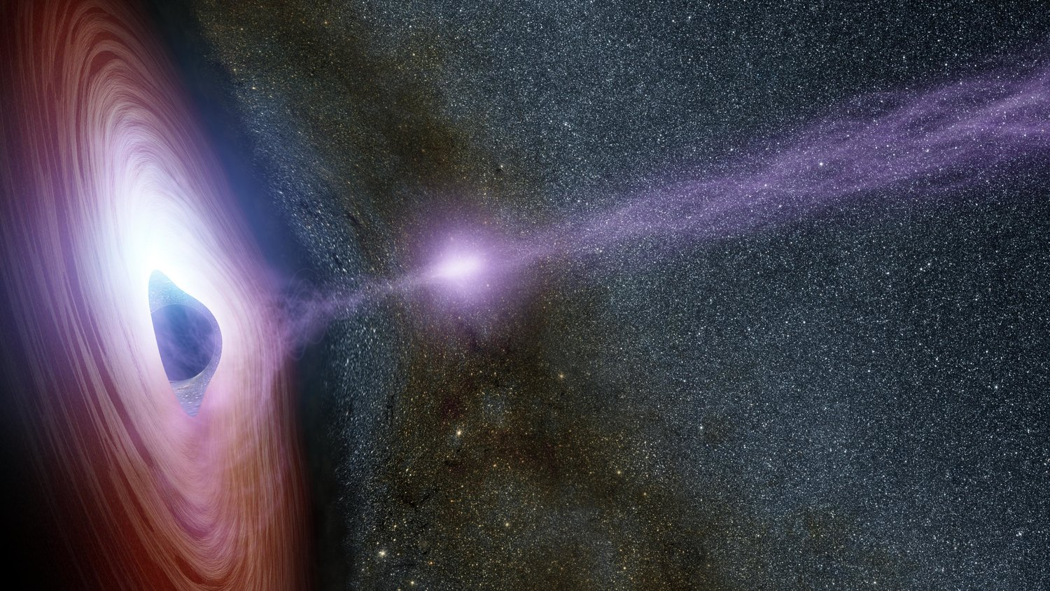
Models for Blazar Jets
Homogeneous, one-zone leptonic and leptohadronic models
“Low” injection energy
Self-consistent: if a process appears in the SED, it also appears in the particle transport equation
Image Credit: IPAC CalTech
Notes:
Leptonic: single homogeneous blob, composed of electrons and positrons.
Leptohadronic: single homogeneous blob, composed of electrons and protons.
A one-zone model allows me to model the particle distribution with respect to energy from first-principles, and calculate the observables self-consistently from there based on specific emission processes.
In Blazars, our telescope looks right down the jet to the emitting region.
We can imagine particles appear at the base of the jet, and the model neglects how. (The Blandford-Znajek process) - particles from the accretion disk should have relatively low energies prior to being accelerated in the jet.
Particles that are accelerated should be expected to emit. Thus, we consider the primary acceleration and emission regions to be cospatial.
We also consider the possibility that some particles will escape the jet system all together. And, that the probability of a particle escaping the jet is greater the more energy the particle has. Thus, we use the Bohm approximation for particle escape.
While the calculations for particle energetics are performed in the comoving frame, we apply corrections for cosmological effects such as redshift and beaming when calculating the observable emission.

Slide 3
Particle Acceleration Mechanisms:
1st & 2nd Order Fermi Interactions
Fermi I:
Shock Acceleration (+) & Adiabatic Expansion (-)
Particles gain energy from shock crossings in proportion to the energy they already have, and can pass through a shock region multiple times
Fermi II:
Hard-Sphere Scattering off of Stochastic MHD Waves
Particles always gain energy from stochastic scatterings in the head-on approximation due to the bulk motions in the jet.
Notes:
We consider particle acceleration within the transport equations bc acceleration should be co-spatial with emission and can impact the model output.
Shock acceleration occurs when the particle traverses a shock front. The particle will gain energy in proportion to the energy it has, meaning there can be a build up of high energy particles in an environment with multiple shock crossings due to backscattering.
Adiabatic expansion is also included in the shock term for practical purposes.
Stochastic acceleration occurs when the particle collides with MHD waves caused by the tangled magnetic field lines.

Slide 4
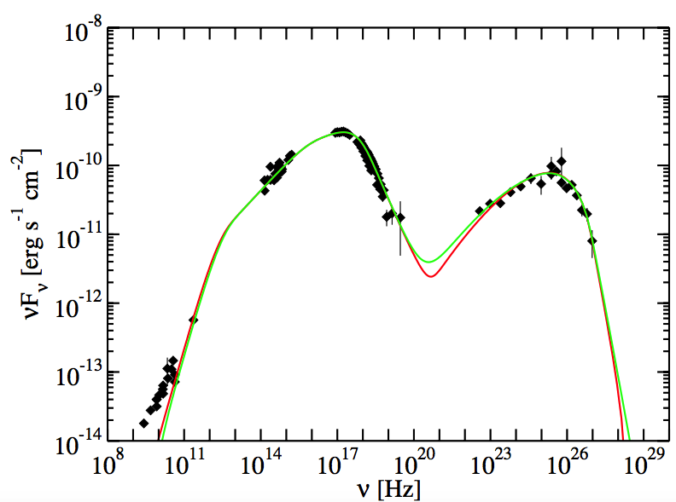
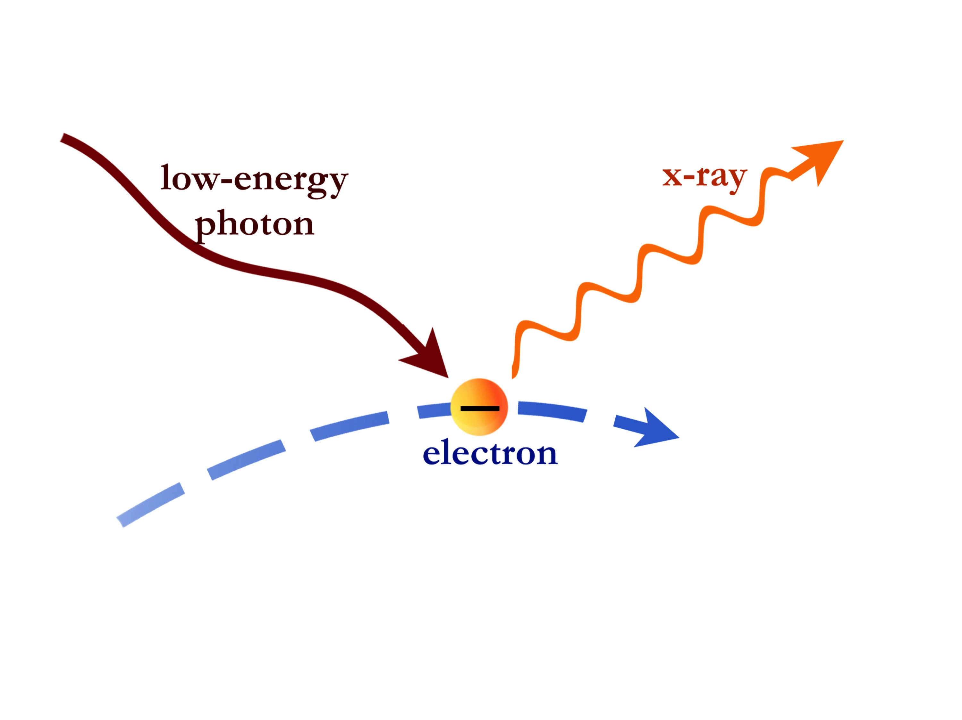
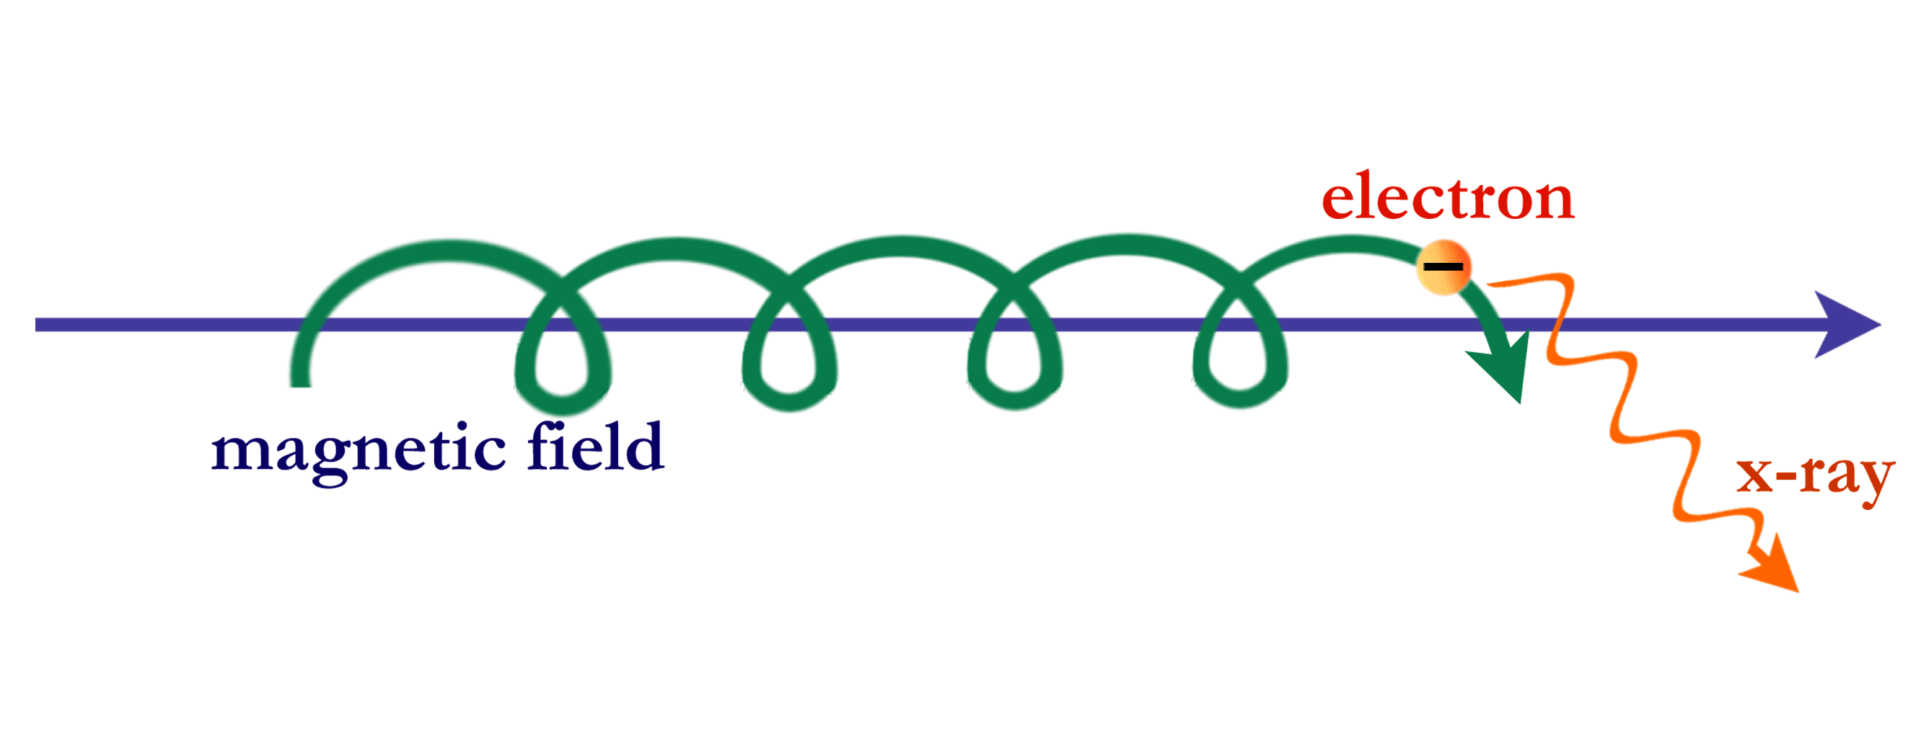
Particle Energy Loss Mechanisms:
Synchrotron, Inverse Compton, Photo-pion Cascade
Abdo et al. 2011 (Mrk 421)
higher-energy photon
p
p
n
$$e^{-}$$
$$e^{-}$$
$$ν_{e}$$
$$π^{+}$$
$$ν_{μ}$$
$$γ$$
particle
$$π^{+}$$
$$ν_{μ}$$
$$ν_{e}$$
Compton cooling describes the high-frequency SED bump in the leptonic picture.
The Compton cooling rate depends on the energy density of the ‘low-energy’ photon field
Photo-pion production contributes to cooling for the proton population
It also has the potential to produce observable neutrinos, but I will not be showing neutrino spectra today.
photon
Both electrons and protons populations can cool through synchrotron radiation.
The rate of synchrotron cooling depends on the strength of the magnetic field.
Illustration: CXC/S. Lee
Illustration: CXC/S. Lee
Illustration adapted from: Jonas Heinze
Notes:
Synchrotron emission is produced when charged particles travel around a magnetic field line and release of photons.
Both electrons and protons can lose energy to synchrotron radiation.
Electron synchrotron makes up the lower frequency bump in the SED spectrum.
In the leptonic picture, Inverse Compton radiation is produced when a low energy photon interacts with a jet electron to produce a higher energy photon.
If the low energy photon came from the synchrotron photon population then this will be synchrotron self-Compton.
For FSRQ, the low energy photon can also come from outside of the jet - from the BLR, torus, disk.
.
In the hadronic picture, Photo-pion Cascades can contribute to high-energy emission of both photons and neutrinos, which makes them an interesting process to include for analysis of the Texas source.

Slide 5
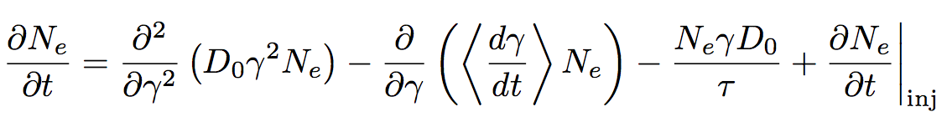
Fokker-Planck Electron Transport Equation
Escape
Injection
N is the number of electrons with respect to the electron Lorentz factor.
This version of the equation can be solved analytically, although generally I employ a more accurate accounting of the inverse Compton processes.
An analogous equation is solved for the proton population.
Lewis, Becker & Finke (2016)
Notes:
This is an electron transport equation in the Fokker-Plank Formalism.
N is the dimensionless number distribution…the number of electrons per energy and the thing we solve for.
Gamma is the electron Lorentz factor - thus representing our particle energy.
Each physical process considered is represented by a term
Notably, here the acceleration processes are considered directly in the equation so that they are co-spatial with the emission.
This version of the equation can be solved analytically, which gives us some ability to trace the effects of the processes.

Slide 6
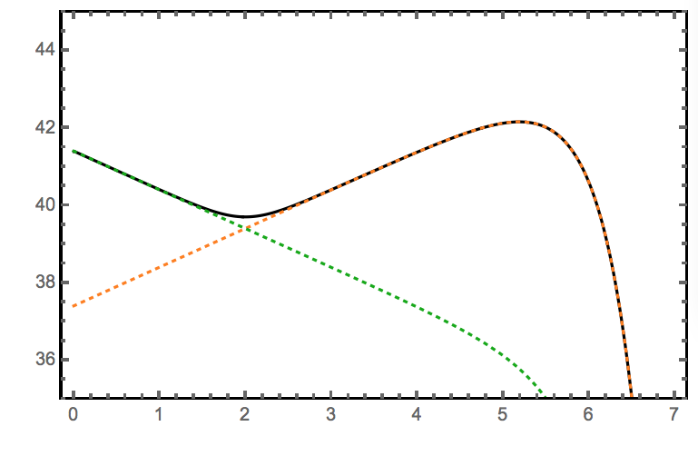
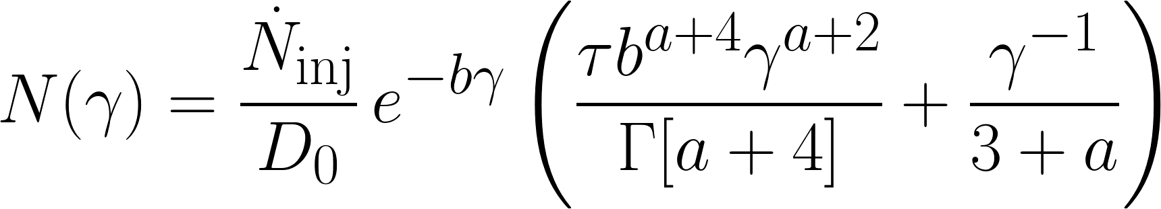
A Simplified Analytic Electron Distribution with Explicit Physics
Orange: balance between Fermi I and Fermi II terms
Green: dominated by Fermi II acceleration
These components of the analytic solution are NOT separable
log₁₀[N(γ)]
log₁₀[γ]
Lewis et al. (2019)
Notes:
This is a slightly simplified version of the solution to the transport equation from the previous slide. It is the number of electrons with respect to their Lorentz factor. You can see that it retains the particle injection rate N-dot, the particle escape timescale tau, the stochastic acceleration parameter D-0, the shock parameter a, and the emission coefficient b.
This arrangement of the plotted components is a bit contrived to demonstrate their domains. But the orange is a perfect balance between Fermi 1 and Fermi 2 terms. This knee can move left to right, up or down, depending on a range of parameters and the left-hand portion can fold up or down depending on the strength of the shock.
The green portion is dominated by Fermi 2 acceleration. It can be shorter or longer depending on the strength of the stochastic term, and move up or down on the plot, normalized by the number of particles, but the shape is essentially fixed.
This flexibility in the shape of the electron distribution without changing the model itself provides flexibility for the model to fit a variety of spectral shapes.

Slide 7
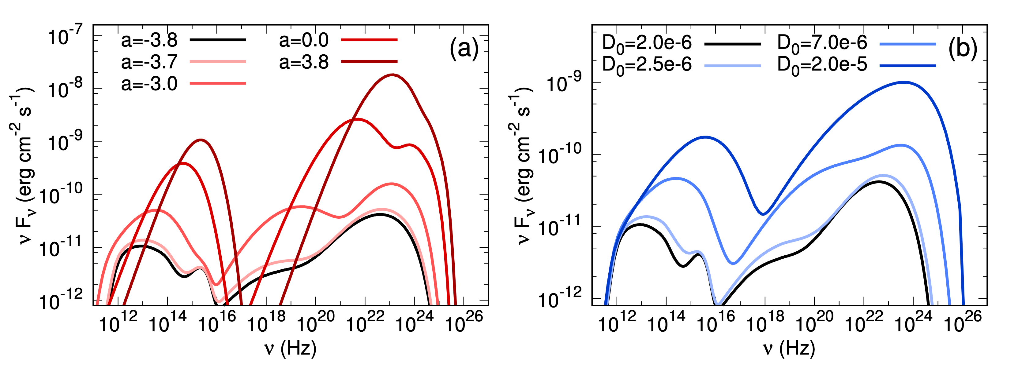
How Acceleration Processes Impact Spectral Features
Fermi-I (shock) acceleration:
As red intensifies, the shock increases
Fermi-II (stochastic) acceleration
As blue intensifies, Fermi-II increases
The black spectrum is the same in both panels.
Lewis, Finke, & Becker (2018)
Notes:
To examine the effects of different types of acceleration on the spectrum, we conducted a parameter study. Both panels here are simulated multiwavelength spectra unassociated with any data set. However the identical black lines toward the bottom of each panel are similar to the average quiescent spectrum of 3C 279.
On the left, I increased the amount of shock acceleration in the blazar zone, completely unmitigated by any other parameter changes. The deeper the red, the more shock acceleration applied. So, it is not unexpected that the spectrum is significantly brighter than the baseline. It also moves to higher frequencies and becomes more pointed with additional (arbitrary) step in increasing shock acceleration.
On the right, I have increased the amount of stochastic acceleration, again without changing any other parameters. The darker the blue, the more stochastic acceleration. And in this case, we see that each of the emission features is broader than in the shock case.
So, the type of acceleration has an effect on the shape of the broad band spectrum.

Slide 8
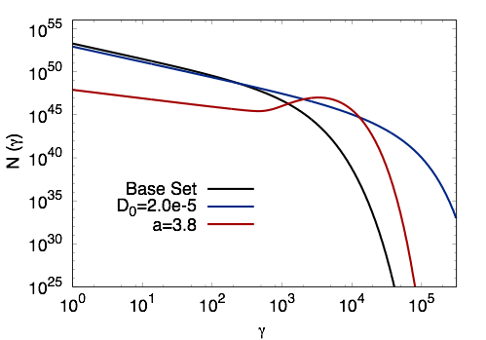
Particle Energy Distributions Impact Spectra
The spectral shape is dictated in part by the shape of the particle spectrum.
Particles accumulating at higher energies lead to sharper peaked spectra.
Lewis, Finke, & Becker (2018)
Notes:
That difference in spectral shape can be traced back to differences in the shape of the electron distribution. These particle spectra are the most extreme cases from the previous slide. The black line is the base case, prior to changes. The blue case increased the Fermi 2 acceleration, and looks like an extension of the same basic shape. The red case increased Fermi 1 acceleration. Here we see the build up of high energy particles that we might expect of the scenario where a subset of the electrons scatter through the shock many times.

Slide 9
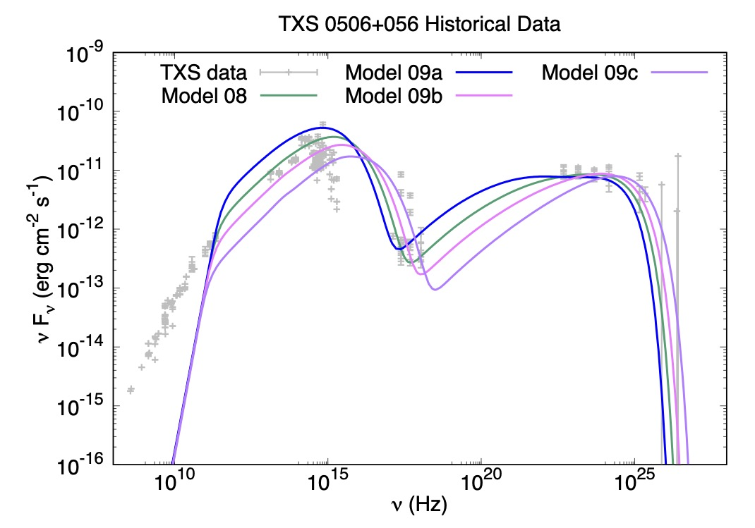
Historical TXS 0506+056 Data
arXiv:2111.10600; submitting to ApJ)
Comparison to historical data to constrain the base-line parameter space
It is only necessary to change a single parameter to illustrate this range of data
B is varied from 0.5 to 1.2 G
Notes:
Electron distribution shape
Data
Components of SED
Bullet points

Slide 10
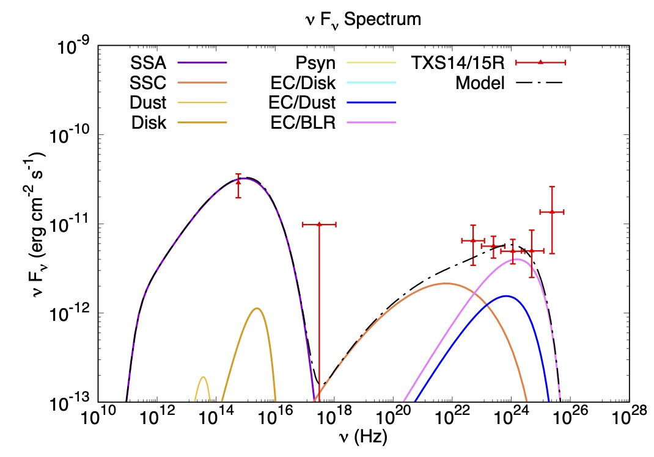
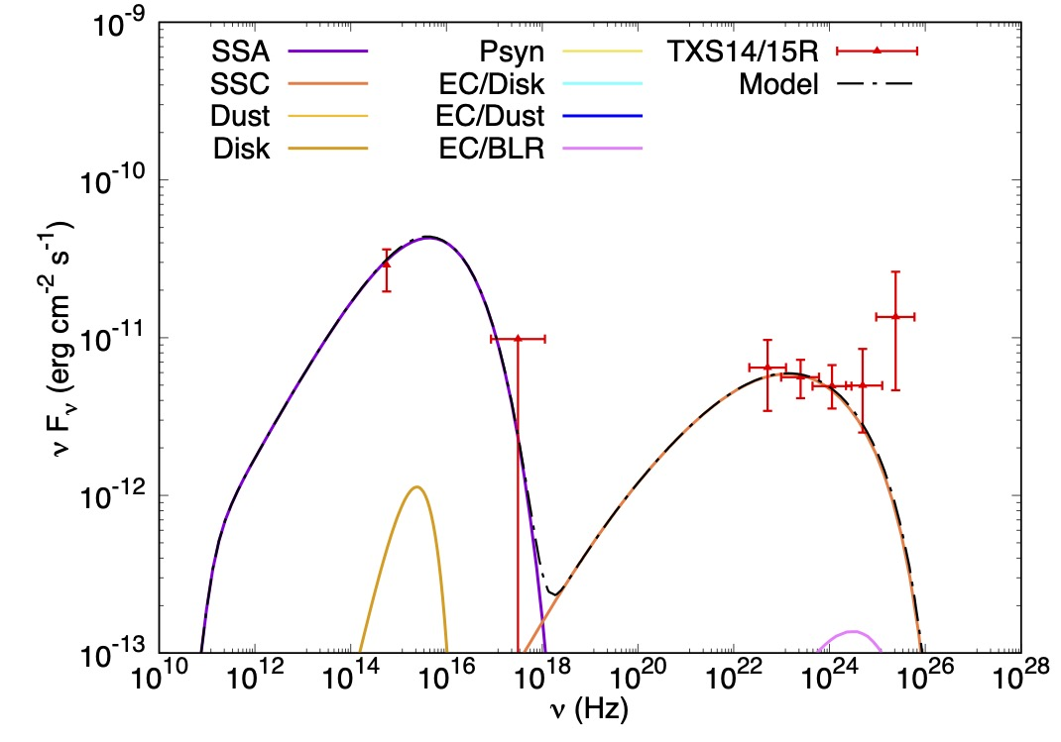
TXS 0506+056 Data: the 2014-2015 Neutrino Flare
Comparison of the FSRQ leptonic model to multiwavelngth flare data
The model is tuned such that external Compton dominates in the γ-rays.
Comparison of the BLL leptonic model to multiwavelngth data
The model is tuned such that synchrotron self-Compton dominates in the γ-rays.
arXiv:2111.10600; submitting to ApJ; Data: Rodrigues et al. 2019
Notes:
This is a subset of the analysis we did for TXS 0506+056, for the neutrino flare that occurred in the winter of 2014-2015.
The TXS source is formally classified as a BLL, but there is also literature disputing that classification, and the multiwavelength data during the neutrinos flares is limited for wavelengths that use pointing instruments because they cannot be everywhere at once and during this flare, no one knew a neutrino co-detection was underway.
So, we started with the historical data for the source to get the model in the right ballpark of parameter space, then tuned the model to express different dominant processes in the high-energy range.
On the left… EC for FSRQ
On the Right… SSC for BLL
Also possible to have Psyn and Hadronic cascade dominated emission.

Slide 11
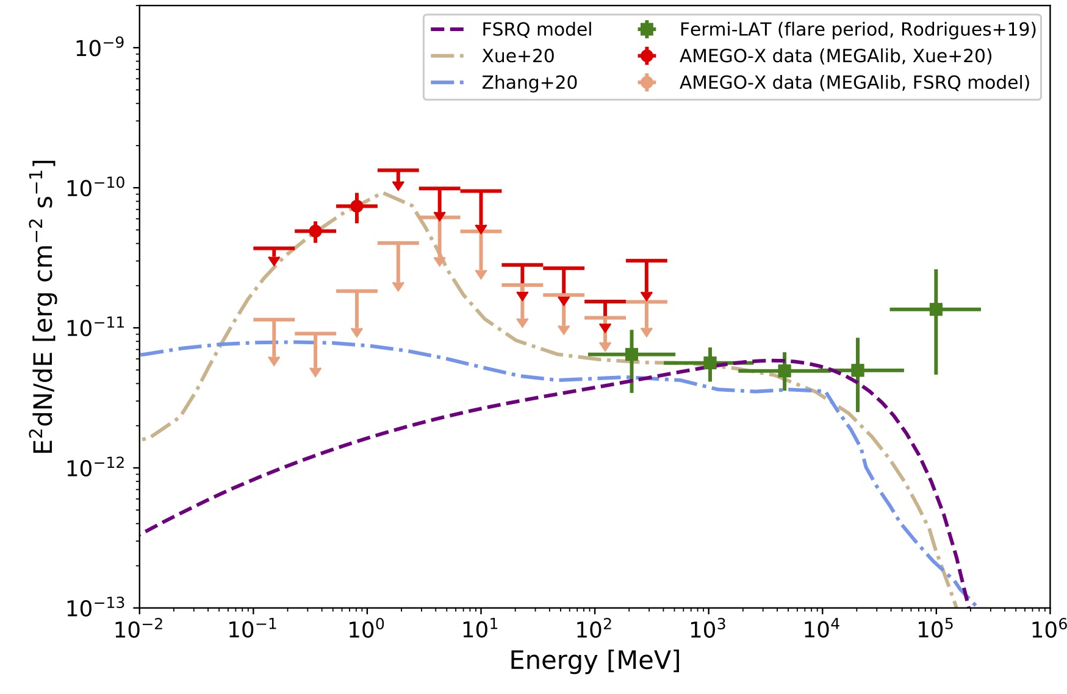
2014 Neutrino Flare MeV Spectra for AMEGO-X
    In the figure:
    Fermi LAT data is in green
    Simulated AMEGO-X data in red & peach
    3 leptohadronic models representing different dominant emission processes.
          Purple is Inverse Compton
          Blue is hadronic cascades
          Tan is 2 zones with coronal gamma-gamma absorbed cascade emission in the MeV, but inverse Compton in the GeV
AMEGO-X would have detected the tan model or ruled it out through non-detection.
arXiv:2111.10600; submitting to ApJ)
(arxiv:2208.04990; accepted to JATIS)
Notes:
This figure contains the MeV and GeV spectral range with the Fermi data from the 2014-15 flare in green.
The purple model has external Compton dominated emission.
The blue model has cascade dominated emission.
The tan model involved 2 zones, where the MeV excess is due to cascade emission, which is cut off by extremely high gamma-gamma-absorption due to a corona, and the GeV data is therefore dominated by Inverse Compton emission.
The Red points are a simulation of what AMEGO-X would have detected if the tan model were true.
The peach points illustrate the upper limits AMEGO-X would have reported for either of the other scenarios.

Slide 12
COSI Will Also Observe Blazars
The purple box, containing the peak of the tan model, is COSI’s sensitivity band.
COSI is a large field of view 0.2-5 MeV gamma-ray satellite mission planned for launch in 2026 (Tomsick et al., arXiv:1908.04334, arXiv:2109.10403)
COSI is expected to detect flares from ~35 blazars/year & a correlation study with IceCube events is planned
arXiv:2111.10600; submitting to ApJ)
Notes:
The AMEGO-X mission concept was not accepted in the current cycle, but the proposal is being refined to compete again with updated sensitivity.
In the mean time, COSI is a large field of view 0.2-5 MeV gamma-ray satellite mission planned for launch in 2026
The purple box indicates COSI’s area of sensitivity, and while it is not their primary science goal, they expect to detect about 35 blazars per year and conduct a correlation study with IceCube events.
So, stay tuned for more, and I’ll stop here for questions.

Slide 13
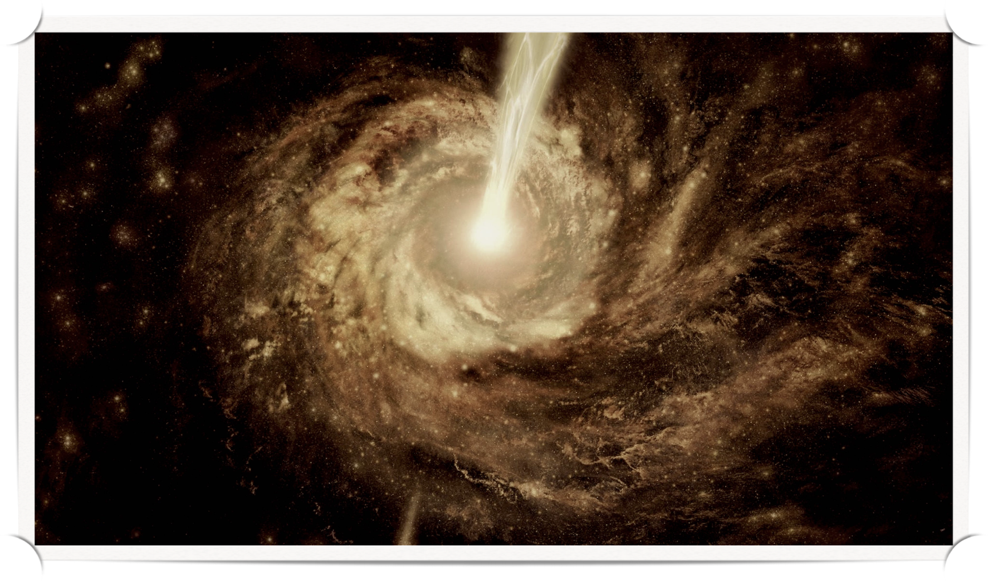
Questions?

Slide 14
Dr. Lewis’s research was supported by an appointment to the NASA Postdoctoral Program at the NASA Goddard Space Flight, administered by Oak Ridge Associated Universities under contract with NASA.
H.F. acknowledges support by NASA under award number 80GSFC21M0002. Any opinions, findings, and conclusions or recommendations expressed in this material are those of the author(s) and do not necessarily reflect the views of the National Aeronautics and Space Administration.
References:
Lewis, T. et al. 2021, Modeling and Simulations of TXS 0506+056 Neutrino Events in the MeV Band, https://doi.org/10.48550/arXiv.2111.10600
Rodrigues, X., Gao, S., Fedynitch, A., Palladino, A.,& Winter, W. 2019a, ApJL, 874, L29, doi: 10.3847/2041-8213/ab1267
—. 2019b, ApJL, 874, L29, doi: 10.3847/2041-8213/ab1267
Xue, R., Liu, R.-Y., Wang, Z.-R., Ding, N., & Wang, X.-Y. 2021a, ApJ, 906, 51, doi: 10.3847/1538-4357/abc886
Zhang, B. T., Petropoulou, M., Murase, K., & Oikonomou, F. 2020, ApJ, 889, 118, doi: 10.3847/1538-4357/ab659a

