Slide 1
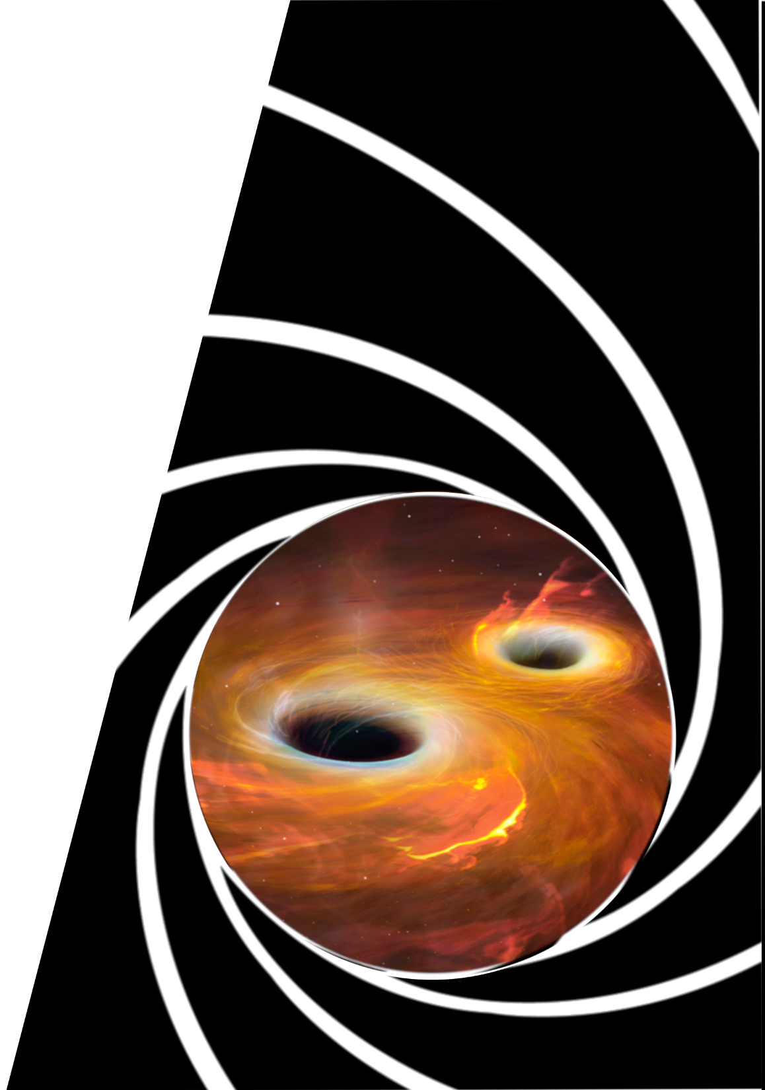


Shaken, not stirred: Test particles in Binary-black-hole mergers
North-West University Centre for Space Research
Pieter vd Merwe
Supervisor: Prof. M. Boettcher

Slide 2
Aims
To develop exploratory code to simulate the acceleration and spectral energy
distribution of any resulting EM-radiation from charged particles
accelerated only due to gravity in inspiraling binary black hole (BBH)
merger environments.
Simplifying assumptions?
  Eccentricity of the BBH orbits are circular
  The BHs are non-rotating and uncharged
  The orbits of the BHs are determined using a 1st order PN effective one-body problem
  Low particle density close to stellar mass BBH (accretion disk dynamics can be neglected)

Slide 3
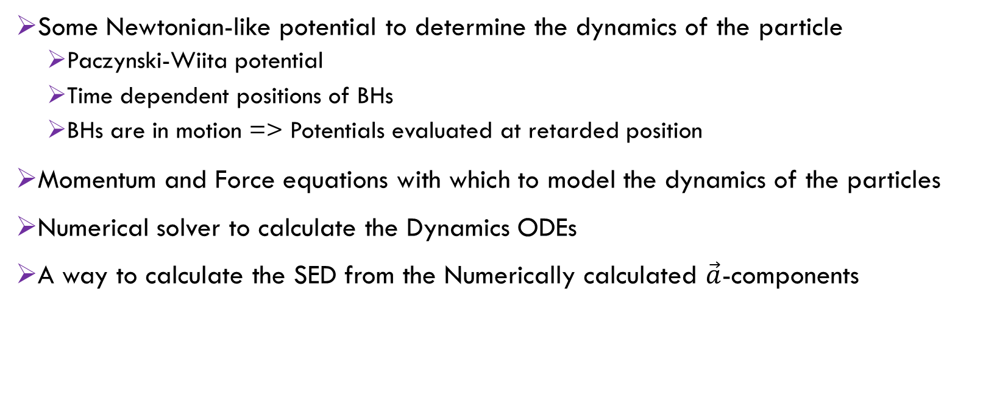
Building the model
What do we need?
Some Newtonian-like potential to determine the dynamics of the particle
    Paczynski-Wiita potential
    Time dependent positions of BHs
    BHs are in motion => Potentials evaluated at retarded position
Momentum and Force equations with which to model the dynamics of the particles
Numerical solver to calculate the Dynamics ODEs
A way to calculate the SED from the Numerically calculated $\vec{a}$-components

Slide 4
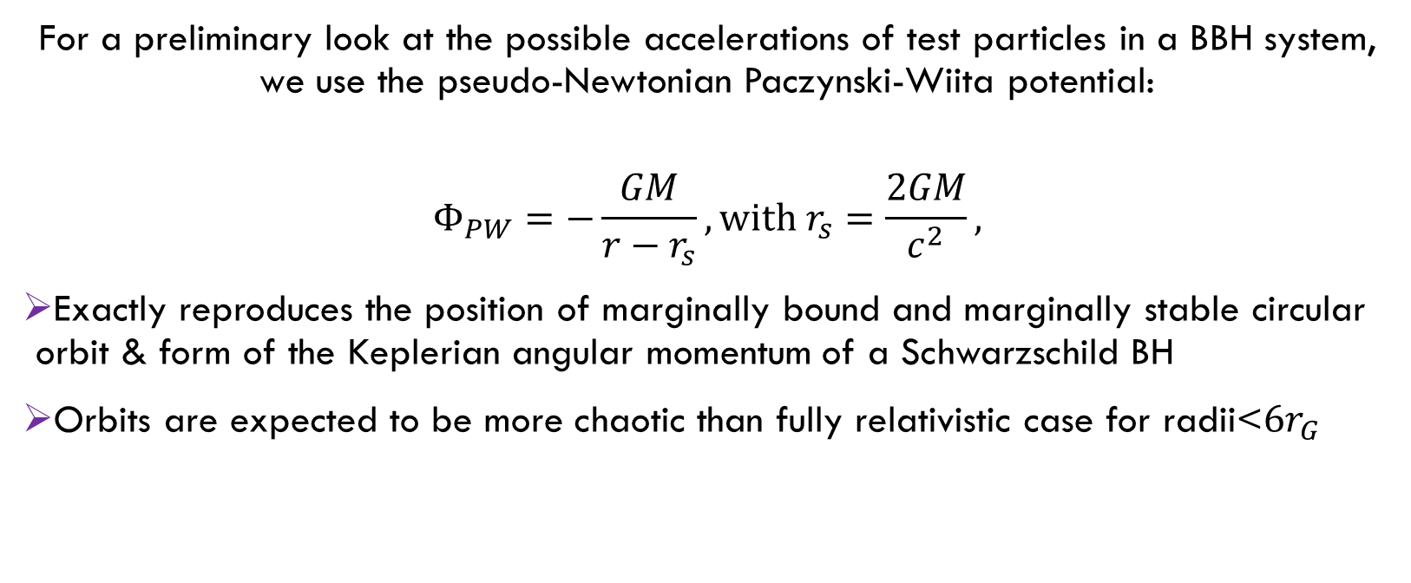
Building the model
Paczynski-Wiita Potential
For a preliminary look at the possible accelerations of test particles in a BBH system, we use the pseudo-Newtonian Paczynski-Wiita potential:
$$Φ_{PW}=−\frac{GM}{r−r_{s}},with r_{s}=\frac{2GM}{c^{2}},$$
Exactly reproduces the position of marginally bound and marginally stable circular orbit & form of the Keplerian angular momentum of a Schwarzschild BH
Orbits are expected to be more chaotic than fully relativistic case for radii<$6r_{G}$

Slide 5
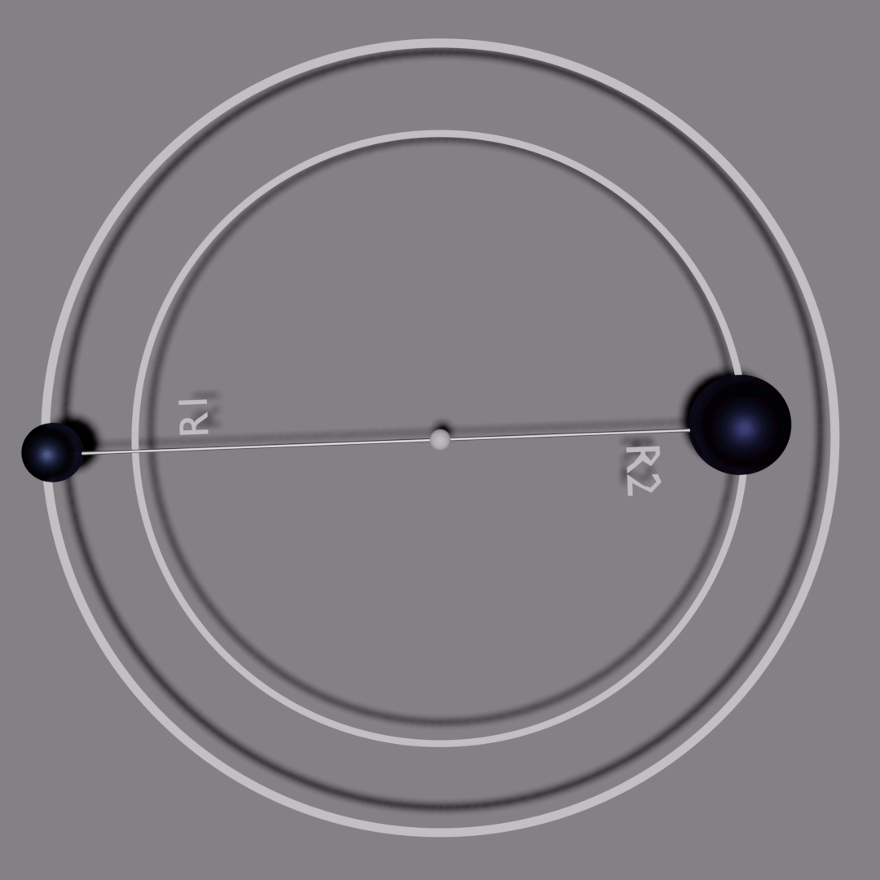
Building the model
Position of BBH
Time dependent description of BBH motion
    Classical effective one-body problem

Slide 6
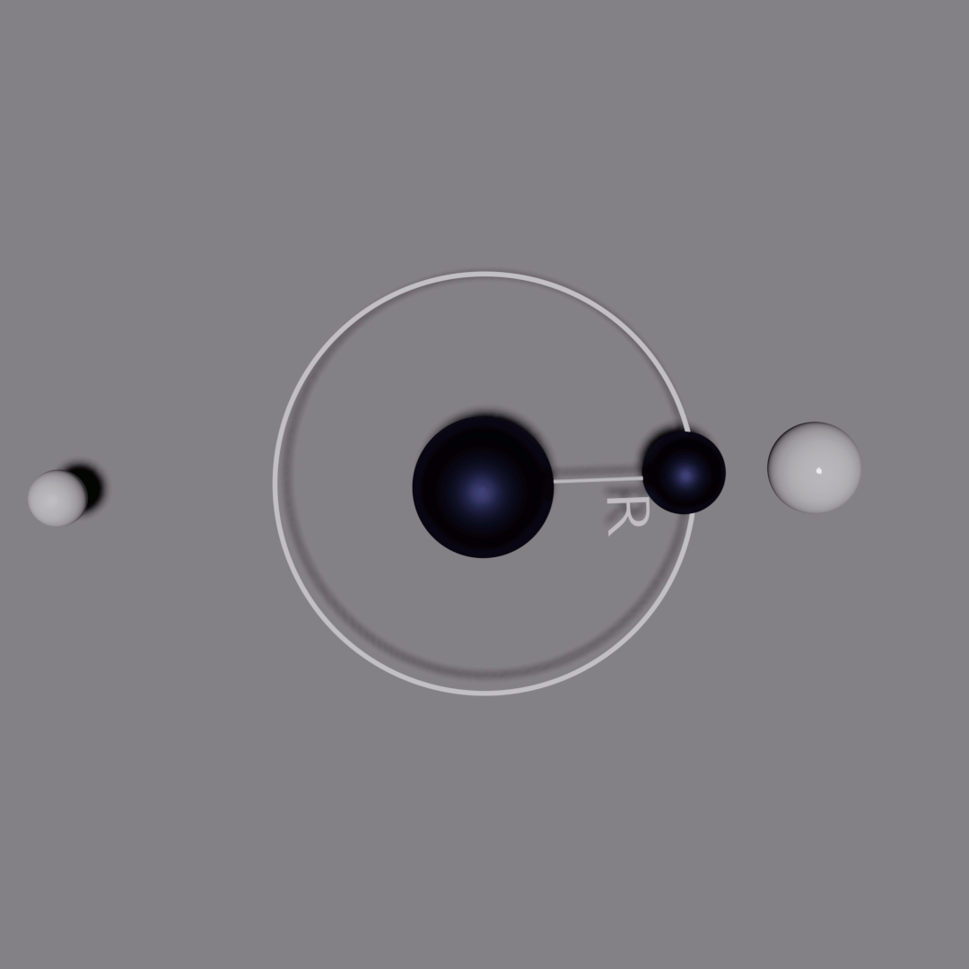
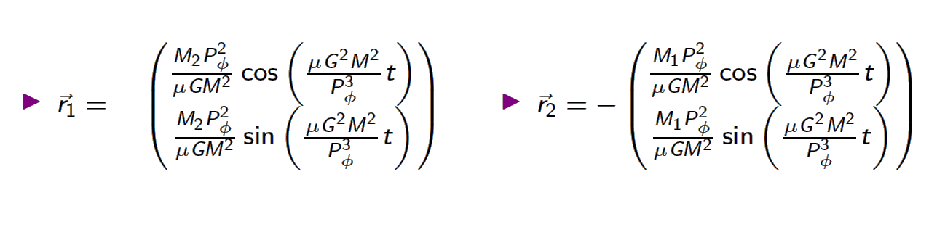
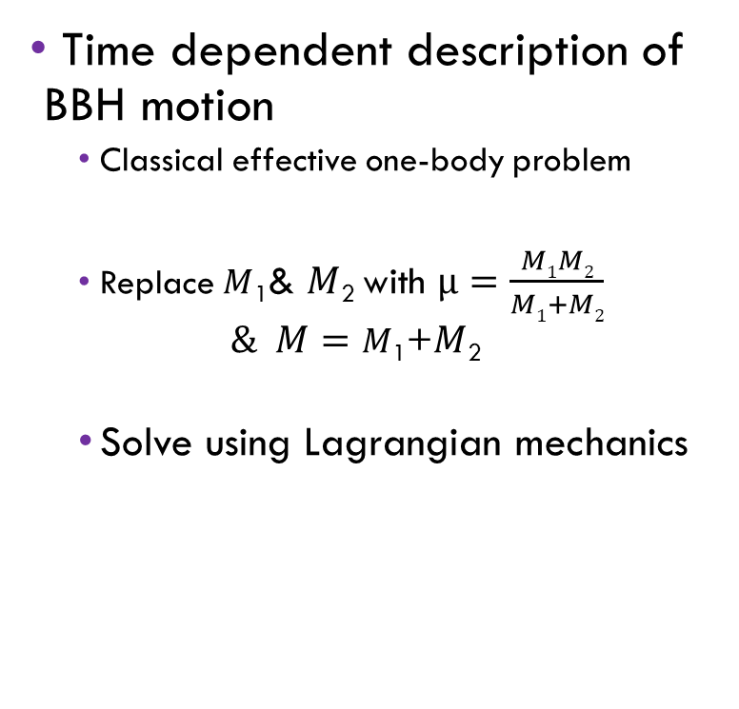
Building the model
Position of BBH (…Then)
Time dependent description of BBH motion
    Classical effective one-body problem
    Replace $M$₁& $M$₂ with $µ=\frac{M1M2}{M1+M2}$
    $$\& M=M\text{1}\text{+}M\text{2}$$
    Solve using Lagrangian mechanics
.

Slide 7
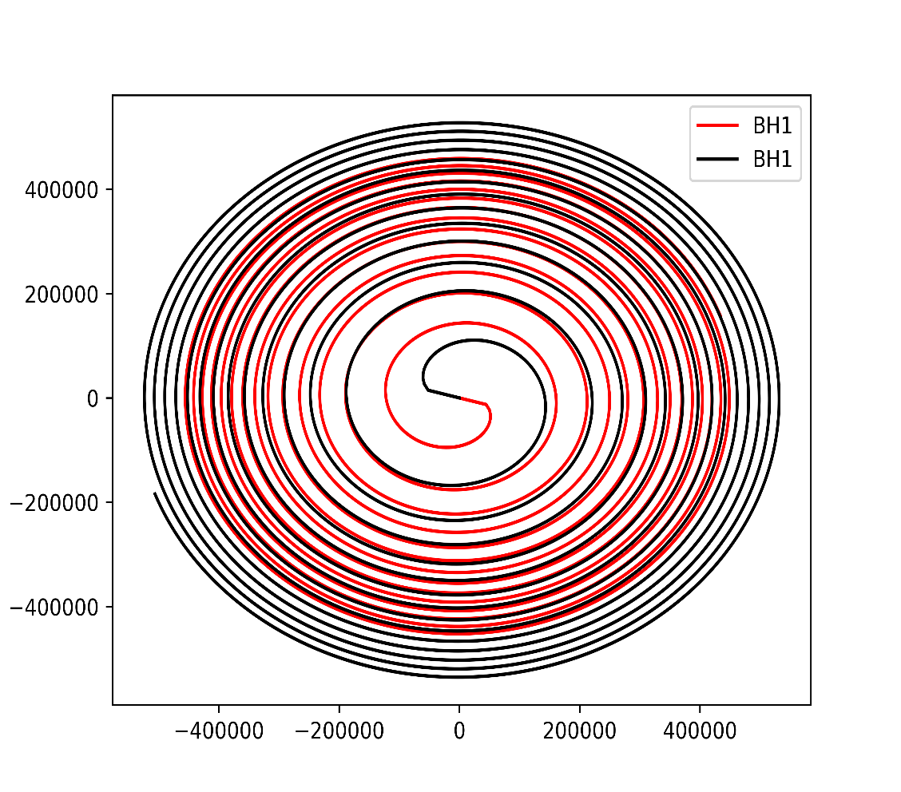
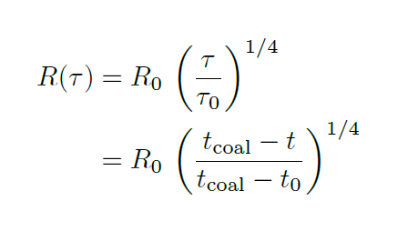
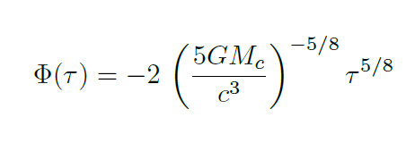
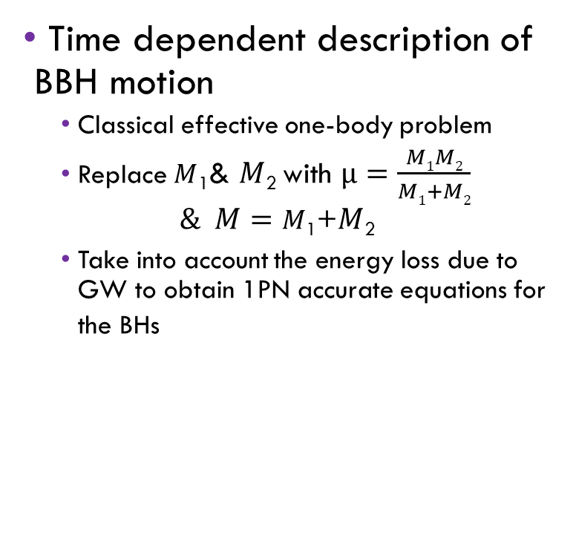
Building the model
Position of BBH (…Now)
Time dependent description of BBH motion
    Classical effective one-body problem
    Replace $M$₁& $M$₂ with $µ=\frac{M1M2}{M1+M2}$
    $$\& M=M\text{1}\text{+}M\text{2}$$
    Take into account the energy loss due to GW to obtain 1PN accurate equations for the BHs
.

Slide 8
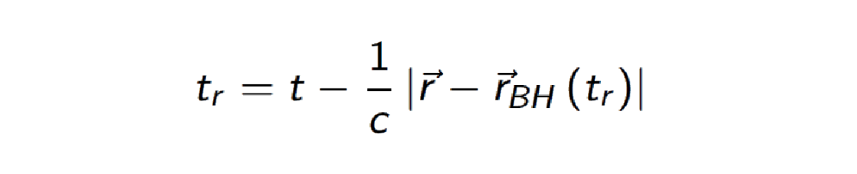

Building the model
Retarded time
To account for the motion of the BH, the implicit definition of retarded time is used
Using the position equations for each BH as a function from the EOB problem, we can solve this numerically using Newton’s method

Slide 9
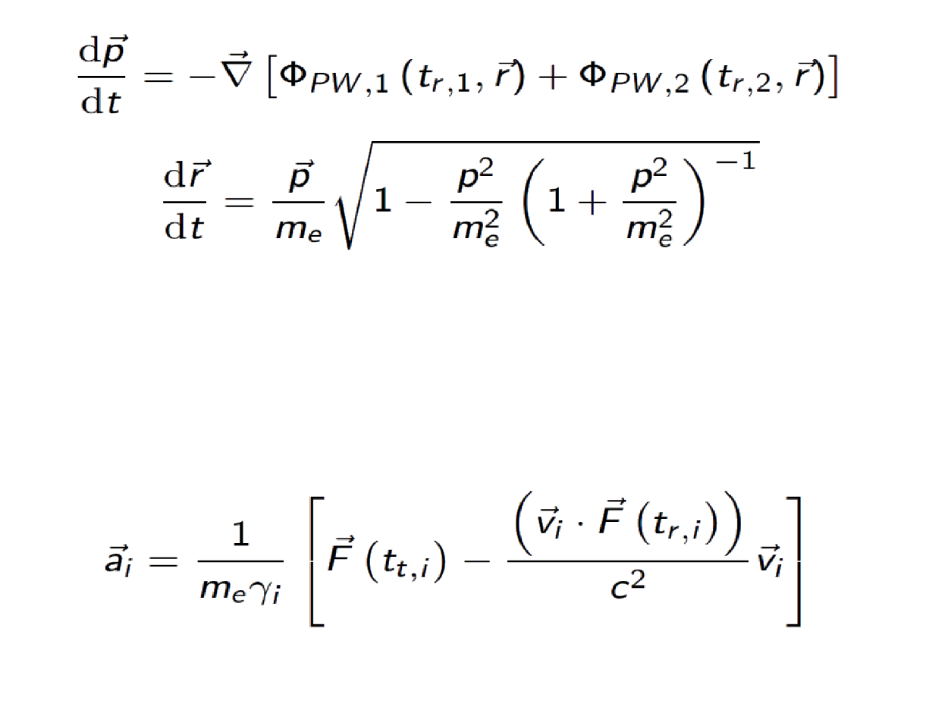
Building the model
Determining the position and acceleration evolution of a particle through the system
The evolution of the position of a particle orbiting in the system is found by simultaneously solving the following set of coupled ODEs using the RKF7(8) adaptive time-step method, with upper and lower limits on the time step size:
where we stop the solver once the particles plummets into a BH or the BHs get too close to
one another.
The acceleration of the particle as a function of time is found using

Slide 10
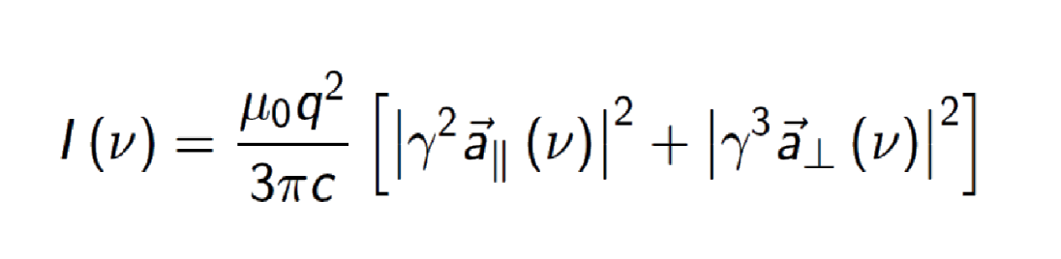
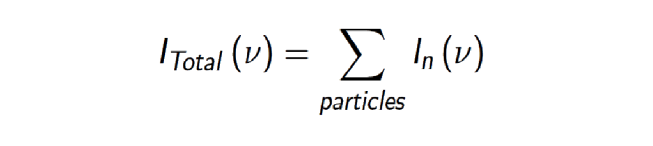
Building the model
Calculating the SED
SED of each particle in the system is calculated by
A non-uniform Fourier transform is applied to the components of the acceleration parallel and perpendicular to the direction of motion using the fiNUFFT library.
Total SED from the system is calculated from:
Due to variable lengths of the generated data, it is necessary to use cubic spline methods to calculate the total SED.

Slide 11
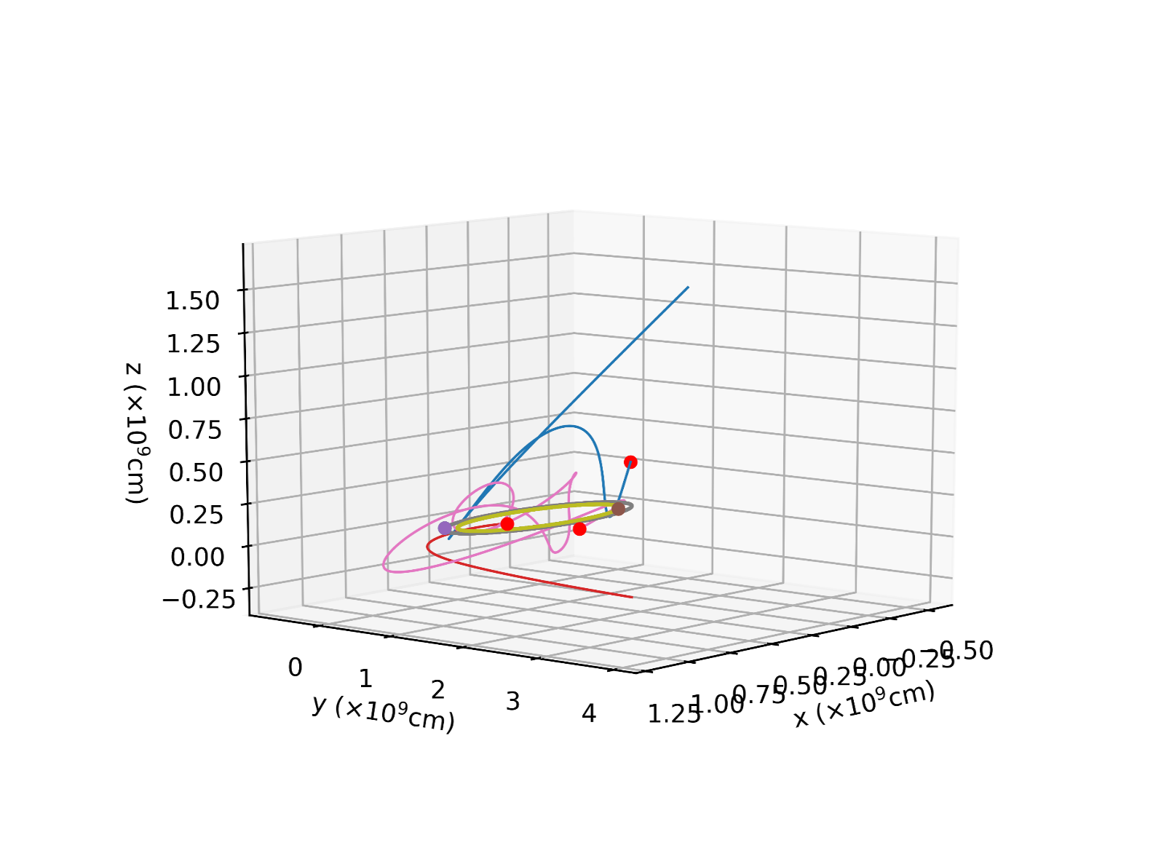
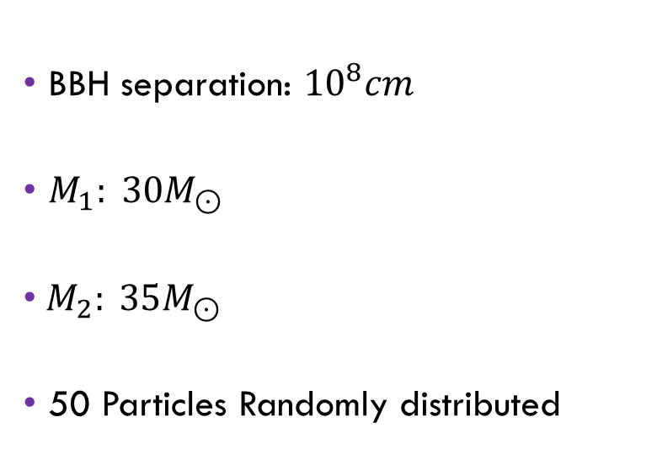
Example trajectories
BBH separation: ${10}^{8}cm$
$M_{1}: 30M_{⊙}$
${ M}_{2}: 35M_{⊙}$
50 Particles Randomly distributed

Slide 12
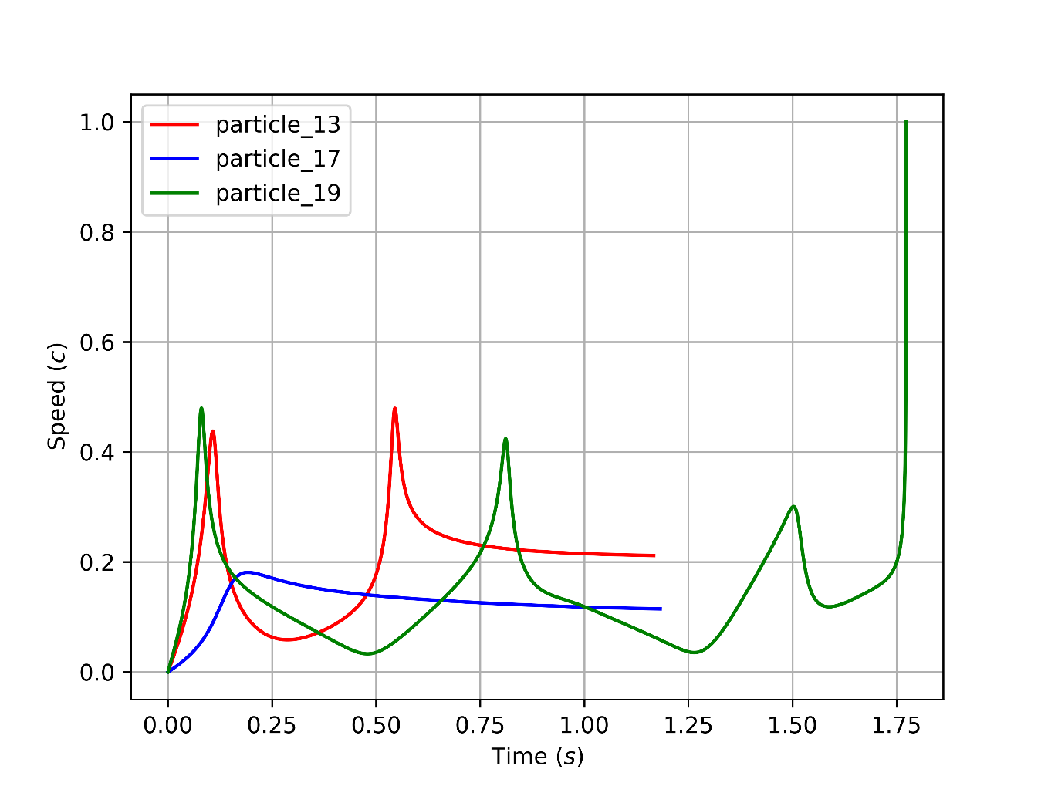
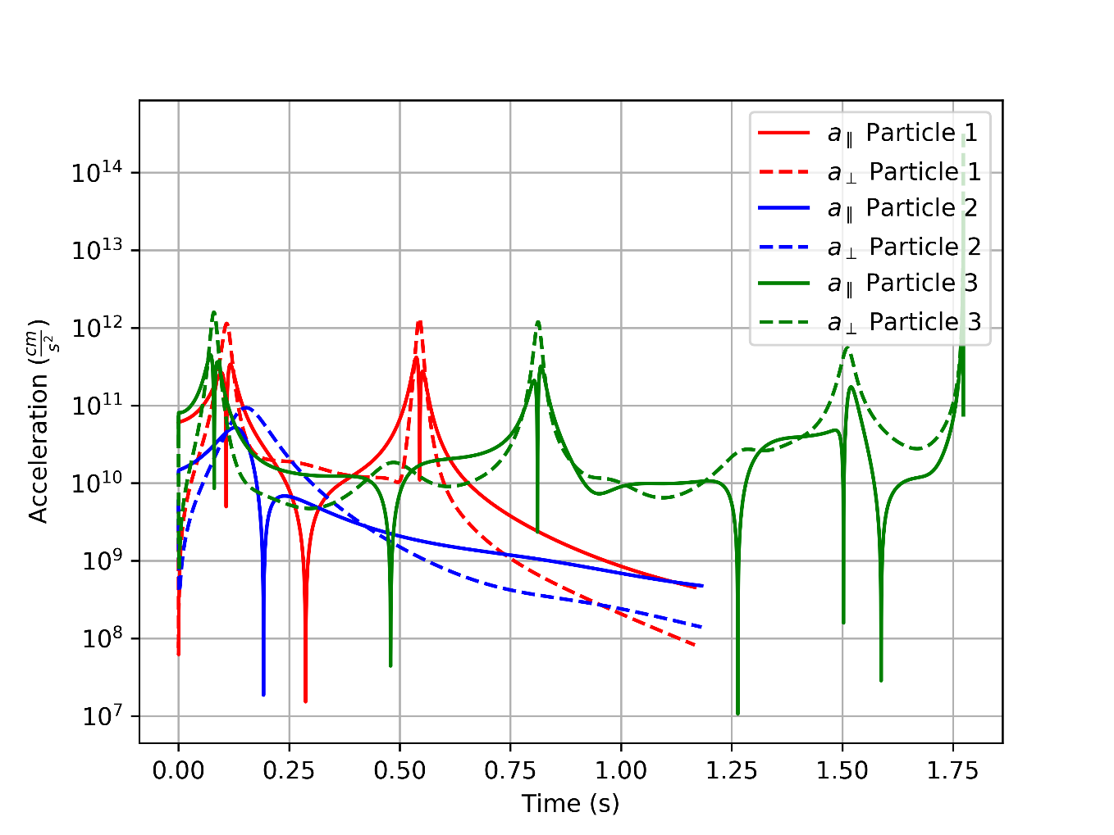
Example speed and acceleration components

Slide 13
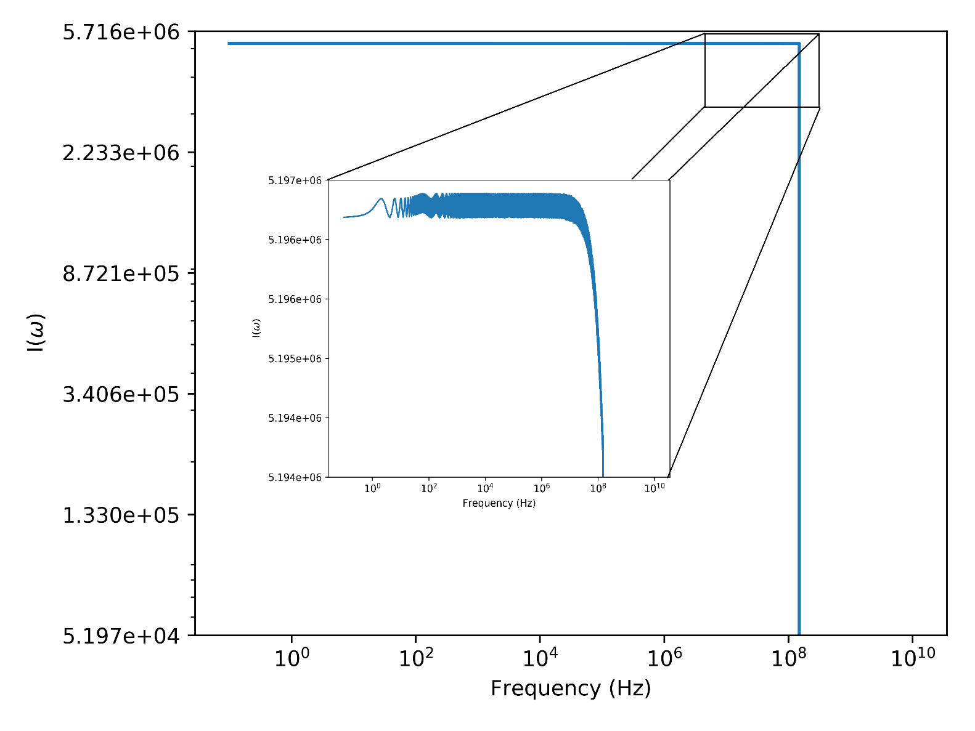
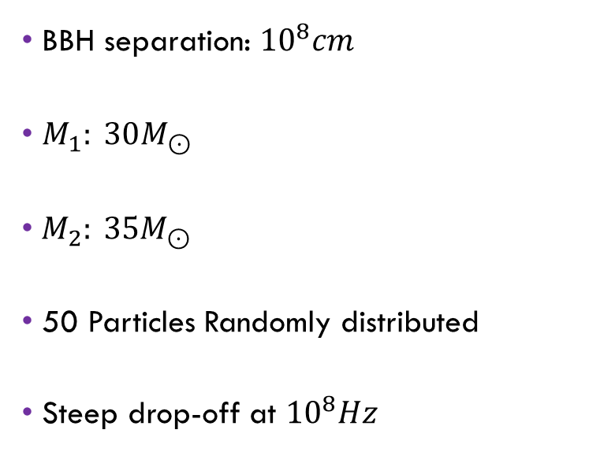
Example Total SED
BBH separation: ${10}^{8}cm$
$M_{1}: 30M_{⊙}$
${ M}_{2}: 35M_{⊙}$
50 Particles Randomly distributed
Steep drop-off at ${10}^{8}Hz$

Slide 14
Final remarks and caveats
This is a very naïve, single particle approach simulation.
It is expected that EM fields will dominate over gravitational effects in these systems.
More work still needs to be done to determine how much of the predicted spectrum could actually be detected.

Slide 15

Thank you for your attention!
Pieter vd Merwe
pietervdmerwejnr@gmail.com

