Slide 1

SN 2016iyc: A Type IIb supernova arising from a low-mass progenitor
Amar Aryan*
Shashi B. Pandey, WeiKang Zheng, Alexei V. Filippenko, Jozsef Vinko, Ryoma Ouchi et al. 2022.
doi:10.1093/mnras/stac2326
*amar@aries.res.in and amararyan941@gmail.com

Slide 2

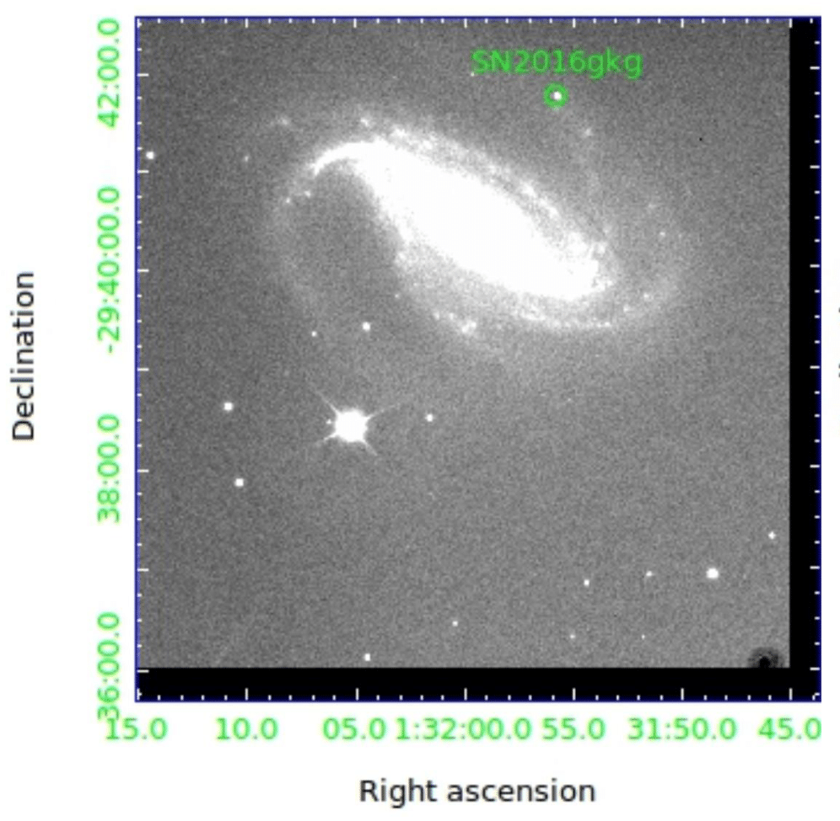
What are Supernovae (SNe)
The bright explosions that mark the death of stars.
Death of stars : Brief and Dynamic.
Responsible for the enrichment of the universe.
Left behind are :
SN remnant : Shell of the exploding star
Birth of compact objects, eg., Neutron Stars and Black Holes.
SN 2016gkg images from 3.6m DOT at ARIES

Slide 3
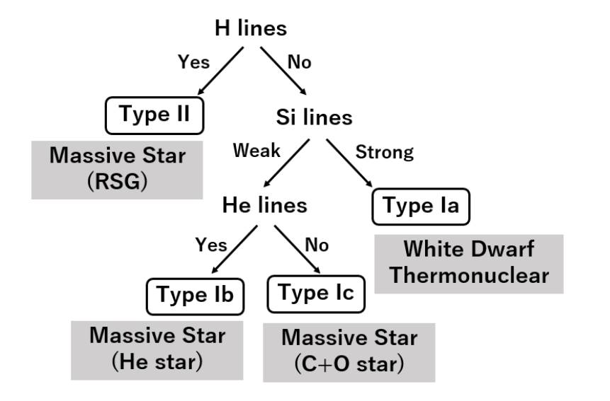
Well celebrated SNe Classification on the Basis of Spectra
H lines
eh…
Type IIb
Massive WRs / Extended YSG
Source: Maeda 2022

Slide 4
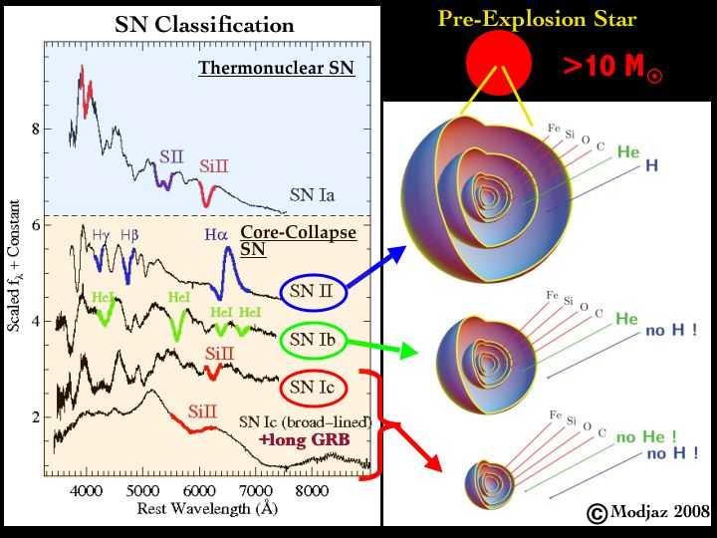
Why do few elements show strong presence or absence in particular SNe spectra???

Slide 5
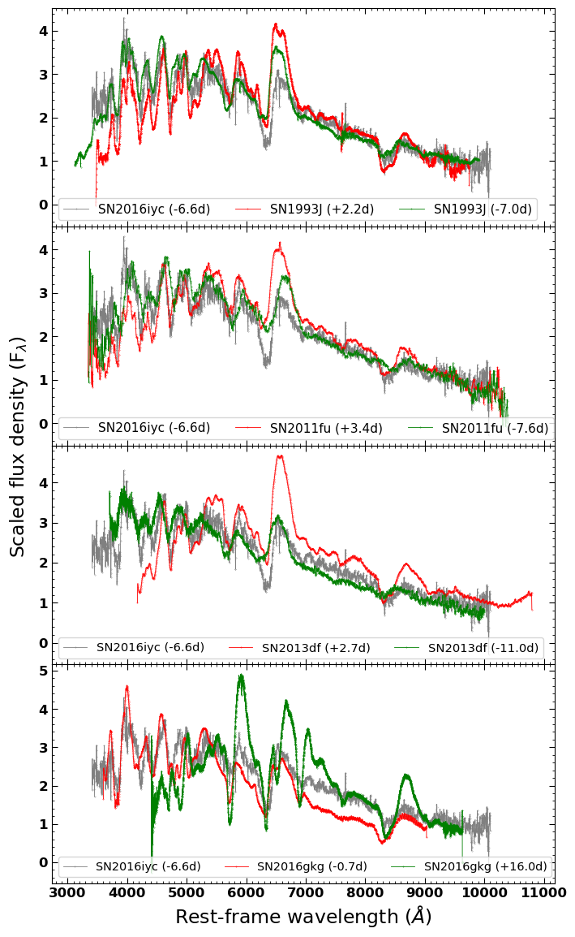
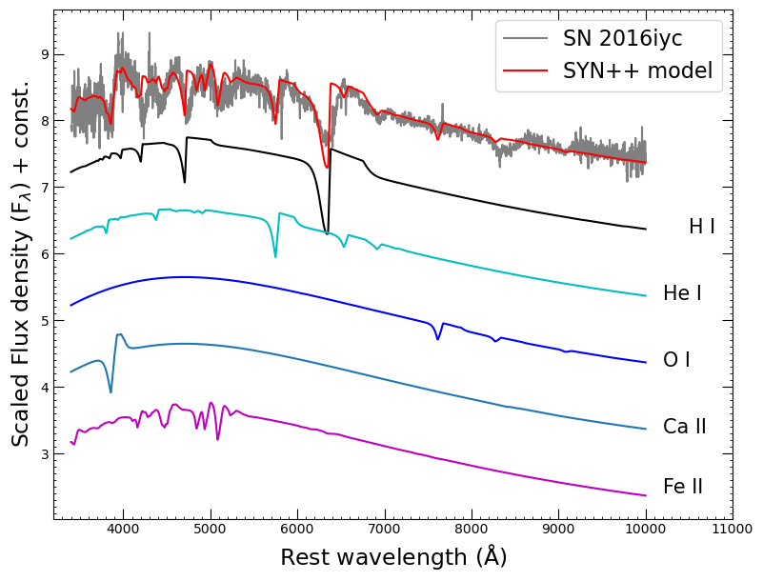
SN 2016iyc: Spectral Properties
Left: Spectral modelling, Right: Spectral comparison with similar Supernovae. Source: Aryan et al. 2022, doi:10.1093/mnras/stac2326

Slide 6
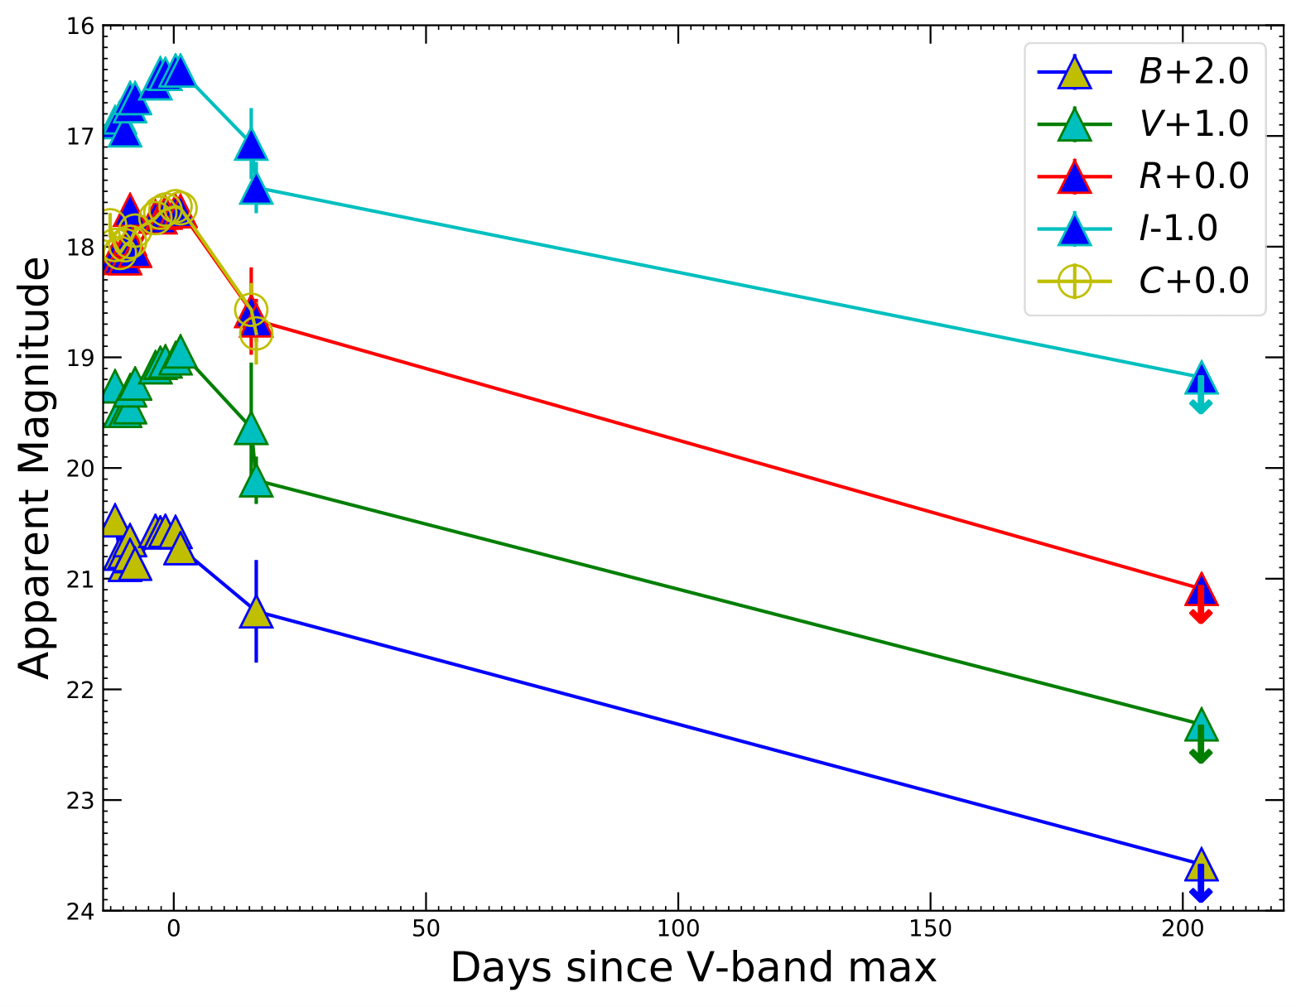
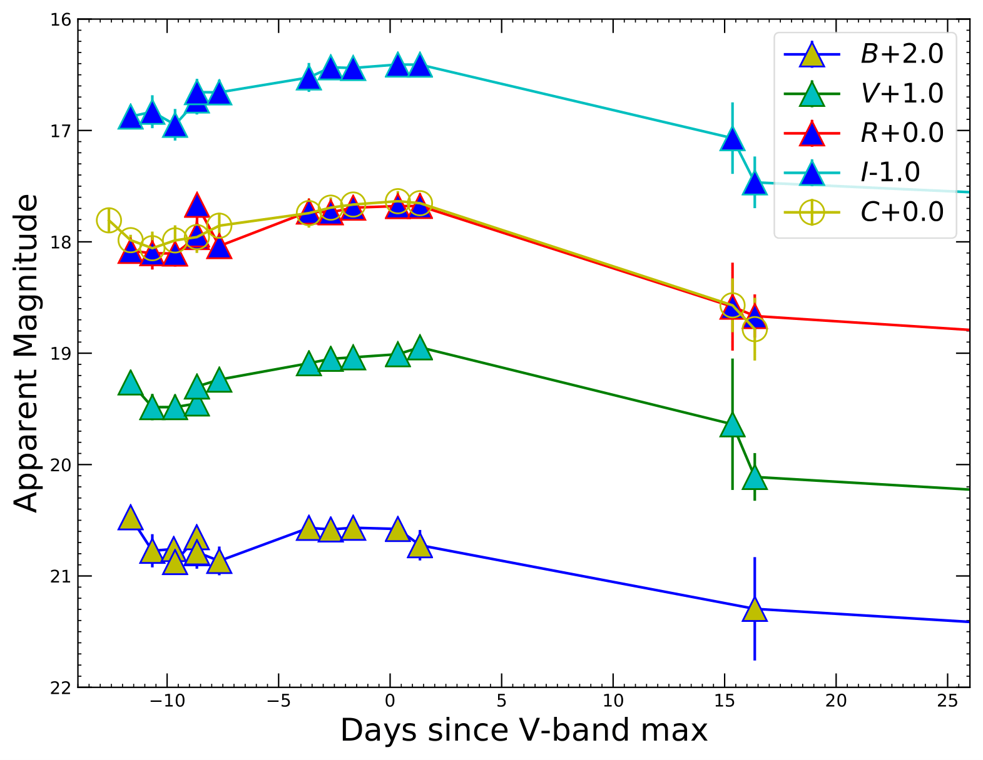
SN 2016iyc: Photometric Properties
Left: The BV RI- and C-band light curves of SN 2016iyc, obtained with KAIT along with the upper limits in each band using the Las Cumbres Observatory global telescope network, Right: Zooming in to early phases shows the generic extended-SBO feature of SNe IIb. Source: Aryan et al. 2022.

Slide 7
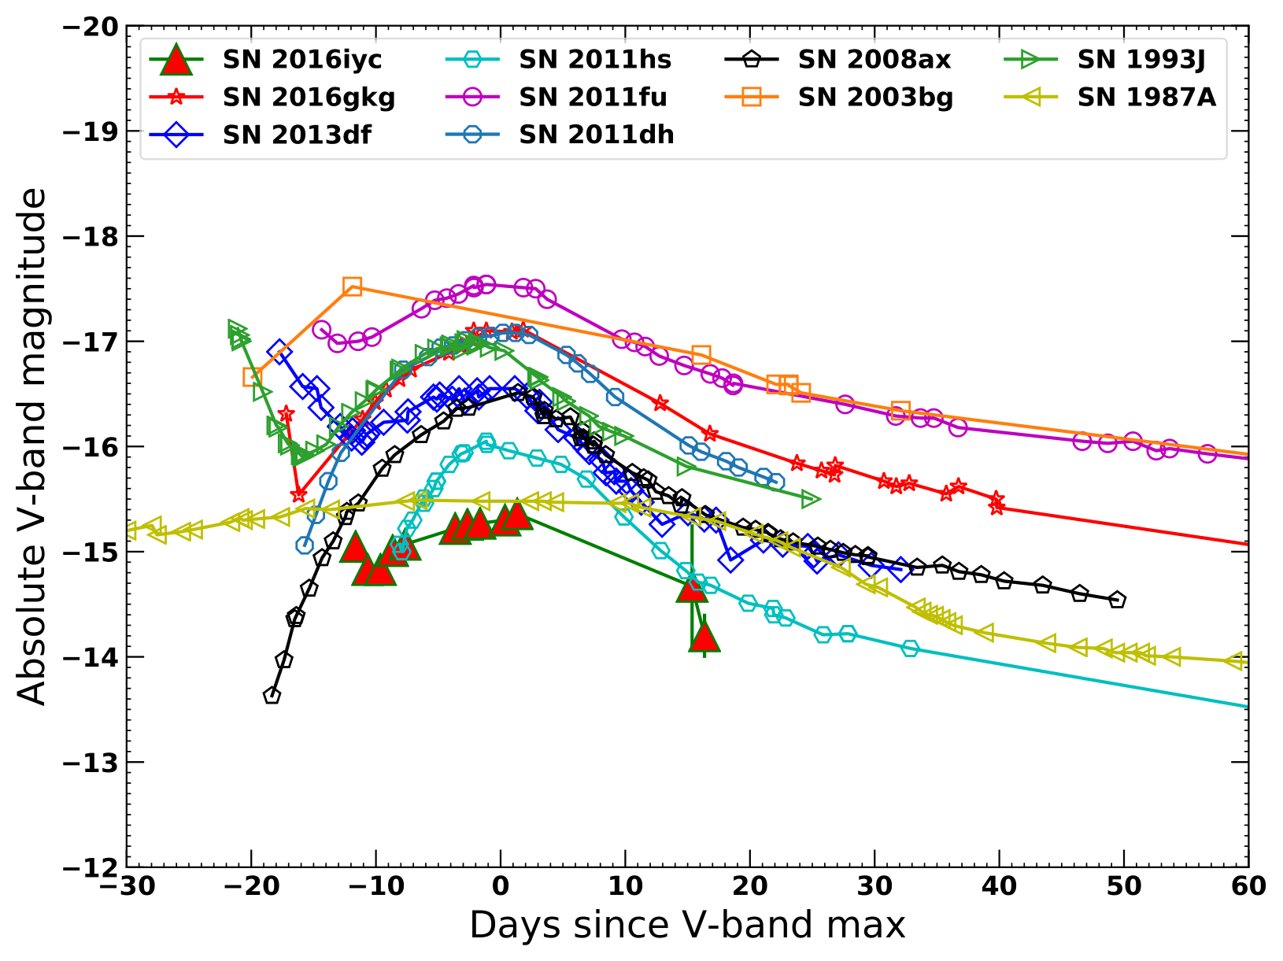
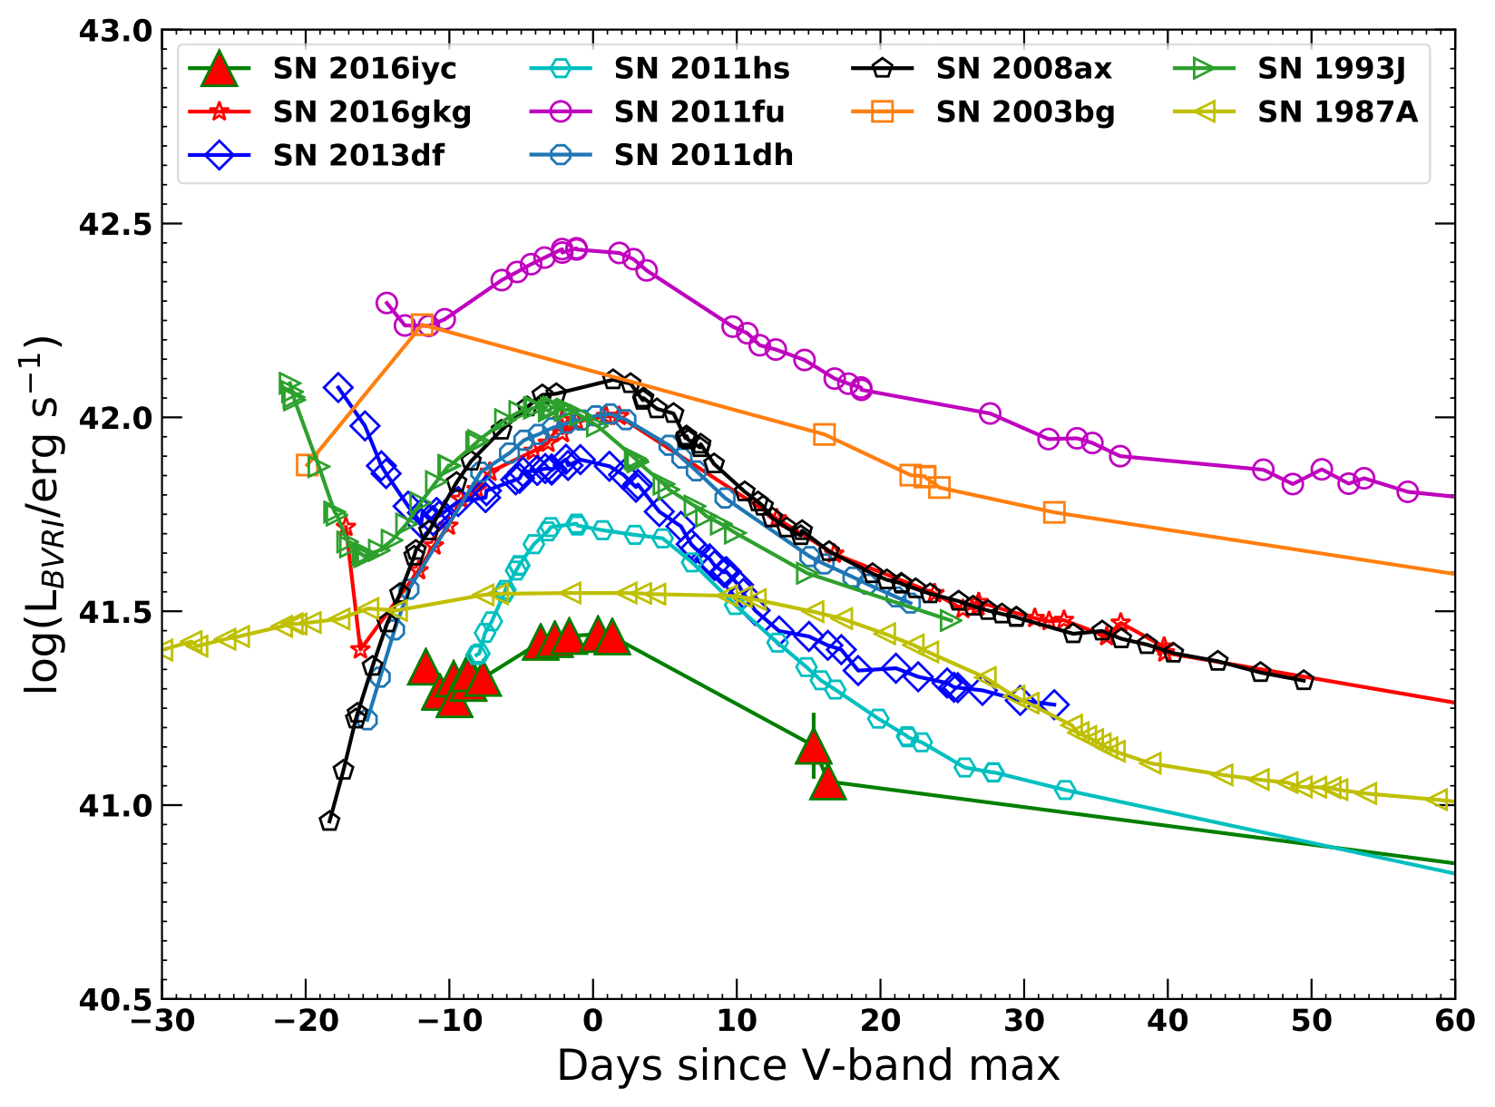
SN 2016iyc: Photometric Properties …continued
Left: Comparison of the absolute V-band light curve of SN 2016iyc with similar SNe, Right: Comparison of the quasi-bolometric light curve of SN 2016iyc with similar SNe. Source: Aryan et al. 2022.

Slide 8
SN 2016iyc: Possible Progenitor Modelling using MESA¹
Non-rotating, 9 - 14 M⊙ ZAMS stars as possible progenitors
Sub-solar, solar and super-solar metallicities
Models evolve from ZAMS upto the stage of core-collapse
Giant
or
Supergiant
Stripping
ZAMS
Core-collapse
Si Burning
¹https://docs.mesastar.org/
Various stages of evolutions

Slide 9
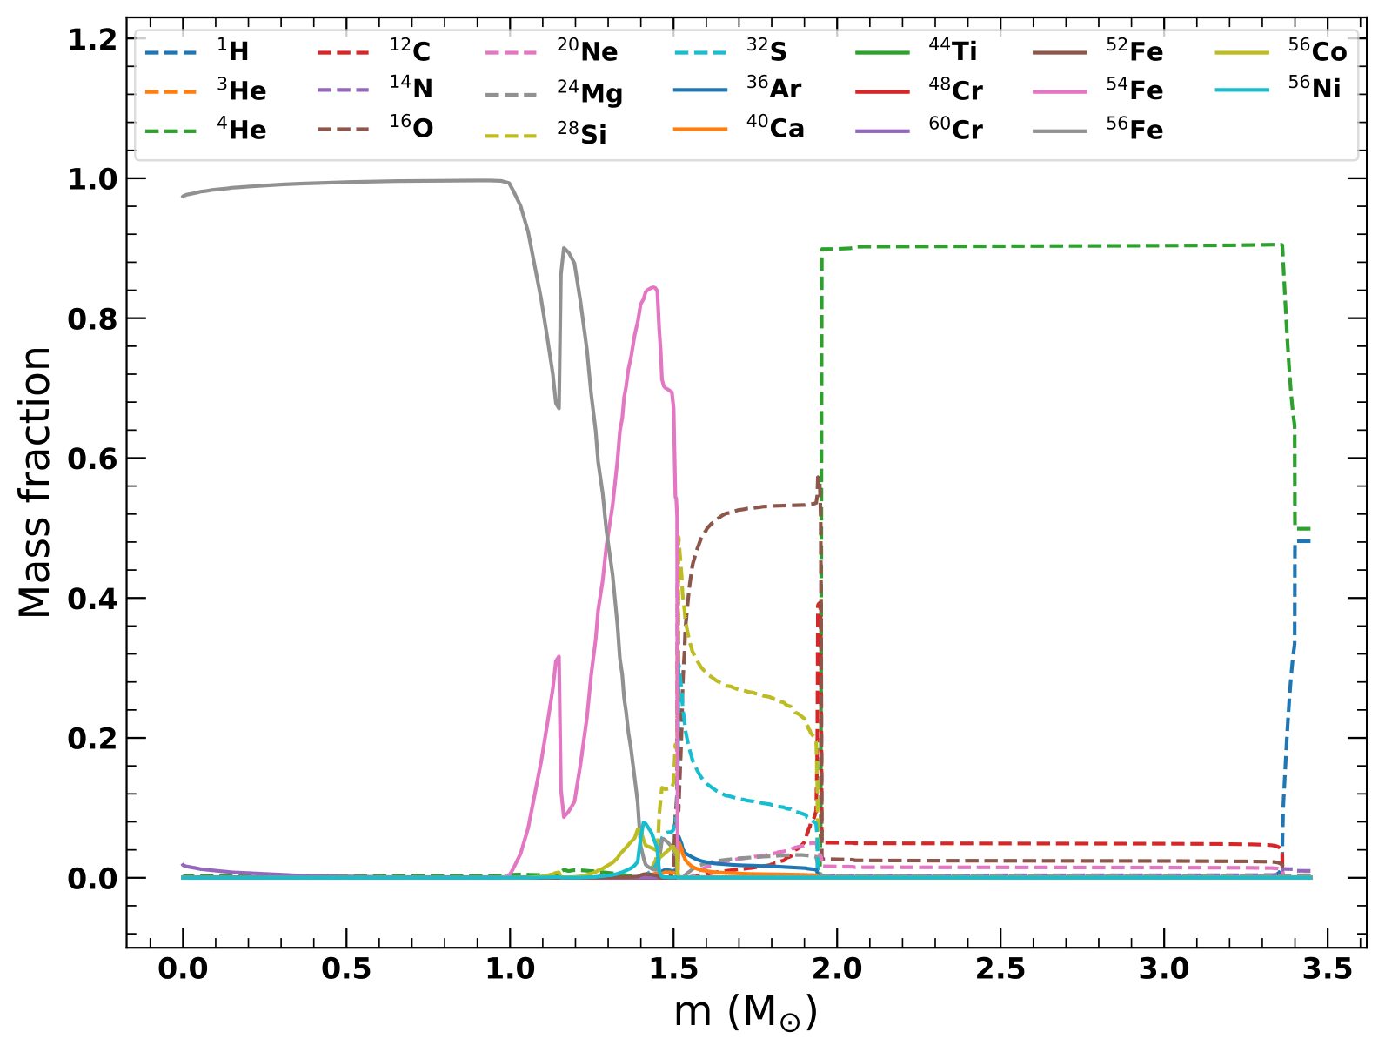
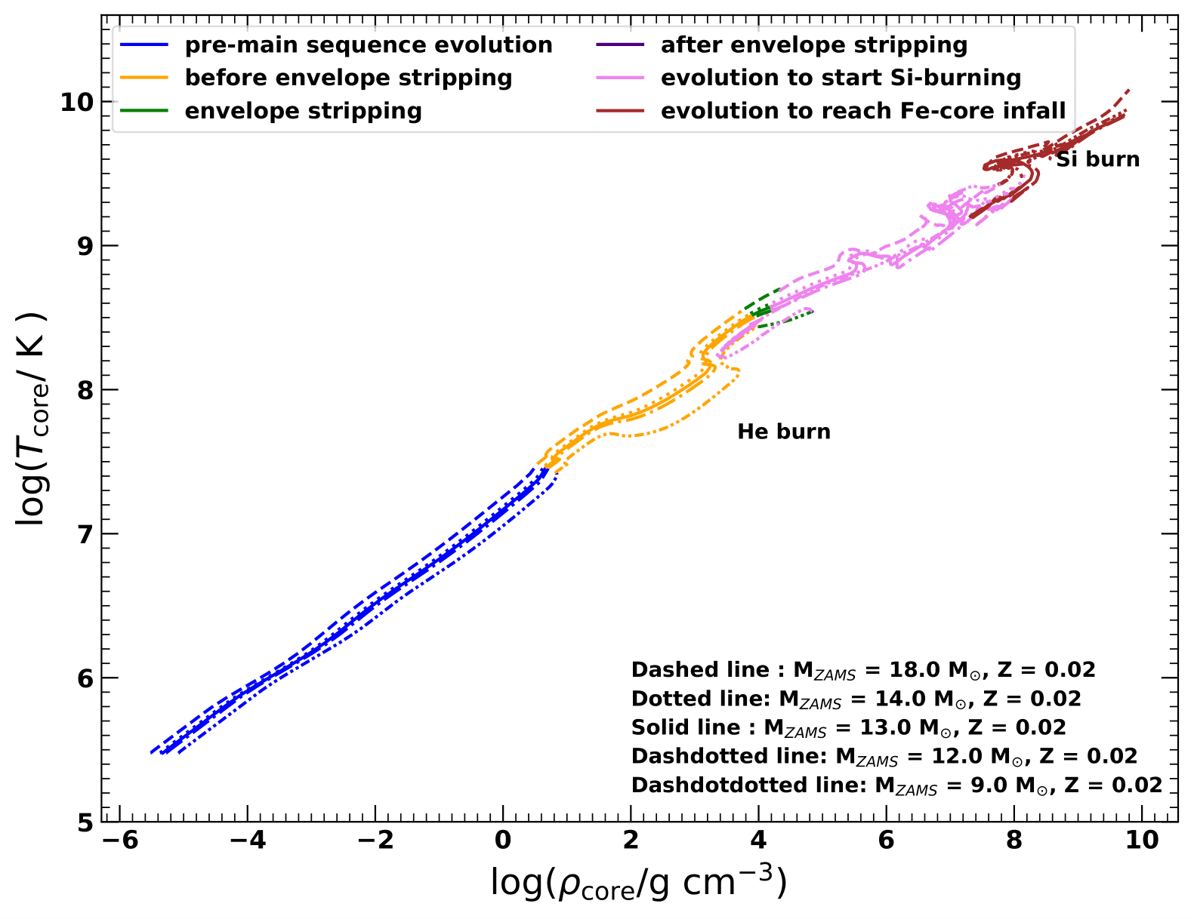
Chemical Compositions and Physical Properties of models at the beginning of core-collapse
Left: The mass fraction of various elements at the stage of the onset of core-collapse of a 12 M⊙ ZAMS progenitor. Right: The variation of core-temperature and core-density throughout the course of evolution upto core-collapse. Source: Aryan et al. 2022.

Slide 10
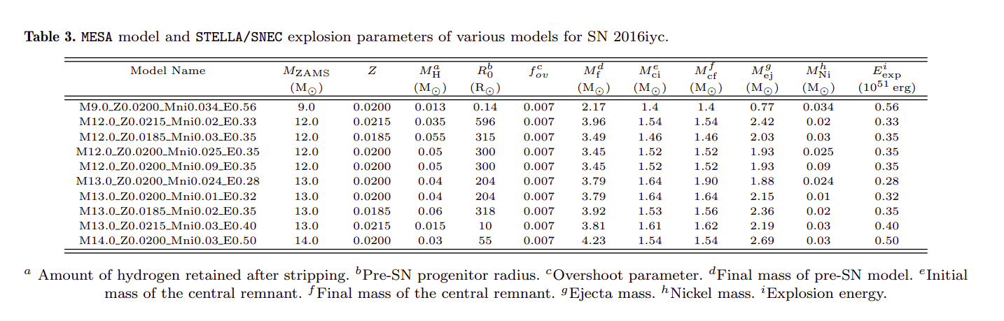
SN 2016iyc: Synthetic Explosions of Various Models Using SNEC¹ and STELLA²
Source : Aryan et al. 2022
²https://stellarcollapse.org/index.php/SNEC.html
³https://ascl.net/1108.013

Slide 11
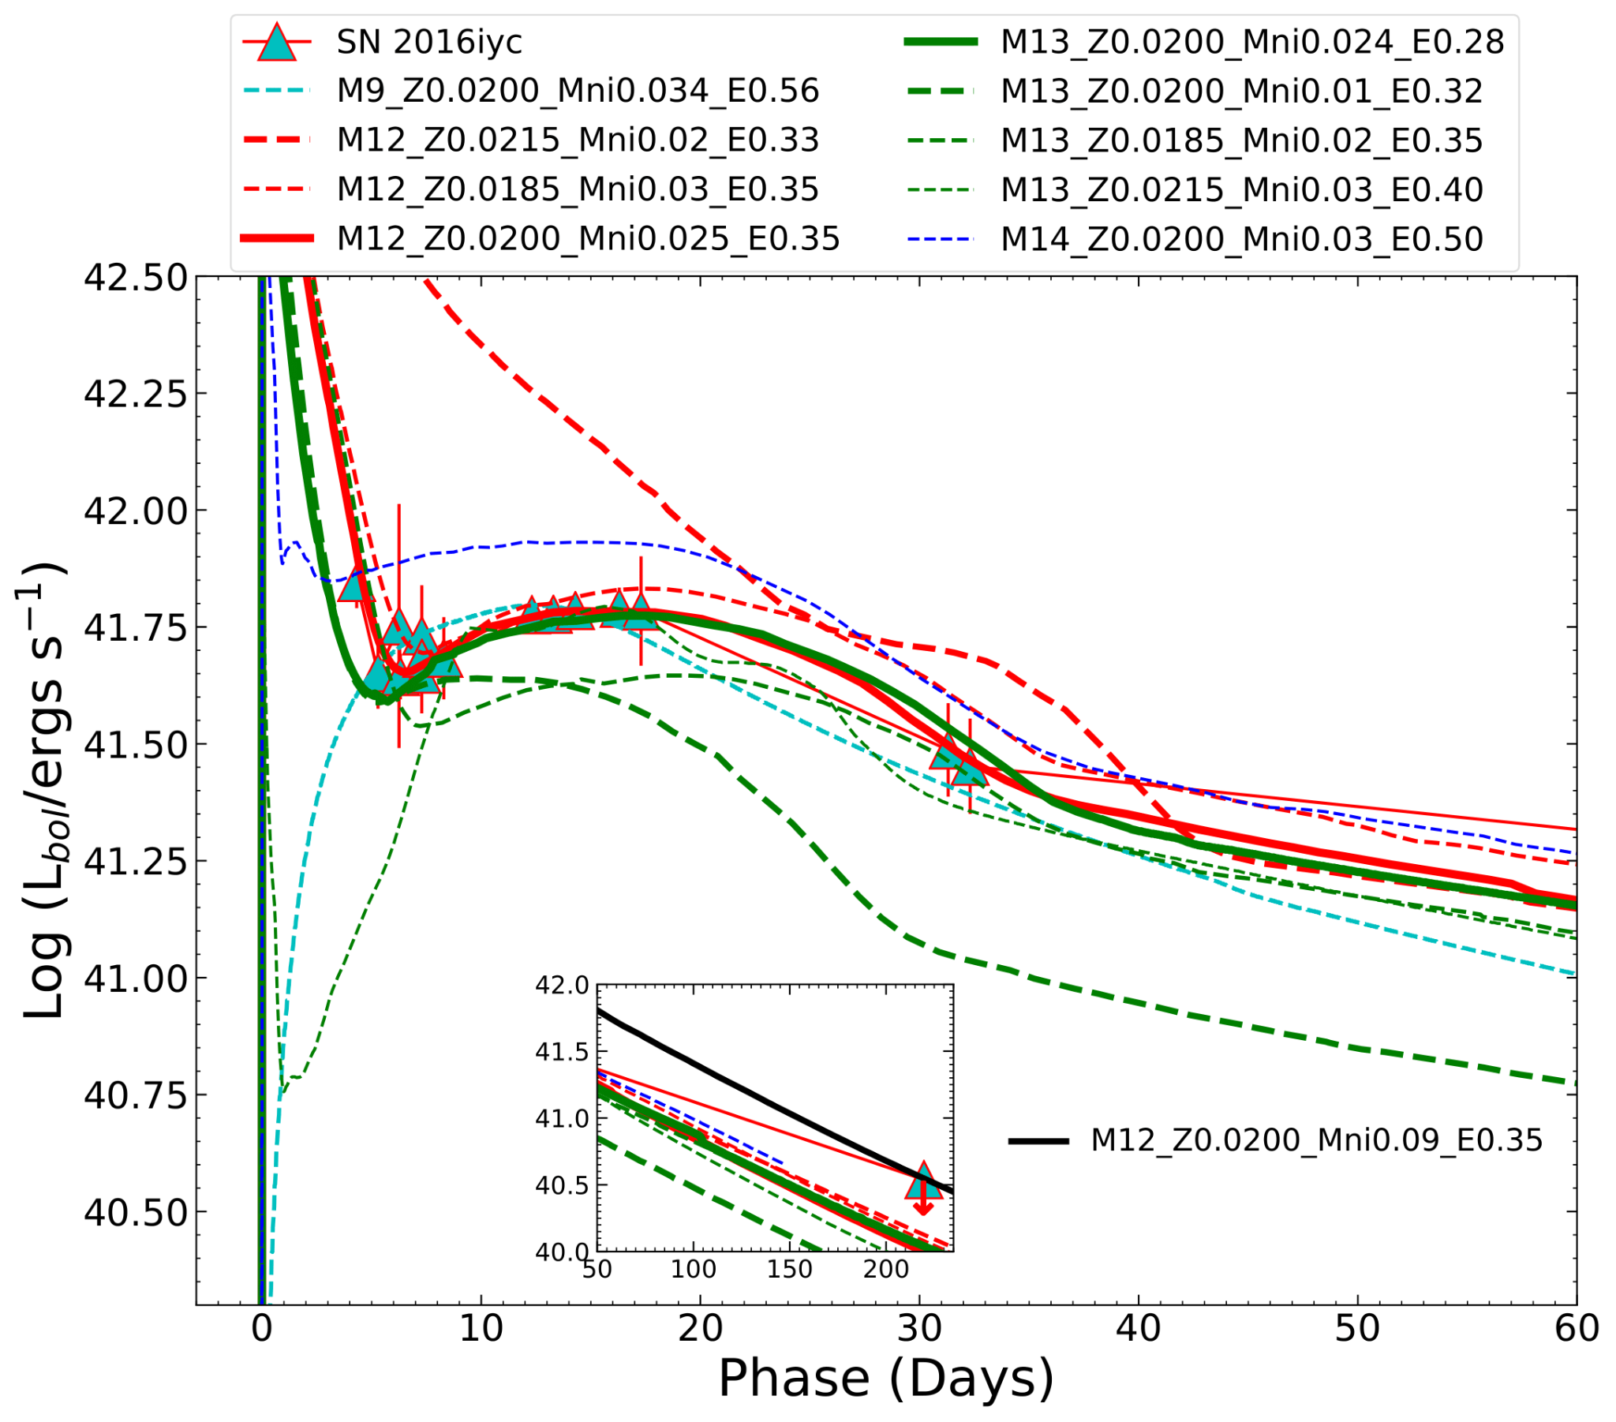
SN2016iyc: Results of Synthetic Explosions
Source : Aryan et al. 2022

Slide 12
SN2016iyc: Outcomes of the Analyses
SN 2016iyc lies near the faint end among the distribution of similar supernovae.
The progenitor modelling using MESA and the synthetic explosions using SNEC and STELLA shows :
1. SN 2016iyc rises from a ZAMS progenitor of mass (12 – 13) M⊙.
2. The progenitor has a pre-supernova radius of (240 – 300) R⊙.
3. SN 2016iyc has an ejecta mass of (1.89 – 1.93) M⊙.
4. SN 2016iyc has an explosion energy of (0.28 – 0.35) ×10⁵¹ erg.
5. SN 2016iyc synthesized no more than 0.09 M⊙ of Nickel mass.
Amar Aryan acknowledges funds and assistance provided by the Council of Scientific & Industrial Research (CSIR), India with the file no. 09/948(0003)/2020- EMR-I.

Slide 13
Thank you for your attention!
Amar Aryan*
*amar@aries.res.in and amararyan941@gmail.com

