Slide 1
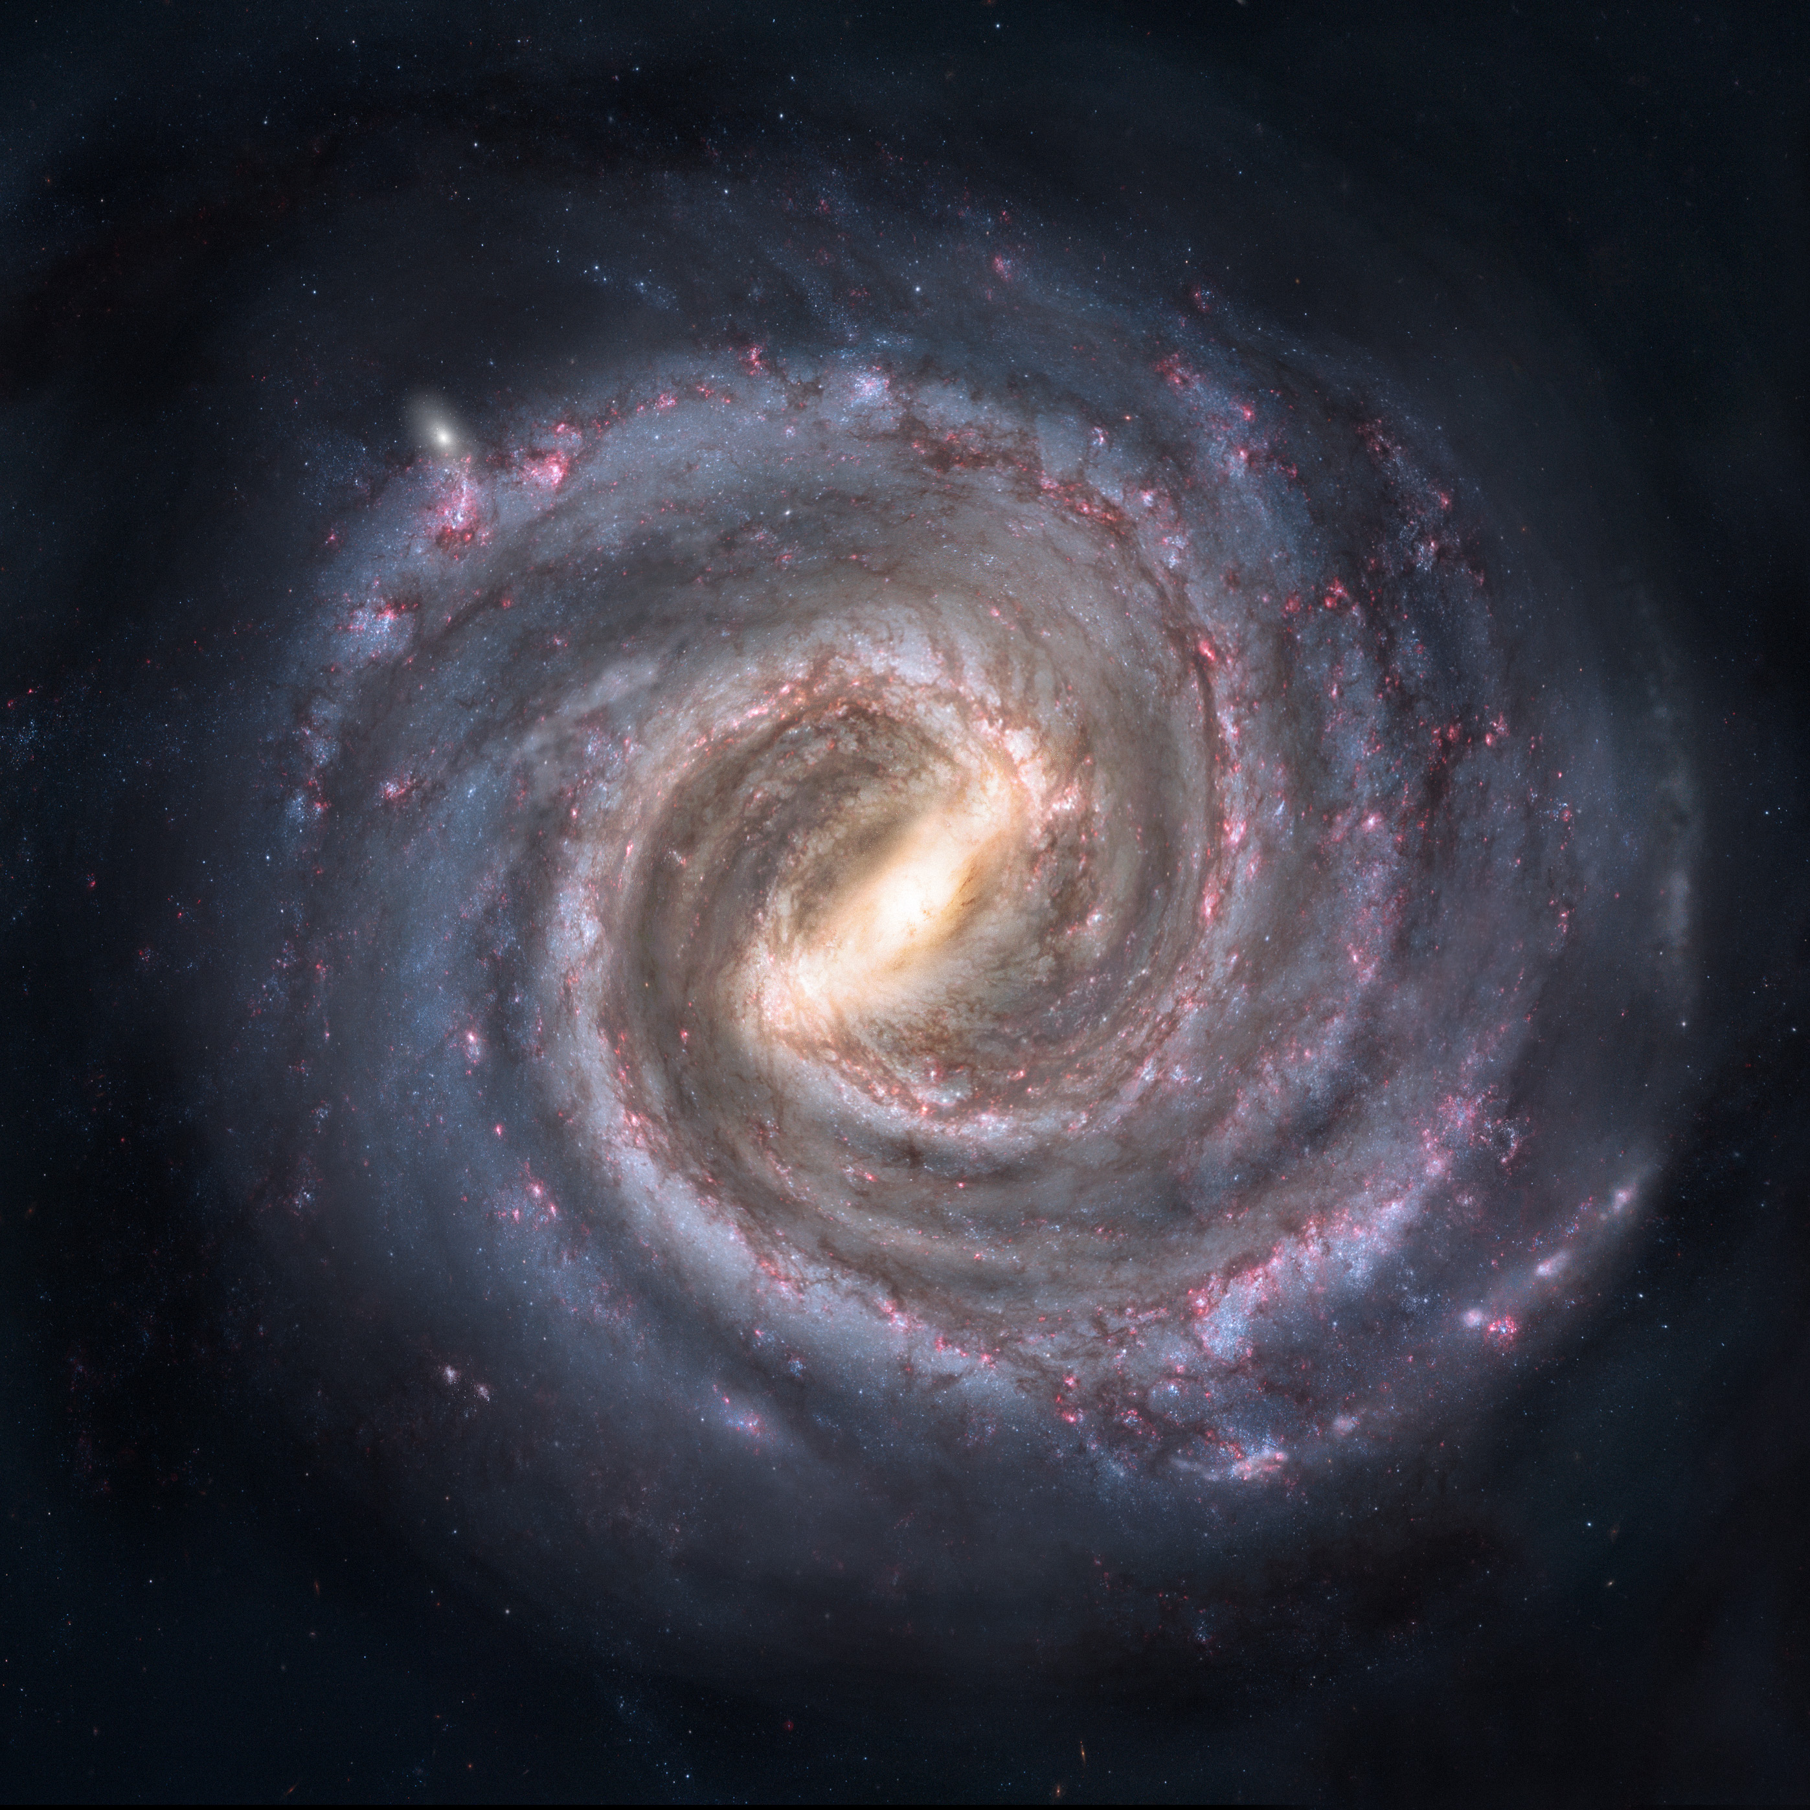


Backward and forward orbital integration of the Milky Way globular cluster system
Chemerynska I.V. , Ishchenko M.V., Berczik P.P.
2021­ - 27th YSC
Notes:
Hello everyone! I’m Ira Chemerynska a student of Taras Shevchenko National university of Kyiv. And today I’m going to present you our work about Backward and forward orbital integration of the Milky Way globular cluster system

Slide 2
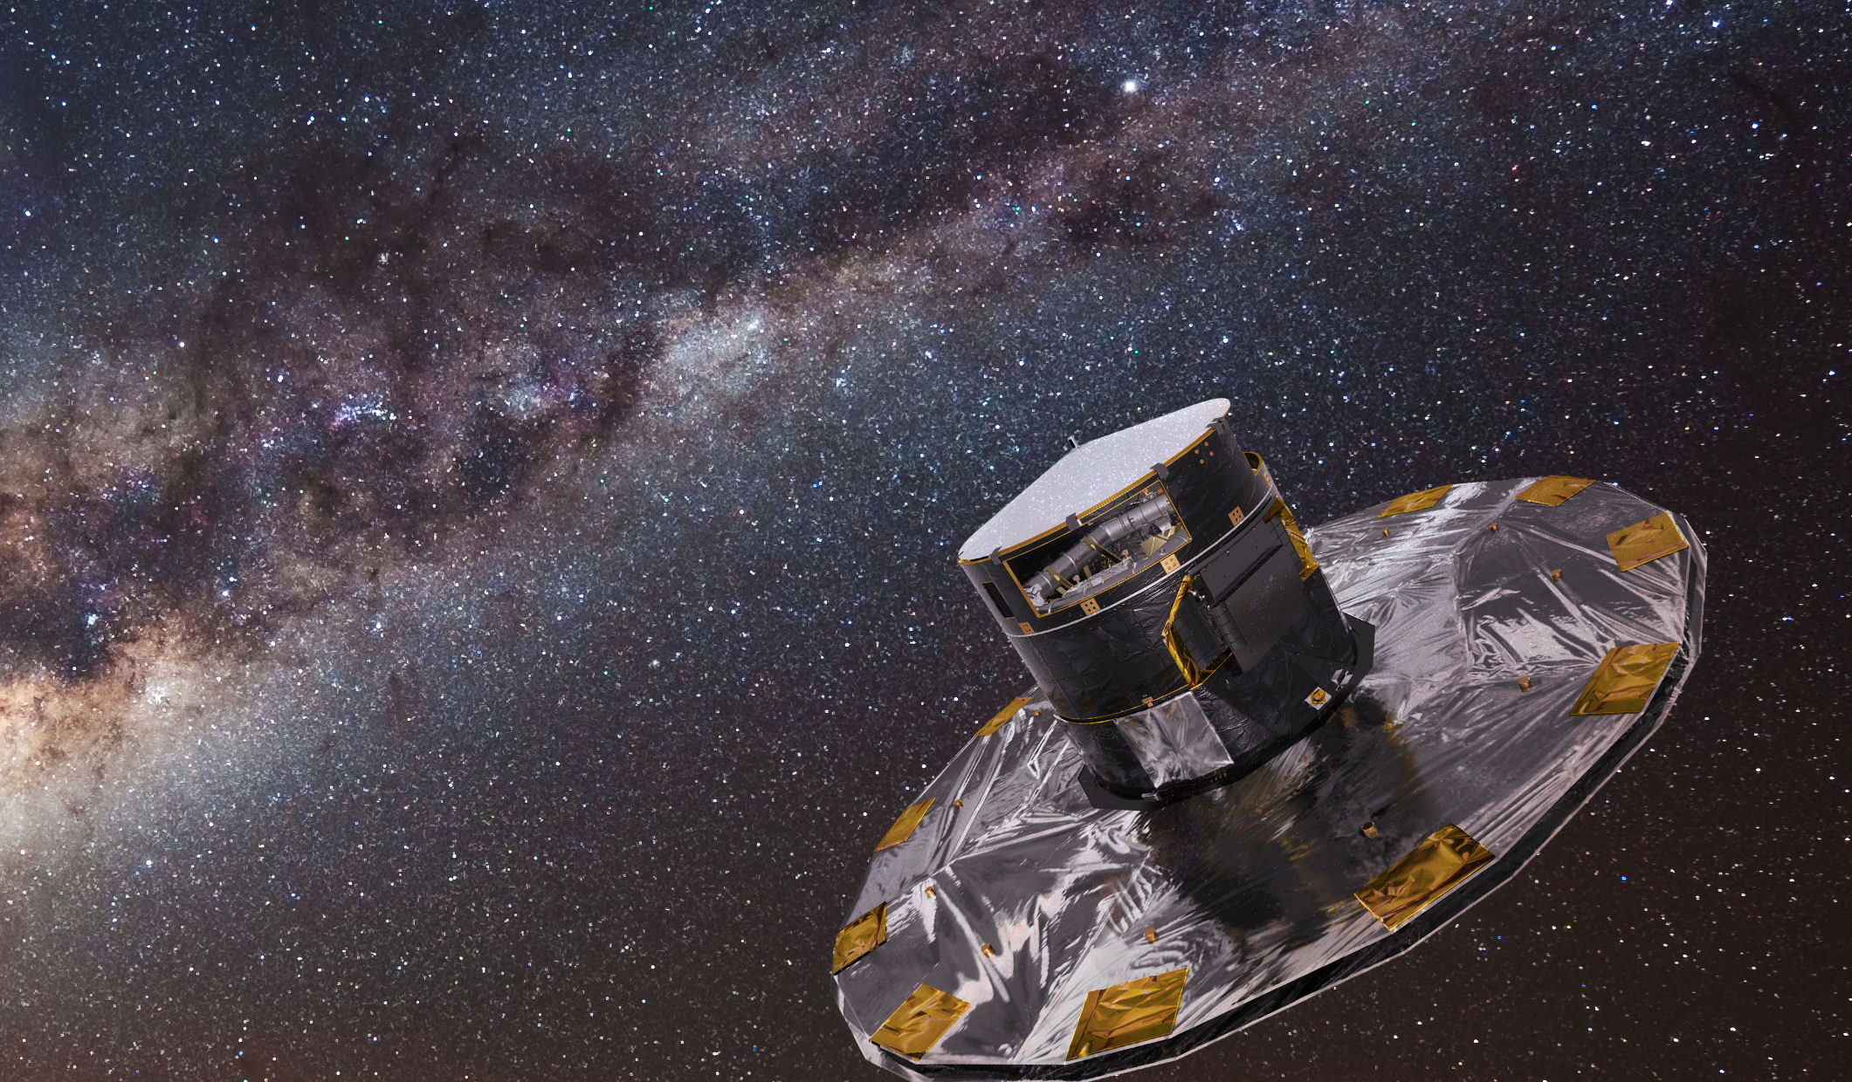
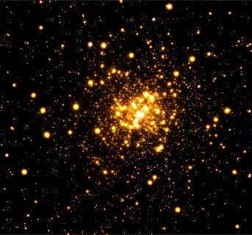
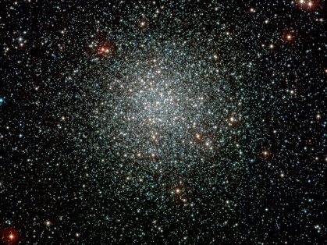
Why are globular clusters so important?
Liller1
Play a central role in cosmological studies
The first stellar systems formed in the early Universe
Help to understand the formation and evolution of galaxies
Help in in stellar evolution theory
NGC3201
The source of data on globular clusters are the Vasiliev (2019) and Baumgardt (2019) catalog serves. They contain average proper motions calculated from data of the Gaia DR2.
1
Notes:
Let`s start with the a little introduction. What is GC? And Why this is interesting for us to learn their orbit and stellar population?
Galaxy clusters play a central role in cosmological studies. As young objects they have been used to probe the initial conditions for structure formation. Their evolution and present dynamical state are of considerable interest for studies both of large-scale structure and of the formation and evolution of galaxies. Clusters are multicomponent systems in which dark matter, hot gas and galaxies evolve in a tightly coupled way. In addition, they were the first stellar systems formed in the early Universe and may be considered true living fossils from which the galaxies like Milky Way were built.
the new finding can help us answer some questions that remain open about the structure and kinematics of the galactic bulge.
Across the entire Milky Way, there are about 150 well known globular clusters. And we couldn’t have done it without a such great space mission like GAIA. From the latest data release of the 3D stellar positions and velocities in our Galaxy now we have a very accurate and homogenous data for the Milky Way Globular Cluster (GC) system space positions and velocities up to 200 kpc of Galactocentric distances. Based on the GC system current coordinates and velocities from the combined mixed catalogues of Baumgardt 2019 and Vasiliev 2019 we perform the full orbital calculations of 152 GC’s in our Galaxy combined gravitational potential.

Slide 3
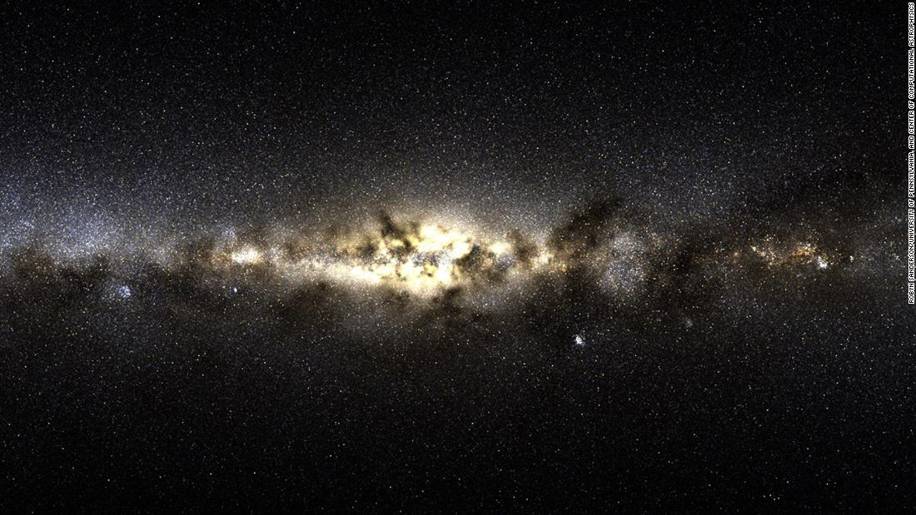
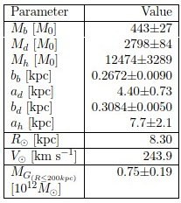


The NFW Milky Way potential
Where:
$r^{2}=X^{2}+Y^{2}+Z^{2}=R^{2}+Z^{2}$
where $M_{b}, M_{d},{ M}_{h}$ are the masses of these components
$b_{b}, a_{d}, b_{d}, a_{h}$are the scale parameters of the components
Bajkova, Bobylev (2020)
Miyamoto, Nagai (1975)
Navarro et al. (1997)
$Ф_{bulge}\left(r\right)=−\frac{M_{b}}{{\left[r^{2}+b_{b}^{2}\right]}^{1/2}}$
$Ф_{disk}\left(R,Z\right)=−\frac{M_{d}}{{\left[R^{2}+{\left(a_{d}+\sqrt{Z^{2}+b_{d}^{2}}\right)}^{2}\right]}^{1/2}}$
$Ф_{halo}\left(r\right)=−\frac{M_{h}}{r}\ln\left(1+\frac{r}{a_{h}}\right)$
2
Notes:
For the Milky Way potential, we use one of the recent combined Bulge + Disk + Halo model Bajkova & Bobylev 2020. Where they express the potentials of the bulge and disk in the form suggested by Miyamoto and Nagai. And for description of the halo component, they used the expression in Navarro-Frenk-White (NFW) form presented in Navarro Frenk and White article
For the cluster’s orbital integration, we use our high order parallel dynamical N-body code phi-GPU CUDA (Berczik at al. 2011). Using this external potential, we first integrate the GC systems up to 5 Gyr back in time (reverse integration set) and after check the integration results with the forward integration set. Using these orbital data set we check the “collisions” conditions of GC’s.

Slide 4
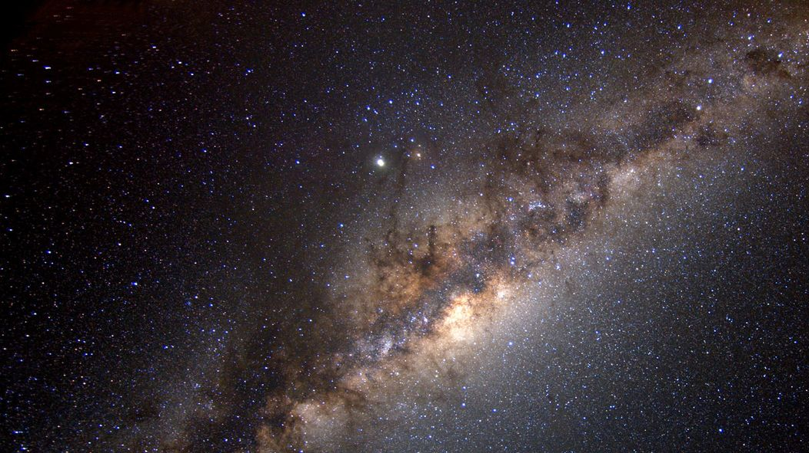
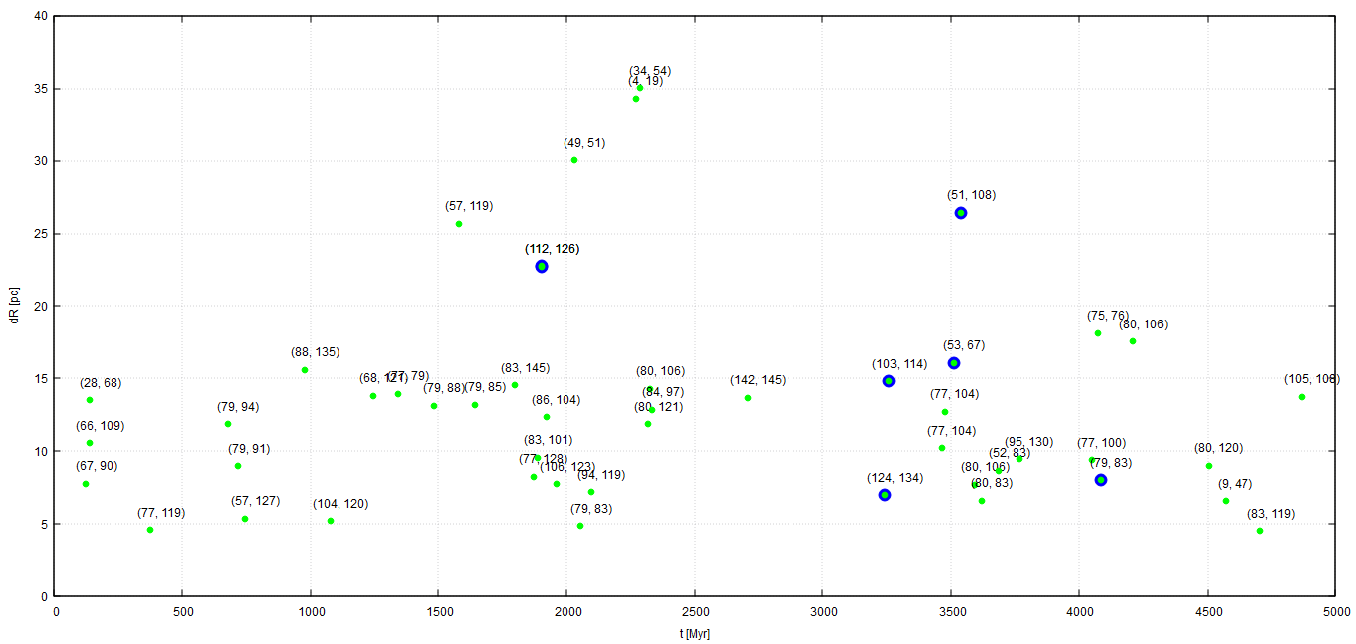
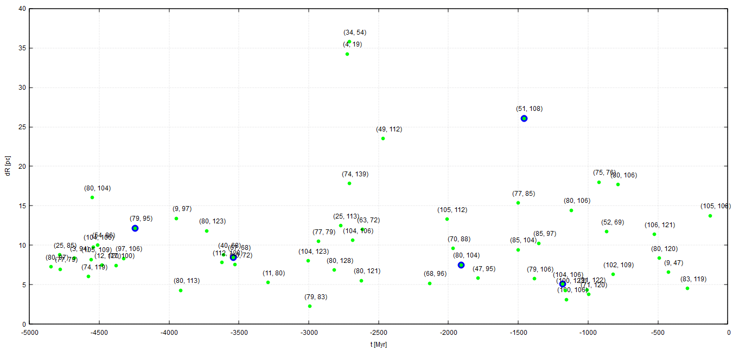


Backward and forward integration
For green objects:
$$dR=2(R_{hm1}+R_{hm2})$$
For blue objects:
$$dR=2(R_{hm1}+R_{hm2})$$
+
$$dV<250 km/s$$
-
-
-
-
-
-
-
-
-
-
3
$${∗R}_{hm}−half mass radius$$
Notes:
Here you can see two plots of those integration. We put some conditions to select right collision pairs, which may exchange of stars. What interesting here is that we have about 10 the same pairs in both integrations. For example 34 and 54, 105 and 108. And we have a blue collision pair, which we will analyze here. Also on this slide we wrote those conditions how we choose those GC’s pairs.

Slide 5
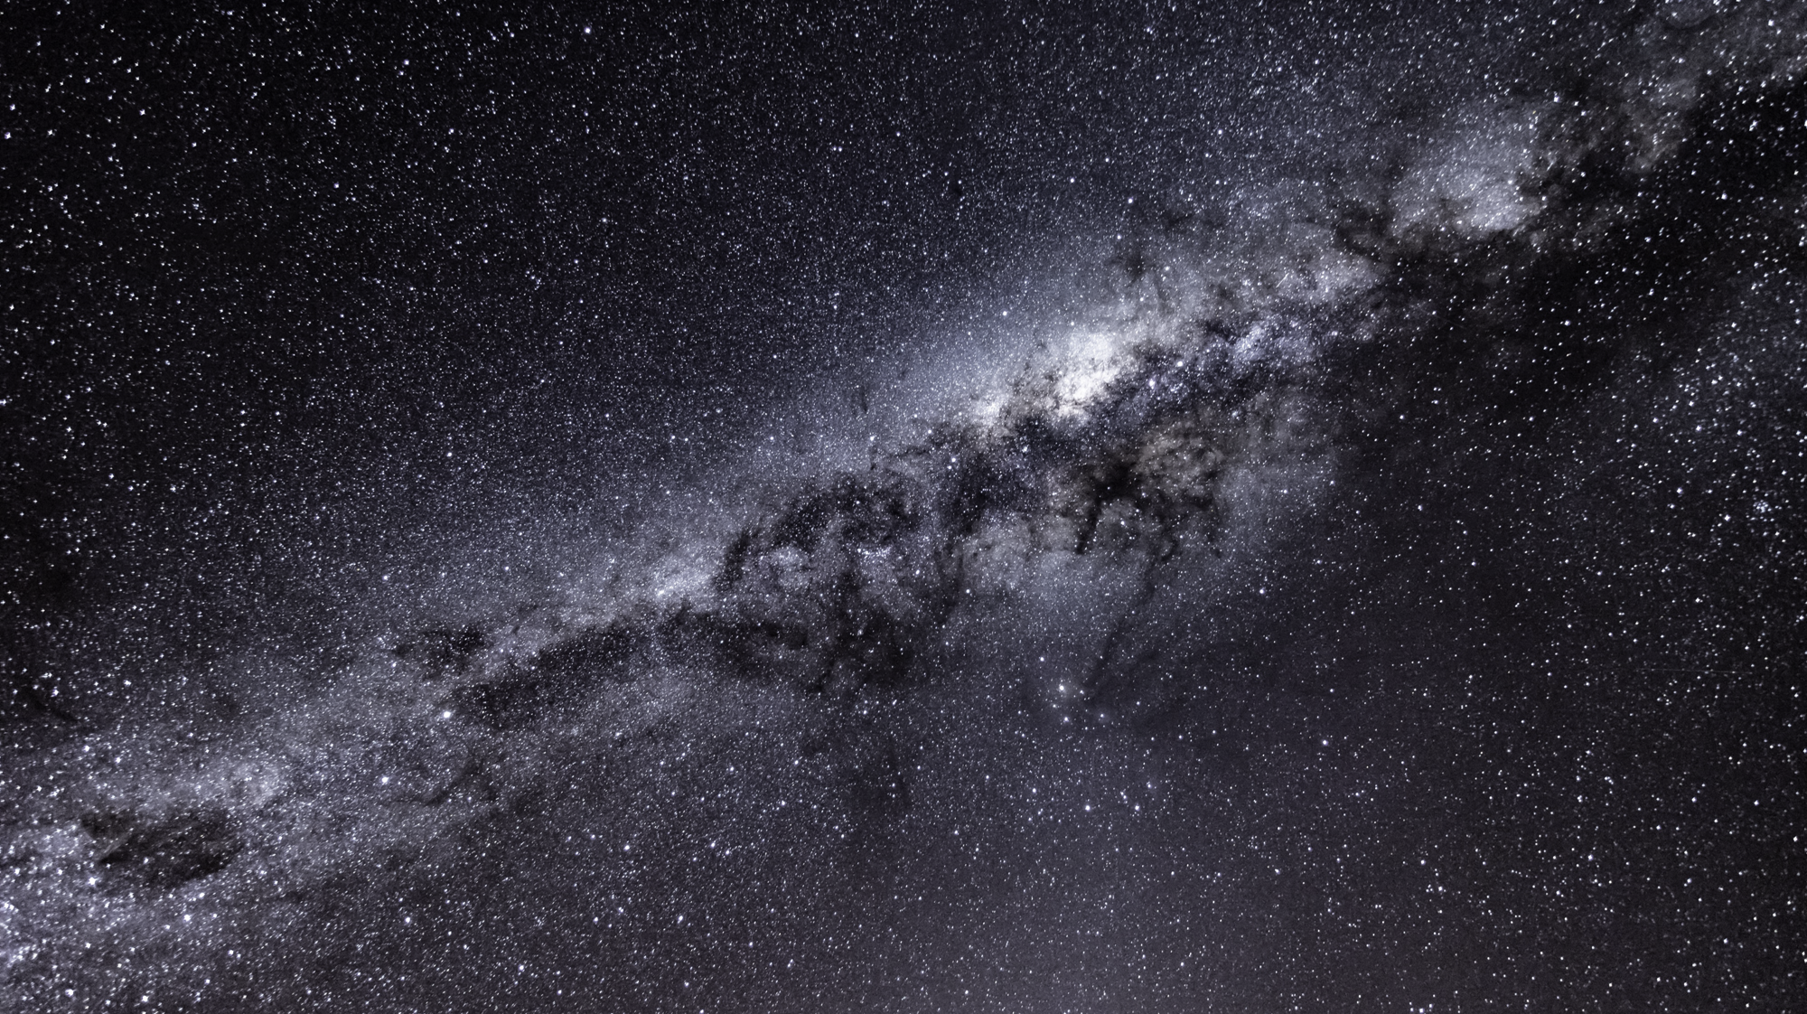
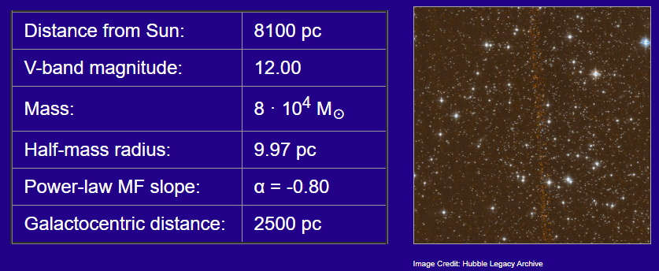
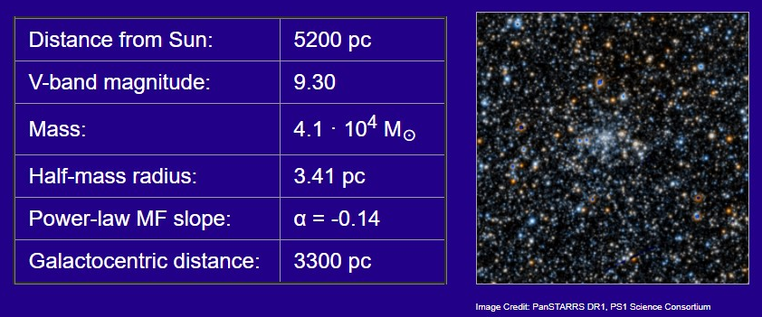
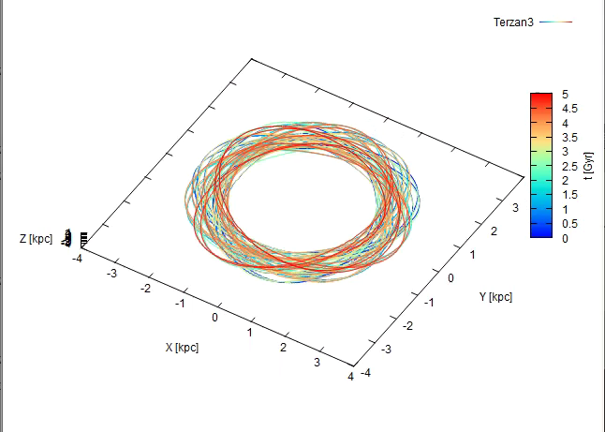
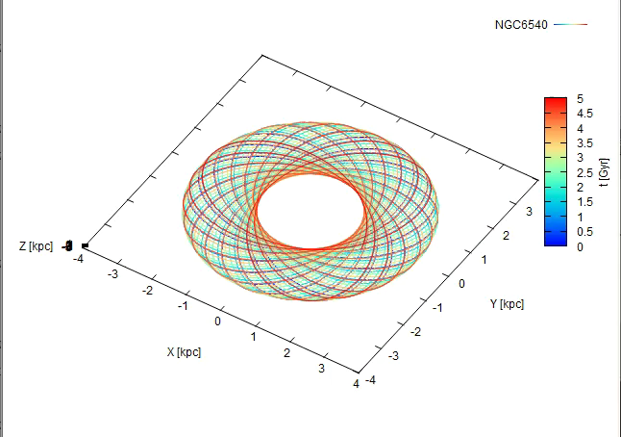
Terzan 3
NGC 6540
https://people.smp.uq.edu.au/HolgerBaumgardt/globular/
4
Notes:
As I said before, for example we will analyze one pair of Globular clusters. On the slide we present some physicals parameters of these GCs and built their orbits. . The orbits are color coded by time. They look pretty beautiful, Aren't they?

Slide 6
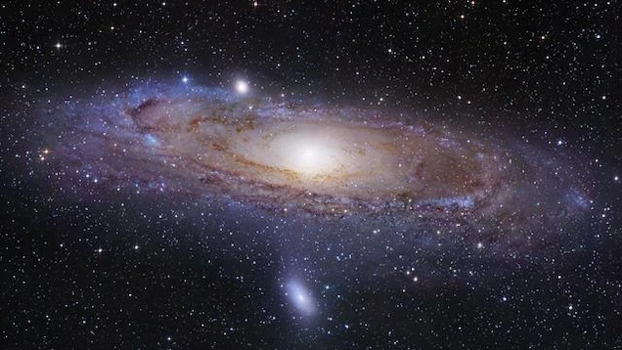
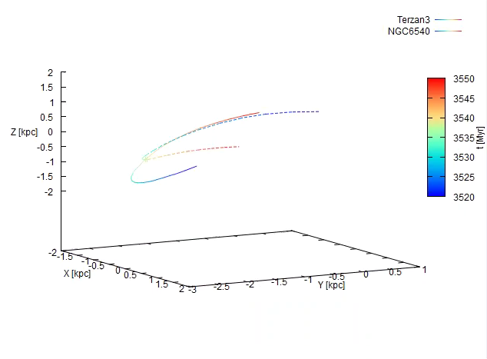
Visualization of orbit
5
Notes:
Here you may see one example of our orbit visualization for this GC pair. Time range about +-10 Myr near the collision. Solid Line – for first GC, dashed line for second one. Those are small trajectory of their orbits. You could see here an intersection of their orbits what means a collision

Slide 7
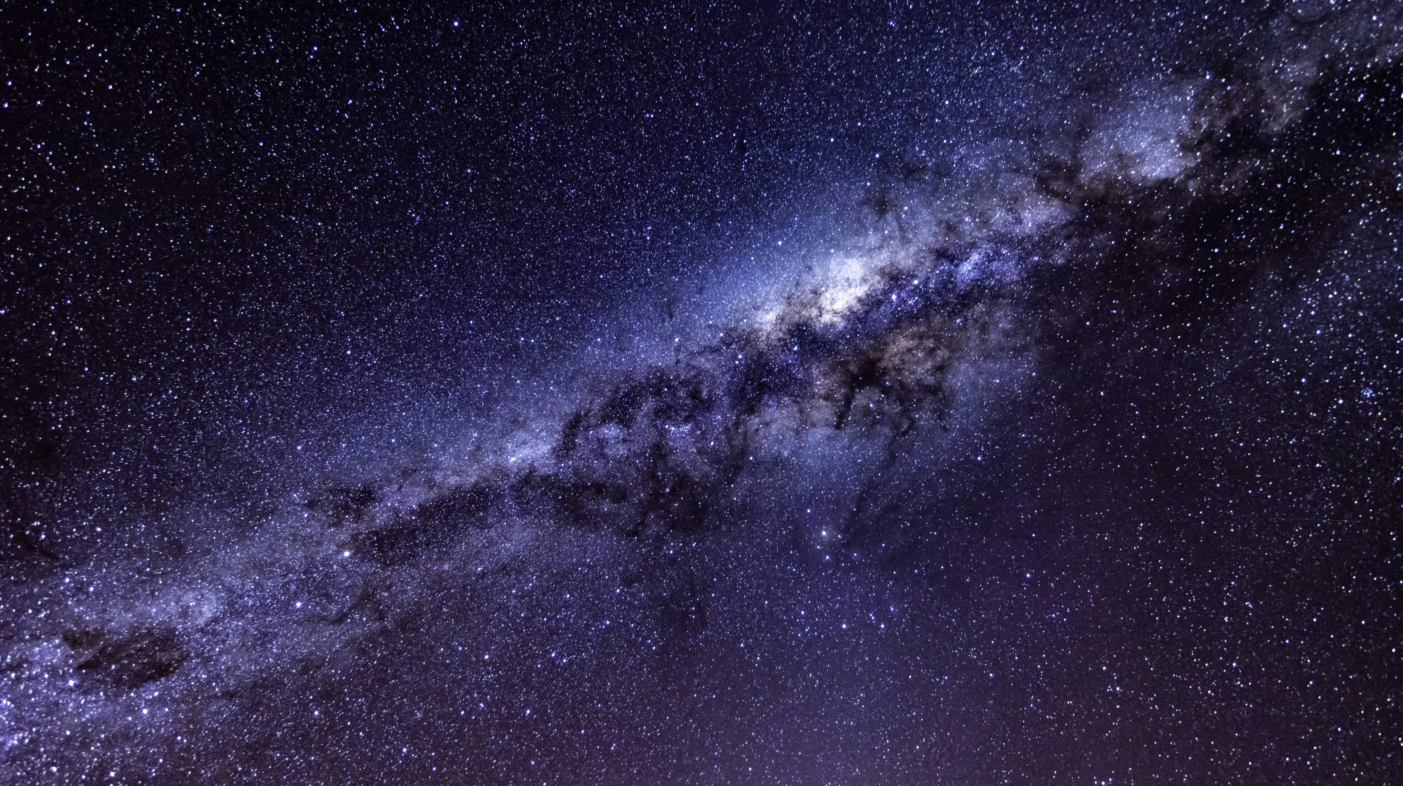
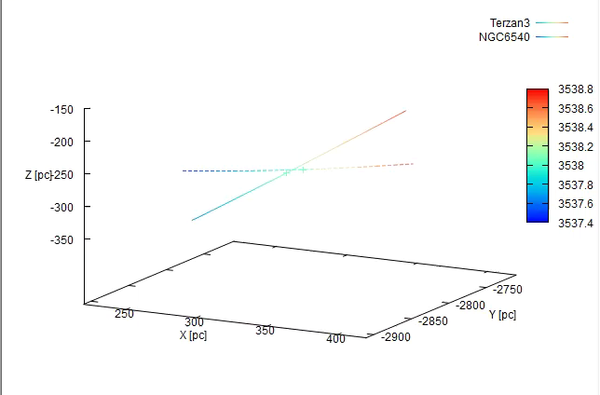
Visualization of orbit (collision)
6
Notes:
In the next video we are getting closer to our collision. And we could see that here which distance between GCs we have and also plases here mean when collision happend. It helps us to really understand how they move and then analyze their ineraction. Of course it`s interesting in future to analyze how the exchange of stars happen.

Slide 8
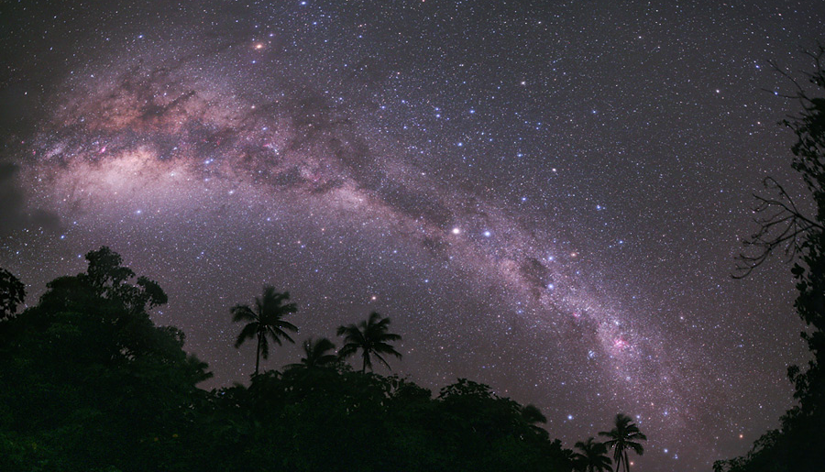
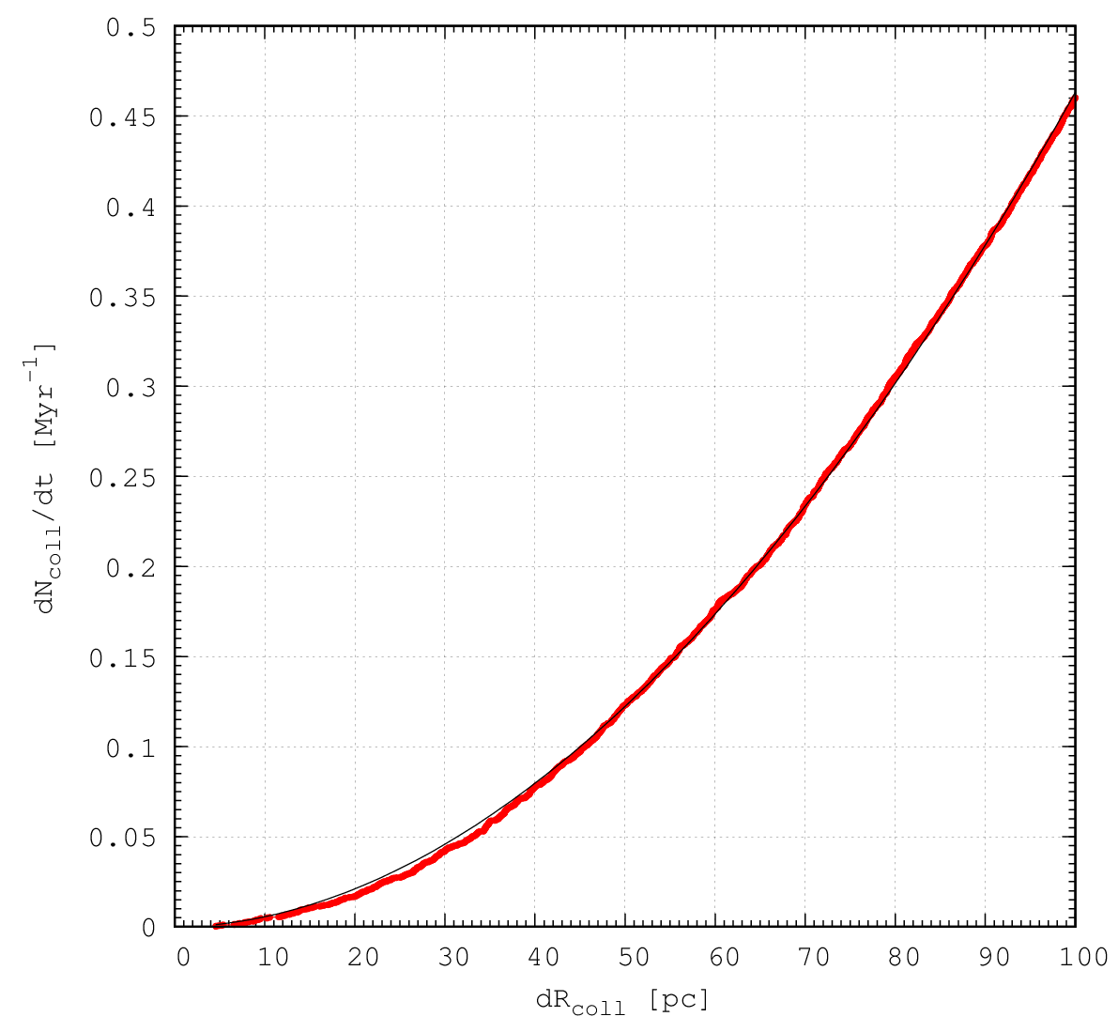

Statistics of GC collision rate in MW galaxy
$f\left(dR\right)={10}^{(a\lg\left(dR\right)+b)}$
a = +1.9213 +/- 0.001072 (0.0558%)
b = -4.17689 +/- 0.002082 (0.04985%)
I.e. In each 10 Myr we have at least 1 collision with dR < 45 pc.
7
Notes:
And now let’s talk about statistic. On slide you could see our fitting function and value of parameters. This plot shows to us Statistics of GC collision rate in MW galaxy.
It means that In each 10 Myr we have at least 1 collision with radiuos difference less then 45 pc.

Slide 9
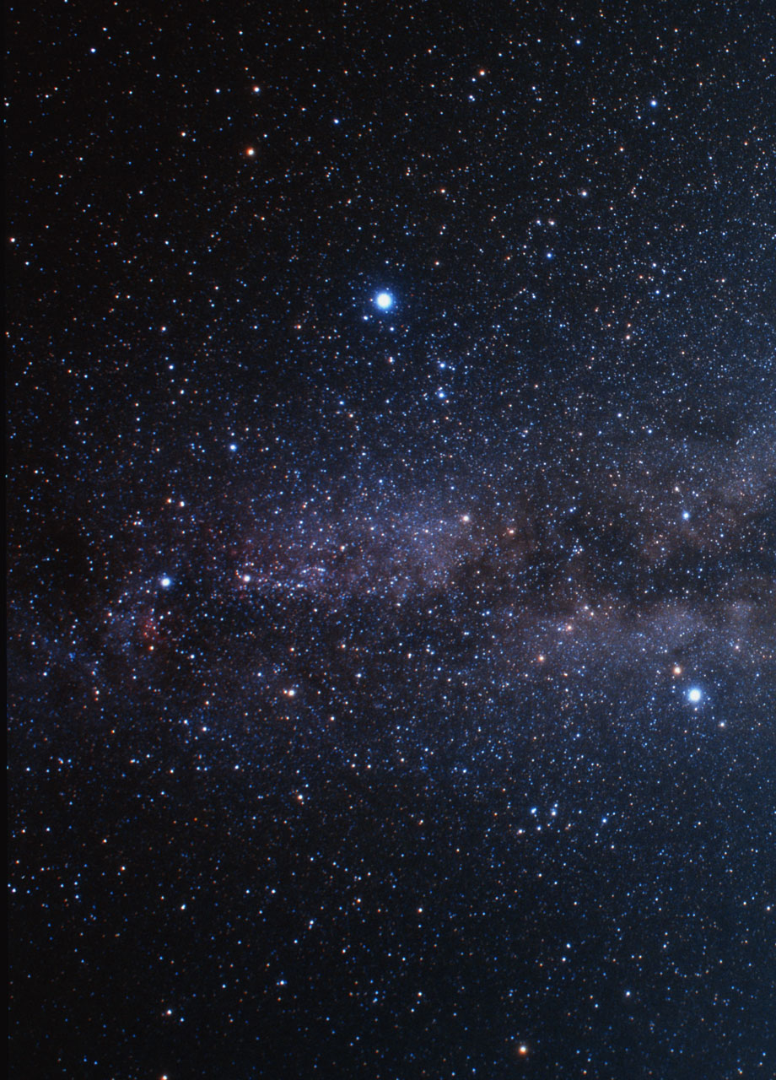
Summary
Backward and forward integrations up to 5 Gyr.
Check the “collisions” conditions of GC’s.
Find stable “collisions” pairs.
Our plans:
determine the mass exchange rate between the individual GC’s…
examine the possible rotation and angular momentum exchange rate between the individual clusters…
study of the individual clusters mass function evolution (Initial MF – Present Day MF)…
8
Notes:
Summary of our work
We integrate the GC systems up to 5 Gyr backward and forward in time to get their orbits.
Then we check the “collisions” conditions of GC’s. and looking for stable pair and analyze their orbits.
In future, the second part of our work is checking in details these potential “collisions” again using our phi-GPU CUDA N-body integration code. As a main result of our simulations we determine the mass exchange rate between the individual GC’s , next point is examine the possible rotation and angular momentum exchange rate between the individual clusters…
study of the individual clusters mass function evolution (Initial MF – Present Day MF)…

Slide 10
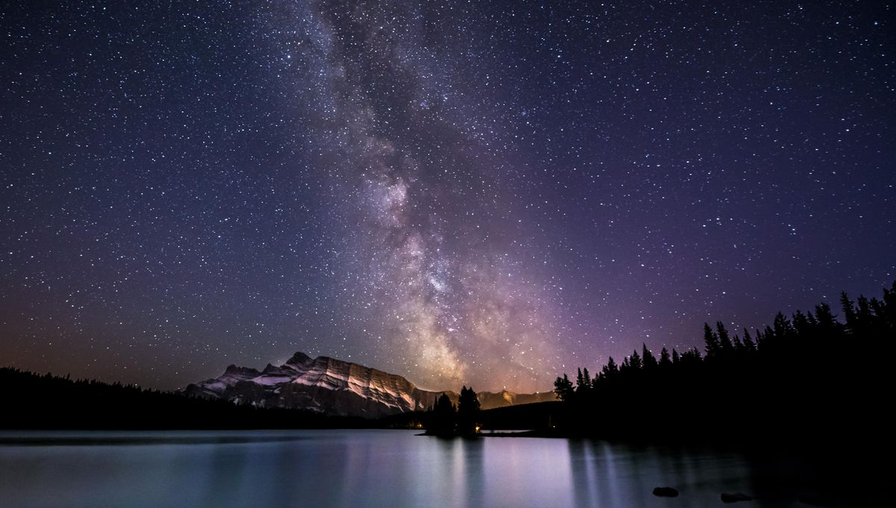
Thanks for you attention!

