Slide 1
RESULTS OF PHOTOMETRIC RESEARCH OF AGN MARKARIAN 501 AND MARKARIAN 421
Orikhovskyi D.A., Ponomarenko V.A., Simon A.O., Vasylenko V.V.
Taras Shevchenko National University in Kyiv
orekhovskiy.math@gmail.com

Slide 2
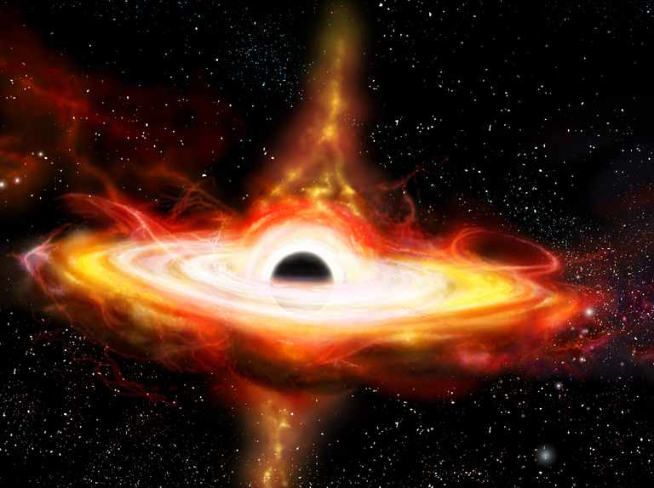
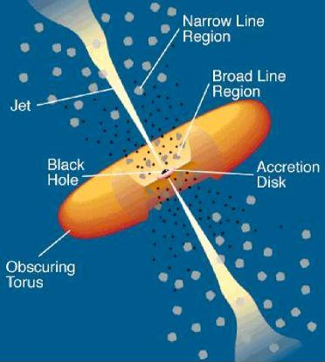
BL lac objects

Slide 3
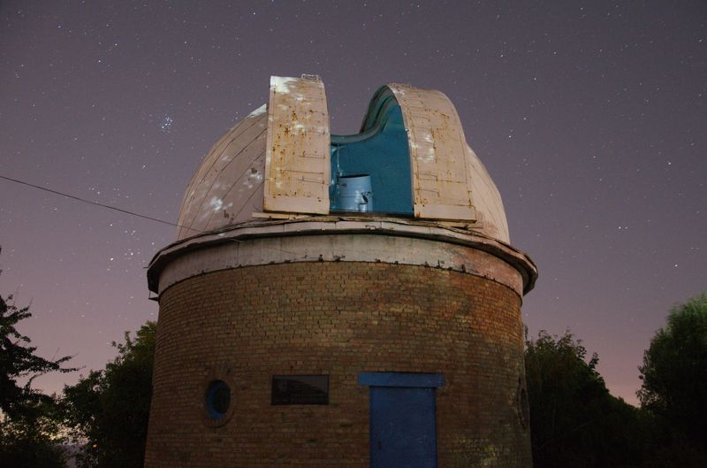
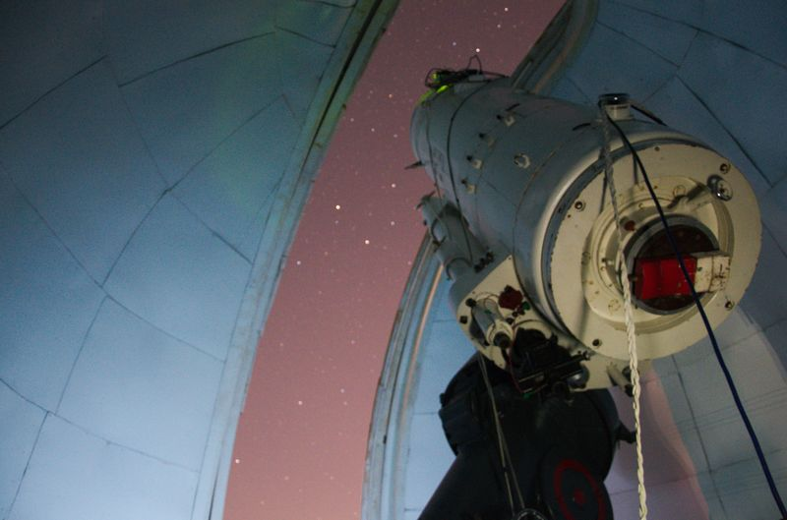
Telescopes
The telescope AZT-8 (D=0.7 m, F=2.83 m) with the CCD camera FLI PL4710-1-BB-E2V (1027x1048 pixels, 13x13 μm/pixel, scale is 0.95 "/pixel, field of view is 16.2 angular minutes) and broadband Johnson/Bessel UBVRI filters.

Slide 4
Information about the objects
Object | Markarian 501 | Markarian 421
R.A. (hh mm ss) | 16 53 52 | 11 04 19
Dec. (dd mm ss) | +39 45 38 | +38 11 41
Distance or Redshift | z=0.0336 | z=0.031
Energy Threshold | 300 GeV | 500 GeV
Spectral Index | 2.72 | 2.2
Discovery Date | 1974 | 1992-08
V_{mag} | ≈13.7^{m} | ≈12.9^{m}

Slide 5
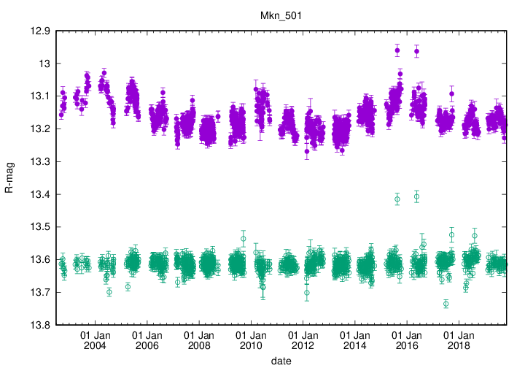
Previous observations of mrk 501
http://users.utu.fi/kani/1m/index.html

Slide 6
Markarian 501 night-to-night observations in 2018
Red – Mrk 501; green and blue – star-standarts

Slide 7
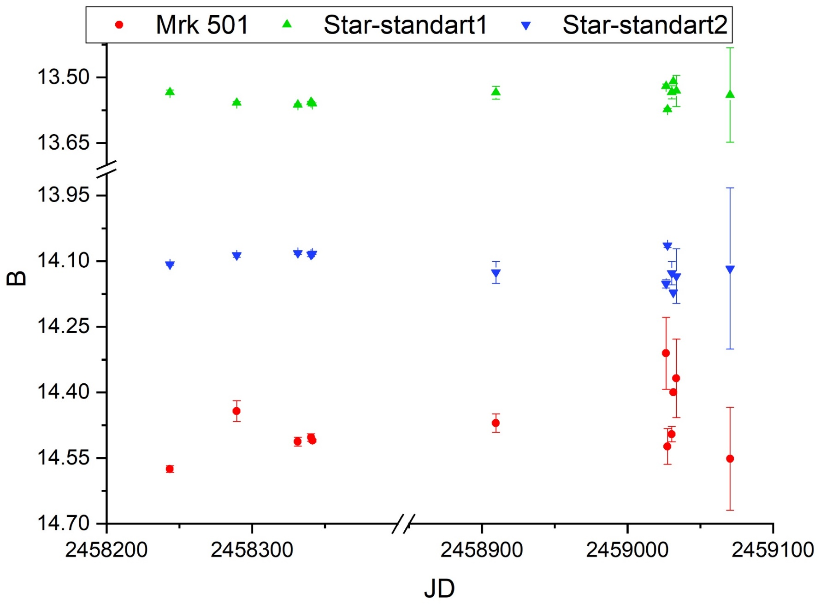
Markarian 501 night-to-night observations in 2018-2020

Slide 8
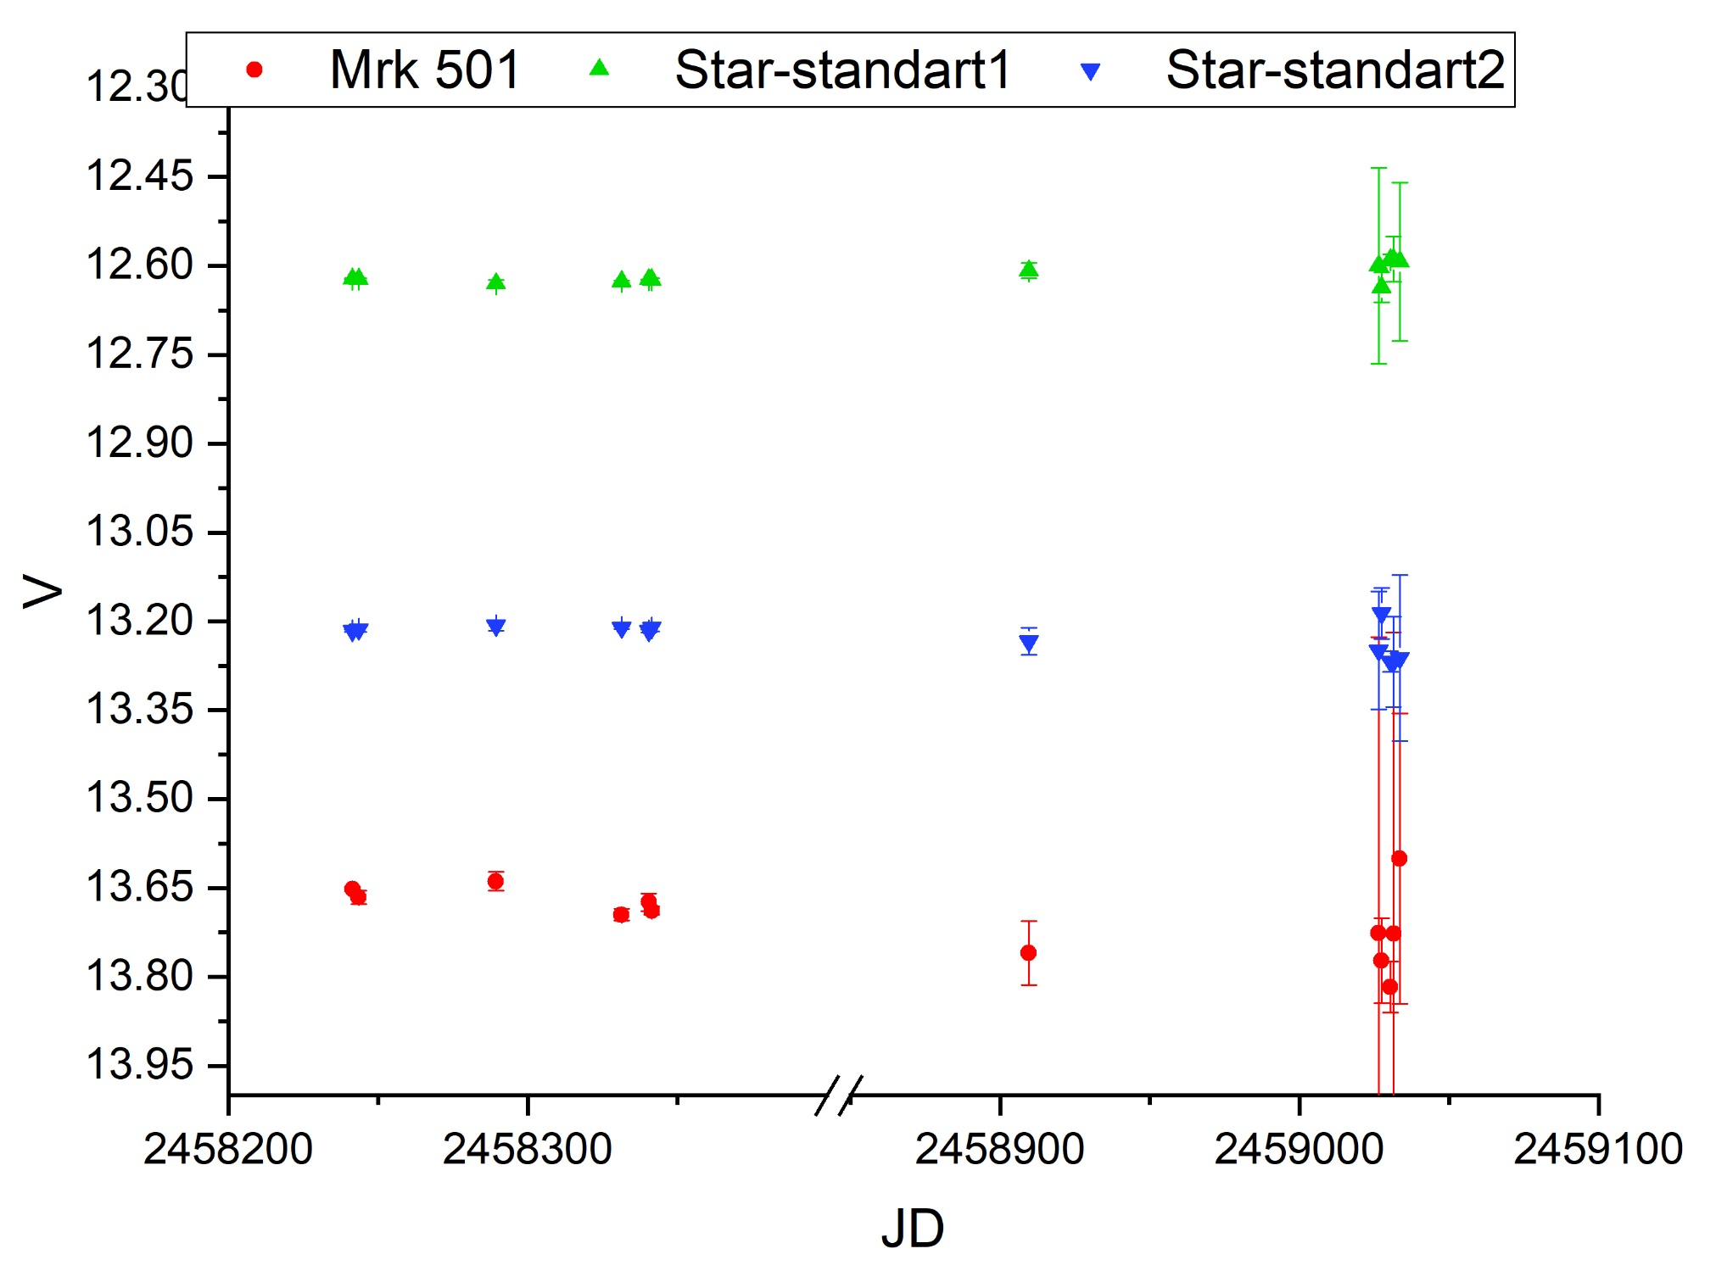
Markarian 501 night-to-night observations in 2018-2020

Slide 9
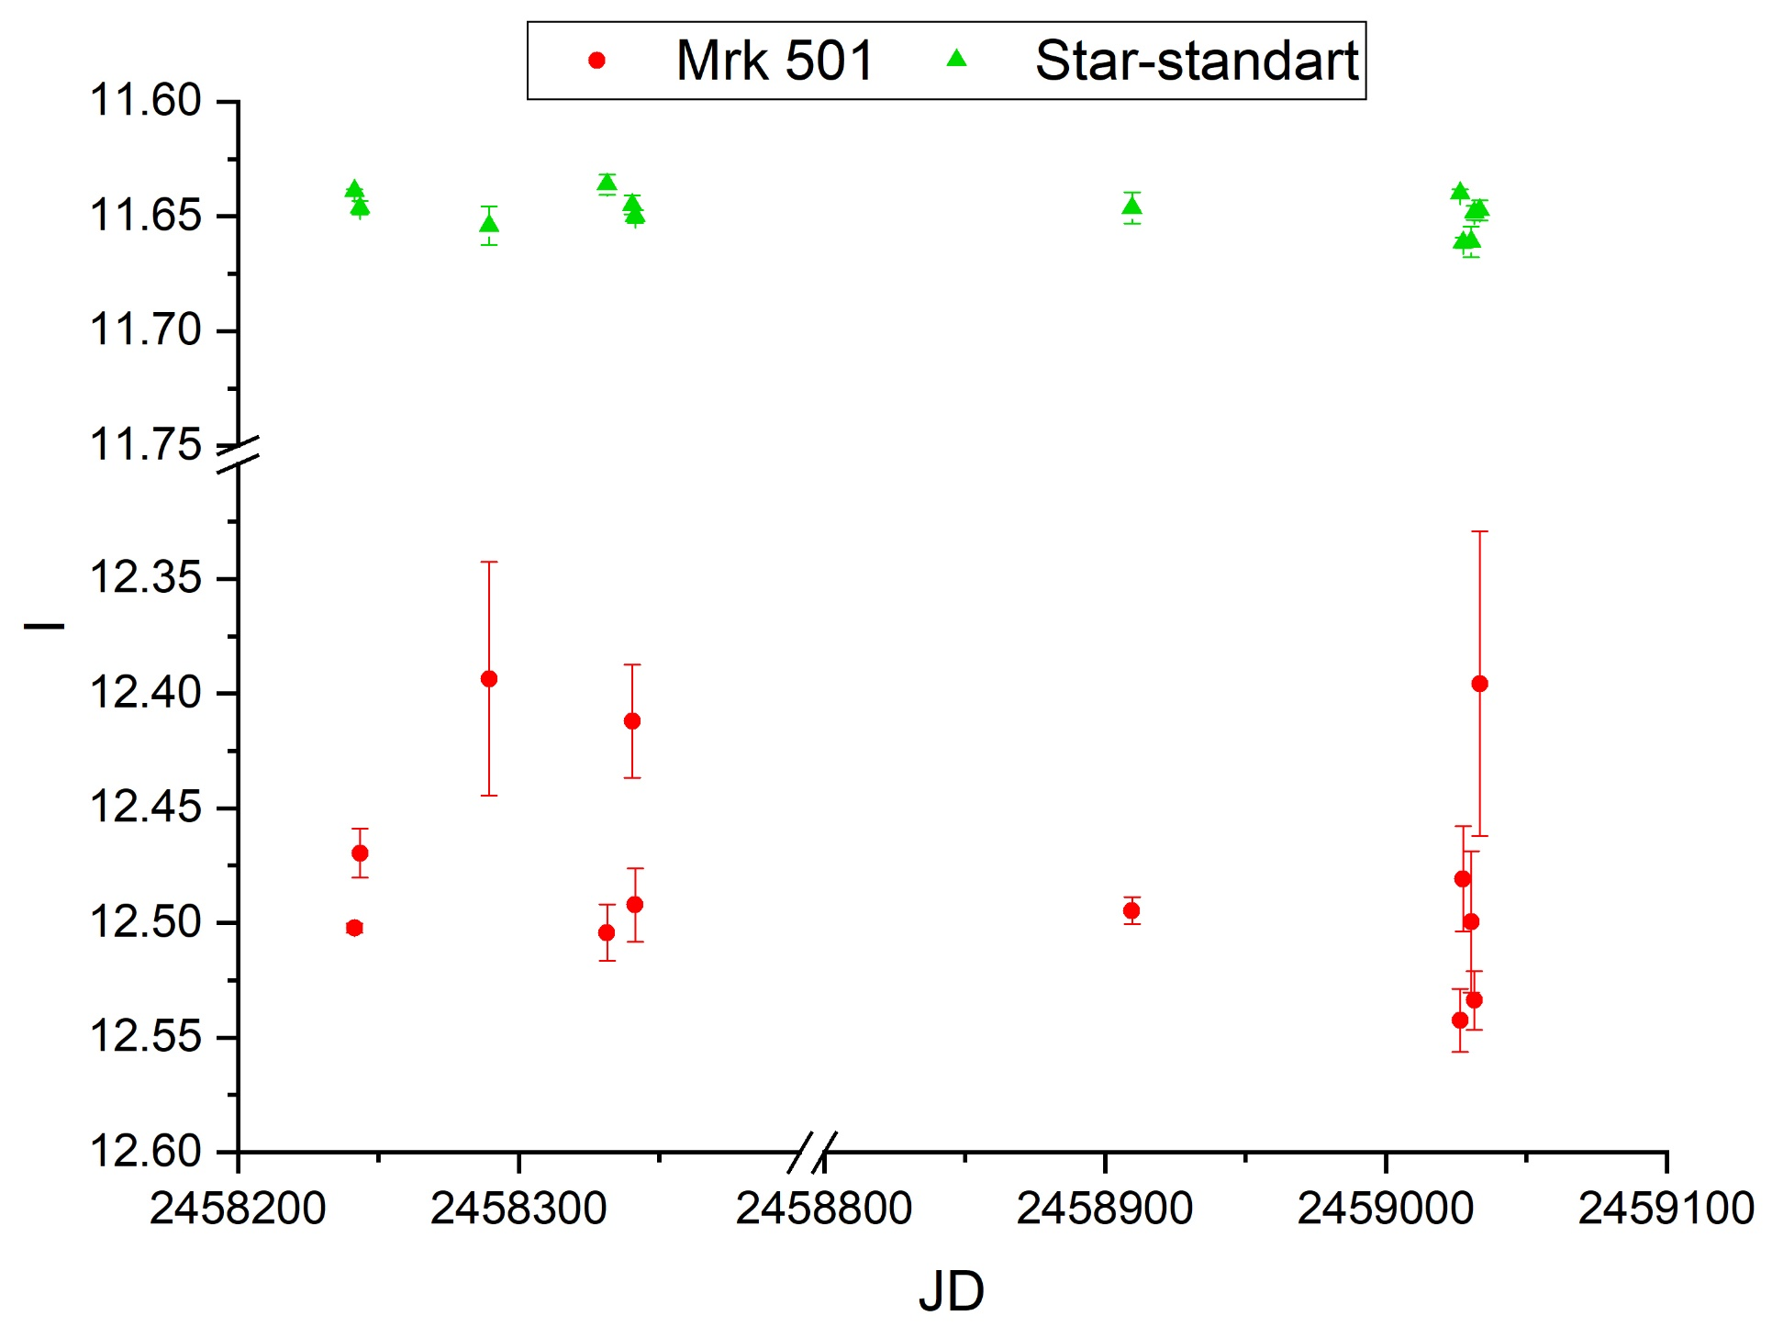
Markarian 501 night-to-night observations in 2018-2020

Slide 10
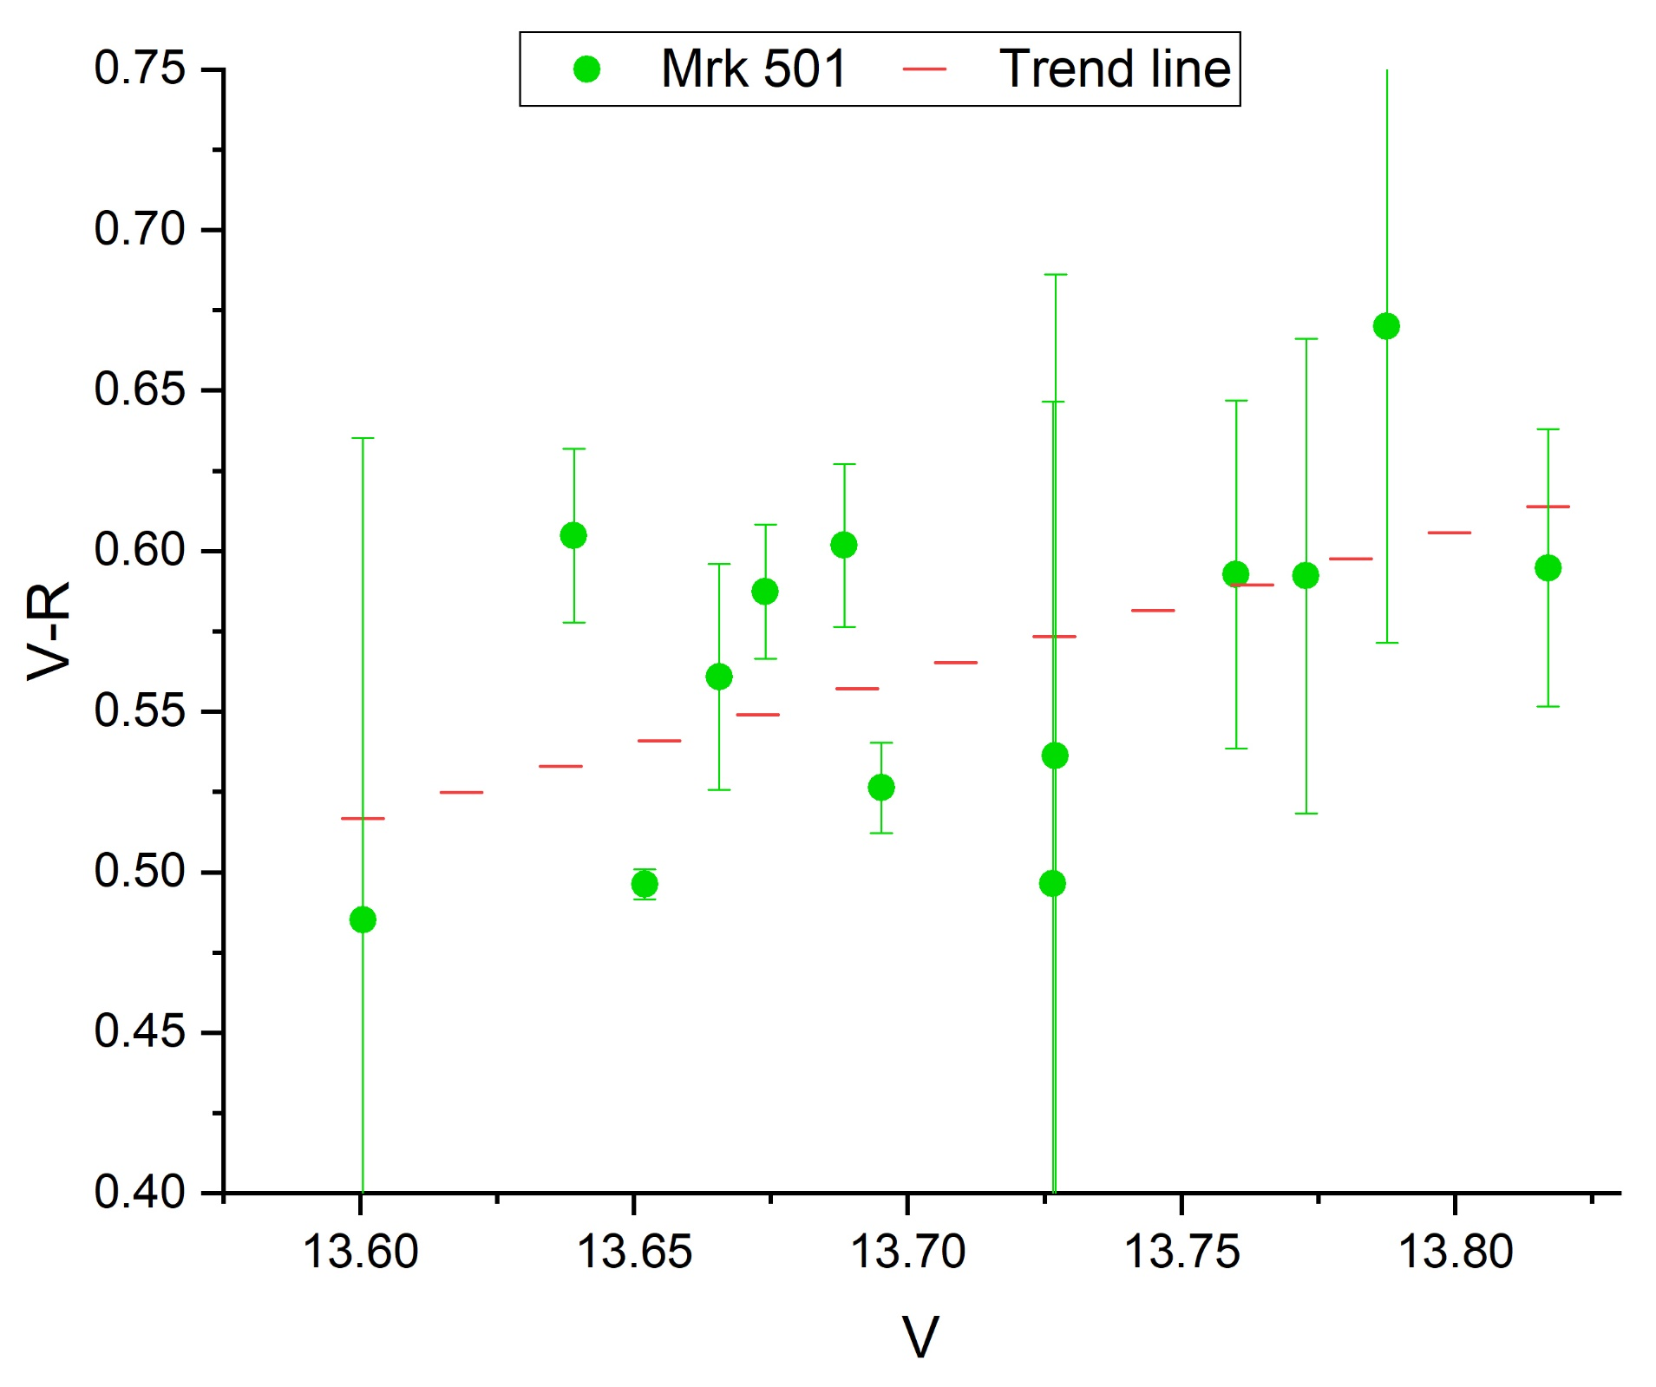
Color indexes

Slide 11
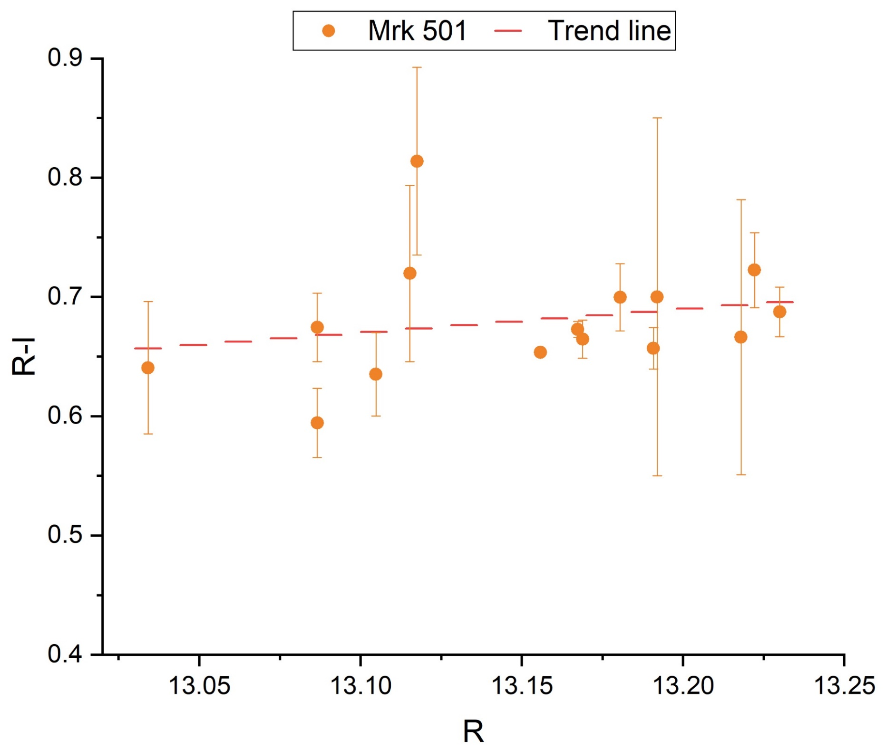
Color indexes

Slide 12
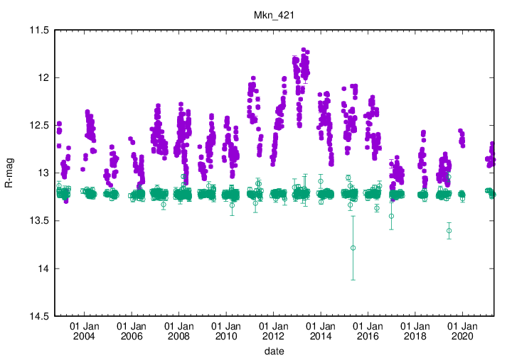
http://users.utu.fi/kani/1m/index.html

Slide 13
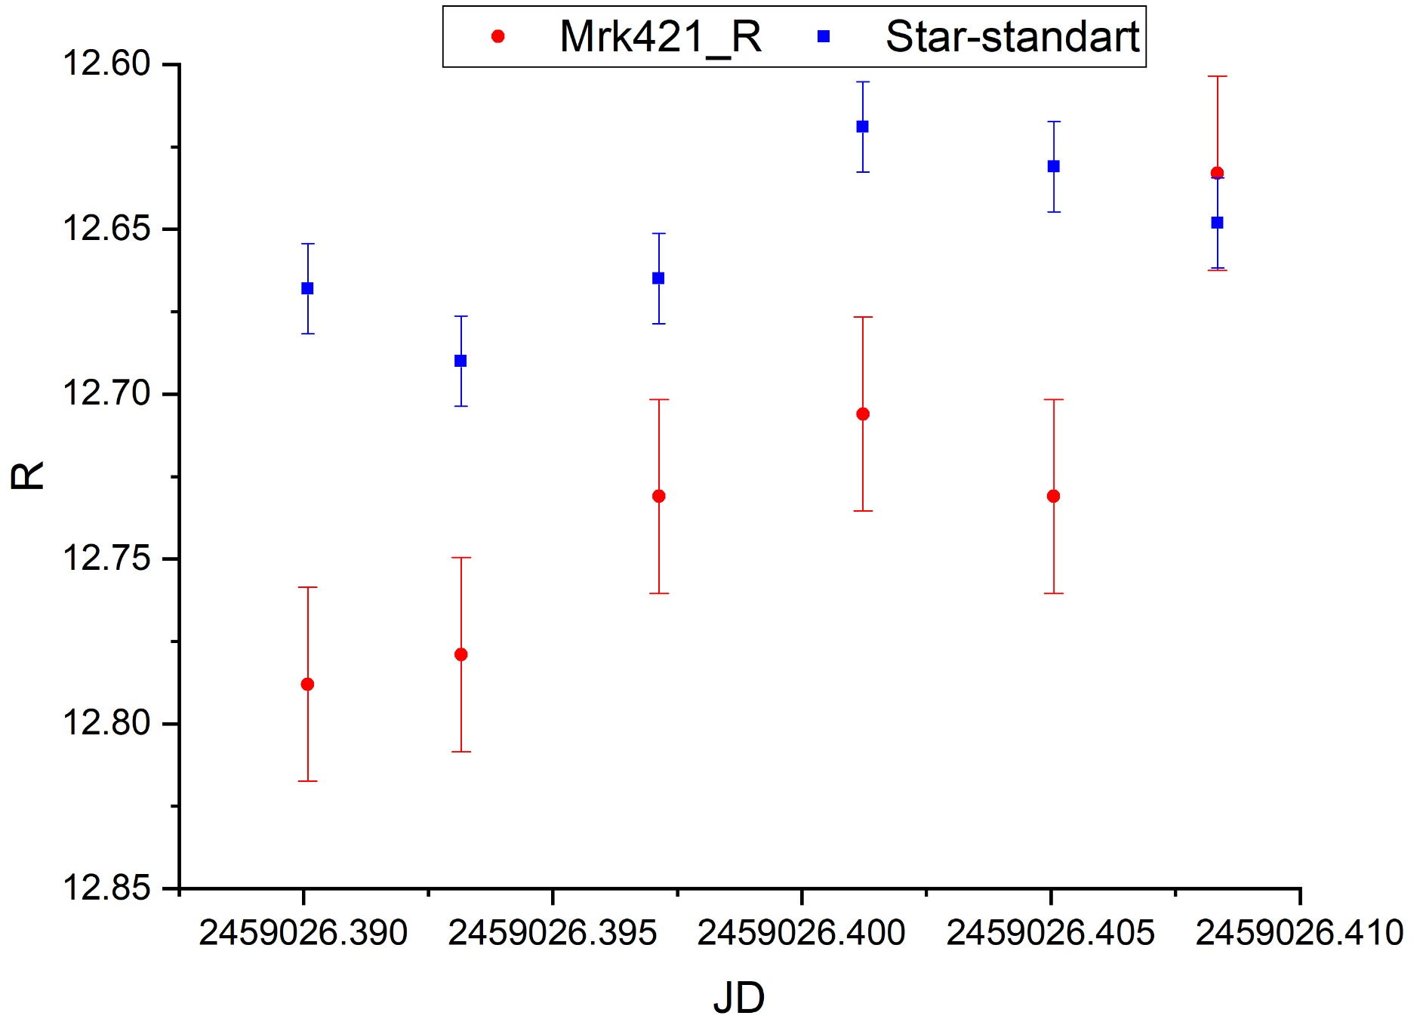
Markarian 421 one night (IDV) observations in 2020 (Filter r)
25.06.2020

Slide 14
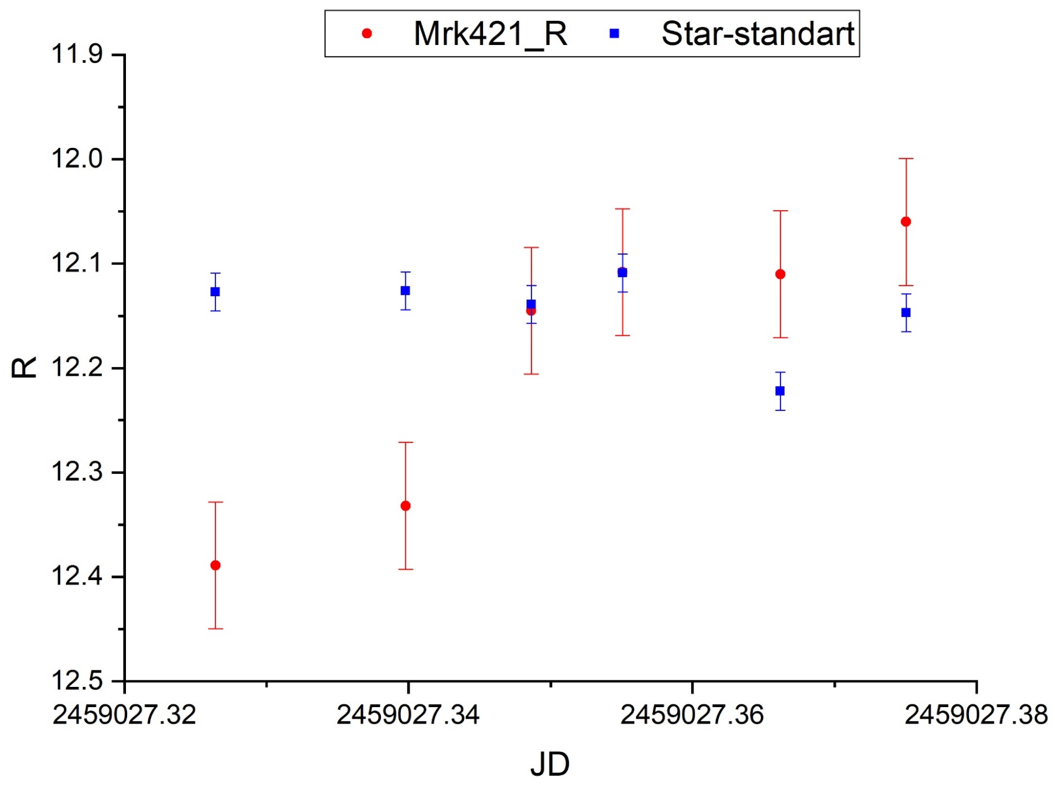
Markarian 421 one night (IDV) observations in 2020 (filter r)
26.06.2020

Slide 15
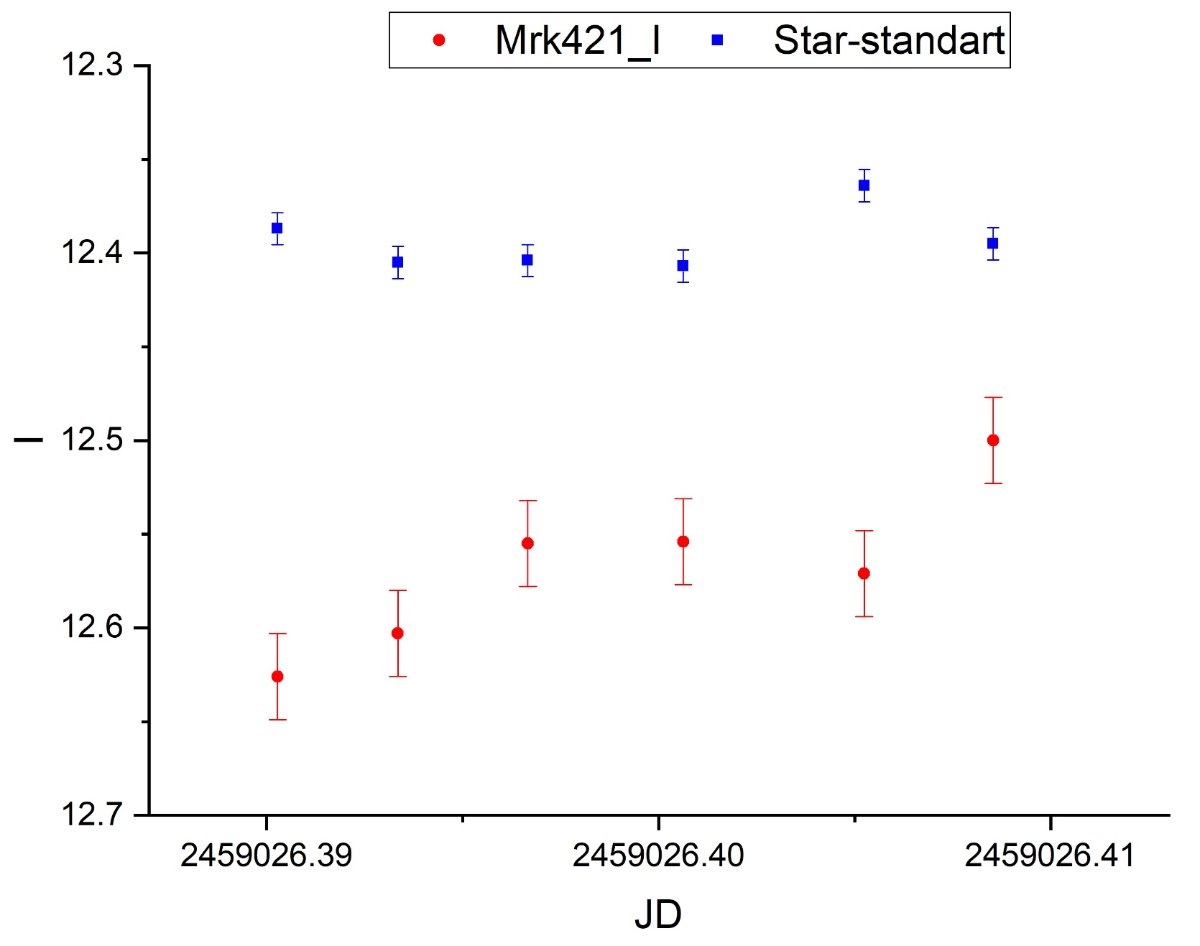
Markarian 421 one night (IDV) observations in 2020 (filter i)
25.06.2020

Slide 16
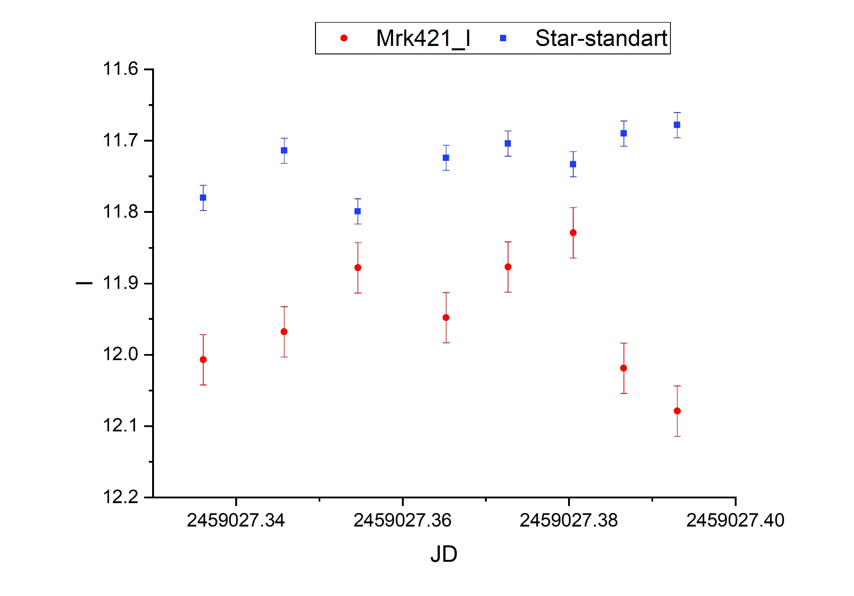
Markarian 421 one night (IDV) observations in 2020 (filter i)
26.06.2020

Slide 17
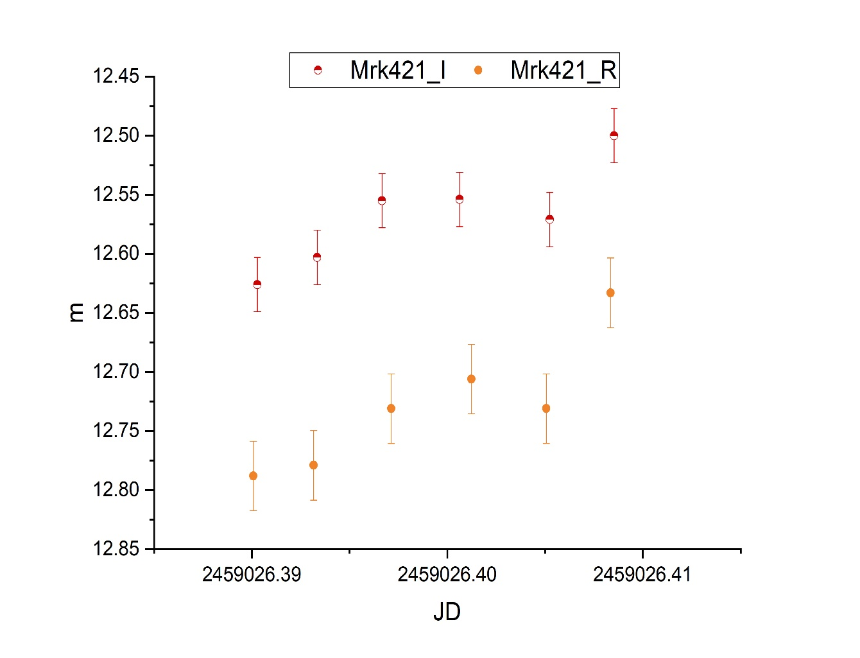
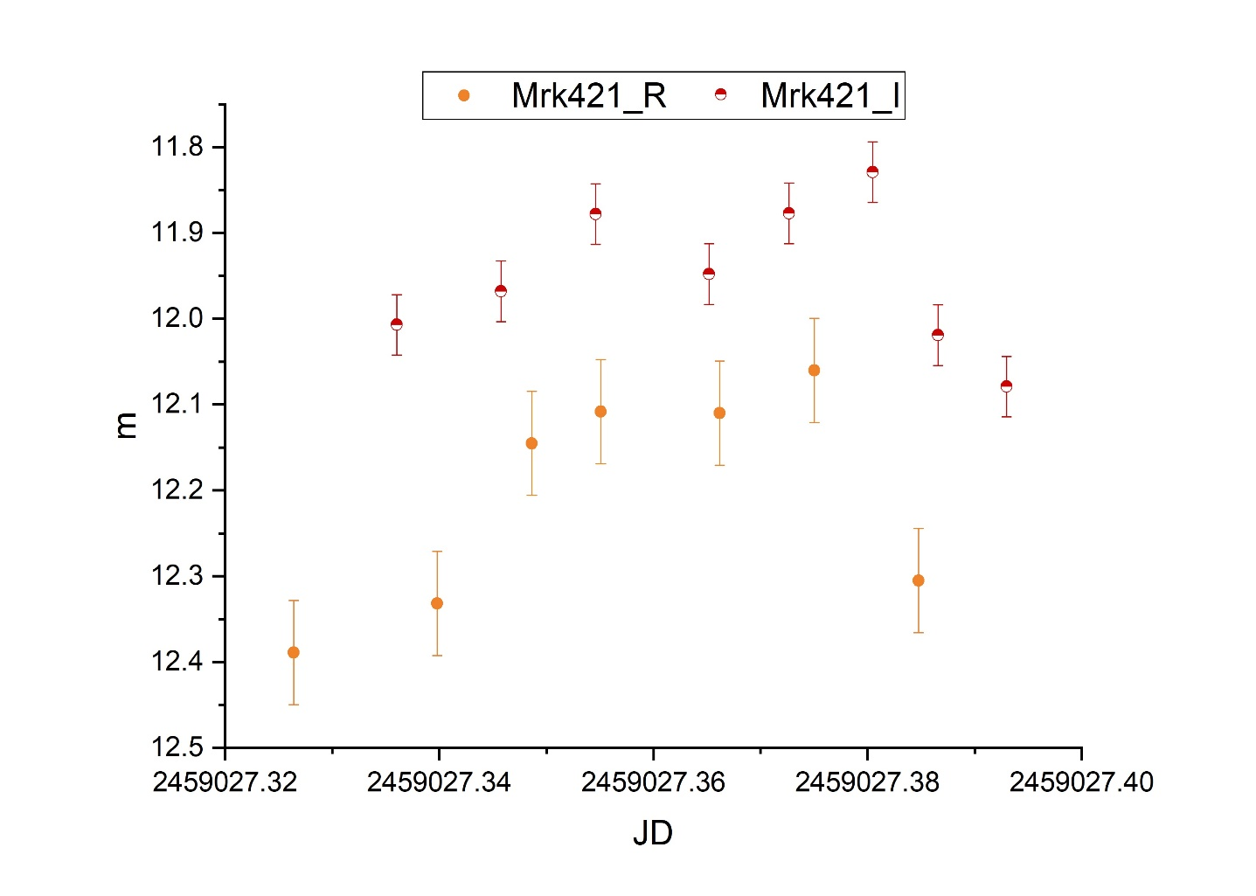
Markarian 421 in filters r and i
25.06.2020
26.06.2020

Slide 18
Conclusions
For AGN Markarian 501 flux changes in filters B, V, I were sighted in 2020.
The increasing of the flux is driven by the growth of synchrotron radiation in the jet.
Intraday variability and flux increment for AGN Markarian 421 in filters R, I was noticed.

