Slide 1

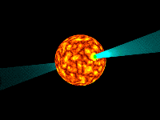
The curvature emission model of peculiar isolated neutron star 2XMM J104608.7-594306
Natia Kevlishvili
Natia.kevlishvili.1@iliauni.edu.ge
Institute of Theoretical Physics, Ilia State University.
Tbilisi, Georgia.
26.04.2021
FR-18-14747

Slide 2

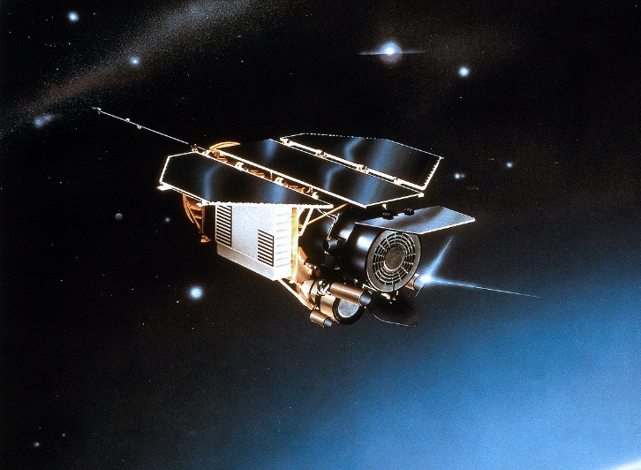
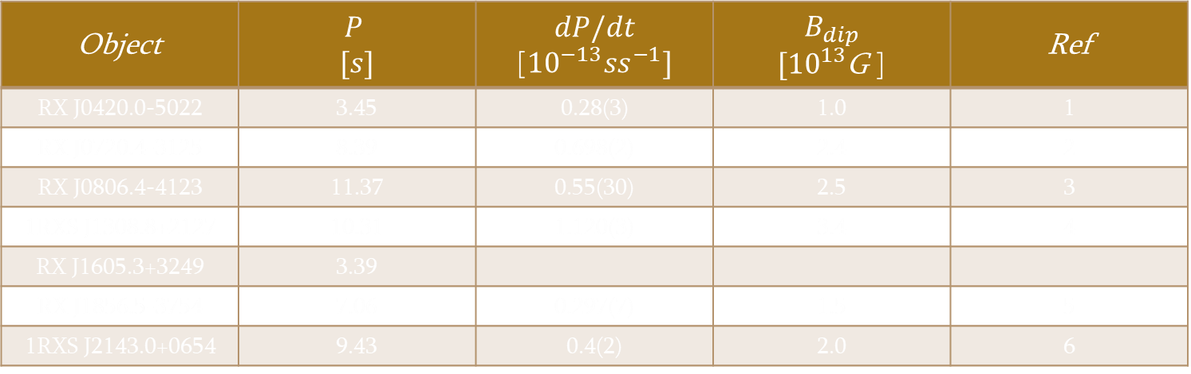
XDINS - X-ray Dim Isolated Neutron Stars
The Magnificent Seven (M7)
RX 1856.5-3754,
RBS1223,
RBS1774,
RXJ1605.3+3249,
RXJ0420.0-5022,
RXJ0720.4-3125,
RXJ0806.4-4123
2XMM J140608.7-594306
RX J1412.9-7922 (Calvera)
ROSAT - Röntgensatellit
Object | $$P$$ $$[s]$$ | $$dP/dt$$ [${10}^{−13}{ss}^{−1}]$ | $$B_{dip}$$ $[{10}^{13}$G ] | Ref
RX J0420.0-5022 | 3.45 | 0.28(3) | 1.0 | 1
RX J0720.4-3125 | 8.39 | 0.698(2) | 2.4 | 2
RX J0806.4-4123 | 11.37 | 0.55(30) | 2.5 | 3
1RXS J1308.8+2127 | 10.31 | 1.120(3) | 3.4 | 4
RX J1605.3+3249 | 3.39
RX J1856.5-3754 | 7.06 | 0.297(7) | 1.5 | 5
1RXS J2143.0+0654 | 9.43 | 0.4(2) | 2.0 | 6
Kaplan & van Kerkwijk 2011, ApJ 740, L30 4. Kaplan & van Kerkwijk 2005b, ApJ 635, L65
Kaplan & van Kerkwijk 2005a, ApJ 628, L45 5. van Kerkwijk & Kaplan 2008, ApJ 673, L163
Kaplan & van Kerkwijk 2009b, ApJ 705, 798 6. Kaplan & van Kerkwijk 2009a, ApJ 692, L62

Slide 3
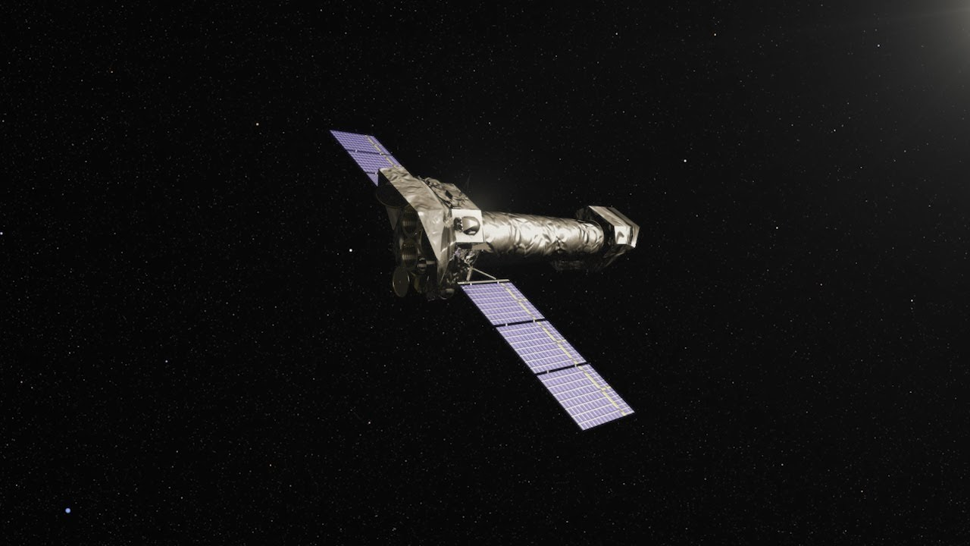
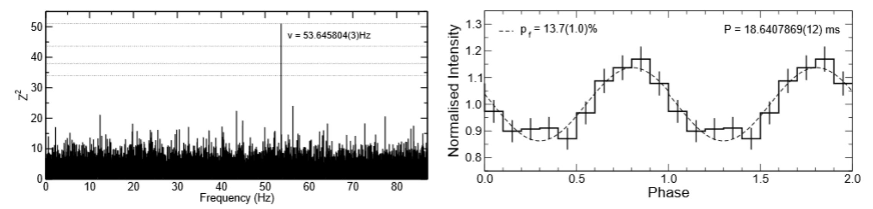

The isolated neutron star candidate 2XMM J104608. 7-594306
A new INS candidate;
Detected by XMM-Newton
Located in the Carina Nebula;
$kT^{∞}\sim \left(133.1±1.9\right)eV$;
$N_{H}\sim 3.2×{10}^{21}{cm}^{−2}$;
P=18.6msec ( M7 – P $\sim$ 3.39-11.37s)
$B_{dip}=\left(3−8\right)∗{10}^{11}G$
(M7- $B\sim {10}^{13}−{10}^{14}G)$
M7-like? Yes! But P≈19 msec
Pires, A.M., Motch, C., Turolla, R., et al. 2015, A&A, 583, A117 .

Slide 4
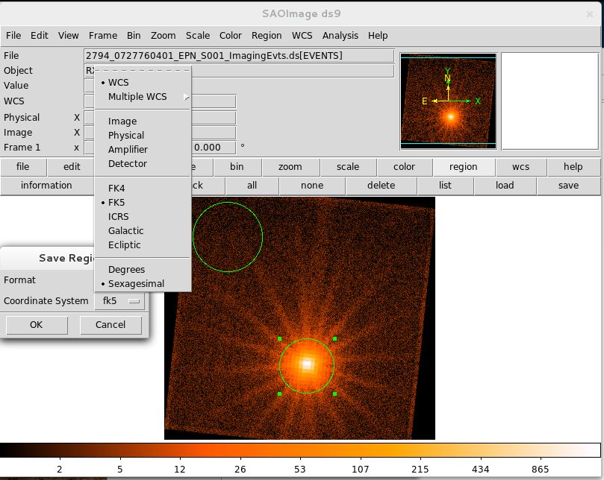
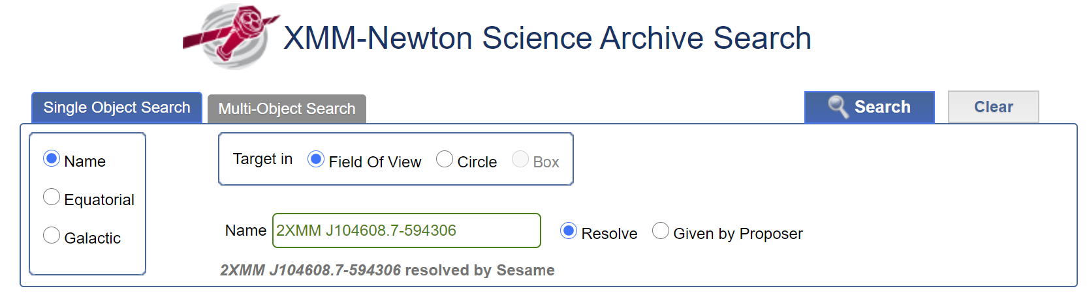
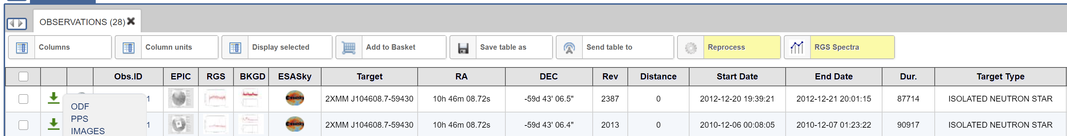
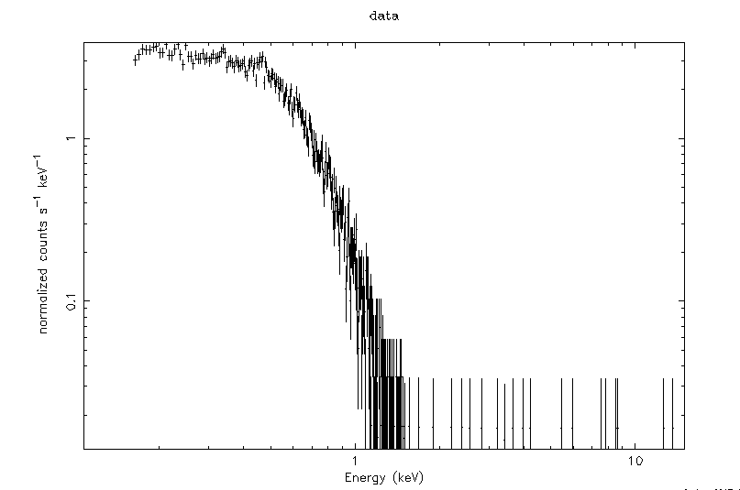
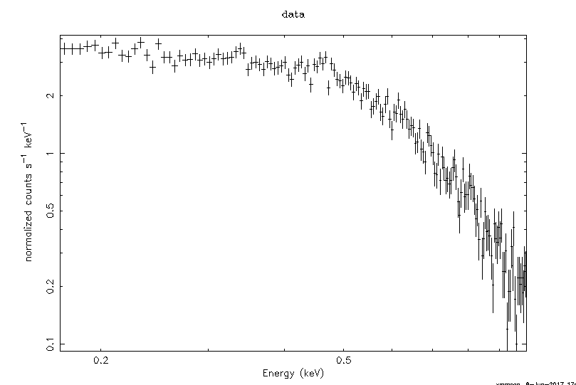
Data analysis
SAS-Science Analysis Software
XSPEC (An X-ray Spectral Fitting Package)

Slide 5
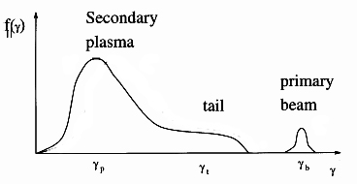
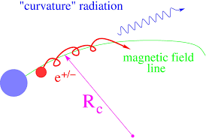


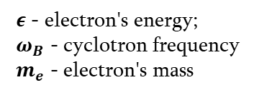

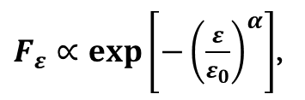
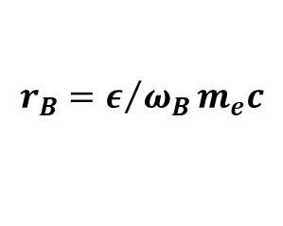


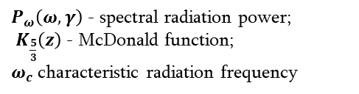
Curvature radiation
$$γ_{p}\sim 1$$
$$γ_{t}\sim {10}^{4−5}$$
$$γ_{b}\sim {10}^{6}$$
One-dimensional distribution function of $e^{−}e^{+}$ plasma
$$r_{B}=ε/{ω_{B}}m_{e}c$$
$ε$ - electron's energy;
$ω_{B}$ - cyclotron frequency
$m_{e}$ - electron's mass
(1)
$P_{ω}\left(ω, γ\right)$ - spectral radiation power;
$K_{\frac{5}{3}}\left(z\right)$ - McDonald function; $ω_{c}$characteristic radiation frequency
$P_{ω}\left(ω, γ\right)=\frac{\sqrt{3}}{2π}\frac{e^{2}}{R_{B}}γ\frac{ω}{ω_{c}}\int_{ω/{ω_{c}}}^{∞}{K_{5/3}\left(z\right)dz, }$ ${ ω}_{c}=\frac{3}{2}\frac{c}{R_{B}}γ^{3}$
(2)
$F_{ε}∝exp\left[−{\left(\frac{ε}{ε_{0}}\right)}^{α}\right]$,
$α$ - positive number;
$ε_{0}$ shows the cutoff energy
(3)

Slide 6
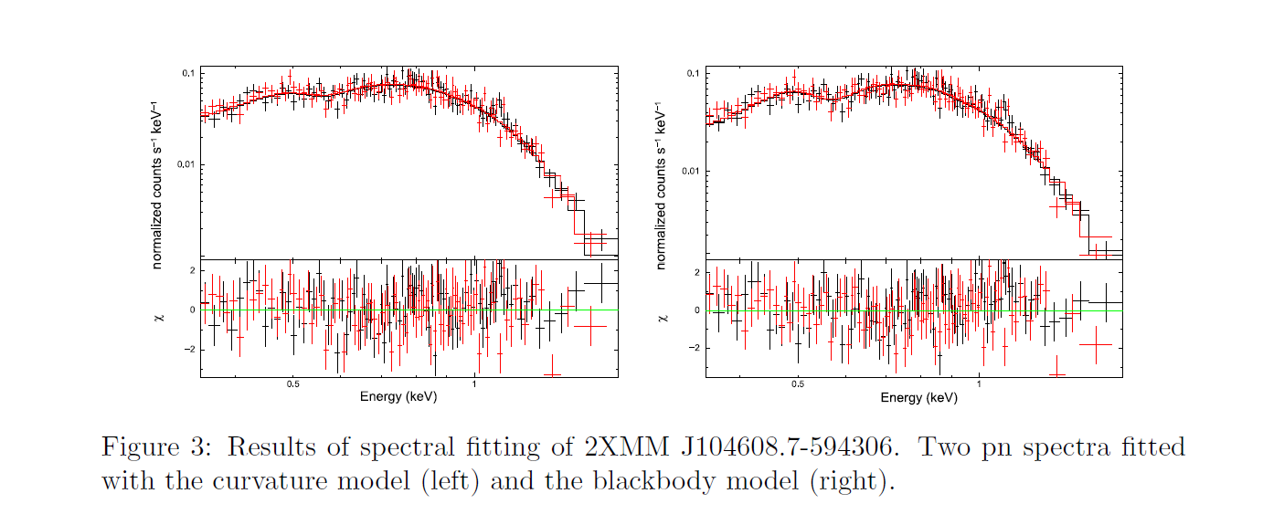
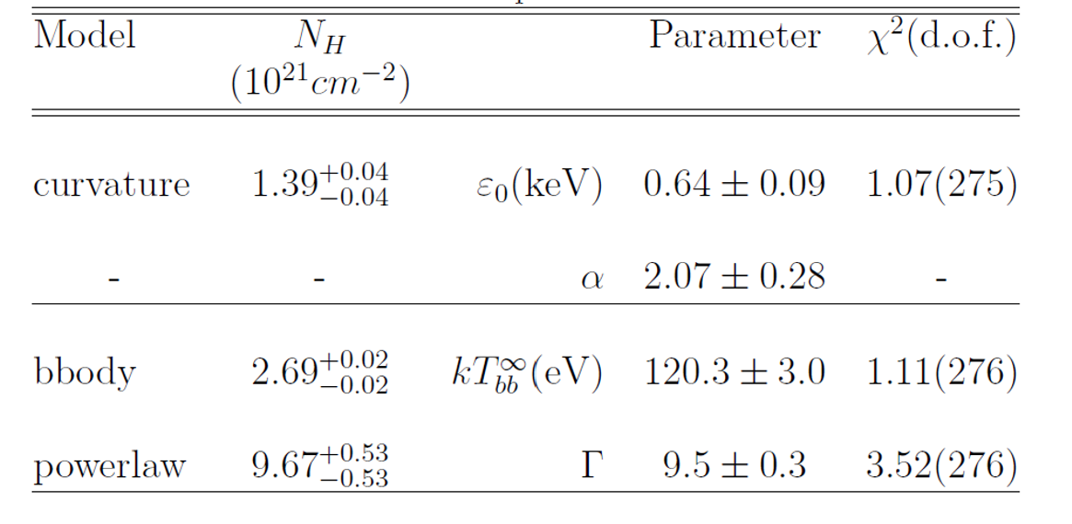
Spectral analysis
Table 2:
Results of spectral fits to XMM-Newton observations

Slide 7

Conclusions
Blackbody component absorbed by cold interstellar matter gives $χ^{2}=1.11;$
The spectrum must undergo super exponential cutoff for higher energies;
The fit with curvature model gave the better results, particularly reduced$χ^{2}=1.07$, than BB model.
The value of curvature radius of the local field lines, that proves that the assumption for emission generation region is correct.

Slide 8
Reference
Kaplan & van Kerkwijk 2011, ApJ 740, L30
Kaplan & van Kerkwijk 2005a, ApJ 628, L45
Kaplan & van Kerkwijk 2009b, ApJ 705, 798
Kaplan & van Kerkwijk 2005b, ApJ 635, L65
van Kerkwijk & Kaplan 2008, ApJ 673, L163
Kaplan & van Kerkwijk 2009a, ApJ 692, L62
Pires, A.M., Motch, C., Turolla, R., et al. 2015, A&A, 583, A117 .
Ruderman, M. 1971, Physics Letters A, Volume 37, Issue 2, p. 125-126
Flowers, E. G., Ruderman, M. A., Lee, J.-F., Sutherland, P. G., Hillebrandt, W., & Muller, E. 1977, Variational calculation of ground-state energy of iron atoms and condensed matter in strong magnetic fields, Astrophysical Journal, Part 1, vol. 215, July 1, 1977, p. 291-301
Pires, A.M., Motch, C., Turolla, R., et al. 2012, A&A, 583, A117
Ginzburg, V. L., & Syrovatskii, S. I., 1963, The Origin of Cosmic Rays, Izdatelstvo AN SSSR
Goldreich, P., & Julian, W. H. 1969 Pulsar Electrodynamics. ApJ, 157, 869 https://doi.org/10.1086/150119
Haberl, F. 2007, Ap&SS, 308, 181-190. https://doi.org/10.1007/s10509-007- 9342-x
Ho. C. G., Kaplan D. L., Chang P., van Adelsberg M., Potekhin A. Y. 2007, MNRAS 375, 281-830. https://doi.org/10.1111/j.1365-2966.2006.11376.x
Chkheidze, N & Kevlishvili, N, 2021, “The plasma emission model of the peculiar isolated neutron star 2XMM J104608.7-594306”, NewA, (submitted)

Slide 9
Thank you for your attention

