Slide 1



Event-by-event simulations of Pb+Pb collisions with anisotropic hydrodynamics
Mike McNelis
Department of Physics, Ohio State University
5/27/2021
M. McNelis, arXiv:2105.06007

Slide 2
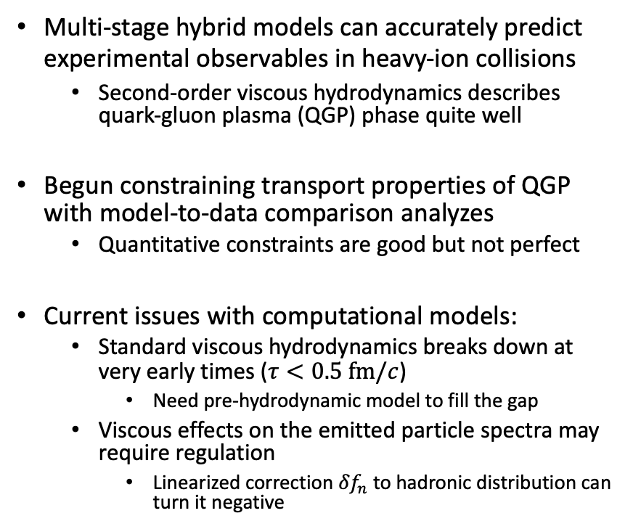
Motivation
Multi-stage hybrid models can accurately predict experimental observables in heavy-ion collisions
  Second-order viscous hydrodynamics describes quark-gluon plasma (QGP) phase quite well
Begun constraining transport properties of QGP with model-to-data comparison analyzes
  Quantitative constraints are good but not perfect
Current issues with computational models:
  Standard viscous hydrodynamics breaks down at very early times ($τ<0.5 fm/c$)
    Need pre-hydrodynamic model to fill the gap
  Viscous effects on the emitted particle spectra may require regulation
    Linearized correction ${δf}_{n}$ to hadronic distribution can turn it negative
D. Everett et al. (JETSCAPE Collaboration), arXiv:2010:03928
C. Shen, U. Heinz, Nucl. Phys, News 25 (2015) 2, 6-11

Slide 3
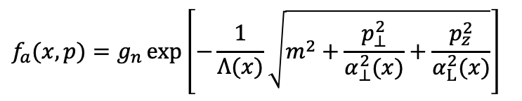
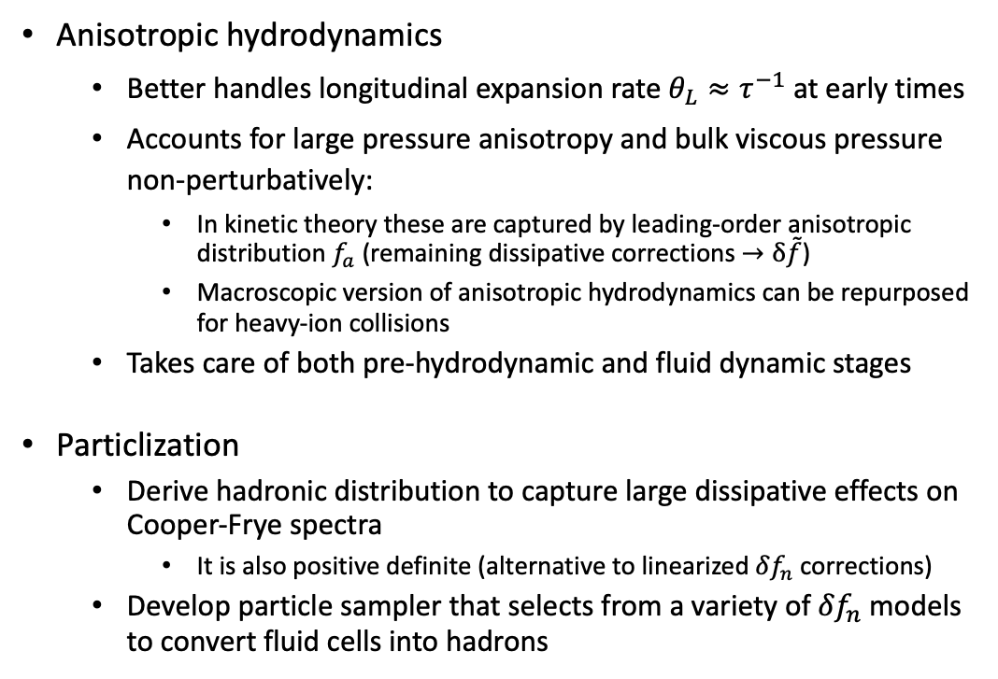

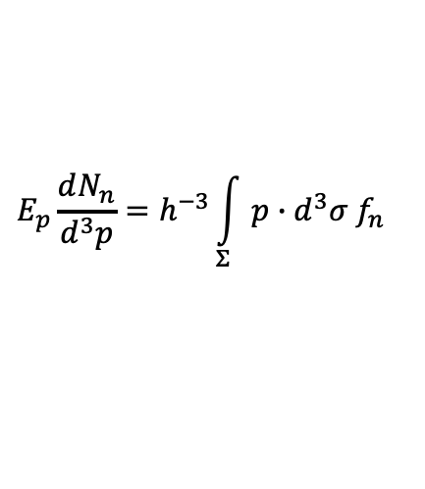

Overview
Anisotropic hydrodynamics
  Better handles longitudinal expansion rate $θ_{L}≈τ^{−1}$ at early times
  Accounts for large pressure anisotropy and bulk viscous pressure non-perturbatively:
    In kinetic theory these are captured by leading-order anisotropic distribution $f_{a}$ (remaining dissipative corrections $→δ\tilde{f}$)
    Macroscopic version of anisotropic hydrodynamics can be repurposed for heavy-ion collisions
  Takes care of both pre-hydrodynamic and fluid dynamic stages
Particlization
  Derive hadronic distribution to capture large dissipative effects on Cooper-Frye spectra
    It is also positive definite (alternative to linearized ${δf}_{n}$corrections)
  Develop particle sampler that selects from a variety of ${δf}_{n}$ models to convert fluid cells into hadrons
$$f\left(x,p\right)=f_{a}\left(x,p\right) + δ\tilde{f}(x,p)$$
$$f_{a}(x,p)=g_{n }exp\left[−\frac{1}{Λ(x)}\sqrt{m^{2}+\frac{p_{⊥}^{2}}{α_{⊥}^{2}(x)}+\frac{p_{z}^{2}}{α_{L}^{2}(x)}}\right]$$
$$\left(Λ,α_{L},α_{⊥}\right)↔\left(ℰ,Ρ_{L},Ρ_{⊥}\right)$$
(generalized Landau matching conditions)
$$E_{p}\frac{dN_{n}}{d^{3}p}=h^{−3}\int_{Σ}{p∙d^{3}σ{ f}_{n}}$$
(Cooper-Frye formula)

Slide 4






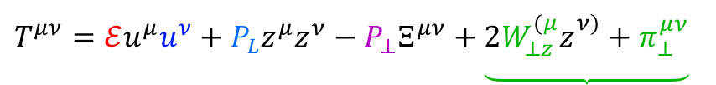


Energy-momentum tensor
Fluid dynamic stage evolves energy-momentum tensor $T^{μν}(x)$of the quark-gluon plasma
Standard decomposition:
Anisotropic decomposition:
$T^{μν}=ℰu^{μ}u^{ν}−\left(Ρ_{eq}+Π\right)$ $∆^{μν}+π^{μν}$
$$T^{μν}=ℰu^{μ}u^{ν}+Ρ_{L}z^{μ}z^{ν}−Ρ_{⊥}Ξ^{μν}+\underbrace{2W_{⊥z}^{(μ}z_{}^{ν)}+π_{⊥}^{μν}}$$
energy density
residual shear stresses
fluid velocity
shear stress
QCD equilibrium pressure
bulk viscous pressure
longitudinal pressure
longitudinal basis vector
transverse pressure
$$Ρ_{L}=Ρ_{eq}+Π+π_{LRF}^{zz}$$
(relation to shear stress $π^{μν}$ and bulk viscous pressure $Π$)
$$∆^{μν}=g^{μν}−u^{μ}u^{ν}$$
(spatial projector)
$$Ρ_{⊥}=Ρ_{eq}+Π−\frac{1}{2}π_{LRF}^{zz}$$
$$Ξ^{μν}=∆^{μν}+z^{μ}z^{ν}$$
(transverse projector)
$$π_{LRF}^{zz}=\frac{2}{3}\left(Ρ_{L}−Ρ_{⊥}\right)$$
$π^{μν}$ $=\frac{1}{3}\left(Ρ_{L}−Ρ_{⊥}\right)\left(2z^{μ}z^{ν}+Ξ^{μν}\right)+2W_{⊥z}^{(μ}z_{}^{ν)}+π_{⊥}^{μν}$
(pressure anisotropy)
E. Molnar, H. Niemi, D.H. Rischke, Phys. Rev. D 93, 114025 (2016)

Slide 5

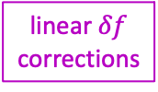

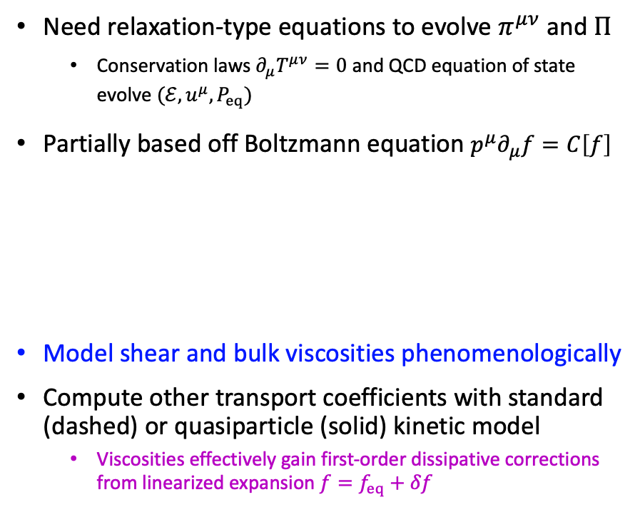
Second-order viscous hydrodynamics
Need relaxation-type equations to evolve $π^{μν}$ and $Π$
  Conservation laws $∂_{μ}T^{μν}=0$ and QCD equation of state evolve $(ℰ,u^{μ},Ρ_{eq})$
Partially based off Boltzmann equation ${p^{μ}∂}_{μ}f=C\left[f\right]$
Model shear and bulk viscosities phenomenologically
Compute other transport coefficients with standard (dashed) or quasiparticle (solid) kinetic model
  Viscosities effectively gain first-order dissipative corrections from linearized expansion $f=f_{eq}+δf$
$$τ_{Π}\dot{Π}=−Π−\left(ζ+δ_{ΠΠ}Π\right)θ+λ_{Ππ}π^{μν}σ_{μν}$$
bulk relaxation time
bulk viscosity
linear $δf$ corrections
gradient forces
shear relaxation time
shear viscosity
$$τ_{π}{\dot{π}}^{\left\langle μν\right\rangle }=−π^{μν}+\left(2η+λ_{πΠ}Π\right)σ^{μν}−δ_{ππ}π^{μν}θ$$
$$+ ∆_{αβ}^{μν}\left(2τ_{π}π_{ λ}^{α}ω_{}^{βλ}−τ_{ππ}π_{ λ}^{α}σ_{}^{βλ}\right)$$
G.S. Denicol, H. Niemi, E. Molnar, D.H. Rischke, Phys. Rev. D 85, 114047 (2012)
L. Tinti, A. Jaiswal, R. Ryblewski, Phys. Rev. D 95, 054007 (2017)

Slide 6
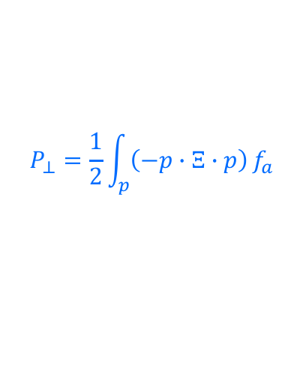
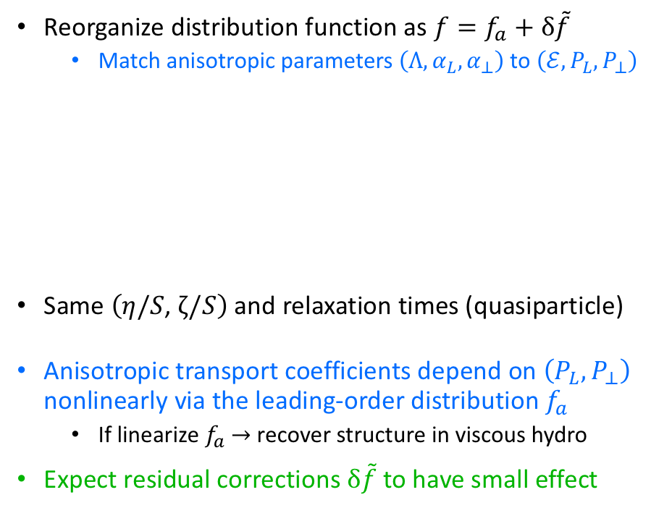
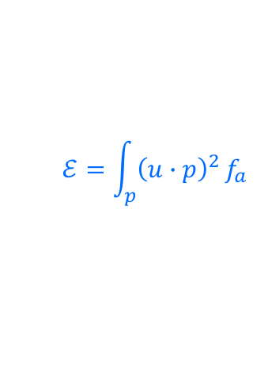

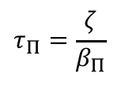

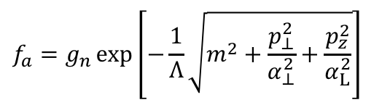
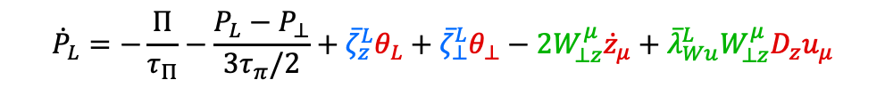
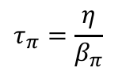
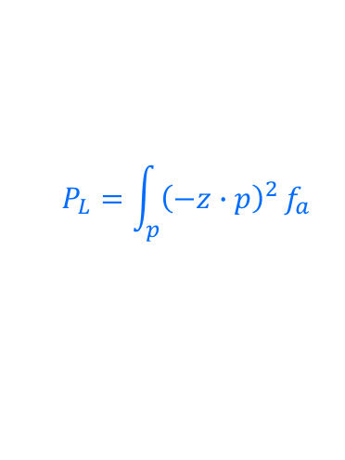
Anisotropic hydrodynamics
Reorganize distribution function as $f=f_{a}+δ\tilde{f}$
  Match anisotropic parameters $\left(Λ,α_{L},α_{⊥}\right)$ to $\left(ℰ,Ρ_{L},Ρ_{⊥}\right)$
Same $\left(η/S\text{,} ζ/S\right)$ and relaxation times (quasiparticle)
Anisotropic transport coefficients depend on $\left(Ρ_{L},Ρ_{⊥}\right)$ nonlinearly via the leading-order distribution $f_{a}$
  If linearize $f_{a}$ $→$ recover structure in viscous hydro
Expect residual corrections $δ\tilde{f}$ to have small effect
anisotropic coefficients
gradient forces
$${\dot{P}}_{L}=−\frac{Π}{τ_{Π}}−\frac{Ρ_{L}−Ρ_{⊥}}{3τ_{π}/2}+{\overline{ζ}}_{z}^{L}θ_{L}+{\overline{ζ}}_{⊥}^{L}θ_{⊥}−2W_{⊥z}^{μ}{\dot{z}}_{μ}+{\overline{λ}}_{Wu}^{L}W_{⊥z}^{μ}D_{z}u_{μ}$$
$$+ {\overline{λ}}_{W⊥}^{L}W_{⊥z}^{μ}z_{ν}∇_{⊥,μ}u^{ν}−{\overline{λ}}_{π}^{L}π_{⊥}^{μν}σ_{⊥,μν}$$
$δ\tilde{f}$ corrections
$$τ_{π}=\frac{η}{β_{π}}$$
$$τ_{Π}=\frac{ζ}{β_{Π}}$$
$$ℰ=\int_{p}{{\left(u∙p\right)}^{2}}f_{a}$$
$$Ρ_{L}=\int_{p}{{\left(−z∙p\right)}^{2}}f_{a}$$
$$f_{a}=g_{n }exp\left[−\frac{1}{Λ}\sqrt{m^{2}+\frac{p_{⊥}^{2}}{α_{⊥}^{2}}+\frac{p_{z}^{2}}{α_{L}^{2}}}\right]$$
$$Ρ_{⊥}=\frac{1}{2}\int_{p}{\left(−p∙Ξ∙p\right)}f_{a}$$
M. McNelis, D. Bazow, U. Heinz, Phys. Rev. C 97, 054912 (2018)

Slide 7
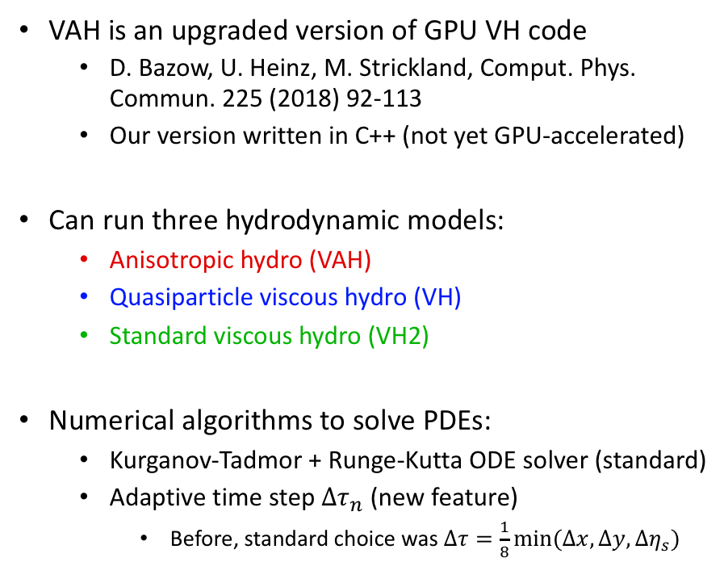
(3+1)-d hydrodynamic simulation VAH
VAH is an upgraded version of GPU VH code
  D. Bazow, U. Heinz, M. Strickland, Comput. Phys. Commun. 225 (2018) 92-113
  Our version written in C++ (not yet GPU-accelerated)
Can run three hydrodynamic models:
  Anisotropic hydro (VAH)
  Quasiparticle viscous hydro (VH)
  Standard viscous hydro (VH2)
Numerical algorithms to solve PDEs:
  Kurganov-Tadmor + Runge-Kutta ODE solver (standard)
  Adaptive time step ${Δτ}_{n}$ (new feature)
    Before, standard choice was $Δτ=\frac{1}{8}min⁡(∆x,∆y,∆η_{s})$
M. McNelis, D. Bazow, U. Heinz, arXiv:2101.02827

Slide 8
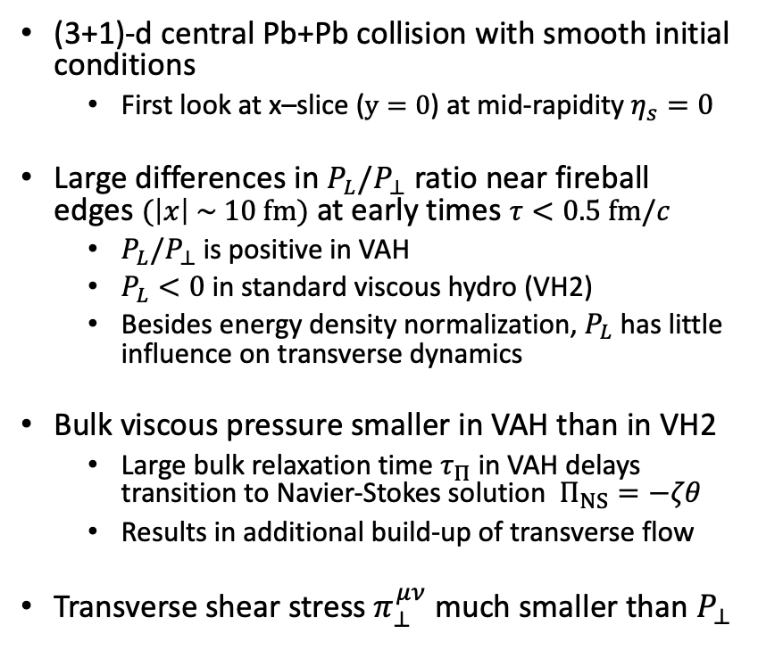
VAH in transverse plane
(3+1)-d central Pb+Pb collision with smooth initial conditions
  First look at x–slice ($y=0$) at mid-rapidity $η_{s}=0$
Large differences in $P_{L}/P_{⊥}$ ratio near fireball edges $(\left|x\right| \sim 10 fm)$ at early times $τ<0.5 fm/c$
  $P_{L}/P_{⊥}$ is positive in VAH
  $P_{L}<0$ in standard viscous hydro (VH2)
  Besides energy density normalization, $P_{L}$ has little influence on transverse dynamics
Bulk viscous pressure smaller in VAH than in VH2
  Large bulk relaxation time $τ_{Π}$ in VAH delays transition to Navier-Stokes solution $Π_{NS}=−ζθ$
  Results in additional build-up of transverse flow
Transverse shear stress $π_{⊥}^{μν}$ much smaller than $P_{⊥}$
M. McNelis, D. Bazow, U. Heinz, arXiv:2101.02827

Slide 9
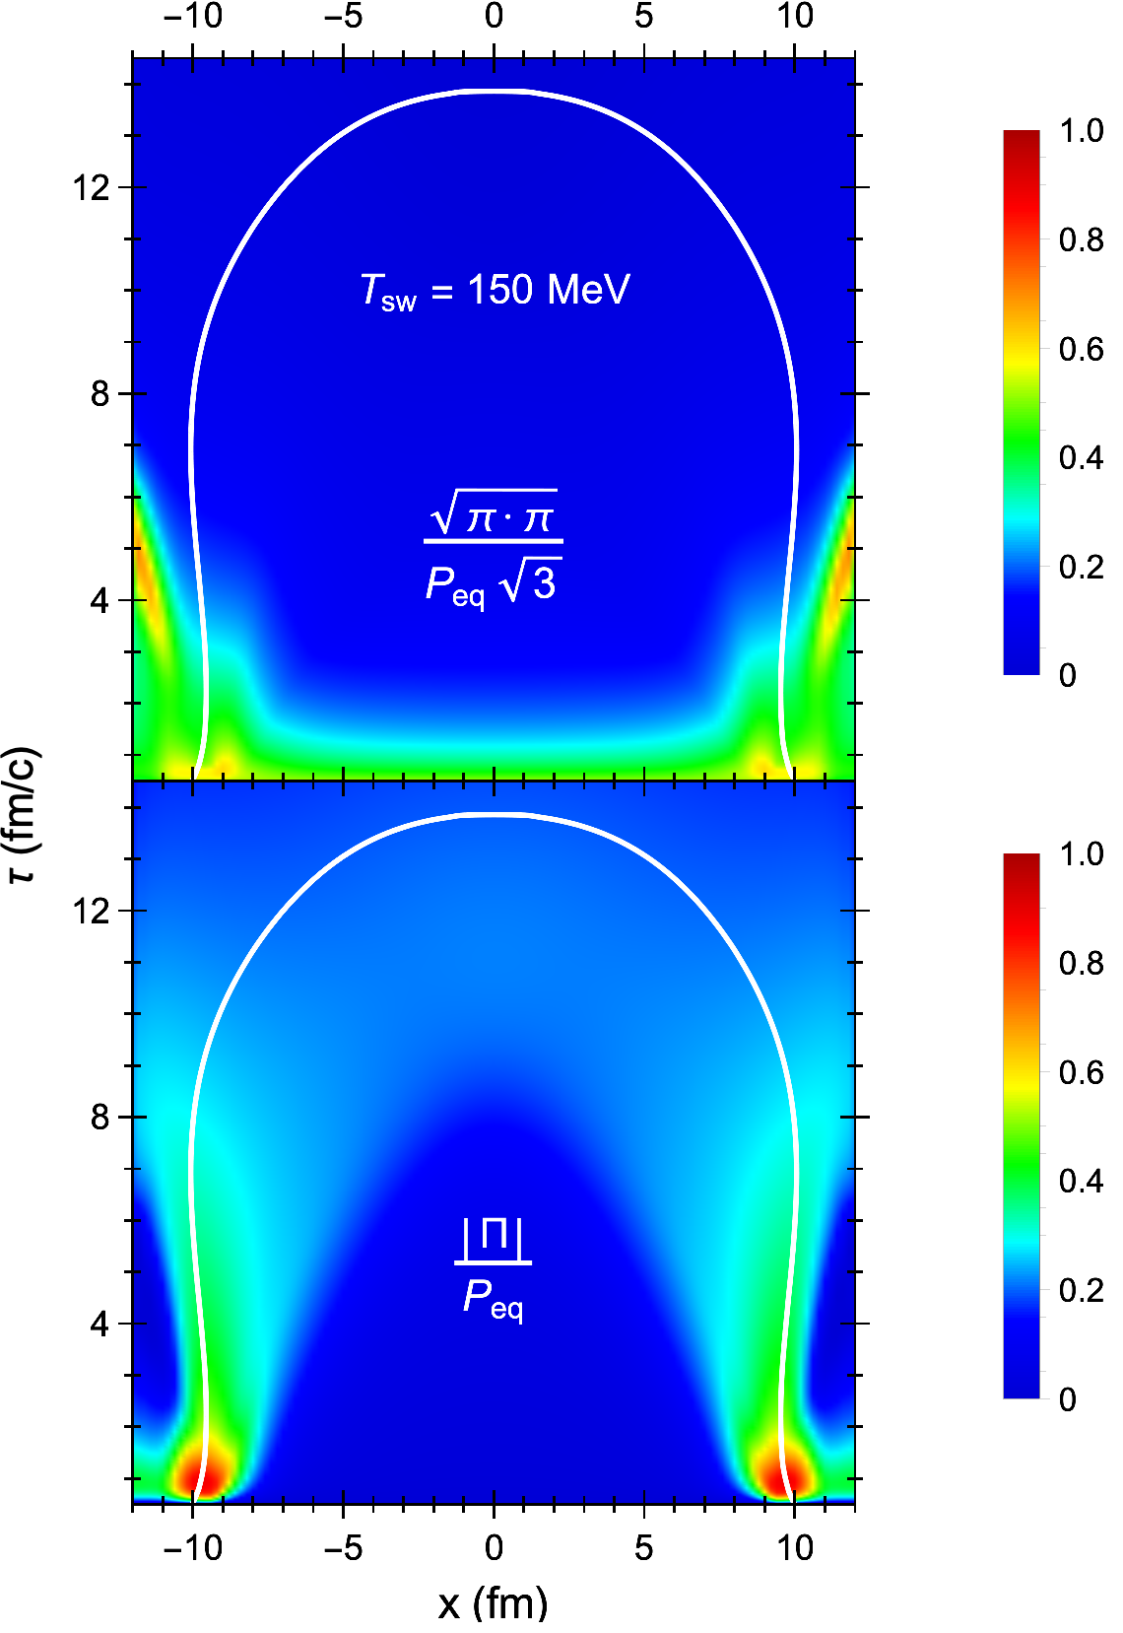
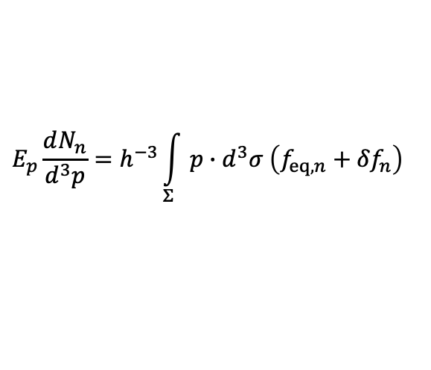
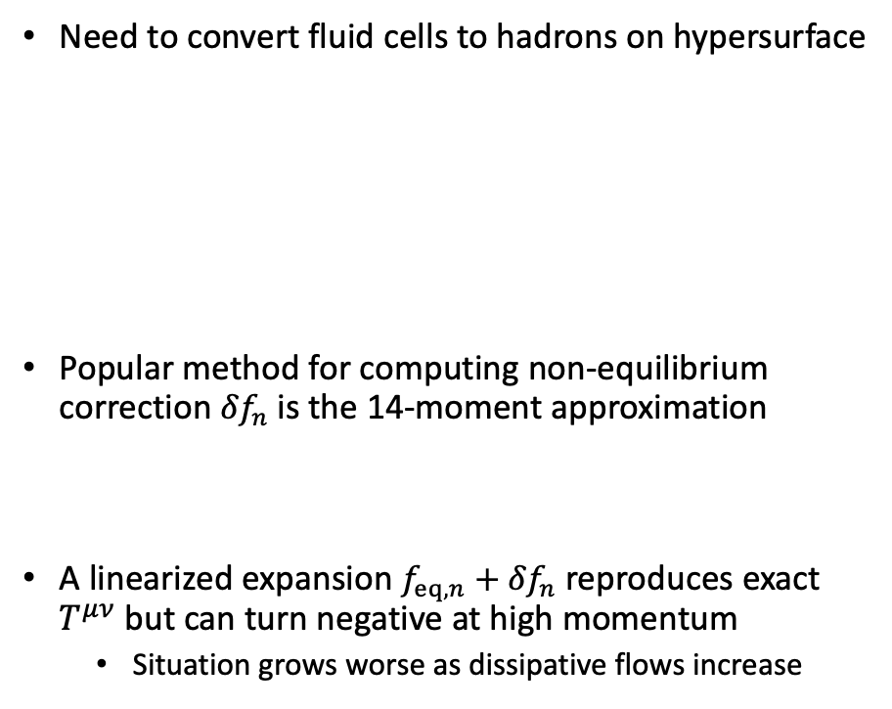

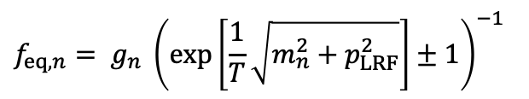
Cooper-Frye particlization
Need to convert fluid cells to hadrons on hypersurface
Popular method for computing non-equilibrium correction ${δf}_{n}$is the 14-moment approximation
A linearized expansion ${f_{eq,n}+δf}_{n}$ reproduces exact $T^{μν}$but can turn negative at high momentum
  Situation grows worse as dissipative flows increase
$$E_{p}\frac{dN_{n}}{d^{3}p}=h^{−3}\int_{Σ}{p∙d^{3}σ \left(f_{eq,n}+{δf}_{n}\right) }$$
(Cooper-Frye formula)
$$f_{eq,n}= g_{n} {\left(\exp\left[\frac{1}{T}\sqrt{m_{n}^{2}+p_{LRF}^{2}}\right]±1\right)}^{−1}$$
(local-equilibrium)
$${δf}_{n}^{14}=f_{eq,n}\left(1∓g_{n}^{−1}f_{eq,n}\right)c_{μν}p^{μ}p^{ν}$$
A. Monnai and T. Hirano, Phys. Rev. C 80, 054906 (2009)

Slide 10
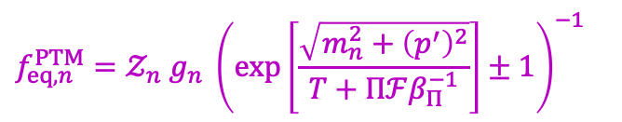

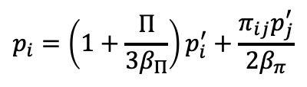
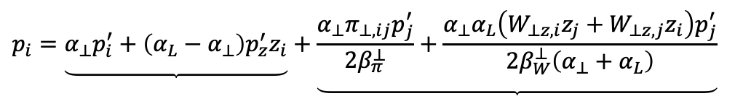
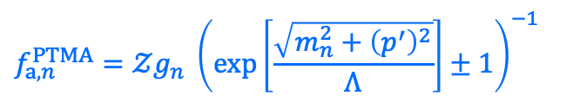
Modified equilibrium distribution
Modify local-equilibrium distribution by applying viscous corrections to Boltzmann factor
  Positive definite but does not output $T^{μν}$ exactly
Can improve formula by modifying leading-order anisotropic distribution
$$f_{eq,n}^{PTM}=𝒵_{n} g_{n} {\left(\exp\left[\frac{\sqrt{m_{n}^{2}+{\left(p^{′}\right)}^{2}}}{T+Πℱβ_{Π}^{−1}}\right]±1\right)}^{−1}$$
$$p_{i}=\left(1+\frac{Π}{3β_{Π}}\right)p_{i}^{′}+\frac{π_{ij}p_{j}^{′}}{2β_{π}}$$
(deforms LRF momentum space)
$$f_{a,n}^{PTMA}=𝒵g_{n} {\left(\exp\left[\frac{\sqrt{m_{n}^{2}+{\left(p^{′}\right)}^{2}}}{Λ}\right]±1\right)}^{−1}$$
$$p_{i}=\underbrace{α_{⊥}p_{i}^{′}+\left(α_{L}−α_{⊥}\right)p_{z}^{′}z_{i}}+\underbrace{\frac{α_{⊥}π_{⊥,ij}p_{j}^{′}}{2β_{π}^{⊥}}+\frac{α_{⊥}α_{L}{\left(W_{⊥z,i}z_{j}+W_{⊥z,j}z_{i}\right)p}_{j}^{′}}{2β_{W}^{⊥}\left(α_{⊥}+α_{L}\right)}}$$
S. Pratt, G. Torrieri, Phys. Rev. C 82, 044901 (2010)
leading order
M. McNelis, U. Heinz, arXiv:2103.03401
residual shear corrections

Slide 11
Continuous transverse momentum spectra

Slide 12
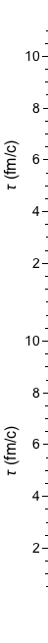
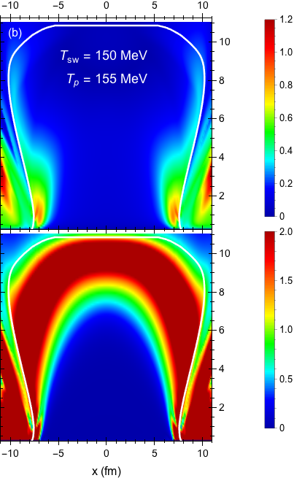
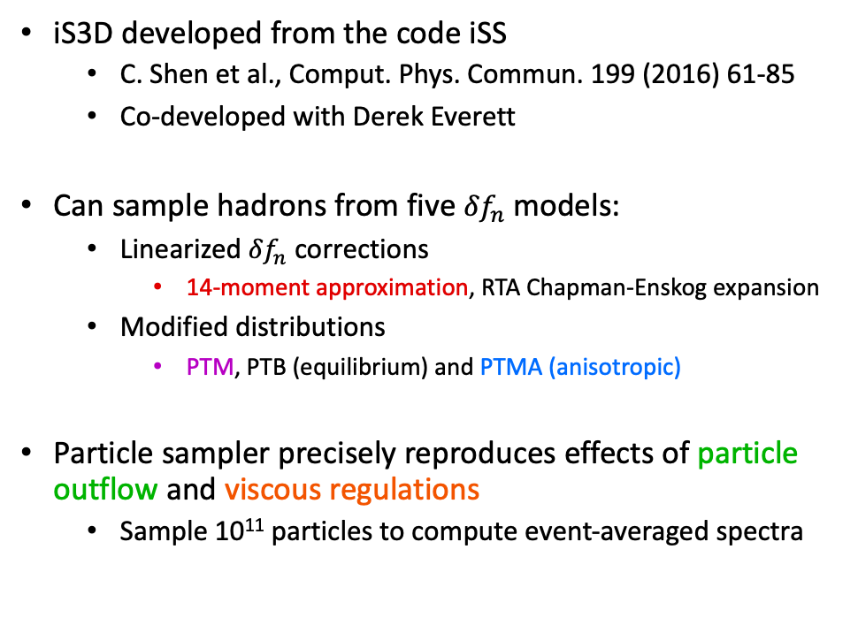



Particlization module iS3D
iS3D developed from the code iSS
  C. Shen et al., Comput. Phys. Commun. 199 (2016) 61-85
  Co-developed with Derek Everett
Can sample hadrons from five ${δf}_{n}$ models:
  Linearized ${δf}_{n}$ corrections
    14-moment approximation, RTA Chapman-Enskog expansion
  Modified distributions
    PTM, PTB (equilibrium) and PTMA (anisotropic)
Particle sampler precisely reproduces effects of particle outflow and viscous regulations
  Sample 10¹¹ particles to compute event-averaged spectra
$$\frac{\sqrt{π∙π}}{2β_{π}}$$
$$\frac{\left|Π\right|}{β_{Π}}$$
$$E_{p}\frac{dN_{n}}{d^{3}p}=h^{−3}\int_{Σ}{p∙d^{3}σ f_{n} Θ\left(p∙d^{3}σ\right) Θ\left(f_{n}\right)}$$
M. McNelis, D. Everett, U. Heinz, Comput. Phys. Commun. 258 (2021) 107604

Slide 13
Sampled transverse momentum spectra
M. McNelis, D. Everett, U. Heinz, Comput. Phys. Commun. 258 (2021) 107604

Slide 14
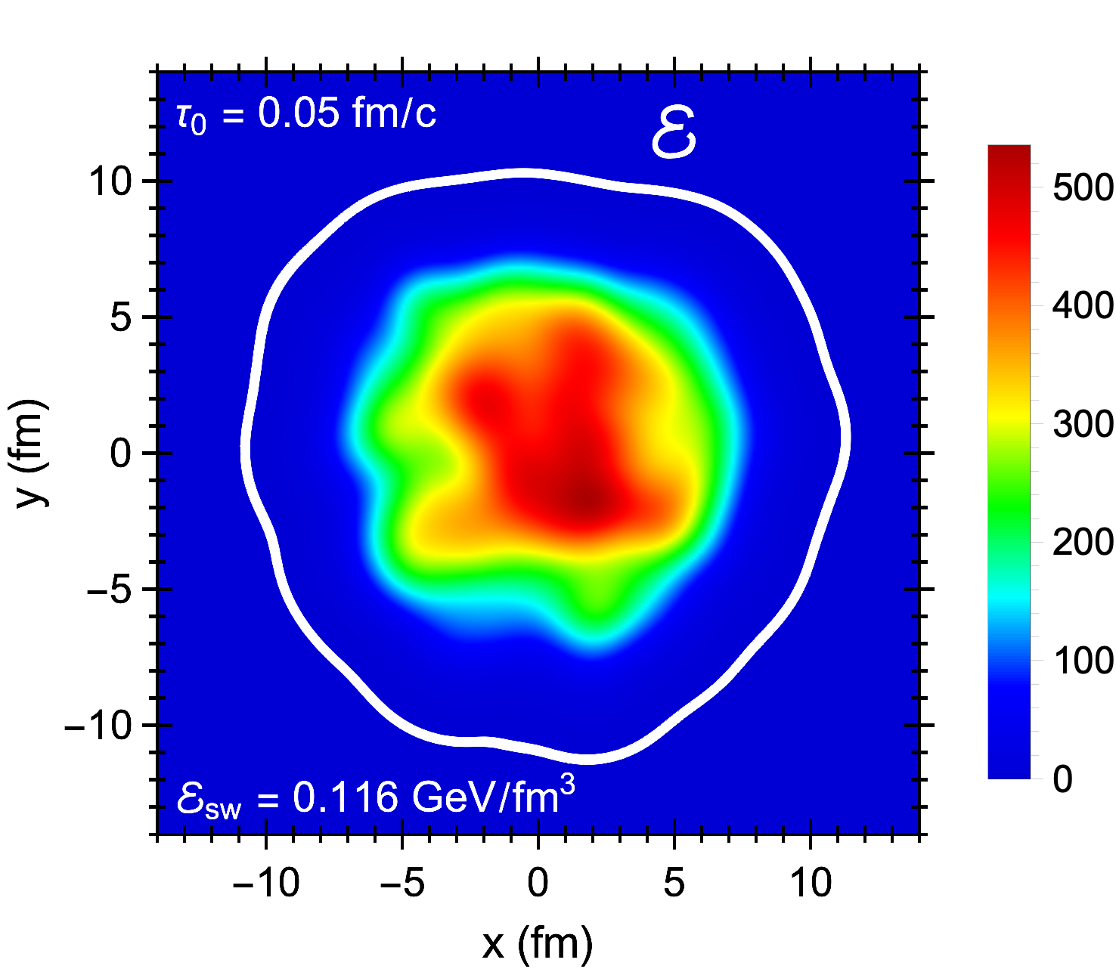
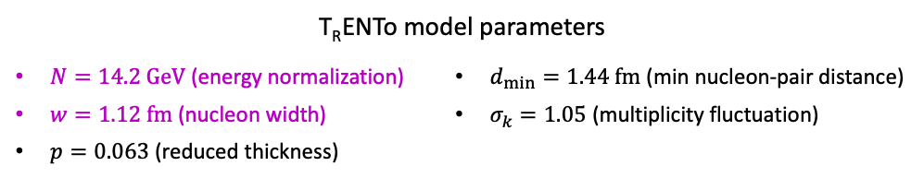

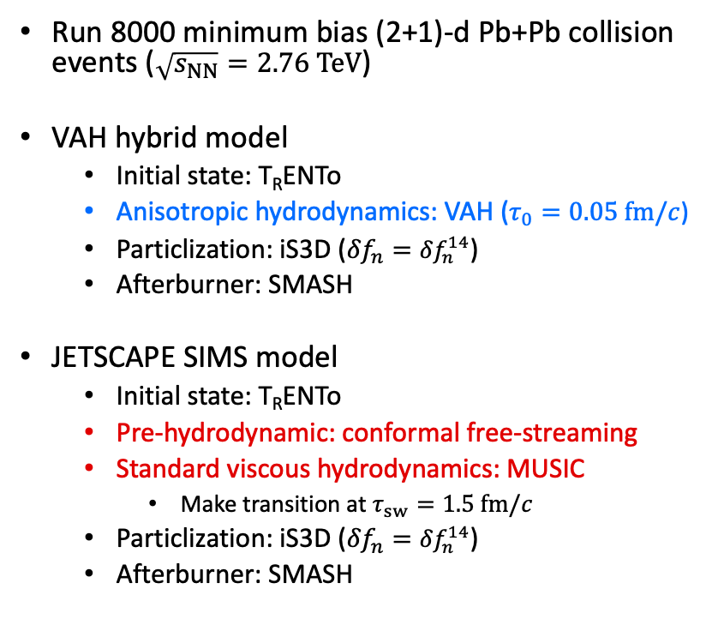
Event-by-event simulations
Run 8000 minimum bias (2+1)-d Pb+Pb collision events ($\sqrt{s_{NN}}=2.76 TeV$)
VAH hybrid model
  Initial state: T_{R}ENTo
  Anisotropic hydrodynamics: VAH ($τ_{0}=0.05 fm/c$)
  Particlization: iS3D (${δf}_{n}={δf}_{n}^{14}$)
  Afterburner: SMASH
JETSCAPE SIMS model
  Initial state: T_{R}ENTo
  Pre-hydrodynamic: conformal free-streaming
  Standard viscous hydrodynamics: MUSIC
    Make transition at $τ_{sw}=1.5 fm/c$
  Particlization: iS3D (${δf}_{n}={δf}_{n}^{14}$)
  Afterburner: SMASH
$$\frac{\sqrt{π_{μν}π^{μν}}}{2β_{π}}$$
$$\frac{\left|Π\right|}{β_{Π}}$$
T_{R}ENTo model parameters
$N=14.2 GeV$ (energy normalization) $w=1.12 fm$ (nucleon width) $p=0.063$ (reduced thickness) | $d_{min}=1.44 fm$ (min nucleon-pair distance) $σ_{k}=1.05$ (multiplicity fluctuation)
D. Everett et al. (JETSCAPE Collaboration), arXiv:2011.01430
D. Everett et al. (JETSCAPE Collaboration), arXiv:2010:03928

Slide 15
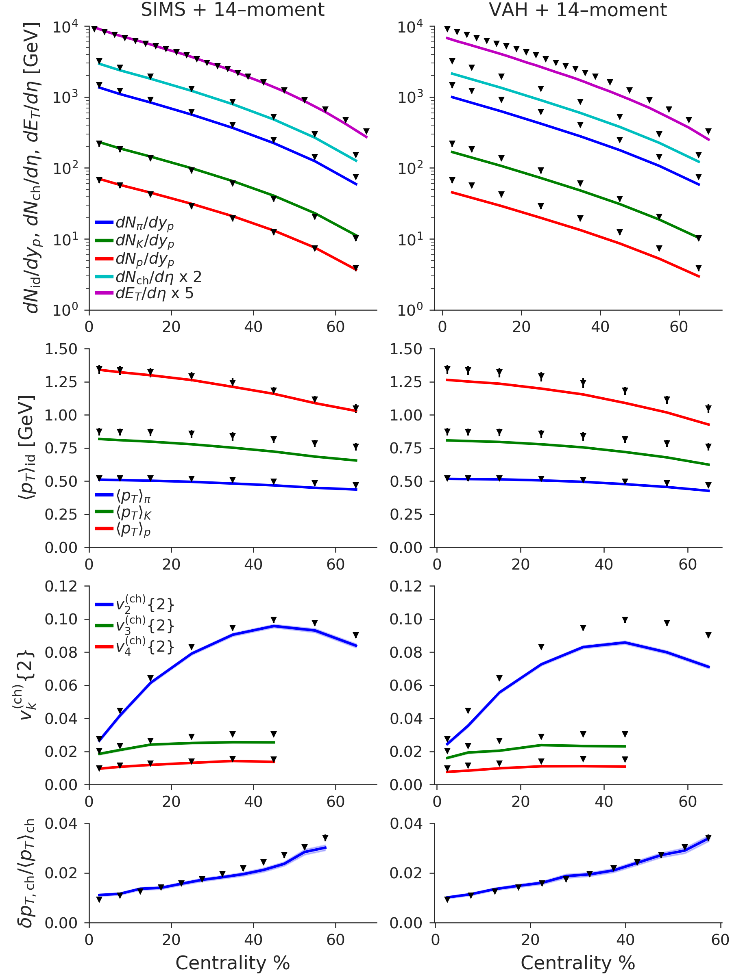
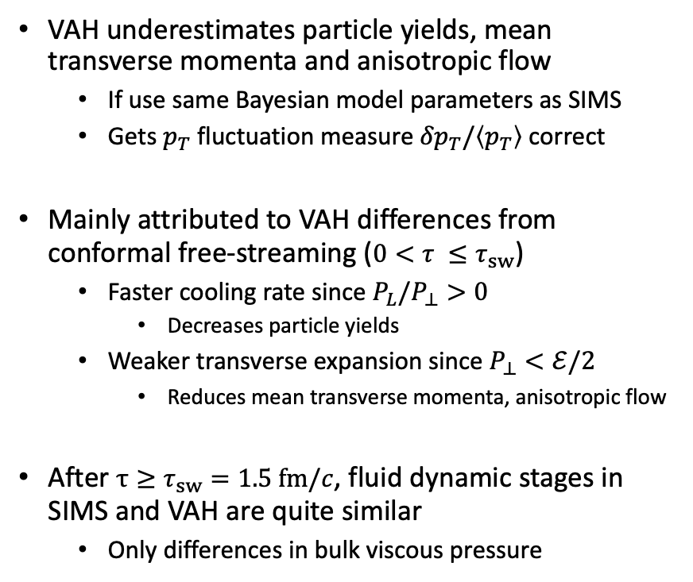
Preliminary results
VAH underestimates particle yields, mean transverse momenta and anisotropic flow
  If use same Bayesian model parameters as SIMS
  Gets $p_{T}$ fluctuation measure ${δp}_{T}/\left\langle p_{T}\right\rangle$ correct
Mainly attributed to VAH differences from conformal free-streaming ($0<τ ≤τ_{sw}$)
  Faster cooling rate since $P_{L}/P_{⊥}>0$
    Decreases particle yields
  Weaker transverse expansion since $P_{⊥}<ℰ/2$
    Reduces mean transverse momenta, anisotropic flow
After $τ≥τ_{sw}=1.5 fm/c$, fluid dynamic stages in SIMS and VAH are quite similar
  Only differences in bulk viscous pressure
$$\frac{\sqrt{π_{μν}π^{μν}}}{2β_{π}}$$
$$\frac{\left|Π\right|}{β_{Π}}$$
D. Everett et al. (JETSCAPE Collaboration), arXiv:2011.01430

Slide 16
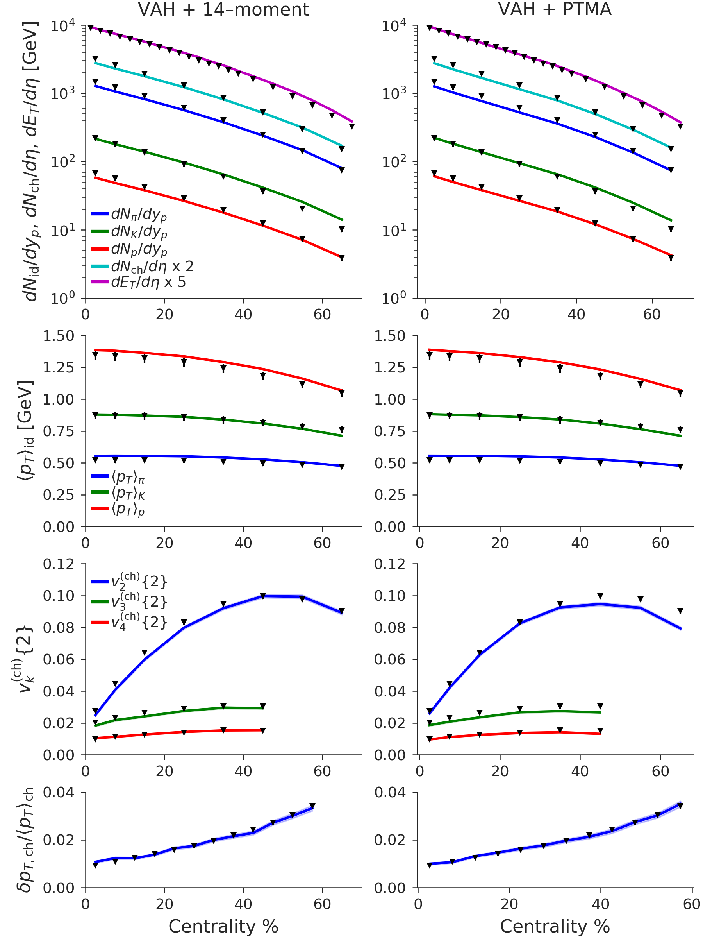
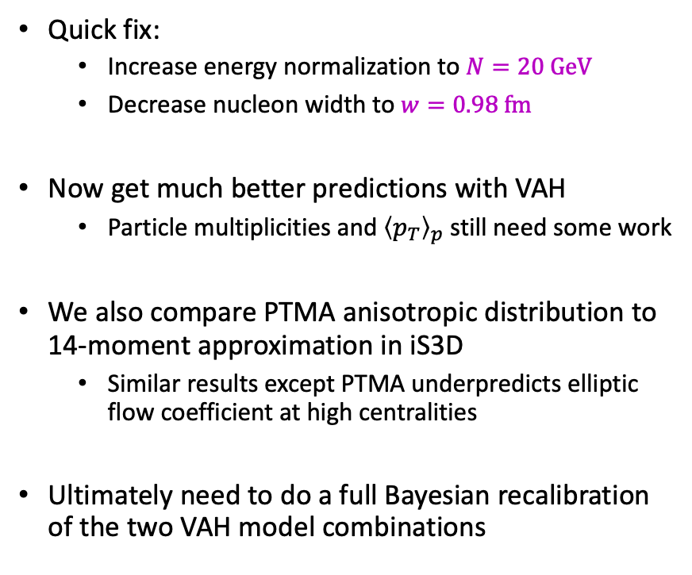
Preliminary results
Quick fix:
  Increase energy normalization to $N=20 GeV$
  Decrease nucleon width to $w=0.98 fm$
Now get much better predictions with VAH
  Particle multiplicities and ${\left\langle p_{T}\right\rangle }_{p}$ still need some work
We also compare PTMA anisotropic distribution to 14-moment approximation in iS3D
  Similar results except PTMA underpredicts elliptic flow coefficient at high centralities
Ultimately need to do a full Bayesian recalibration of the two VAH model combinations
$$\frac{\sqrt{π_{μν}π^{μν}}}{2β_{π}}$$
$$\frac{\left|Π\right|}{β_{Π}}$$

Slide 17
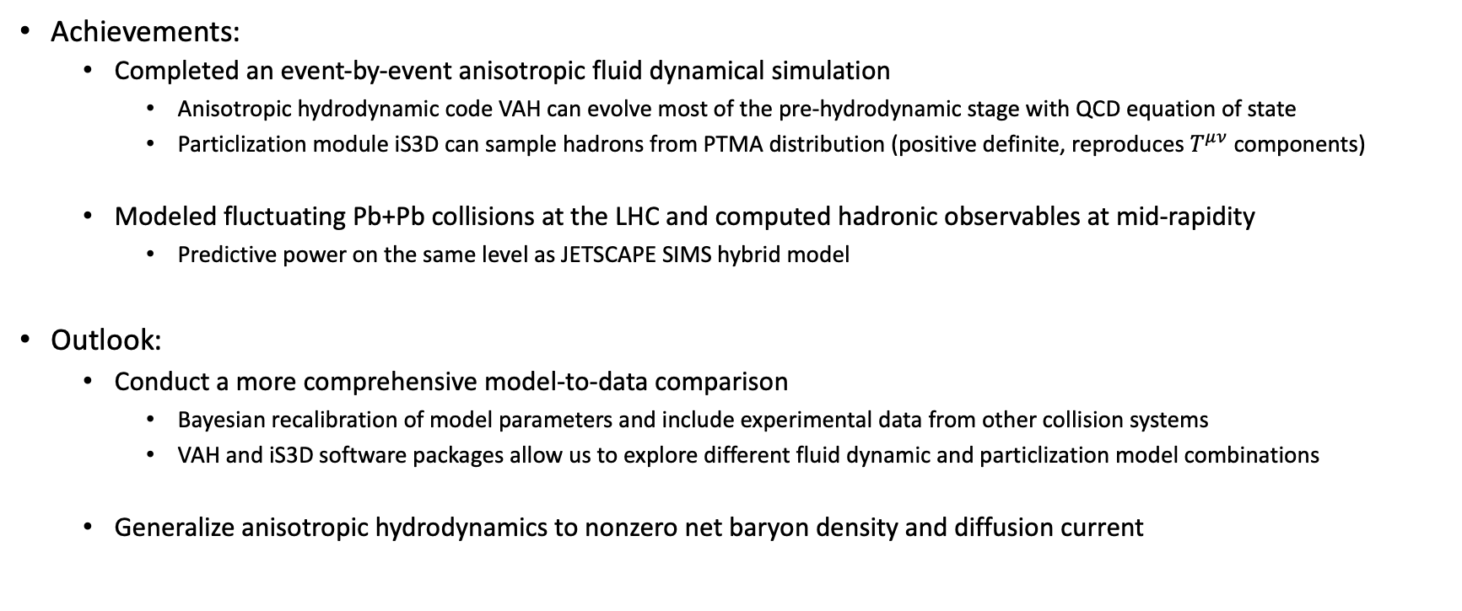
Summary
Achievements:
  Completed an event-by-event anisotropic fluid dynamical simulation
    Anisotropic hydrodynamic code VAH can evolve most of the pre-hydrodynamic stage with QCD equation of state
    Particlization module iS3D can sample hadrons from PTMA distribution (positive definite, reproduces $T^{μν}$ components)
  Modeled fluctuating Pb+Pb collisions at the LHC and computed hadronic observables at mid-rapidity
    Predictive power on the same level as JETSCAPE SIMS hybrid model
Outlook:
  Conduct a more comprehensive model-to-data comparison
    Bayesian recalibration of model parameters and include experimental data from other collision systems
    VAH and iS3D software packages allow us to explore different fluid dynamic and particlization model combinations
  Generalize anisotropic hydrodynamics to nonzero net baryon density and diffusion current

Slide 18
Backup Slides

Slide 19
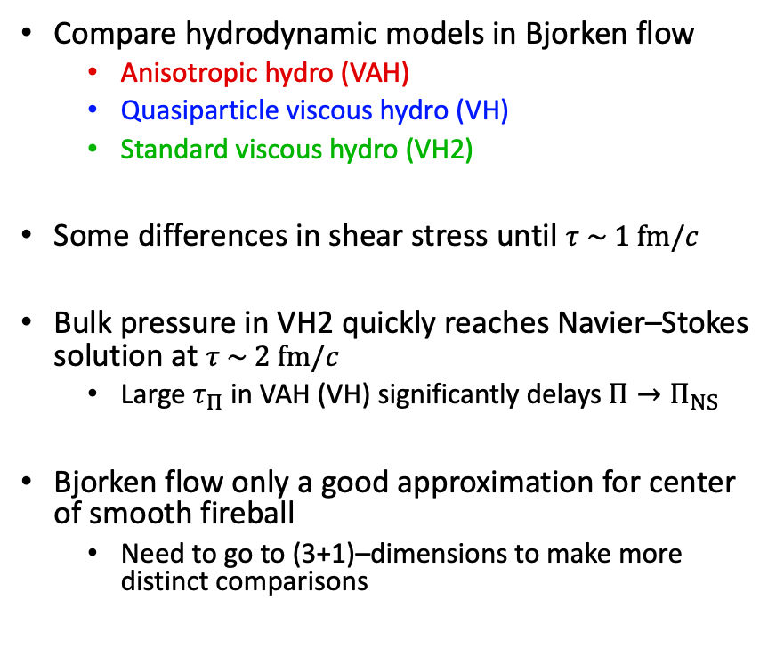
(0+1)–d non-conformal Bjorken flow
Compare hydrodynamic models in Bjorken flow
  Anisotropic hydro (VAH)
  Quasiparticle viscous hydro (VH)
  Standard viscous hydro (VH2)
Some differences in shear stress until $τ \sim 1 fm/c$
Bulk pressure in VH2 quickly reaches Navier–Stokes solution at $τ \sim 2 fm/c$
  Large $τ_{Π}$ in VAH (VH) significantly delays $Π→Π_{NS}$
Bjorken flow only a good approximation for center of smooth fireball
  Need to go to (3+1)–dimensions to make more distinct comparisons
M. McNelis, D. Bazow, U. Heinz, arXiv:2101.02827

Slide 20
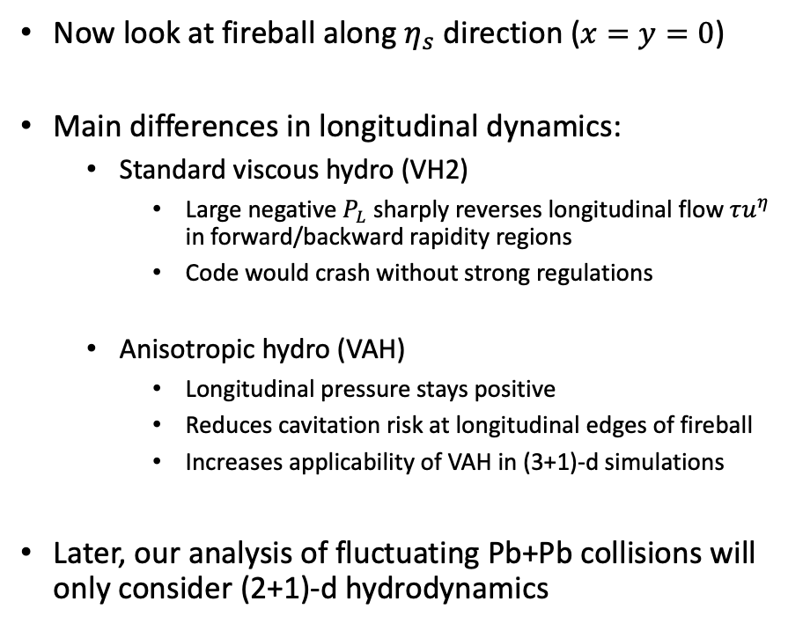
VAH in rapidity direction
Now look at fireball along $η_{s}$ direction ($x=y=0$)
Main differences in longitudinal dynamics:
  Standard viscous hydro (VH2)
    Large negative $P_{L}$ sharply reverses longitudinal flow $τu^{η}$ in forward/backward rapidity regions
    Code would crash without strong regulations
  Anisotropic hydro (VAH)
    Longitudinal pressure stays positive
    Reduces cavitation risk at longitudinal edges of fireball
    Increases applicability of VAH in (3+1)-d simulations
Later, our analysis of fluctuating Pb+Pb collisions will only consider (2+1)-d hydrodynamics
M. McNelis, D. Bazow, U. Heinz, arXiv:2101.02827

Slide 21
Continuous elliptic flow coefficients

Slide 22
Sampled spacetime distribution
M. McNelis, D. Everett, U. Heinz, Comput. Phys. Commun. 258 (2021) 107604

Slide 23
Sampled elliptic flow coefficients
M. McNelis, D. Everett, U. Heinz, Comput. Phys. Commun. 258 (2021) 107604

Slide 24
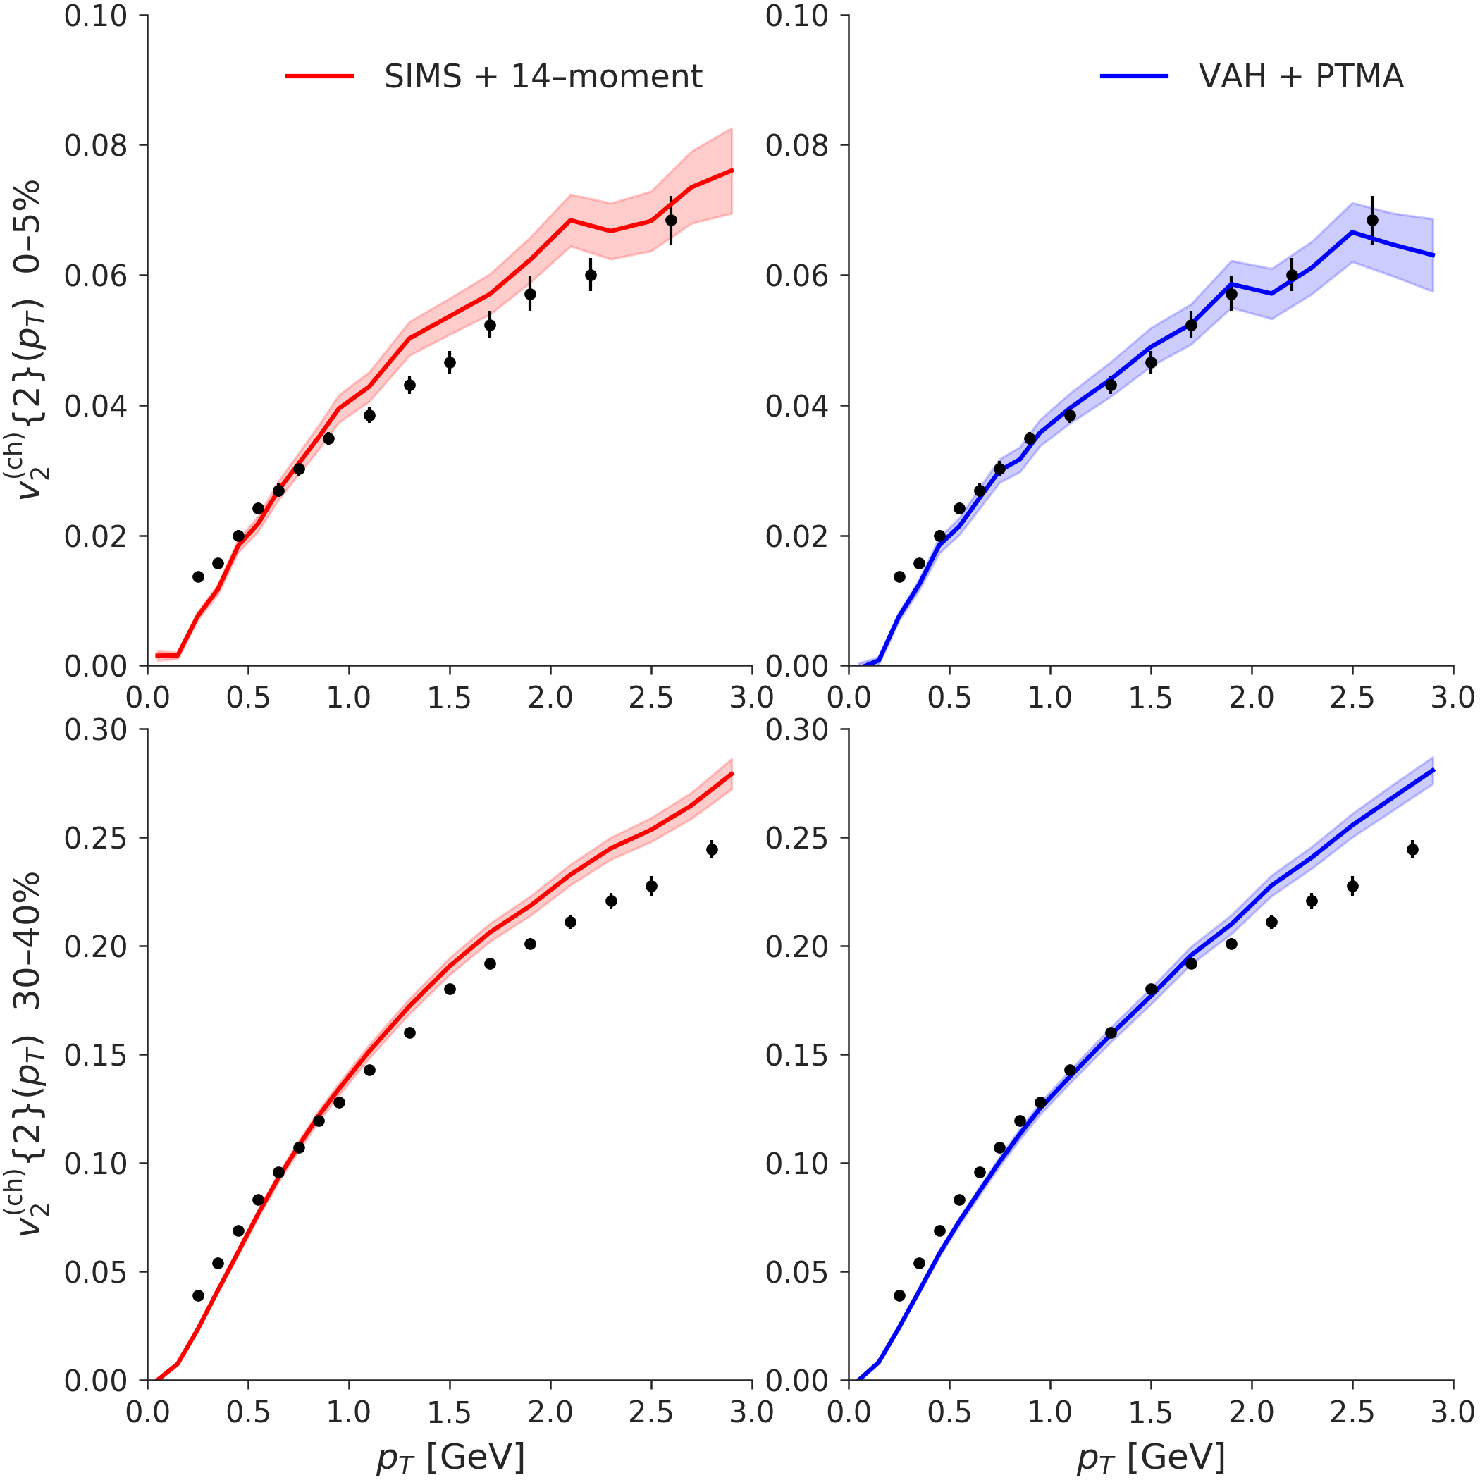
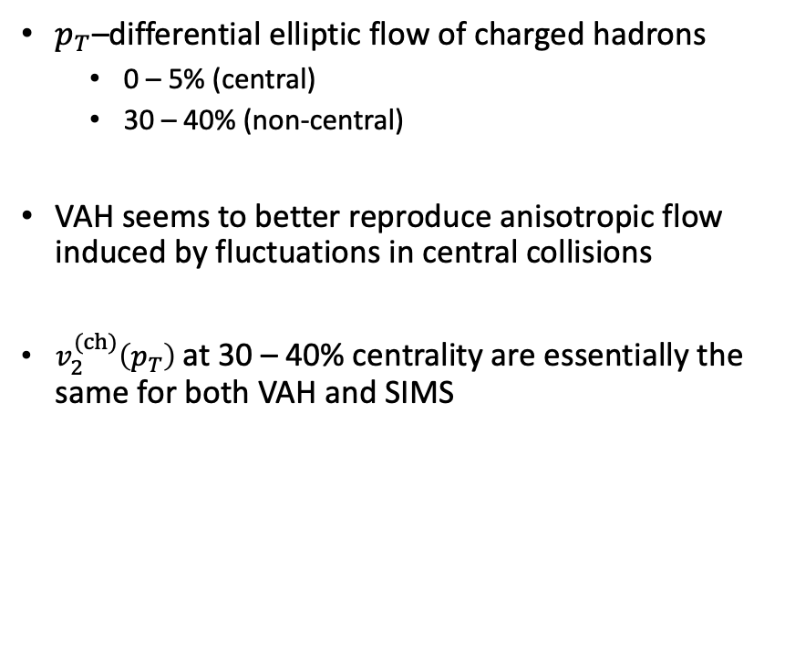
Preliminary results
$p_{T}$–differential elliptic flow of charged hadrons
  0 – 5% (central)
  30 – 40% (non-central)
VAH seems to better reproduce anisotropic flow induced by fluctuations in central collisions
$v_{2}^{(ch)}\left(p_{T}\right)$ at 30 – 40% centrality are essentially the same for both VAH and SIMS
$$\frac{\sqrt{π_{μν}π^{μν}}}{2β_{π}}$$
$$\frac{\left|Π\right|}{β_{Π}}$$

