Slide 1
CompOSE
CompStar Online Supernovae
Equations of State
htt://composeps.obspm.fr.
Achely Martínez Quintero
4th year student, Faculty of Physics
University of Havana
Cuba

Slide 2
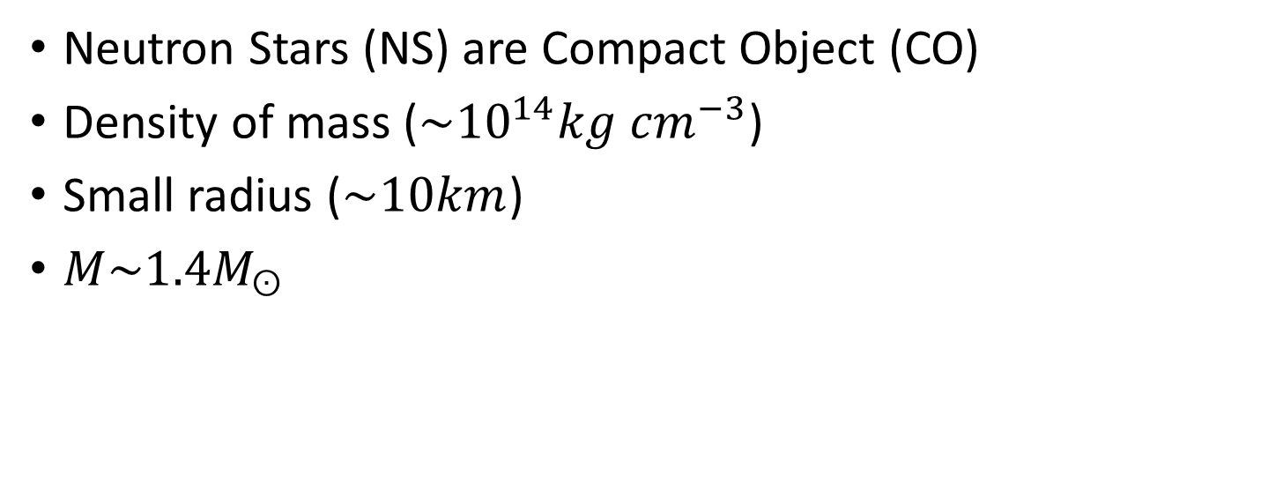
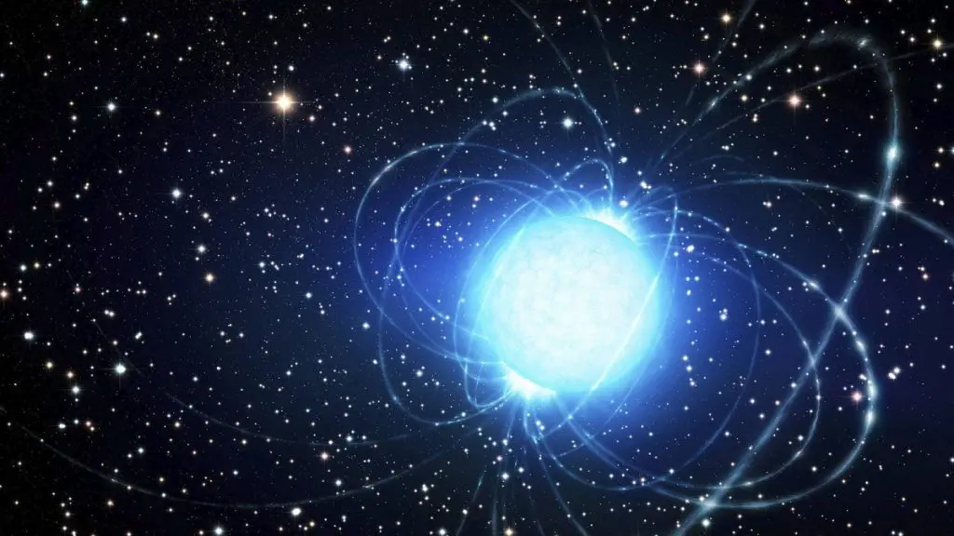
Introduction

Slide 3
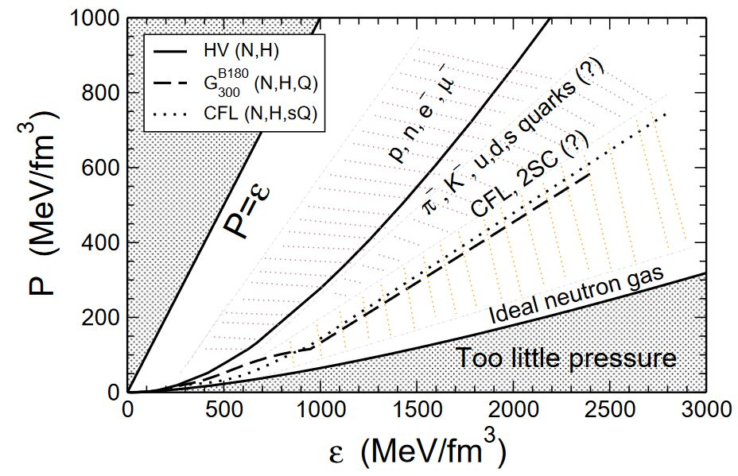
What CompOSE can do?
The online service CompOSE provides information and data tables for different equations of state (EoS) ready for further use in astrophysical applications, nuclear physics and beyond.
The cold neutron star EoS tables can be used directly within LORENE to obtain models of (rotating/magnetised) neutron stars.
[arXiv:astro-ph/0612132 [astro-ph]].

Slide 4
CompOSE has three main purposes:
CompOSE is a deposit of EoS tables
CompOSE permits the interpolation of the tables provided using different schemas
CompOSE can provide information on additional thermodynamic quantities, which are not stored in the original data tables and other quantities that characterize an EoS.

Slide 5
How to extract data from the tables?
Different computational tools are provided to extract the data from the tables that are relevant for our use. They can be obtained from the CompOSE web site:
https://compose.obspm.fr

Slide 6
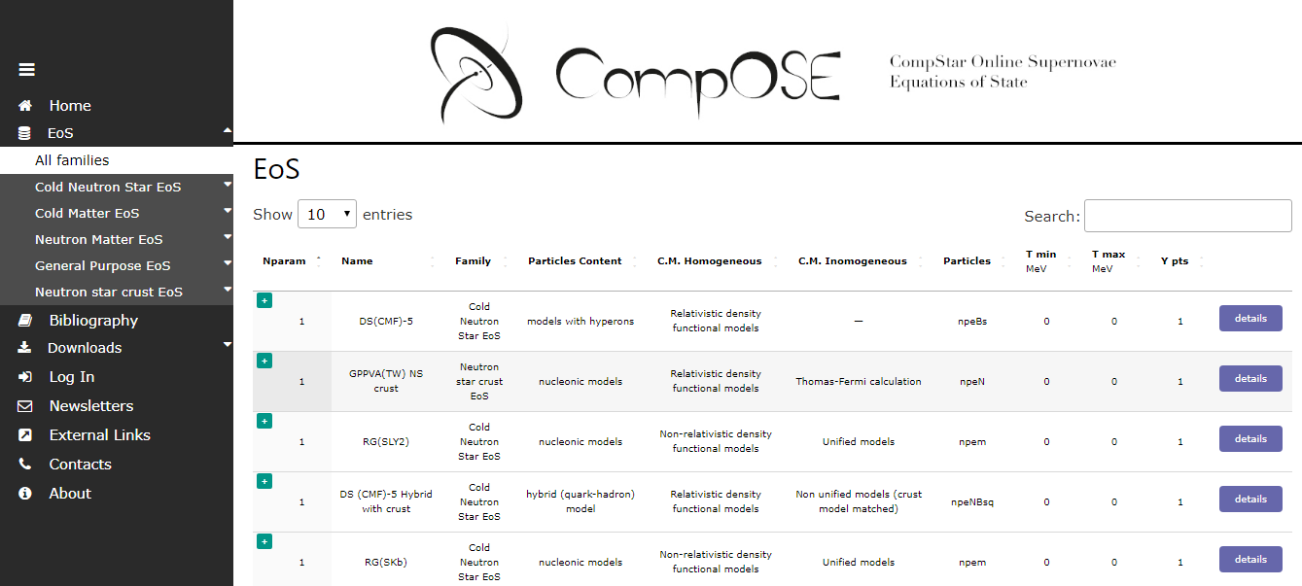

Slide 7
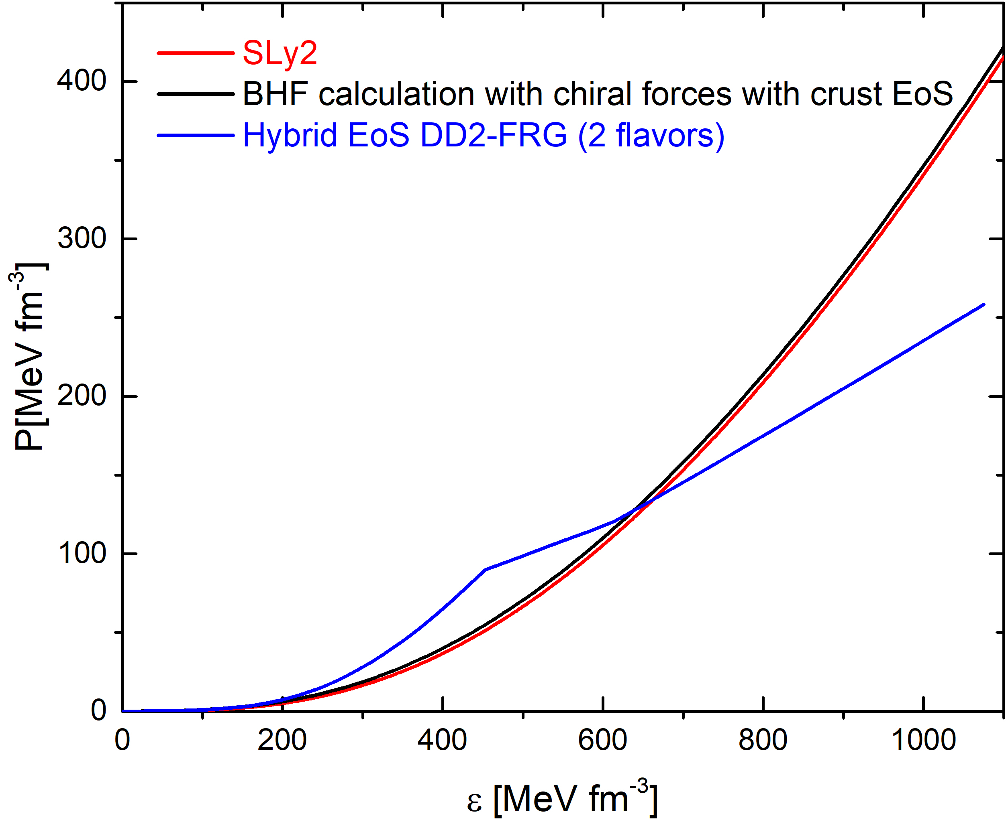
Example of EoS from CompOSE

Slide 8
Bibliography:
[TOK_2015] S. Typel, M. Oertel, T. Klähn, Phys.Part.Nucl. 46, 633
[OHKT_2017] M. Oertel, M. Hempel, T. Klähn, S. Typel, Rev. Mod. Phys. 89, 015007
[TOK_2022] S. Typel, M. Oertel, T. Klähn et al, arxiv:2203.03209

Slide 9
Conclusions:
The use of CompOSE facilitates the work with EoS.
You can use the EoS tables to make calculations or contribute your own EoS.

Slide 10
¡Thanks!

