Slide 1
Teacher Engagement and Outreach
2023 09 25
Vilnius
Assoc. Res. Prof. Andrius Juodagalvis, Assoc. Prof. Aušra Kynienė
VU Physics faculty, Experimental nuclear and particle physics center
Assoc. Prof. Brigita Abakevičienė
Kaunas University of Technology · Department of Physics
Notes:
Kas pristatys – tai to pavardė dar reikalinga

Slide 2
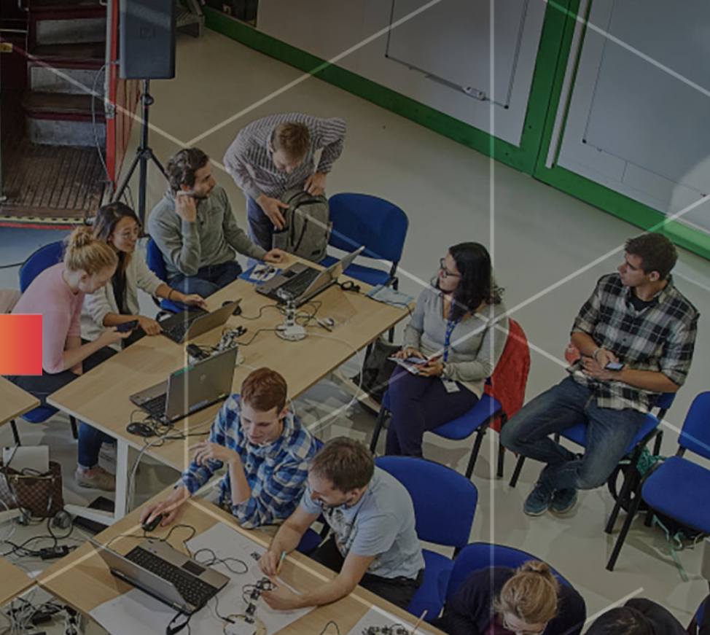
Short term student visits to CERN
October 22-28, 2022: first visit at “CERN-Lithuanian Entrepreneurship Week” event (20 students and 5 lecturers) -
September 18-22, 2023: “Lithuanians at IdeaSquare” (18 students and 6 lecturers) – incoming
November 27 – December 02, 2023: PhD student from Kaunas University of Technology will visit CERN
Notes:
2022: The Vilnius University 10 students and 2 lecturers and Kaunas University of Technology 10 students and 3 lecturers were attended the event.
2023: Vilnius University 8 students and 2 lecturers and Kaunas University of Technology 10 students and 4 lecturers
Due to the global pandemic situation and financial constraints, the first visit will take place in 2022.

Slide 3
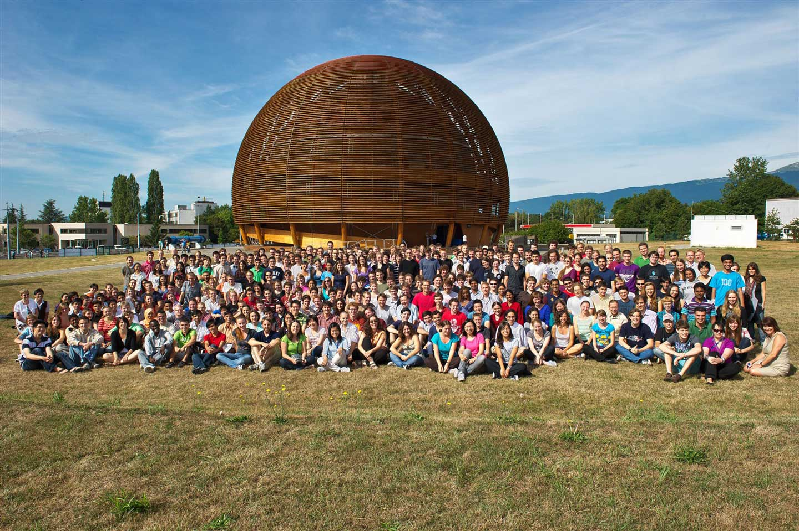
Participation in the CERN Summer Student Program
One student from Kaunas University of Technology took part at CERN Summer Student Program from July till August of 2023
Notes:
The CERN-LT Consortium partners inform students about all the CERN student programmes on their institutional webpages. Also, the Lithuanian student could individually follow information and apply for CERN Student programmes on CERN webpage. Students are using the CERN Funds according the Student programmes.

Slide 4
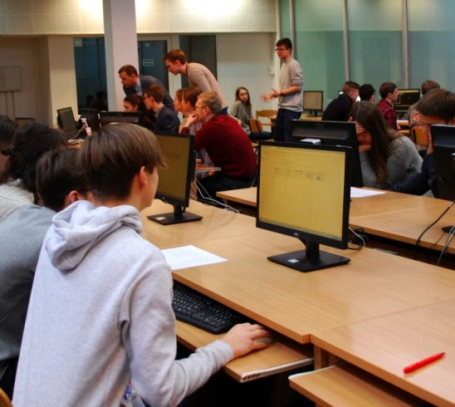
Presentations, seminars and workshops for primary and secondary schools pupils, as well as for university students
“International MasterClass: Hands on Particle Physics”:
2018 – VU and VGTU
2019 and 2020 – VU, VGTU, KTU
2021 and 2022 – VU, VGTU, KTU virtual due pandemic situation
2023 – VU, KTU, VGTU
Notes:
Typically, around 120 participants (pupils (from 8th to 12th grade, from more than 20 different schools in different parts of Lithuania), teachers, and 1st and 2nd year students of higher education institutions) take part in these masterclasses. Doctoral students and senior students from Vilnius University are always involved in moderating the experiment. The teaching material for the lessons is translated into Lithuanian. Each year, all moderators participate in a training course on elementary particle identification methodology. From 2023 onwards, the school is funded by the Ministry of Education, Science and Sport of the Republic of Lithuania. Until 2023, the activities were supported by scientific institutions and business partners (https://web.quarknet.org/mc/cms/imc2021/cmslt.html ).
The lesson is live-streamed between Vilnius and Kaunas

Slide 5
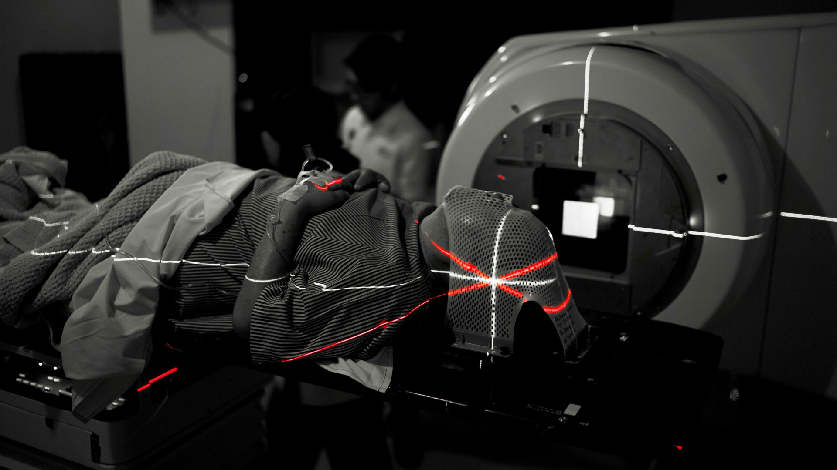
Presentations, seminars and workshops for primary and secondary schools pupils, as well as for university students
“The Particle Therapy MasterClass”:
2021 – VU, KTU, NVI virtual due pandemic situation
2022 VU, KTU, NVI, LSMU virtual due pandemic situation
2023 – VU, KTU, NVI, LSMU
Notes:
Typically, around 100 participants (pupils (from 8th to 12th grade, from more than 20 different schools in different parts of Lithuania), teachers, and 1st and 2nd year students of higher education institutions) take part in these masterclasses. Doctoral students and senior students from Vilnius University are always involved in moderating the experiment. The teaching material for the lessons is translated into Lithuanian. Each year, all moderators participate in a training course on elementary particle identification methodology. From 2023 onwards, the school is funded by the Ministry of Education, Science and Sport of the Republic of Lithuania. Until 2023, the activities were supported by scientific institutions and business partners (https://web.quarknet.org/mc/cms/imc2021/cmslt.html ).
Since 2018, the Nuclear and Particle Physics website has been reporting on World Data Day (W2W2). On that day, students who take part in the event will be guided by staff from the Centre for Nuclear and Particle Physics (https://www.ff.vu.lt/cern/naujienos). Information is also provided to upper secondary school students about the International School on Modern PhYsics and Research – INSPYRE.

Slide 6
Teacher Engagement
The Baltic Teacher Programme 2021 (from 25-30 April 2021)
10 teachers were selected
The Baltic Teacher Programme 2022 (from 3-9 April 2022)
Cancelled due to COVID-19
The Baltic Teacher Programme 23-28 April 2023.
Lectures, on-site visits, exhibitions, and hands-on workshops will introduce its participants to
cutting-edge particle physics. Participants will return to Lithuania as ambassadors who will pass on
new physics trends to a new generation of physicists, engineers, IT professionals...
September 2023 incoming teachers selection
II. Modern physics is reinforced in the updated secondary and primary school curricula
III. Initial activities with pupils in STEM centres developed
IV. A "Modern Physics in School" qualification programme for teachers to implement new curricula
V. Purchase of equipment to implement teacher training
VI. Educational sessions for teachers 2018, 2019, 2023
Notes:
This year, 10 teachers went to CERN (https://www.cern.lt/baltijos-mokytoju-programa-2023/). Teacher guidance material for teachers is currently being revised and will be made available on the website of the Centre for Nuclear and Particle Physics (https://www.ff.vu.lt/cern/renginiai/48-cern-lt/647-l2-daleliu-fizikos-sklaidos-grupe#istekliai) and on the forthcoming fully independent website of the CERN-LT consortium.

Slide 7

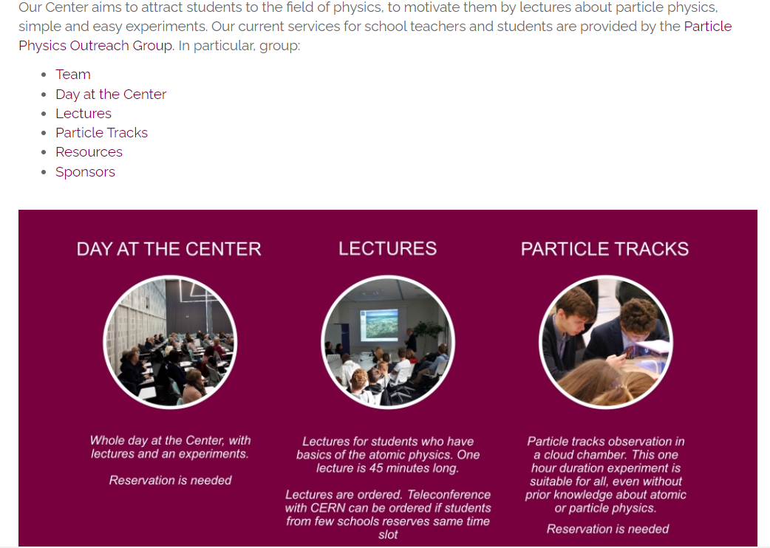
Outreach center
Notes:
The website of the Centre for Nuclear and Particle Physics has been launched with methodological material for teachers.
In 2018, the Nuclear and Particle Physics Dissemination Centre hosted, at different times, students from two gymnasiums to learn about CERN's activities, the accelerator's working principles and the evolution of the Universe. In addition, two public presentations on data communication and the need for CERN and on the current state of science were given at two national conferences.
In 2019, at different times, students from two gymnaziums visited the dissemination center and listened to a lecture about CERN - the Large Hadron Collider. The staff of the center not only welcomed the schools coming to the center, but also visited Utena, Trakus, Plunge with lectures and activities and gave a lecture on "Smart technologies" at the Global Lithuanian Leaders (GLL) summer retreat (Vilnius).
In 2020, the staff of the Nuclear and Elementary Particle Physics Dissemination Center visited two Vilnius schools (one of them is a pro-gymnasium, where students study up to the eighth grade) with the activities of the dissemination center. In the same year, a public lecture "Physics Afternoon" was held (an event for young scientists https://www.facebook.com/ktu.smd/photos/paskaitą-subatominis-pasaulis-ir-tyrimai-cerne -per-fizikos -popietė-ves- co-author/10158668842355761/) and the Public Lecture "The Big Bang and CERN's Large Hadron Collider" at the Vrublevskii Library (Vilnius http://sena.mab.lt/lt/naujienos/2556).
In 2021, the lectures "Introduction to particles, accelerators and detectors" were given at the Vilnius American International School and the International Physics Olympiad. The particle physics review classes were held at the National School Academy (NMA) and the cosmic ray seminar at the gymnasium. The staff of the Center for Nuclear and Elementary Particles participated in two "Science Soup" programs about CERN activities (Part I: https://youtu.be/RXR86auv-Os?si=Tx7eLSV--jn1nws2, Part II - https:// youtu.be/ kIuWWn1zJeQ?si=tfgwCIXIOWqr8CsI ://www.youtube.com/watch?v=yOoSSPOmUmA).
In 2022, an interview with prof. Rolf-Dieter Heuer (previous CERN DG) at 15min.lt and a discussion took place at ``Skeptiški pokalbiai'' youtube channel.
In 2023, a lecture about CERN was held at the bookstore-café (https://www.facebook.com/photo?fbid=109802995480393&set=a.109803078813718).

Slide 8
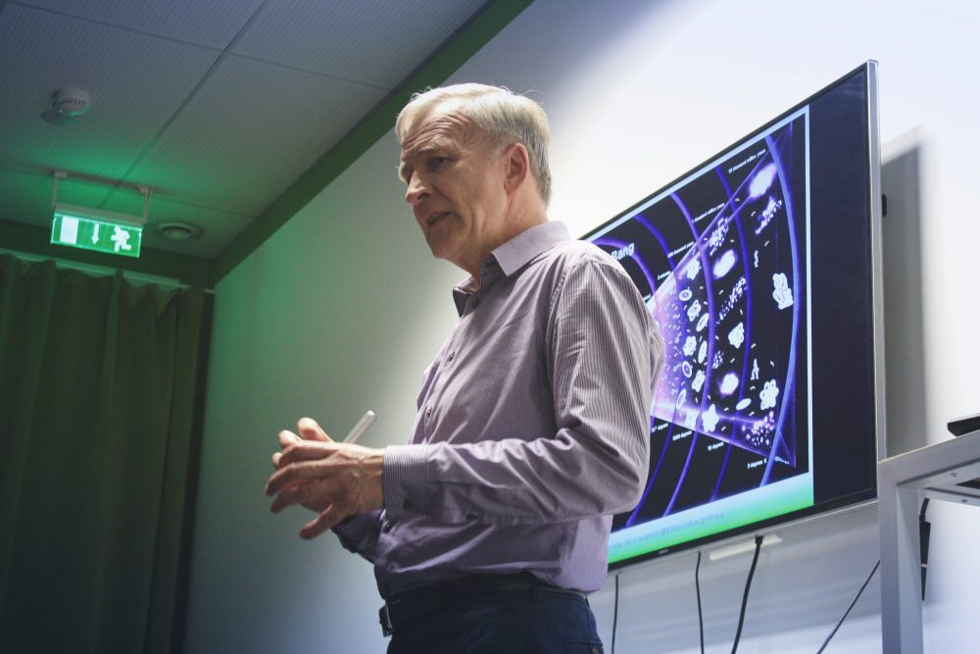
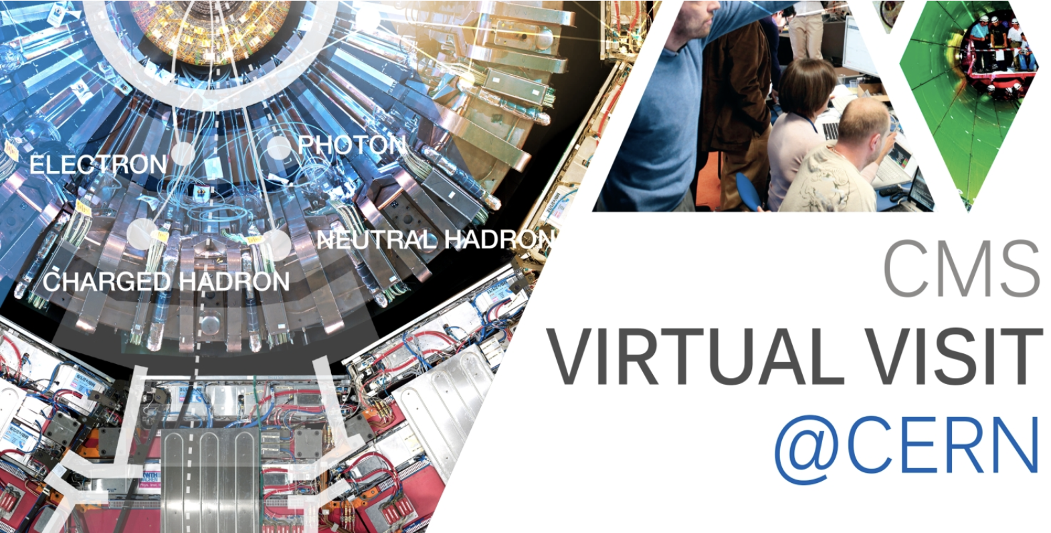
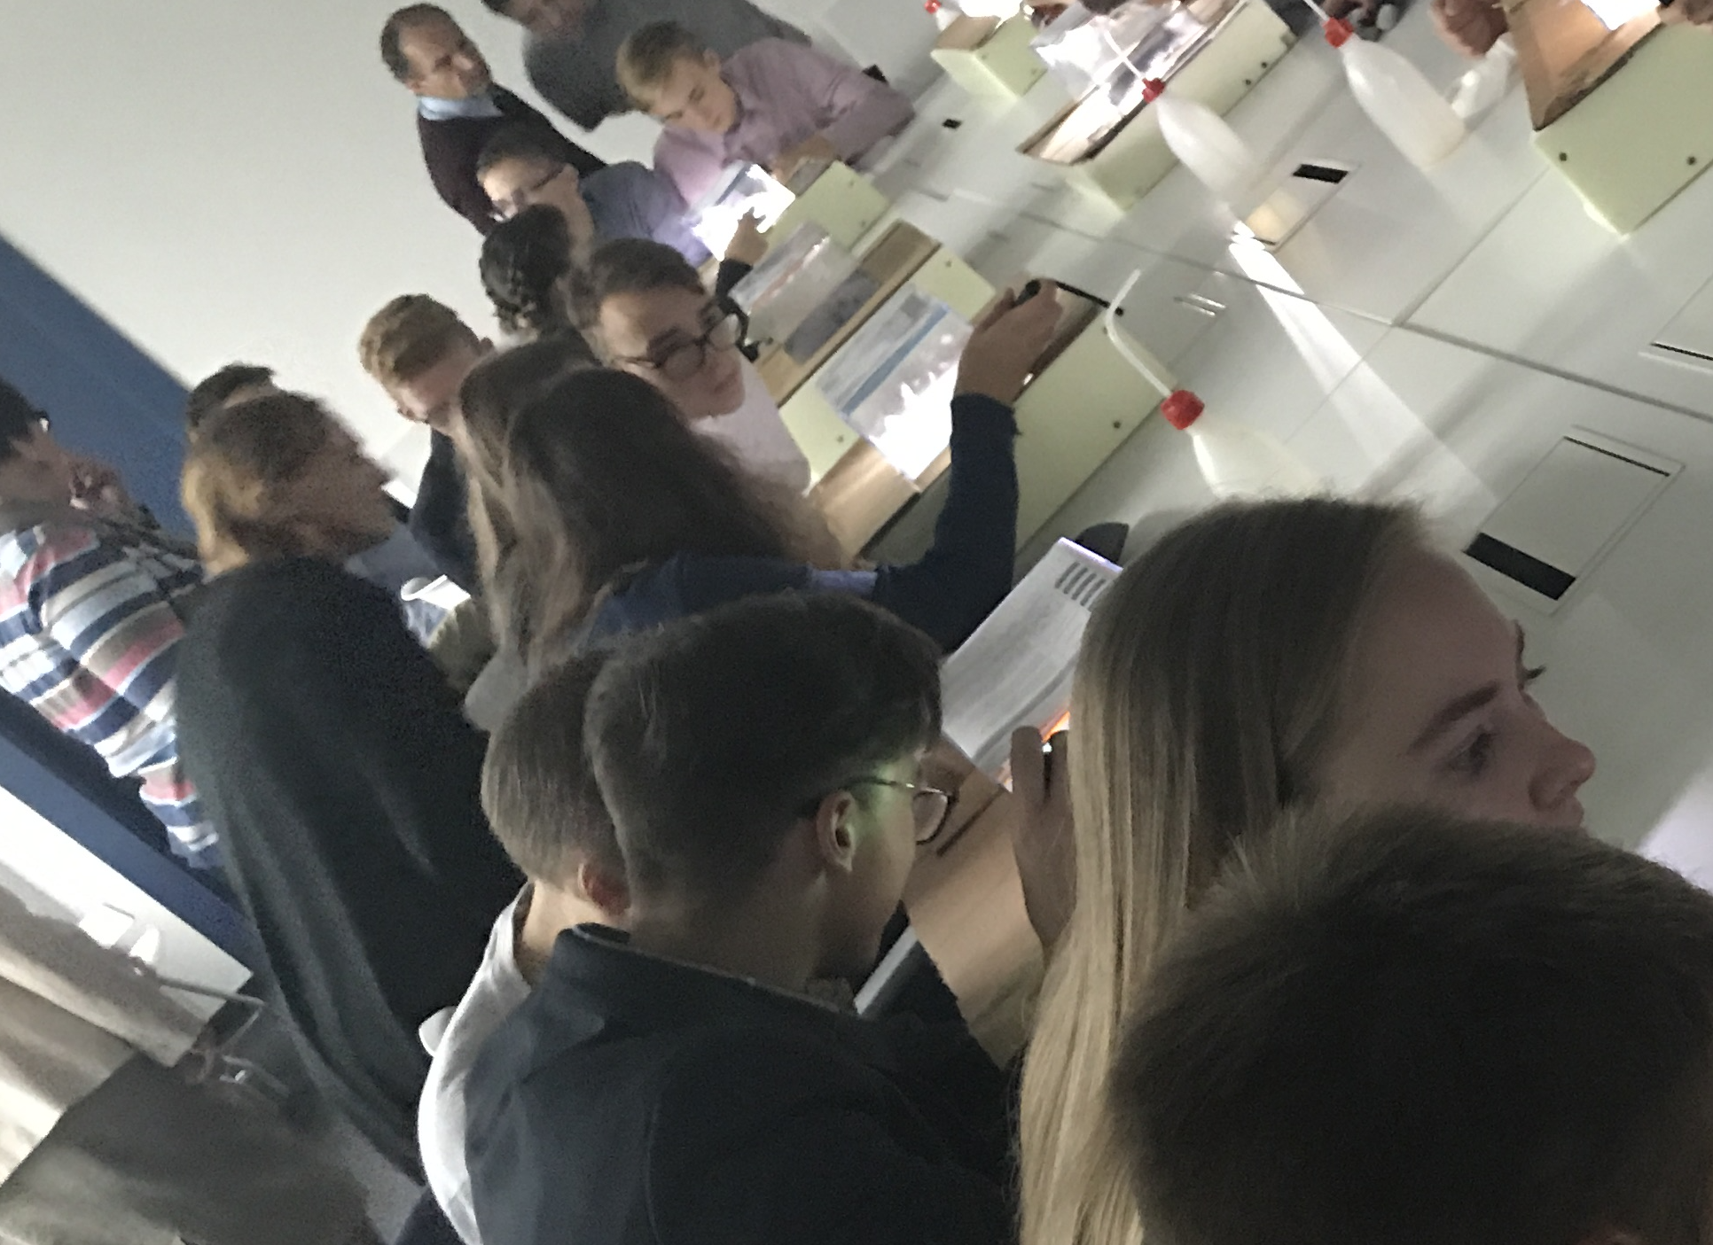
“Spaceship Earth”
About: 2 hands-on activities and 2 lectures every years from 2015. In 2023 – 2 hands-on activities and 4 lecture.
Researchers' Night
CERN virtual tours and lecture for
students and publics
2014, 2016, 2017, 2018, 2019, 2023
Notes:
All events were free for participants. It is still planned to continue activities in planned events for the public.

Slide 9

THANK YOU!!!
cern@ff.vu.lt

