Slide 1
CERN Baltic Group
https://indico.cern.ch/category/10023/
Dr. Brigita Abakevičienė
brigita.abakeviciene@ktu.lt
Kaunas University of Technology
25/9/2023

Slide 2
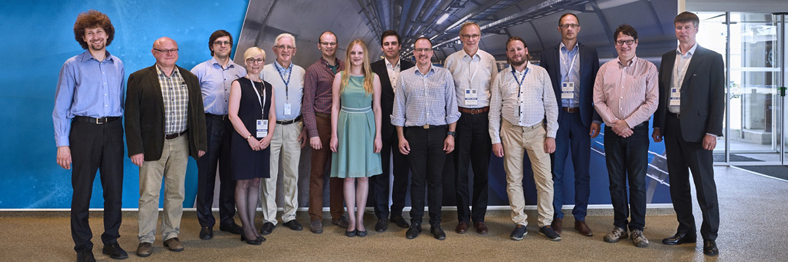

CERN BALTIC GROUP (CBG)
https://www.rtu.lv/en/hep/baltics-cern-grupa
This is a group of Latvian, Estonian, and Lithuanian research institutions which are involved in CERN activities. The group is designed to meet regularly and to coordinate activities between Baltic countries and CERN.
The main objectives of the CERN Baltic Group are:
  Coordination of the Baltic research institutions activities towards CERN and related Collaborations/experiments.
  Strengthening and development of Baltic High Energy Physics community.
  Development of the Baltic international multidisciplinary masters/doctoral lever study program in High Energy Physics and Accelerator Technologies.
The group was founded on 28.05.2018. at CERN.
Chairman of CERN Baltic Group: Ants Koel (Tallinn University of Technology)
Deputy Chair: Brigita Abakevičienė (Kaunas University of Technology)
Notes:
The CERN Baltic Group (CBG) is a collaboration of Estonian, Latvian and Lithuanian higher education and research institutions involved in CERN-related activities.

Slide 3
CERN BALTIC GROUP (CBG)
The main principles of the CERN Baltic Group are:
transparency, honesty, sharing, and collaboration.
Members:
1. Riga Technical University (RTU) - Latvia
2. University of Latvia (UL) - Latvia
3. Tallinn University of Technology (TalTech) - Estonia
4. National Institute of Chemical Physics and Biophysics (NICPB) - Estonia
5. Vilnius University (UV) - Lithuania
6. Riga Stradins University (RSU) - Latvia
7. University of Tartu (UT) - Estonia
8. Kaunas University of Technology (KTU) - Lithuania
9. Vytautas Magnus University (VMU) - Lithuania
10. Lithuanian Energy Institute (LEI) – Lithuania
11. Lithuanian University of Health Sciences (LSMU) – Lithuania
12. Ventspils University of Applied sciences (VU) – Latvia
13. Daugavpils University (DU) – Latvia

Slide 4
CBG objectives
Coordination of the Baltic research institutions activities towards CERN and related Collaborations/Experiments
Strengthening and development of Baltic High Energy Physics Community
Development of the Baltic international multidisciplinary masters/doctoral level study programme in High Energy Physics and Accelerator Technologies

Slide 5
Policy Actions - strengthening and developing the Baltic High Energy Physics community
To support to the Baltic Teacher Programme
Organising the Baltic School on High Energy Physics and Accelerator Technologies
To continue active engagement with TIARA in order to promote CBG member institution participation in the accelerator community projects
To support and encourage member institution participation FCC project. To seek synergies between partners of CBG
Engaging in the major CERN-coordinated projects: I.FAST – RTU+TalTech+VMU; HITRIplus/NIMMS – RTU+KTU; PRISMAP – LU+RTU; HERTIS – RTU+UT
Investigating feasibility of the CERN Baltic Internship Programme
Investigating participation options for the CBG and its Members in CERN project Science Gateway

Slide 6
Policy Actions - strengthening and developing the Baltic High Energy Physics community
To continue successful liaison with Baltic Assembly - Parliamentary support at a Baltic level for the CERN related activities
Inviting new Partners to join the CBG
Maintaining a high-efficiency and collegiality of the CBG Technical Coordination Team and the CBG Secretariat
Organizing a CBG Conference under auspices of University of Tartu
CBG Mission Statement – work in progress
CBG collaboration with Scandinavia and Finland still to be explored ...

Slide 7
Study Programme Actions
Certifying the HEP&AT doctoral Study Programme between RTU and LU
CBG expresses gratitude to all member institution experts for substantial contribution to the development of the curricula
CBG is reiterates importance of the linked master level study programme

Slide 8
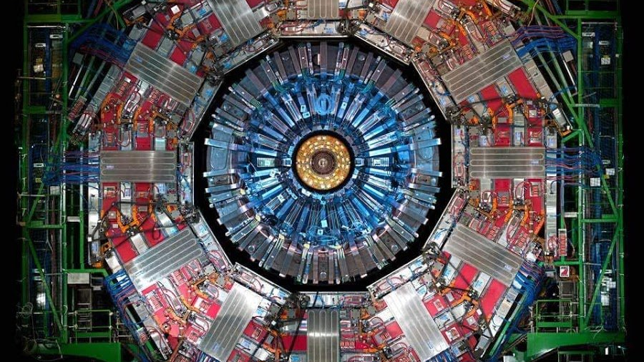
CMS Actions
Development of Tier2 Center in Latvia - strong technical support and advise of Estonia (NICPB) and Lithuania was joined on 2023
The Baltics contribution to CMS projects is of 1.4 MCHF in total
Collaborative and aligned efforts for the CMS Phase 2 upgrade - in-kind contribution via national industries and research entities - instead of cash payments
Representative to the CMS Computing Resources Board
To intensify work by engaging partner institutions and personal working in CMS projects: better coordination and personal encouragement is needed

Slide 9
CERN CMS TIER2 project
The main goal is to unite high-performance computing resources from multiple academic institutions in a federated HPC resource pool for efficient processing of CERN CMS TIER II workloads.
To establish framework between individual institutions IT teams for HPC resources availabilities and accessibilities
To create collaboration and experience sharing platform for best practices of managing HPC resources and serving them to TIER II community.
Using Baltic NREN’s and GEANT optical networks infrastructure interconnect institutional HPC resources at international-Baltic level for at least of 100Gbps lines
Contact person:
Arvydas Žiliukas
Director of Department of Information Technology Services
Computer Networks Centre
arvydas.ziliukas@ktu.lt

Slide 10
Still valid and OK
General Meeting
Coordination Team & Secretariat
Study Program Group
Industry Group
CMS
Group
- exchanging
- learning
- building
- involving
- engaging
- recognising
General Meetings: Riga-Geneva-Tallinn-Kaunas-…-virtual /
Daily work of the Coordination Team
Regular Technical Coordination Meetings /
Study Programme Meetings: Vilnius-Tartu… / CMS Group Meetings /
Industry Group Meetings /
- community
- visibility
- goal
- connecting
- developing
- motivating
https://indico.cern.ch/category/10023/

Slide 11
CERN Baltic Group General meetings:
9th meeting: April 21, 2022, Riga
10th meeting: November 21-20, 2022, Tallinn
11th meeting: May 4-5, 2023, Kaunas
12th meeting: October 12, 2023
https://indico.cern.ch/event/1325565/

Slide 12
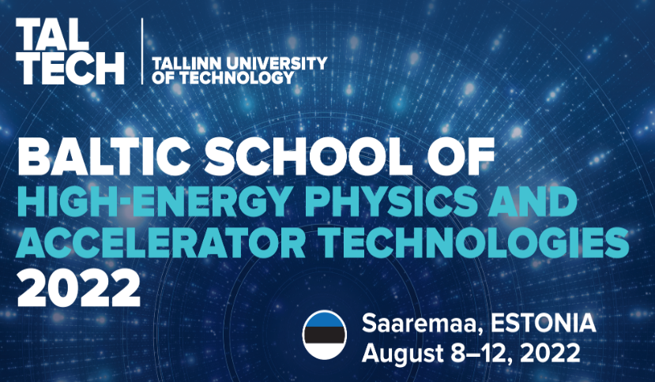
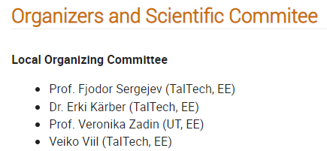
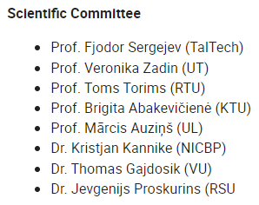
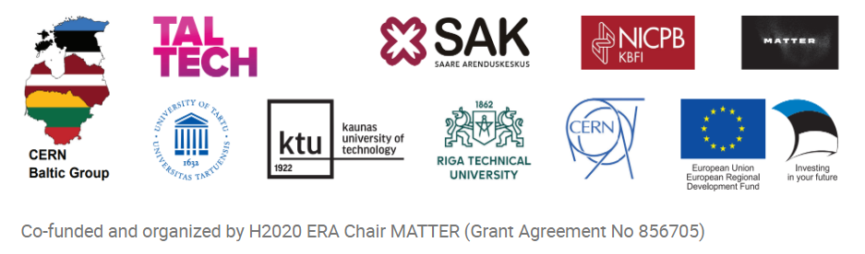
2nd Baltic School of High-Energy and Accelerator Technologies
https://indico.cern.ch/event/1123671/
Notes:
The school will focus on the fundamental aspects of high-energy physics theory and touch on the cutting edge research currently on-going. In addition, the school will also cover both the basic principles and the current cutting edge technologies of particle accelerators, as well as their applications.
The school is organised by the CERN Baltic Group, a collaboration of nine higher education and research institutions in the Baltic states, and is endorsed by CERN.

Slide 13

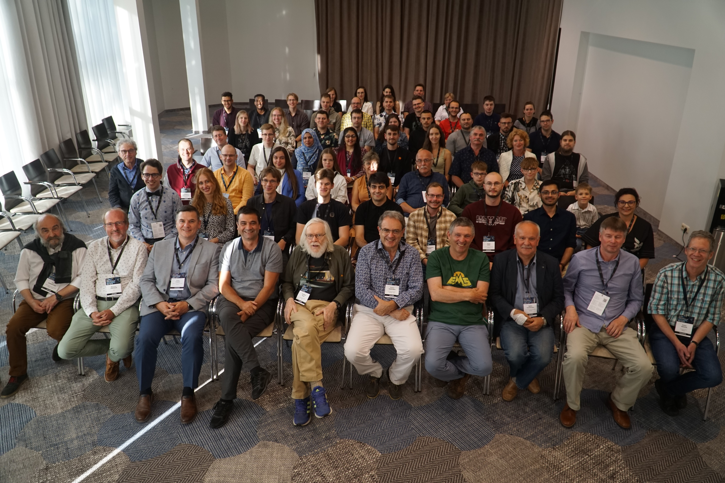

3rd Baltic School of High-Energy and Accelerator Technologies
https://indico.cern.ch/event/1249205/
Notes:
The school will focus on the fundamental aspects of high-energy physics theory and touch on the cutting edge research currently on-going. In addition, the school will also cover both the basic principles and the current cutting edge technologies of particle accelerators, as well as their applications.
The school is organised by the CERN Baltic Group, a collaboration of nine higher education and research institutions in the Baltic states, and is endorsed by CERN.

Slide 14


2nd CERN Baltic Conference
https://indico.cern.ch/event/1147717/
Notes:
The Scope and Topics
The scientific and technical CERN Baltic Conference covers the full spectrum of CERN and related activities (e.g. research, engineering, computing, industrial, and policy).
Topics are related, but not limited to: Accelerator, Detector and other Advanced Technologies, High Energy Physics, Data Science and Computing, Nuclear Medicine. From physics to engineering, from fundamental science to industry.
Topics will be logically linked to the CBG activities within the CERN collaborations, experiments and studies: such as CMS, CLIC, FCC, MEDICIS, AEGIS, CLOUD, and others.

Slide 15
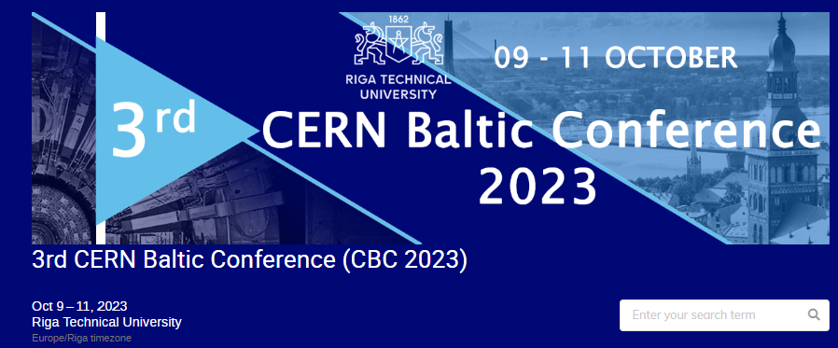
3rd CERN Baltic Conference
https://indico.cern.ch/event/1288731/

