Slide 1
LITHUANIAN PARTICIPATION IN INTERNATIONAL RESEARCH INFRASTRUCTURES
Dr. Eugenijus Stumbrys, Head of Research and Higher Education Policy Analysis Unit of the Research Council of Lithuania
Vilnius, September 25th, 2023

Slide 2
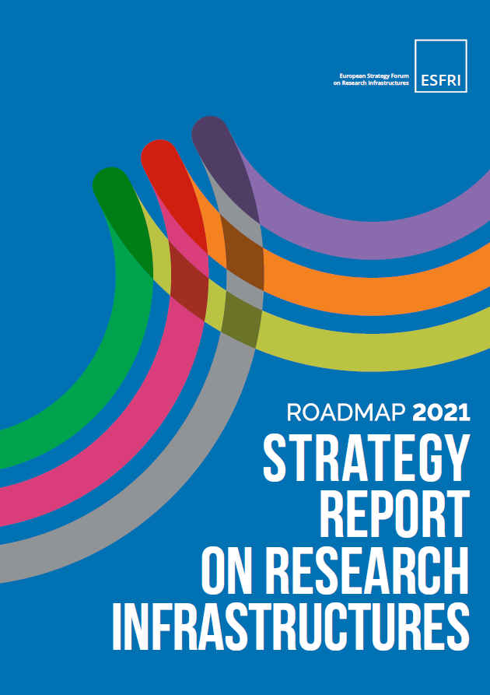
ESFRI Roadmap
There is in Roadmap 2021 the updated and complete list of 22 ESFRI PROJECTS and 41 ESFRI LANDMARKS.
The ESFRI PROJECTS are RIs in their Preparation Phase, which have been selected for the excellence
of their scientific case and for their maturity, according to a sound expectation that the Project will reach the Implementation Phase within a ten-year period.
The ESFRI LANDMARKS are RIs that are implemented – reached an advanced implementation stage – and represent major elements of the competitiveness of the ERA.

Slide 3
Lithuanian Participation
The Landscape Analysis has been realized in 6 domains:
DATA, COMPUTING & DIGITAL RESEARCH INFRASTRUCTURES,
ENERGY,
ENVIRONMENT,
HEALTH & FOOD,
PHYSICAL SCIENCES & ENGINEERING,
SOCIAL & CULTURAL INNOVATION.
Lithuania doesn’t participate in any ESFRI PROJECT and participates in 7 ESFRI LANDMARKS:
HEALTH & FOOD (2 RI),
PHYSICAL SCIENCES & ENGINEERING (2 RI),
SOCIAL & CULTURAL INNOVATION (2 +2).

Slide 4
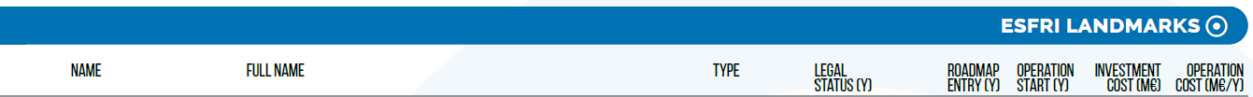
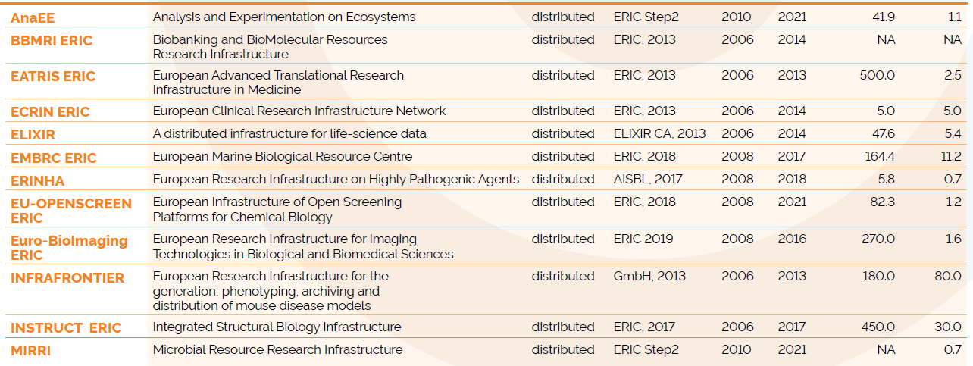
Lithuanian Participation
Health & Food RI

Slide 5
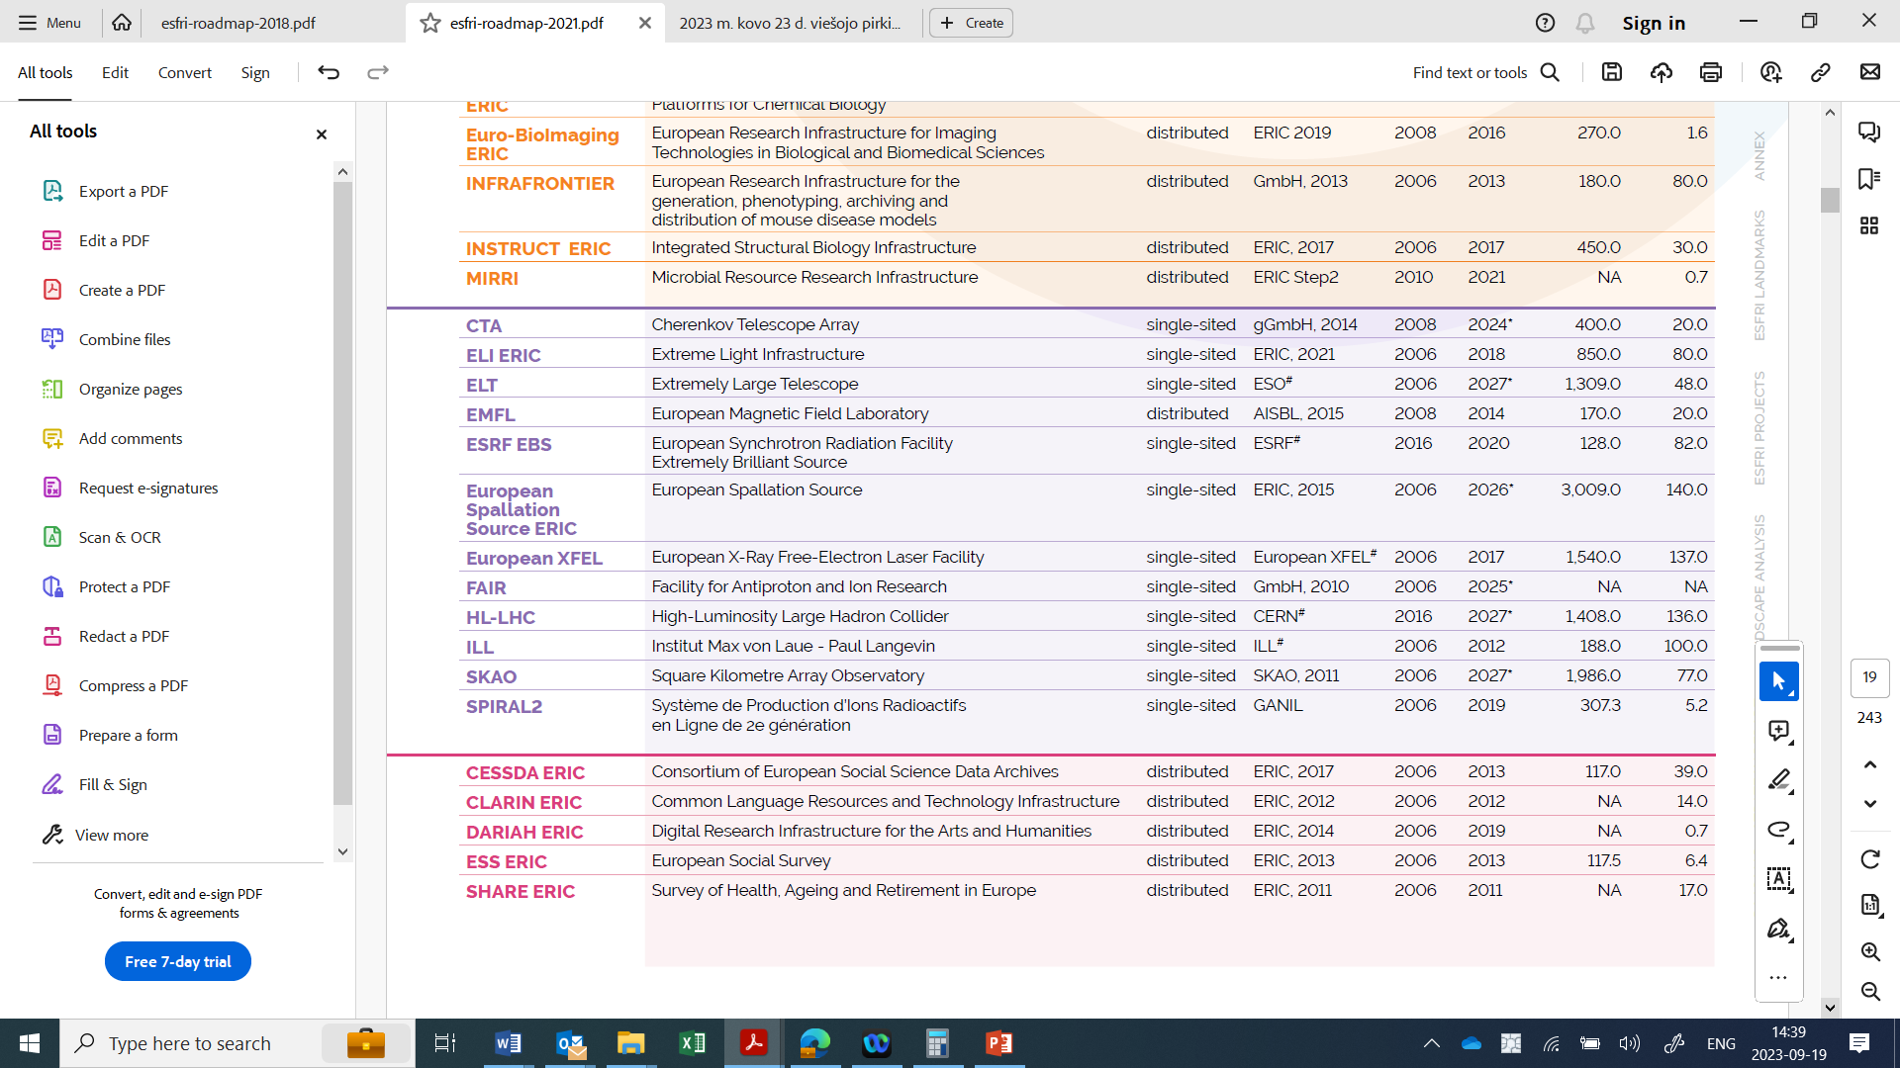
Lithuanian Participation
Physical Sciences & Engineering RI
Social & Cultural Innovation RI

Slide 6
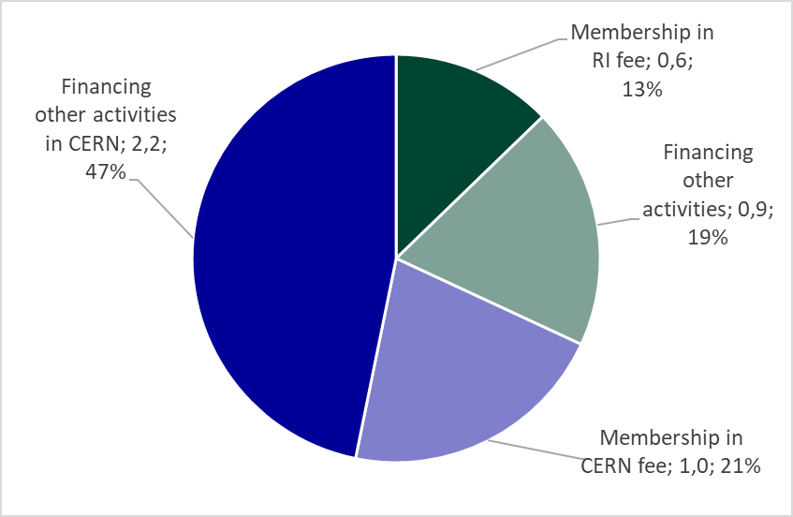

Cost of Participation in RI
The cost of participation in millions of euros.

Slide 7
Thank you for Attention!

