Slide 1
Superradiant Instability of Extremal Black Hole in STU Model
Zhan-Feng Mai
Center for Joint Quantum Studies, School of Science
Tianjin University
Arxiv: : 2110.14942
Collaborating with Run-Qiu Yang and Hong Lu

Slide 2
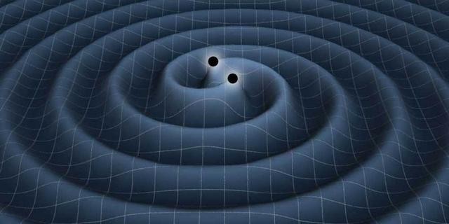
Black Hole Stability
Black Hole is important objects in gravitational physics.
Black Hole image
Gravitational Wave

Slide 3


Motivation
What is superradiant Instablity?
Can it arise in static black hole ?
Superradiance effect
$$E$$
Black Hole Bomb [S. A. Teukolsky (1972)]
Boom!!!
Kerr black hole [A.A. Starobinskil and S.M. Churilov (1974)] [S.M.Dolan (2007)]
Kerr-Newmann Black Hole [H. Furuhashi and Y. Nambu (2004)] [Y.Huang (2018)]
RN Black Hole [S. Hod (2012)][S. Hod(2015)][J. H. Huang and Z. F. Mai (2016)]

Slide 4
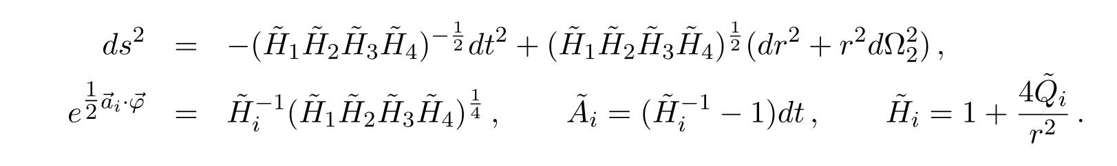
Motivation: Why Extremal black hole in STU
Remark:
No Hawking Radiation.
It is a static black hole.
When four charges are equal, it reduce to Extremal RN black hole.
G
F
STU: rich structure

Slide 5
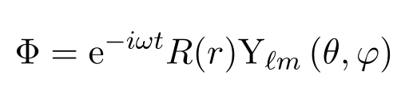
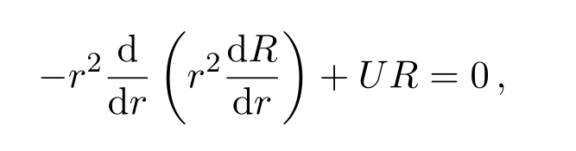
Linear Perturbation
KG equation:
Anstaz:
Radial Equation

Slide 6
















Boundary Condition
$${R∼e}^{\frac{i(ω−ω_{c})}{r}}$$
$$R∼\frac{ℐ}{r} e^{−i\sqrt{ω^{2}−m_{p}^{2}}r}$$
Scattering
$$r→r_{h}$$
$$ω∈ ℝ$$
$$R∼\frac{ℛ}{r} e^{i\sqrt{ω^{2}−m_{p}^{2}}r}$$
$${R∼e}^{\frac{i(ω−ω_{c})}{r}}$$
Quasi-Normal Modes
$$r→r_{h}$$
$$ω=ω_{r}+iω_{i}∈ ℂ$$
$$R∼\frac{1}{r} e^{i\sqrt{ω^{2}−m_{p}^{2}}r}$$
$$ω_{i}>0$$
$$φ∼e^{ω_{i}t}$$
$$ω_{i}<0$$
$${R∼e}^{\frac{i(ω−ω_{c})}{r}}$$
Quasi-Bound States
$$r→r_{h}$$
$$ω=ω_{r}+iω_{i}∈ ℂ$$
$$R∼\frac{1}{r} e^{−\sqrt{m_{p}^{2}−ω^{2}}r}$$

Slide 7
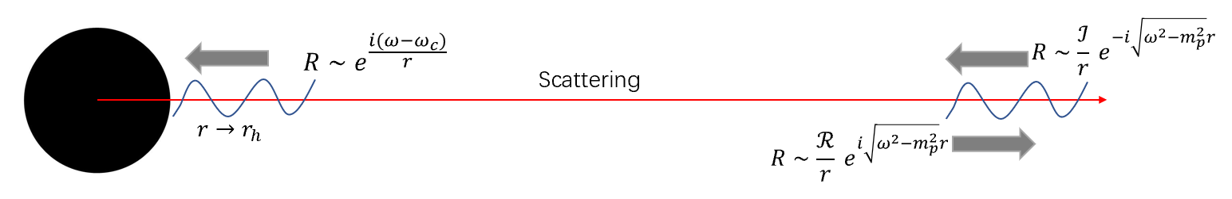
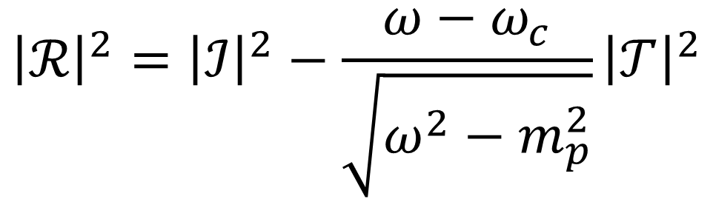
Superradiant Scattering
Wroskain Determinant
$${\left|ℛ\right|}^{2}={\left|ℐ\right|}^{2}−\frac{ω−ω_{c}}{\sqrt{ω^{2}−m_{p}^{2}}}{\left|𝒯\right|}^{2}$$

Slide 8
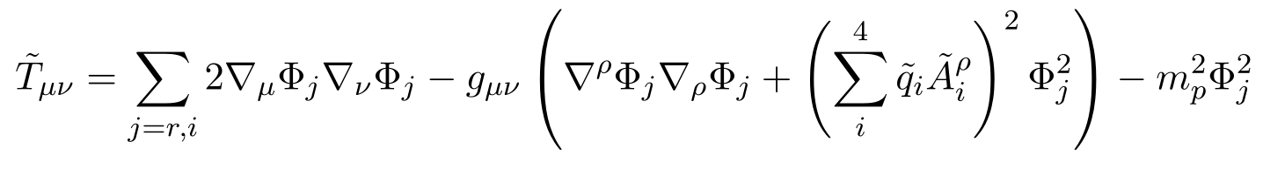
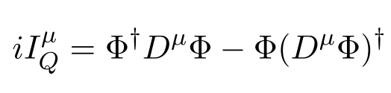
Conserved Current
Energy Momentum Tensor
Energy Current:
Total Energy:
Energy Flux:
Charge Current
Total Charge
Charge Current:

Slide 9






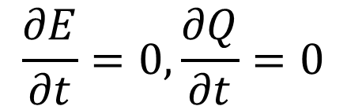



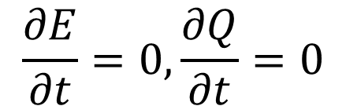




Current (Superradiant Scattering)
$$ω>ω_{c}$$
$$I_{Q}^{μ}$$
$$J_{E}^{μ}$$
$$I_{Q}^{μ}$$
$$J_{E}^{μ}$$
$$\frac{∂E}{∂t}=0, \frac{∂Q}{∂t}=0$$
$$r→r_{h}$$
$$ω∈ ℝ$$
$$ω<ω_{c}$$
$$I_{Q}^{μ}$$
$$J_{E}^{μ}$$
$$\frac{∂E}{∂t}=0, \frac{∂Q}{∂t}=0$$
$$r→r_{h}$$
$$I_{Q}^{μ}$$
$$J_{E}^{μ}$$

Slide 10







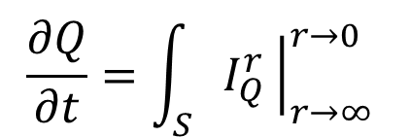

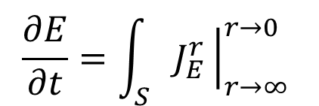
Superradiant Condition for Complex Frequency
$$ω_{i}>0$$
$$E,Q$$
Unstable
$$\frac{∂E}{∂t}=2ω_{i} E, \frac{∂Q}{∂t}=2 ω_{i}Q$$
$$ω_{i}<0$$
$$E,Q$$
Stable
$$\frac{∂E}{∂t}=\int_{S}{J_{E}^{r}}{\left.​\right|}_{r→∞}^{r→0}$$
$$\frac{∂Q}{∂t}=\int_{S}{I_{Q}^{r}}{\left.​\right|}_{r→∞}^{r→0}$$
Conservation Law:
$$ω_{r}>ω_{c}$$
Quasi-Bound State
$$ω_{r}<ω_{c}$$
Quasinormal Modes
Superradiant Condition for instability :
$${ ω_{i}>0→ ω}_{r}<ω_{c}$$

Slide 11
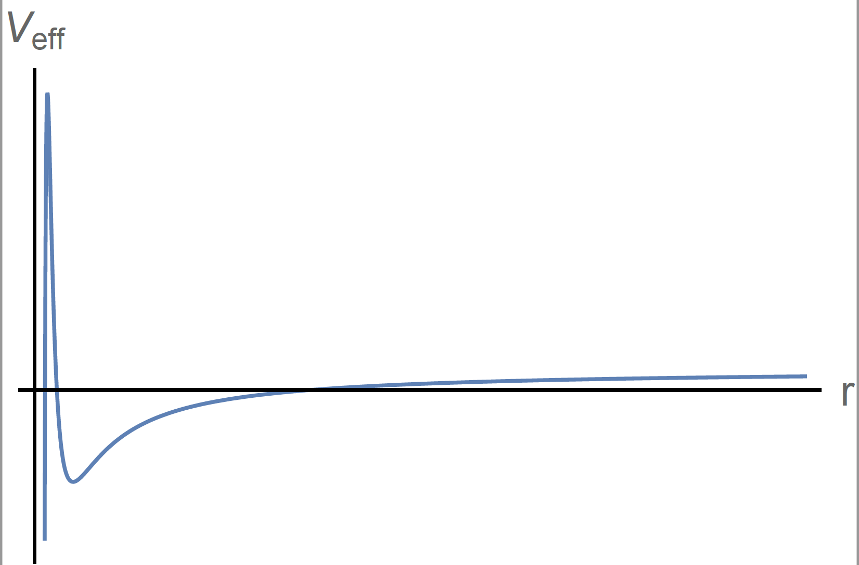
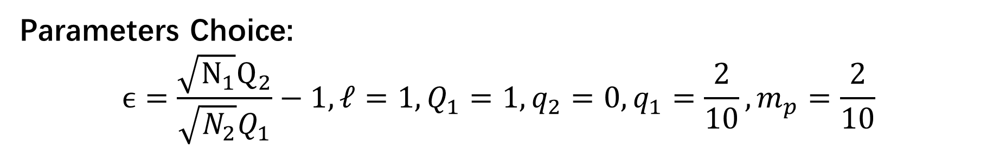

Numerical Result: Single Peak (Only $\left(N_{1},N_{2}\right)=(2,2)$)
Parameters Choice:
$$ϵ=\frac{\sqrt{N_{1}}Q_{2}}{\sqrt{N_{2}}Q_{1}}−1, ℓ=1, Q_{1}=1, q_{2}=0,q_{1}=\frac{2}{10}, m_{p}=\frac{2}{10}$$

Slide 12
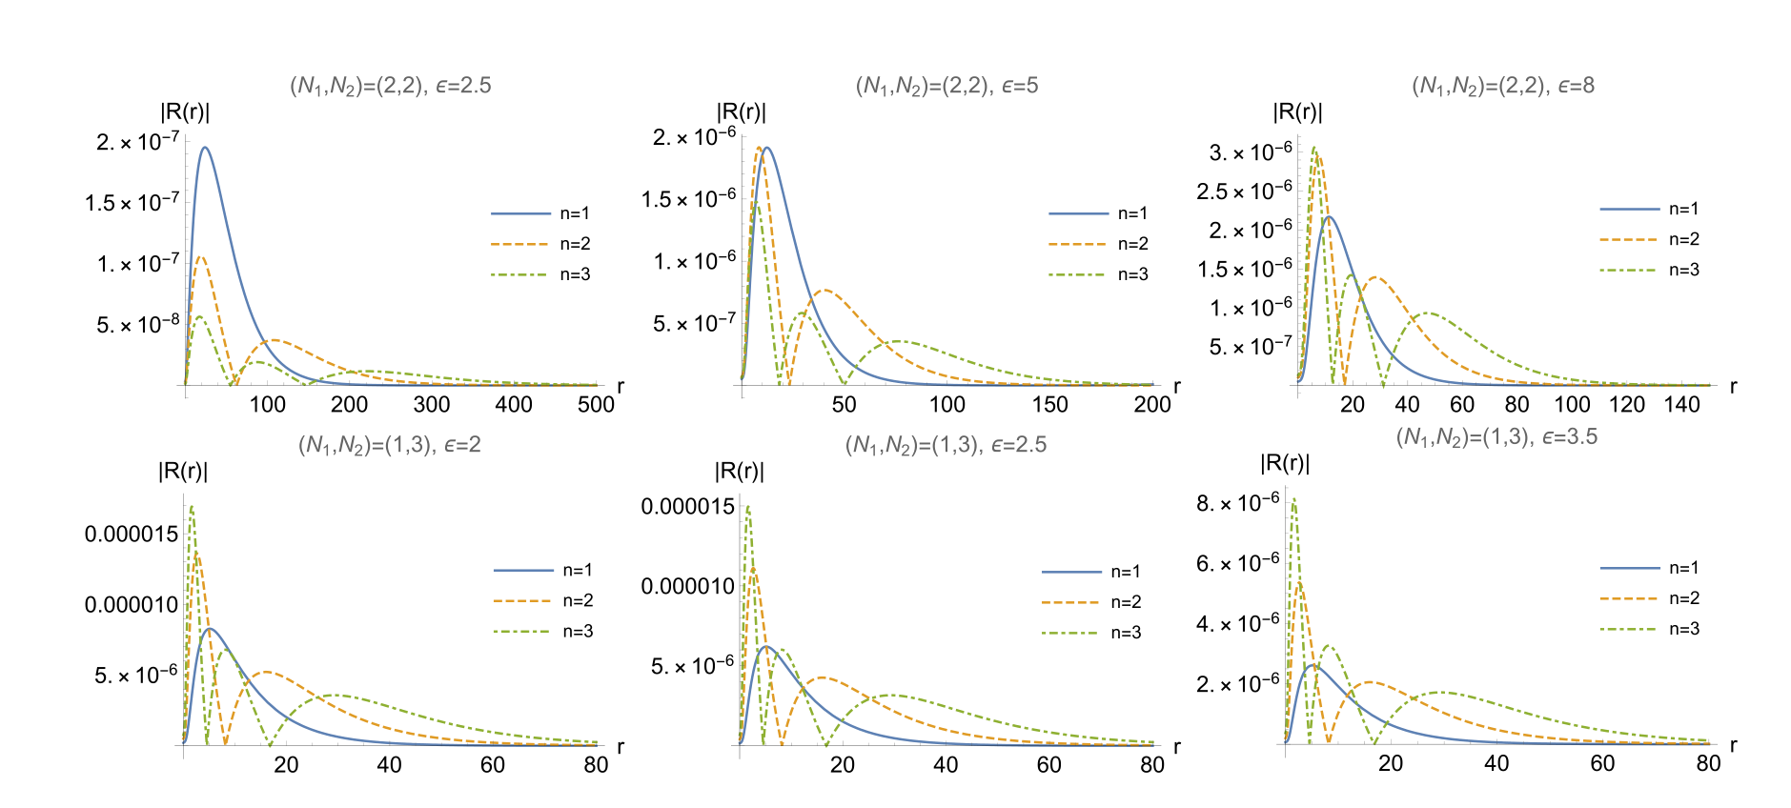
Numerical Result: Single Peak

Slide 13
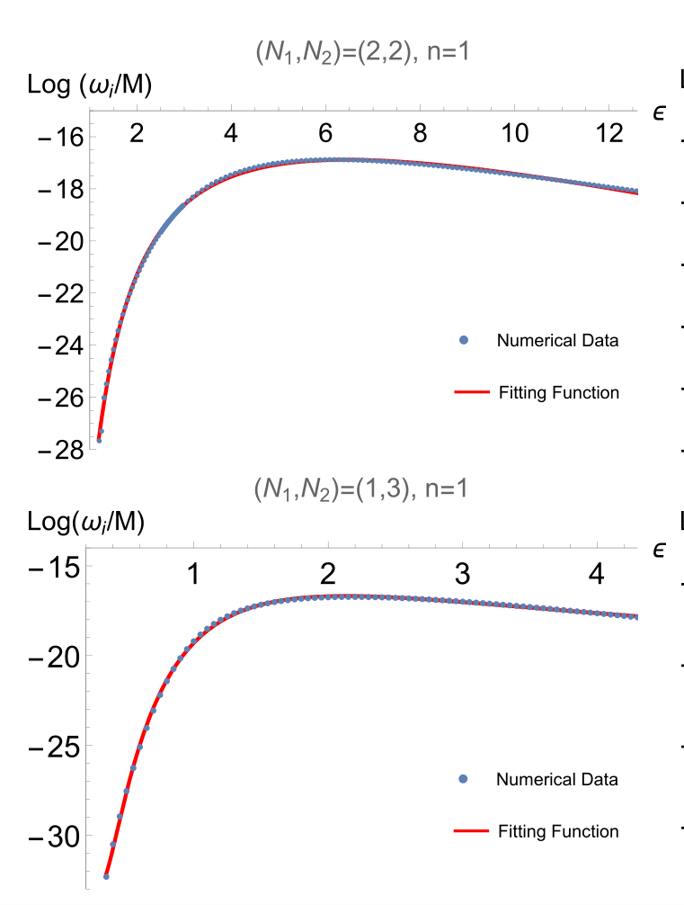
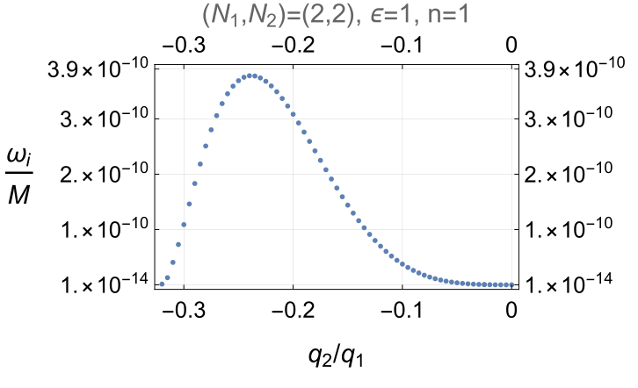
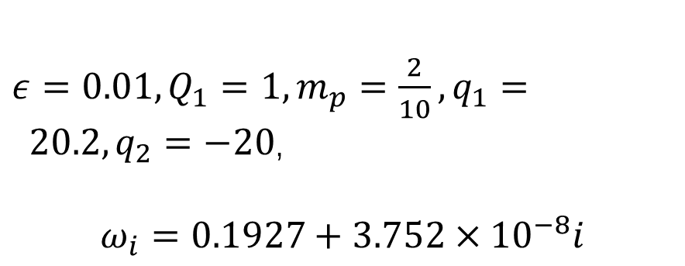
Result
Grow again!
RN limit
$ε=0.01, Q_{1}=1, m_{p}=\frac{2}{10},q_{1}= 20.2, q_{2}=−20$,
$$ω_{i}=0.1927+3.752×{10}^{−8}i$$
Superradiantly stable RN black hole is a fine-tuning case

Slide 14
Conclusion
The relation between superradiant instability and unstable quasi-bound states or quasi-normal modes.
RN black hole is a fine-tuning case in superradiant instability in the framework of STU supergravity model.

Slide 15
Thank you for your attention !

