Slide 1
Hidden Markov Model and Viterbi algorithm

Slide 2
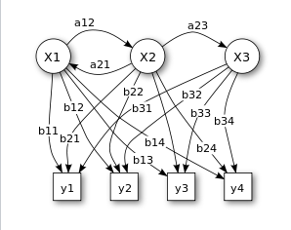

Hidden Morkov Model (HMM)
$Hidden state:\{q_{1}…q_{N_{Q}}\}$
$Observable state:\{o_{1}…o_{N_{O}}\}$
$Transition probability matrix:A$
$Emission probability matrix:L$

Slide 3
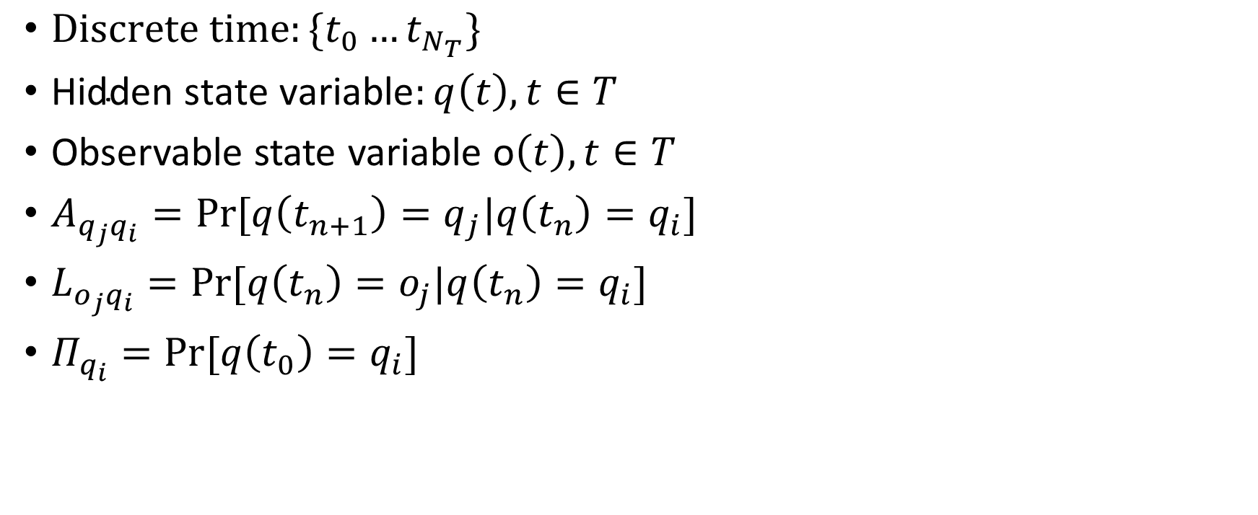
Hidden Morkov Model (HMM)
$Discrete time:\{t_{0}…t_{N_{T}}\}$
$\text{Hidden} \text{state} \text{variable}:q\left(t\right), t∈T$
Observable state variable o$\left(t\right), t∈T$
$A_{q_{j}q_{i}}=Pr⁡[q\left(t_{n+1}\right)=q_{j}|q\left(t_{n}\right)=q_{i}]$
$L_{o_{j}q_{i}}=Pr⁡[q\left(t_{n}\right)=o_{j}|q\left(t_{n}\right)=q_{i}]$
$Π_{q_{i}}=Pr⁡[q\left(t_{0}\right)=q_{i}]$

Slide 4
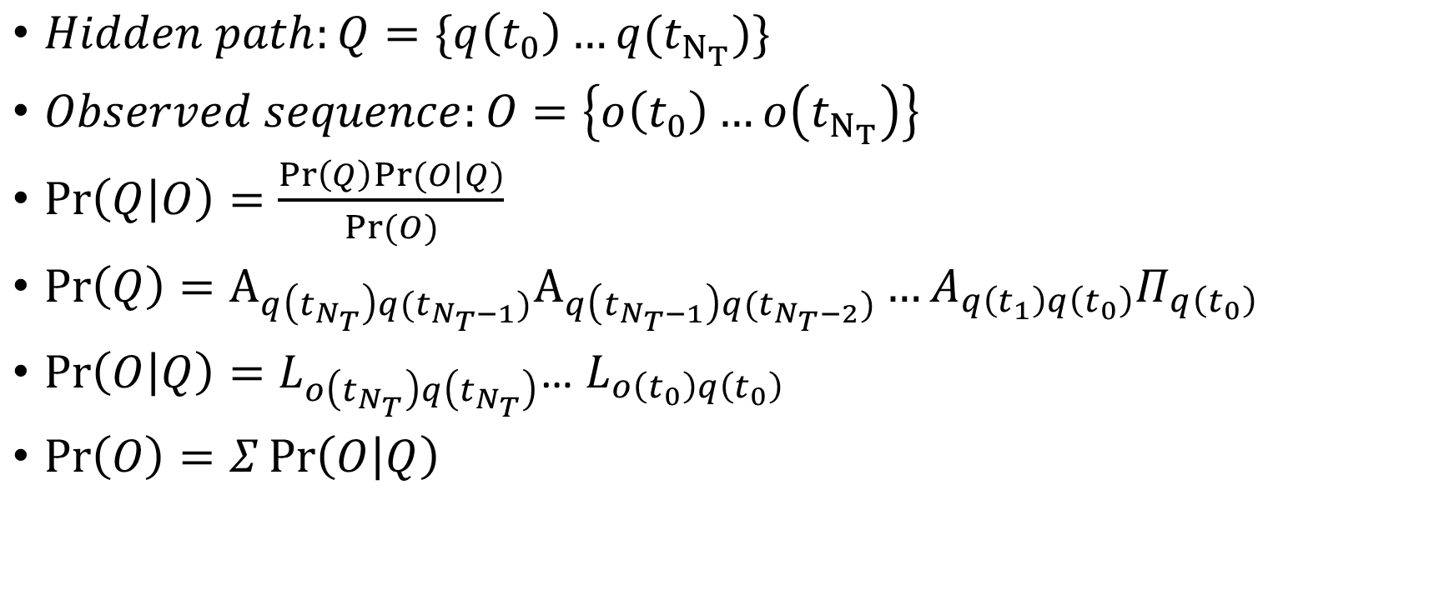
Hidden Morkov Model (HMM)
$Hidden path:Q=\{q\left(t_{0}\right)…q(t_{N_{T}})\}$
$Observed sequence:O=\left\{o\left(t_{0}\right)…o\left(t_{N_{T}}\right)\right\}$
$\operatorname{Pr}\left(Q | O\right)=\frac{\operatorname{Pr}\left(Q\right)Pr⁡(O|Q)}{Pr⁡(O)}$
$\operatorname{Pr}\left(Q\right)=A_{q\left(t_{N_{T}}\right)q(t_{N_{T}−1})}A_{q\left(t_{N_{T}−1}\right)q(t_{N_{T}−2})}…A_{q\left(t_{1}\right)q\left(t_{0}\right)}Π_{q\left(t_{0}\right)}$
$\operatorname{Pr}\left(O | Q\right)=L_{o\left(t_{N_{T}}\right)q\left(t_{N_{T}}\right)}$… $L_{o\left(t_{0}\right)q\left(t_{0}\right)}$
$\operatorname{Pr}\left(O\right)=Σ\operatorname{Pr}\left(O | Q\right)$

Slide 5

Hidden Morkov Model (HMM)
$\operatorname{Pr}\left(Q | O\right)∝L_{o\left(t_{N_{T}}\right)q\left(t_{N_{T}}\right)}A_{q\left(t_{N_{T}}\right)q\left(t_{N_{T}−1}\right)}…{×L}_{o\left(t_{1}\right)q\left(t_{1}\right)}A_{q\left(t_{1}\right)q\left(t_{0}\right)}Π_{q}\left(t_{0}\right)$
$The most probable path:Q^{∗}\left(O\right)=argmax⁡\{Pr⁡(Q|O)\}$

Slide 6
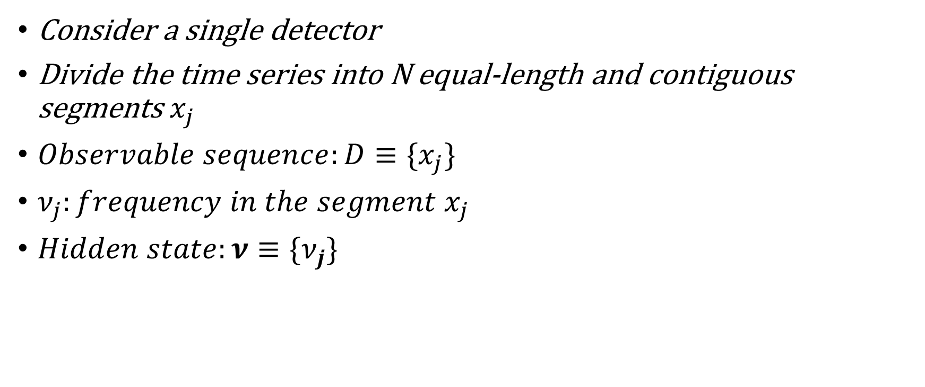
Application of HMM in GWs search
Consider a single detector
Divide the time series into N equal-length and contiguous segments $x_{j}$
$Observable sequence:D≡\{x_{j}\}$
$ν_{j}:frequency in the segment x_{j}$
$Hidden state:ν≡\{ν_{j}\}$

Slide 7
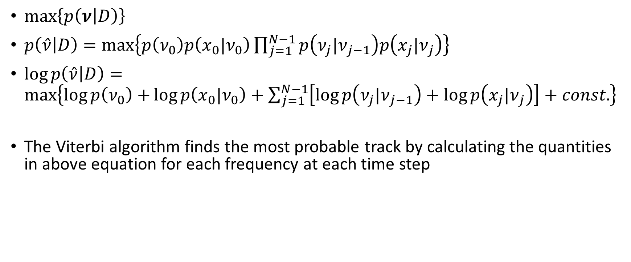
Application of HMM in GWs search
$\max\left\{p\left(ν | D\right)\right\}$
$p\left(\hat{ν} | D\right)=\max\left\{p\left(ν_{0}\right)p\left({x_{0}|ν}_{0}\right)\prod_{j=1}^{N−1}{p\left({ν_{j}|ν}_{j−1}\right)p\left({x_{j}|ν}_{j}\right)}\right\}$
$\log{p\left(\hat{ν} | D\right)}=\max\left\{\log{p\left(ν_{0}\right)+}\log{p\left({x_{0}|ν}_{0}\right)+\sum_{j=1}^{N−1}{\left[\log{p\left({ν_{j}|ν}_{j−1}\right)+\log{p\left({x_{j}|ν}_{j}\right)}}\right]+const.}}\right\}$
The Viterbi algorithm finds the most probable track by calculating the quantities in above equation for each frequency at each time step

Slide 8
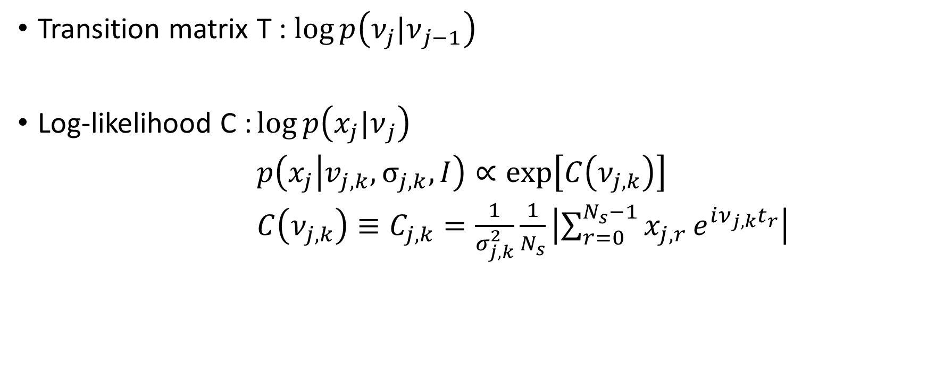
Viterbi algorithm
Transition matrix T : $\log{p\left({ν_{j}|ν}_{j−1}\right)}$
Log-likelihood C : $\log{p\left({x_{j}|ν}_{j}\right)}$
$p\left(x_{j} | v_{j,k}, σ_{j,k}, I\right)∝exp\left[C\left(ν_{j,k}\right)\right]$
$C\left(ν_{j,k}\right)≡C_{j,k}=\frac{1}{σ_{j,k}^{2}}\frac{1}{N_{s}}\left|\sum_{r=0}^{N_{s}−1}{x_{j,r}}e^{iν_{j,k}t_{r}}\right|$

Slide 9
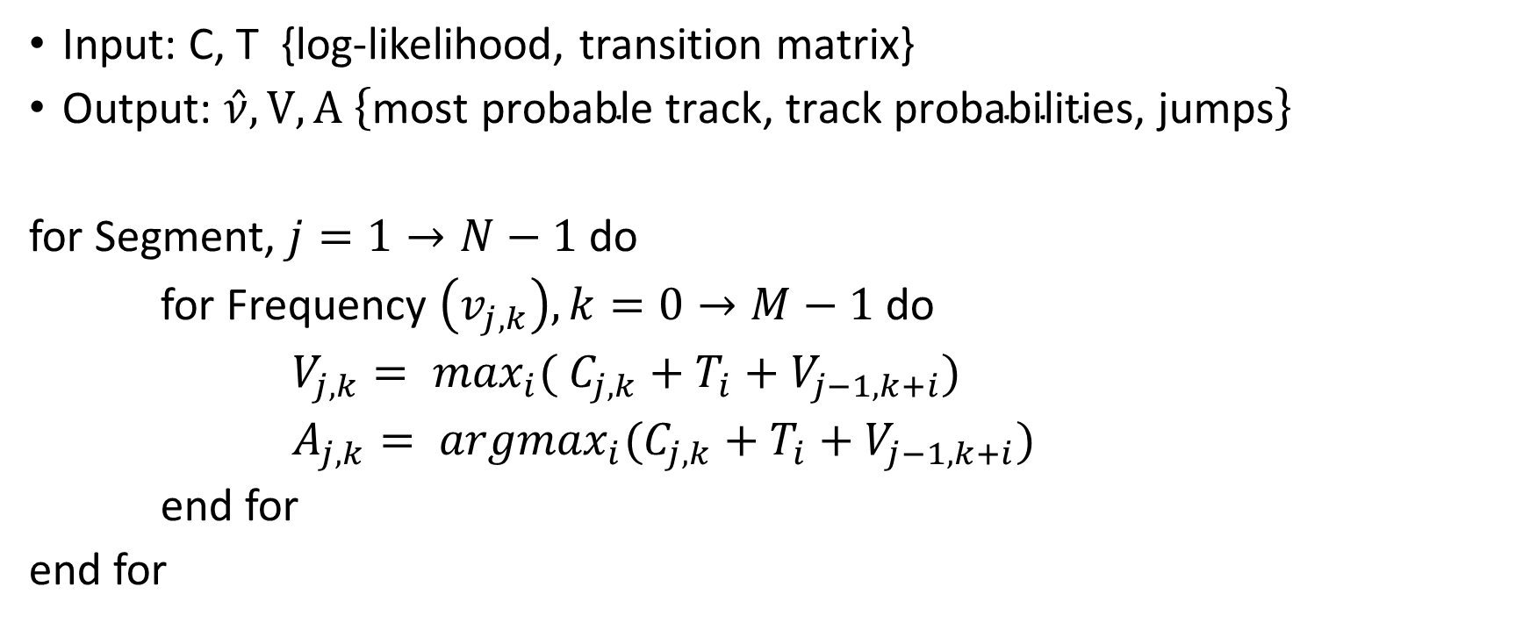
Viterbi Algorithm
Input: C, T {log-likelihood, transition matrix}
Output: $\hat{ν}, V, A \left\{\text{most} \text{probable} \text{track}\text{, }\text{track} \text{probabilities}\text{, }\text{jumps}\right\}$
for Segment, $j=1→N−1$do
for Frequency $\left(v_{j,k}\right), k=0→M−1$ do
$V_{j,k}= \max_{i}⁡( C_{j,k}+T_{i}+V_{j−1,k+i})$
$A_{j,k}= {argmax}_{i}(C_{j,k}+T_{i}+V_{j−1,k+i})$
end for
end for

Slide 10
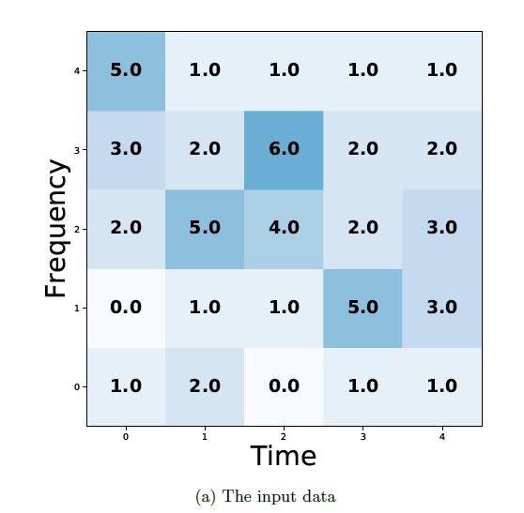
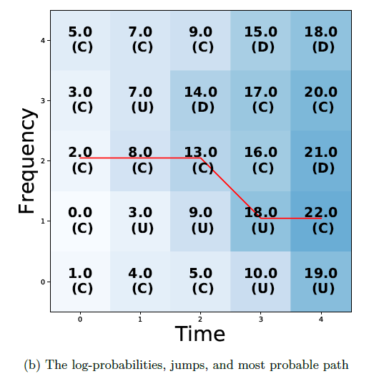
Viterbi Algorithm

