Slide 2
225:Convolutional neural network classifier for the output of the time-domain F-statistic all-sky search for continuous gravitational waves
Motivation : Searching for rotating non-axisymmetric neutron stars emitting long-lasting, almost-monochromatic gravitational waves
Method : Training 1D and 2D CNN on a broad range of signal frequencies
Data resource :

Slide 3
226:Deep-learning continuous gravitational waves
Motivation : Using DNNs for continuous gravitational waves (CWs) from unknown spinning neutron stars.
Method : Training CNN with residual (shortcut) connections.
Data resource :

Slide 4
227:Deep-learning continuous gravitational waves:
Multiple detectors and realistic noise
Motivation : The sensitivity of wide-parameter-space searches for continuous gravitational waves.
Method : (i) using strain data from two detectors simultaneously.
(ii) training for directed (i.e., single sky-position) searches in addition to all-sky searches.
Data resource :

Slide 5
228:SOAP: A generalised application of the Viterbi algorithm to searches for continuous gravitational-wave signals
Motivation :
Method :
Data resource :

Slide 6
229:How effective is machine learning to detect long transient gravitational waves from neutron stars in a real search?
Motivation : The effectiveness of CNNs to detect long duration transient gravitational-wave signals lasting O(hours - days) from isolated neutron stars.
Method : Training one CNN on signal/noise maps in a single 150 Hz band
Data resource :
Notes:
Search for remnant of GW170817

Slide 7
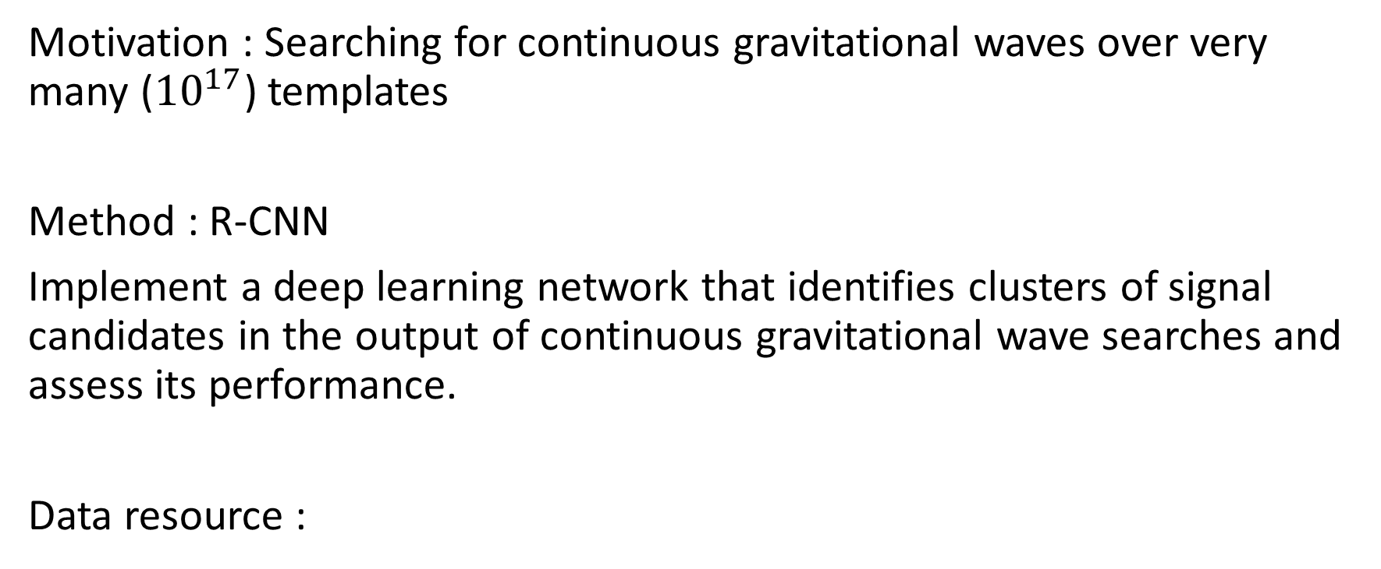
231:Deep learning for clustering of continuous gravitational wave candidates
Motivation : Searching for continuous gravitational waves over very many (${10}^{17}$) templates
Method : R-CNN
Implement a deep learning network that identifies clusters of signal candidates in the output of continuous gravitational wave searches and assess its performance.
Data resource :

Slide 8
232:Search for gravitational waves from five low mass X-ray binaries in the second Advanced LIGO observing run with an improved hidden Markov model
Motivation : Searching for GWs from low mass X-ray binaries
Method : The search algorithm uses a hidden Markov model to track spin wandering, the J–statistic maximum likelihood matched filter to track orbital phase, and a suite of five vetoes to reject artefacts from non-Gaussian noise.
Data resource :

Slide 9
233:A robust machine learning algorithm to search for continuous gravitational waves
Motivation : Many continuous gravitational wave searches are affected by instrumental spectral lines that could be confused with a continuous astrophysical signal
Method : Using a CNN and SOAP algorithm which reduce the impact of instrumental artefacts on searches .
Data resource :

Slide 10
235:Search for continuous gravitational waves from Fomalhaut b in the second Advanced LIGO observing run with a hidden Markov model
Motivation : Search for continuous gravitational waves from Fomalhaut b
Method : The search is based on a hidden Markov model scheme
Data resource :

Slide 11
236:Hidden Markov model tracking of continuous gravitational waves from a neutron star with wandering spin
Motivation : Gravitational wave searches for continuous-wave signals from neutron stars with unknown a priori from electromagnetic observations and wanders stochastically under the action of internal
Method : Frequency tracking by hidden Markov model (HMM) methods can be combined with existing maximum likelihood coherent matched filters like the F-statistic to surmount some of the challenges raised by spin wandering
Data resource :

Slide 12
237:Hidden Markov model tracking of continuous gravitational waves from a binary neutron star with wandering spin. II. Binary orbital phase tracking
Motivation : Tracking continuous-wave gravitational radiation from neutron stars in low-mass X-ray binaries (LMXBs)
Method : Hidden Markov model (HMM) scheme and wandering spin is extended by introducing a frequency-domain matched filter, called the J -statistic
Data resource :

Slide 13
238:Application of hidden Markov model tracking to the search for long-duration transient gravitational waves from the remnant of the binary neutron star merger GW170817
Motivation : The search for long-duration transient gravitational waves from the remnant of the binary neutron star merger GW170817
Method : efficient frequency tracking scheme based on a hidden Markov model
Data resource :

Slide 14
239:Hidden Markov model tracking of continuous gravitational waves from young supernova remnants
Motivation : Searches for persistent gravitational radiation from non-pulsating neutron stars in young supernova remnants (SNRs)
Method : Based on a hidden Markov model (HMM) tracking scheme, solved by the Viterbi algorithm, combined with a maximum likelihood matched filter, the F-statistic.
Data resource :

Slide 15
240:Search for gravitational waves from Scorpius X-1 in the second Advanced LIGO observing run with an improved hidden Markov model
Motivation : semi-coherent search for continuous gravitational waves from the low mass X-ray binary Scorpius X-1.
Method : Hidden Markov model (HMM) to track spin wandering and improved frequency domain matched filter, the J -statistic
Data resource :

Slide 16
243:Use of Excess Power Method and Convolutional Neural Network in All-Sky Search for Continuous Gravitational Waves
Motivation : Propose and examine a new method to select candidates, which reduces the cost of coherent search by following-up only the selected candidates
Method : Consider idealized situation in which only a single-detector having 100% duty cycle and its detector noise is approximated by the stationary Gaussian noise.
Assume the signal has no spindown and the polarization angle
The short-time Fourier transform with the re-sampled data
The excess power search in the Fourier transform of the time series
The deep learning method to further constrain the source sky position
Data resource :

Slide 17
244:Deep learning for clustering of continuous gravitational wave candidates II: identification of low-SNR candidates
Motivation : Identification of low-SNR candidates
Method : R-CNN
network is implemented that can detect clusters due to much fainter signals
Data resource :

Slide 18
245:Search for continuous gravitational waves from ten H.E.S.S. sources using a hidden Markov model
Motivation : Isolated neutron stars are prime targets for continuous wave (CW) searches by ground based gravitational wave interferometers
Method : combines the maximum - likelihood F-statistic with a hidden Markov model (HMM)
Data resource :

Slide 19
246:Continuous Gravitational-Wave Data Analysis with General
Purpose Computing on Graphic Processing Units
Motivation : searching for Continuous gravitational Waves (CWs) emitted by isolated rotating neutron stars
Method : porting of one of the algorithms used to search for CW signals, the so-called FrequencyHough transform, on the TensorFlow framework
Data resource :

Slide 20
247:Hidden Markov model tracking of continuous gravitational waves from a neutron star with wandering spin. III. Rotational phase tracking
Motivation : Rotational phase tracking
Method : hidden Markov model (HMM) solved recursively by the Viterbi algorithm
Data resource :

Slide 21
248:Search for Continuous Gravitational Wave Signals in Pulsar Timing Residuals: A New Scalable Approach with Diffusive Nested Sampling
Motivation : Detecting continuous nanohertz gravitational waves (GWs) generated by individual close binaries of supermassive black holes (CB-SMBHs)
Method : diffusive nested (DNest) sampling
Data resource :

