Slide 1
Plans on Deploying Deepclean for Low-Latency Denoising during O4 in KAGRA
Chai-Jui Chou
National Yang Ming Chiao Tung University, Taiwan
2022/04/25

Slide 2
Low-Latency Detection and Multi-Messenger Astronomy
Gravitational Wave detection can provide early alert and the information of sky location to the Binary Neutron Star mergers.
Low-latency noise subtraction will increase the Signal-to-Noise Ratio of the detection.
Deepclean is the low-latency denoising technique based on Machine Learning developed in LIGO.
Ref: 2005.06534, 2108.12430

Slide 3
Deepclean: Denoising using PEM and Auxiliary Channels
w(t): witness channels that record the data from the auxiliary sensors and PEM.
p(t): predicted noise in strain by Deepclean from w(t).
Both w(t) and p(t) are timeseries with the same sampling rate (4096Hz) and duration.
Ref: 2005.06534, 2108.12430
latent vector
TransposeConv1d
TransposeConv1d
TransposeConv1d
TransposeConv1d
w(t)
Conv1d
Conv1d
Conv1d
Conv1d
Conv1d
p(t)
Encoder (down-sampler)
Decoder (up-sampler)

Slide 4
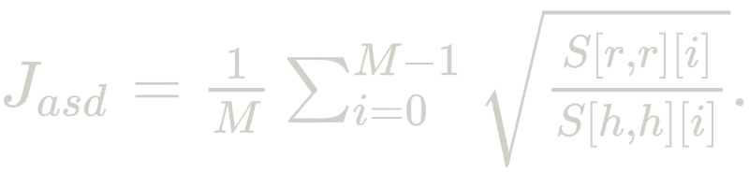
Deepclean: Training and Cleaning
h(t): raw strain data.
r(t) = h(t) - p(t): residual.
Loss function:
Training: Minimizing the ASD ratio of r(t) over h(t).
Inferencing: produce p(t) using trained Deepclean model and get the cleaned strain r(t).
latent vector
TransposeConv1d
TransposeConv1d
TransposeConv1d
TransposeConv1d
w(t)
Conv1d
Conv1d
Conv1d
Conv1d
Conv1d
p(t)
-
r(t)
h(t)
Encoder (down-sampler)
Decoder (up-sampler)

Slide 5
Members from Taiwan
Shih-Chieh Hsu (UW), Yi Yang (NYCU), Guo-Chin Liu (TKU), Albert Kong (NTHU)
Chia-Jui Chou (NYCU), Hong-Yin Chen (NYCU), Li-Cheng Yang (NYCU), Sheng-Hong Lai (NYCU), Shu-Wei Yeh (NTHU)

Slide 6
Collaboration with LIGO
Michael Coughlin (UMN), Phillip Harris (UMN), Erik Katsavounidis (MIT), Tri Nguyen (MIT), Alec Gunny (MIT), Muhammed Saleem (UMN), Ryan Magee (CIT)
The onine Deepclean for low-latency denoising is under development in LIGO, focusing on 60Hz powermain noise and low-frequency noise (8Hz ~ 22Hz).
We are parallely pushing the Deepclean for low-latency denoising both in KAGRA and LIGO.

Slide 7
Collaboration in KAGRA
Takaaki Yokozawa (ICRR), Yousuke Itoh (OCU), Tatsuki Washimi (NAOJ), Junya Kume (RESCEU)
We are working with PEM team to test the ability of Deepclean.
The denoising result should be consistent with the Independent Component Analysis.

Slide 8
Low-Latency Denoising during O4
We will focus on subtracting the 60Hz powermain noise or the acoustic noise or the control noise in Vibration Isolation System from the calibrated low-latency strain (1-sec-long frame files).
PEM channels related to the target noises at the same time of the low-latency strain is needed during online cleaning.
Setup the Triton Server (Github) within a singularity container and the Triton Client API to do the cleaning (using 1 GPU) and stream out the cleaned 1-sec-long frame files online.
Regularly train and update the Deepclean model during O4 (using the other GPU). The model will be trained using the earlier data of the PEM channels and the low-latency strain channels.

Slide 9
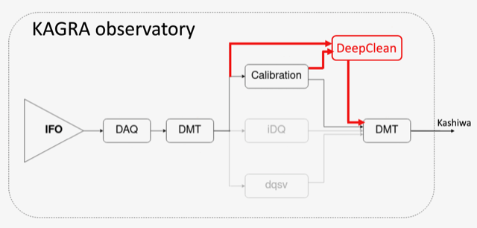
Low-Latency Denoising during O4
by Sawada-san

Slide 10
Spec Reference from LIGO
2 Intel Xeon Gold 6342
256GB RAM
2 NVIDIA A30 GPUs connected by NVLink
It’s better to set the Triton server, Deepclean models and Triton client on the same machine near the detector to reduce the latency.

Slide 11
Hardware Solution:
Case: Dell T550 Tower Server
CPU: Xeon Gold 6326 * 2 (16 cores 2.9GHz) including coolers
GPU: Dell Nvidia Ampere A30 * 2, PCIe, 165W, 24GB Passive, Double Wide, Full Height GPU with cable
Storage: HDD 3.5” 8TB * 8 (RAID5) + 960GB NVME SSD * 2
RAM: DDR4-2933 ECC REG 32GB * 8 (256GB)
RAID: H745
Power: 1400W Power Supplies (1+1)
1024506 NTD (4467368.66 Yen)

Slide 12
Before O4:
We are setting up and testing the prototype of online Deepclean pipeline in Taiwan (Academia Sinica, NCHC).
We will run the Mock Data Challenge to show the performance including latency, ASD ratio, improvement on SNR of BNS events, etc. of the online Deepclean. Parameter Estimation of the injected signals have to be done to show that Deepclean does not corrupt the GW signals.

