Slide 1
BH Formation and Multi-messenger Signals from 3D Rotating CCSN Simulations
Chia-Jui Chou
National Yang Ming Chiao Tung University, Taiwan
2022/02/18

Slide 2
3D Core-collapse Supernova
Ref: 2010.02453
Progenitor mass: 40 solar mass.
3 initial angular velosities: 0, 0.5, 1 rad/s.
No BH formation are found in rapidly-rotating model.
BH formation at 776 ms postbounce and 936 ms postbounce for non-rotating model and slowly-rotating model
Slowly-rotating model: extremely high GW frequency (f ~ 3000Hz) at BH formation.
The parameter space of CCSN explosion models and multi-messenger signal predictions are not fully explored.

Slide 3
3D Core-collapse Supernova
CCSNe with non-rotating intermediate-mass progenitors show weak GW emissions.
Massive progenitors with fast rotation, might provide stronger GW emissions, detectable at extra-galactic distances by the current LIGO-Virgo-KAGRA network.
The evolution of GW frequencies from core bounce to BH formation reflect the evolution and oscillation of the central proto-neutron star (PNS), which are crucial probes to understand the microphysics and supernova engine(s).

Slide 4
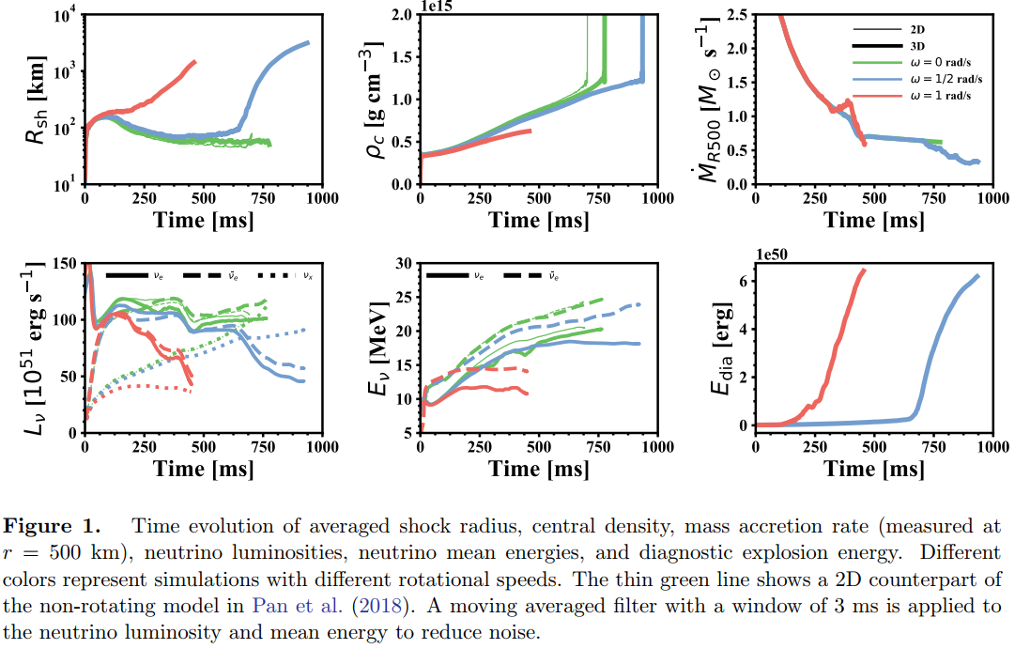
Time Evolution

Slide 5
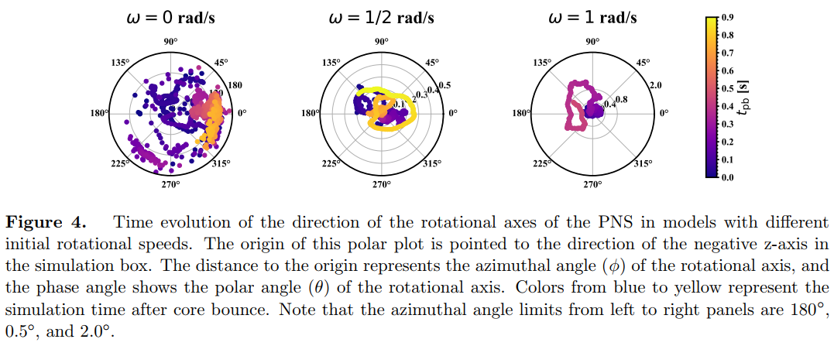
Time Evolution of the Angular Momentum of the PNS

Slide 6
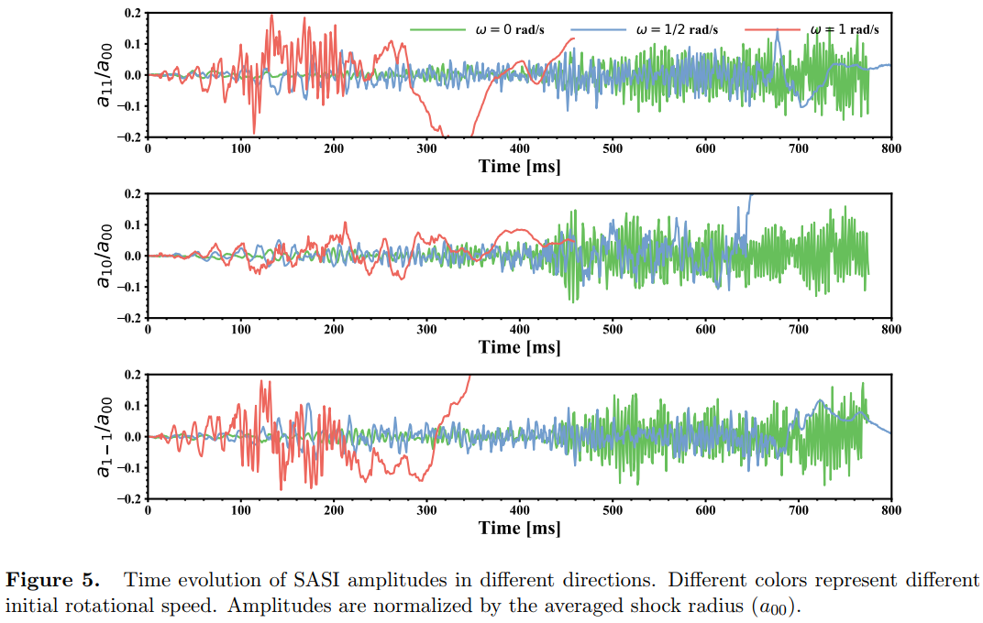
Time Evolution of Standing Accretion Shock Instability

Slide 7
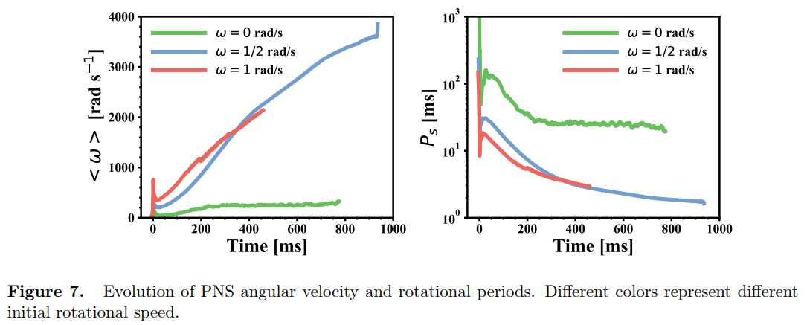
Time Evolution of PNS Angular Velocity and Rotational Periods

Slide 8
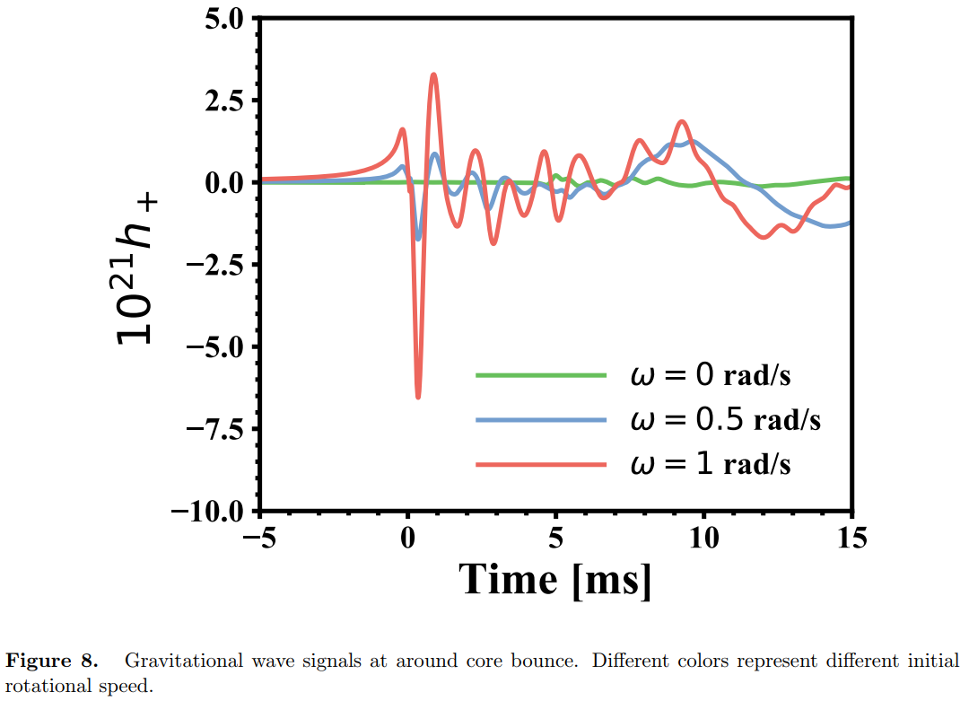
GW Emission

Slide 9
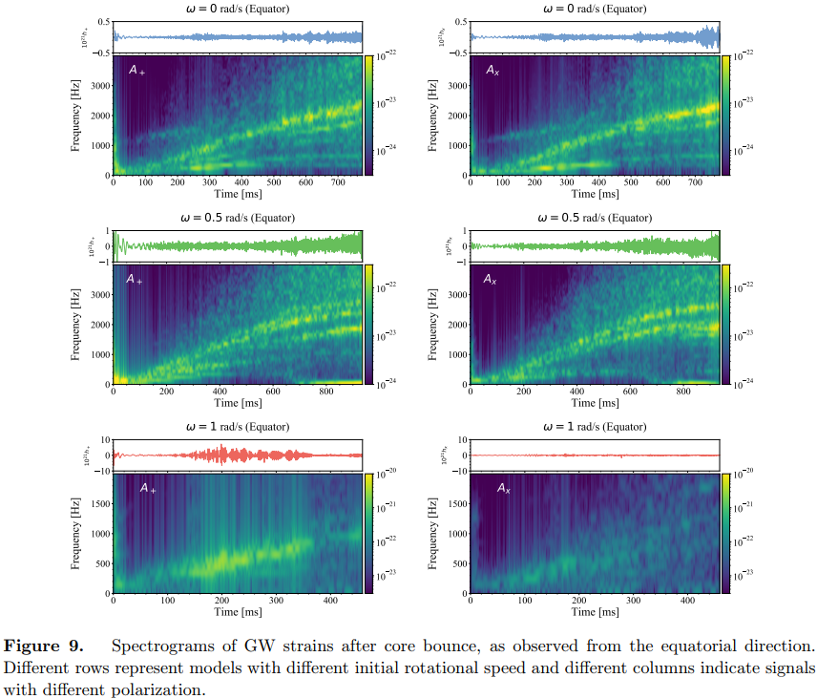
GW Emission

Slide 10
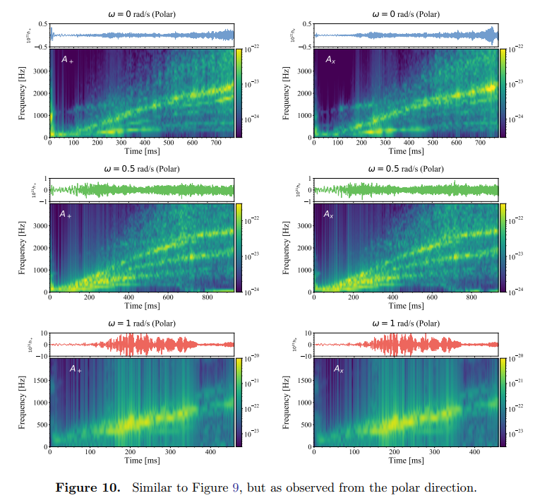
GW Emission

Slide 11
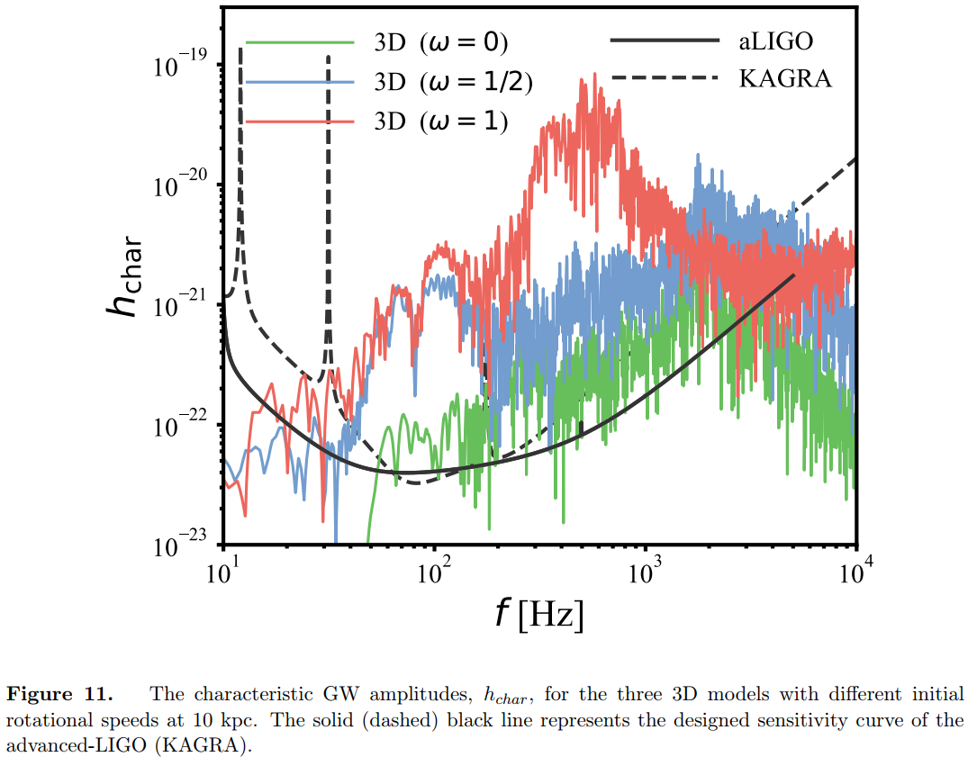
GW Emission

Slide 12
Detection using Machine Learning
Injection of the CCSN GW into the background of O3 data.
Detection: Gstlal, cWB.
Classification of of BH rotation, PNS angular velocity?

