Slide 1
offline Deepclean in MDC data
Li-Cheng Yang
National Yang Ming Chiao Tung University, Taiwan
2022/05/05

Slide 2
MDC
covers a 40-day period: [1262304000, 1265760000) = [Sun Jan 05 23:59:42 GMT 2020, Fri Feb 14 23:59:42 GMT 2020).
choose gps time 1265280000 and 2000 second long to test

Slide 3
Step
60hz line
1.
ASC dither lines
2.
3.
ASC arm noise

Slide 4
Training and Cleaning setup(60hz)
# GPS time to train on
train_t0 = 1265280000
train_duration = 2000
# GPS time to clean
clean_t0 = 1265280000
clean_duration = 2000
# sampling rate
fs = 4096
# timeseries properties
train_kernel = 8
train_stride = 0.25
clean_kernel = 8
clean_stride = 4
window = hanning
pad_mode = median
# bandpass filter
filt_fl = 55
filt_fh = 65
filt_order = 8

Slide 5
Channel List (60hz)
H1:GDS-CALIB_STRAIN
H1:PEM-CS_MAINSMON_EBAY_1_DQ
H1:ASC-INP1_P_INMON
H1:ASC-INP1_Y_INMON
H1:ASC-MICH_P_INMON
H1:ASC-MICH_Y_INMON
H1:ASC-PRC1_P_INMON
H1:ASC-PRC1_Y_INMON
H1:ASC-PRC2_P_INMON
H1:ASC-PRC2_Y_INMON
H1:ASC-SRC1_P_INMON
H1:ASC-SRC1_Y_INMON
H1:ASC-SRC2_P_INMON
H1:ASC-SRC2_Y_INMON
H1:ASC-DHARD_P_INMON
H1:ASC-DHARD_Y_INMON
H1:ASC-CHARD_P_INMON
H1:ASC-CHARD_Y_INMON
H1:ASC-DSOFT_P_INMON
H1:ASC-DSOFT_Y_INMON
H1:ASC-CSOFT_P_INMON
H1:ASC-CSOFT_Y_INMON

Slide 6
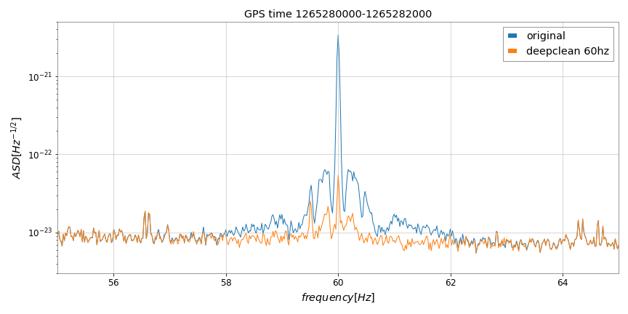
result (60 hz)

Slide 7
Training and Cleaning setup (ASC dither)
# GPS time to train on
train_t0 = 1265280000
train_duration = 2000
# GPS time to clean
clean_t0 = 1265280000
clean_duration = 2000
# sampling rate
fs = 4096
# timeseries properties
train_kernel = 8
train_stride = 0.25
clean_kernel = 8
clean_stride = 4
window = hanning
pad_mode = median
# bandpass filter
filt_fl = 10
filt_fh = 30
filt_order = 8

Slide 8
Channel List (ASC dither)
H1:ASC-SRC1_P_INMON
H1:ASC-SRC1_Y_INMON
H1:ASC-SRC2_P_INMON
H1:ASC-SRC2_Y_INMON
H1:ASC-DHARD_P_INMON
H1:ASC-DHARD_Y_INMON
H1:ASC-CHARD_P_INMON
H1:ASC-CHARD_Y_INMON
H1:ASC-DSOFT_P_INMON
H1:ASC-DSOFT_Y_INMON
H1:ASC-CSOFT_P_INMON
H1:ASC-CSOFT_Y_INMON
H1:ASC-ADS_PIT10_DEMOD_I_OUT16
H1:ASC-ADS_YAW10_DEMOD_I_OUT16
H1:ASC-ADS_PIT10_DEMOD_Q_OUT16
H1:ASC-ADS_YAW10_DEMOD_Q_OUT16
H1:ASC-ADS_PIT2_DEMOD_I_OUT16
H1:ASC-ADS_YAW2_DEMOD_I_OUT16
H1:ASC-ADS_PIT2_DEMOD_Q_OUT16
H1:ASC-ADS_YAW2_DEMOD_Q_OUT16
H1:ASC-ADS_PIT3_DEMOD_I_OUT16
H1:ASC-ADS_YAW3_DEMOD_I_OUT16
H1:ASC-ADS_PIT3_DEMOD_Q_OUT16
H1:ASC-ADS_YAW3_DEMOD_Q_OUT16
H1:ASC-ADS_PIT4_DEMOD_I_OUT16
H1:ASC-ADS_YAW4_DEMOD_I_OUT16
H1:ASC-ADS_PIT4_DEMOD_Q_OUT16
H1:ASC-ADS_YAW4_DEMOD_Q_OUT16
H1:ASC-ADS_PIT5_DEMOD_I_OUT16
H1:ASC-ADS_YAW5_DEMOD_I_OUT16
H1:ASC-ADS_PIT5_DEMOD_Q_OUT16
H1:ASC-ADS_YAW5_DEMOD_Q_OUT16
H1:GDS-CALIB_STRAIN_DC60
H1:FAKE_SINE_FREQ_18POINT37
H1:FAKE_SINE_FREQ_19POINT653
H1:FAKE_SINE_FREQ_20POINT131
H1:FAKE_SINE_FREQ_20POINT789
H1:FAKE_SINE_FREQ_21POINT9
H1:FAKE_SINE_FREQ_22POINT147
H1:ASC-INP1_P_INMON
H1:ASC-INP1_Y_INMON
H1:ASC-MICH_P_INMON
H1:ASC-MICH_Y_INMON
H1:ASC-PRC1_P_INMON
H1:ASC-PRC1_Y_INMON
H1:ASC-PRC2_P_INMON
H1:ASC-PRC2_Y_INMON

Slide 9
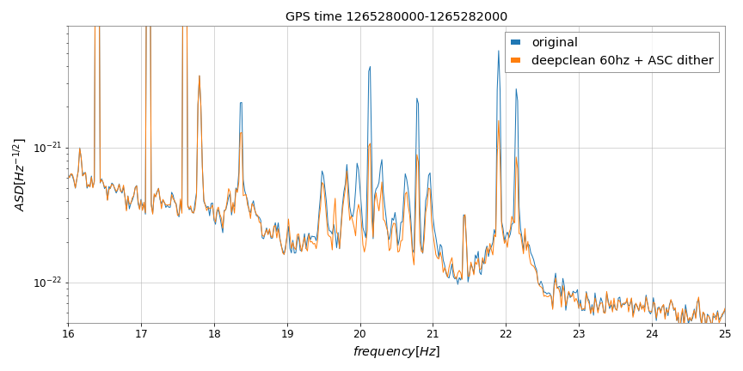
result (60hz + ASC dither)

Slide 10
Training and Cleaning setup (ASC arm)
# GPS time to train on
train_t0 = 1265280000
train_duration = 2000
# GPS time to clean
clean_t0 = 1265280000
clean_duration = 2000
# sampling rate
fs = 4096
# timeseries properties
train_kernel = 8
train_stride = 0.25
clean_kernel = 8
clean_stride = 4
window = hanning
pad_mode = median
# bandpass filter
filt_fl = 8
filt_fh = 22
filt_order = 8

Slide 11
Channel List (ASC arm)
H1:DCS-CALIB_STRAIN_DC60hz_DClf
H1:ASC-DHARD_P_OUT_DQ
H1:ASC-DHARD_Y_OUT_DQ
H1:ASC-CHARD_P_OUT_DQ
H1:ASC-CHARD_Y_OUT_DQ
H1:ASC-DSOFT_P_OUT_DQ
H1:ASC-CSOFT_P_OUT_DQ
H1:ASC-MICH_P_OUT_DQ
H1:ASC-MICH_Y_OUT_DQ
H1:ASC-PRC2_P_OUT_DQ
H1:ASC-PRC2_Y_OUT_DQ
H1:ASC-SRC1_P_OUT_DQ
H1:ASC-SRC1_Y_OUT_DQ
H1:ASC-SRC2_P_OUT_DQ
H1:ASC-SRC2_Y_OUT_DQ
H1:LSC-MICH_OUT_DQ
H1:LSC-PRCL_OUT_DQ
H1:LSC-SRCL_OUT_DQ

Slide 12
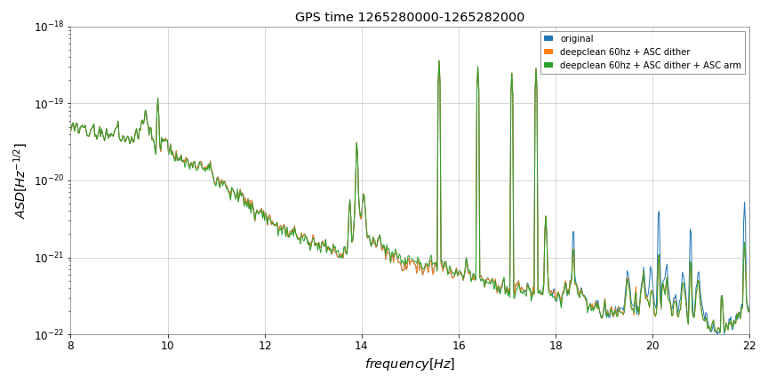
result (60hz + ASC dither + ASC arm)

Slide 13
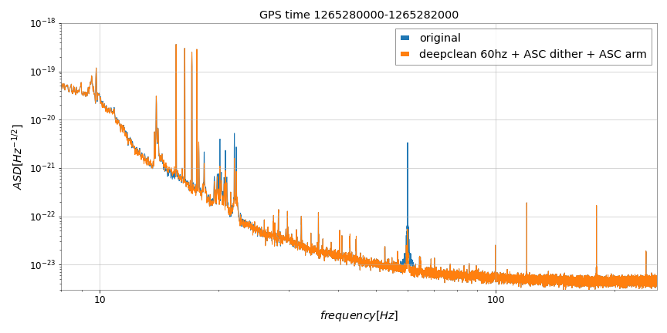
result (60hz + ASC dither + ASC arm)

