Slide 1
GW-IaaS Online Tests (Mock Data Challenge)
Chia-Jui Chou
2022/02/24

Slide 2
Suggested Hardware
2x Intel Xeon Gold 6342
256GB RAM
2x NVIDIA A30 GPUs connected by NVLink

Slide 3
Computing Resources: Triton Server
ASGC:
  Testing, maybe ready before 3/11
  2GPUs: 1080Ti or 3090
NCHC:
  Ready
  1GPU: A100

Slide 4
GW-IaaS: Client
https://github.com/ML4GW/DeepClean

Slide 5
LIGO O3 Data
O3a: 2019/04/01 15:00:00 (1238166018) ~ 2019/10/01 15:00:00 (1253977218)
O3b: 2019/11/01 15:00:00 (1256655618) ~ 2020/03/27 17:00:00 (1269363618)
Powerline and the side bands (60*nHz, n = 1, 2, 3, …)
Low-frequency noise (8Hz ~ 22Hz)

Slide 6
Virgo O3 Data
Have sent mail to Irene Fiori asking about useful PEM channels to subtract powerline noise in Virgo.

Slide 7
KAGRA O3GK Data
O3GK: 2020/04/07 06:00:00 (1270274418) ~ 2020/04/20 00:00:00 (1271376018)
Testing Deepclean by Software Noise Injection Test with the reference of the Hardware Noise Injection Test on 2020/06/11.
2020/06/11 06:21:02 (1275891680) ~ 2020/06/11 06:29:02 (1275892160)
Noise Injection
Noise Injection
Training
Cleaning

Slide 8
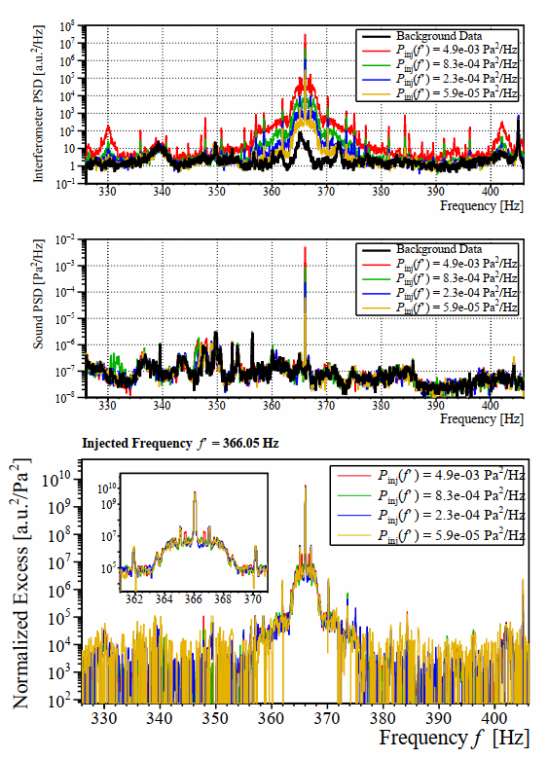
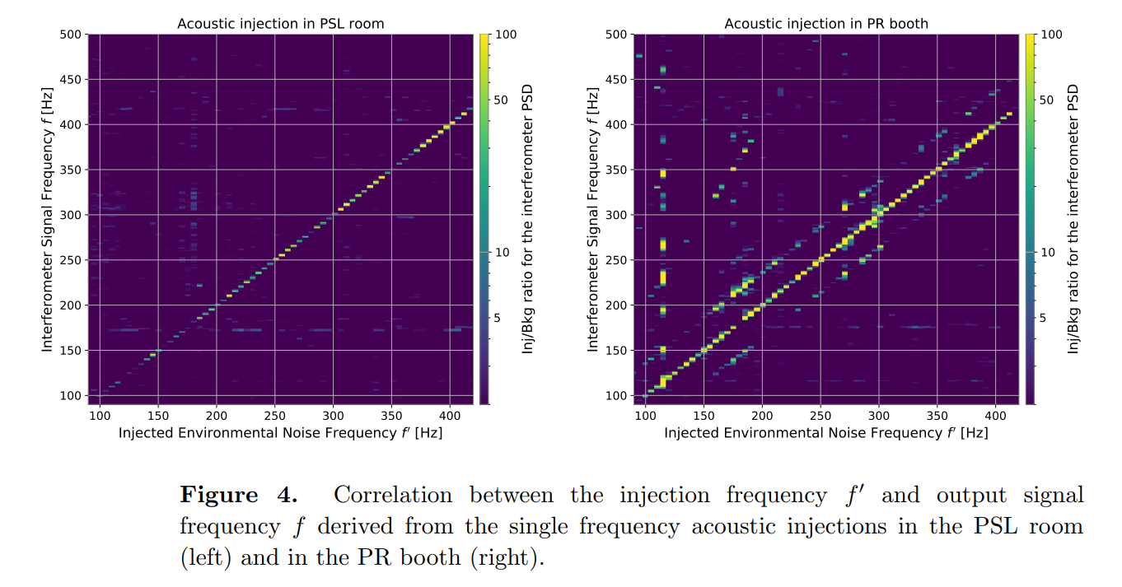
Noise Esimation via Injection Tests

Slide 9
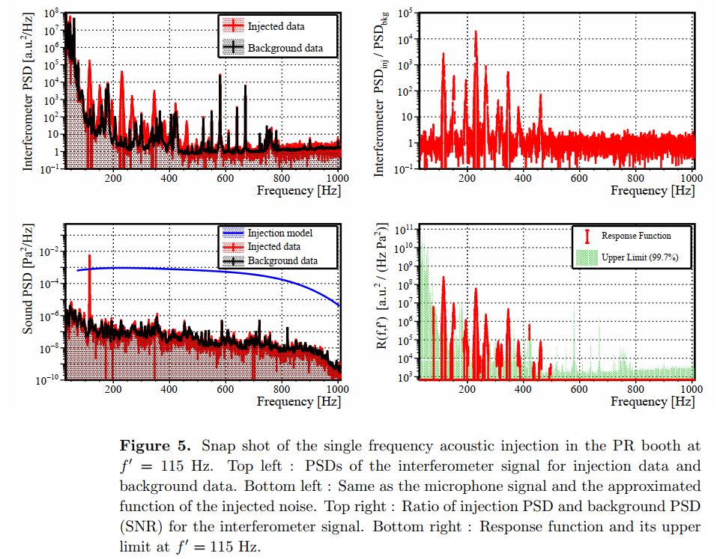
Noise Esimation via Injection Tests

Slide 10
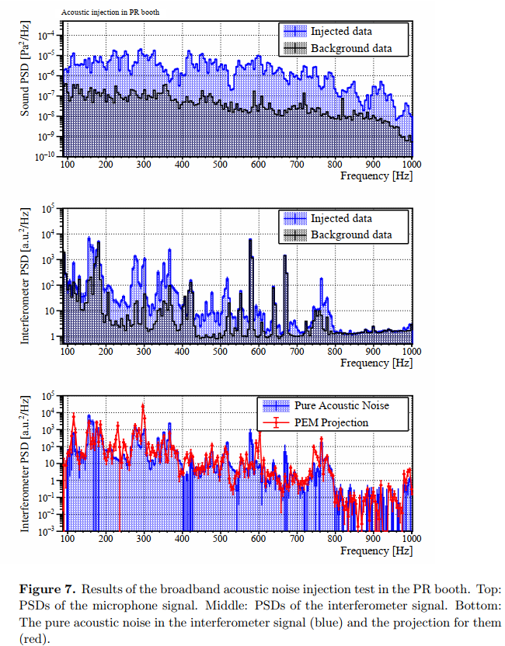
Noise Esimation via Injection Tests

Slide 11
Performance Evaluation: GstLAL
Have sent mail to Ryan Magee for his suggestions on the mock data and testing the cleaned data by GstLAL.

