Slide 1
Applying Deepclean in KAGRA
Chai-Jui Chou
National Yang Ming Chiao Tung University, Taiwan
2022/01/27

Slide 2
Contacted KAGRA Members:
PEM team:
  Yosuke Itoh (Noise Estimation via Injection, ICA)
  Takatsuki Washimi (Noise Estimation via Injection, ICA)
  Takaaki Yokozawa (Noise Estimation via Injection, ICA)
  Junya Kume (Noise Estimation via Injection, ICA)
  Hirotaka Yuzurihara (Noise Hunting)
  Hirotaka Takahashi
DET team:
  Takahiro Yamamoto (Data Quality)
  Shouichi Oshino
CAL team:
  Takahiro Sawada

Slide 3
Deepclean and Independent Component Analysis (ICA)
ICA is used to do the denoising of C01 strain.
Deepclean is designed to do the fast denoising of low-latency C00 strain.
DARM Loop
(Front-End)
C00 (Low-Latency)
C01 (Offline)
cleaned h(t)
Partial Calibration
Residual Calibration
Full Calibration
ICA
Deepclean
cleand h(t) in low-latency

Slide 4
Deepclean and Independent Component Analysis (ICA)
ICA is used to do the denoising of C01 strain.
Deepclean is designed to do the fast denoising of low-latency C00 strain.
However, during O3GK, only C01 strain can be used for any analysis. The C00 strain is corrupted.
DARM Loop
(Front-End)
C00 (Low-Latency)
C01 (Offline)
cleaned h(t)
Partial Calibration
Residual Calibration
Full Calibration
ICA
Deepclean

Slide 5
Applying Deepclean in KAGRA
We need to show that Deepclean can do the “correct” denoising and pass the Noise Injection Tests.
Noise Injection Tests:
  Software Injection ?
  Hardware Injection
Comparison to Independent Component Analysis (ICA)
PEM team and CAL team in KAGRA can provide help.
After the approval of PEM team and CAL team, we can move on to build up the GW-IaaS pipeline.
What tests are done in LIGO to verify the denoising results of Deepclean?

Slide 6
Noise Esimation via Injection Tests
Low frequency(< 100 Hz): control noise of the suspensions,
Floor level of the high frequency (approximately > 400Hz): shot noise,
peaks: violin-modes of the suspension thermal noise, artificila lines used to control the interferometer.
2012.09294

Slide 7
Noise Esimation via Injection Tests
The power spectral density (PSD):
The coupling function model:

Slide 8

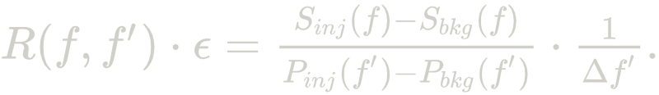
Noise Esimation via Injection Tests
The response function model:
The coupling function model is included as:
For a single frequency f’ PEM Injection:

Slide 9
Noise Esimation via Injection Tests
The experiment is performed on 2020/06/11.
The acoustic noise at the input optics (Pre-Stablized Laser room and Power Recycling booth) is focused.
Confirmation of the frequency conversion and PSD linearity (so we can set ε to 1) are performed by single-frequency PEM injection varying the injection power.
Acoustic injection: 200 frequencies from approximately 70.0 Hz to 1070.0 Hz, 10 s for each frequency.

Slide 10
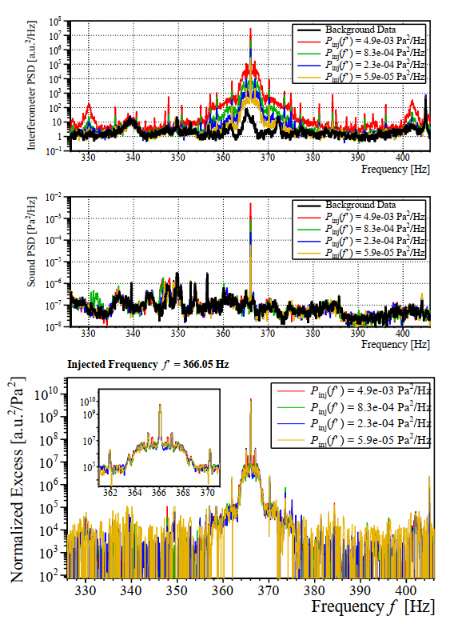
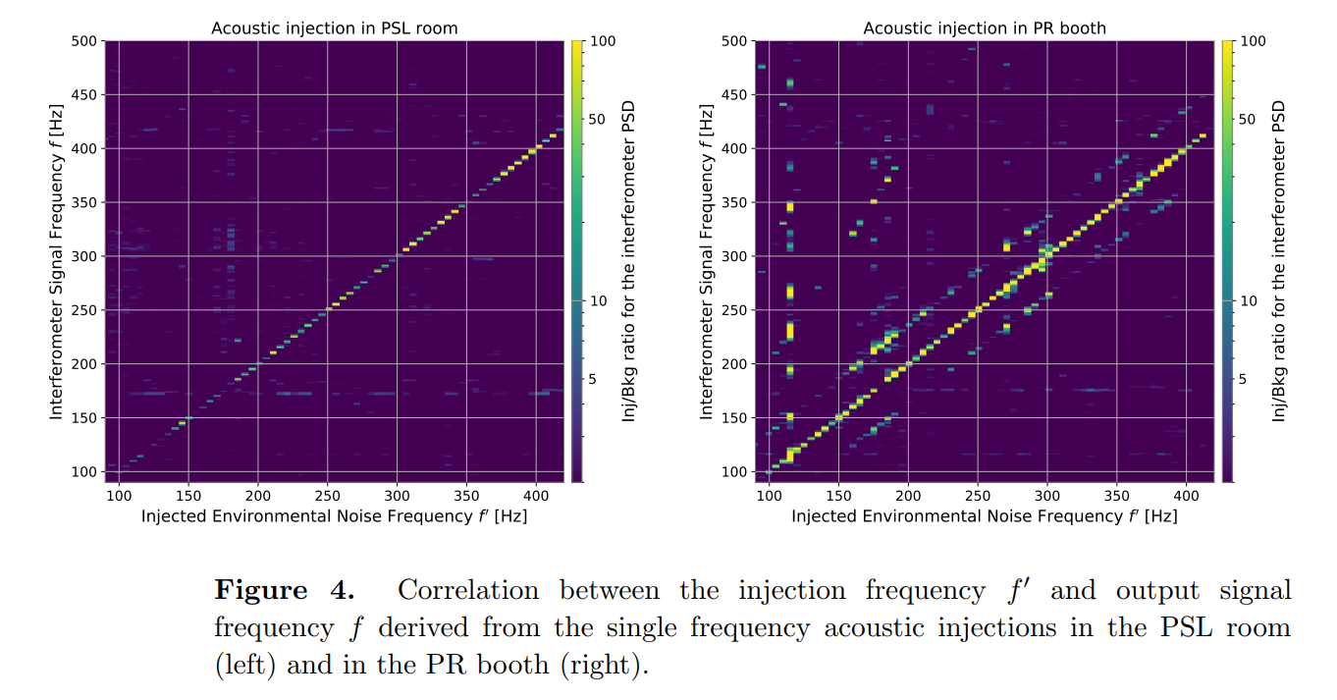
Noise Esimation via Injection Tests

Slide 11
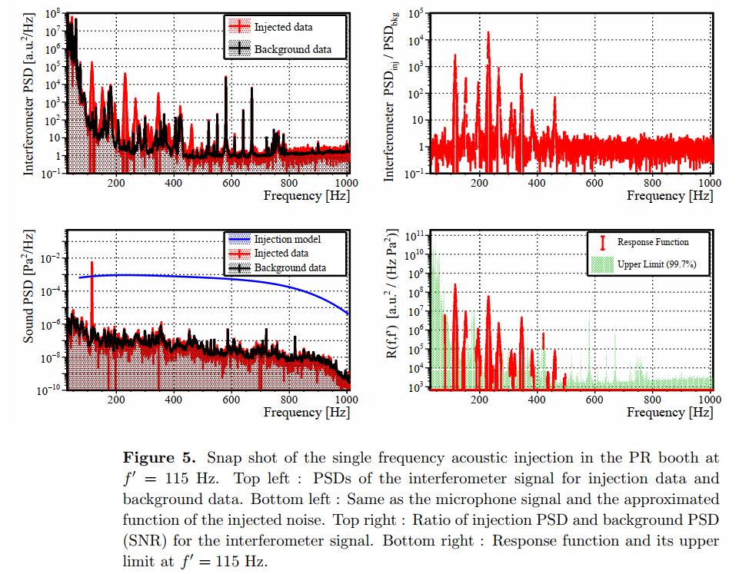
Noise Esimation via Injection Tests

Slide 12
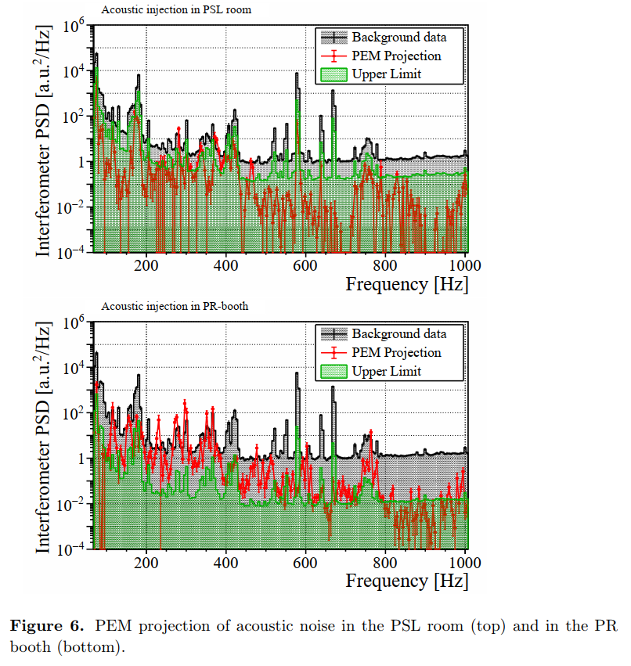
Noise Esimation via Injection Tests

Slide 13
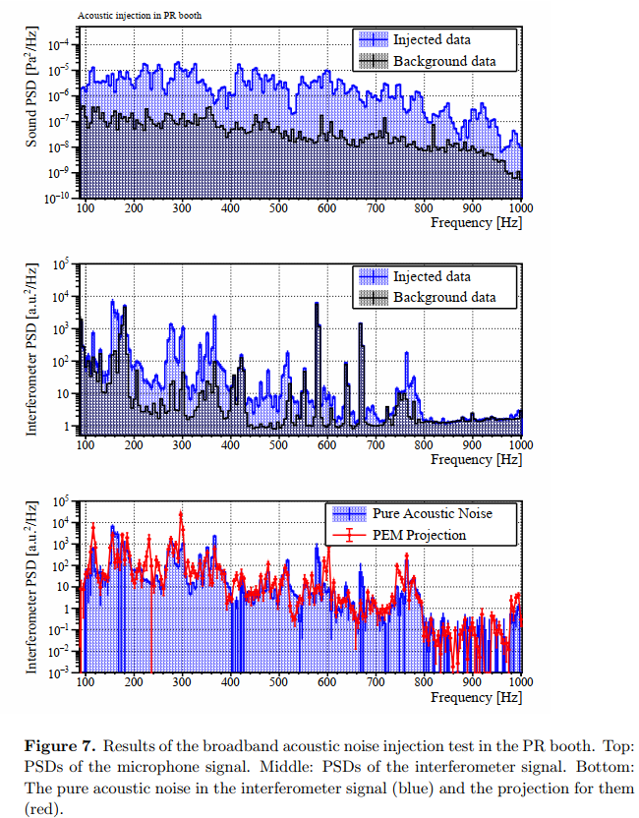
Noise Esimation via Injection Tests

Slide 14
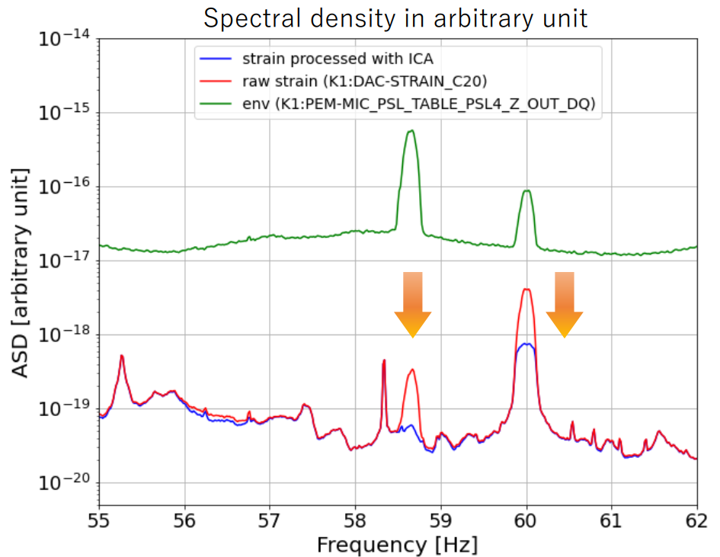
Comparison to Independent Component Analysis (ICA)
From Jun’ya Kume’s talk in 7th KAGRA International Workshop, 2020/12/19

Slide 15
State Vector of C01 Strain in O3GK
bit | Identifier | Description
0 | HOFT_OK | h(t) was successfully computed
1 | OBS_INTENT | The “observation intent” is set by the operator
2 | OBS_READY | Interferometer is in “observation ready” mode
3 | (not in use) | (not in use)
4 | NO_GAP | The input data was present (not a gap)
5 | NO_STOCH_HW_INJ | No stochastic hardware injections
6 | NO_CBC_HW_INJ | No compact binary coalescence hardware injections
7 | NO_BURST_HW_INJ | No burst hardware injections
8 | NO_DETCHAR_HW_INJ | No detector characterization hardware injections

Slide 16
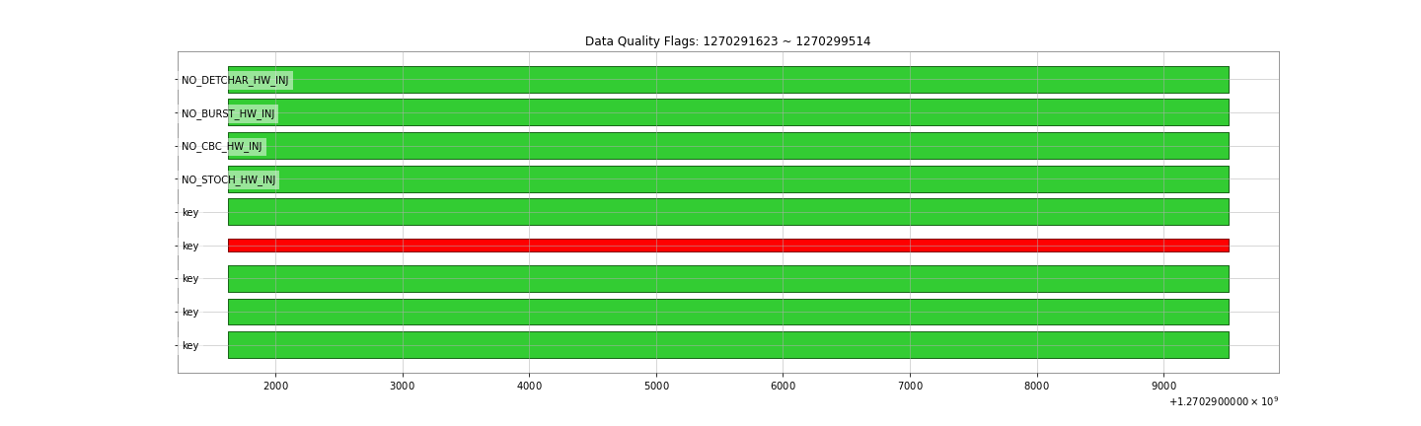
Data Quality: 1270291623 ~ 1270299514

Slide 17
Denoising between 55 ~ 65Hz (2-Channel)
Strain data used:
  K1:DAC-STRAIN_C20
PEM channel used:
  K1:PEM-SENSOR_RACK_OMC1_DSUB2_OUT_DQ
  K1:PEM-MIC_PSL_TABLE_PSL4_Z_OUT_DQ
Frequency Filter: 55Hz ~ 65Hz
Training Time: 1270291623 ~ 127029371 (2048 second)
Cleaning Time: 1270291623 ~ 127029371 (2048 second)

Slide 18
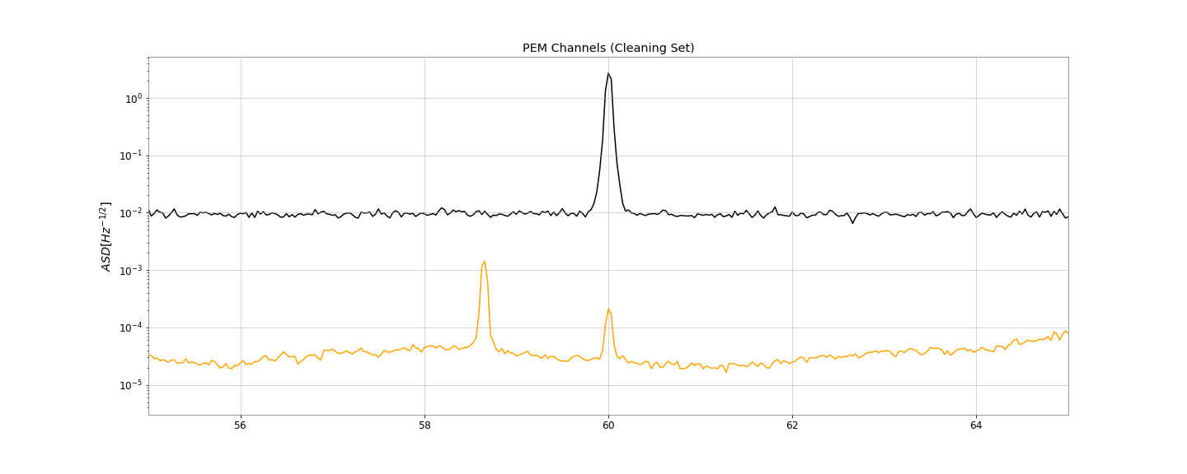
Denoising between 55 ~ 65Hz (2-Channel)

Slide 19
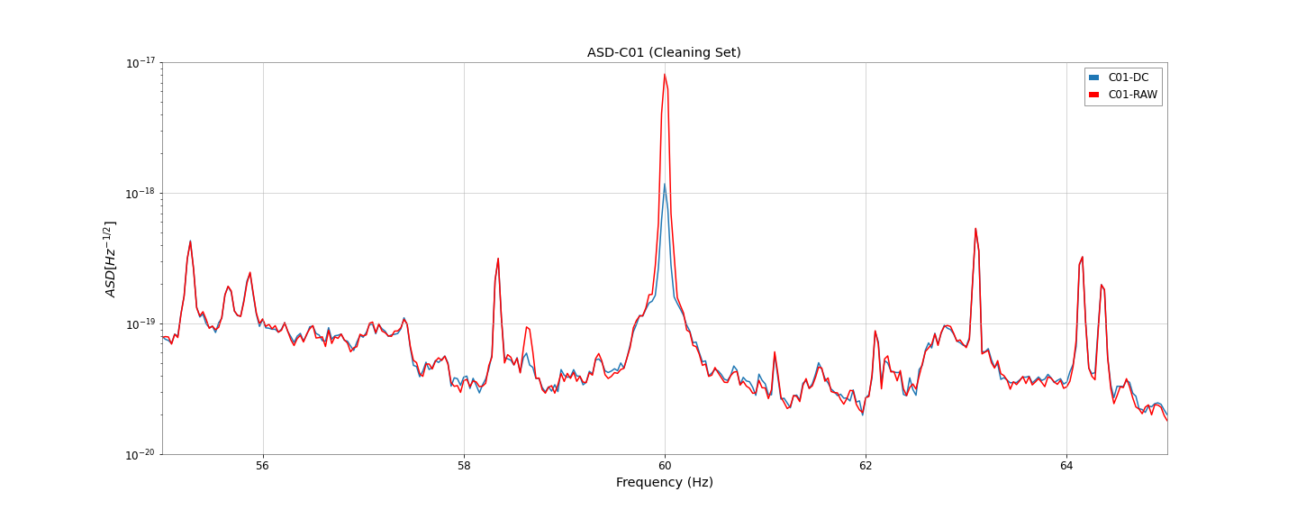
Denoising between 55 ~ 65Hz (2-Channel)

Slide 20
Denoising between 55 ~ 65Hz (Sensor)
Strain data used:
  K1:DAC-STRAIN_C20
PEM channel used:
  K1:PEM-SENSOR_RACK_OMC1_DSUB2_OUT_DQ
Frequency Filter: 55Hz ~ 65Hz
Training Time: 1270291623 ~ 127029371 (2048 second)
Cleaning Time: 1270291623 ~ 127029371 (2048 second)

Slide 21
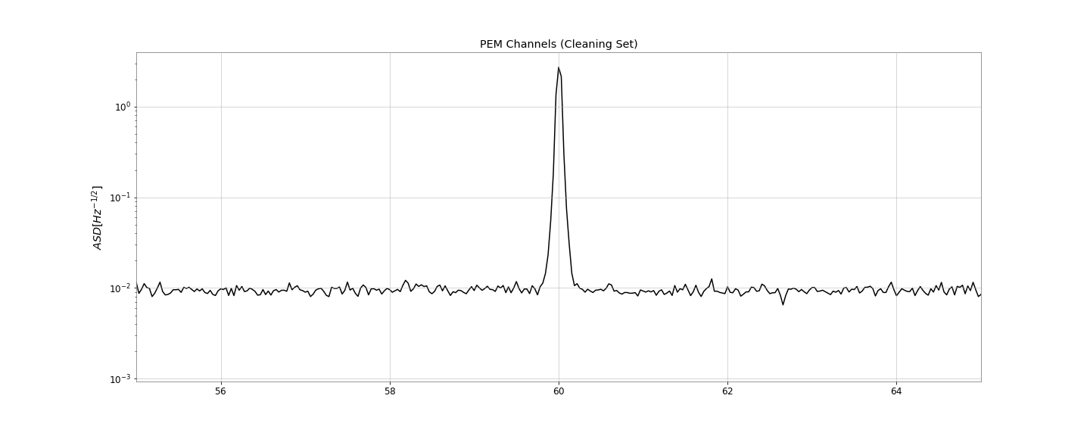
Denoising between 55 ~ 65Hz (Sensor)

Slide 22
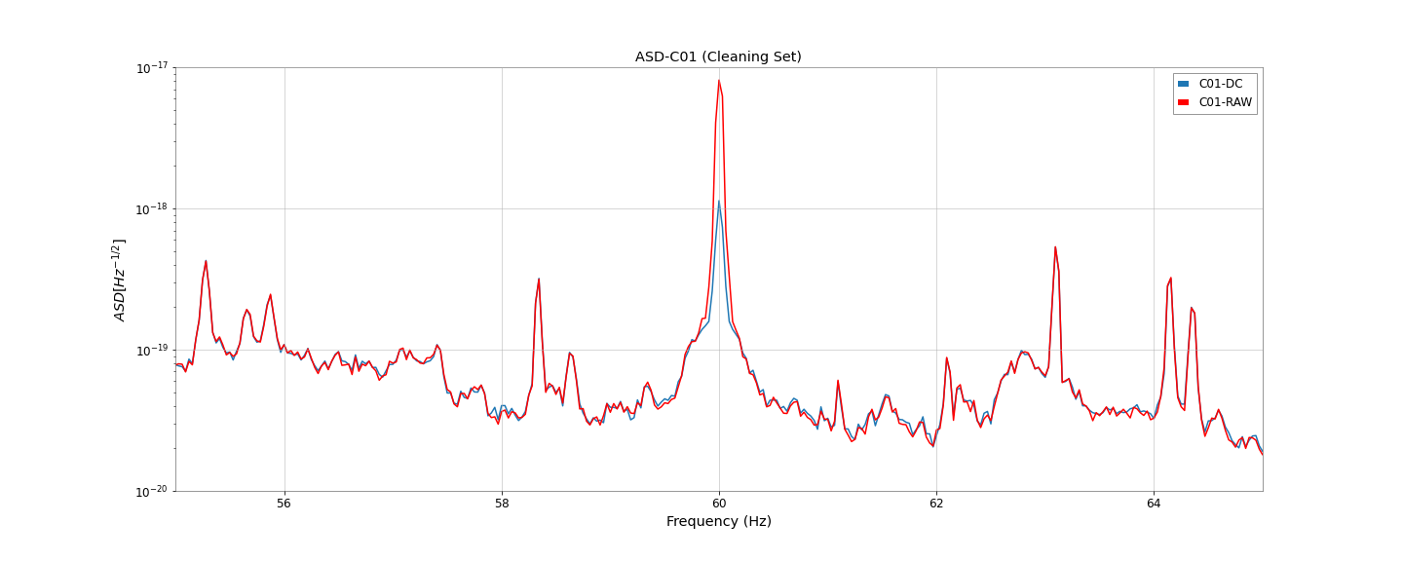
Denoising between 55 ~ 65Hz (Sensor)

Slide 23
Denoising between 55 ~ 65Hz (MIC)
Strain data used:
  K1:DAC-STRAIN_C20
PEM channel used:
  K1:PEM-MIC_PSL_TABLE_PSL4_Z_OUT_DQ
Frequency Filter: 55Hz ~ 65Hz
Training Time: 1270291623 ~ 127029371 (2048 second)
Cleaning Time: 1270291623 ~ 127029371 (2048 second)

Slide 24
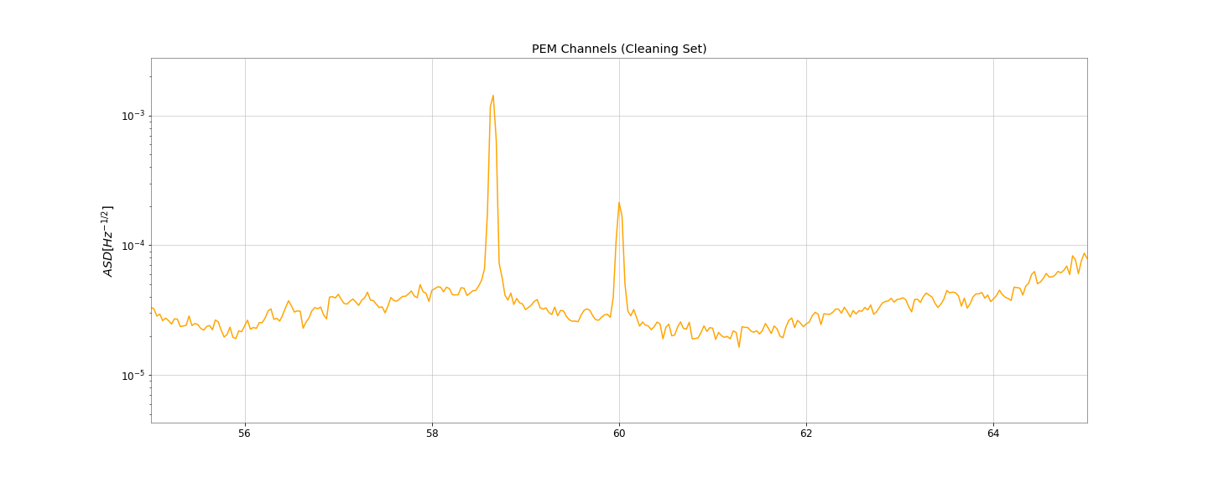
Denoising between 55 ~ 65Hz (MIC)

Slide 25
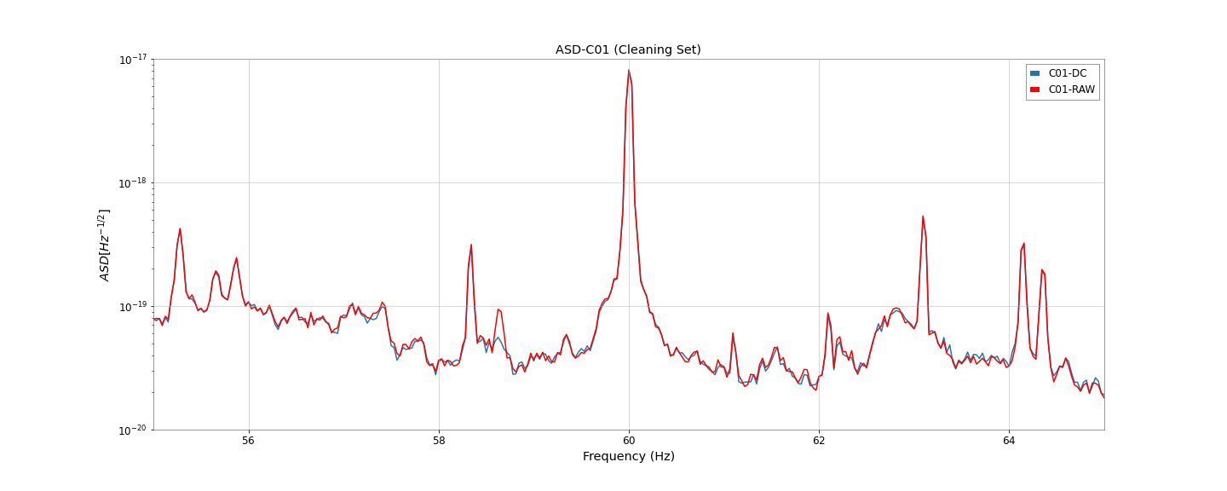
Denoising between 55 ~ 65Hz (MIC)

Slide 26
Denoising between 59 ~ 61Hz (MIC)
Strain data used:
  K1:DAC-STRAIN_C20
PEM channel used:
  K1:PEM-MIC_PSL_TABLE_PSL4_Z_OUT_DQ
Frequency Filter: 59Hz ~ 61Hz
Training Time: 1270291623 ~ 127029371 (2048 second)
Cleaning Time: 1270291623 ~ 127029371 (2048 second)

Slide 27
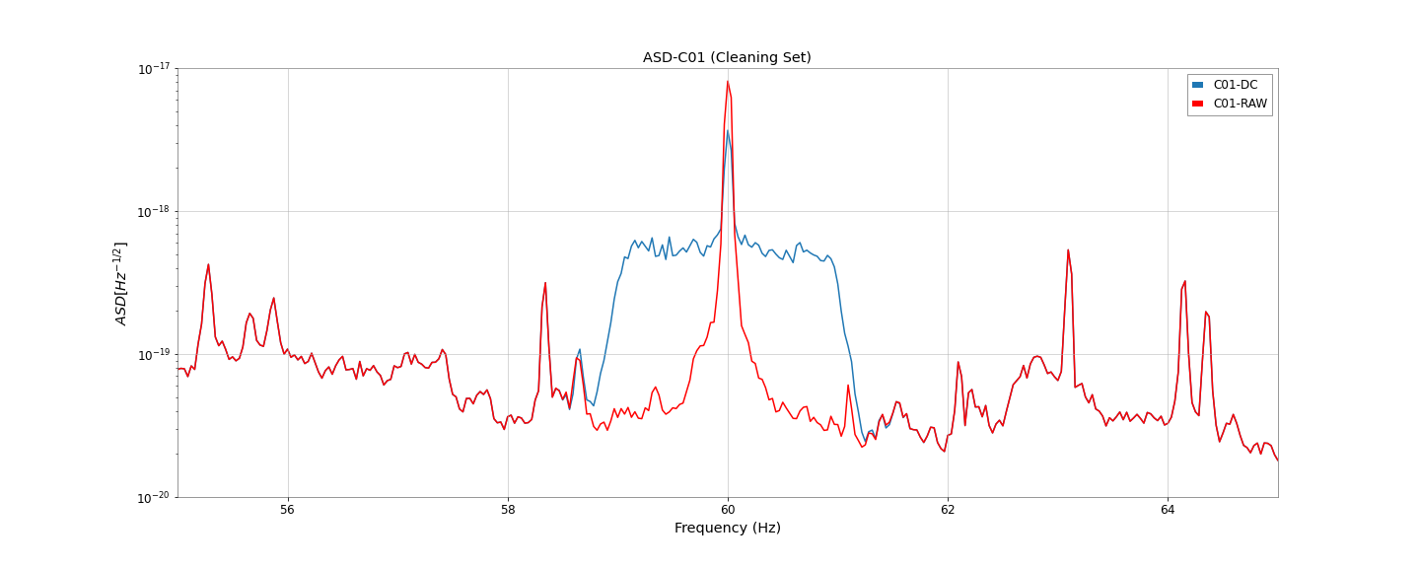
Denoising between 59 ~ 61Hz (MIC)

Slide 28
Denoising between 58 ~ 59Hz (MIC)
Strain data used:
  K1:DAC-STRAIN_C20
PEM channel used:
  K1:PEM-MIC_PSL_TABLE_PSL4_Z_OUT_DQ
Frequency Filter: 58Hz ~ 59Hz
Training Time: 1270291623 ~ 127029371 (2048 second)
Cleaning Time: 1270291623 ~ 127029371 (2048 second)

Slide 29
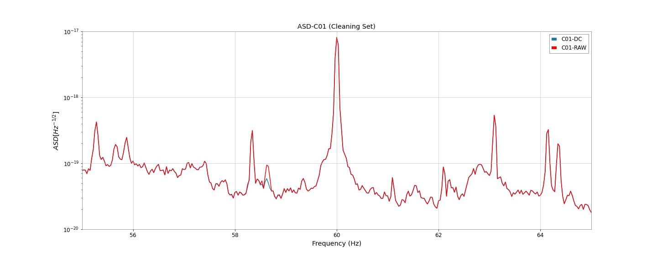
Denoising between 58 ~ 59Hz (MIC)

Slide 30
Denoising between 59 ~ 61Hz (Sensor)
Strain data used:
  K1:DAC-STRAIN_C20
PEM channel used:
  K1:PEM-SENSOR_RACK_OMC1_DSUB2_OUT_DQ
Frequency Filter: 59Hz ~ 61Hz
Training Time: 1270291623 ~ 127029371 (2048 second)
Cleaning Time: 1270291623 ~ 127029371 (2048 second)

Slide 31
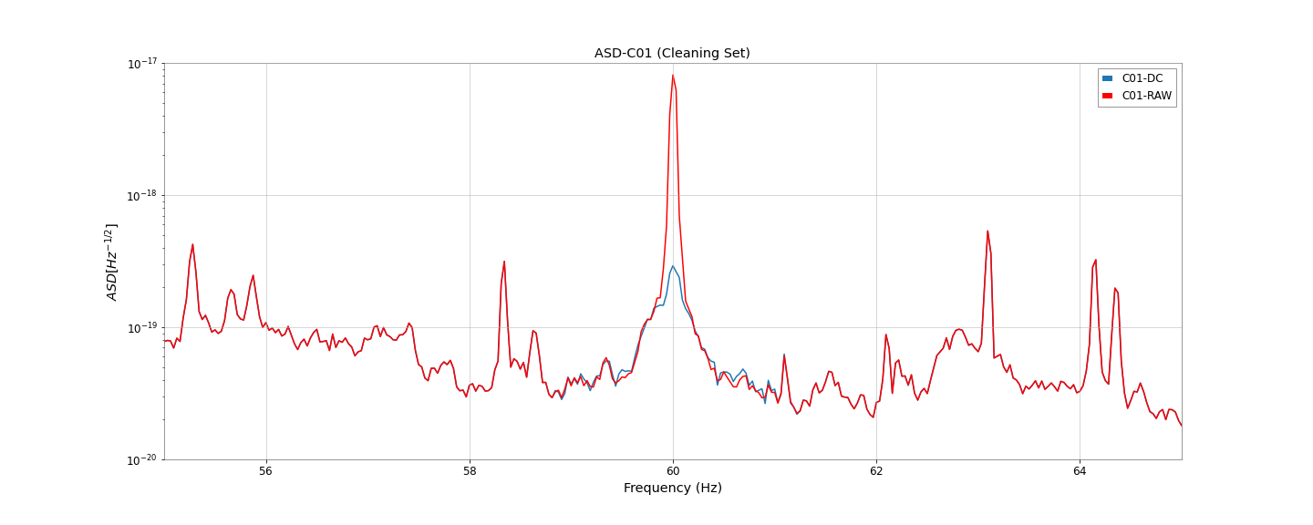
Denoising between 59 ~ 61Hz (Sensor)

Slide 32
Denoising between 58 ~ 59Hz (Sensor)
Strain data used:
  K1:DAC-STRAIN_C20
PEM channel used:
  K1:PEM-SENSOR_RACK_OMC1_DSUB2_OUT_DQ
Frequency Filter: 58Hz ~ 59Hz
Training Time: 1270291623 ~ 127029371 (2048 second)
Cleaning Time: 1270291623 ~ 127029371 (2048 second)

Slide 33
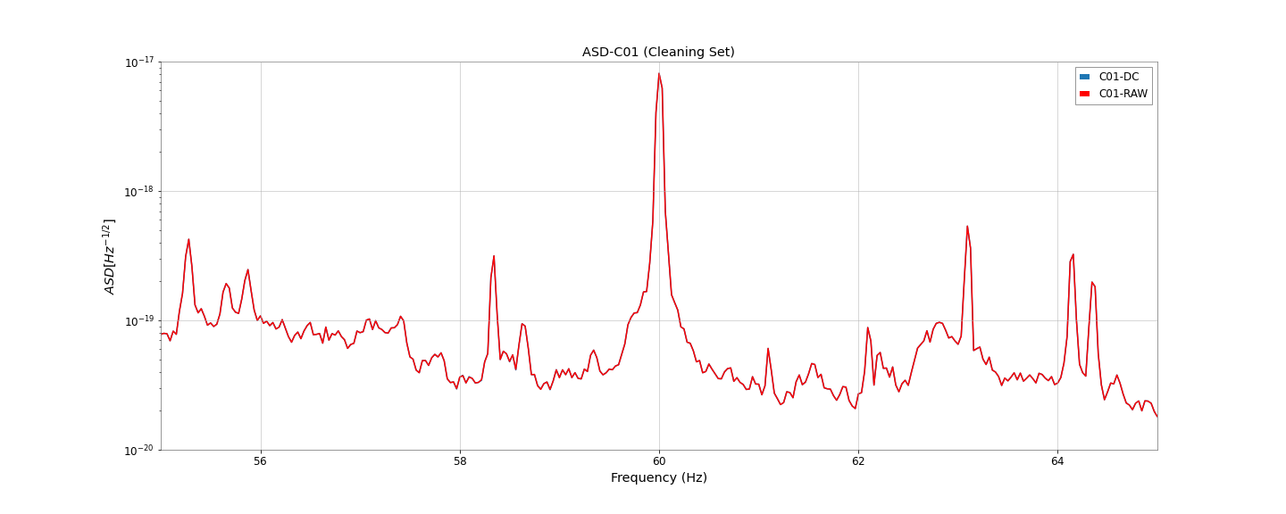
Denoising between 58 ~ 59Hz (Sensor)

Slide 34
Summary
Only C01 strain during O3GK can be used to show the capability of Deepclean doing the correct denoising.
Using the verified witness channels from the PEM team in KAGRA.
The denoising results from Deepclean has to be compared to the Independent Component Analysis (ICA).
Establish the evaluation of performance and the improvement of current Deepclean.
Deepclean as a witness channel finder?

Slide 35
Appendix

Slide 36
Segments of C01 Strain in O3GK
Observation summary and the available segements for science research can be found in this Sheet.

Slide 37
State Vector of C01 Strain in O3GK
bit | Identifier | Description
0 | HOFT_OK | h(t) was successfully computed
1 | OBS_INTENT | The “observation intent” is set by the operator
2 | OBS_READY | Interferometer is in “observation ready” mode
3 | (not in use) | (not in use)
4 | NO_GAP | The input data was present (not a gap)
5 | NO_STOCH_HW_INJ | No stochastic hardware injections
6 | NO_CBC_HW_INJ | No compact binary coalescence hardware injections
7 | NO_BURST_HW_INJ | No burst hardware injections
8 | NO_DETCHAR_HW_INJ | No detector characterization hardware injections

Slide 38
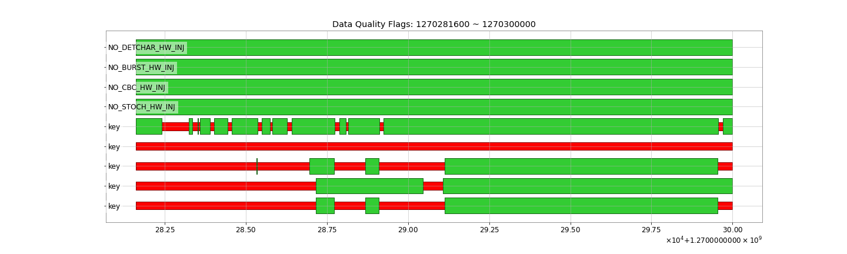
Data Quality of C01 Strain in O3GK

Slide 39
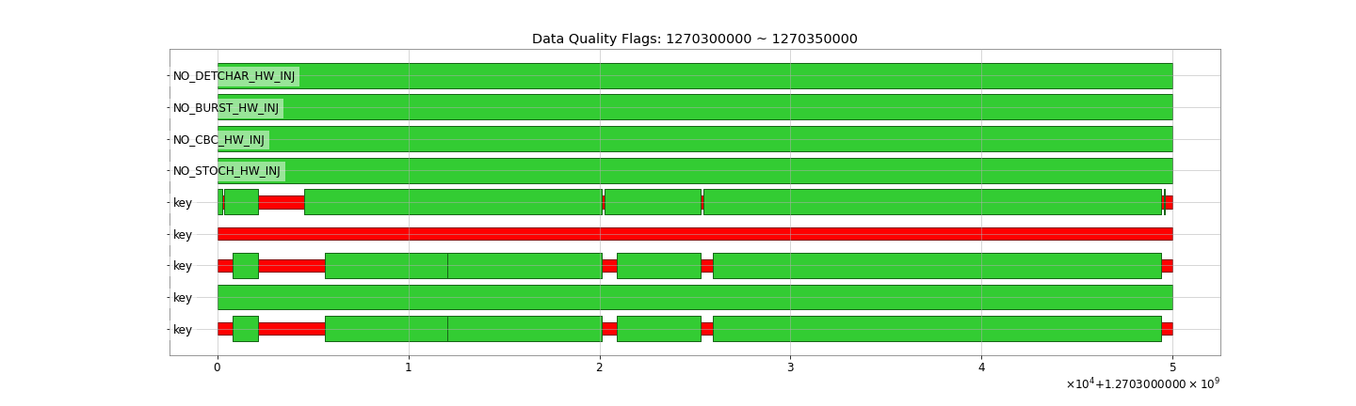
Data Quality of C01 Strain in O3GK

Slide 40
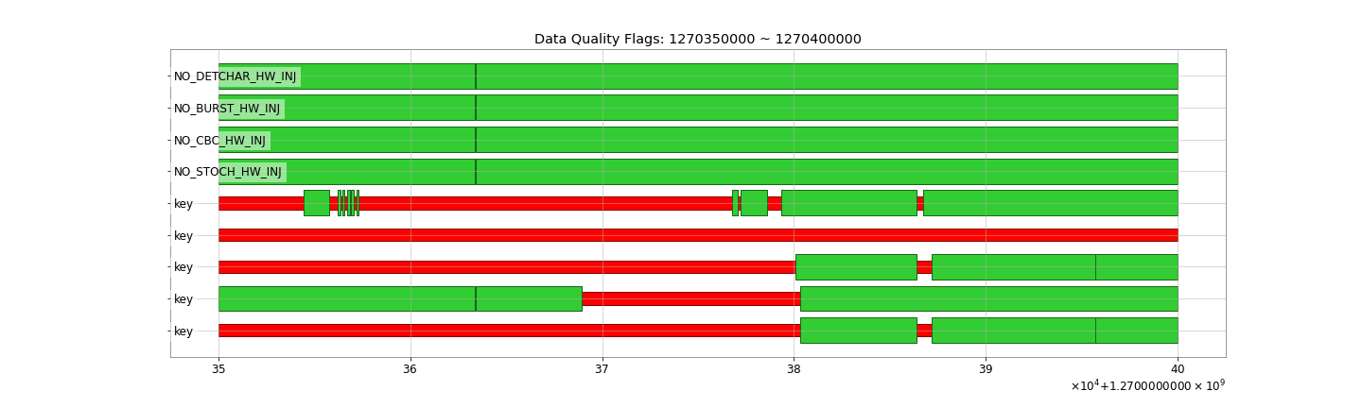
Data Quality of C01 Strain in O3GK

Slide 41
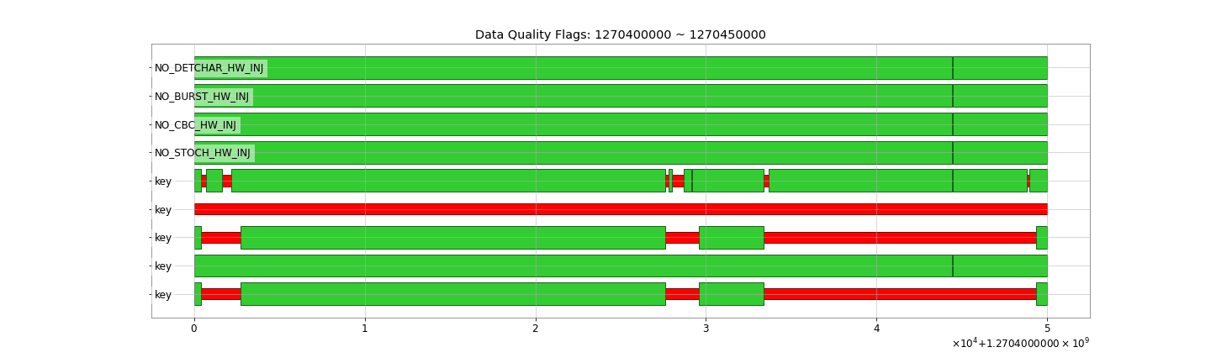
Data Quality of C01 Strain in O3GK

Slide 42
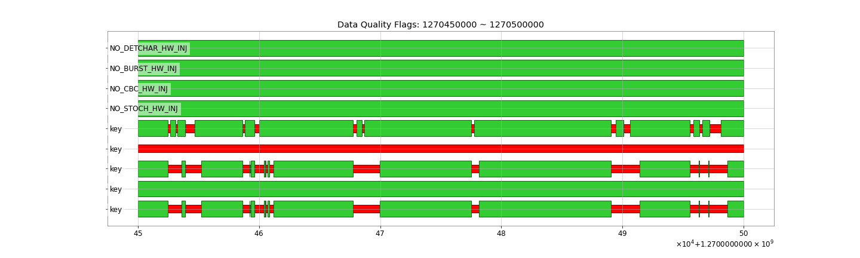
Data Quality of C01 Strain in O3GK

Slide 43
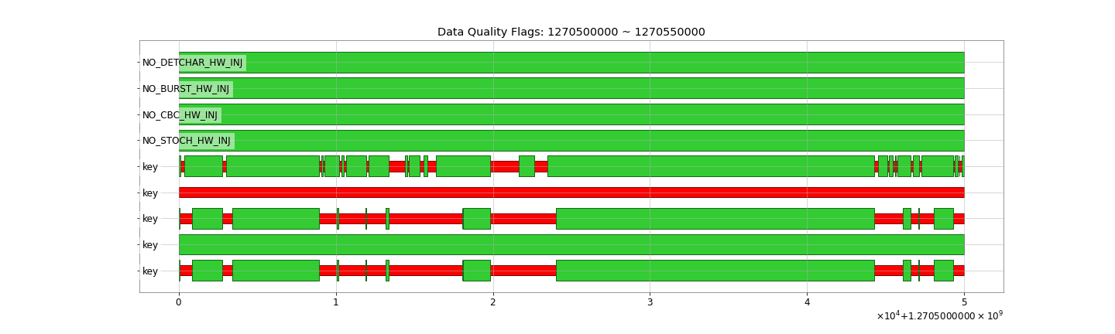
Data Quality of C01 Strain in O3GK

Slide 44
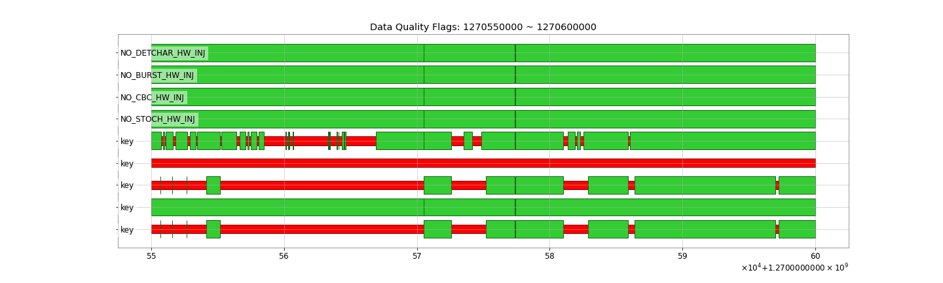
Data Quality of C01 Strain in O3GK

Slide 45
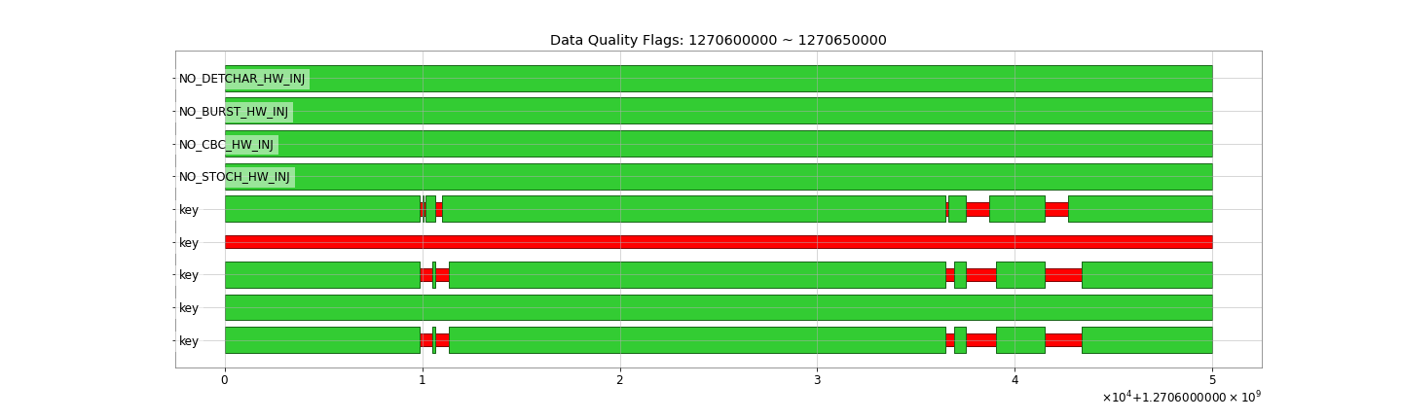
Data Quality of C01 Strain in O3GK

Slide 46
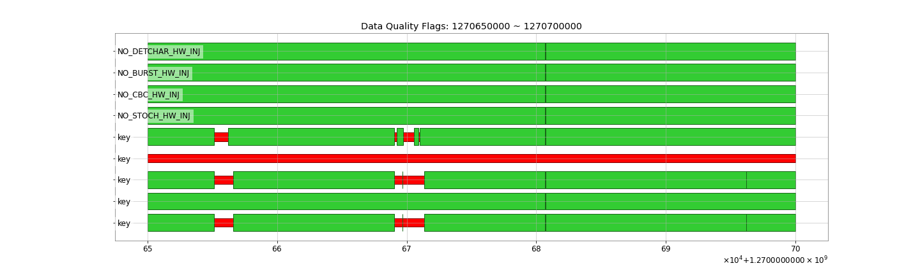
Data Quality of C01 Strain in O3GK

Slide 47
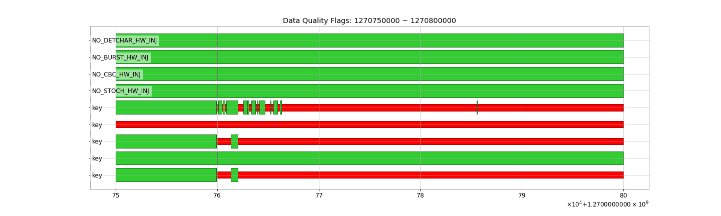
Data Quality of C01 Strain in O3GK

Slide 48
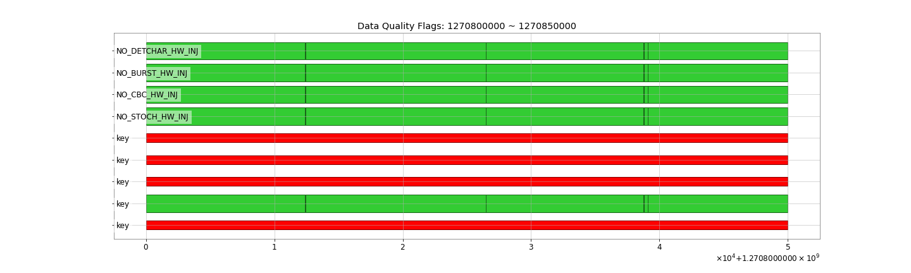
Data Quality of C01 Strain in O3GK

Slide 49
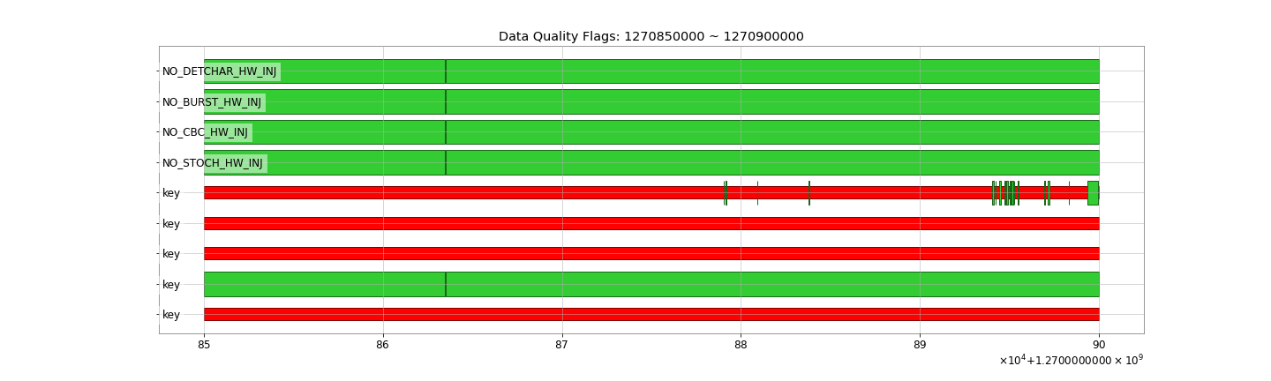
Data Quality of C01 Strain in O3GK

Slide 50
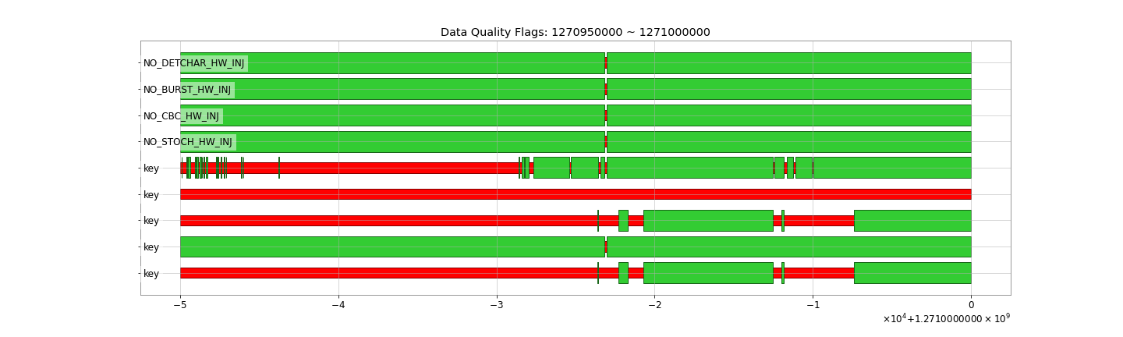
Data Quality of C01 Strain in O3GK

Slide 51
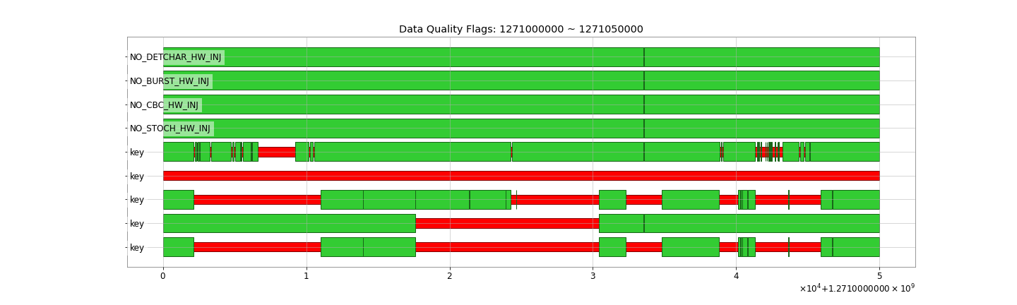
Data Quality of C01 Strain in O3GK

Slide 52
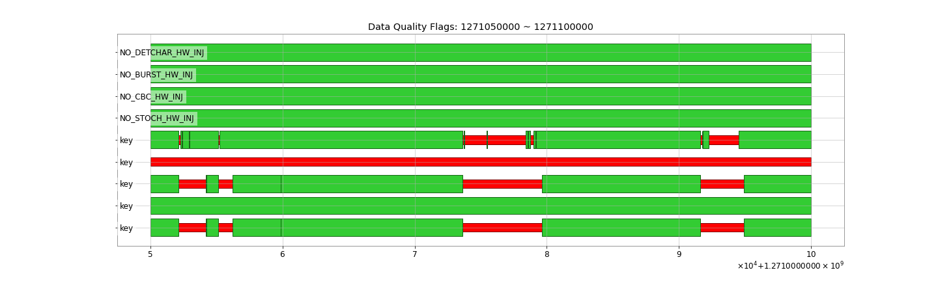
Data Quality of C01 Strain in O3GK

Slide 53
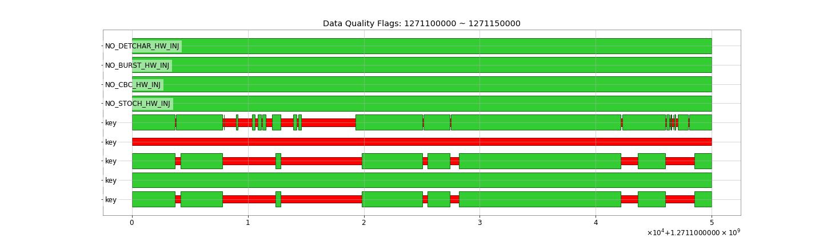
Data Quality of C01 Strain in O3GK

Slide 54
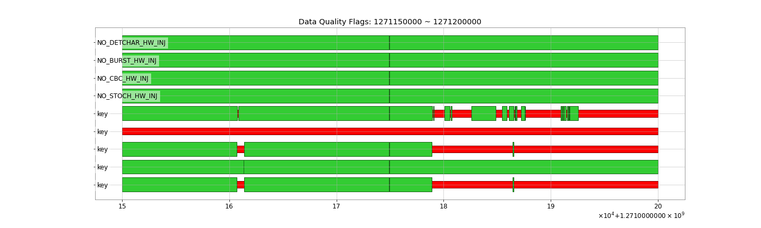
Data Quality of C01 Strain in O3GK

Slide 55
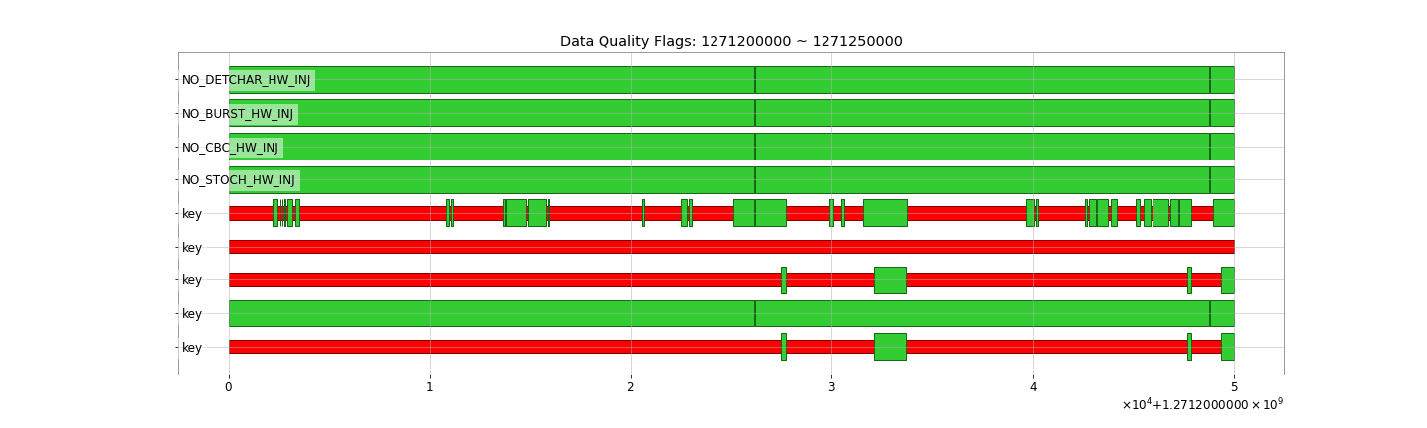
Data Quality of C01 Strain in O3GK

Slide 56
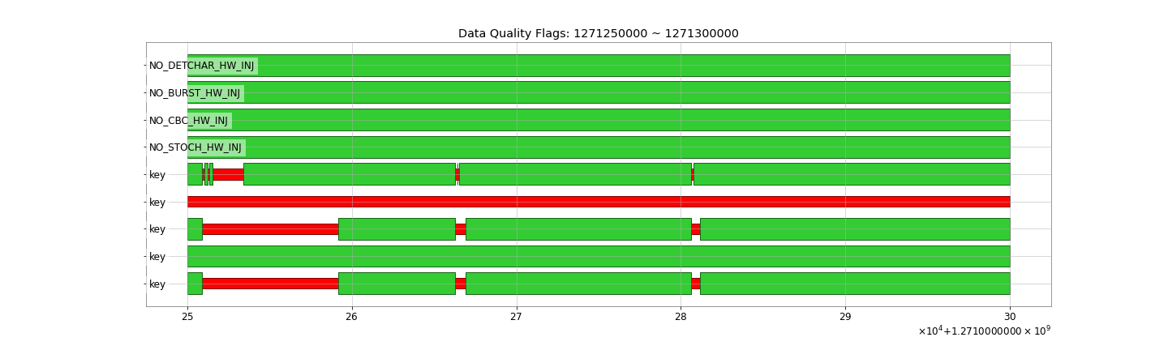
Data Quality of C01 Strain in O3GK

Slide 57
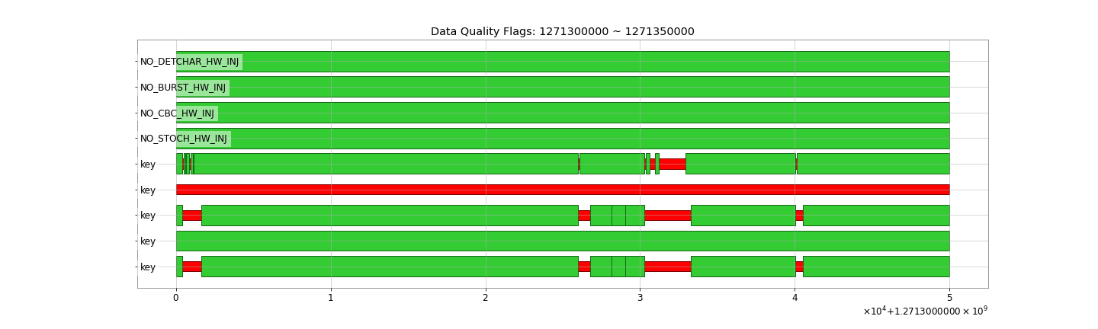
Data Quality of C01 Strain in O3GK

Slide 58
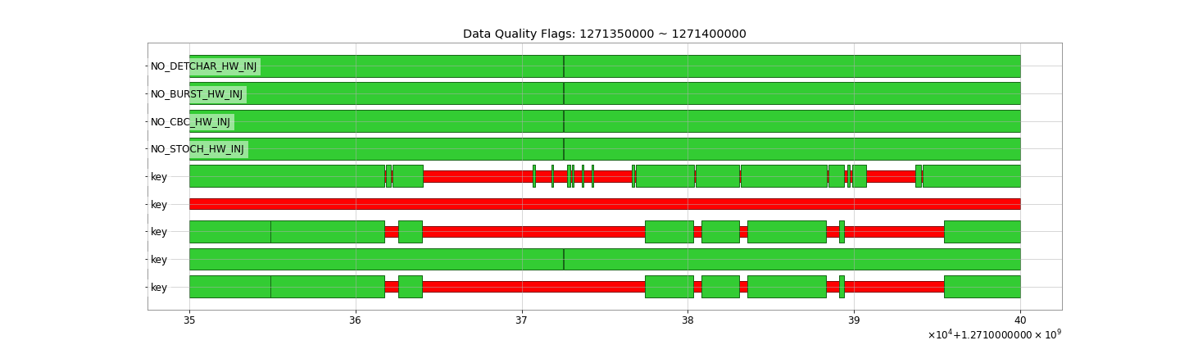
Data Quality of C01 Strain in O3GK

Slide 59
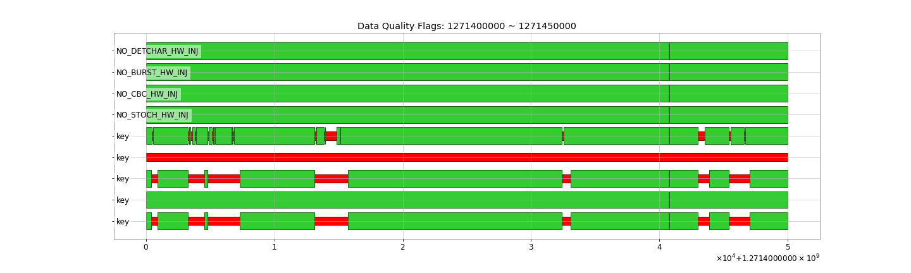
Data Quality of C01 Strain in O3GK

Slide 60
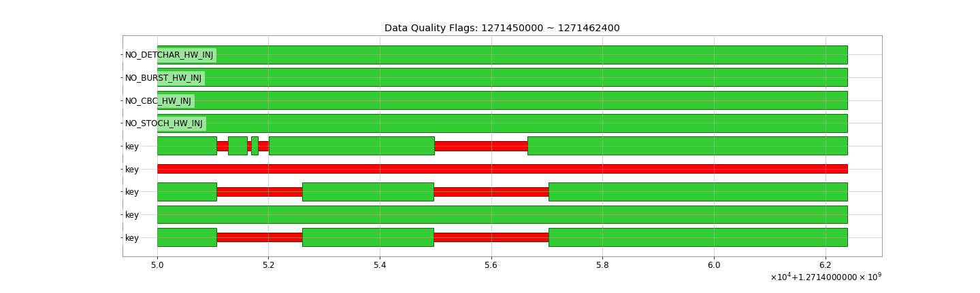
Data Quality of C01 Strain in O3GK

