Slide 1
Demonstration of GW-IaaS Denoising Pipeline
Chai-Jui Chou
National Yang Ming Chiao Tung University, Taiwan
2022/02/10

Slide 2
Motivation: Early Warning GW Alerts
Refs: 2102.04555, 2008.04288, 1107.2665
Binary Neutron Star (BNS) mergers have long duration in inspiral phase which can be detected before merger.
GW detection can provide early warning alert to the EM emission (γ-ray burst, kilonovae) in post-merger phase.
Source localization and other properties from GW is important.

Slide 3
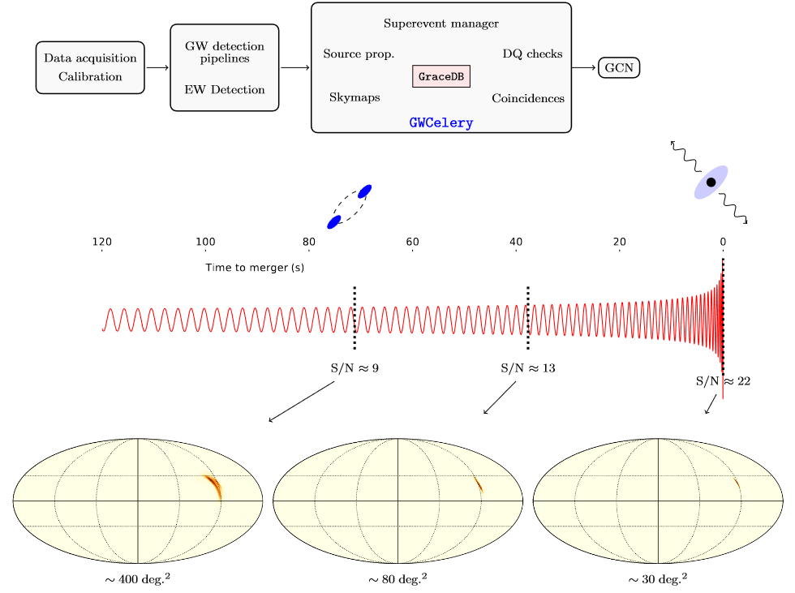
Motivation: Early Warning GW Alerts
From 2102.04555

Slide 4
Motivation: Early Warning GW Alerts
Low latency pipelines: cWB, GstLAL, MBTAOnline, PyCBC Live, SPIIR.
The candidates will be uploaded to GRAvitational-wave Candidate Event DataBase (GraceDB) and the task manager GWCelery will orchestrate the processes and send the alerts to the Gamma-ray Coordinates Network (GCN).
Localization: BAYESTAR
Spatial conincidence check with γ-ray bursts or neutrino bursts: RAVEN

Slide 5
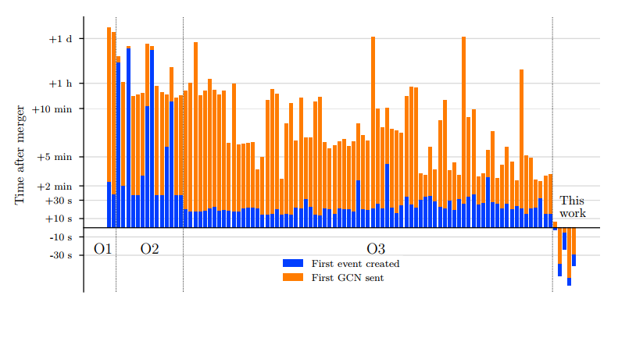
Motivation: Early Warning GW Alerts
The alert infrastructure is tested by the mock data challenge carried out between 2020/01/11 1700 UTC and 2020/06/19 1700 UTC. (O3)

Slide 6
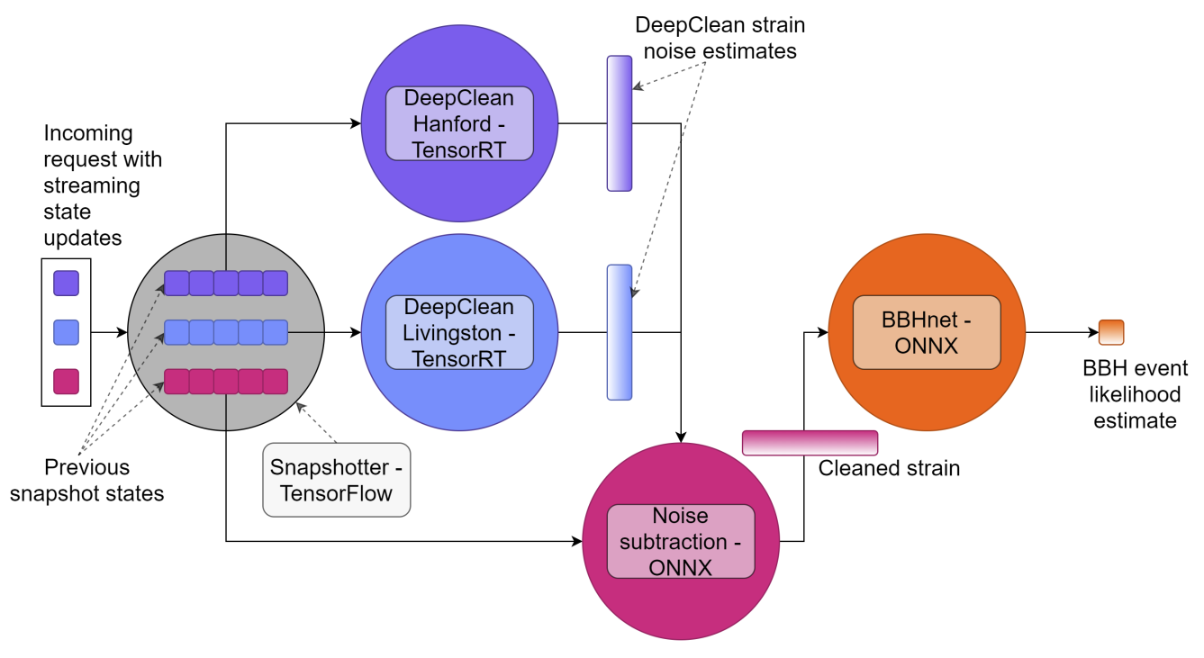
Our Goals

Slide 7
Our Goals
Functional low latency denoising (Deepclean) pipeline, deliverable for LIGO, Virgo, KAGRA.
BBHnet (ML for the Binary Black Hole search) working with the ouput of Deepclean.
Follow up Parameter Estimation with ML.

Slide 8
To Do
Triton Server Setup: We can use the GPU nodes in Academia Sinica. We can discuss the contributed resources for KAGRA in the future. We will attend the DiCOS user meeting to state our request.
Establish the procedure of Data Quality check, Model Training, Inference.
Focusing on the powerline noise and low frequency noise (< 30Hz).
Preparation for the low-latency Data replay: LIGO, Virgo (O3), KAGRA (O3GK)?
Performance Evaluation: ASDR, SNR of the mock data challenge, Latency evaluation.
Optimization and Hyper parameter tuning of Deepclean.

