Slide 1
Deepclean on 2-channel denoising in KAGRA
Chia-Jui Chou
National Yang Ming Chiao Tung University, Taiwan

Slide 2
Deepclean using 2 PEM Channels
O3GK run:
  2020/04/07-06:00:00 (1270274418) ~ 2020/04/20-00:00:00 (1271376018) UTC
Strain data used:
  K1:DCS-CALIB_STRAIN_C10
  K1:DAC-STRAIN_C20
PEM channel used:
  K1:PEM-MIC_PSL_TABLE_PSL4_Z_OUT_DQ
  K1:PEM-SENSOR_RACK_OMC1_DSUB2_OUT_DQ
Frequency Filter: 58Hz ~ 59 Hz, 59Hz ~ 61 Hz, 55Hz ~ 65 Hz
Training Time: 1270299936 ~ 1270300064 (128 second)
Cleaning Time: 1270300064 ~ 1270300192 (128 second)

Slide 3
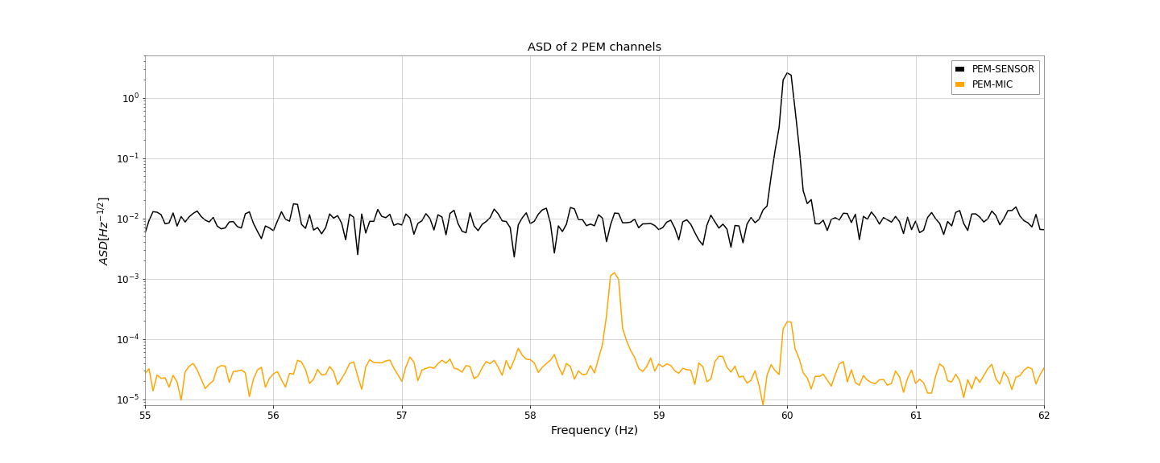
ASD of the PEM channels

Slide 4
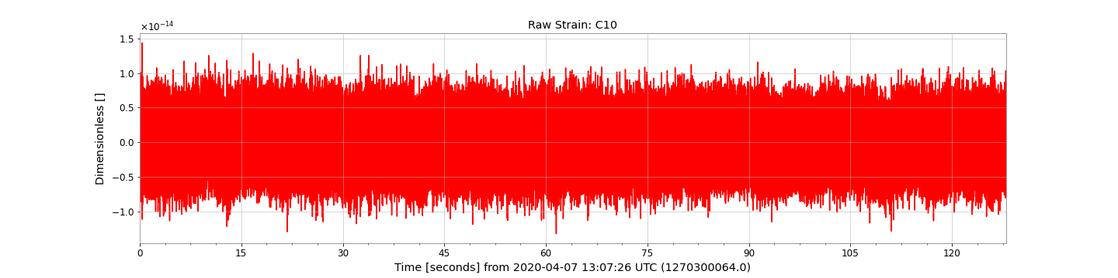
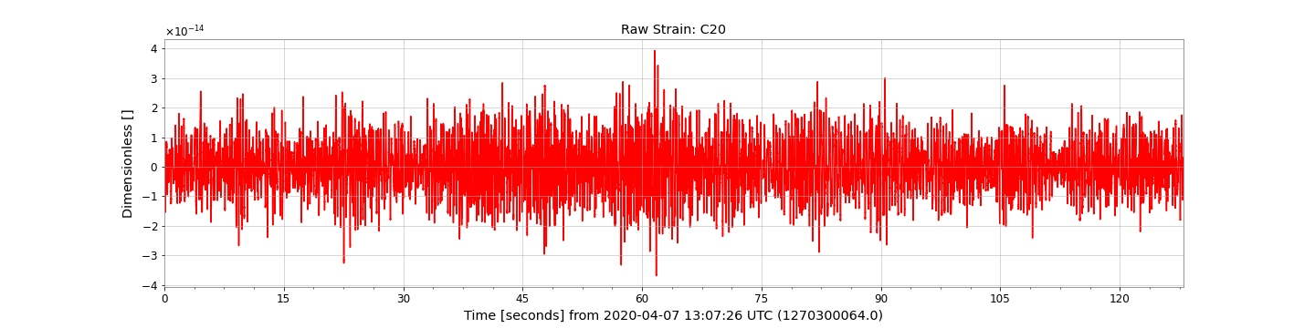
Raw Strain

Slide 5
SEN-channel Input

Slide 6
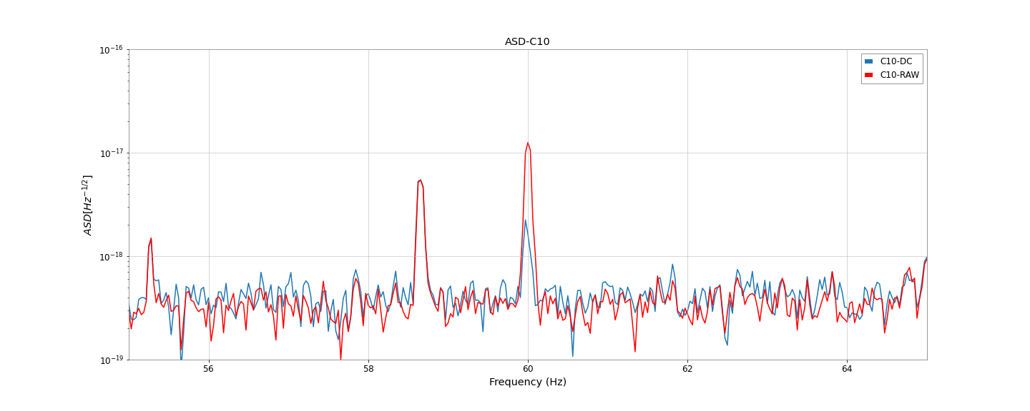
ASD of C10 strain: SEN-channel Input, Filter: 55~65Hz

Slide 7
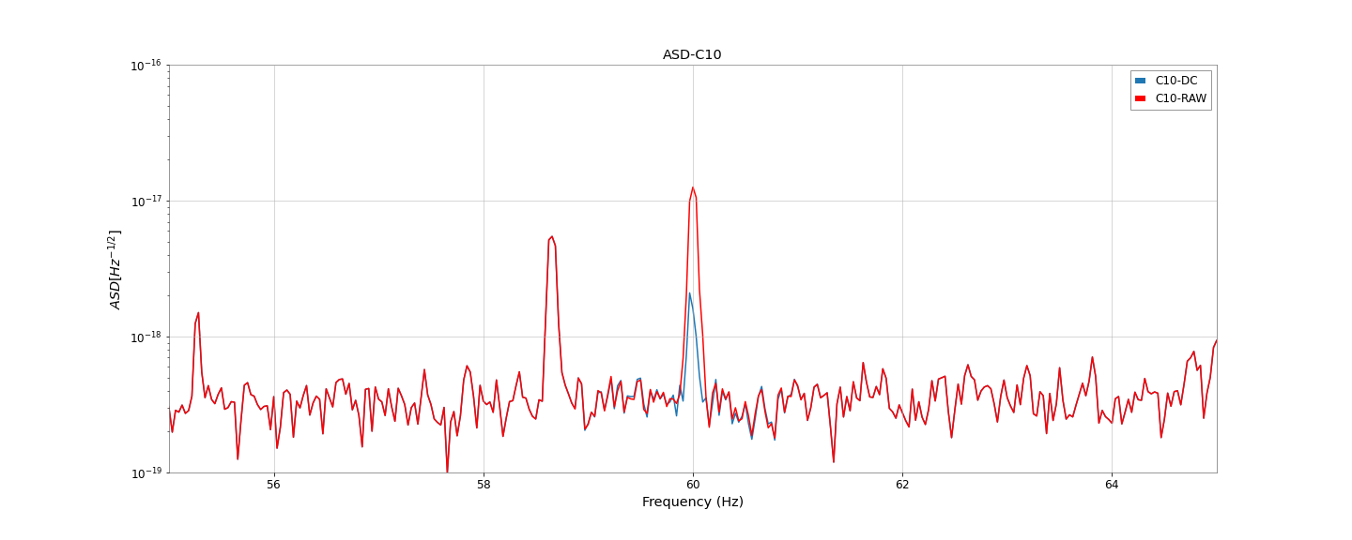
ASD of C10 strain: SEN-channel Input, Filter: 59~61Hz

Slide 8
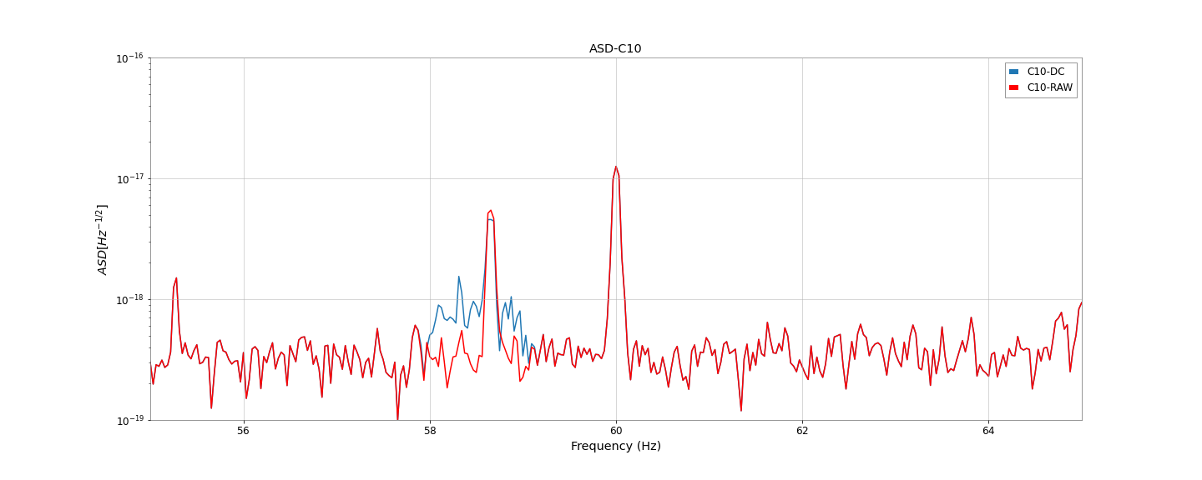
ASD of C10 strain: SEN-channel Input, Filter: 58~59Hz

Slide 9
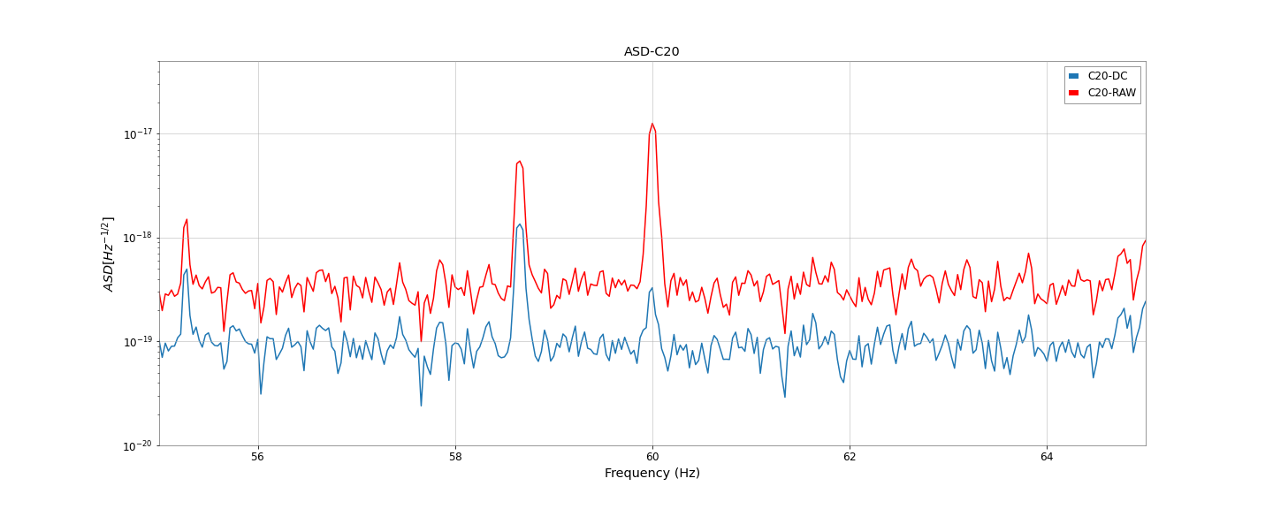
ASD of C20 strain: SEN-channel Input, Filter: 55~65Hz

Slide 10
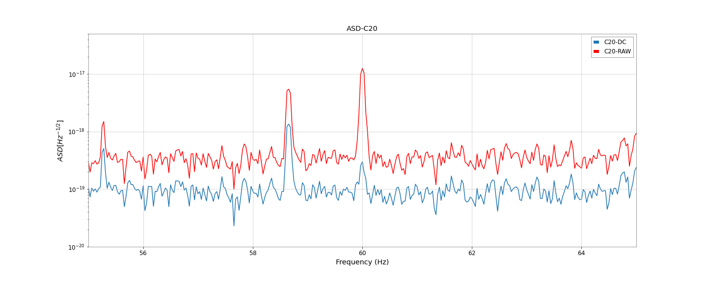
ASD of C20 strain: SEN-channel Input, Filter: 59~61Hz

Slide 11
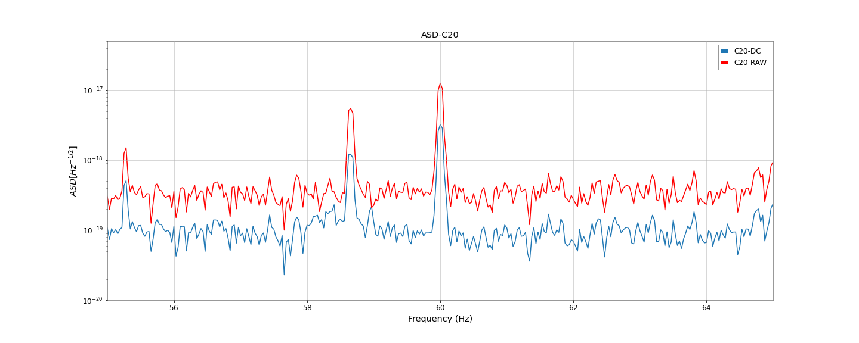
ASD of C20 strain: SEN-channel Input, Filter: 58~59Hz

Slide 12
MIC-channel Input

Slide 13
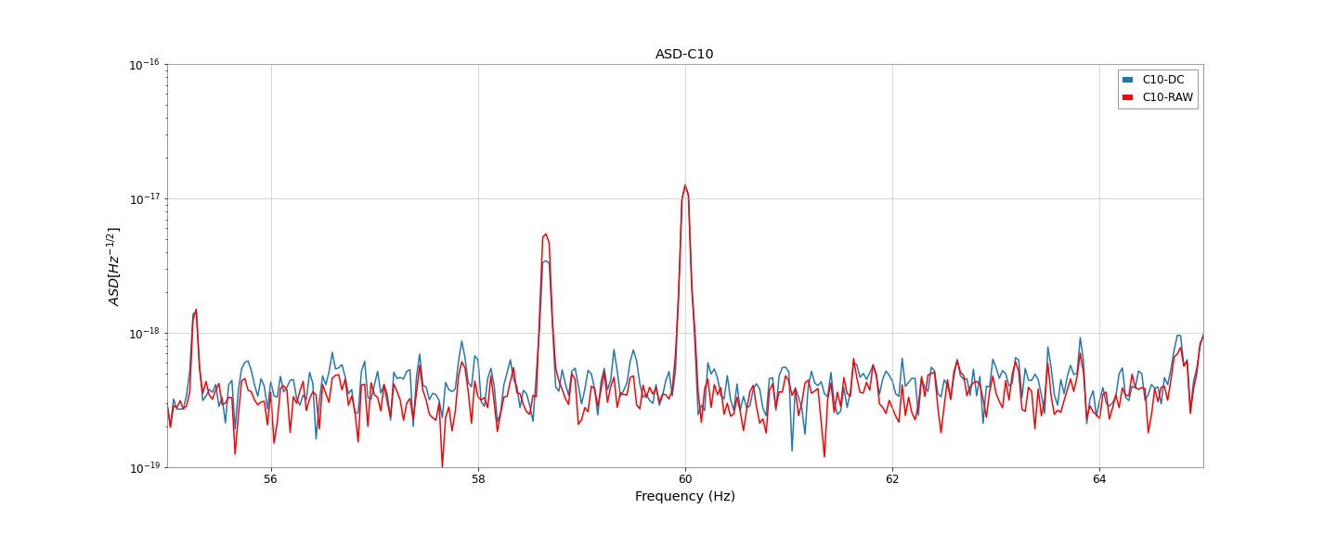
ASD of C10 strain: MIC-channel Input, Filter: 55~65Hz

Slide 14
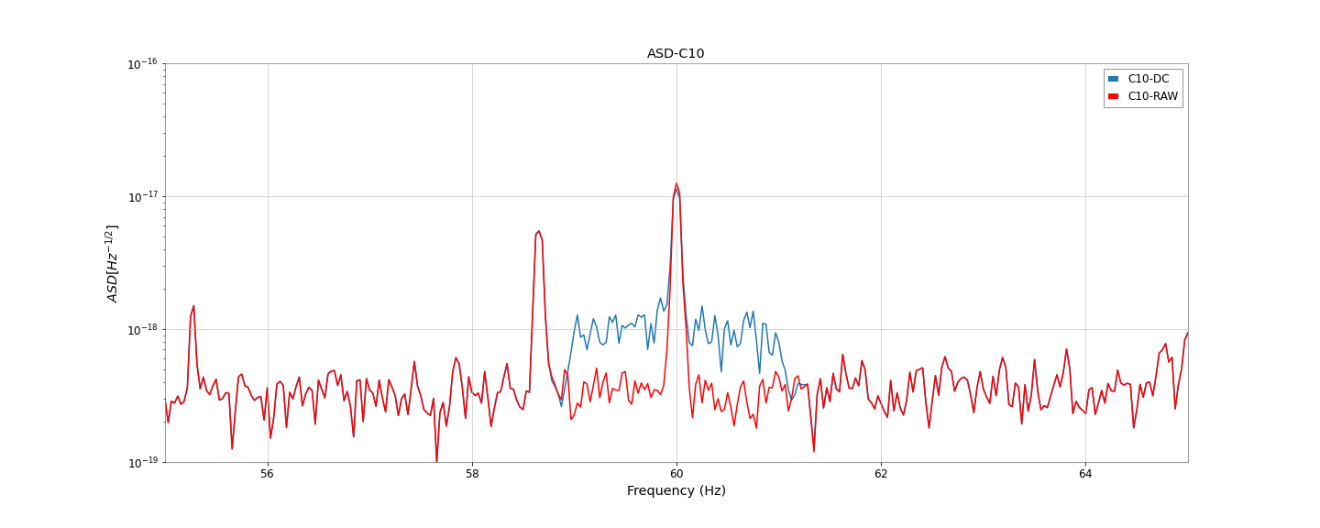
ASD of C10 strain: MIC-channel Input, Filter: 59~61Hz

Slide 15
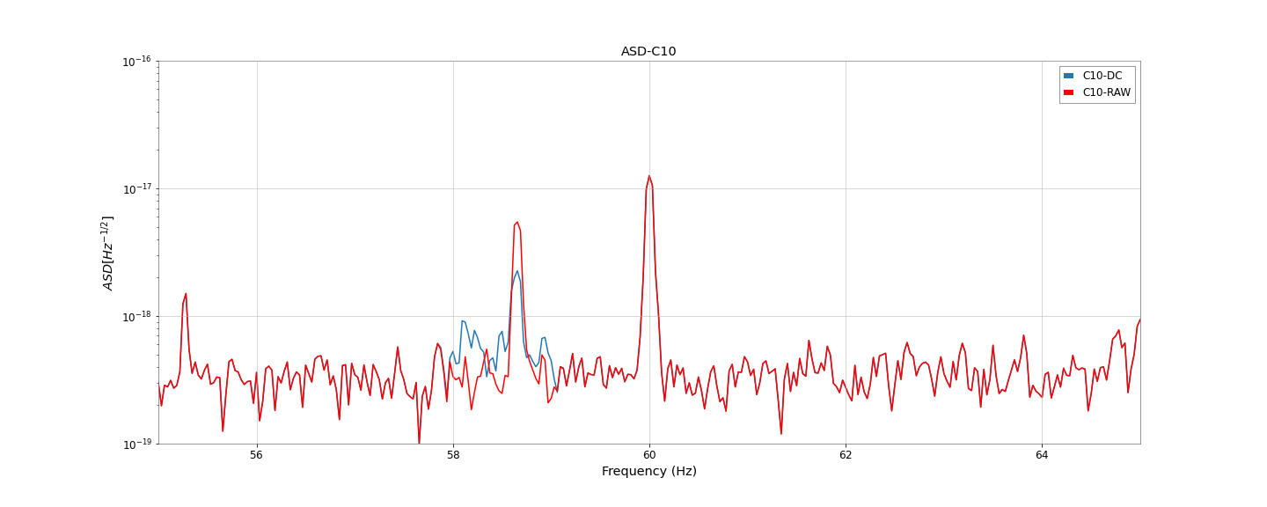
ASD of C10 strain: MIC-channel Input, Filter: 58~59Hz

Slide 16
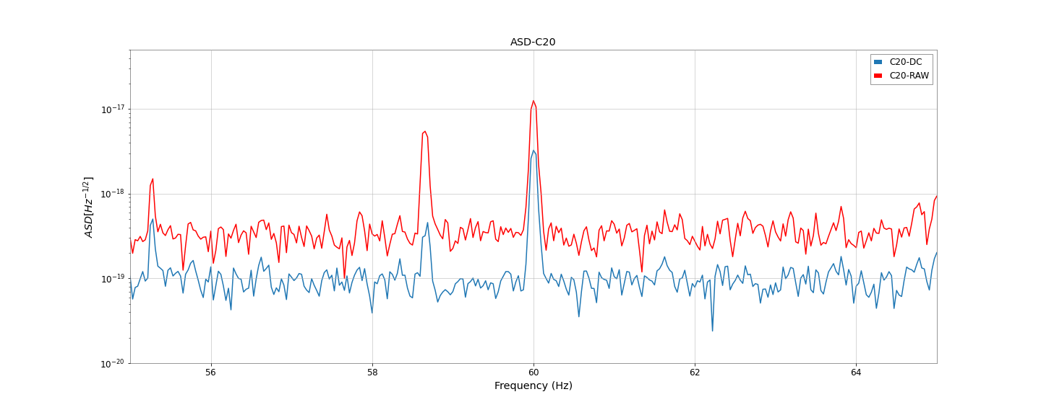
ASD of C20 strain: MIC-channel Input, Filter: 55~65Hz

Slide 17
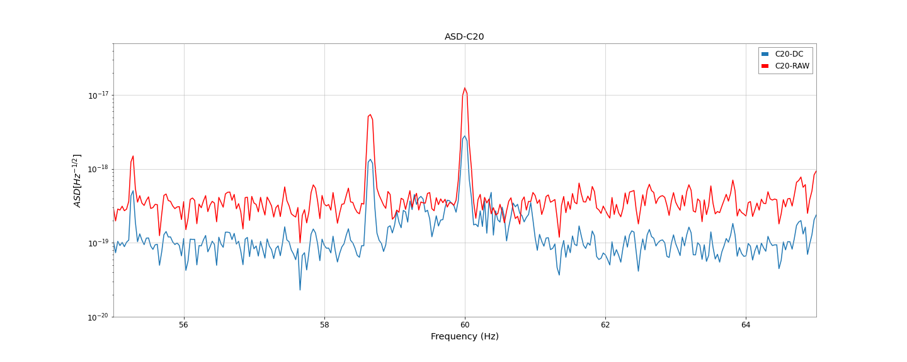
ASD of C20 strain: MIC-channel Input, Filter: 59~61Hz

Slide 18
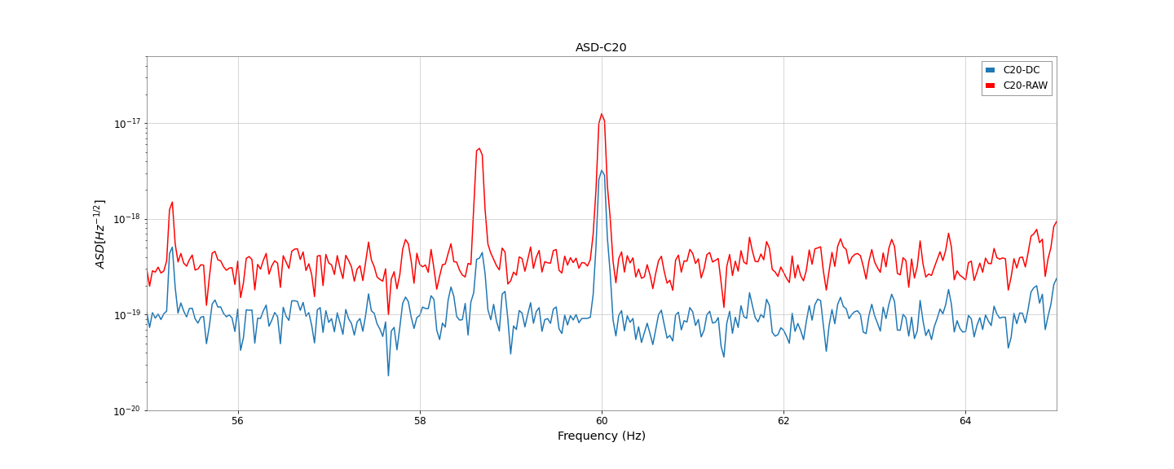
ASD of C20 strain: MIC-channel Input, Filter: 58~59Hz

Slide 19
2-channel Input

Slide 20
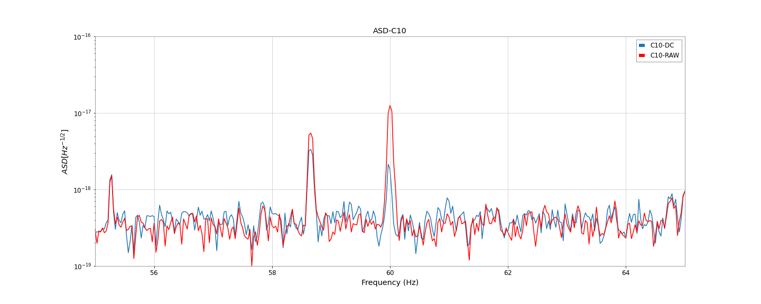
ASD of C10 strain: 2-channel Input, Filter: 55~65Hz

Slide 21
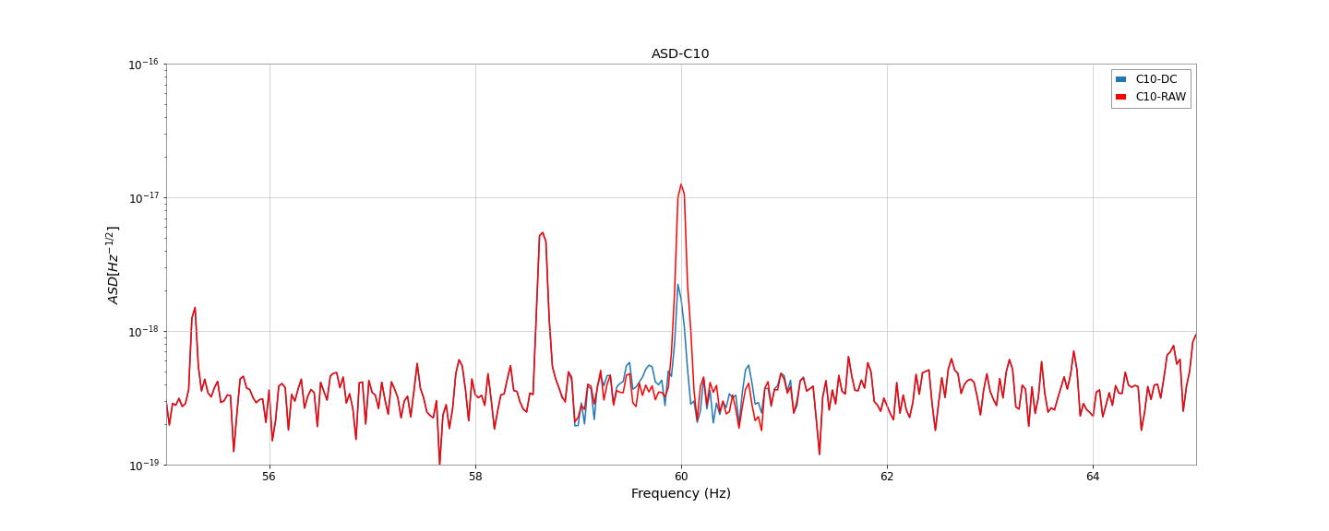
ASD of C10 strain: 2-channel Input, Filter: 59~61Hz

Slide 22
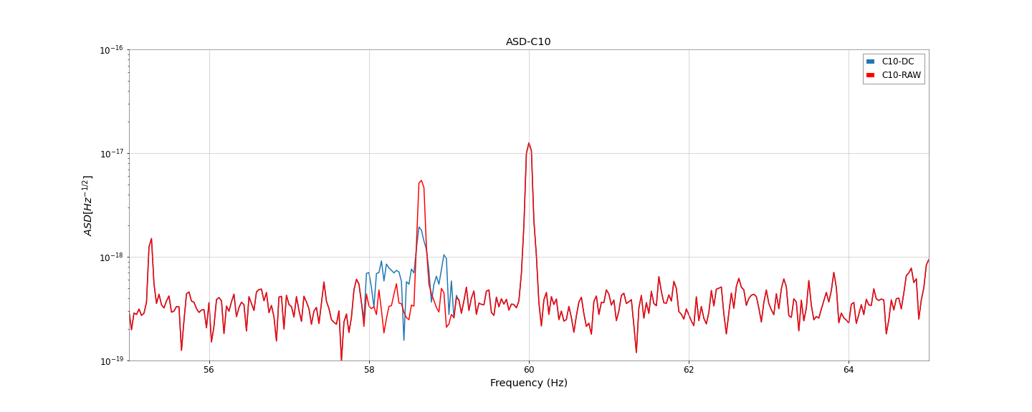
ASD of C10 strain: 2-channel Input, Filter: 58~59Hz

Slide 23
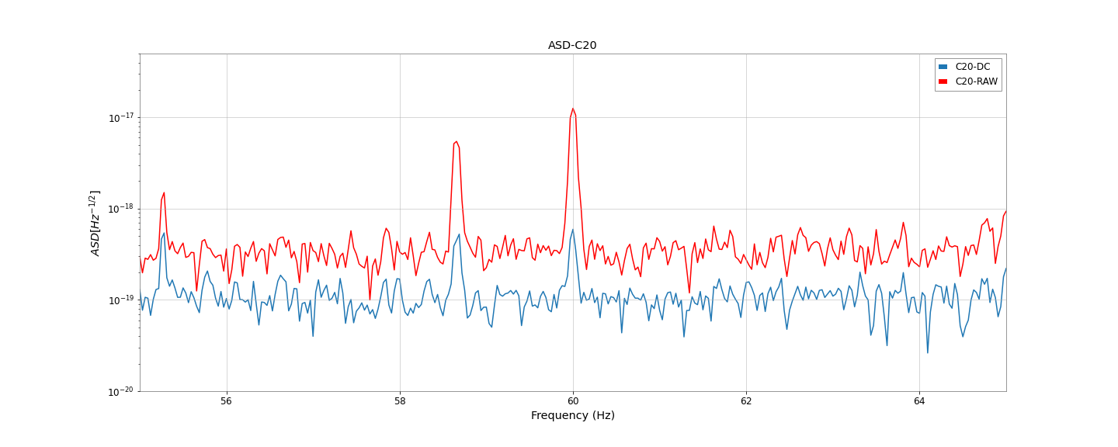
ASD of C20 strain: 2-channel Input, Filter: 55~65Hz

Slide 24
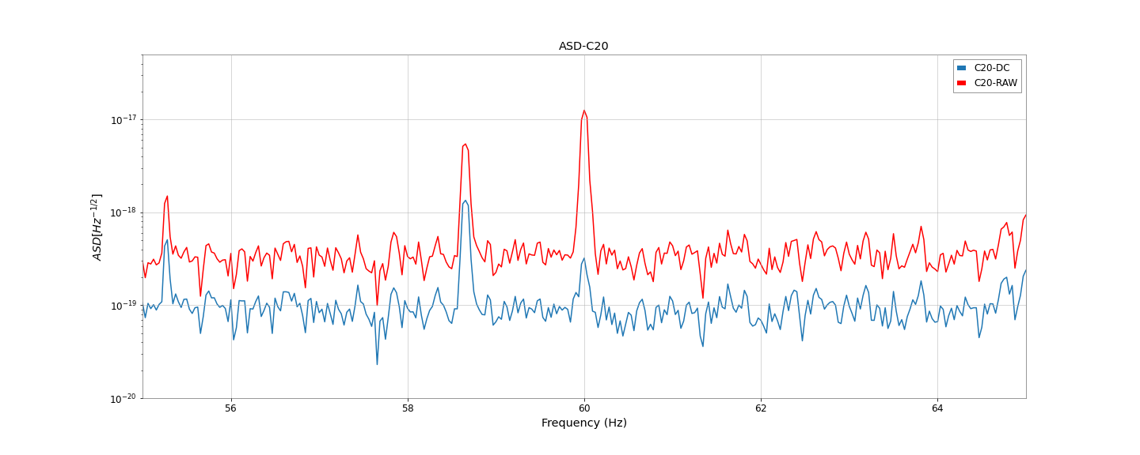
ASD of C20 strain: 2-channel Input, Filter: 59~61Hz

Slide 25

ASD of C20 strain: 2-channel Input, Filter: 58~59Hz

