Slide 1
Software Injection Tests on Deepclean: Long Single Frequency Injection
Chai-Jui Chou
National Yang Ming Chiao Tung University, Taiwan
2022/04/19

Slide 2
Software Injection based on Noise Injection Tests
PEM injection before/after O3GK
Hardware Injection: 15:21 NoInjection_6.xml
Strain channel: K1:CAL-CS_PROC_C00_STRAIN_DBL_DQ
PEM channel: K1:PEM-MIC_PSL_TABLE_PSL4_Z_OUT_DQ
Frequency Filter:
  10Hz wide, centered at the injected frequency
  120Hz ~ 150Hz
Training Time: 1275891678 ~ 1275891998 (320 seconds)
Cleaning Time: 1275891678 ~ 1275891998 (320 seconds)

Slide 3
Injection: Training Data
1275891678 ~ 1275891998
Inject sine waves with frequencies: 125Hz, 130Hz, 135Hz, …, 145Hz.
Each injection lasts for 300 seconds.
PEM Amplitude: 8e-3 Pa.
Strain Amplitude: 2e-20.
No phase shift between PEM and Strain injection.

Slide 4
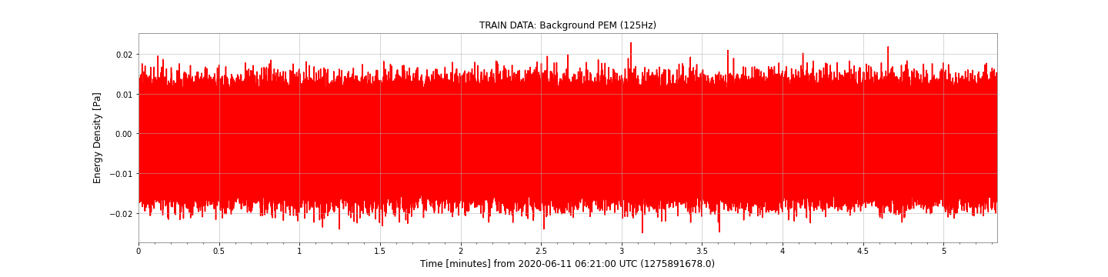
Injection: Background PEM

Slide 5
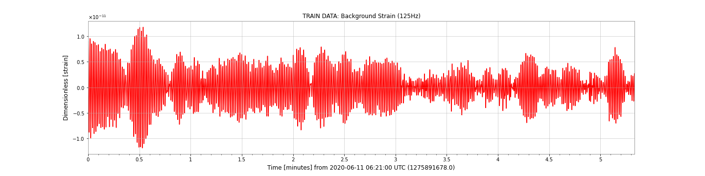
Injection: Background Strain

Slide 6
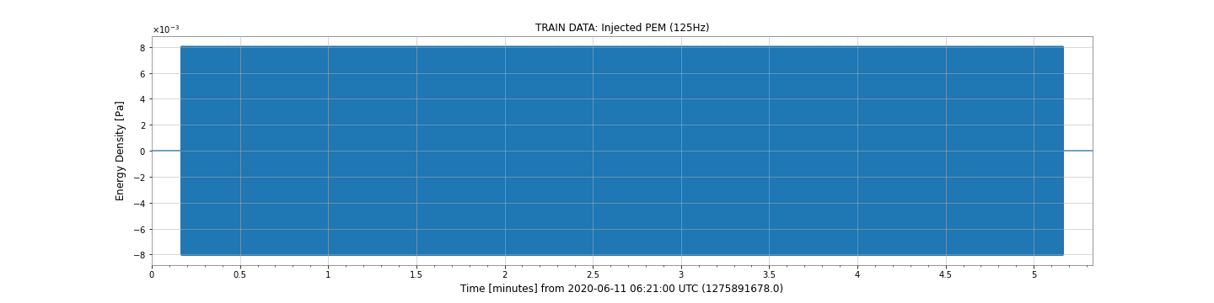
Injection: Injected Sine Wave (125Hz)

Slide 7

Injection: Injected Sine Wave (125Hz)

Slide 8
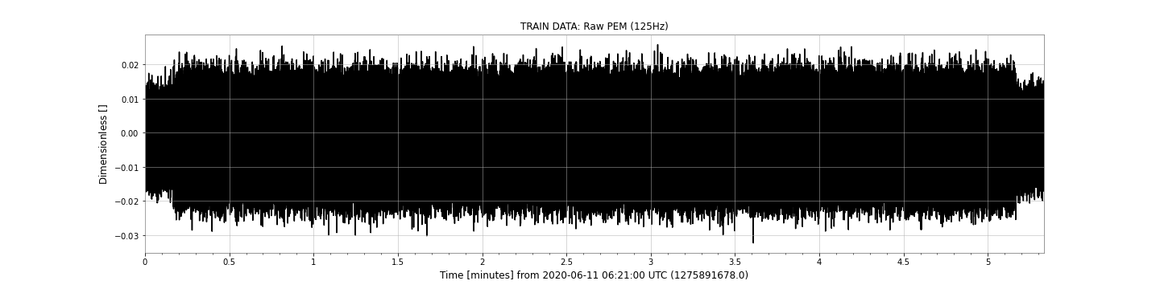
Injection: Injected PEM (125Hz)

Slide 9
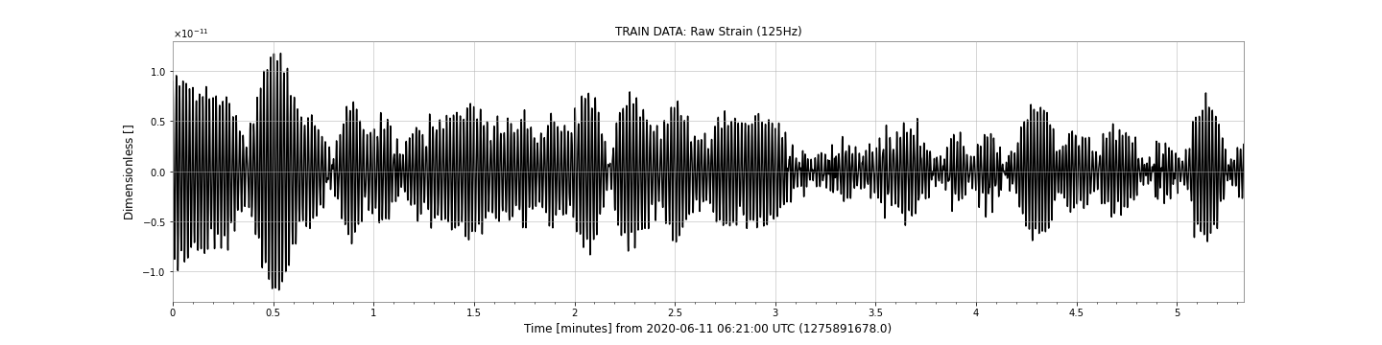
Injection: Injected Strain (125Hz)

Slide 10
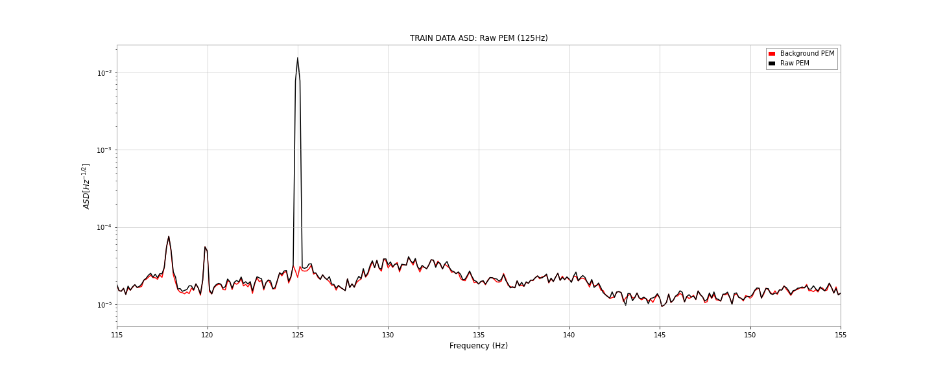
PEM ASD: Background and Injected

Slide 11
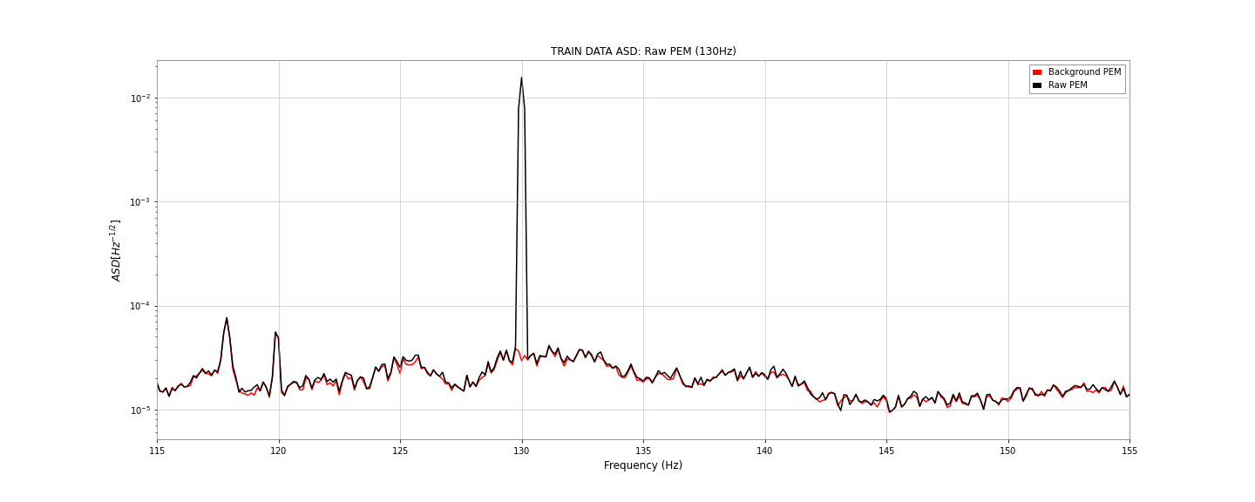
PEM ASD: Background and Injected

Slide 12
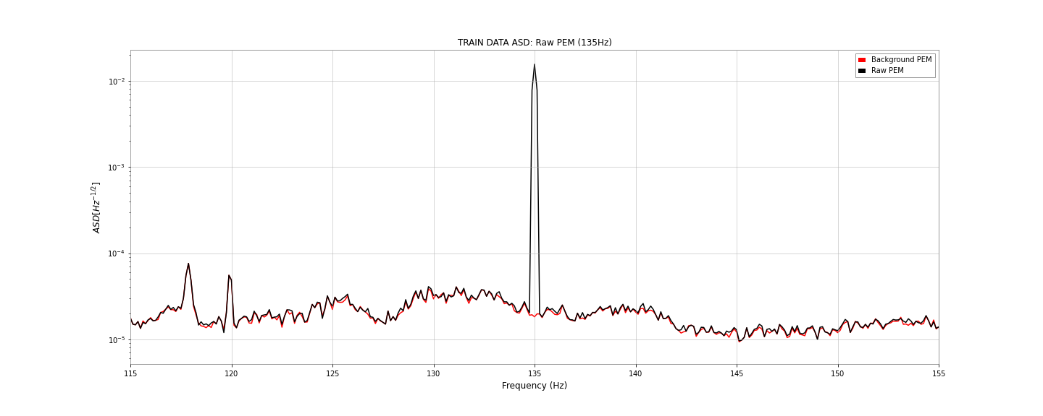
PEM ASD: Background and Injected

Slide 13
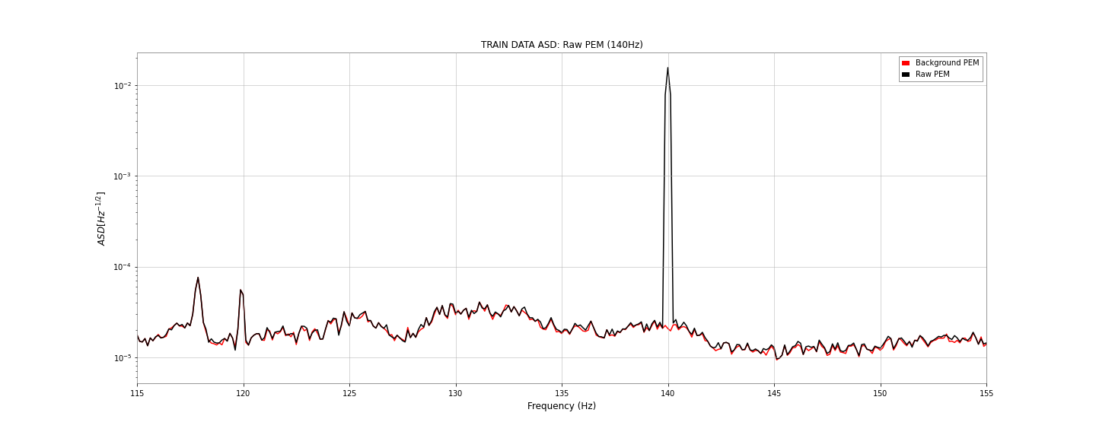
PEM ASD: Background and Injected

Slide 14
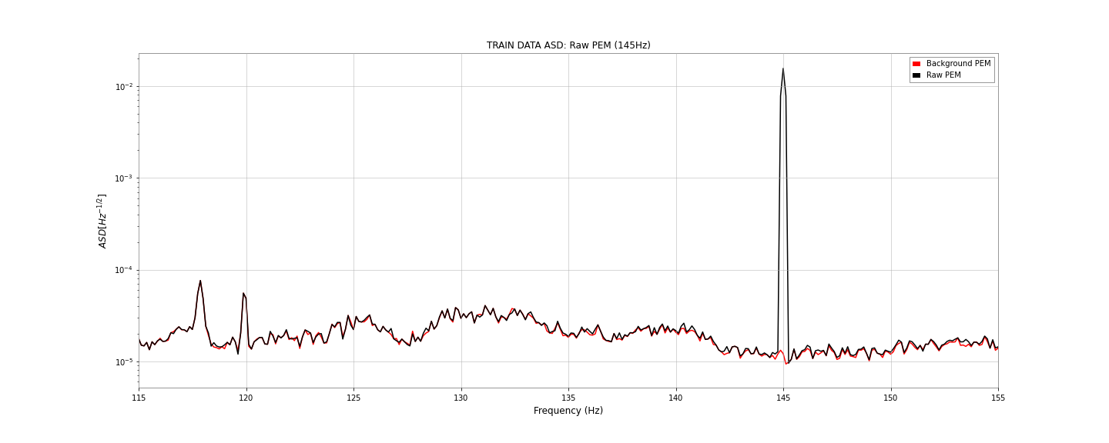
PEM ASD: Background and Injected

Slide 15
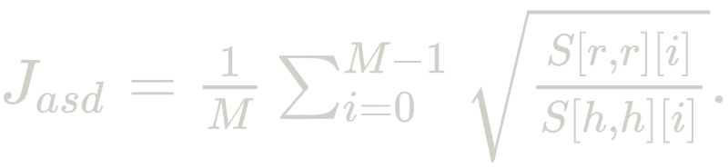
Training Deepclean: 30 Epochs
Strain channel: K1:CAL-CS_PROC_C00_STRAIN_DBL_DQ
PEM channel: K1:PEM-MIC_PSL_TABLE_PSL4_Z_OUT_DQ
Training Time: 1275901678 ~ 1275901998 (320 seconds)
Frequency Filter: 115Hz ~ 150Hz
Loss Function:
FFT Length: 4
Batch Size: 32
Epochs: 30
Weight Decay: 1e-5

Slide 16
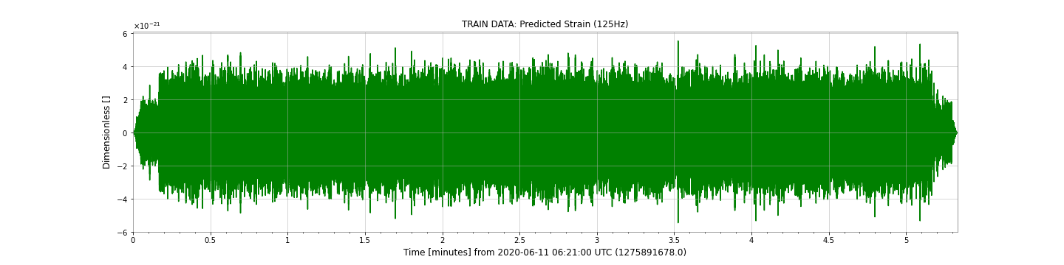
115Hz ~ 150Hz-Band: 125Hz

Slide 17
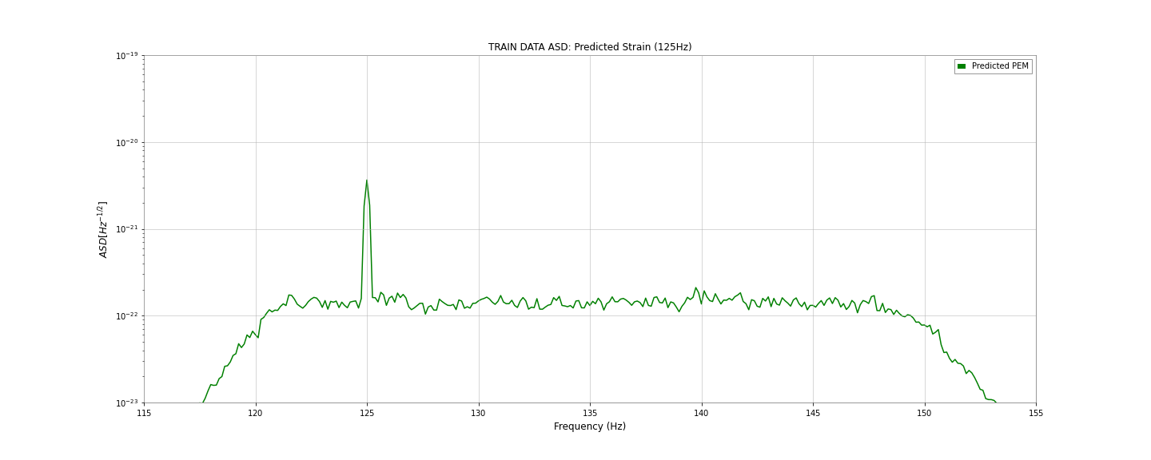
115Hz ~ 150Hz-Band: 125Hz

Slide 18
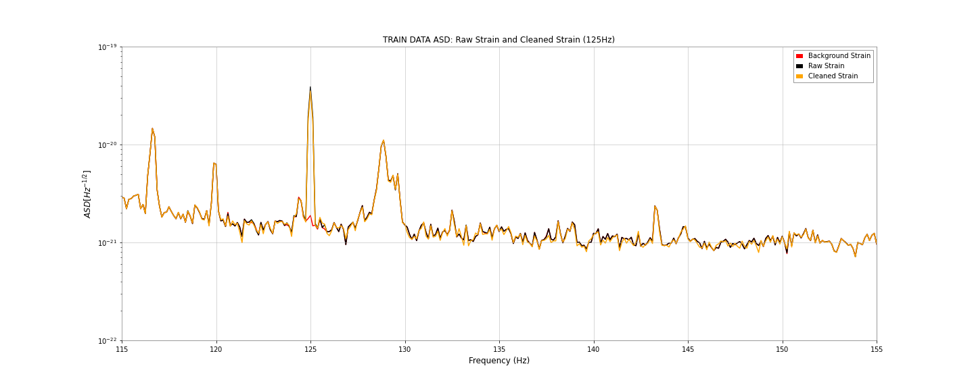
115Hz ~ 150Hz-Band: 125Hz

Slide 19
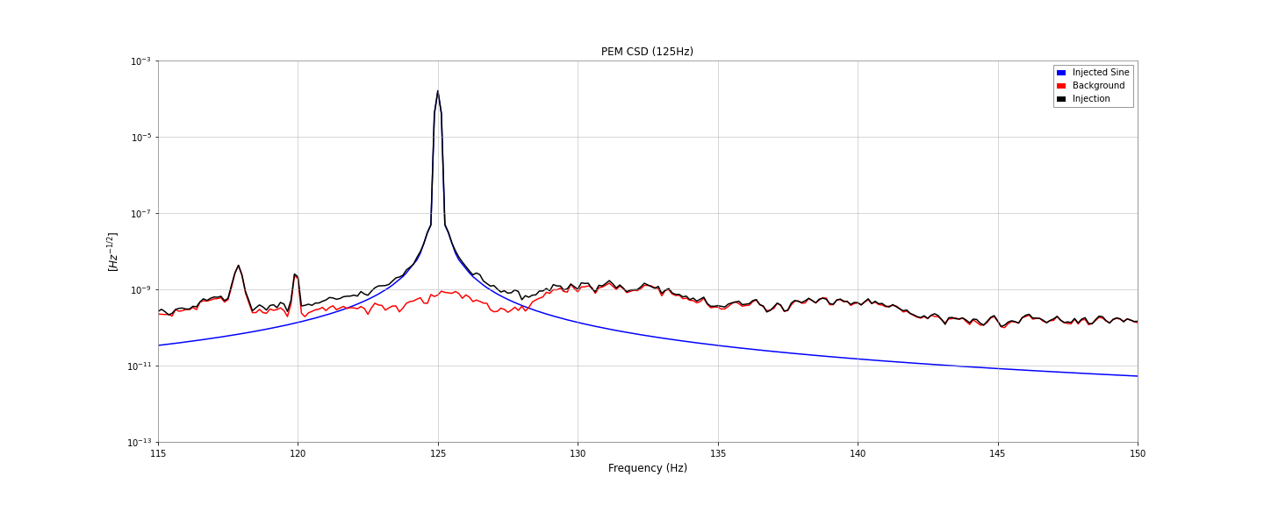
115Hz ~ 150Hz-Band: 125Hz

Slide 20
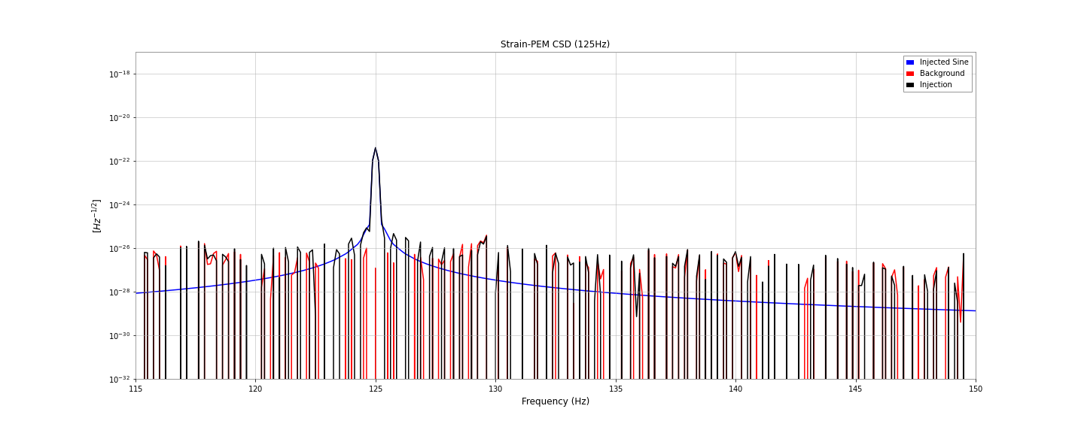
115Hz ~ 150Hz-Band: 125Hz

Slide 21
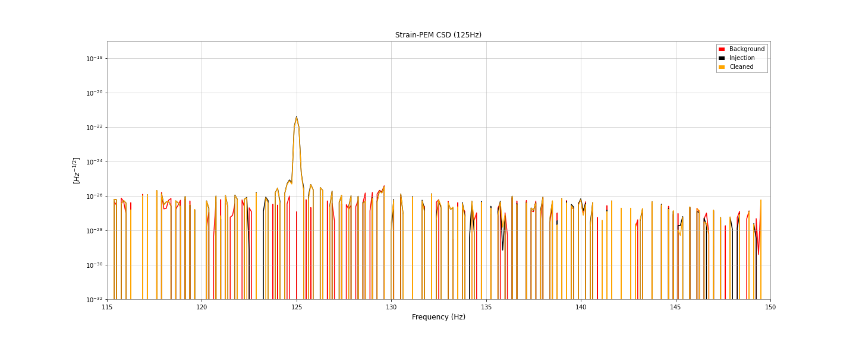
115Hz ~ 150Hz-Band: 125Hz

Slide 22
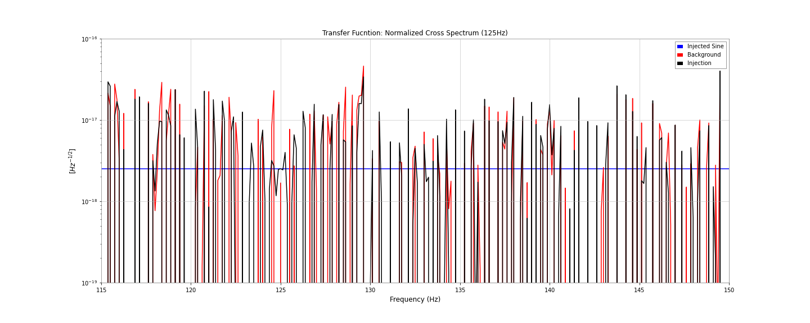
115Hz ~ 150Hz-Band: 125Hz

Slide 23
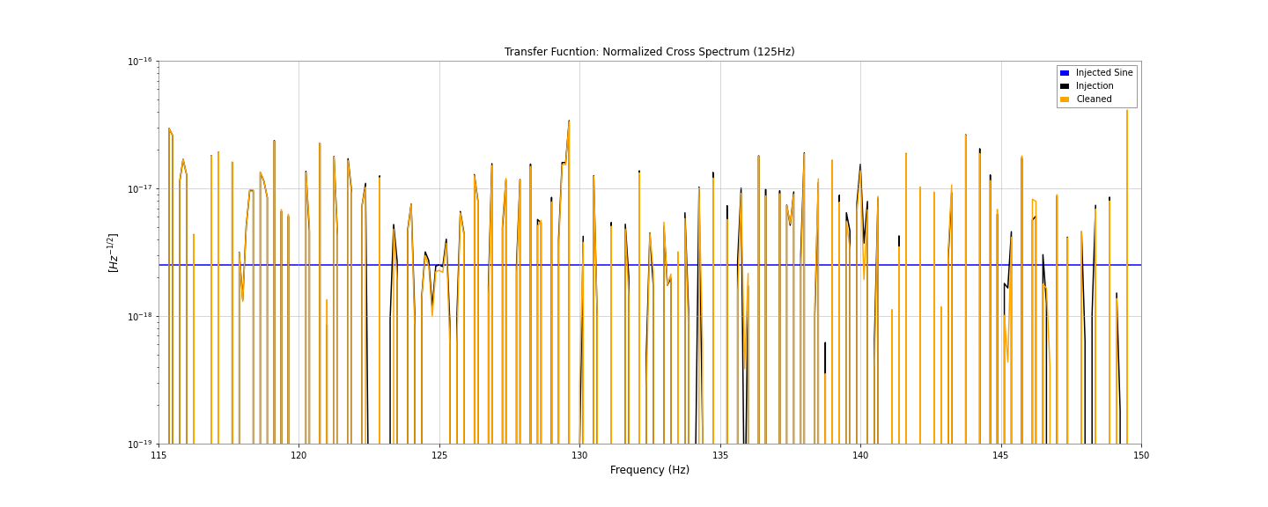
115Hz ~ 150Hz-Band: 125Hz

Slide 24
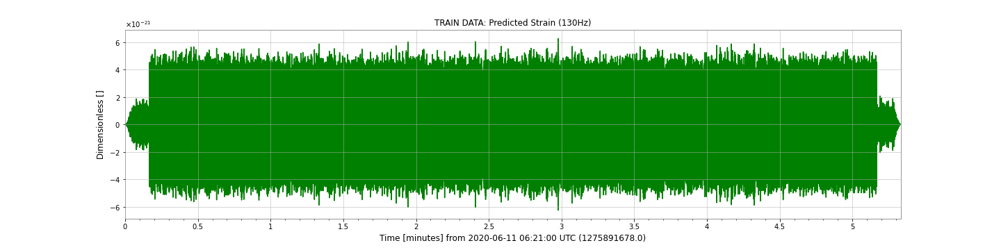
115Hz ~ 150Hz-Band: 130Hz

Slide 25
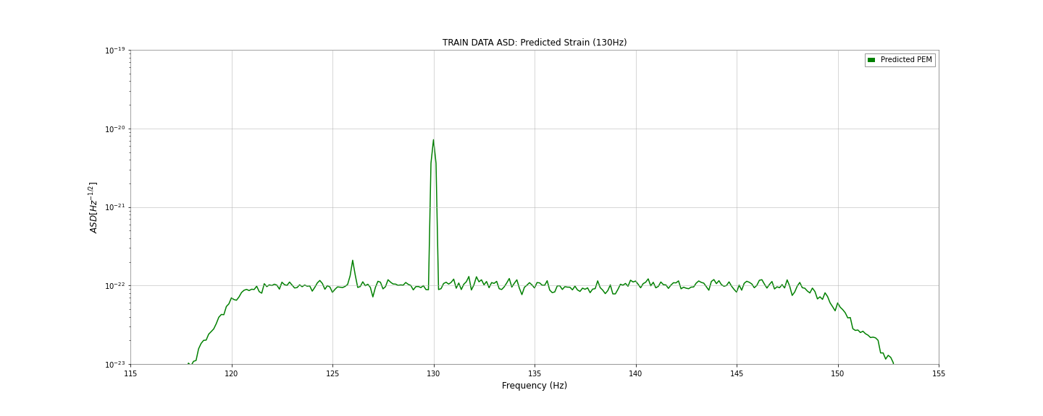
115Hz ~ 150Hz-Band: 130Hz

Slide 26
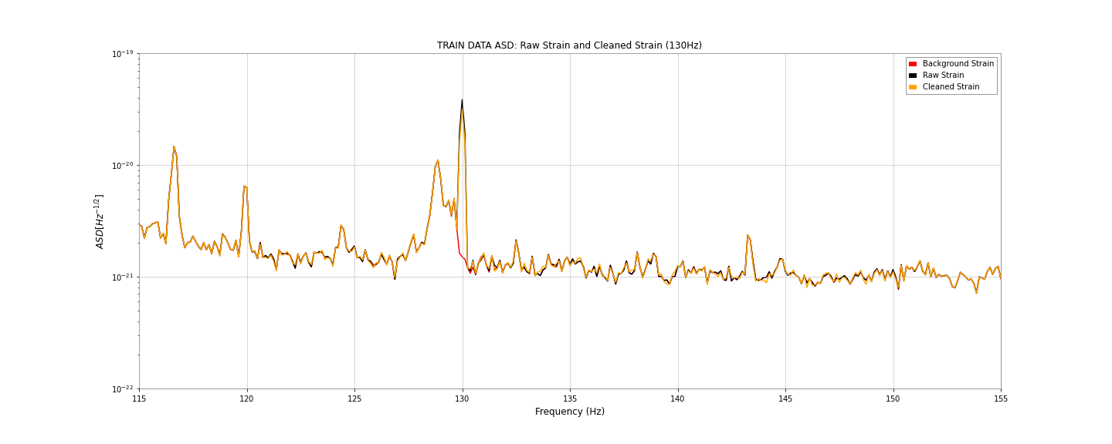
115Hz ~ 150Hz-Band: 130Hz

Slide 27
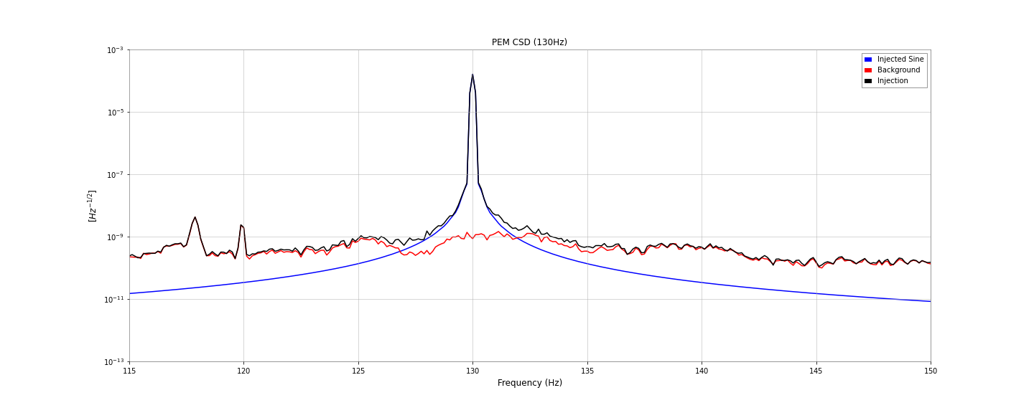
115Hz ~ 150Hz-Band: 130Hz

Slide 28
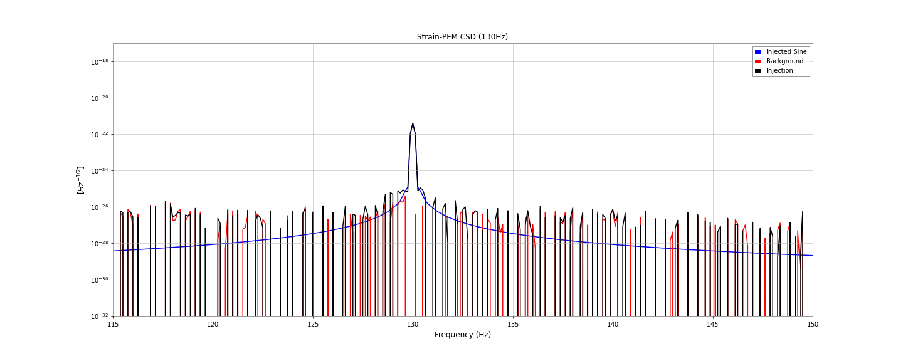
115Hz ~ 150Hz-Band: 130Hz

Slide 29
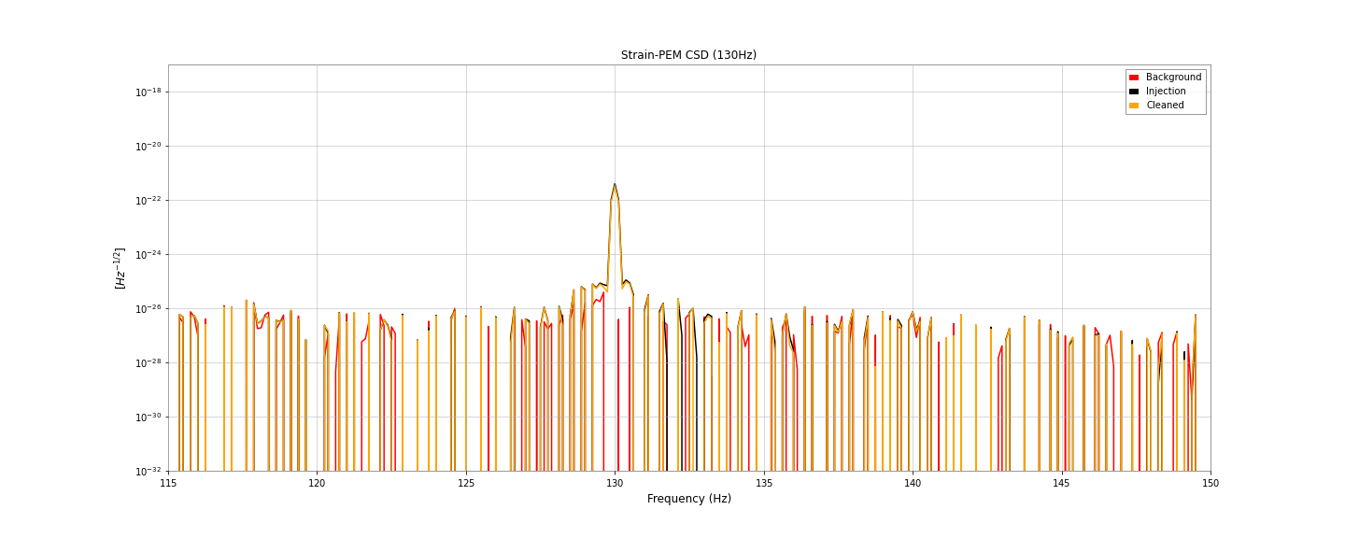
115Hz ~ 150Hz-Band: 130Hz

Slide 30
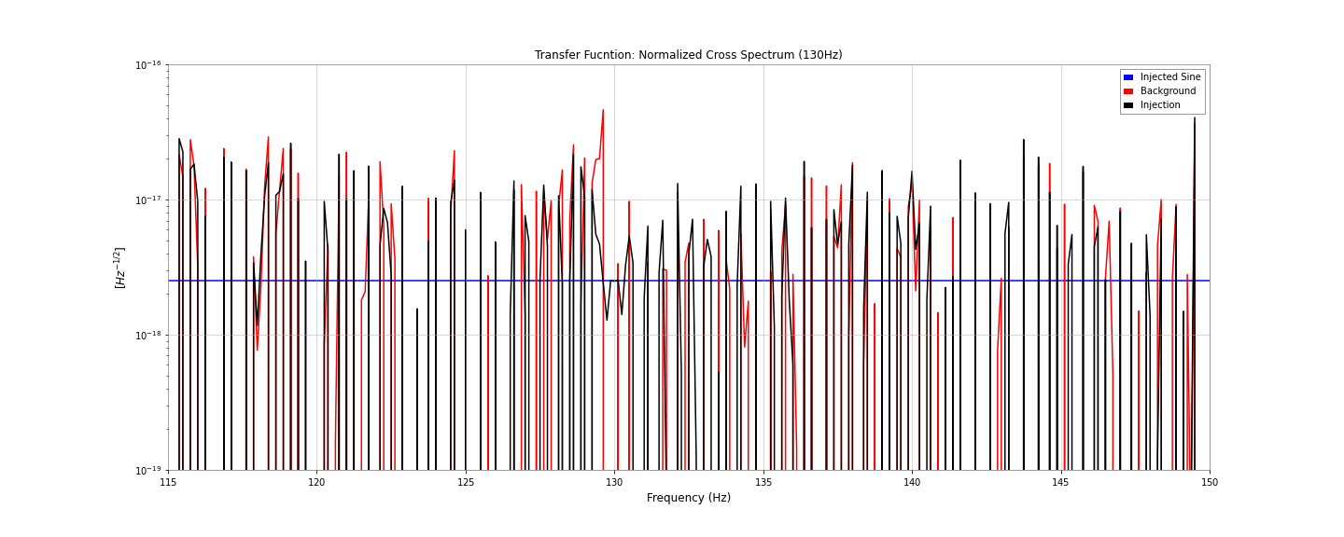
115Hz ~ 150Hz-Band: 130Hz

Slide 31
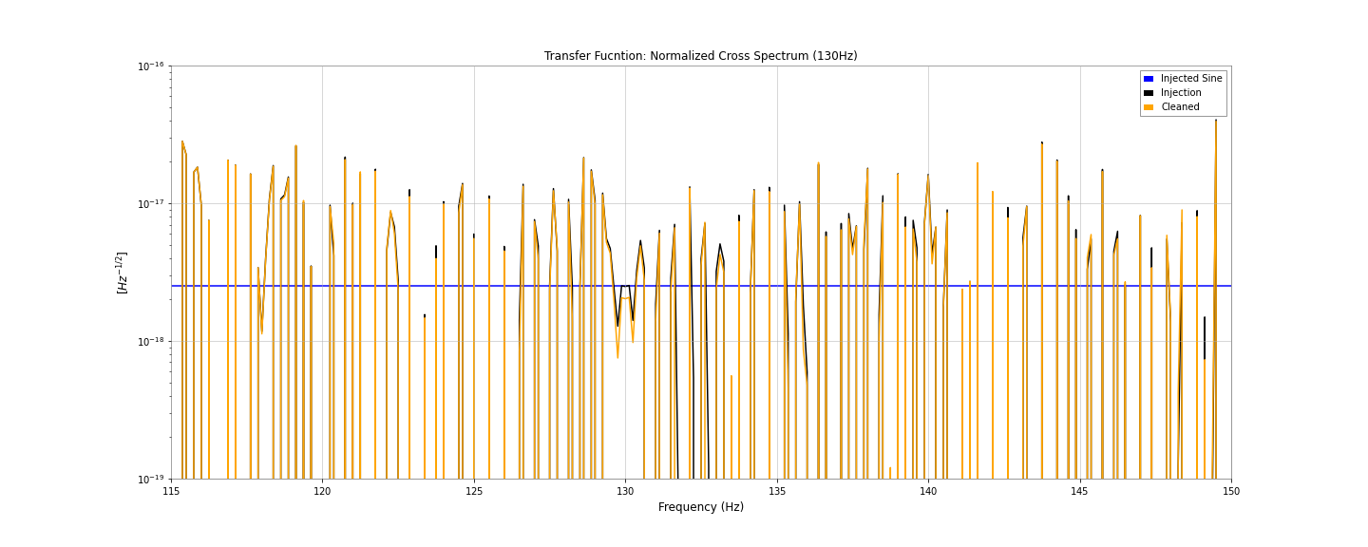
115Hz ~ 150Hz-Band: 130Hz

Slide 32
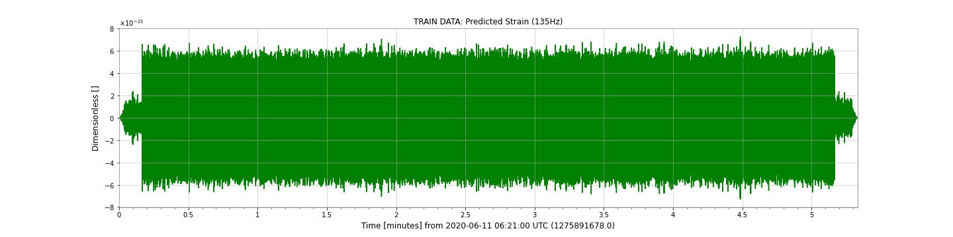
115Hz ~ 150Hz-Band: 135Hz

Slide 33
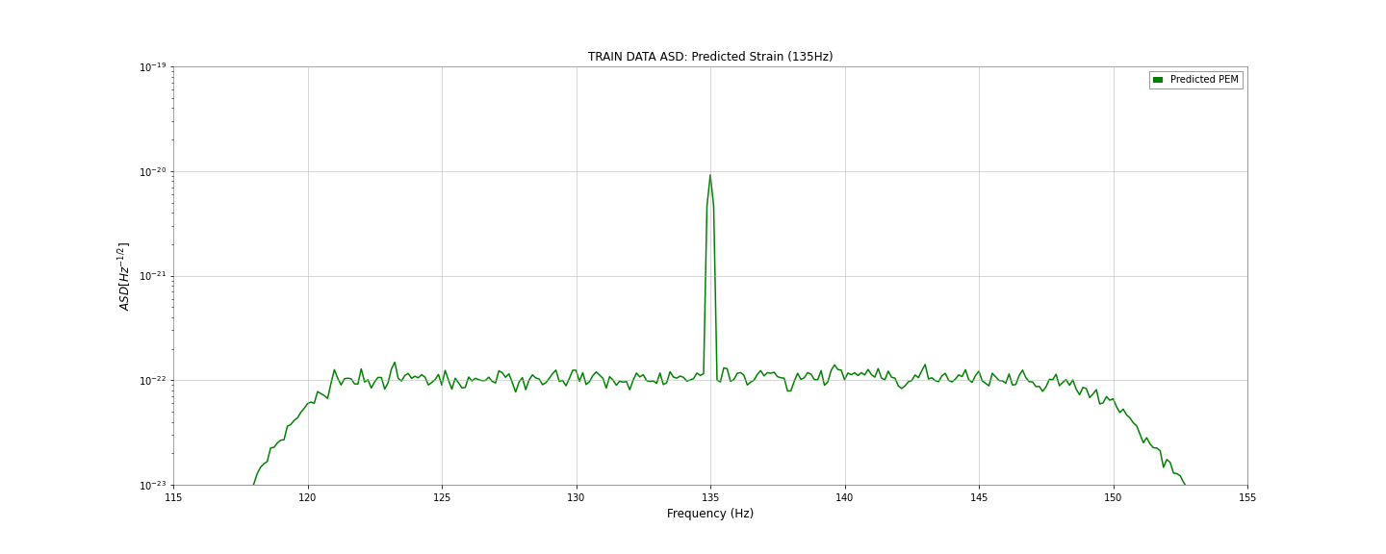
115Hz ~ 150Hz-Band: 135Hz

Slide 34
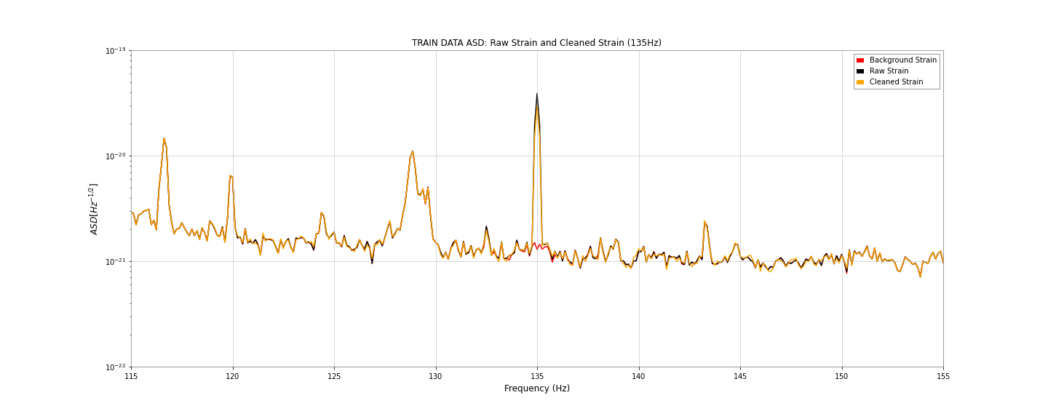
115Hz ~ 150Hz-Band: 135Hz

Slide 35
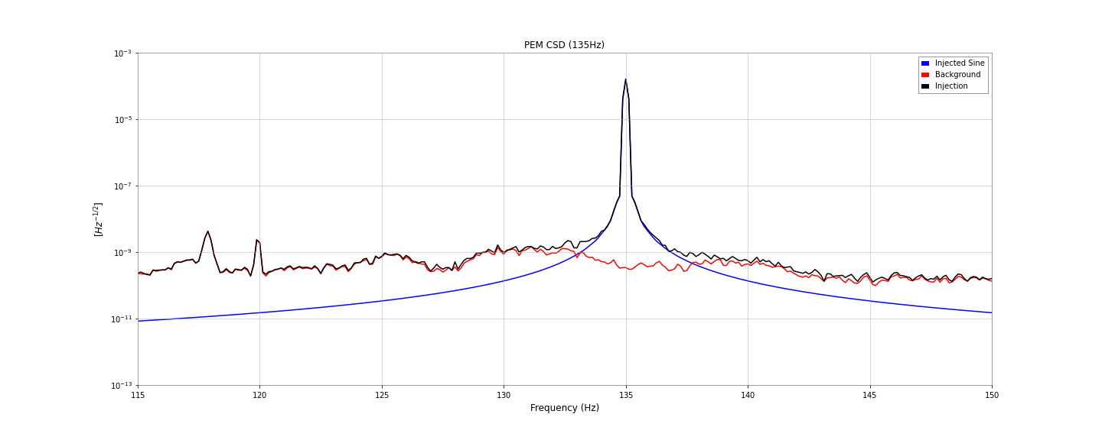
115Hz ~ 150Hz-Band: 135Hz

Slide 36
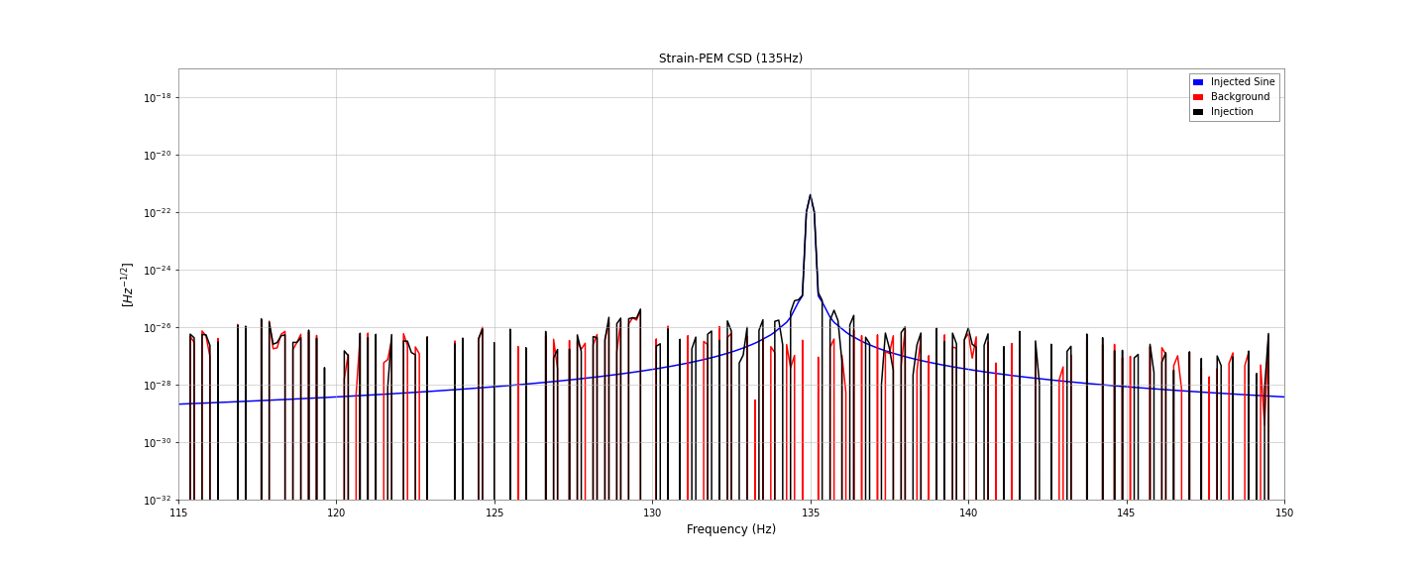
115Hz ~ 150Hz-Band: 135Hz

Slide 37
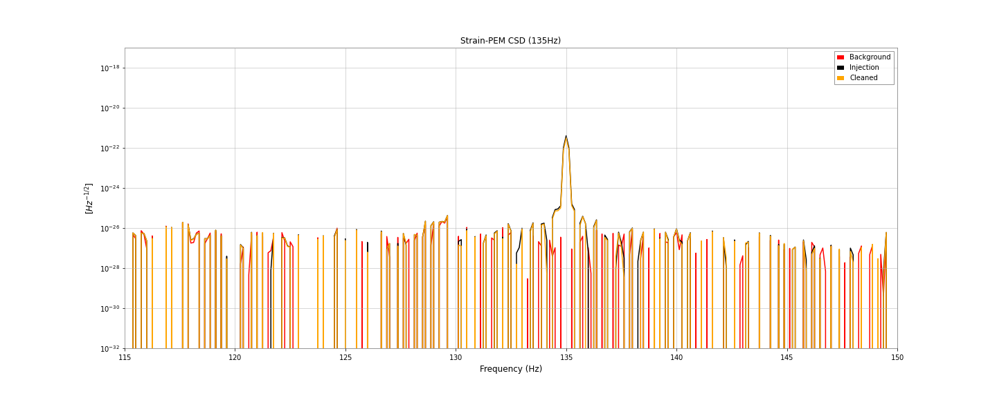
115Hz ~ 150Hz-Band: 135Hz

Slide 38
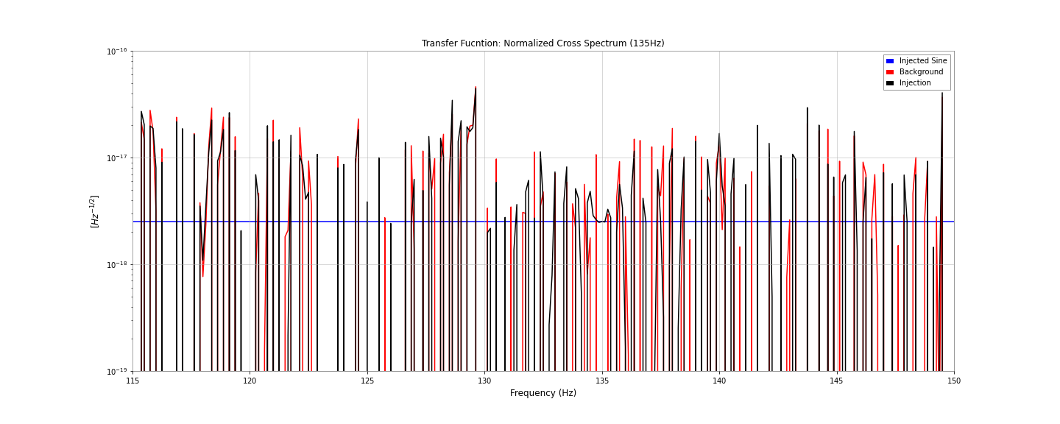
115Hz ~ 150Hz-Band: 135Hz

Slide 39
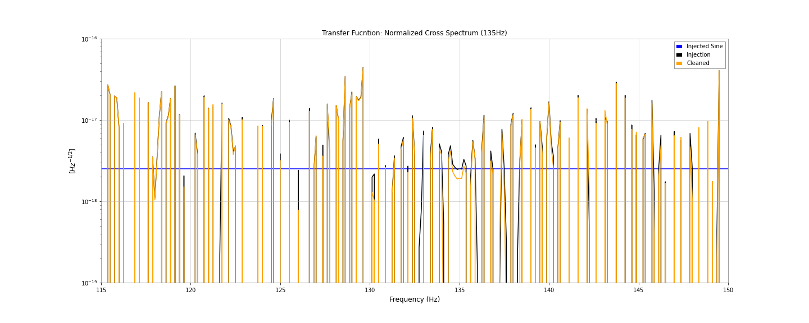
115Hz ~ 150Hz-Band: 135Hz

Slide 40
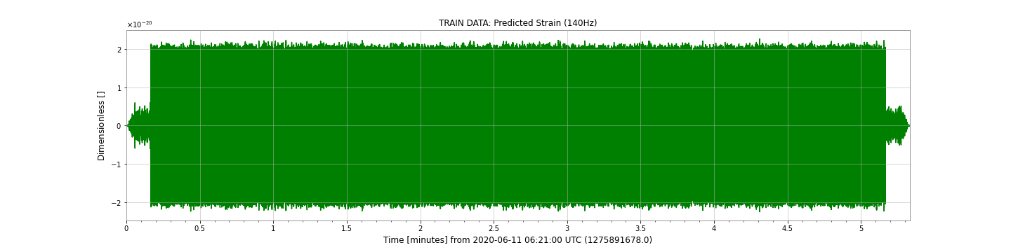
115Hz ~ 150Hz-Band: 140Hz

Slide 41
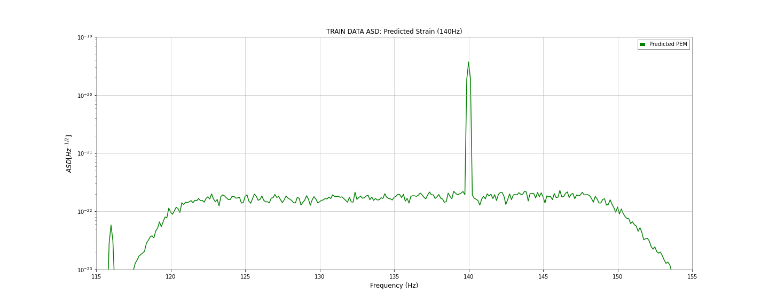
115Hz ~ 150Hz-Band: 140Hz

Slide 42
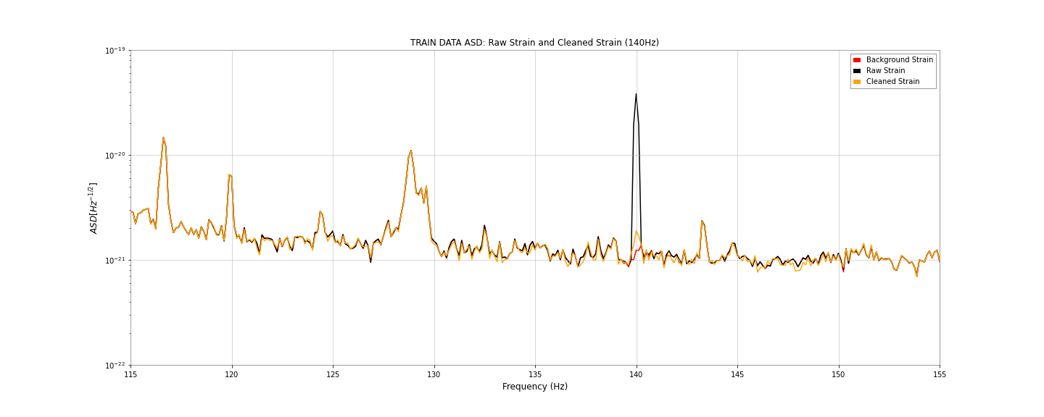
115Hz ~ 150Hz-Band: 140Hz

Slide 43
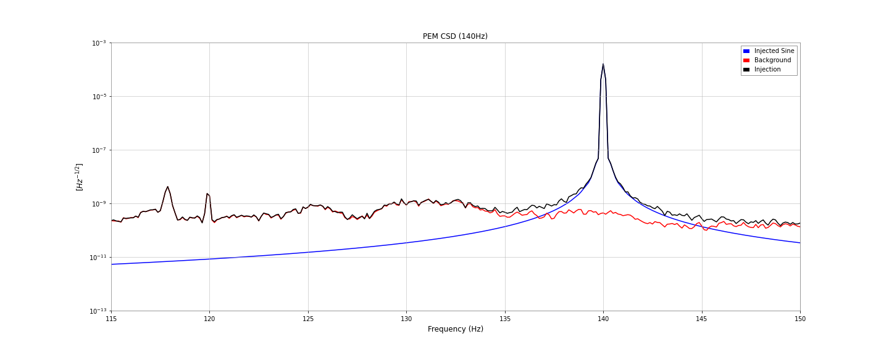
115Hz ~ 150Hz-Band: 140Hz

Slide 44
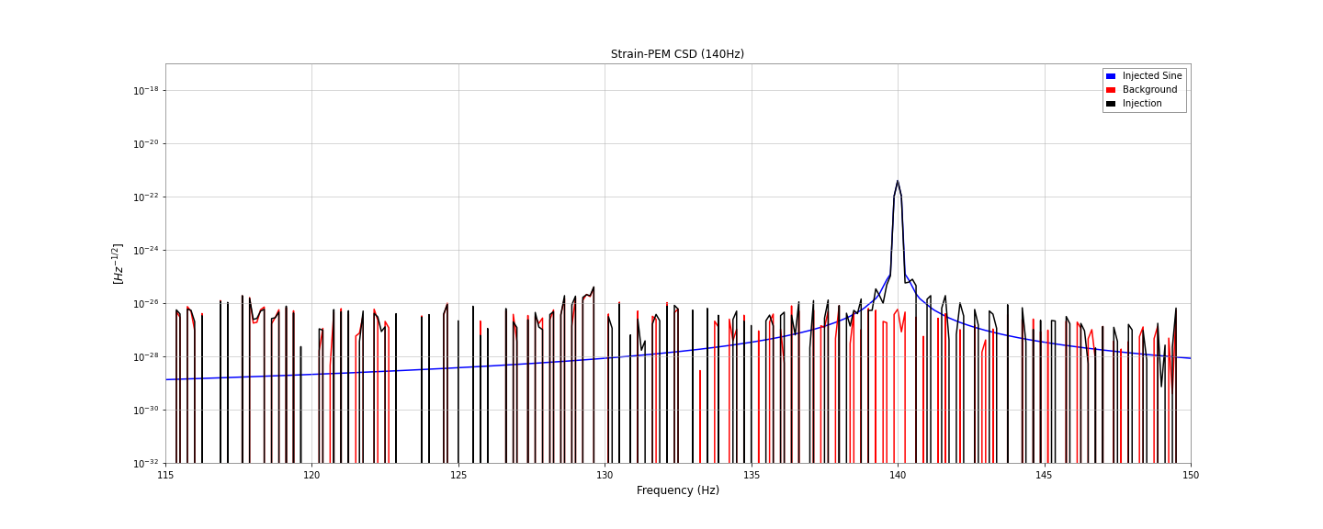
115Hz ~ 150Hz-Band: 140Hz

Slide 45
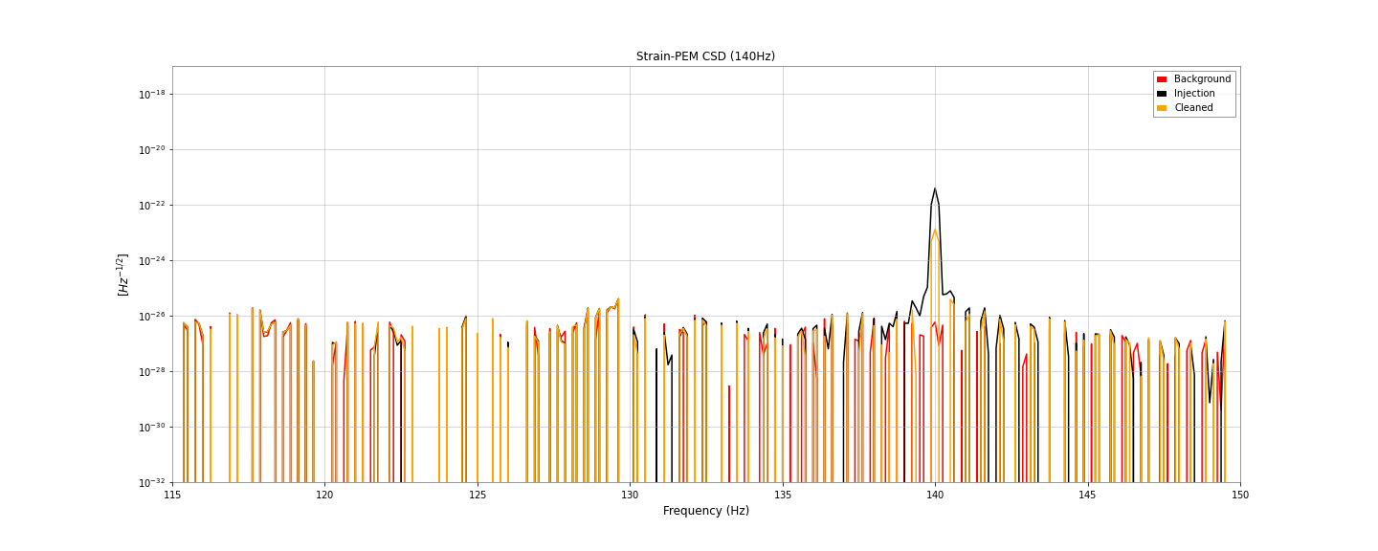
115Hz ~ 150Hz-Band: 140Hz

Slide 46
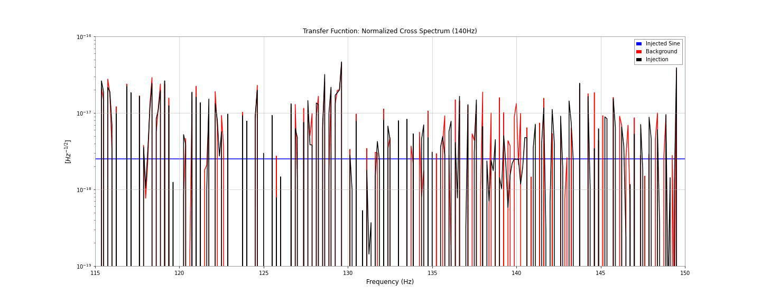
115Hz ~ 150Hz-Band: 140Hz

Slide 47
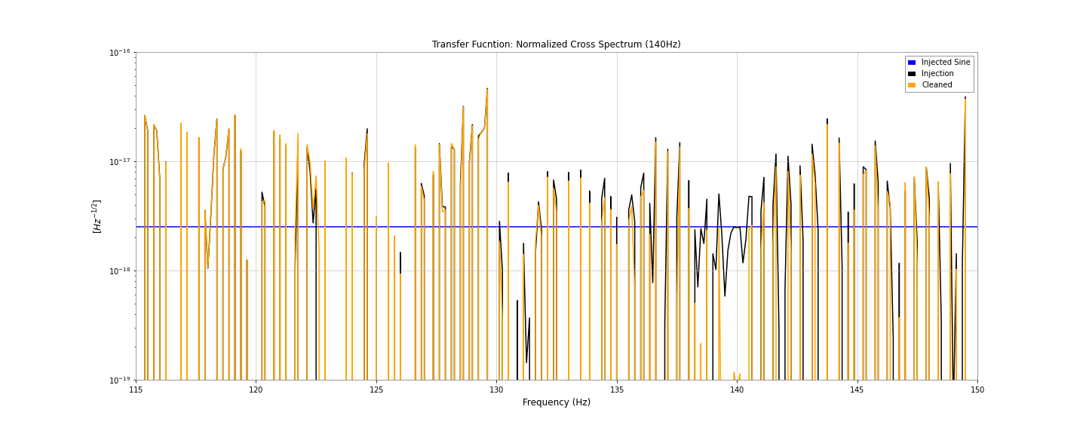
115Hz ~ 150Hz-Band: 140Hz

Slide 48
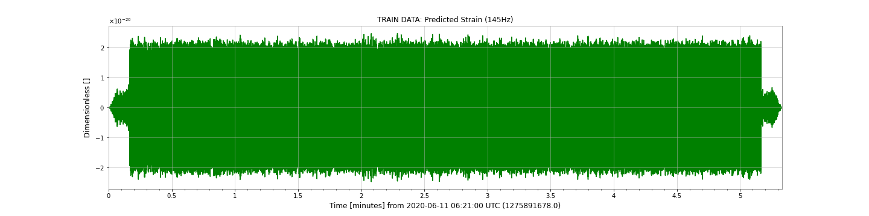
115Hz ~ 150Hz-Band: 145Hz

Slide 49
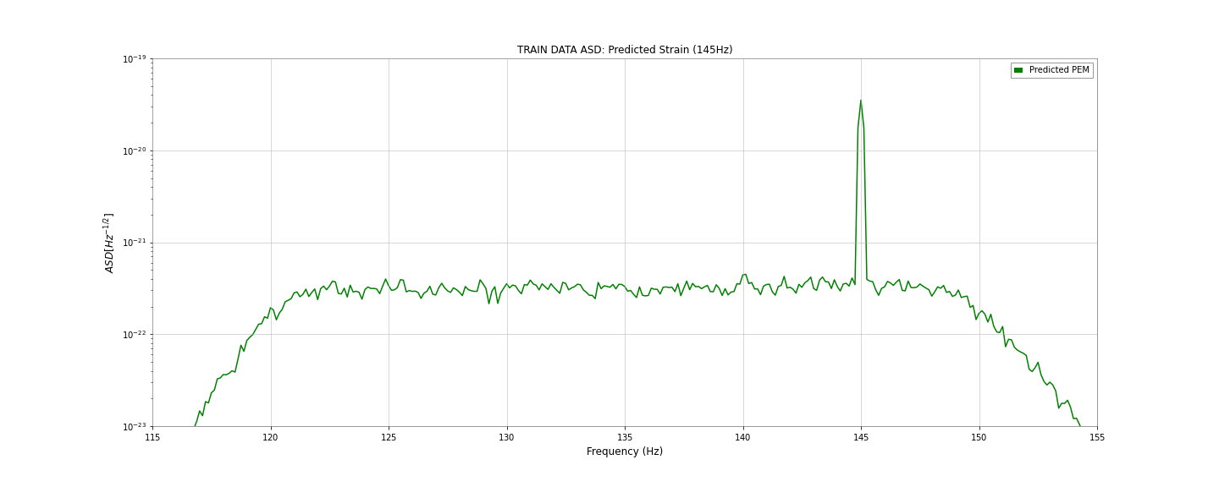
115Hz ~ 150Hz-Band: 145Hz

Slide 50
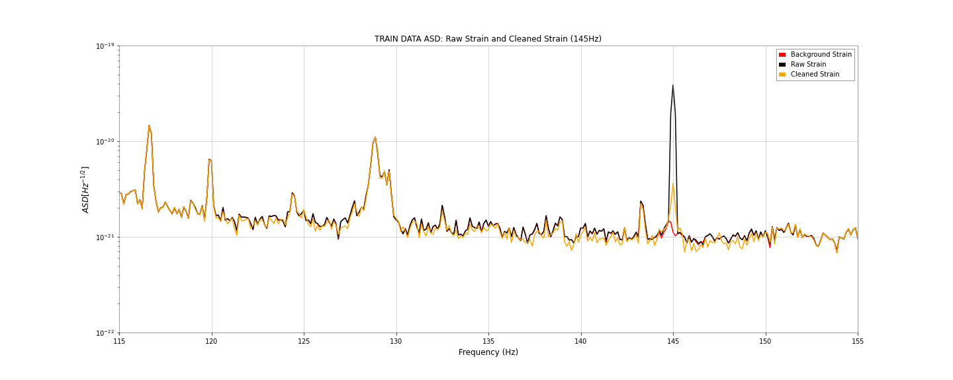
115Hz ~ 150Hz-Band: 145Hz

Slide 51
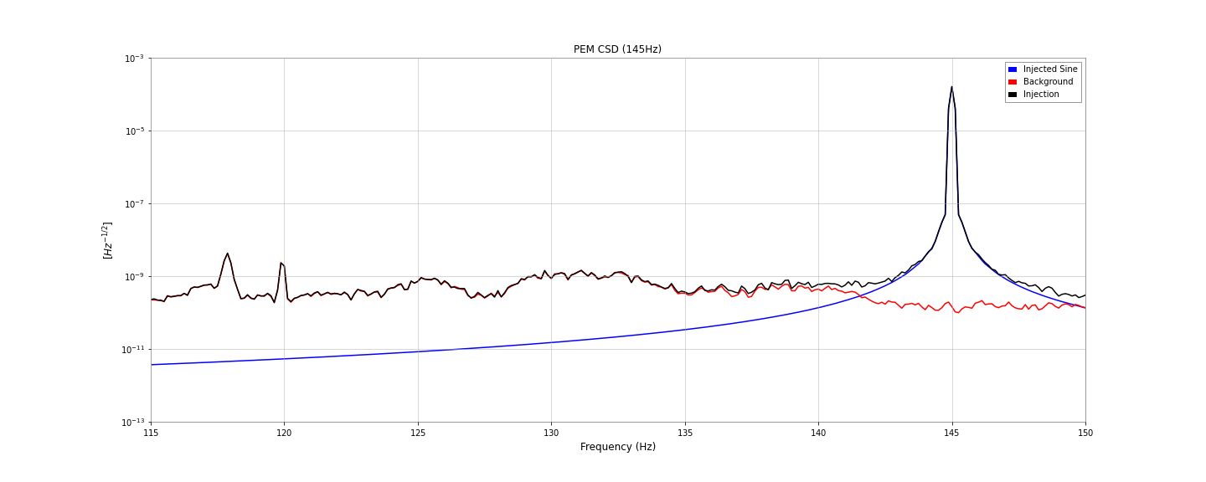
115Hz ~ 150Hz-Band: 145Hz

Slide 52
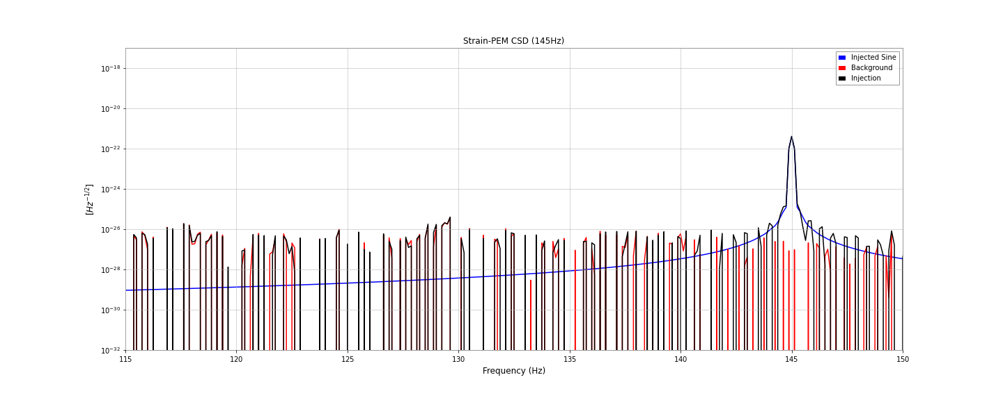
115Hz ~ 150Hz-Band: 145Hz

Slide 53
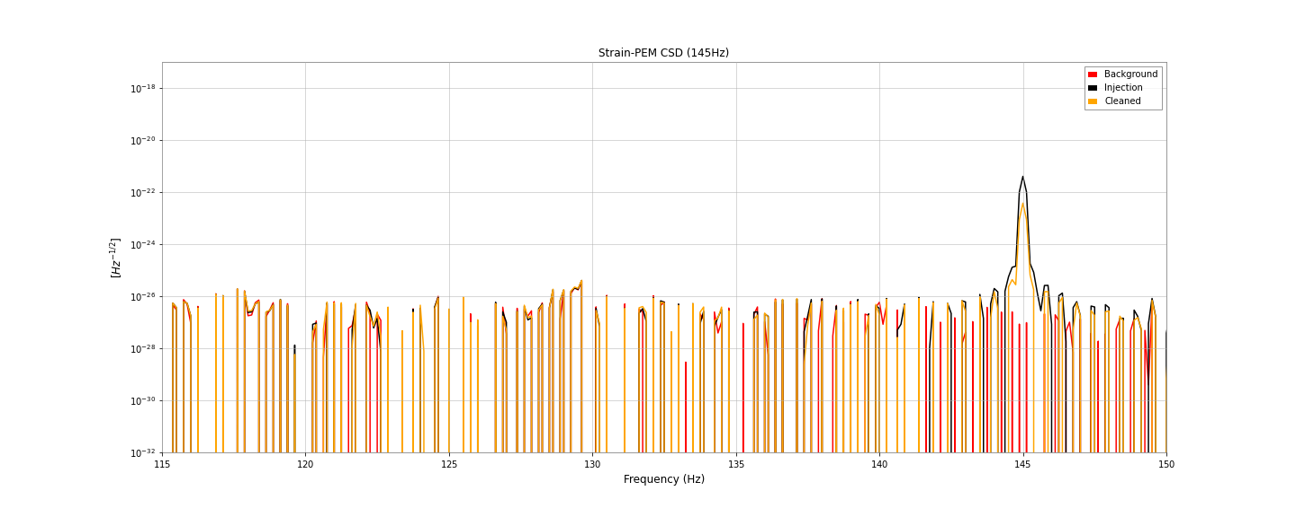
115Hz ~ 150Hz-Band: 145Hz

Slide 54
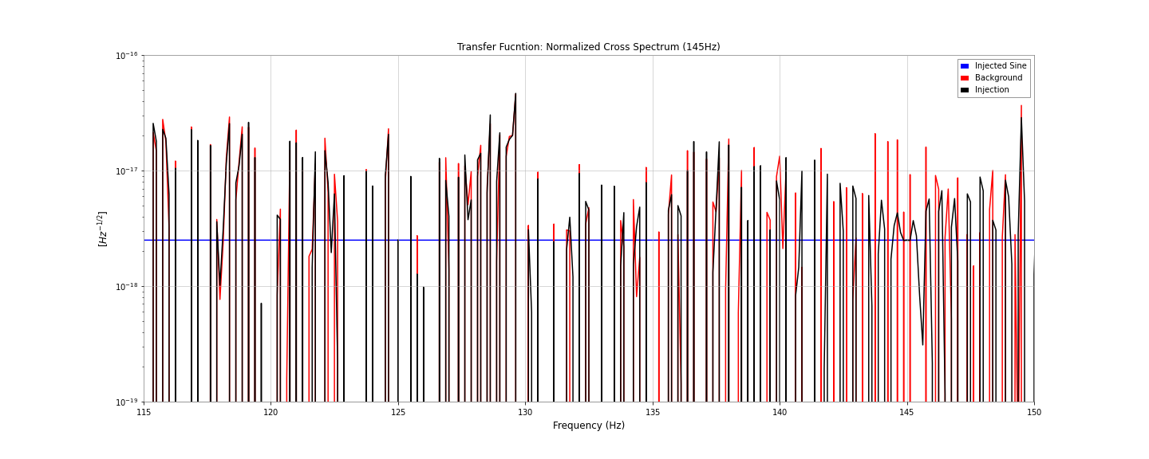
115Hz ~ 150Hz-Band: 145Hz

Slide 55

115Hz ~ 150Hz-Band: 145Hz

Slide 56
Training Deepclean: 30 Epochs
Strain channel: K1:CAL-CS_PROC_C00_STRAIN_DBL_DQ
PEM channel: K1:PEM-MIC_PSL_TABLE_PSL4_Z_OUT_DQ
Training Time: 1275901678 ~ 1275901998 (320 seconds)
Frequency Filter: 10Hz wide, centered at the injected frequency
Loss Function:
FFT Length: 4
Batch Size: 32
Epochs: 30
Weight Decay: 1e-5

Slide 57

10Hz-Band: 125Hz

Slide 58

10Hz-Band: 125Hz

Slide 59

10Hz-Band: 125Hz

Slide 60
10Hz-Band: 125Hz

Slide 61
10Hz-Band: 125Hz

Slide 62

10Hz-Band: 125Hz

Slide 63
10Hz-Band: 125Hz

Slide 64

10Hz-Band: 125Hz

Slide 65

10Hz-Band: 130Hz

Slide 66

10Hz-Band: 130Hz

Slide 67

10Hz-Band: 130Hz

Slide 68
10Hz-Band: 130Hz

Slide 69
10Hz-Band: 130Hz

Slide 70

10Hz-Band: 130Hz

Slide 71
10Hz-Band: 130Hz

Slide 72

10Hz-Band: 130Hz

Slide 73

10Hz-Band: 135Hz

Slide 74

10Hz-Band: 135Hz

Slide 75

10Hz-Band: 135Hz

Slide 76
10Hz-Band: 135Hz

Slide 77
10Hz-Band: 135Hz

Slide 78

10Hz-Band: 135Hz

Slide 79
10Hz-Band: 135Hz

Slide 80

10Hz-Band: 135Hz

Slide 81

10Hz-Band: 140Hz

Slide 82

10Hz-Band: 140Hz

Slide 83

10Hz-Band: 140Hz

Slide 84
10Hz-Band: 140Hz

Slide 85
10Hz-Band: 140Hz

Slide 86

10Hz-Band: 140Hz

Slide 87
10Hz-Band: 140Hz

Slide 88
10Hz-Band: 140Hz

Slide 89

10Hz-Band: 145Hz

Slide 90

10Hz-Band: 145Hz

Slide 91

10Hz-Band: 145Hz

Slide 92
10Hz-Band: 145Hz

Slide 93
10Hz-Band: 145Hz

Slide 94

10Hz-Band: 145Hz

Slide 95
10Hz-Band: 145Hz

Slide 96

10Hz-Band: 145Hz

Slide 97
Summary and Discussion
We prepare the 5-minute long single-frequency injection to the PEM background and strain background.
We have shown the training and cleaning on the same segment of the 125Hz, 130Hz, 135Hz, …, 145Hz injection.
10Hz-wide band filter and 120Hz-150Hz band filter have been used and 10Hz-wide band filter performs better on each frequency of injections.
Next: fake white Gaussian channel with fake transfer function.

Slide 98
Appendix

Slide 99
Deepclean: Denoising using PEM and Auxiliary Channels
w(t): witness channels that record the data from the auxiliary sensors and PEM.
p(t): predicted noise in strain.
Both w(t) and p(t) are timeseries with the same sampling rate and duration.
Ref: 2005.06534, 2108.12430
latent vector
TransposeConv1d
TransposeConv1d
TransposeConv1d
TransposeConv1d
w(t)
Conv1d
Conv1d
Conv1d
Conv1d
Conv1d
p(t)
Encoder (down-sampler)
Decoder (up-sampler)

Slide 100
Deepclean: Training and Inferencing
h(t): raw strain data.
r(t) = h(t) - p(t): residual.
Loss function:
latent vector
TransposeConv1d
TransposeConv1d
TransposeConv1d
TransposeConv1d
w(t)
Conv1d
Conv1d
Conv1d
Conv1d
Conv1d
p(t)
-
r(t)
h(t)
Encoder (down-sampler)
Decoder (up-sampler)

Slide 101
Noise Esimation via Injection Tests
The experiment is performed on 2020/06/11.
The acoustic noise at the input optics (Pre-Stablized Laser room and Power Recycling booth) is focused.
Confirmation of the frequency conversion and PSD linearity (so we can set ε to 1) are performed by single-frequency PEM injection varying the injection power.
Acoustic injection: 200 frequencies from approximately 70.0 Hz to 1070.0 Hz, 10 s for each frequency.

Slide 102


Noise Esimation via Injection Tests

Slide 103

Noise Esimation via Injection Tests

Slide 104

Noise Esimation via Injection Tests

Slide 105

Noise Esimation via Injection Tests

